Slide 1
Report on BL04-MSPD
Staff
Scientists Francois Fauth (electrochemistry, strongly correlated electron materials,
instrumentation)
Inma Peral (catalysis, pdf measurements, microdiffraction)
PostDoc Catalin Popescu (Feb 2012) (high pressure IH projects + collaborations,
HP setup development (pressure calibration, membrane cell))
Oriol Vallcorba (Jan 2014) (inorganic structure determination,
amorphous phase quantification, ‘grains’ microdiffraction)
Technician Francesc Farre (exp div -> technical developments)
Lab Technician Robert Oliete (exp div ->chemistry lab support)
Engineer Edmundo Fraga (exp div), Joaquin Gonzalez (Jan 2014)
Controls Zbigniew Reszela (-> May 2014), Daniel Roldan
Electronics Xavi Serra
Acknowledgement to all ALBA staff and users

Slide 2
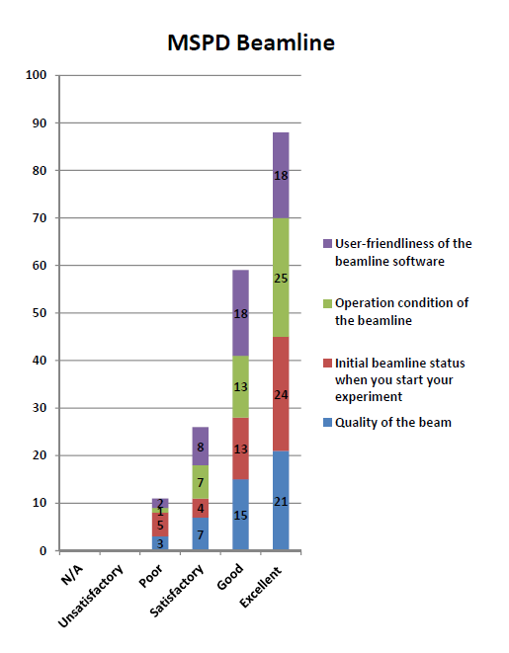
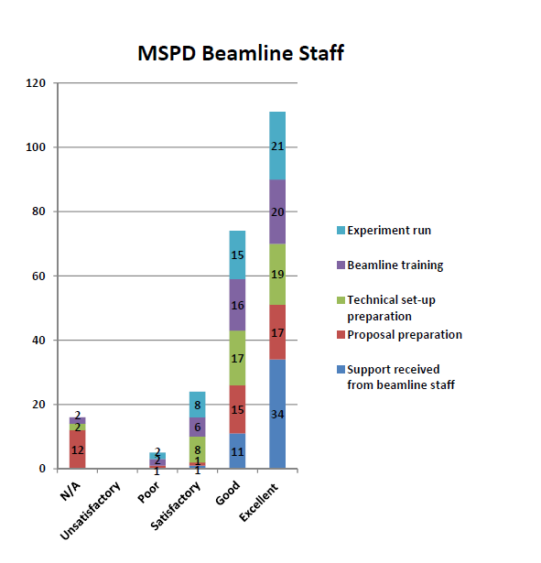
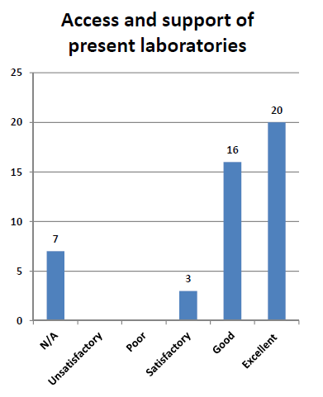
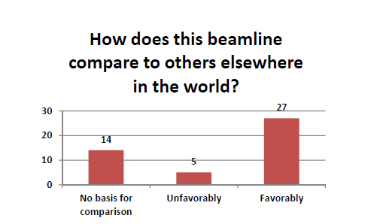
How is performing the beamline ?
Users point of view : Hard to decipher users’ feedback …
at least to my opinion !
Truth is in details
What was wrong ?
Which experiment ?
Comparison to which other beamline ?
One should consider time evolution

Slide 3
How is performing the beamline ?
MSPD staff point of view : The beamline is perfoming well !
No problem with SC wiggler source (one power supply failure in Oct 2012).
Still operating with initial lHe refill (mid 2011)
No technical problems with optical components
MONO : May 2013 one water cooling pipe changed -> 2nd Xtal vert translation encoder down
Dec 2013 slight vacuum increase -> tighten cryocooling pipes (but a 3d experiment cancelled)
MOCO to commission (if necessary)
MIRROR : live with initial ‘galistan’ droplet spills on surface
COOLING : OK at 120mA, thought flow below initial requirement (under engineering study)
Experimental stations components + detectors running smoothly
MOTORS solved IcePap power overload problems on pd_oc/pd_mc (led to beamtime loss)
CONTROLS got 90% of desired functionalites, 10% remaining in the pipe
25 users experiment in 2013 / 29 (13 done) users experiments in 2014
(65% / 35 % PD/HP-microdiffraction, 2-3 days expt on average)
11 (6 HP) paper published (+ 3 accepted) from MSPD data since opening in June 2012
8 (+2) with MSPD staff coauthorship
(JACS, PRB, InorgChem, ChemMat, JPhys CondMatC, CementConcreteRes,
PowderDiffraction, MatResBull, JPhysChemC)
Industrial beamtime sold to 6 different companies since July 2013
+ 1 new to come (July 2014) + 1 new contact + industrial related research project
(51 hours over 10 sessions, 4 users came back)

Slide 4
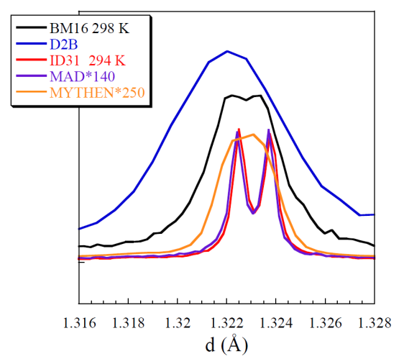
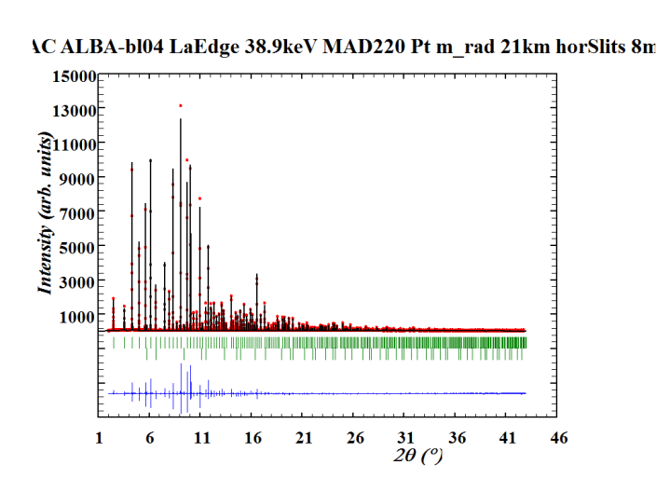
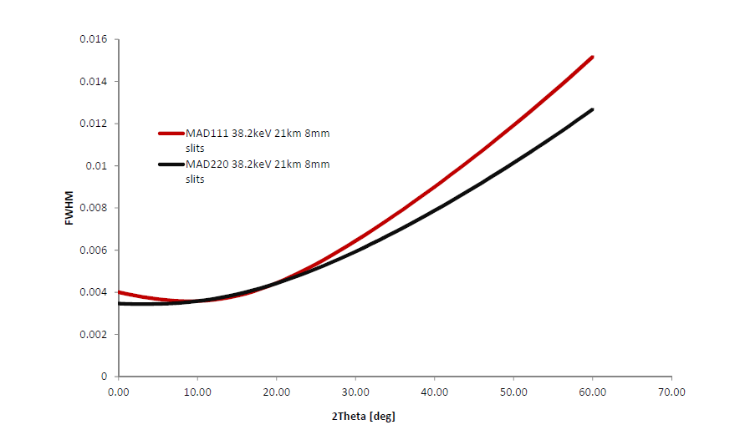
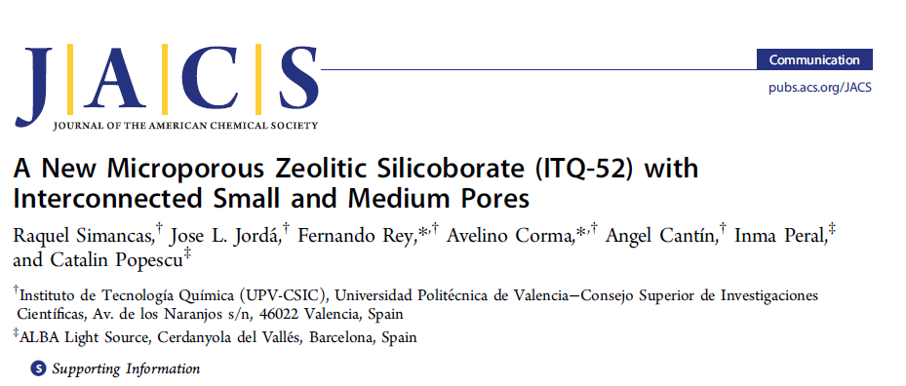
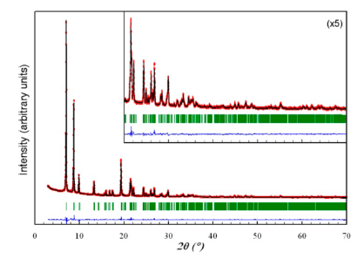
PD : high angular resolution (figure of merit)
Activity on MAD :
- exchange central Si₁₁₁ Xtal – intrinsic width
was broader - with outer one (i13)
- commissioned the Si₂₂₀ Xtal set
ALBA 30 keV
NAC 220 at 38.2 keV
111
220
38.2 keV
YNiO₃
90.0754 º monoclinic distortion
Alonso et al, PRL (1999) 3871
Why high resolution needed ?
-> small distortions
-> overlap in structure determination
Xray lab
-> Le Bail Fit orthorhombic S.G
-> extinction : Ima2m,I2cm, Imam, Imcm
-> no reasonable structure
MAD data @MSPD
I12/m1 S.G -> correct structure 10 Si , 19 O

Slide 5
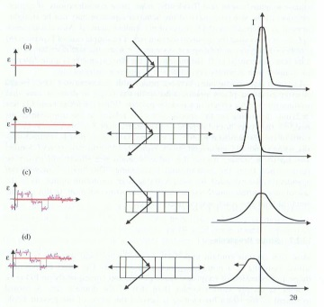
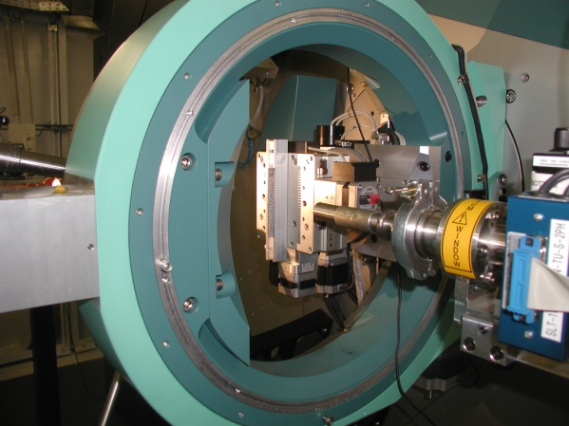
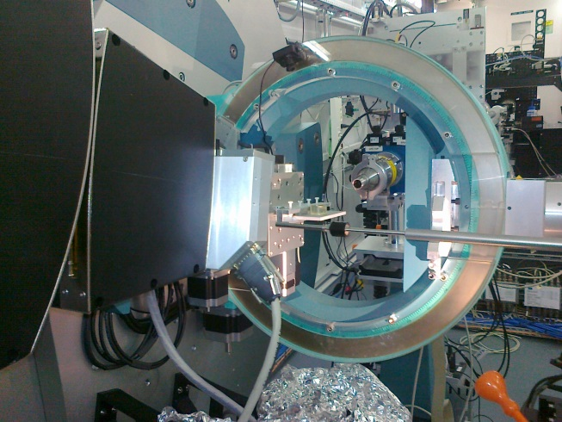
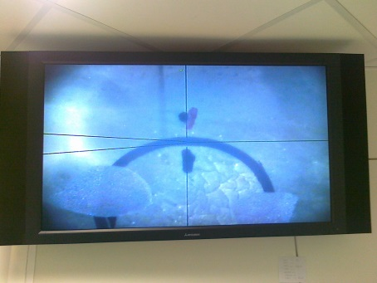
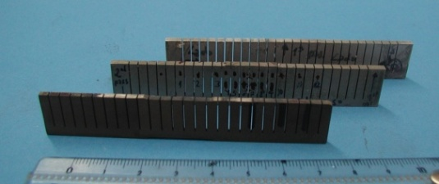
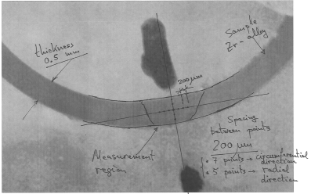
PD : strain scanning experiments (Feb 2014)
Basics
~0.1 mm
Q_{hkl}
Experiment performed March 2014
E = 40 keV, mirror focusing
Slits in front of central channel
of MAD
No strain
Macrostrain (e.g. tensile strain)
Microstrain
Macrostrain + Microstrain
2θ
~0.1mm
2124Al-25vol%SiCp
d₂₂₀
ZrH
Fwhm
Determination of the microscopic residual stress in friction stir welds
Gaspar González Doncel, Ricardo Fernández Serrano, Florencia Cioffi
Dept. of Physical Metallurgy, CENIM, C.S.I.C.
+ J. Hervias et al
Departamento de Ciencia de Materiales ETSI Caminos. Universidad Politécnica de Madrid

Slide 6
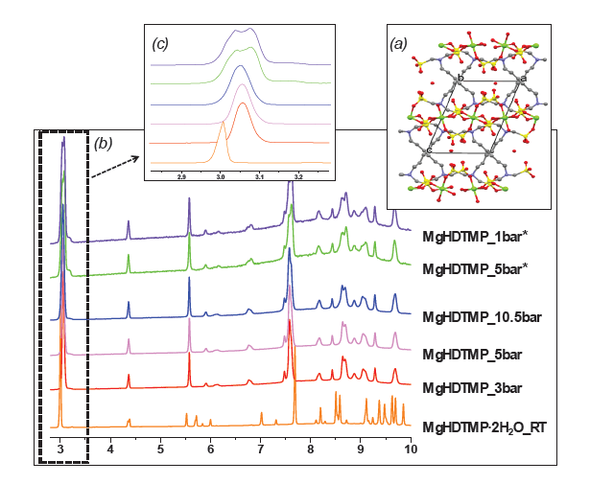

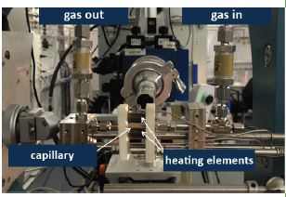
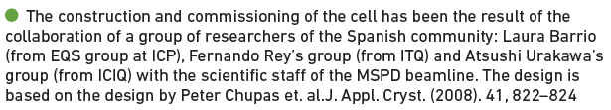
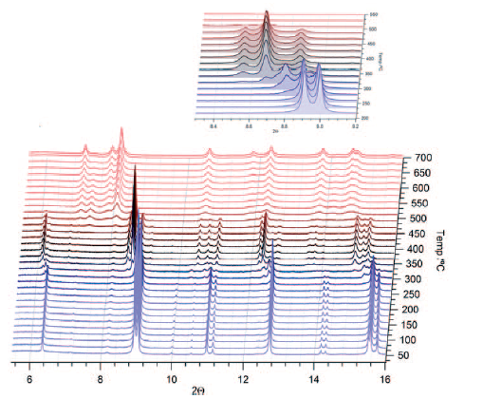
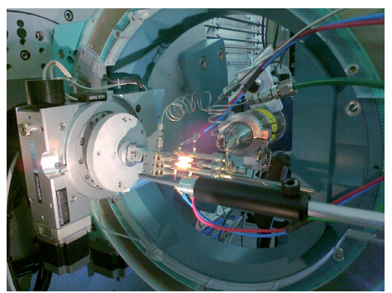

PD : catalysis/gas flow experiments (Feb 2014)
MYHTEN
20 keV
Cabeza et al ,
Dept Inorganic Chemistry
Uni Malaga
Inma Peral
Drawback :
share equipment with CLAESS
(gas mixing cabinet)
-> users expt scheduling problem
Adopt same protection system
as in CLAESS (€ € €)
if we accept selected gases
MAD 30 keV, L. Barrio et al, CSIC Madrid

Slide 7
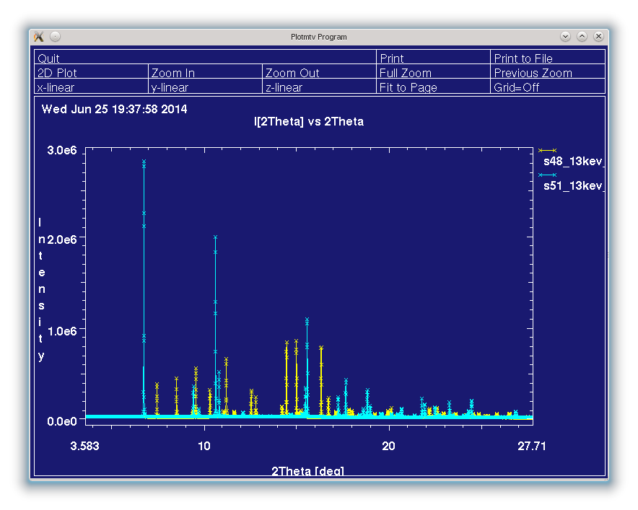
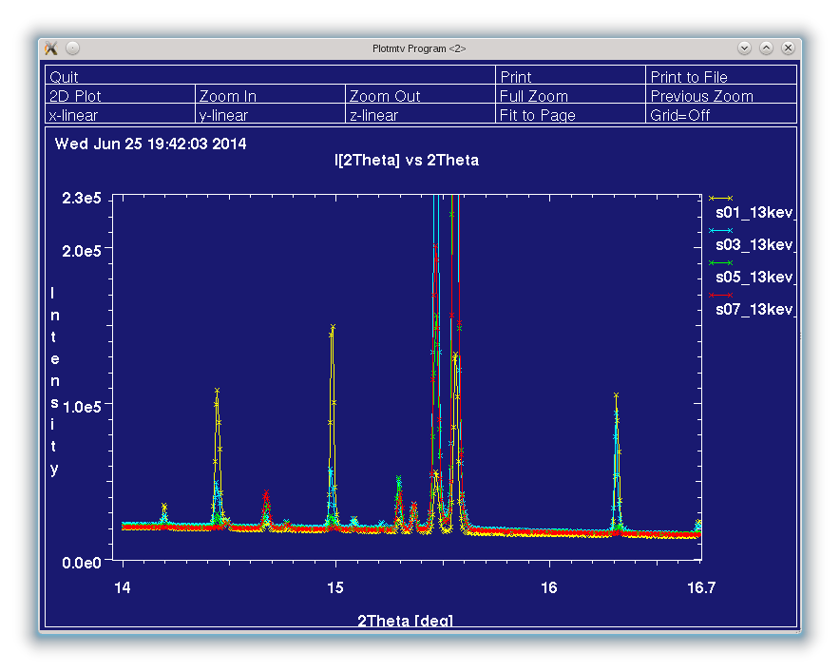
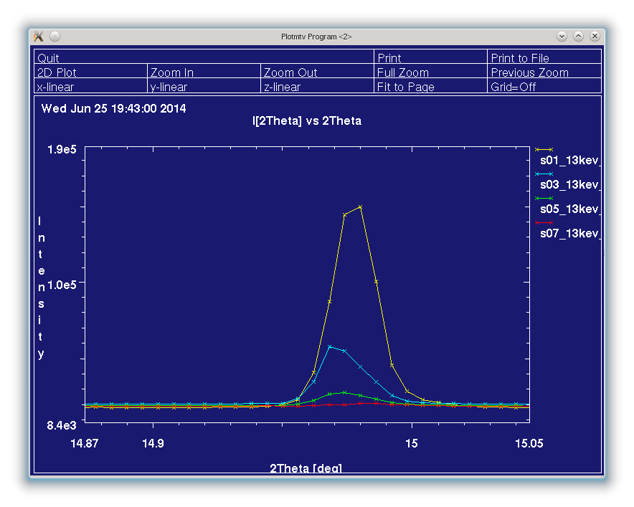
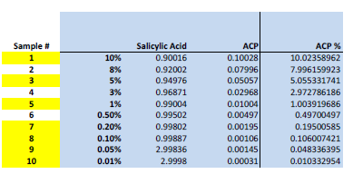
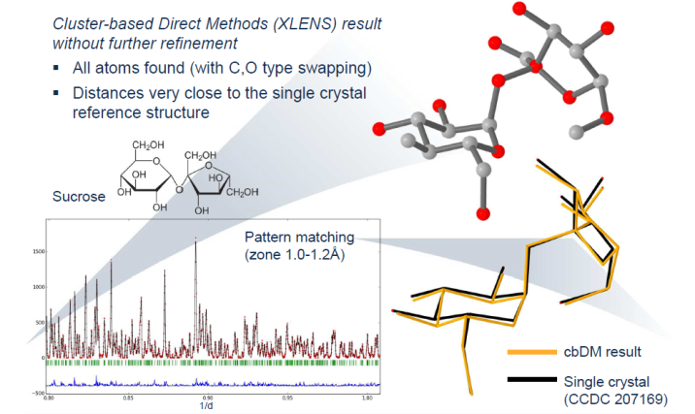
PD : using MYTHEN for inorganic compounds
Detection limits of crystalline phase, paramaceutical examples
(O Vallcorba, F. Fauth collaboration with F. Gozzo)
Salycilic acid
ACP (“paracetamol”)
10% ACP
5 %
1%
0.20 %
Detection/quantification limit ~0.5 %
Industrial related projects in quantitative
determination of amorphous/crystalline phase
(O Vallcorba with a Local Pharmaceutical company )
(O Vallcorbaa)

Slide 8
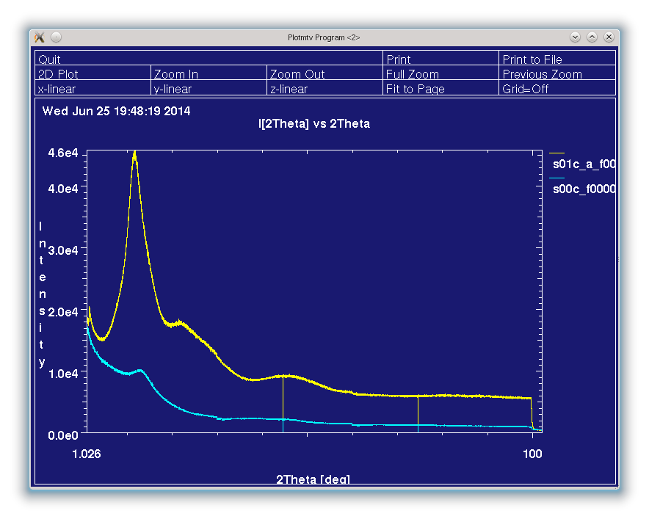
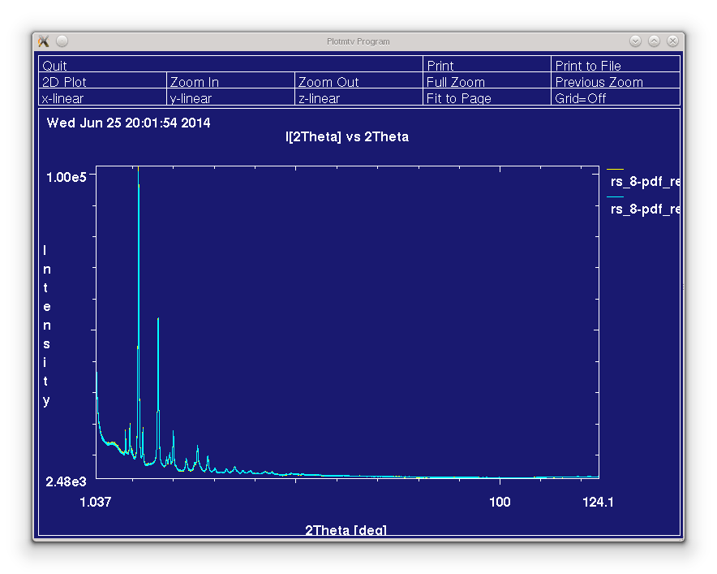
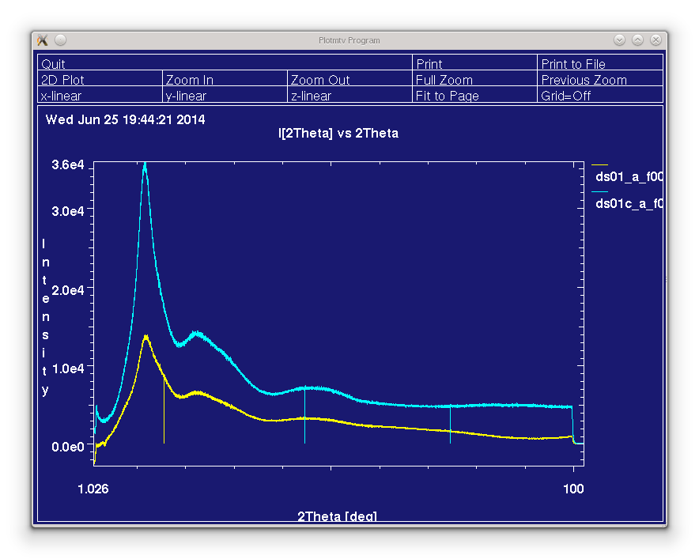
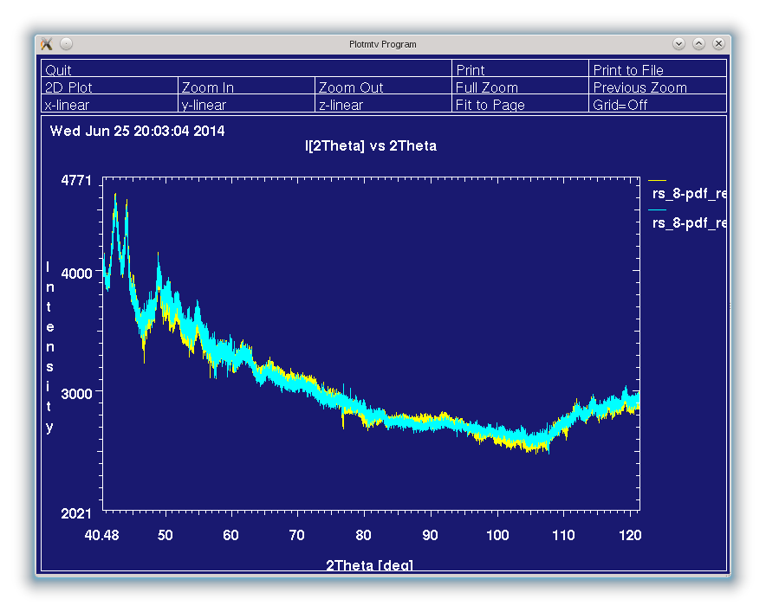
PD : inline/offline MYTHEN data processing
Hardware/software development for MYTHEN data acquisition/processing
- real beam monitor + real accurate position reading for each MYTHEN position
(PS ongoing project to integrate similar beam monitoring for the HP station as well)
software for merging multiple positions from MYTHEN raw data inline/offline
(Bad channels option / flat field file option / merging selected position / produce converted file for each position, binning option,….)
- Protocol for fast flat field data collection (1-2 hours) either scanning a Silicon peak or glass sample data collection at high angle
Amorphous lactose
(subtracted)
(capillar / flat)
Amorphous
Lactose
6*30sec
flat field corrected
Empty cap
6*30sec
Steps at starting position of aquisition
What about continuous scan with MYTHEN ? (Briefly raised during last SAC meeting)
Motor speed + integration time + angular detector resolution (5 mdeg) are limiting factors
80 deg pattern -> 40 deg scanning (reminder 40deg angualr coverage), at 5 deg/min => 8minutes
but 5 deg/min -> 30ms integration over 2.5mdeg range
-> 16000 raw data files (7680points) to process

Slide 9
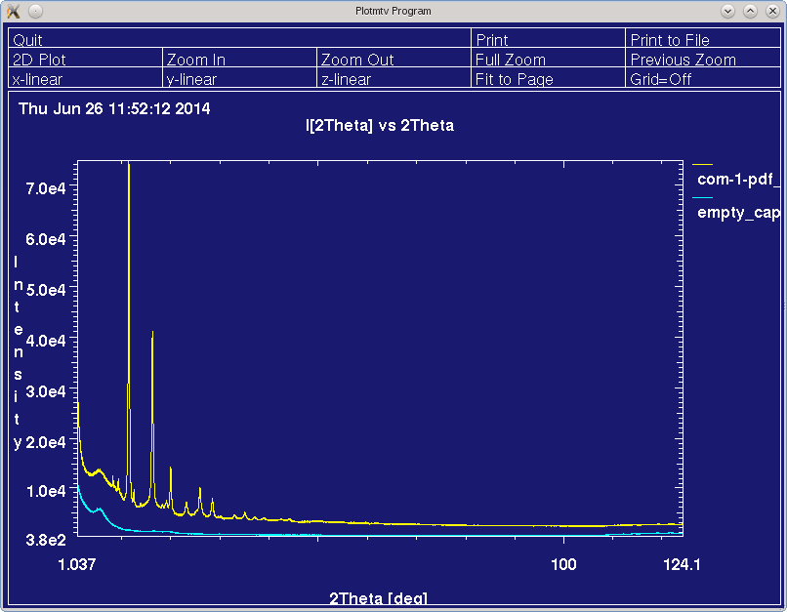
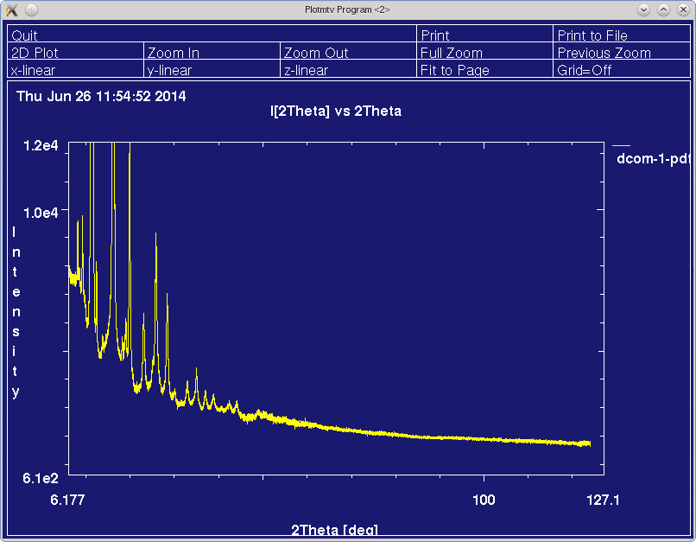
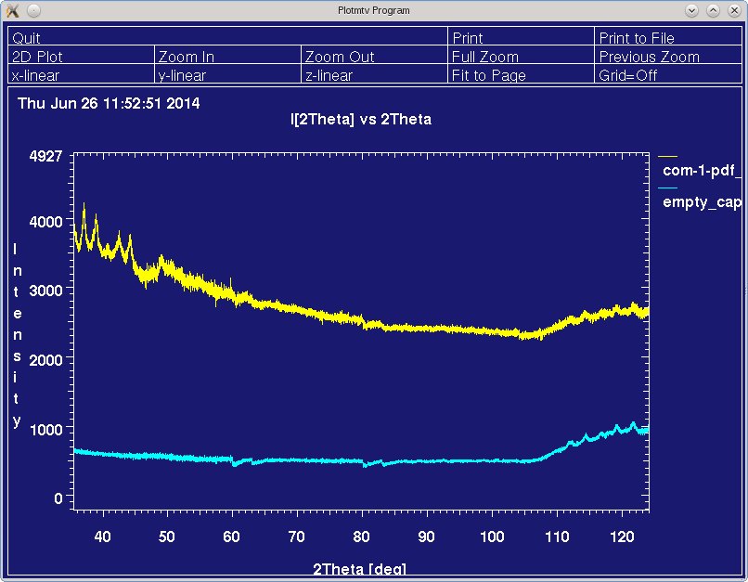
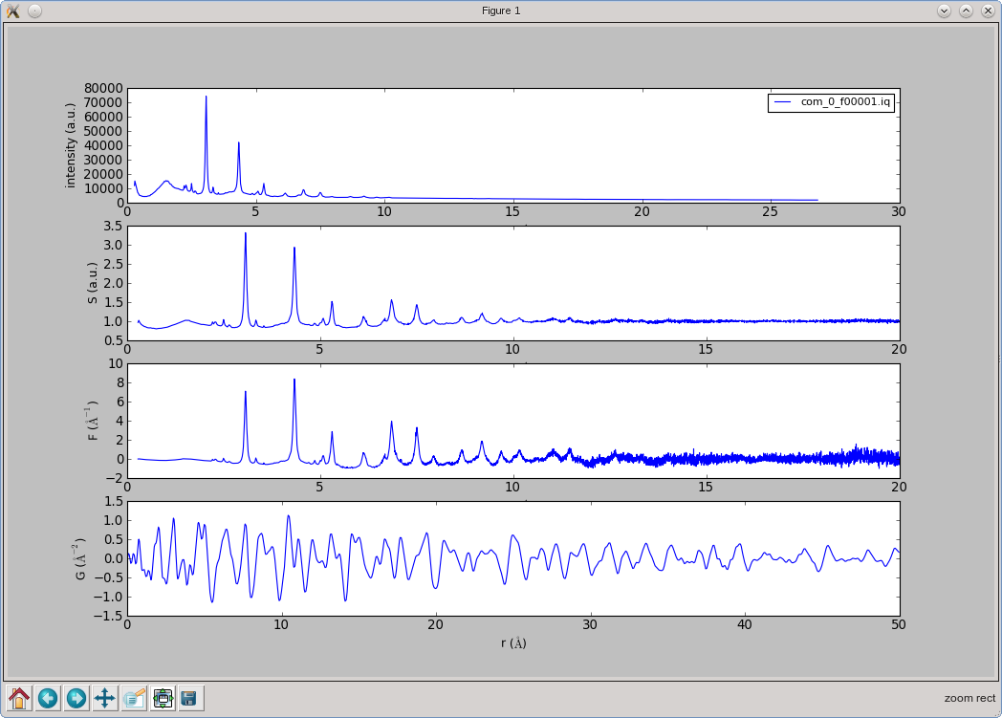
PD : pdf using MYTHEN
14 * 60 sec
MYTHEN data collection at 30keV
14 positions of 1min
-> q_{max} ~ 25 1/Ang
Real users’ sample (June 25th)
In Top Up mode !!!
BTW : no problem with Top Up on MSPD

Slide 10
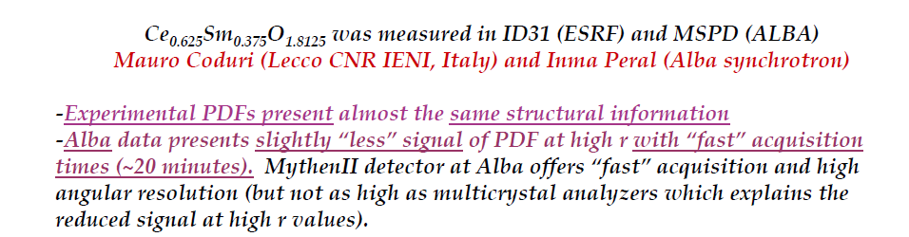
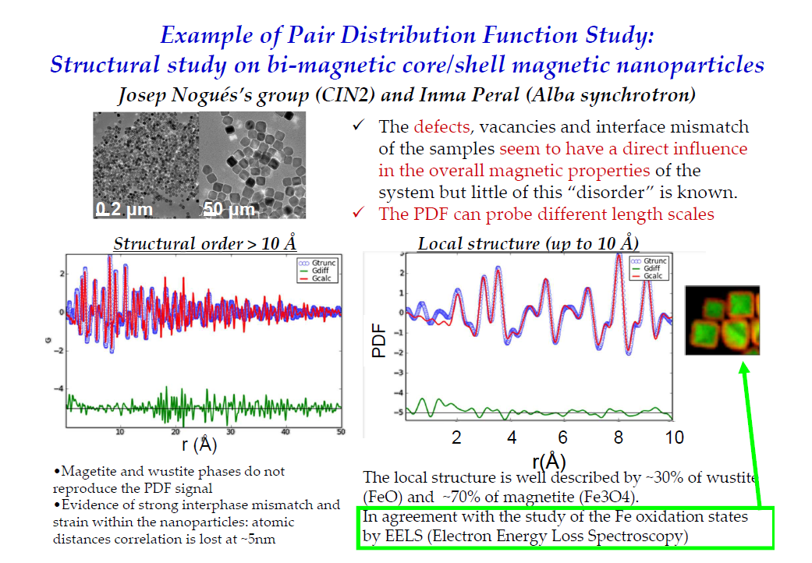
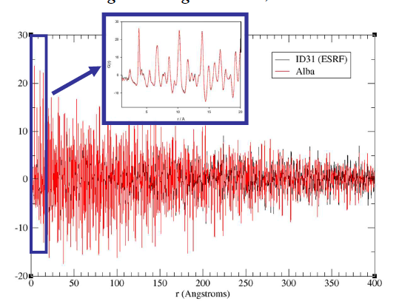
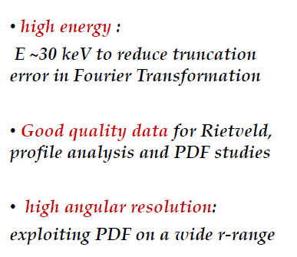

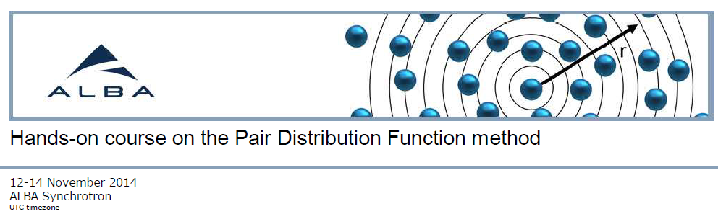
PD : pdf on BL04 I. Peral
+ 2 ‘expert’ users experiments to come (Coduri + Barrio)

Slide 11
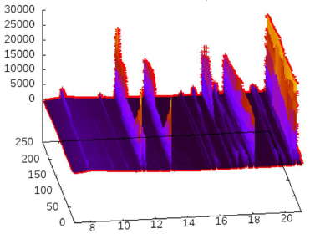
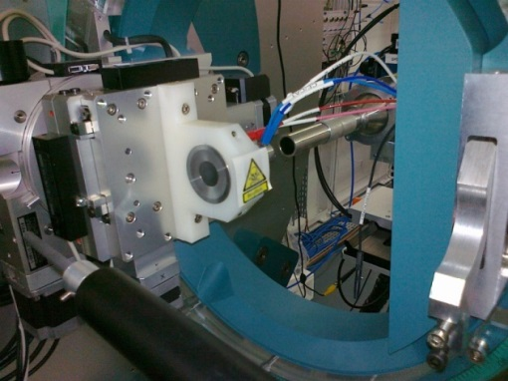
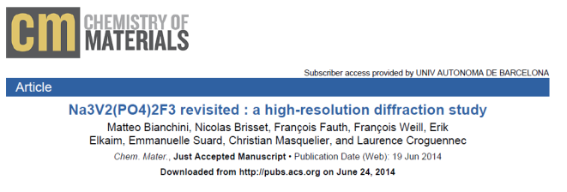
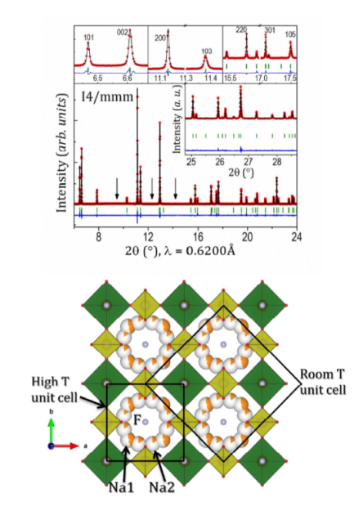

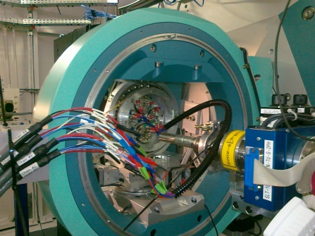
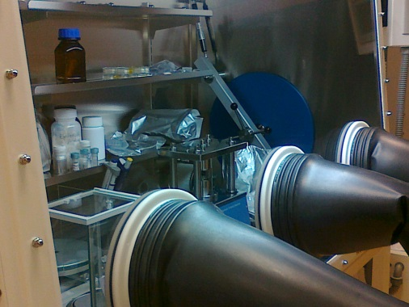
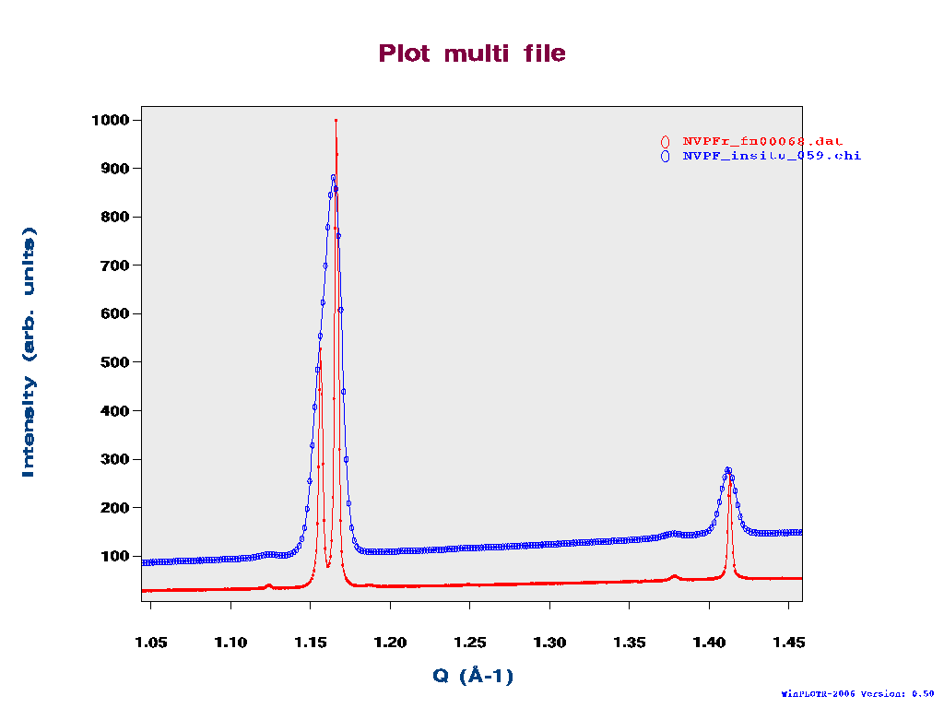
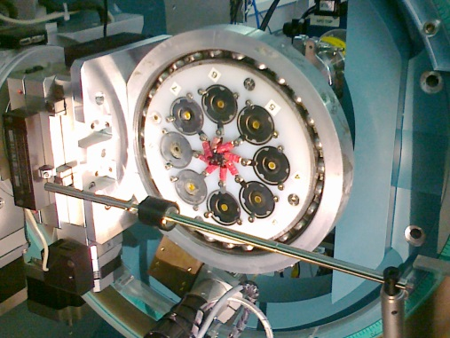
PD : electrochemistry, energy storage
Electrochemistry using the MYTHEN detector
Bianchini, Suard (Grenoble) Croguennec (Bordeaux), Masquelier (Amiens), Palacin (Barcelona), Fauth (Alba)
just accepted
ALBA MAD data
HT and LT
(down to 100K)
RT at SOLEIL
IH Oct 2013
Ar glove box
KIT
In situ data
MYTHEN @ALBA
ImagePlate @SOLEIL
KIT
In 2014 :
Bianchini 3 days, Palacin 3 days, (Following preliminary IH test )
Karlsruhe Institut Technology group (M. Knapp) : 5d + 4d + 4d (oct)
-> all will likely apply for 2015-I round

Slide 12
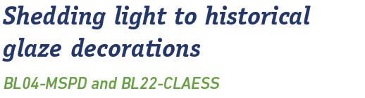
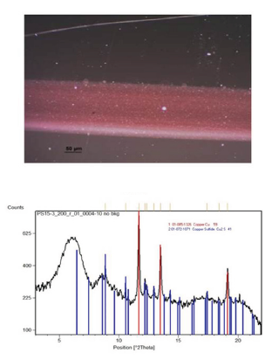
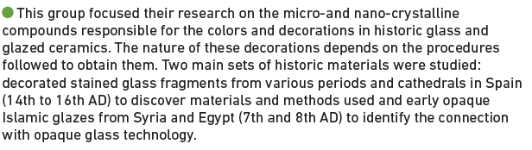
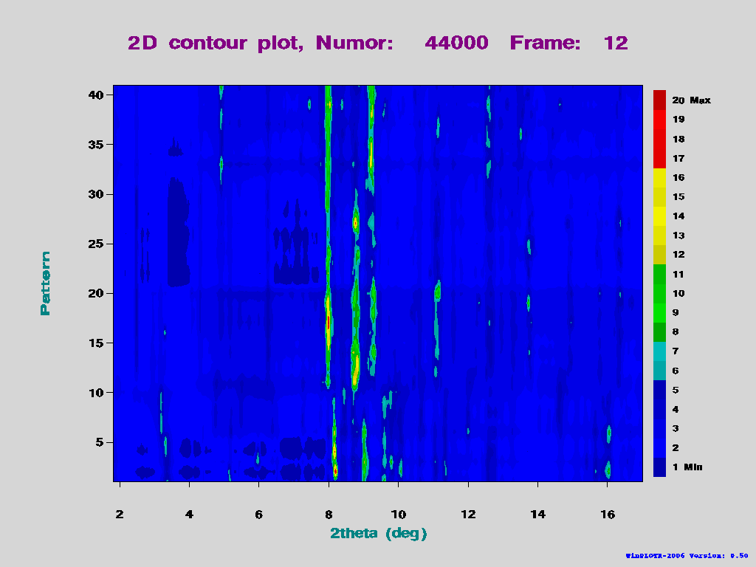


HP : microdiffraction
T Pradell, G Molina Universitat Politecnica de Catalunya
J Pla, J Molera, Universitat de Vic
Cultural Heritage
X. Turillas, UPM-CSIS - ALBA
3 micro diffraction
users’ experiments so far
3 to come in 2014-II

Slide 13


HP : technical development for micrdiffraction
On axis visualisation (I Sics development)
-shared with CLAESS
OAV–pinhole interference
xyz motorized translation,
zoom/focus motorization
…but lack of magnification and
proper GUI interface :
frame grabber, 3-click centering,
‘drawing ‘objects (line, circle, distances….)
Such a GUI as well needed for the HP calibration setup
50 μm as seen by
Pressure Calibration setup
50 μm as seen by
On Line visualisation

Slide 14



HP : technical development for pressure calibration
C Popescu, I Sics
ALBA awards for technical development
Pressure determination ?
Put an internal standrad (e.g. Cu, Au…)
EoS known : d_{111 spacing} <-> internal pressure
(drawback : possible overlap with other peaks)
Ruby fluorescence technique :
Al₂O₃:Cr³⁺ crystals illuminated by a laser
(blue) -> fluorescence signal
-> peak position <-> internal pressure

Slide 15


HP : inhouse research C Popescu
CdAl₂S₄ under high pressure
Defect chalcopyrite Disordered Rocksalt Cubic Spinel
See Poster

Slide 16



HP : Microdiffraction
Intensity extraction from random oriented grains
(O Vallcorba, J Rius, I Peral)
Epidote mineral, Ca₂Al_{2.25}Fe_{0.75}(Si₂O₇)(SiO₄)O(OH)
Orientation result
Requirements:
- Image with the contribution of a reduced number of grains
- Cell parameters
- Slight oscillation of the sample (more reflections, reliable intensities)

Slide 17




PD : Sample environment projects
Compact fast spinner
based on hard drive motor
F. Farre
-> 1000 ºC furnace
(2 proposals required
for it last round)
commercial STOE chamber ?
halogen lamp furnace like at ESRF ?
-> in house technical development
but technical/engineering ressources
lHe continuous flow cryostat – to be shared with CLAESS-
order to the ESRF (expected delivery end 2014)
Ancillary equipment to be ordered
transfer line, controller, pump,
dewars if local lHe supply, organize lHe supply/recovery ?)
Engineering design for integration and sample spinning
E Fraga, ExpDiv transverse
- WARNING : shared equipment -> users scheduling, limit number experiments

Slide 18




HP : Sample environment projects
First HT-HP experiment performed in Dec2013
Errandonea, McLeod, McMahon
Isothermal pressure dependencce in Ti
(EoS : up to 250 C, 30 GPa)
-> continuation at higher T in Dec 2014
more poweful ALBA power supply + internal heaters
Using own equipment, agree to transfer technology
Commercial solution (BETSA)
compatible with our
HT ready membrane cell
limited to 400º C in air,
? 600º C in vacuum
(chamber to be designed)
ESRF design
Purely based on
internal microheaters
(up to 1200 ºC)
HP instrumental developments are delicate,
time consuming, high level of engineering/technical skill
HP demand for development might increase
if CLAESS and MIRAS jump in
bullky ,
specific cells and heaters required

Slide 19






HP : beam size as limiting factor
Direct spot size illumination
Beam size at HP
-> limit measurements
to Ø 80 μm gaskets
~ 50 GPa
50 μm pin hole
Knife edge scans
hor
ver
Fwhm 15 μm
Fwhm 18 μm
75 μm
75 μm
0.7 mm x 0.7 mm aperture in FE and before KB, Ø 50 μm pinhole

Slide 20





PD Striation effect on 1st mirror
Signorato et al , SPIE 3152, Moreno et al , SPIE 5921
Beam after mono
Beam at PD sample
21 km bending (collimating)
15 km
21 km
15 km bending
12 km
12 km bending
Peak structured reflected
in MYTHEN not in MAD
-> focus at MYTHEN (9.5 km bending) to have symmetric – non structured - peak shape
-> small vertical beam (~0.7mm height), hard to operate with capillars (organics)…but good angular resolution
-> not the same bending setting for MAD and MYTHEN, limit simultaneous data collection

Slide 21

BL04 : long term ‘unreasonable ?’ projects
HP : a smaller source is desired for beam size < 10 μm
PD-MYTHEN : get rid of mirror to eliminate striation structure effects
but keep a reasonable vertical divergence
PD-MAD : keep reasonable vertical divergence without mirror
for preserving angular resolution
-> change the wiggler by lN₂ cryogenic undulator and
operate without 1st mirror
(BL04 designed for operating in unmirrored, check heatload !)
MSPD : SC Wiggler
@200mA -> B= 2.1 T , K=6.08, P_{max} 11.8 kW
mono designed fro 800W locally
Done at SLS-MS beamline (2.3 geV machine, 5-40 keV energy range):
Nd-Dy-Fe_B alloy at 150K 14mm periode, 2m length, 3.6mm min magn gap
Development at SOLEIL
Pr-Fe-B alloy eg 15 mm periode 5,5 magn gap, 5.5 x 2 mm pole size -> B= 0,93 T K=1,303
Courtesy COUPRIE Marie Emmanuelle, SOLEIL
Of course low flux at high E …but to compare Wiggler/Undulator numbers with our small FE aperture

Slide 22



BL04 : long term ‘more reasonable ?’ projects
Commission KB mode to PD station (20-50keV)
(No time, no high demand for it so far… may be for strain scanning )
PDF using focused beam and 2D image plate detector to acquire (Perkin Elmer)
SNBL @ ESRF
Relatively cheap option but
afterglow problem
Now Perkin Elmer
HP technical development (in collaboration with Valencia group + CLAESS + MIRAS ?)
Low Temperature cryostat
He gas cell loading equipment
High temperature
Inhouse design/production of membrane
HP Workshop likely to be organized in 2015 at ALBA

Slide 23
How is performing the beamline ?
I am giving the floor to SAC
Thanks for your attention !

