Slide 1
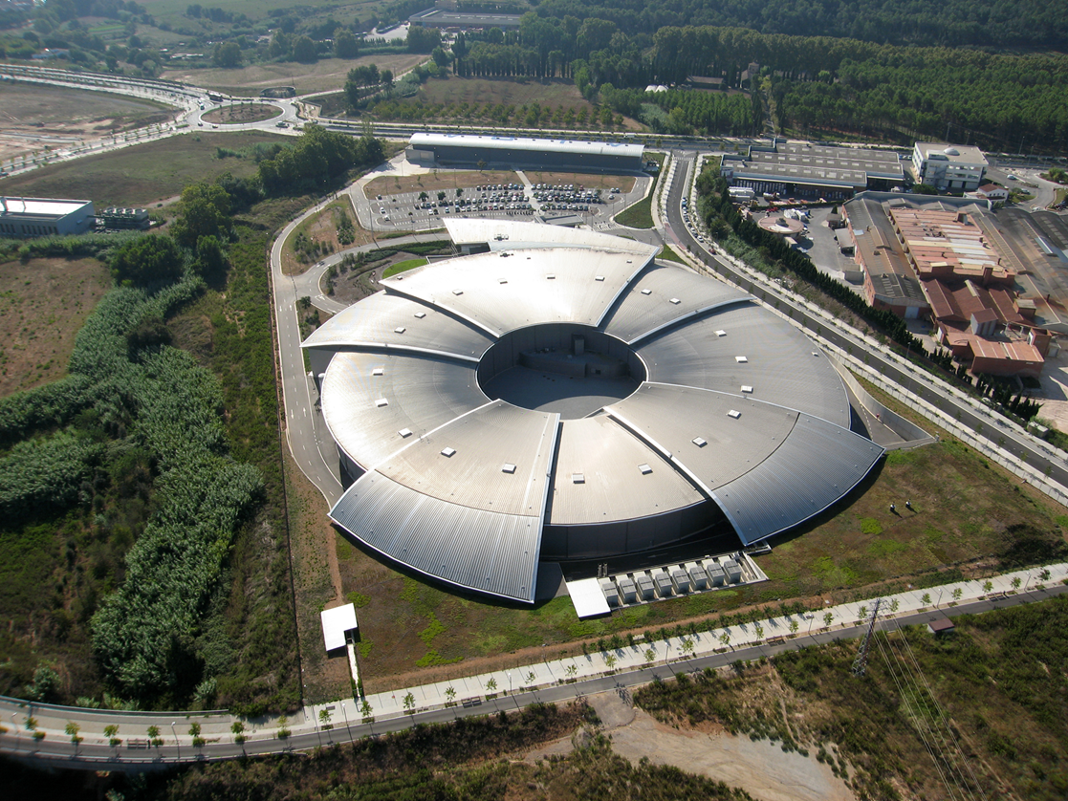
ALBA Industrial Liaison Office

Slide 2
INDUSTRIAL OFFICE
VISION
Contributing to improve the Industry competitiveness by using the latest Synchrotron Light developments.
MISSION
To promote and to make available to the Industry all the potential of the Synchrotron Light applications.
STRATEGY
Customer satisfaction, one-stop shop service
ORGANIZATION
Office reporting to the Director
Two persons

Slide 3
INDUSTRIAL OFFICE ACTIVITIES
Industrial outreach
Industrial Workshops, Industrial facility visits,…
Industrial access
Beam time access
Other lab access: magnetic, metrology, RF…
Other in-house developments
Technology Transfer
Patents
Licensing
Spin-offs
Long term industrial collaborations
R&D Projects
Scientific staff funding
Industrial PhD students funding
Scientific instrument developments

Slide 4
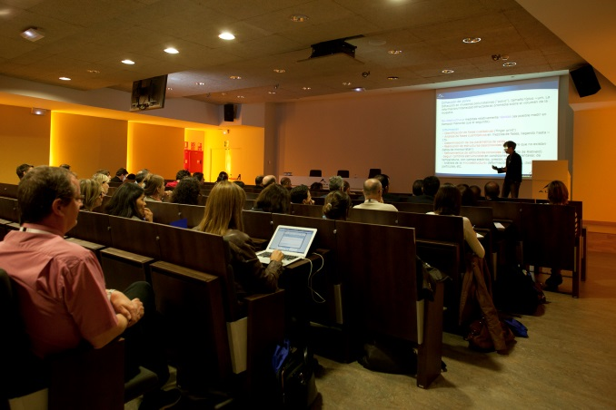
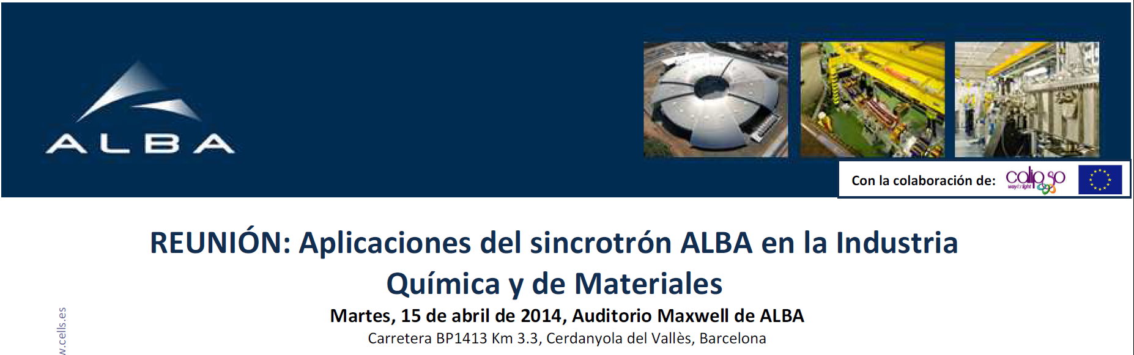
INDUSTRIAL OUTREACH
Industrial Workshops
Industry associations
Industry facility visits
Industry exhibitions
European projects

Slide 5
INDUSTRIAL USERS

Slide 6
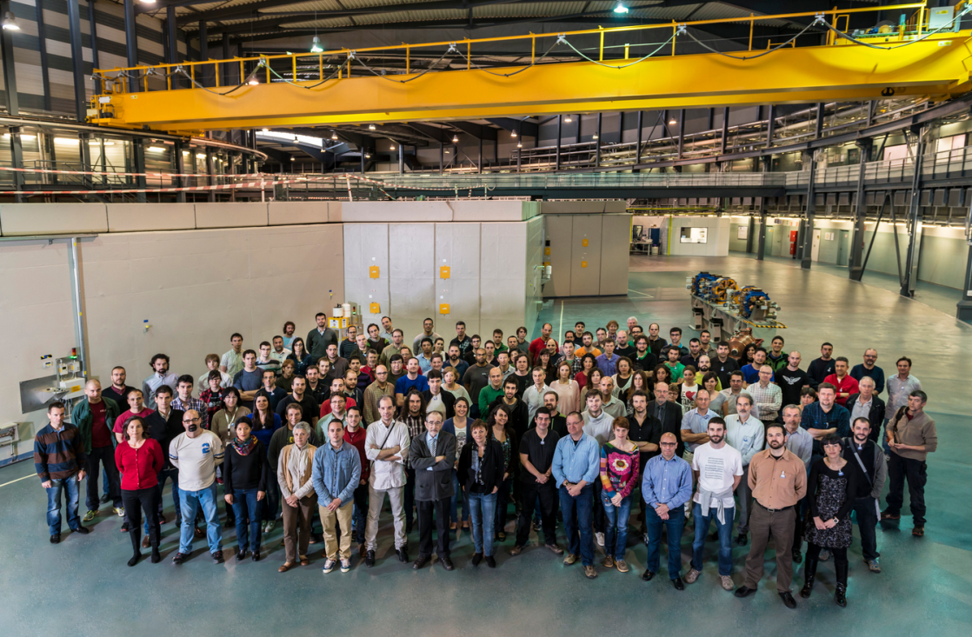
INDUSTRIAL USERS
More beamtime requests are in the pipeline for the coming months.
Beamlines are becoming more mature for industrial measurements.
Industry is interested in solving problems not in raw data. Data analysis and scientific expertise are essential. Resources are limited.
Other labs than the BLs,
like the magnetic, is
also providing service
to commercial users.
ALBA staff is keen to
collaborate with the
industry. This is key.

Slide 7


LONG TERM COLLABORATIONS
Collaboration agreement signed with the company Henkel.
ALBA, Henkel hub of collaborations.
Post-doc based on ALBA fully funded by the company Henkel.
A long term R&D project with the company Almirall is being defined.
Application for an Industrial PhD student at ALBA funded by the company Almirall and the Catalonian Government.

Slide 8
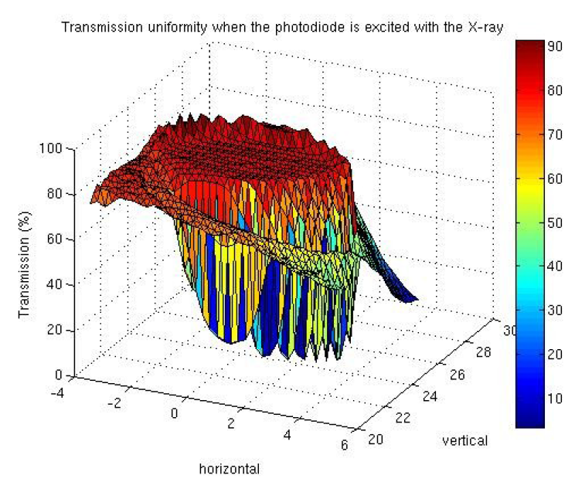
TECHNOLOGY TRANSFER
Patent application for an in-house development has started:
  Magnetic measurements bench
Collaborations with industries to commercialize in-house developments under the innovation program funded by the FCRI (Fundació Catalana de Recerca i Innovació):
  Photodiode detector
  Precision positioning table
Licensing negotiations for
in-house developments
  X-ray mirror nanobender
Support to industry scientific
instrument developments
  Industry proposal to the CDTI
  funding agency

Slide 9
CONCLUSIONS
One ALBA main goal is to improve Industry competitiveness.
ALBA has set an Industrial Liaison Office focused on the industrial costumer needs.
Industrial users have come to ALBA during the first year of operations. They came back after the first visit!
Data analysis is essential. It is a very limited resource.
Long term industrial collaborations have also started.
Other services, besides beamtime, are being provided such as technology transfer and other lab accesses.
Technology transfer is at the early stages.

Slide 10
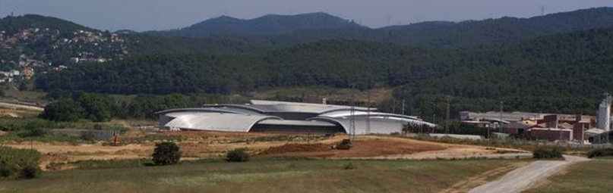
industrialoffice@cells.es
THANK YOU!

