Slide 1
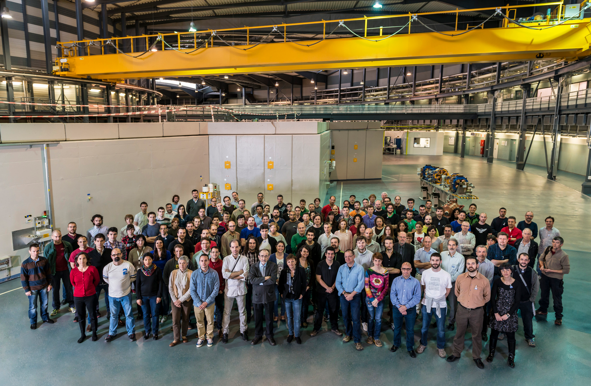
ALBA Status Report
C. Biscari
1 July 2014 – SAC18

Slide 2
Operation, Staff, Users

Slide 3
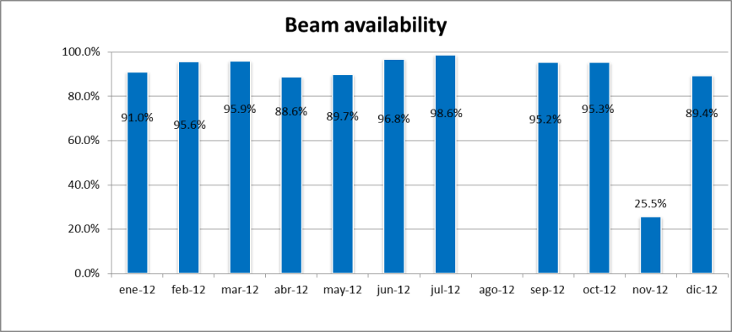
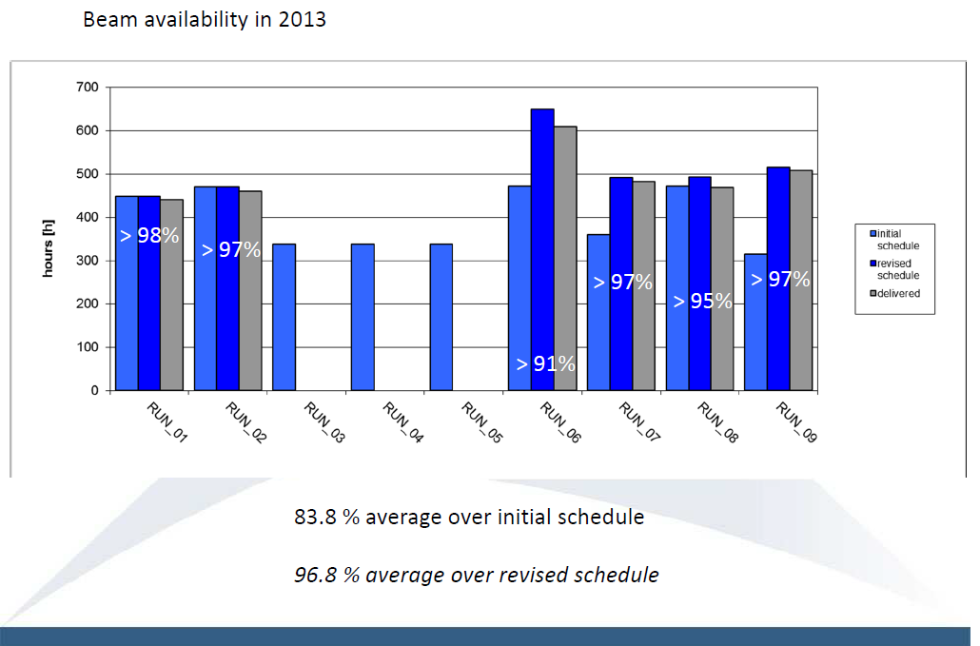
2013 Operation Summary
(compared with 2012)
2012
Long shutdown due to cooling system unavailability
85 % average
94 % average without vacuum incident
137 days for BLs

Slide 4
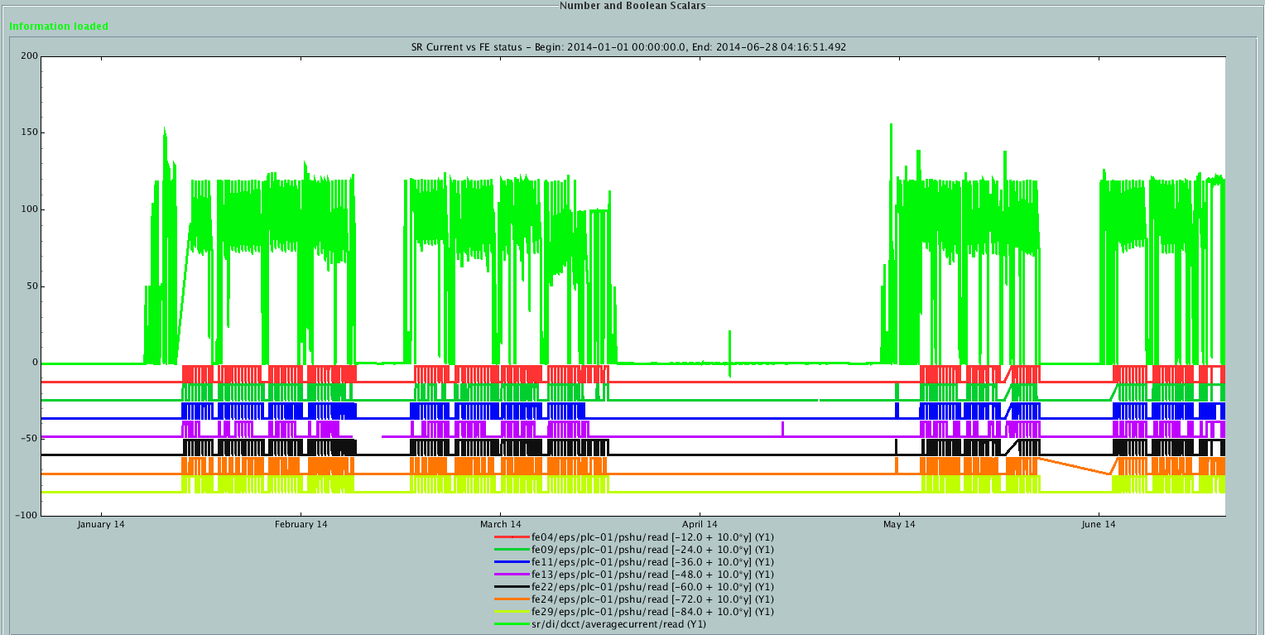
Operation 2014, RUN_01&02&03&04
Beam availability:
RUN_01 96.7 %
RUN_02 97.1 %
RUN_03 97.6 %
RUN_04 98.0 % (until 28/06/2014)

Slide 5
Availability

Slide 6
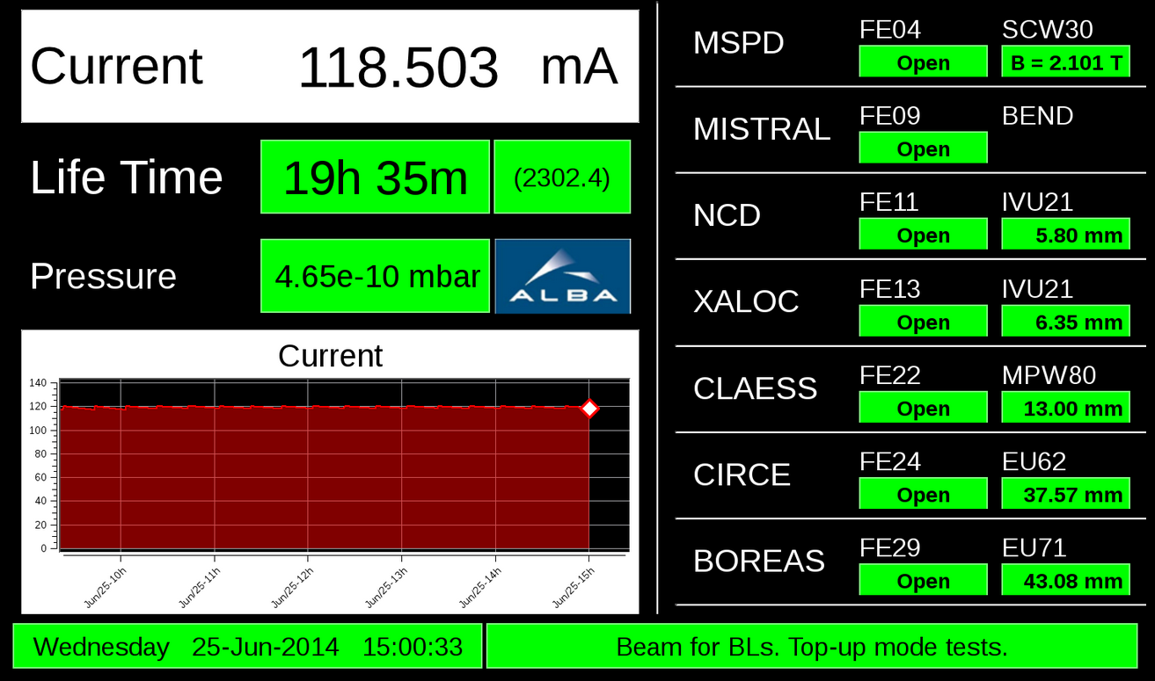
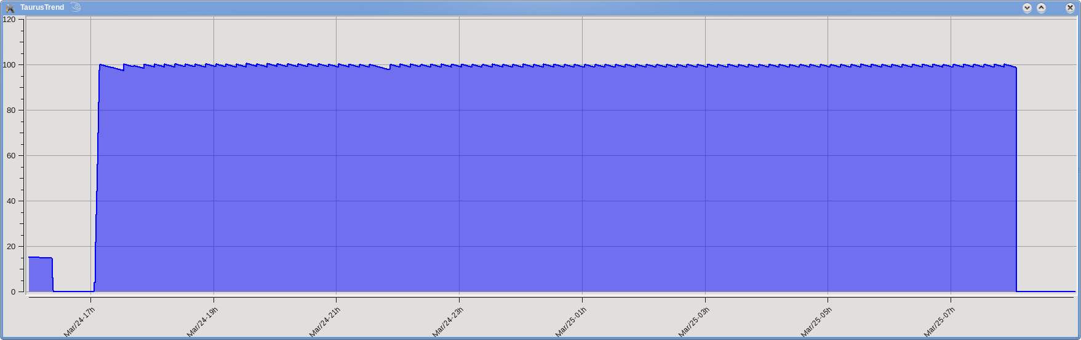
Top-Up
(more on Perez talk)
Top-up test at 100 mA
Constant current and constant photon flux
Several BLs taking data (no users)
25/03/2014
100 mA, re-injections of ≈ 1 mA every 10 min
Top-up operation with users : last week of June 2014

Slide 7
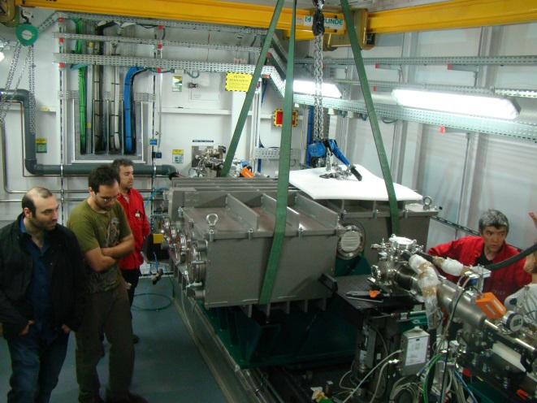
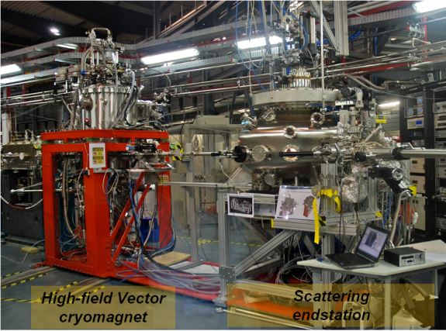
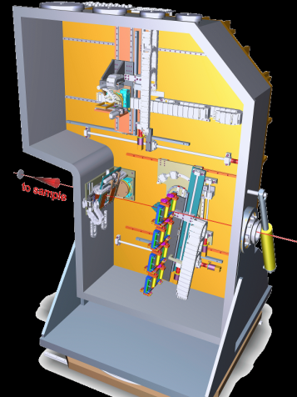
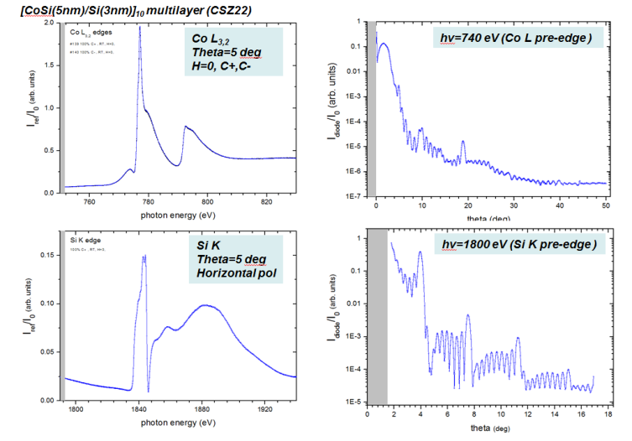
Phase I latest developments
(more on Herrero-Simonelli talks)
MARES at Boreas
CLEAR at CLÆSS
CLEAR installation on CLÆSS - April 2014
Ready for users on next cycle starting Jan’15
N.B: Ready For resonant scattering with 20K sample cryo-cooling, UHV in-situ preparation/evaporation; magnet or special detectors will be made available when ready along the year (related hardware by Eng. Div. and cabling is pending)
First tests with beam of the MaReS scattering endstation checking a CoSi/Si 10-period multilayer, last March. Test demonstrate excellent data quality, reproducibility in 5-6 orders of magnitude for continuous spectra and reflectivity even at high photon energies.
CLEAR
x-ray emission spectrometer
(2-22 keV)
In commissioning from May 2014
Left: Reflectance resonant spectra.
Right: extended angle specular reflectivity at “magnetic atom” energies, and at rather exclusive high energy (Si Kedge)
First analyzer prototype ready for users on Dec. 2014

Slide 8
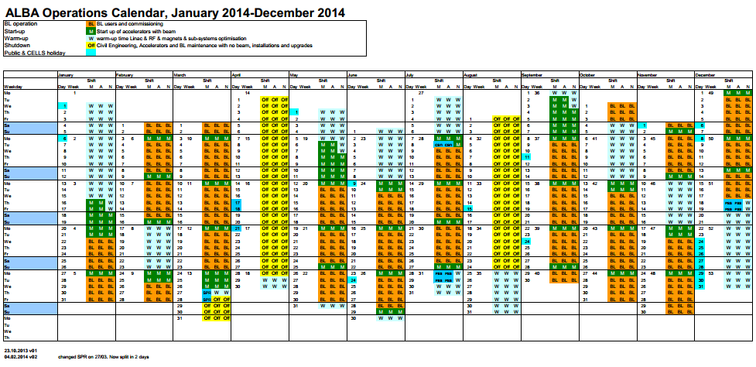
Operation calendar 2014 – 5250 hours

Slide 9
Operation calendar 2015 – 5730 hours

Slide 10
Staff
4 people left in first 6 months of 2014 (24 in all 2013)
Increasing the staff (174 at end of June, including PostDocs and external funds)
9 extra positions already approved
Average age: 37 years
Experimental Division
48 % International (18% on total staff)
28% female (27% on all staff)
Women percentage

Slide 11
Experiments performed until April 2014
USERS
VISITS
3rd call experiments started in May 14
Run May-Dec 2014
From 2015 two user calls per year
4th user call is open until 7th July
National / International Beamtime

Slide 12
Users feedback received during 2013
-Not all users answer feedback
-In the same group of users: sometimes different opinions (some users more critical, some users always nice)
-Therefore: these results should not be taken like absolute truths, but very ‘relative’.
Histograms contain absolute number of answers during this period

Slide 13
From user feedbacks

Slide 14
From user feedbacks

Slide 15
SAFETY
Related to the main SAC17 recommendations
Checking if the safety declaration from the user home institution ‘could be skipped or simplified significantly’:
Checked with local authorities (Departament de Treball de la Generalitat), with UAB, UPC and CSIC H&S responsible. All checks up to now confirm the necessity of such form. In spite of this we are still investigating the possibility to have agreements with some of the institutions to get a single safety declaration for all their users.
Thanks to this form, we were able to not accept a user last month, for health reasons
It is suggested that substances disallowed for user experiments should be defined and that information should be available before submitting a proposal. This would prevent “black” signed proposals. Examples are: radioactive or high bio safety level samples like Ebola virus.
This list has not been created yet, however in the biological case it is clear from the proposal template that the maximum biohazard level allowed is 2.

Slide 16
The risk assessment of the proposed experiments is to be done by the safety group. The BL-responsible opinion about the safety is also welcome, even if the beamline staff may be not competent or impartial for this task.
Since the first call, all the user proposal (in-house included) have been checked and approved by the H&S group.
The safety paper work should be incorporated as much as possible in the online training: The users should sign after this training (and online test) that they are capable to do the experiments, that they will take care about the experiments and their safety, that they know the general information about emergencies (which should be the same at every beamline) and that they understand the warning signs, ie knowing about not removing radiation shielding and that they will operate the experiment/beamline only after an introduction by the local contact.
The on-line training include all aspects related with conventional (an general) H&S issues and radioprotection ones. All the specific aspects: beamline PSS, gas handling, biosafety, etc… are controlled under check list risk assessment signed by the user, local contact and H&S.
The introduction to the beamline and BL Personal Support System (‘PSS’) should be done by the Local Contact and should be documented ie via an ALBA approved template. Both user and local contact should sign a list clearly displayed at each beamline so that the ALBA safety section staff can confirm that this has been done
The user PSS training has been done by the Local Contact, only in the case that the LC is very new at ALBA, H&S gives this training.

Slide 17
• It is highly recommended for experiments with yellow or red flags that the ALBA Safety Section advise the users in doing a safe experiment and be responsible for the final check of the experimental setup prior to the start of the experiment. This procedure would also apply in the cases whenever the local contact and/or the beamline controller state that they do not have the expertise for checking all the safety aspects of a given experiment.
For yellow and red experiments the H&S group prepare a specific document, where it is specified all the risk assessment found during the proposal risk assessment stage, to record that the user and local contact are informed about the risks, and H&S has checked the state of the experiment before starting. Checking the starting conditions is not enough to assure that the experiment will be done under safety conditions; it is important that Local Contacts know how to safely hand the experiments. Collaboration between H&S and BL scientists has constructively developed during last runs.

Slide 18
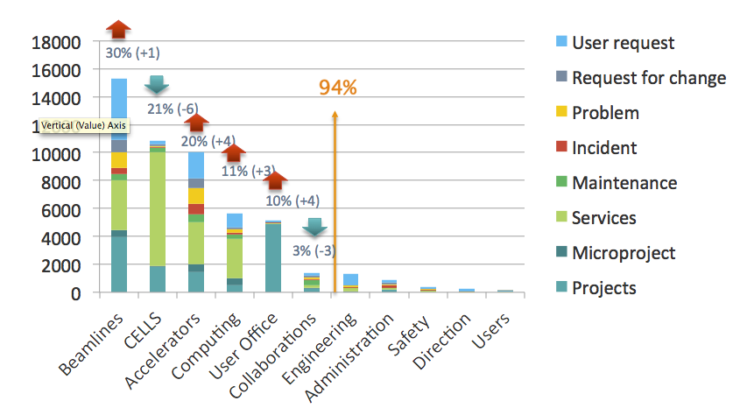



Computing & Controls general activity highlights
GO
First priority: Services: 6327 tickets in 2013 (requests, changes, incidences, problems).
Second highest priority: Projects: new Beamlines, experimental stations and generic transversal projects:
Authentication, remote access and high performance computing environments
  Central Authentication System
User office continuous improvement, Budget Management, new WEB ALBA-CELLS, Document management system being evaluated;
Harmonization of data acquisition. Common data formats and metadata management.

Slide 19
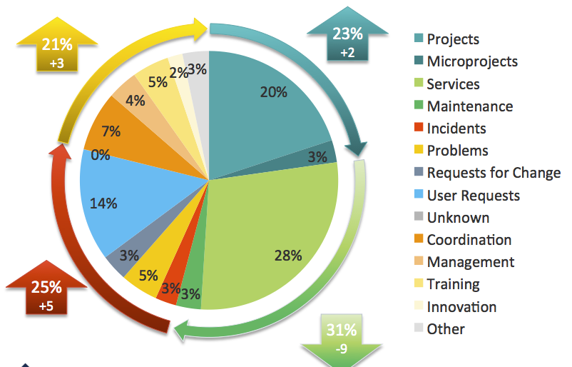
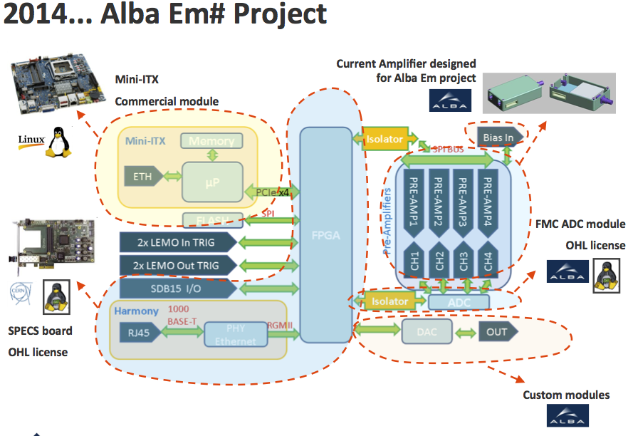

Computing & Controls general activity highlights
Generic continuous scans, implementation of fast orbit feedback and Top-up in good progress. Use of metadata through ICAT, adaptation to Sardana.
  New electrometer project: Upgrades the performances: up to 4 channels 18 bits ADCs 400kS/s. Conceived for integration in continuous scans.
Developments in detectors for diagnostics: In collaboration with CNM, first prototypes and characterization of thin silicon (10 um) and SiC transmissive diodes.

Slide 20
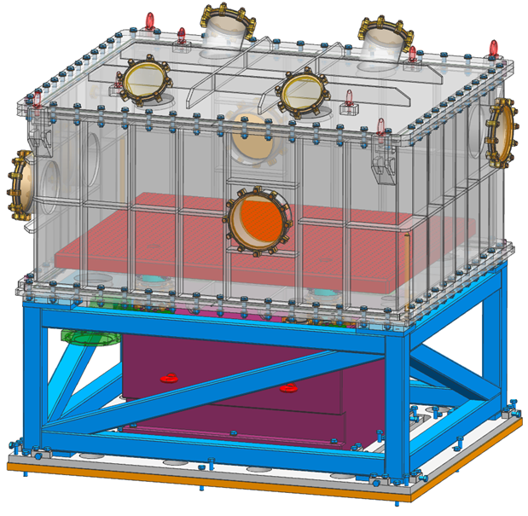
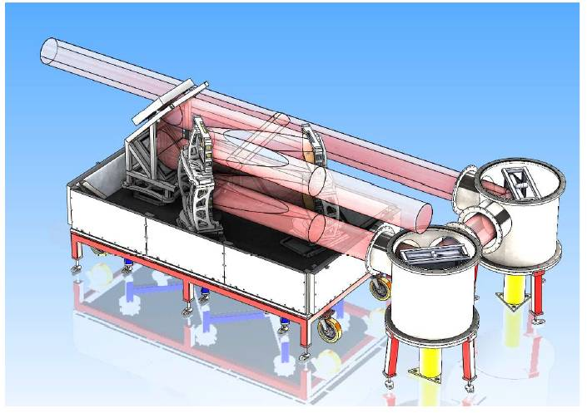
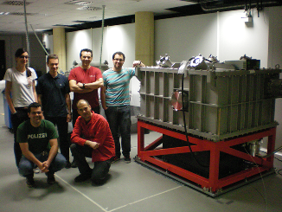
1 PW Laser CLPU chamber
NEW
done
Design and Amplitude proposal
CLPU 200TWComp. Chamb.
One FTE on CLPU funds

Slide 21
INDUSTRIAL USERS
(more on Sanchez talk)

Slide 22
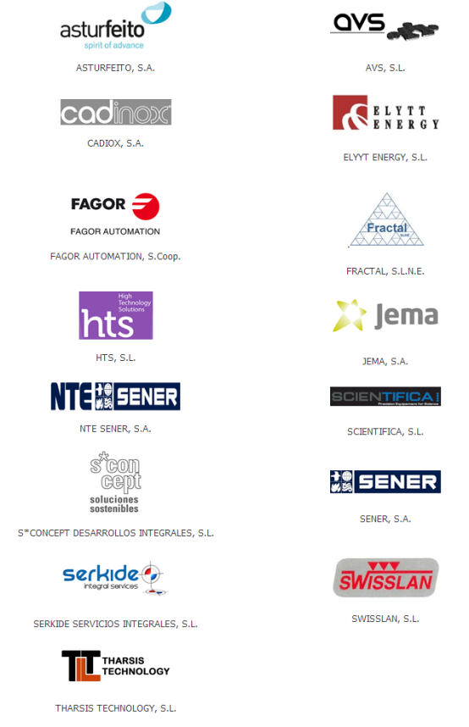
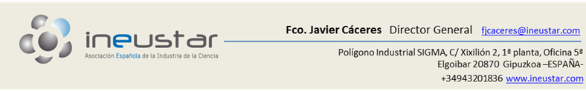
Technological Transfer
(more on Sanchez talk)
Contacts and collaborations with several companies
First patent being prepared
Licensing negotiations for in house developments

Slide 23
23
Highlight on
Collaborations with other institutions

Slide 24
Mexico -Turkey
Mexico
2011: MOU between Ministerio de Ciencia e Innovación de España and Consejo Nacional de Ciencia y Tecnología (CONACYT) de México for scientific and technologica collaboration.
2012-2013: Grants from MINECO to two Mexican researchers to be trained in Alba
2014: Preparation of a feasibility study of a synchrotron light source in the state of Morelos. Collaboration of ALBA with UNAM which is charge of the study.
Proposal of several PhD grants from Mexico to carry out research in Alba.
Turkey
Different Research Institutions and Universities are evaluating the possibility of constituting a consortium to build a Turkish PBL in Alba, based on Turkish Structural Funds
07-07-14 : Workshop in ALBA to discuss the project - Attendance of seven Turkish researchers from different Universities, including people presently at DESY and HZB

Slide 25


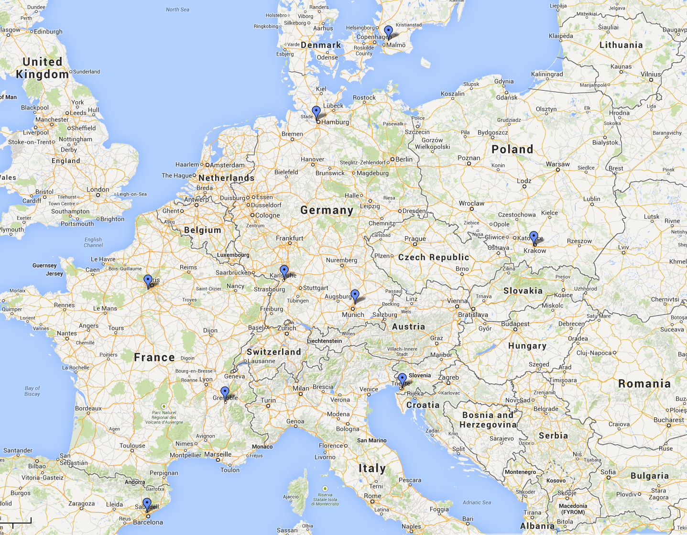















C&C Main Collaborations
+ PaNDAAS
(proposal for H2020 on data analysis)
Sardana - MX

Slide 26
International collaborations on accelerators
SESAME -- dipoles measurement (Prototype in September at Alba)
CERN: FCC (Future Circular Collider) and CLIC
CIEMAT – IFMIF rf cavity tests (in progress) + future magnetic measurements
Contact with IRAN Synchrotron Light Source team – Possibility of a PhD Student
ELI-NP Gamma System – Agreement with E-Gamma Consortium for Magnet simulations and measurements, Beam diagnostic testing, Operation training and participation in commissioning

Slide 27
27
Looking
towards the future

Slide 28
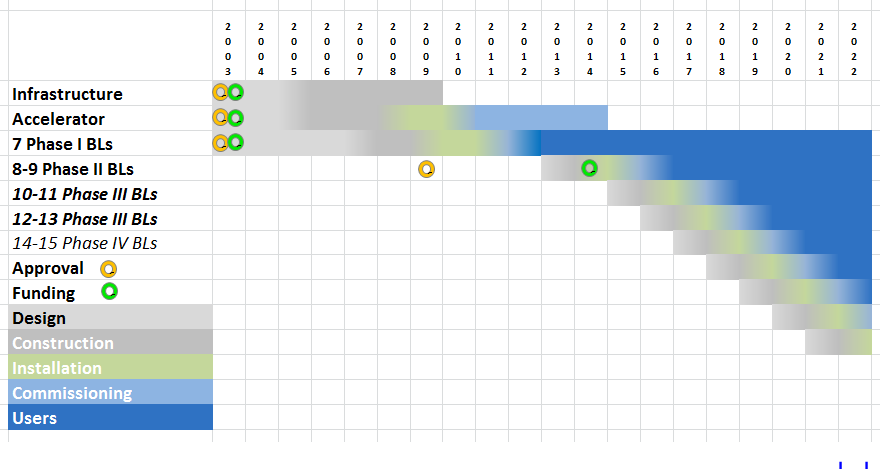
ALBA Simplified time schedule
‘Austerity’ shift

Slide 29
Phase II BLs: MIRAS and LOREA
(more on Garcia-Nicolas talk)
Approved by CE in 2009
Project Coordinator: Gaston Garcia, Josep Nicolas as deputy
Initial team: 20 people working part-time
Two Positions for BL responsible already open – 20 candidates (preselected 4 for MIRAS and 3 for LOREA)
Interviews for BL responsibles are being performed

Slide 30
BL31-LOREA
BL34-Diagnostic
BL29-BOREAS
BL01-MIRAS
BL04-MSPD
BL24-CIRCE
BL22-CLAESS
BL09-MISTRAL
BL11-NCD
BL13-XALOC

Slide 31
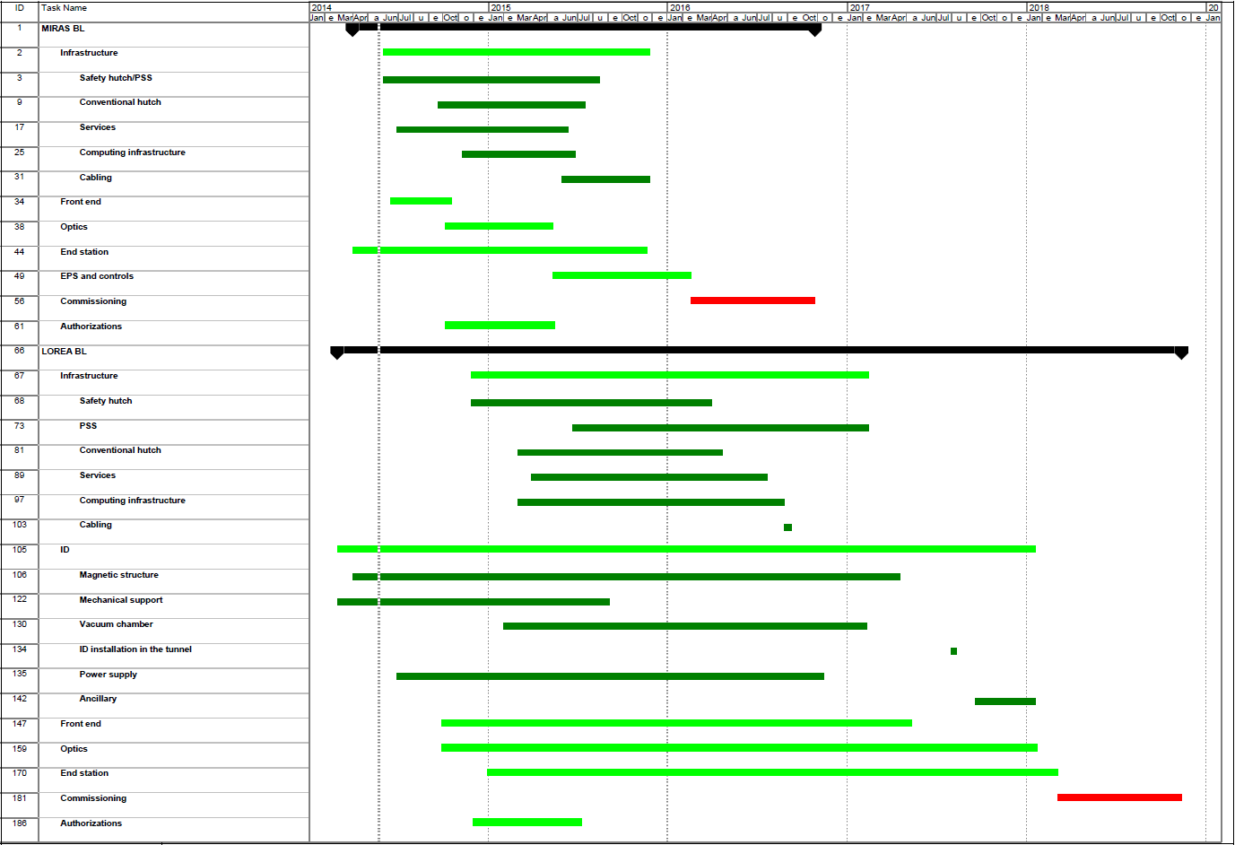
2014 2015 2016 2017 2018
MIRAS
Commissioning
(friendly users)
LOREA

Slide 32
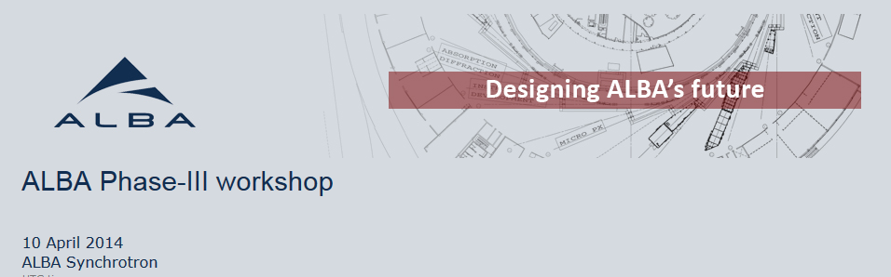
For each phase-III beamline proposal a presentation is expected including: I) Person or group of at most three persons, who would lead the proposal in case it was pre-selected; II) User groups supporting the proposal; III) Preliminary brief scientific case; IV) Connection between the scientific case and the priority lines of Horizon 2020; V) Possible synergies with the techniques and human resources currently available at ALBA; VI) Possible returns of the beamline investment to society (commercial use, regional development, ...); VII) Any other relevant features.
Presentations shall be done by the person (or team) leading the proposal and will be available to ALBA for further analysis
Once the pre-selected proposals are known, the scientific-technical projects and associated budgets shall be elaborated. This document, a full ALBA phase-III beamline proposal, shall be submitted in electronic format to the ALBA SAC in October 2014.
Beamline proposals shall be presented and defended before the ALBA SAC on its meeting to be held in November 2014.
The ALBA SAC shall make a prioritized and justified recommendation for approval of ALBA phase-III beamlines.

Slide 33
Six BLs to be presented to SAC in Dec 14
1. Microfocus diffraction beamline for macromolecular crystallography
Spokesperson(s): Núria Verdaguer (IBMB-CSIC, Barcelona); Maria Solà (IBMB-CSIC, Barcelona,); Isabel Usón (IBMB-CSIC, Barcelona); Jeronimo Bravo, IBV)
ALBA-spokesperson: Jordi Juanhuix
2. Submicrometer-beam diffraction, fluorescence and absorption beamline
Spokesperson (s): Adela Muñoz (Universidad de Sevilla); Gema Martinez Criado. (ESRF))
ALBA-spokesperson: Josep Nicolas/Laura Simonelli
3. High-energy imaging beamline
Spokesperson (s): Juan Gómez Barreiro (Universidad de Salamanca), Federico Sket (IMDEA Materials Institute - Madrid)
ALBA-spokespersons: Xavier Turrillas/Eva Pereiro
4. Surface-interface diffraction beamline
Spokesperson(s): Xavier Torrelles (ICMAB-CSIC)
ALBA-spokesperson: Salvador Ferrer (ALBA)
5. Skiron: Chiroptical spectroscopy beamline
Spokesperson(s): Salvador Ferrer (ALBA)
6. Instrument development and Innovation beamline
Spokesperson(s): Miguel A. G. Aranda (ALBA) Josep Nicolas (ALBA)

Slide 34
Next steps
Phase III proposals being prepared
End of September 2014 delivered to SAC
December 2014 presented to SAC in meeting at ALBA
End 2014: SAC Priority List
End 2014: ALBA management decision
In the hipothsys that four Phase III BL will be started in 2015 and 2016
(funds are still to be secured)

Slide 35
Conclusions
ALBA 1000th User on 11/06/14
Starting Top-up with users
Phase II BLs in construction
Phase III BLs program in preparation

Slide 36
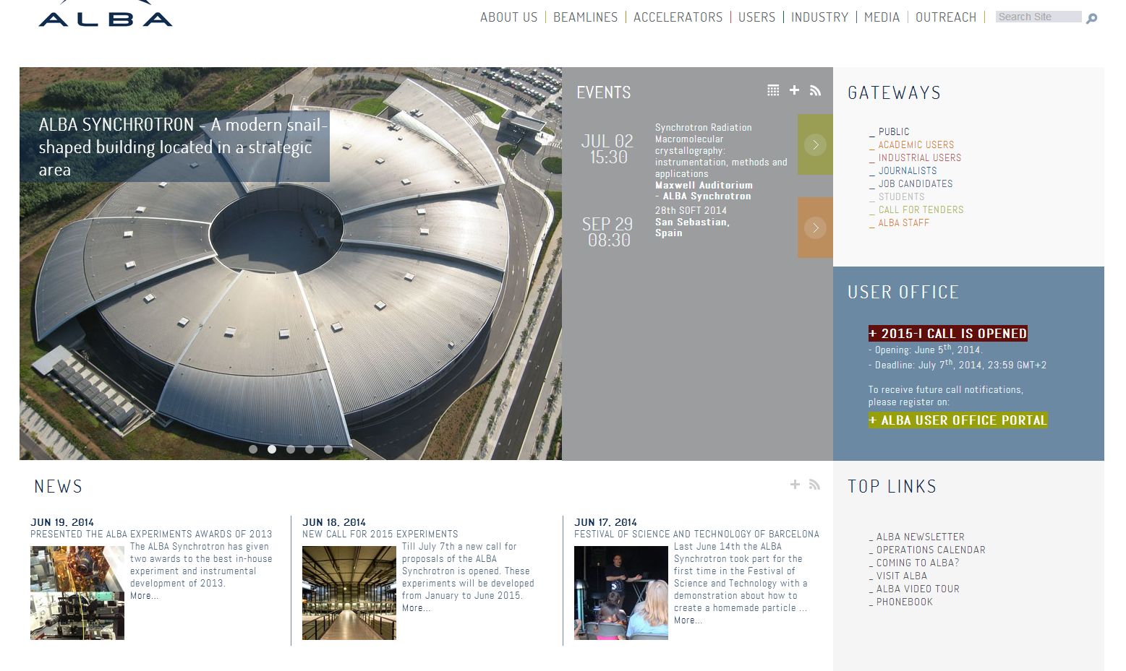
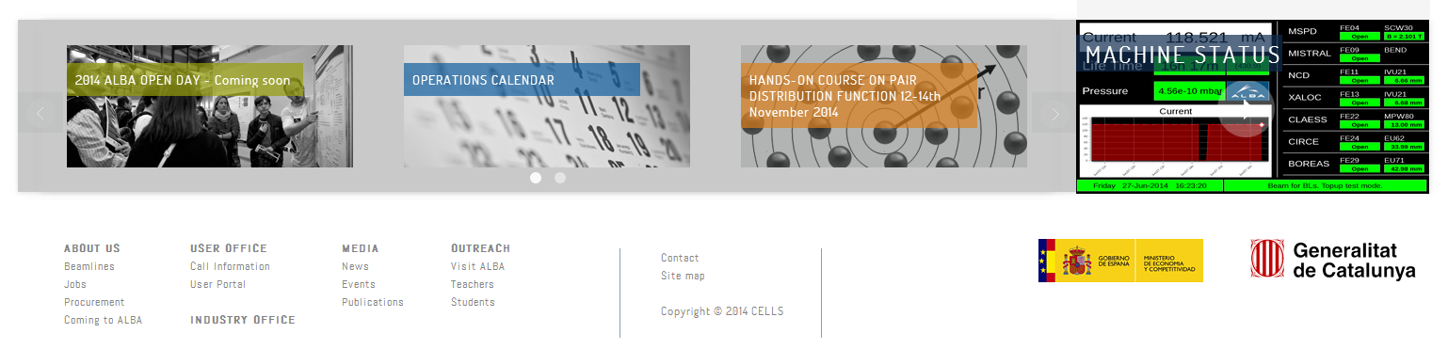
www.cells.es, www.albasynchrotron.es
Thank you for your attention

