Slide 1
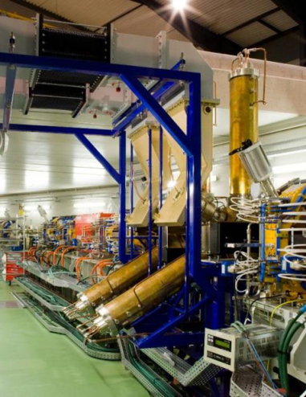
Machine Status and
Top Up Operation
Francis Perez

Slide 2
Outline
2
Operation
  2013
  2014 (so far)
Top Up
Accelerator Developments
  Injection bump closure
  FOFB
  Beam lifetime
  Energy measurement
  Interferometry beam size
  “67 MeV” injector

Slide 3
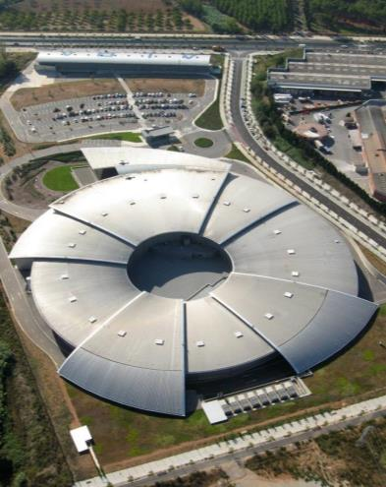
Operation
ALBA Accelerators
Operation 2013
Operation 2014 (so far)

Slide 4
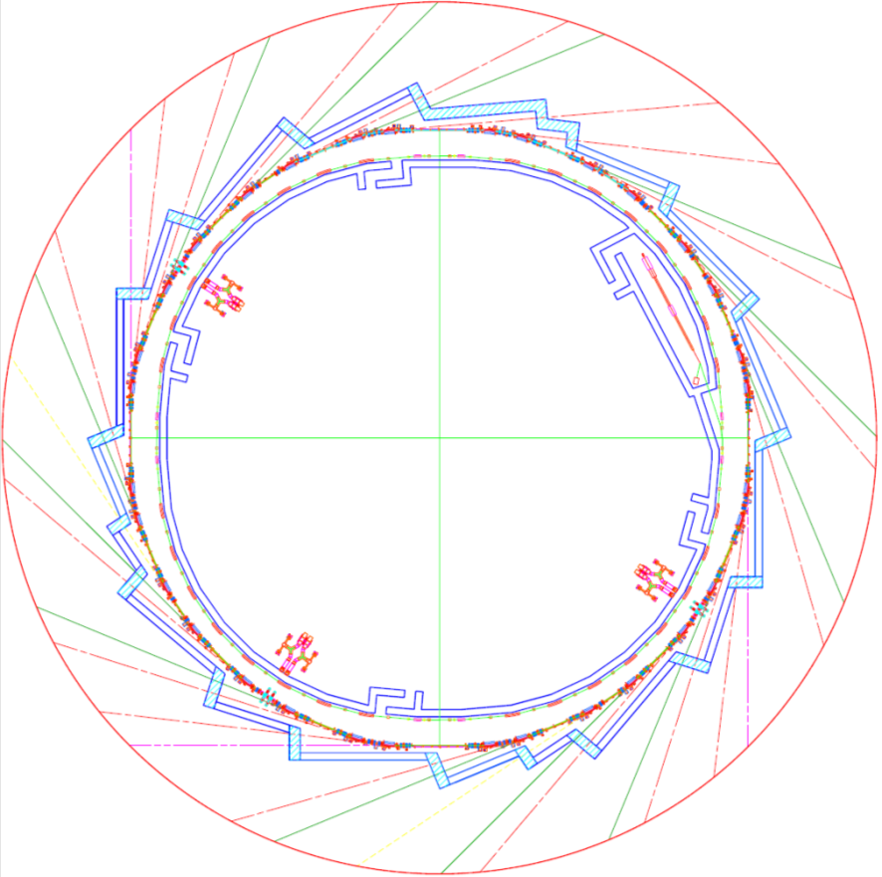
ALBA Accelerators
ALBA Accelerators
LINAC
100 MeV
BOOSTER
100 MeV – 3 GeV
STORAGE RING
3 GeV

Slide 5
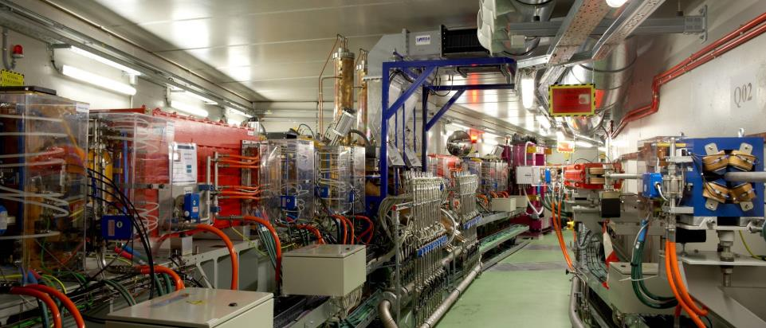
SR and BOOSTER sharing the tunnel
ALBA Accelerators
Bending
RF cavities
In vacuum undulator
SR
Booster

Slide 6
ALBA Storage Ring
Storage Ring: Main Parameters
Electron beam energy 3.0 GeV
Storage Ring Circumference 268.8 m
Number of cells 16
Symmetry 4
Straight sections: 4 Long 8.0 m for 3 ID & Injection
12 Medium 4.4 m for 12 ID
8 Short 2.6 m for 2 ID & RF & Diagnostics
Beam current 250 mA
Emittance 4.3 nm.rad
Lifetime > 10 h

Slide 7
ALBA Storage Ring
E [GeV] | 3
C [m] | 268.8
Q_{x} | 18.19
Q_{y} | 8.24
ε_{x} [nm rad] | 4.3
ξ_{x} | -34
ξ_{y} | -24.5
α_{p} | 8.4×10⁻⁴
a₂ | 2.5×10⁻³
δE/E | 1.05×10⁻³
J_{x}/J_{y}/J_{E} | 1.3/1/1.7
t_{x}/t_{y}/t_{E} [ms] | 4.0/5.3/3.1

Slide 8
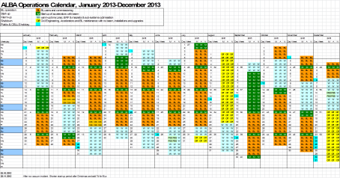
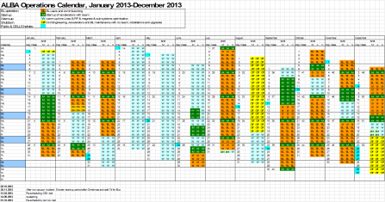
Operation 2013
The cooling incident force a major modification of the operations calendar in July 2013
Total hours lost (runs 03 to 05): 1416 h
Total hours added (runs 06 to 09): 824 h

Slide 9
Operation 2013
The cooling incident force a major modification of the operations calendar in July 2013
 | Initial schedule | Revised schedule | Delivered
BL(2012) |  |  | 2387.3
BL(2013) | 3539.5 | 3069.0 | 2971.5
Injections | 252.5 | 219.0
M+csn | 1488.0 | 1368.0
W | 2432.0 | 3240.0
Off | 1048.0 | 864.0
Total hours lost (runs 03 to 05): 1416 h
Total hours added (runs 06 to 09): 824 h

Slide 10
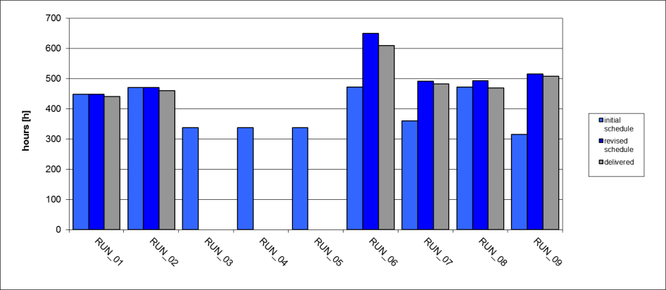
Operation 2013
Beam availability
2 shifts/day
> 98%
> 97%
> 97%
> 97%
> 95%
> 91%
83.8 % average over initial schedule
96.8 % average over revised schedule

Slide 11
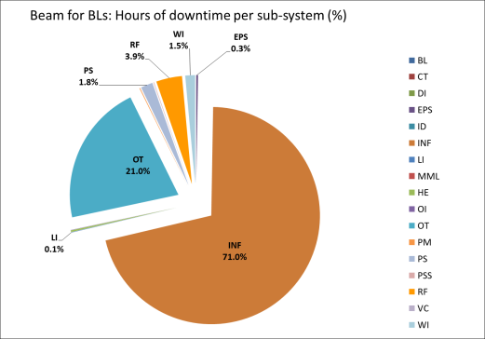
Operation 2013
Analysis of failures per sub-system
Total of 1109.5 h of beam downtime
BL Beamlines PSS
CT Controls
DI Diagnostics
EPS EPS interlock
ID Insertion Devices
INF Infrastructure
LI Linac
MML High Level Software (MML)
OE Human error
OI Orbit Interlock
OT Others
PM Pulsed magnets
PS Power Supplies
PSS PSS (except BLs)
RF Radio Frequency
VC Vacuum
WI Water interlocks

Slide 12
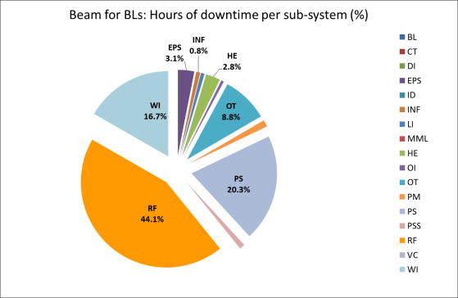
Operation 2013
Analysis of failures per sub-system w/o cooling & MPW chamber replacement
Total of 97 h of beam downtime ≈ 0.7 h/BL day
BL Beamlines PSS
CT Controls
DI Diagnostics
EPS EPS interlock
ID Insertion Devices
INF Infrastructure
LI Linac
MML High Level Software (MML)
OE Human error
OI Orbit Interlock
OT Others
PM Pulsed magnets
PS Power Supplies
PSS PSS (except BLs)
RF Radio Frequency
VC Vacuum
WI Water interlocks

Slide 13
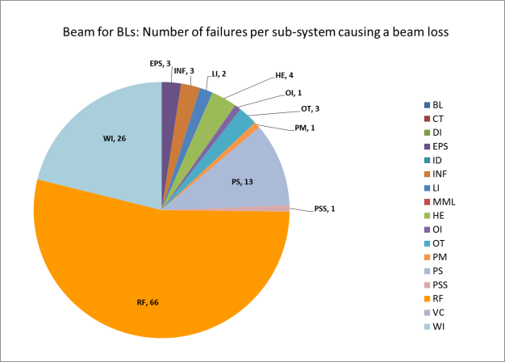
Operation 2013
Analysis of failures per sub-system w/o cooling & MPW chamber replacement
Total of 123 failures causing a beam dump ≈ 0.9 failure/BL day → 25 h MTBF
BL Beamlines PSS
CT Controls
DI Diagnostics
EPS EPS interlock
ID Insertion Devices
INF Infrastructure
LI Linac
MML High Level Software (MML)
OE Human error
OI Orbit Interlock
OT Others
PM Pulsed magnets
PS Power Supplies
PSS PSS (except BLs)
RF Radio Frequency
VC Vacuum
WI Water interlocks

Slide 14
Operation 2013
Summary
 | 2012 | 2013
Beam for BLs | 2387.3 | 2971.5
Availability | 85 % | 96 % *
MTBF | 21.0 | 25.0 *
MTTB(back) | 1.0 | 0.8 *
* Excluding water cooling problem

Slide 15
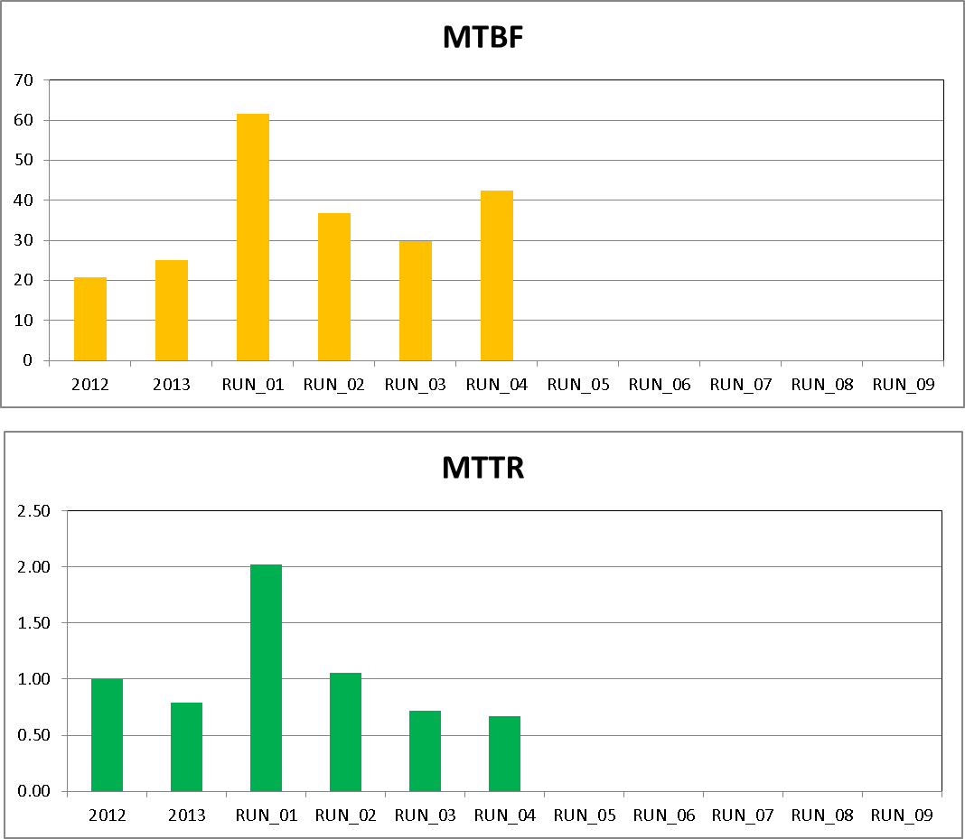
Operation 2014 (so far)
Beam availability:
RUN_01 96.7 %
RUN_02 97.1 %
RUN_03 97.6 %
RUN_04 97,7 %
41,2 h
11.0 h Water leak at FE34
2.3 h PSS intlk at BL09
1,1 h

Slide 16
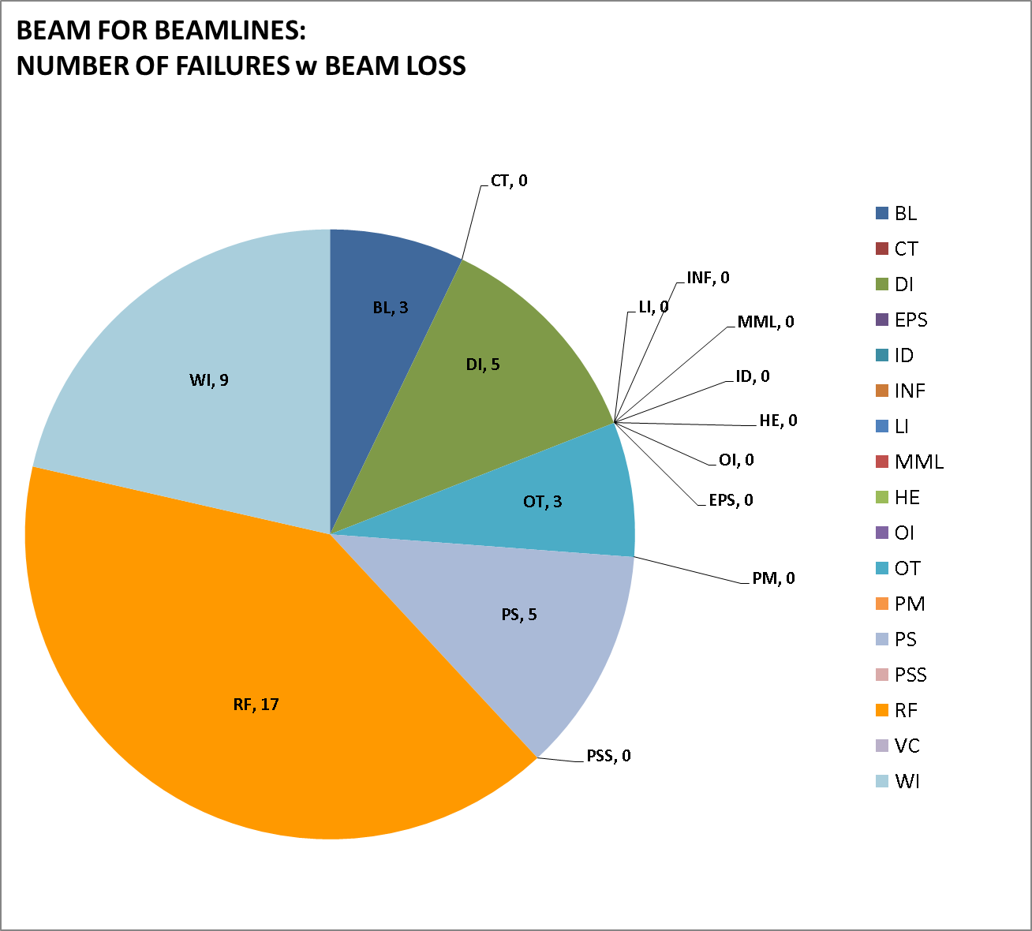
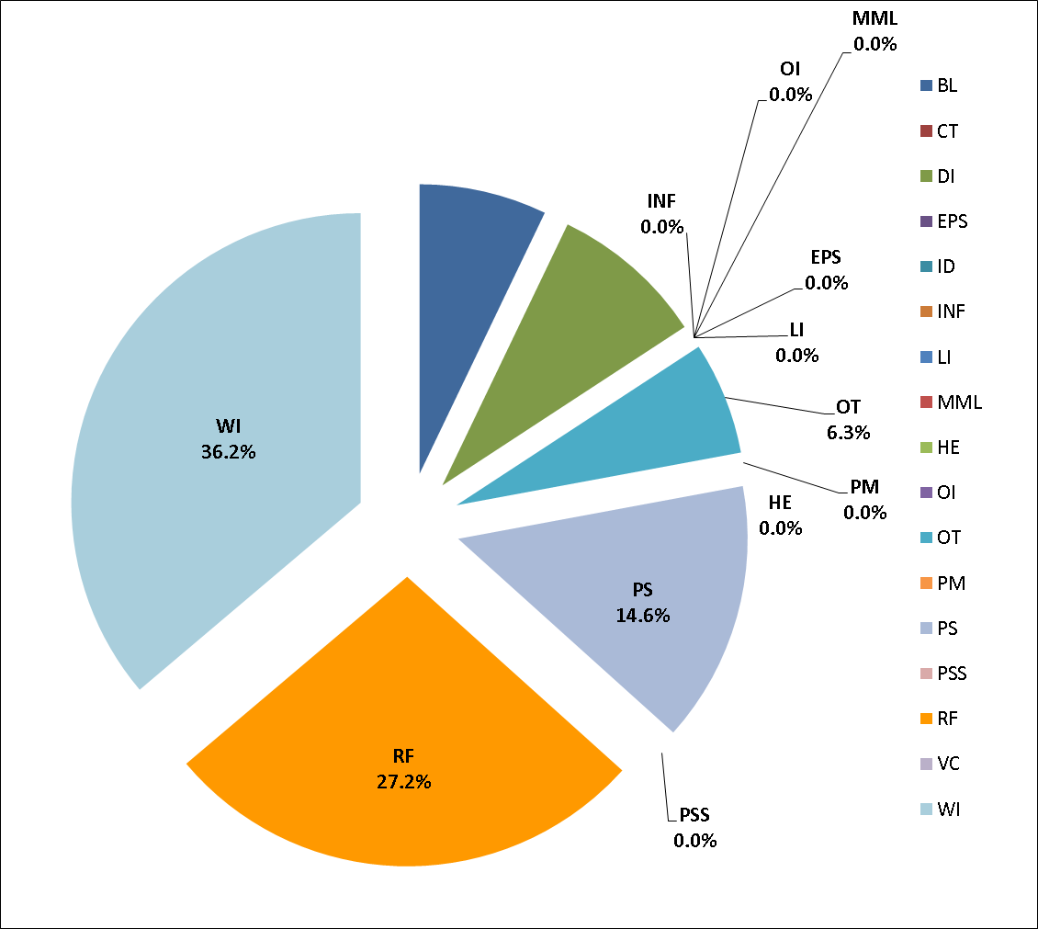
Operation 2014 (so far)

Slide 17
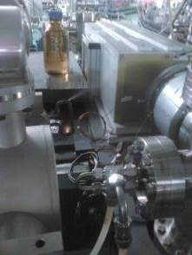
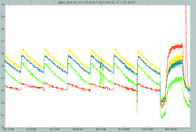
Pinhole aluminium window water leak
Damaged
Kicker
Electronics
FE absorber temperature – ok

Slide 18
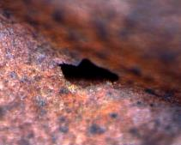
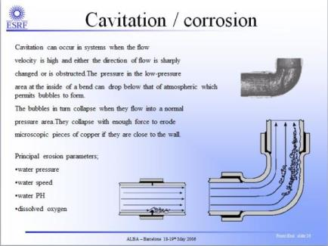
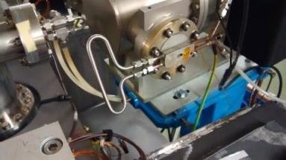
Pinhole aluminium window water leak
Small (350um) hole in the Cu cooling pipe
?
Microscope image
Repaired the following day

Slide 19
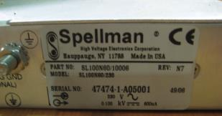
LINAC Gun High Voltage PS
Before starting run #3, during the subsystem tests,
the LINAC Gun High Voltage PS (-90 kV) did broke.
We did not have available spare:
Exchanged by -50 kV PS (from RF group) and commissioned the Linac with reduced e-gun beam energy.
BESSY lend us a -90 kV as back-up
(many thanks to Andreas that pick up the phone on May 1st and SOLEIL that offered also their spare)
Reparation already done and new spare purchased
Back to normal along this week

Slide 20
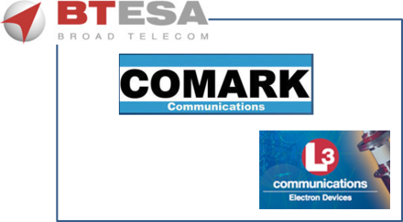
IOTs – RF transmitter upgrade
IOTs Upgrade: 1 prototype end of 2014
4 series units summer 2015
In addition, more Thales IOTs spares purchased.

Slide 21
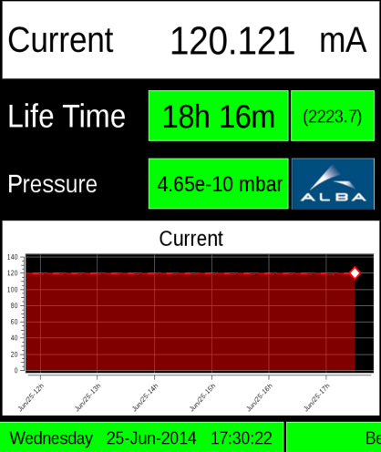
Top Up

Slide 22
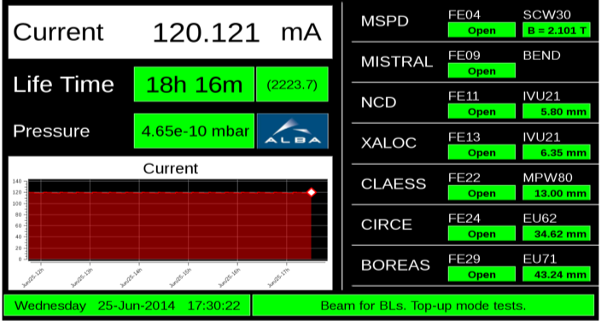
Top Up
Top-up operation test with users: last week
June 25th – 28th, 2014

Slide 23
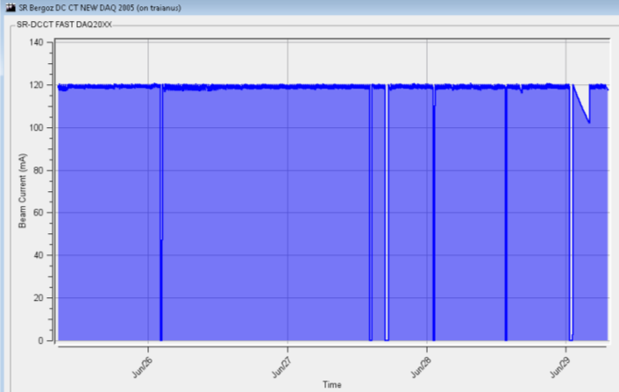
Top Up
Top-up operation test with users: last week
June 25th – 28th, 2014

Slide 24
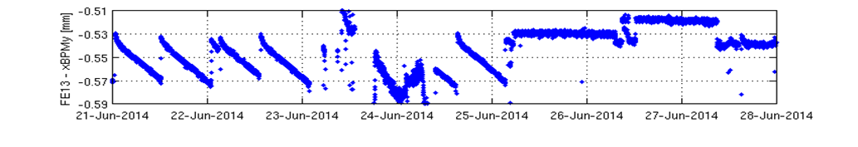
Top Up
Top-up operation test with users: last week
June 25th – 28th, 2014
XALOC: xBPM_{(y)}
Machine day
Decay mode
Top-up
(jumps are due to changes in the ID gap)

Slide 25
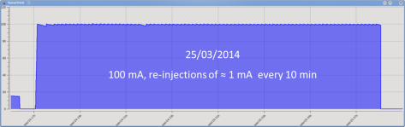
Top Up
    Influence of injection on BLs,
    after several test together with the BL scientists.
 | sensitive to BO | sensitive to KI
BL04 | No
BL09 | No
BL11 | No
BL13 | No
BL22 | No
BL24 | Slight increase of noise, but the effect is marginal | Yes, gating is needed
BL29 | No | Slight increase of noise but the effect is marginal. No gating is needed
Soft gating provided to BLs

Slide 26
© Safety
Top Up
Acoustic noise -due to the Booster PS ramping at 3 Hz- at Experimental Hall
(close to CIRCE)
12.5 kHz
Technical solutions to damp the noise are under investigation

Slide 27
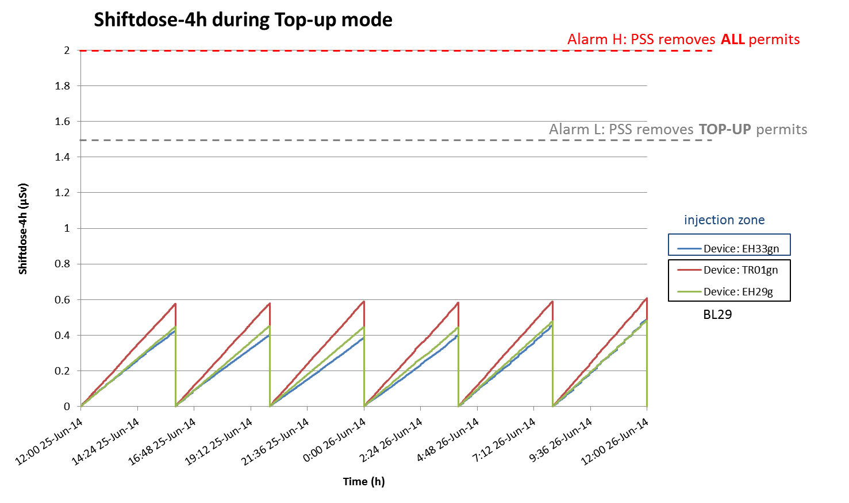
© Safety
Radiation measured during Top-Up
June 25th
Well below Public Zone & Similar to decay mode

Slide 28
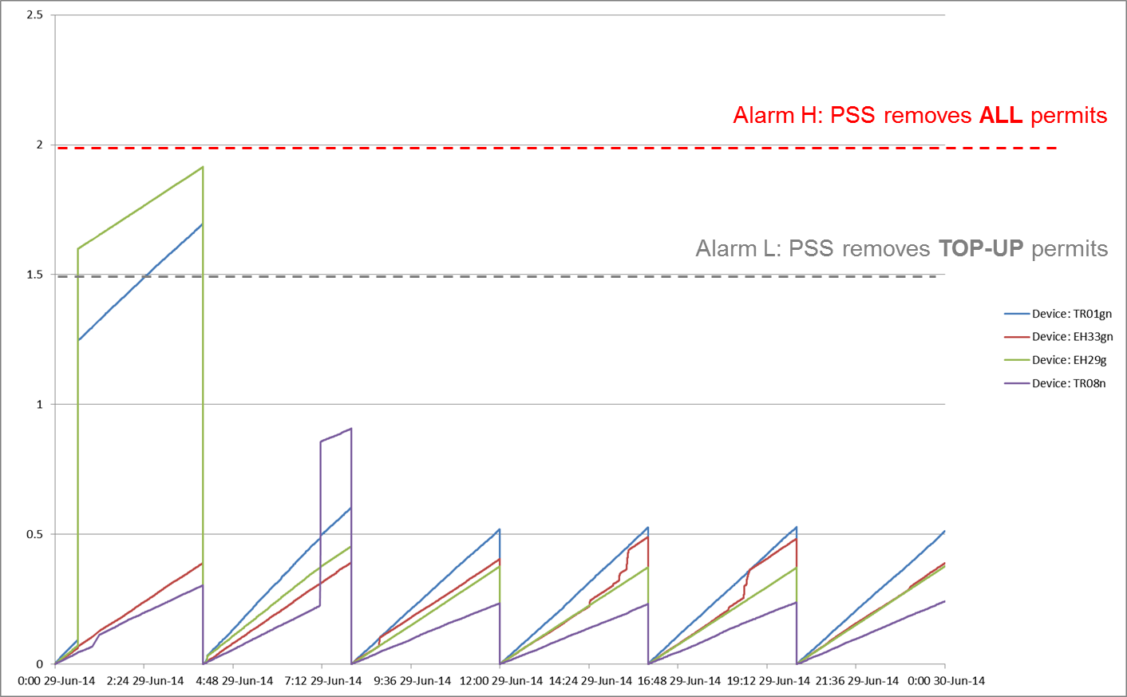
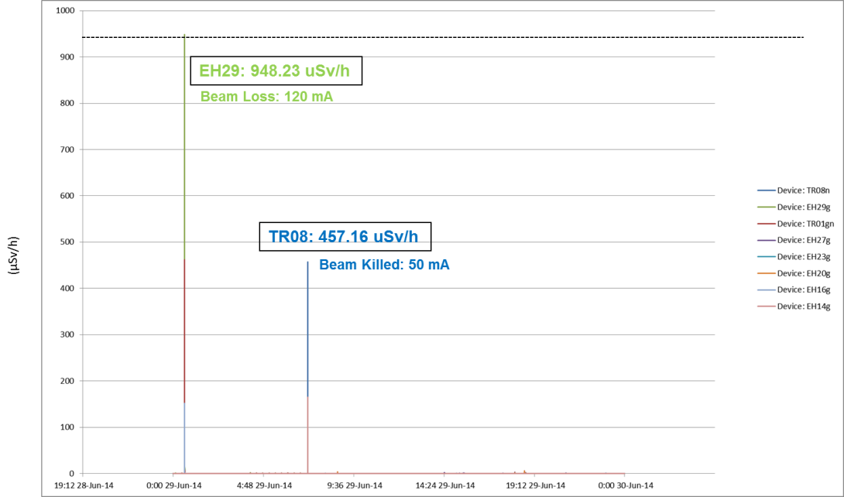
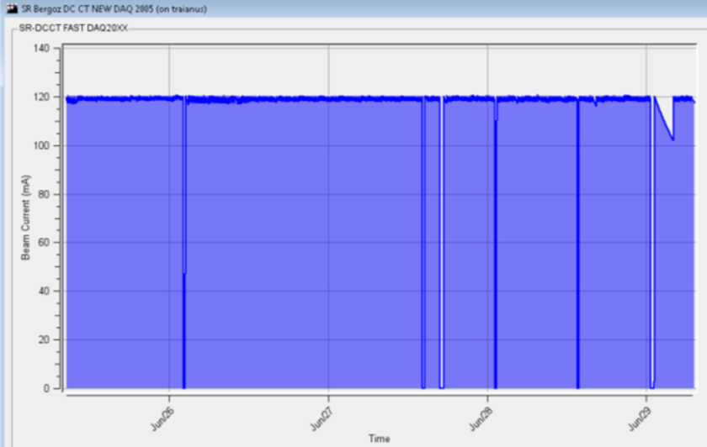
© Safety
Radiation measured during Top-Up
June 29th
Top Up – FE open
M day – FE closed
These are beam loses, not Top Up related radiation, but triggered the Top Up PSS logic to act in order to maintain the dose below 2 uSv / 4h – Public Zone.

Slide 29
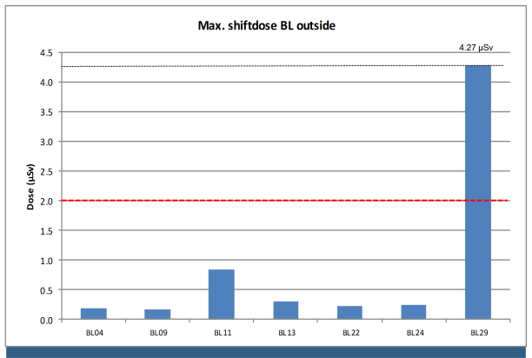
© Safety
Radiation measured during Top-Up
    Specific measurements at BOREAS Optical Hutch, only BL where higher doses were detected
Data taken for the
worst (not allowed) conditions
From last SAC

Slide 30
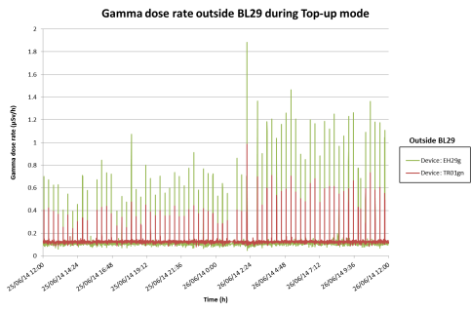
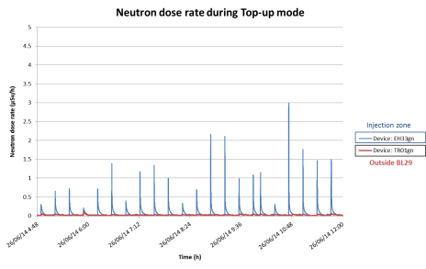
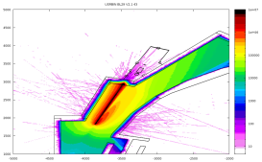
© Safety
Radiation measured during Top-Up
Only gammas detected
at BOREAS
Under investigation

Slide 31
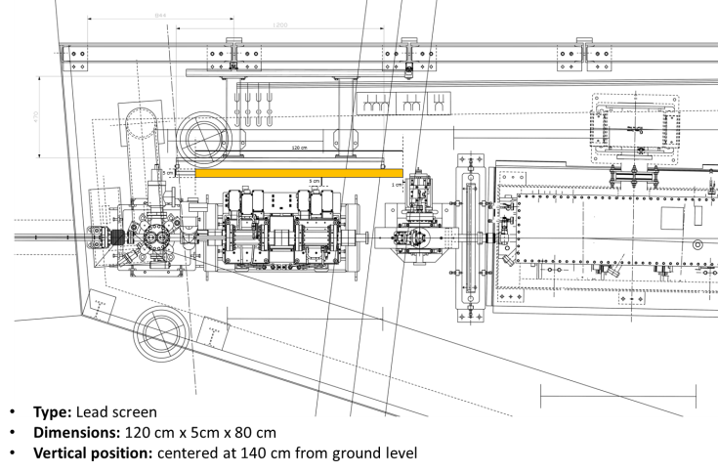
© Safety
Additional Shielding
BOREAS - BL29

Slide 32
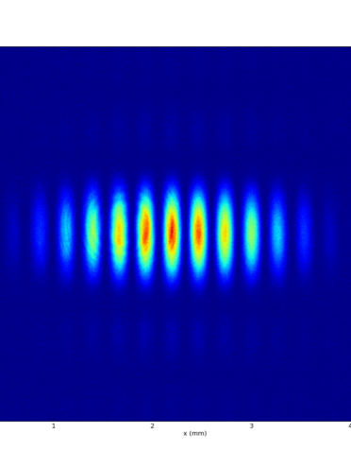
Accelerator Developments
Injection bump closure
FOFB
Beam lifetime
Energy measurement
Interferometry beam size
“67 MeV” injector

Slide 33
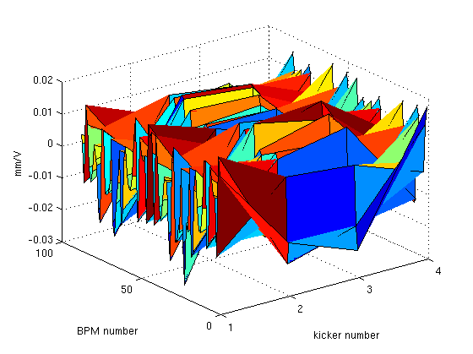
Top Up – Closing injection bump
Injection Bump Closure
  The BPM turn by turn data response matrix to the kicker voltage is measured at turn #9 (end of kicker pulse)
dX [mm] / Kicker dV [V]
  TbT orbit oscillations are corrected applying an SVD
  Nowadays, manual readjustment are done

Slide 34
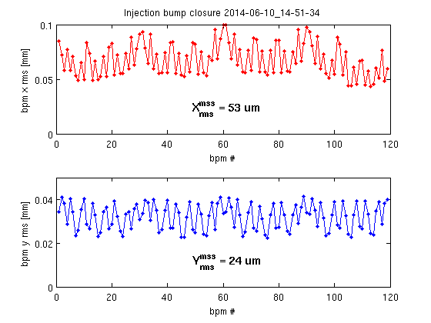
Top Up – Closing injection bump
Injection Bump Closure
Best achieved
X
Distortion
at
Medium
Straigth
Section
Y

Slide 35
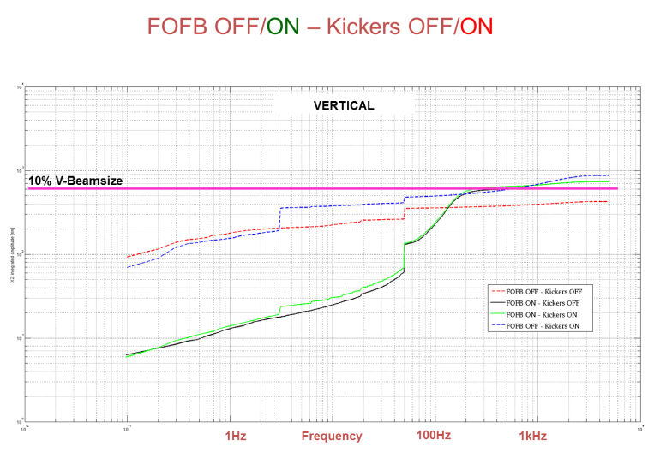
Fast Orbit FeedBack (Vertical)
3 Hz
FOFB OFF
FOFB ON
Notes:
35

Slide 36
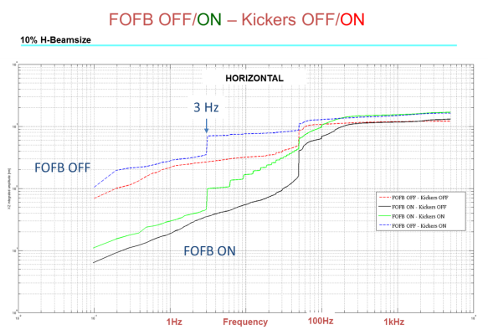
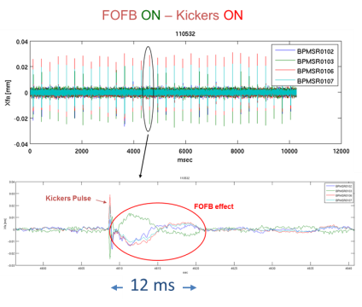
Fast Orbit FeedBack (Horizontal)
3 Hz horizontal
kicker induced noise
is amplified by FOFB
Notes:
36

Slide 37
Fast Orbit FeedBack
FOFB is working but still:
  Fine tune required
  Robustness (long runs) to be tested
  Error handing
  Friendly user interface
Notes:
37

Slide 38
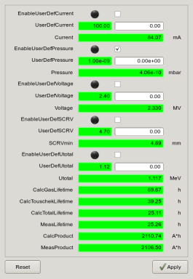
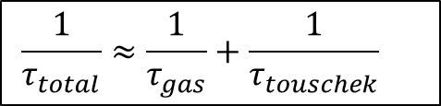
Lifetime
Theoretical Lifetime Calculation
Lifetime calculator
Measured data
or
User defined values
$$\frac{1}{τ_{total}}≈\frac{1}{τ_{gas}}+\frac{1}{τ_{touschek}}1τ$$
Project under development,
but we already take into account:
Current
Pressure
SCRV
RF Voltage
Energy Loss per Turn
Next step:
Improve Touschek Lifetime Calculation using Piwinski Model (Coupling, RF Voltage)

Slide 39
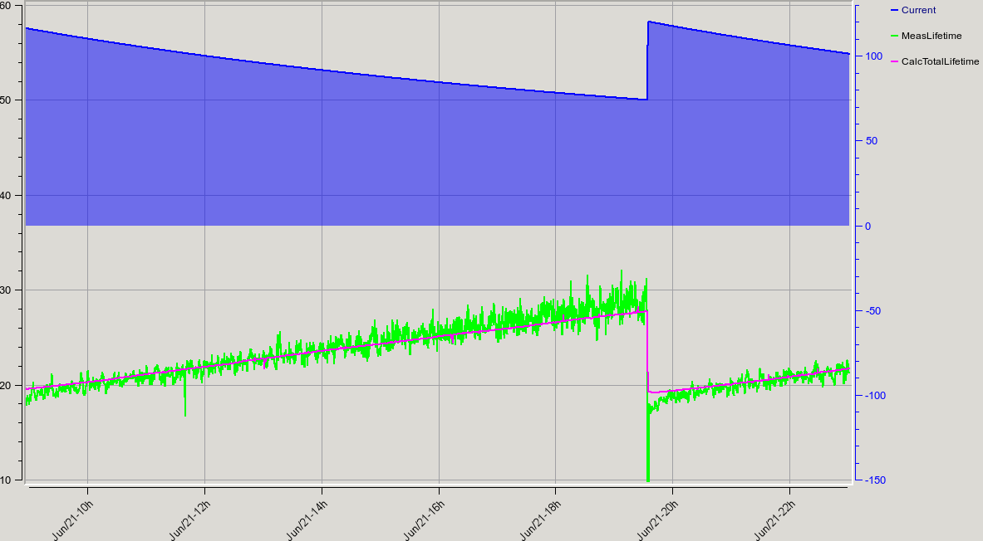
Lifetime
Good agreement with the measured Lifetime
Err < 3%
It is still a work in progress, some constants are manually adjusted

Slide 40
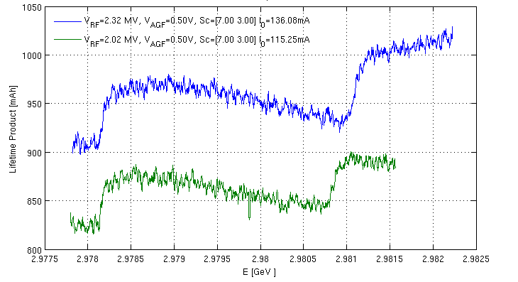
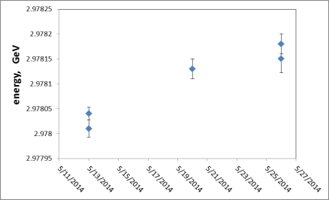
Energy Measurement
Spin depolarization
2.97813 ±0.00002 GeV
3 different days
3 different RF frequencies
3 different energies: ±0.0001 GeV

Slide 41
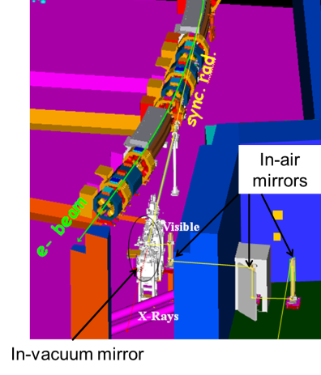
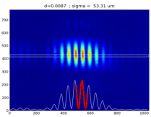
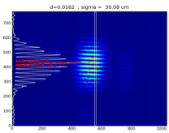
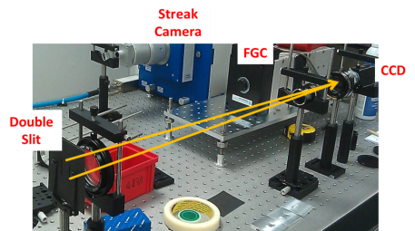
Interferometry beam size

Slide 42
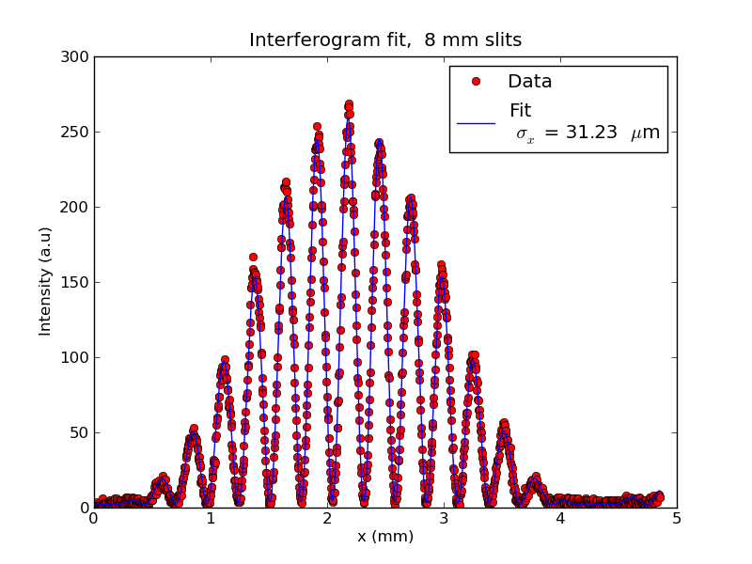

Interferometry beam size
But…
Vibration of the mirrors? Air turbulence?

Slide 43



“67 MeV” injector
Objective:
Operate the LINAC with only one Klystron:
  Either KA1 or KA2, for redundancy
  Compatible with installation and test of the second one

Slide 44


“67 MeV” injector
1st turn in Booster

Slide 45
Summary
  SUMMARY
Accelerators operate reliable for users
    96% 2013 (excluding cooling problem)
    97% 2014 (so far)
Top Up operational, but
    Acoustic shielding of Booster PS
    Radiation local shielding at BL29
Objectives until end of 2014
    FOFB operational
    Injector “67 MeV”
    Increase operation current

Slide 46
Division Head
F. PEREZ
Operations
M. PONT
Operators
F.FERNANDEZ
M. ALVAREZ
R. NUÑEZ
D. YEPEZ
P. SOLANS
RF & Linac
RF
A. SALOM
B. BRAVO
J. OCAMPO
Linac
R. MUÑOZ
D. LANAIA
IDs
J. CAMPMANY
Magn Lab
J. MARCOS
V. MASSANA
Beam Physics
U. IRISO
Beam Dynamics
G. BENEDETTI
T. GÜNZEL
Z. MARTÍ
M. CARLÀ
oPAC
Diagnostics
A. OLMOS
A. NOSYCH
L. TORINO
oPAC
J.C GIRALDO
M. SOS
N. AYALA
Thanks to you,
to the accelerators team
and many others

