Slide 1
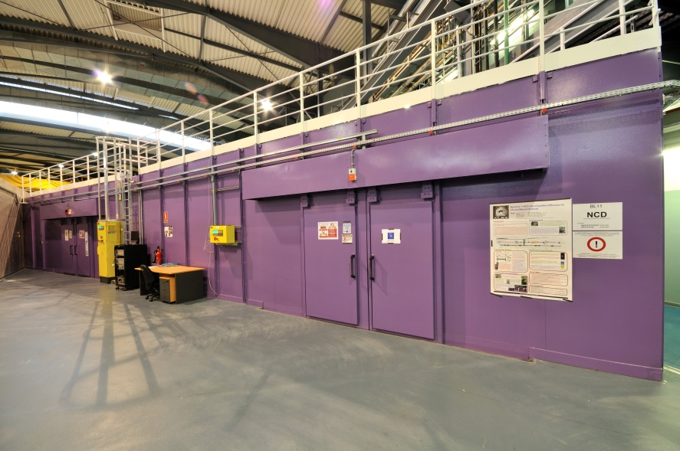
Beamline specifications
1
Report on BL11-NCD
Sac 18, 1st July 2014

Slide 2
Beamline specifications
2
Wavelength (Energy) range | 0.9 - 1.9 Å ( 6.5 -13 keV)
Flux at sample | >1.25 10¹¹ ph/s 1.24 Å for a beam current of 250 mA
Bandpass (ΔE/E) | < 10⁻⁴
Beam size at sample | Variable between ~65 - 1200 μm horizontally ~30 - 265 μm vertically
Beam divergence at sample | <0.5x0.1 mrad²
Q range SAXS | 0.0066-0.7 Å⁻¹
2Ɵ range WAXS | 3.0° - 62°

Slide 3
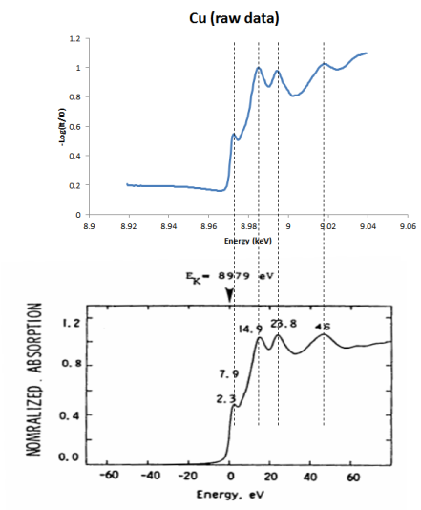
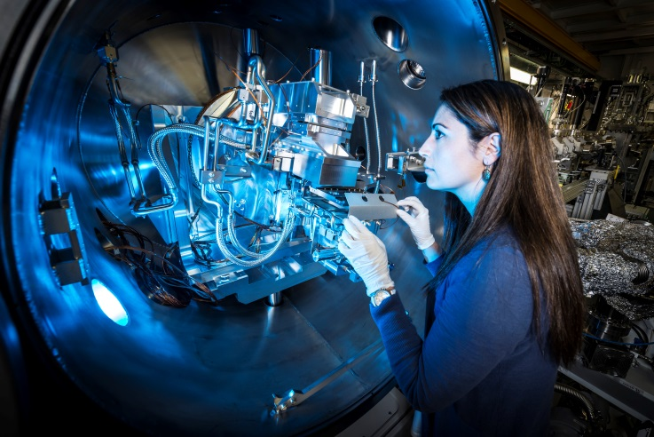
Optics Hutch - Monochromator
3
Bragg Angle calibration
Slope: 1.0010
Intercept: 0.0006

Slide 4
Optics Hutch - Monochromator
4
2nd Crystal pitch Calibration

Slide 5
Undulator
5
Energy scan
ID gap = 5.8mm
Experimental data
Theoretical data calculated with no offset in the front end aperture.

Slide 6
Undulator
6
Undulator gap calibration

Slide 7
Energy pseudo-motor
7
Done:
Calibration of the Bragg angle of the DCM
Calibration of the 2nd crystal pitch
Calibration of the undulator gap for the 5th and 7th harmonic
To be done :
Calibration of the undulator gap for the 3rd harmonic
Calibration of the vertical translation of the 2nd crystal

Slide 8
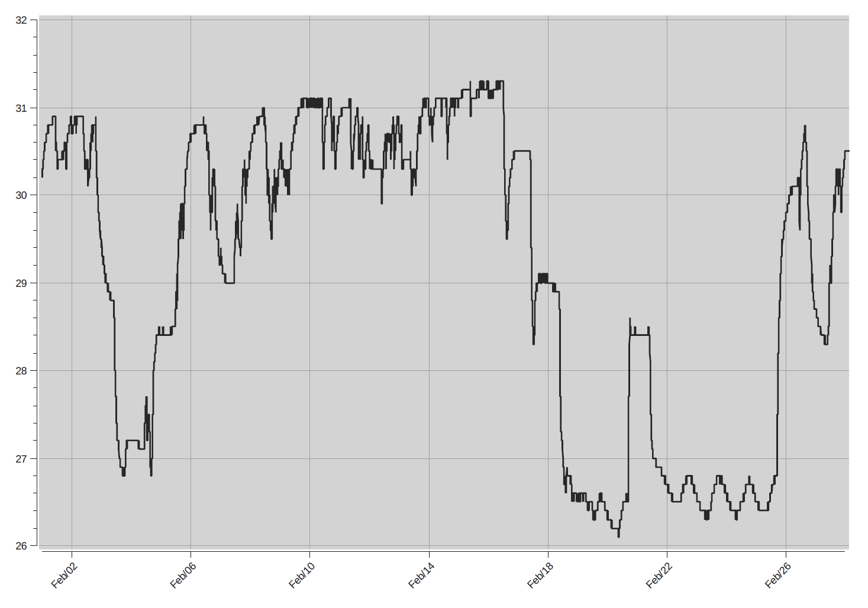
Upgrade – Air conditioning
8
February 2014

Slide 9
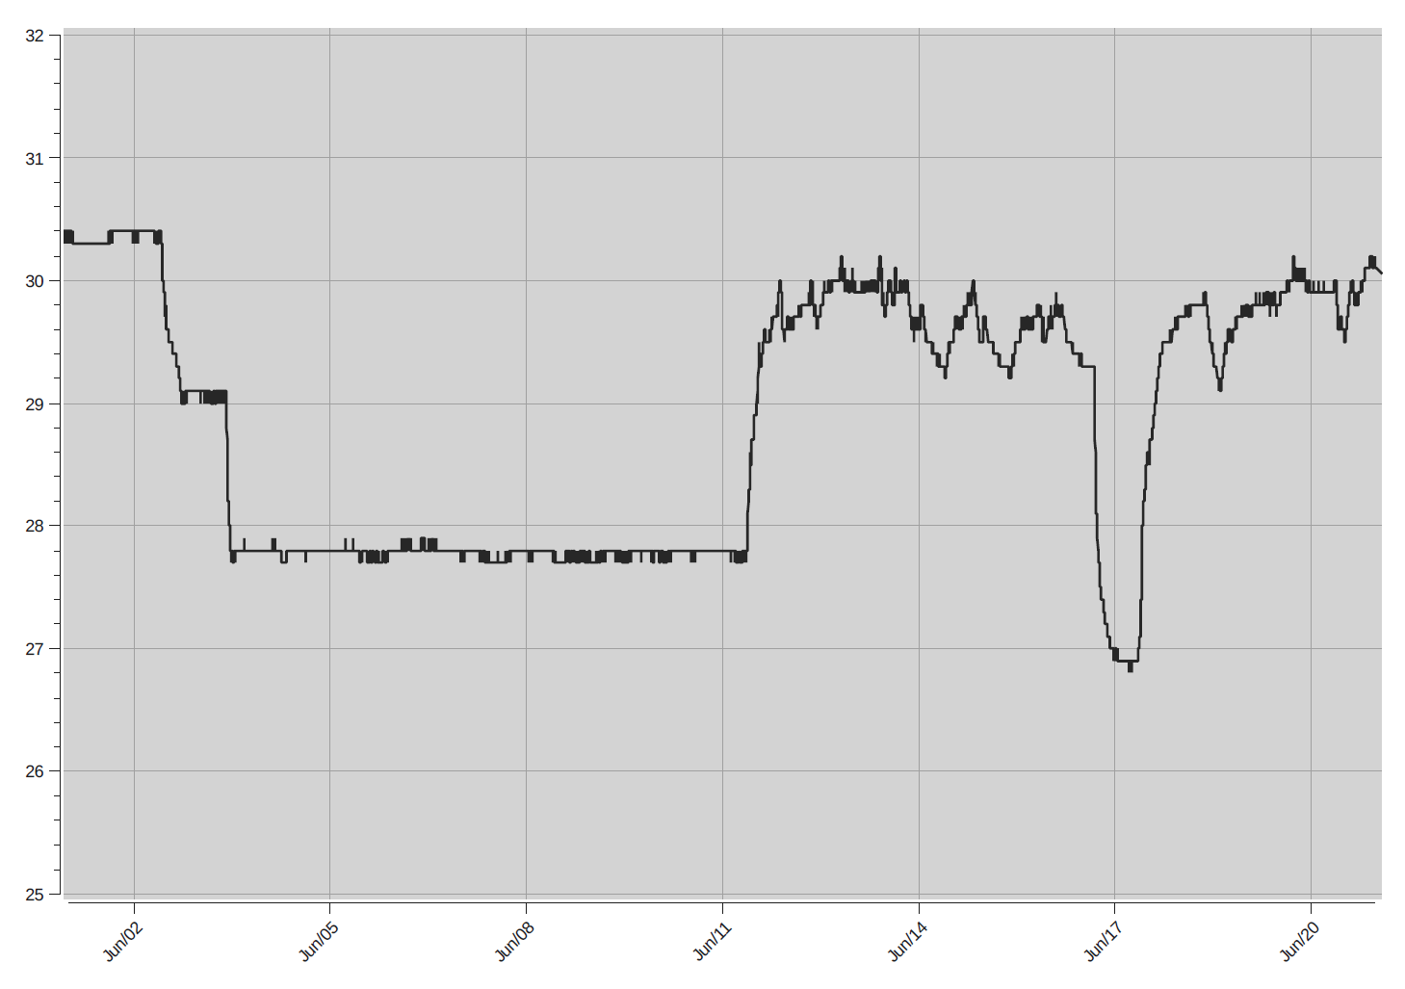
Upgrade – Air conditioning
9
June 2014 (After fans installations)
Proper air conditioning to be installed by the end of this year

Slide 10
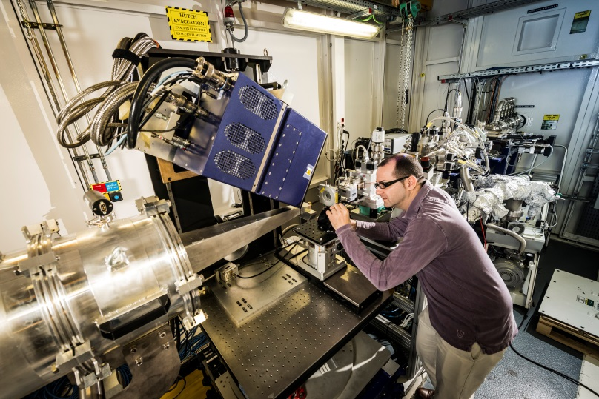
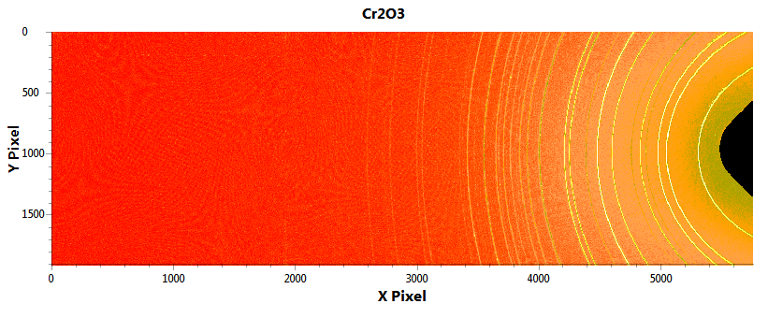
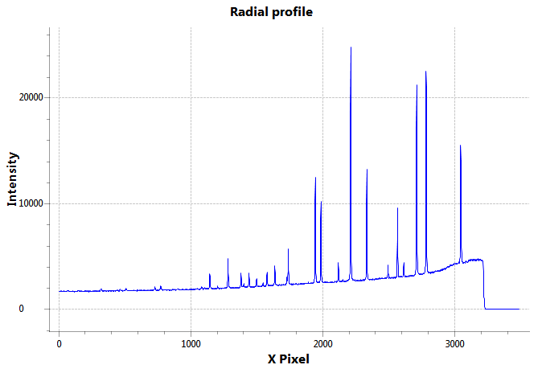
Detector - Rayonix
10
Waxs detector
Active image area: 255 x 85 mm²
Total number of pixels: 5760 x 1920
Pixel size ( not binned): 44 µm
Frame rate: 10 – 140 frames / sec
Global count rate: unlimited
Dynamic range: 16 bits

Slide 11
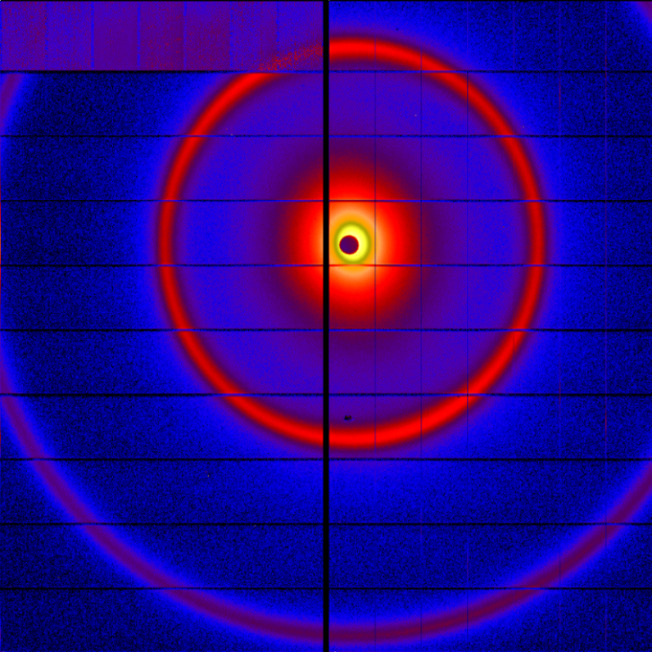
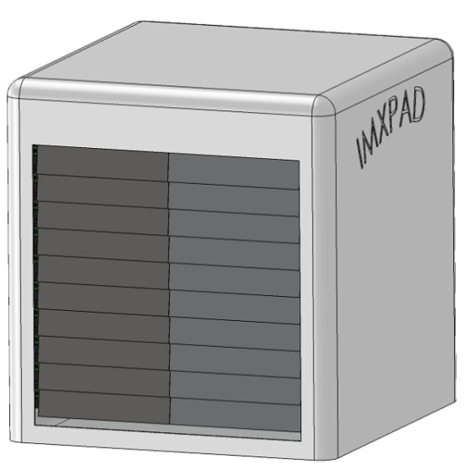
Detector - ImXPAD
11
Saxs detector
Active image area: 152 x 149.6 mm²(H x V)
Total number of pixels: 1200 x 1120 pixels² (H x V)
Pixel size ( not binned): 130 µm
Frame rate: 250 frames / sec
Global count rate: >10¹¹ photons/sec
Factory Acceptance Test done in May 2014
Site Acceptance Test planned for September 2014

Slide 12
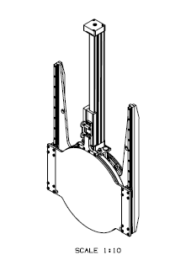
Upgrade – Window protection
12
Connected to the photon shutter
Possibility to open it manually if the vacuum is broken in the pipe
Light on doors => Safe to enter in the EH
Available in September 2014

Slide 13
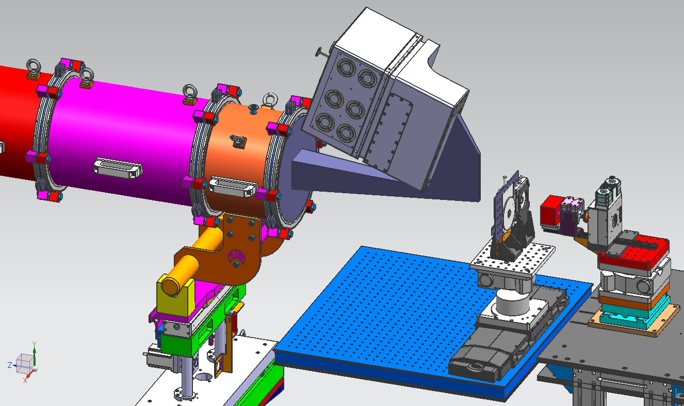
Upgrade – WAXS nose cone
13
Available in April 2014

Slide 14
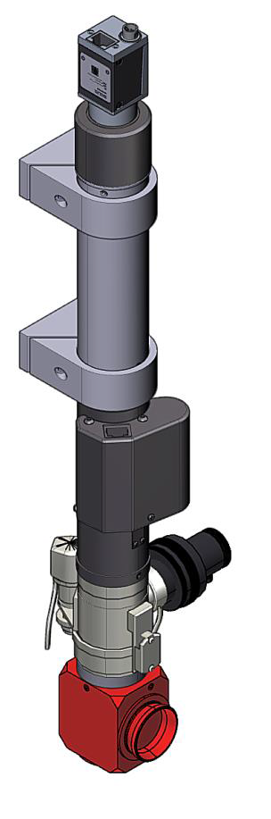
Upgrade – On-Axis Camera
14
1.67X \ 120FL Lower lens 35-00-04-000 | WD 155mm, Min Zoom: Mag - 0.47X; Res-22.2m; DOF-2.5mm; 10mm x 7.7mm Max Zoom: Mag - 5.80X; Res-4.2m; DOF-0.089mm; 0.83mm x 0.63mm
1mm
10mm
0.75mm
7.25mm
Available in September 2014

Slide 15
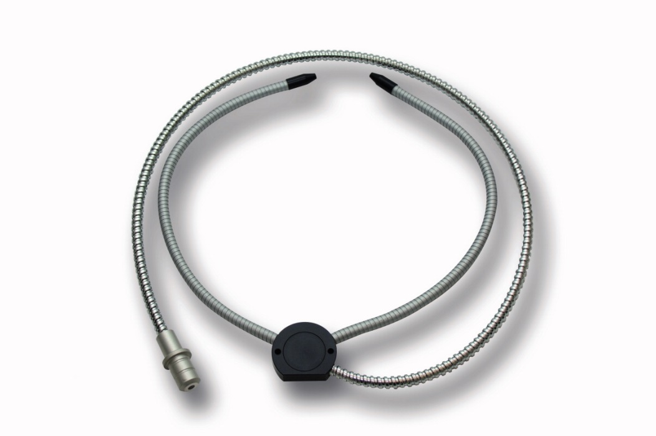
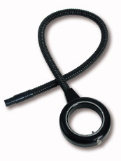
Upgrade – On-Axis Camera
15
Different lighting system depending on the contrast of the sample
Available in September 2014

Slide 16
Upgrade – Schedule
16
Project | Status | Delivery
Flight tube autom. protection | Under production | 20/06/2014
WAXS + Nose cone sup. Stages | Conceptual Design | 22/04/2015
Sample platform |  | 29/05/2015
SAXS detector table |  | 15/04/2015
Microfocus lenses |  | 01/04/2015
BCE fast shutter/camera |  | 27/05/2015
DCM foils |  | 08/07/2015
Beam stopper |  | 01/07/2015
KF support pipes |  | 30/06/2015
Flight tube cable chains |  | 14/10/2015
Support various |  | 28/10/2015
KB system |  | 30/08/2016

Slide 17
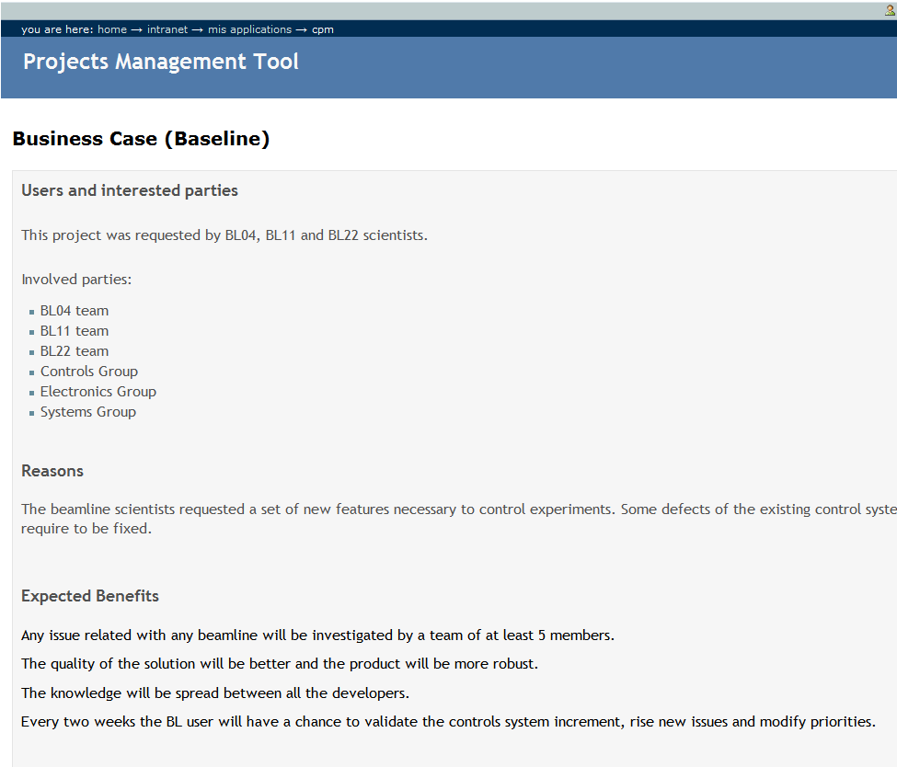
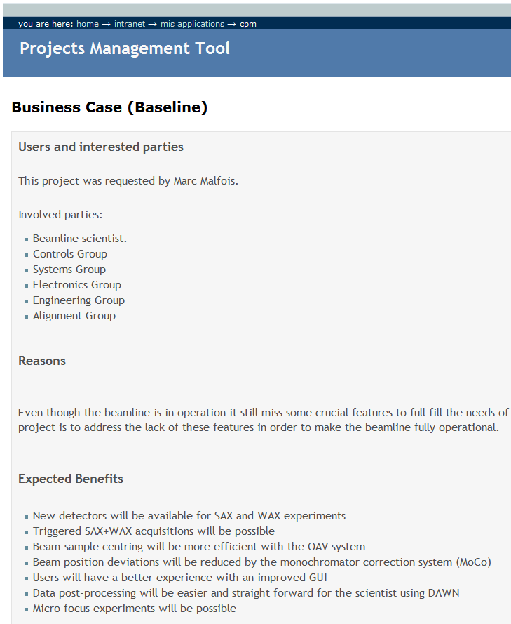
Control – New projects
17

Slide 18
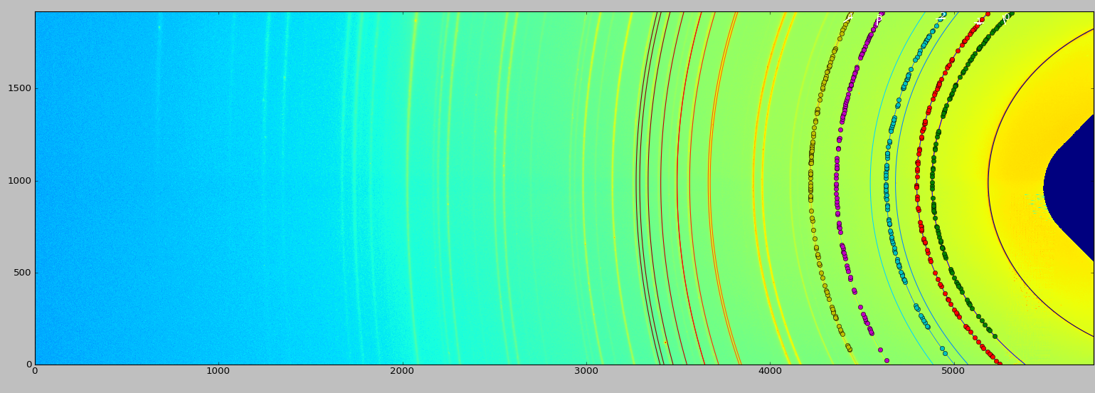
Control – pyFAI implementation
18
J. Kieffer, PyFAI, Journal of Physics: Conference Series 425 (2013)
Source code available from ESRF
SampleDetDist= 1.260982e-01m
PONI= 4.351847e-02, 1.918830e-01m
rot1=-0.556464 rot2= -0.000100 rot3= -0.000000 rad
DirectBeamDist= 148.503mm
Center: x=6143.644, y=988.719 pix
Tilt=31.883 deg
tiltPlanRotation= -0.011 deg

Slide 19
Control –New features
19
Save environment information in image headers
  Basic image information: Exposure time, time stamp and readable image date time. (End of March 2014)
  To have this information in the ASCII file(End of March 2014)
  First energy, machine current, ion chamber current (End of March 2014)
  Next will be to have other values as temperatures for linkam scans
  Final solution will be a way to set a list of attributes to be saved in image headers (End of summer shutdown 2014)
  To have Rayonix information like time stamp in the header

Slide 20
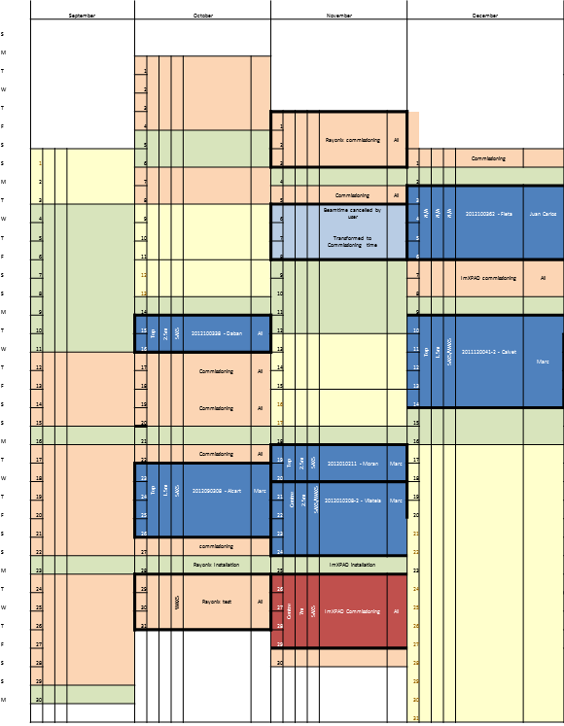
Users - 2013
20
8 users groups
7 publications
but 1 group is publishing 3 articles after 5 days of beamtime

Slide 21
Users feedback 2013
21

Slide 22
Users feedback 2013
22

Slide 23




The role of decorin in organizing the extracellular matrix
Christina Kamma-Lorger (PI), Marc Malfois, Juan Carlos Martinez, Eva Crosas, Keith M Meek, Carlo Knupp, Cecilie Bredrup, Eyvind Rødahl, Alex Peralvarez
23

Slide 24
In house project 2014
An investigation of structural changes of fibrillar skin proteins and microRNAs in cancer
Christina Kamma-Lorger (PI) and Marc Malfois
24
Skin Cancer
Study skin collagen and keratin ultrastructure in squamous cell carcinoma using SAXS and EM 3D tomography
Human miRNA structure using BioSAXS solution scattering
Current progress:
Internal funding was granted for 2014. Installation of cell culture laboratory facility.

Slide 25
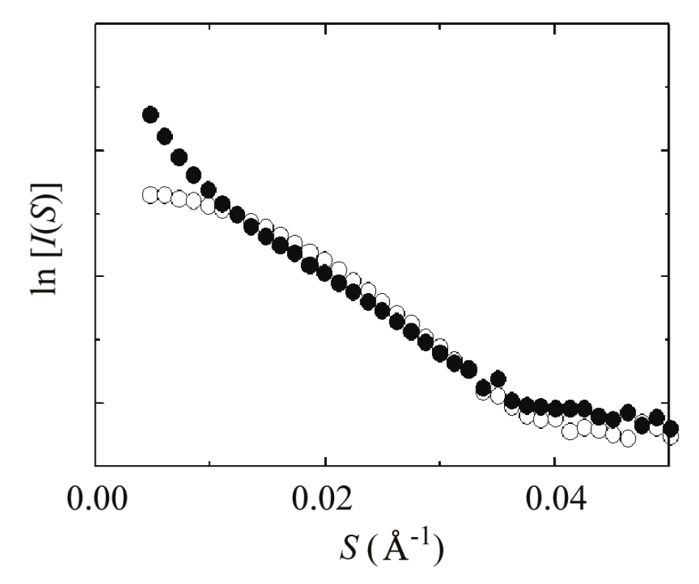

Study of radiation damages on Macromolecules – A NCD/XALOC project
E. Crosas, C. Kamma-Lorger, J.C. Martinez, M. Malfois, A. Castellvi, F. Gil, J. Juanhuix
25
Funded by the Spanish Safety Nuclear Council (CSN)
Radiation damage is observed as aggregation of the protein in the small angle S region, affecting size and shape determination of the protein.
Figure
Effect of radiation damage on lysozyme. Open circles: short-exposure (165 Gy); solid circles: long-exposure (3300 Gy). The upward curvature in the small S region (solid circles) points to the presence of radiation-induced aggregates.
From Kuwamoto S., J Synchrotron Radiat. 2004 Nov 1;11(Pt 6):462-8

Slide 26
Study of radiation damages on Macromolecules – A NCD/XALOC project
E. Crosas, C. Kamma-Lorger, J.C. Martinez, M. Malfois, A. Castellvi, F. Gil, J. Juanhuix
26
Systematic comparison of radiation damage on several proteins using both SAXS and MX techniques
Test different pH conditions and scavengers, including new potential compounds against radiation damage
Correlation of SAXS and MX results with functional studies such as:
  Mass Spectrometry MALDI-TOF
  Enzyme activity assay
Beamtime awarded:
ALBA
ESRF and Diamond to take advantage of the BioSAXS robot.
For more information, see the related poster tomorrow

Slide 27

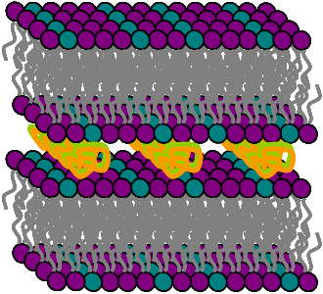
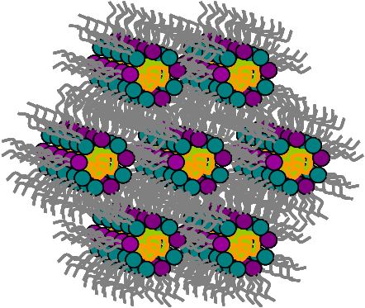

Liposomes in gene therapy: Lipoplex structure-biological activity relationship
A. L. Barrán-Berdón, B. Yélamos, M. Malfois, E. Aicart and E. Junquera
27
Submitted in Langmuir
(100)
(10)
(11)
(20)
(200)
(300)
(21)
(30)
(22)
(31)
Lipofection is a technique used to introduce genetic information (DNA or siRNA) into a cell by means of lipid nanostructures that can easily fuse with the cell membrane.
Lipoplex (lipids + DNA or siRNA) structure is known to clearly affect transfection efficiency (TE).
-
+
Transfection Efficiency

Slide 28
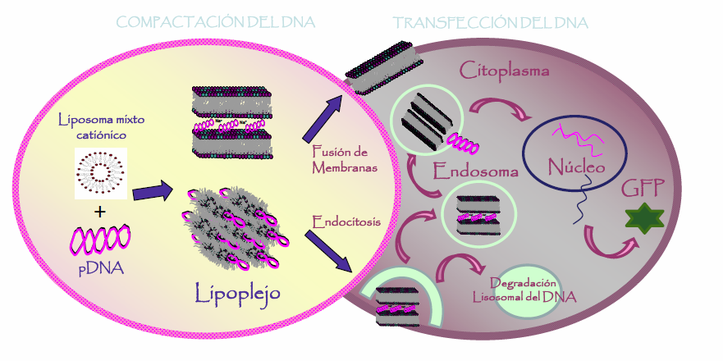
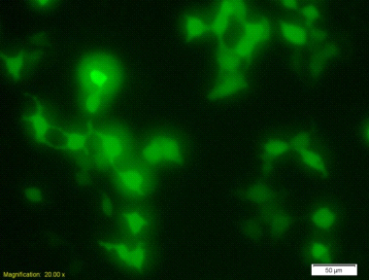
Liposomes in gene therapy: Lipoplex structure-biological activity relationship
A. L. Barrán-Berdón, B. Yélamos, M. Malfois, E. Aicart and E. Junquera
28
Submitted in Langmuir
GFP expression
Lipoplex structure depends on the molecular characteristics of the lipids used.
Lipoplexes showing inverted hexagonal phases (H_{II}) are more efficient on transfection than lipoplexes with a lamellar ones (L_{α}). Hexagonal phases are more fusogenic; accordingly, after endocytosis, they release more easily DNA, from the endosome to the cytosol.
SAXS together with transfection assays reveal as a potent tool to correlate lipoplex structure with transfection levels (structure-biological activity relationship).

Slide 29

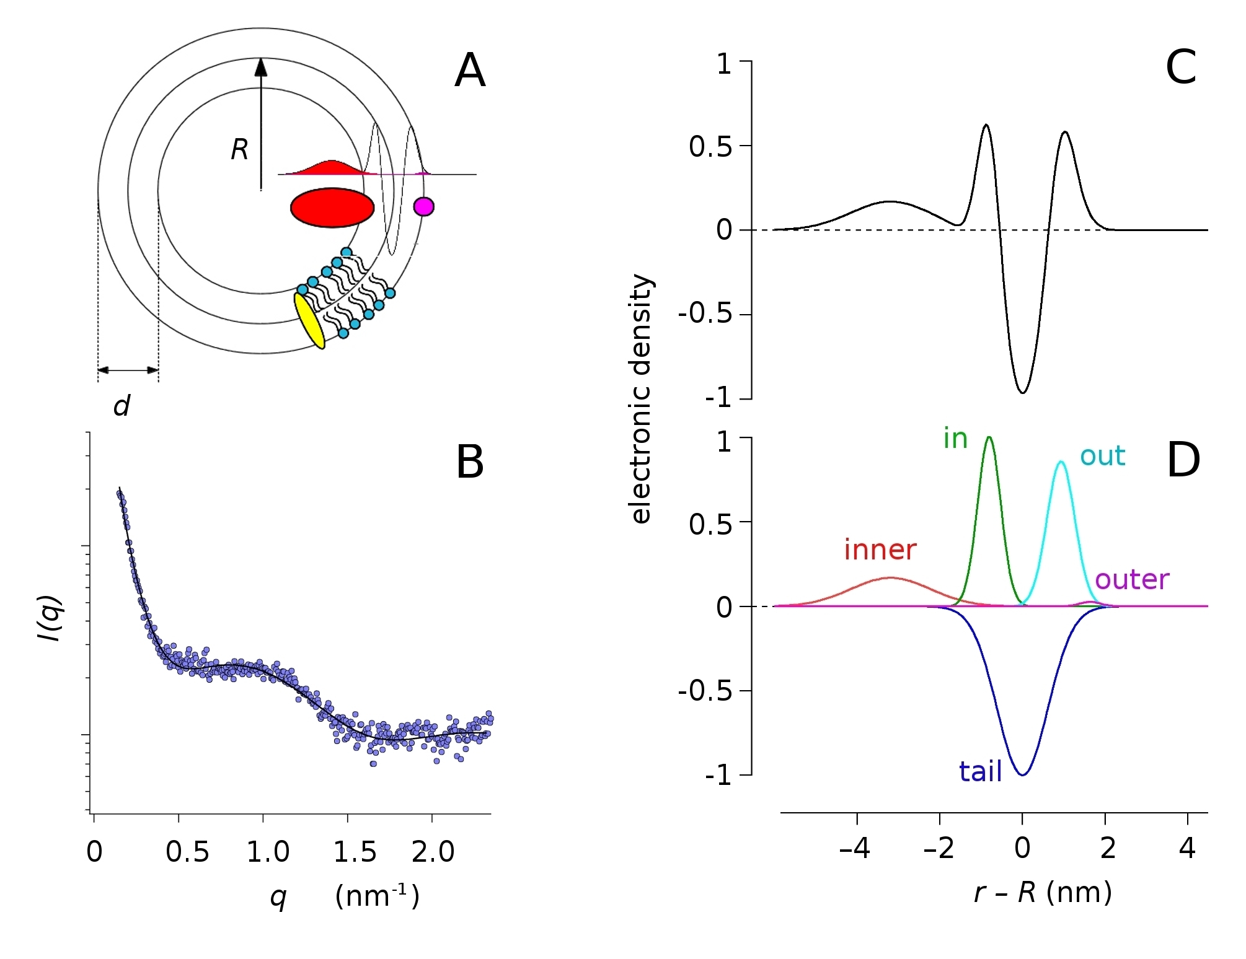
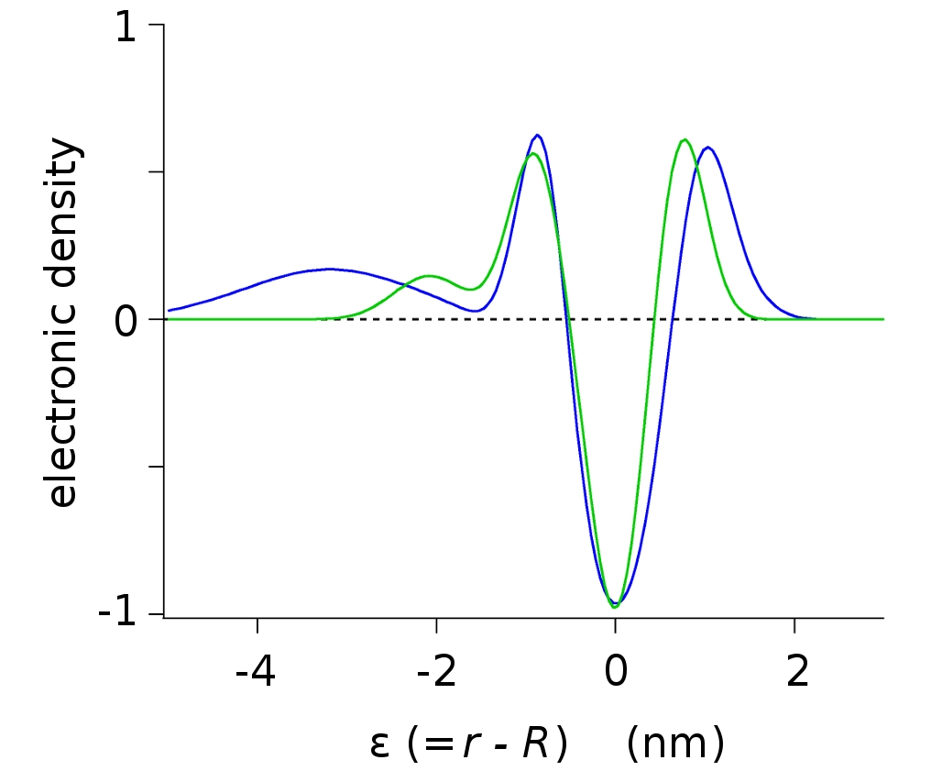
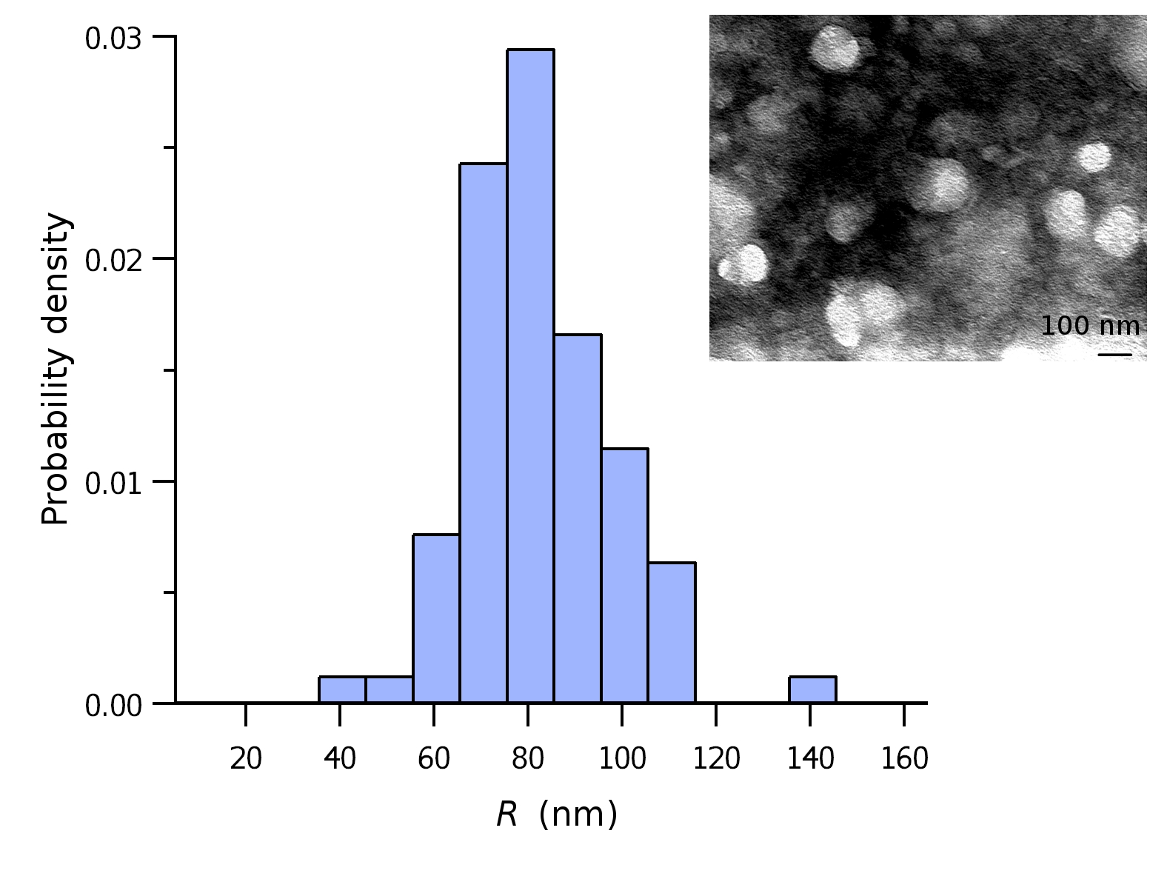
Application of SAXS to the structural analysis of membrane vesicles
Oscar Moran, Istituto di Biofisica, CNR, Genova, Italy
29
Published in Eur. Biophys. J.
Submitted in Cellular and Molecular Life Sciences
From scattering theory, analytic expressions are derived for the bilayer form factor over a spherical geometry, assuming the lipid bilayer electron density to be composed of a series of Gaussian shells.
Sketch of the model of a vesicle consistent with the measured SAXS data.
SAXS spectra of the WT-CFTR membranes
The electronic density profile was calculated from the five Gaussian model
The decomposition of each singular Gaussian used to model the electronic density
Microsome membranes unilamelar vesicles
Electron density profiles of from microsome vesicles wall of native cells (green) and cells overexpressing CFTR (blue; protein involved in cystic fibrosis). Micrographs of vesicles are shown.

Slide 30
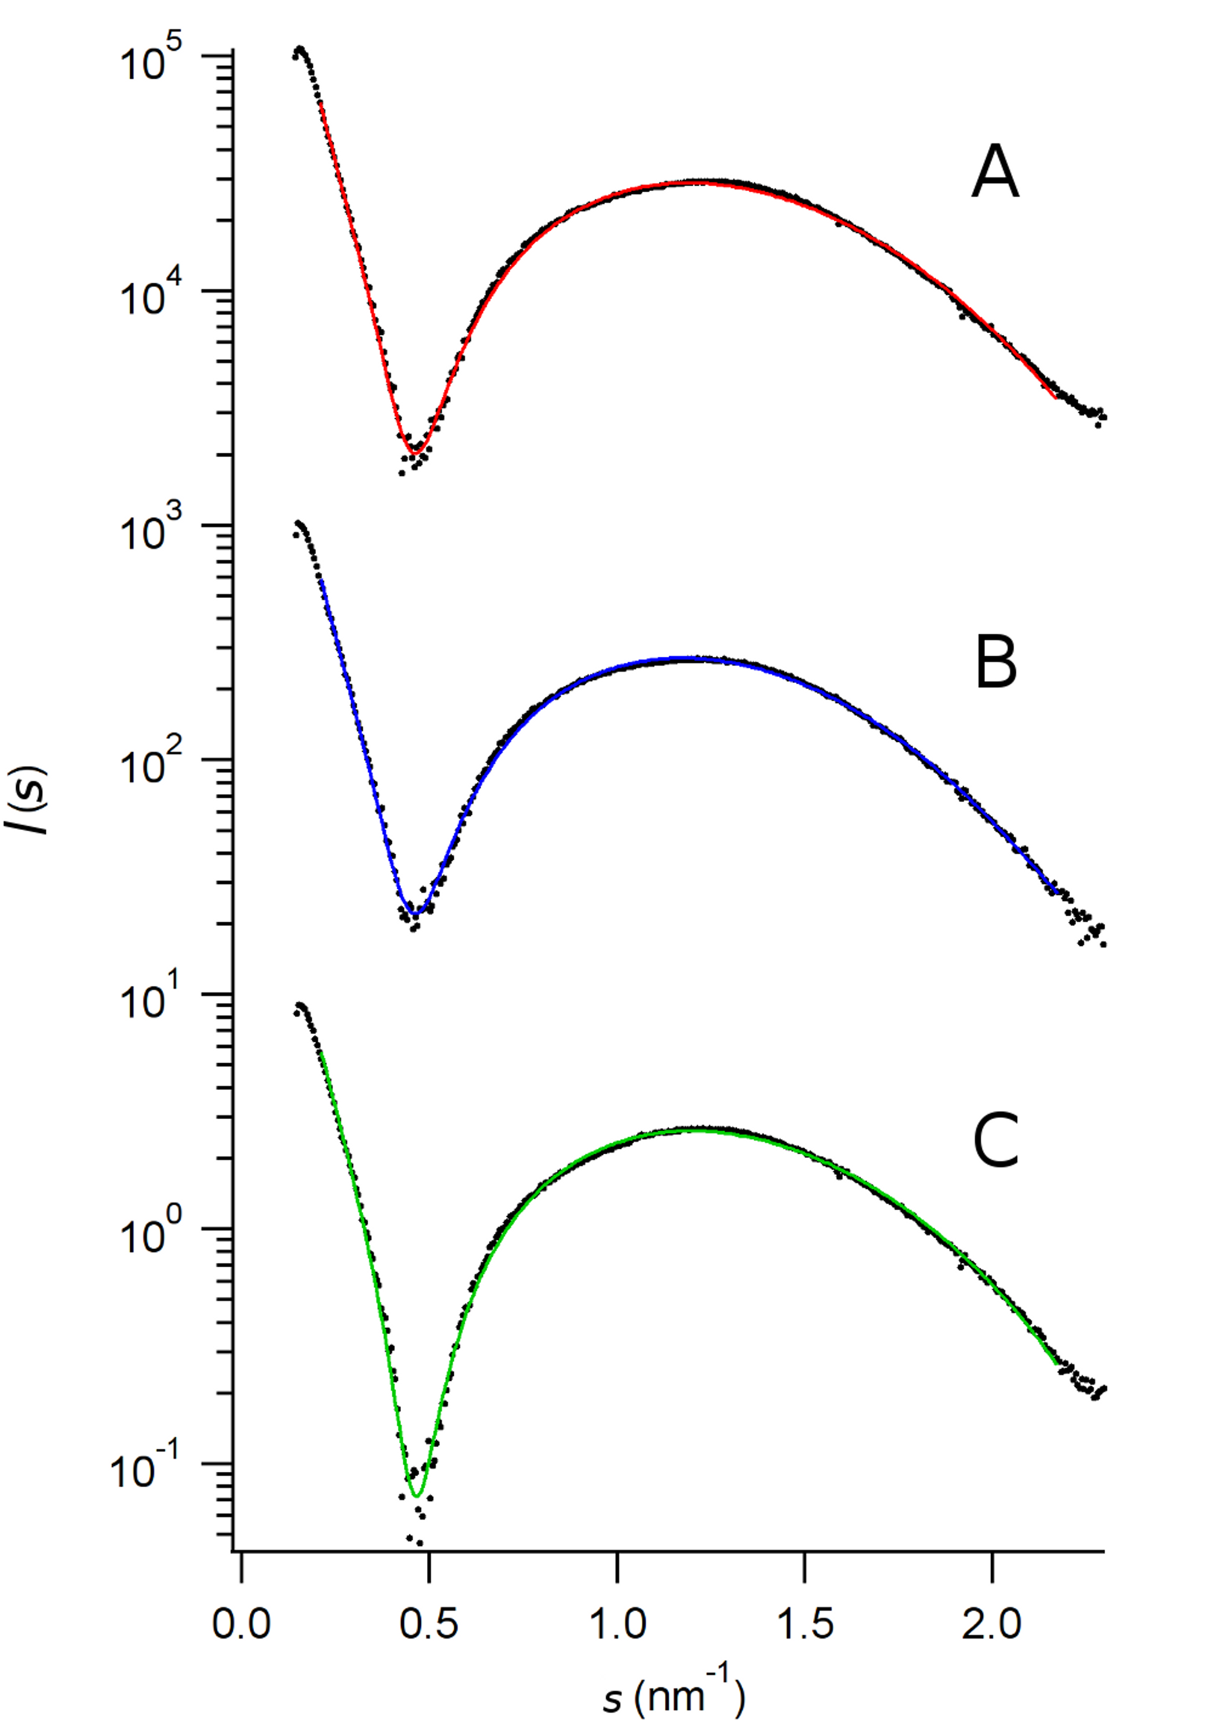
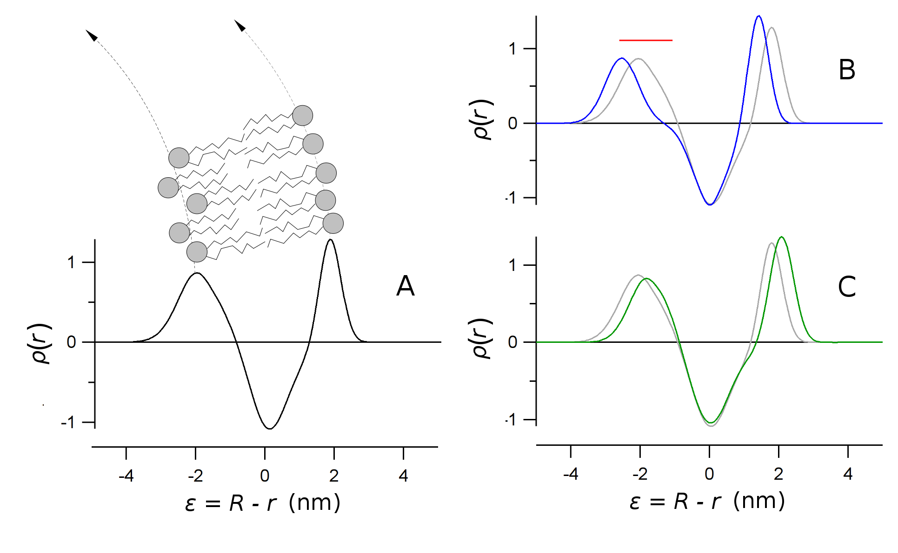

Application of SAXS to the structural analysis of membrane vesicles
Oscar Moran, Istituto di Biofisica, CNR, Genova, Italy
30
Published in Eur. Biophys. J.
Submitted in Cellular and Molecular Life Sciences
untreated
Large unilamellar liposomes (LUV) obtained by extrusion of phospholipids, treated with drugs for the cystic fibrosis therapy.
+ VX-770
+ VX-809
Electron density of the LUVs wall showing the destabilization induced by drugs.
Partially supported by the Italian Cystic Fibriosis Foundation

Slide 31

Carbon nanotube - 1-
Controlling carbon nanotube type in macroscopic fibers synthesized by the direct spinning process Reguero et al. accepted at Chemistry of Materials
The research group has a process to produce kilometres of continous macroscopic fibres of CNTs
Synchrotron XRD confirms the increase of graphitic layers at turbostratic separation
S ↑ in feedstock → Intensity ratio [(100)Graphite / (111)Fe]
Low S → SWCNTs
High S → MWCNTs
They can tailor thee type of nanotubes through the addition of sulphur precursor (thipohene)

Slide 32
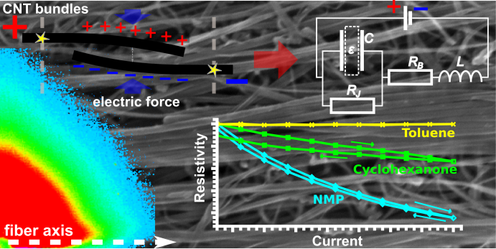
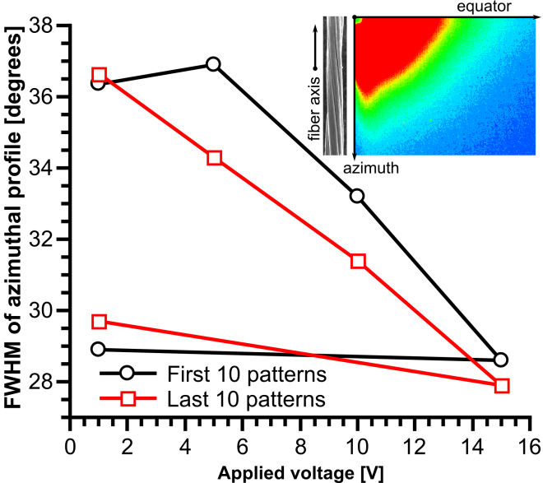
Carbon nanotube - 2-
Electric Field-Modulated non-Ohmic Behavior of Carbon Nanotube Fibers in Polar Liquids (Terrones et al., ACS Nano, submitted)
The CNT fibres have a complex hierarchical structure.
Its mesoporosity makes liquids infiltrate the fibre,
which changes its eletrical conductivity.
This non-Ohmic behaviour is a manifestation of
nanoscale effects observed on a macroscopic scale.
It arises due to fibre swelling, which can be observed by SAXS.

Slide 33
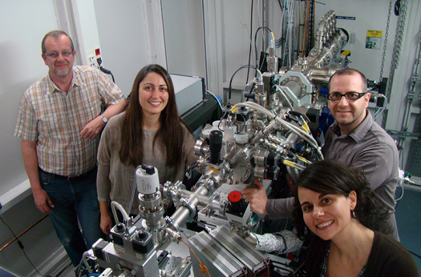
Beamline staff
33
Beamline Responsible:
  Marc Malfois
Beamline scientist:
  Christina Kamma-Lorger
  Juan-Carlos Martinez
Postdoctoral Research Associate:
  Eva Crosas
Technician:
  Alejandro Enrique (Left June 2014)
Controls:
  Gabriel Jover
Engineering:
  Joaquin Gonzalez
  Carles Colldelram
Electronics:
  Abel Fontsere

