Slide 1

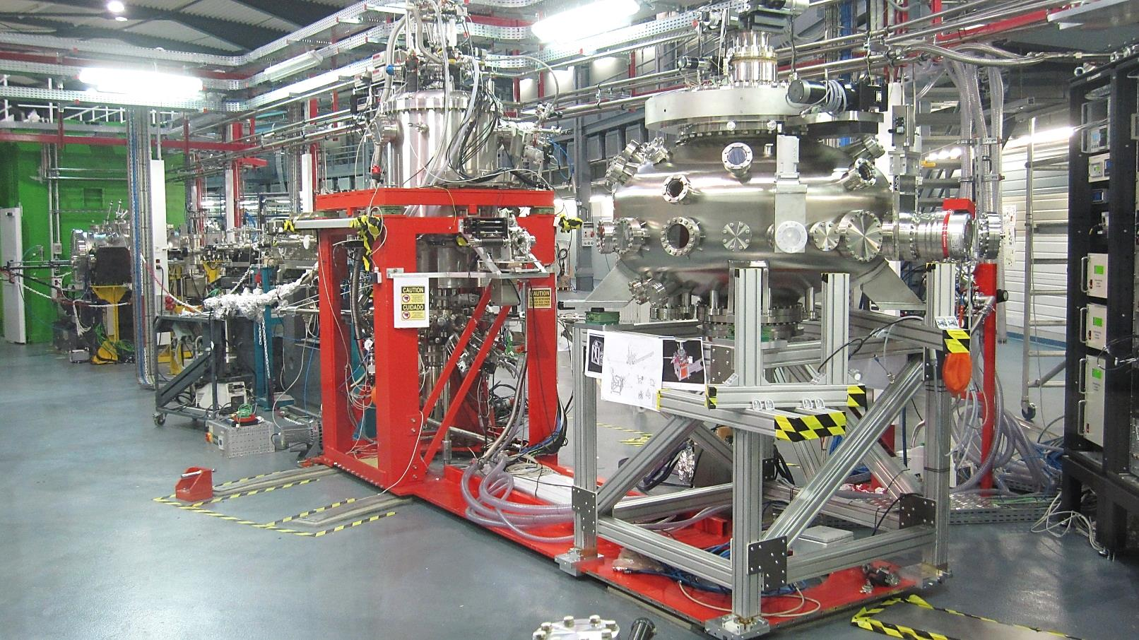
BL29 BOREAS
Resonant X-ray Absorption and Scattering
BOREAS

Slide 2
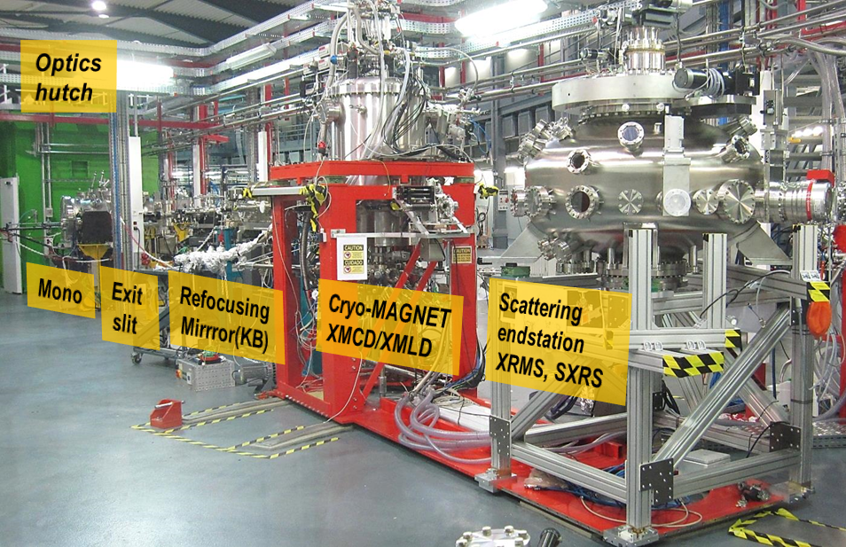
Soft XAS/XMCD & RMXS beamline
> Apple II undulator + VLS gratings mono → 80-4000 eV energy range
Scientific case
> 2 endstations - HECTOR 6 T cryomagnet & MARES chamber+ 2 T magnet
Outline
1) BL performance
2) Endstations status
3) Users’ output

Slide 3
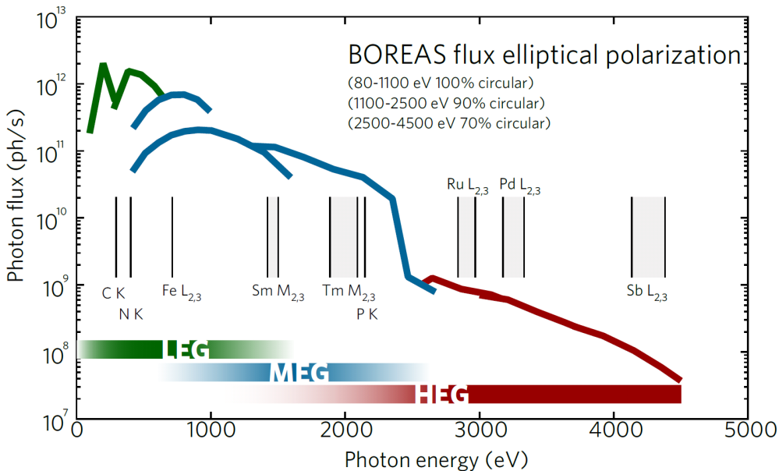
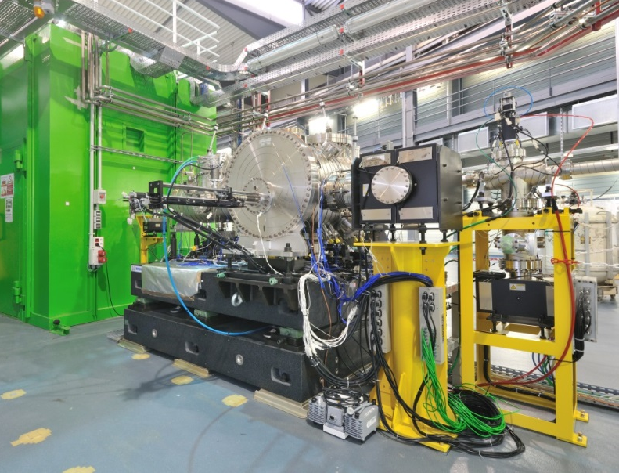
BL performance - monochromator
3rd
5th and beyond
1st und. harm.
@ 100 mA
Issues & Interventions (by Toyama)
> March’13 : grating exchange motion friction (risk of leak opening)
> April’14 : SM1 pitch blockage and SM double piping (DP) leak, friction (E reproducibility)
> end 2014 (foreseen) : grating DP leak (Temp. stability)

Slide 4
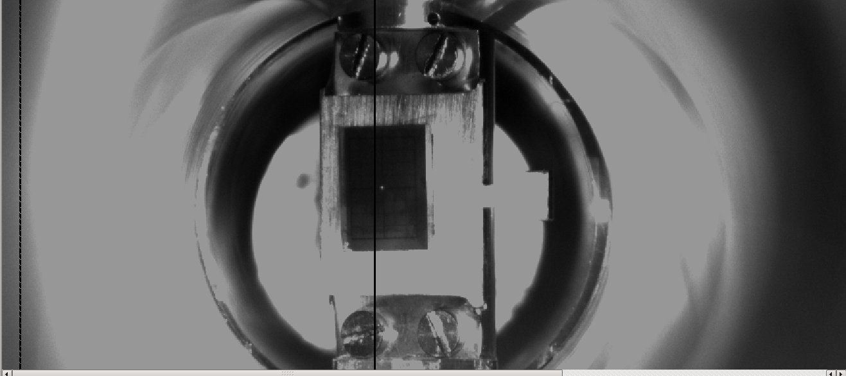
BL performance – KB mirrors
Intervention on april ‘14
YAG crystal on STM plate (HECTOR sample holder)
> Blocked translations fixed (replacement of damaged IRELEC motors)
> Beam spot size not tunable before april’14 ∼ 300 (H) x 800 (V) um (fixed)
Variable beam spot size from april’14. Best focusing ∼ 80 (H) x 30 (V) um

Slide 5
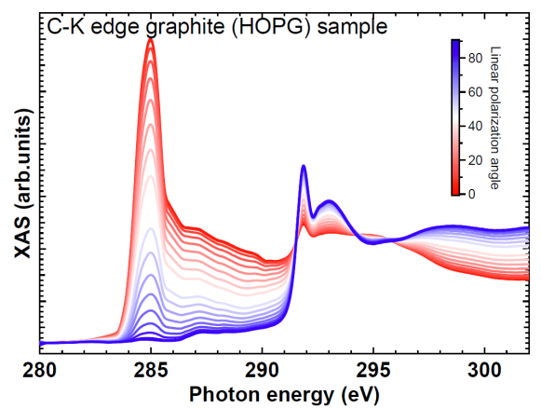
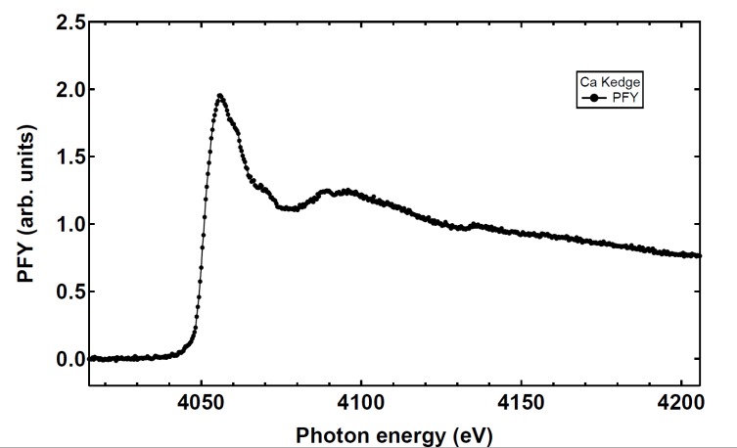
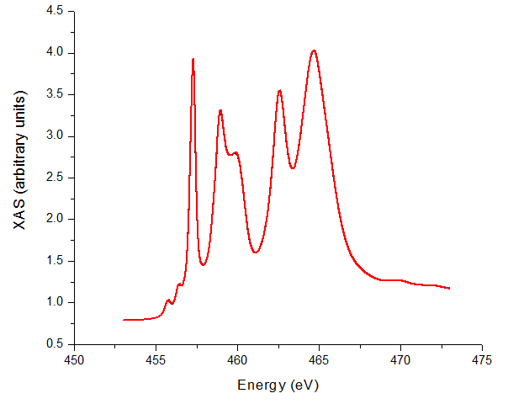
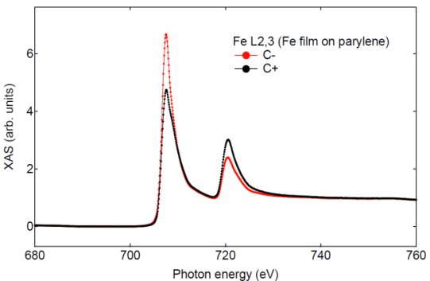
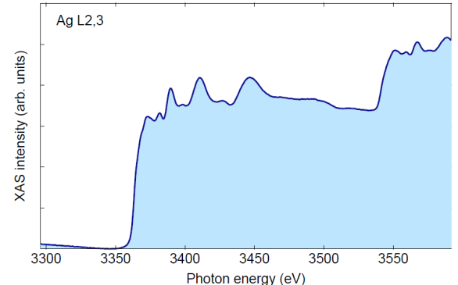
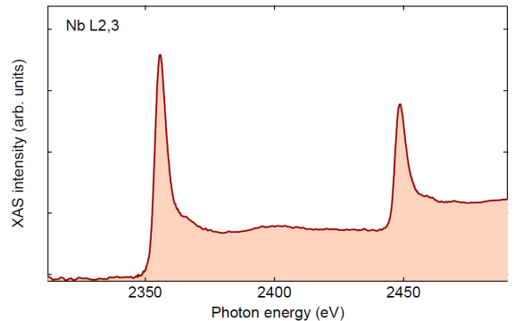
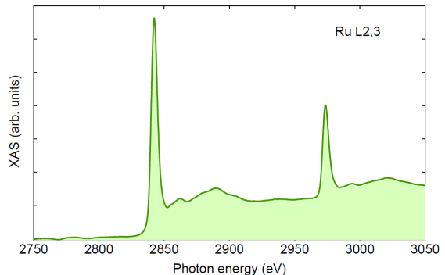
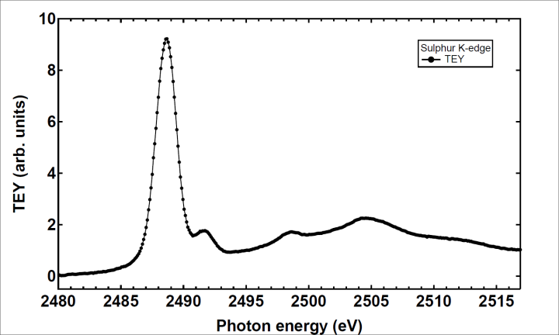
BL performance - E calibration & refs.
C K
Calcium K-edge
Ca K
Ti L_{2,3}
-
+
Fe L_{2,3}
Ag L_{2,3}
Photon energy
Niobium L23
Nb L_{2,3}
Ruthenium L23
Ru L_{2,3}
S K

Slide 6
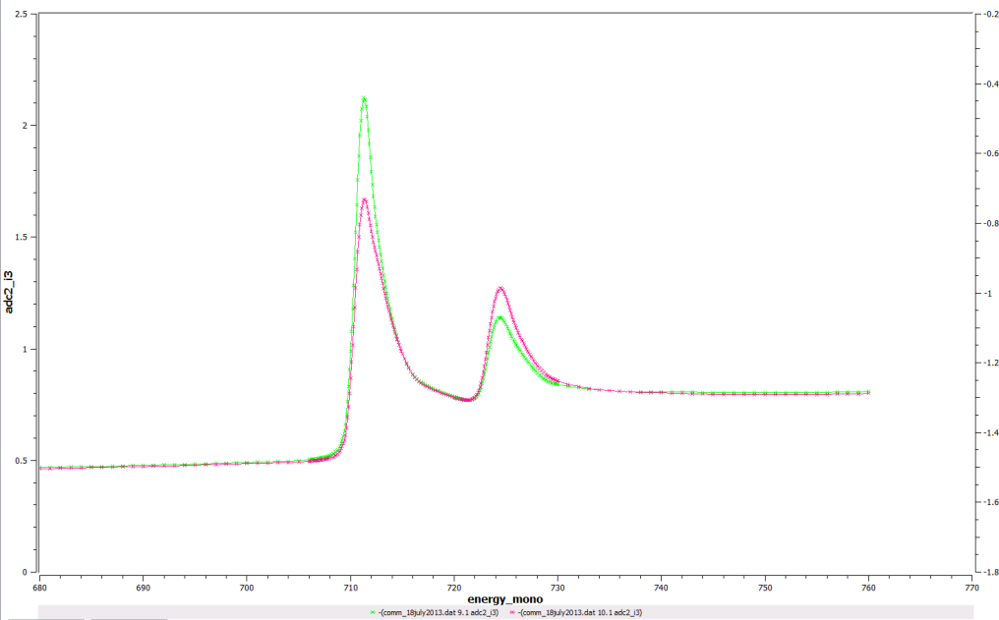
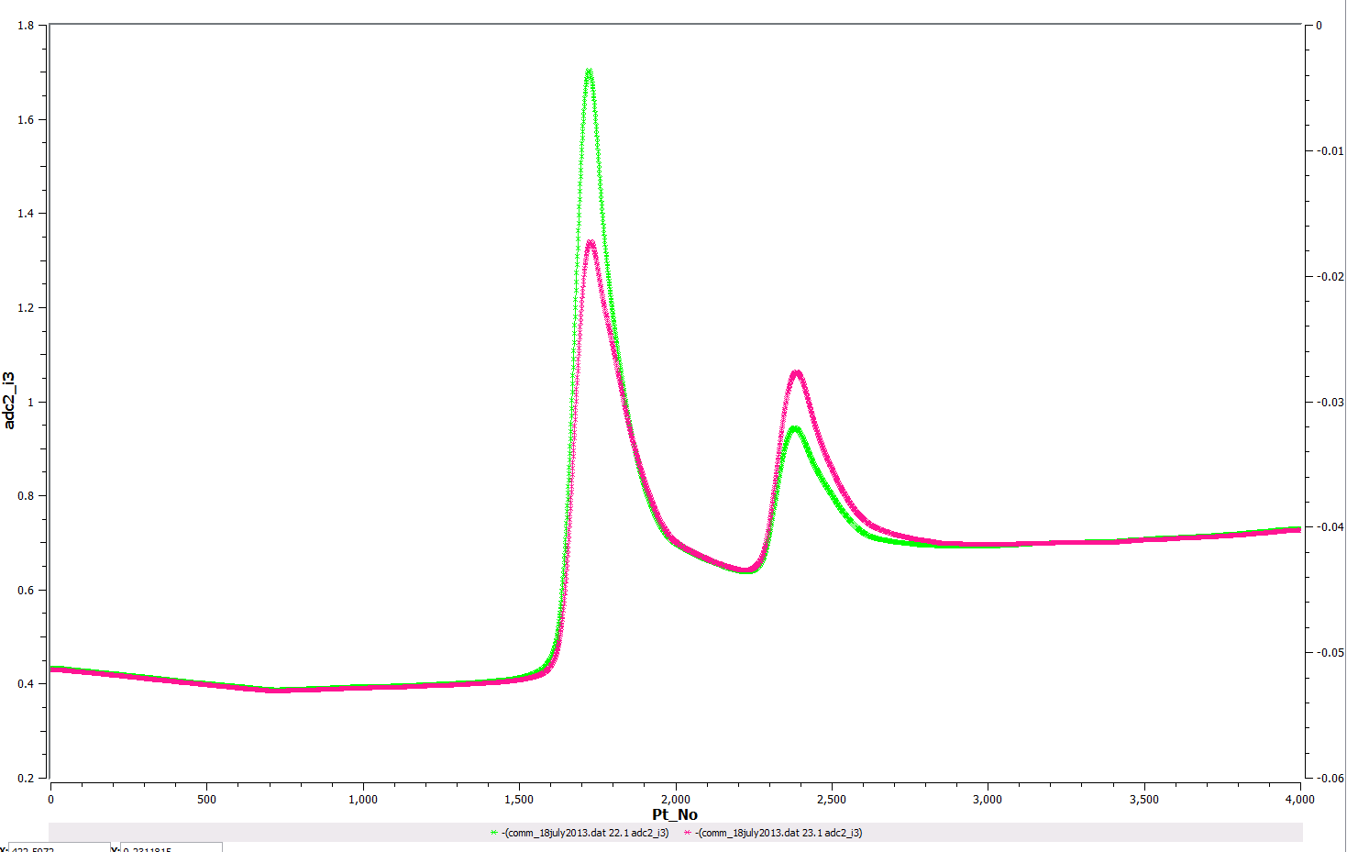
BL performance - continuous scans
Fe metal L_{2,3} XMCD
Fe metal L_{2,3} XMCD
Step scan
Continuous scan
Variable step (open loop) und.+mono movement Total scan time ∼ 18 min.
Continuous und.+ mono movement.
Total scan time ∼ 2 min. (same resolution as step mode)
> High sampling frequency → larger density of pts/eV
> Less time between scans → better reproducibility
> Faster scans → more efficient use of beamtime
> Pending: implementation for “antiparallel mode” (i.e. linear intermediate pol.)

Slide 7
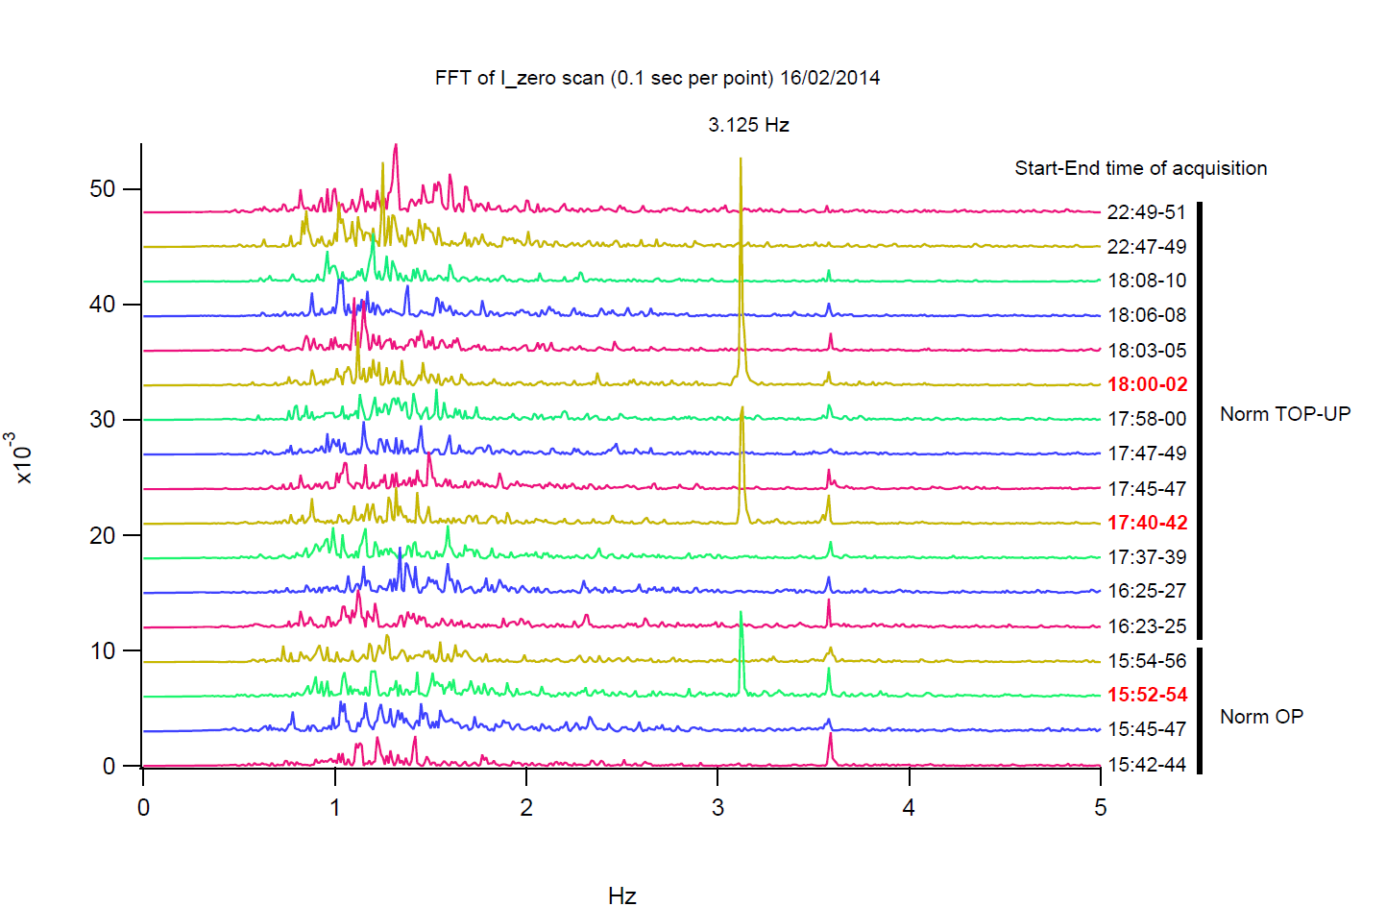
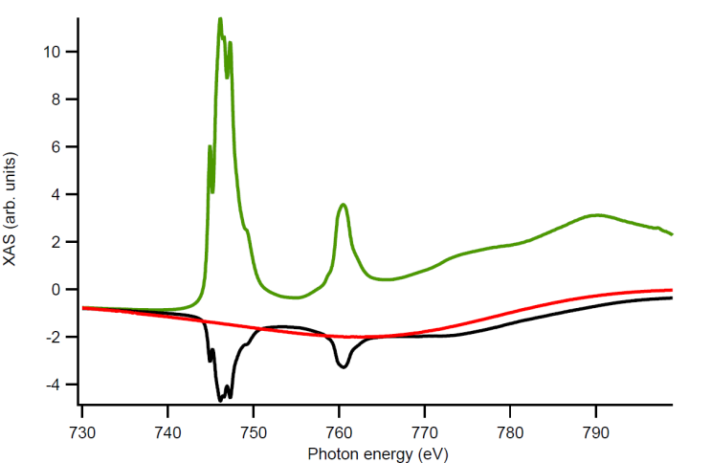
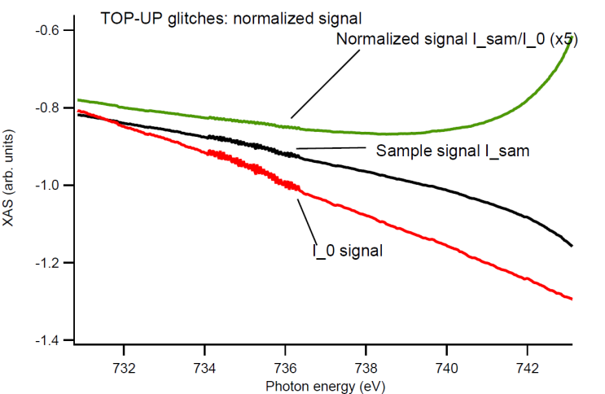
BL performance - TOP UP tests
injection
I₀ FFT signal vs time (x10³)
Freq. (Hz)
> During injection we see noise increase @ 3.125 Hz due to kickers operation
> Limited impact on BL op. since number of affected scans is small
> The injection process ~10/20 s usually affects small portion of the spectra (typical scans take ~2 min)
Conclusion : No gating needed so far at BOREAS for TOP-UP operation

Slide 8
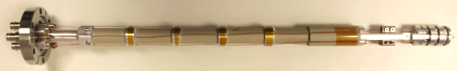
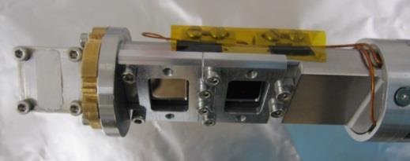
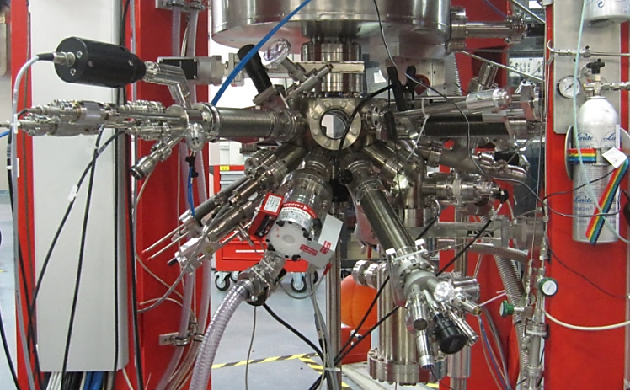
BL endstation 1 - XMCD cryomagnet
1st endstation, “HECTOR” SC 6T/2T/2T magnet with VTI
> Running user experiments since May 2012 (29 till today, >5 days long in average)
> Performs according to specs (B_{y} up to 6 Tesla, 1.5 K<T <370 K)
> Detection modes: TEY + TFY, transmission
Recent upgrades
> Improved vacuum scheme (safe if blackout)
> Broadened remote macro-controlled operation
> Motorization of transmission diode arm
> Auto magnetic field-on flashing lights
In progress upgrades
> Fast loadlock (up to 4 sample holders simultaneously)
> Sample bias (to enhance TEY with X, Z- applied field)
> Anti-ice / condensation barriers
> Definitive Scaffold (for LN, LHe refill…)
> PFY detection (collaboration agreement with MPI Dresden under study)
> Dock for travelling suitcase, STM (coll. agr. with ICN2 under study)
Growing equipment @ preparation chamber
> Heating stage, evaporators, wobble stick, gas lines, ion gun, quartz balance, mini LEED
> New large turbo pump + ion pump → base pressure ∼ 10⁻¹⁰ mbar

Slide 9
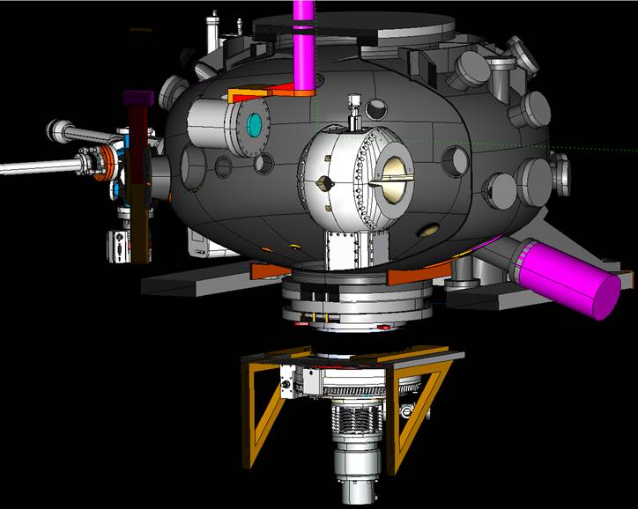
BL endstation 2 - Magnetic Scattering
> Final assembly and commissioning mid-late 2014
> Open to users from feb. 2015 (i.e. available in currently open call)
> Availability : reflectometry exps. without applied magnetic field
“MARES” endstation
Two detector arms
(IH-designed, manufacturing)
Provisional support (definitive one late 2014)
2 T magnet in/out tool (manufacturing)
> Assembly, first tests with point detector
> Cabling, control (pool) in progress
> CCD commissioning in progress
Magnet rotation by McAllister (commissioning)

Slide 10
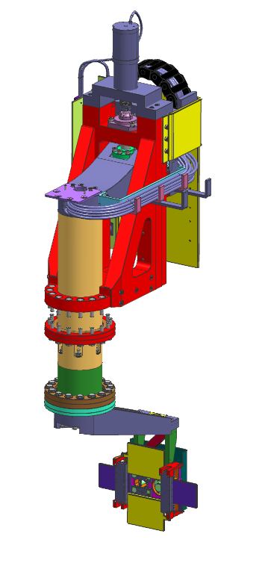
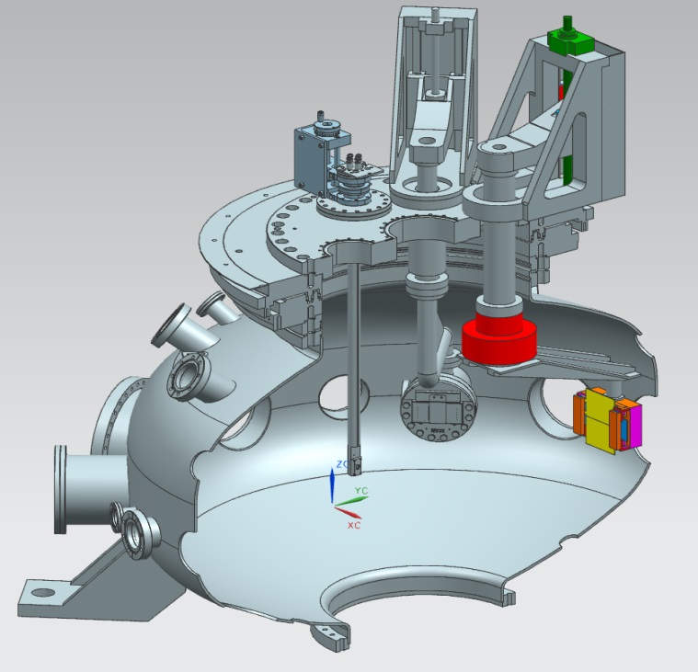
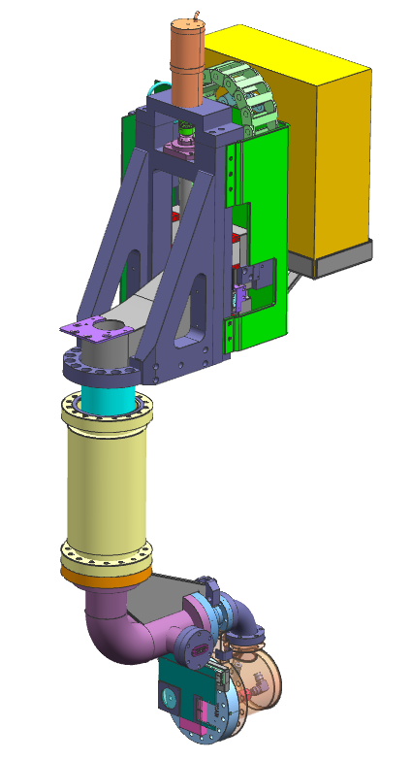
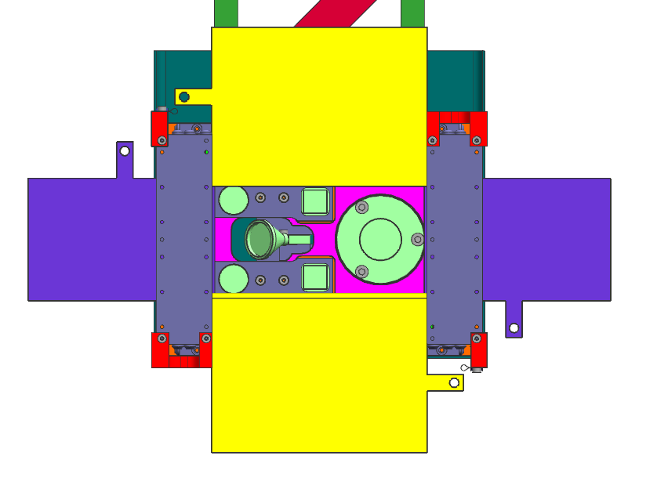
BL endstation 2 - detector arms
> Arm 1 – channeltron, microchannel plate, diodes, slits
> Arm 2 – XCAM CCD (SAT OK, june’14)

Slide 11
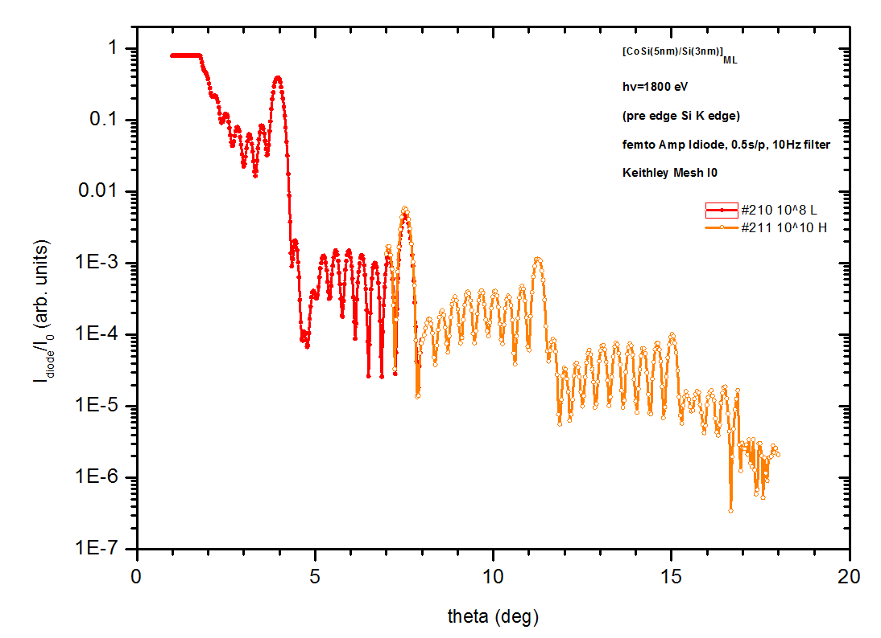
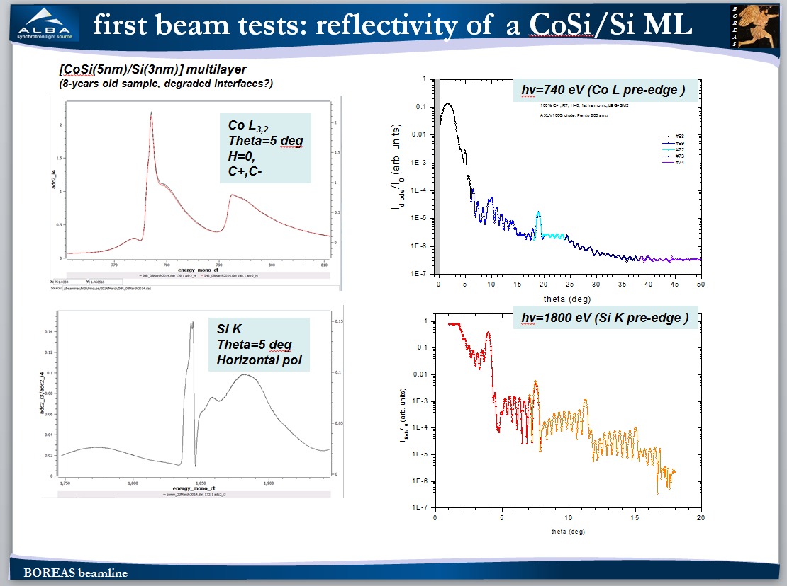
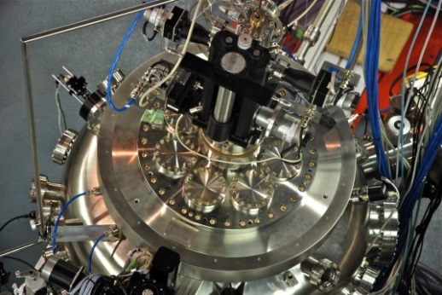
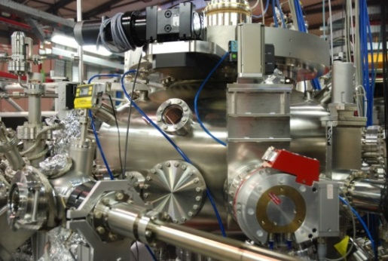
BL endstation 2 – first spectra
> March 2014 IHR/Commissioning beamtime
[CoSi(5nm)/Si(3nm)] ML test sample reflectivity
Diode detection on temporary arm support

Slide 12
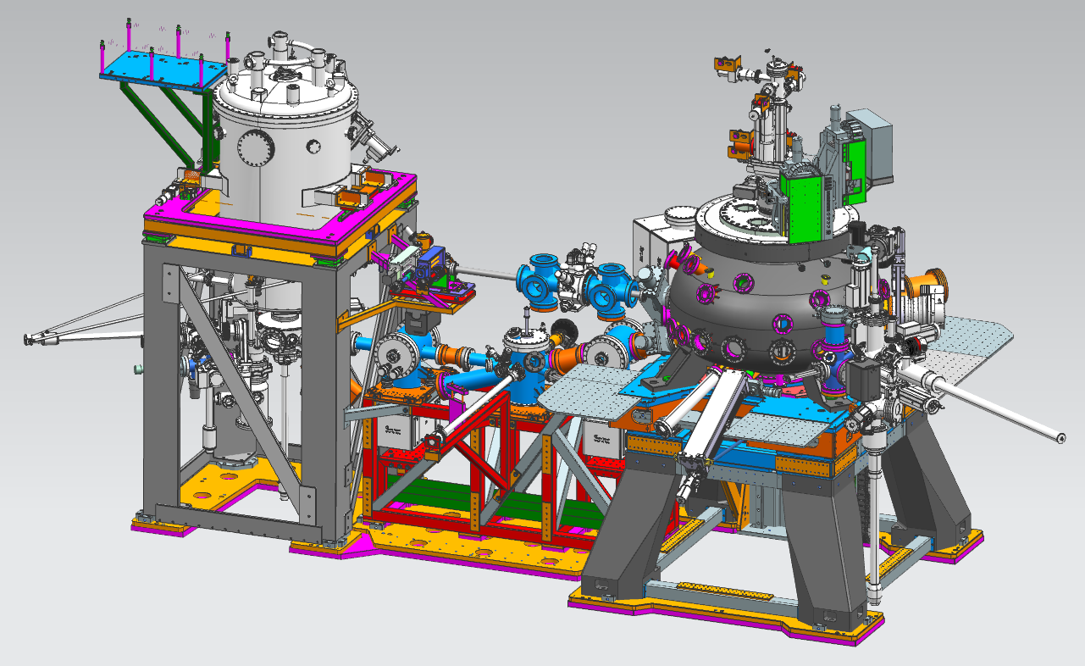
Interstations transfer system – STM coupling
XMCD
Vector-magnet
user STM-chamber
x-ray beam
Scattering endstation
Interstation sample transfer
> In house-designed support (ready to assemble)
> System in service late 2013 / early 2014 (expected)

Slide 13
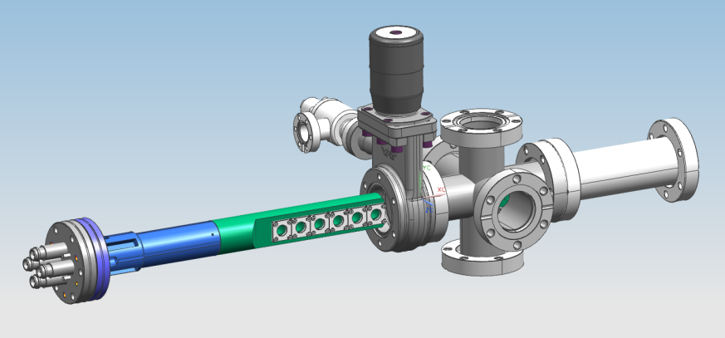
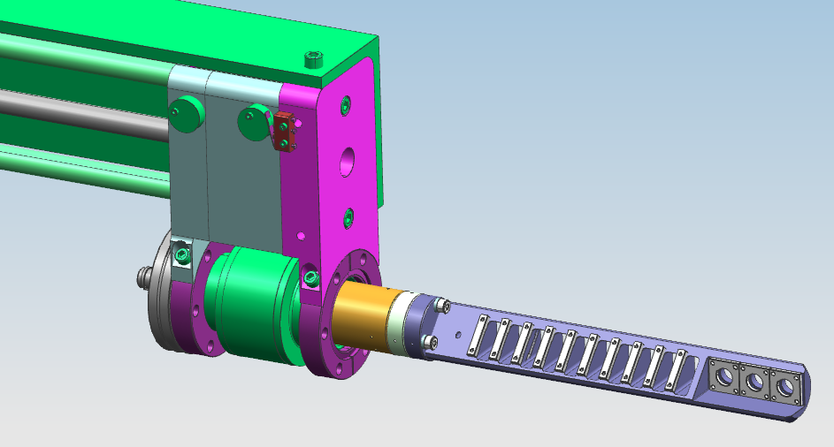
Other developments - upgrades
equipment
> Small UHV prep. chamber, coupling to interstations transfer system
> “OESS” (off-endstation samples stage) for quick exchange of dirty samples
> Motorized system for (more) E reference samples
> Surface science instrumentation for MARES (mini-LEED head, linear translator…)
controls
> Deeper macro / GUI control of vectorial magnetic field & sample temperature
> New macros for cooling down/warming up VTI, valves & EMs control…
> Long macros (overnight…) stability
> MARES macros

Slide 14
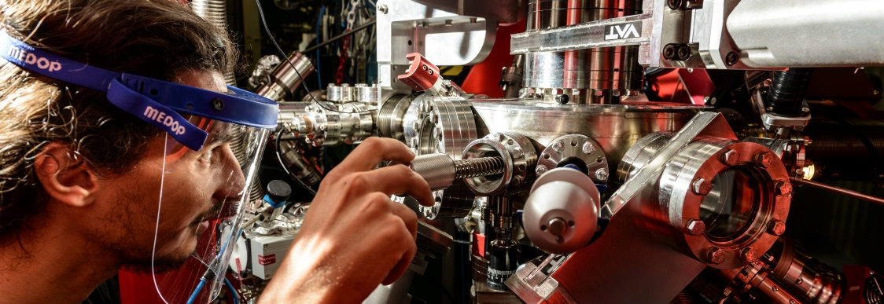
BL users operation 2013-2014
User experiments in HECTOR
> Jan. 2013– Mar. 2014 : 14 user experiments performed (14 beamtime granted user proposals from 2012 call)
> May 2014 – Dec. 2014 : 13* accepted proposals (5 so far carried out) from 2013 call
* 7/13 require in-situ surface preparation (single crystal cleaning, evaporation etc.)
Major issues / technical interventions in HECTOR
> Cold He-leak in VTI tail, drain current and 4-point contact wires, sample heater)
> Oct. – Nov. 2013 : liquid He supply shortage (global issue) → some experiments cancelled, beam profited to: 1) perform friendly users RT/zero B-field measurements, and 2) improve continuous scan mode

Slide 15
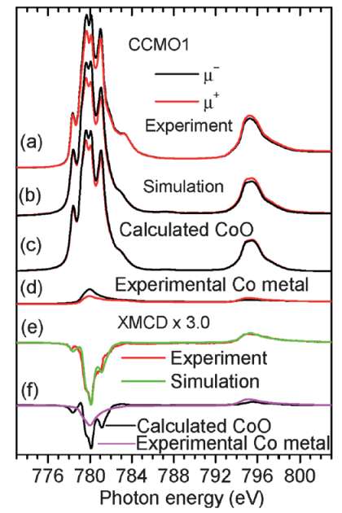
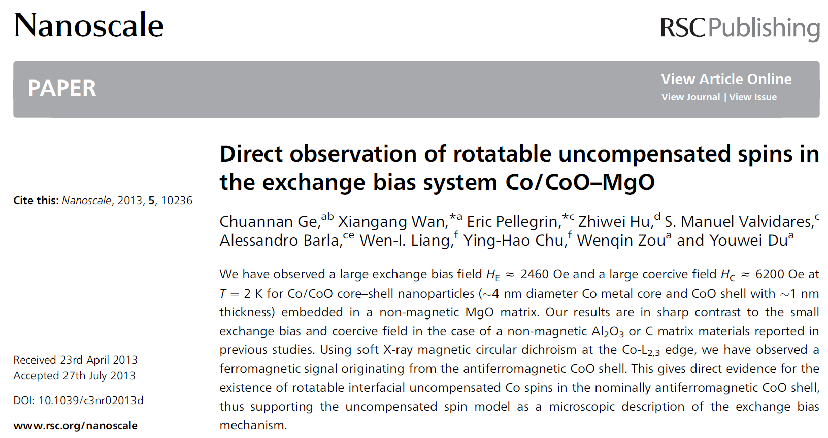
IHR experiments – first publications
2012 beamtime

Slide 16
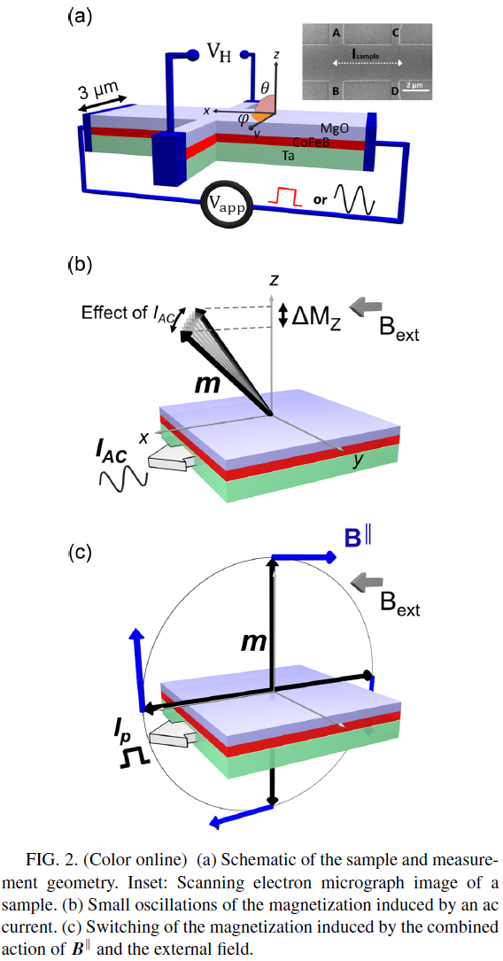
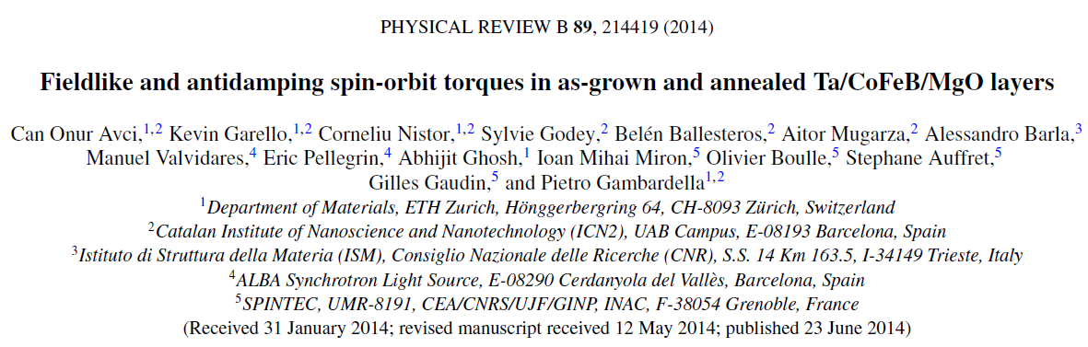
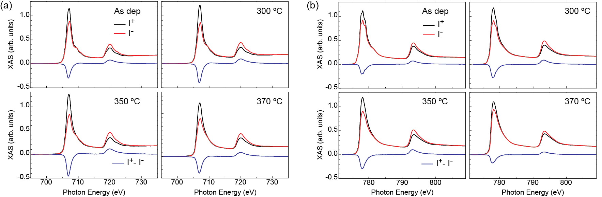
User experiments – first publications
2012 beamtime
Fe
Co

Slide 17
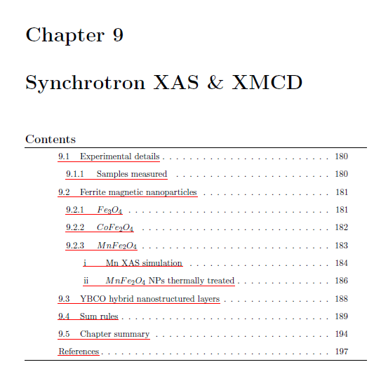
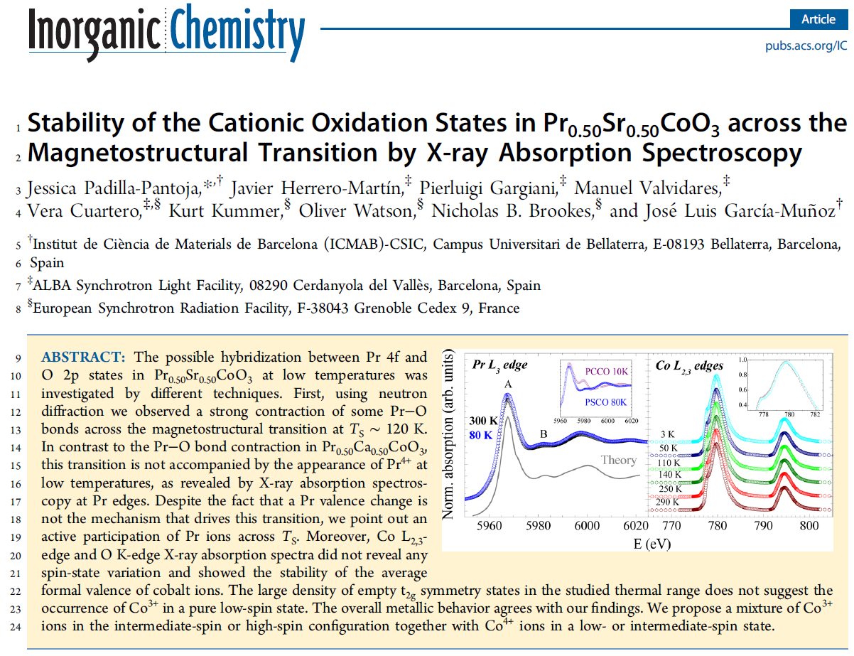
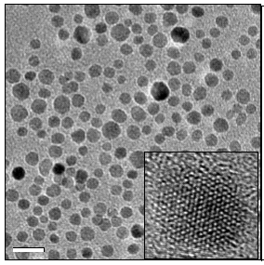
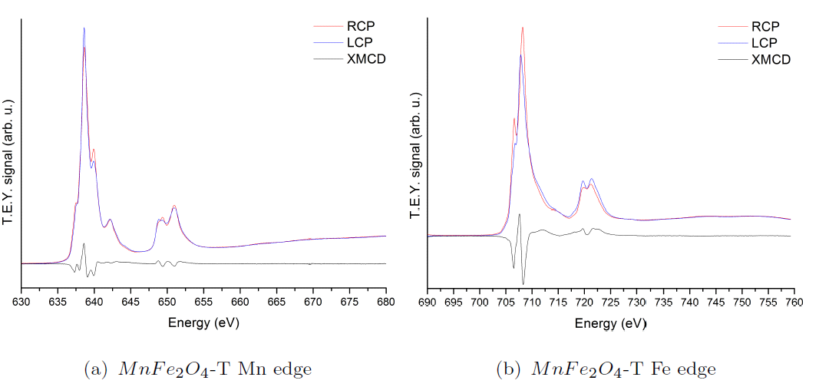
User experiments – PhD thesis contribs.
2012 beamtime
2013 beamtime
> High T SC with embedded nanoparticles
J. Padilla-Pantoja et al (in press, PhD thesis in prep.)
E. Solano et al, UAB-ICMAB-ALBA (PhD thesis, publication in prep.)

Slide 18
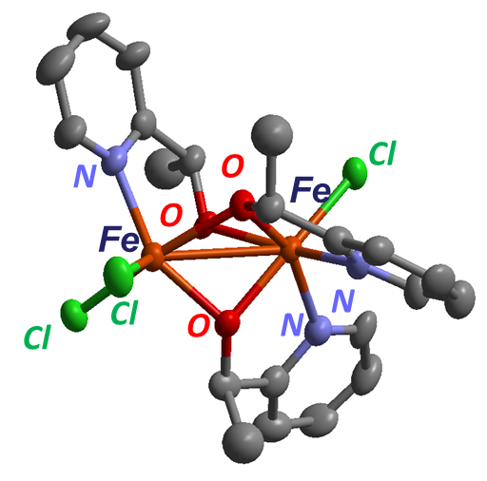
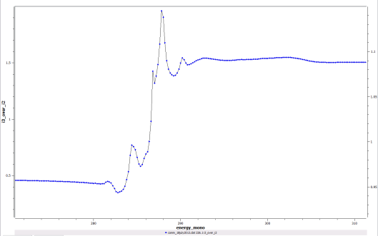
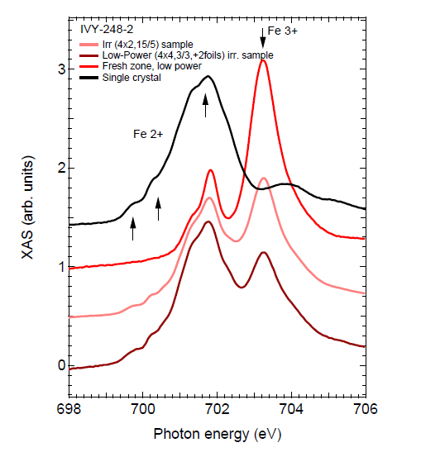
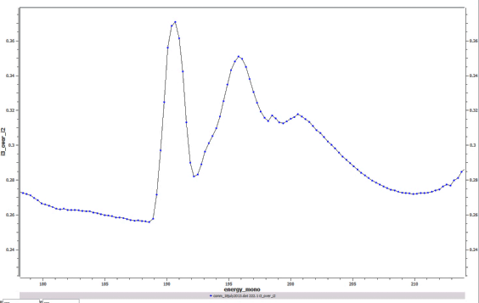
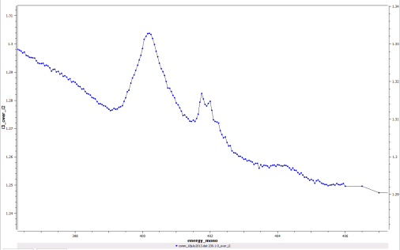
IHR projects - collaborations
> Di-Fe (III) chiral complex molecular magnets (preliminary measurements)
J. Giner-Planas, F. Di Salvo, M. Y. Tsang, S. M. Valvidares, P. Gargiani, J. Herrero-Martín, F. Teixidor, C. Viñas, N. Aliaga-Alcalde, E. Ruiz, D. Choquesillo-Lazarte,
ICMAB-CSIC, Univ. Barcelona, IACT-CSIC (Granada), ALBA
C K (∼ 290 eV)
Cl L₁ edge (∼ 200 eV)
(20 times flux attenuation)
N K (∼ 400 eV)
Fe L_{2,3}

Slide 19
Users evaluation (1/2)

Slide 20
Users evaluation (2/2)
Users’ comments
> Bad pressure conditions in analysis chamber
> Some of the equipment is new and needs to be debugged
> J. Herrero, P. Gargiani and M. Valvidares were supporting us the whole time

Slide 21
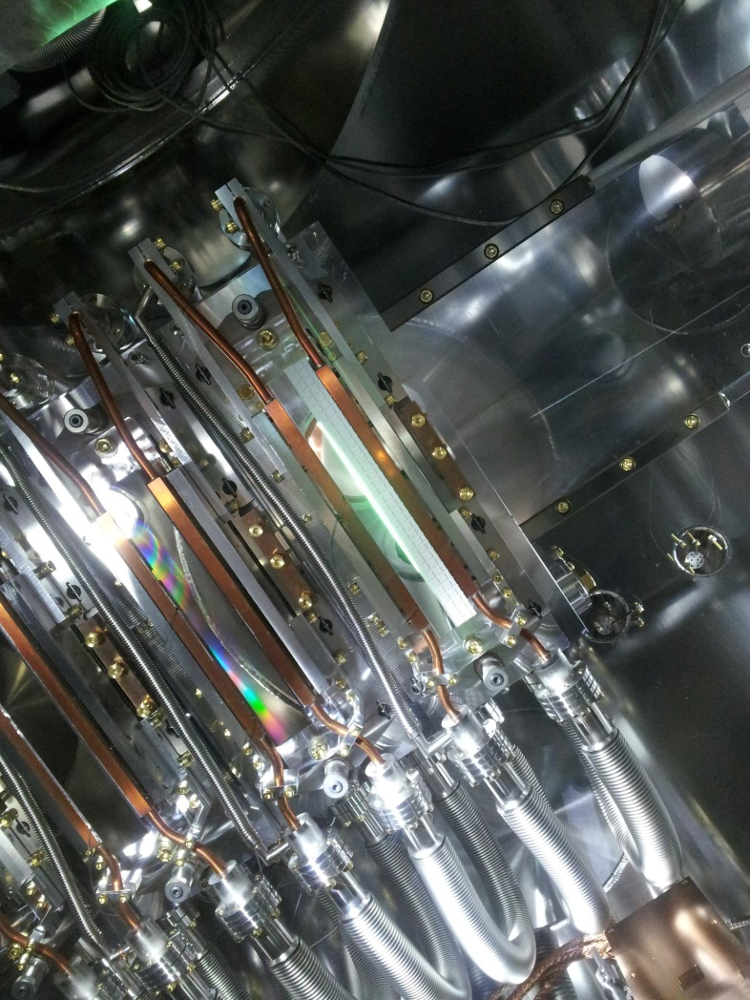
Acknowledgements
BL29 Staff
M. Valvidares, P. Gargiani (BL scientists),
J. Moldes (controls), A. Crisol (eng.), F. Farre (tech.),
X. Fariña and X. Serra (electronics)
Special ALBA contributors
E. Pellegrin, S. Ferrer, C. Colldelram, J. Nicolas, D. Fernandez, G. García, M. A. García-Aranda, L. Campos, User Office
Former staff & technical help
A. Barla, R. Martin, J.F. Moreno, D. Bacescu, J. C. Martinez, J. Lidon, Y. Nikitin, O. Matilla, S. Rubio, F. Becheri, J. Navarro, Ll. Ginés, A. Pascual, C. Ortiz, M. Llonch, C. Ruget, Alex, Paco, Eshraq, Xavi P. , C. Orozco, D. Iriarte, Thiago, A. Ruz, S. Astorga, Bern, Oscar, David, J. Ferrer, legal section (CFTs)
Externals: J. B. Kortright, N. Brookes, J. Criginski, C. Quiros, J. M. Alameda, C. Piamonteze, T. Schroder
External companies
TOYAMA, SCI-MAG, CVT, VG, HTS-110, PINK, SPECS, DODECON, FERROVAC, GAMMVAC, TECNOVAC, VAT, IBERLASER, HOSITRAD, VCS, AVS, AVACTEC,VAQTEC, MCALLISTER, HAMAMATSU, XCAM, AMBAR, INSERTY, SPARK,NANOTEC, SJUTS, KONIK, MDC, TRINOS, VAT

