Slide 1
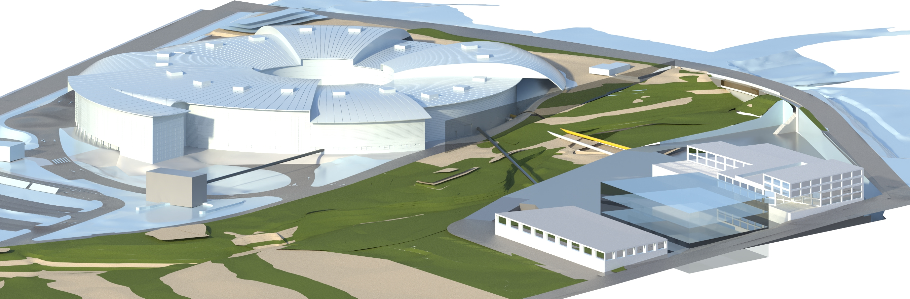
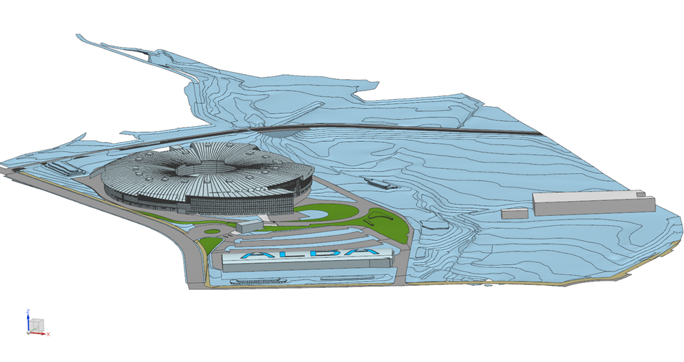
ALBA of the future
ALBA today
Future of the Existing Programs
Klaus Attenkofer
19 January 2024 – ALBA II Symposium

Slide 2
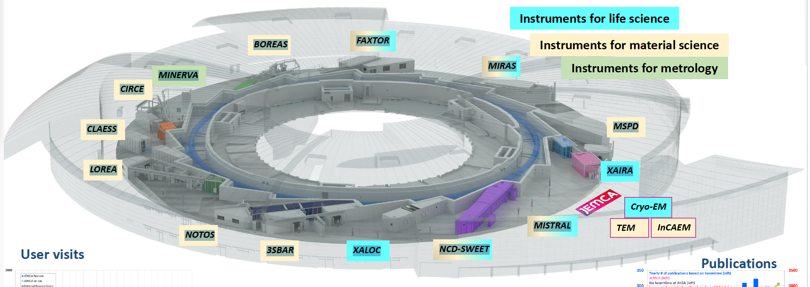
Which Beamlines are Available:
Alba is a 3. generation synchrotron source with 11 operating beamlines and 3 in construction/commissioning:
XAIRA (microfocus/phasing MX beamline)
FAXTOR (full-field imaging beamline)
3Sbar (HEXPAS and surface diffraction beamline)
CODI (long beamline)
CORUS (long beamline)
Bio-SAXS
Alba’s organization:
Three scientific sections support the user program:
Life Sciences Section.
Chemical and Materials Sciences Section.
Electronic and Magnetic Structure Section.
Interdisciplinary and Multimodal Section.
commissioning
End phase installation
End phase design
Decided not yet funded
Decided not yet funded
Decided not yet funded
11 operating beamlines:
  MIRAS (IR)
  MSPD (PD)
  MISTRAL (soft X-ray microsc.)
  NCD (SAXS/WAXS)
  XALOC (MX)
  NOTOS (XAFS + PD)
  LOREA (ARPES)
  CLAESS (XAFS)
  CIRCE(NAPP/PEEM) (NAPP: scientifically represented by CMS)
  BOREAS (XMCD, soft X-ray scattering)
  MINERVA (Industrial metrology beamline)
9 Non-committed ports are left:
BL03 –Long BL on superbend
BL08 –Medium BL on ID
Other 7 dipole or superbend ports available
19. January 2024
ALBA II Symposium

Slide 3
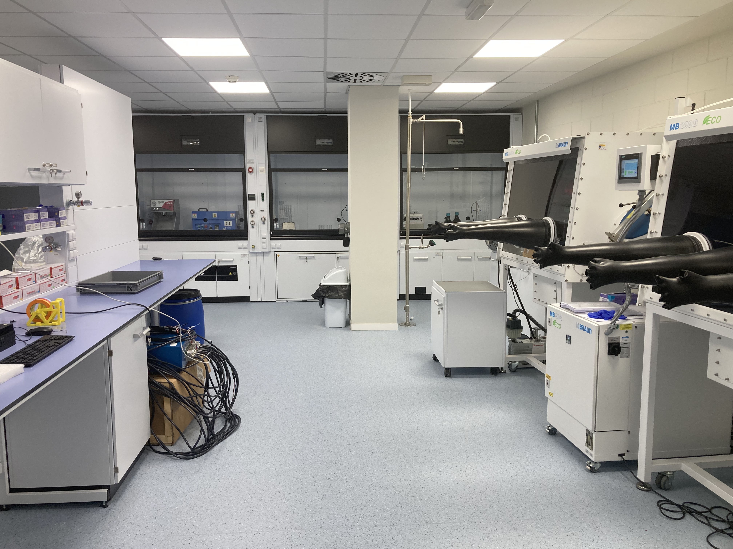
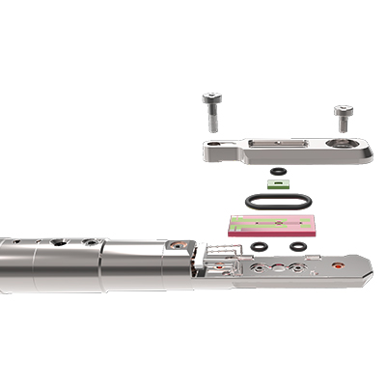
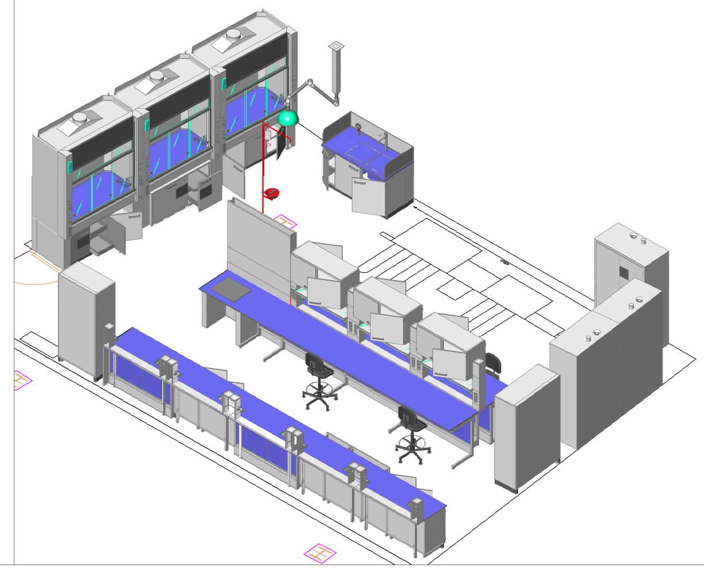
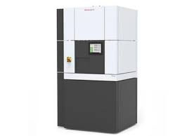
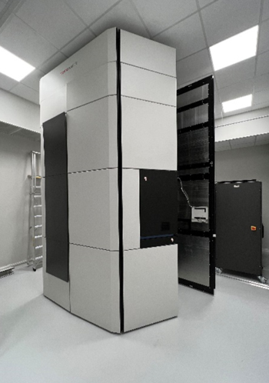
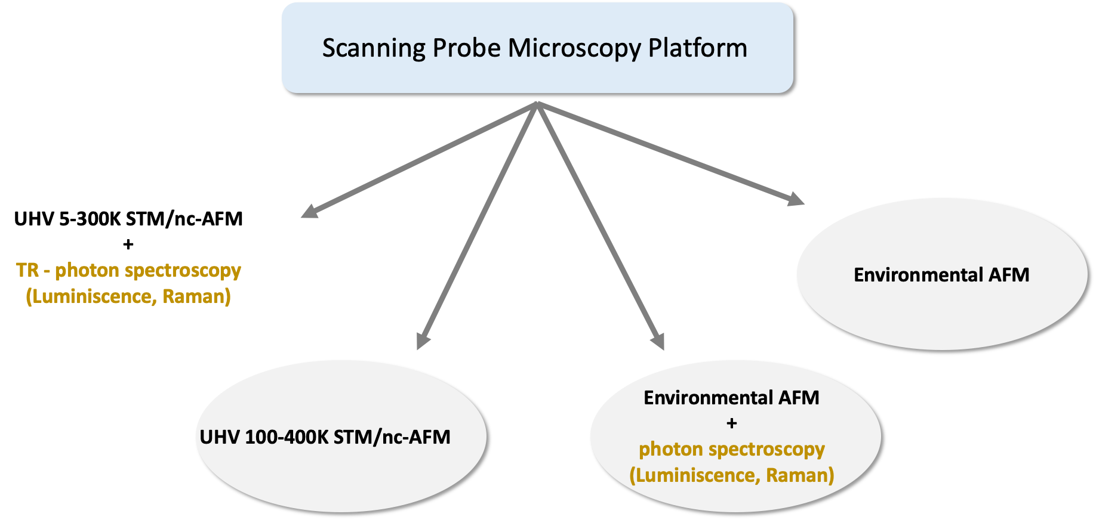

Non X-ray Based Infrastructures:
Operando supporting Infrastructure:
Battery Lab
Microscopy platform:
JMCA & InCAEM platform
Operando TEM
InCAEM
Cryo-TEM
MetCAM
Funded by Consortia (including ALBA)
Operated by IBMB (cryo-EM) and ICN2 (MetCAM
Funded by InCAEM
Operated by ICN2
Funded by ICMAB & ITQ (CSIC) and ALBA
Operated by ICMAB & ALBA
In Construction
Fully operational
19. January 2024
ALBA II Symposium
3

Slide 4
ALBA II: a Package for
Your Research Needs
What ALBA II will stand for:
Correlative Imaging approach.
Multimodal
Big-Data and High Throughput
Providing operando and in-situ capabilities
The new methodologies and approaches have to :
  Imaging from the smallest building unit to the functional unit. Interpreting the structural information.
  Providing statistically relevant information.
  Understanding the structure-function correlation.
19. January 2024
ALBA II Symposium
4

Slide 5
What is the Fabric of ALBA II:
The major upgrade activities users will experiencing:
  Guaranteeing operational excellence by beamline upgrade program.
  Promoting multimodal approaches by coordinating beamlines and support structures and developing computational capabilities.
  Investing in operando capabilities (X-ray and non X-ray based).
  Creating and adapting new access modes to accommodate the needs of changing services.
A key-component will be strengthening the In-House research to develop directly with YOU
the next state-of-the-art services
19. January 2024
ALBA II Symposium
5

Slide 6
The Beamline Upgrade Program:
Goal of the beamline upgrade program is:
  To maintain operational reliability on all existing beamlines.
  Optimize some of the beamline for the multimodal approach.
  Adjust some programs to the changing user needs and research funding realities.
  Bring some of the beamlines to the forefront level of research capabilities.
The need of YOU as a user will be in the center of consideration
19. January 2024
ALBA II Symposium
6

Slide 7
The Beamline Upgrade Program:
Carefully planning the upgrades per beamline with minimal impact on operation.
Each beamline will have 4 upgrade categories:
  Essential ALBA: These are absolute essential upgrades or the current program will face possible termination.
  Enabling ALBA: These are upgrades necessary to be state-of-the-art or to reorient the program.
  Essential ALBA II: These are absolute essential upgrades or the program cannot be executed at ALBA II.
  Enabling ALBA II: These are upgrades necessary to be state-of-the-art or to reorient the program at ALBA II.
Final decision depends on available budget; project can fast react on new opportunities or threats.
Important time lines:
  First presentation of preliminary project at User Meeting in September (save the date).
  Review process finished January 2025.
The need of YOU as a user will be in the center of consideration
19. January 2024
ALBA II Symposium
7

Slide 8
The Beamline Upgrade Program:
The first beamline upgrades have already started:
  First set of beamlines will be:
    XALOC: goal to increase throughput and ensure reliable operation.
    Major components: Detector, robot, goniometer and software (in progress)
    MSPD: goal is to relocate from port 4 to port 30 and strengthening the microfocus diffraction capabilities: ID, beam transport, hutches & infrastructures.
    MISTRAL: goal is to simplify operation; multiple options are currently discussed, In any case the microscope will be replaced.
    CLAESS: goal is to increase scanning speed and integrate micro-focus capability. Plan is currently developed.
19. January 2024
ALBA II Symposium
8
The need of YOU as a user will be in the center of consideration

Slide 9
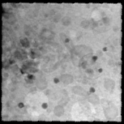
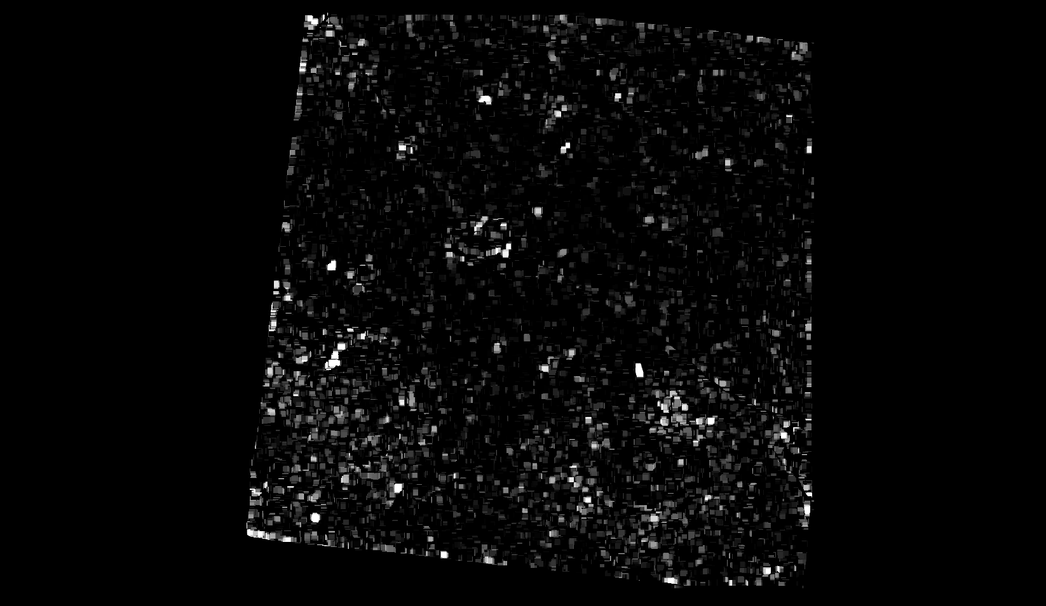
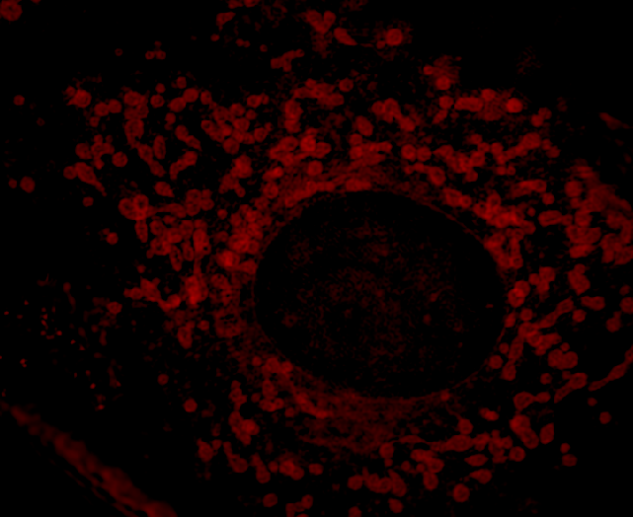
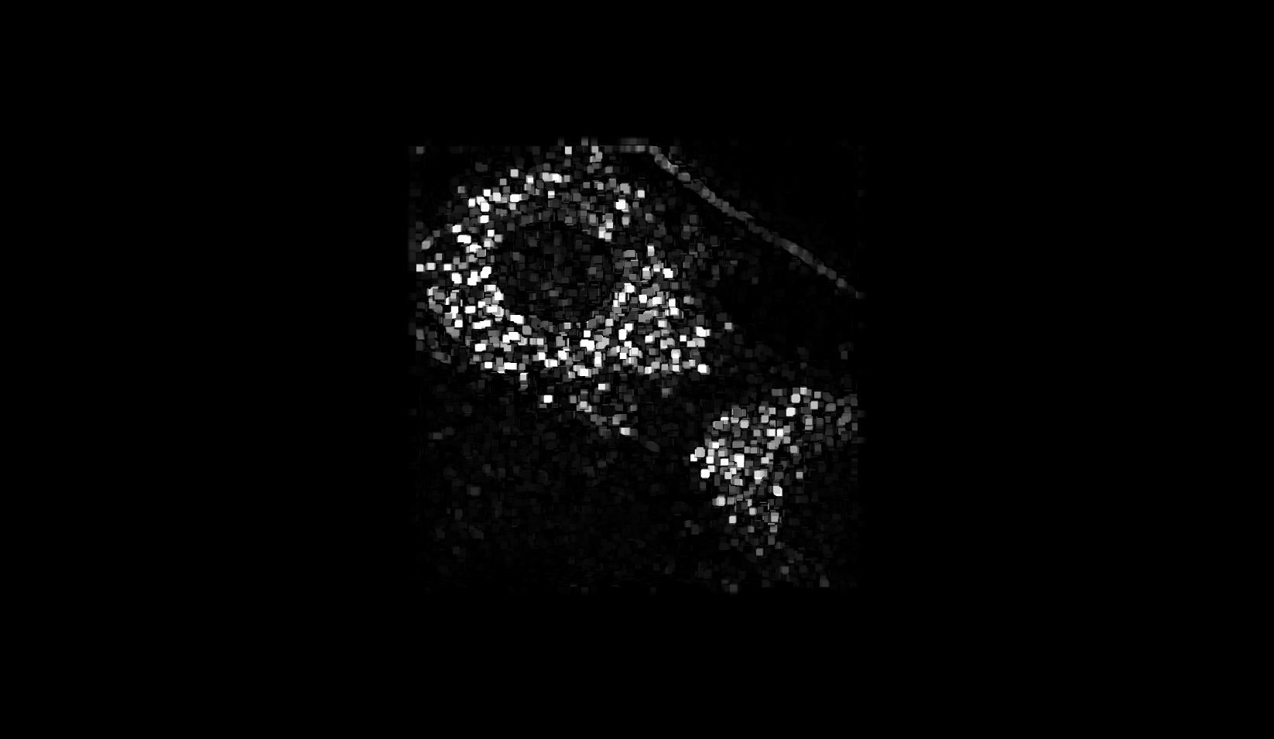

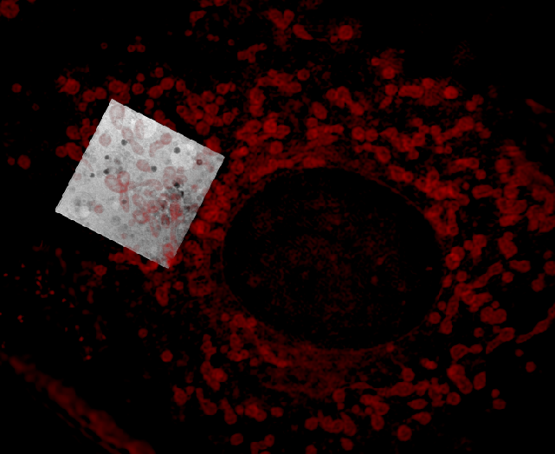



Building New Methodologies for Multimodal and Operando:
Computational Tools for Multi-Length Scale Imaging
SXM Tilt series
Feature detection:
Size range filter
Multi-length scale imaging is key to image in 3D the complex morphology of macroscopic structures with the ability to zoom in up to sub-atomic resolution:
Automated process allows the combination of data sets with different resolution and different techniques sensitive to different properties
Current data pipeline will be extended to include large scale X-ray imaging, various x-ray microscopies, light microscopies, HRTEM, and other imaging techniques
Intermediate alignment:
SXM Mosaic
0° proj.
SXM
Mosaic
3DSIM
0° proj.
3DSIM
Proj.
2D pre-alignment
Orientation
search
3D fine alignment
Tilt series
2D Corr.
⊗
2D Corr. Backprojection
19. January 2024
ALBA II Symposium

Slide 10

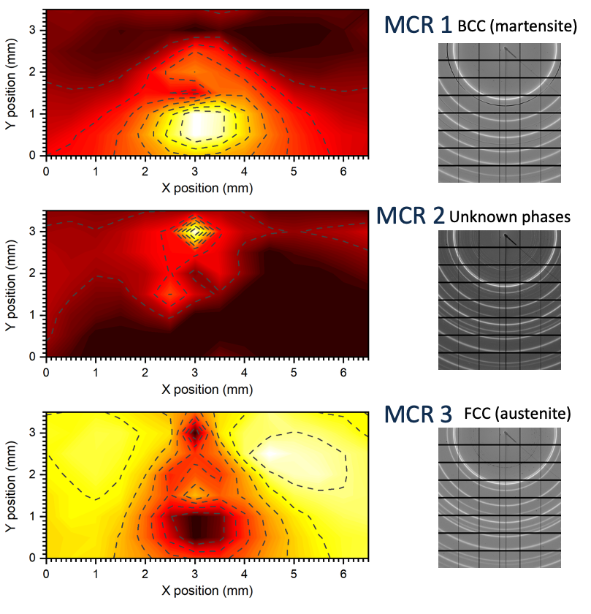


Building Methodologies for Multimodal and Operando:
Computational Tools
First steps to develop high throughput data mining capabilities:
A tool developed for steel industry and research community but can also applied for many other communities (see below)
Automatic phase mapping of Dual Phase Steel after stress test:
Map resolution depends on beam size
The two main components of the dual phase steel were automatically identified.
Phase map is quantitative and fast to create (in optimized beamline about 2 min)
Currently unidentified phase exists only on crack.
Very small phase contributions can be identified.
Perfect method for data mining, digital twinning and cost-effective and fast materials development.
MCR 2
Individual crystallites are visible
In collaboration with EureCAT
19. January 2024
ALBA II Symposium

Slide 11
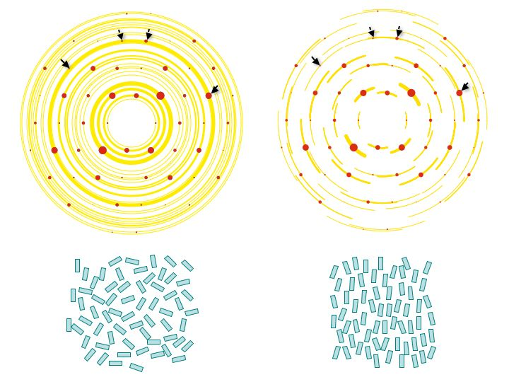
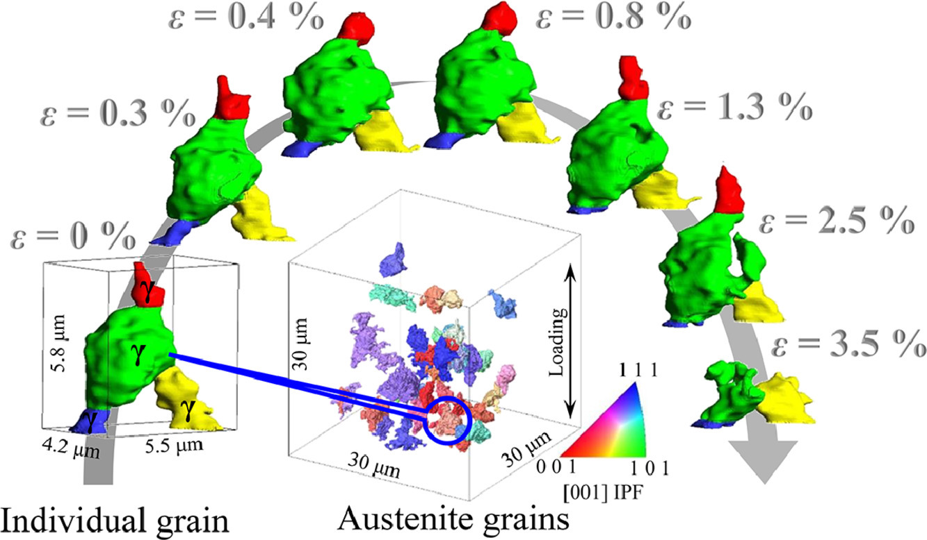
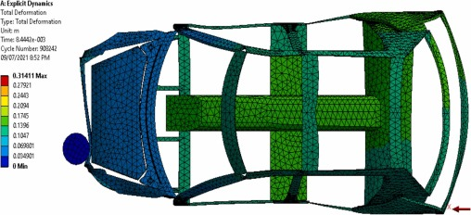
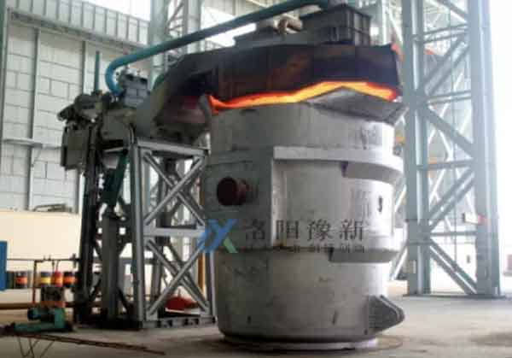
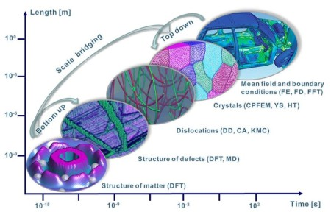
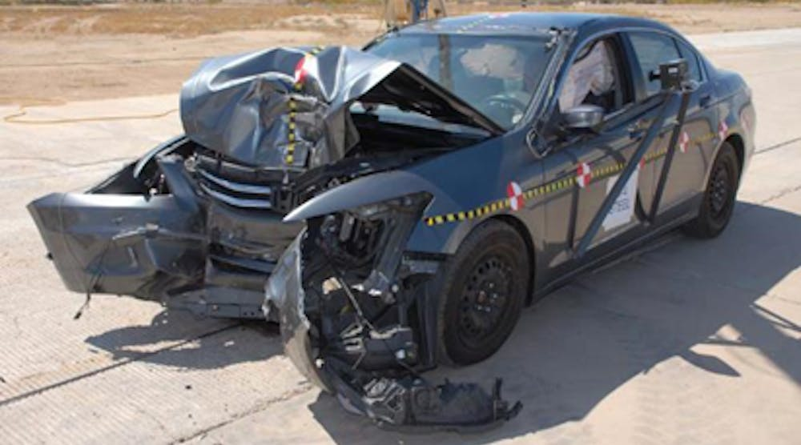
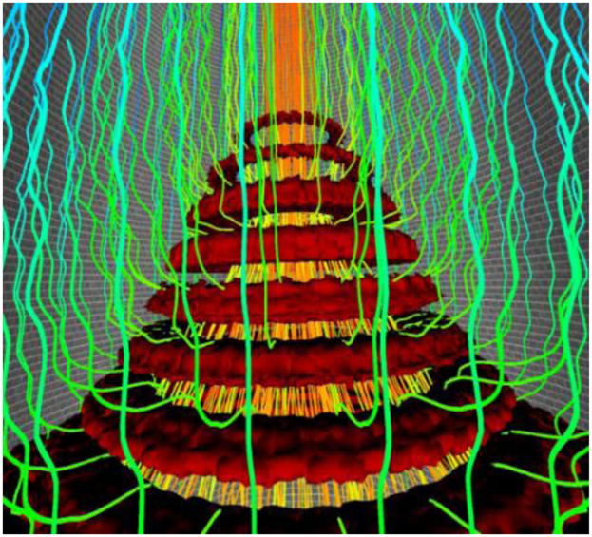
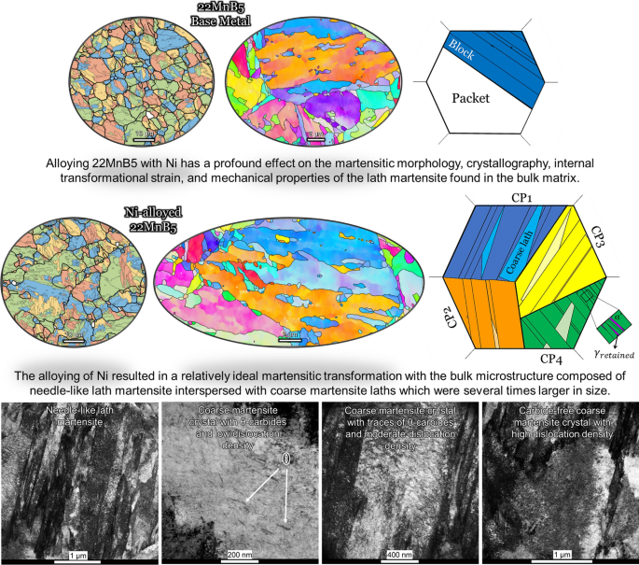
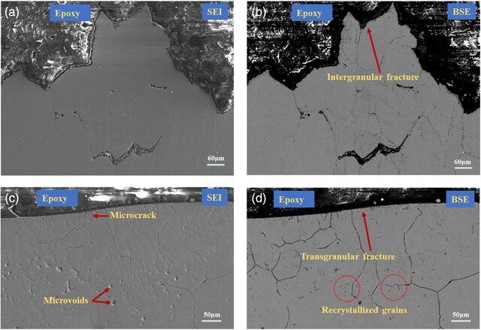
Applied and Basic Science: Data Mining is the Connection
Database Domaine
Statistically relevant morphology data
Multi-length scale towards atomic resolution
Manufacturing processes, process parameter and their control
FEA for final product
https://doi.org/10.1016/j.actamat.2022.117956
https://www.crystal.mat.ethz.ch/research/ZeolitesPowderDiffraction/Texture.html
Simulation on the different length scales
https://www.sciencedirect.com/science/article/pii/S230718772300007X
https://www.lmmgroupcn.com/summary-of-scrap-preheating-methods/
Final product with manufacturing yield & reliability
Simulation of manufacturing process
https://www.dierk-raabe.com/ab-initio-modeling/
Steel morphology
Correlation between steel morphology and fatigue.
https://www.tdworld.com/transmission-reliability/article/20973370/impact-of-a-car-crash-on-a-steel-transmission-pole
https://onlinelibrary.wiley.com/toc/1869344x/2019/90/4
https://link.springer.com/article/10.1007/s10853-022-07916-z
https://www.researchgate.net/publication/349540159_Hot_Ductility_and_Fracture_Behavior_of_High-Ti_Weathering_Steel/figures?lo=1
Synchrotron Light Facility Domaine
19. January 2024
11
ALBA II Symposium

Slide 12

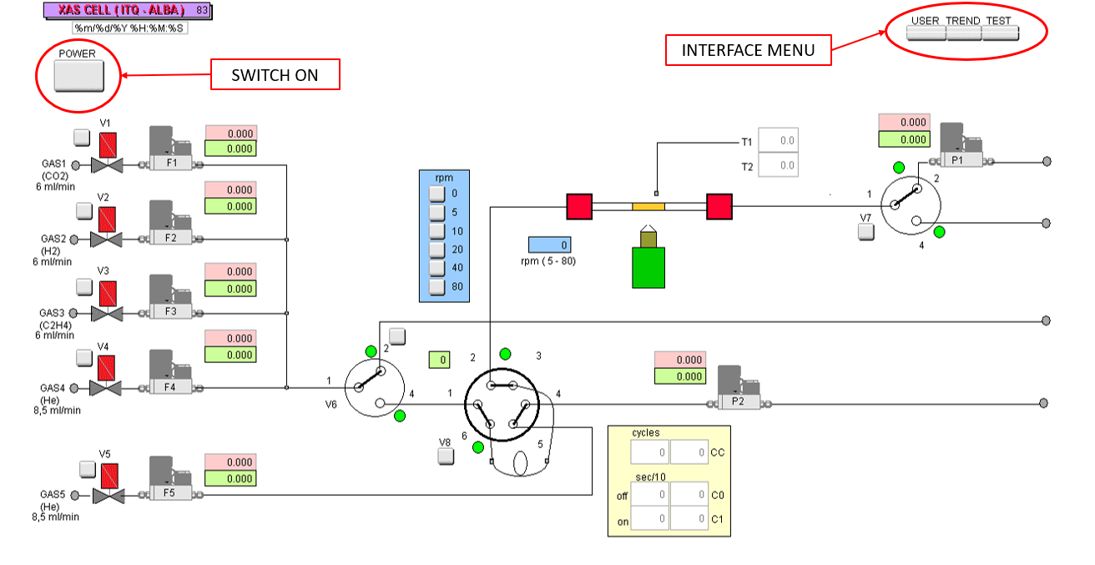
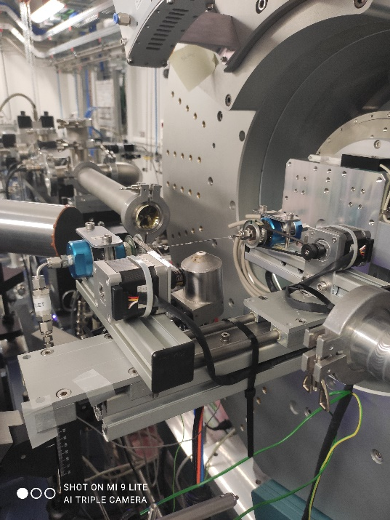
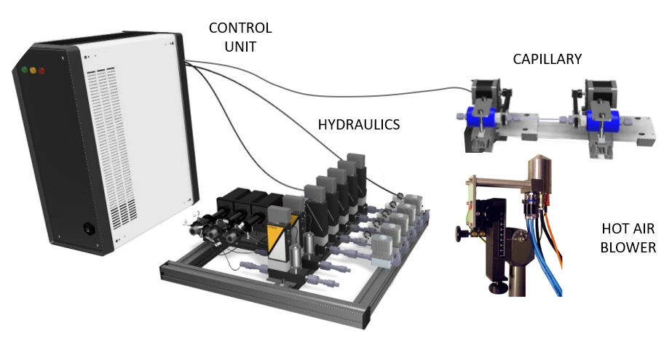
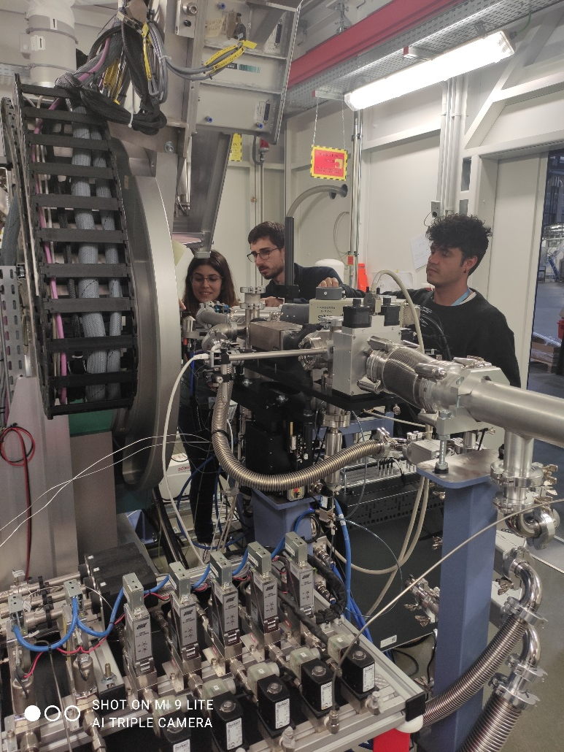
Building New Methodologies for
Multimodal and Operando:
The Catalysis Lab
CATALYSIS INSTRUMENTATION INSTALLED AND COMMISIONED AT NOTOS
19. January 2024
ALBA II Symposium

Slide 13
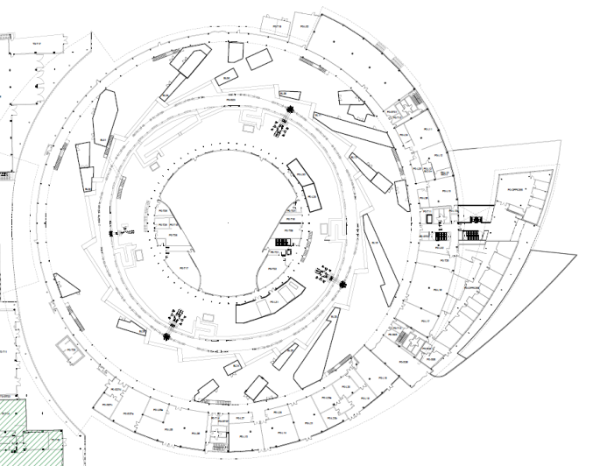
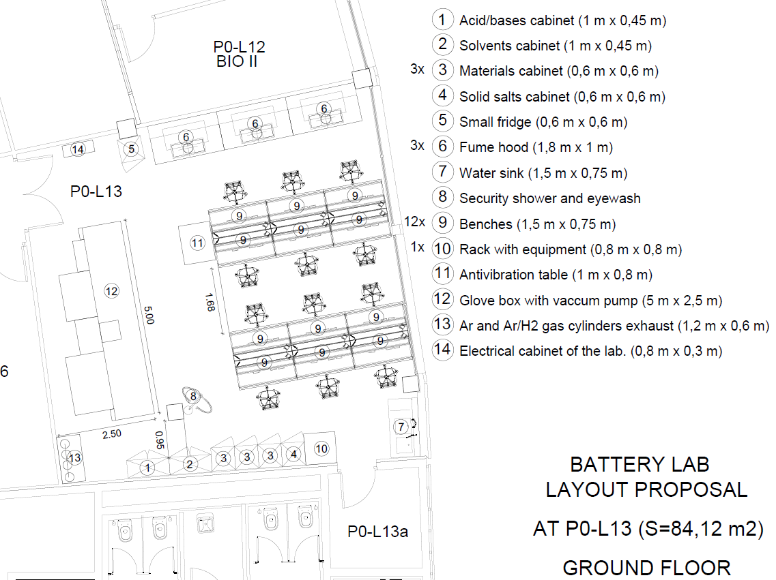
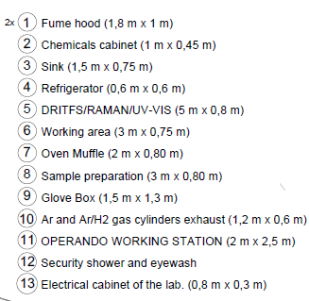
Building New Methodologies for
Multimodal and Operando:
The Catalysis Lab
Catalysis staging lab
Goal of the laboratory is the preparation of reactors and their test.
All gasses available which are used at beamlines and TEM.
Automatic processing is planned.
Additional functional tests (DRIFT, mass spectroscopy)
Available end of 2025
19. January 2024
ALBA II Symposium

Slide 14
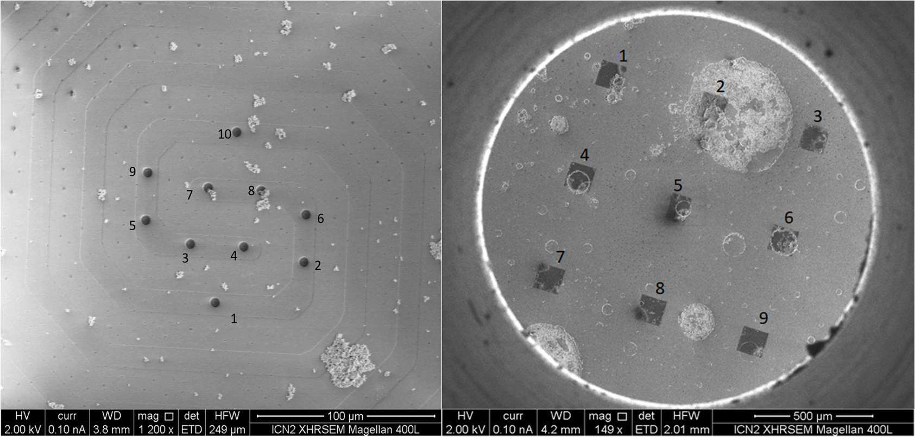
Building New Methodologies for
Multimodal and Operando:
TEM Integration into the Beamline Program
Sample chip holder: home made holder, currently not compatible with operando conditions. Commercial system will be purchased together with the TEM.
Tested chip systems:
  DENS Climate (old model) catalysis chip
  PELCO chips 21513CL-10:
  DENS Infinity catalysis chip
  Hummingbird P15 electrochemistry chip
Sample:
CeO loaded with PdO/Pt nano particles (1.5% weight % of Pd and Pt with a particle size of about 50nm).
Reaction and sample details: Divins, et al., Nat. Comm. 13, 5080 (2022).
SEM images of two types of substrates (loaded with sample) used for the feasibility tests.
Left: DENS Climate. Right: PELCO chip ´Lu3´.
L. Aballe and collaborators
19. January 2024
ALBA II Symposium

Slide 15
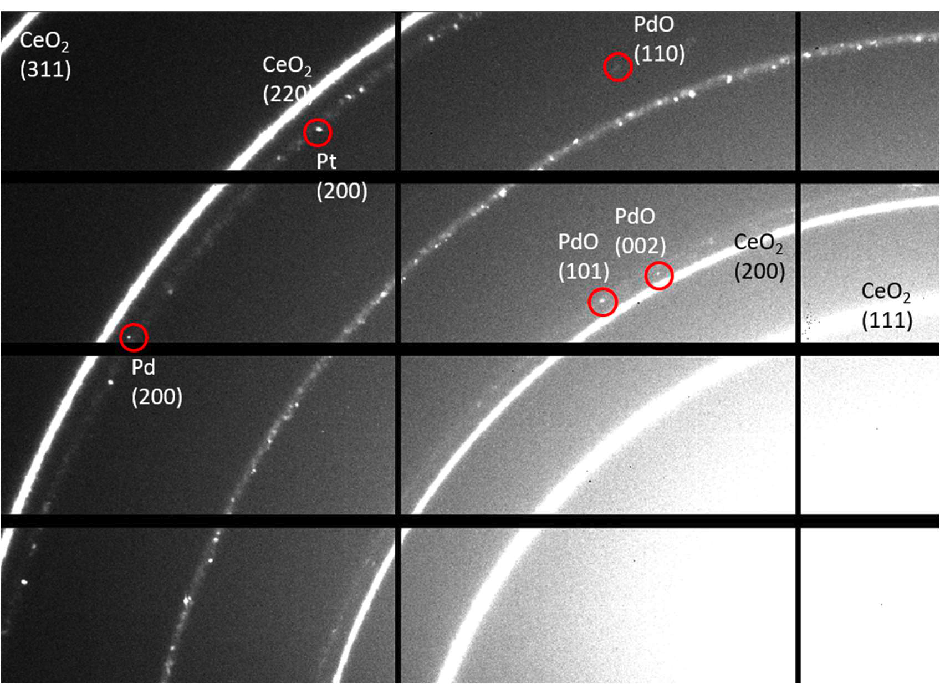
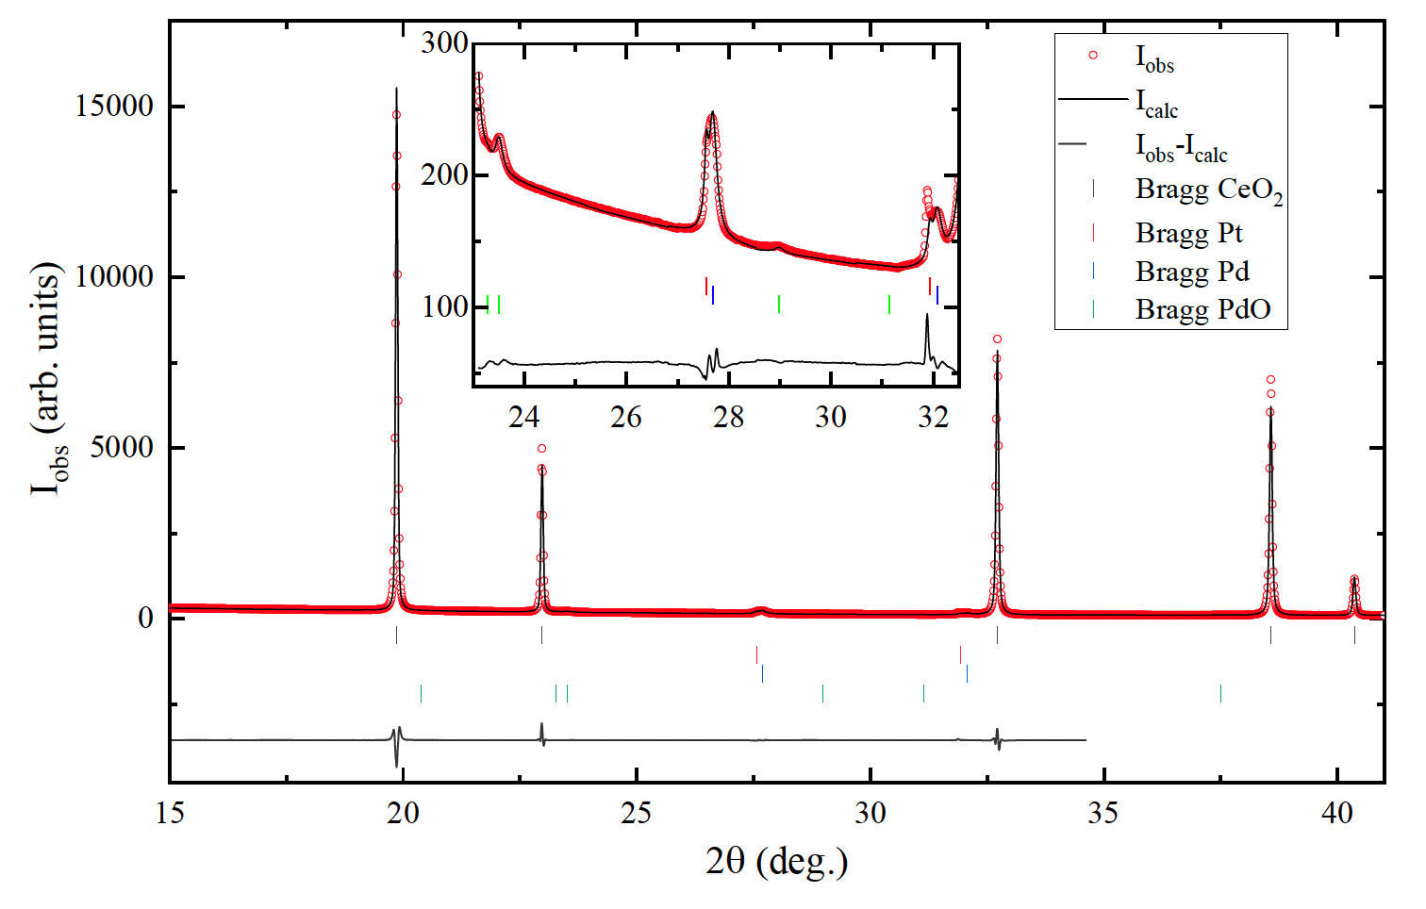
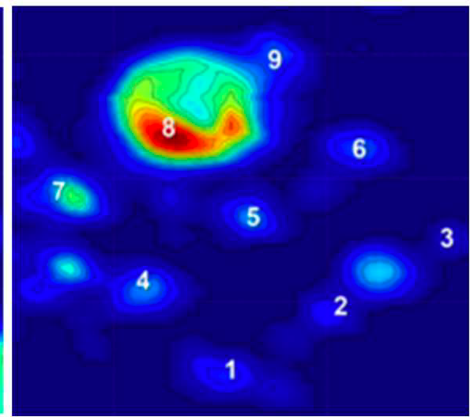
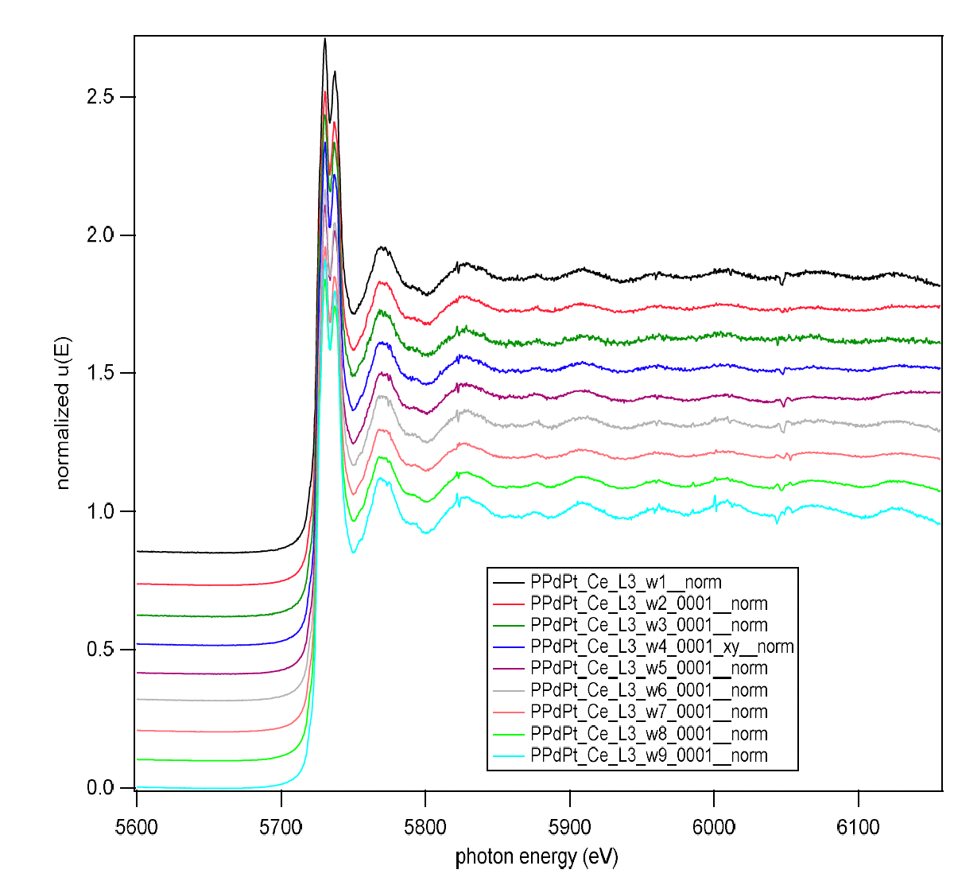
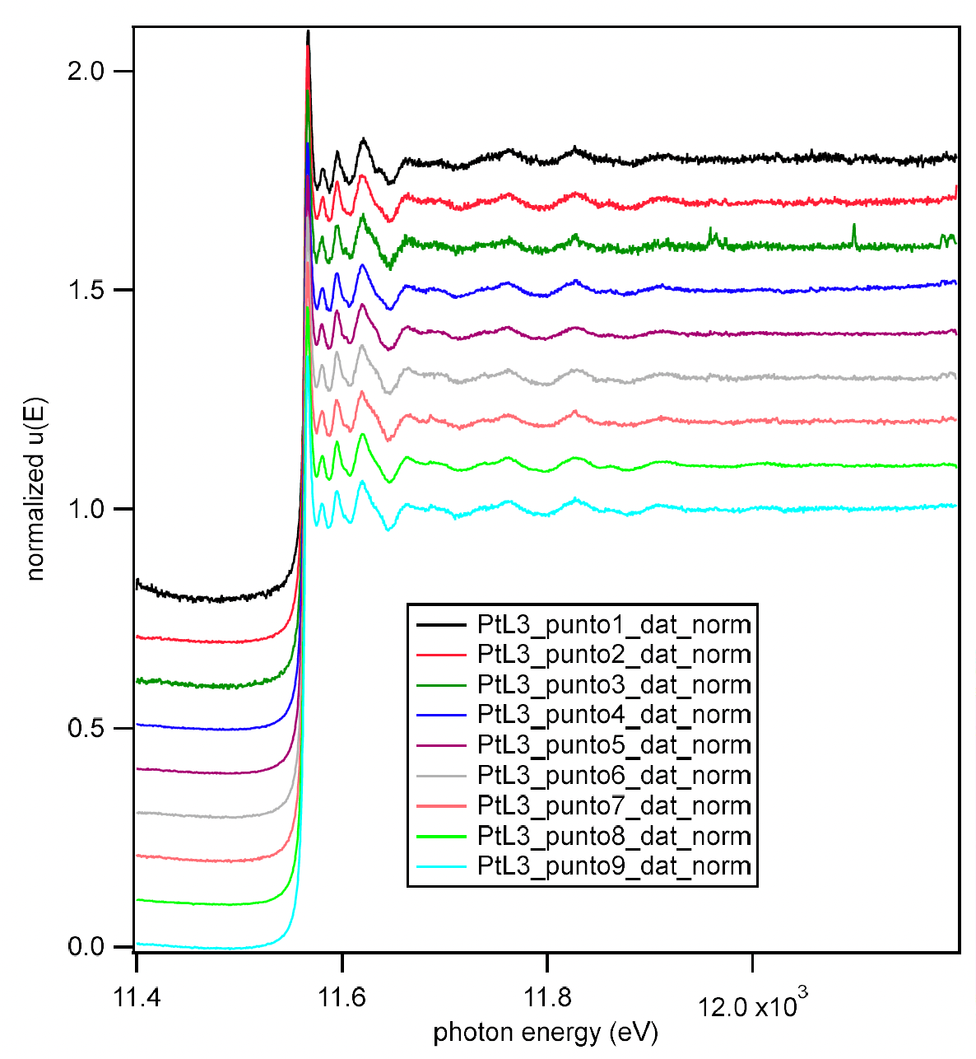
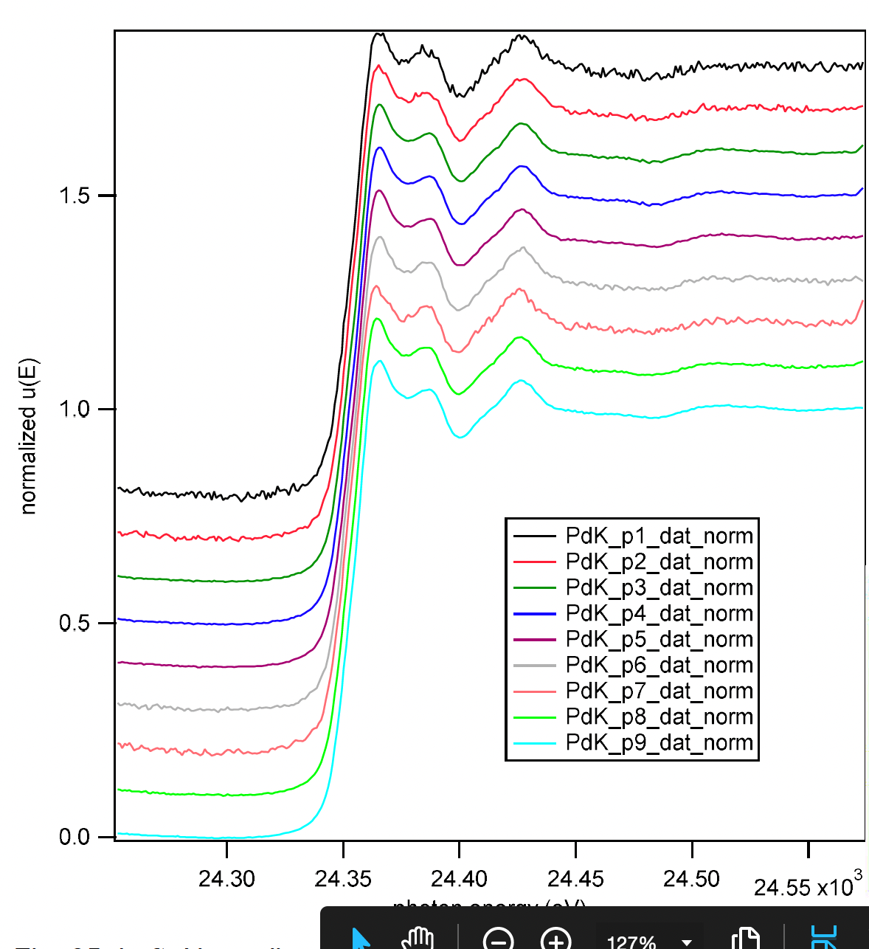
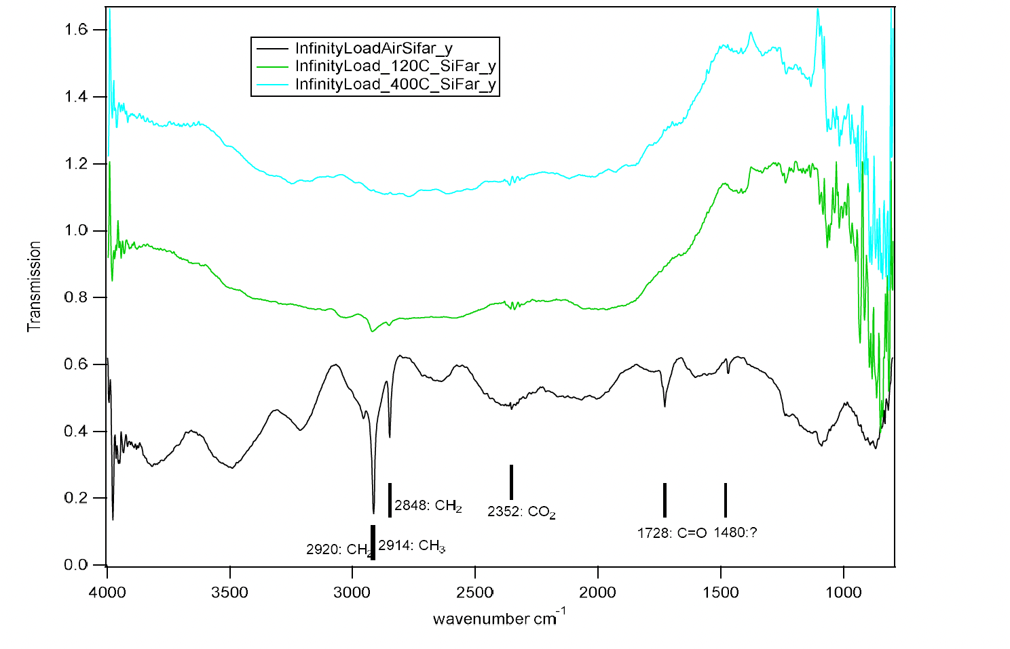
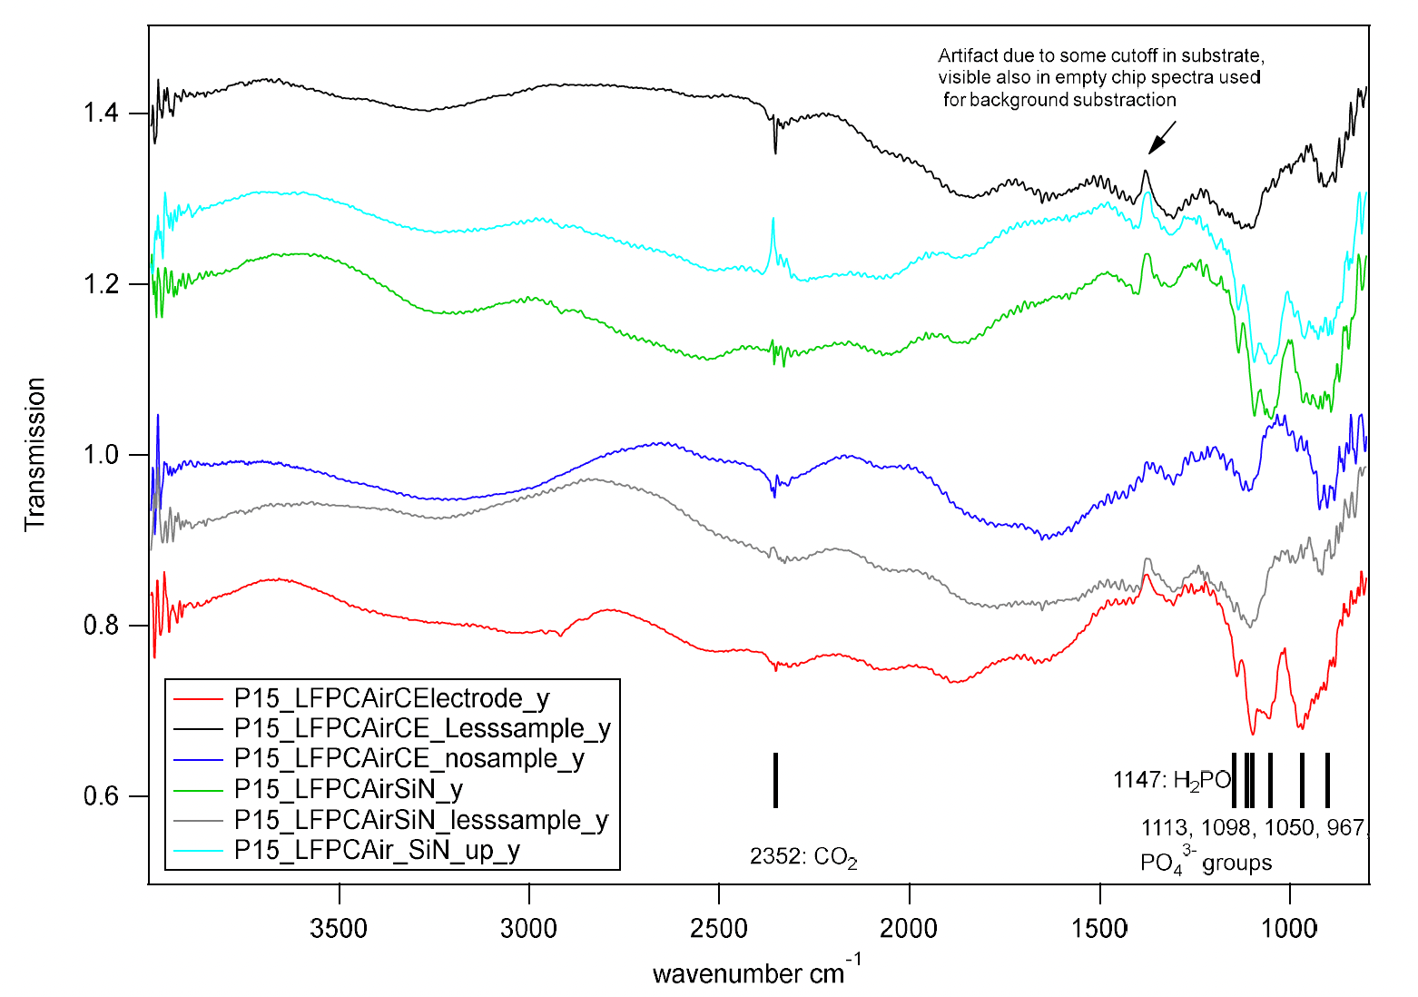
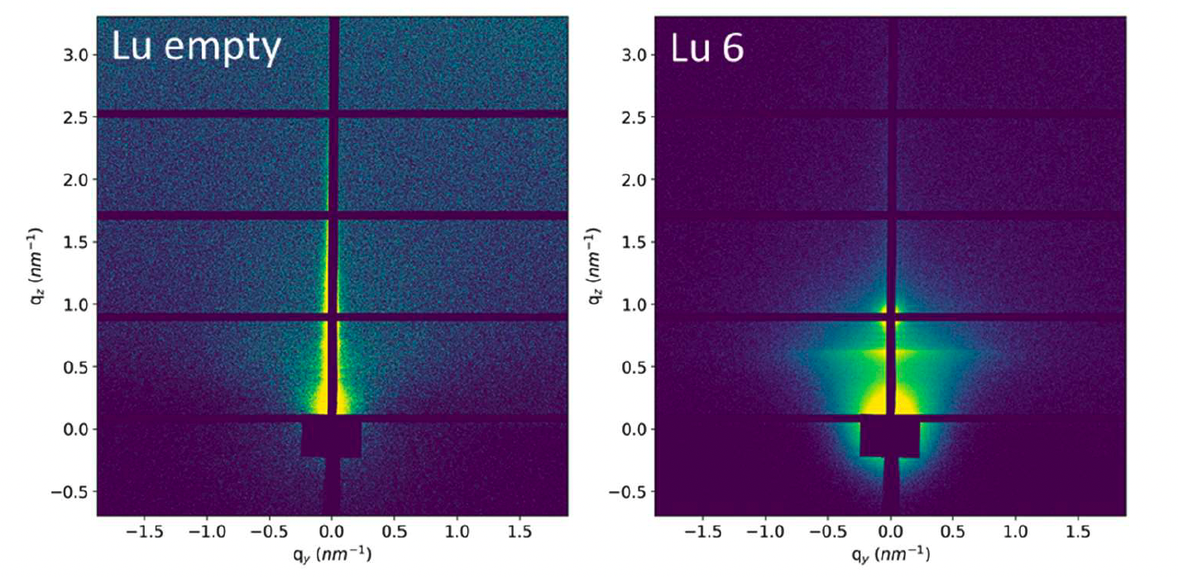
Building New Methodologies for
Multimodal and Operando:
TEM Integration into the Beamline Program
Measurements are possible for diffraction, hard X-ray spectroscopy and IR measurements with existing instrumentation and realistic beamtime requirements.
Micro focused capabilities will largely benefit this activities and make the experiments to a standard effort.
This was the first time at ALBA that 6 of the 10 beamlines have worked together with an internal and external (ALBA + ICN2 + ICMAB + UCP) collaboration on a single project.
  It was successfully proving that the measurements are possible.
  It collected important information for improving the data collection and provided data for data pipeline developments.
  Proved effectiveness of IMM section
Diffraction pattern from XALOC
Rietveld refinement
EXAFS at NOTOS
26 min
84 min
150 min
IR-spectrum of different holders (with heating)
GI-SAXS at NCD
L. Aballe and collaborators
19. January 2024
ALBA II Symposium

Slide 16
New Access Modes: Rapid Access
Criteria for rapid access:
  Urgent research projects related to a pandemic or similar threatening situation, for which data can have significant impact.
  A new emerging and fast-moving research field with high scientific or societal impact, requiring imminent response for assuring competitiveness.
  Research projects which require an access to fulfill a major milestone; examples are:
    An additional data set requested during the review process after manuscript submission.
    Concluding experiments necessary to submit a PhD thesis.
    Preliminary data for funding proposal submission.
    Sample pre-characterization for planned operando, in-situ, or multimodal experiments.
    Other experiments with minimum beam time requirements and important for a larger research project.
    Experiments enabling applied research necessary to achieve an important milestone or to enable a specific innovation in non-proprietary context.
Key question the SAC: Are criteria appropriate and is process OK (especially time lines)
19. January 2024
ALBA II Symposium

Slide 17
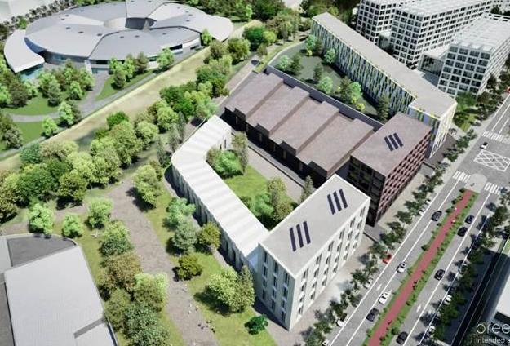
New Access modes:
Resident user:
A new mode to address complexity of operando and multimodal
This User mode will be part of the public user program (reviewed and competitive).
Developed and tested within InCAEM project.
New buildings and potential new institutes allows to host users for long stays (1-2 years) and provide them with general laboratory space.
The goals:
  mode will open more complex infrastructure to non-local user groups.
  Allows to plug ALBA’s capabilities into forefront day-to-day research challenges.
  Will fast allow to develop methodologies and tools for emergent research directions and innovation needs.
19. January 2024
ALBA II Symposium

Slide 18
Questions?
19. January 2024
ALBA II Symposium

Slide 19
The Beamline Upgrade Program:
How do we do the upgrade without impacting operation:
  Carefully planning the upgrades per beamline with minimal impact on operation by:
    Using additional ports as often as budget and resources allow.
    Increasing staff to maintain user support independent from construction resources.
    Optimizing schedule for minimum downtime.
    Ramping up other services allowing higher productivity.
    Preparing some programs to be ready already under ALBA conditions.
19. January 2024
ALBA II Symposium
19
The need of YOU as a user will be in the center of consideration

Slide 20
The Beamline Upgrade Program:
Each beamline will have 4 upgrade categories:
  Essential ALBA: These are absolute essential upgrades or the current program will face possible termination.
  Enabling ALBA: These are upgrades necessary to be state-of-the-art or to reorient the program.
  Essential ALBA II: These are absolute essential upgrades or the program cannot be executed at ALBA II.
  Enabling ALBA II: These are upgrades necessary to be state-of-the-art or to reorient the program at ALBA II.
The four categories allow dynamic and fast actions to respond to fast changing frame conditions but still allow to keep the overview on the impact of the decisions.
Process:
  Each beamline team has made at this point a bottom-up 4-step upgrade plan for the instrument.
  In a first step, the technical feasibility will be double checked by ALBA experts.
  Each section will prioritize actions under given budget constrains.
  First large picture will be presented to the community at the user meeting in September.
  A first external review most likely by SAC
  A first full beamline upgrade document will be available in about one year.
YOUR Input is needed
19. January 2024
ALBA II Symposium
20

