Slide 1




New beamlines at ALBA 2
Josep Nicolas
19th January 2024

Slide 2
Low emittance storage ring
The main accelerator of ALBA-II is a low emittance storage ring
(i.e. the same flux in a smaller and more collimated source).
ALBA
ALBA-II

Slide 3
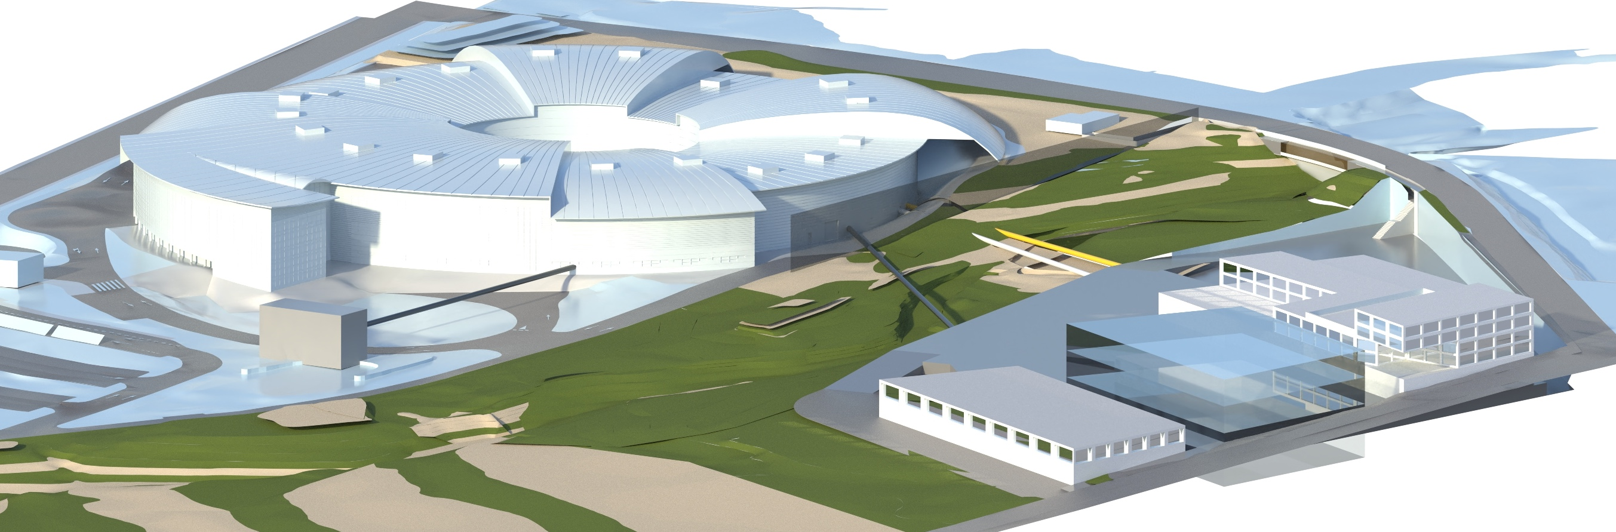
Long beamlines
ALBA main building
- A new low emittance SR
- Upgraded BLs
- New BLs
- …
ALBA-II extension
- New BL (Long)
- New Laboratories

Slide 4
Beamline map of ALBA-II (day 1)
30) BM (3.2T)
Faxtor
Boreas
32) BM (3.2T)
IDs
28) BM (3.2T)
31
MSPD*
Xanadu
BL08
BMs
29
34
Miras
New
BL32
1
CORUS
Minerva
CODI
BL30
Circe
3SBar
BL28
25
24
MSPD
BL23
13 IDs = 9+3+1
CoDI
23) BM (1T)
12 BMs=4+1+7
5) BM (1T)
CLAESS
BL14
CLAESS
03) BM(3.2T) (150-260 m)
22
Boreas
BL05
6
Xaira
Circe
BL03
New
Lorea
20
Upgrades
20
Lorea
Calima
Calima
Xaira
Miras
11
9
16
Mistral
NCD
Mistral
Corus
Upgrades
Notos
13
3SBar
NCD-sweet
Xaloc
Notos
14) BM (1T)
Xaloc
8) ID (108-120 m)
Faxtor
Minerva

Slide 5
4 new BLs when ALBA-II opens
3SBar
High pressure HEXPES+Surf.Diffraction
Calima
BioSAXS beamline
CoDI
Coherent Diffraction and Nanoprobe for Material Sciences
Corus
Nanoimaging and nanoSpectroscopy for life sciences
CoDI
Calima
Corus
3SBar

Slide 6
How BLs have been chosen
All four beamlines have been proposed by ALBA’s user community.
The selection process has been assisted by international reviewers + SAC.
2021-2022 Selection of new normal length beamlines (3SBar, Calima)
2022-2023 Selection of long beamlines (CoDI, Corus)

Slide 7
Timeline (work in progress)
Design + prototyping
Procurement
Installation
If funding is secured soon
3sbar
CODI
CORUS
Upg-MSPD
Calima

Slide 8
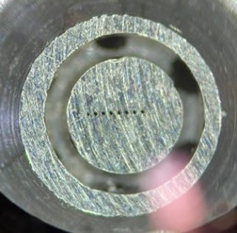
3SBar
“Surface Structure and Spectroscopy at 1 bar”
3SBar will combine X-ray Photoemission Spectroscopy (XPS) at Ambient (1 bar) Pressure (AP-XPS) and surface X-ray diffraction (SXRD) at grazing incidence angles.
analyzer nozzle
Incoming gas
Diffracted beam, to Detector,
SXRD
Incoming x-ray beam
e-
Sample
The nozzle and its gap to sample must be small, to allow for high pressures atmosphere on sample preserving the vacuum on the analyzer.
A smaller source allows for a smaller spot on sample, the higher brilliance allows doing this without spoiling the coherence length for diffraction.

Slide 9
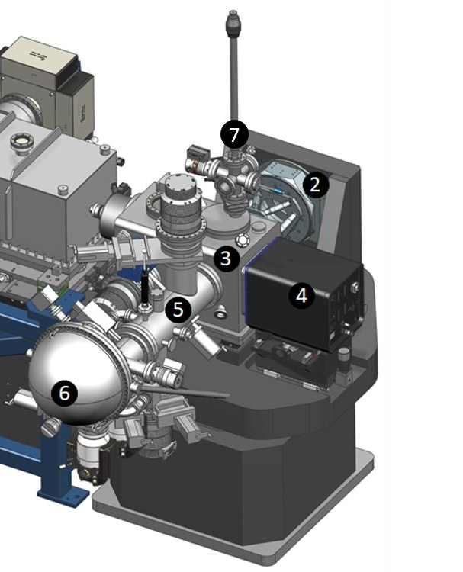
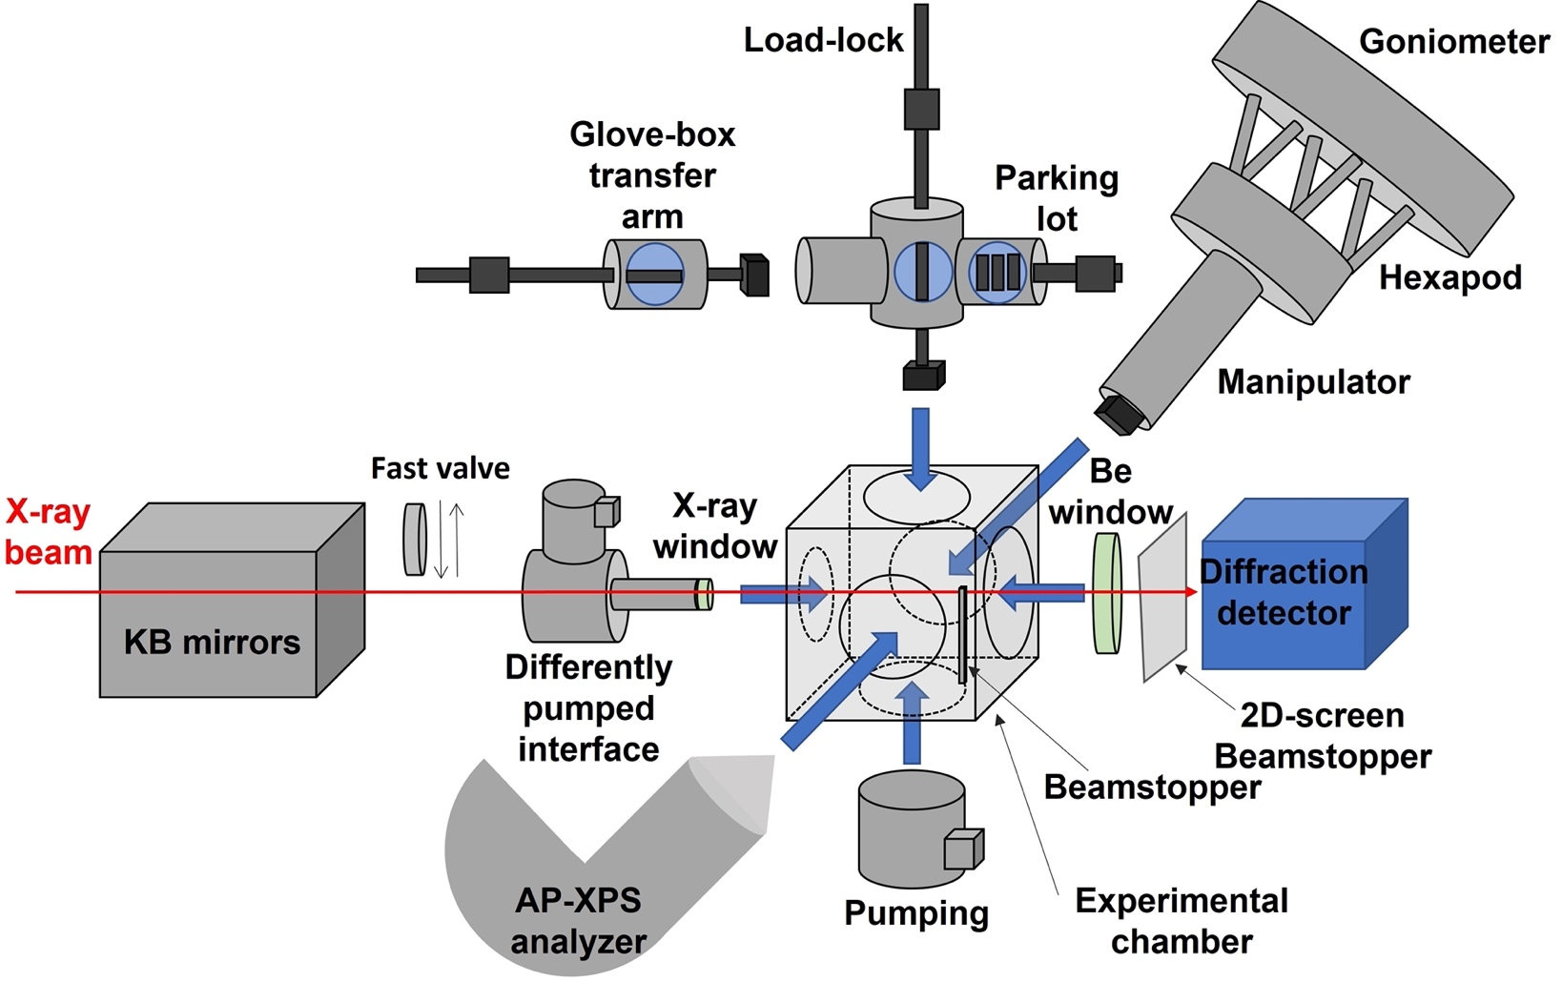
3sbar endstation
Load Lock
Sample manipulator
Sample Chamber
X-ray detector
Differential pumping analyzer
XPS analyzer
Support and motion system(s)
Features and discussion topics
Sample plates / Membrane cells / Electrochemical cells
Gas dosing on chamber / virtual cell / membranes
APXPS nozzle exchangeable
Gas safety
Alignment motions and control
Chamber geometry, Be-Window

Slide 10
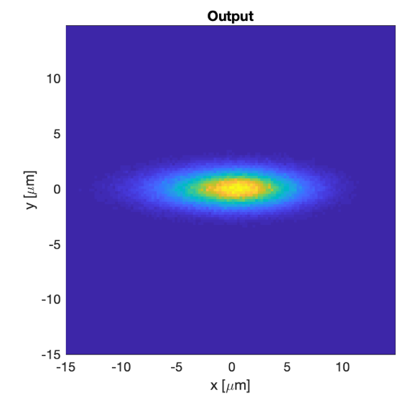
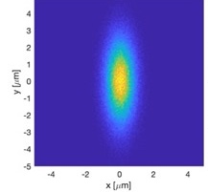
Beamline performance (ALBA)
Parameter | Value | Remark
Photon Energy | 3-17 keV | In vacuum undulator
Flux at 5 keV | 7.13x10¹² ph/s | Si(311) B4C
Resolution at 5 keV | 126 meV | Si(311)
Spectral Flux at 5 keV | 2.86 x10¹⁴ ph/s@0.1%BW | Si(311) B4C
Spot size on sample | 8.6 x 2.4 µm² fwhm
Divergence on Sample | 1.56 x 0.35 mrad² fwhm
Focus Depth | 10.0 mm / 18.8 mm | Rayleigh length

Slide 11
Beamline performance (ALBA-II)
Parameter | Value | Remark
Photon Energy | 3-17 keV | In vacuum undulator
Flux at 5 keV | 1.76x10¹³ ph/s | Si(311) B4C
Resolution at 5 keV | 128 meV | Si(311)
Spectral Flux at 5 keV | 6.91 x10¹⁴ ph/s@0.1%BW | Si(311) B4C
Spot size on sample | 1.27 x 3.66 µm² fwhm
Divergence on Sample | 0.76 x 0.30 mrad² fwhm
Focus Depth | 3.14 mm H / 21.57 mm V | Rayleigh length

Slide 12
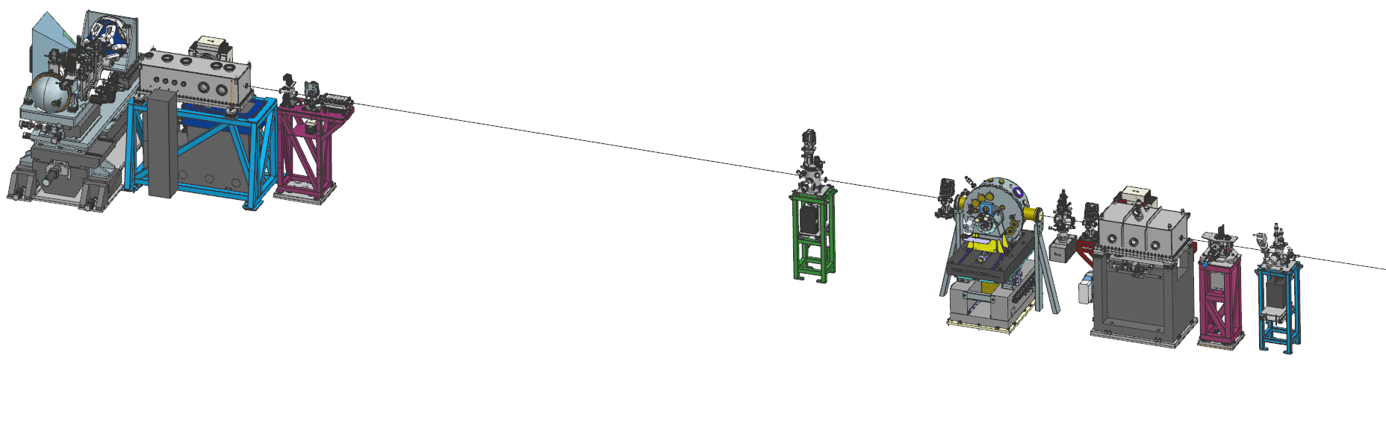
3SBar beamline project
The beamline project started March ’22
All concept designs finished and reviewed.
All major contracts already in place (ID, FE, Optics, Hutches, Detectors,…)
Detailed mechanical of endstation (+ others) in progress.
Infrastructure installation starts in summer’24
Installation instrumentation starts in spring‘25
Commissioning early ‘26
Endstation
Refocusing KB
Shutter
Double crystal Mono
Collimating mirror

Slide 13
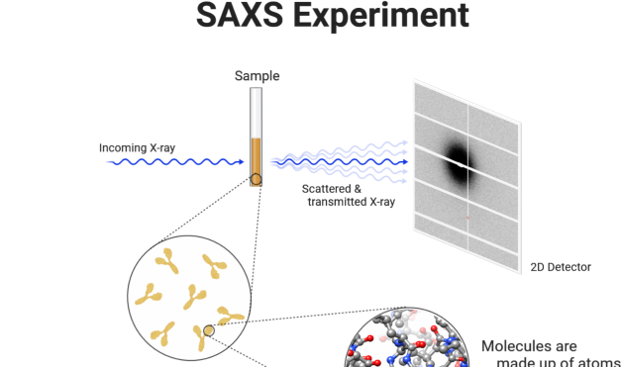
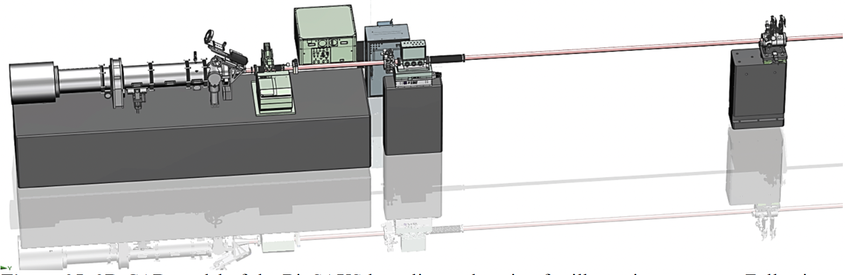
Calima
Calima is a BioSAXS beamline for ALBA for low-resolution structural analysis of samples in solution. Complementary to high-resolution crystallography BLs
SAXS
detector
WAXS
detector
Sample position
Microfocus unit (CRLs)
Sec. Source Slits
(microfocus mode)
Sample mounting robot
The orientation of BMs beamlines, like Calima, will change in the new SR
Calima will be oriented following the layout of ALBA-II, and will not operate before the dark period.

Slide 14
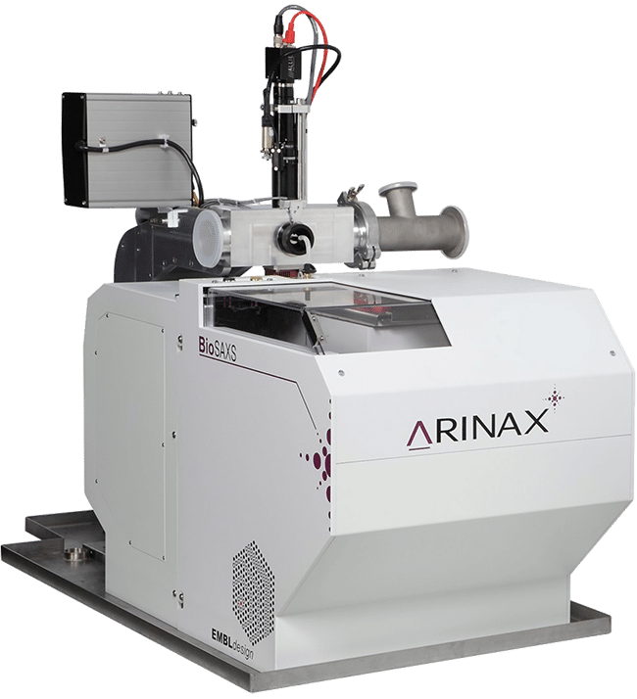
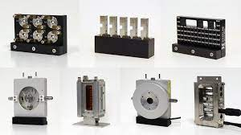
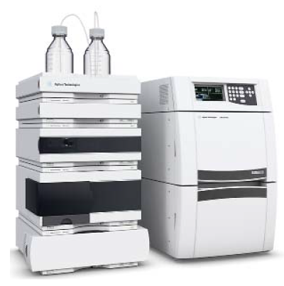
Calima Endstation Features
Sample mounting robot (HT-SAXS
Sample holders:
  Capillaries (solution), gels/solid (polymer slice, tissues, pellet), liquids/gels holder, high pressure cell (pressure induce preparation of super crystals) and shear aligning cell (fibre diffraction).
  Temperature-controlled flow cell will be placed in a vacuum chamber.
  Stopped-flow cell
  Novel continuous flow cell for TR-SAXS designed in collaboration with Dr. Ros
  Other cells will also be considered: rheometer, traction cell.
HPLC system for a variety of EC and IEC columns
Laser for photo-activation

Slide 15
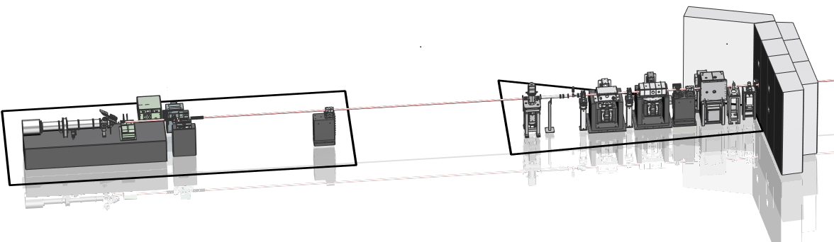
Calima optics
 | ALBA (BM) | ALBA-II (superbend)
Standard mode (focus at detector)
Spot at sample position | 532×520 um² 176×198 urad² | 532×590 um² 175×175 urad²
Spot at detector position | 174×76 um² | 23×58 um²
Microfocus mode (focus at sample)
Spot at sample position | 37×15 um² 425×403 urad² | 5.3×11 um² 428×425 urad²
Spot at detector position | 1.30×1.24 mm² | 1.30×1.28 mm²
The source is a BM
ML monochromator
KB for standard focus
CRL transfocator for microfocus
31

Slide 16
CoDI and Corus
CoDI and Corus are both very long beamlines, hard x-ray, devoted to imaging techniques and nano-probe techniques, with a enough space around the sample
Main building
Far Experimental Hall
BL02-CODI
BL03
BL04-CORUS
Stream course
(not usable)

Slide 17
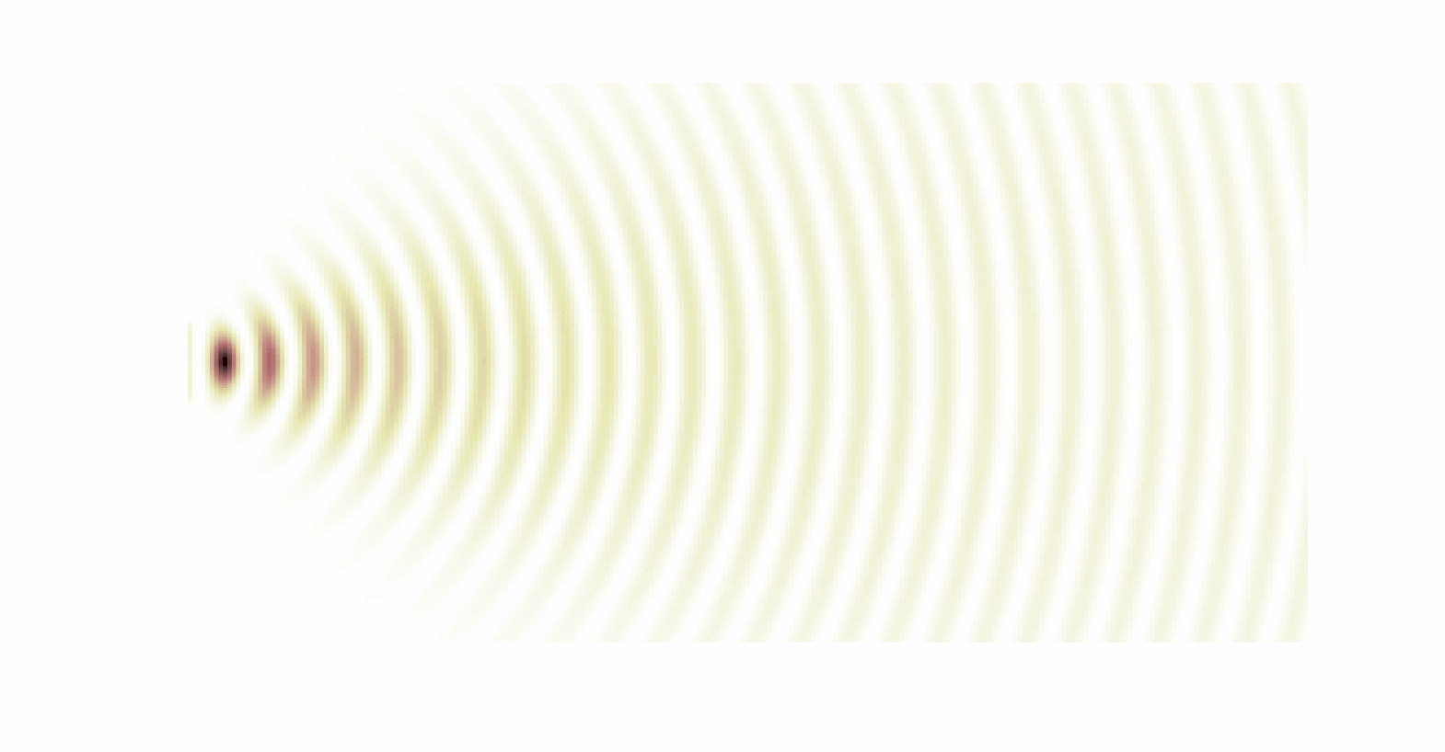
Imaging techniques
“An x-ray beam propagates as a wave: if we can record the amplitude and phase of an expanded wavefront we can numerically backpropagate it to a plane (the sample) where it is sensitive to much smaller features, resulting to effective magnification.”
Wave: Lack of coherence hides the wave behavior of the x-ray beam.
Detectors do not measure the phase of the wavefront. We need to use techniques like Holography, Interferometry, Ptychography, CDI,….
Determining the phase, with sufficient quality, using numerical methods often requires heavy computation.

Slide 18





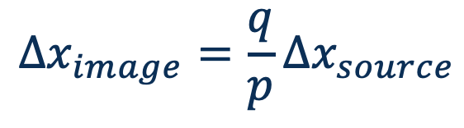
Nanoprobes
Long beamlines allow having large source demagnification preserving a “large” distance around the sample
$$Δx_{source}$$
Source
$$p$$
$$q$$
$$Δx_{image}$$
sample
$$Δx_{image}=\frac{q}{p}Δx_{source}$$
Optical
element
Optical elements could be:
KB mirrors, capillaries (mirrors), Fresnel zone plates, CRLs, Kinoforms,

Slide 19
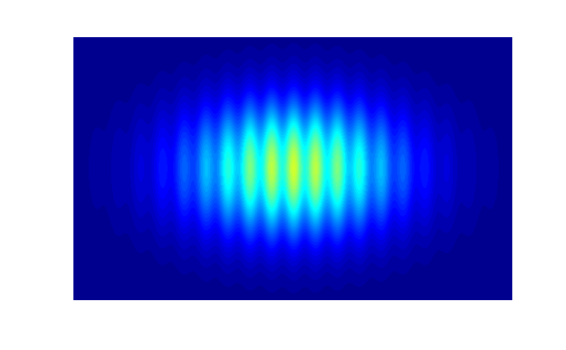
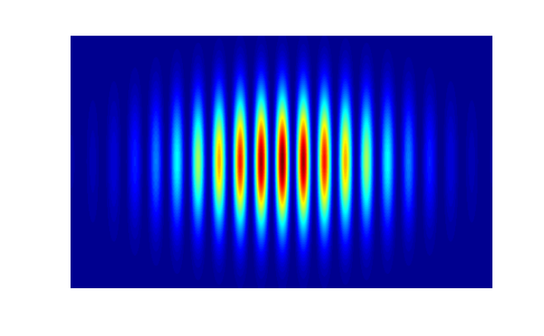

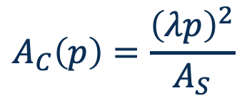


Enhanced coherence for hard x-rays
$$A_{C}\left(p\right)=\frac{{\left(λp\right)}^{2}}{A_{S}}$$
Correlation length increases with distance
J. Goodman “statistical optics” Ch. 5
Pinhole
$$A≤A_{C}$$
$A_{S}$ area
Coherence based experiment
Incoherent Source
$$p$$
Coherent Source
Most basic example: Young’s Double slit interference
Low coherence
High coherence

Slide 20
BL02-CoDI: Optical layout
Side view
DCM
VXS
SLIT2
Sample
VFM
M1 (mcyl)
HFM
IVU19
M2 (scyl)
40.3
230.17
19.5
19.8
40.0
230
230.4
Top view
2.5 mrad
2.5 mrad
HXS
3.2 mrad
17.541
42.560
134
5.5 mrad
249
Tunel
Exp. Hall
Far Exp. Hall
Source
Focusing optics and monochromator
Secondary source
(Stability, spot size tuning)
Refocusing optics and end-station
Their limit acceptance (tunable) enhances coherence

Slide 21
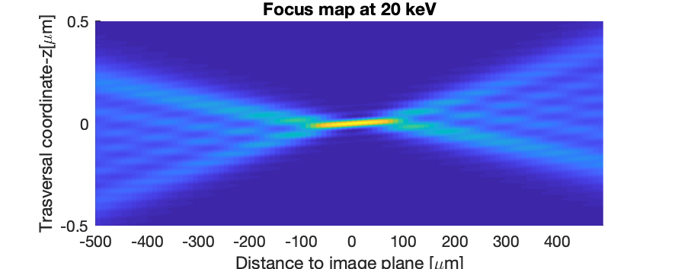
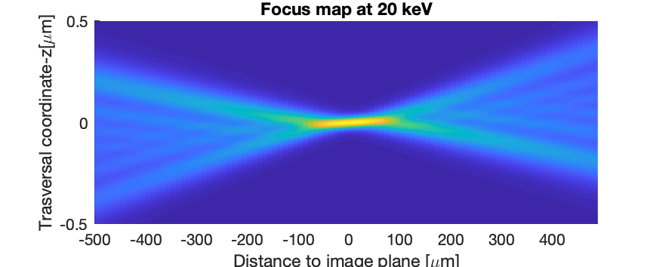
BL02-CoDI: Spot size and coherence
VFM
HFM
343.55
Diffraction Limit......: 31.62 nm fwhm
Spot size..................: 48.58 nm fwhm
Divergence..............: 1.51 mrad fwhm
105
150
177
255
Transversal coherence v flux depending on secondary source

Slide 22
BL02-CoDI
Hard X-ray nanoprobe beamline devoted to Coherent Diffraction Imaging techniques, for in-operando studies in material science.
 | CoDI
Source | In vacuum undulator (IVU19)
Energy Range | 10 - 30 keV (DCM + MLM)
Spot Size | 30-50 nm
Technique | nanoDiffraction, nanoFluorescence, CDI, Ptychography, Holo-tomography, Bragg-ptychography, Tele-ptychography
Features | 20 m flight tube Laser Heating, High Pressure, Gas dosing, Cryostream, Cryostat… (space around sample for versatile sample environment)
Sample | Micro reactors / Electro chemistry cells for in-situ and operando
Detector | One large area detector (6M type) One small detector mounted on robot arm Multielement SDD
3D reconstruction and Evolution of strain in a Pt nanoparticle as varying electrode potential. Useful for the design of strain-engineered nano-catalysts
From C. Atlan, et al. Nat. Mater. 23, (2023). https://doi.org/10.1038/s41563-023-01528-x

Slide 23
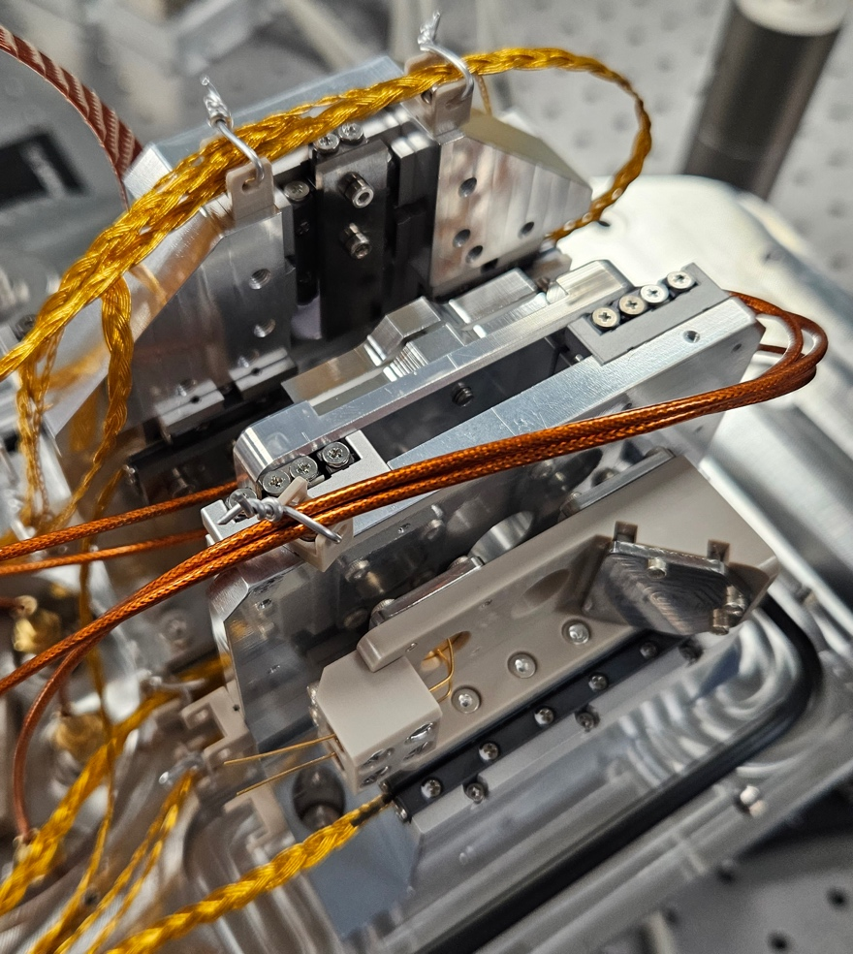
Endstation (CoDI)
Endstations for CoDI include
- Sample positioning (hexapods, scanners)
- Detectors (Pixel detectors, Fluorescence, Izero)
- Sample environment (gases, cryogenics…)
Detector robot
KB-mirror pair
Sample manipulator
Fly-tube
Detector
Plinth
Lightweight, speed and compactness are required.
Watchmaker mechanics.
Up to 20 m

Slide 24
BL04-Corus
Hard X-ray nanoprobe beamline devoted to spectral Imaging and tomography for life sciences.
 | Corus
Source | In vacuum undulator (IVU19)
Energy Range | 10 - 27 keV (DCM + MLM)
Spot Size | 20-50 nm
Technique | 3D-nanoXRF, XANES (STXM) Holo-tomography (Full Field)
Features | LN2 cryogenics, 180º Rotation, XY mapping UHV, Visible microscope
Sample | Multi-sample shuttle system
Detector | Nanospec:: Two Multielement SDD, Diode NanoImag: Two Multielement SDD, sCMOS Area detector.
Determination of intra-cellular location of Ir in breast cancer cells. Imaging at nm-resolution with chemical sensitivity.
From Conesa et al. Angew Chem Int Ed Engl 2020, 59 (3), 1270-1278. DOI:10.1002/anie.201911510.

Slide 25
BL04-CORUS: Optical layout
Side View
M1 (mcyl)
IVU19
M2 (scyl)
VFM
MLM
VXS
HFM
Sample
21
41.5
275
19.5
19.8
41.8
275.17
275.4
Top view
HXS
nanoImag
2deg
nanoSpec
DCM
17.541
42.560
173
292
HXS
Tunel
Exp. Hall
Far Exp. Hall
Source
Focusing optics and monochromator
Secondary source
Refocusing optics and end-station

Slide 26
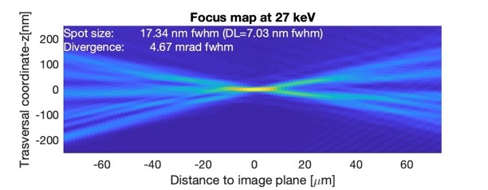
Corus nanoImag Optics
The intended nanoprobes represent a challenge, first in optics
VFM
HFM
Spot size <25 nm fwhm
Limited by figure error
Depth of focus < 10 µm
Distance to sample <40 mm
202.5
122.5
80
80
40
165
120
plano-elliptic mirrors
Graded multilayer coating
R_{min} ~ 10 m
Length >80 mm
Figure Errors < 1 nm, < 50 nrad
Transversal acceptance < 1 mm²

Slide 27
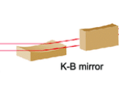
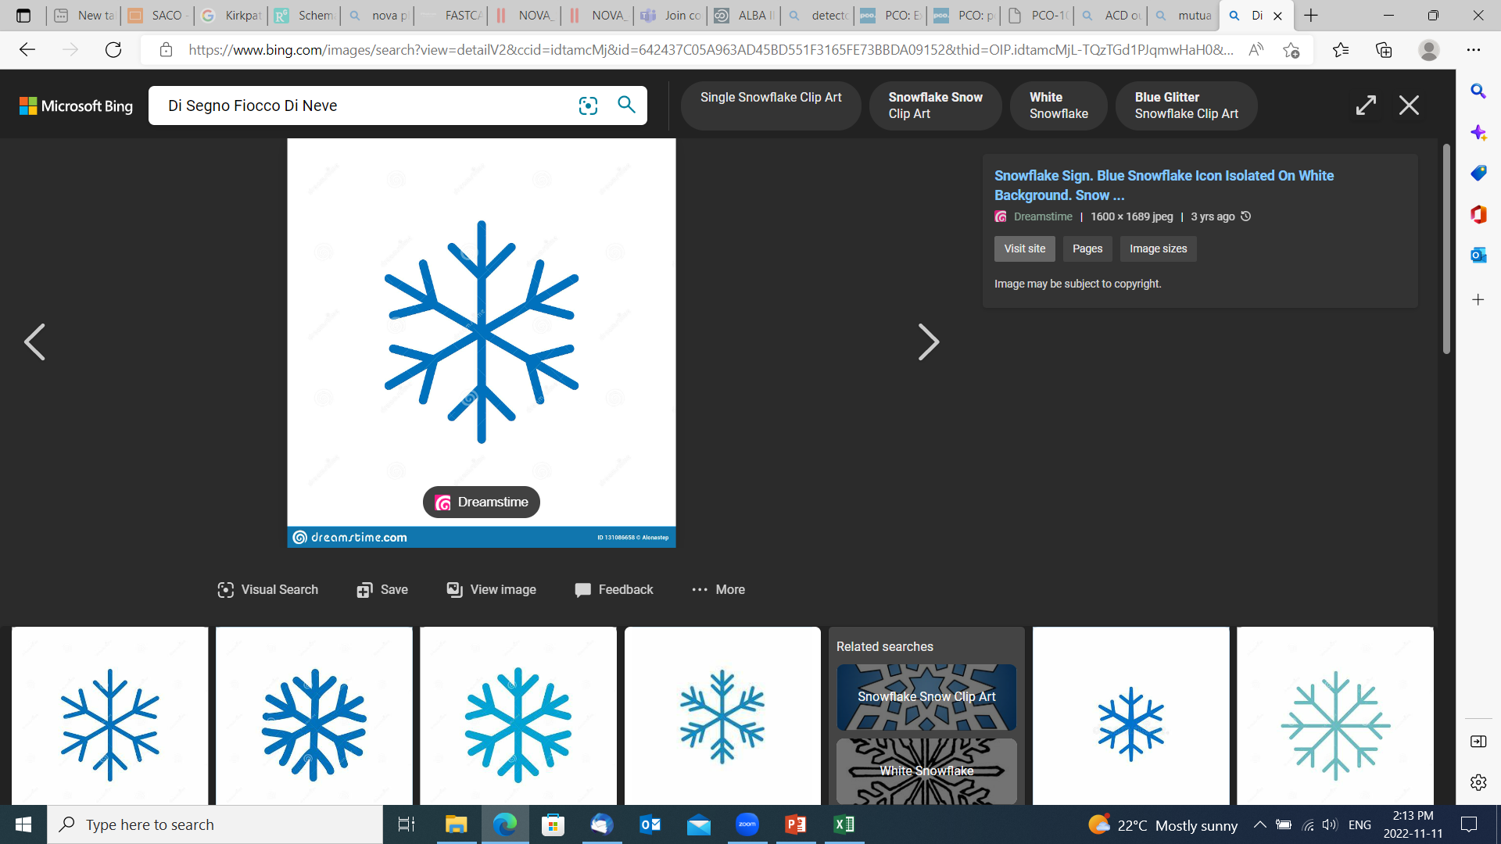
Corus Endstations
CORUS nanoImag
CORUS nanoSpec
Sample positions
Detector
XRF detector
Detector
XRF detector
XRF detector
XRF detector
Sample
Sample
KB mirrors
KB mirrors
Cryogenic stage temperature
Cryogenic stage temperature

Slide 28
Timeline (work in progress)
If funding is secured soon

Slide 29
Many challenges ahead
Nanometer stability
Nanometer positioning accuracy
Vibration isolation (traffic+pumps+…)
Drift compensation along 200 m
Temperature, humidity stability
Feedback positioning systems
Nanometer resolution
Nanometer guidance errors
Fast actuators
∆T = 0.006 ºC in 12 h
Runout
±32 nm

Slide 30
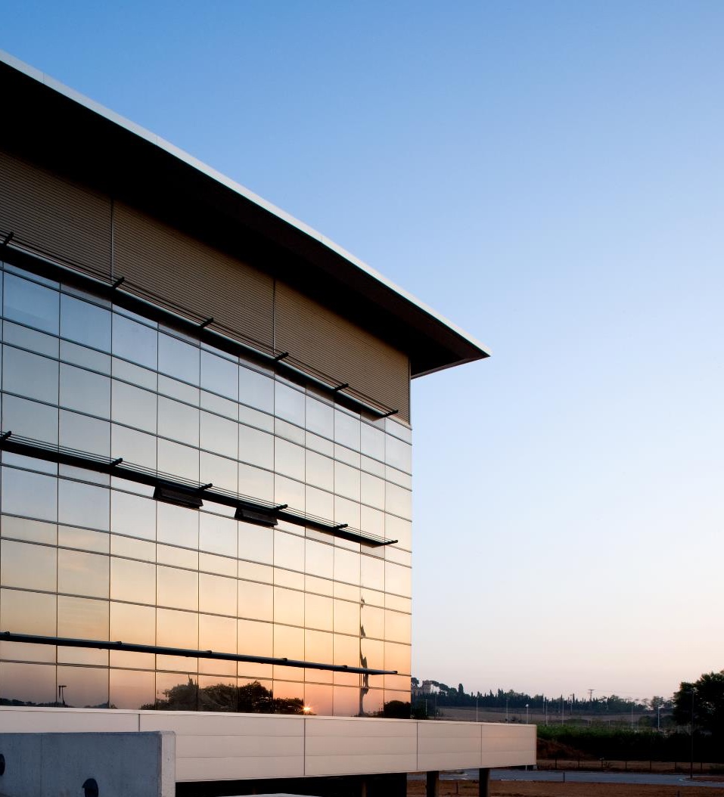
Thanks!

