Slide 1

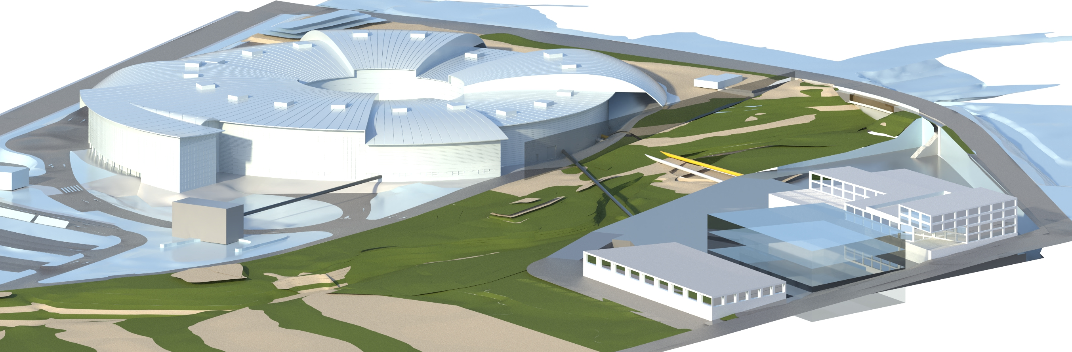
ALBA II Status and Perspectives
Caterina Biscari
ALBA II Symposium
Madrid - 19 January 2024

Slide 2
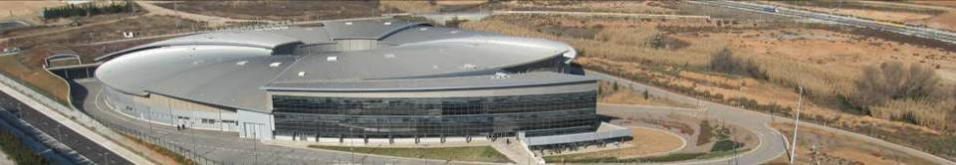


ALBA Synchrotron Radiation Facility
National public institution with 50% national + 50% regional funding: Consortium owned by Ministerio de Ciencia, Innovación y Universidades and Department de Recerca i Universitats
National and international (28%) staff
National and international (40%) users
National and international collaborations

Slide 3
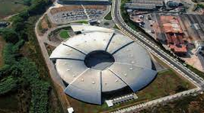
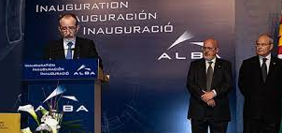
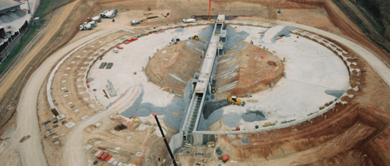
ALBA and ALBA II
2003 – Creation of CELLS Consortium (Spanish Government and regional Catalan Government), and agreement on facility funding for the period 2003 to 2022
2023 – Addendum for 2023 funding
Now: negotiating agreement on facility funding for the period 2024-2038
2003 ALBA Approval
2012 Starting ALBA Operation
2020
Starting ALBA II design
2024
ALBA II Approval
2032
ALBA II Operation
2006
Starting ALBA construction

Slide 4
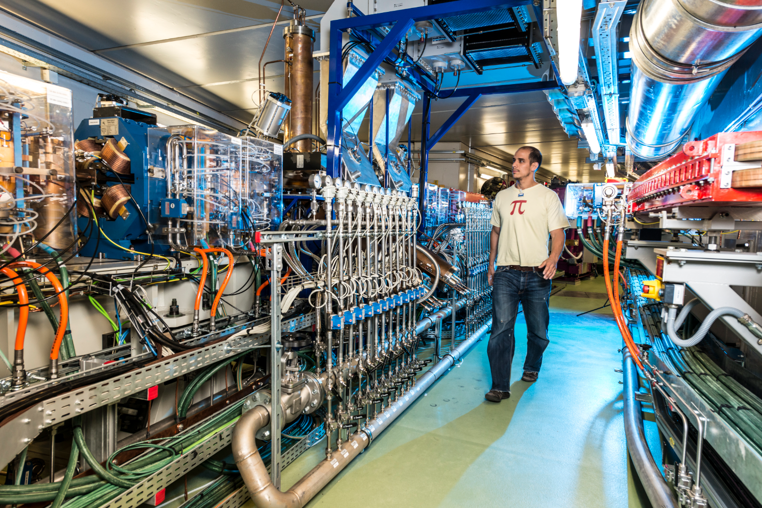
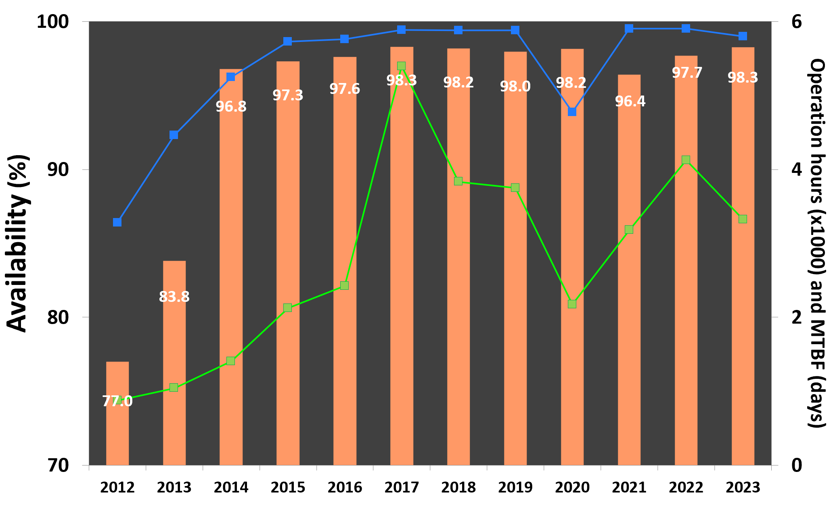
Storage ring : 269 m circunference
3 GeV electrons, 250 mA, 4.4 nmrad emittance

Slide 5
ALBA beamlines: past and future
Phase I BLs:
MISTRAL: Soft X ray tomography
XALOC: MX
CIRCE: PEEM and NAPP
BOREAS: resonant absorption
MSPD: HR and HP Powder Diffraction
NCD: SAXS-WAXS
CLAESS: Absorption/emission spectroscopy
2003 ALBA Approval
2014
Phase III BLs
2021
ALBA II short BLs
2023
ALBA II Long BLs
2011
Phase II BLs
Phase II BLs:
MIRAS: IR spectroscopy and microscopy
LOREA: ARPES
Phase III BLs:
NOTOS: Absorption, Diffraction
XAIRA: Microfocus MX
FAXTOR: Hard X-ray Tomography
ALBA II short BLs:
3Sbar: Surface Spectroscopy and Structure at 1 bar
CALIMA: BioSAXS
2005
Phase I BLs
ALBA II Long BLs:
CODI: coherent diffraction and imaging
CORUS: nanospectroscopy and imaging

Slide 6
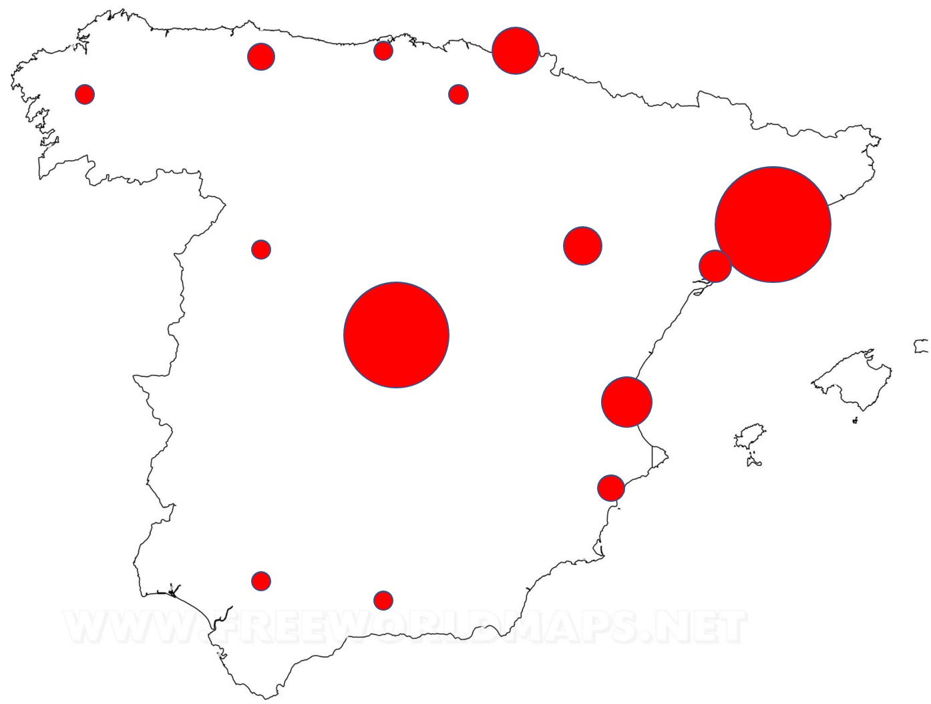
ALBA beamlines: past and future
All processes for decision on Beamlines technology and scientific fields have relied on the fruitful collaboration of the whole user community
One Beamline (on a dipole port) has been agreed with ESA, which has participated in its funding
2003 ALBA Approval
2014
Phase III BLs
2021
ALBA II short BLs
2023
ALBA II Long BLs
2011
Phase II BLs
Proposals for ALBA II BLs
98 Proposers from Spain
+ 13 from Germany, UK, France, Portugal, Sweden, Switzerland, USA
2005
Phase I BLs

Slide 7
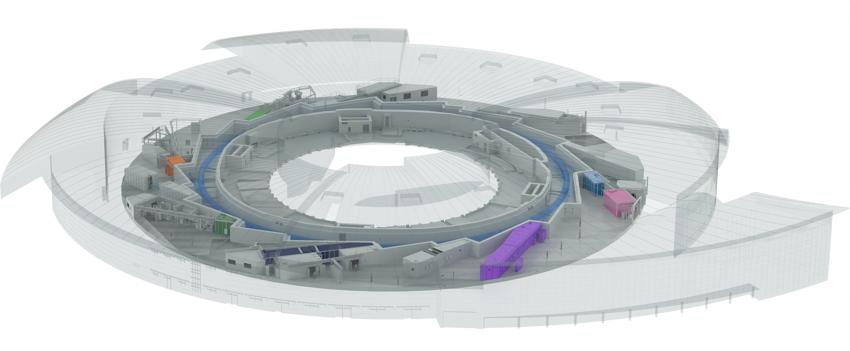
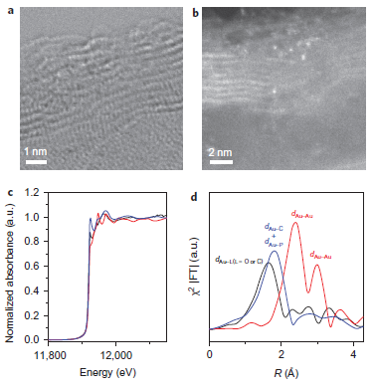
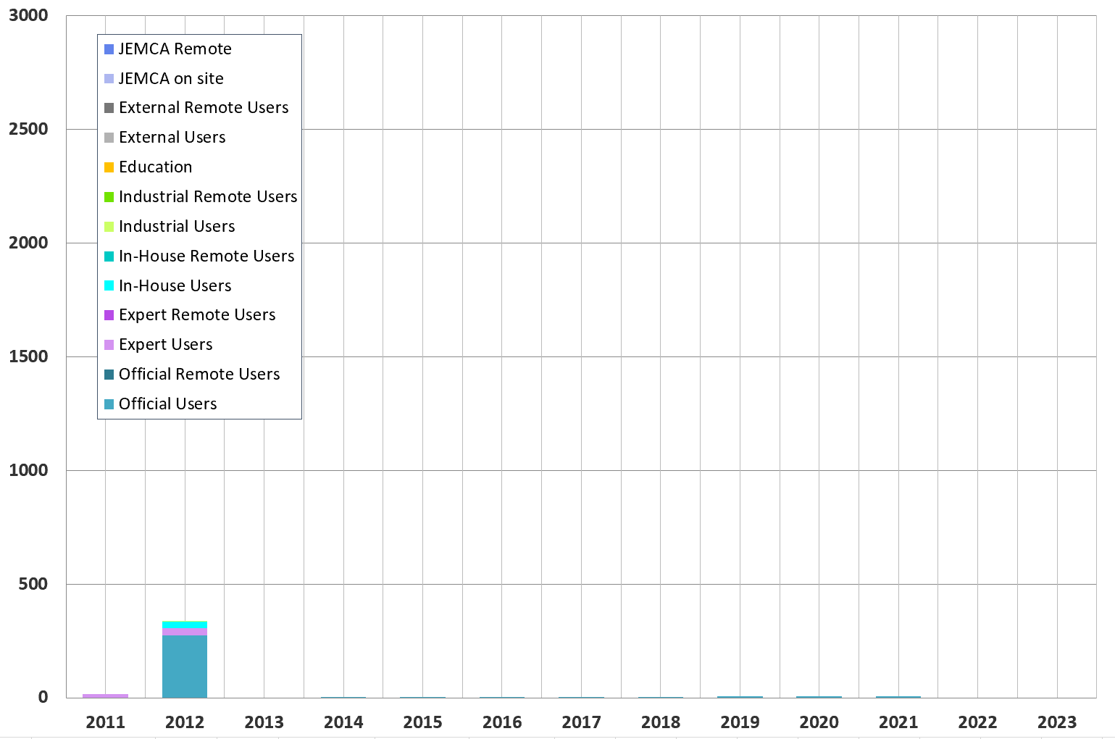
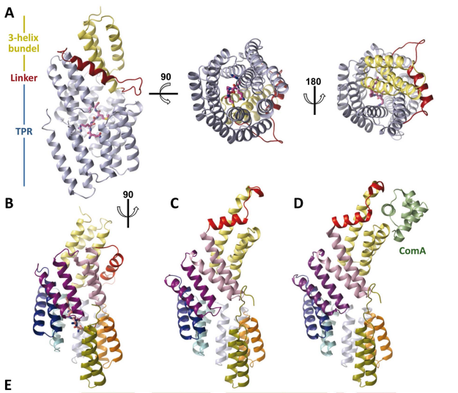
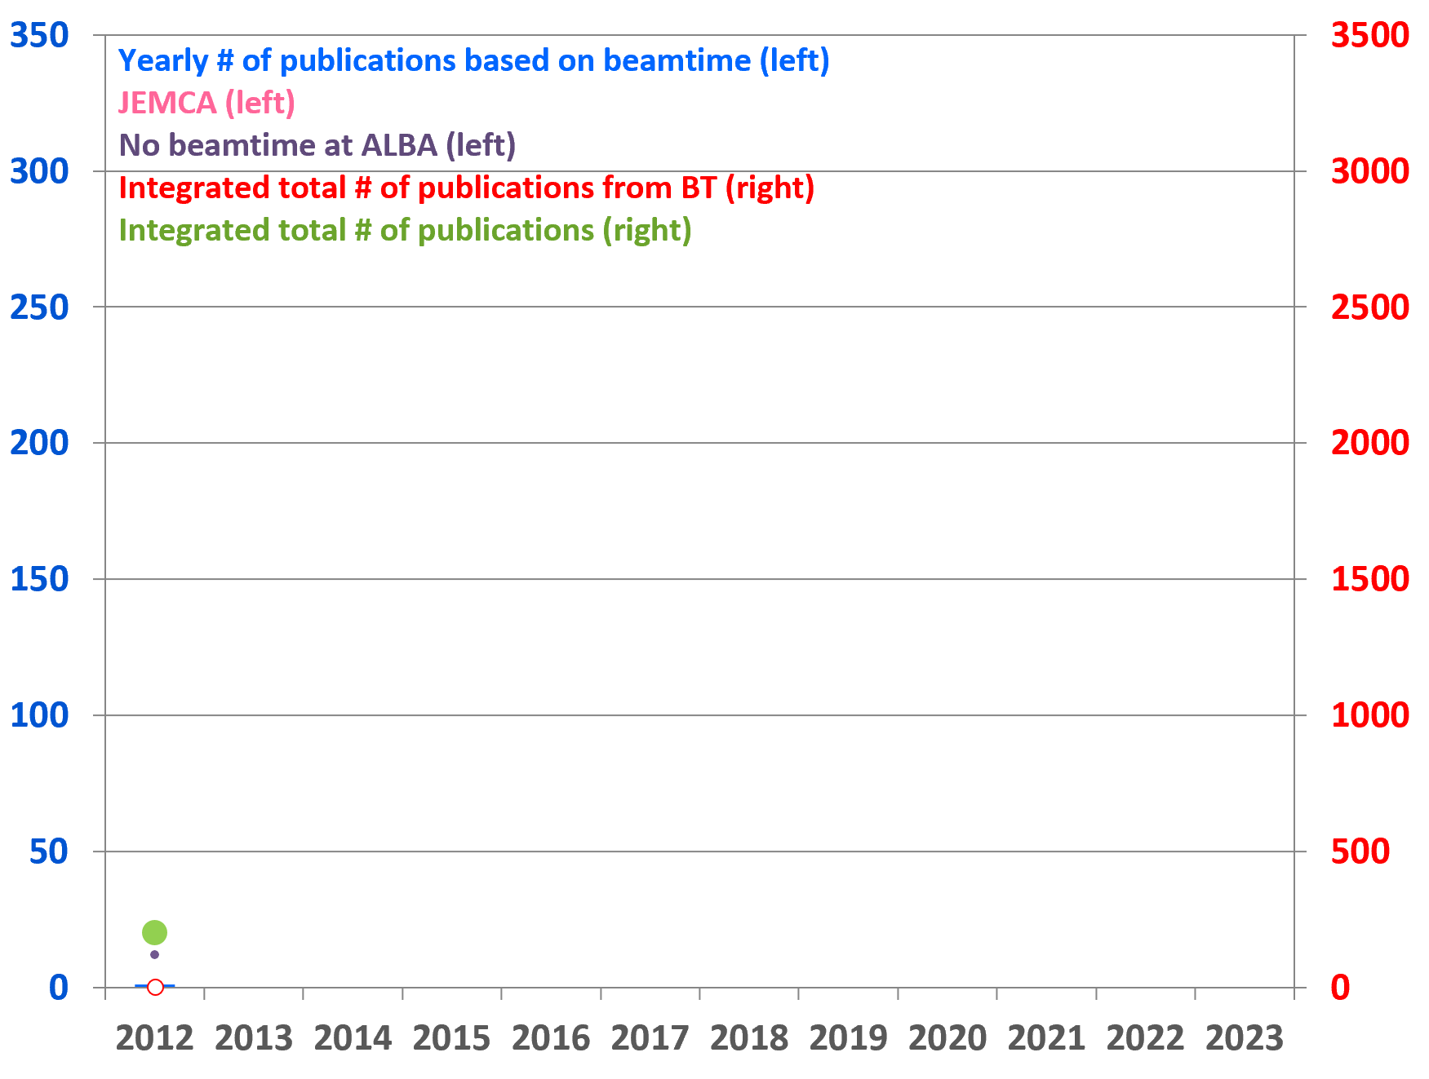
ALBA 2012
Instruments for life science
BOREAS
Instruments for material science
Instruments for metrology
CIRCE
CLAESS
MSPD
MISTRAL
User visits
XALOC
NCD-SWEET
Publications
F.Gallego et al, PLoS Biol 11(3): e1001511. doi:10.1371/ journal.pbio.1001511
A.Corma et al, Nature Chemistry
DOI: 10.1038/NCHEM.1721

Slide 8
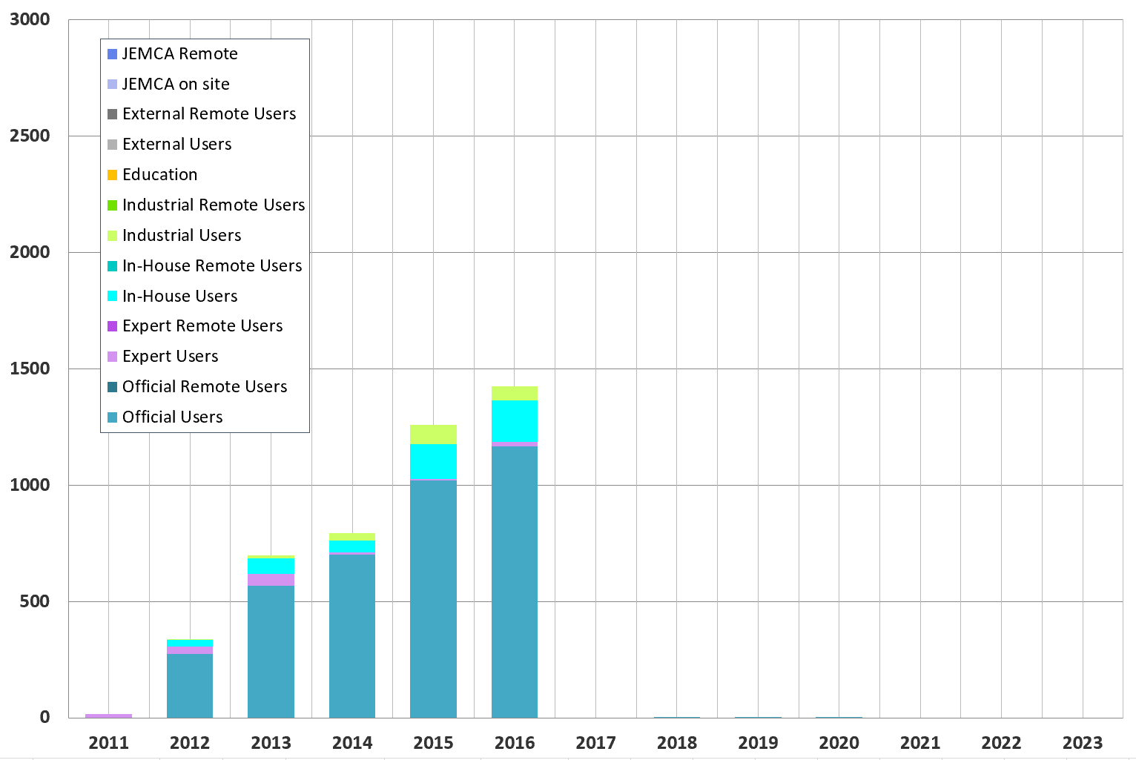
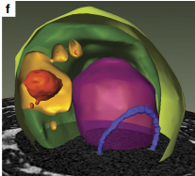
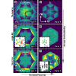
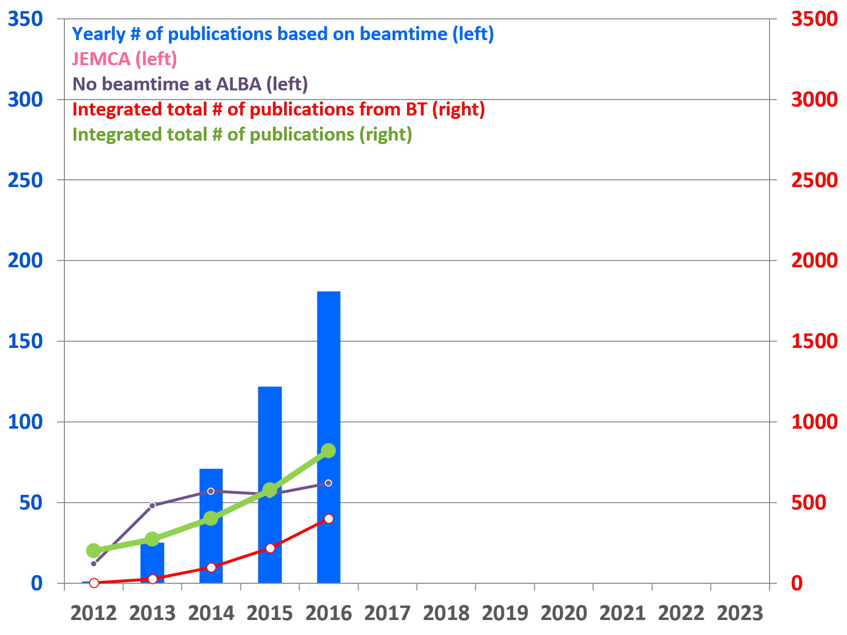
ALBA 2016
Instruments for life science
BOREAS
Instruments for material science
MIRAS
Instruments for metrology
CIRCE
CLAESS
MSPD
MISTRAL
User visits
XALOC
NCD-SWEET
Publications
F.Sviben et al. Nature Communication: doi:10.1371/ journal.pbio.1001511
P.Sessi et al, Phys. Rev. B 94, 075137

Slide 9
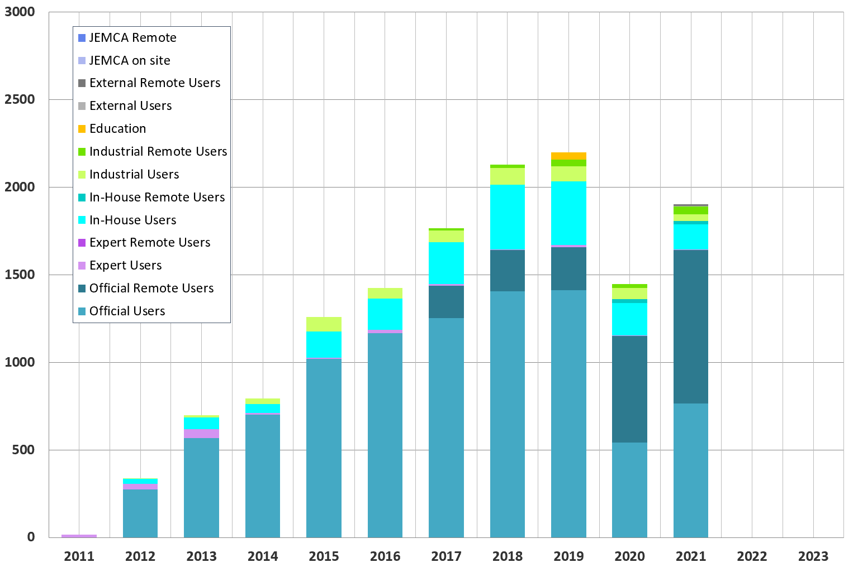
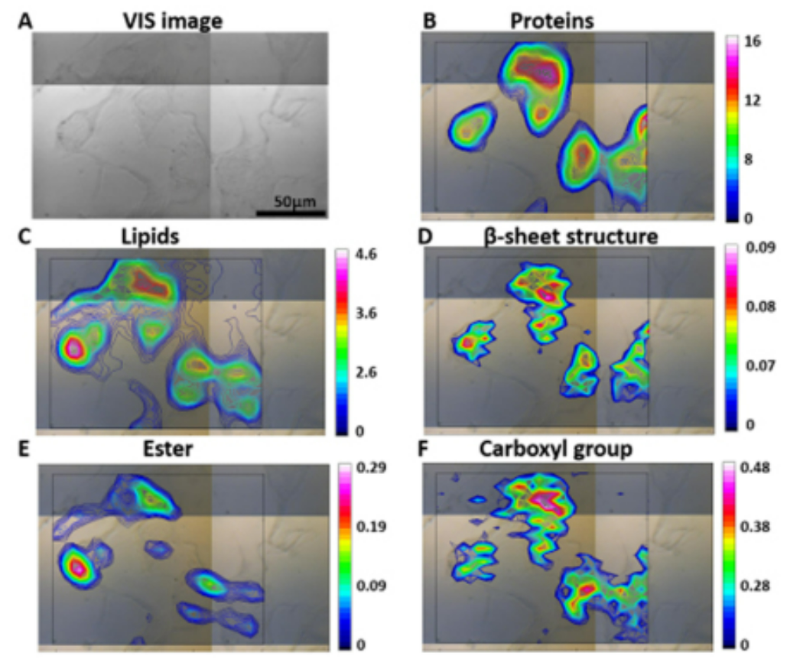
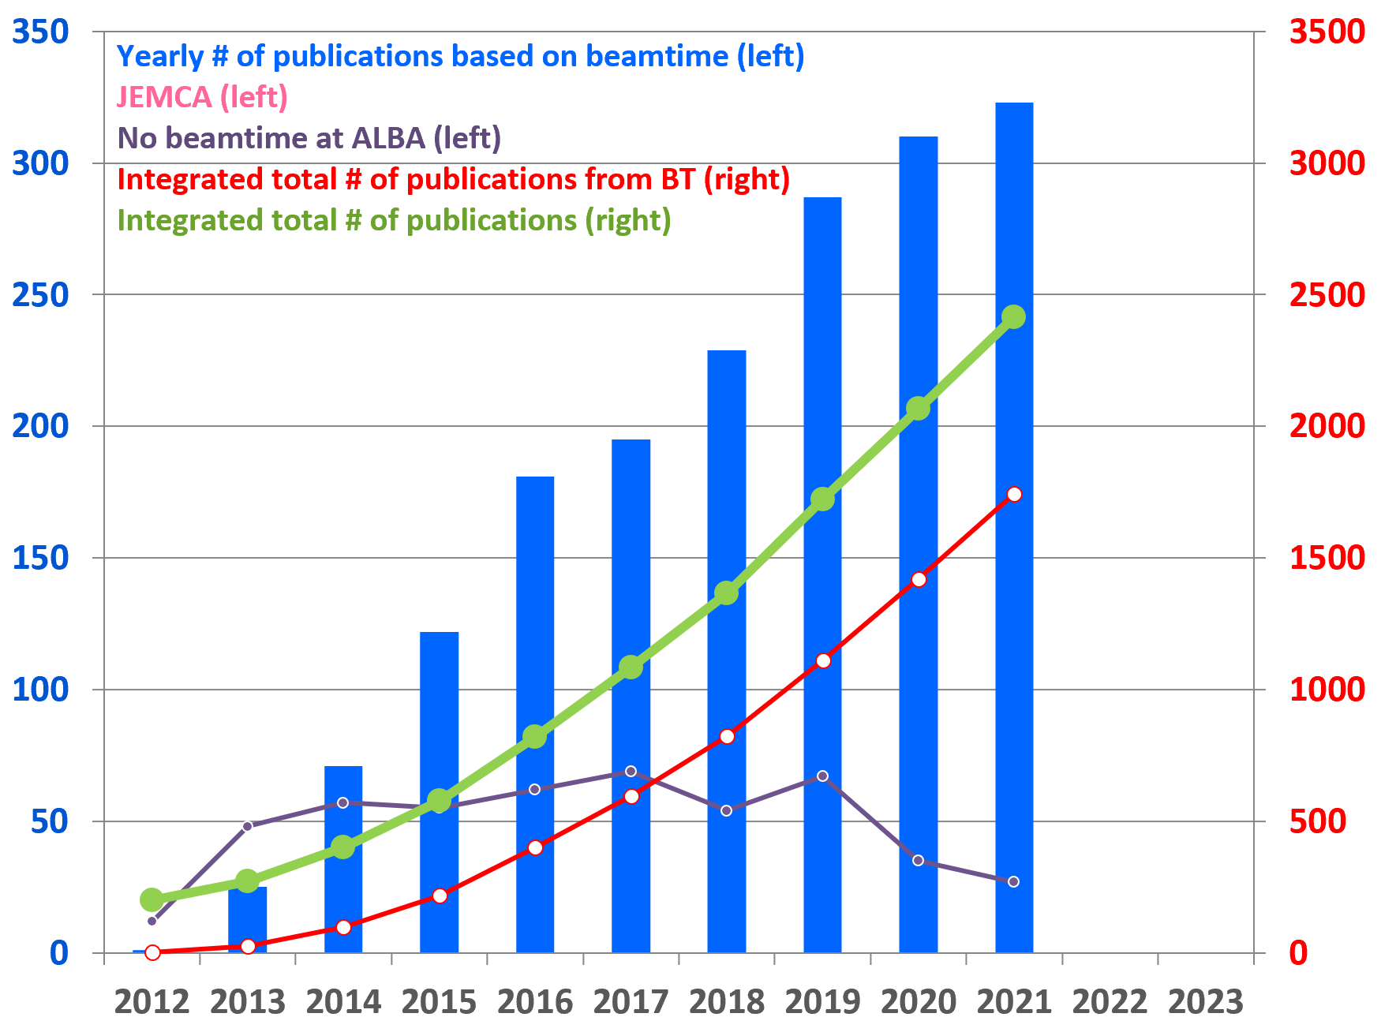
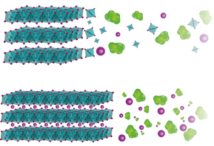
ALBA 2021
Instruments for life science
BOREAS
Instruments for material science
MIRAS
Instruments for metrology
CIRCE
CLAESS
MSPD
LOREA
MISTRAL
User visits
XALOC
NCD-SWEET
Publications
Analytical Chemistry 94, 4, 1932-1940. 10.1021/acs.analchem.1c02076
Nat. Mater. (2021). https://doi.org/10.1038/s41563-021-01060-w
.

Slide 10

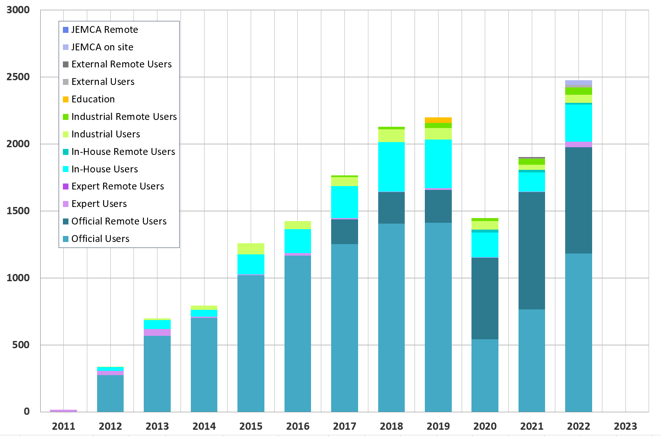
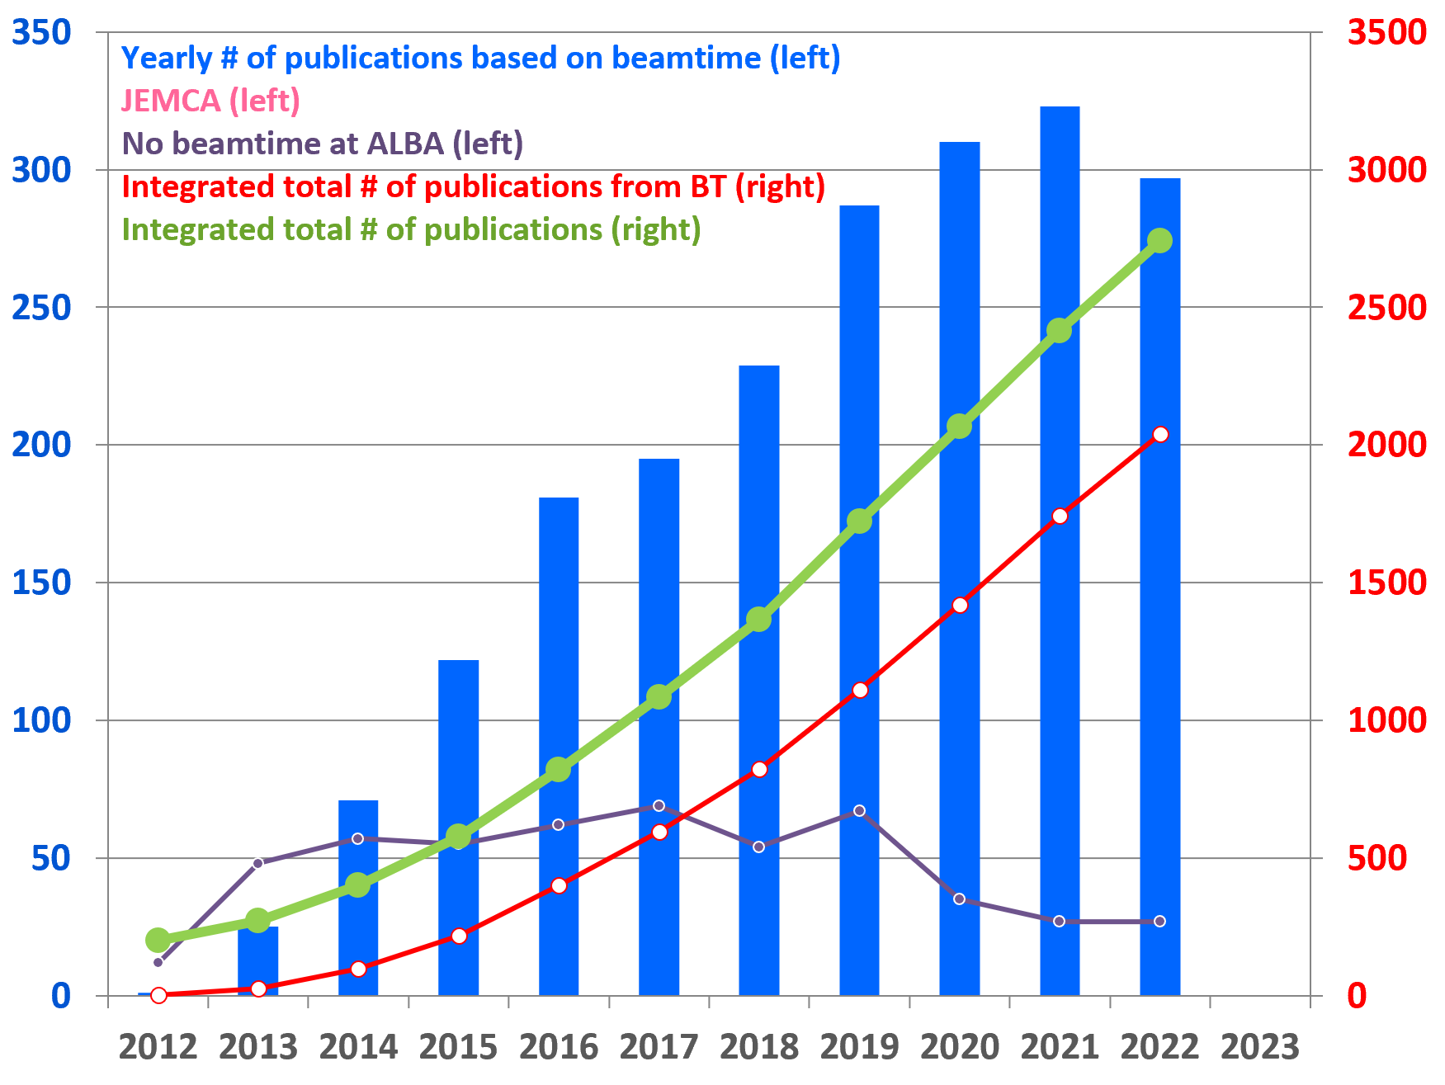
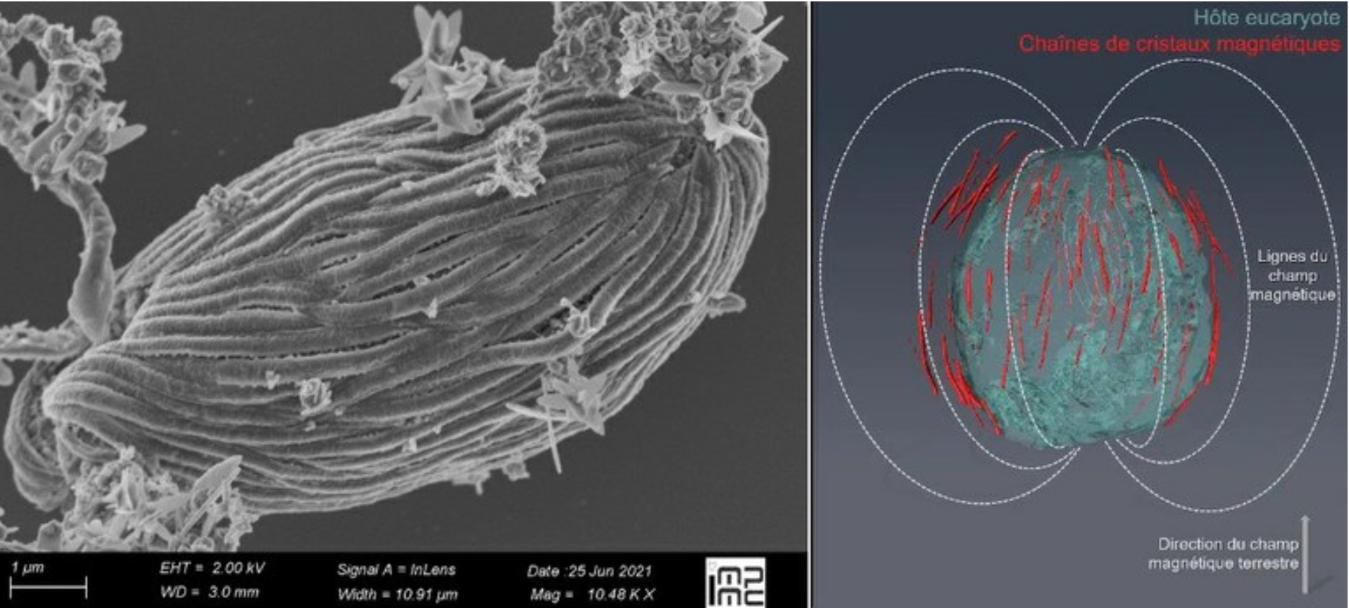
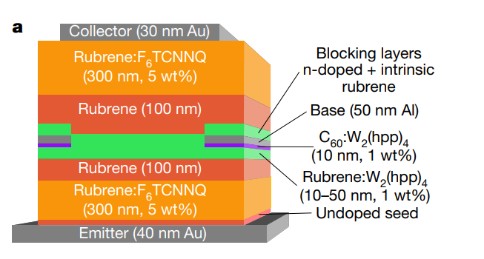
ALBA 2022
Instruments for life science
BOREAS
Instruments for material science
MIRAS
Instruments for metrology
CIRCE
CLAESS
MSPD
LOREA
Cryo-EM
MISTRAL
NOTOS
User visits
XALOC
NCD-SWEET
Publications
PNAS, Vol. 120, No. 10. doi/10.1073/pnas.2216975120
Nature 606, 700–705 https://doi.org/10.1038/s41586-022-04837-4

Slide 11
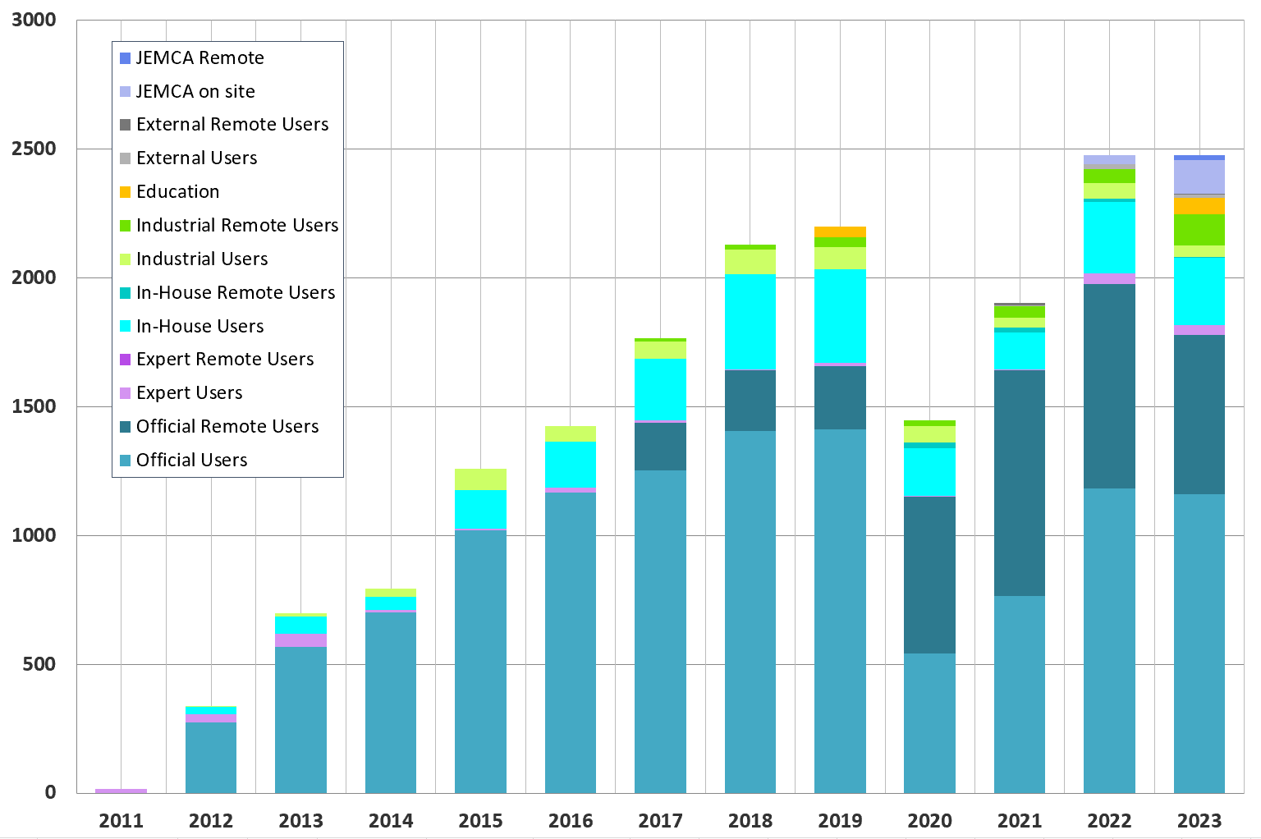
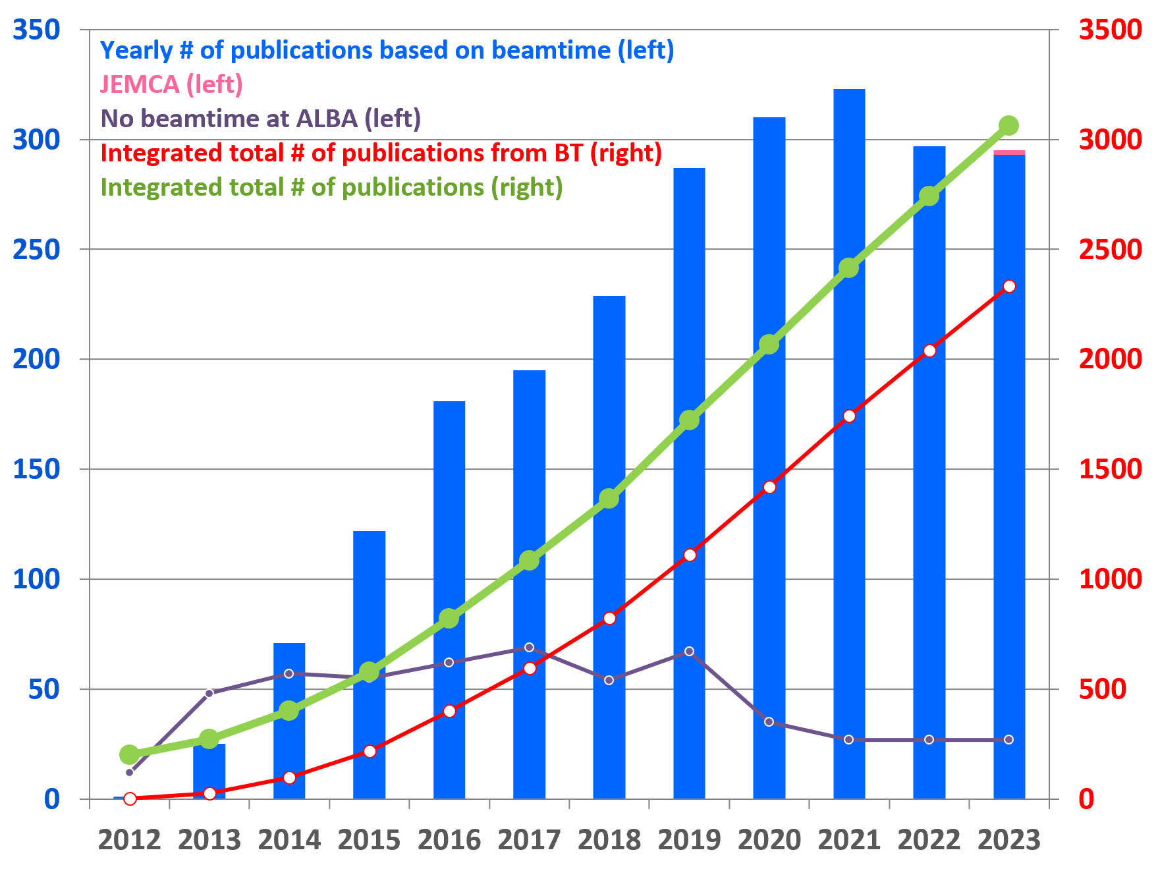


ALBA 2023
Instruments for life science
BOREAS
Instruments for material science
MIRAS
Instruments for metrology
MINERVA
CIRCE
CLAESS
MSPD
LOREA
Cryo-EM
MISTRAL
TEM
NOTOS
User visits
XALOC
NCD-SWEET
Publications
V.Castro et al ACS Nano. DOI: 10.1021/acsnano.3c07265
X.Y.Chin et al, Science, 2023, 381, 59–63

Slide 12
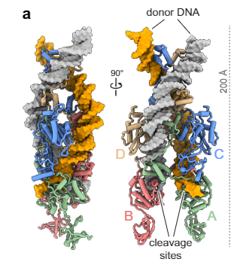

JEMCA
Joint Electron Microscopy Center at ALBA
ALBA is more and more a center for partnerships
In full operation since 2023 - Users through ALBA User Portal
Up to 25% competitive and free user access - User calls with ALBA BL calls
CRYO-TEM
METCAM
60-300 keV (S)TEM (ThermoFisherSpectra 300) dedicated to Material Science
200 kV TEM (ThermoFisherGlacios) dedicated to Life Sciences
10.1021/jacs.3c06288
K. Gupta et al. -Atomic resolution HAADF STEM Co2FeO4 catalytic nanoparticles
Spínola-Amilibia, et al., Nat. Comm. 2023 0.1038/s41467-023-38071-x

Slide 13

In preparation: InCAEM
In Situ Correlative Facility for Advanced Energy Materials
Part of Advanced Materials Program of Planes Complementarios
New Infrastructure in ALBA premises, to be open to all the scientific community in 2026
In collaboration with several partners
Multi-modal
Multi-lengthscale
in situ/operando experiments
Correlative
(Scanning) transmission electron microscopy
Scanning probe microscopies
Synchrotron X-rays (spectroscopy, diffraction,…)
Advanced data analytics (HPC, deep learning, AI,…)

Slide 14
ALBA 2024
Instruments for life science
BOREAS
Instruments for material science
MIRAS
Instruments for metrology
MINERVA
CIRCE
CLAESS
MSPD
LOREA
XAIRA
Cryo-EM
MISTRAL
TEM
NOTOS
User visits
XALOC
NCD-SWEET
Publications

Slide 15
ALBA 2025
Instruments for life science
BOREAS
FAXTOR
Instruments for material science
MIRAS
Instruments for metrology
MINERVA
CIRCE
CLAESS
MSPD
LOREA
XAIRA
Cryo-EM
MISTRAL
TEM
NOTOS
User visits
XALOC
NCD-SWEET
Publications

Slide 16
ALBA 2026
Instruments for life science
BOREAS
FAXTOR
Instruments for material science
MIRAS
Instruments for metrology
MINERVA
CIRCE
CLAESS
MSPD
LOREA
XAIRA
Cryo-EM
MISTRAL
TEM
InCAEM
NOTOS
User visits
3SBAR
XALOC
NCD-SWEET
Publications

Slide 17
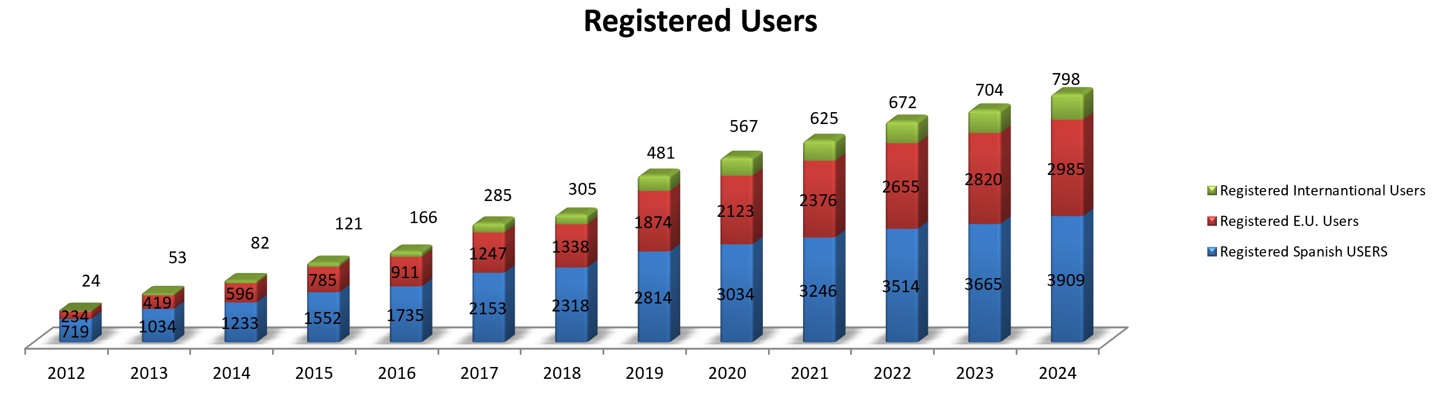
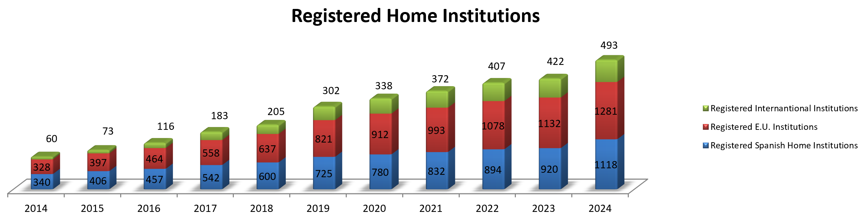

Slide 18



+ 2400 yearly user visits
+300 yearly experiments
3900 national and 3800 international users
+2600 experiments
ALBA
key features
+7500 yearly public visits
+3000 publications
+250 trained students
+250 staff
JEMCA – EM center

Slide 19
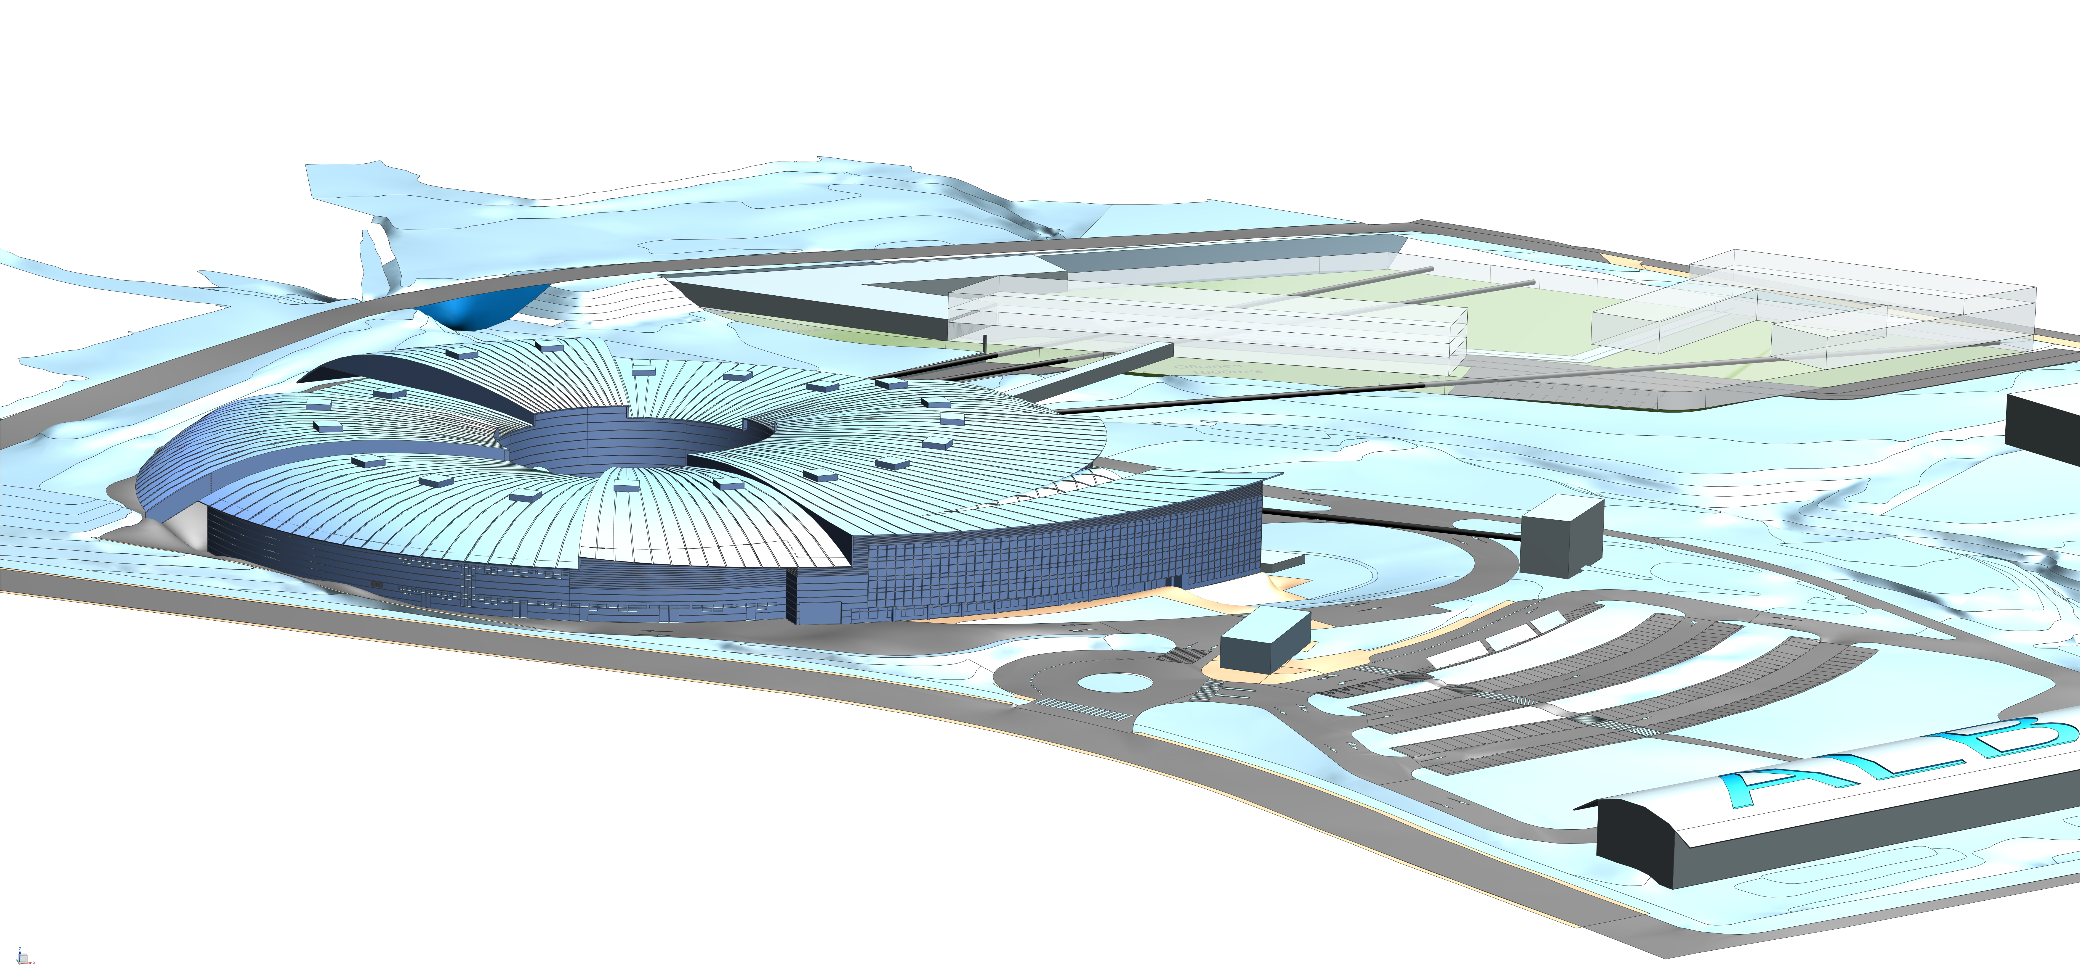
ALBA future: ALBA II

Slide 20
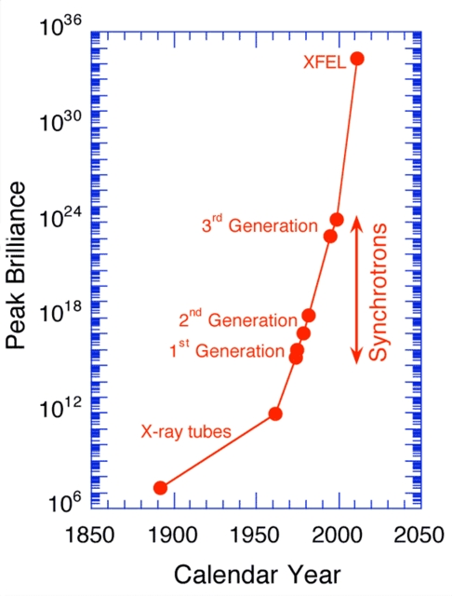
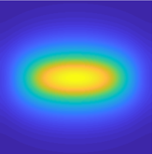


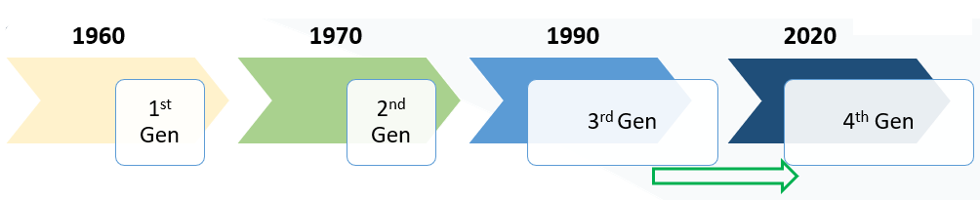
Evolution of Synchrotron Radiation Sources
Increase in Brilliance
Increase in Resolution Power
Increase in Coherence
Increase in Data Analytics capacity

Slide 21

Synchrotron
Radiation
Facilities
PETRA III
MAXIV
SSRC
ASTRIDII
SOLARIS
BESSYII
ANKA
DELSY
CLS
DIAMOND
SLS
KSRS
HEPS
SPRING8
CHESS
SOLEIL
BSRF
NSSR
PFKEK
PLS
UVSOR
ALS
APS
NSLS II
ALBA
NSRL
TSRF
CAMD
SSRF
PLS
SUBARU
SSRL
SURF
DAFNE
INDUS
SRLI
HISOR
RITSSR
ESRF
ELETTRA
TPS
SAGA
NSRRC
SESAME
HELIOS2
SIRIUS
AS
4th Generation IN OPERATION
4th Generation in construction
Upgrading or planning upgrade from 3rd to 4th generation
3rd generation

Slide 22
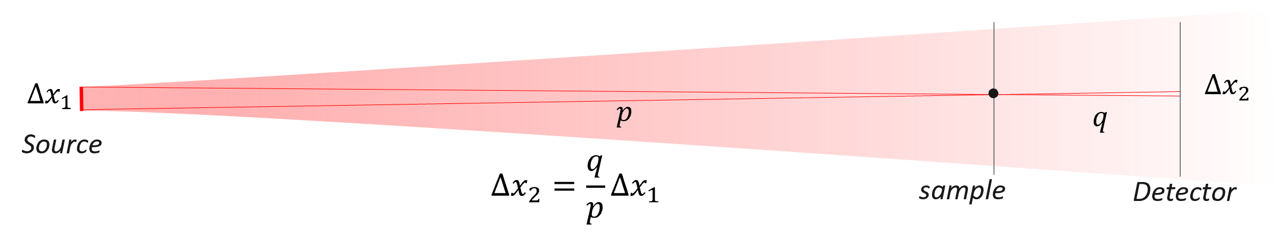
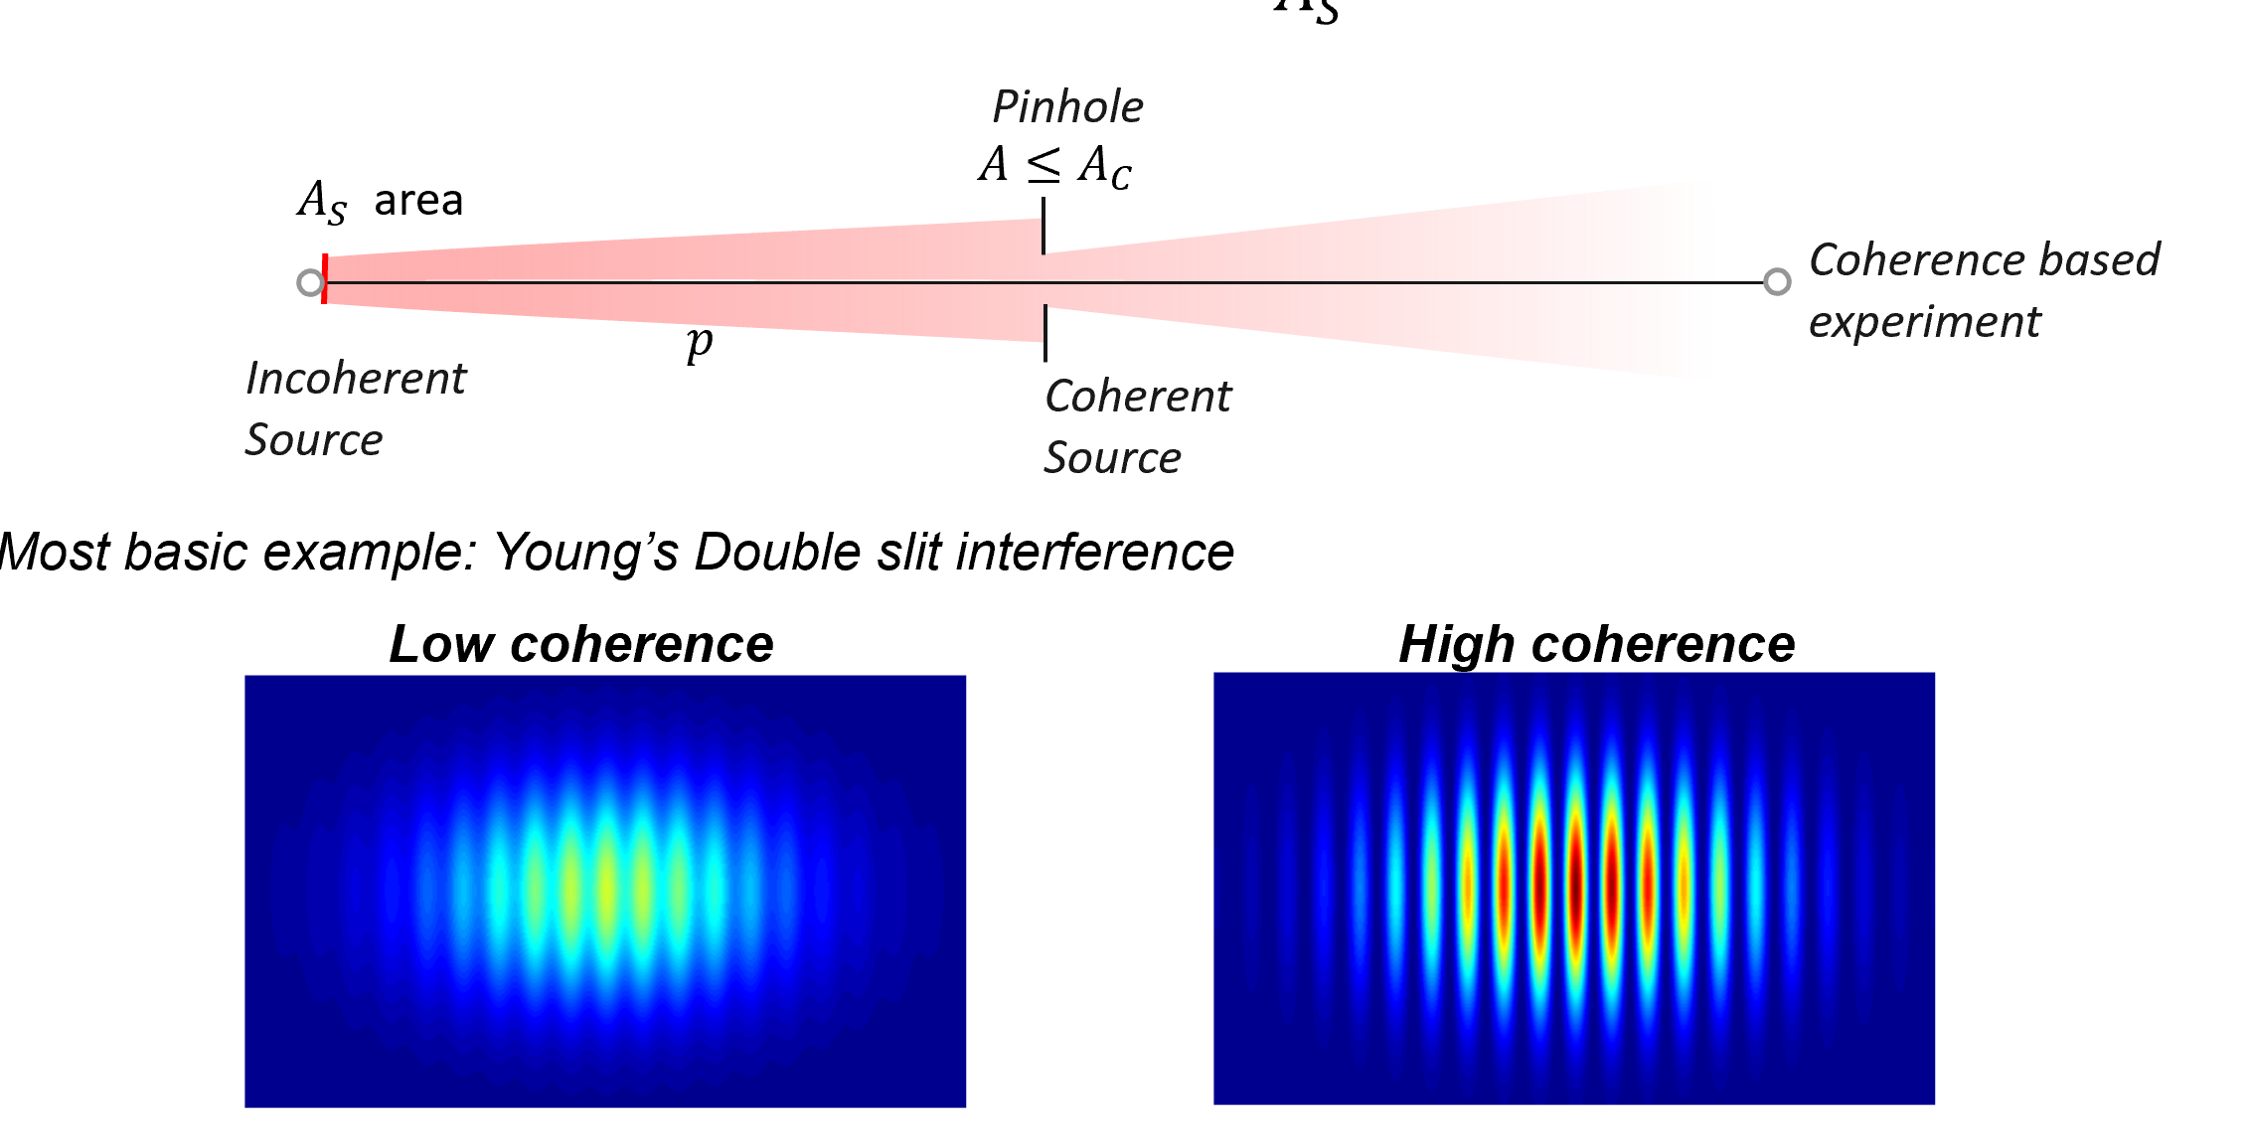
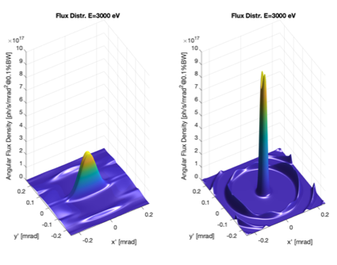
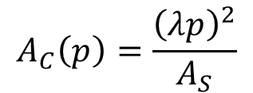
Evolution from 3rd to 4th generation synchrotrons increase in Brilliance, flux, coherence of synchrotron light by orders of magnitude – boosted by long photon paths
FLUX
$$A_{C}\left(p\right)=\frac{{\left(λp\right)}^{2}}{A_{S}}$$

Slide 23
ALBA II project main dates
2020 2021 2022 2023 2024 2025 2026 2027 2028 2029 2030 2031 2032 2033
Starting the design
Presenting to funding agencies the ‘pre-White Paper’
ALBA II included in 2021-2024 ALBA Strategy Plan
First funding for prototyping – 7.5 M€, in execution
1st call for BL proposals (short): 3Sbar and CALIMA chosen
Funding for 1st ALBA II BL (3Sbar) – 10 M€, in construction
New plots assigned for Long BLs extension - 16 M€
White Paper published
2nd call for BL proposals (long) – CODI and CORUS chosen
Advancing in the design
Negotiating approval of whole project

Slide 24
ALBA II - Day One - 2032
Instruments for life science
Instruments for material science
BOREAS
MSPD
FAXTOR
Instruments for metrology
MIRAS
MINERVA
CIRCE
CODI
CLAESS
New Storage Ring
CORUS
LOREA
XAIRA
CALIMA
Cryo-EM
MISTRAL
TEM
InCAEM
NOTOS
3SBAR
XALOC
NCD-SWEET
Upgraded Beamlines

Slide 25
Long Term Agreement for the period 2024-2038
(in negotiation)
Long Term Agreement includes
Operation of ALBA, including related maintenance
Construction and installation of ALBA II storage ring and related infrastructures
Upgrades of all present beamlines, including realignment for bending-source BLs
Repositioning of MSPD in port # 30
Construction of CALIMA in port #7
Construction of CODI in port #2
Basic infrastructure for future beamline in port #3
Construction of CORUS in port #4
Upgrade of data infrastructure
Staff evolution

Slide 26
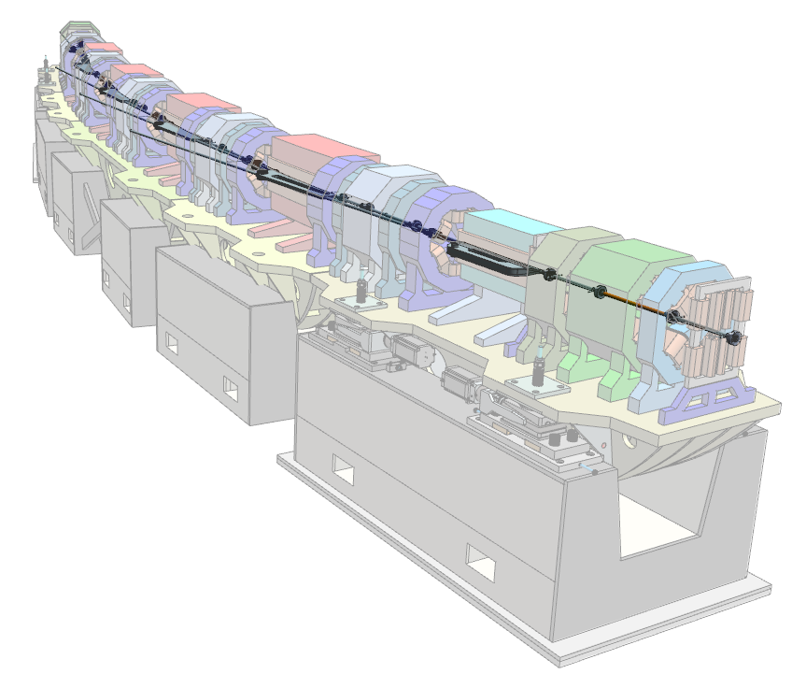
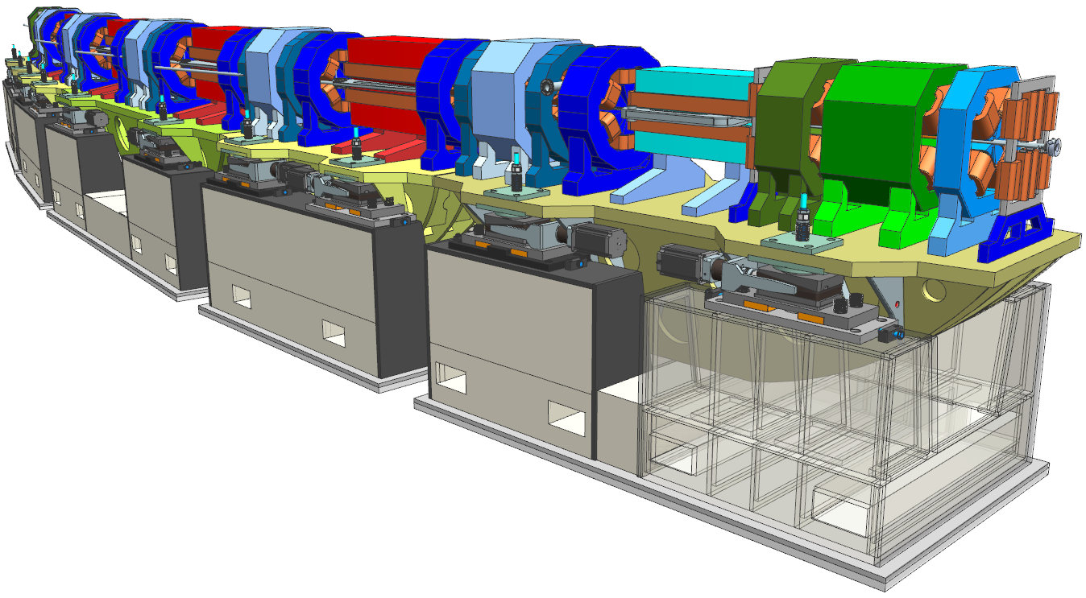
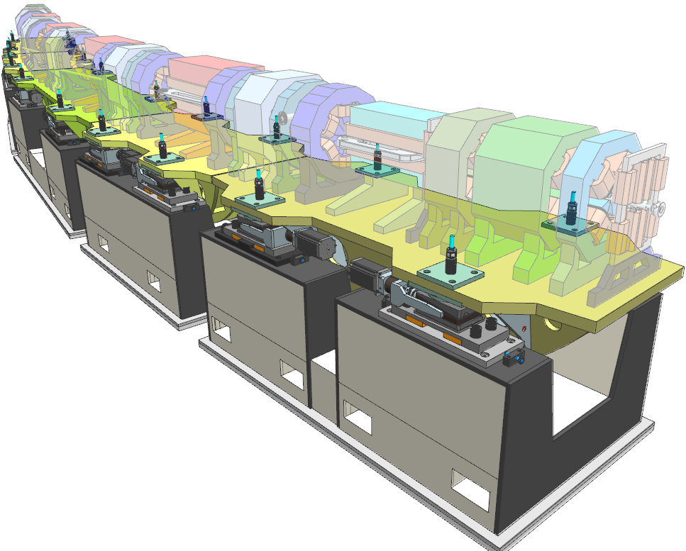
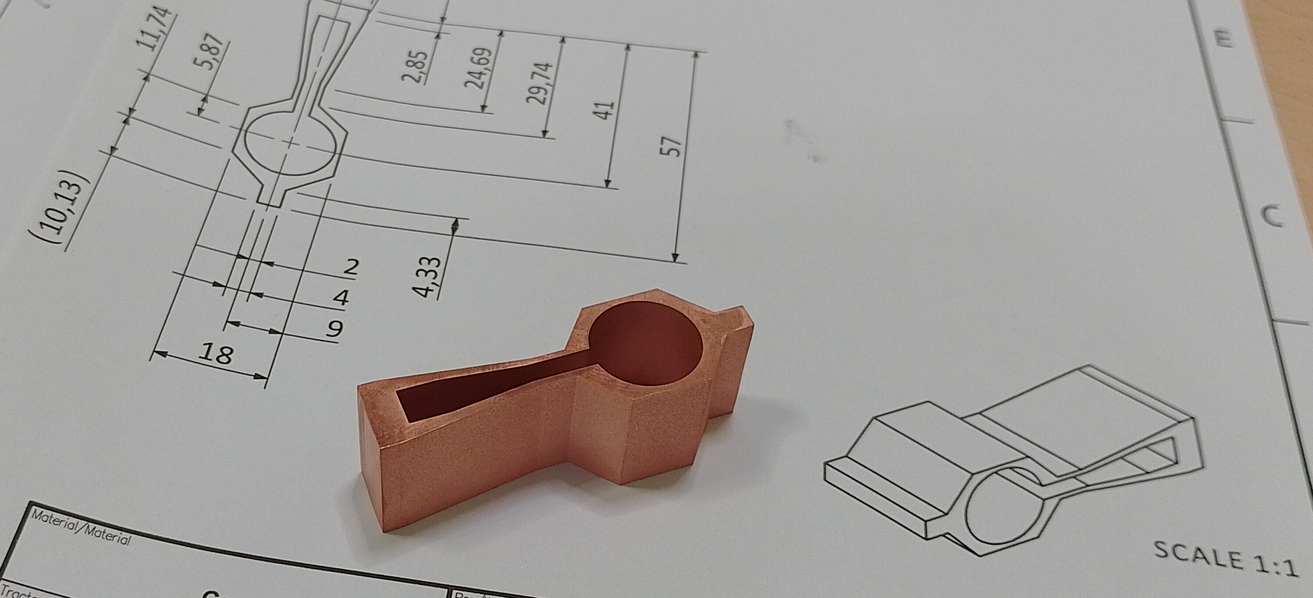
Designing and prototyping ALBA II storage ring
4th generation light source
Emittance 200 pm (20 times smaller than ALBA)
Current 300 mA (+ 20% with respect to ALBA)
Increase of brilliance by orders of magnitude
Increase of coherence
Maintain tunnel, e- energy, injection system
Maintain all present BLs
  Magnets
  NEG Coated vacuum chambers
  Pulsed magnets
  Girder for arc assembly tests
  Superconducting Undulator

Slide 27
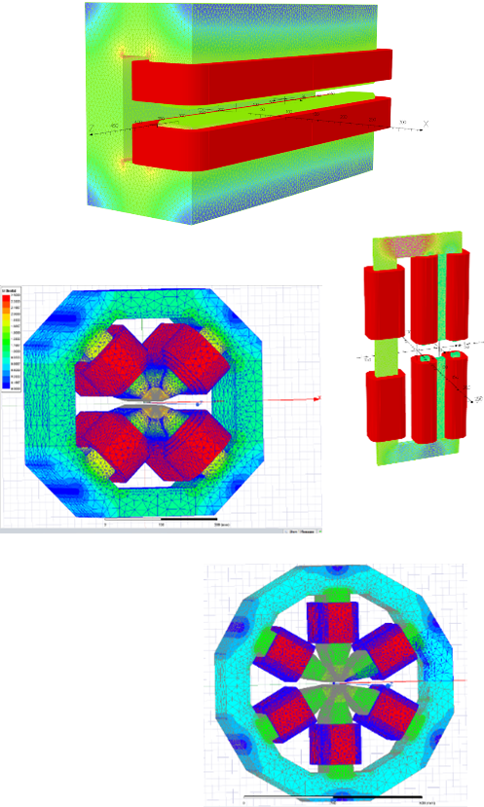
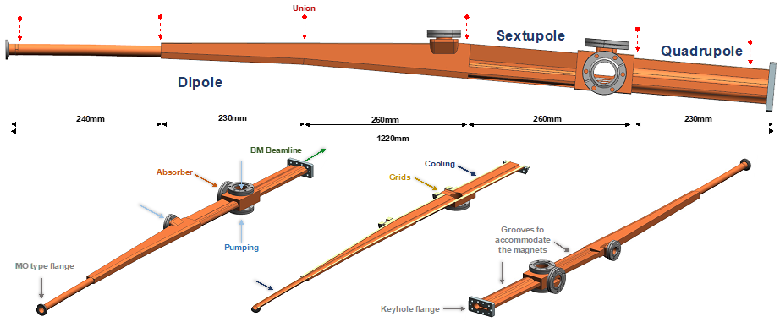
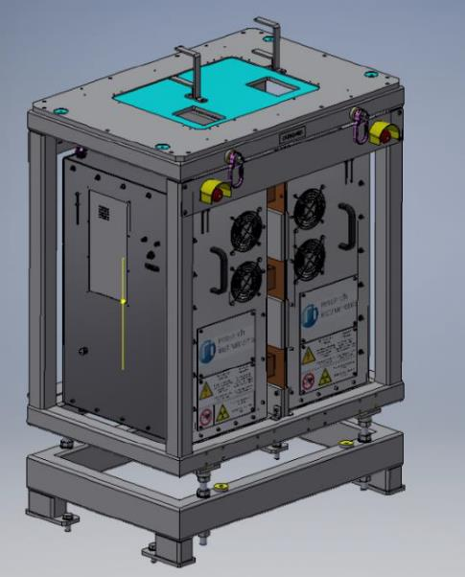
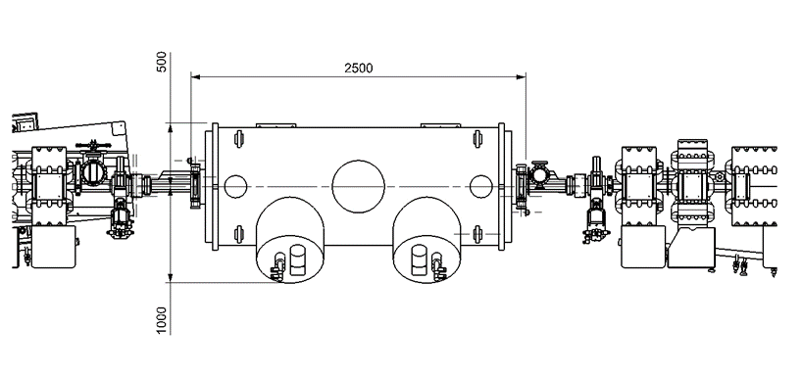



Prototype program
Prototypes will be delivered in 2025
Magnets
Vacuum
SC Undulator
Pulsed Magnets

Slide 28
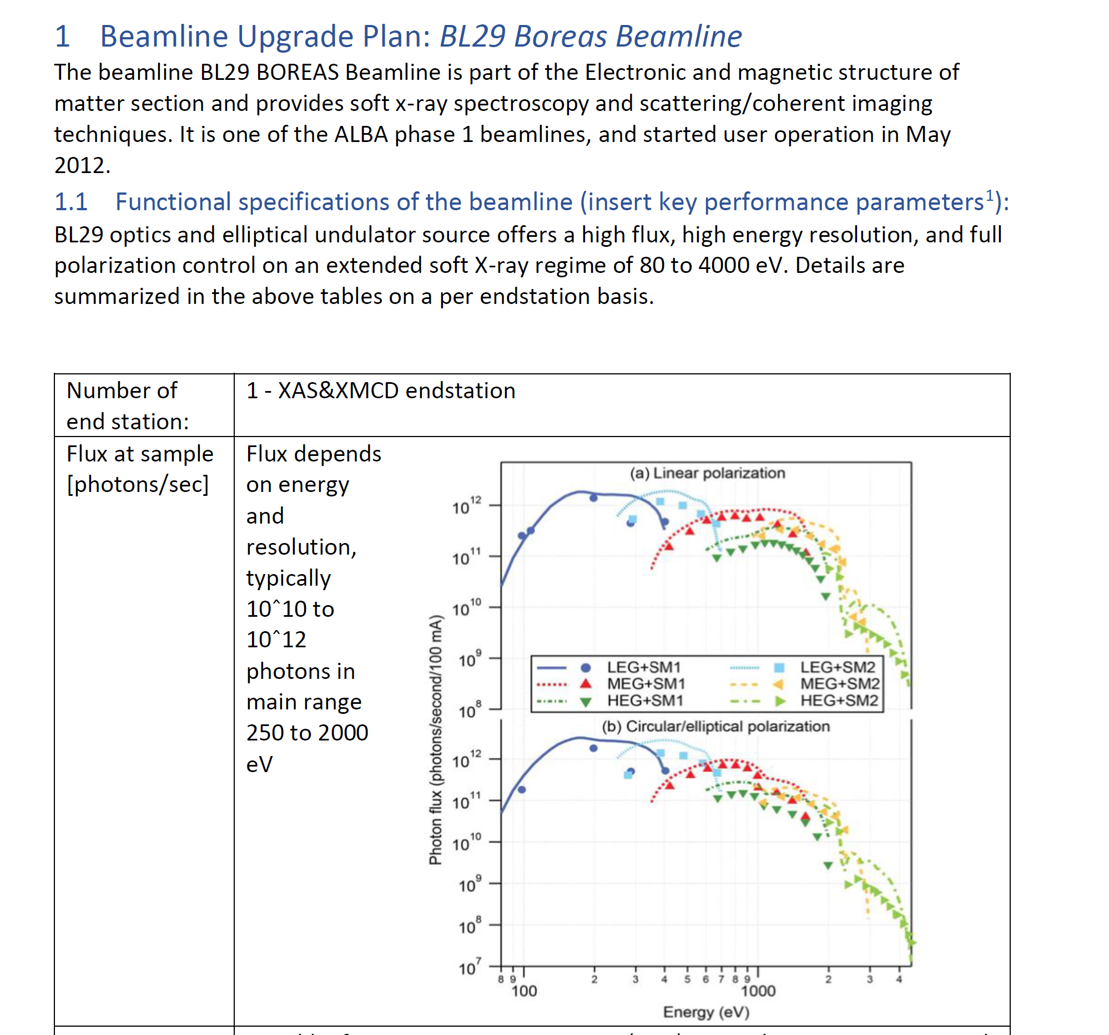
BL upgrades
All BL teams are working out the plans for the upgrades
Beamline Upgrade Plan
The beamline under ALBA conditions
The beamline under ALBA II conditions
The upgrade-package
ALBA essential
ALBA enabling
ALBA II essential
ALBA II enabling
During 2024: detailed plan for the different phases
Flexibility to account for urgent interventions

Slide 29
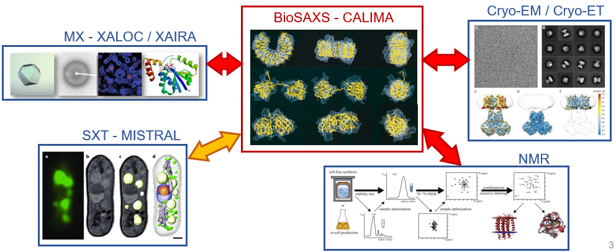
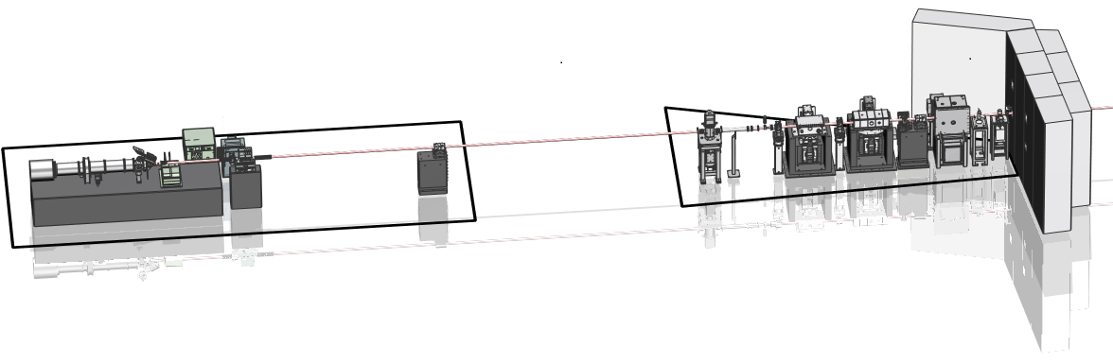
New BL: BL07 - CALIMA
Techniques
Scientific case
Batch mode SAXS
SAXS + chromatography
Time-resolved SAXS
Fiber diffraction
3D scanning SAXS
nLC/MS SAXS
WAXS
Allosteric biomolecules modulation
Intrinsically Disordered Proteins
Membrane proteins
Amyloid proteins
Domain swapping in diseases
Complex biological assemblies
RNA folding
Microtubules GTPase cycle
Bone arrangement
Brain connectivity
Skin damage
Polymers
Superbend (ALBA II)
2 optical setups:
  Large (standard): ~200-500 μm beam size
  Microfocus: ~10 μm beam size
Experimental Hutch
Optical Hutch
29

Slide 30
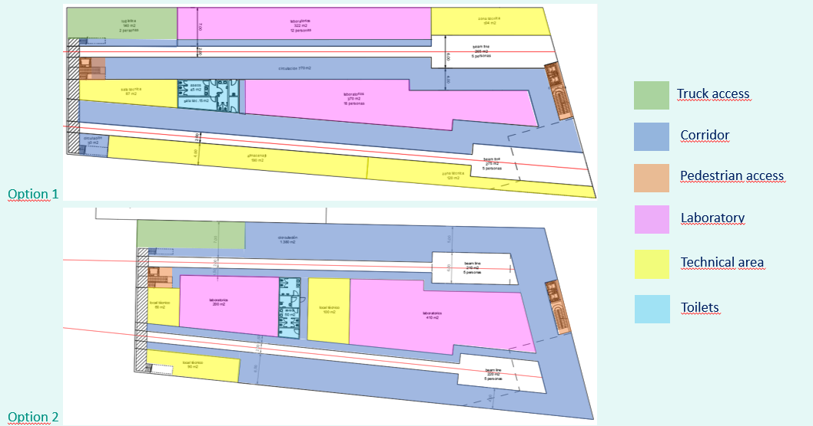


New BL: BL02 - CODI
Coherence Diffraction Imaging
The main scope of CoDI is to perform in situ and operando characterization of thick samples with nanometer resolution.
Options for CODI experimental hall layout – Work in progress (see Joan’s talk)
10-30 keV to probe thick samples in their relevant conditions.
Efficient control of the coherence and flux using a secondary source to tailor the beam features with the long beam path of 250 m.
Nano-focusing Kirkpatrick–Baez (KB) mirror (sub-50 nm focus) that enable a long working distance, more than 150 mm.
Multilayer Laue lenses (MLLs) to produce the ultimate efficient nano-focus (sub-10 nm focus).
Long sample to detector distance (with minimum range 0-20 m) that help to spread the photon flux in the detector and results in a high spatial resolution.

Slide 31




New BL: BL04 - CORUS
Cryo bio-nano-imaging beamline
CORUS nanoImag
Sample positions
Detector
XRF detector
XRF detector
KB mirrors
Sample
Cryogenic stage temperature
CORUS nanoSpec
Options for CORUS experimental hall layout (see Joan’s talk)
Detector
XRF detector
XRF detector
KB mirrors
Sample
Cryogenic stage temperature

Slide 32



DATA and Scientific Computing
PB
Data Deluge at ALBA II
  Specialized data processing and analysis will require High Performance Computing optimization.
Actions in progress
  Ambitious IT investment program
  Develop methods and software tailored for specific scientific cases (two groups already working operatively at ALBA).
  Crafting versatile data tools
Users will benefit of additional Computing Services, further ensuring their ability to navigate and harness the scientific potential of ALBA II's data-rich environment.

Slide 33
New Infrastructures
New Buildings and related Infrastructures being designed
© VVV arquitectes

Slide 34


New buildings layouts – in preparation
EDIFICIO 1: Instalaciones técnicas.
EDIFICIO 2: Hall experimental BL02 & BL03.
Laboratorios. Auditorio y oficinas.
EDIFICIO 3: Construido y explotado por terceros.
EDIFICIO 4: Hall experimental BL04.1 y BL04.2
Laboratorios y oficinas.

Slide 35




Working on the design of the long BLs across the two plots
New buildings
BL02
BL03
BL02
BL04
BL03
BL04

Slide 36





ALBA II and proposals for its park
Preparation of proposals on- going, together with negotiations with funding agencies
and
2.000 m2 clean room infrastructure for development of semiconductors technologies, offering a solution to the current gap between research and commercial development of innovative prototypes:
Research Lab
Fab-in-Fab space for start-ups.
An R&D Pilot Line equipped with 200 mm high-volume manufacturing equipment.
A national network for long-term collaborative R&D programmes.
Dedicated access to advanced characterization offered by a unique integration with ALBA Synchrotron and CODI Beamline
The center will respond to the multiple challenges raising from climate change for our One Health, as defined by WHO. In particular:
Zoonotic diseases and environment surveillance,
Neurodegenerative diseases and relation with environment,
Impact of emergent climates and new pollutants in public health
unique integration with ALBA Synchrotron and CORUS Beamline
Combining the strength of 3 national Irs with the power of one large university, R2OH will incorporate a unique infrastructure for one of a kind X-ray, cryo-EM and optical microscopy characterization suite within a bio safety level 3 as manipulation and infection facility for plants and animals
BRISA

Slide 37

Rendering of a possible future

Slide 38
ALBA II - Future developments
ALBA II total capacity: 26 beamlines
New resources (investments and staff) not yet planned
Aiming at including other institutions with partnerships (JEMCA model)
Instruments for life science
Instruments for material science
BOREAS
MSPD
FAXTOR
Instruments for metrology
MIRAS
MINERVA
CIRCE
CODI
CLAESS
New Storage Ring
BL03
CORUS
LOREA
XAIRA
CALIMA
Cryo-EM
Upgraded Beamlines
NOTOS
MISTRAL
TEM
InCAEM
3SBAR
XALOC
NCD-SWEET
BL03 – Long BL on superbend
BL08 – Medium BL on ID
Other 7 dipole or superbend ports available
BL08

Slide 39

Save the date
AUSE and ALBA Users Meeting
Oviedo, 2-5 September 2024
Thank you for your attention
Questions welcome

