Slide 1
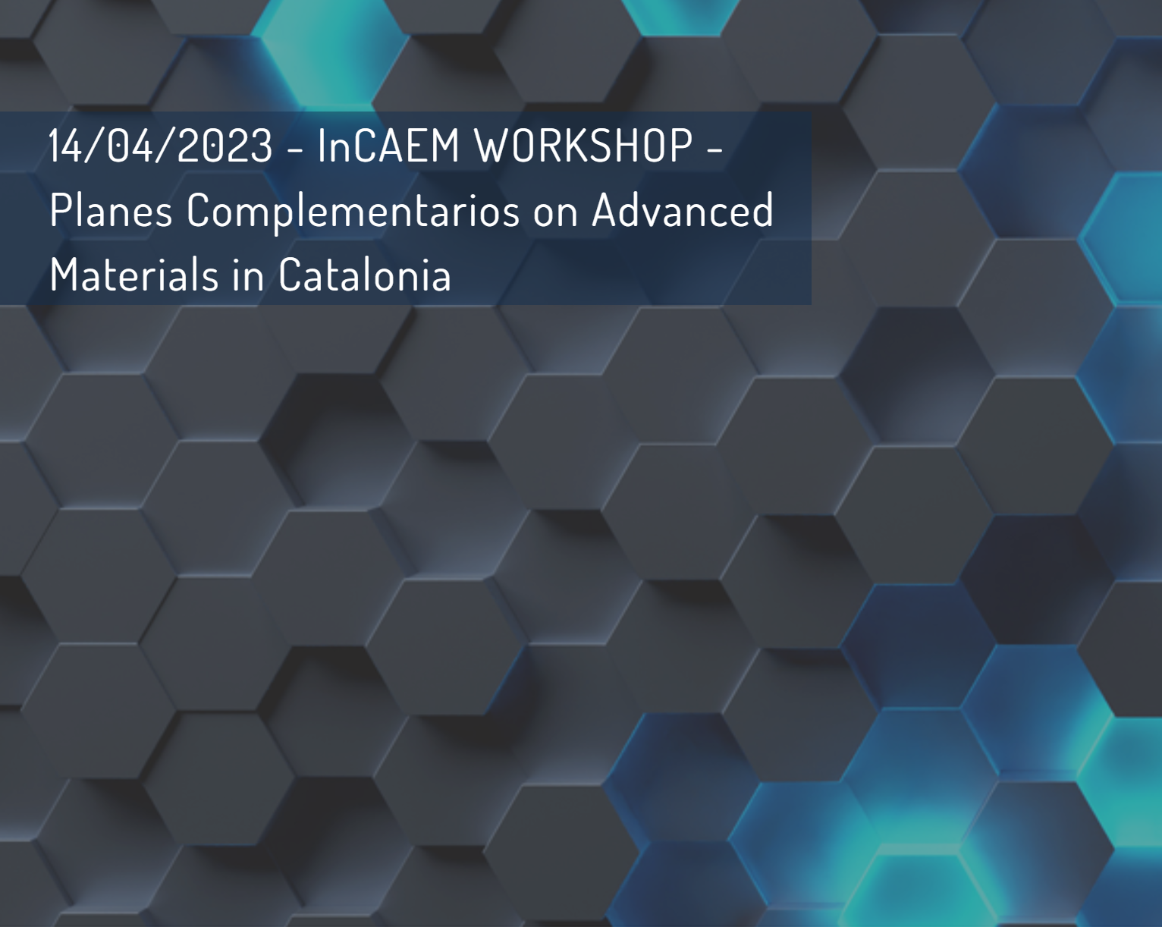
InCAEM access and collaborations
C. Biscari
14 April 2023

Slide 2
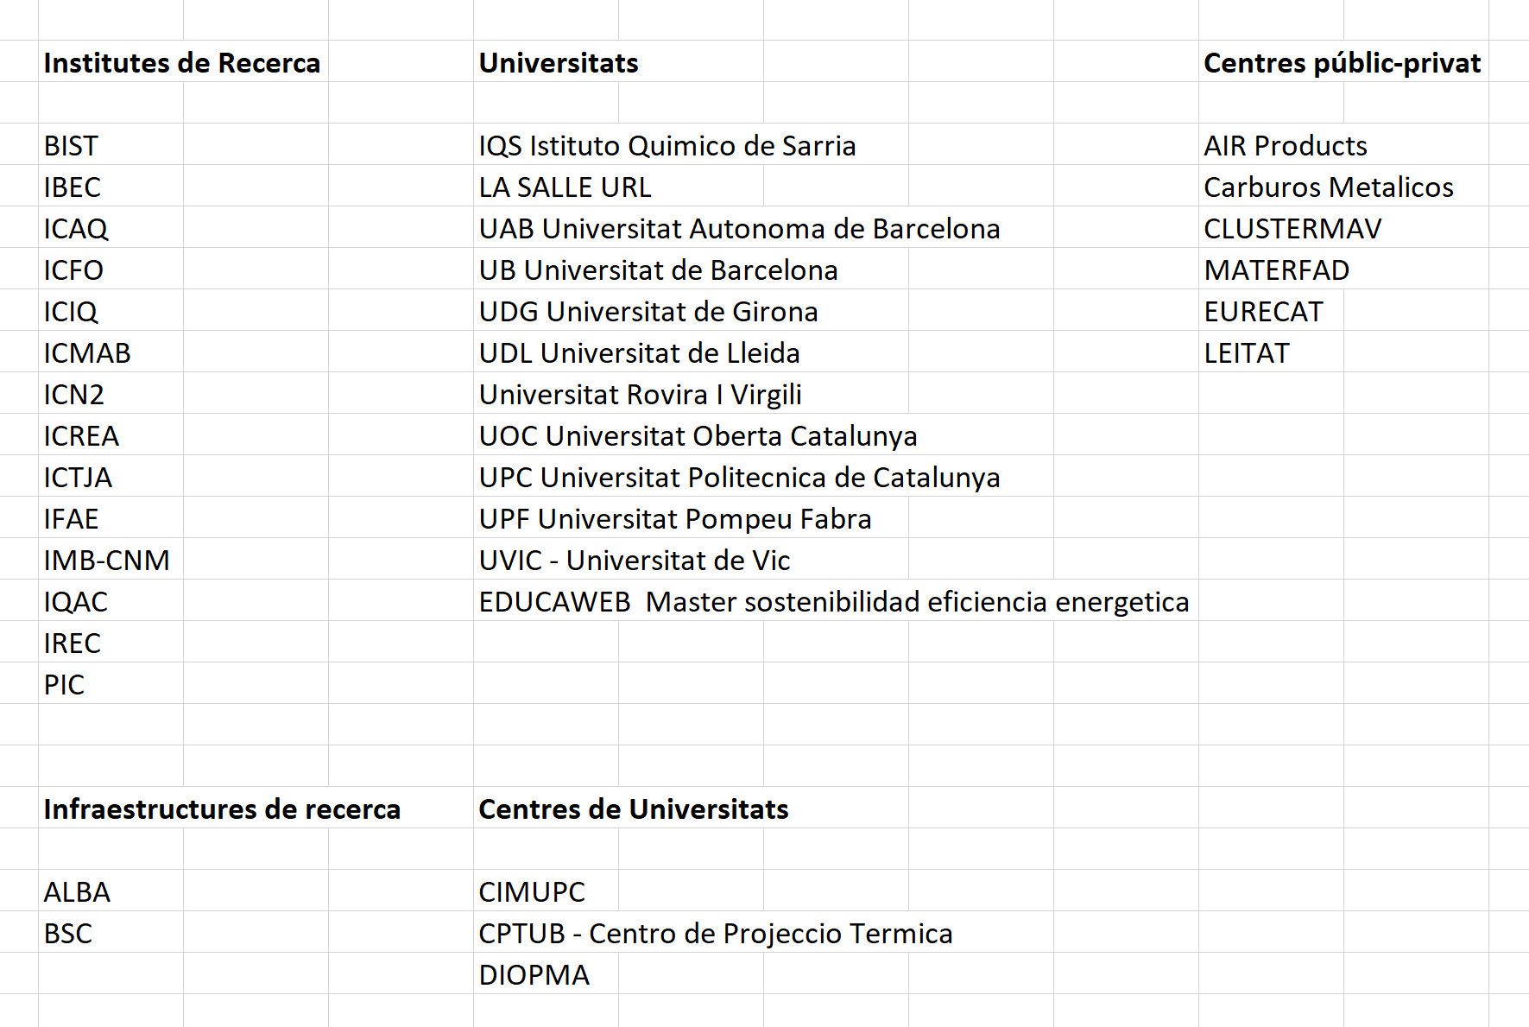
Institutions with activity on Advanced Materials in Catalunya (to our knowledge*)
~ 40
*Please let us know if someone is missing

Slide 3
Advanced Materials in Catalunya from Planes Complementarios
Creation of a new infrastructure with complementary analytical capabilities with respect to the existing ones at ALBA
Period of design, procurement, installation : end of 2022 to end of 2024
Commissioning, benchmark experiments, start of operation: 2025
Investment funds: 12.5 M€
Personnel funds: 2.5 M€

Slide 4

Planes Complementarios
Funding: CCAA complementing Plan de Recuperación, Transformación y Resiliencia
Analytical techniques complementing X-ray and existing EM
Institutions complementing resources for the new infrastructure
Complementary Funding
Complementary Analytical Techniques
Complementary Institutions

Slide 5

InCAEM Users
ALBA
Partners
Catalan Institutions
Open Access
Other CCAA from Advanced Materials program
Complementary Research
Communities
Different levels of involvement in the definition of the facility, its set-up, and its operation

Slide 6
InCAEM construction and commissioning
(2022-2025)
ALBA
Partners
Coordinator (ALBA) – 38 FTEs (of which 23 funded through the program)
Partners (ICN2, ICMAB, PIC-IFAE)
30.5 FTE (of which 22.5 funded through the program)

Slide 7
InCAEM operation
(after 2025 – in definition)
ALBA
Partners
Catalan Institutions
Coordinator (ALBA) – FTE tbd
Partners (ICN2, ICMAB, PIC-IFAE) - FTE tbd
Other partners from Catalunia could join in the future

Slide 8
InCAEM operation
(after 2025 – in definition)
If the program funding is continued
ALBA
Partners
Catalan Institutions
Coordinator (ALBA) – FTE tbd
Partners (ICN2, ICMAB, PIC-IFAE) - FTE tbd
Other partners will join in the future
FTEs for operation, development and more services to user community

Slide 9
InCAEM Users
ALBA
Partners
Catalan Institutions
Open Access
Other CCAA from Advanced Materials program
Coordinator (ALBA) – in house + industrial users
Partners (ICN2, ICMAB, PIC-IFAE) – in house - Other partners could join in the future
Access through Long Term Projects
Access through LTP in collaboration with a Catalan Institution
Access through open calls (as ALBA BLs)

Slide 10
InCAEM Users
If the program funding is continued
ALBA
Partners
Catalan Institutions
Open Access
Other CCAA from Advanced Materials program
Coordinator (ALBA) – in house + industrial
Partners (ICN2, ICMAB, PIC-IFAE) – in house - Other partners could join in the future
Access through Long Term Projects calls may include funding for staff and-or projects
Access through LTP in collaboration with a Catalan Institution
Access through open calls (as ALBA BLs)

Slide 11
Long-Term Partnership (LTP) Proposal
What is a LTP:
  An LTP is a research collaboration which is scientifically driven by the proposal team and supported by In-CAEM instrumentation and research capabilities. It has a clear deliverable and is limited in time.
  The PI is from a Catalan institution
  Some time will be also reserved to proposals with PIs from institutions of other CCAA of the same program, for collaborations including at least a Catalan institution
  Proposal duration: 1-2 years
  Call frequency: 1-2 years
  Peer review process granting:
    Beamtime and instrument access time (multimodal approach) limited to a certain number of shifts
    some FTE support time (technician, engineering……)
    some FTE researcher time for coordinating and optimizing research plan
  In blue = to be defined

Slide 12
Long-Term Partnership (LTP) Proposal
What are the advantages:
  Is inclusive to all Catalan institutions working on Advanced Materials
  Links to the other CCAA participating in the program
  Strategic to motivate the Spanish funding authorities to invest in future if the pilot projects are successful
  Open and transparent peer review process
  Strengthen the research collaborations within Catalan institutions and gives them another competitive advantage on the European stage (in view of LEAPS challenge-targeted strategic access and similar programs of eDREAM network)
  Pilot project for future user programs of new funding opportunities

Slide 13



Linking to European Initiatives
Collaboration of LEAPS with different initiatives, among which:
ESAPS 2022: EUROPEAN STRATEGY
ACCELERATOR-BASED PHOTON SOURCES
Requiring to European Commission
A) common understanding on the need
to bridge Pillar 1 (RIs) and Pillar 2 (Challenges & Missions)
B) European funding for targeted access to support
taylored operando technologies at LEAPS facilities
and specific operation costs
→ recommendation: European funding for targeted access & technology development
www.ami2030.eu
www.battery2030.eu

Slide 14
Thank you for your attention
Discussion is open

