Slide 1
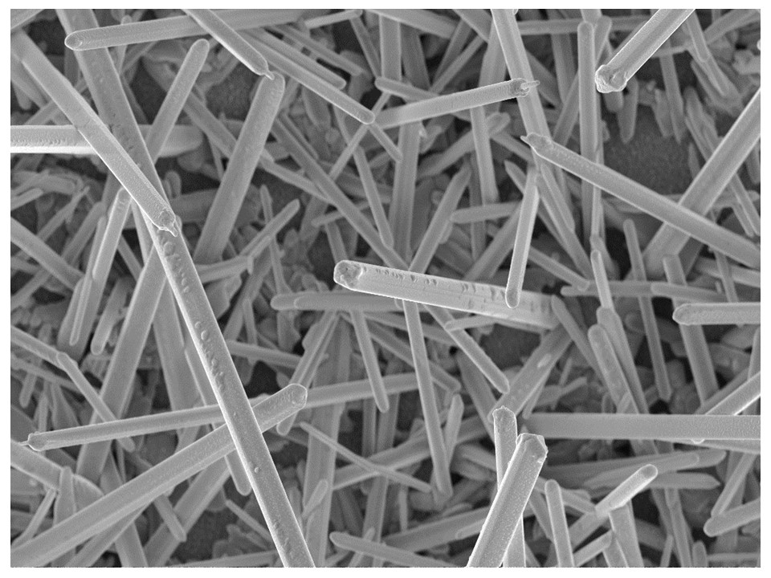




Novel Chaclogenide and Chalcohalide Semiconductors for Next Generation Thin Film Solar Cells
Kunal J. Tiwari, Dr. Sergio Giraldo, Prof. Zacharie Jehl Li Kao, Prof. Marcel Placidi, Prof. Edgardo Saucedo
By: Kunal J. Tiwari Ph.D.
Post Doctoral Researcher IREC & UPC Barcelona

Slide 2
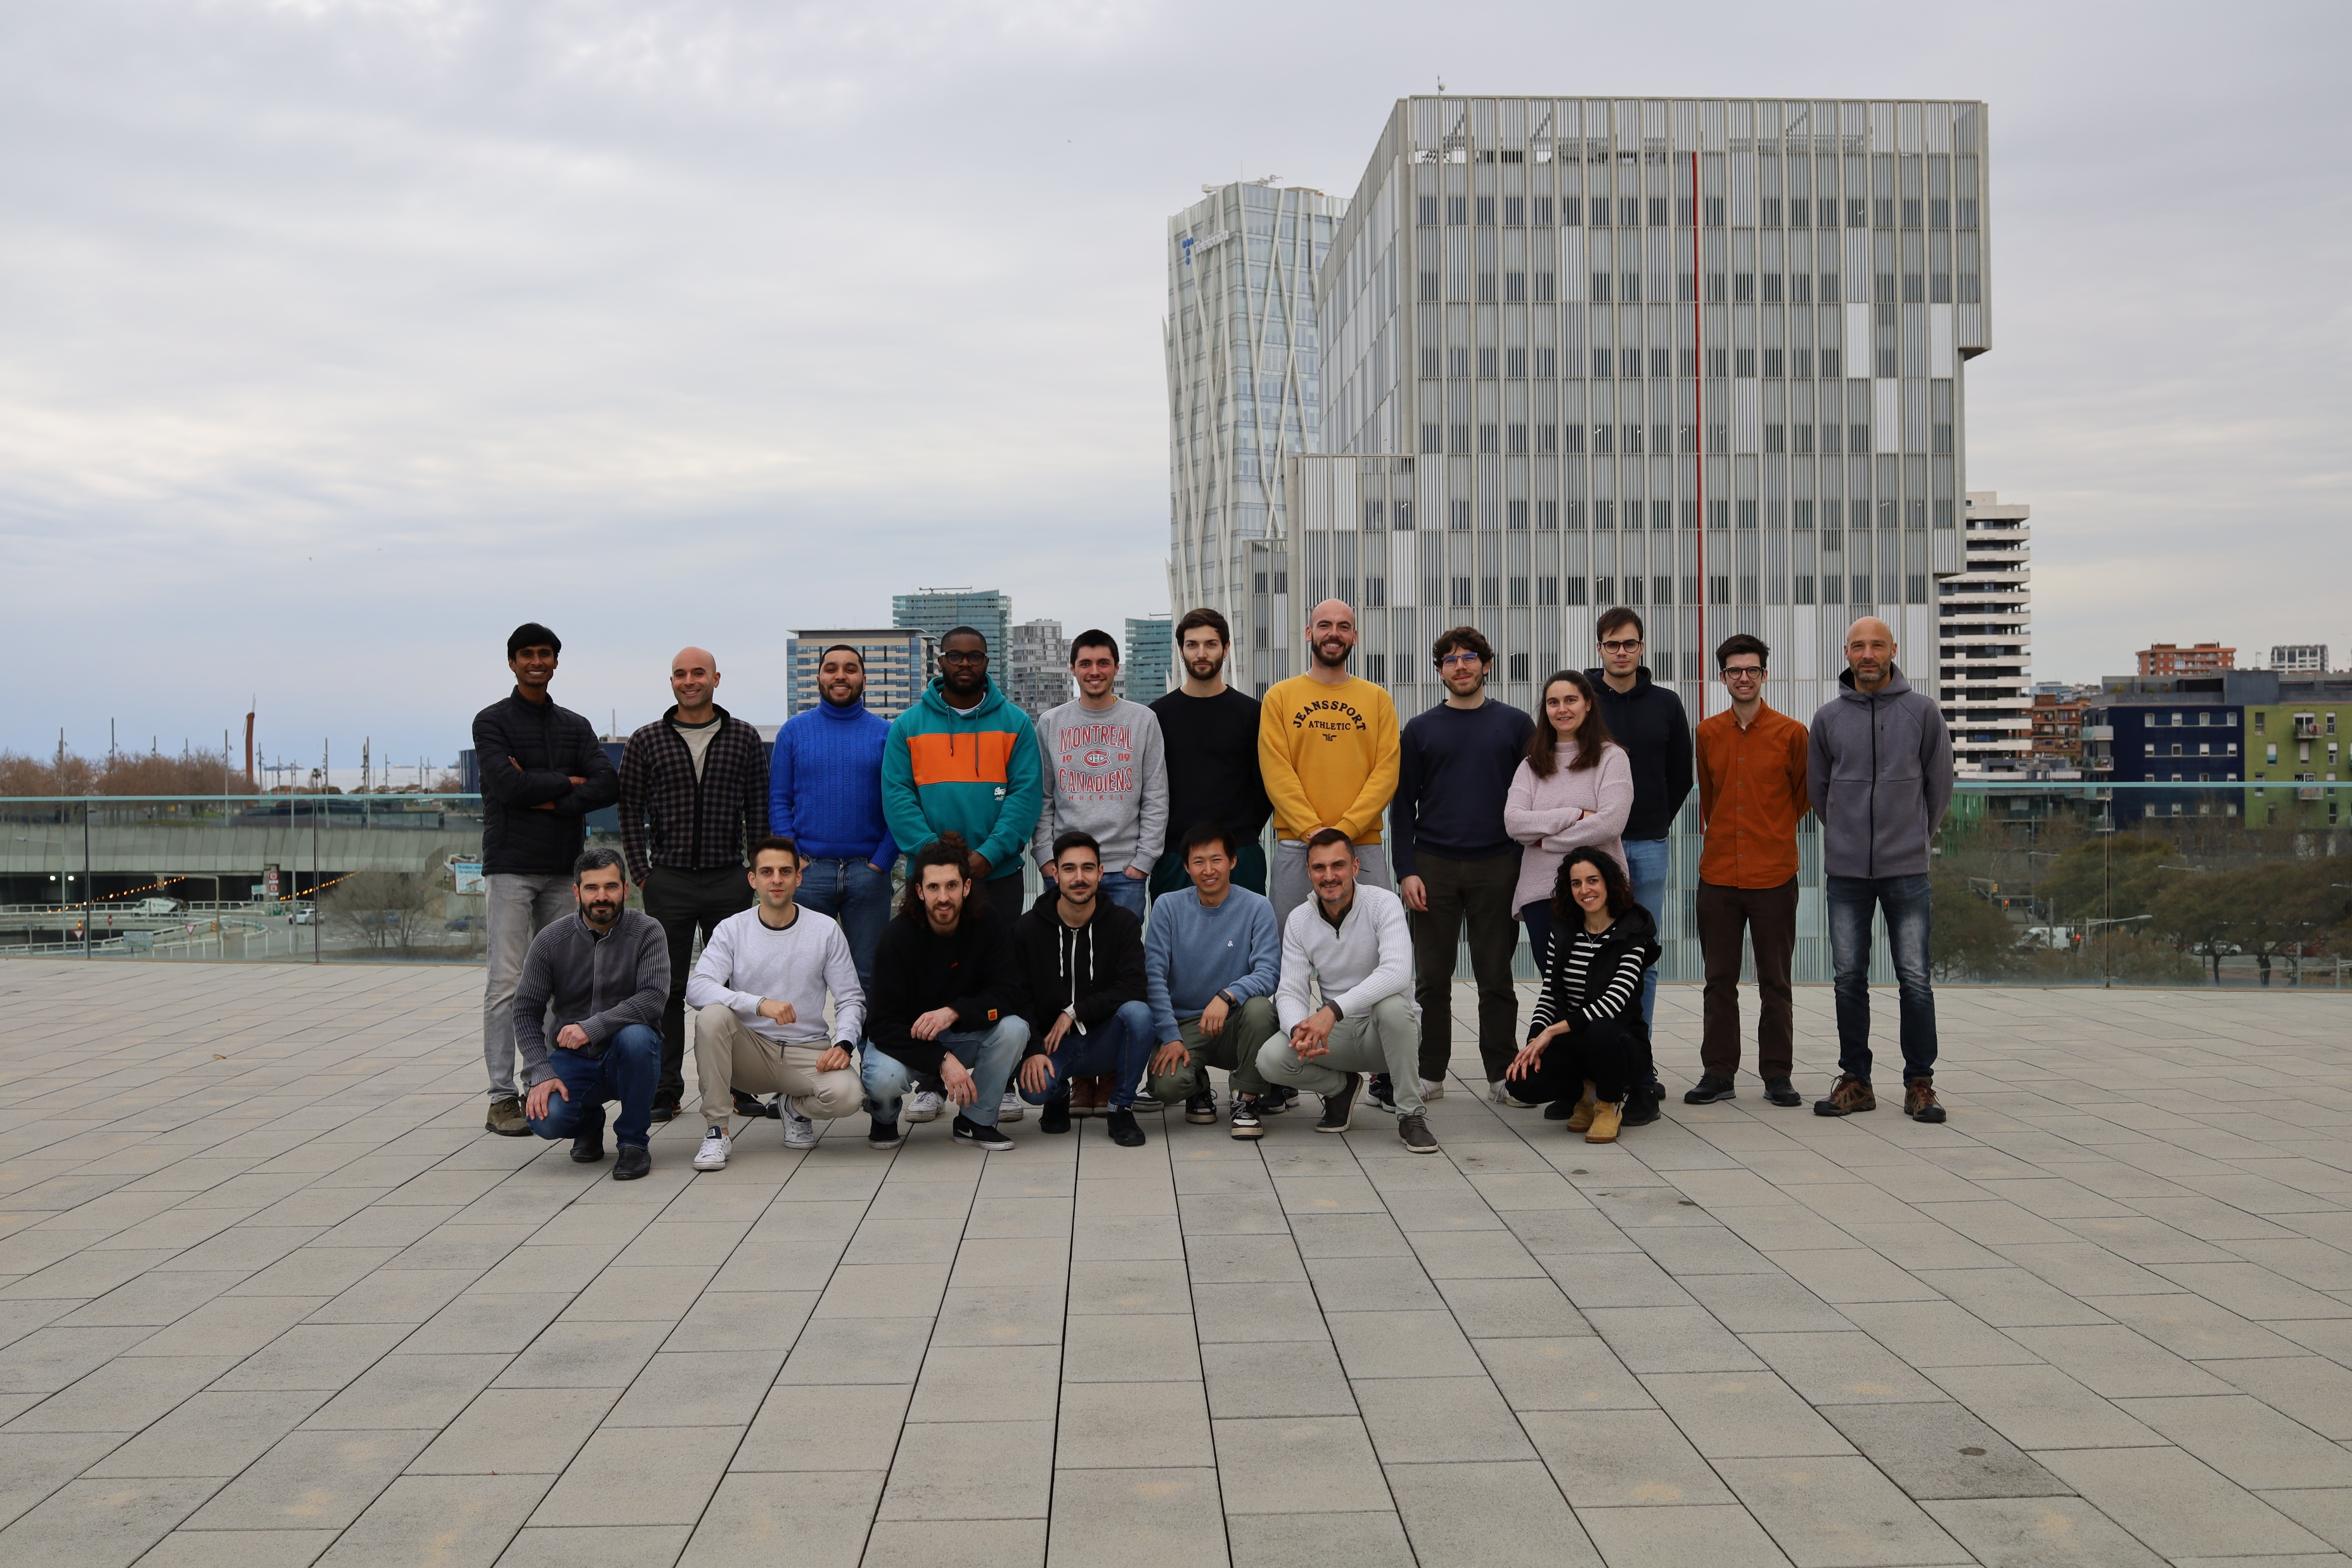
Kunal J. Tiwari Ph.D.
Catalonia Institute for Energy Research (IREC) & Polytechnic University of Catalonia (UPC-BarcelonaTech), Barcelona, Spain.
Investigating chalcohalide semiconductors for thin film PV application.
Materials of interest:(Sb/Bi)₂Se₃ and other emerging binary chalcogenides and chalcohalides.
Research Interest: Exploratory materials synthesis for solar to energy and fuel conversion. Advanced optical characterizations for materials and devices, device simulations(solar cells).
Emerging 2D materials e.g. MXene for application as selective contacts in opto electornic devices.
Research Group
Interested in learning about:
Development of methods and techniques for advanced optoelectronic characterization of semiconductors.
Interface engineering and study of interface between 2D MXene and Quasi 1-D chalcohalide semiconductors
Visit us for more information:
http://sensate.eu/
https://www.irec.cat/research/group/solar-energy-materials-and-systems/

Slide 3
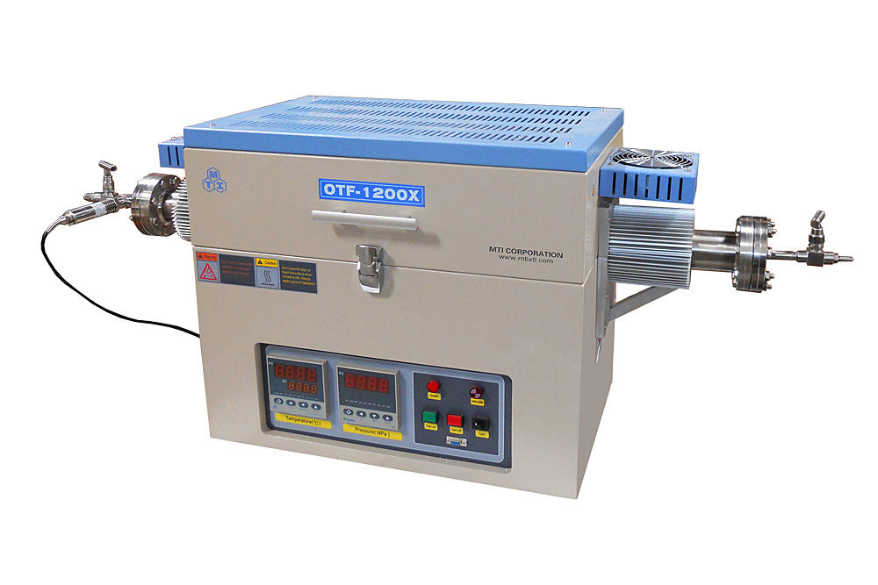
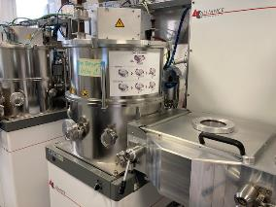
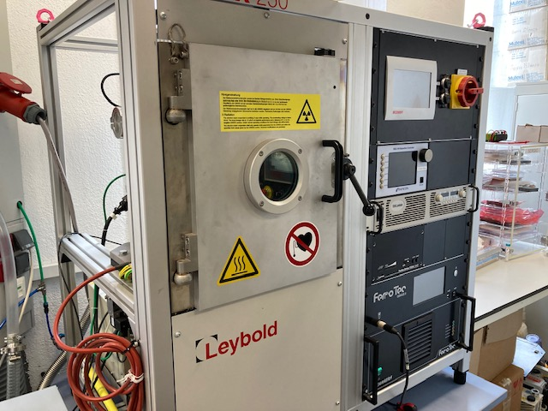
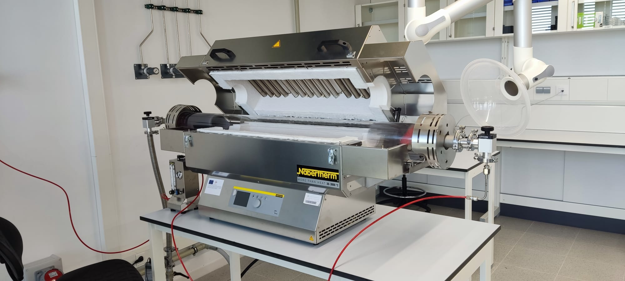
Development of the methods to deposit absorbers with controlled orientation
Exploration of new device structures
Incorporation of halides such as Br, I to realize mix chalcohalide compounds
Synthesis methods such as above ambient pressure reactive thermal annealing.
Interface modification with MXene´s and organic interlayers
Device simulation and development of advanced optoelectronic characterizations tools for materials and device characterization
Active Research Lines
Sb/Bi Chalcogenide
Sb/Bi Chalcohalide
Charge Selective Contacts
Materials Processing
Research Facilities
Institutional Infrastructure
Characterization

Slide 4
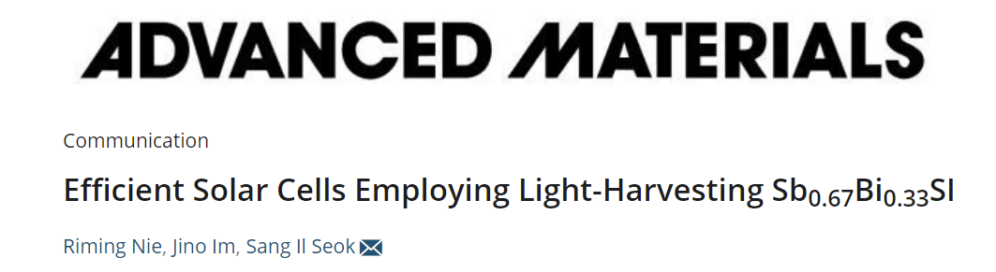
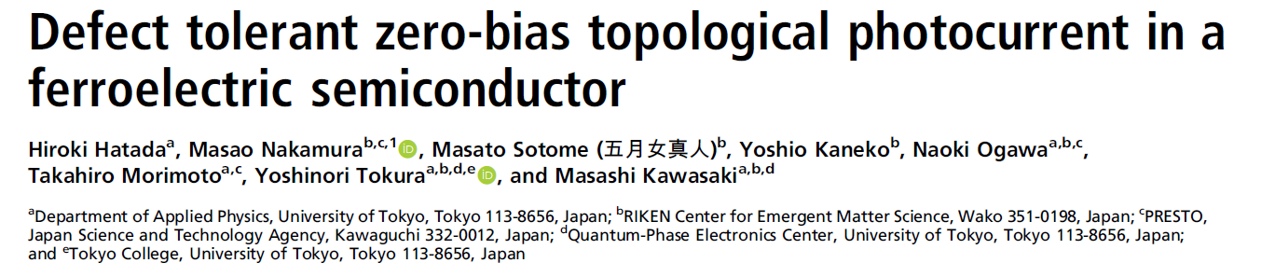
Background and Important Properties of antimony chalcohalide materials
Sb
Bi
Ferroelectric
Large dielectric constant
Photoconductive
Suitable E_{g} and α
Photoferroelectrics
Effect on PCE?
Se/S
I/Br
Why Chalcohalides??
Relatively less explored as compared to other compound semiconductors of this class.
Interesting platform for exploring the exotic properties such as contribution of ferroelectric behavior on photoelectric properties.
Detailed optoelectronic characteristics are not reported till yet.
Prospective applications beyond PV such as PEC, Memristors etc.

Slide 5
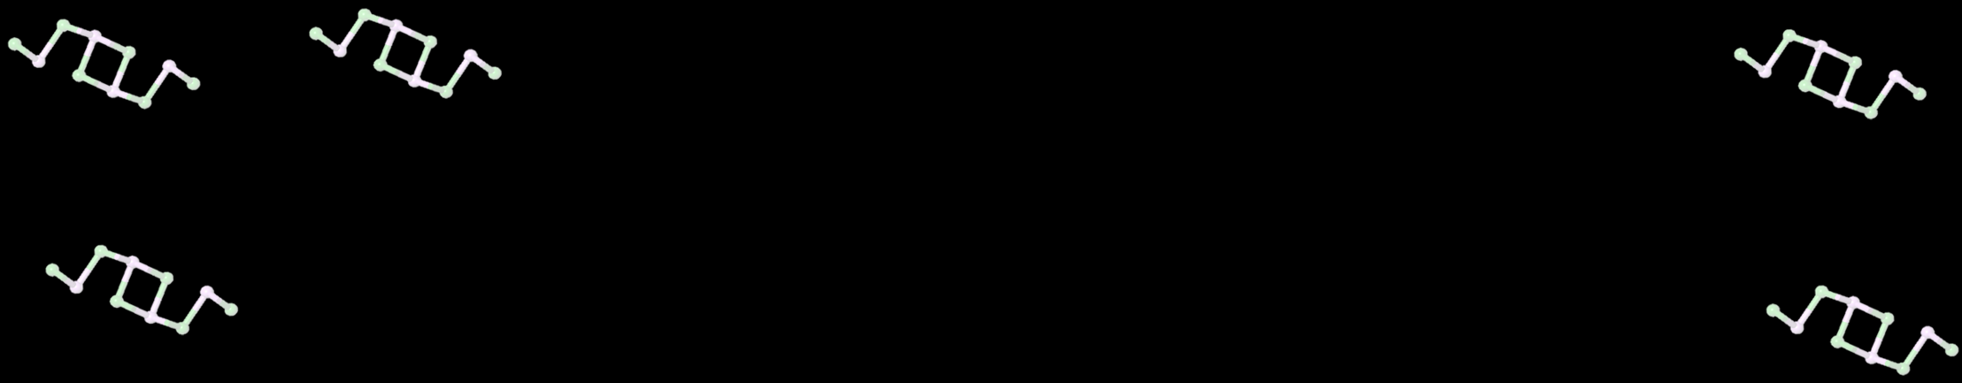
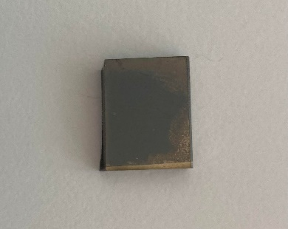
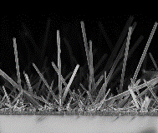
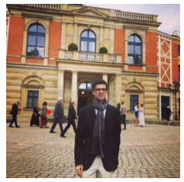
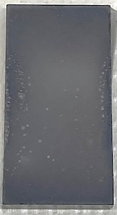
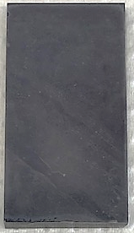
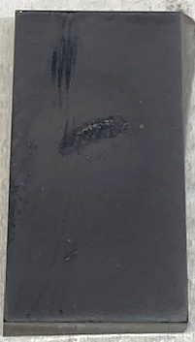
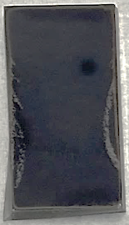
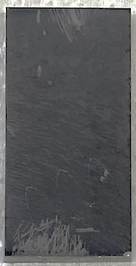
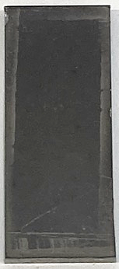
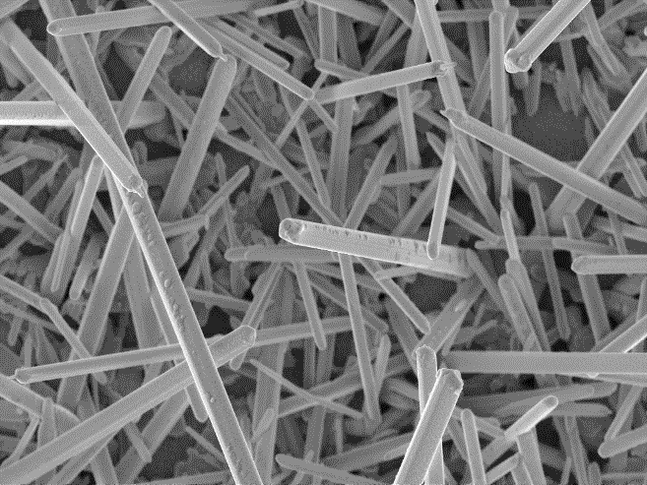
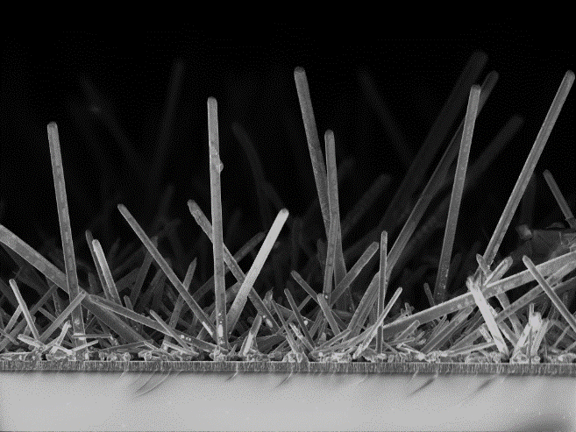
SbSeI
Preliminary Results
2 bar
7 bar
14 bar
SEM – Formation of SbSeI micro-columnar structures
Increasing T → height and density of micro-columnar structures increases
Thickness and uniformity of unreacted Sb₂Se₃ layer decreases
250ºC
275ºC
300ºC
450ºC
450ºC
500ºC
250ºC / 2 bar
275ºC / 2 bar
300ºC / 2 bar
450ºC / 2 bar
SbSeI
Mo
Sb₂Se₃ – 500 nm
I. Caño et al, under preparation.
Notes:
This slide is good

Slide 6
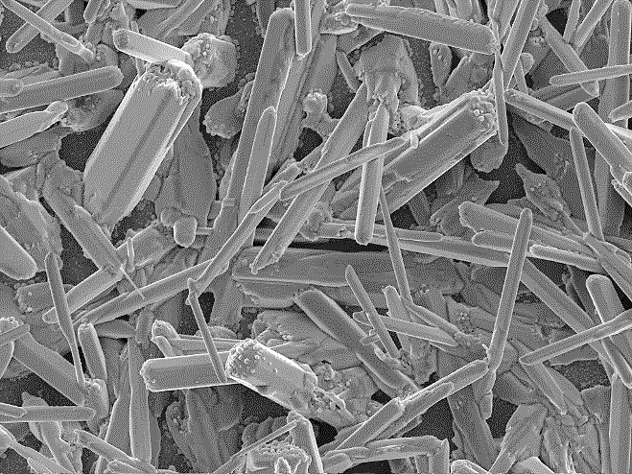
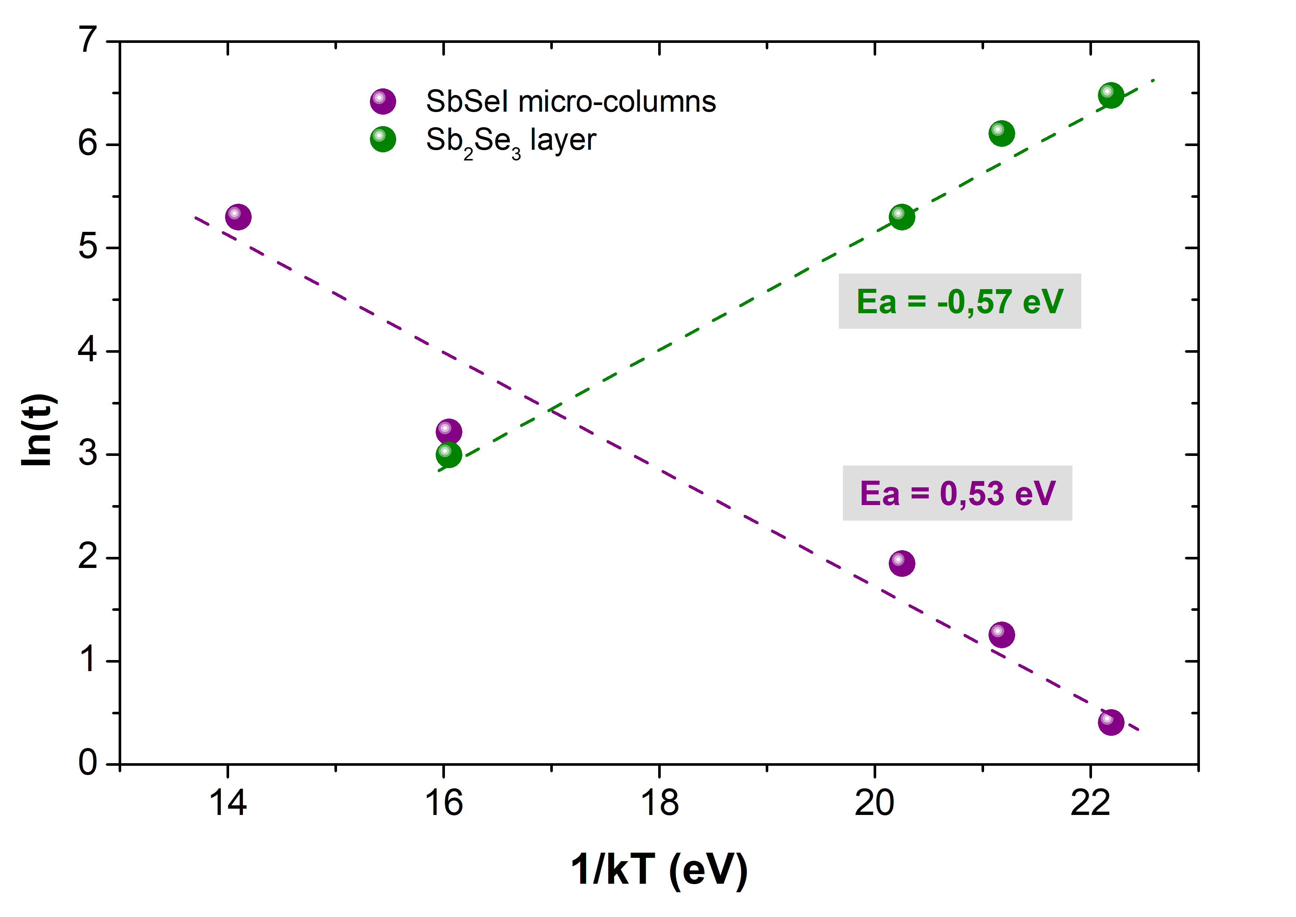
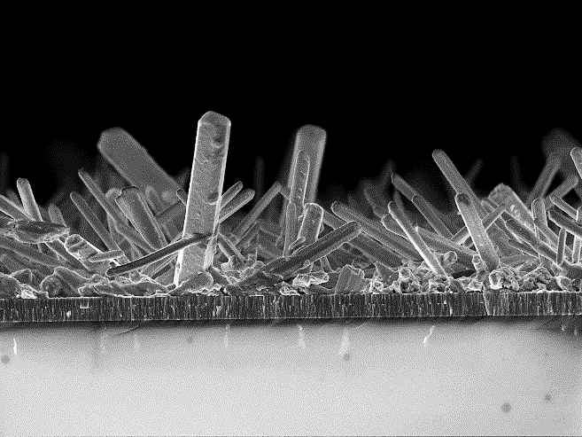
SbSeI
Preliminary Results
2 bar
7 bar
14 bar
SEM – Formation of SbSeI micro-columnar structures
Increasing T → height and density of micro-columnar structures increases
Thickness and uniformity of unreacted Sb₂Se₃ layer decreases
Increasing P → height of micro-columns decreases
Tunable morphology by modifying annealing conditions
250ºC
275ºC
300ºC
450ºC
450ºC
500ºC
250ºC / 2 bar
275ºC / 2 bar
300ºC / 2 bar
450ºC / 2 bar
450ºC / 7 bar
500ºC / 14 bar
Thickness (t) vs. Temperature (1/kT)
SbSeI
30 μm
10 μm
6 μm
6 μm
Similar Ea for SbSeI formation and Sb₂Se₃ consumption → process intimately linked
Low Ea → conversion to SbSeI is very favorable process
Sb₂Se₃
I. Caño et al, under preparation.
Notes:
This slide is good

Slide 7
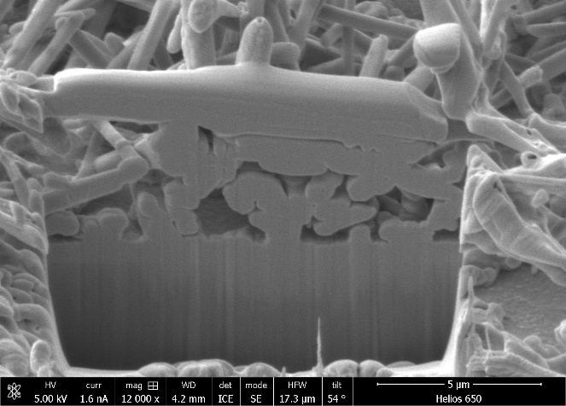
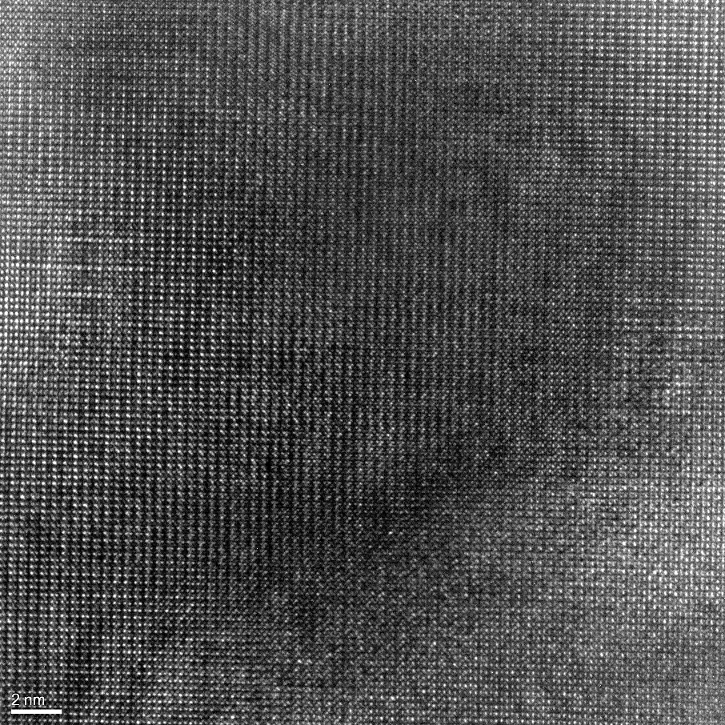
SbSeI
Preliminary Results
Structural and crystallographic characterization
Sb₂Se₃
XRD – Detected phases of Sb₂Se₃ (unreacted layer) and SbSeI
Sb₂Se₃ amount decreases as T increases
Full conversion to SbSeI at 450ºC – no preferred orientation
SbSeI
HR-TEM – Performed on a lamella of 450ºC / 2 bar sample
Excellent crystalline quality of micro-column structures
Constituted by a single crystal – absence of grains
500ºC / 14 bar
450ºC / 7 bar
450ºC / 2 bar
300ºC / 2 bar
275ºC / 2 bar
250ºC / 2 bar
I. Caño et al, under preparation.
Notes:
This slide is good

Slide 8

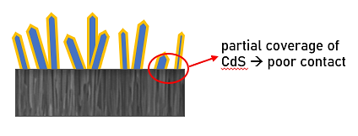
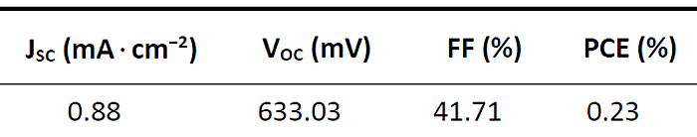
SbSeI
Preliminary Results
Optoelectronic characterization
J-V measurements
External Quantum Efficiency
Mo/SbSeI/CdS/ZnO/ITO samples
V_{oc} up to 550 mV (among the highest reported for SbSeI)
Low Jsc & FF → poor carrier collection (columnar morphology)
Bandgap of 1.8 eV – SbSeI is the dominant phase
Lower Eg due to Sb₂Se₃ absorption (layer of unreacted precursor)
300ºC
Bandgap:
275ºC | 1.25 eV
300ºC | 1.78 eV
Sb₂Se₃
V_{oc} around 550 mV, with PCE close to 1%
Both Sb₂Se₃ and SbSeI phases absorbing → contribution of a low Eg material (1.25 eV)
SbSeI
275ºC | 21 meV
300ºC | 31 meV
Previous results (solution-based)⁸
Urbach energy
275ºC
⁸ YC Choi, K Jung, Nanomaterials, 2021, 11, 3206
I. Caño et al, under preparation.
Notes:
Discuss also some applications beyond PV maybe?

Slide 9
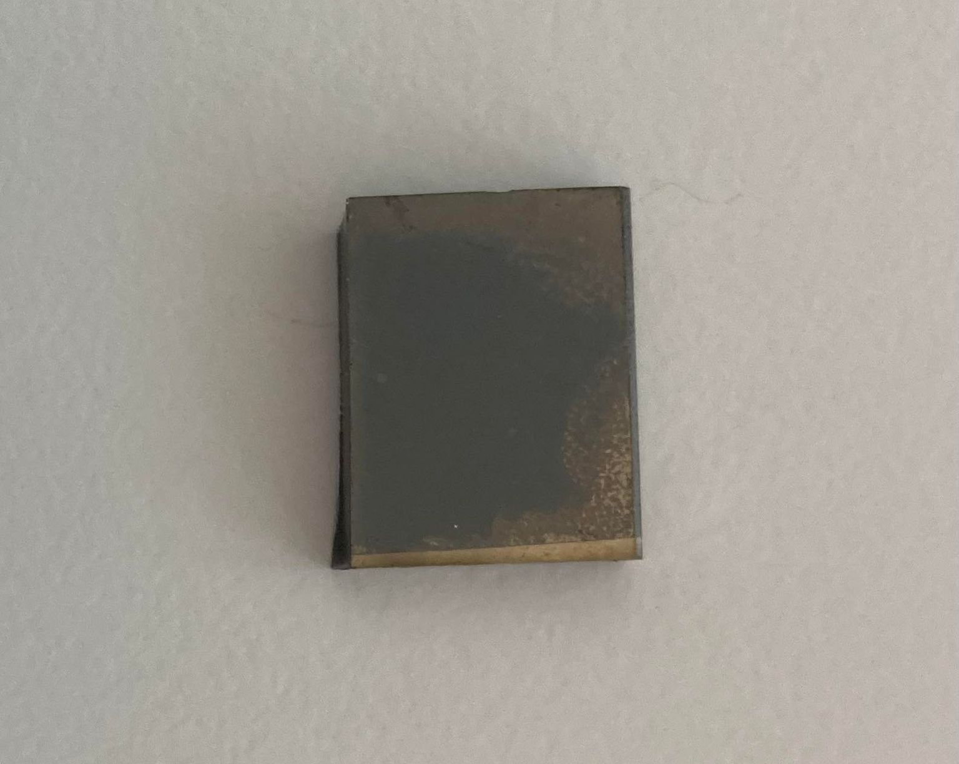
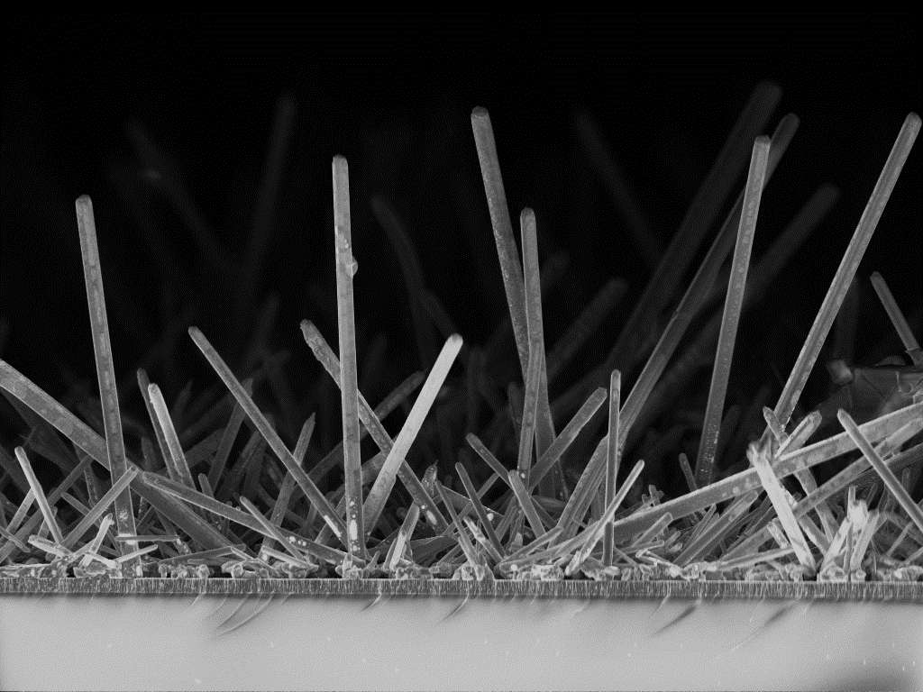
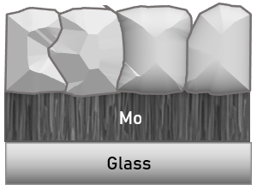
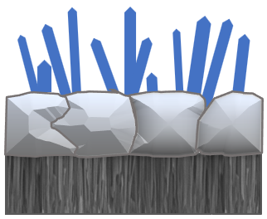

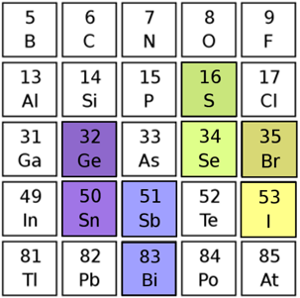
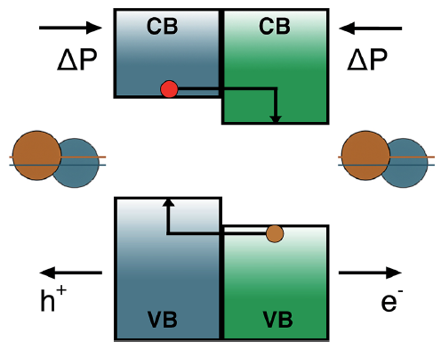
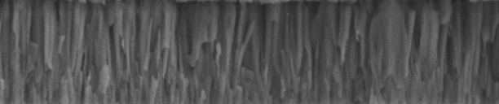
SbSeI Conclusion
SbSeI micro-columnar samples have been synthesized by high-pressure iodination of Sb₂Se₃ thin films
  Morphology can be tuned by varying annealing conditions (T and P)
  Samples annealed at T ≤ 300ºC → Sb₂Se₃ unreacted layer. Its amount decreases with increasing T
  T = 450ºC → Full conversion to SbSeI (no secondary phases)
Sb₂Se₃
SbSeI
Proposed formation model: columnar structures are form by a self-catalyzed SLV mechanism (solid-liquid vapor)
  Decomposition of SbI₃ to realease I_{2(g)}
  Sb₂Se_{3(s)} + I_{2(g)} → 2SbSeI_{(s)} + Se_{(l)}
  Precipitation of SbSeI_{(s)} from the liquid-Se leads to formation of micro-columnar morphology
SbI₃
NEXT STEPS
Expand the family of quasi-1D chalco-halides
New synthesis routes
First promising solar cells show V_{oc} values up to 562 mV
  Bandgap = 1.8 eV
  Low J_{sc} due to poor carrier collection leads to PCE slightly above 0.3%
Improve front contact
SbSeBr
BiSeI
SbSI
Sb(Se,S)I
(Sb,Bi)SeI
…
SbSeI
SbSeBr⁵
PVD: Co-evaporation
Full coverage by Atomic Layer Deposition (ALD)
Solution-based:
SbI₃ deposition on Sb₂Se₃ films
Single-source precursors
Improve carrier collection → J_{sc} ↑
New selective contacts: oxides (TiO₃, VO₅)
⁵ KT Butler, JM Frost, A Walsh, Energy & Environmental Science, 2015, 8, 838
I. Caño et al, under preparation.

Slide 10
Future Research Directions
Utilization of advanced characterization methods to develop a more complete understanding of these emerging compound semiconductors
Physico-chemical
Band Structure
Intrinsic Carrier Dynamics
Performance Limiting Factors
Carrier Dynamics
Transport layers screening
Absorber
Device

Slide 11
Thank You
We always remain open for suggestions and collaborations.

