Slide 1

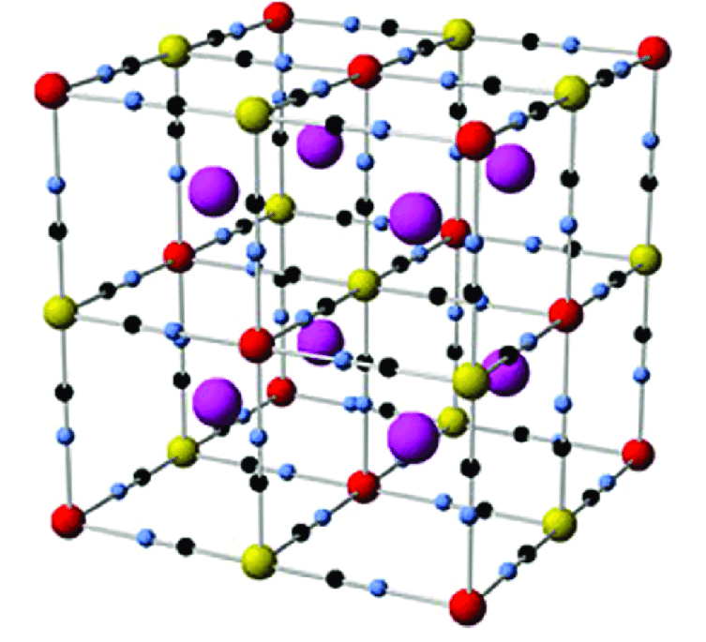
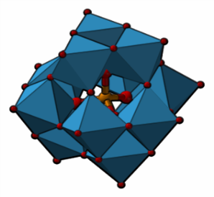
Advanced materials for hybrid energy storage devices
Novel Energy-Oriented Materials Group
Dr. Rosa Maria González Gil
Postdoctoral Researcher and Project Manager
14 abr. 2023
Maxwell Auditorium (ALBA Synchrotron)

Slide 2

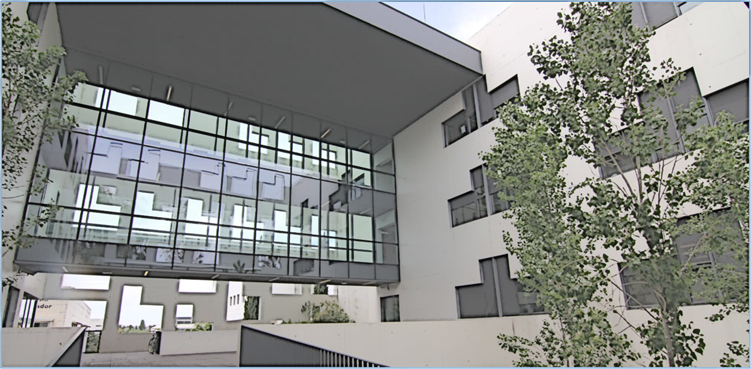
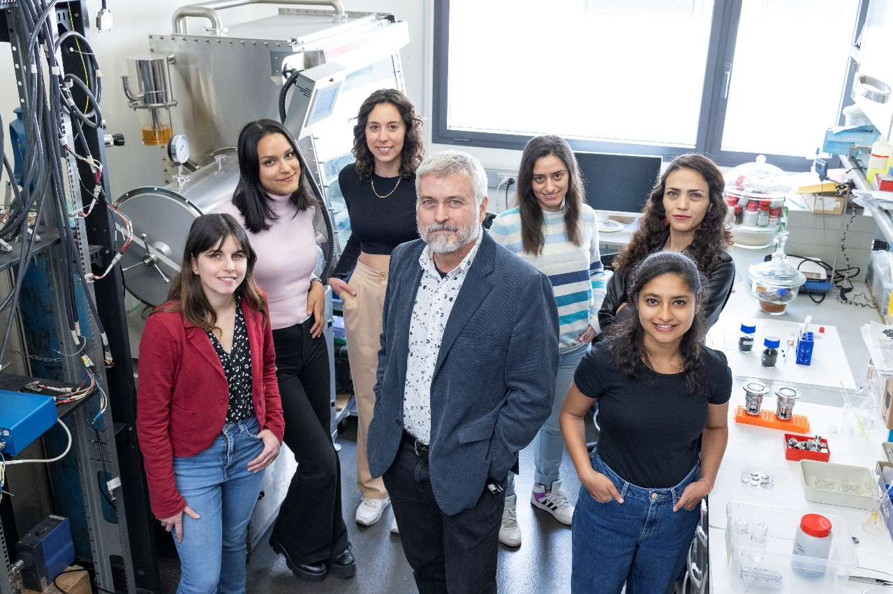




Novel Energy-Oriented Group (NEO-Energy)
Prof. Dr. Pedro Gómez Romero (Group Leader)
Postdoc:
Dr. Rosa Maria González Gil
Dr. Leandro Bengoa Abraham (MSCA)
PhD:
Anukriti Pokhriyal (DOC-FAM)
Verónica Fabían Puerta (DI-NBL)
Sharin Maria Thomas (SO)
Lipeng Wang (CSC)
Research technicians:
Judith Quiñones Acuña
Shamim Tayar
Degree students:
Bauke Roeterink Cerrillo
Georgia Martimianaki

Slide 3


Novel Energy-Oriented Group (NEO-Energy)
Research Objectives
Electrochemistry
Materials science
Supercapacitors
Batteries
ENERGY STORAGE
Energetic transition to renewables
Hybrid supercapacitors
Hybrid devices
Hybrid electrodes

Slide 4
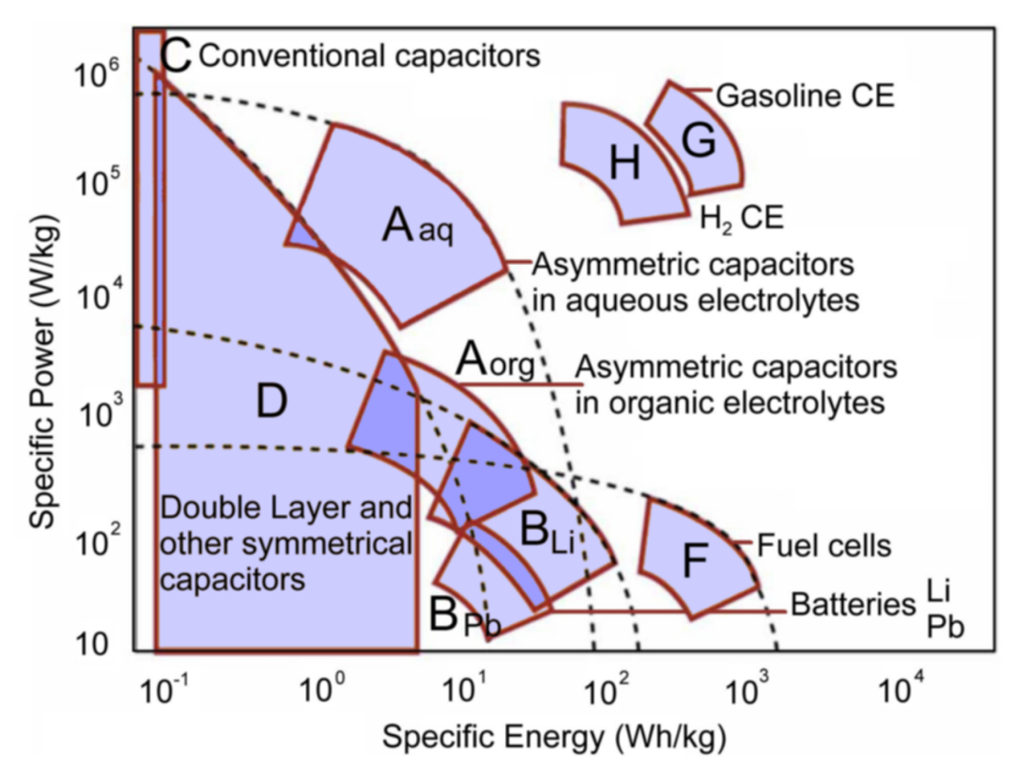
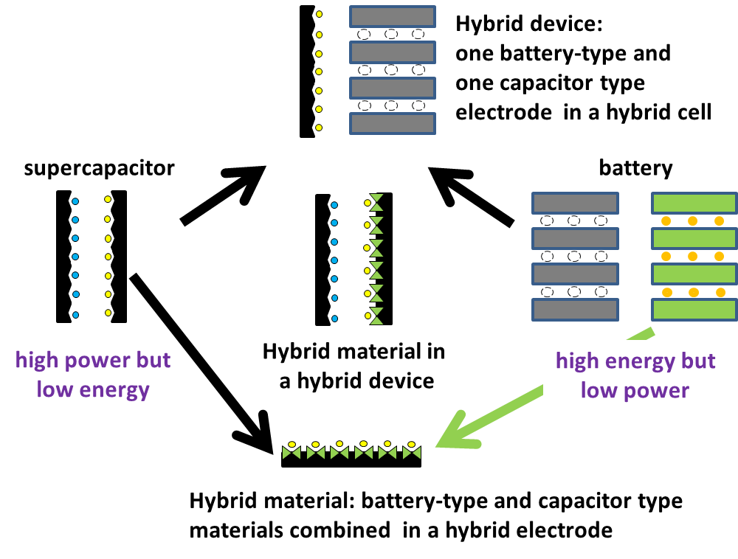
Energy storage devices
Supercapacitors
Hybrids
Ragone Plot
High Power Density
Fast charge discharge cycles
High cyclability (up to 10⁴ cycles)
Batteries
High Energy Density
Slow charge-discharge cycles
Low –regular cyclability (6·102 aprox)

Slide 5
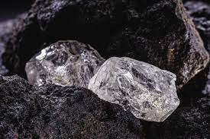
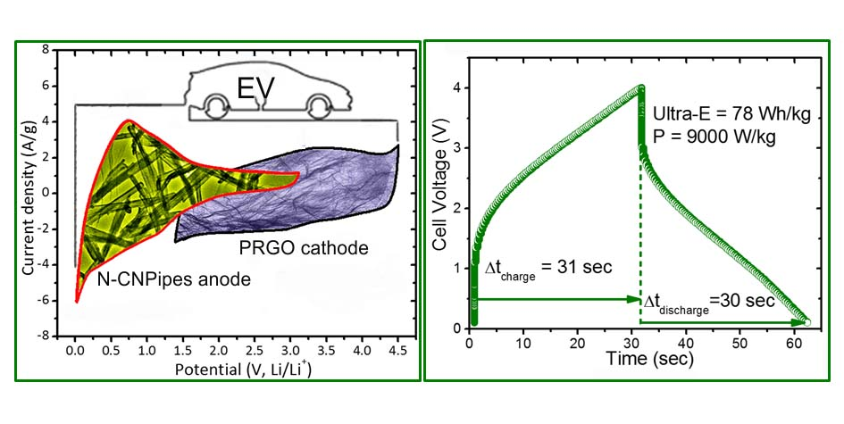
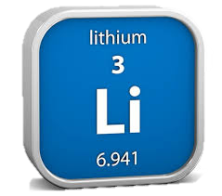
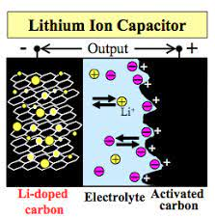
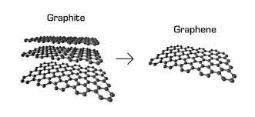
Advanced materials for hybrid energy storage devices
Li-ion supercapacitor
All Nanocarbon Li-Ion Capacitor with High Energy and High Power Densities.
Deepak P. Dubal,* Pedro Gomez-Romero** Materials Today Energy 2018, 8, 109-117

Slide 6
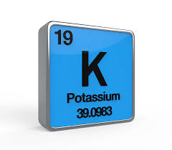
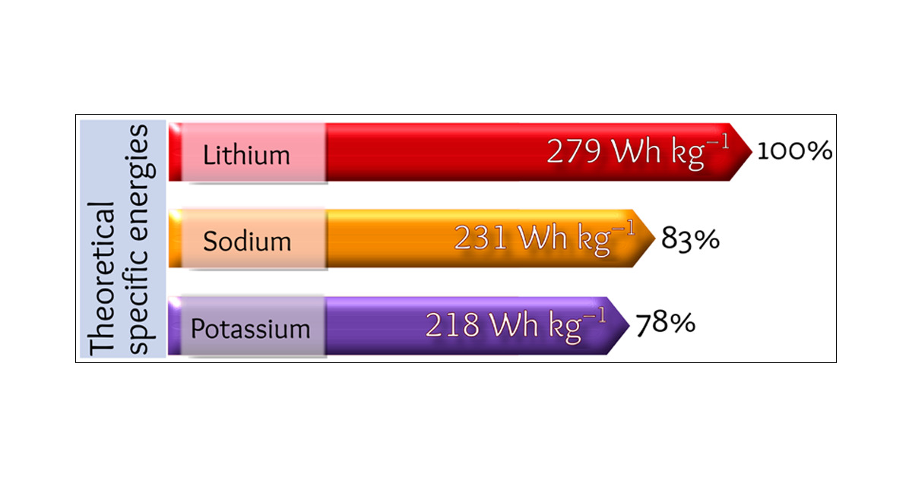
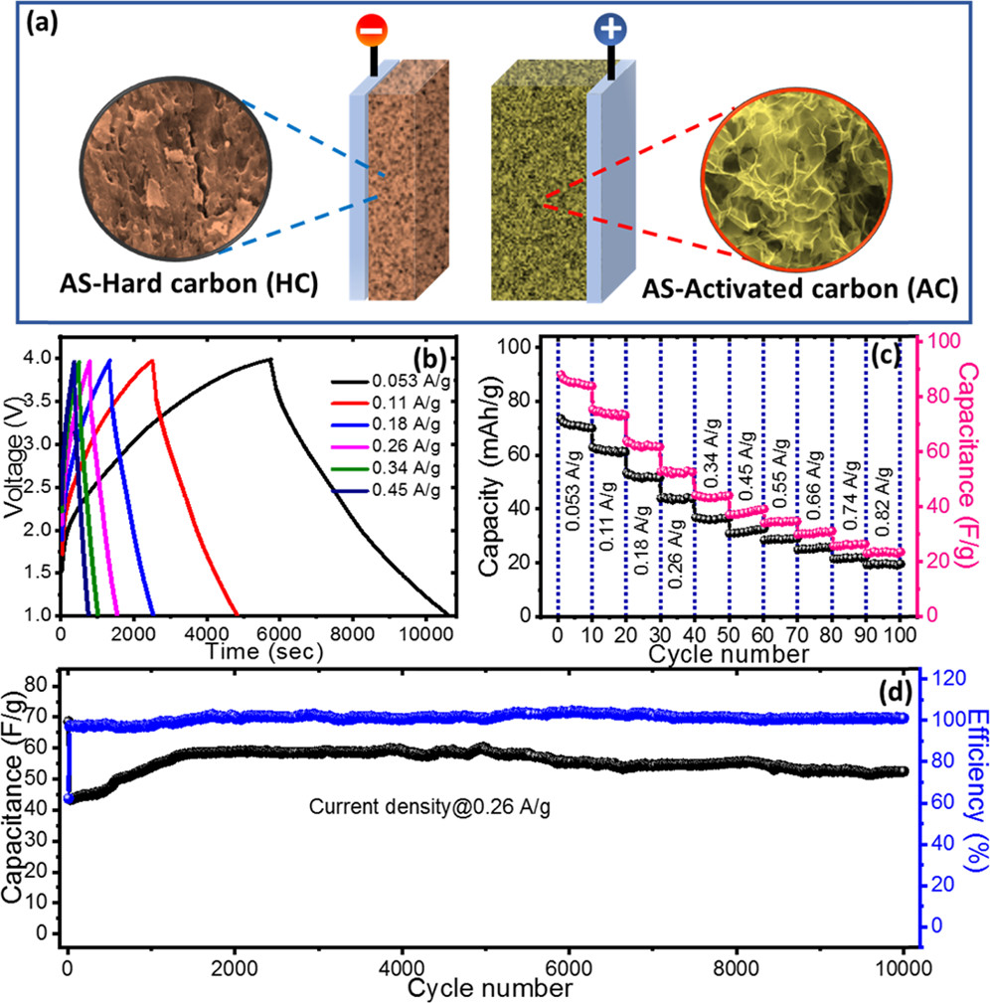
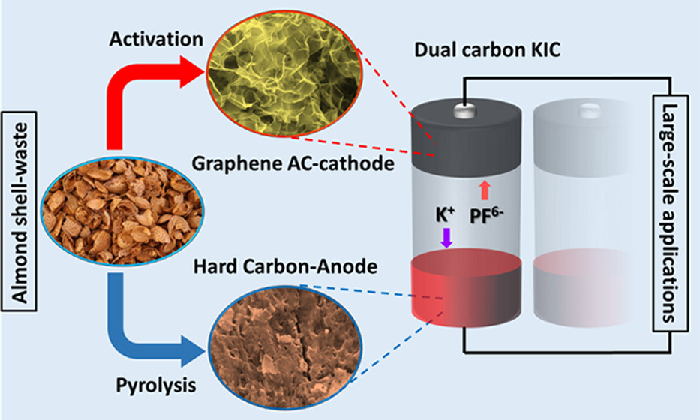
Advanced materials for hybrid energy storage devices
K-ion supercapacitor
Fabrication of graphene-like materials from Agro-wastes
Dual carbon potassium-ion capacitors: Biomass-derived graphene-like carbon nanosheet cathodes.
Pham, Hong Duc; Mahale, Kiran; Hoang, Thi My Linh; Mundree, Sagadevan G.; Gomez-Romero, Pedro; Dubal, Deepak P.
ACS Applied Materials & Interfaces 2020, 12(43), 48518-48525.

Slide 7
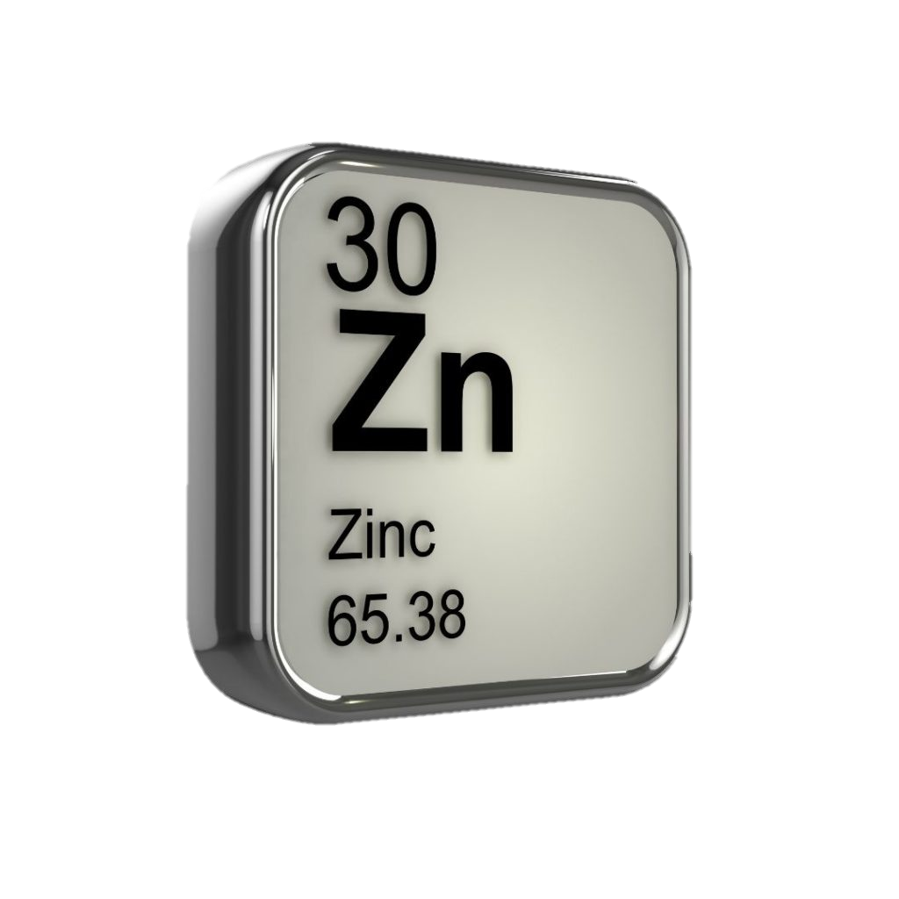
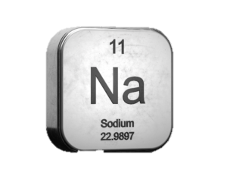
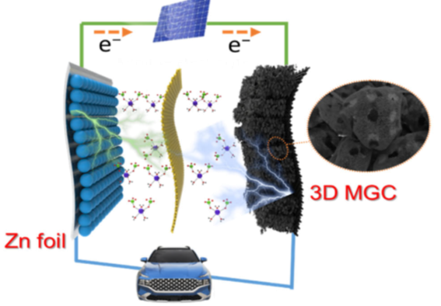
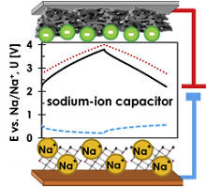

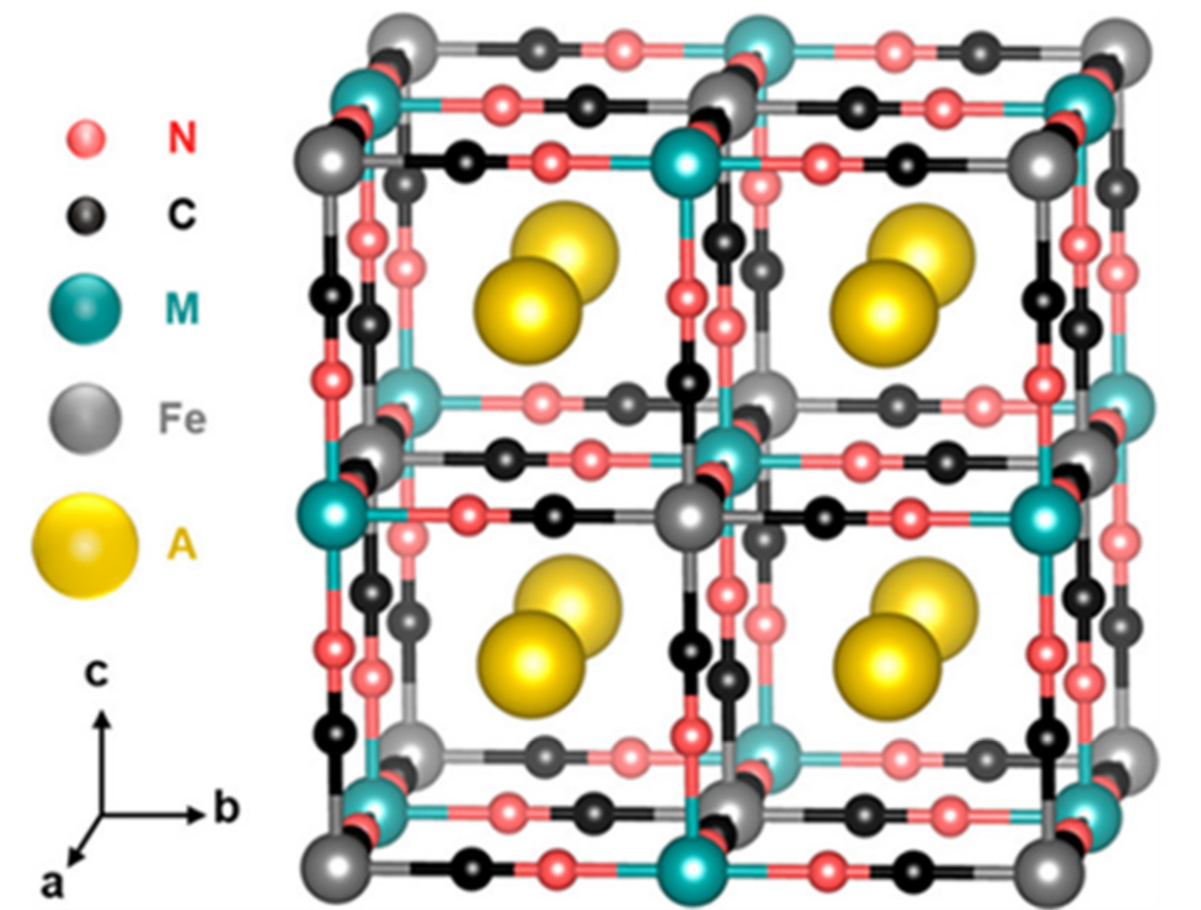
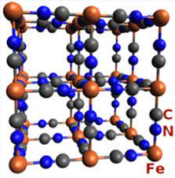
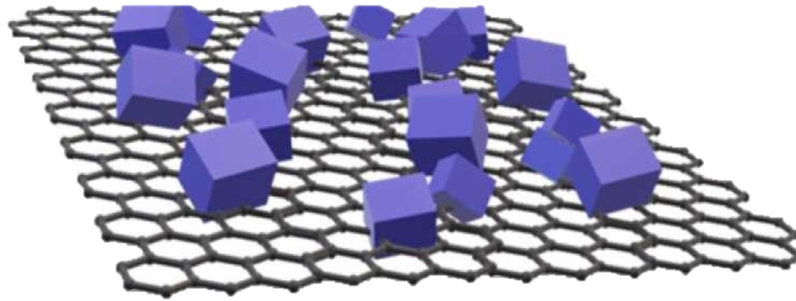
Advanced materials for hybrid energy storage devices
Na-ion supercapacitor
Zn-ion supercapacitor
Abundant
Safe
Low cost
Prussian Blue and Prussian Blue Analogues
Suitable cathodes for hybridization
Cation insertion
Sustainable
Scalable synthesis
Low cost production
Stable structure
PB@G

Slide 8

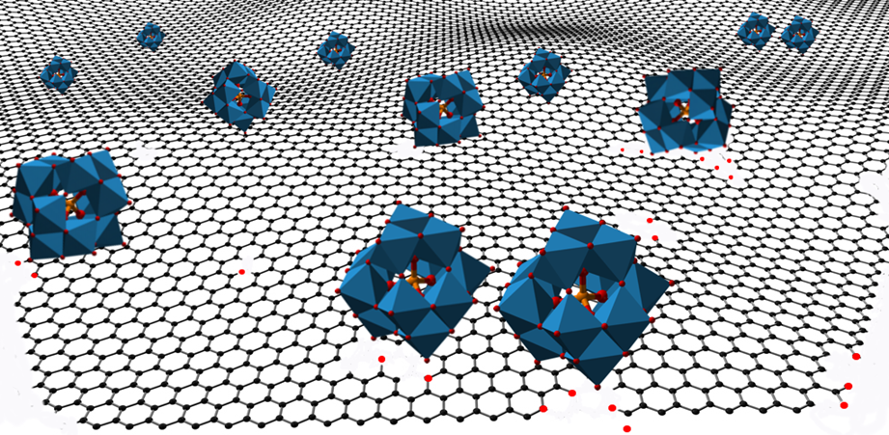
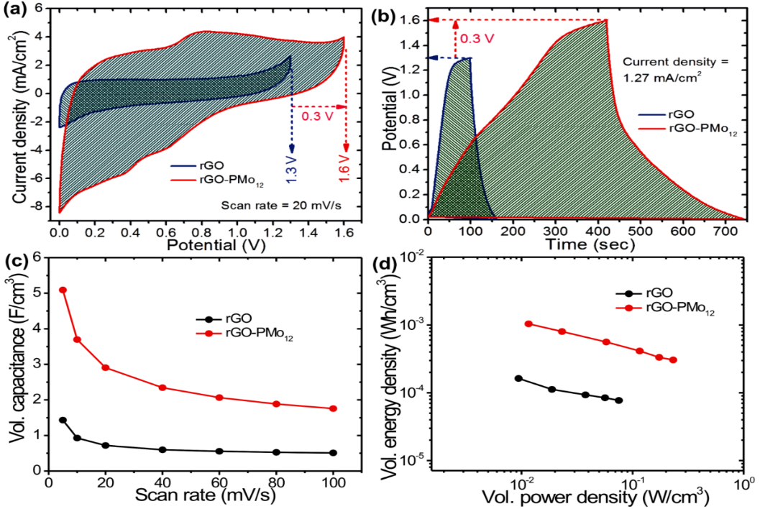
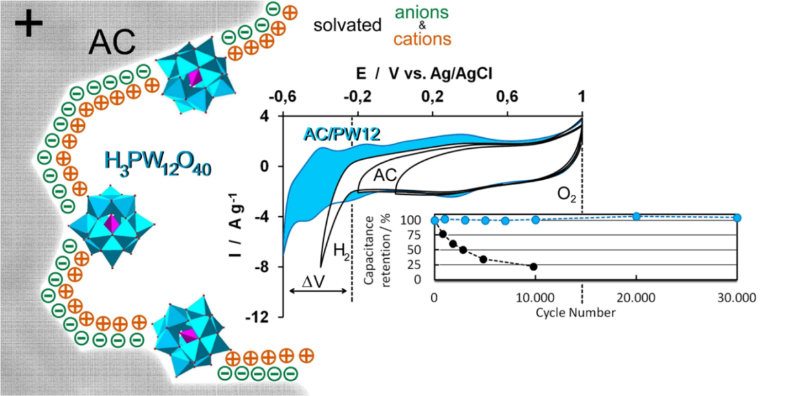
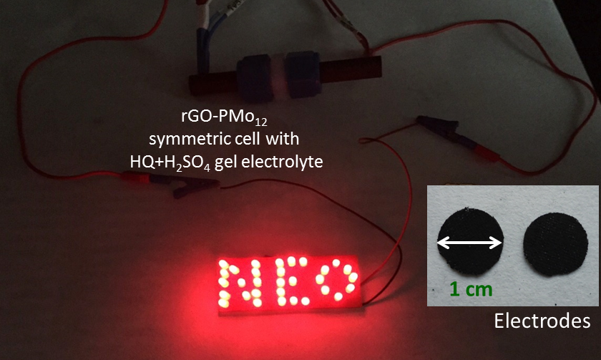
Hybrid supercapacitors based on POMs
Polyoxometalates (POMs): redox-active oxo-anion nanoclusters
Can store up to 24 e-
multi-electron redox processes
High structure stability
1nm of size
 | AC | AC-PW12
C (Fg-¹) ª (mAh/g) | 185 (77) | 254 (106)
E_{sp} (Wh/Kg) | 4.05 | 4.96 (1.6 A/g)
P_{sp} (kW/Kg) | 45 | 115
E_{d} (Wh/L) | 1.55 | 2.32
cycles | 10,000 | > 30,000 (6 A/g)
J. Suárez-Guevara, V. Ruiz, P. Gomez-Romero J. Mater. Chem. A, 2014, 2 (4), 1014-1021
Michael Horn et al. Energy and Environmental Science, 2021, 14(4), pp. 1652–1700

Slide 9
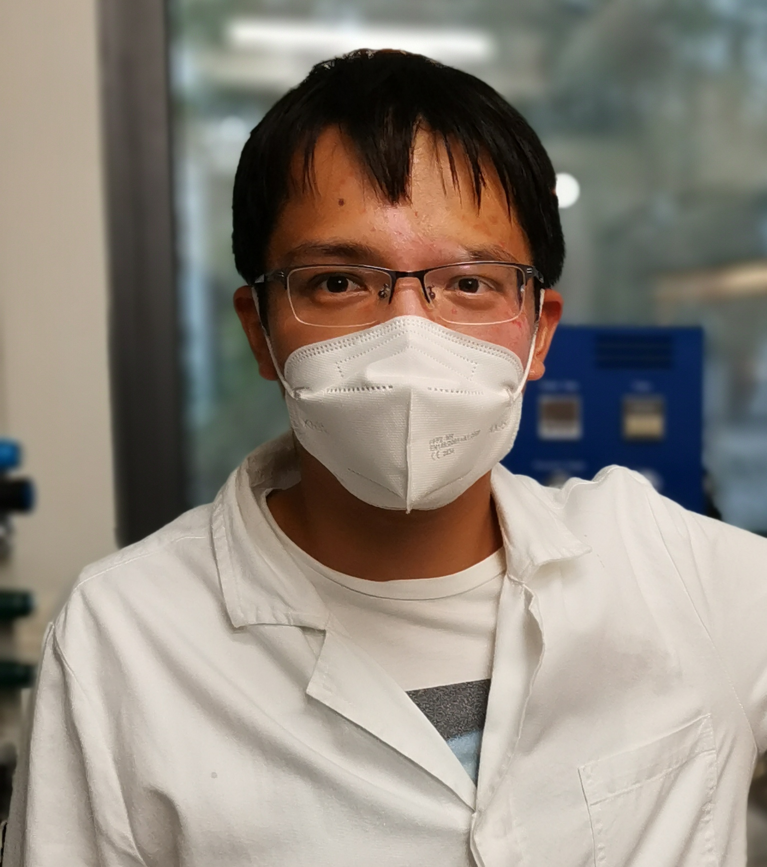
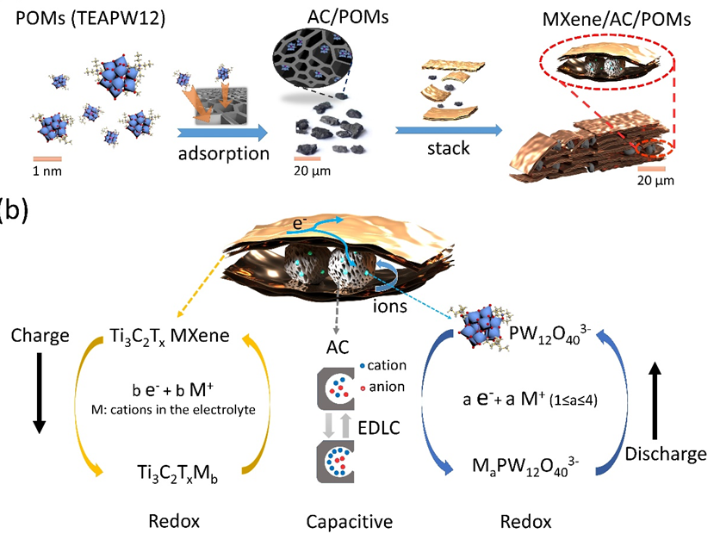
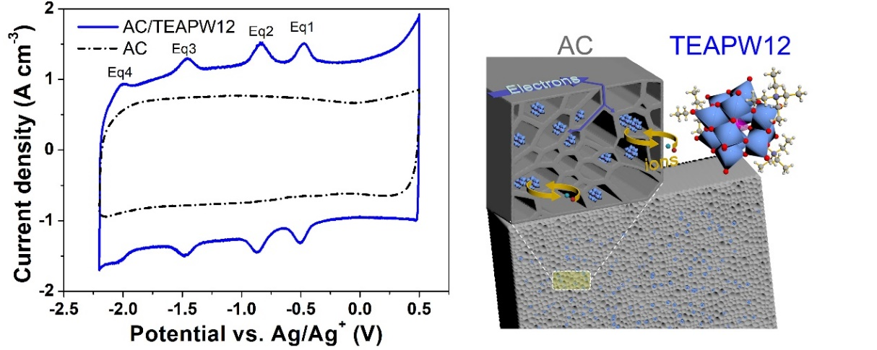
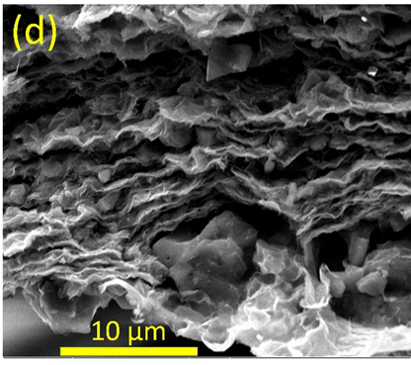
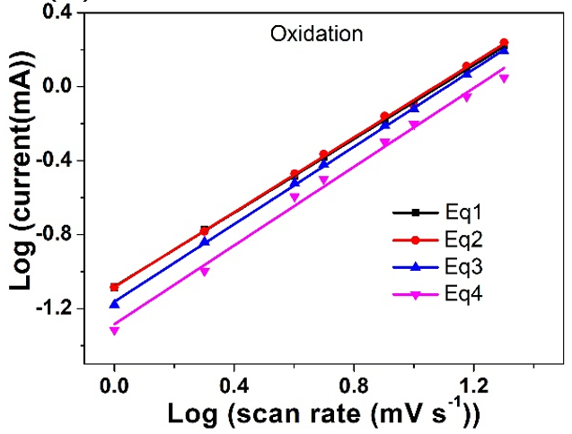
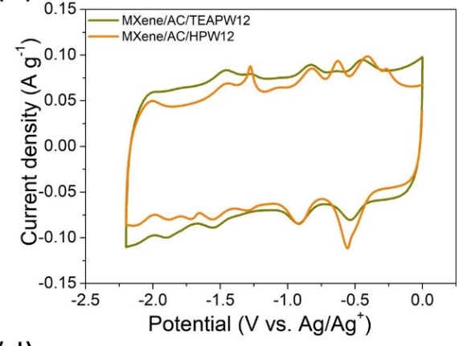
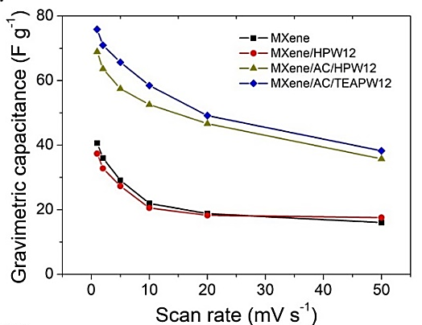

Hybrid supercapacitors based on POMs (organic electrolytes)
Polyoxometalates (POMs): redox-active metal nanoclusters
Combined with 2D-MXenes
Gravimetric capacitance of the hybrid was 2.2 times that of MXene.
$$i=av^{b}$$
(Ti₃C₂T_{x})
current
scan rate
b=1
NOT limited
by diffusion
as in supercapacitors
JJ Zhu, R Benages-Vilau, P Gomez-Romero* Electrochimica Acta 2020 137007
J-J. Zhu*, H. Avireddy, J.Jacas-Biendicho, L. Martinez-Soria, B. Ballesteros, D. Rueda-Garcia, J. Ramon Morante, P. Gomez-Romero*. Colloid and Interface Science, 2022, 623, 947–961.

Slide 10
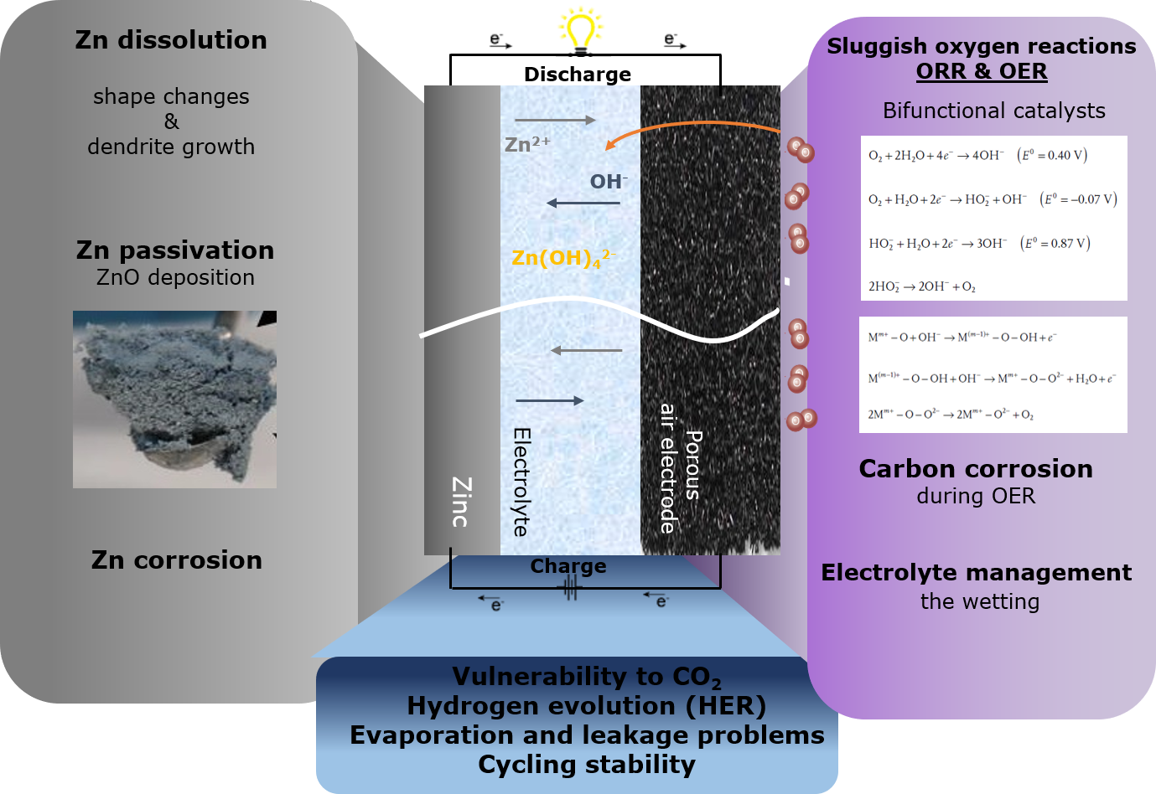
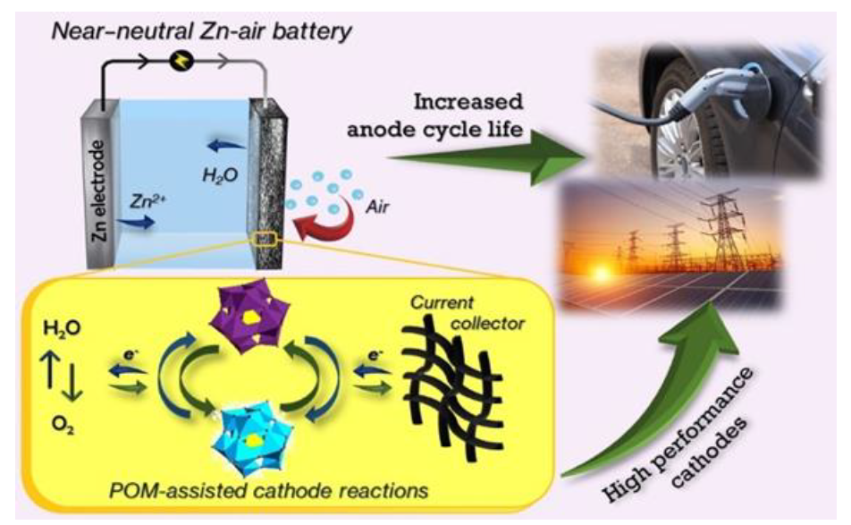
Hybrid supercapacitors based on POMs
Polyoxometalates (POMs): redox-active metal nanoclusters for Zn-air batteries

Slide 11

Thank you!
Dr. Rosa Maria González Gil
rosamaria.gonzalez@icn2.cat

