Slide 1
Adaptation of ALBA beamlines
InCAEM workshop 14th apr’23
Lucía Aballe¹, Josep Nicolas¹, Carlos Frontera²
¹ ALBA, ² ICMAB

Slide 2
Goal
… the adaptation of ALBA beamlines to allow correlative analysis of advanced materials for energy applications, i.e., to combine x-ray based techniques with other capabilities that will be made available within the InCAEM project such as operando/in-situ (S)TEM and scanning probe microscopies, for multi-modal and multi-length scale studies of complex problems”.
Workpackage 3 of the InCAEM project

Slide 3
Part 1: TEM micro reactors
To adapt XRD and XAS beamlines to allow them using TEM portable micro reactors.
Catalysis sample holder system
  Controlled gas mixing and flow
  RGA
  Controlled T
Electrochemistry sample holder system
  Liquid Flow
  In situ electrodes
  Potentionstat
(S)TEM
BL04-MSPD
BL13-XALOC
X-ray absorption spectroscopy
FTIR spectro-microscopy
BL16-NOTOS
BL22-CLAESS
BL01-MIRAS

Slide 4
Part 2: SPM sample exchange
To allow surface science beamlines at ALBA (soft x-rays) to enable correlative studies with the SPM platform.
a) Transport of samples in controlled conditions (UHV)
b) Fiducialization: finding the exact position tested within the sample
SPM platform
X-ray photoemission electron microscopy
BL24-CIRCE
Soft XAS
X-ray magnetic dicroism
Near ambient pressure photoemission spectroscopy
BL29-BOREAS
BL24-CIRCE
Angle resolved photoelectron spectroscopy
BL20-LOREA

Slide 5
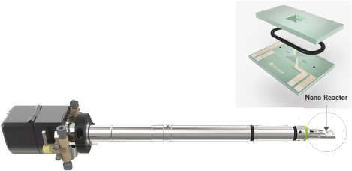
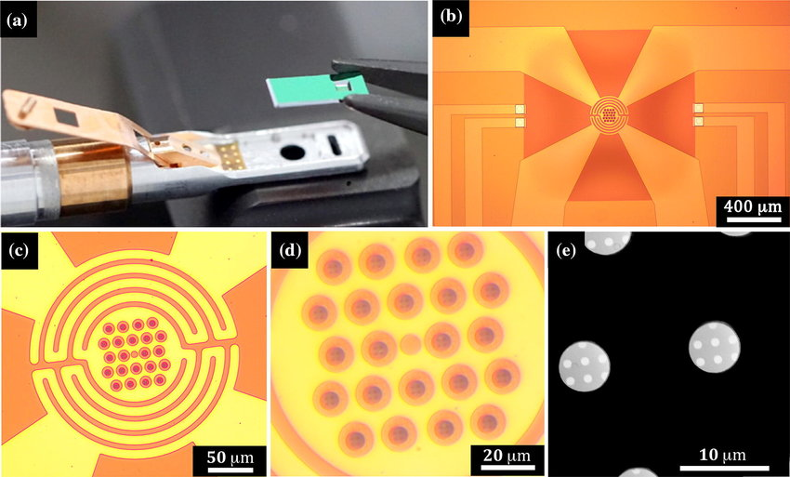
micro reactors
  The full sample holder of the SEM does not fit with the geometry of any beamline
  ➔ Dissassemble the tip with the chip
  ➔ Rebuild and connect gas/liquid manifold.
  The sample is tiny, as well as the Si3N4 Windows
  ➔ Is signal strong enough?
  Need microfocus
    Bulky system
    No space for Izero, or fluo detector
    Microscope, and positioning system

Slide 6
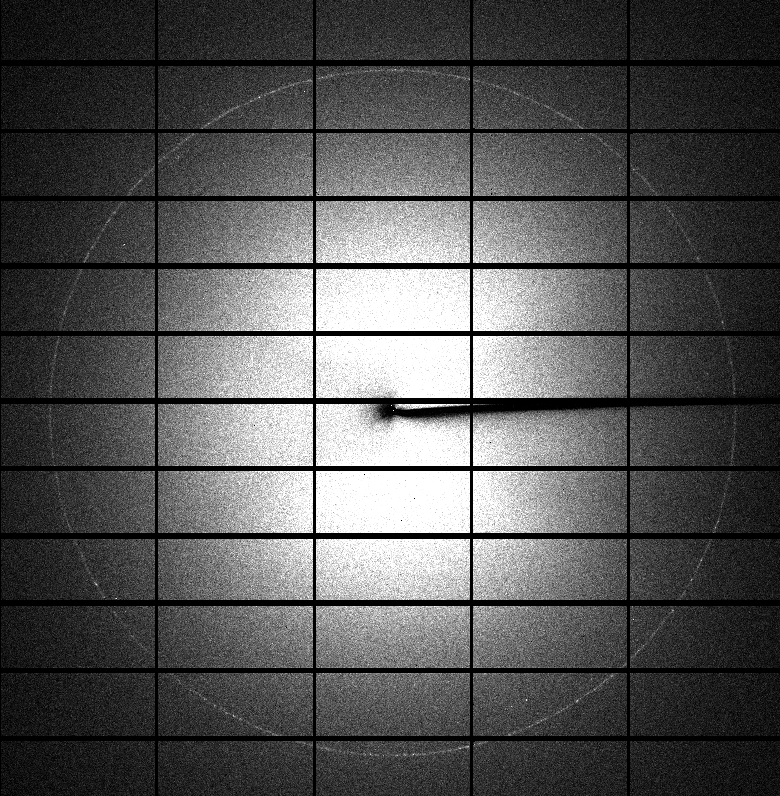
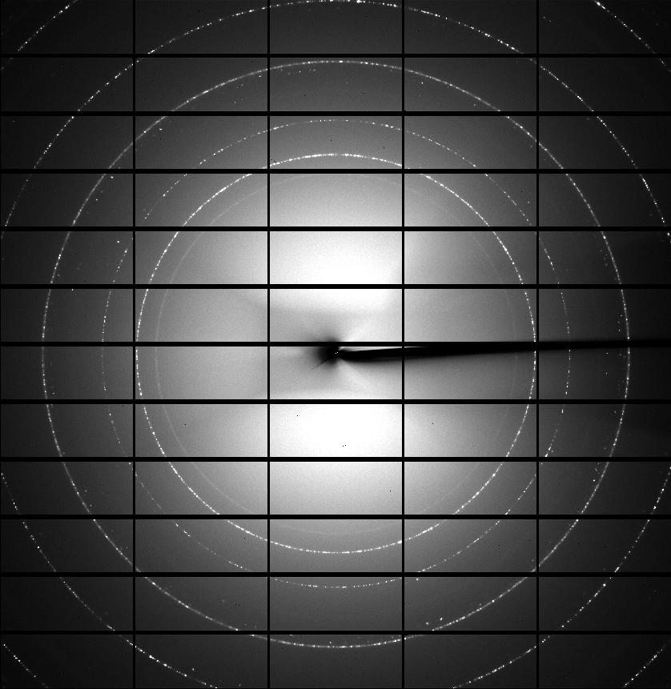
Feasibility tests (Diffraction)
We are conducting feasibility tests, at the different beamlines, mainly to determine the level of signal, spot size requirements, and information obtained
EMPTY
LOADED
BL04-MSPD,BL13-XALOC
These beamlines already have a small spot size on sample (but >10µm)
Good level of signal.
Some parasitic peaks from substrate and heater circuit
High resolution sample viewing system necessary.
Sample: Pt/PdO nanoparticles supported in a CeO₂ matrix

Slide 7
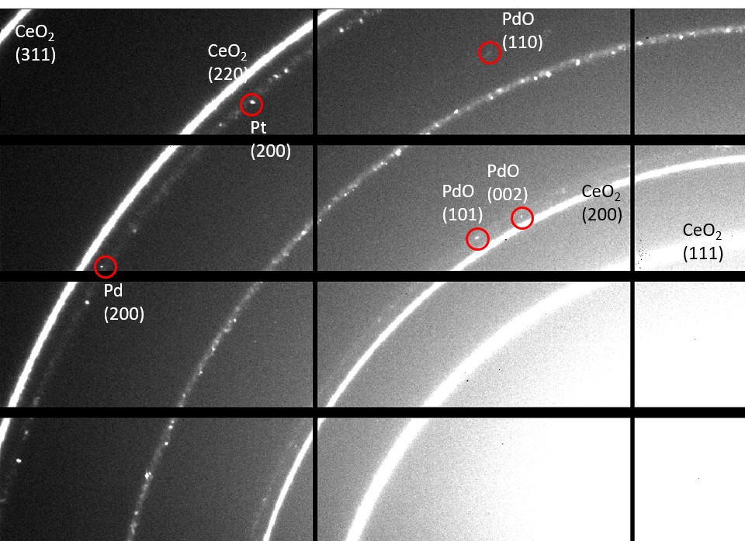
Feasibility tests (Diffraction)
Single-crystal like diffraction spots can be found at d-spaces corresponding to very diluted phases present in the sample.
Whether these could be used to characterize the evolution of these phases, is under study.
Sample: Pt/PdO nanoparticles supported in a CeO₂ matrix

Slide 8
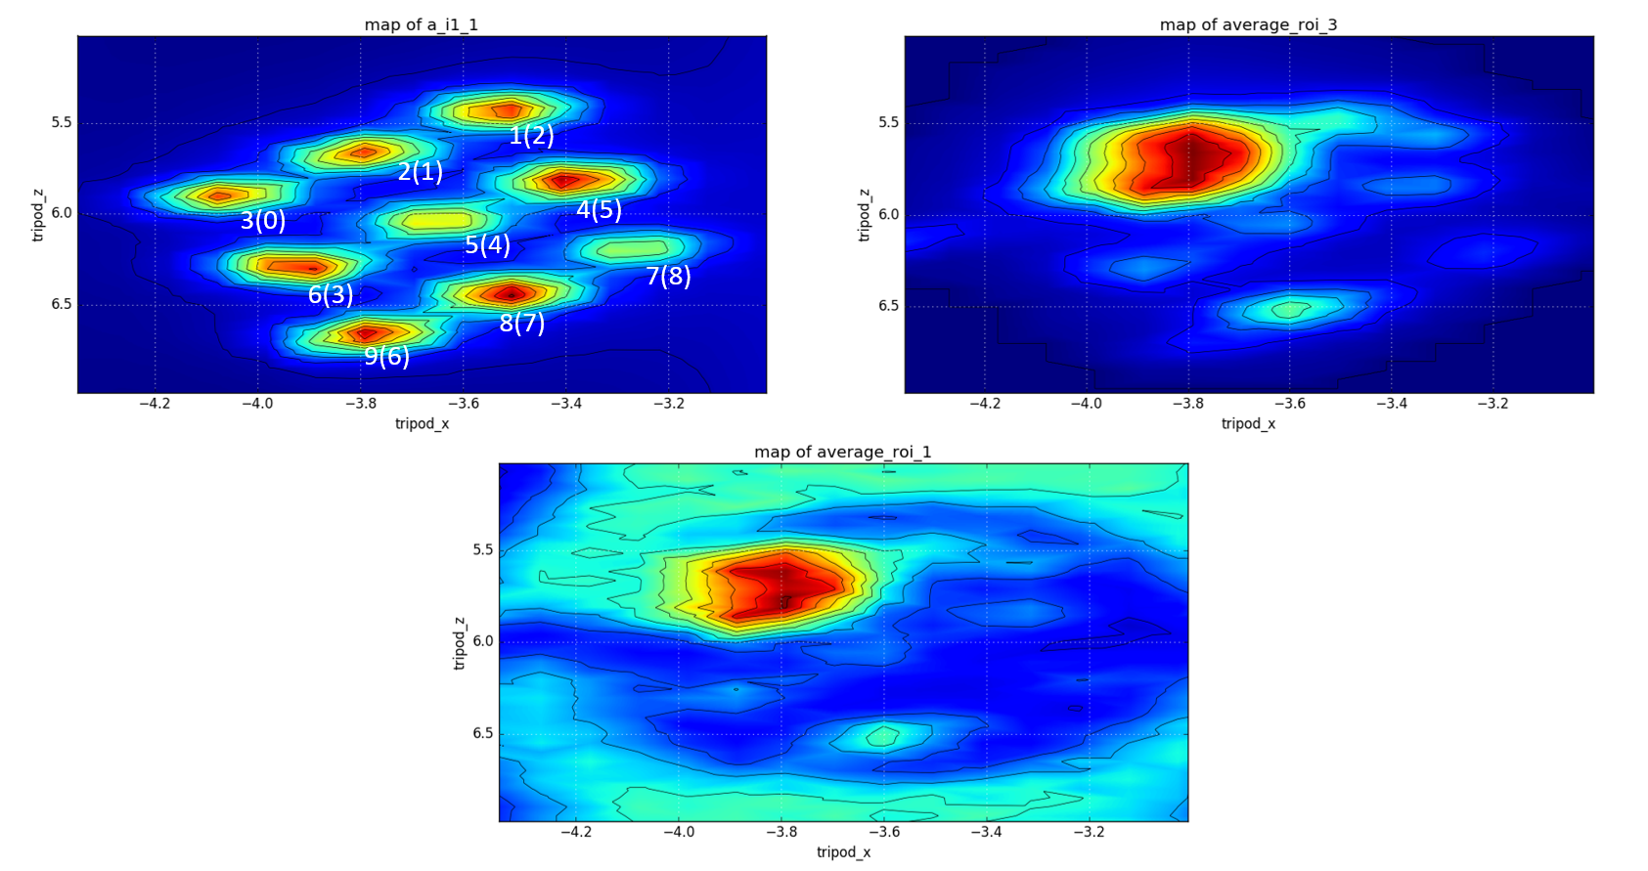
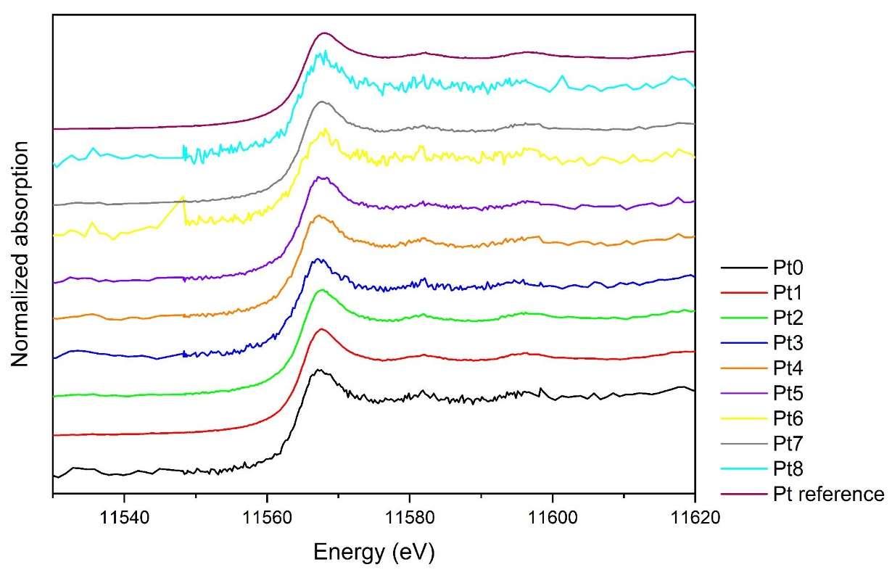
Feasibility tests (Spectroscopy)
Tests at CLAESS and NOTOS
Spot size about 100 µm in these beamlines (larger than Windows)
Review of statistics is pending.

Slide 9
Microfocus for spectroscopy
Fluo-Detector
XRays
Capillary
I₀?
I₁
Micro-Reactor
Positioning system
Positioning system
Micron size focus is required to obtain clean and intense spectra through the windows of the microreactor
Currently working on a compact add-on system for NOTOS and CLAESS, based on polycapillary refocusing
Still some issues need solution
Space for I0
Geometry of fluo-detection

Slide 10
Part 2: SPM sample exchange
To allow surface science beamlines at ALBA (soft x-rays) to enable correlative studies with the SPM platform.
a) Transport of samples in controlled conditions (UHV)
b) Fiducialization: finding the exact position tested within the sample
SPM platform
X-ray photoemission electron microscopy
BL24-CIRCE
Soft XAS
X-ray magnetic dicroism
Near ambient pressure photoemission spectroscopy
BL29-BOREAS
BL24-CIRCE
Angle resolved photoelectron spectroscopy
BL20-LOREA

Slide 11
Sample exchange SPM-SXR BLs
Sample holder compatibility between the different BL stations and the SPM
UHV suitcase to transport the beamlines
Inert gas globe box
Sample location at globe box, SPM and Beamlines

Slide 12
Sample holders
Platelets are standard among all BLs, except LOREA
LOREA sample manipulator must be modified to allow sharing samples

Slide 13
UHV suitcase
Upgrades needed
Reduce base pressure
Improve wobblestick rigidity and alignment control
Reduce weight
Improve sample parking design

Slide 14
Fiducialization
The beam size, detector acceptance or field of view of most stations is below 10 µm
However, one can add visual marks on the sample holders.
Visible at the beamline sample position using in-air (long distance microscope. LOREA’s solution good also for BOREAS, but not for CIRCE/PEEM
Effective fiducialization of the explored region of the sample (requires accurate manipulator motions, simple transformation between images and motions)

Slide 15
Summary
To exchange microreactor chips between STEM, diffraction and spectroscopy beamlines.
Some modifications are required at beamlines.
Feasibility tests provide promising results
A microfocus add-on in perspective for spectroscopy.
To exchange samples between SPM and surface science s Xray beamlines
Allow sharing sample holders within the beamlines
Improve the existing vacuum suitcase.
Develop sample fiducialization schemes in the different stations.

