Slide 1
SPM in In-CAEM - CAT
Aitor Mugarza
Carmen Ocal

Slide 2






Infrastructure for Correlative Analysis of Energy Materials
In-CAEM will develop a singular infrastructure for research in advanced energy materials in order to address the scientific challenges of the European Green Deal:
Multi-modal
Multi-lengthscale in situ/operando experiments, combining
Correlative
Open to all the scientific community.
(Scanning) transmission electron microscopy
Scanning probe microscopies
Synchrotron X-rays (spectroscopy, diffraction,…)
Advanced data analytics (HPC, deep learning, AI,…)
Mix & Match techniques and methodologies to tackle complex problems
Single entry point: ALBA User office

Slide 3
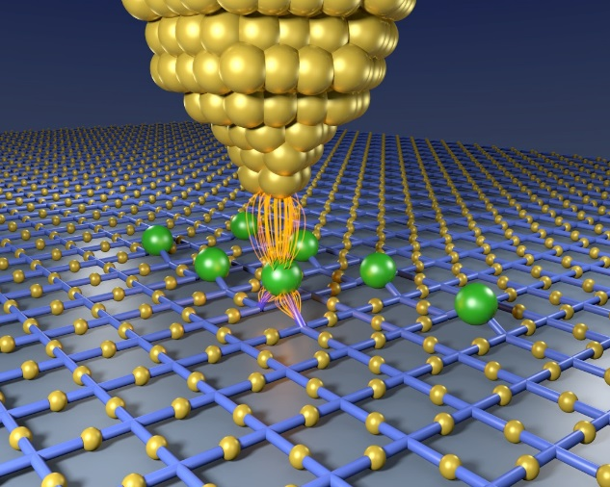
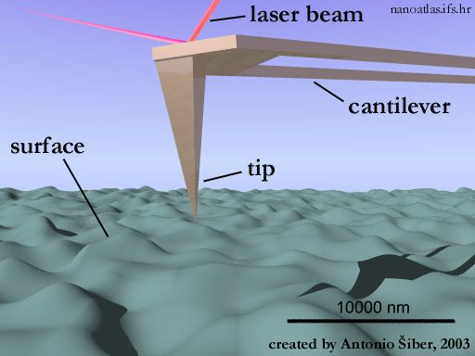
SPM techniques
Magnetic
(IETS, Kondo STS, SP-STS)
Nanolitography
Atomic manipulation
Chemical
(F(z))
Magnetic
(MFM)
STM
AFM
Electrostatic
(KPFM, SCM, EFM)
Friction
(LFM)
Atomic
(BR)-STM
Vibrational
(IETS, Action Specroscopy)
Electronic
(STS)
Electrical
(c-AFM)
Piezoelectric
(PFM)
Notes:
-Violin analogy

Slide 4
SPM Platform
UHV 5K STM/nc-AFM
+
photon spectroscopy
Ultra-High Vacuum
UHV STM/nc-AFM
Environmental AFM
+
photon spectroscopy
Multipurpose
AFM
Environmental, gas/liquid

Slide 5
SPM Platform
UHV 5K STM/nc-AFM
+
photon spectroscopy
UHV STM/nc-AFM
SPM + Photon spectroscopies
SPM
Environmental AFM
+
photon spectroscopy
Multipurpose
AFM

Slide 6





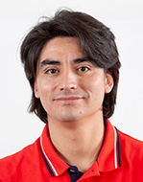

SPM Platform
ICMAB
Carmen Ocal
Esther Barrena
ICN2
Aitor Mugarza
Laser Technician
SPM Technician
UHV 5K STM/nc-AFM
+
photon spectroscopy
Alba Cazorla
UHV STM/nc-AFM
Scientist
Roger Palacios
Environmental AFM
+
photon spectroscopy
Multipurpose
AFM
Emigdio Chavez
Daniel Martín

Slide 7


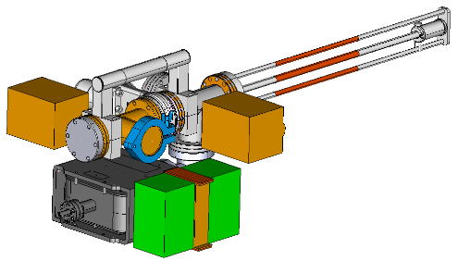
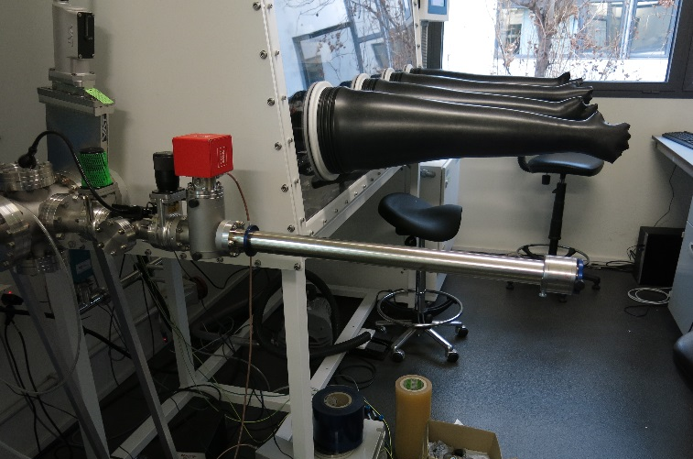
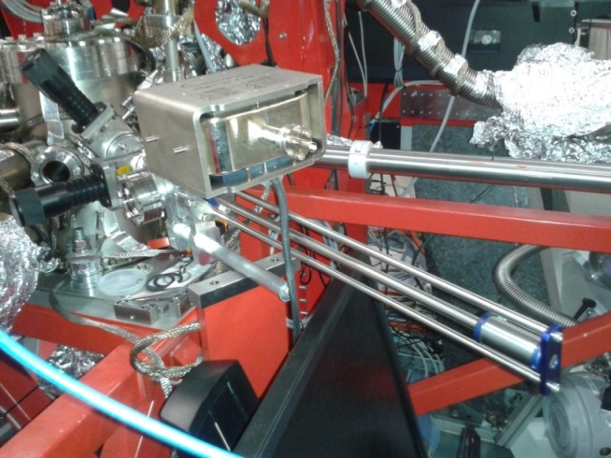
Connecting Facilities at ICN2-ALBA
UHV connection of 10 different facilities of ICN2 and ALBA
MBE
PLD
Globe Box
STM
AFM
XPS/ARPES
Mounted on glove box
Mounted on BOREAS beamline
NAP-XPS
PEEM/LEEM
XAS/XMCD
Magnetic scatt.
ARPES

Slide 8
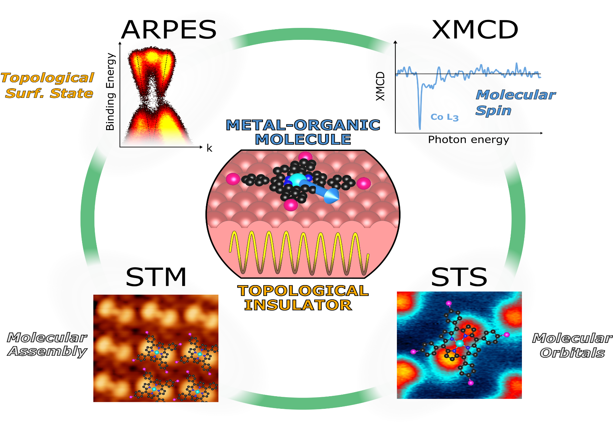
In-situ multimodal spectroscopy: SPM + synchrotron
@ BOREAS
In-situ:
Materials growth
Atomic scale structural & electronic properties
Band structure
Element-resolved magnetic properties
ICN2-ALBA
M. G. Cuxart et al. ACS Nano 14, 6285 (2020)
M. Caputo et al., Nano Lett. 16, 3409 (2016)

Slide 9
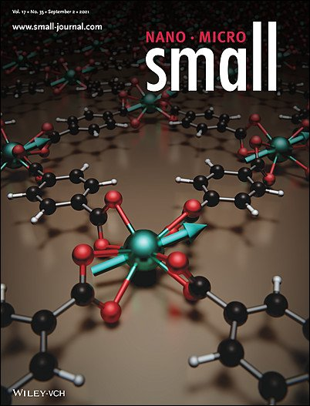
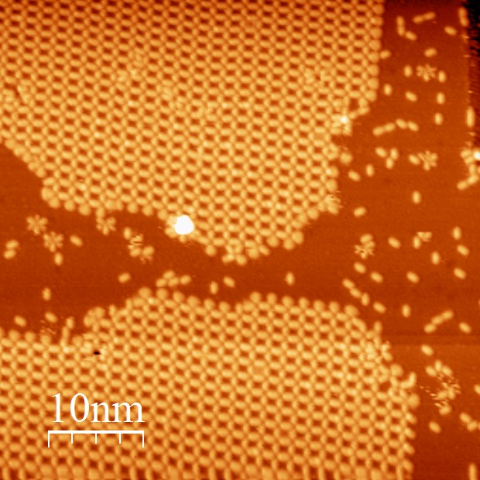
In-situ Multimodal STM + XMCD
Lanthanide-based Metal-organic frameworks
Oxidation of FePc on Ag(110)
FePc
FePc + 2O
Dy-TPA
STM @ BOREAS
XMCD magnetization curves @ BOREAS
ICMA-ICMAB-ICN2-ALBA
IMDEA-ICN2-ALBA
E. Bartolomé et al., Solid State Phenom. 257, 219 (2016)
E. Bartolomé et al., J. Phys. Chem. C. 124, 13993 (2020)
S. O. Parreiras et al., Small 17, 2102753 (2021)

Slide 10
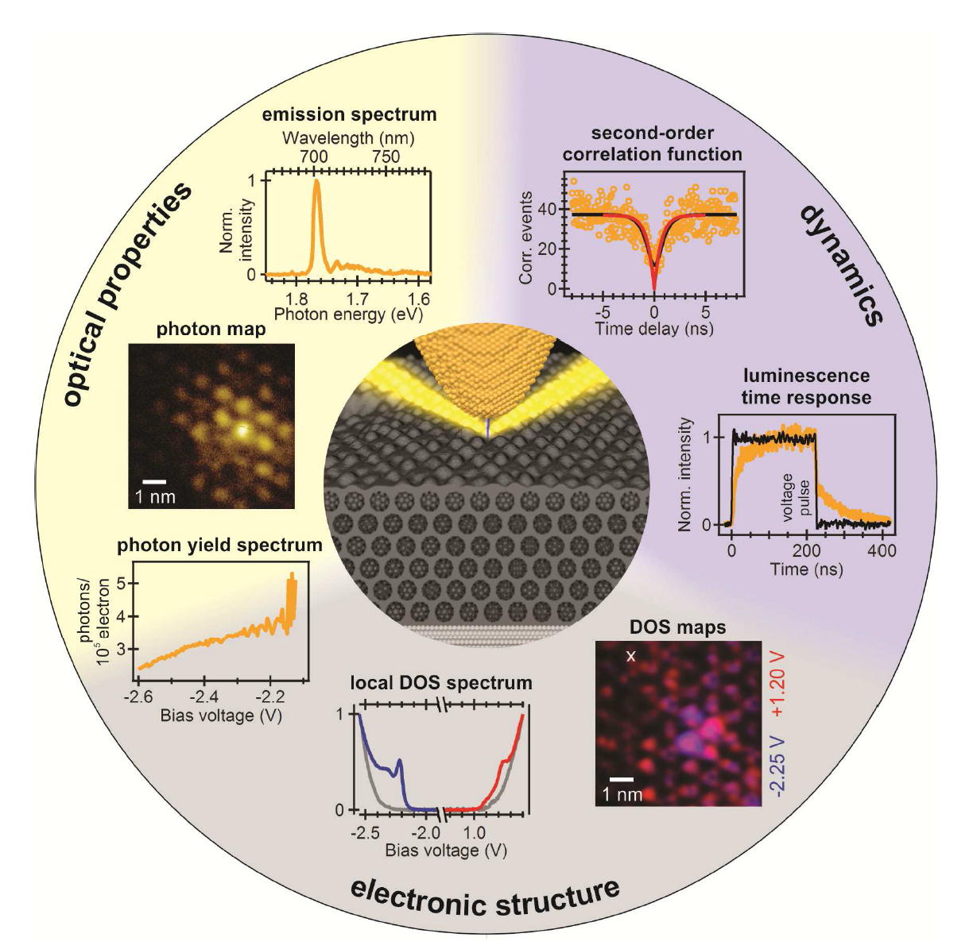
Photon SPM
Electroluminiscence
Photoluminiscence
Raman
Photoelectron tunneling
K. Kuhnke, et al. Chem. Rev. (2017)

Slide 11
Scanning tunnelling Luminiscence (STL): 2D materials
Electroluminescence from individual atomic defects
Raman at the single-bond limit
B. Schuler et al., Sci. Adv. 6, eabb5988 (2020)
J. Xu et al., Science 371, 818–822 (2021)

Slide 12
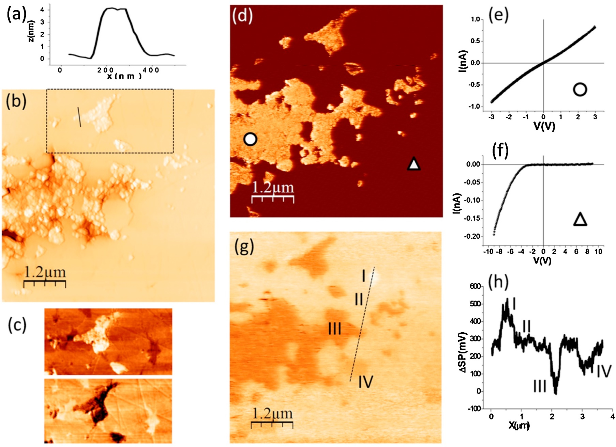
Carmen Ocal
Esther Barrena
Correlative AFM
3) Current intensity (Conductive AFM)
4) I-V spectroscopy
(Conductive AFM)
1) Topography
Correlative topo + multimodal maps of graphene percolated networks synthesized in SiC and Si₃N₄ composites
ICV-ICMAB
C. Ramírez et al., Carbon 153, 417 (2019)
P. Miranzo et al., J. Eur. Ceram. Soc. 36, 3073 (2016)
C. Ramirez et al., Carbon 49, 3873 (2011)
P. Miranzo et al., J. Eur. Ceram. Soc. 33, 1665 (2013)
2) Lateral force
(Friction Force Microscopy)
5) Surface potential / work function (Kelvin Probe Force Microscopy)

Slide 13
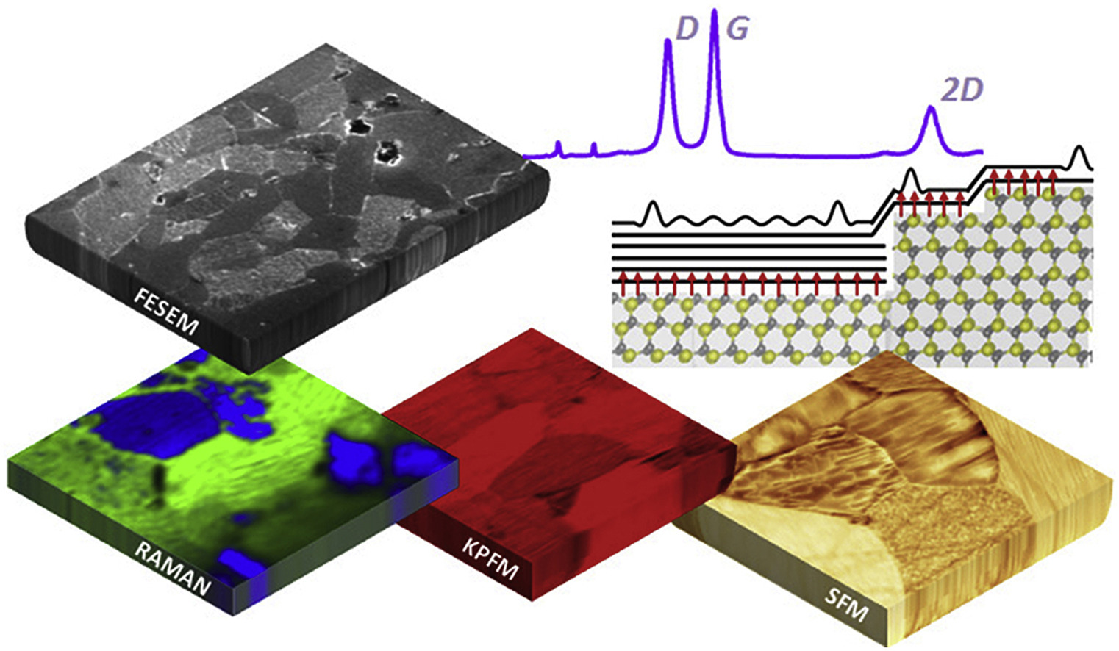
Carmen Ocal
Esther Barrena
Correlative AFM + FESEM + μ-Raman
Correlative topo + multimodal maps of graphene percolated networks synthesized in SiC and Si₃N₄ composites
ICV-ICMAB
C. Ramírez et al., Carbon 153, 417 (2019)
P. Miranzo et al., J. Eur. Ceram. Soc. 36, 3073 (2016)
C. Ramirez et al., Carbon 49, 3873 (2011)
P. Miranzo et al., J. Eur. Ceram. Soc. 33, 1665 (2013)

Slide 14
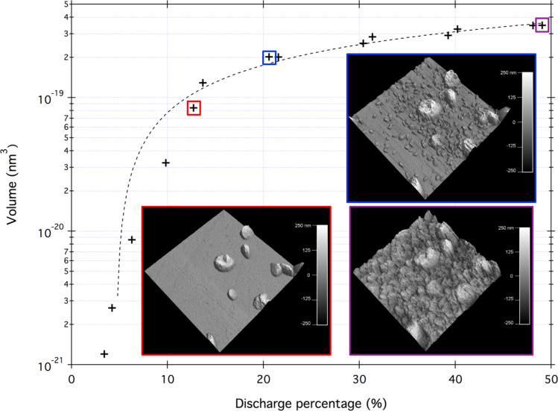
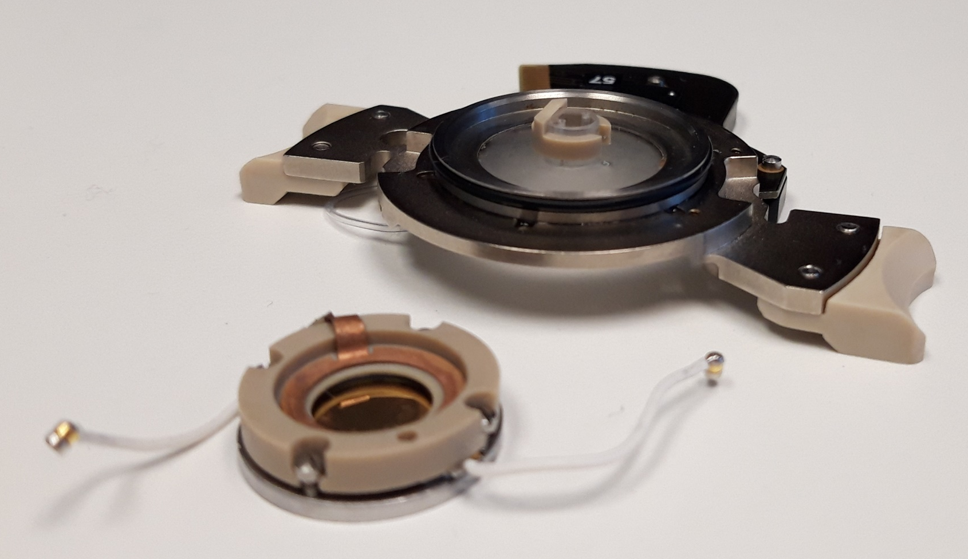
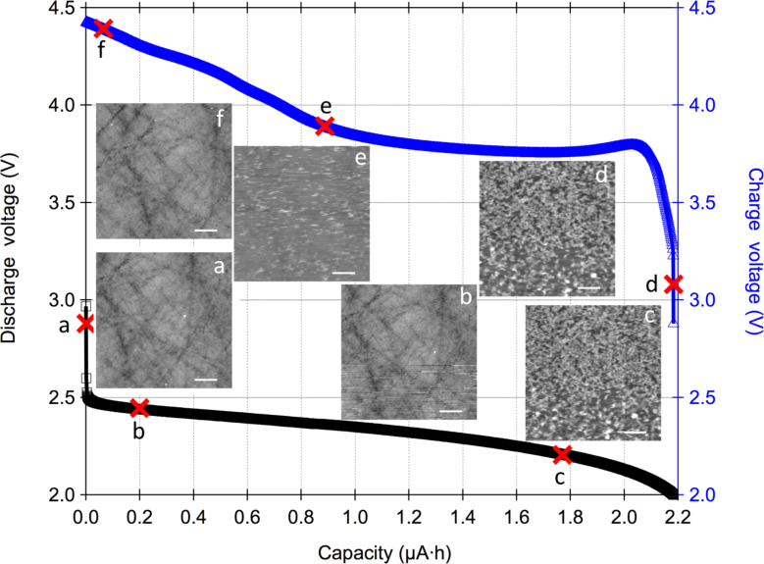
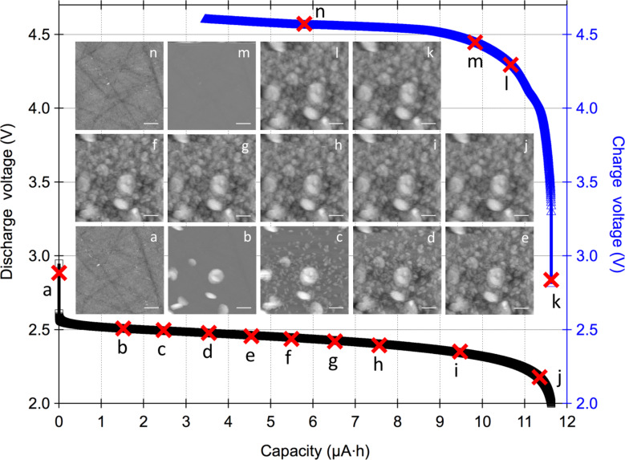
In situ EC-AFM
In situ AFM imaging of Li-O₂ electrochemical reaction on highly oriented pyrolytic graphite with ether-based electrolyte
3D volume analysis
Reversible formation of reaction products during the discharge–recharge cycles correlate with the simultaneously recorded electrochemical data.
In-situ EC-AFM:
- Electrode status
- Deposition dynamics
- Chemical info missing!
1M LiNO₃ in TEGDME with < 20 ppm of water
1M LiNO₃ in TEGDME with 2500 ppm of water
Virwani et al. B. J. Nanotechnol. 2019
Notes:
1.- for 20 ppm: discharge capacity not limited by clogging of the electrode by the deposits, some area still clean. Attribute to O2 depletion due to slow diffusion (high transfer resistance)
2.- AFM gives topography but no chemical identification: other techniques necessary! NAP-XPS, Raman…
The two figures at the bottom demonstrate the reversible “material growth/de-growth” as the product of the physical processes taking place on the cathode surface of a highly reactive lithium–oxygen battery system at different water concentrations in the solvent.
The topographic AFM images taken during the discharge/recharge cycles (at the marked points at black/blue data) capture the formation of discharge products as correlated electrical and topographical channels.
The impact of the presence of water in the solution is measured by varying the water concentration (low concentration at the left and high concentration at the right): there is an increase in the cell discharge capacity at increased water concentration by modifying the charge transfer resistance.
The shape and size of the deposits at different discharge capacity gives information on the kinetics of the processes.
Figure at the top right: The analysis of the volume of precipitates indicates the onset of the process (threshold capacity) and the (second-order polynomial function) behavior of the cell.

Slide 15
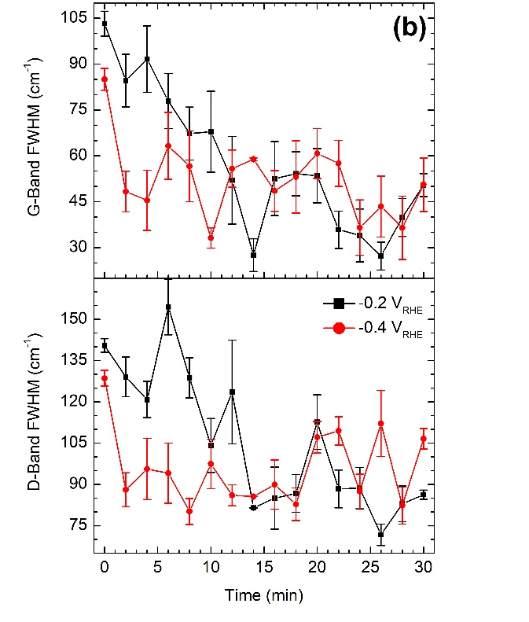
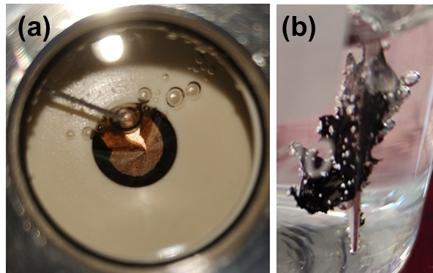
Raman spectroscopy for H₂ generation
In situ detection of the hydrogen generation in electrochemical cell by Raman
Add spatial resolution of
~10-50 nm by TERS
Emigdio Chavez
ICN2-IREC-ICFO
A. Pinilla et al. Carbon 200, 227 (2022)

Slide 16
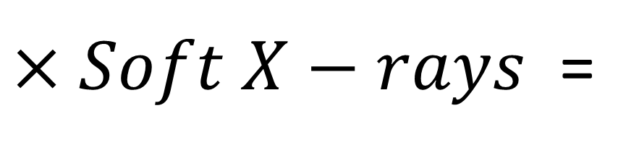
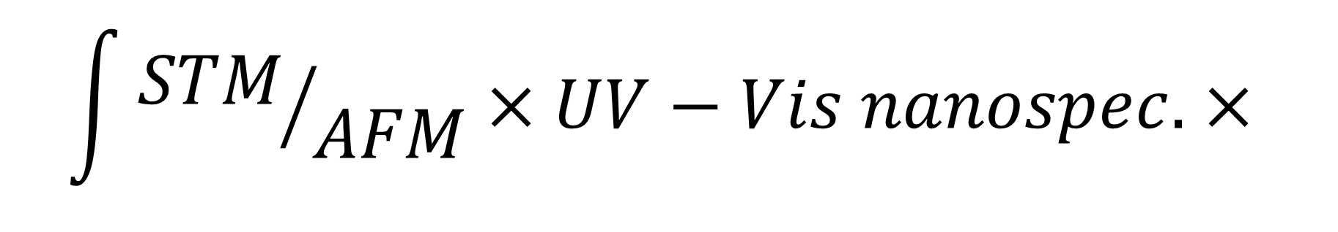
SPM Platform @ ALBA
$$\int{{STM}/{AFM}×UV−Vis nanospec. × }$$
SINGULAR INFRAESTRUCTURE
FOR
ADVANCED MATERIALS
CHARACTERIZATION
$×Soft X−rays$ =
Thanks!!

