Slide 1






InCAEM
Planes complementarios
Advanced Materials

Slide 2
In Situ Correlative Facility for Advanced Energy Materials
In-CAEM will develop a singular infrastructure for research in advanced energy materials in order to address the scientific challenges of the European Green Deal:
Multi-modal
Multi-lengthscale in situ/operando experiments, combining
Correlative
Open to all the scientific community.
(Scanning) transmission electron microscopy
Scanning probe microscopies
Synchrotron X-rays (spectroscopy, diffraction,…)
Advanced data analytics (HPC, deep learning, AI,…)
Mix & Match techniques and methodologies to tackle complex problems
Single entry point: ALBA User office

Slide 3
Catalan sub-project: InCAEM
15 M€
Partners (all in the Cerdanyola area):
    ALBA.
    ICMAB (Materials Science Institute Barcelona).
    ICN2 (Catalan Institute Nanoscience and Nanotechnology).
    PIC-IFAE (Scientific Information Port – High Energy Physics Institute).
Participation in all main lines of the global project.
Administrative Coordinator: Caterina Biscari, ALBA.
Scientific Coordinator: Jordi Arbiol, ICN2.

Slide 4
Project Structure
Direction
Management
Delivery
PROJECT BOARD
Executive: C.Biscari (CELLS)
Senior user: K. Attenkofer (CELLS), G. Merino (PIC-IFAE), X. Obradors (ICMAB), P. Ordejón (ICN2)
Senior supplier: E. Aigner, J. Casas, O. Matilla (CELLS), J. Arbiol (ICN2), G. Merino (PIC-IFAE)
Work package
PROJECT ASSURANCE
M. Pont, J. Nicolás, E. Hernández (CELLS)
PROJECT MANAGER L.Aballe (CELLS)
Work package
Work package
….

Slide 5
WP1: (S)TEM
J. Arbiol (ICN2), L. Aballe (ALBA), B. Ballesteros (ICN2), J. Oró (ICMAB)
149 person*month (30% staff)
Aberration corrected EM:
  4D STEM
  EDX
  EELS
Catalysis sample holder system
  Controlled gas mixing and flow
  RGA
  Controlled T
Electrochemistry sample holder system
  Liquid Flow
  In situ electrodes
  Potentionstat
Liquid nitrogen cooled sample holder
Song et al, ACS Nano (2020)
Singh et al, ACS App. Ener. Mat. (2020)
CFT in preparation

Slide 6
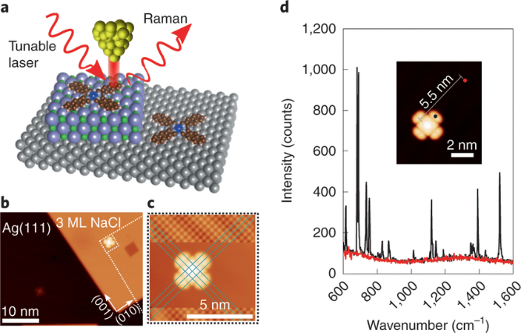
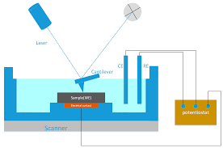
WP2: SPMs
Mugarza (ICN2), C. Ocal (ICMAB), E. Barrena (ICMAB)
191 person*month (19% staff)
Low temperature photon STM/AFM
  Pulsed laser
  Tip-enhanced Raman (TERS)
  Photoluminescence
  Electroluminescence,
  …
Environmental photon STM/AFM
Environmental AFM
+ Existing UHV nc-AFM/STM (ICMAB)
Jaculbia et al, Nat. Nano. 15 (2020)
CFT in preparation
CFT in preparation
Chen et al, Materials 13 (2020)

Slide 7
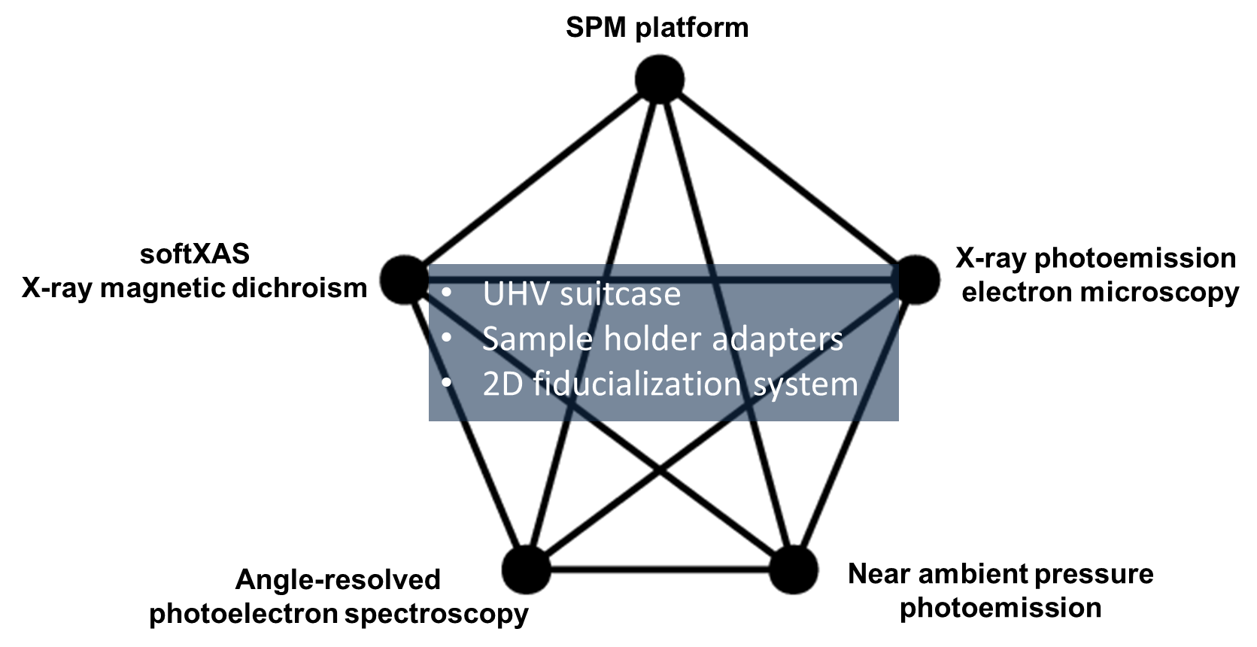
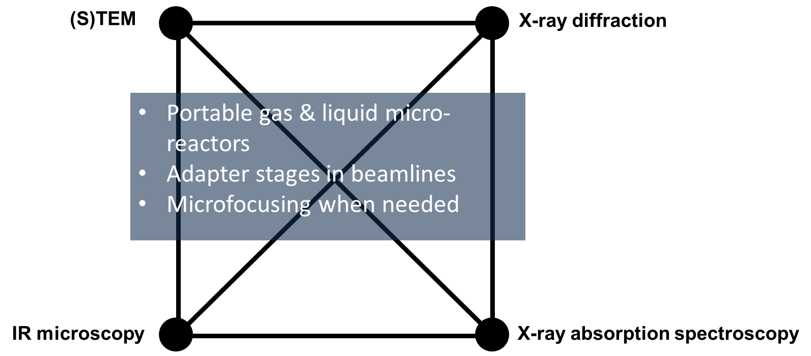
WP3: BL adaptations for correlative experiments
L. Aballe (ALBA), J. Nicolás (ALBA), C. Frontera (ICMAB)
134 person*month (47% staff)
UHV sample exchanger
Environmental sample exchanger
2D Fiducialization system
Spectroscopy setup for gases
Diffraction setup for gases
Spectroscopy setup for liquids
Diffraction setup for liquids
IR microscopy setup for liquids
IR microscopy setup for gases
Scope defined, conceptual design in progress with participation of ICN2 and ICMAB scientists

Slide 8
WP4: Infrastructure & methods for data analysis
G. Merino (PIC), P. Ordejón (ICN2), A. García (ICMAB), M. Eriksen (PIC), F. Torradeflot (PIC), V. Acín (PIC)
81 person*month (40% staff)
WP4&5 teams working together in definition
Computational methods survey
WP5: Infrastructure & methods for in situ data analysis
S. Vicente (ALBA), A. García (ICMAB), J. Otón (ALBA), N. Soler (ALBA), G. Rosas (ALBA)
132 person*month (18% staff)
WP6: Infrastructure
J. Casas (ALBA), C . Orozco (ALBA), N. Martí (ALBA)
45 person*monty (100% staff)
STEM lab conditioning
New STEM sample preparation space
SPM platform lab building
Specs and civil works definition in progress

Slide 9
WP7: Outreach
A.B. Martínez (ALBA), A. May (ICMAB), A. Argemí (ICN2), S. Grinschpun (IFAE)
8 person*month (100% staff)
Ciencia Viva (together with other PPCC projects where Catalunya participates)
InCAEM talks
First meetings
WP8: Coordination, exploitation model
C. Biscari (ALBA), J. Arbiol (ICN2), M. Pont (ALBA)
13 person*month (100% staff)
Participation 1st Conference on Advanced Materials in Spain 11/2022
This workshop 04/2023!

Slide 10
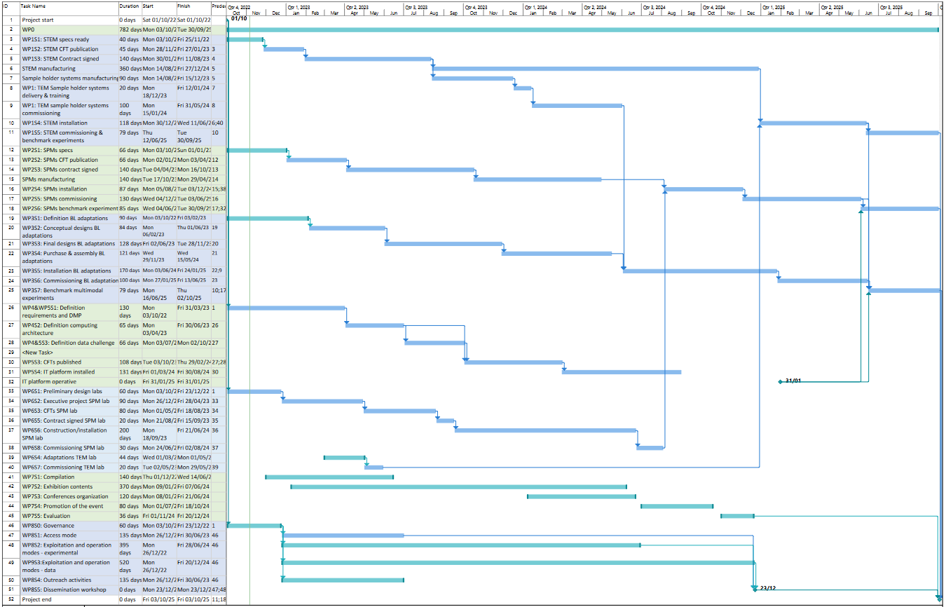

Slide 11
Recruitment
STEM
ALBA: EM scientist
ICN2: EM scientist: to be reopened (Alba Garzón → RyC)
PhD
EM technician: Bernat Mundet
SPM
ICN2: Laser technician
Environmental SPM/TERS scientist: Emigdio Chávez
LT/UHV SPM/TERS scientist
ICMAB: SPM technician: Alba Cazorla
AFM scientist: Daniel Martin Jimenez (→ MC)
STM/nc-AFM postdoc: Rogger Palacios
TRANSVERSAL
EureCAT/ALBA: Shared industry postdoc: Vacant
ALBA: Interface X-rays/EM group leader: In progress
Micro-reactors engineer : In progress
Micro-reactors technician
Project office assistant: Anna Rossell Navarro
Procurement assistant: Ivette Borrás Vilaseca
DATA INFRASTRUCTURE & ANALYSIS
ALBA: Multimodal methodology postdoc: Oleg Utsolev
Multilengthscale methodology postdoc: Vacant
Integration engineer: Andrés Fraile
Scientific data engineer: Przemyslaw Karczmarczyk
IFAE: Methodology scientist: Martin Eriksen

