Slide 1
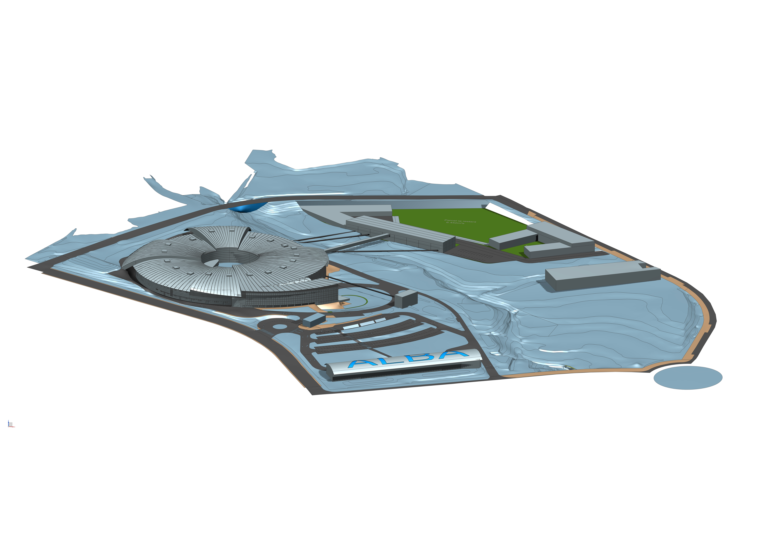
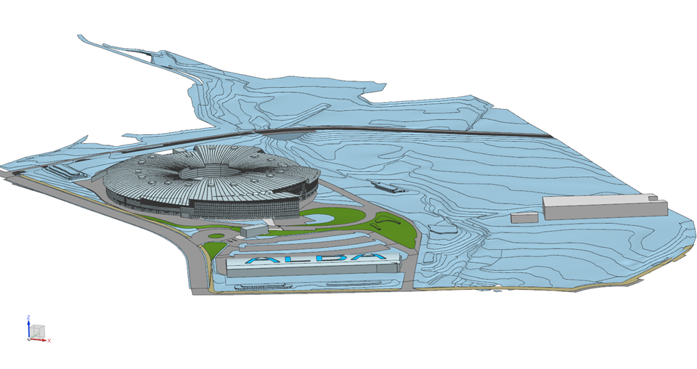
ALBA of the future:
ALBA today:
Science Opportunities at ALBA and ALBA II
Klaus Attenkofer
14. April 2023 – InCAEM Workshop

Slide 2
Alba’s Role in Science
In general, ALBA’s role is:
  to provide to the existing user community in Spain state-of-the-art X-ray characterization tools.
  to provide access to a vast international European network of specialists.
Specifically, for the 3 focus area:
  to develop cutting edge characterization tools to address the socio-economical challenges in Spain and Europe. This includes:
    Instrumentation.
    Methodologies.
    Data analysis strategies.
  to make the tools available to a large user community which benefits from these.
Our tools:
Public and Proprietary User Program
Training and Outreach Program
In-house Research Program
14. April 2023
InCAEM workshop

Slide 3



+ 2200 yearly user visits
225 staff
3400 national users
+300 yearly experiments
ALBA numbers
+2700 publications
3200 international users
+7500 yearly public visits
10 operating Beamlines
+200 trained students
4 Beamlines
In construction
14. April 2023
InCAEM workshop

Slide 4
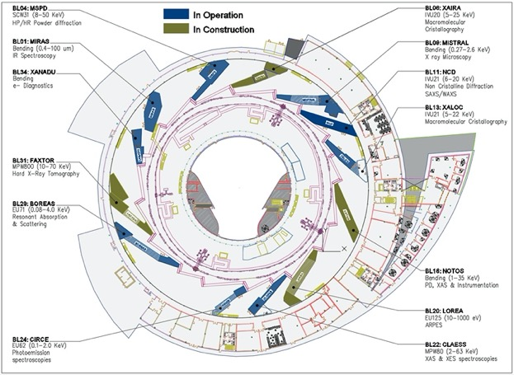
The Provided Techniques:
Alba’s organization:
Three scientific sections support the user program:
Life Sciences Section.
Chemical and Materials Sciences Section.
Electronic and Magnetic Structure Section.
Alba is a 3. generation synchrotron source with 10 operating beamlines and 4 in construction.
XAIRA (microfocus/phasing MX beamline)
FAXTOR (full-field imaging beamline)
3Sbar (HEXPAS and surface diffraction beamline)
MINERVA (Industrial metrology beamline)
10 operating beamlines:
  MIRAS (IR)
  MSPD (PD)
  MISTRAL (soft X-ray microsc.)
  NCD (SAXS/WAXS)
  XALOC (MX)
  NOTOS (XAFS + PD)
  LOREA (ARPES)
  CLAESS (XAFS)
  CIRCE(NAPP/PEEM) (NAPP: scientifically represented by CMS)
  BOREAS (XMCD, soft X-ray scattering)
14. April 2023
InCAEM workshop

Slide 5
Focus Area: Energy
Tuning Electronic and Chemical Properties by Controlling Atomic Structure of Functional Materials.
using a suite of techniques and services enabling the catalytic role of ALBA
Focused on scientific fields:
Techniques
Services
Energy storage.
Hydrogen circular economy.
Carbon sequestration.
High throughput ensemble averaging probes including IR, XAFS, and diffraction and XPS.
X-ray microscopy in scanning and full field mode with absorption and phase contrast.
TEM.
Multi-modal approach combination of ex-situ, in-situ, and operando experiments.
Sample preparation tools allowing remote combinatorial approaches.
multi-modal pipelines and access modes for providing solutions for main focus area applications.
Big data gateway for data mining community.
data analytics tools to identify structure-function correlations in multi-modal experiments.
14. April 2023
InCAEM workshop

Slide 6
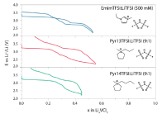
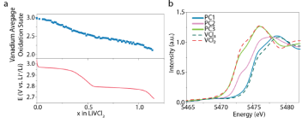
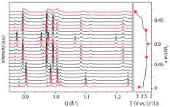
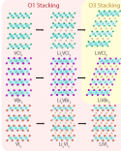
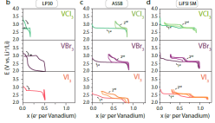
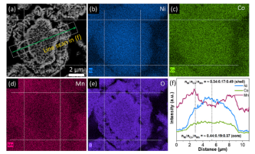
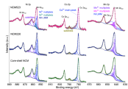
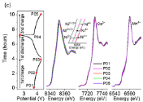
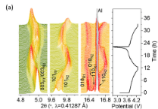
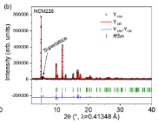
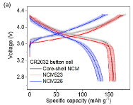
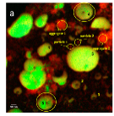
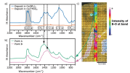
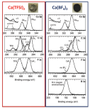
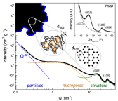
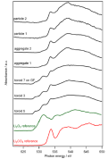
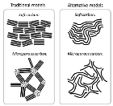
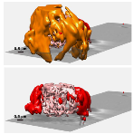
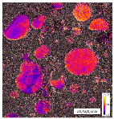
Energy Strategy at a Glance
Imaging, Tomography
Spectroscopy
(molecule)
Spectroscopy
(electronic configuration)
Diffraction
(crystal structure)
Laboratory
(performance,
discovery)
MIRAS
CLAESS, NOTOS-XAS
MSPD , NOTOS-PD
SEM and EDX
Electrolyte bulk
Computing
Dubouis et al Nat Mat , accepted
SEI
TEM
XPS
Wua et al Nat Mat , Nano Energy 78 (2020)
MISTRAL
CIRCE-NAPP
NCD-SWEET
Saurel et al Nat Mat , Energy Storage Materials 21 (2019)
Tchitchekoav et al Nat Mat , Chem Mat 30 (2018)
Olivares-Marin et al Nat Mat , Nano Lett 15 (2015)
Forero-Saboya et al Nat Mat , Energy Environ. Sci 13 (2020)
14. April 2023
InCAEM workshop
Notes:
.
This is a very difficult slide but I think you really know what you want to say if you can make this one.
FF I have made something for battery example based on multitechniques . I do not feel competent producing the same for catalysis. I would hence supply Highlight of catalysis and gas sequestration examples
This slide is pretty dense and long time will be spent on it
https://www.albasynchrotron.es/en/media/news/new-synthesis-procedure-to-optimize-the-catalytic-performance-of-platinum-based-materials
https://www.albasynchrotron.es/en/media/news/researchers-design-a-nanotechnology-based-system-that-can-transport-methane-at-lower-pressure-and-cost

Slide 7
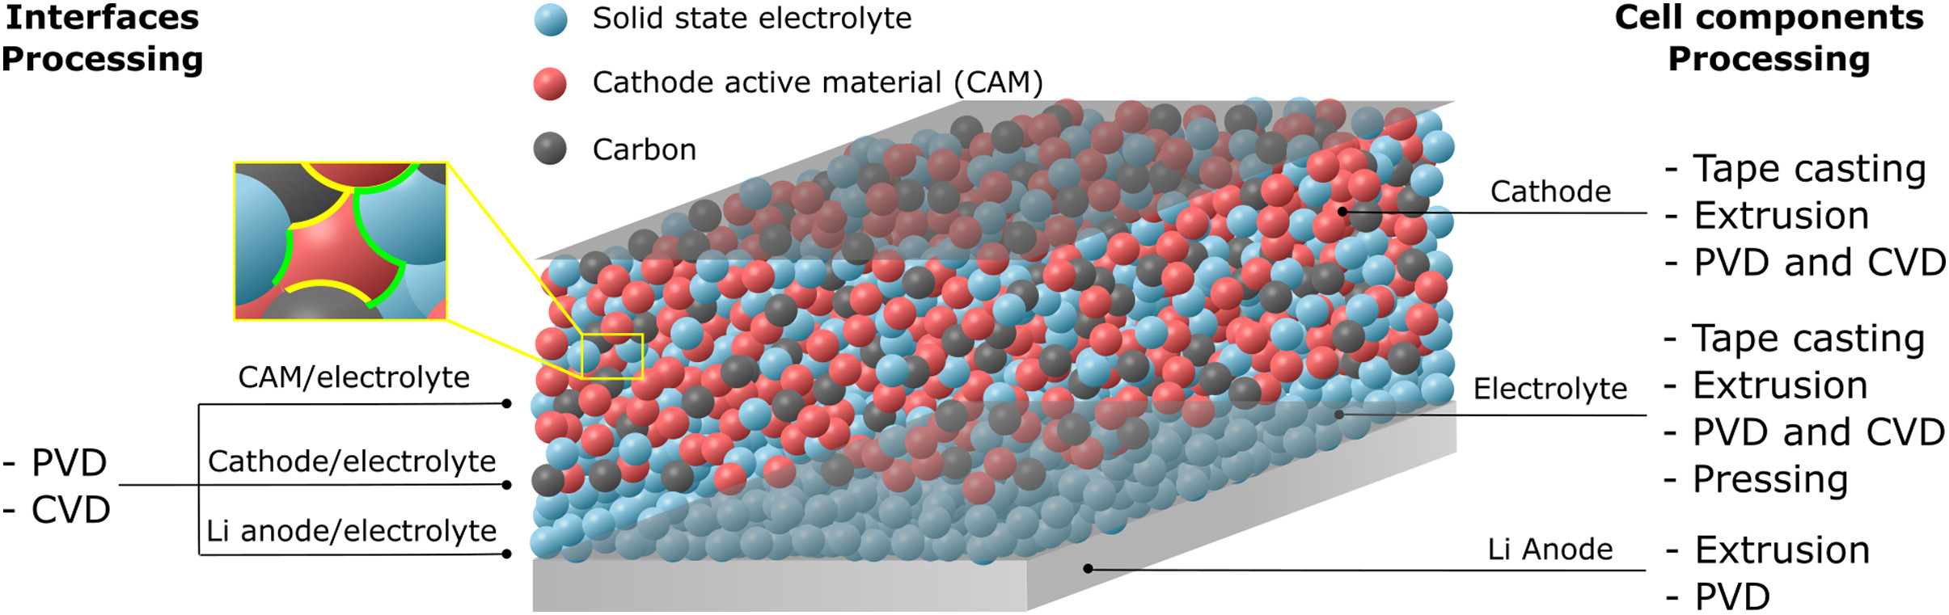
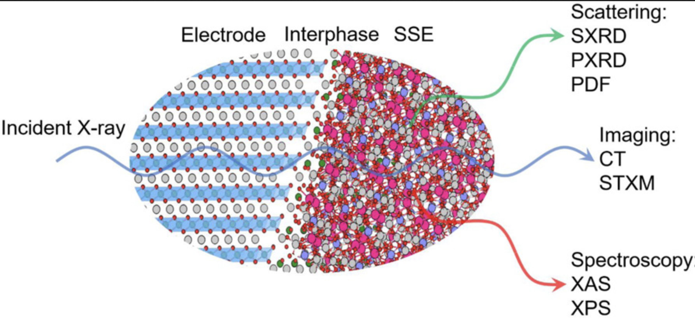
Optimizing Interfaces is Key to Make Better Batteries
Same can be said as already explained in context with catalysis:
Multimodal approach under operando conditions combining imaging on the different length scales with ensemble averaging spectroscopic tools is key to “understand” how the battery works. High throughput and fast structural characterization is key to impact the high TRL developments.
Specific example: Development of high power density solid state electrolyte Li batteries:
The battery has a large number of different interfaces which all define the performance but also the reliability.
ALBA II has the potential to provide:
Improved microscopy: operando TEM, nano probe and micro-spectroscopy/diffraction.
Data analytics: enabling multi modal approach.
Operando focus: reliable fast operando experiments
https://doi.org/10.1016/j.jpowsour.2021.229919
14. April 2023
InCAEM workshop
Notes:
It would be great if you can conclude this with a slide which graphically explains what is your branding and how the different tools contribute to this.
This is a very difficult slide but I think you really know what you want to say if you can make this one.
FF I have made something for battery example based on multitechniques . I do not feel competent producing the same for catalysis. I would hence supply Highlight of catalysis and gas sequestration examples
This slide is pretty dense and long time will be spent on it
https://www.albasynchrotron.es/en/media/news/new-synthesis-procedure-to-optimize-the-catalytic-performance-of-platinum-based-materials
https://www.albasynchrotron.es/en/media/news/researchers-design-a-nanotechnology-based-system-that-can-transport-methane-at-lower-pressure-and-cost

Slide 8
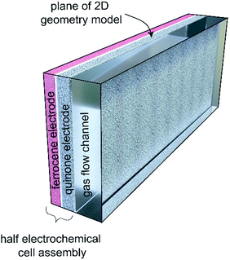
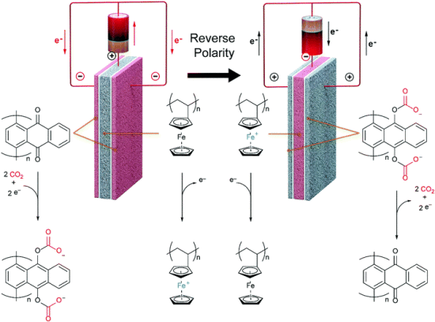
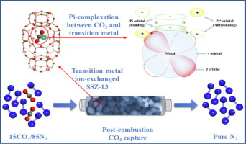
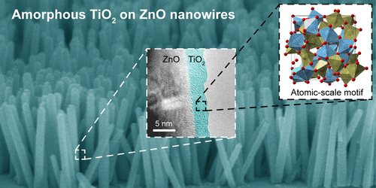
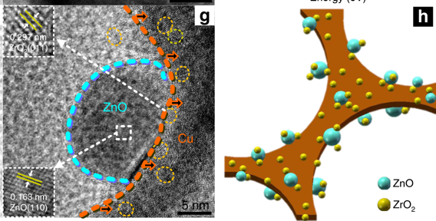
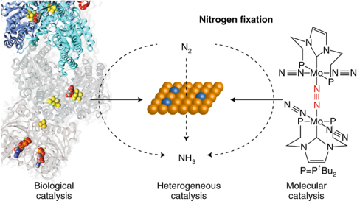
The Larger Picture: Synchrotron Characterization .
https://doi.org/10.1039/c9ee02412c.
https://doi.org/10.1016/j.cej.2019.03.234
Example of technologies allowing a full C-cycle economy currently developed and tested by Thyssenkrupp (TR7-TR8).
Example catalysts are state-of-the-art developments on TR1-TR3 level.
DOI: 10.1021/jacs.9b07088
DOI: 10.1021/acs.nanolett.8b04888
CO₂-emitting Industry
https://doi.org/10.1038/s41467-019-09072-6
Renewable energy production
Integrated storage and reconversion
Natural Gas Grid
Integrated Hydrogen SNG Plant
SNG
Refineries
H₂
Electrolytical Hydrogen Plant
Consumer
Key to a sustainable and circular economy are:
Electrocatalysis.
Heterogeneous catalysis.
Homogeneous catalysis.
Fuel
Integrated Hydrogen Methanol complex
H₂
Methanol
Mobility
Integrated Hydrogen amonea/urea complex
Ammonia
Fertilizer
Chemical Industry
https://ucpcdn.thyssenkrupp.com/_legacy/UCPthyssenkruppBAISMicrositePowertoX/assets.files/power-to-x/hydrogen-brochure.pdf
https://doi.org/10.1038/s41929-018-0092-7
Farms
ALBA II: development of new generation of catalysts for sustainable and circular economy

Slide 9
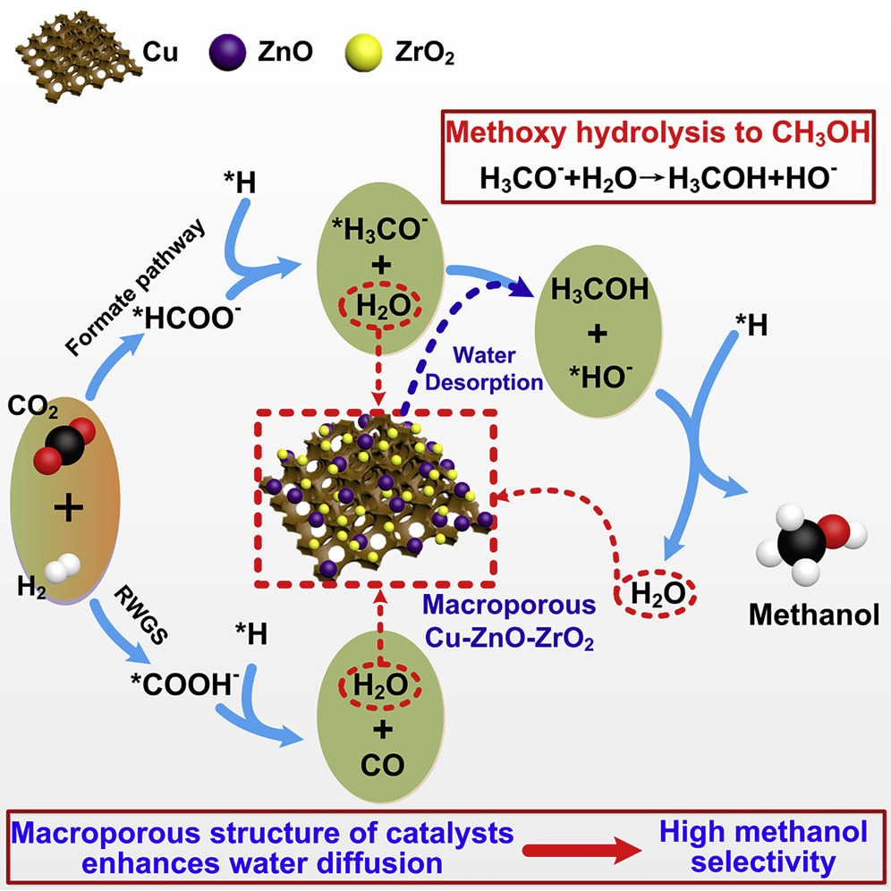
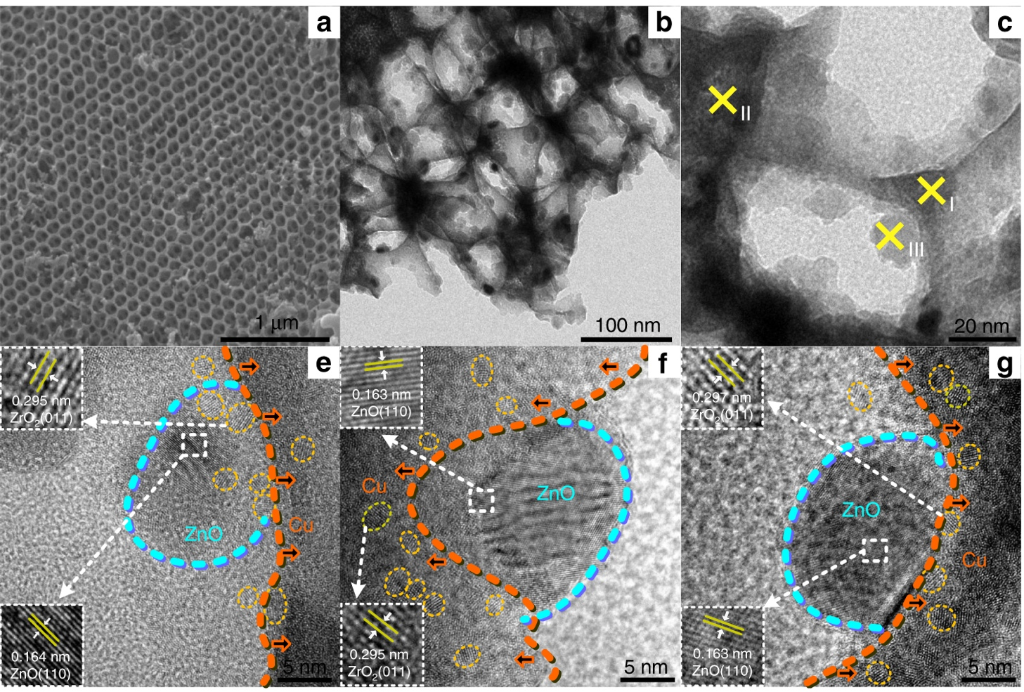
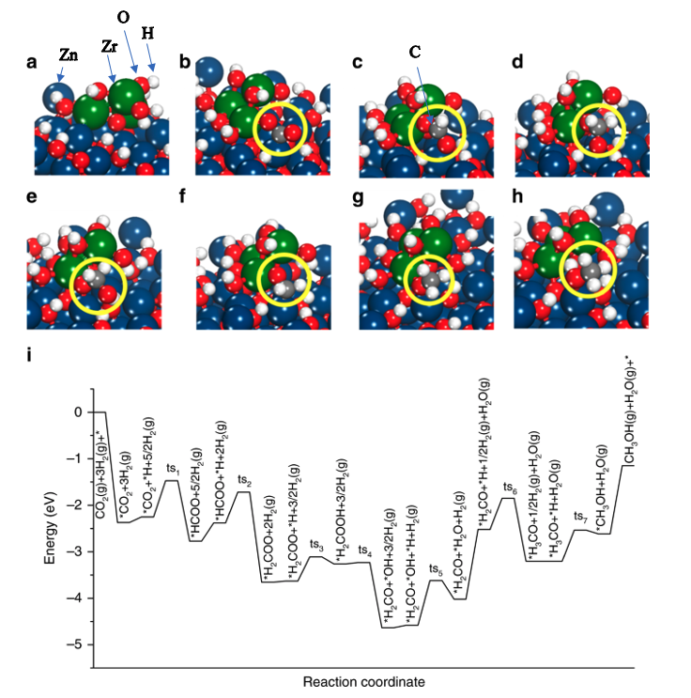
Identification of Active Site of Complex Catalysts
Multimodal approach under operando conditions combining imaging on the different length scales with ensemble averaging spectroscopic tools is key to “understand” how catalysts work. High throughput and fast structural characterization is key to impact the high TRL developments.
Specific example: macroporous Cu-ZnO-ZrO₂ (CZZ) catalysts for Methanol production from CO₂:
Simple cartoon to explain the key steps of the reaction pathway.
TEM showing the morphology and different interfaces of the catalyst.
Reaction pathway and corresponding structural models showing the complex changes during the reaction based on DFT calculations.
ALBA II has the potential to provide:
Improved microscopy: operando TEM, nano probe and micro-spectroscopy/diffraction.
Data analytics: enabling multi modal approach.
Operando focus: reliable fast operando experiments
Goal has to be to refine the existing often cartoon like models by visualizing the structural changes throughout the reaction pathway.
https://doi.org/10.1016/j.chempr.2019.10.023
https://doi.org/10.1038/s41467-019-09072-6).
14. April 2023
InCAEM workshop
Notes:
It would be great if you can conclude this with a slide which graphically explains what is your branding and how the different tools contribute to this.
This is a very difficult slide but I think you really know what you want to say if you can make this one.
FF I have made something for battery example based on multitechniques . I do not feel competent producing the same for catalysis. I would hence supply Highlight of catalysis and gas sequestration examples
This slide is pretty dense and long time will be spent on it
https://www.albasynchrotron.es/en/media/news/new-synthesis-procedure-to-optimize-the-catalytic-performance-of-platinum-based-materials
https://www.albasynchrotron.es/en/media/news/researchers-design-a-nanotechnology-based-system-that-can-transport-methane-at-lower-pressure-and-cost

Slide 10
Focus Area: Information Technology
Resolving and Manipulating the Electronic and Magnetic States, and its Spatial and Dynamic Characteristics in Quantum Materials.
      using a suite of techniques and services enabling the catalytic role of ALBA
Focused on scientific fields:
Techniques
Services
Spintronics and Spinorbitronics.
Topological materials.
Materials discover.
Device physics.
Materials growth and device fabrication.
XAS, XMCD, XMLD, XLD, XRMS.
ARPES (including Spin-ARPES).
X-ray microscopy and coherent imaging with chemical, magnetic, spin/orbital- momentum contrast.
TEM.
Structural and functional characterization tools.
Sample preparation tools allowing remote combinatorial approaches.
multi-modal pipelines and access modes for providing solutions for main focus area applications.
Computational modeling tools for understanding impact of structure and environment on topological entanglement.
14. April 2023
InCAEM workshop
Notes:
This slide would be great if you can create. I suggest that you make a first go and we can iterate next week together.
Perhaps this will be the last slide which you should make.

Slide 11
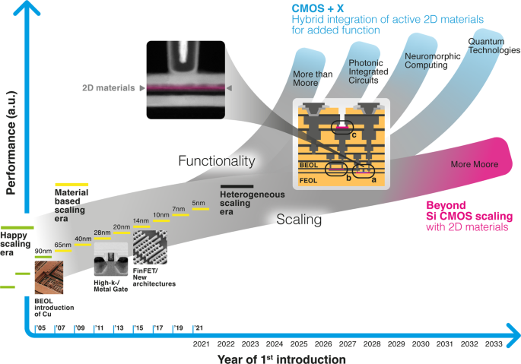
Where Does Information Technology Stands
The section will focus on the development of characterization suites optimized for device characterization. This will not only benefit the high TRL levels (including CMOS) but also is essential for many basic topics for which the observable effect is depending on electric fields and currents.
ALBA II has the potential to provide:
Improved microscopy: TEM, nano probe, coherent based tomography and aberration corrected PEEM.
Improved emittance: enabling micro spectroscopy (ARPES and XMCD).
Improved infrastructure: enabling to perform efficient and successful experiments with high end samples.
14. April 2023
InCAEM workshop

Slide 12
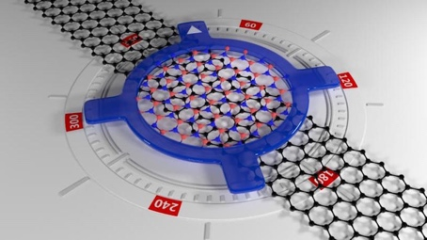
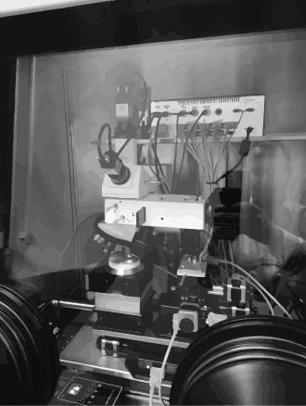
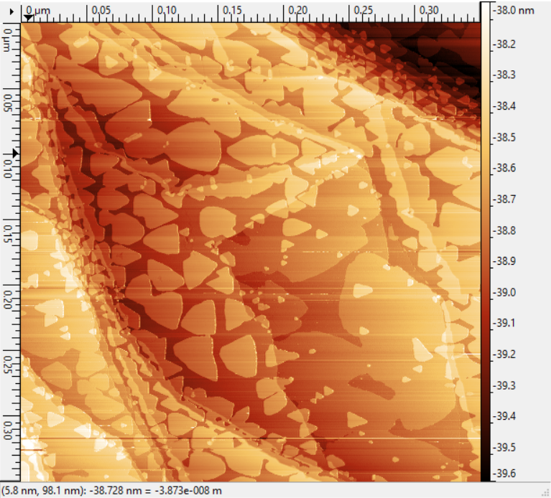
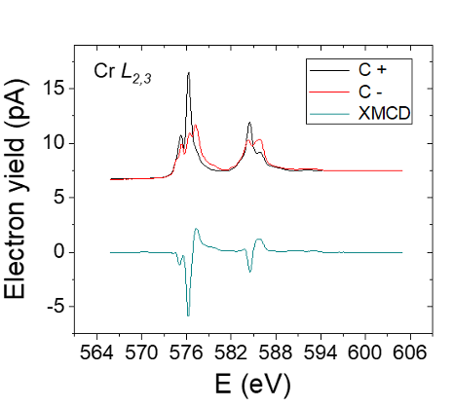
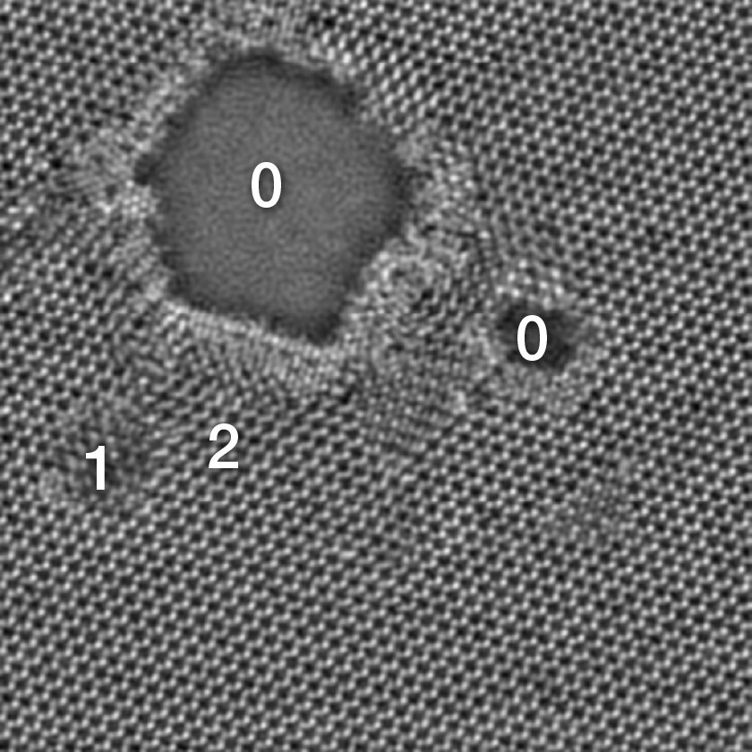
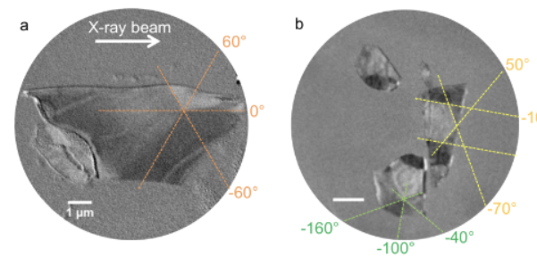
Our Goal at a Glance
example: 2D-VdW materials
MBE, 2D Materials and VdW Foundry at MS Lab, offline bl equipment, as a complement & bridge to user facilities
Challenges addressed and advantages:
air sensitive / short duration
repeatibility / efficiency / on-the-go experiment adjustments
Deeper partnership (projects, shared PhDs, short and mid term stays related to experiments and projects)
Raman
STM
twistronics
VdW transfer setup
-ALBA to provide the X-ray & electron- tools, enhanced sample preparation capabilities enabling pre-experiment preparation, mid-term visitor missions/collaborations and deeper partnerships
-Aiming at a multi-modal approach from meso to nanoscale, from surface to bulk-like
-ALBA embedded within their strategic partners provides leading capabilities
Microscale* averaged electronic & magnetic properties
Micro to nanoscale imaging
Atomic imaging
LOREA: ARPES
BOREAS - XMCD
CIRCE, MISTRAL & BOREAS
HR-(S)TEM
ARPES in twisted BLG,
Soleil, Sci Reports 2016
*Sub-micron to nano scale if a nano-focusing upgrade is considered
Defects in a MoS2
imaged with
high-resolution STEM
Spectra, ThermoFischer
Cr XMCD in CrCl3 sl,
ArXiv 2020
PEEM, Multilayer flakes of
CrTe2 VdW, ACS AMI 2020
 | Resolution | complementary x-ray + SPM, TEM imaging capabilities
XTM MISTRAL | 20-30 nm | fast ; 2D imaging ; 3D tomo ; bulk (only C+ BM)
PEEM CIRCE | 20-30 nm (<10nm possible) | fast; 2D; part 3D (shadow tech.) ; surface, mod. Field & LN temp
Coh. Imag. BOREAS | 25 nm (3-5 nm possible) | slow (reconst. or scanning) 2D ; 3D possible; LHe ; Hig field

Slide 13
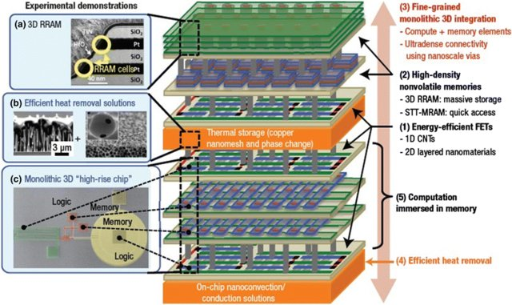
What ALBA can Provide?
2D imaging with sub-atomic resolution (including chemical analysis and strain) by TEM (with destruction).
Fast 3D imaging of large volumes at low resolution without destruction (1μm³)
(FAXTOR)
Imaging of functionality within a 40x40μm² area with 5-10nm resolution unpackaged device) (CIRCE-PEEM)
Additional Potential
Imaging of large volumes (10mm³) with 30nm³ resolution without destruction (full field hard X-ray probe (soft X-ray full field probe exists/MISTRAL).
Phase and chemical information for combinatorial and in-situ process development (CLAESS, MSPD, 3Sbar).
Functionality test of Spin and Charge under device conditions for new concepts (BOREAS, LOREA, CIRCE-PEEM).
3D imaging with ˜10nm resolution for chemical phase and strain resolution without destruction (nano-probe)
14. April 2023
InCAEM workshop
DOI: 10.1007/s11244-018-0964-8

Slide 14
A Short Reminder: ALBA’s Branding:
Alba’s role as a hub for complex analysis problems:
Correlative Imaging approach.
Big-Data and High Throughput
Providing External Expertise and Facilities.
The Grand Challenge:
  Imaging from the smallest building unit to the functional unit. Interpreting the structural information.
  Providing statistically relevant information.
  Understanding the structure-function correlation.
14. April 2023
InCAEM workshop

Slide 15
Getting the Division Ready for the New Opportunities:
Planned Re-org.
Experiments Division
User Office
As it is
Life Science
Chemical and Material Sciences
Electronic and Magnetic Structure of Matter
Instrumentation and Development
Beamline Support
New group
Transferred
FAXTOR
CLEASS
BOREAS
Optics
Technician
MISTRAL
MSPD
CIRCE
Methodology
Floor Coordinator
MIRAS
NCD
LOREA
Minerva
XALOC
NOTOS
Nano-Positioning
XAIRA
3Sbar
TEM - X-ray
  New Groups:
  3Sbar new beamline project (see talk of tomorrow). Group leader hired; first scientist under evaluation.
  Methodology group. Group leader hired; two postdoc positions available through InCAEM.
  Nano-Positioning group. Group leader and engineer position available (first interview round was not successful).
  TEM – X-ray group. Group leader and scientist position is available through InCAEM.
14. April 2023
InCAEM workshop

Slide 16
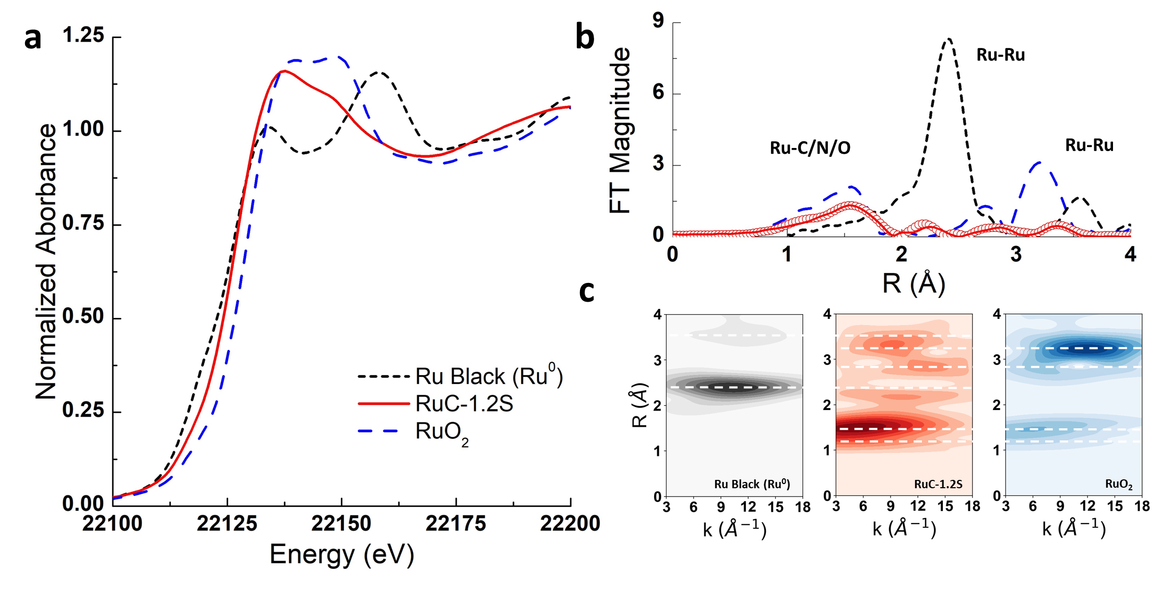
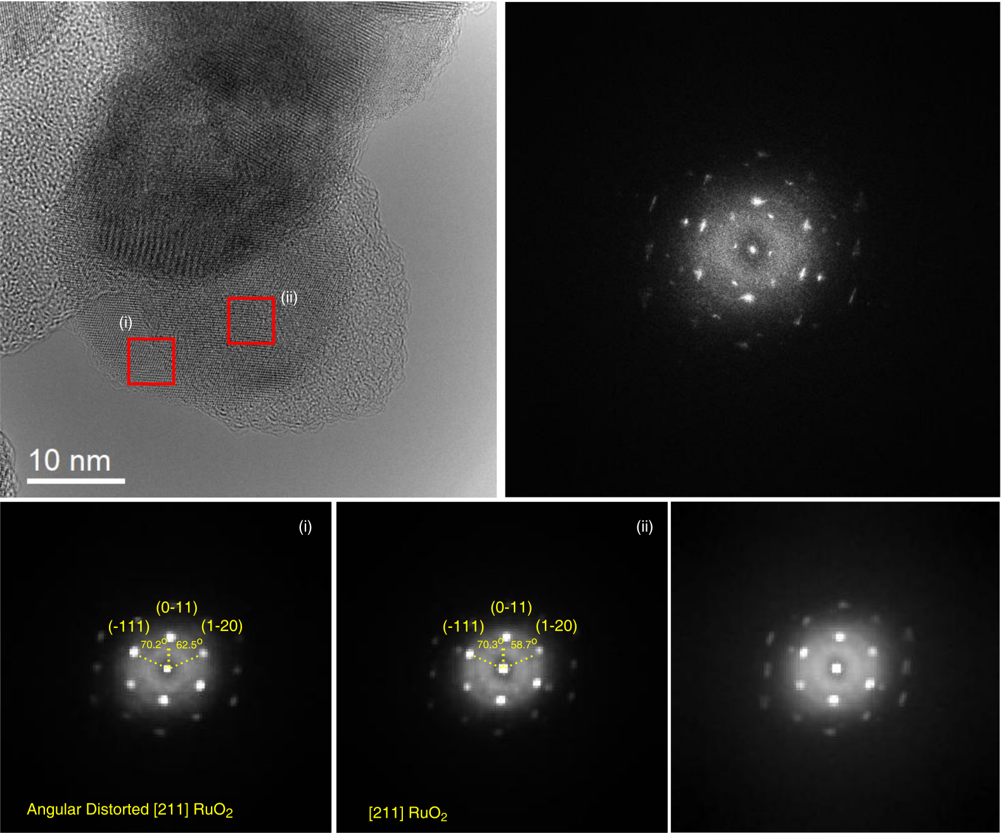
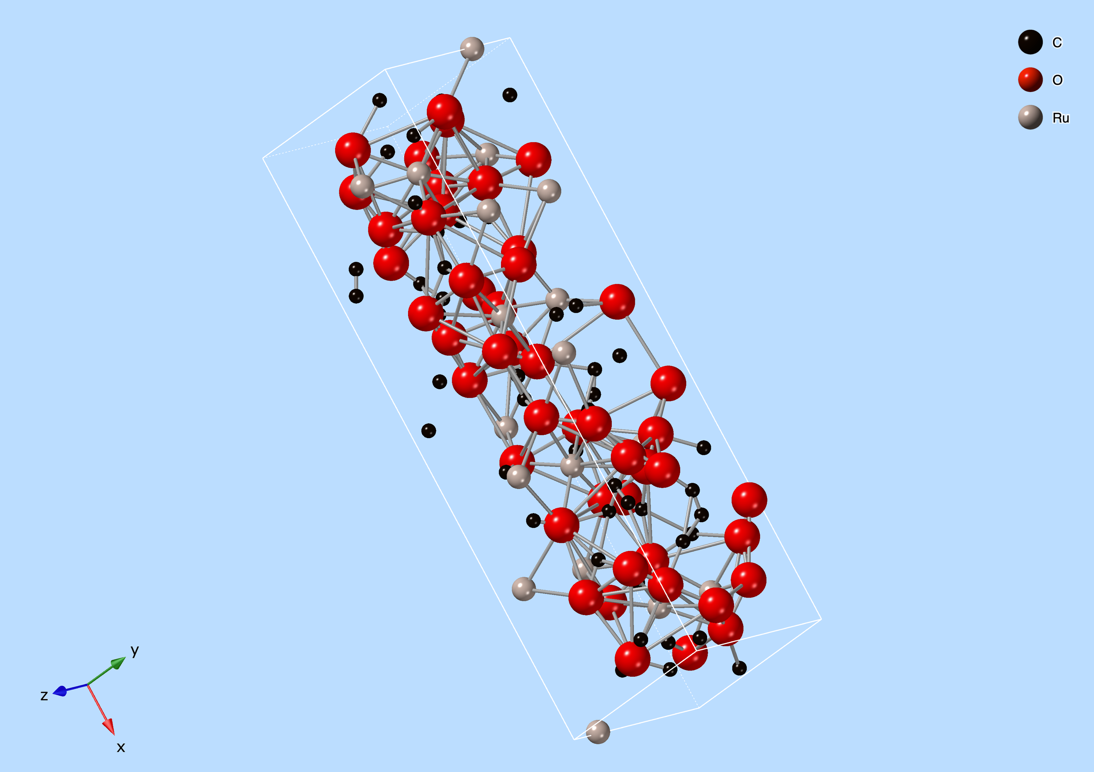
STEM and X-rays:
A perfect tool combination to understand active sites!
The Ru-C catalyst
Combination of STEM, XAFS, EXAFS & powder diffraction reveals structure of catalyst:
Ensemble averaging tools like spectroscopy and diffraction allows to sample full sample.
STEM gives the full view with all “non-active” sites and a first structure information.
X-ray diffraction gives high resolution structural data.
Spectroscopy allows to characterize also the defect structure.
To be done:
  Complete reiterative data pipeline.
  Data analytics approach for spectroscopy to identify the active site (see next slide: operando experiments)
InCAEM workshop
DOI: 10.1021/jacs.9b07088 J. Am. Chem. Soc. 2019, 141, 19304−19311 and additional data (currently published) from Patricia Concepcoón (ITQ)
14. April 2023

Slide 17
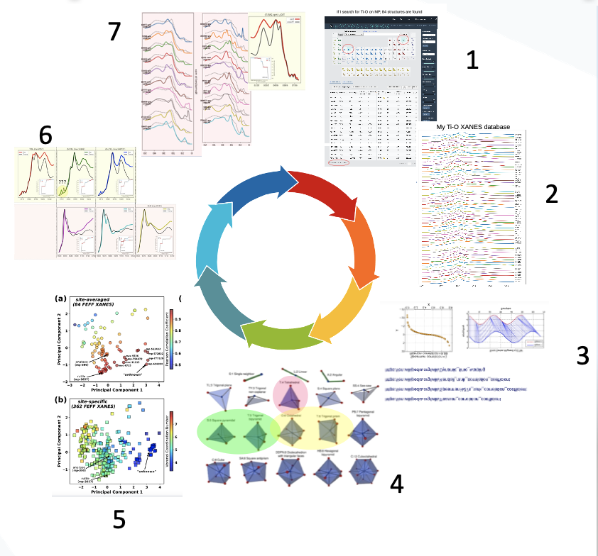
The Importance of Data Analytics
Steps:
Identification of all known structures (database).
Calculating spectra of all structures and specific sites.
Defining metric to compare and rate results
Define “descriptors” to describe structure
Test descriptors and metric on calculated data
Measure reference spectra and compare with simulated spectra.
Refine calculations (choose appropriate code)
Structure –Spectrum correlation
Site – Spectrum correlation
Enabling technologies provided by ALBA II:
Data analytics competence.
High throughput facilities to create training sets and make systematic testing of the tools.
Computation capabilities (by partnerships and databases).
Big data capabilities.
14. April 2023
InCAEM workshop
Notes:
It would be great if you can conclude this with a slide which graphically explains what is your branding and how the different tools contribute to this.
This is a very difficult slide but I think you really know what you want to say if you can make this one.
FF I have made something for battery example based on multitechniques . I do not feel competent producing the same for catalysis. I would hence supply Highlight of catalysis and gas sequestration examples
This slide is pretty dense and long time will be spent on it
https://www.albasynchrotron.es/en/media/news/new-synthesis-procedure-to-optimize-the-catalytic-performance-of-platinum-based-materials
https://www.albasynchrotron.es/en/media/news/researchers-design-a-nanotechnology-based-system-that-can-transport-methane-at-lower-pressure-and-cost

Slide 18
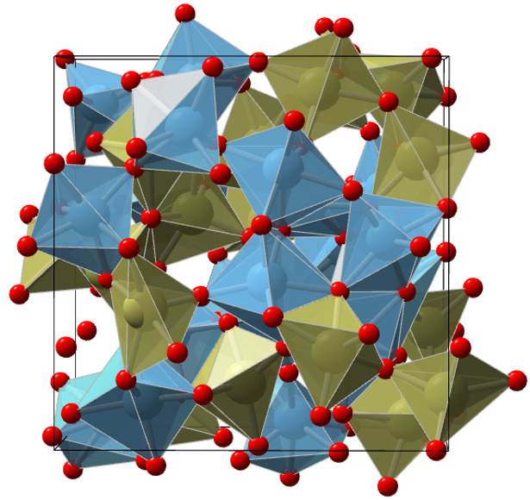
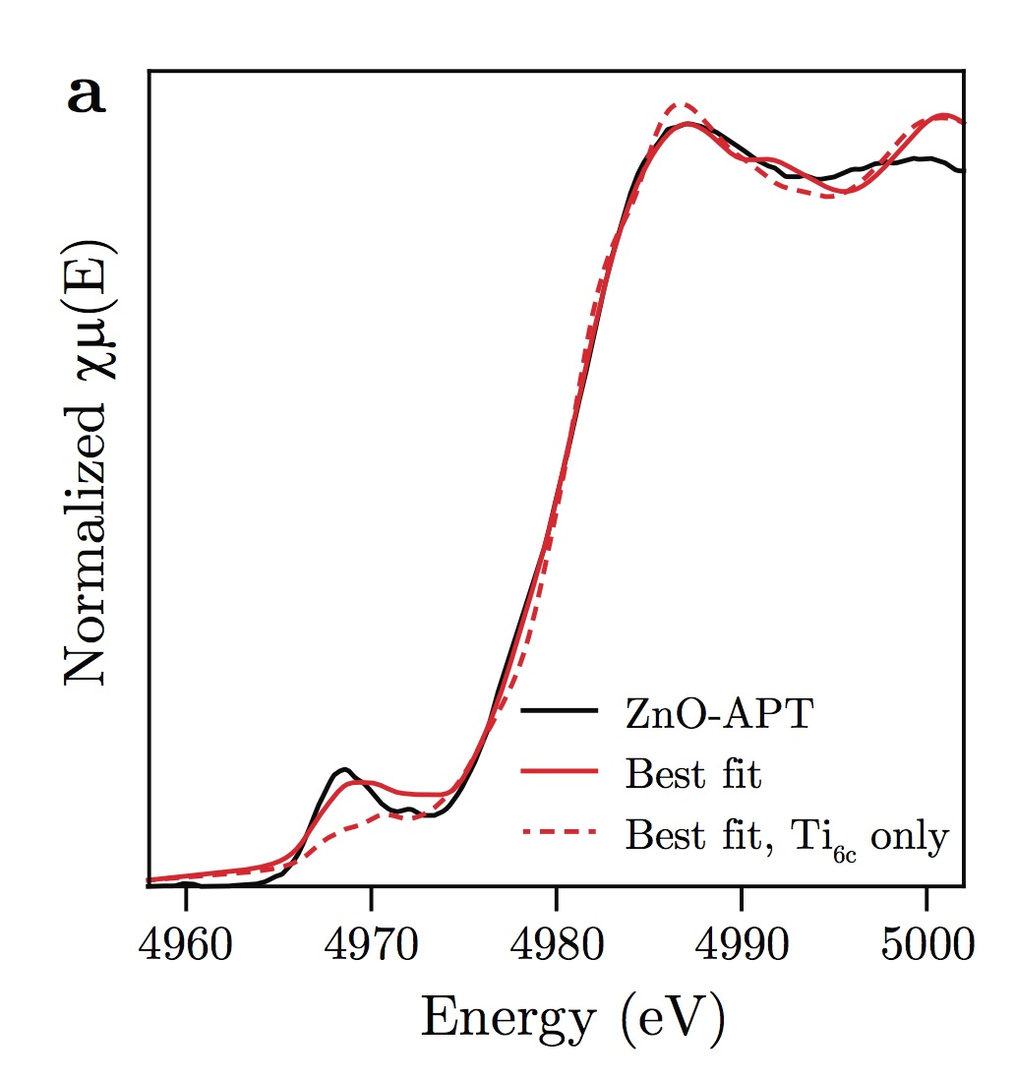
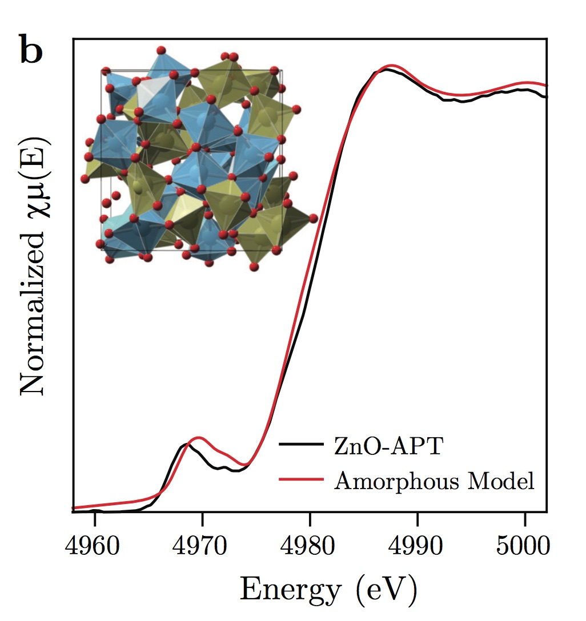
Structure Visualization
Crystalline, nano-crystalline, or amorphous
Data analytics can be answering the reverse problem
It can be used to identify a specific site which is changing in an operando experiment!
Nano-crystalline
Amorphous
22%
16%
62%
Only 5- and 6-coordinated (50%)
Qu, Xiaohui; Yan, Danhua; Li, Ruoshui; Cen, Jiajie; Zhou, Chenyu; Zhang, Wenrui; Lu, Deyu; Attenkofer, Klaus; Stacchiola, Dario J; Hybertsen, Mark S; “Resolving the evolution of atomic layer-deposited thin-film growth by continuous in situ x-ray absorption spectroscopy”, Chemistry of Materials, 33, 5, 1740-1751, 2021, American Chemical Society.
Good agreement in pre-edge range indicates ~22% 4-coordinated contribution
Good agreement in main peak indicates strong influence of low long range order
Nano Lett
. 2019 Jun 12;19(6):3457-3463.
doi: 10.1021/acs.nanolett.8b04888. Epub 2019 May 7.
14. April 2023
InCAEM workshop

Slide 19
The Structure Function Correlation and the Multi-Modal Approach
How can you understand the Structure-Function correlation:
Identify correlations between spectral features and descriptor of matter.
Identify spectral changes during operando experiment and correlate with the functional behavior.
Correlate descriptor of matter with functional behavior.
Simulation
Ensemble averaging techniques
DFT and data simulation
Particle Structure
Gas/solid interface
XAFS
(soft & hard)
PDF &
Powder diffraction
XPS
(Ambient & high energy)
Surface diffraction
Data analytics
Structure and data reference data bases
Imaging techniques
Structure model
Scanning
Lens-less
(coherent techniques)
Operando Techniques
Diffraction
(coherent techniques)
Ensemble averaging techniques
Data analytics
DFT and data simulation
Structure-function
correlation
14. April 2023
19
InCAEM workshop

Slide 20
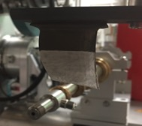
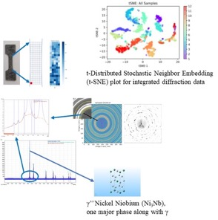


Additive Manufacturing:
From the Raw Material to the Manufacturing Process
Reliability Issues of 3D printed Ni-superalloy turbine blades:
Inconel 718 microstructure and density analysis.
High throughput hard XRD is used to image the structural and chemical variations over each dog-bone and correlate these structures with the failure probability during the tensile test.
Test blade printed by GE
For what parts of the development are Synchrotron facilities used:
Traditional micro diffraction imaging allows to characterize structure after tensile test is performed.
In addition: very fast 2D XRD (20000-50000 per day) can be used to determine:
  Crystal phases and their orientation.
  Particle size distributions and teir orientation.
  Amorphous and crystaline distributions
  Density variations
14. April 2023
InCAEM workshop

Slide 21

Upgrades of synchrotrons light sources allow integration of complex instrumentations.
Upgrades provide new potential to integrate complex infrastructures:
The potential of ALBAII is boosted by the availability of nearby green field – Activities for plot urbanization just started. Space for long beamlines experimental stations and space for other research institutions
Building capacity up to 40000 m²
ALBA II will use ~ 10000 m²
Partnerships welcome to profit from the opportunity
14. April 2023
21
InCAEM workshop

Slide 22

Thank you for the attention!
Any questions?
14. April 2023
Foto Sergio Ruiz
InCAEM workshop

