Slide 1

Νοτος
Instrument development and innovation beamline
ό
Pablo Pedreira, Josep Nicolas, Miguel A. G. Aranda

Slide 2
Outline
Motivation
Scientific case
Technical proposal
Budget and calendar
Νοτος
Instrument development and innovation beamline
ό
Pablo Pedreira, Josep Nicolas, Miguel A. G. Aranda

Slide 3
Motivation
ALBA strategic plan 2013-2016
Decision to increase the in-house and local developments of instrumentation for the future ALBA beamlines
This is channeled through:
Full in-house design, production and assembly
In house design, contract production
Joint effort with private companies or research institutes

Slide 4
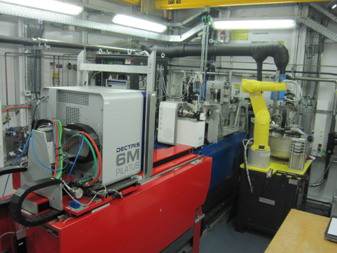
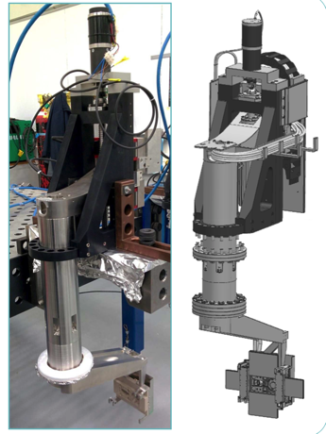
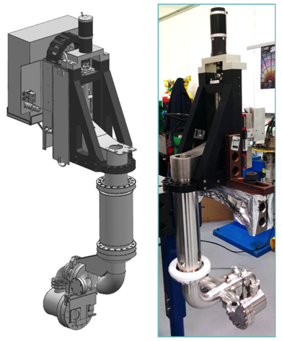
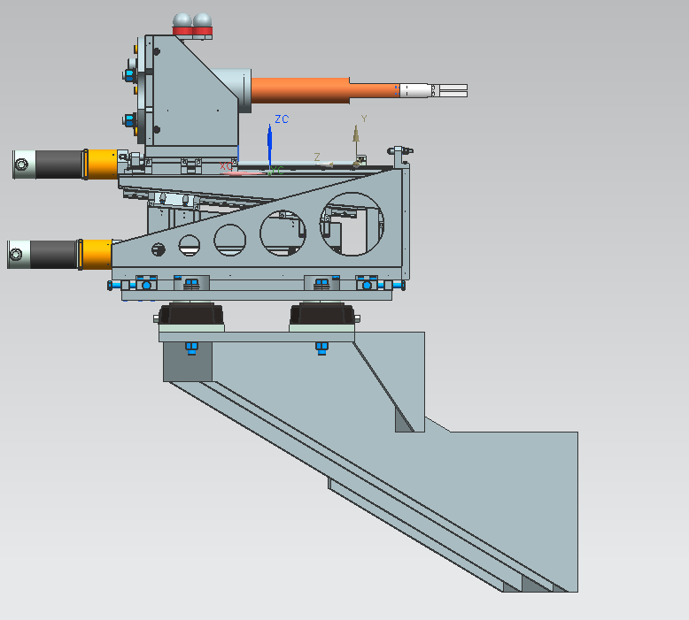
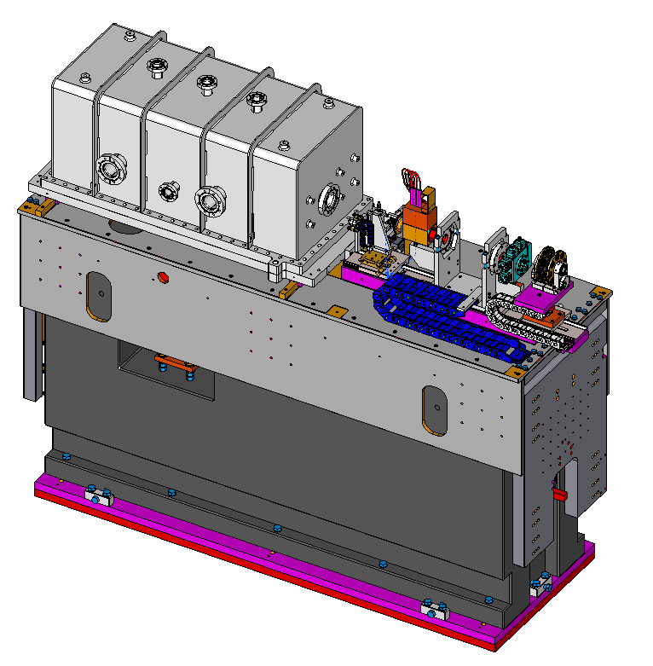
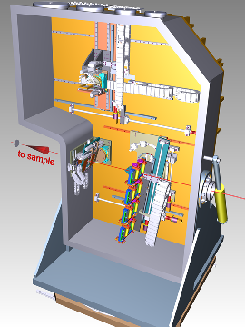
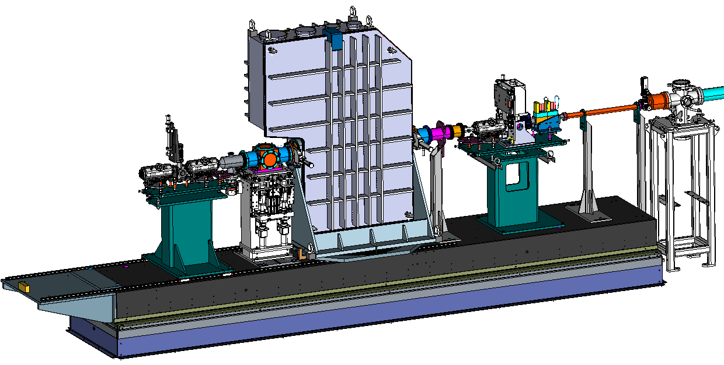
In-house developments
A number of instruments at ALBA have been developed in-house

Slide 5
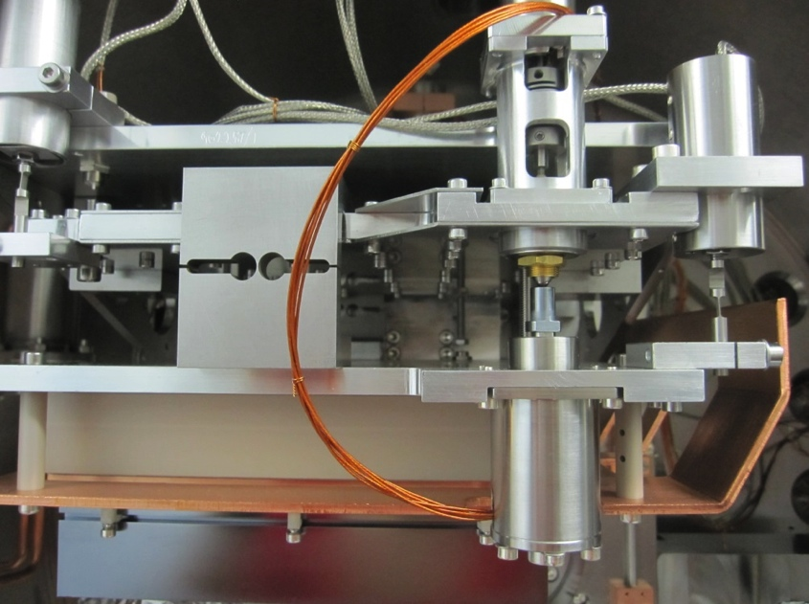
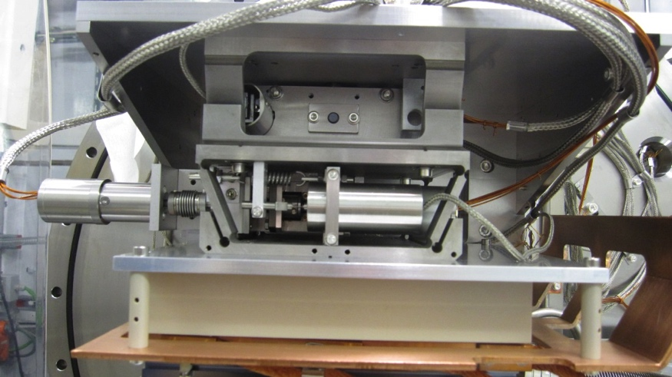
Benefits
Reduce cost of equipment (incl. maintenance)
Design flexibility for better adapted technical solutions
Easier maintenance, faster repairs
Example:
A DCM for fast Energy Scan but has a weak crystal cage
Increase staff experience to face more complex projects

Slide 6
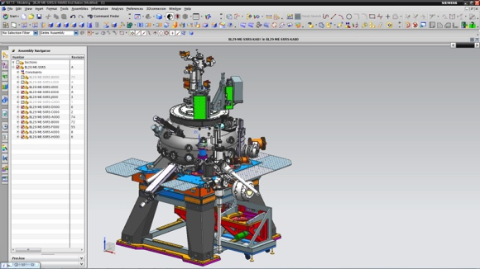
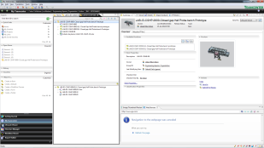
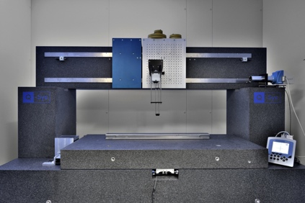
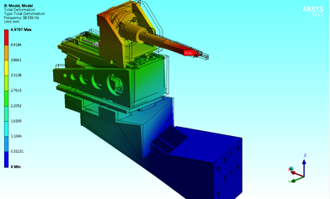
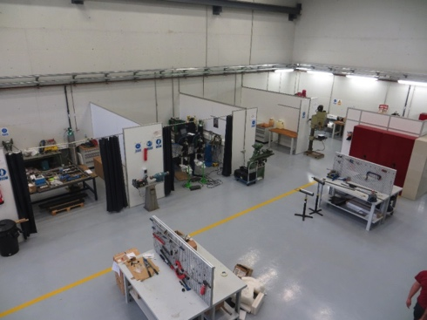
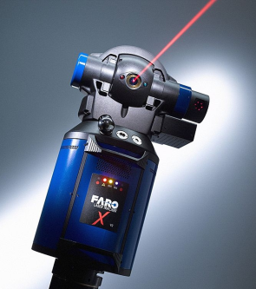
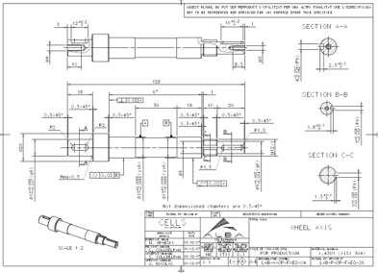

Capacity
Exploit
ALBA has the structures for production of scientific instrumentation
Commiss.
Specify
Design
Production
Test
Ideas,
Team,
Funds
Technical office (incl calculists)
Electronics
Controls
Collab. Univ.
Workshop
Elec.WS.
Network of suppliers
Vacuum
Hydraulics
Alignment
ID lab
Metrology lab
Optics lab
At the beamline
Competition users – commissioning.
Instruments not fully commissioned
Not in BL conditions
No detector lab

Slide 7
Need of a test platform
Allows for testing instruments in real beamline conditions
Allows for offline testing/calibration of instruments and improvement of techniques
A high performance x-ray source available for collaborations
Releases user-oriented beamlines from some commissioning activity

Slide 8
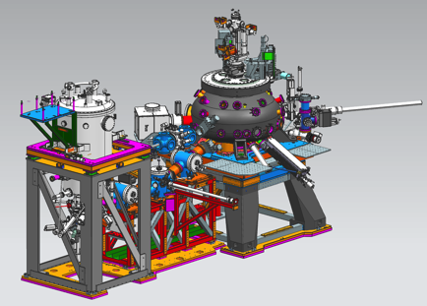
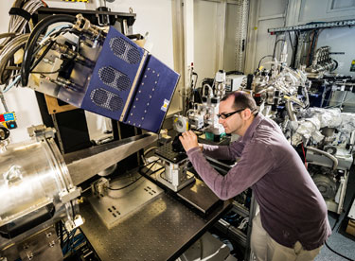
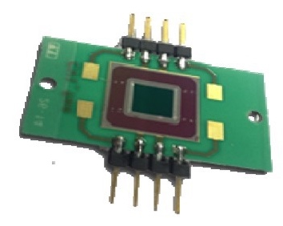
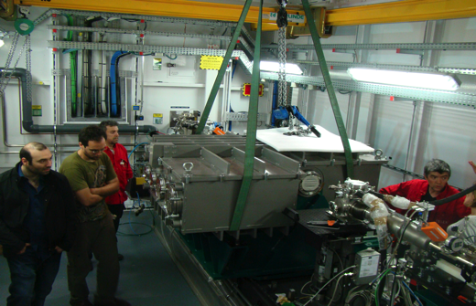
Examples
Actual examples where a test beamline would benefit ALBA
The MaRES station
CIRCE Grating contamination tests
NCD detectors
NanoBender
Transmissive diodes
The CLEAR station
On-Axis dignostics

Slide 9

Scientific case
“The main goal of the NOTOS beamline is to provide a platform to perform calibrations of beamline instrumentation in aspects that require at-wavelength metrology, or require actual beamline conditions”
At wavelength metrology
BL conditions
Reflectivity/Transmission
Diffraction
Wavefront metrology
Spectral responsivity
X-rays
Vacuum
Cryogenics, cooling
Power load

Slide 10
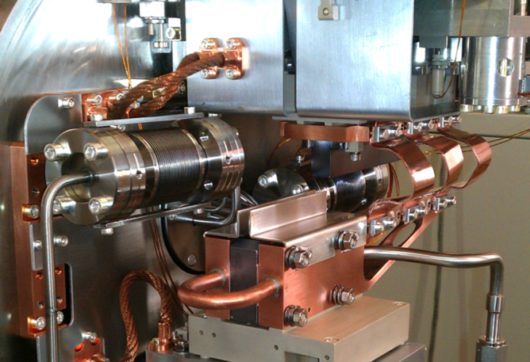
Beamline instrumentation testing
Motion and optics metrology provide accurate description of the performance.
However, direct measurement of the performance is only obtained at a beamline.
Some conditions which affect mechanics and electronics cannot be reproduced in the laboratory:
  Wavelength dependent parameters and phenomena
    Crystal diffraction,
    Compton scattering heating,
    Actual resolution,
    Actual throughput.
  Power obsorption on mirrors.
  Cryogenics and vacuum conditions
  Bakeout effects
DLS-DCM tested at B16 at Diamond

Slide 11
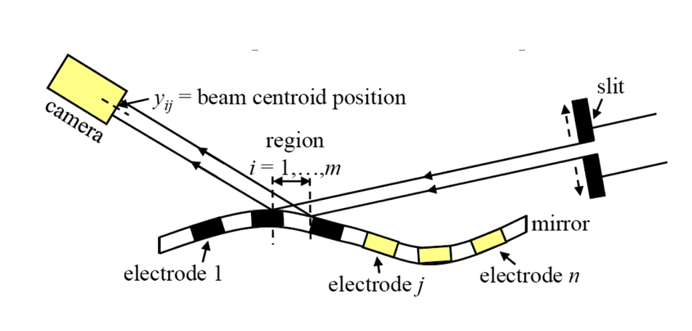
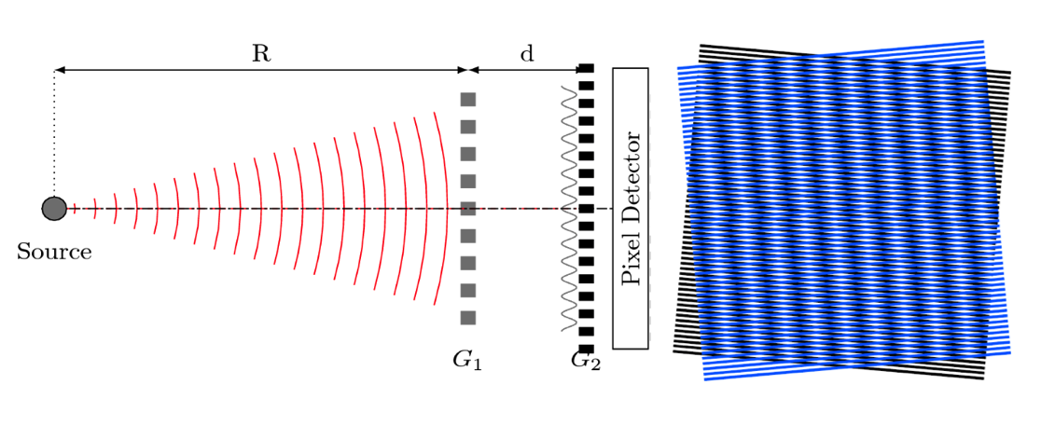
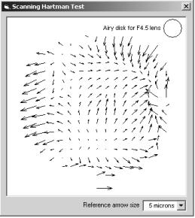
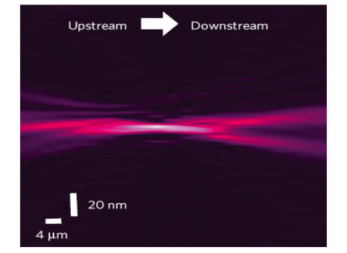
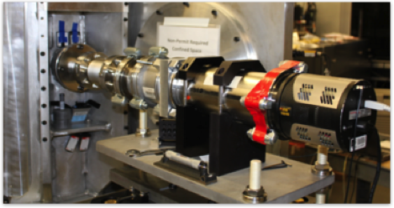
Wavefront metrology
Many wavefront analysis techniques in evolution
Pencil beam
Shearing interferometry
Hartmann sensors
Speckle tracking
Phase retrieval

Slide 12
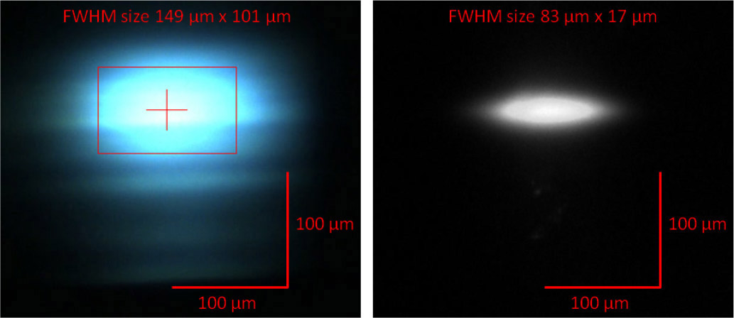
Wavefront metrology
Wavefront metrology techniques are aimed to be implementable in user-oriented beamlines as a tool for diagnostics.
Pencil beam is a standard method to optimize the focus of mirror benders
Example of pencil beam method to determine the VLS parameters at Mistral

Slide 13
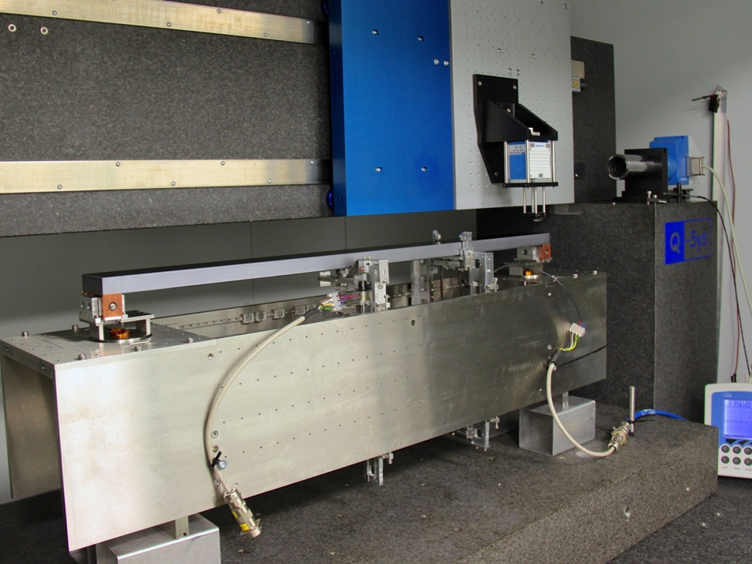
Wavefront metrology
Wavefront metrology is fundamental for active optics as it provides the necessary feedback from which calculating mirror correctors.
ALBA has been successful implementing adaptive optics with nanometer accuracy on long mirrors using mechanical – which has never been reached by piezoelectric approach.
Wavefront metrology has allowed checking that correction is preserved after three years of operation in the beamline.
Correction of a 600 mm long mirror
Comparative of Lab and BL measurements of the mirror profile
Nanobender prototype

Slide 14
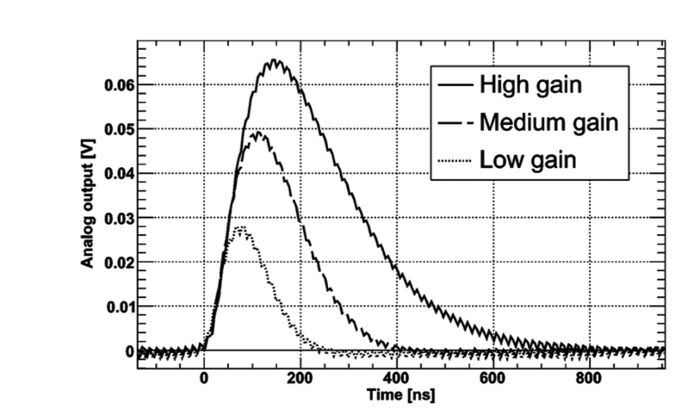
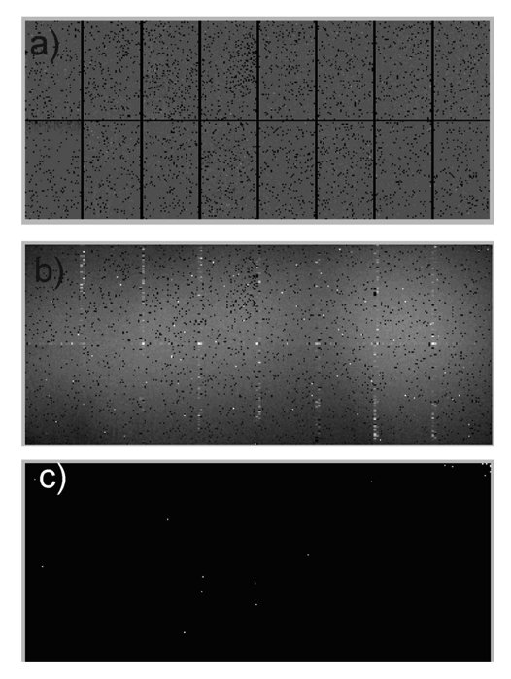
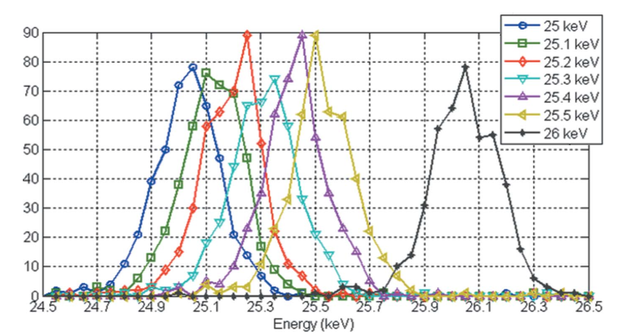
Detector metrology
High performance detectors are complex instrument and need long commissioning and calibrations.
Notos is a key instrument for a Detector Service at ALBA
Spectral responsivity
Spatial resolution
Linearity/Noise
Time response
Configuration parameters
Integration with detector optics.
…

Slide 15
Reflectometry and transmission
Reflectivity, Diffraction efficiency and transmission are directly dependent on wavelength.
Include scattering effects and wavefront deformations for very demanding BLs
Transmission elements
  CRL lenses
  Filters
  Windows
To measure
Contamination of mirrors and gratings
Rocking curves of crystals
Reflectivity of multilayer mirrors.
Multilayer grade profiling.
Diffraction efficiency of gratings (¿?)
10 nm C/50 nm Au
50 nm Au
Example of C contamination effect

Slide 16
User-oriented
Notos is conceived to be a very flexible hard x-ray beamline, and it could also allocate non high-demanding user-experiments as a relief of very oversubscribed beamlines.
BL equipment includes
2D detectors
Positioning tables
Focus flexibility
Notos could host HW decomissioned fom other beamlines (v.g. BM25A)
Sample environment and specific experimental hardware can be lent from other beamlines at ALBA
Likely XAS, imaging or powder diffraction experiments could be conducted at Notos

Slide 17
Selected communities involved
“ to research, deliver and maintain methods and techniques with which to conduct synchrotron light based research and development in such a way that knowledge and added value data are pumped into the scientific and industrial communities”
Besides ALBA, NOTOS will benefit third parties:
Subcontracted companies and workshops. A network of quality workshops and small engineering companies near ALBA
Industrial partners in development projects: v.g. Nanobender, DCM project, Diode projects
Technological and research institutes: Current and potential partners CIEMAT, CLPU, CNM, IFAE
SR community

Slide 18
Technical proposal
Expanded
Collimated
Convergent
Divergent
Focused
Monochromatic
Pink
White
Low energy
High energy
Variable Spot size and position
Several working modes
Wide Energy range
Large hutches
The beamline design aims to provide maximum versatility at reasonable cost.
It is a hard x-ray beamline, but we consider to extend its low energy end.

Slide 19
Optical layout
1.Dipole source
Wide spectrum
Unexpensive
Small source
Simple
2.Collimating mirror
Higher flux/resolution
Reduces power on mono
Collimation required often
3.DCM
Low energy range
Multiple crystals
4. Torus focusing
Large H acceptance
Acceptable focusing

Slide 20
Optical layout
Monochromatic – collimated beam

Slide 21
Optical layout
Pink beam - collimated

Slide 22
Spaces
Two hutches are proposed to reduce lead cost and provide BL flexibility.
Large optics hutch, providing space for experiments requiring white beam
8 m downstream nominal focus

Slide 23
Performances (Flux)
Flux >10⁺¹² ph/s/0.1% for hν < 40keV
2 mrad H-acceptance
Continuous spectrum

Slide 24
Energy Range
Mono Bragg angle 0-30 deg
E_{min} Si(111) = 5 keV
Multilayer to extend the energy range to about 1 keV

Slide 25
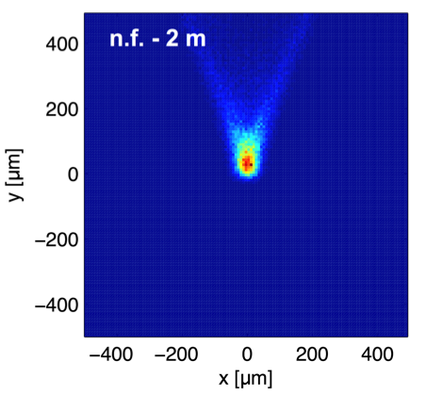
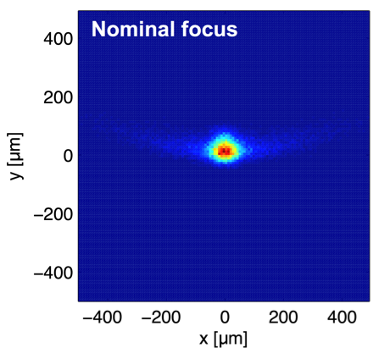
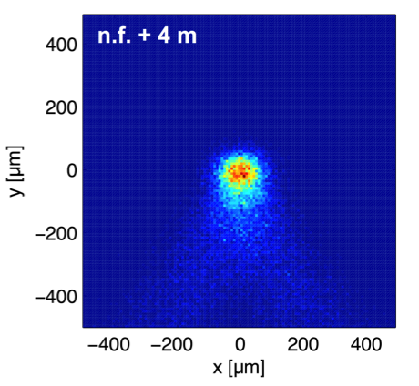
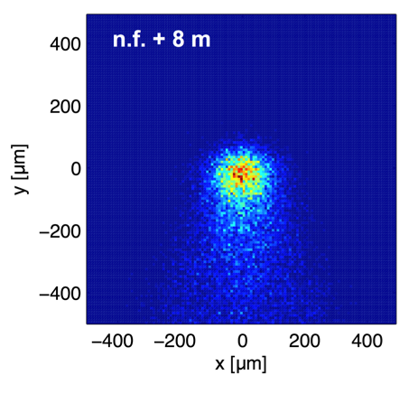
Focusing
Meridional focusing controlled by mechanical bending
Sagittal focusing controlled by tuning incidence angle (mostly to more grazing)

Slide 26
Stations
Ancillary
Vacuum Chambers
Slit systems
Fluorescent screens
Detectors
Area detectors
IC. Diodes
X-ray microscope?
Positioning stages
Large stable positioning table
Smaller modular translation and angular tables
Vacuum Goniometer
For reflectivity measurements.

Slide 27
 | Item | Budget [kEur]
Source
 | Bending magnet | 0
 | Frontend | 200
Beamline & Optics
 | General pipe and vacuum components (incl. controllers) | 150
 | Collimating mirror (including the positioning system) | 110
 | Double crystal monochromator | 30
 | New prototype DCM (crystals and multilayers) | 100
 | Focusing mirror (including the positioning system) | 110
 | Four slits | 100
 | Spare high precision table for tests | 70
Endstation
 | Detector(s) and electronics (including synchronization issues) | 150
 | Spare high precision table for tests | 70
 | Goniometer | 100
 | General pipe and vacuum components (incl. controllers) | 100
 | Hutches (optical and experimental) | 350
Control room/infrastructure
 | Enclosure | 40
 | Control electronics | 100
 | Data acquisition computing and electronics | 50
SUBTOTAL |  | 1,830
Contingency (10%) |  | 183
TOTAL |  | 2,013
Budget

Slide 28
Construction strategy
The NOTOS beamline should be built as much as possible by means of in-house projects:
Quickly increase staff technical compentences, to build a complete beamline.
Make it available soon, so that future beamlines can benefit from it.
Risk is not transferred to any user-oriented beamline.
Required opto-mechanical components fit well with already set projects.
Re-utilizing hardware from BM16 (monochromator, detectors, positioning tables)

Slide 29
Calendar
Design of mirror system is already available, only adaptation is needed
BM16 mono to be refurbished
Project for a new DCM ready for starting
BL available
Layout
BM16 DCM
Mirrors
New DCM
Hutches
Infrastructure
Controls Infr.
Design
Install
Refurbish
Design
Prod
Install
Design
Prod
Design
Prod
Design
Prod
Design
Prod
BL should be fully staffed from the beginning of the project.

Slide 30
Summary
In-house developments are strategic for ALBA, and contribute to fulfilling this mission
A test BL is an essential tool for this purpose. And it decouples commissioning from exploitation.
Variety of techniques on optics, detector and optomechanics can be host
A flexible, moderate cost beamline is proposed

Slide 31
Summary
In-house developments are strategic for ALBA, and contribute to fulfilling this mission
A test BL is an essential tool for this purpose. And it decouples commissioning from exploitation.
Variety of techniques on optics, detector and optomechanics can be host
A flexible, moderate cost beamline is proposed
Thank you for your attention

