Slide 1
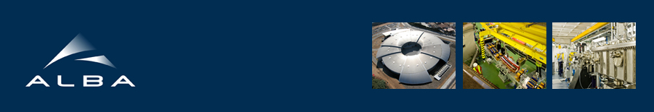

Fast X-ray Tomography & Radioscopy Beamline
(FaX-ToR)
Proposers: F. Sketª, E. Solórzano^{b}, J. Gómez Barreiro^{c}
ªIMDEA Materials Institute, Madrid, Spain
^{b}Universidad de Valladolid, Spain
^{c}Universidad de Salamanca, Spain
E. Pereiro^{d}, J. Nicolas^{d}
^{d}ALBA Synchrotron
ALBA phase III – Evaluation of proposals
ALBA, December 3rd, 2014

Slide 2

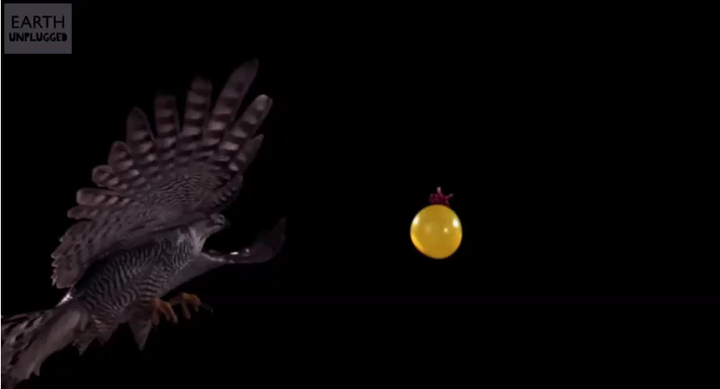

Slide 3

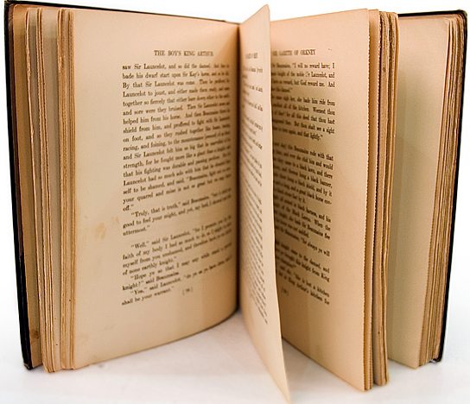
A average novel = 70,000 – 100,000 words
The amount of information is huge!!!
This information can be produced with the beamline we propose
= 1 Word
An image of 1000x1000 pixel = 1,000,000 words

Slide 4

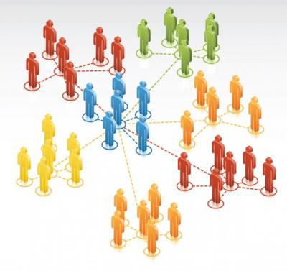
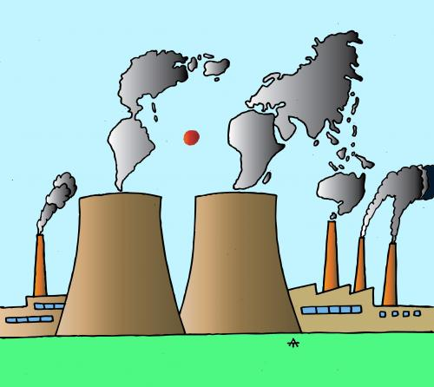


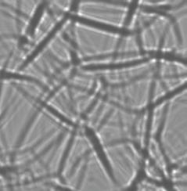
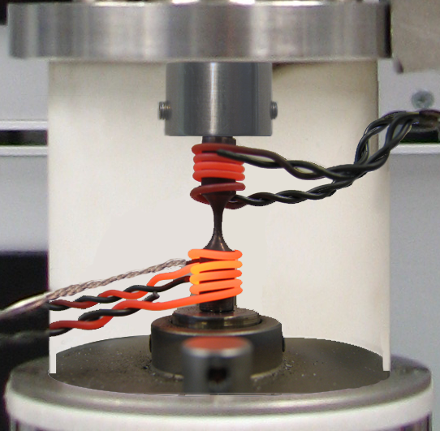

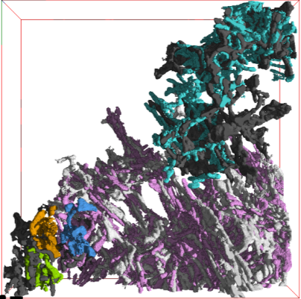
Introduction
How was the FaX-ToR proposal born?
  Groups & Industry interested in tomography
    +
  Experienced research groups
    +
  Cooperation & Projects
  +
  Complex experimental research
  (phase contrast, in-situ testing, fast tomo)
  Critical mass
  TOMOGRAPHY @ ALBA?

Slide 5
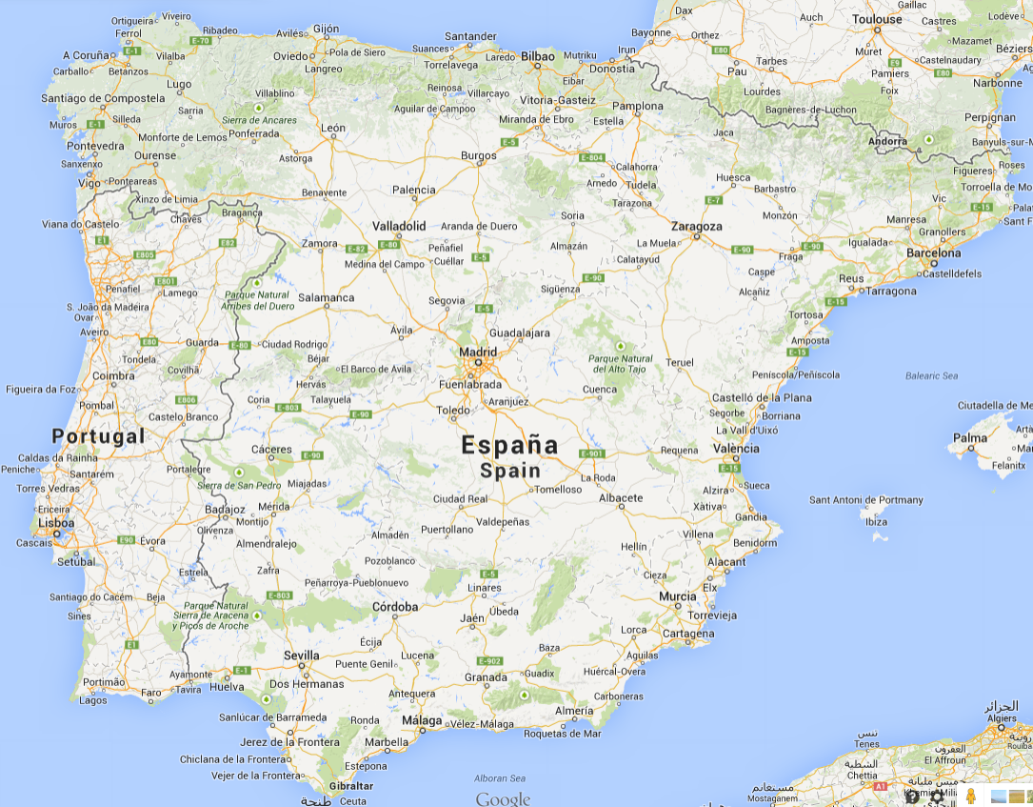
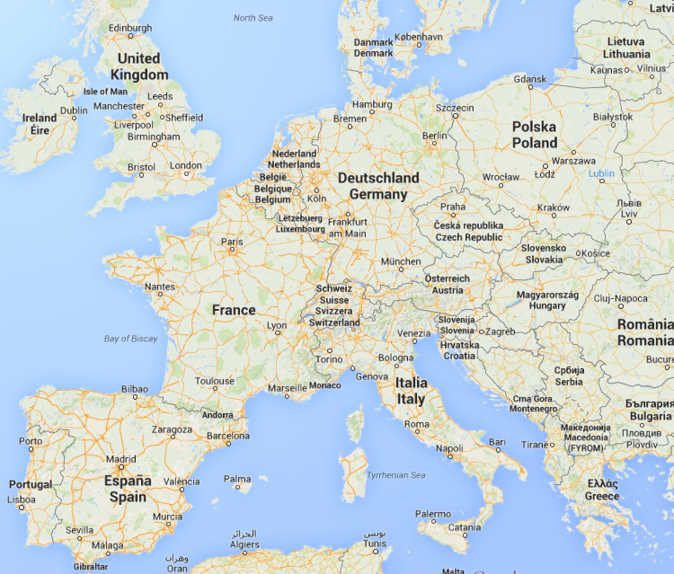
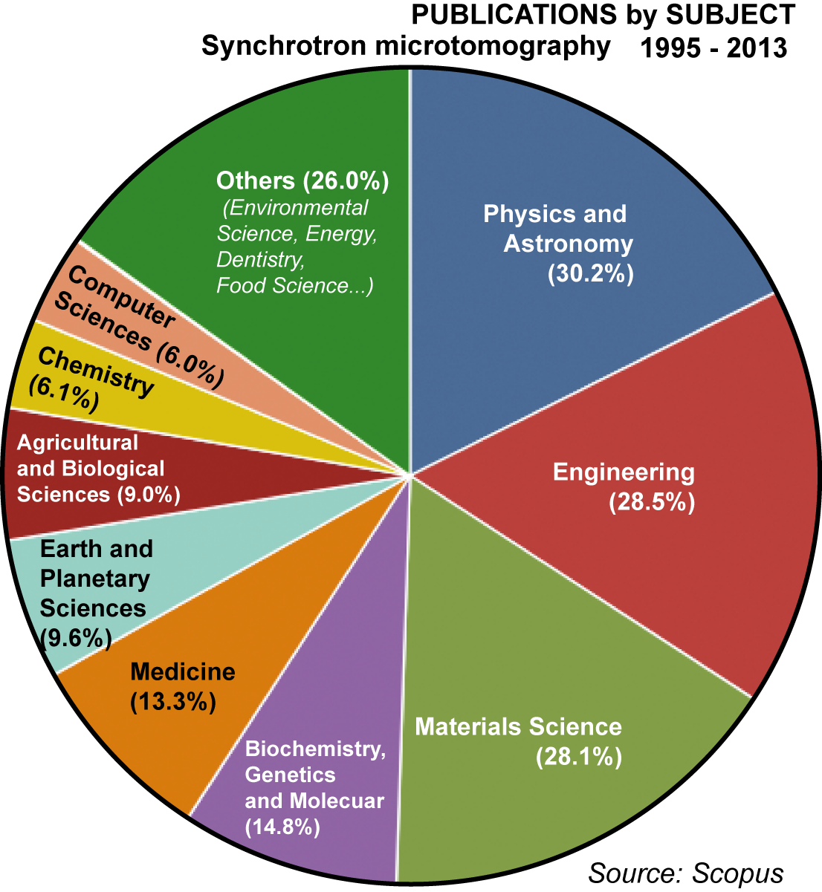
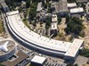

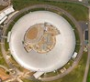
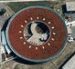




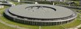
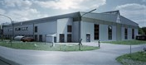
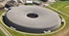

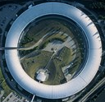
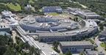
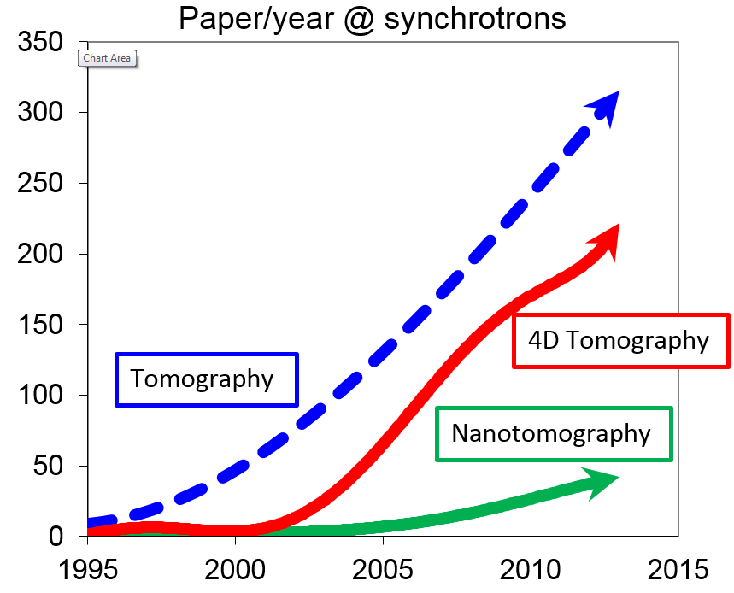
User community and synchrotrons
Current panorama of SXCT in Europe
(e)
MULTIDISCIPLINARY & VERSATILITY
Overload factor for tomography is by far higher than for other techniques. e.g.: ESRF(4), TOMCAT (2)

Slide 6

Attract new fields of research
Industrial applications
High impact publications (nature science, PNAS, etc)
High demands

Slide 7
X-ray-based imaging and tomography
Lab- µCT
- High resolution
- Non-destructive
- Larger volumes
- Reveal phases
Synchrotron Tomography
Synchrotron Radiation features important for imaging:
High Brilliance → real time experiments, ultra fast acquisition times
Tunability → posibility of using monochromatic beam, use of the most suitable energy for a certain experiment/material
Coherence → phase contrast
Combination with other techniques available at the beamline (e.g. diffraction)

Slide 8

Scientific cases
Fast
SXCT
In-situ
SXCT
Fast
radioscopy
Bubble
nucleation
Creep
in metals
SXCT
Molten metal dynamics
Multi-disp.

Slide 9

Research examples 1
Fast radiography
Kinetic processes in molten metals

Slide 10
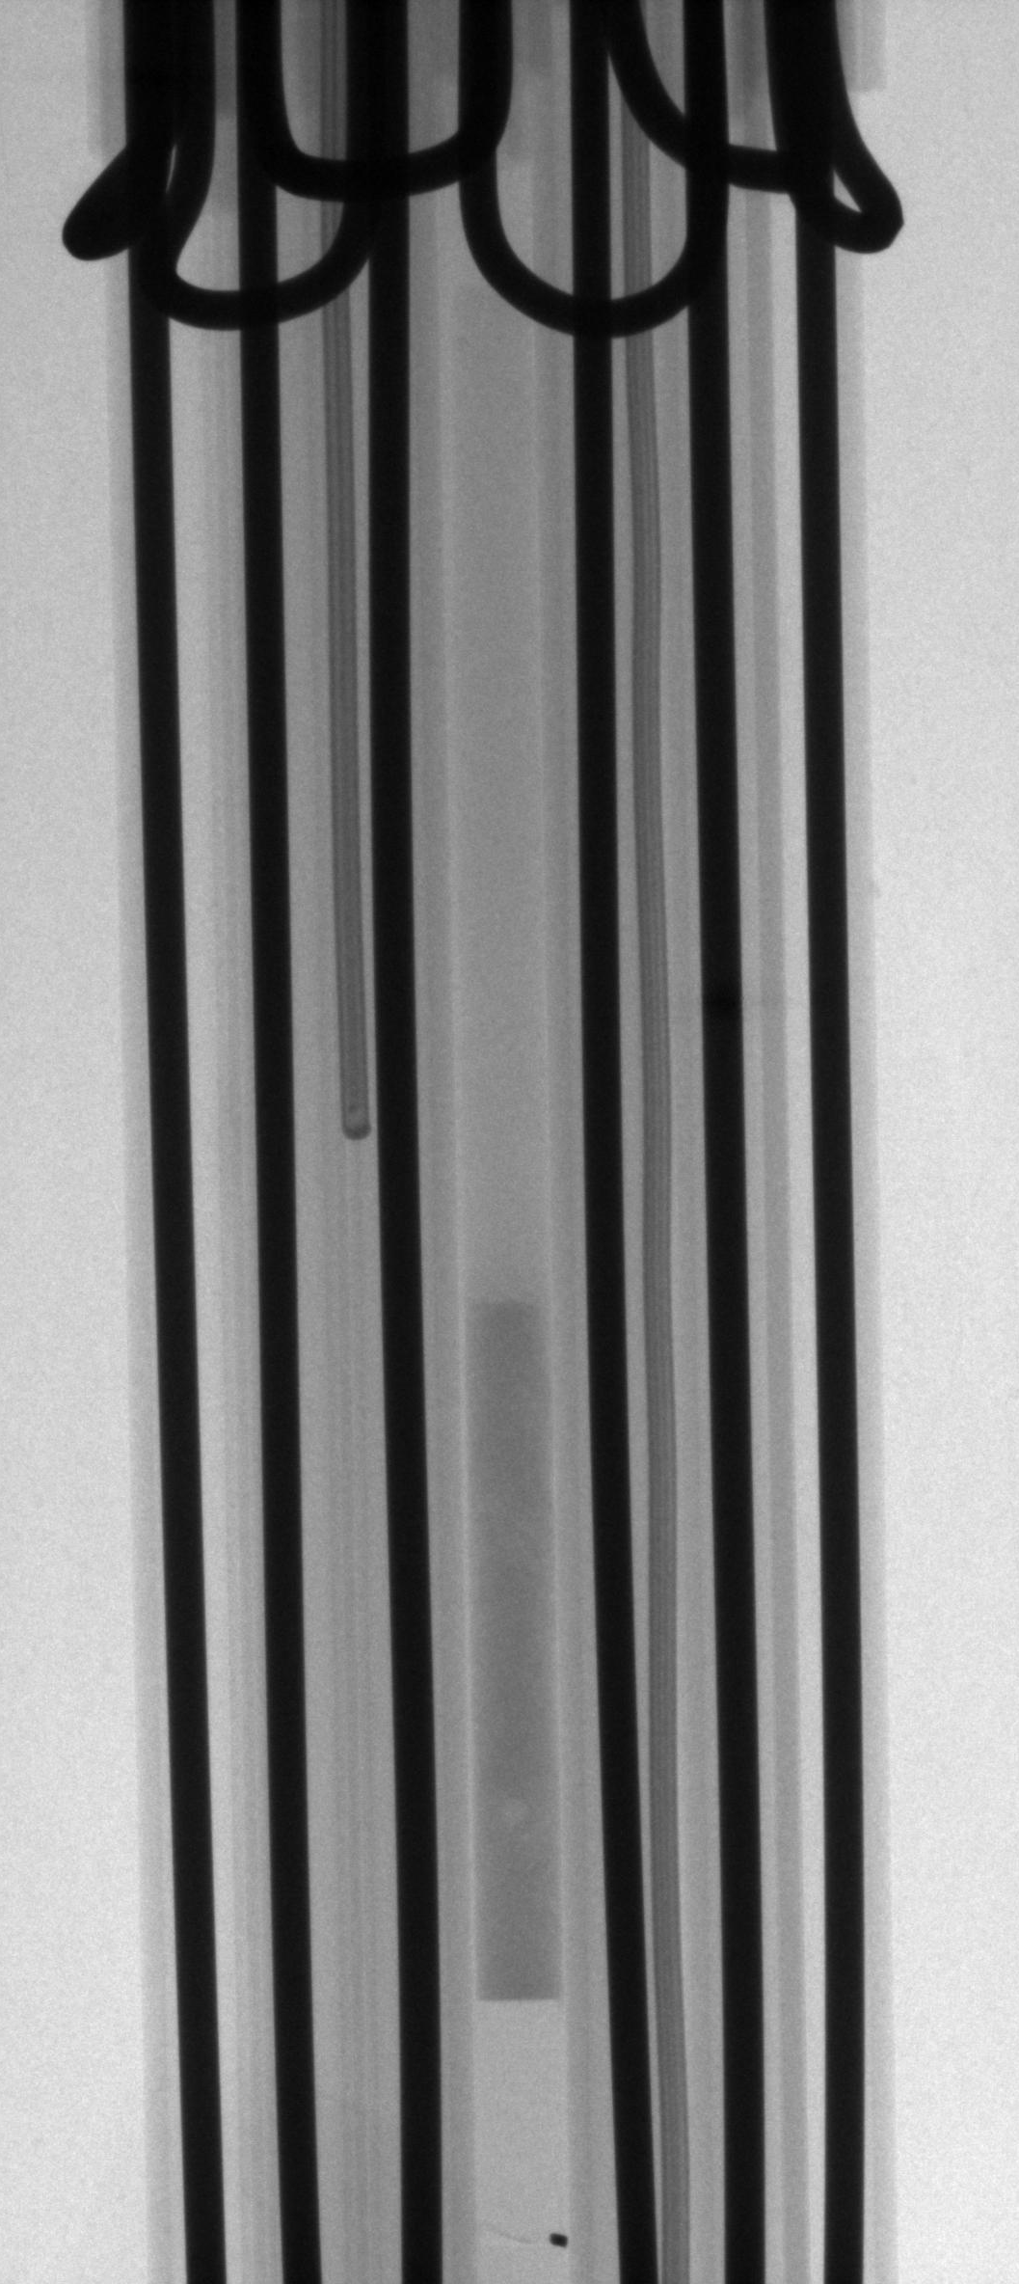
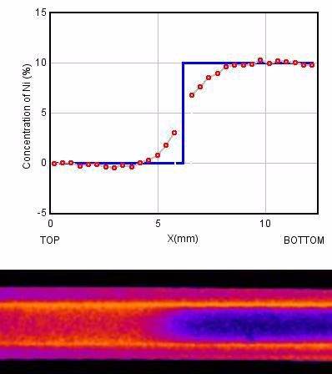
Capillary diffusion in binary alloys
Vaccum
Beer-Lambert Law:
It is possible to change intensities into concentrations by using proper calibration
Al
Thermocouples
Mo heating wires
Al10Ni
Diffusion is a rather slow process → 1 fps → lab experiments
A. Griesche, B. Zhang, E. Solórzano, F. Garcia-Moreno
X-ray radiography for measuring chemical diffusion in metallic melts
Rev. Sci. Instrum. 81, 056104 (2010)

Slide 11
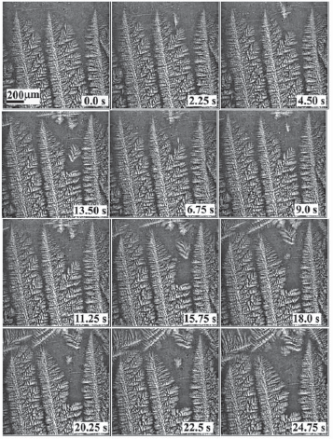
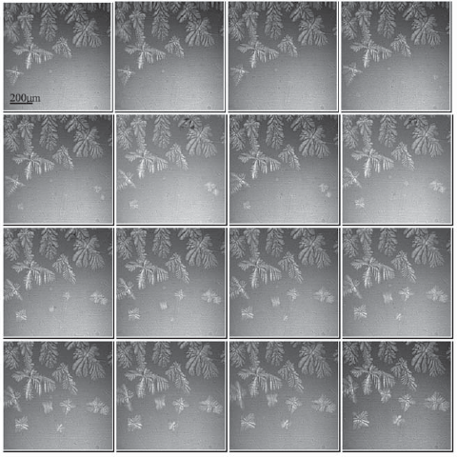
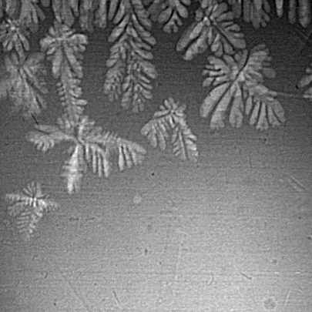
Solidification of AlCu20 alloys
Primary aluminium dendrites are lighter than the melt and experience buoyancy
Directional solidification experiments parallel and antiparallel to gravity show significant differences in stray crystal formation tendency
Constant pulling or pushing velocity to cold furnace compartment
7.5 to 75.0m/s
Temperature gradient was varied between
11–50 K/mm
Temporal resolution (2005)
0.15 (exposure times 100 ms)
g
_
+
_
+
R.H. Mathiesen∗, L. Arnberg Materials Science and Engineering A 413–414 (2005) 283–287
Stray crystal formation in Al–20 wt.% Cu studied by synchrotron X-ray video microscopy

Slide 12
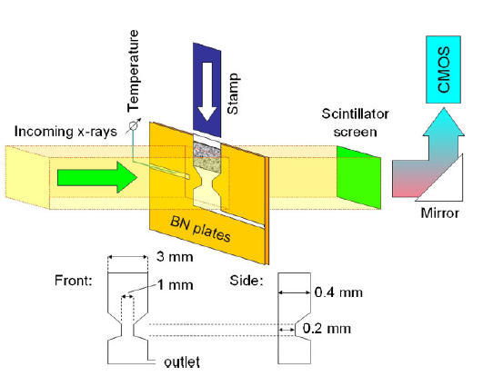
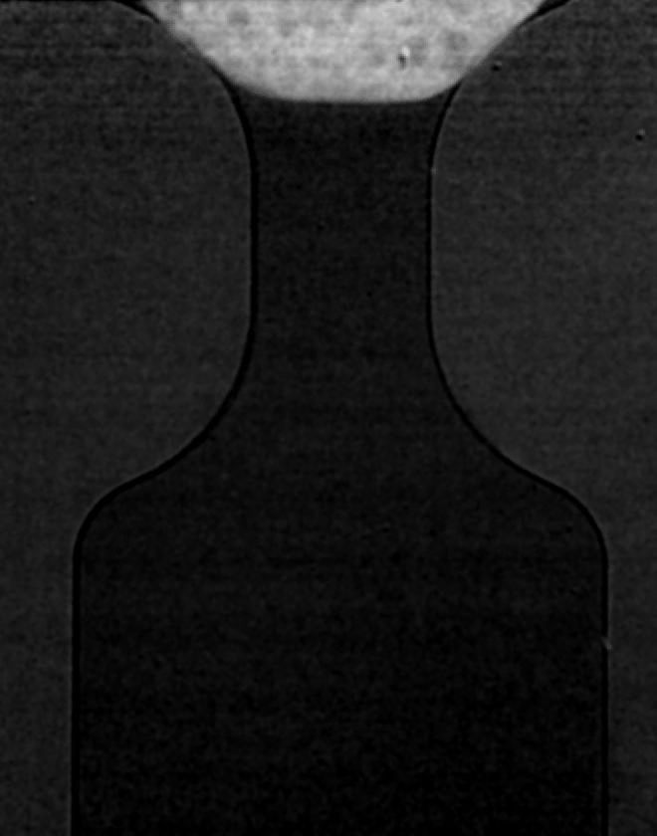
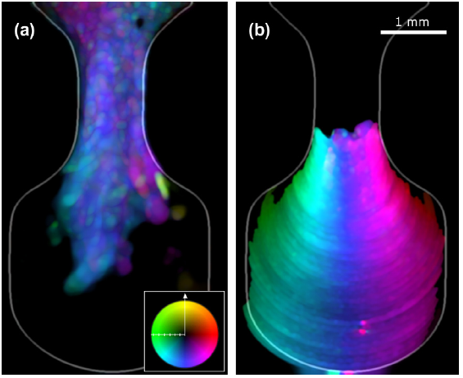
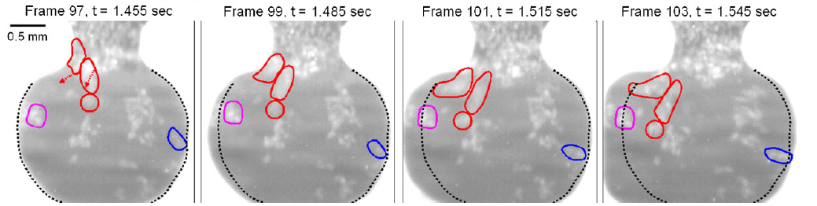
Thixocasting of Al-Ge alloys
Data acquisition rate of 67 frames/s employing a polychromatic X-ray beam
Fast injection of semisolid slurry into the mould
S. Zabler, A. Ershov, A. Rack, F. Garcia-Moreno, T. Baumbach J. Banhart
Particle and liquid motion in semi-solid aluminium alloys: A quantitative in situ microradioscopy study
Acta Materialia 61 (2013) 1244–1253

Slide 13
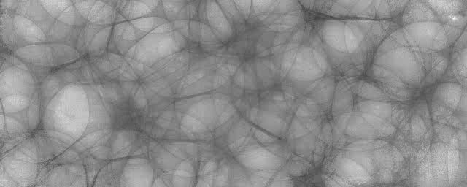
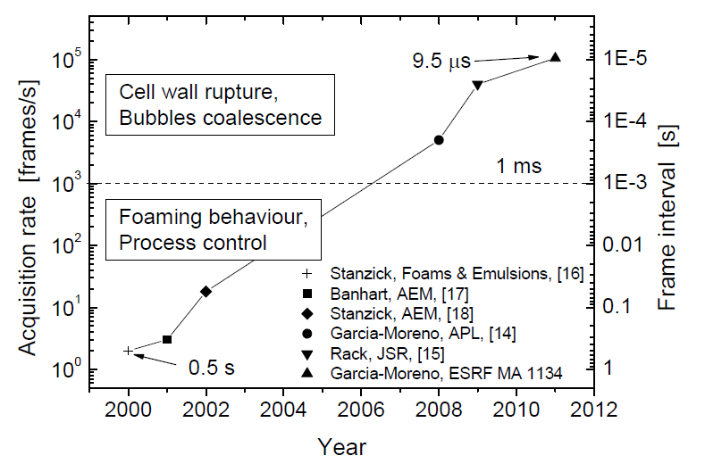
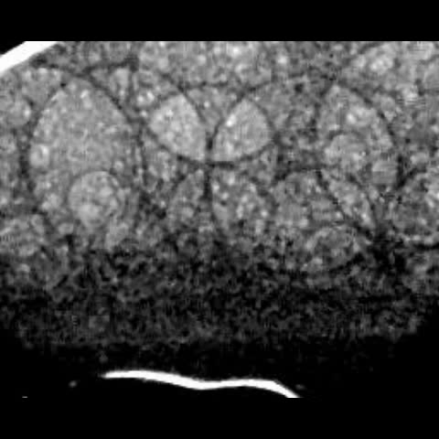
Coalescence of bubbles in aluminium foam

Slide 14
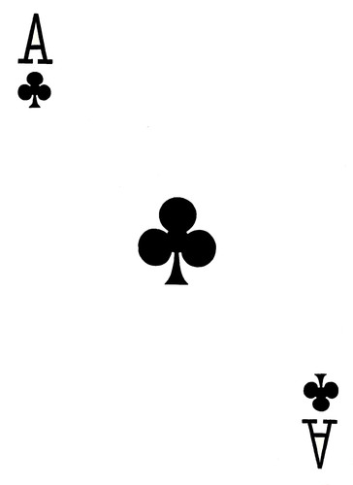
Research example 2
(Ultra) Fast tomography
Physics of bubble nucleation

Slide 15
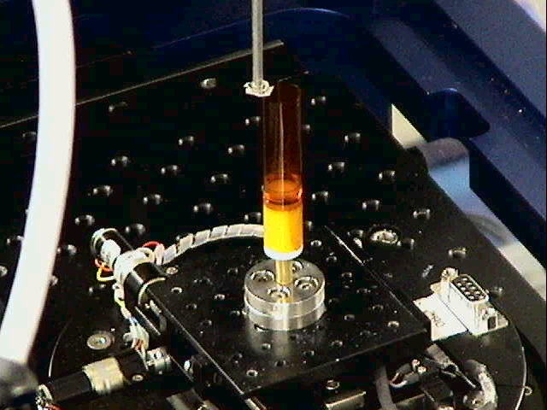
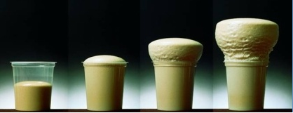
Nanocomposite foams: materials for the future (and present)
Reactive polyurethane & nanofillers:
Enhancement of bubble nucleation
Why??? How???
Development of miniature in-situ mixing set up!!
7Hz tomography

Slide 16
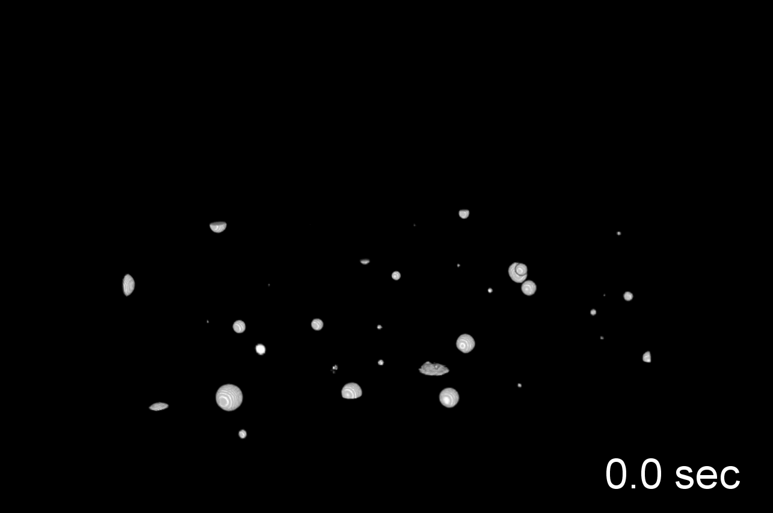
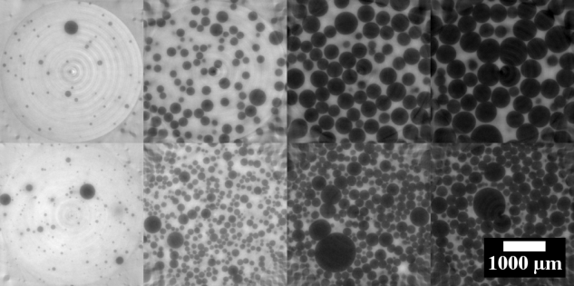
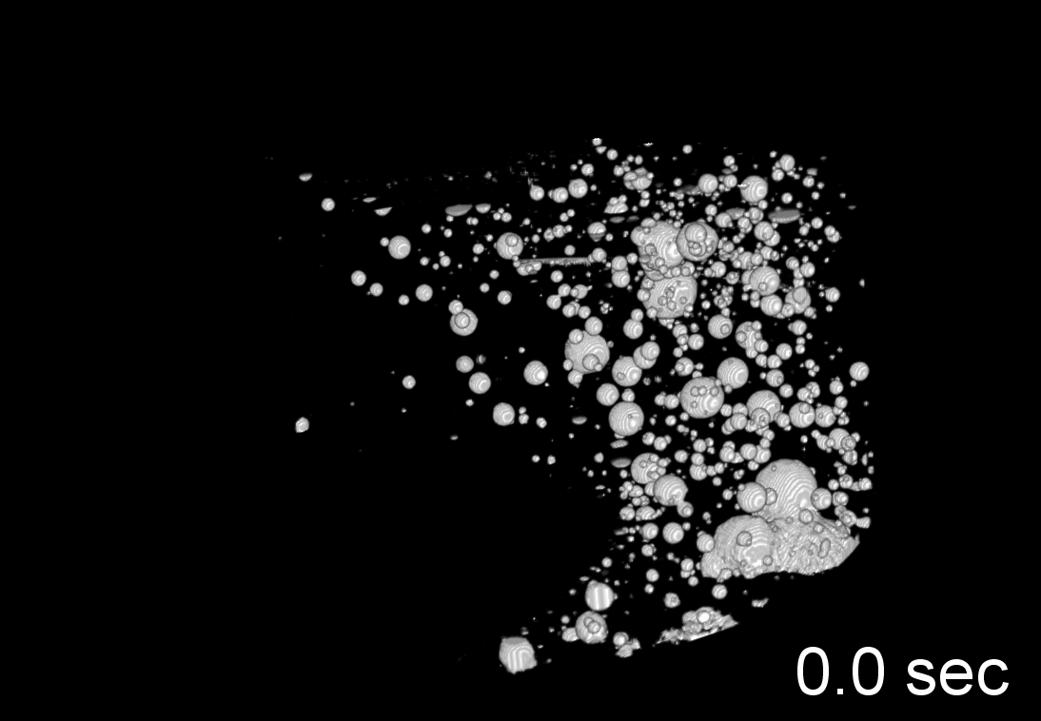
Physics of bubble nucleation
PU + 3% nanosilica
Neat PU formulation
PU with nanoclay
Neat PU

Slide 17
Physics of bubble nucleation
Cell density
Cell size
Constant pore growth
Agreement with models
Nanosilica (wt. %) | C_{het}f_{het}
0 | 5.8·10³
3% | 1.5·10⁵
Direct determination
Constant nucleation rate

Slide 18
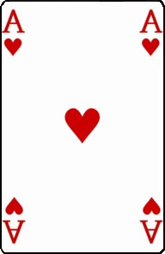
Research example 3
In-situ tomography
Mechanisms of creep in metals

Slide 19
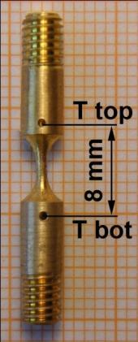
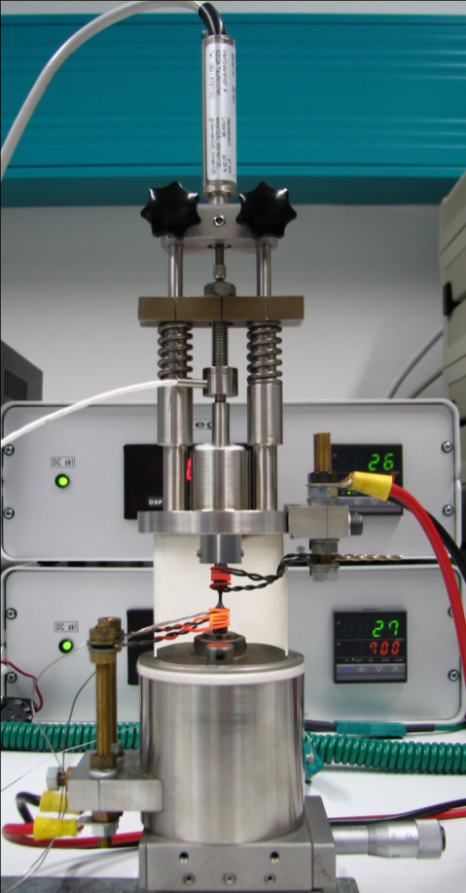
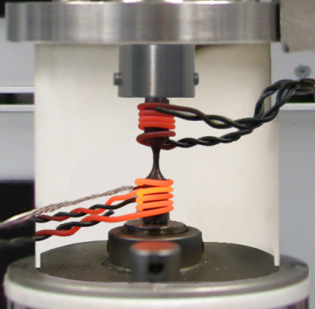
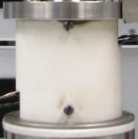
Experimental Details – In situ creep test
Materials:
- CuZn40Pb2 (α, β, Pb)
- Martensitic Stainless Steel 1.4112
(X90CrMoV18)
- OFHC Cu
Creep tests at constant load:
- Brass: σ = 25 MPa, T_{b}= 400ºC
- Steel: σ = 210 MPa, T_{b}= 740ºC
- Copper: σ = 25-87 MPa, T_{b}= 300-500ºC
In-situ: ID15 ESRF (Grenoble, France)
pink synchrotron radiation (~80 keV, bandwidth:~50%)
time resolution: 3 min per tomogram
pixel size: 1.6 µm

Slide 20
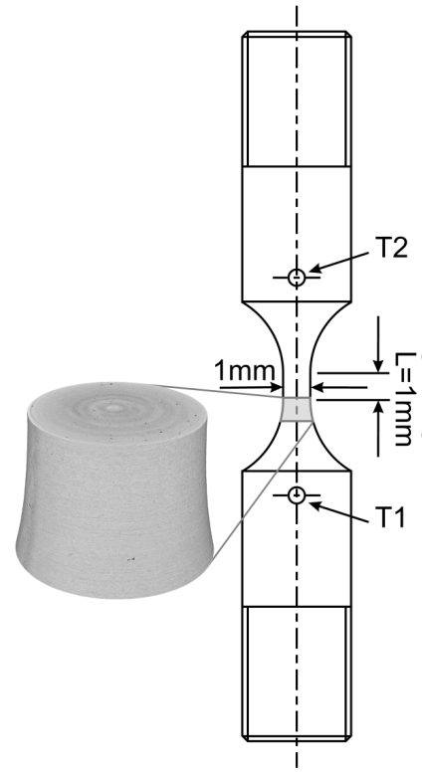
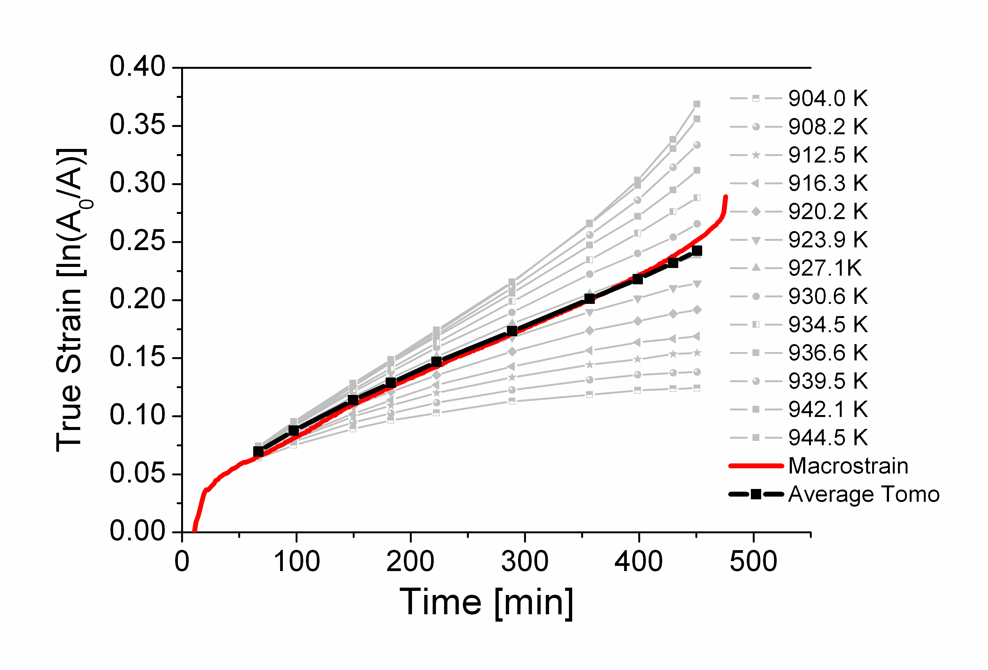
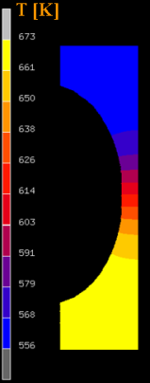
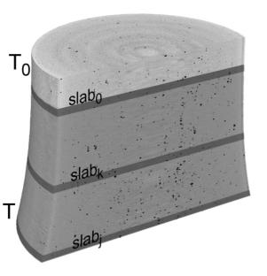
Experimental values of local strain – Steel
Different behavior of the local creep curves due to difference in temperature and stress
σ₀
Δt
σ
Local creep curves for various slabs of 10 slices each.
Each slab represent a creep test at its specific temperature and stress

Slide 21

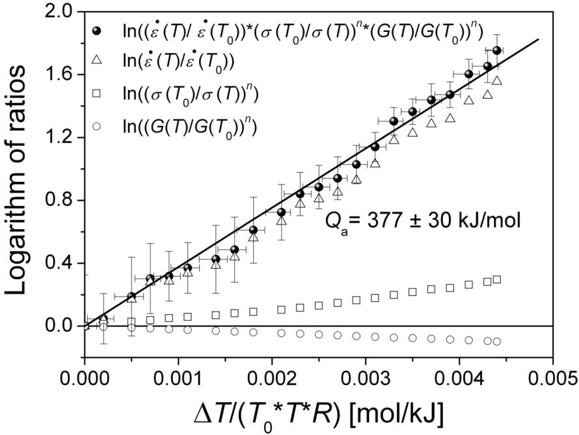
Apparent activation energy - Steel
Steady-state strain-rate follows an Arrhenius law
Values of Q_{a} from-in situ tests are equal within an error of 5% of the value obtained from the conventional method (377±30kJ mol⁻¹)

Slide 22
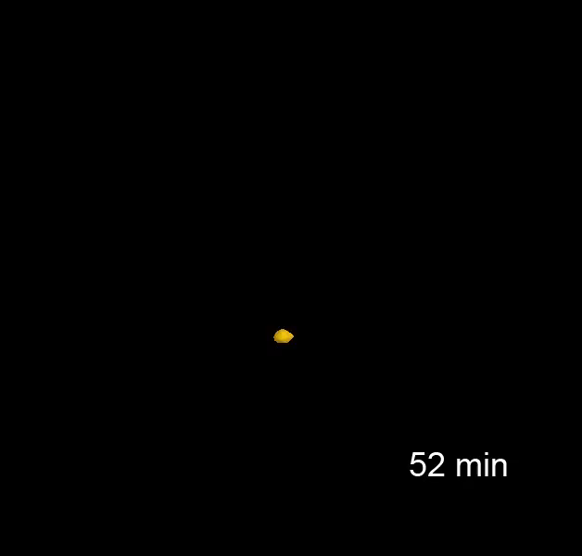
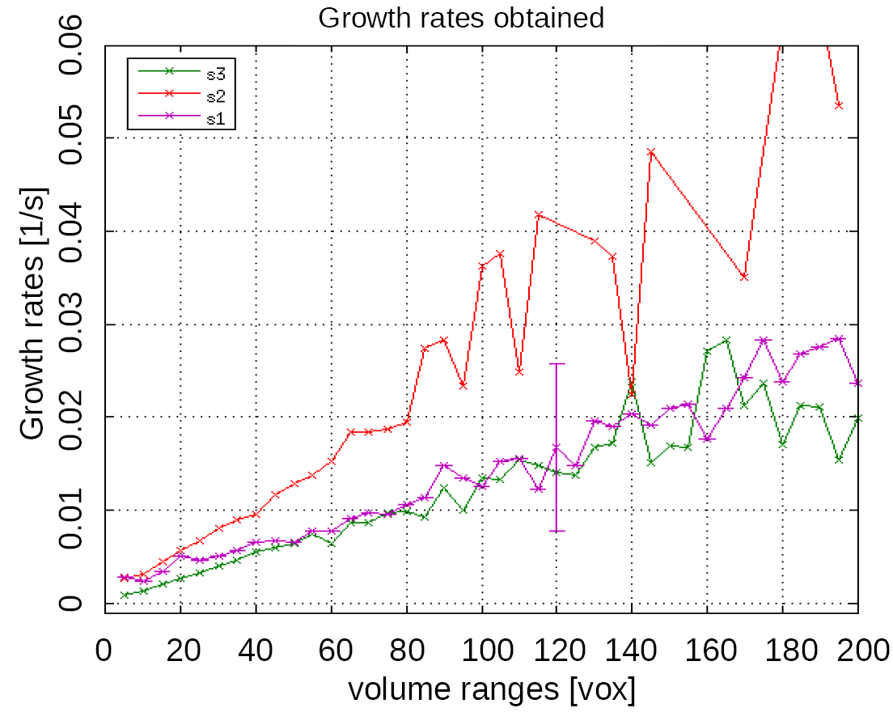









Individual Cavity Evolution
α ≈ 45
µCT + image processing
allows to follow the evolution of cavities and compare real 3D void growth with the theories of void growth
16μm

Slide 23


Research example 4
Multidisciplinarity

Slide 24







Flow fields computed on sandy samples
Sand pack
Sandstone
Limestone
Applicable to several fields:
- Earth science
- Soil aggregates
- Porous materials (foams)
- Fibre reinforce composites (manufacturing)
- Gas lickage
- Oil industry
Retarded plume
Stagnant plume
Prob. Displ. // Main flow
Displacement

Slide 25


Geology/oil extraction technology
Elementary pore-scale displacement processes in real-time observed at TOMCAT
* Interaction oil – Water during in situ injection
In water saturated Berea sandstone.
* Competition between wetting (water) and
nonwetting (oil) fluids
* Activation of complex events
(e.g. Haines jumps)
* Quantification of those events is critical to understand hysteresis and oil entrapment.
@ 21.25 keV voxel width 3μm
Each tomogram 1,401 projections (12 ms exposure time) over 180°
Total acquisition time = 16.8 s
Berg et al. (2013) PNAS
www.pnas.org/cgi/doi/10.1073/pnas.1221373110--

Slide 26

Geoscience/Enviromental
Climate change mitigation: dynamical monitoring of CO₂ storage
Interaction of CO2 @ reservoir:
Determines system physicochemical fate
Carbonates reservoir rocks are common
and complex → Dissolution
Dynamical monitoring of:
*Dissolution-induced changes (pores)
*Impact on permeability, diffusivity,
entry pressure…
*Leak risk, injection conditions…
ALS-Berkeley
Voltolini & Ajo-Franklin (2013)NGCG

Slide 27




Biomedical
Imaging of different forms of tumour angiogenesis:
Oral squamous cell carcinoma
One of the most common
/highest mortality
Need for
Improvement of prognosis
Development of new
(anti-angiogenic)
treatment options
Ex vivo 3D analysis of tumour angiogenesis and vascular system architecture
Pabst et al. 2014

Slide 28


Food science
Microstructures can have a direct influence to the taste of our favorite drink → coffee
From: Evaluation of microstructural properties of coffee beans by synchrotron X-ray microtomography: a methodological approach. P. Pittia, G. Sacchetti, L. Mancini, M. Voltolini, F. Brun, G. Tromba, N. Sodini, F. Zanini. Journal of Food Science (2011) 76(2), E222-E231.

Slide 29


Paleontology
Teeth in hominids: a window into their health
Teeth: hardest material in our body, source of pain, biological and social information (diet, health, growth rates…).
Human fossils very rare → non-destructive technique
Hublin Nature (2013)
Root extension rate
Macchiarelli et al. (2006)
Atapuerca (Burgos) the most important site in palaeoanthropology of the world
50-70 keV 45μm
ID17@ERSF

Slide 30


Paleontology
100 Ma Fossil inclusions in opaque amber
Lak et al. (2008) Micro.Micro, 14:251
ID 19 @ ESRF

Slide 31

Beamline concept, layout and requirement
Scheme of the synchrotron X-ray Tomography

Slide 32

Technical requirements
Technical requirement | Expected value
Energy range | 10-55keV
Min Flux | 7x10¹² photon/s/mm at 50keV and 0.1%BW
Max Flux | 10¹⁸ photon/s/mm in white beam
Beam type | White beam Monochromatic beam (2-3% bandwidth) Monochromatic beam (0.1% bandwidth)*
Max spatial res | Better than 1 micron
Max. FOV | 30x12mm
Max temp. res | Better than 1ms/image
Available techniques | Absorption Tomography Phase contrast tomography Holotomography Absorption-edge Tomography Fast tomography & radioscopy Nanotomography, topography, laminography*
Optical layout
Beamline layout

Slide 33
Source
The imaging beamline requires a small source to achieve the 0.5-1µm spatial resolution and quite large divergence, with high flux in the range between 10 and 50 keV.
Proposed Solution:
Mini-beta section + Wavelength shifter
S14-BL31
Hybrid in-vacuum
Permanent magnet (NdFeB)
Gap 8mm
Max. peak field 2.75T
Magnetic length 400mm
Total length 800mm
Size & divergence
Phase space distribution @ 20keV

Slide 34
Source properties
Flux integrated in 1 mrad, compared to the source of a bending magnet
Source size for 1mrad horizontal acceptance
Side lobe
Source size [mm]

Slide 35
Monochromators
Multilayer & Si(111)
High spectral resolution
High flux
Mono. limited vertical acceptance
Monochromators inside the tunnel to minimize limiting the vertical size
DMLM @ 11.5m
@20 keV the full beam is accepted
Detail FEA to analyze power load is required

Slide 36

Experimental Hatch
Optical table with wheels (2.3x1.5m)
Long X stage
  50kg, ±1µm (for phase contrast and holotomo)
Short Y stage
  Range 300mm (for flat fields images)
Z stage & 3-point tip tilt table
  For Z, phi and psi angles (range over 1º and accuracy 0,005º)
  Range 200mm
Rotating stage
  High speed (200-600rpm)
  High precision
  Feedthrough contacts
X-Y micropositioner
  Piezomotors range 6mm
Sample holder
  Magnetic or customized
Sample positioning system

Slide 37


Experimental Hatch:
Detectors
12bit
2048x2048 (pix. 11µm)
Memory 36GB
7039fps (1000x1000)
5469fps (1400x1050)
2277fps (2000x2000)
Two detectors are envisaged
16bit
dynamic range 36000:1
Low noise (0.8e-)
2048x2048 (pix. 6.5µm)
420fps (1000x1000)
Bending
mirror
3 Objectives (x1.25, x4, x10)
  Spatial resolution: ~4.8, 1.5, 0.6 µm
Motorized focus
Motorized nosepiece for 3 objectives
Tiltable single scintillator support
Reduced numerical aperture and lower resolution
1(2) Objectives (x4, x10)
  Spatial resolution: ~2.5, 1.5 µm
Motorized focus

Slide 38




Experimental Hatch:
Sample environments
In-situ devices that are considered in the proposal
Tensile/compression/fatigue rig + Temperature
  Load=2-5KN, strain rate=0.1-10µm/s, temperature=RT-1200K
High temperature furnace
  500W halogen lamps + golden parabolic mirrors Vacuum or inert gas
Cryogenic cell
  -150ºC, double layer cylindrical chamber
High pressure cell
  250bar, 250ºC, gas atmosphere,
Infiltration device
  For simulated VARTM process
Steering device
  Foam creation
Electrochemical cell
  Corrosion studies

Slide 39
Computing and data storage
Fast tomography generate large data set that need to be computed (and stored)
Normal modus operandi of synchrotrons: users should take home the full treated data sets before the campaign is ended
High capability CPU cluster for fast reconstruction
Cluster update (medium capacity cluster currently at ALBA)
Data storage (now 400TB) => other 800TB? (considered in the proposal but discussable)
  8 month data storage policy (1-2TB/day collection)

Slide 40
Budget (1/2)
Experimental end-station | Price (k€)
Beam limiter (X-Y slits) | 30
Beam Shutter II | 18
Optical table | 90
Long X translation Axis | 120
Short Y translation Axis | 37
Z elevation 3-point tip-tilt table | 75
Rotating stage, high speed, trough contacts | 160
X-Y micropositioners | 12
Sample holder system | 6
Motor controllers | 45
White beam microscope | 38
Monochromatic beam microscope | 55
PCO DIMAX camera and accessories | 74
PCO Edge camera and accessories | 22
Scintillators | 18
Computers, monitors | 8
SUBTOTAL | 808
Beamline Optics | Price (k€)
UHV, mechanics, gate valves, control | 205
Insertion device | 797
Monochromator and mirror optics | 448
Vacuum guide and CVD window | 40
Front end | 163
SUBTOTAL | 1653
Lead Hutch
X-ray shielding | 302
SUBTOTAL | 302

Slide 41
Budget (2/2)
Experimental end-station (sample environments) | Price (k€)
Tensile test rig | 20
1200K furnace | 38
Cryogenic | 26
High pressure cell | 20
SUBTOTAL | 104
Computation and data storage
CPU cluster | 122
800Tb storage (8 months storage data policy; collecting 1-2 Tb/day) | 626
SUBTOTAL | 748
Infrastructure
Conventional hutch (furniture & air conditioning included) | 35
Supplies infrastructure | 165
SUBTOTAL | 200
Total | 3815 k€
CONTINGENCY (10%) | 382 k€
TOTAL | 4197 k€

Slide 42

… and after construction
&
commissioning process???

Slide 43

First academic experiment
+
Best caracteristics of the beamline:
Speed
Phase contrast
Sample enviroment
  One particular unexplored field using in-situ experimentation:
  Fluid infiltration in rocks under high pressure conditions
  Non-conventional crude oil extraction

Slide 44
First foreseen industrial experiment
    Industries interested in the technique:
    ITP (Solidification process in Ti- & Ni-alloys => phases and porosity)
          Airbus (manufacturing defects and damage in CFRP)
          Repsol (3D Microstructure of rocks & non-conventional extraction)
          Tolsa (3D Microstructure of Composite Polymeric materials)
          The realization of projects with these and other companies is feasible since the proposers are currently undergoing projects with these companies
          Advertisement plan in collaboration with
          Industrial laison office at Alba

Slide 45
Single scientific field/technique –Leading BL-
  Fast tomography with an added value → In-situ devices:
  Simpler for users
  Increase success rate of experiment
  “Standard” testing procedures for in-situ studies.
  Participation of companies and partial funding of new special devices available for all users
  Oil extraction
  Water treatment
  Materials processing

Slide 46
Risk assessments: Scientific developments elsewhere
  So far, only 2(3) beamlines with such temporal/spatial resolution in Europe: ID19,(ID15), TOMCAT
  Risk 1: Plan of many other already developed beamlines to focus on fast tomography with emphasis on in-situ testing?
  Still possible to success in a continuously growing user community with several application field
  Risk 2: XFEL. Imaging in the pico- or fempto- second and nm scale.
  Is another time and spatial scale => complementary technique
  Risk 3: Lab X-ray developments promise to achieve higher brilliance and sensibility.
  Far from quality and brilliance of synchrotron.
  This is actually more publicity for this beamline.

Slide 47
Risk assessments: Delay, cost increase, realization…
    This beamline concept is rather simple
    No technical risks are foreseen
    Components could actually reduce their value
    The expected return to society is high and valuable
    We expect overload factor in the beamtime request
    Manpower
    Software and hardware integration for “in-line” reconstruction

Slide 48

Conclusions
Synchrotron tomography is a powerful tool for 3D characterization for a wide field of disciplines (materials science, biomedical science, geology, environment, cultural heritage, biology, palaeontology, etc)
In-situ testing using the propose testing devices opens up new possibilities for characterization with experienced ALBA scientists
The high brilliance of the proposed beamline provides the possibility for performing 3D time-resolved experiments at a temporo-spatial resolution in leading European beamlines in this issue
The creation of this beamline would be very interesting both for the Spanish and International scientific community.
Notes:
48

Slide 49
Also contributing to this proposal
Prof. José A. Yagüe Fabra – Universidad de Zaragoza
Dr. Bart Bijens – Universitat Pompeu Fabra
Dr. Vicente Gomez Ruiz de Argandona – Universidad de Oviedo
Prof. Guillermo Requena – Technical University of Vienna
Dr. Francisco García Moreno – Helmholtz-Zentrum Berlin
staff

Slide 50
User group actively supporting the proposal
Juan Gómez Barreiro – Universidad de Salamanca – High pressure and temperature of geological materials
Rocío Campos Egea – CIEMAT – Geological materials
Josep Costa Balanzat, Universidad de Girona, Composite Materials.
Jaime C. Gálvez, Universidad Politécnica de Madrid – Fracture of Steels and Cement based material
Luis E. Hernández, Universidad Autónoma de Madrid – vegetal materials
Javier Sánchez, Científico Titular, Instituto de Ciencias de la Construcción Eduardo Torroja (IETcc-CSIC), Modelado y Durabilidad de Estructuras, Cementos
Marcos Lanzón, Universidad Politécnica de Cartagena - Materiales de Construcción, Alteración de piedra y materiales de interés patrimonial.
David A. Cendón Franco, Universidad Politécnica de Madrid, Metallic materials
Fernando San Jose Martinez, Universidad Politécnica de Madrid - Cuantificación de la estructura de suelo
Fernando A. Lasagni, Materials & Processes Department Center for Advanced Aerospace Technologies (CATEC), Composite materials and metal alloys
Vicente Gomez Ruiz de Argandona, Grupo de Tomografía de Rayos-X, Universidad de Oviedo, Geomaterials
Gerardi Garcés Plaza, CENIM, Multiphase metallic materials
José Antonio Yagüe, Universidad de Zaragoza, Metrology, Image treatment
Lucia Franco Ferreira, Aimen, NDT, dimensional metrology, material characterization
Alberto Mendikute, IDEKO, Image treatment, non-destructive testing
Joost van Duijn, Universidad de Castilla-La Mancha – Pilas combustibles de oxido solido
Vicente Amigó Borrás, Universidad Politécnica de Valencia, Titanium alloys characterization
Carlos Capdevila, Grupo Materalia del CENIM-CSIC, Fe-based alloys, steels
Lander Galdos, Universidad de Mondragon - Super Plastic Forming of Aluminium Sheets.
Pedro Bravo, Universidad de Burgos, HPDC of Mg alloys, polymers
Juan Carlos Suárez Bermejo, Universidad Politécnica de Madrid, Materiales Híbridos estructurales (orgánico/inorgánico), adhesivos, mecanismos de daño.

Slide 51
User group actively supporting the proposal
Eusebio Solórzano, Universidad de Valladolid, Cellular materials, technique development
Diego Val, GRUPO ANTOLIN-IRAUSA, S.A., Magnesium and aluminium alloys
Ricardo Arenas Martín- Universidad Complutense de Madrid. Petrología y geoquímica de rocas metamórficas de alta Presión
Antonio Álvarez Valero, Universidad de Salamanca – potencial explosividad volcánica, flujo de gases en volcanes.
José Ramón Martínez Catalán - Universidad de Salamanca. Tectónica y geofísica
Puy Ayarza – Universidad de Salamanca. Geofísica: Sísmica y Magnetismo
Jose Manuel Benítez Pérez. Universidad de Salamanca. Difracción neutrónica y microestructura
Emilo González Clavijo. Instituto Geológico y Minero de España. Tectónica y Recursos naturales
Mercedes Suárez Bárrios. Universidad de Salamanca. Cristalografía y Mineralogía
Carlos González. IMDEA Materials (Madrid). Fibre reinforced polymers
Teresa Perez Prado. IMDEA Materiales (Madrid). Light metal alloys
Jon Molina. IMDEA Materiales (Madrid). Micro- and Nano- mechanics metallic materials
Federico Sket. IMDEA Materiales (Madrid). FRP; light metal alloys; steels
Alicia Rodríguez Barbero (Universidad Salamanca). Fisiopatología Renal y Cardiovascular
Total Number of groups = 35
But…, there are research groups not aware of the proposal which may benefit from it…

Slide 52
THANK YOU FOR YOUR ATTENTION

