Slide 1
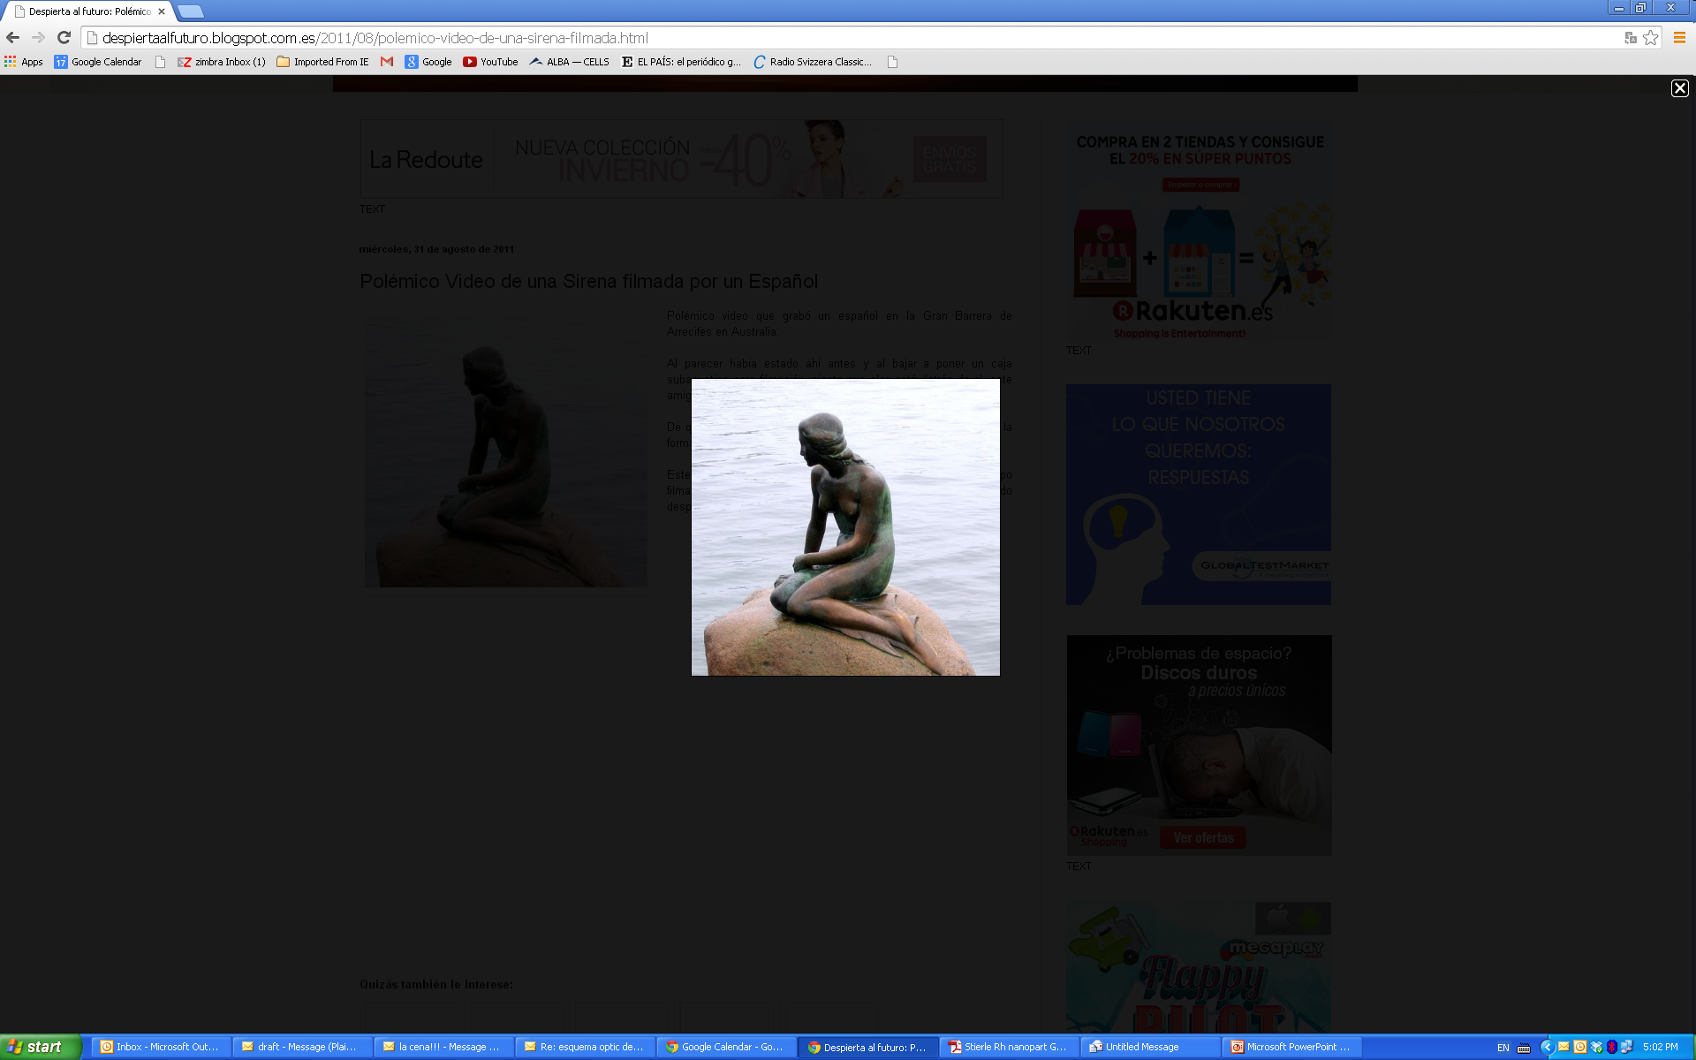

SIRENA: the Surface, Interface and REsonant diffractionN beamline at Alba
Surface-Interface Diffraction Beamline
        19th Scientific Advisory Committee Meeting
        ALBA, 3 December 2014

Slide 2
the Surface, Interface and REsonant diffractionN beamline at Alba
      This proposal was promoted by:
Dr. X. Torrelles Albareda Inst. Mat. Science Barcelona ICMAB-CSIC
Collaborators:
Dr. M.J. Capitán Aranda Inst. for the Struct. of Matter IEM-CSIC
Dr. J. Álvarez Alonso Dpt. of Condensed Matter Physics UAM
Local contact:
Prof. S. Ferrer Fàbregas Scientific Advisor ALBA Synchrotron ALBA-CELLS
With contributions of:
Dr. Javier Herrero Martín BL29 BOREAS, ALBA Synchrotron ALBA-CELLS
Dr. Oier Bikondoa BM28 XMAS, ESRF Synchrotron ESRF
Prof. J. L. García Muñoz Inst. Mat. Science Barcelona ICMAB-CSIC
Dr. Esther Barrena Inst. Mat. Science Barcelona ICMAB-CSIC
Prof. J. A. Martín Gago Inst. Mat. Science Madrid ICMM-CSIC
        19th Scientific Advisory Committee Meeting
        ALBA, 3 December 2014

Slide 3
Referees Report
- Spanish SAXS community was not contacted to avoid:
This community are regular users of NCD beamline.
Specifications of SIRENA different and complementary to NCD (lower resolution than NCD)
Priority for a versatile beamline able to work in several fields in good conditions.
Something has to be sacrificed: high resolution against focus.
A reduction of the beam divergence by a factor 10 would imply the use of refractive collimators making more difficult and expensive the optics design (NCD will also have High Resolution GISAXS)
BUT apart of that the BEAMLINE in its current format is very valuable and can give an EXCELLENT PERFORMANCE in several areas of science: chemistry, physics and biology mainly DUE to its VERSATILITY.
A MULTIPURPOSE beamline with OPEN CONFIGURATION experimental geometry makes possible different experimental designs to study the same system in different conditions permitting to get complementary information about one or several aspects on the same phenomena.
-SPEC/SARDANA: (SPEC: 30 years of experience controlling instrumentation).
Human resources // Software analysis (stand by) // Real time analysis to modify strategy if necessary
        19th Scientific Advisory Committee Meeting
        ALBA, 3 December 2014

Slide 4
Outline:
      Beamline objectives
      Source characteristics & Optics layaout
      Scattering geometry
      Scattering techniques
      Equipment and sample environments
      Scientific cases. Examples:
        Molecular self-assembling. Chiral system: Adenine
        Surface structure: BaTiO₃(001)
        Heterogeneous catalysis: CO oxidation NPs
      Budget
      Areas of scientific impact: energy, health and nanoelectronics
      Research lines: catalysis, NPs, multiferroics, electrochemistry
      Synergies with other ALBA beamlines (BOREAS, NCD, CIRCE)
      Participating research groups
        19th Scientific Advisory Committee Meeting
        ALBA, 3 December 2014

Slide 5
Objectives: beamline aims (1/2)
      To provide to the scientific community a beamline with
      - surface diffraction set-up
      - controlled sample environment (physics, chemistry and biology)
      - to satisfy the present and FUTURE needs of the scientific community
      ◉ How to get that?
      • Offering a multipurpose beamline with an open configuration to permit the users the design of their optimal experiment
      • Open diffractometer able to accommodate from baby chambers to heavy portable sample preparation chambers, reactors and liquid cells
      • Make available to users a workshop (attached to the beamline) for UHV surface preparation (AES, LEED, STM, RGA, cleaning and deposition equipment for organic /inorganic systems)
      • Building a beamline ready for developing new tools according to the new and / or future experimental requirements: AFM (even photoemission), focalization elements, imaging tools, software,… (DEPENDING ON THE REQUIREMENTS OF THE USERS)
        19th Scientific Advisory Committee Meeting
        ALBA, 3 December 2014

Slide 6
Objectives: beamline aims (2/2)
Baby chamber;
Reaction cells;
Electrochemistry;
Ambience pressure;
Liquid cells
UHV lab. Support: LEED, STM,...
GIXRD (-C)
Surfaces & Interfaces beamline:
structural studies
+
COMPLEMENTARY
TECHNIQUES
GISAXS
(C-oherent)
GIDAFS; Anomalous Scattering
XRR
POLARIZATION
      Able to combine different scientific aspects permitting simultaneous types of experiments
XRMS
(C-XRMS)
        19th Scientific Advisory Committee Meeting
        ALBA, 3 December 2014

Slide 7
Outline:
      Beamline objectives
      Source characteristics & Optics layaout
      Scattering geometry
      Scattering techniques
      Equipment and sample environments
      Scientific cases. Examples:
        Molecular self-assembling. Chiral system: Adenine
        Surface structure: BaTiO₃(001)
        Heterogeneous catalysis: CO oxidation NPs
      Budget
      Areas of scientific impact: energy, health and nanoelectronics
      Research lines: catalysis, NPs, multiferroics, electrochemistry
      Synergies with other alba beamlines (BOREAS, NCD, CIRCE)
      Participating research groups
        19th Scientific Advisory Committee Meeting
        ALBA, 3 December 2014

Slide 8
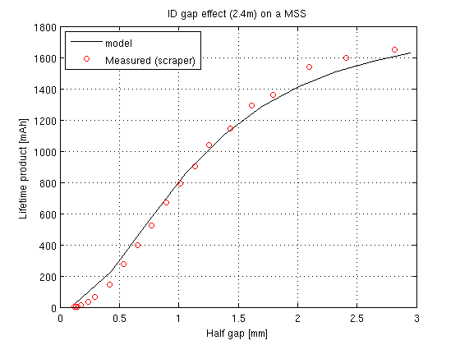
Source Characterisitics (1/2)
      In vacuum undulator placed in a 4m straight section
      4.5 to ~ 25 keV // beam divergence: 3.2 mrad
      Widowless beamline to reduce absorption at low energies.
      Filters and/or attenuators to reduce heat load if required.
      Absorption edges covered:
      3d transition metals
      K-edges of Se & Br
      4d from lanthanides
      most of 5d elements (L-edges)
      M-edges (actinides)
Worse case: ~20% reduction
actual: 13%
Viability:
In-Vacuum undulator
Assumption: 2 m long
4.8 mm gap
In a medium straight section
- 20% reduction lifetime (smaller V-acceptance)
- Increase of impedance (smaller gap)
- TopUp mode: acceptable
        19th Scientific Advisory Committee Meeting
        ALBA, 3 December 2014

Slide 9
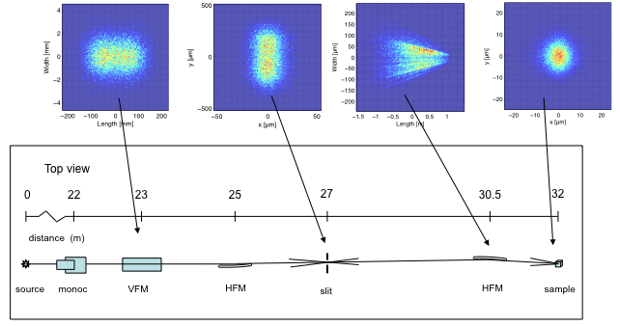
Optics Layaout(2/2)
~ 3
(VD)
12.5
(HD-1)
Demagnification: 12.5 x 2.3
2.3
(HD-2)
~300x20 μm
(HxV)
~ 10x10 μm
(Horiontal/Vertical)
Demagnification
        19th Scientific Advisory Committee Meeting
        ALBA, 3 December 2014

Slide 10
Outline:
      Beamline objectives
      Source characteristics & Optics layaout
      Scattering geometry
      Scattering techniques
      Equipment and sample environments
      Scientific cases. Examples:
        Molecular self-assembling. Chiral system: Adenine
        Surface structure: BaTiO₃(001)
        Heterogeneous catalysis: CO oxidation NPs
      Budget
      Areas of scientific impact: energy, health and nanoelectronics
      Research lines: catalysis, NPs, multiferroics, electrochemistry
      Synergies with other alba beamlines (BOREAS, NCD, CIRCE)
      Participating research groups
        19th Scientific Advisory Committee Meeting
        ALBA, 3 December 2014

Slide 11
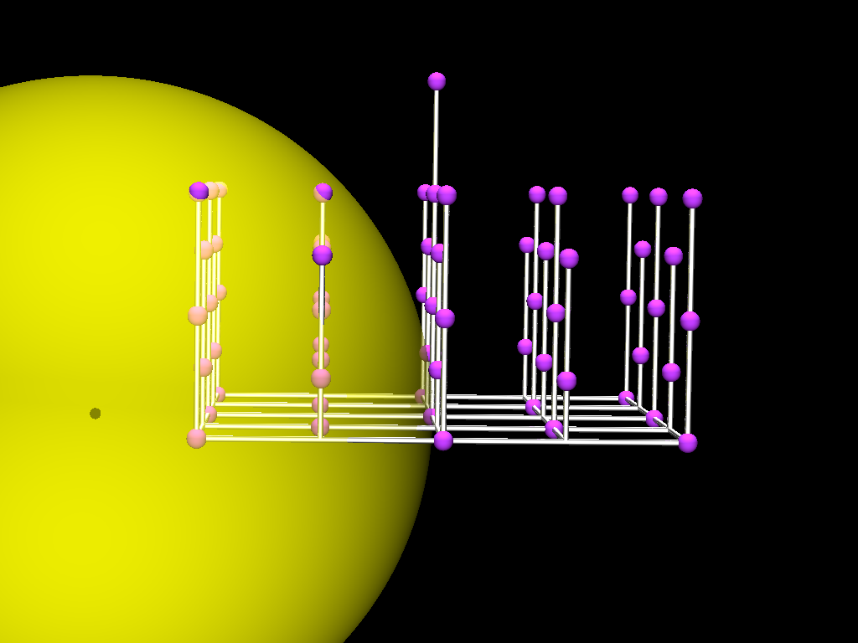
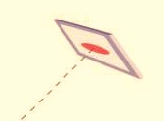
X-ray geometry for Grazing Incidence diffraction (1/4)
Reciprocal Space Layout
Diffractometer: vertical geometry
surface normal || vertical plane
Reciprocal lattice Pt(110):
Bragg reflections (L_{HKL} Integer)
Surface reflections (L_{HKL} Fractional)
Ewald sphere (K_{in} = 2π/λ)
L
Detector
(006)
•
ΔK
K_{out}
K
2θ
(000)
H
K_{in}
ΔK = na* + mb* + lc*
•Linear combination of
reciprocal lattice vectors
•Reciprocal Lattice point
        19th Scientific Advisory Committee Meeting
        ALBA, 3 December 2014

Slide 12
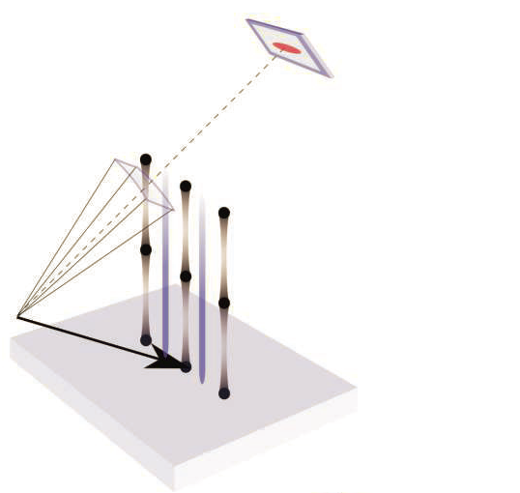
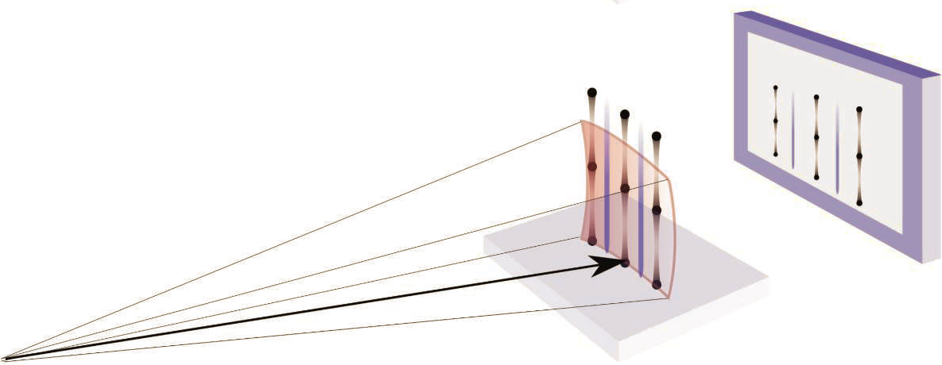
X-ray geometry (2/4)
Conventional surface x-ray diffraction
•Small area detector
Ewald sphere
Superstructure rod
Bragg peak
Crystal Truncation rod
E ∼ 20 keV
Incident x-ray beam
•Large area detector
- E ∼ 22 keV
- S = Cu(111)
- D_{size} = 40 x 40 cm
- d_{S-D} = 50 cm
− Θ_{(In/Out)-Plane(max)} ∼ 38º
H(1 to 3); K(1 to 2);
L_{max} ∼ 5.5 (rlu)
L
Ewald sphere
1 2 3 (H,K)
Incident x-ray beam
        19th Scientific Advisory Committee Meeting
        ALBA, 3 December 2014

Slide 13
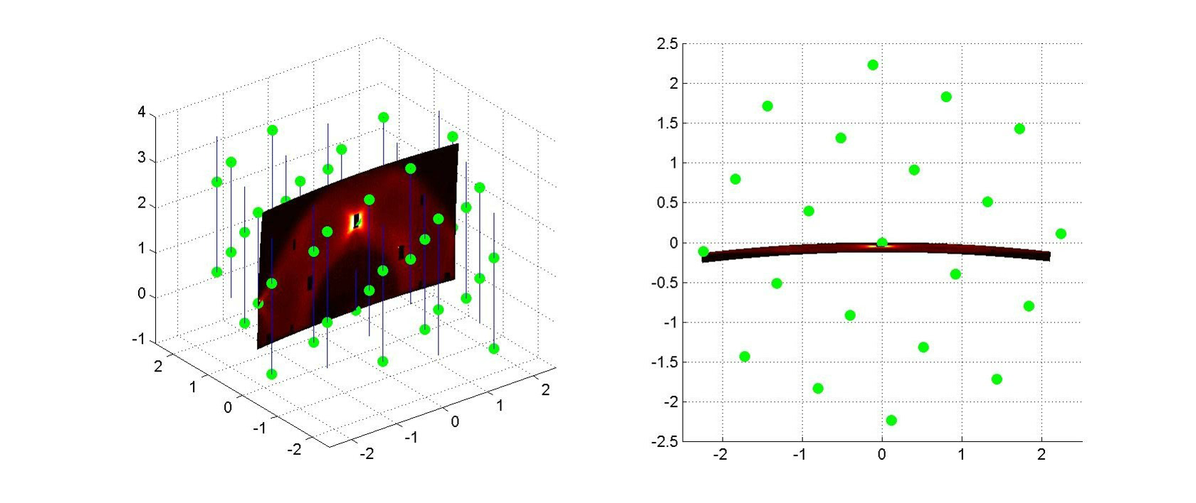
Surface and interface scattering geometry (3/4)
Lateral view
Top view
J. Gustafson et al., Science 343 (2014) 758
        19th Scientific Advisory Committee Meeting
        ALBA, 3 December 2014

Slide 14
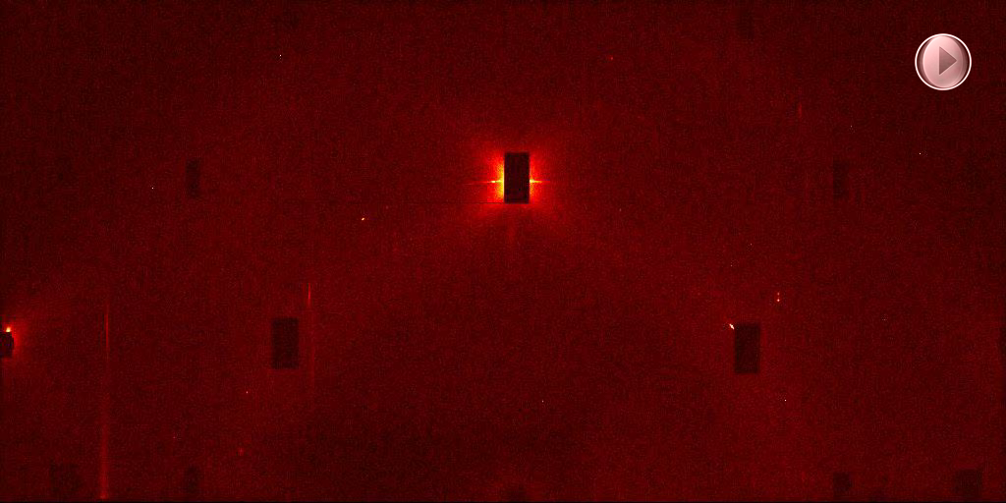
Surface and interface scattering geometry (4/4)
Front view
J. Gustafson et al., Science 343 (2014) 758
        19th Scientific Advisory Committee Meeting
        ALBA, 3 December 2014

Slide 15
Outline:
      Beamline objectives
      Source characteristics & Optics layaout
      Scattering geometry
      Scattering techniques
      Equipment and sample environments
      Scientific cases. Examples:
        Molecular self-assembling. Chiral system: Adenine
        Surface structure: BaTiO₃(001)
        Heterogeneous catalysis: CO oxidation NPs
      Budget
      Areas of scientific impact: energy, health and nanoelectronics
      Research lines: catalysis, NPs, multiferroics, electrochemistry
      Synergies with other alba beamlines (BOREAS, NCD, CIRCE)
      Participating research groups
        19th Scientific Advisory Committee Meeting
        ALBA, 3 December 2014

Slide 16
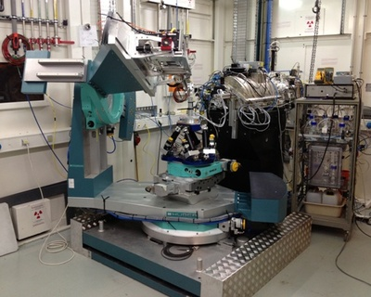
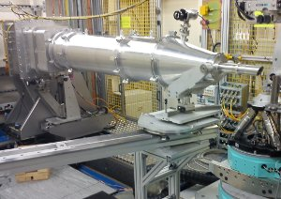
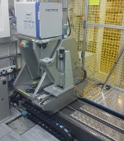
Surface and interface scattering techniques (1/2)
2D -CCD
2D -CCD
Flight tube
Sample support
      Grazing Incidence Wide Angle Scattering (GIXRD)
      Grazing Incidence Small Angle X-ray Scattering (GISAXS)
      Reflectivity (θ - 2θ)
      Magnetic scattering (XRMS)
      Coherent scattering: 'imaging’
      Grazing Incidence Anomalous Diffraction Fine Structure (GIDAFS and AS)
      Polarization
        19th Scientific Advisory Committee Meeting
        ALBA, 3 December 2014

Slide 17
Scattering techniques. Scientific fields (2/2)
      Nanostructures
      Quantum Dots.
      Soft-Condensed Matter: Self-Organized Systems
      Chiral Systems
      Thin films
      Magnetic materials
      Buried Interfaces
      Polymers
      Biomolecules
      Surface and Interfaces
      Surface in UHV
      Harsh environments
      Solid-Liquid (/gas /solid) interfaces: Electrochemistry
      Langmuir Blodgett films
Soft-Condensed Matter
Magnetism
      catalysis
        19th Scientific Advisory Committee Meeting
        ALBA, 3 December 2014

Slide 18
Outline:
      Beamline objectives
      Source characteristics & Optics layaout
      Scattering geometry
      Scattering techniques
      Equipment and sample environments
      Scientific cases. Examples:
        Molecular self-assembling. Chiral system: Adenine
        Surface structure: BaTiO₃(001)
        Heterogeneous catalysis: CO oxidation NPs
      Budget
      Areas of scientific impact: energy, health and nanoelectronics
      Research lines: catalysis, NPs, multiferroics, electrochemistry
      Synergies with other alba beamlines (BOREAS, NCD, CIRCE)
      Participating research groups
        19th Scientific Advisory Committee Meeting
        ALBA, 3 December 2014

Slide 19
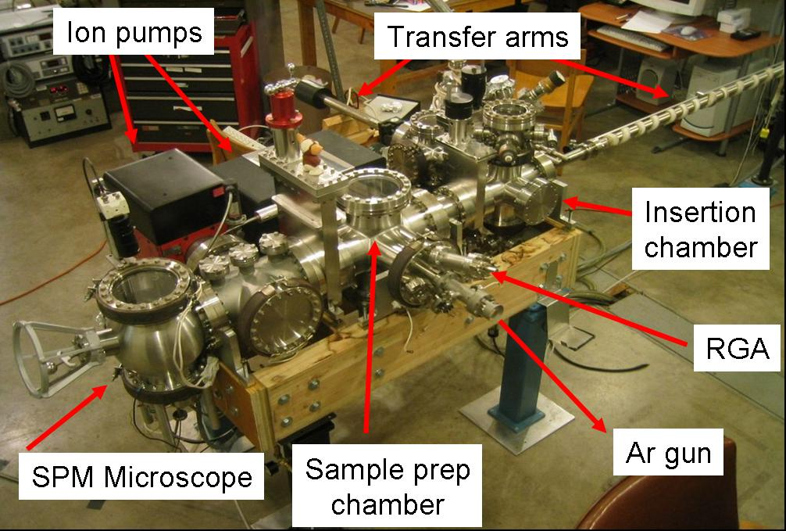
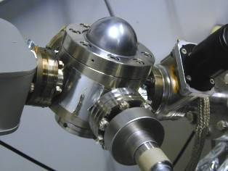
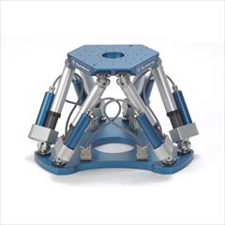
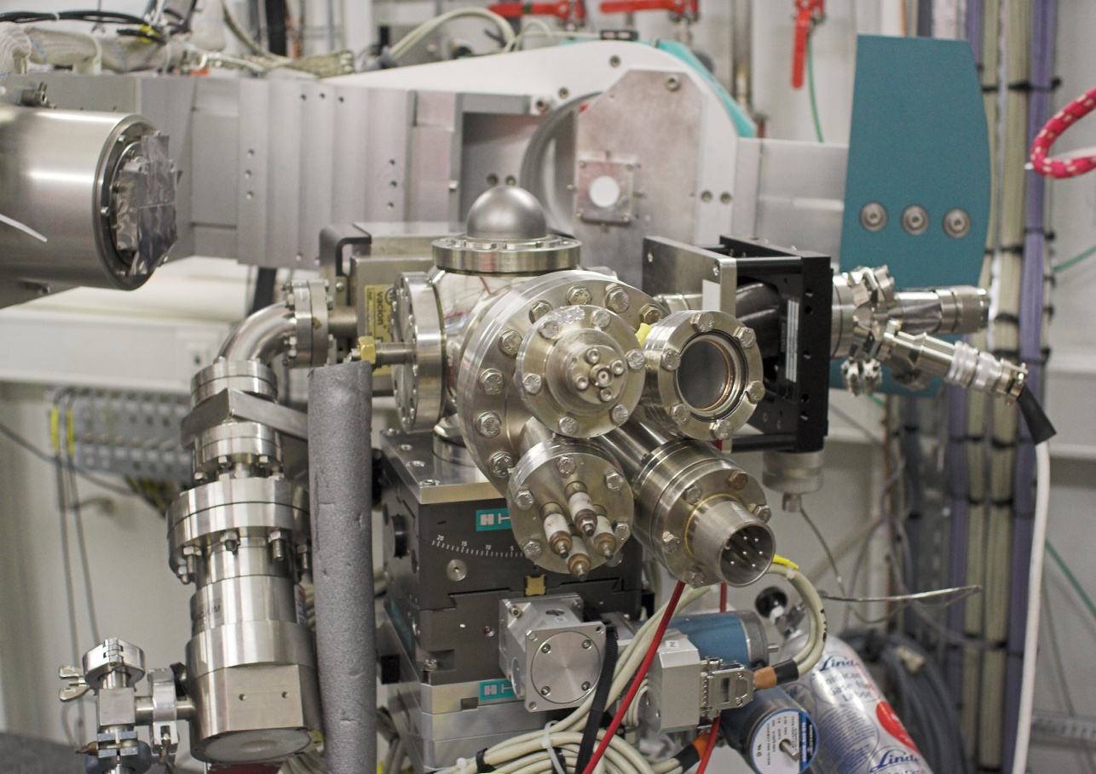
Additional equipment (1/2)
HV environment
Workshop: UHV Surface Preparation Laboratory
Hexapod sample support
Mandatory !!
“In situ” preparation minichamber
        19th Scientific Advisory Committee Meeting
        ALBA, 3 December 2014

Slide 20
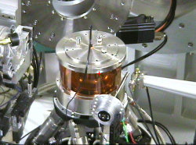
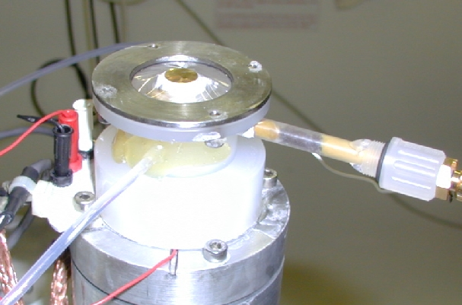
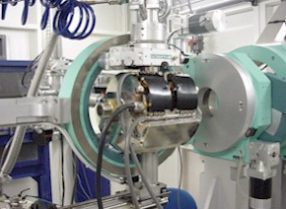
Examples of sample environments (2/2)
Harsh reactor
Leak valve for gas introduction.
- O₂ rich: 800K
- UHV: 1400K
Flow reactor with UHV section
Mass flow controllers (gas inlet)
Batch reactor
Controlled environment gas
Electrochemical Cell
Magnetic field
        19th Scientific Advisory Committee Meeting
        ALBA, 3 December 2014

Slide 21
Outline:
      Beamline objectives
      Source characteristics & Optics layaout
      Scattering geometry
      Scattering techniques
      Equipment and sample environments
      Scientific cases. Examples:
        Molecular self-assembling. Chiral system: Adenine
        Surface structure: BaTiO₃(001)
        Heterogeneous catalysis: CO oxidation NPs
      Budget
      Areas of scientific impact: energy, health and nanoelectronics
      Research lines: catalysis, NPs, multiferroics, electrochemistry
      Synergies with other alba beamlines (BOREAS, NCD, CIRCE)
      Participating research groups
        19th Scientific Advisory Committee Meeting
        ALBA, 3 December 2014

Slide 22
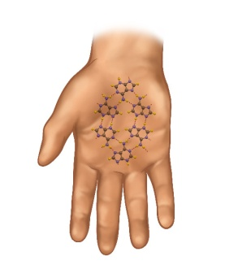
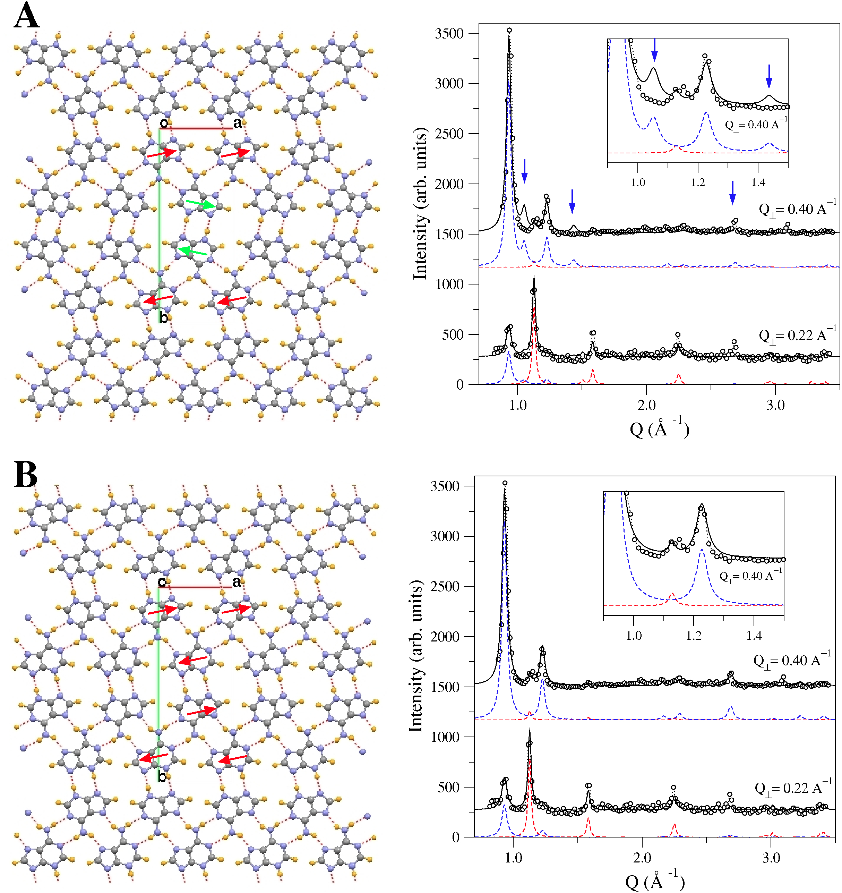

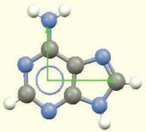
Scientific cases (1/3). Organic films and chirality: Adenine/Au(111)
Chirality
: p2gg
Adenine/Au(111)
m
      •Bragg_{FWHM} ∼ 15 nm (grain size).
      •Two possible stacking models: α (p2)
      and β (p2gg)
      •Textured growth along z-direction.
      •I_{Q} = (I_{Q||},I_{Qz})
      •Radial scans at different Q_{z}
      •(I_{exp}–I_{calc}) permits identify the grown phase.
      •DFT confirms the higher stability of β-phase.
: p2
R(180º)
Flip (E>>)
Capitán et al., CHEMPHYSCHEM 12 (2011), 1267; 14 (2013) 3294
        19th Scientific Advisory Committee Meeting
        ALBA, 3 December 2014

Slide 23

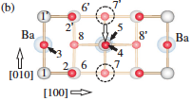
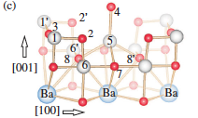
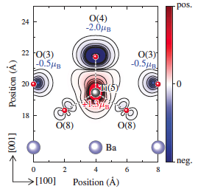
Scientific cases (2/3). Surface structure: BaTiO3(001)-(2x1)
BaTiO₃: perovskite-based ferroelectric material (FE):
- Spontaneous polarization (P). Its direction can be switched by an applied field
- Origin: P is due to a distortion of the Ti-octahedra (TM transition metal)
- Hopping of electrons between a TM, as Ti⁴⁺ with empty d⁰-shell, and O 2p ions.
Surface x-ray diffraction (SXRD/GIXRD) can provide direct evidence for a structural model concerning the atomic geometry of the BTO(001)-(2x1) reconstruction
(a) Paterson function of the projected structure. (b) Structure model of the (2x1) reconstructed unit cell projected along [001]. Atoms within the two top TiO2 layers are labeled from 1–8. O and Ti atoms are represented by red and gray spheres, respectively. Dashed circles indicate the position of Ti atom 5 in the unreconstructed (1x1) unit cell, which is shifted to the position (1/2, 1/2) as indicated by the open arrow (c) Perspective side view of the structure.
Calculated spin density contour plot (DFT): Ti (5) and O (4) are antiferromagnetically coupled characterized by magnetic moments of +1.3 μ_{B} and -2.0 μ_{B}, respectively. The total energy calculations reveal that the surface is magnetic with the total magnetic moment of 1.5 μ_{B} and metallic.
H.L. Meyerheim et al., Phys. Rev. Lett. 108 (2012) 215502
        19th Scientific Advisory Committee Meeting
        ALBA, 3 December 2014

Slide 24
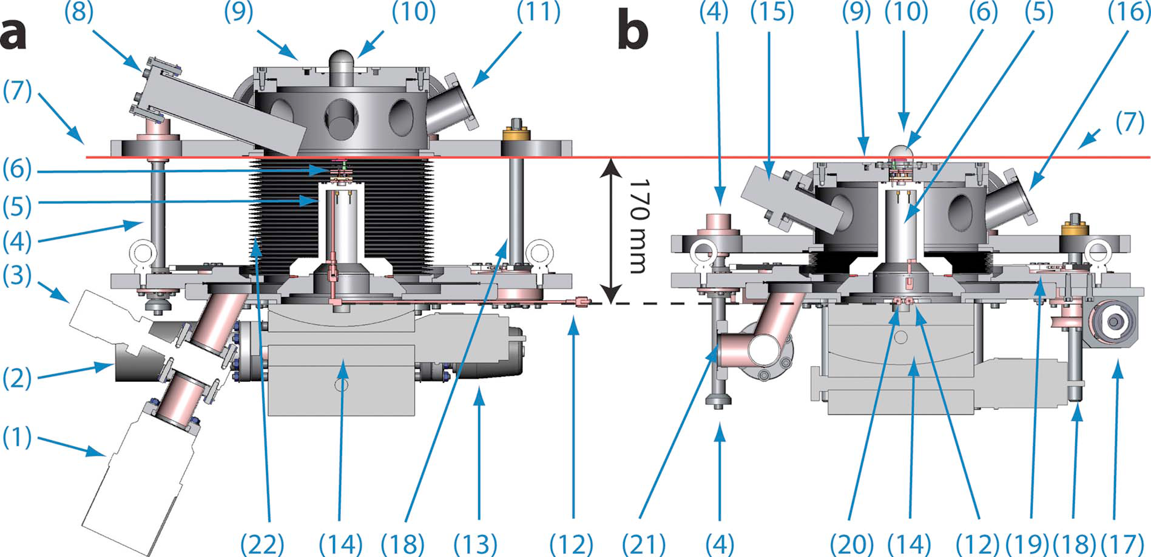
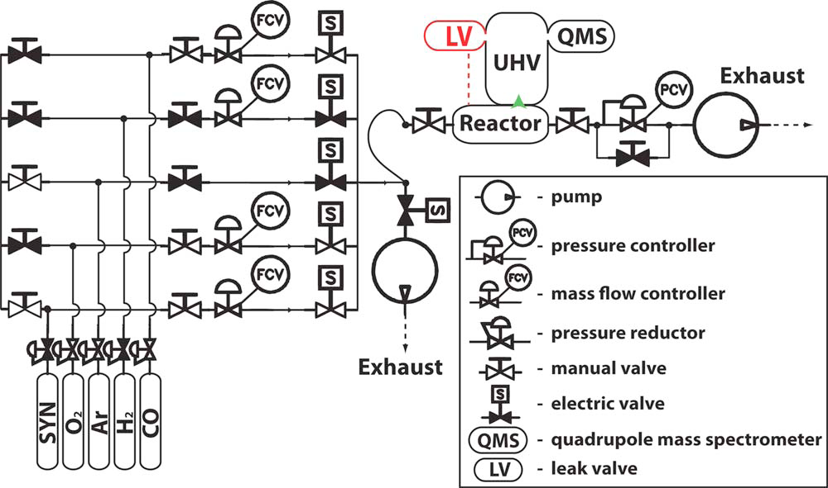
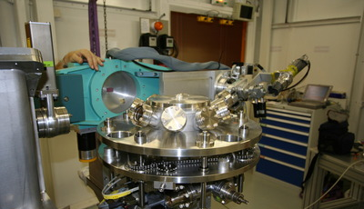
Scientific cases (3/3)-1. Catalysis in “operando”: GIXRD & GISAXS (1)
Metal nanoparticles dispersed on substrates are standard systems for catalysts of gas phase reactions.
FRC: flow reactor chamber
Gas line distribution
R. Van Rijn et al., Rev. of Sci. Instrum. 81 (2010) 014101
        19th Scientific Advisory Committee Meeting
        ALBA, 3 December 2014

Slide 25
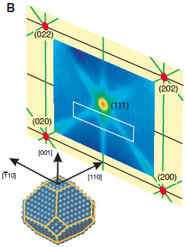
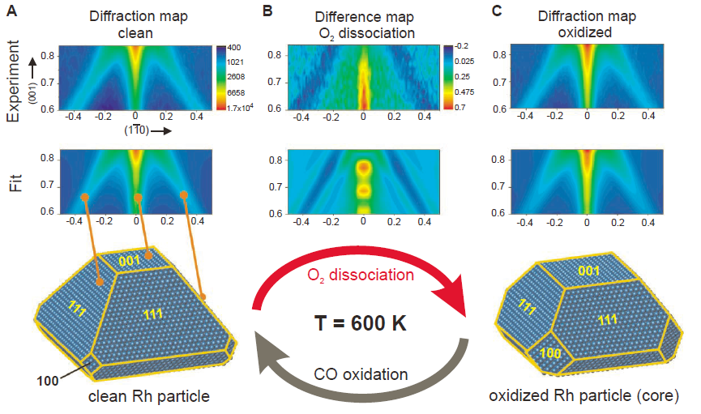
Catalysis from NPs: Rh (GIXRD) (3/3)-2
○ Rh NPs (shape): consists of low index faces with (001) face in contact with
the substrate and the (100) and (111) facets in the sides of the NPs.
○ 2D diagram: consists of an intense (111) Bragg reflection and on diffuse scattering
rods emanating from this reflection
• Oxidation: 001 facet
increases at cost of
decreasing 111 facets
• Reducing the NP (CO oxidation) makes
recover its original shape
JP. Nolte et al., Science 321 (2008) 1654
        19th Scientific Advisory Committee Meeting
        ALBA, 3 December 2014

Slide 26
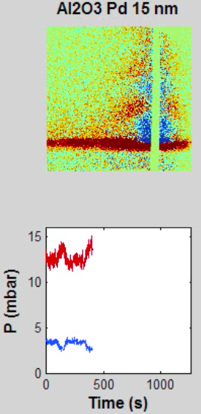
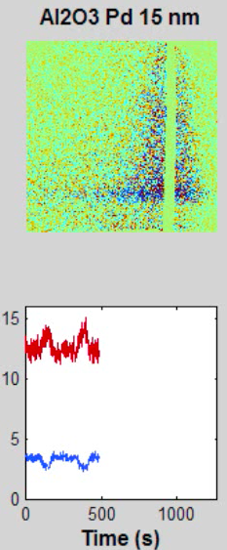
Catalysis from NPs: Pd (GISAXS) (3/3)-3
ID03 experiment: gas phase oxidation of CO to CO₂ in oxygen rich atmosphere using catalyst Pd NPs.
The catalytic activity follows an oscillatory reaction rate.
Experiment description:
- Pd NPs size: 15 nm
- Reaction conditions: gas pressure 0.5 atm; T_{sample} ∼ 600 K; d_{D-S} = 540 mm; E = 18 keV
- Measurements: in’ operando’ conditions. Partial pressures (CO, CO₂) and T_{sample} monitored simultaneously
Under the conditions of the experiment the production of CO₂ is oscillatory with time between a high and a low reactivity regimes (HRR / LRR), and consequently the concentration of CO is also oscillatory with opposite phase.
Right image: the maximum of reaction rate is associated to a diffuse diffraction that extends continuously along the surface normal with decreasing intensity from bottom to top.
Left image: in the LRR the pattern displays two lobed pattern along the surface normal. It could be due to constructive interference between the upper and lower facets of the particle (in contact with gas and substrate).
Although the analysis of the data is still in progress, the experiment illustrates the possibilities of the technique for
CO
CO₂
investigating the changes of the catalyst in operando conditions.
        19th Scientific Advisory Committee Meeting
        ALBA, 3 December 2014

Slide 27
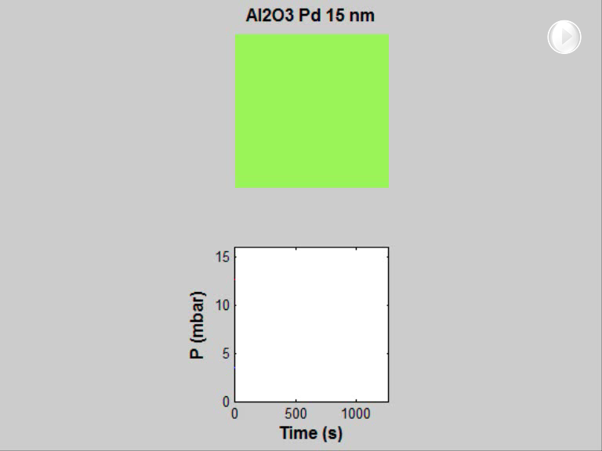
Catalysis from NPs: Pd (GISAXS) (3/3)-4
Q⊥
Q||
CO
CO₂
W.G. Onderwaater et al. (to be published)

Slide 28
Outline:
      Beamline objectives
      Source characteristics & Optics layaout
      Scattering geometry
      Scattering techniques
      Equipment and sample environments
      Scientific cases. Examples:
        Molecular self-assembling. Chiral system: Adenine
        Surface structure: BaTiO₃(001)
        Heterogeneous catalysis: CO oxidation NPs
      Budget
      Areas of scientific impact: energy, health and nanoelectronics
      Research lines: catalysis, NPs, multiferroics, electrochemistry
      Synergies with other ALBA beamlines (BOREAS, NCD, CIRCE)
      Participating research groups
        19th Scientific Advisory Committee Meeting
        ALBA, 3 December 2014

Slide 29
Budget:
Source
Insertion device + frontend 900 k€
Beamline & Optics
Other equipment (Slits cooled + flight tubes + pumps + etc.) 390 k€
Three mirrors set plus mechanisms 500 k€
Monochromator System 300 k€
Single diamond phase retarder setup (UHV chamber and mechanics) 50 k€
Diamond crystal 20 k€ (2160 k€)
Experiment
Multiaxis Diffractometer (with analyzers) 530 k€
Polarization analyzer 50 k€
Detectors 350 k€
SAXS table+tube 190 k€
Magnetic scattering devices 60 k€
UHV flow reactor: 200 k€
Sample environments 500 k€
Nitrogen gas stream cooling system 50 k€
Helium gas stream cooling system and control electronics 60 k€
Cryostat (close cycle) 60 k€ (2050 k€)
Infrastructure & control room 840 k€
Contingency (10%) 505 k€
Total 5555k€
        19th Scientific Advisory Committee Meeting
        ALBA, 3 December 2014

Slide 30
Outline:
      Beamline objectives
      Source characteristics & Optics layaout
      Scattering geometry
      Scattering techniques
      Equipment and sample environments
      Scientific cases. Examples:
        Molecular self-assembling. Chiral system: Adenine
        Surface structure: BaTiO₃(001)
        Heterogeneous catalysis: CO oxidation NPs
      Budget
      Areas of scientific impact: energy, health and nanoelectronics
      Research lines: catalysis, NPs, multiferroics, electrochemistry
      Synergies with other alba beamlines (BOREAS, NCD, CIRCE)
      Participating research groups
        19th Scientific Advisory Committee Meeting
        ALBA, 3 December 2014

Slide 31
Areas of scientific impact
SOFCs
H-production
Hybrid systems photocatalysis
Organic photovoltaic cells
CO oxidation
3-way catalysts
Energy
1: GIXRD
2: GISAXS
3: XRR
4: GIDAFS
5: AS (Anom. Scatt.)
6: Polarization
7: XRMS
Layered systems
Chiral compounds
Dispersed aggregates
Encapsulated nanocomp.
Organic/organic interfac.
Multiferroic systems
Thin films
Nanostructures
Buried structures
Strain
Health
Electronics
        19th Scientific Advisory Committee Meeting
        ALBA, 3 December 2014

Slide 32
Outline:
      Beamline objectives
      Source characteristics & Optics layaout
      Scattering geometry
      Scattering techniques
      Equipment and sample environments
      Scientific cases. Examples:
        Molecular self-assembling. Chiral system: Adenine
        Surface structure: BaTiO₃(001)
        Heterogeneous catalysis: CO oxidation NPs
      Budget
      Areas of scientific impact: energy, health and nanoelectronics
      Research lines: catalysis, NPs, multiferroics, electrochemistry
      Synergies with other alba beamlines (BOREAS, NCD, CIRCE)
      Participating research groups
        19th Scientific Advisory Committee Meeting
        ALBA, 3 December 2014

Slide 33
Research lines: energy / catalysis
Catalysis {GIXRD, GISAXS, (GI)DAFS, AS: Anomalous Scattering}
SOFCs: electrochemical conversion device producing electricity when oxidizing a fuel. The electrolyte is a solid oxide or ceramic.
Challenges: low pollutant emission levels, improving catalytic activity and robustness and low thermal activation (600 ºC)
*Anode: low tolerance to sulphur compounds, cathode oxidation, C-deposition ➔ damage
*Cathode: development of new specifications: material and microstructure having high catalytic activity for oxygen reduction (600 ºC), high electron and ion conductivity and low sensitivity for poisoning.
*Electrolyte: no catalytic requirements; sufficient oxygen ion conductivity at 600 ºC (thin films, chemical stability)
*Design of efficient reactors.
Multifunctional hybrid organic-inorganic photo-catalysts: artificial photosynthesis of fuels (water splitting and CO₂ reduction)
        19th Scientific Advisory Committee Meeting
        ALBA, 3 December 2014

Slide 34
Research lines: energy / catalysis
ITQ (Institute of Chemical Technology)-Valencia
* Prof. Jose Manuel Serra:
- development of solid oxide fuel cells components → design and characterization of new electrocatalysts;
- mixed ionic-electronic conducting membranes for oxygen and hydrogen separation and catalytic membrane (thin-film based) reactor applications
EU FP7 GREEN-CC - Graded Membranes for Energy Efficient New Generation Carbon Capture Process (09/2013). Oxyfuel combustion (higher flame temperatures). Exhaust gases: CO2 + H2O: ready for CO2 sequestration.
EU-FP7 ELECTRA - High Temperature Electrolyser with novel proton ceramic tubular modules of superior efficiency, robustness, and lifetime economy (03/2014): H2 production using electricity from renewable sources.
* Prof. Fernando Rey: Zeolites. Interest in surface reaction in new model systems.
* Prof. A. Corma: Multi-Functional hybrid photo-catalytic materials.
        19th Scientific Advisory Committee Meeting
        ALBA, 3 December 2014

Slide 35
Research lines: health / organic NPs
Priming polymers {GIXRD, GISAXS, (GI)DAFS, AS: Anomalous Scattering}
* ICN2 researchers have developed a novel nano fabrication method permits imprinting nano-scale functional polymeric surface structures by topography instead of chemistry. Tailoring functional surfaces (curved) possible.
Plast4Future awarded “best on-going EC FP7 project” (2014)
Responsibles: Dr Nikos Kehagias, Nanofabrication Division, and ICREA Prof Clivia Sotomayor, Phononic and Photonic Nanostructures Group
Bio-NPs {GISAXS, (GI)DAFS, AS: Anomalous Scattering}
Combination of nanotechnology and molecular biology permits the development of a new class of NPs for biomedicine combining biocompatibility and bioselectivity
NANOMOL Group (ICMAB): Prof. Jaume Veciana: (GIXRD, GISAXS, GiDAFS ans AS)
*ELECTROMAGIC: Multifunctional surfaces structured with electroactive and magnetic molecules for electronic devices.
*Nanomedicine: Multi Functional NPs (i.e. polymer particles, nanocapsules, vesicles, polymer-drug conjugates, micelles) to be used in new drug delivery systems with tailored properties, including biocompatibility, size, structure, addressability, and functionality. MFMagneticNPs
*Multi Functional Magnetic NPs 6-20 nm: magnetized by external magnetic field.
        19th Scientific Advisory Committee Meeting
        ALBA, 3 December 2014

Slide 36
Research lines: electronics / multiferroics
Multiferroics: Materials combining ferroelectricity (FE), (ferro)magnetism and (ferro)elasticity. Coexistence of magnetism (M) and FE at T > RT
Type I: FE and M exists independently
Type II: FE due to certain type of magnetic ordering
ABO₃ (single perovskite): the M/FE coupling at RT remains challenging.
A₂B’B’’O₆ (double perovskite): control and/or to induce M/FE coupling in oxides.
- Control of the B’/B’’ cation ordering, i.e. Mn/Ni, modifies magnetic ground states, ferromagnetic transition temperature, phonon behaviour, and spin-phonon coupling: cations have (partially/filled) empty states.
- B’/B’’ ordering is crucial in determining their functional properties.
- Larger number of systems available and flexibility of synthesis: thin films (PLD)
ICMAB:
* CRYMEOS (CRYstallography of Magnetic and Electronic Oxides and Surfaces): Double Co perovskites, Ca3MnCoO6, La2MnCoO6, PrBaCo2O6, Sr2CoWO6. National Spanish Research founding.
* MULFOX (MultiFunctional Oxides Group). Thin films with magnetic, ferroelectric properties, piezoelectric, catalysers,... (Bi/La)NiMnO6,...
ICMA:
* Department: Synchrotron X-ray Resonant Scattering in metallic oxides: Charge and Orbital ordering. Fe3O4, LuFe2O4, TbMnO3, TbBaCo2O5.5,...
        19th Scientific Advisory Committee Meeting
        ALBA, 3 December 2014

Slide 37
Research lines: electrochemistry
* The size of Pt-catalyst NPs as function of continual potential cycling can increase very rapidly depending on the carbon NP support.
Relevant for the future of fuel cells: lifetime of the fuel cells could be coarsening dependent of the Pt-electrocatalyst NPs.
* Battery-electrode materials: ICMAB, ICMM, CNM, CIN2 (CSIC), UAM
* Corrosion behaviour of Cu in acidic environments by EIS: IETCC (CSIC).
* Corrosion behaviour in Al and Al-Si-Cu alloys (electrodes and civil engineering), and protection (cultural heritage): CENIM (CSIC)
* Coatings (ICV): Protecting and functional coatings (sol-gel): doped silica (/zirconia), doped Si-nitride, consumer electronics ... // Electrodes and electrolites for SOFC.
IETCC: Eduardo Torroja Institute (CSIC)
CNIM: National Center for Metallurgical Research (CSIC)
ICV: Institute of Ceramics and Glass (CSIC)
GIXRD, GISAXS, (GI)DAFS, Anomalous Scattering, Polarization
        19th Scientific Advisory Committee Meeting
        ALBA, 3 December 2014

Slide 38
Outline:
      Beamline objectives
      Source characteristics & Optics layaout
      Scattering geometry
      Scattering techniques
      Equipment and sample environments
      Scientific cases. Examples:
        Molecular self-assembling. Chiral system: Adenine
        Surface structure: BaTiO₃(001)
        Heterogeneous catalysis: CO oxidation NPs
      Budget
      Areas of scientific impact: energy, health and nanoelectronics
      Research lines: catalysis, NPs, multiferroics, electrochemistry
      Synergies with other alba beamlines (BOREAS, NCD, CIRCE)
      Participating research groups
        19th Scientific Advisory Committee Meeting
        ALBA, 3 December 2014

Slide 39
Synergies between SIRENA and other ALBA beamlines
UHV: “Surf. Prep. Lab.”
Surfaces & Interfaces beamline
UHV instrumentation: compatible baby chambers
CIRCE (PEEM and NAPP) (microscopy and spectroscopy)
NCD (SAXS)
(WAXS)
BOREAS (absorption and dichroism
Hard & soft matter
Electronic structure ←→ complementary with structure in surfaces and interfaces
        19th Scientific Advisory Committee Meeting
        ALBA, 3 December 2014

Slide 40
Synergies between SIRENA and other ALBA beamlines
BOREAS:
Energy: 80-4000eV Soft condensed Matter // SIRENA: 4.5 – 25 keV
Absorption and adjustable polarization.
Special UHV-compatible cryomagnet equipped with superconducting coils allowing maximum fields up to 6 T.
The system is equipped with a UHV sample-suitcase to transport samples to the UHV distribution beamline station (XMCD / diffraction chambers)
Two end-stations:
Soft X ray absorption and dichroism (NEXAFS, XMCD, XMLD)
UHV reflectometer for scattering and reflections (RXR, RMXS, GISAXS)
NCD:
Energy: 6.5 – 13 keV Soft condensed Matter
SAXS (1-to 1000 n) and WAXS (< 1nm) // beam divergence @ sample 0.5x0.1 mrad²
SIRENA: 3.2 mrad (Horizontal) // Q_{max} 0.33 Å⁻¹
Sample-detector distance: 2-5 m (focused beam / refractive lenses) < 5x5 μm
> 10 m (standard operation) 10x150 μm (VxH)
Soft Materials: biological and polymers.
CIRCE (NAPP): P. range (UHV to 25 mb), T range (200 to 1000 K) E range (0.1 to 2 keV)
SIRENA (UHV to 1000 mb) (RT to 1250 K) (4.5 to 25 keV)
        19th Scientific Advisory Committee Meeting
        ALBA, 3 December 2014

Slide 41
Outline 2:
      General risk assessment
      Proposed experiment: catalysis
      Industrial type of experiment(s)
      Leading scientific area
        19th Scientific Advisory Committee Meeting
        ALBA, 3 December 2014

Slide 42
General risks assessment
- SIRENA beam line has a plus over others that makes it “more” versatile:
ID03, DIAMOND, SIXS, SIRIUS, P09 (PETRA III) don’t provide all combination of techniques proposed in this beamline and/or range of energy. From this point of view the beamline would have a particular sector of synchrotron users interested in using this beamline (among others)
- Economical risks:
The solutions adopted for building this beamline permitted to reduce costs:
*Optics hutch: solutions already tested not needing extra developments
*Experimental hutch: only one hutch instead of the two (UHV/air) typically designed for these type of beam lines.
Savings make possible investing in diversified sample environments.
        19th Scientific Advisory Committee Meeting
        ALBA, 3 December 2014

Slide 43
Highlight (catalysis): PCO-(LSCO)-cobaltite catalyst films: structure and electronic changes.
SOFCs {GIXRD, GISAXS, (GI)DAFS, AS: Anomalous Scattering}
Oxygen deficient perovskites can be seen as a matrix where the metal ions (Co) are embedded to increase the effective surface area of the catalyst. Hydrogen gas production by catalytic partial oxidation of methane induces a strong mass transport to the surface since metallic Co is the responsible of the catalytic dissociation of methane.
PCO-cobaltites shows two reduced temperatures 650 and 850 K. LSC samples show higher reducing temperatures (850ºC). Co aggregates during the reaction and oxidizes when reducing temperature forming the LSC. The process is reversible.
Experiment:
Measure of the structure during operando conditions using large area detector.
Recording T, in-gases and products during the reaction.
Recording (GI)DAFS spectra through Co absorption edge.
Follow evolution of CoO and Co3O4 oxide phases during the reaction.
Check reactivity dependence with in-gases stoichiometry and T.
Explore appearance of new oxide phases on the surface.
Results:
Evaluation whether the CH4 oxidation rate depends on the oxidation state of the Co surface, roughness, or local reordering of Co-atoms at the surface.
Compare the Co-DAFS spectra between non-reactive/reactive situations to get additional
local structural information on the topmost Co surface atoms.
        19th Scientific Advisory Committee Meeting
        ALBA, 3 December 2014

Slide 44
Highlight: Industrial type of experiment(s)
Soft interfaces (SI)
SI used as model system → biological applications: ML = 1/2 cell membrane
A bilayer accounts for a cell membrane: transport properties accross the membrane in presence of proteins: advanced biomimetic models, i.e. Phospholipid bilayers in contact with water¹; DPPC-ML in presence of vapor of an active molecule to understand its effect for pulmonary diseases²; antimicrobial peptide injected in water subphase of phospholipid-ML to understand interaction with biomembranes³ (GIXRFluorescence: amount of material adsorbed at the interface), GIXRD and GISAXS (structure and kinetic of the grown material). Anomalous/resonant Ba-doped(Ca, Pb,...): concentration of adsorbed ions or helping to solve the structure of metalloproteins⁴ (4. BIO-SAXS @ NSRRC, Taiwan 2013)
Corrosion and electrochemistry: combination of GIDAFS and polarization analysis gives information on structure and chemistry of adsorbates in electrochemical interfaces and/or solid-gas interfaces. The differences between σ/π DAFS scans are related with the local ordering around the adsorbate.
1. G. Fragneto et al.,: Eur. Phys. Lett. 53, (2001) 100; Langmuir 19, (2003) 7695.
2. A. Ivankin et al., Ang. Chemie Int. Edition 89 (2010) 8462
3. D. Gidalevitz et al., Proc. Natl. Acad. Sci. 100 (2003) 6302: MS Kent, Biophysical Journal 94 (2008) 2115
        19th Scientific Advisory Committee Meeting
        ALBA, 3 December 2014

Slide 45
Single scientific field/technique (BL European-leading)
Resonant diffraction and polarization analysis (X-rayRMS):
Beam properties (intense, tunable, polarized): magnetic structures in surfaces and thin films.
Against Non-XRMS, XRMS benefits of an enhancement of the magnetic scattering (edge). The resonant enhancement is particularly pronounced at the spin-orbit split L and M edges of the 3d, 4f, and 5f magnetic atoms.
Resonant cross sections: K edges of 3d elements (5-9 keV) magnetic polarization of conduction states
Profile magnetization across layers (thin films): 5d, 4f states (XMCD).
Magnetic morphology of nano-objects (on surface or buried*): new opportunities to give a statistical description of the magnetic morphology of nanometer scale aggregates self organized in a thin film matrix.
GIDAFS and polarization dependence (in/out-of-plane) to probe local distortions at the surface of films (lattice distortions) (evolution with depth: incidence angle dependence)
GIDAFS (nanostructures): analysis of strain and composition in regions selected by diffraction condition (3D visualization of these properties → 2D GIDAFS mappings).
New areas of interest when combining these techniques with GISAXS/catalysis/electrochemistry/imaging or simultaneously between them.
* E. Dudzki et al., Phys. Rev. B 62 (2000) 5779 // F. Zighem & S. Mercone (2014) arXiv:1411.5700v1
        19th Scientific Advisory Committee Meeting
        ALBA, 3 December 2014

Slide 46
Supporting scientist
Dr M.J. Capitán Aranda IEM-CSIC
Dr. J. Álvarez Alonso Dpto. FMC-UAM
Dr. J. J. de MiguelLlorente Dpto. FMC-UAM
Dr. Oier BikondoaXMAS (UK beamline) @ ESRF, UK
Dr. José Santiso ICN2-CSIC
Prof. José Luis García Muñoz ICMAB-CSIC
Dr. Enrique Herrero Dpto. QF-Univ. Alicante
Prof. Juan M. Feliú Dpto. QF-Univ. Alicante
Dr. Alfonso Cebollada IMM-CSIC
Dr. Jorge M. Martínez García IMM-CSIC
Dr. Miguel A. Rodríguez Pérez Dpto. FMC-Univ. Valladolid
Prof. José A. de Saja Sáenz Dpto. FMC-Univ. Valladolid
Dr. Rafael Andreu Fondacabe Dpto. QF-Univ. Sevilla
Dr. Juan J. Calvente Pacheco Dpto. QF-Univ. Sevilla
Prof. Enrique Fatás Dpto. QF-UAM
Dr. Concepción Alonso Dpto. QF-UAM
Dr. Miguel Clemente León ICM-Univ. Valencia
Dr. Javier Díaz Dpto. FMC-Univ. Oviedo
Prof. Fausto Sanz Dpto. QF-Univ. Barcelona
Dr. Mercedes Perez-Mendez ICyTP-CSIC
Dr. Julio Camarero de Diego Dpto. FMC-UAM
Dr. Germán Castro ICMM(SPLINE)-CSIC (ESRF)
Dr. Jose A. Martín Gago ICMM-CSIC
Dr. Maria F. Lopez ICMM-CSIC
Dr. Julio Camarero de Diego Dpto. FMC-UAM
Dr. Germán Castro ICMM(SPLINE)-CSIC (ESRF)
Dr. Jose A. Martín Gago ICMM-CSIC
Dr. Maria F. Lopez ICMM-CSIC
Dr. Maria Alonso ICMM-CSIC
Dr. F. Pigazo ICMM-CSIC
Dr. F. Javier Palomares ICMM-CSIC
Dr. Carlos Prieto ICMM-CSIC
Dr. Alicia de Andrés ICMM-CSIC
Dr. Esther Barrena ICMAB-CSIC
Dr. Carmen Ocal García ICMM-CSIC
Prof. Federico Soria ICMM-CSIC
Dr. M. Eugenia Dávila Benítez ICMM-CSIC
Dr. Juan de la Figuera Ballón Dpto. FMC-UAM
Prof. Rodolfo Miranda Soriano Dpto. FMC-UAM
Dr. Amadeo L.V. de Parga Dpto. FMC-UAM
Dr. Leonardo Soriano Dpto. FA-UAM
Dr. Juan José Hinarejos Murillo Dpto. FMC-UAM
Prof. Clara Conde Dpto. FMC-Univ. Sevilla
Dr. Mª Ángeles Gómez Rodríg. IcyTP-CSIC
Dra. Mª Esperanza Cagiao IEM-CSIC
        19th Scientific Advisory Committee Meeting
        ALBA, 3 December 2014

Slide 47
Supporting scientist
Prof. Xavier Obradors Dtor. ICMAB-Institute
Prof. Pablo Ordejón Dtor. CIN2- Institute
CIN2-Groups: CIN2-CSIC
Quantum Nanoelectronics: Dr. José Santiso López Oxide Nanoelectronics: Prof. Gustau Catalán
Physics and Engineering of Nanodevices: Prof. Sergio Valenzuela Atomic Manipulation and Spectroscopic: Dr. Aitor Mugarza
Magnetic Nanostructures: Prof. Josep Nogués Supramolecular NanoChemistry and Materials: Prof. Daniel Maspoch Phononic and Photonic Nanostructures: Prof. Clivia Sotomayor
UAM-Groups: UAM
Electronic Properties Novel Mater. Lab.: Prof. Enrique Garcia Michel Coatings, Interf. & Nanostructures: Prof. Leonardo Soriano
NANOMOL Group ICMAB-CSIC
Prof. Jaume Veciana - Prof. Concepció Rovira - Dr. Inma Ratera - Dr. Marta Mas Torrent Dr. Evelyn Moreno
Heterogeneous catalysis (HT and P) ITQ, UPV-CSIC
Prof. Fernando Rey García – Dr. José M. Serra. –Dr. J.L. Llordá, - Dr. S. Valencia, M. Palomino
CAMRADS Group ICMA-CSIC
Dr. Maria Gloria Subías Peruga - Dr. Javier Blasco Carral
International Support:
Dr. Vaclav Holy Charles University in Prague
Dr. Roberto Felici ID03, ESRF
Dr. Maddalena Pedio CNR-Italy
Dr. Massimo Innocenti USF-Firenze
Dr. Stefano Cariglio UG-Genève
Dr. Marie-Ingrid Richard & Prof. Olivier Thomas IM2NP-CNRS
Dr. Johan Gustafson Lund University
        19th Scientific Advisory Committee Meeting
        ALBA, 3 December 2014

