Slide 1
PROPOSAL FOR A MICROFOCUS BEAMLINE FOR
MACROMOLECULAR CRYSTALLOGRAPHY AT ALBA SYNCHROTRON
19th ALBA SAC meeting
ALBA phase III beamlines
December 3, 2014

Slide 2
I) Proposal leaders.
II) User groups supporting the proposal.
III) Scientific case.
IV) Connection between the scientific case and priority lines of EU Horizon 2020.
V) Other relevant features (social impact, ‘health’ / ‘aging’ / ‘food securement’ / etc.).
VI) Synergies with techniques and human resources currently available at ALBA.
VII) Return of beamline investment to the society (commercial use, regional development, etc.).
VIII) Technical aspects.
IX) Tentative budget.

Slide 3
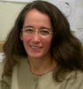
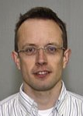
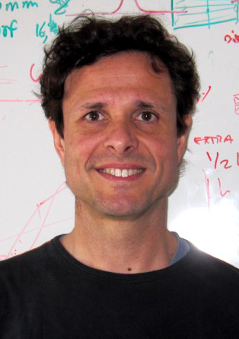
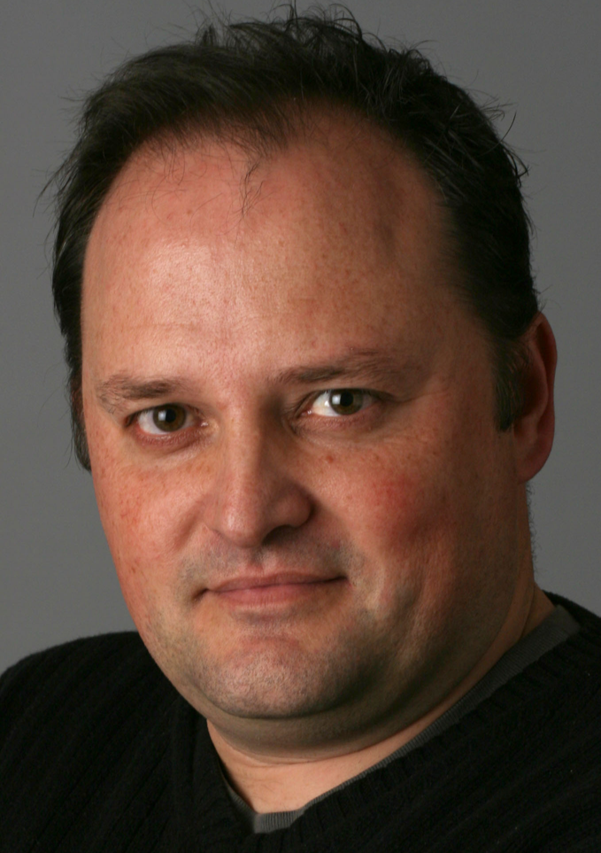
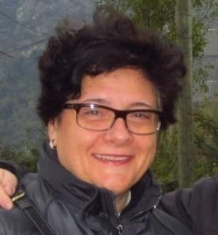

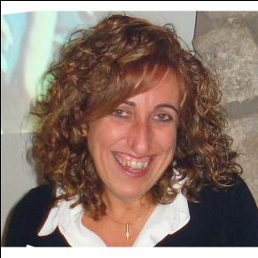
I) Proposal leaders
Maria Solà IBMB-CSIC, Barcelona
Mark J. van Raaij CNB –CSIC, Madrid
Jordi Juanhuix
ALBA Sychrotron Light Source
Jeronimo Bravo
IBV-CSIC, Valencia
Ana Cámara
Universidad de Almeria
Isabel Usón, ICREA, IBMB-CSIC, Barcelona
Núria Verdaguer, IBMB-CSIC, Barcelona

Slide 4
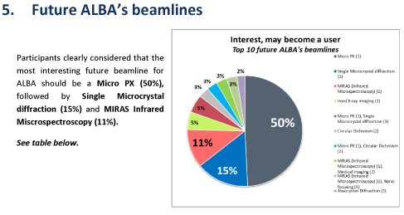
II) Supporting user groups
Conclusions of the Synchrotron Users Survey launched by ALBA in fall 2013:
-Participants clearly considered that the most interesting future beamline forALBA should be a Micro PX (50%), followed by Single Microcrystal diffraction (15%) and MIRAS Infrared Miscrospectroscopy (11%).
- Respondents also chose Micro PX (45%), MIRAS Infrared Miscrospectroscopy (11%) and Single Microcrystal diffraction (9%) as beamlines that they will actively support, expressing a strong interest in them.
Notes:
In summary, the majority of the ALBA user community has repeatedly responded that the most important future beamline for ALBA should be a micro-focus MX beamline.
Moreover, the SEBBM, the Spanish Society of Biophysics (SBE) and Spanish and international directors of research centres and structural biology departments have provided letters of support, expressing that the availability of a micro-beam MX facility will foster the scientific research in their Institutions. In addition to numerous Spanish groups, crystallographers from a number of Portuguese, Argentine and Italian groups have shown high interest and expressed their support for a new microfocus beamline located at ALBA.

Slide 5
II) Supporting user groups
The Spanish society of Biochemistry and Molecular Biology (SEBBM), the Spanish Society of Biophysics (SBE) and Spanish and international directors of research centers and structural biology departments have provided letters of support, expressing that the availability of a microfocus MX facility will foster the scientific research in their Institutions.
Notes:
In summary, the majority of the ALBA user community has repeatedly responded that the most important future beamline for ALBA should be a micro-focus MX beamline.
Moreover, the SEBBM, the Spanish Society of Biophysics (SBE) and Spanish and international directors of research centres and structural biology departments have provided letters of support, expressing that the availability of a micro-beam MX facility will foster the scientific research in their Institutions. In addition to numerous Spanish groups, crystallographers from a number of Portuguese, Argentine and Italian groups have shown high interest and expressed their support for a new microfocus beamline located at ALBA.

Slide 6
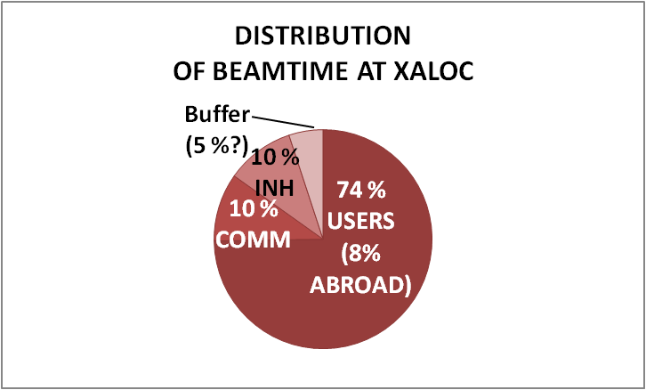
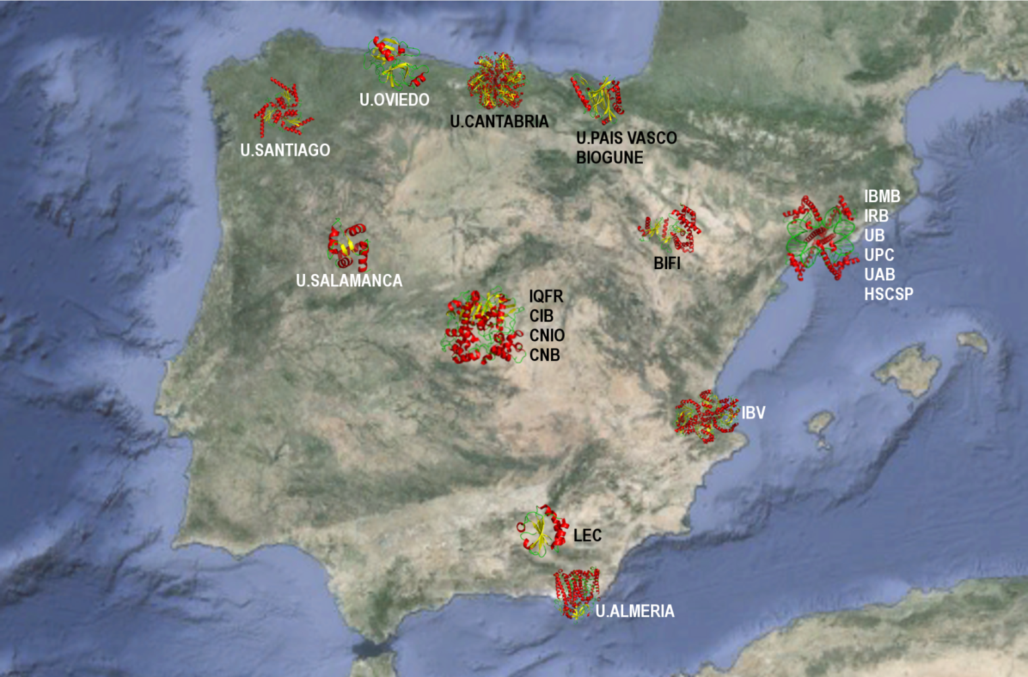
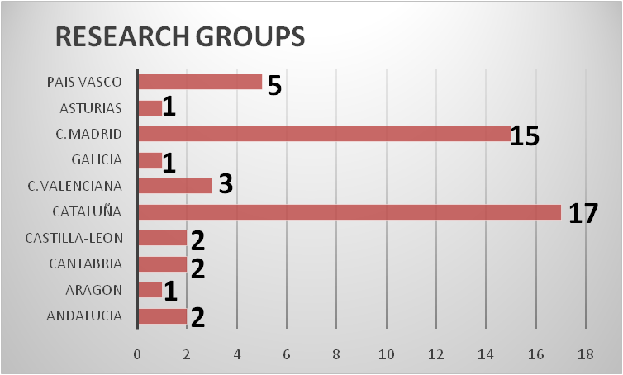
II) Supporting user groups
Standard (but not full) operation in fall 2012
users Visits
2013 188 107
2014 170 111
Spanish groups also visit
ESRF (6% of public MX beamtime, 4% of public overall beamtime), Diamond, Soleil and SLS
TOTAL 49 groups
(40 in 2009)
There is sufficient critical mass
of researchers
Notes:
The size of the Spanish macromolecular crystallography (MX) user community has dramatically increased over the last decades and is continuing to grow, with over 50 PIs currently identified in Spain. The number of institutes hosting MX has increased threefold in the same period and are distributed throughout Spain including Barcelona, Madrid, Valencia, Zaragoza, Santiago de Compostela, Oviedo, Santander, Bilbao, Salamanca, Granada and Almería. As the number of PIs employing MX continues to grow the demand for this microfocus beamline will increase in the near future.
Here at the left panel I am showing the distribution of the beam time in Xaloc and the number of users and visists since its begining.

Slide 7
_________________________________________________________ Scientific case
Science to be done at the microfocus MX beamline
Data collection of multiprotein complexes, nucleic acid-protein complexes, membrane proteins, fibril-forming proteins
  Small (<10μm), non-homogeneous and weakly diffracting crystals
Data collection of crystals obtained by high throughput crystallization
  Nanodrops and microfluidics
Crystal scanning
  Before a measurement in order to optimise mosaicity
  During data collection to minimize radiation damage

Slide 8
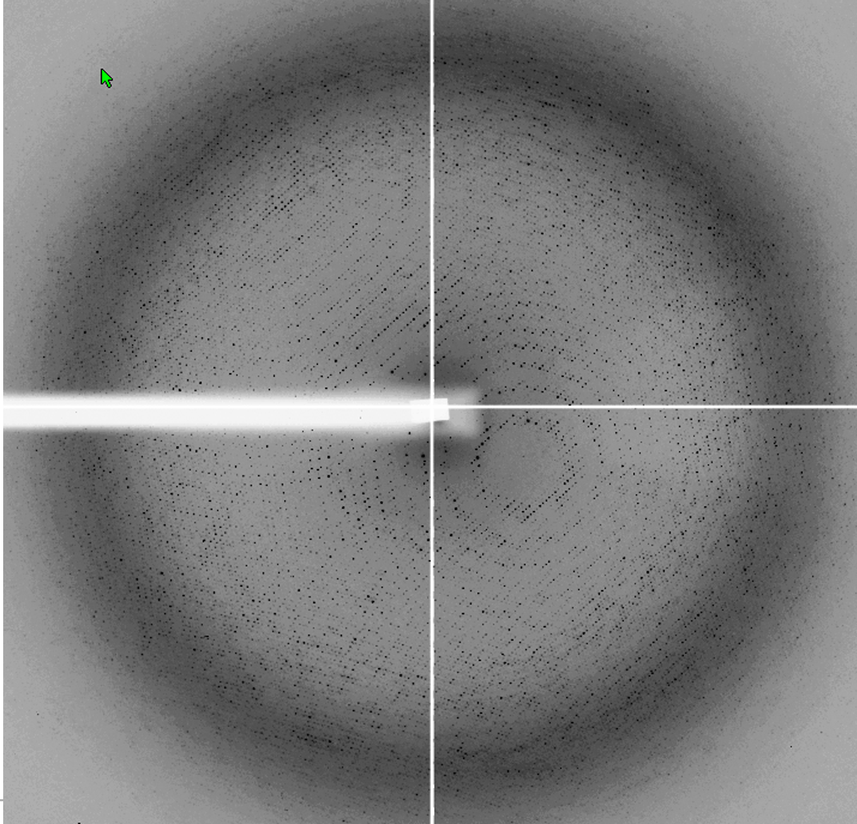
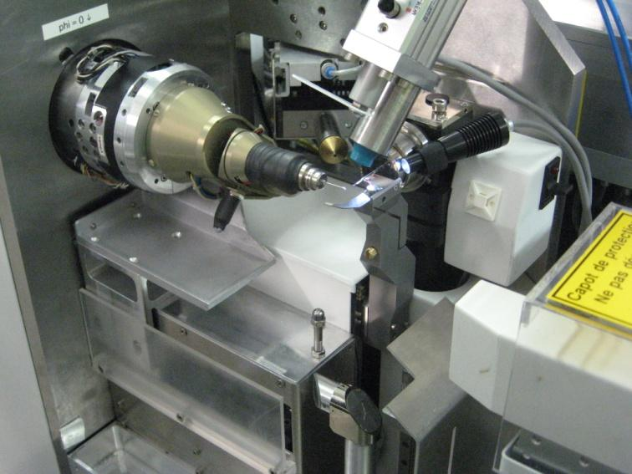
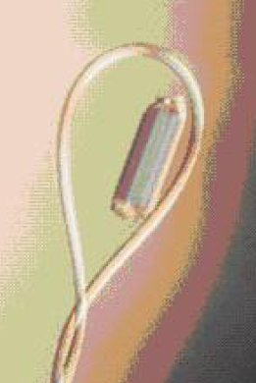
_________________________________________________________ Scientific case
Background
Diffraction experiment
Notes:
- X-ray beam is focused on the crystal.
- Crystal is rotated during the exposition to x-rays.
- A detector records the diffraction pattern.
- A complete data set consists of between a few tens and a several hundred images
- Crystal is rotates by ∼0.1 to 2º in each exposure depending on the sample

Slide 9
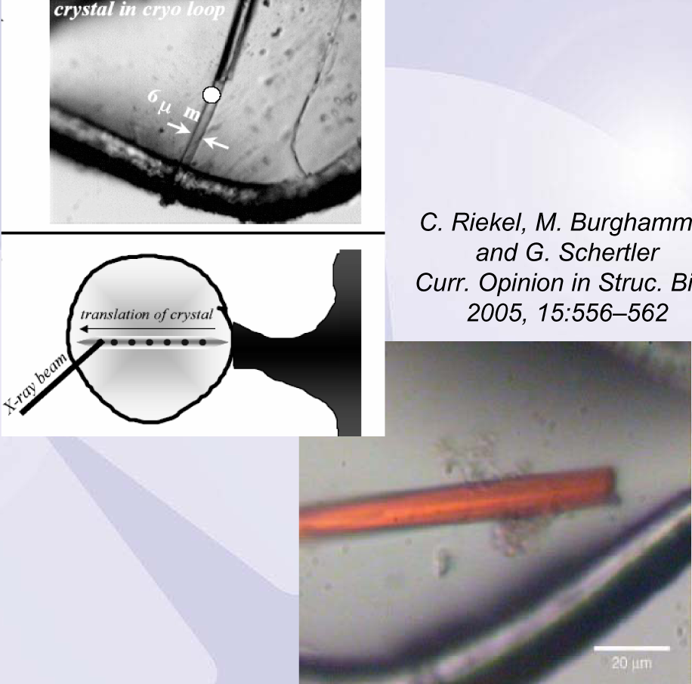
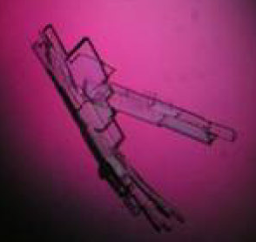
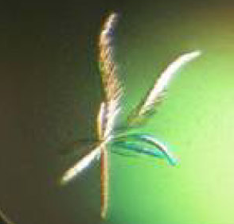
_________________________________________________________ Scientific case
Select regions of crystals that are more ordered than others
Reduce the radiation by exposing different regions of the crystal
Background scatter is reduced by matching the beam size to the sample
Riekel et al., Curr. Opin. in Strut.Biol, 2005, 15: 556-562
Notes:
Benefits of a microbeam

Slide 10
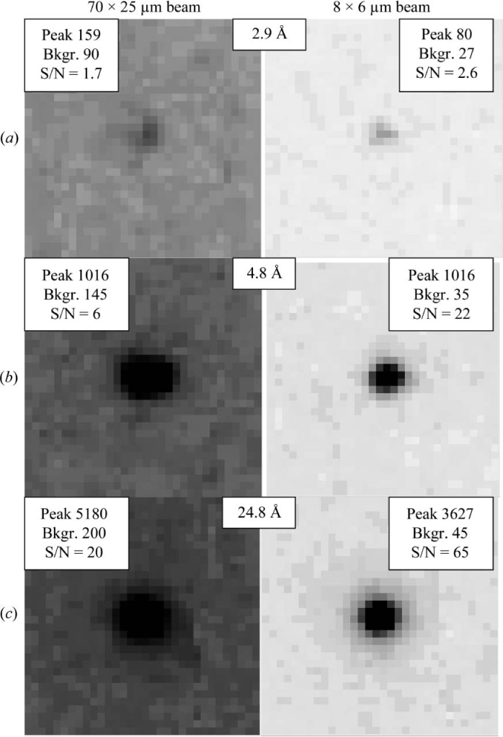
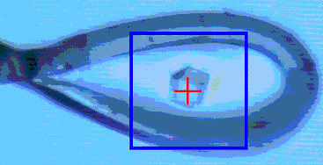
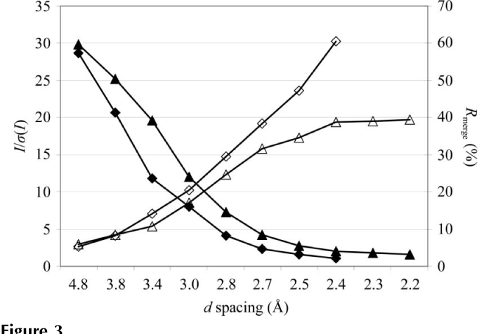
Microbeams improve signal-to-noise ratio for tiny crystals
_________________________________________________________ Scientific case
_{8x6μm}
_{70x25μm}
Sanishvili et al., Acta Cryst (2008) D64, 425-435

Slide 11
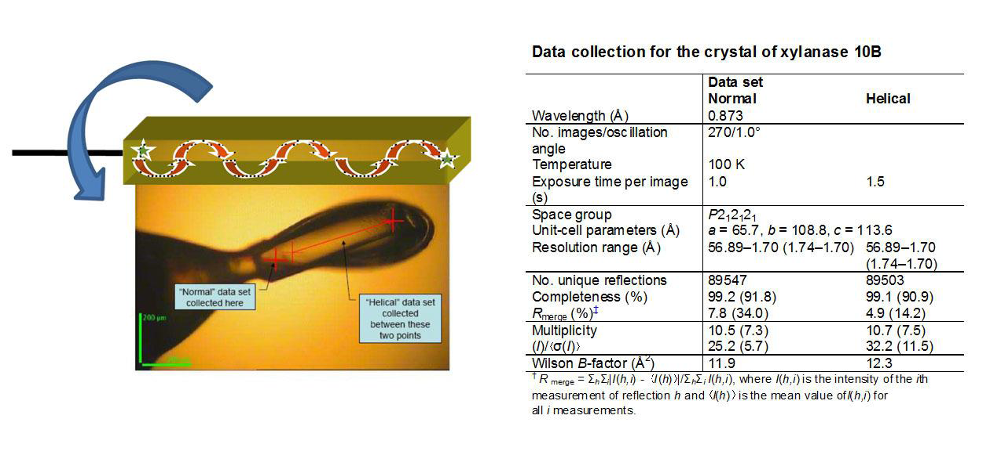
Microfocus-specific data collection
Helical data collection
Strategy for obtaining good data from thin needle - or rod- like crystals
Two points on the crystal are defined by the user as the start and end points. One single data set is collected during which the crystal is automatically translated between these two points so as to move fresh sample gradually into the beam
(From Flot et al., 2010 J. Synch Rad., 17, 107-118).
Notes:
This has the potential to allow a longer exposure per image without significant radiation damage occurring and thereby increasing signal-to-noise ratios. A crystal of xylanase 10B from Clostridium thermocellum was used to compare normal and helical data collection methods in ID23-2. The beam size was 7 μm in diameter; the crystal used was approximately 600 μm long by 150 μm wide

Slide 12
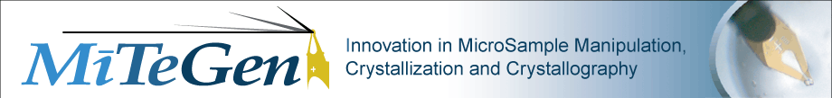
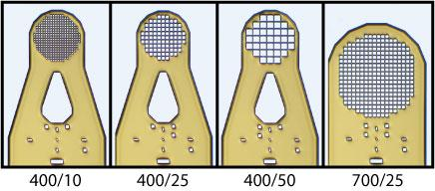
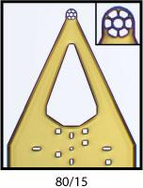
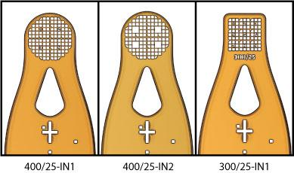
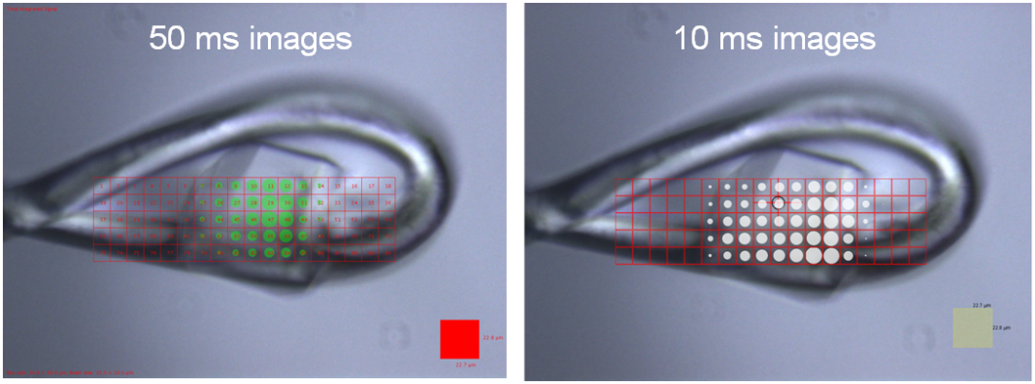
Microfocus-specific data collection
MicroMeshes Used in protein structure determination from crystals < 5 µm.
Multiple small samples can be retrieved and mounted together, spread out over the mesh.
GridScan, as implemented in Diamond:
It can help with:
Locating small crystals in the loop
Locating crystals in opaque mother liquors (e.g. LCP)
Identifying the optimal diffraction from a large crystal
X-ray centering on a crystal
Bowler, M.W., et al. (2010). Acta Cryst. D66, 855-864
Notes:
Useful Tools for micro-crystallography

Slide 13

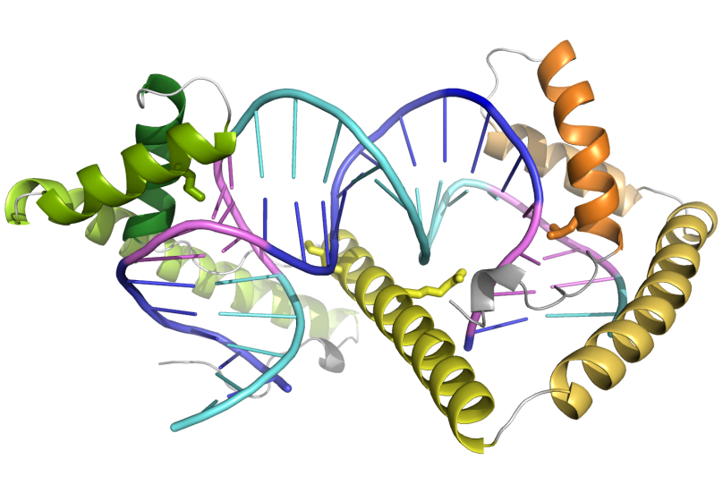
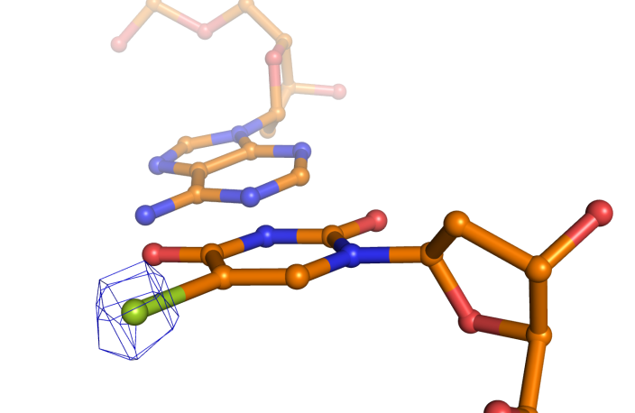
Br anomalous signal in data collected with microfocus
A data set was collected with the helical option from crystals that contained a Thy substituted by a Br-Uracyl, which at ID23-EH2 (λ above Br edge) yielded anomalous signal in a data set of 2.4 Å resolution.
Peak of the
anomalous
difference
map
Transcription factor A in complex with DNA was refined at 2.7 Å resolution. The sequence of the DNA was assigned based on the Pur/Pyr-like features. We needed confirmation.
With this information we could confirm the DNA sequence assignment
Rubio-Cosials, A., Sydow, J.F., Jiménez-Menéndez, N., Fernández-Millán, P., Montoya, J., Jacobs, H.T., Coll, M., Bernadó, P. &Solà, M.* (2011) Human mitochondrial transcription factor A induces a U-turn structure in the light strand promoter. Nat Struct Mol Biol18: 1281–1289. ESRF-ID23-EH2
Jiménez-Menéndez, N., Rubio-Cosials A., Arnan, C., Montoya, J., Jacobs, H.T., Bernadó, P., Coll, M.,
Usón, I. & Solà, M.* (2010) Human mitochondrial mTERF wraps around DNA through a left-handed superhelical tandem repeat. Nat Struct Mol Biol 17: 891-3. . ESRF-ID23-EH2 and other beamlines
Notes:
Both NSMB’s where selected as "article of the month" in 2010 and 2011 issues of the Journal of the SEBBM.
Both first authors got a prize, Nereida was awarded a José Tormo" Prize to a Young Investigator in the XXXIV SEBBM Congress in 2011. Anna was awarded with the 2nd Prize (Accésit) “Fischer Scientific” to a Young Investigator in the XXXV SEBBM Meeting, held in Sevilla (Spain) in September 2012.
ID23-eh2 0.873Å
Br edge 0.9202
(Se edge 0.9795)-seesuppl data

Slide 14
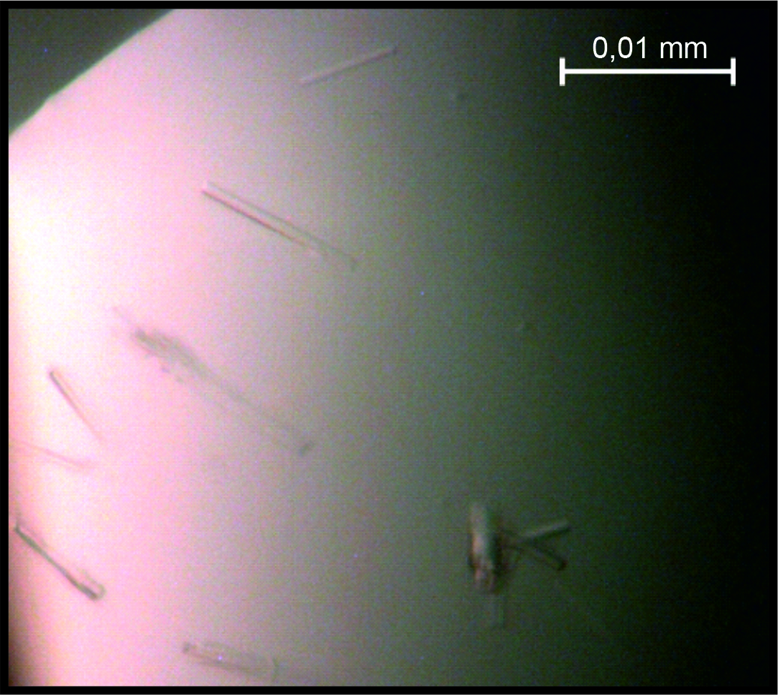
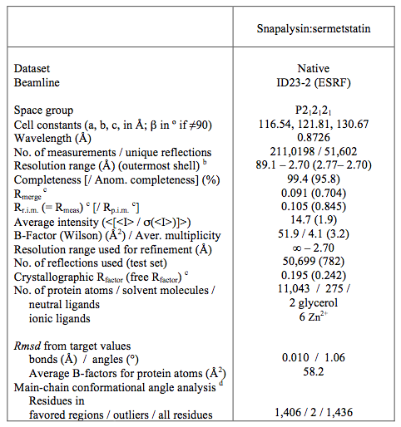
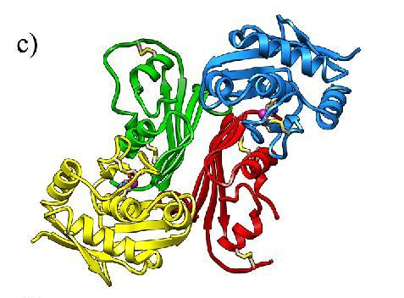
A classical case: very thin needles
Thin,elongated bar-shaped crystals that were fragile in front of X-rays. They required helical collection at microfocus beamline ID23-2
Snapalysin:Sermetstatin
(yellow, blue: green, red)
S. Trillo-Muyo, S. Martínez-Rodríguez, J.L. Arolas and F. X. Gomis-Rüth(2013) Mechanism of action of a Janus-faced single-domain protein inhibitor simultaneously targeting two peptidase classes. ChemSci4:791_797

Slide 15
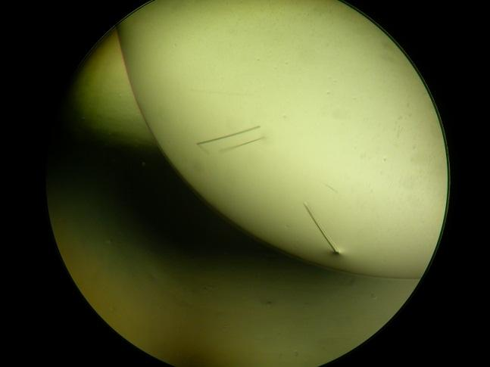
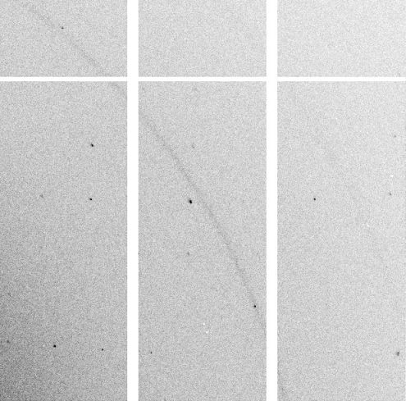
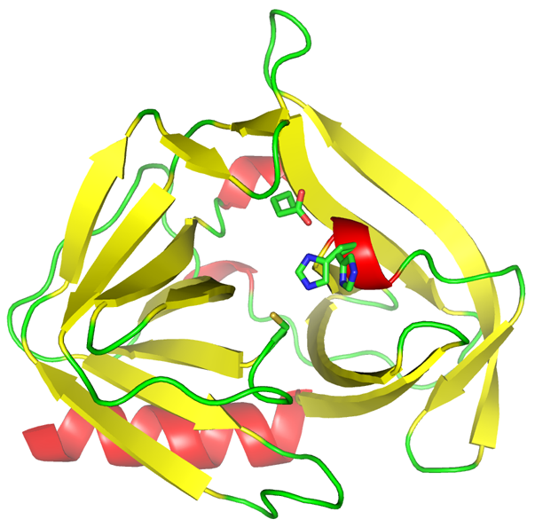
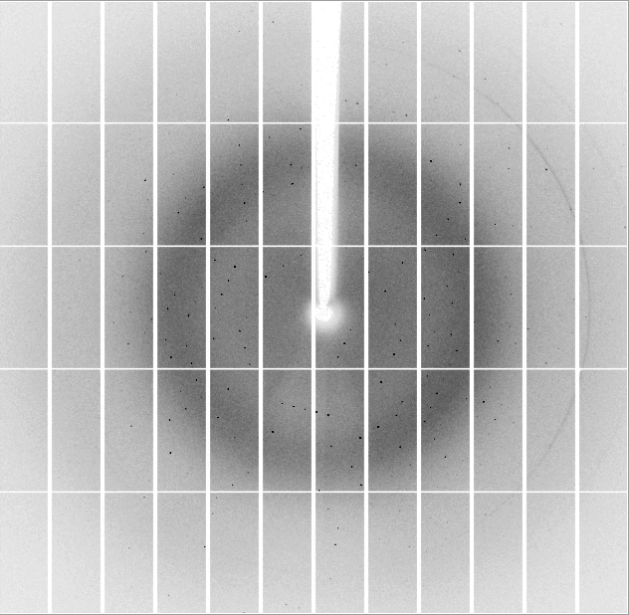
A classical case: very thin plates
EN93 3C protein crystallizes as very thin plates that are usually not big enough to diffract them in a normal beamline.
2.39 Å
The protein is being used as a target for drug design.
Zuzanna Kaczmarska & Miquel Coll,
Work undergoing
ESRF ID23-2, DECTRIS PILATUS 2M-F

Slide 16
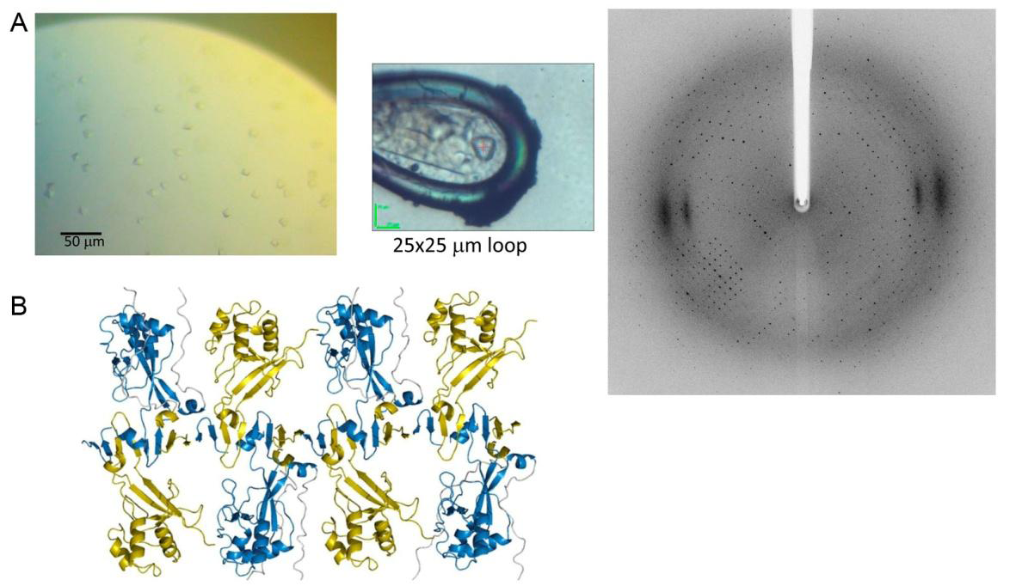
A case of extremely small crystals
The membrane remodeling protein 2B from HAV.
∙ Crystal size 5 - 8 μm
∙ Data collection ESRF, ID23-EH2
∙ ADSC Q315R detector.
∙ 14.20 keV ( λ = 0.873)
. 2.5 Å, native ,and 2.7 Å SeMet data
∙ 1º oscillation, 1min exposure
Garriga et al., 2011; Vives-Adrián, Garriga et al. & Verdaguer 2014; submitted
Notes:
Despite the small size of the crystals (5 -10 μm per edge), complete data sets were collected from native and SeMet derivative crystals to 2.5 Å and 2.7 Å resolution respectively on the microfocus beamline ID23-2 (ESRF).
These crystals were previously tested in other highly brilliant beamlines (including ID23.1 and Xaloc). In this case the problem arises from the fact that they are so small that the signal-to-noise ratio was very bad except when the beam is very small.

Slide 17
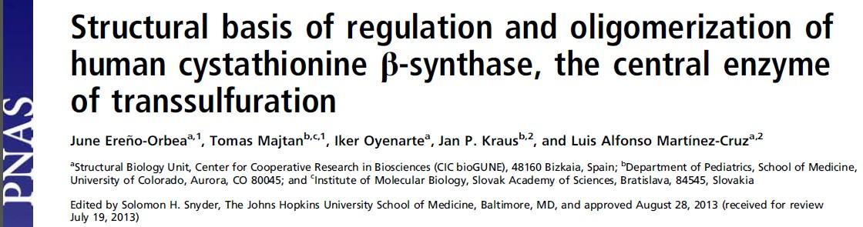
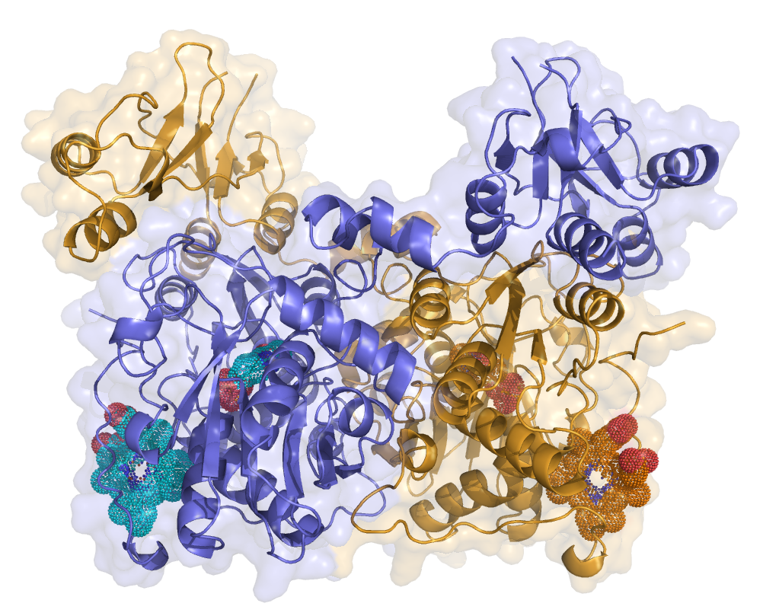
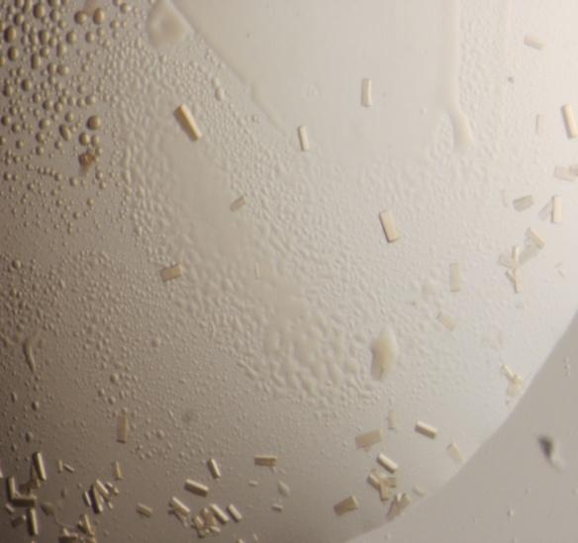
100 μm
R/R_{F}= 0.270/0.279
Protein half-life at 4ºC (measured experimentally): 27 hours
Crystallization conditions tested to get first crystallization hits: > 50,000
Optimization solutions tested: > 1000
Average size of crystals: 15x20x100 μm
Number of crystals tested at beamlines ID23-1, ID23-2 and ID29: > 1000
Structure solved from a 3.2 Å data set obtained from different crystals.
Notes:
Small and highly unstable protein crystals. Half-life of 27 hours at 4ºC. The best diffracting crystals, of average size 15x20x100 μm, extremely fragile, were obtained after testing more than 50000 crystallization conditions and more than 1000 optimization solutions. Complete datasets from only 3 crystals served to solve the structure to 3.2 Å resolution (from (Ereno-Orbea et al., 2013); CIC BioGUNE, Derio, Spain).

Slide 18


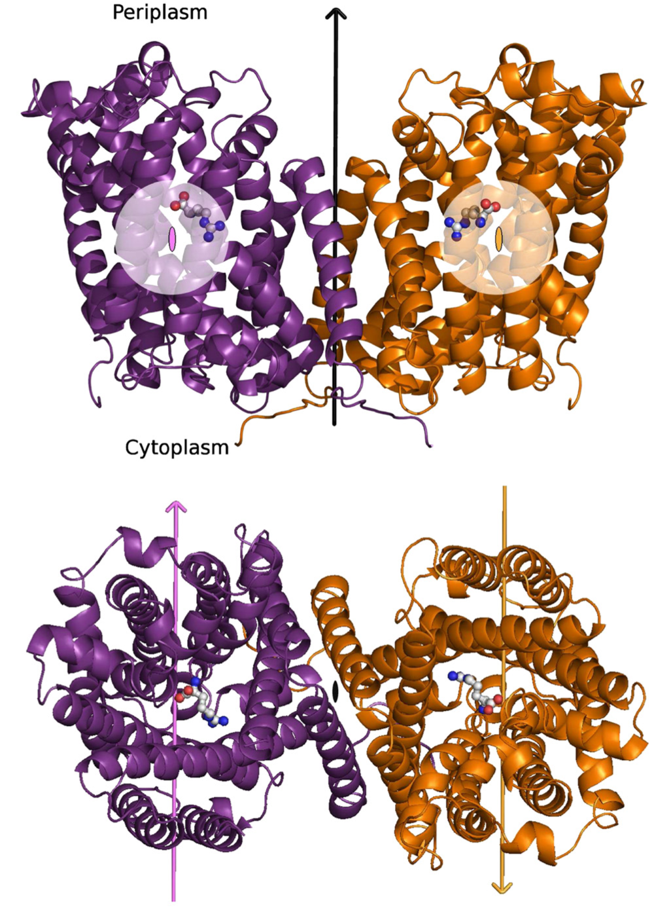
The proton pump AdiC N101A bound to Arg+.
Lateral and periplasmic views of the complex homodimer
Data collected at beamlines X06SA (PXI) in the SLS and ID23-2 in the ESRF.
Collaboration IRB and IBMB-CSIC groups, Barcelona
Notes:
Other example the successful use of microfocus beamlines to obtain high quality data of a membrane protein.
In this case, the microfocus beamlines were used to collect datasets from very small and unstable crystals.

Slide 19
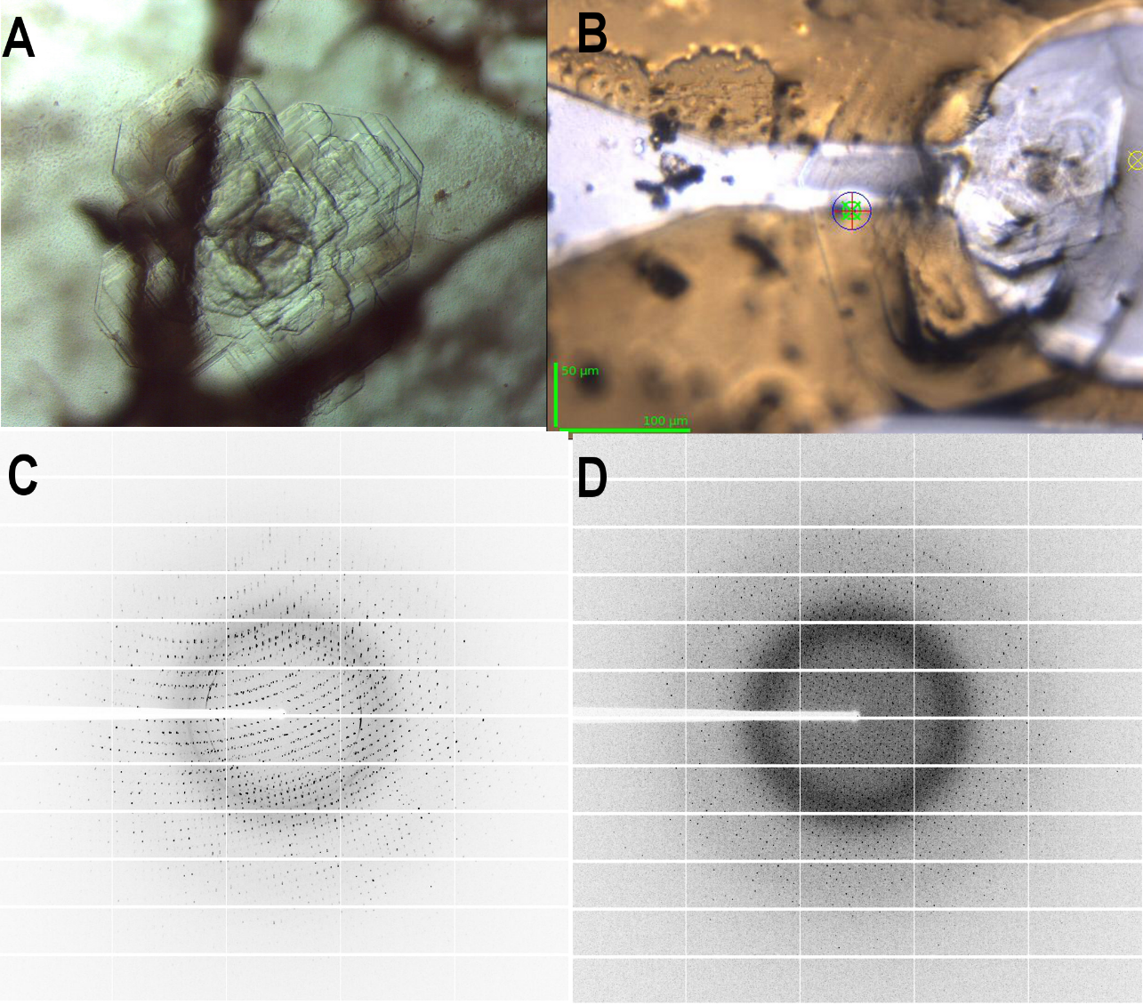
The third PDZ domain of the post-synaptic density protein 95 (PSD95) polycrystals
Crystals obtained after six years trials of different crystallization conditions.
Diffraction image in D collected after selecting a well-diffracting region in the crystal.
From Ana Cámara, Univ de Almería
Notes:
A construct of a PDZ model protein lacking the third alpha helix (PSD95-PDZ3-h) was obtained and characterized. Crystallization trials to obtain well diffracting crystals were carried out during six years. Crystals were four years old and very polycrystalline. B. Images were collected at beamline ID29 (ESRF, Grenoble) February 16, 2014. After selection an homogeneous area of the crystal, a complete dataset could be collected and processed by selecting one crystal lattice.

Slide 20
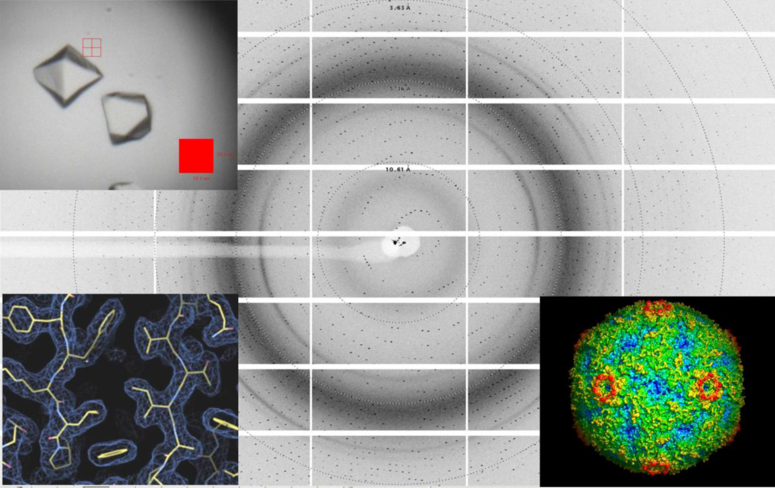
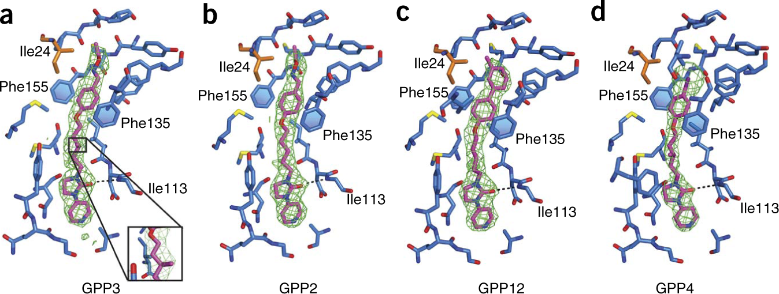
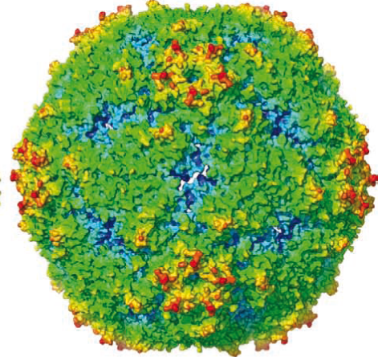
Other applications: In situ diffraction at room temperature
_________________________________________________________ Scientific case
Identification of diffraction quality crystals for biological systems that are difficult and expensive to crystallize (membrane proteins; large complexes)
To obtain diffraction datasets for crystals resistant to cryogenic procedures (large complexes; viruses; membrane proteins)
Characterization of protein-ligand interactions rapidly by collecting large numbers of datasets from similar crystals with different compounds added (industrial drug development)
Enterovirus 71
Data collected “in situ” at 21º avoiding the problems of harvesting and cryoprotecting the fragile crystals .
X-ray data collected at Diamond light source beamlines I03 and I24
From Wang et al., 2012; doi:10.1038/nsmb.2255; and deColibus et al., 2014; doi:10.1038/nsmb.2769
Notes:
In situ diffraction addresses many current needs in MX.
The number of crystallographic projects that depend on using very few amounts of protein result in an increase in the demand for microfocus beamlines. In addition, the in situ diffraction protocols at room temperature (where crystals are not extracted from their crystallization media prior to data collection) established at SLS X06DA and Diamond I24 beamlines, using small beam sizes have demonstrated important advantages in the identification of good quality crystals for difficult proteins or in rapidly obtaining large numbers of X-ray datasets for protein complexes with different compounds in industrial drug development.
It is also useful for successful data collection of different biological systems for which crystals are too sensitive to either manipulation or standard cryogenic procedures (viruses and other large macromolecular assemblies)

Slide 21
_________________________________________________________ Scientific case
Other possible application: Native phasing in a microfocus
No need of heavy atom derivative crystals is required. Anomalous scattering atoms such us Ca, Cl, S, P or Mg , present in many native crystals can be used for light-atom-only native SAD phasing.
Difficulties: Only the very well diffracting crystals allow an accurate mesure of the weak anomalous signals from native biological macromolecules .
Low-energy X-ray diffraction in synchrotron beamlines would enhance the anomalous signal. Data averaging also increases the signal to noise ratio.
A low energy microfocus beamline should reduce the chances of potential anisomorphism among crystals, since several data sets could be collected at several positions of the same crystal, maximizing the statistical equivalences.
Notes:
Native SAD methods are increasingly used for phasing since no need of heavy atom derivative crystals is required.

Slide 22
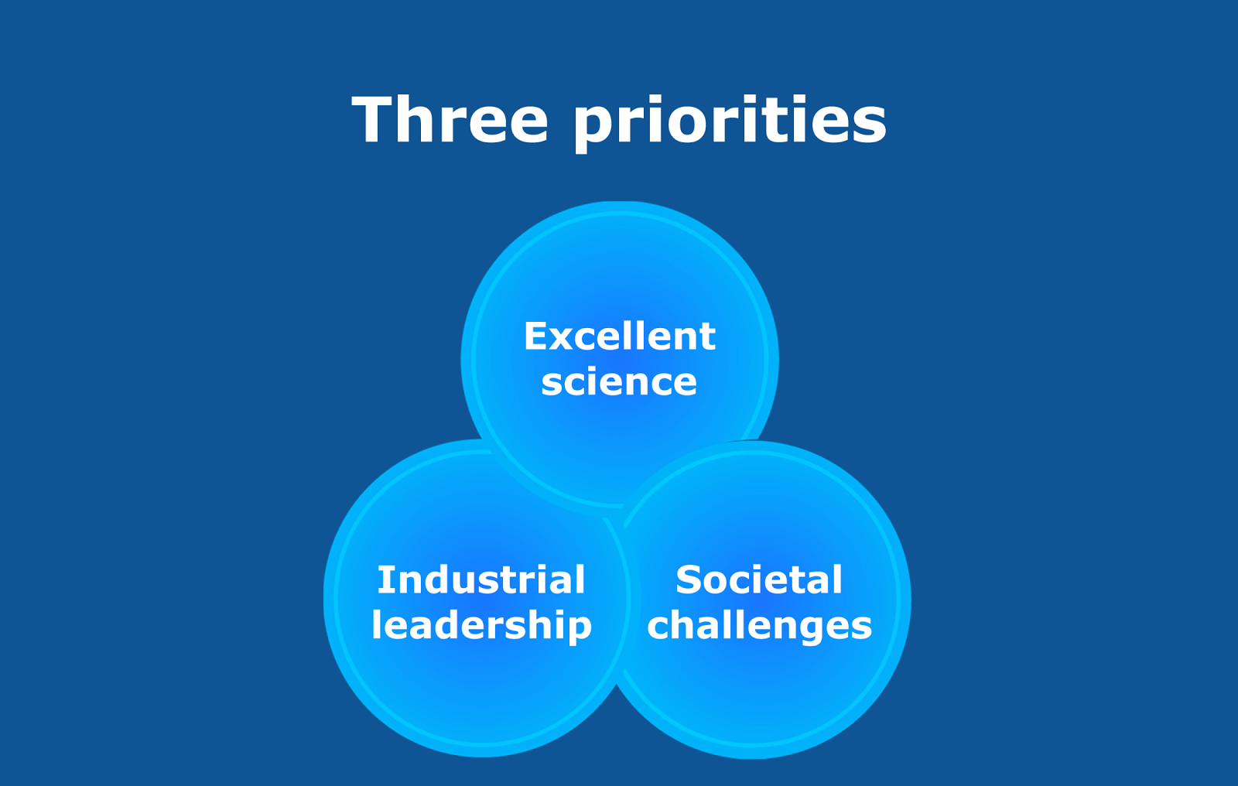
IV) Connection between the scientific case and the priority lines of Horizon 2020
Horizon 2020
From the general H2020 presentation, EC
• World class science is the foundation of tomorrow’s technologies, jobs and wellbeing
• Europe needs to develop, attract and retainresearch talent
• Researchers need access to the best
infrastructures
• EU policy objectives (Health, food security, climate, etc)
cannot be achieved without innovation
• Breakthrough solutions come from multi-disciplinary
collaborations
• Promising solutions need to be tested, demonstrated
and scaled up
• Strategic investments in key technologies
• Attract more private investment in research and innovation
• More innovative small and medium-sizedenterprises to create growth and jobs

Slide 23
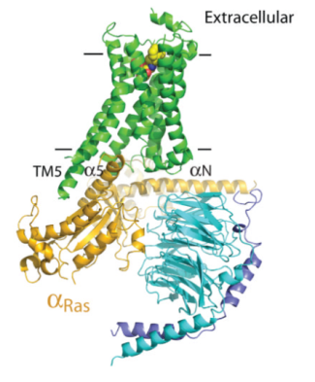
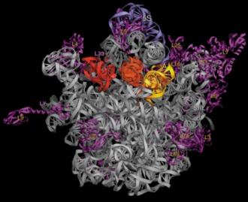
Priority1. Excellent science
Detailed structural knowledge of proteins, nucleic acids and other biological molecules,
provided by this technique has led to a number of Nobel prizes in chemistry including
Lefkowitz and Kobilka (2012) for studies of G-protein-coupled receptors; Ramakrishnan, Steitz and Yonath (2009) for studies of the structure and function of the ribosome; and Kornberg (2006) for studies of the molecular basis of eukaryotic transcription.
The proposed microfocus MX beamline will be designed to address the most challenging problems in structure determination of biological macromolecules
Notes:
Research of this calibre would be possible at the proposed micro-focus beamline

Slide 24
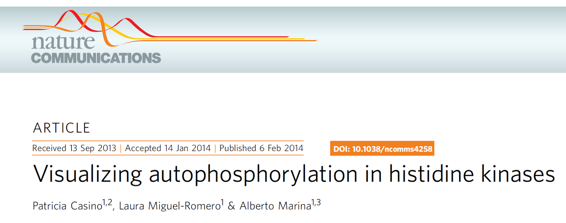

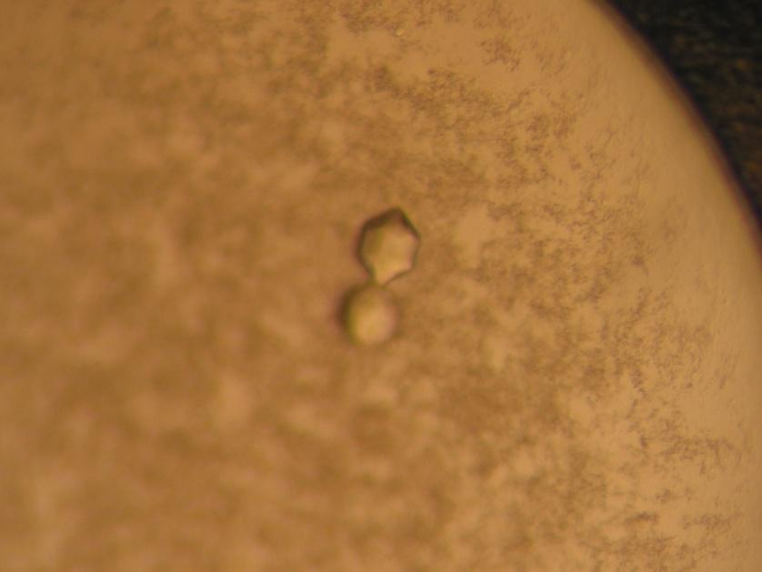
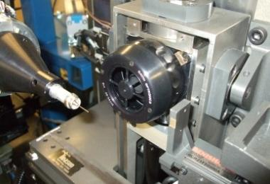
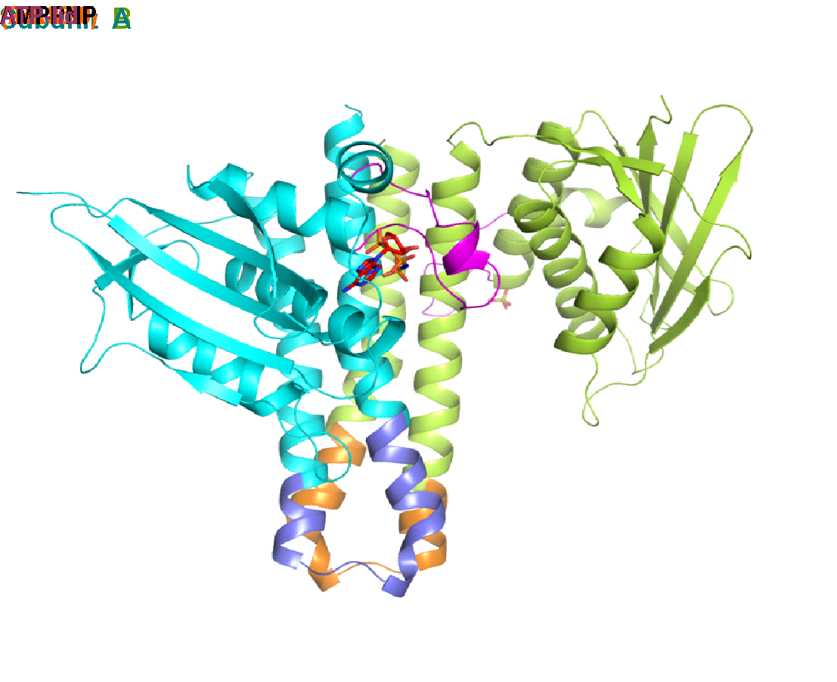

Crystals of EnvZ^{chim}
Crystals of EnvZ^{chim}diffracted at Microfocus I24 beamlineat Diamond Light Source (Oxfordshire, UK)
∙ Tuneable microfocus beamline
∙ First beamline of its kind built in Europe
∙ Unprecedented flux densities
∙ Measure crystals as small as 1.5 microns
∙Versatile optics combined with sophisticated detectors and advance automation systems
∙ New PILATUS3 detector (readout time 0.95ms)
Statistics of data collection , reduction and refinement
Asymmetric conformation in the autophosphorylation reaction
Molecular mechanism of autophosphorylation reaction
Notes:
Spanish MX researchers also perform excellent science
Alberto Marina IBV, Valencia
Structuredetermination of theEnvZ^{chim}kinase

Slide 25




ID23-2
600 kDa
14 subunits
1 2 3 4 5
Initial native dataset to 4 Å resolution
Small wedges of ~30⁰ were collected from 5 spots on the same crystal, yielding a complete dataset after merging
With this crystal in particular the first full data set was collected at the microfocus (ID23, ESRF).
Notes:
Centro de Investigaciones Biológicas, Consejo Superior de Investigaciones Científicas, Ramiro de Maeztu 9, 28040 Madrid, Spain
Carlos Fernández-Tornero,
Nicholas M. I. Taylor &
Federico M. Ruiz

Slide 26



Spanish MX researchers
perform excellent science

Slide 27
Priority 2. Societal Challenges
VII) Other relevant features (including possible societal impact, ‘health’ / ‘aging’ / ‘food securement’ / etc.)
Since its beginning, Macromolecular Crystallography has strongly contributed in the understanding of fundamental molecular mechanisms underlying biological processes and related diseases. The characterized specimens range from single molecules (proteins, DNA) to macromolecular complexes.
This body of knowledge enables development of molecules that can alter macromolecular interactions, enzymatic activities or conformational changes that underlie pathological processes, thus contributing in the development of therapeutic molecules.
Health challenges
Health challenges will remain daunting in the decades to come. There is still no effective vaccine or cure for such pandemics as HIV/AIDs, dengue fever and malaria, for instance, which continue to ravage the developing world in particular. Other serious health concerns that affect rich and poor countries alike include the emergence of new pathogens and the growing resistance of bacteria to existing medical treatments. Several projects of the Spanish MX community are searching of new drugs against emerging and re-emerging viruses or the growing resistance of bacterial to antibiotics.
Both developing and developed countries are also exposed to health burdens, including heart disease, cancer, ageing-related diseases (rheumatoid arthitis, age-related neuropathologies),
neurological disorders and, increasingly, diabetes. MX Spanish Researchers are likewise contributing in these health issues.

Slide 28
In addition, Spanish XALOC users participate in other strategic areas of research, such as:
Food Challenges
The world population is expected to grow from 7 billion in 2011 to 9.1 billion by 2050. The combination of rapid population growth and a diet more heavily reliant on meat and dairy products than in the past may increase the demand for food by 70% by 2050. This presents a major challenge for agriculture. Some potential threats include animal and plant diseases caused by microorganisms, or drought and salinity to plants due to the environmental global change.
State-of-the-art MX techniques may help in the agricultural and food sectors. Structural studies on plant and animal proteins can contribute to the development of cures for plant and animal diseases, for example the development of vaccines to prevent diseases such as avian or swine flu. In addition, agricultural productivity is threatened, and the 3D structures of functional multiprotein complexes in plants (such as abscisic acid (ABA) receptors and interacting partners) might help to design plant varieties with enhanced properties, or to develop structure-based novel agrochemicals to improve crop performance.
Microbial Biodegradation, Bioremediation and Biotransformation
The elimination of a wide range of pollutants and waste from the environment is an absolute requirement to promote a sustainable development of our society with low environmental impact. Biological processes play a major role in the removal of contaminants and they take advantage of the astonishing catabolic versatility of microorganisms to degrade/convert such compounds. New breakthroughs in structural characterization are producing vast amounts of information.

Slide 29




Health challenges
Researchers from the UPC, the CSIC and the University of Glasgow prove the effectiveness of a new drug against malaria using synchrotron light at the ALBA synchrotron

Slide 30

Spanish Users Research
Notes:
All other MX groups in Spain addressed health and other societal challenges. Their work is summarized in the following table

Slide 31

Spanish Users Research

Slide 32

Spanish Users Research

Slide 33

Spanish Users Research

Slide 34

Spanish Users Research

Slide 35

Spanish Users Research

Slide 36

Spanish Users Research

Slide 37

Spanish Users Research

Slide 38


Spanish Users Research

Slide 39
ALBA question 1. Highlight in a single slide the first key academic experiment you propose to carry out after the BL is commissioned.
The structure of the Replication/Transcription Machinery of Ebola virus and other members of the Filoviridae family; Identification of suitable targets for drug design and development.
N.Verdaguer (IBMB-CSIC)
The genome of Ebola virus contains instructions for building seven proteins, which assemble with the genomic RNA to form the particle: the glycoprotein; the viral matrix proteins (VP24 and VP40); the nucleoprotein, always associated with the viral genome; the polymerase cofactor (VP35); the transcription activator (VP30), and the protein L (250 kDa; 2212 aa) that contains the RNA-dependent RNA polymerase domain possessing all the enzymatic activities necessary for viral replication and transcription.
The high resolution structures of L proteins are impatiently awaited, not only for the Filoviridae family but also for all other non-segmented (-) ssRNA viruses.
Unknown structure
From PDB. The molecule of the month. doi: 10.2210/rcsb_pdb/mom_2014_10
Notes:
A large number of challenging projects are currently undergoing in many MX laboratories in Spain: Proteins of pathogenic viruses, related with bacterial diseases, Malaria, Alzheimer’s and Cancer, among others.
The crystallographic analyses of many othe these proteins will probably require a microfocus. Here I have selected one project currently in progres in my lab. We are interested in the understanding of the molecular mechanisms of replication and trnascription of EBOV, with the long-term objective of identifying suitable targets for drug design and development.

Slide 41
V) Synergies with techniques and human resources currently available at ALBA
We foresee a clear synergy between the proposed MX microfocus and existing resources at ALBA:
- The beamline XALOC is key in providing the acquired know-how and experienced personnel for the construction, commissioning and operation of a microfocus beamline for macromolecular crystallography. Both beamlines are technically strongly related, thus they will benefit from exchange of equipment, personnel, knowledge and expertise, and together will foster scientific research, technological development, and academic and industrial exploitation.
- In addition, the proposed microfocus will be in a context of excellent complementary instrumentation that will deal with the study of biological samples at different observation levels. XALOC is a beamline specialized in structure determination at the atomic level of macromolecules from crystals of “regular” size and homogeneity, which will be complemented by a microfocus that will tackle crystals of minimal size and/or very limited homogeneity. The future BioSAXS beamline at BL11-NCD will allow the determination of (macro)molecular structures in solution (not “frozen”), a technique that is strongly enhanced by crystal structures. Finally, the presence of the soft X-ray microscope MISTRAL, is intended for cryonano-tomography for biological applications, among which the determination of the molecular content in cells. EXAFS BL22-CLAESS Synergy among all these resources will provide an excellent interdisciplinary flavor to ALBA in Life Sciences.
Notes:
The synergy with xaloc is obvious, beyond that, other beamlines
Posible en alba instrumentacion
Human resources ya tienen know how
Complementa xaloc
Complementa life sciences
4p
Linea exafs-xanes bl22 claess comprueba

Slide 42
VI) Returns of the beamline investment to society – regional development
From a technical point of view, the conception and construction of a new beamline at ALBA includes the design and production of synchrotron-related specific solutions that can be developed by neighboring companies, in ALBA’s case at the industrial Vallès area. This fosters regional economical development with contracts with local industry.
To our knowledge, XALOC is the first beamline at ALBA to have generated scientific instrumentation currently under commercial development. It is expected that with the Microfocus beamline the trend will be reinforced.
Employment: currently, 4 scientists, 0.75 technicians and 1.25 engineers that can contribute to the development of the new beamline, together with new contracts that adapt to the existing resources.
Education potential: Education in crystallography and in high–level technical development will increase the critical mass of MX researchers in Spain in number but also in quality. In this regard ALBA, and the MX beamlines in particular, have a strong potential in contributing into the academic formation of future researchers in the field.
Notes:
~0.75, ~1.25
Diodo transmisivo de silicio
Concepto de mesa de posicionamiento (van or la cuarta)
Mirror bender, original xaloc design

Slide 43
ALBA question 2. Highlight in a single slide the first key industrial experiment you propose to carry out after the BL is commissioned.
Synchrotron(source) | SLS (Stefan Jansen) | ESRF (Ed Mitchell) | Diamond (Elizabeth Shotton)
Of total beamtime sold to Industry, % belonging to MX | 90 % | 50 % | 70 %
Evidences the potential of (pharmaceutical) industry in MX
Time pressure. Tackle small crystals that would require optimization
Protein complexes with ligands. As illustrated before, data collected in situ from plates
At SLS they have different models of how the beamlines can collaborate with the industry:
research contracts. The industrial partner pays e.g. a PhD-student or Postdoc and a fee for beamtime
partner contracts. The company pays investment money for instruments (new or upgrades) and a certain amount for usage of the facility.
beamtime usage: The company pays a fee for beamtime. If there is additional service included then it also pays for this service.
Notes:
Before any MX beamline exists at ALBA (XALOC is under construction) local pharmaceutical companies already show their interest and give their full support.
JJ: NO he tocado esta slide

Slide 44
VII) Overview of beamline and experimental hardware
To achieve the scientific case we require a state-of-the art, dedicated beamline with instrumentation specifically designed to reach full beam size 2.6μ x 1.1μ (reducible to 1.3μ x 1.1μ).
Brightness [Photons/(s * Size * Divergence * spectral bandwidth)]
is a limit. In order to provide a small beam at still appropriate divergence the flux has to be optimized, at least for a fixed condition.
Create very stable beam conditions in time and space at all optical elements in order to translate this stability to the sample
The photon source is an in-vacuum undulator (IVU) placed in a mid straight section featuring:
  Intensity optimised around the Se K-edge (12.658 keV)
  Tuneable to cover common K and L edges
  The beamline design should not preclude the possibility to reach longer wavelengths.
Notes:
Link to previous: what we are asking for is an optimal beamline as required for the scientific case
The formula is physics, we cannot change that for a given synchrotron, so small beam comes at a price
But we can choose where to pay the price. We give up tuneability in order to optimize for Se peak and maximize flux under this conditions
IVU conditions everything
ID has to be an invacuum undulator placed in a MID STRAIGHT SECTION. That is, a straight section of the storage ring with the smallest electron beam size

Slide 45

VII) Overview of beamline and experimental hardware
Photon source: in-vacuum undulator
The proposed ID is the IVU20 (λ_{U}=20.4mm) able to operate at a minimum gap of 4.8mm
The calculated photon flux exceeds 5·10¹³ph/s/(0.1%spectral bandwidth) at the Se K-edge energy, with a current of 100 mA in the storage ring
The undulator offers full energy tuneability between 5.3 and 19 keV (2.32 -0.69 Å), ensuring accessibility to all common K and L edges used in MX
-> Data from Pep Campmany/Jordi Juanhuix
Notes:
Horizontally the beam dimension is determined by the storage ring emittance (currently 4.5 nm rad), whereas the vertical dimension is contributed mainly by the emission cone and the energy spread of the electron beam.
The focal spot produced by the U20 undulator at Se K-edge is 291x19 m FWHM (HxV).
Remove here all references to XALOC
λ_{U}=20.4mm is the exact magnetic period of the undulator. (es el parámetro más relevante del IVU)

Slide 46
Microfocus Macromolecular Crystallography Beam line
Effect of the Source on the ALBA Storage Ring
Source: In-Vacuum Undulator, 2 m long, 4.8 mm gap. In a Medium Straight Section
Two main consequences, mainly due to the smaller ID gap
Reduction of lifetime by around 20%, due to the reduced vertical physical acceptance
In Top Up mode this reduction of lifetime is acceptable by Accelerator Division
Moderate increase of the vacuum impedance
The impedance added by the IVU should be moderate considering an appropriate tapering. It is acceptable by Accelerator Division
Other minimum undulator gaps should be studied in the conceptual design of the beamline
ALBA Accelerator Division

Slide 47
Aditional considerations: lower energies and smaller beam
Possibilities to broaden the energy range in the low energy limit should be assessed:
Use of other magnetic materials. Pure permanent magnets have been assumed for the undulator (Sm₂Co₁₇ or Nd₂Fe₁₄B). However, the use of a hybrid undulator or a hybrid cryoundulator, which produce higher magnetic field, must be studied.
Reduce the minimum gap achievable. The current estimation is that a gap of 4.8 mm can be safely adopted. A further reduction of 0.3 mm in the minimum gap will be pondered. This would allow shorter magnetic periods, which would increase the flux at the Se K-edge. Furthermore, the proposed gap reduction would bring about an increase of tuneability of about 0.4 keV at 5.3 keV.
A dramatic improvement of the photon source could be achieved by reducing the emittance of the Alba storage ring, either in the whole ring or locally at the straight section. This reduction of the emittance would relax the requirements of the beamline optics and/or reduce proportionally the beam size at sample position.
Notes:
Beware of the last sentence: “which could lead to new scientific cases” . This is most probably true, but the SAC could ask which is the added scientific case! Lo he quitado
Permanent magnet, hibrid has magnetizable tambien
Fuente mas colimada!

Slide 48
Tuneability of the undulators:
XALOC undulator
Possible microFocus cryogenic undulator
#3
#3
#5
#5
#7
#9
#7
#11
#13
Tuneability of the cryogenic undulator is more limited
Ip 12.658 KeV
Pk 12.661 KeV
5th harmonic
Hybrid-cryogenic
-> Data from Pep Campmany/Jordi Juanhuix
Notes:
Intensity optimised around the Se K-edge (12.658 keV). Undulator would be tuneable around peak (12.658 KeV) and inflection point (Pk 12.661 KeV), rather than fully tuneable
Use 5th harmonic (rather than 7th as in XALOC) to deliver Se K-edge
This choice increases by 55% the flux at 12.658 keV (0.979Å)
Se-MAD compatible as intensity drop within 100eV is under 10% without changing the undulator gap
• Use of cryogenic undulator: The use of cryogenically refrigerated
undulators has been tested successfully in other synchrotrons. The effect
of this technology would be similar to the reduction of the minimum gap.
A careful evaluation of all the practical costs and constraints this choice
would impose in exchange to delivering an evident flux increase needs to
be fully assessed.
• Increase the period: Increasing the undulator magnetic period in a way
that the Se K-edge is covered by the 9th harmonic of the undulator at the
minimum gap would increase the tuneability of the undulator at low
energies. However, this choice would entail a flux reduction at the Se Kedge
by 10%. Consequently, this option is not preferred due to the large
number of projects demanding this energy.
Besides, other options such as aperiodic or hybrid undulators should be
explored.
3rd harmonic at 7.595 keV (1.632 Å), useful for SIRAS
7th harmonic at 17.722 keV (0.700Å), for experiments with low radiation damage

Slide 49

Beamline optics instrumentation
Proposed beamline optics layout
Front end: Bremsstrahlung stopper, 4-blade beam position monitor, primary slits and primary shutter
Monochromator: Channel-cut Si(111)
Focusing optics: reflective optics (KB mirrors)
  1 vertical focusing stage (VFM)
  2 horizontal focusing stages (HPM+HFM)
Notes:
Short distance, podemos llegar a 40, robust monochromator
2 mirrors to cope with different horizontal emmittance
As users we are happy with what we have now but naive to say we want the same. Remove here the prejudice that we are going to use the same as in Xaloc
For monochromator, choice of cryogenically cooled channel cut is for simplicity and thus stability, good results at xaloc
spectral and spatial stability
Experimental Hutch
Channel cut: stability, reproducibility of beam excursion and reliability
standard DCM: fixed exit
Optical System
Beam conditioning unit
Monochromator options:
Channel cut: stability, reproducibility of beam excursion and reliability
standard DCM: fixed exit
Focusing optics:
Preferred option: mirrors
Other options: compound refractive lenses (CRL) or multilayer mirrors
Focusing scheme: prefocusing horizontal mirror + pair of KB mirrors
Extensive diagnostic system along beam path.
Kirkpatrick-Baez mirrors : they are well-proven technology, in-house know-how, non dispersive (thus ensuring effective tunability of the beamline)

Slide 50


Beamline instrumentation: monochromator
Use of Si(111) reflection, vertically deflecting
Effective energy bandwidth DE/E ~ 2·10⁻⁴ for 5-18 keV range
Cryogenically cooled
Commercially available
To explore
Use of multilayer to increase the flux
Use of multiple gap channel-cut monochromator
  Reduces the height excursion of the beam,
  very relevant at low energies
  But: introduces a shadowed energy range
Notes:
As users we are happy with what we have now but naive to say we want the same. Remove here the prejudice that we are going to use the same as in Xaloc
For monochromator, choice of cryogenically cooled channel cut is for simplicity and thus stability, good results at xaloc
spectral and spatial stability
Experimental Hutch
height excursion: channelcut monos change the height of the exit beam
The multiple gap channel

Slide 51
Beamline instrumentation: focusing optics
Proposed design: 1 vertical and 2 horizontal focusing mirrors
2-motor mechanical benders
4.5 mrad grazing incidence angle for all mirrors
3 coating stripes: bare Si, Rh, Ir
  to reject harmonics
  expand the high-end energy range
Very low slope errors required (<100 nrad RMS)
  To defocus the beam uniformly
Horizontal | Length | 600 | mm
Pre-focusing Mirror | Demagnification factor | 8
Horizontal slit | Position from source | 24.3 | m
Vertical | Length | 300 | mm
Focusing Mirror | Demagnification factor | 18
Horizontal | Length | 600 | mm
Focusing Mirror | Demagnification factor | 12.5
 | Overall horizontal demagnification factor | 100
Working distance | Mirror-sample distance | 325 | mm
To explore
Use of Compound Refractive Lenses and Transfocators
Notes:
Proposed focusing optics is reliable, stable and non-dispersive (non-energy dependent)
2-motor mechanical benders to produce elliptical figures
Espejos cortos, low slope errors
Slope errors are required
Crl de berilio y necesitas lentes al cambiar energia
height excursion: channelcut monos change the height of the exit beam
The multiple gap channel

Slide 52
Beamline instrumentation: Ancillary equipment
White beam conditioning unit
White beam attenuators
Transmissive diamond fluorescence screen
Extensive diagnostic system
4-quadrant X-ray Beam Position Monitors:
  fluorescence-detecting diodes OR 4-quad diamond membrane
Diamond or Ce:YAG fluorescence screens
Facilities
Personnel Safety System
Fluids: L N₂, N₂ gas, compressed air
Electronics and cabling with shielded electromagnetic noise
Excellent environmental control in optical and specially experimental hutch
  Temperature control ΔT<0.5 K
  Humidity control in Exp Hutch RH<30%
Controls
Data acquisition and analysis
Notes:
Estabilidad necesita monitorizacion, reduced electromagnetic noise, ensure electromagnetic compatibility

Slide 53

Experimental Hutch instrumentation
  EH beam conditioning elements
    monochromatic beam attenuators
    shutters, slits and pinholes
    Diagnostics: PIN diodes, fluorescence screens, beam position monitors
    Effective diagnostic at sample position, if possible measuring during data collection
  Diffractometer
    single rotation axis on air-bearing stage, with sample micropositioning adjustments
      To discuss: vertical/horizontal orientation
    Minikappa option: to be discussed considering SOC degradation and geometrical constraints
  Sample camera
    Very high resolution on-axis visible microscope and CCD camera
    Explore new lighting systems for micron-sized crystals:
      SONICC (second order nonlinear optical imaging of chiral crystals)
      UV-excited fluorescence microscope
  Gonio and Detector positioning tables
    decoupled tables for easy adjustment
    Required to allow data collection at approx. 2 Å resol at Fe K-edge
  Fluorescence Detector
    MAD/SAD experiments
    Elemental analysis
  Cryostream
  Vacuum hardware to reduce the air path of the beam
    Vacuum/He cone between the sample and the detector
    Special design of the instrumentation to bring
    the vacuum pipe ~30 mm before the sample
  (Optional) Spectroscopy studies
    combining UV-Vis or Raman spectroscopy
Notes:
Diamond has just announced that they will change your supported PUCK design towards the universal puck from ALS/SSRL. They will no longer be compatible with the ESRF pucks...
Air bearing:rodaments per fer desplaçar, en comptes de coixinets és aire a pressió
SOC: sphere of confusion
Pilatus: current state of the art

Slide 54

Experimental Hutch instrumentation
Detector
Pixel array photon-counting detector
  No background induced by the detector
  Very large effective dynamic range
Very large detecting area
  To cover the largest possible section of the reciprocal space at high spatial resolution
Very high frame rate
  To allow data collection before radiation damage effects show up in the diffraction pattern
The combination of microfocus beam, high flux and fast frame rate opens the door to new data collection strategies
Diffraction experiment on multiple microcrystals at the P14 microfocus beamline (PETRA III) with a 4x5 μm FWHM beam, and a flux of 1.2x10¹² ph/s. Images every 5 μm at 240 fr/s
Gati et al., 2014
Sample changer
Reliable, commercial sample changer
  Compatible with current (at the time) pin and cassette standards
  Large capacity Dewar
In-situ diffraction
  Scanning the plate to test the microcrystals on the drop
  (Optional) Possibility to rotate the plate to collect data: difficult due to SOC and small beam
Notes:
Pixel array photon-counting detector is the technology of choice
Diamond has just announced that they will change your supported PUCK design towards the universal puck from ALS/SSRL. They will no longer be compatible with the ESRF pucks...
Pilatus: current state of the art
OR EIGER!!
Gati et al. Example of what it can be done with a small beam, high flux and fast frame rate pixel array detector

Slide 55
Beam characteristics
Full acceptance
Hor slit 20 μm
  Beam size at sample position: <3×1 μm FWHM
  Reduce the beam size down to 1×1 μm FWHM
  Possibility to defocus the beam up to 20×20 μm
  Beam divergence at sample: 2.5×0.1 mrad
  Flux: Highest possible, >10¹² ph/(s*250mA)
  at sample position at 12.66 keV
  Energy range
    Up to 18 keV
    Down to 5.3 keV
  Energy resolution
    ΔE/E = 2·10⁻⁴, using Si(111) reflection
    To be studied: Multilayer monochromator to increase
    the flux at the expense of broader energy resolution
  Required beam stability
    <0.1 μm during 3 minutes
    <1 μm during 4 hours
2.6×1.1 μm
1.3×1.1 μm
Full acceptance
5.3×5.1 μm
-> Raytracing modeling by Jordi Juanhuix using ART suite (J. Nicolás et al, 2014)
Notes:
55
Diamond has just announced that they will change your supported PUCK design towards the universal puck from ALS/SSRL. They will no longer be compatible with the ESRF pucks...
[-0.1,+1 keV, en rang d’ E baixos les jaws del gap de l’undulador estan màxim a 5.7 mm, per tant no es pot baixar de 0.1 12.56-13.56, 7.85-8.85
Air bearing:rodaments per fer desplaçar, en comptes de coixinets és aire a pressió
SOC: sphere of confusion
Pilatus: current state of the art

Slide 56
SAC question 1. Are there scientific developments elsewhere that could affect the research foreseen at the beamline?
Microfocus beamlines complement general-purpose beamlines. The opportunity to solve specific scientific cases at the same synchrotron is highly attractive to users. Users that can solve a specific problem at ALBA will not go to other synchrotrons to solve the same type of problem.
Synchrotron-based MX is a very synergistic and open field, in which the improvements in methods and instrumentation in a synchrotron facility are rapidly adopted by the rest of the facilities, thus pushing development. In particular, the microfocus-specific improvement developed at other synchrotrons, such as new data collection strategies, will influence eventual beamline implementation.
Notes:
Synchrotron-based MX is a very synergistic and open field, in which the improvements in methods and instrumentation in a synchrotron facility are rapidly adopted by the rest of the facilities. This is now being extended with the advent of XFELs. There are currently a number of research lines which could be permanently considered to be implemented at the microfocus beamline. These lines involve, among others, data collection strategies, serial crystallography, room temperature data collection, fast data collection to overcome radiation damage effects, etc

Slide 57
SAC question 2. Which are in your view the risks that could delay, increase costs of, or make realization of the beamline impossible. Have you identified any specific technical risks?
The feasibility of the beamline is not under question, technology is proved.
We do not foresee delays in the construction of the beamline since the basic concept has been designed as highly feasible.
Regarding a potential risk in cost increase, a possible source could be the fast development of the pixel array detectors. The field is introducing new detectors with striking perfomance but at a high economical cost, as recent products (PILATUS3, EIGER from Dectris Ltd). If during the beamline construction emerging detectors opened new possibilities for a microfocus beamline, such a detector should be strongly considered.
Technically, a possible potential problem is to reach the stability of the beam to the point that a beam of a micron hits a crystal of a micron during the whole data collection, in which the crystal rotates. Variation in temperature, air currents, vibrations, etc, could be critical for beam and crystal position stabilities. However, this can be solved efficiently as demonstrated in other modern synchrotrons.
Notes:
Synchrotron-based MX is a very synergistic and open field, in which the improvements in methods and instrumentation in a synchrotron facility are rapidly adopted by the rest of the facilities. This is now being extended with the advent of XFELs. There are currently a number of research lines which could be permanently considered to be implemented at the microfocus beamline. These lines involve, among others, data collection strategies, serial crystallography, room temperature data collection, fast data collection to overcome radiation damage effects, etc

Slide 58
5. Estimated Cost
CONCEPT | COST
In-vacuum Undulator U20 | 650
Front-end | 300
Safety hutches (optics, experimental) | 450
Personal Safety System | 100
Cabling | 120
Fluids | 100
White beam attenuator | 40
White beam fluorescence screen | 40
Optics - monochromator | 280
Optics – mono cryocooling | 120
Optics – HPM, VFM and HFM mirrors | 460
Optics - Horizontal secondary source slit | 80
Optics - Beam apertures | 100
Monochromatic beam diagnostics | 100
Vacuum elements (pipes, bellows, ion pumps) | 100
Vacuum electronics (gauges, controllers) | 80
Vacuum windows | 20
End station - Beam attenuator | 10
End station - diagnostics | 80
End station - beam apertures | 20
End station - shutter | 30
CONCEPT | COST
Diffractometer alignment table | 70
Diffractometer | 350
Sample viewing system | 30
Automatic sample changer | 300
Sample cryogenic system | 40
Detector alignment table | 60
Pixel Detector | 1500
Fluorescence detector+MCA | 20
Racks | 25
Motor drivers | 50
Electronic boards | 100
Networking | 25
Air conditioning | 50
Temperature / Humidity conditioners and sensors | 30
Tools | 15
Control hutch | 35
Lab equipment | 20
Microscopes | 10
Furniture | 10
Contingency 10 % | 602
TOTAL (kEUR) | 6622

Slide 59
ALBA question 3. Pick up a single scientific field/technique where the BL could be European-leading. Why and how?
Only a handful among the 40 synchrotron worldwide are capable of carrying out these micro-MX experiments. All these facilities are highly oversubscribed. The proposed micro-focus beamline, would provide the thriving community of crystallography researchers access to a state of- the-art facility on par with the best facilities in the world.
The proposed microfocus beamline would allow to collect useful diffraction data using much smaller crystals and very radiation sensitive crystals at room temperature. The proposed new micro-beam station will be able of producing a beam size of only 1.3 μm x 1.1 μm at 1.3 x10¹² photons/s. By matching the beamsize to the crystal size, thus reducing signal to noise, the proposed new micro-beam beamline will enable data collection from crystals down to about 1 μm x 1 μm.
The very small beamsize together with an extremely high photon flux would also bridge the gap between classical synchrotron based photon science and modern XFEL experiments.
Low energy phasing. Optimization of anomalous scattering from high energy resolution for sharp transitions at resonant edges and lower energy for increased f '‘ with light elements (sulfur).
Notes:
A large number of challenging projects are currently undergoing in many MX laboratories in Spain: Proteins of pathogenic viruses, related with bacterial diseases, Malaria, Alzheimer’s and Cancer, among others.
The crystallographic analyses of many othe these proteins will probably require a microfocus. Here I have selected one project currently in progres in my lab. We are interested in the understanding of the molecular mechanisms of replication and trnascription of EBOV, with the long-term objective of identifying suitable targets for drug design and development.

Slide 60
Thank you

