Slide 1
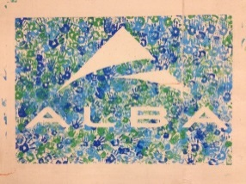
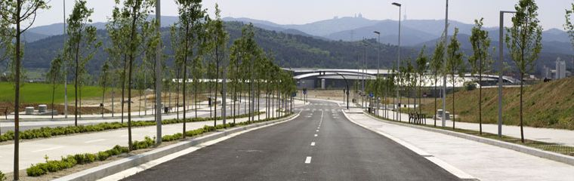
ALBA Status
19th SAC meeting
Caterina Biscari

Slide 2
Welcome to SAC members
John Helliwell, Manchester University, Chair
Ian Robinson, London Centre for Nanotechnology
Jose Enrique Ortega, University of the Basque Country
Andrew Fitch, ESRF
Sakura Pascarelli, ESRF
Peter Guttmann, BESSY II
Oliver Bunk, PSI
Nick Terrill, Diamond
Amor Nadji, SOLEIL
Andreas Jankowiak, BESSY II (excused)
Mari Cruz Garcia, AUSE Observer
Laurent Nahon, SOLEIL (Coopted)

Slide 3
Introduction

Slide 4
ALBA History
4
ALBA founded 14 March 2003
ALBA 1st worker Dec 2003
Design work 2004-2005
Start construction May 2006
Start Accelerator installation Feb 2008
Start Accelerator commissioning Oct 2008
Beamlines commissioning 2011 - 2012
First official user May 2012
7 Phase I Beamlines Operative February 2013
2 Phase II Beamline Construction 2014
Phase III Beamline Definition 2014
Phase III Beamline Construction 2015 on

Slide 5
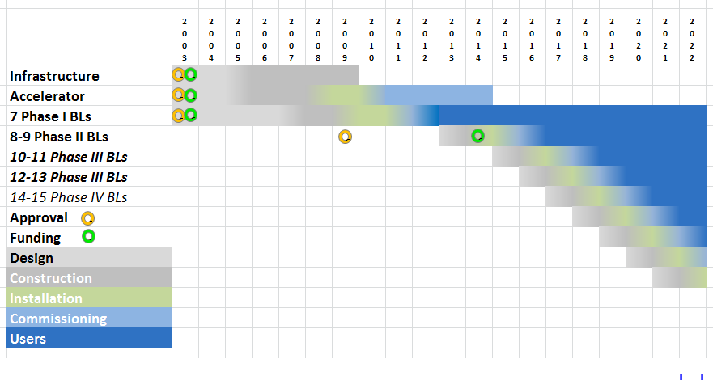
ALBA Simplified time schedule
‘Austerity’ shift

Slide 6
ALBA in the Spanish ICTS Map
(Infraestructuras Científicas y Tecnológicas Singulares)
ICTS Map includes the ICTS whose 2013-16 Strategy Plan (SP) has been positively evaluated by an international panel and thereafter approved
ICTS provide user access and R&I facilities
ICTS are eligible for ERDF (FEDER) funds in 2014-2020, based on SP investments
Indicators on results, facilities, etc. will be yearly updated.
Next SP for 2017-2020

Slide 7
From SP evaluation
The stated objectives are appropriate, realistic and achievable given a proper level of funding
Implementation of new beam lines is deemed mandatory since it will determine the relevance of this infrastructure in the world map of light sources.
The results achieved so far speak loudly for the qualifications and motivation of the staff.
ALBA has successfully finished construction and commissioning of the first beamlines phase of the facility. The presented Strategy Plan for 2013 -2016 will allow bringing this unique instrument to its full potential and use. Any slowdown in the proposed build-up of the facility will result in a waste of initial investment and in the loss of the leading position this facility can enjoy in the next few years.
All effort should be put in order to provide all the resources that are needed in order to fully exploit its potential in the next coming years

Slide 8
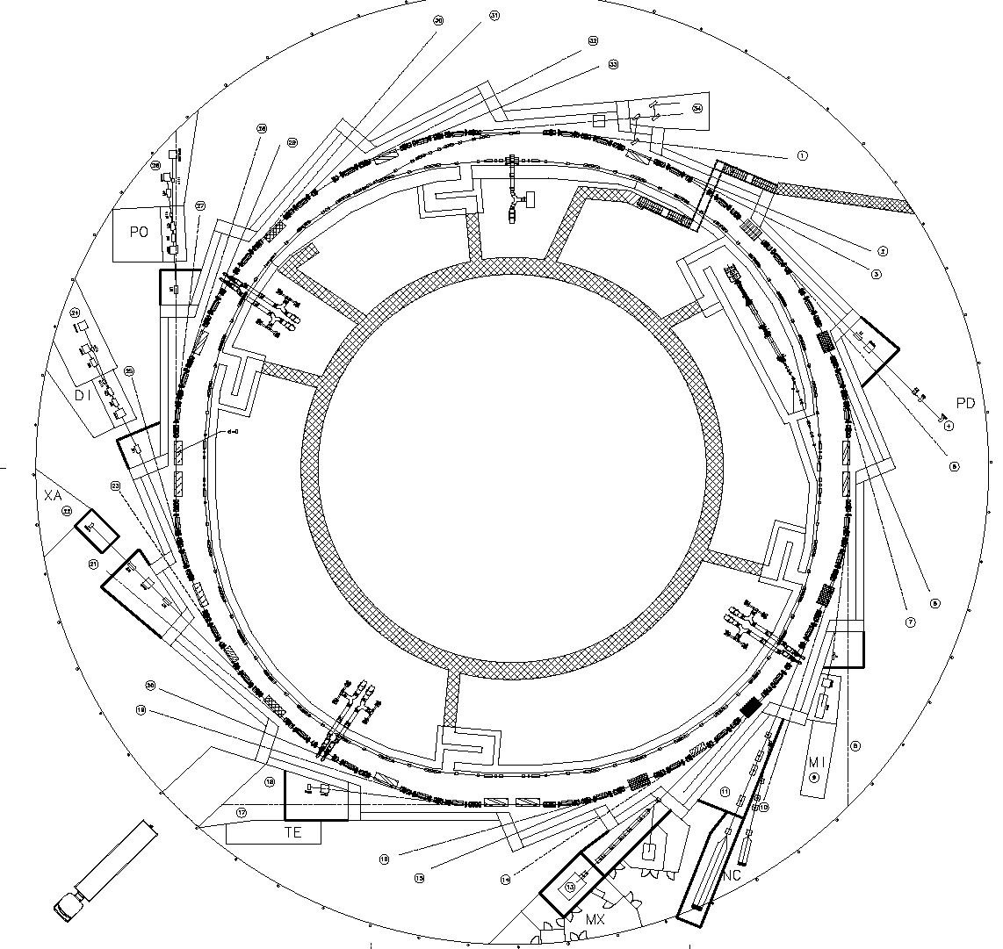
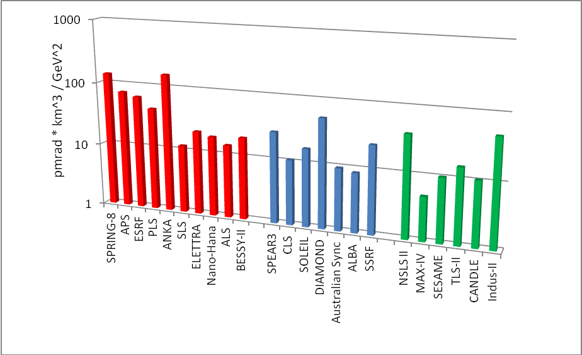

ALBA Accelerators
Accelerators
Parameter | Value
Energy | 3 GeV
Circumference | 269 m
Emittance | 4.4 n mrad
Current | 250 mA
Rf frequency | 500 MHz
# cavities | 6
Long straights | 4 (8 m)
Medium straights | 12 (4 m)
BOOSTER
100 MeV ->
3 GeV
LINAC
100 MeV
STORAGE RING
3 GeV

Slide 9
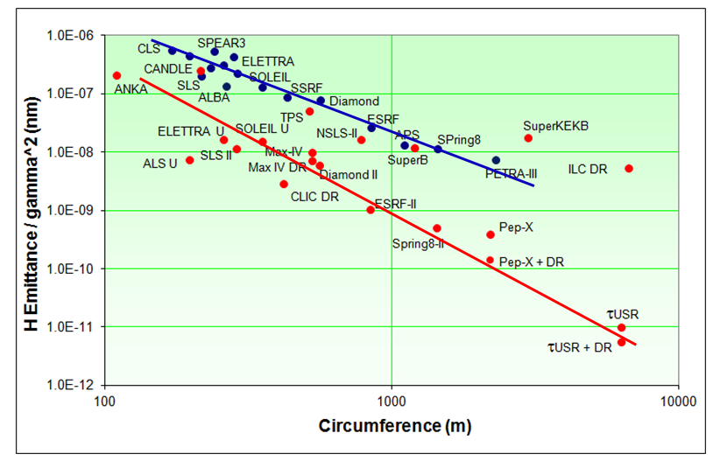
Emittance of 3rd generation and DL SL
Emittance normalized to beam energy vs. circumference for storage rings in operation (blue dots) and under construction or being planned (red dots). The ongoing generational change is indicated by the transition from the blue line to the red line. (R. Bartolini, LER-2014)

Slide 10
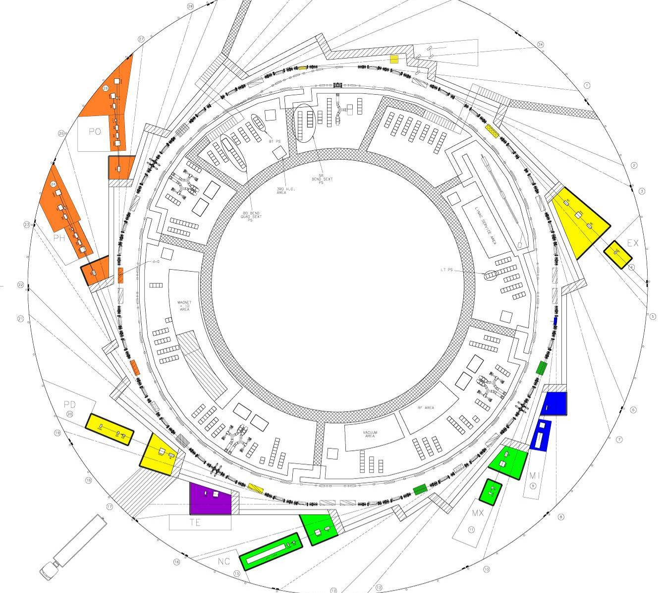
ALBA BEAMLINES
Beamlines
In operation
In construction
BL29: BOREAS
EU71– (0.08-3 keV)
REsonant Absorption
and Scattering
Bending: e⁻ Diagnostics
BL01: MIRAS
Bending – (0.4-100 µm)
IR Spectroscopy
BL24: CIRCE
EU62– (0.1-2 keV)
Photoemission
spectroscopies
BL04: MSPD
SCW31 – (8-50 keV)
HP/HR
Powder Diffraction
BL22: CLÆSS
MPW80– (2-63 keV)
Absorption &
Emission Spectroscopies
BL09: MISTRAL
Bending– (0.27-2.6 keV)
X ray Microscopy
BL11: NCD
IVU21– (6-13 keV)
Non Cristalline Diffraction
SAXS/WAXS
BL20: LOREA
EUXX– (15-450 eV)
ARPES
BL13: XALOC
IVU21 – (5-22 keV)
Macromolecular Cristallography

Slide 11
Staff, Operation,Users

Slide 12
Staff
8 people left in 2014 (dropping from 15% of total staff in 2013 to 4.5% in 2014)
International representation maintained
Women percentage maintained (28%)
181 people + 16 Students (FP and PhD)

Slide 13
Experiments Division #50
M.A.G. Aranda
Chemistry & Material
Science section #8
Francois Fauth
Electronic & Magnetic Structure
of Matter section #9
Eric Pellegrin
Life Science & Soft
Condensed Matter section #13
Jordi Juanhuix
Optics, Metrology &
Support section #19
Josep Nicolas
● BL04 MSPD #4
FF, IP, CP₁, OV₂,
(XT)
● BL22 CLAESS #4
LS, CM, MA₃, WO₄
♦ Chemistry lab
♦ High-pressure lab
● BL24 CIRCE #4
LA, VP, MF, CE
● BL29 BOREAS #4
MV, JH, PG, HB₅
♦ Material lab
● BL09 MISTRAL #4
EP, TD, AP, AS₆
● BL11 NCD #4
MM, CK, JC, EC_{2-II}
● BL13 XALOC #5
JH, RB, DF, FG₇,
AC_{PhD1-II}
♦ Biology labs
● BL01 MIRAS #3
IY, PD_{8- open,} BL-sci_{to-be-op}
● BL06 LOREA #2
MT, BL-sci_{open}
● Scientists & Eng. #3
EF, IS, PP₀₉
● Technicians #5
FF, JP, RV, RO, JP
● Floor coordinators #4
Open
● Addition. activities #1
KWC_{1-II}, …
♦ Optics lab
♦ Prox. mechanic lab
Project-funded personnel
+ Xavier Turrillas (funded by CSIC until July 2016)
+ Kang Wei Chou ‘postdoc funded by HENKEL for 2 years’, until 30th September, 2015
+ Eva Crosas (postdoc funded by CSN for 3 years) @ NCD, until 04th December, 2016
+ Albert Castellví (PhD student funded by CSN for 4 years) @ XALOC, until 05nd May, 2018

Slide 14
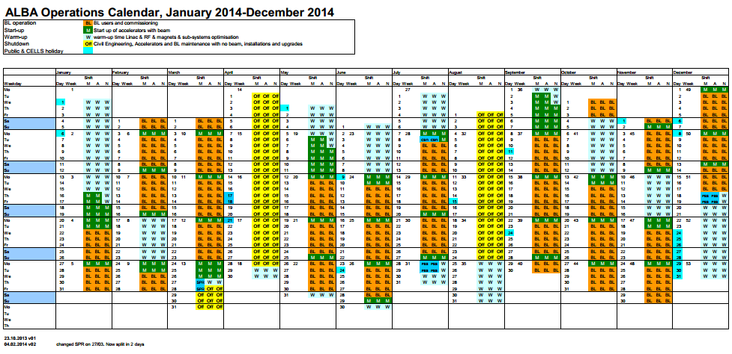
Operation calendar 2014 – 5250 hours will be 5730 in 2015

Slide 15
Availability (1 Dec 2014)
96.0
96.7
94.0
84
77

Slide 16
Beam for users at ALBA
 | 2012 | 2013 | 2014 | 2015
Accelerator operation [h] | 3280 | 4464 | 5250 | 5730
Scheduled user beam [h] | 2387.3 | 3539.5 | 3888.0 | 4320.0
Availability [%] | 77.0 | 83.8 | 96.7*
MTBF [h] | 21.0 | 25.0 | 32.7*
MTTR [h] | 1.0 | 0.8 | 1.1*
Beam for BLs: scheduled user beam, including injection time
MTBF: Mean time between failures
MTTR: Mean time to have the beam back
* Data until 01/12/2014

Slide 17
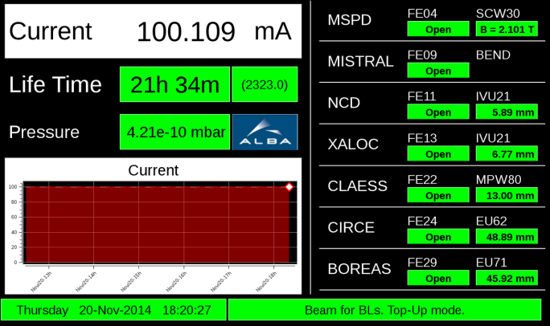
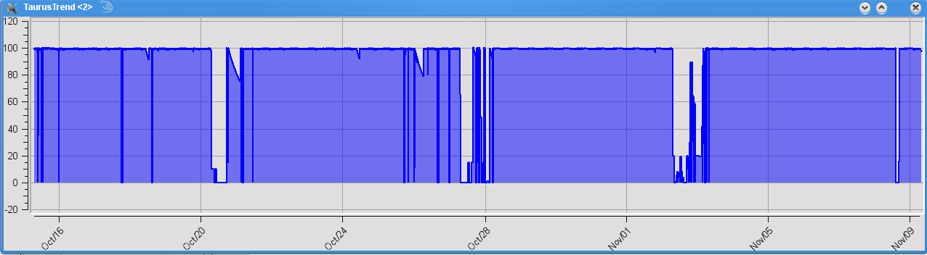
Operating conditions
Top up – Injection every 20 minutes up to 100 mA (since summer 2014)
Slow orbit feedback (since 2012)
Fast orbit feedback from 2015 – will allow higher injection frequency
Transverse Bunch by bunch feedback from 2015 – will allow increasing current
(up to 250 mA)
100% availability 28 Oct- 7 Nov 2014
Machine studies
Machine studies
Machine studies

Slide 18
User calls
2012-2014: One user call per year
From 2015: Two calls per year
In the hypothesis of maintaining the same number of proposals in the 2nd call of 2015
Overbooking factor above 2

Slide 19
User call statistics
/1
International proposals increase both in absolute and relative numbers
Overbooking factor in average >2

Slide 20
Experiments performed until today
Finishing 3rd call experiments
(Run May-Dec 2014)
Defined the 4th call experiments

Slide 21
INDUSTRIAL USERS

Slide 22
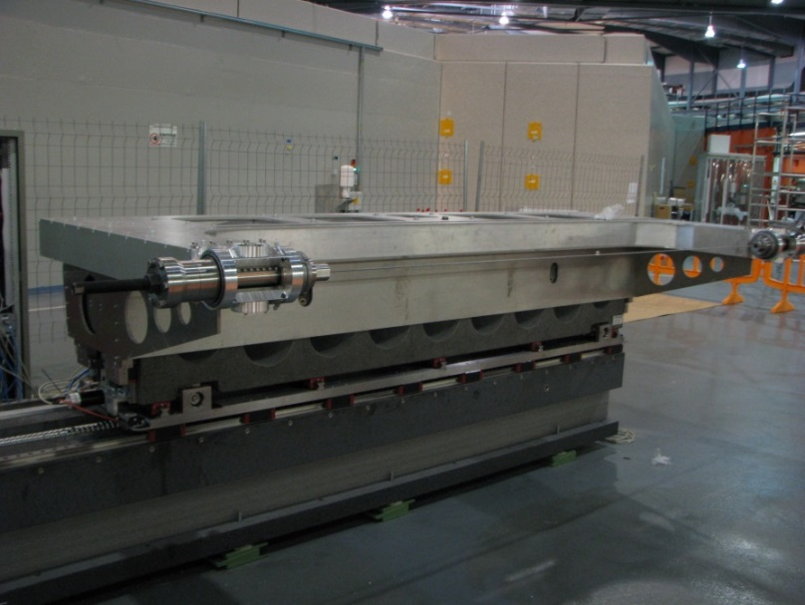
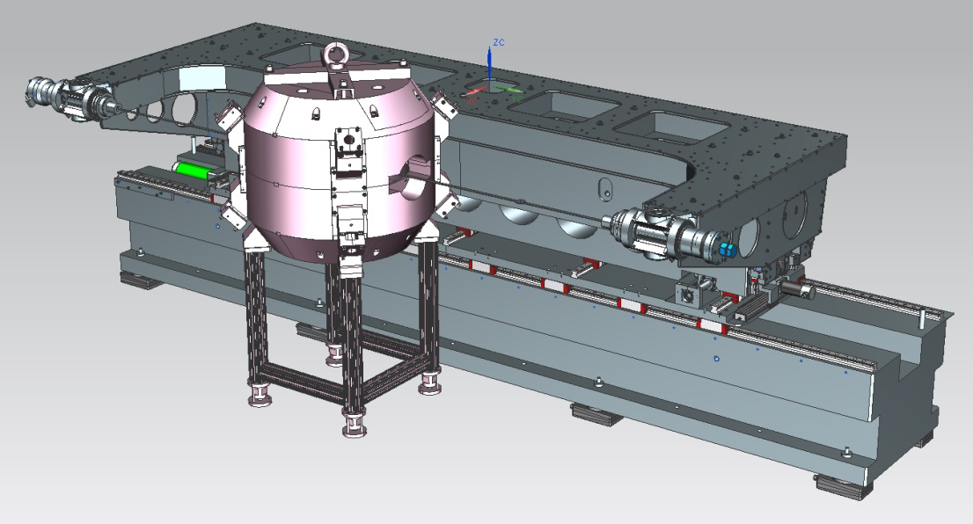
Patents
Magnetic measurement bench (Spanish patent registered) – first user: CIEMAT for measuring a Cyclotron for isotope production
Ultra high-vacuum motor (Spanish patent application registered)
Vacuum chamber window (Spanish utility model application registered together with CLPU)
Transmitter photodiode (Spanish utility model application registered together with CSIC and CSIC spin-off )
Precision positioning bench (utility model in consideration)
X-ray mirror bender (utility model or patent in consideration)
MM Bench at Alba
3D rendering of MM Bench with Cyclotron

Slide 23
Scientific highlights

Slide 24
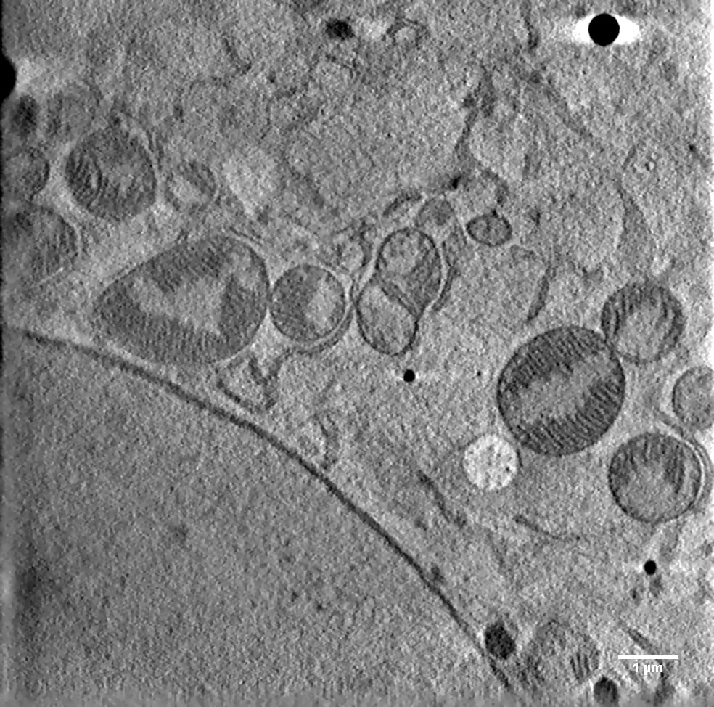
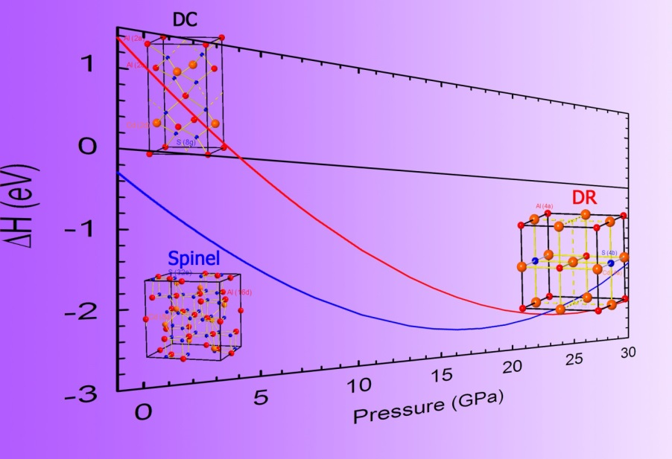
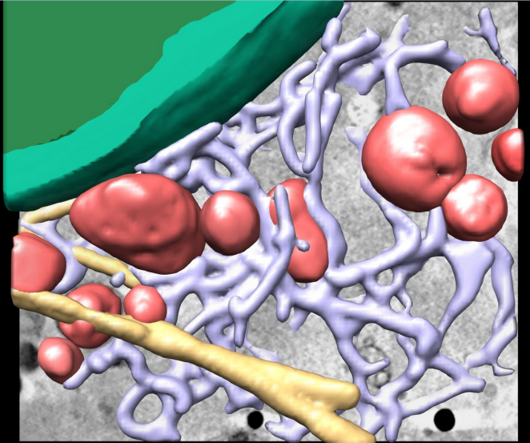
Life Science
Material Science
The structural and vibrational properties of CdAl2S4, a promising semiconductor applicable to photonic devices in the blue spectral range, have been investigated in a joint experimental and theoretical study under high pressure and ambient temperature . Results show a new CdAl2S4 phase in spinel structure after high pressure conditions, which may have direct implications in both technological applications and geophysics MSPD
Studies of Hepatytys_C in humans
at MISTRAL
Virtual slices of a reconstructed volume of Huh- 7.5 cells (human hepatocyte cell line)
M
M
ER
NM
M
N
The Journal of Physical Chemistry. 118 15363-15374 (2014).
E. Pereiro et al.- to be published

Slide 25
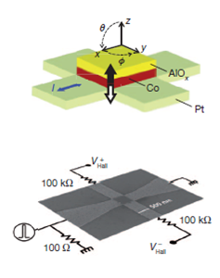
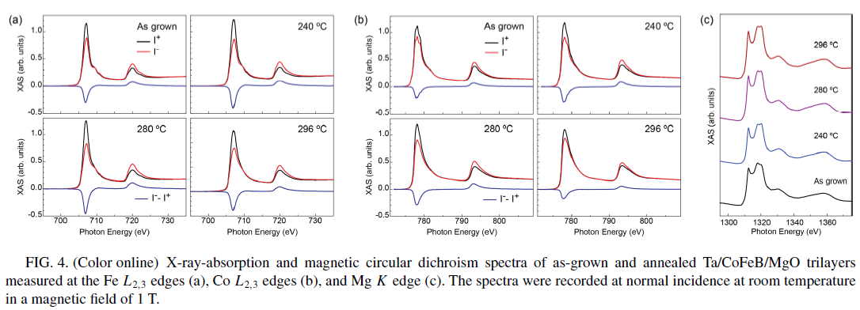
Electronic and Magnetic Structure of Matter
BOREAS
Materials for batteries
Spin-orbit fields mechanisms for in-plane current induced magnetization reversal of magnetic tunnel junctions, and their optimization
Fieldlike and antidamping spin-orbit torques in as-grown and annealed Ta/CoFeB/MgO layers
Physical review B 89 214419 (2014)

Slide 26
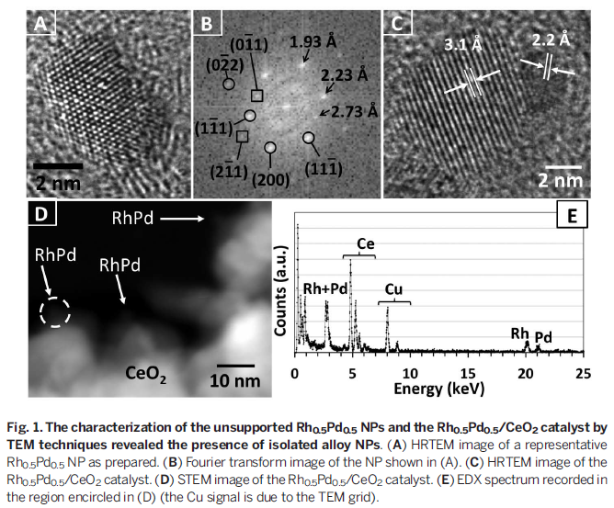
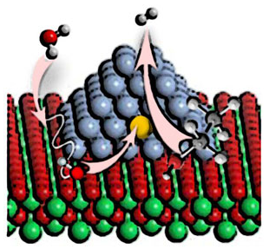
Influence of the support on surface rearrangements of bimetallic nanoparticles in real catalysts – going versus custom made catalysts
Electronic and Magnetic Structure of Matter
A group of researchers, led by UPC university, has discovered that atoms react differently depending on the characteristics of the support that is used. Part of this study, published
in Science, was performed at the NAPP endstation of CIRCE beamline of ALBA Synchrotron.
Science 346, 620 (2014) – N. Divins et al.

Slide 27
Other activities

Slide 28
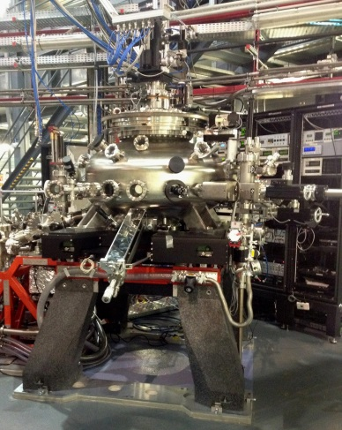
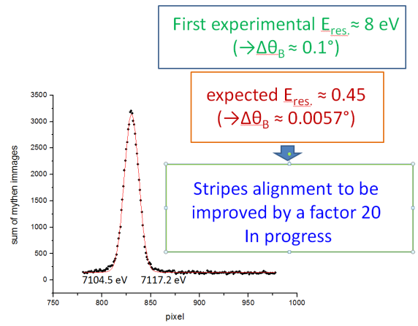
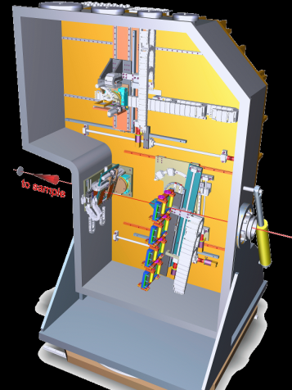
Phase I latest developments
MARES at Boreas
CLEAR at CLÆSS
Ready 2015-I,-II cycle
N.B: special detectors and magnet progressively available along the year
CLEAR commissioning
Tests with beam on SRO/STO superlattice at liquid He (20K) in July demonstrated:
publication level data (similar to published data)
Fast (X10 ALS) continuous reflectance spectra with low noise
Feasibility of reflectivity at mid-high photon energies
(rather exclusive of BOREAS)
CLEAR
x-ray emission spectrometer
(2-22 keV)
In commissioning from May 2014
Sample courtesy
J.B.Kortright (LBNL)
& Ramesh group (UCB)
First analyzer prototype ready for users on Dec. 2014

Slide 29
NCD BL Review on 19-11-14
Wim Bras (Chair), Tiberio Ezquerra, Stephan Roth, Nick Terrill
Main weaknesses
Long time for changing between accessible q-ranges, i.e. sample to detector distances.
Sample Environment area with limited types of both stage and environment for users
Complicated optical design of fixed focus at the detector and moveable sample, time consuming for BL staff.
Lack of technical documentation
Vibration and lack of climate control, both in the Experiments hutch and Optics Hutch
General Recommendations
Decouple energy selection from focusing
Extend energy range to both higher and lower energies up to 5-22 keV
Consider requirements for Grazing incidence in all developments
Short term solutions
Add window upstream the HV section for separating UHV from normal vacuum to decrease the time for changing camera length
Shielding of all vacuum pumps vibration with rubber mattings
Sample stages including 3 translation and 3 rotation stages
Update technical documentation
Long term solutions
Implementation of K-B mirrors plus CRL at front end
Operate standard SAXS/WAXS routinely with a beamsize of 100-200 μm
Consider microfocus options and plan for them as a future upgrade

Slide 30
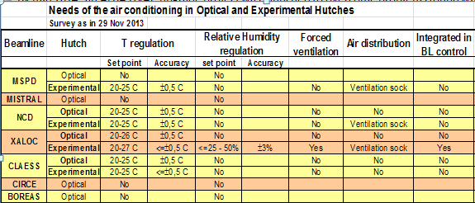
BL thermal drift upgrade project
By mid 2014, an ALBA HVAC upgrade project was launched to overcome problems found with ambient humidity ( incidents at BIO II+ with samples accidentally frozen, and at XALOC with the robot blocked by ice in some joints).
WP1: reduction of the ambient humidity at the experimental Hall
WP2: improvement of temperature and humidity in the experimental and optical hutches
WP3: improvement of humidity control at BLII+ and other Labs
Status
WP1: going on (60%) to be completed during 2015 [50% relative humidity and 23ºC±1ºC]
WP2: completed at XALOC (not yet with air diffusion device) and NCD. Both in the experimental Hutch only.
WP3: completed.

Slide 31
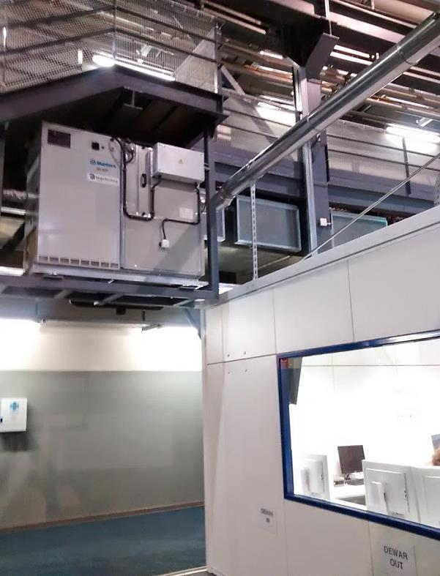
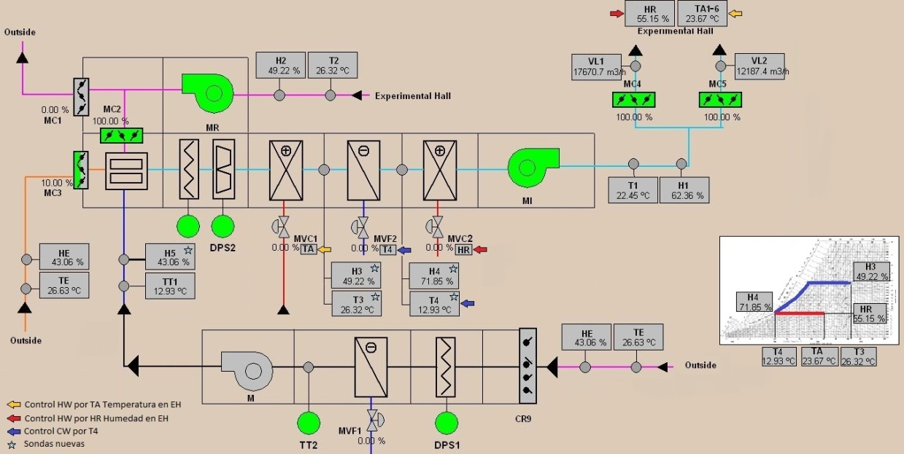
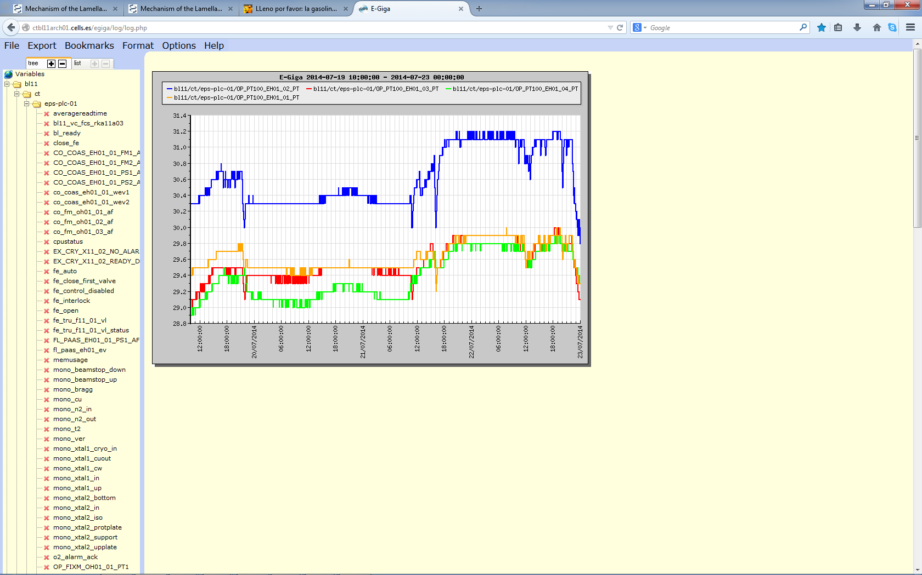
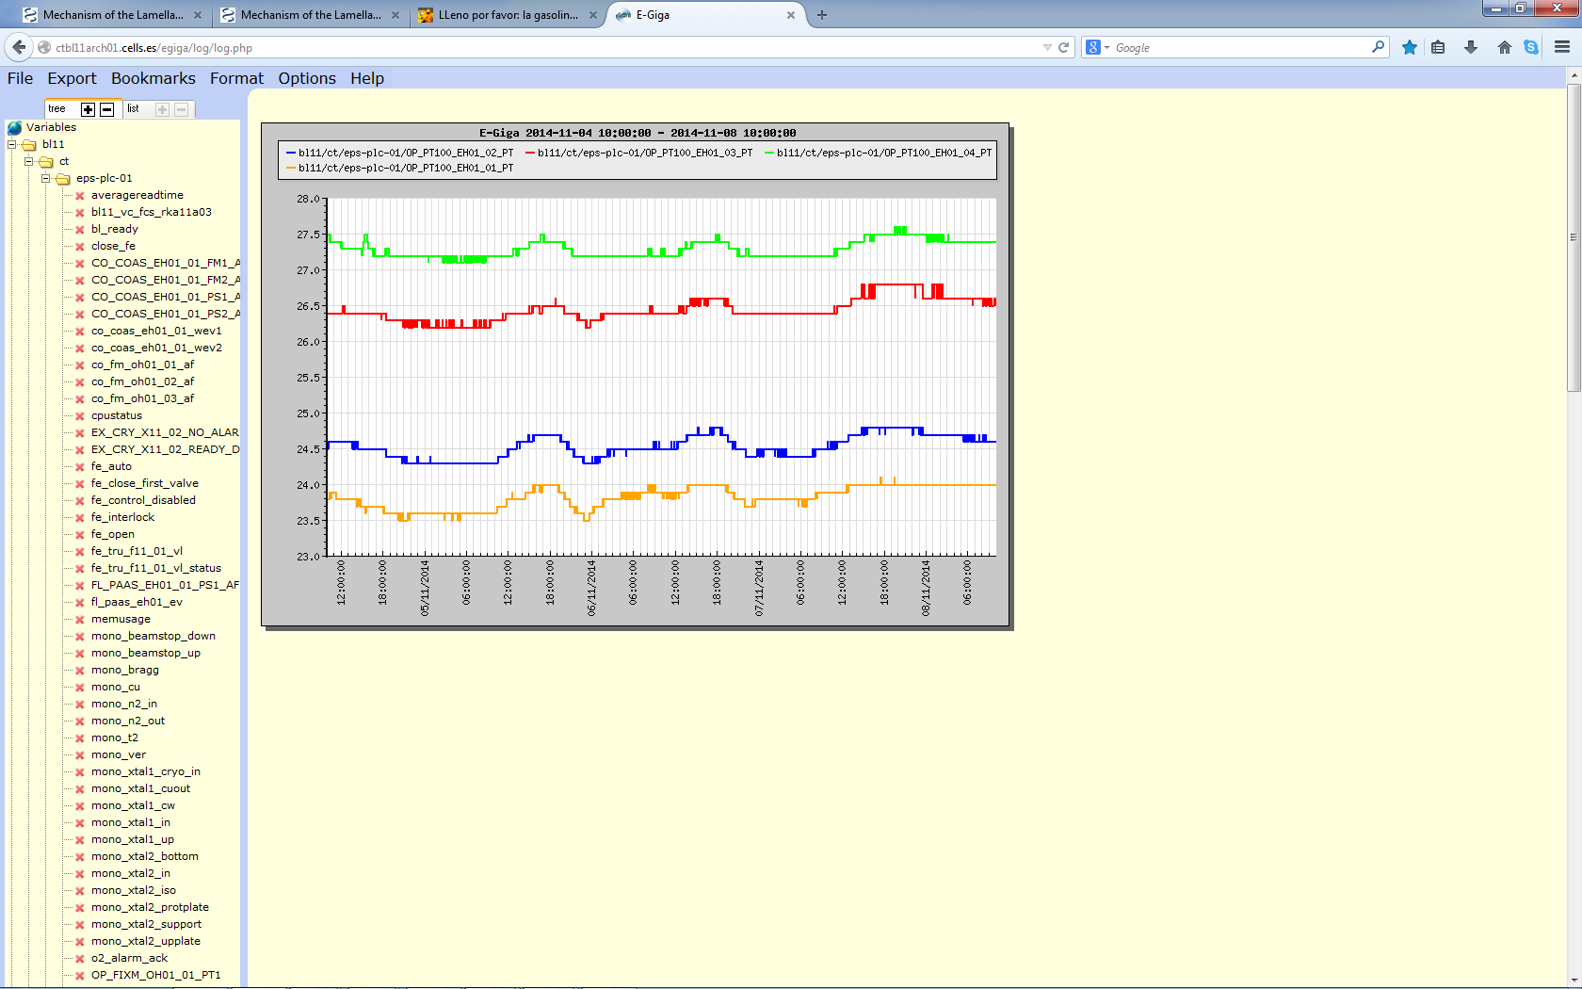
BL thermal drift upgrade project
Updated
New
Control screen for the new HVAC system at the Exp. Hall
New unit installed at XALOC
Humidity:
  Always <40% Hr
  Regulation Min 25% Hr Max 40% Hr
  Stability ±5%
Temperature
  Regulation 20º - 25º
  Set point: 23º
  Stability ±0,5º
1.2 ºC pk-pk
0.5 ºC pk-pk
Before
After

Slide 32

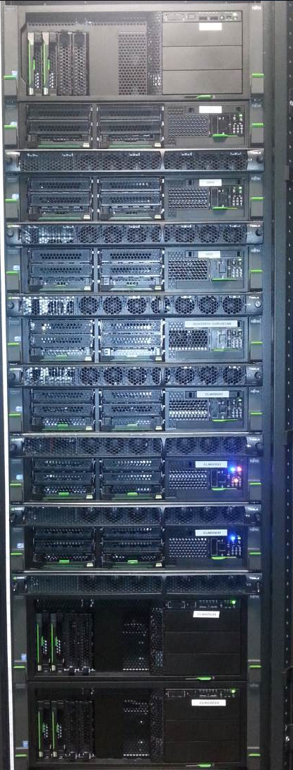
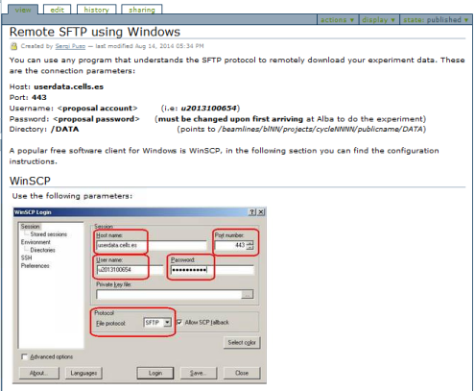
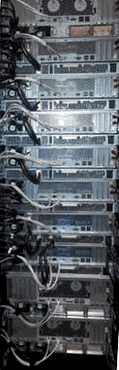
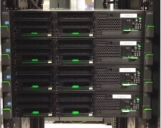

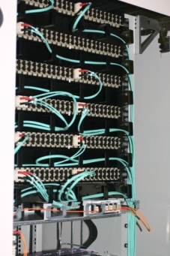
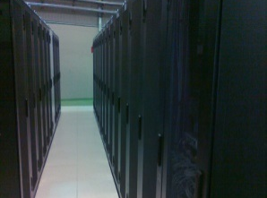
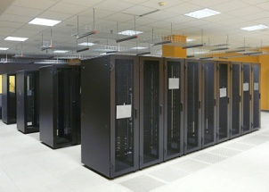
Computing IT Systems.
32
Beamline dedicated servers
User portal to retrieve experimental data. Remote sftp server.
Project successfully delivered and in service
Automated usage of proposal usernames
Volumes >2GB now transferred using simple sftp clients
High Performance Computing cluster
9 machines
Test bed. Hardware received and installed. Project in progress for BL09 reconstruction and BL13 Data Analysis. Beamline dedicated servers also in place.
BLs network redundant links to Data Center
Ensuring redundant network paths
Beamlines remote access project
in progress.
Virtualization & remote access of CAD desktops
in progress.
HPC Cluster

Slide 33
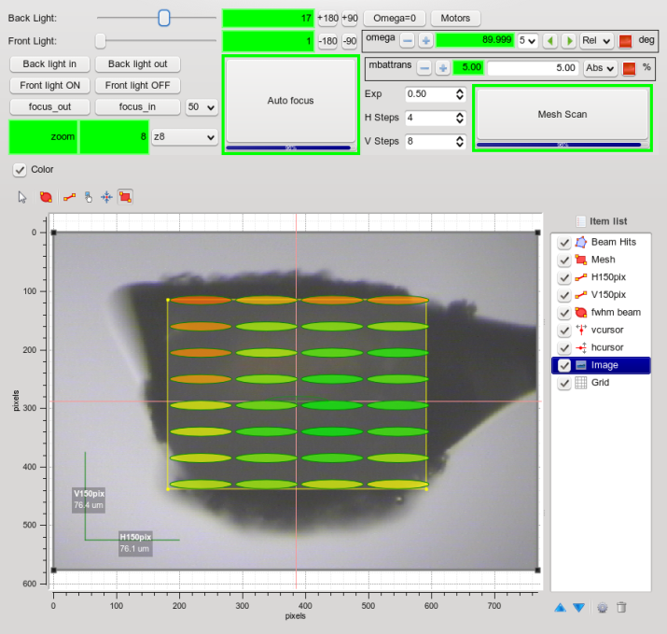
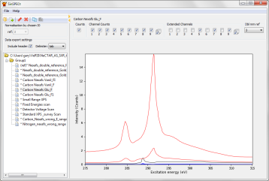
Sardana & Beamline Controls
BL13 MX. Visually defining the mesh scan area to find the best spot areas.
BL09. Automatic reconstruction procedure in place. Working on speeding up the data analysis.
BL24 NAPP. I0 integrated in data collection process.
BL29. Generic Controls. Improvements in user satisfaction by stability in the generic continuous scans. Generic triggering project in progress

Slide 34
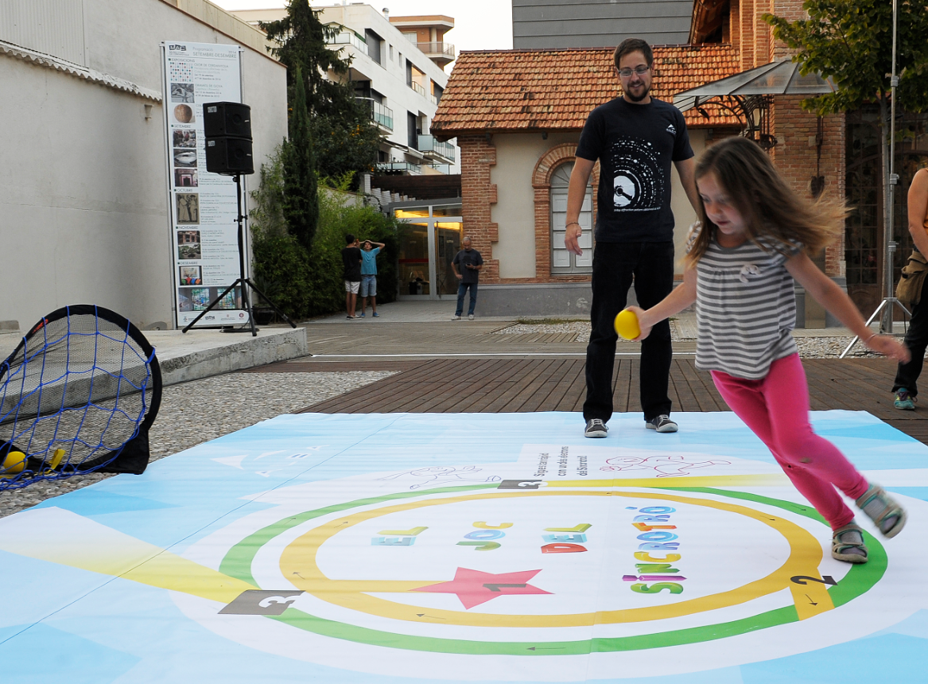

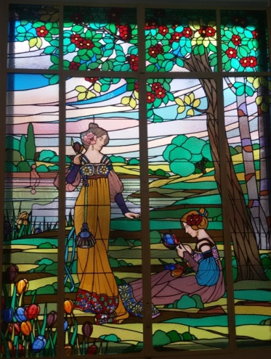
Outreach & Divulgation
Participation in IYL2015 organization
The researchers night – 29-09-14
Participation inside a H2020 project
Art Museum of Cerdanyola del Valles

Slide 35
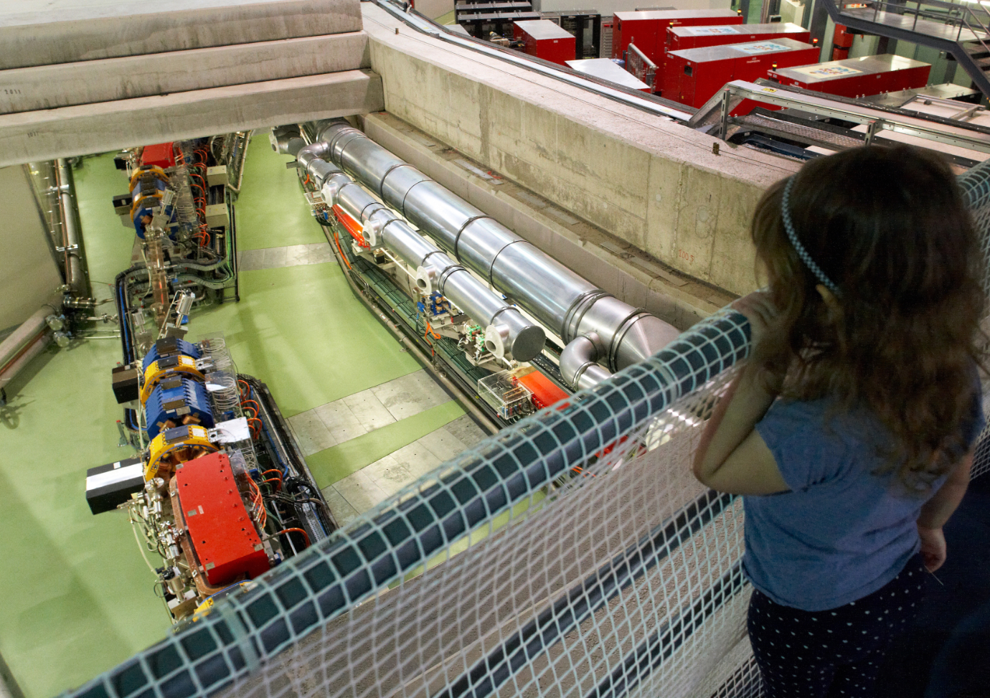
Open day
1630 visits
FECYT funding

Slide 36
Highligths on Collaboration with other Institutions

Slide 37
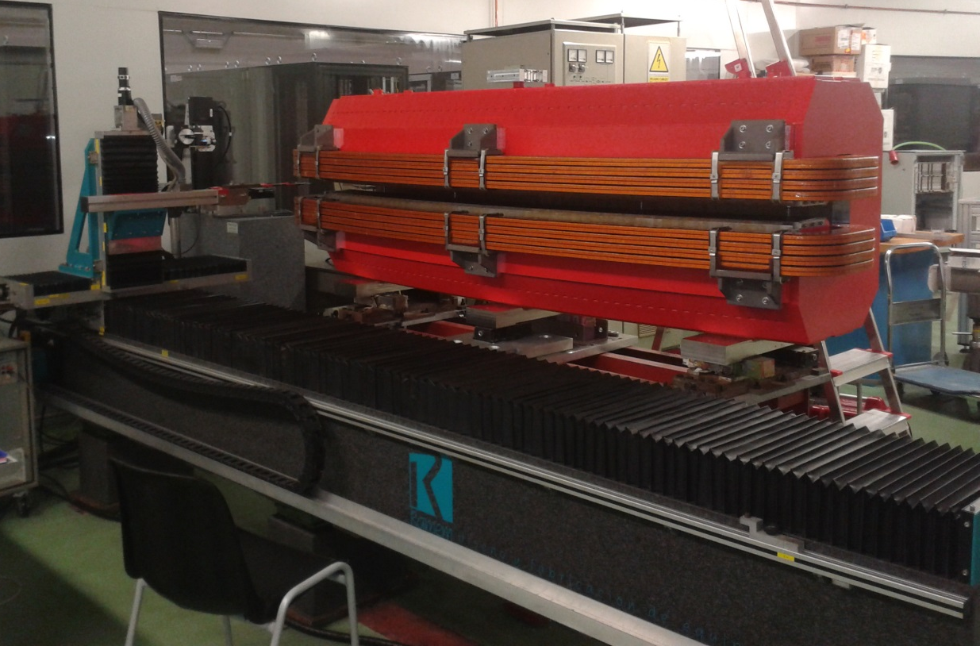
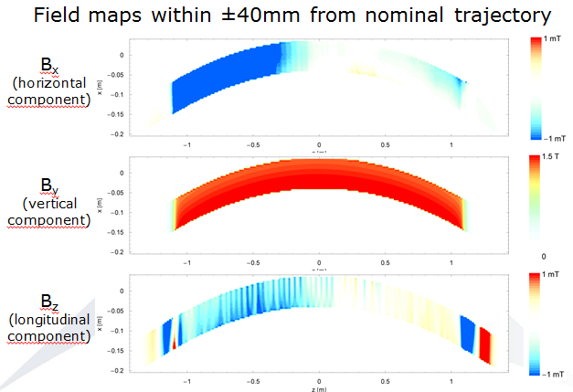
Nov 2014: measurement of prototype SESAME SR dipole
Characteristics:
B₀=1.455 Tesla
G₀=−2.79 Tesla/m
Bending angle=22.5º
Effective length=2.25m
Excitation current=494 Amp
Collaboration through CERN
1 + 16 series dipoles to be measured along 2015

Slide 38
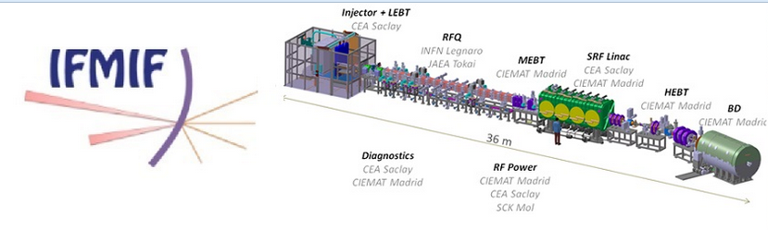
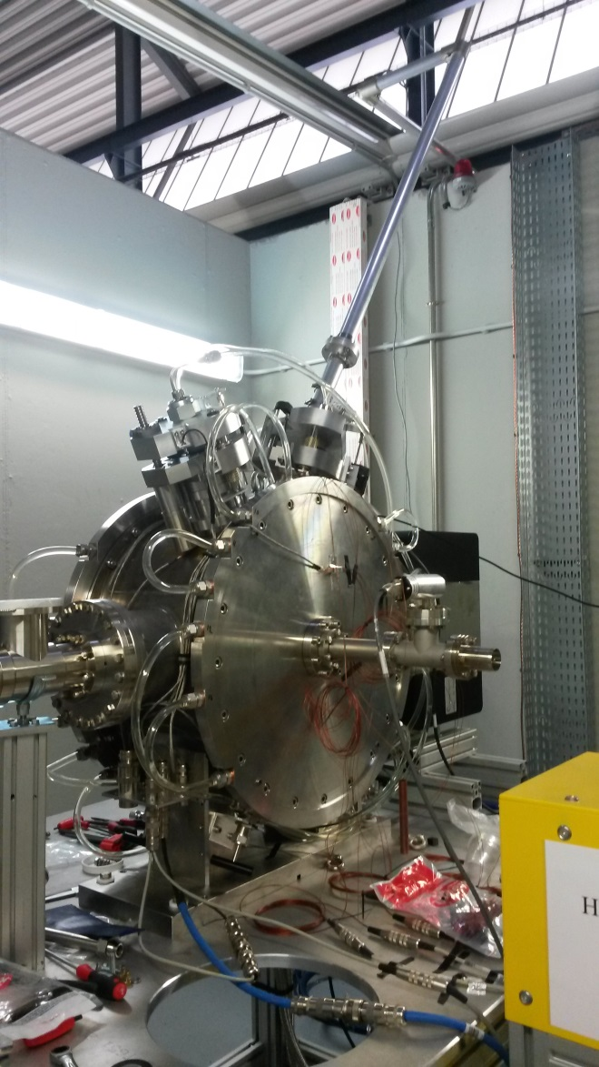
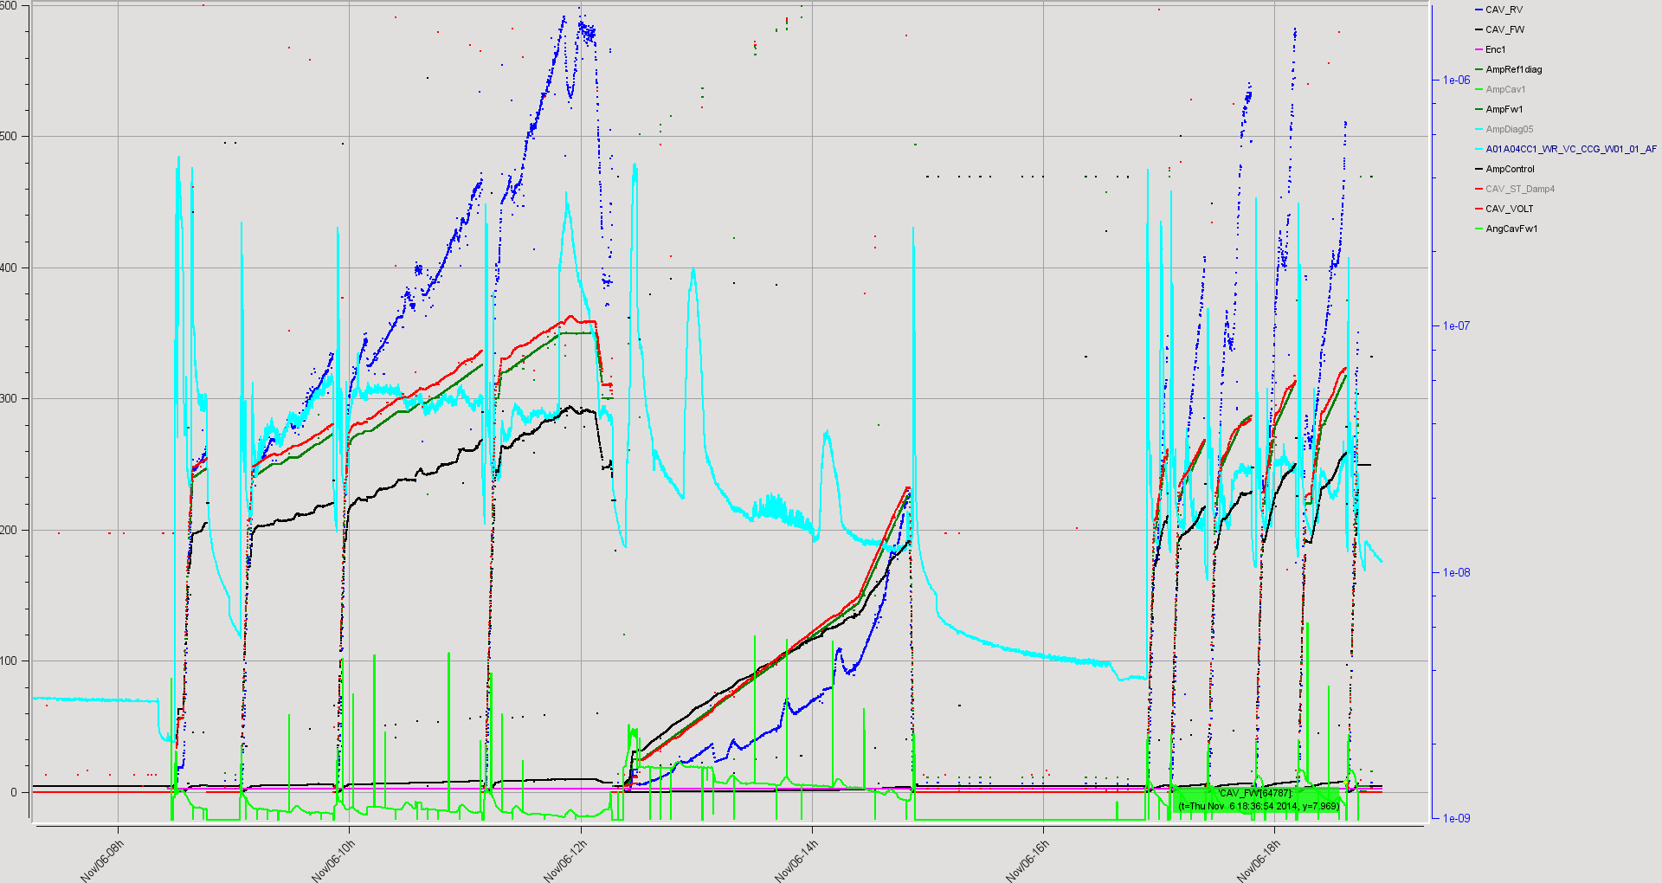
Buncher Cavity for IFMIF project in Japan
- Built by CIEMAT
- Tested at high power at ALBA
350 kV – Nominal Voltage – 40% duty cycle
(data of the conditioning process)
Buncher cavity
in ALBA RF Lab

Slide 39
Phase II BLs

Slide 40
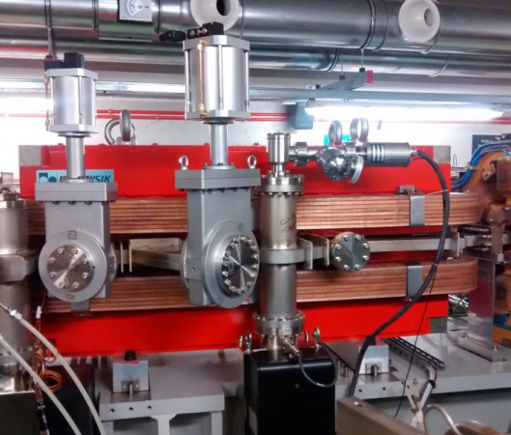
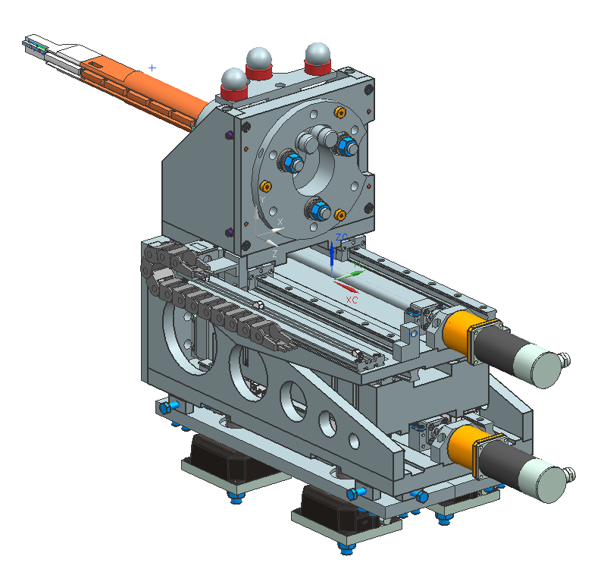
MIRAS
Progress highlights since Jul’14:
Infrared Beamline on a dipole
Beamline scientist appointed (Oct’14), arriving on 2015
Installation of the dipole vacuum chamber (Aug’14)
Design of Extraction mirror finished (Oct ’14)
Specification of in-tunnel transport optics and mechanics finished (Sep’14)
Design of In-tunnel vacuum system finished (Oct’14)
Preliminary Layout of the beamline ready (Nov’14)
BL01-MIRAS Layout
Extraction
mirror mechanics

Slide 41
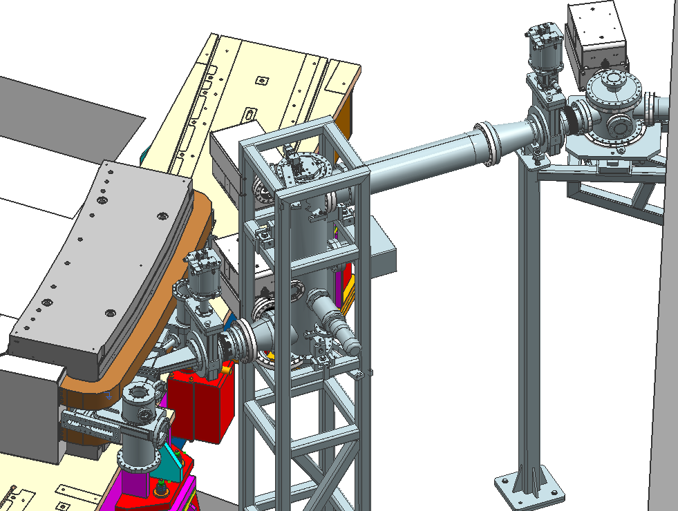
MIRAS
Installation plans highlights
Main activities inside the tunnel planned for the following long shutdown periods
1. Aug’14: install vacuum chamber ✔
2
2. Jan’15: Drill wall
3. Aug’15: install extraction mirror + vacuum system inside tunnel
4
3
1
4. Dec’15 install optics inside tunnel

Slide 42
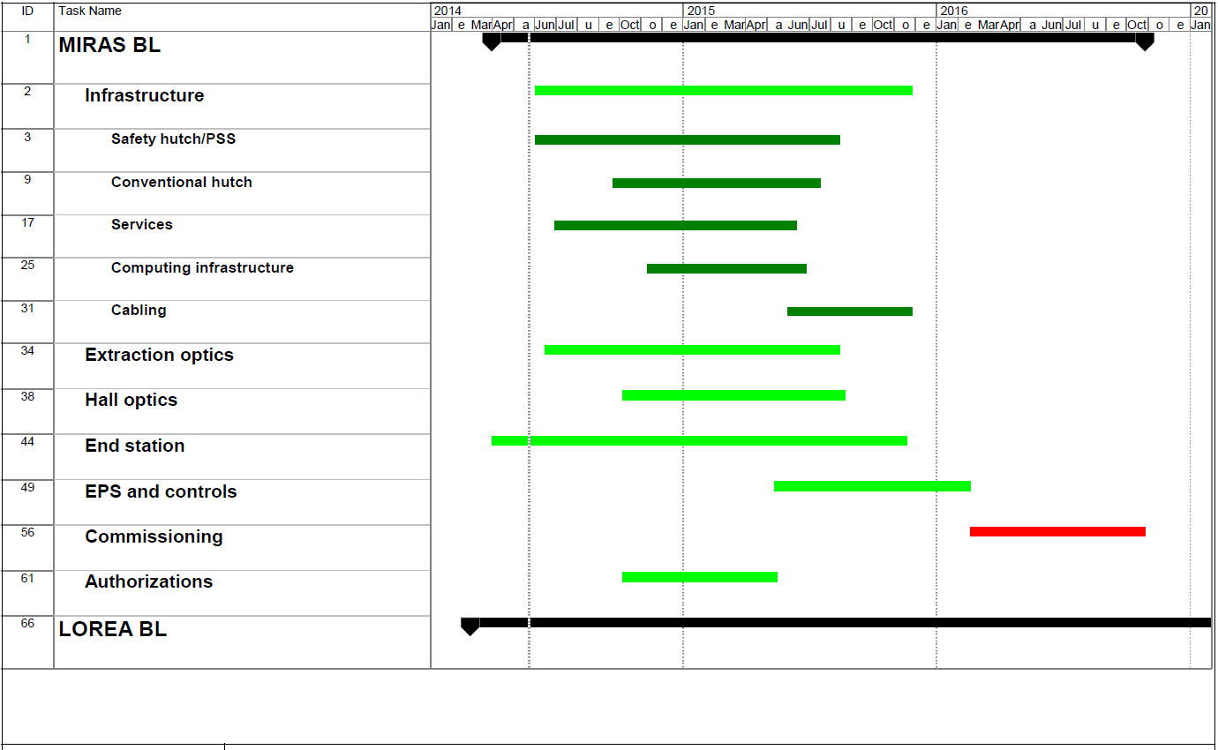
STATUS/SCHEDULE: MIRAS

Slide 43
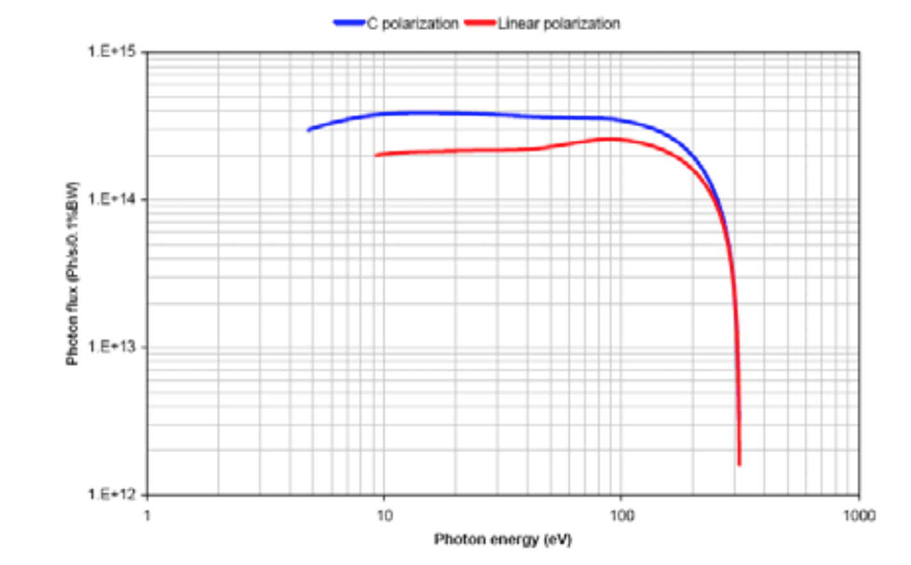
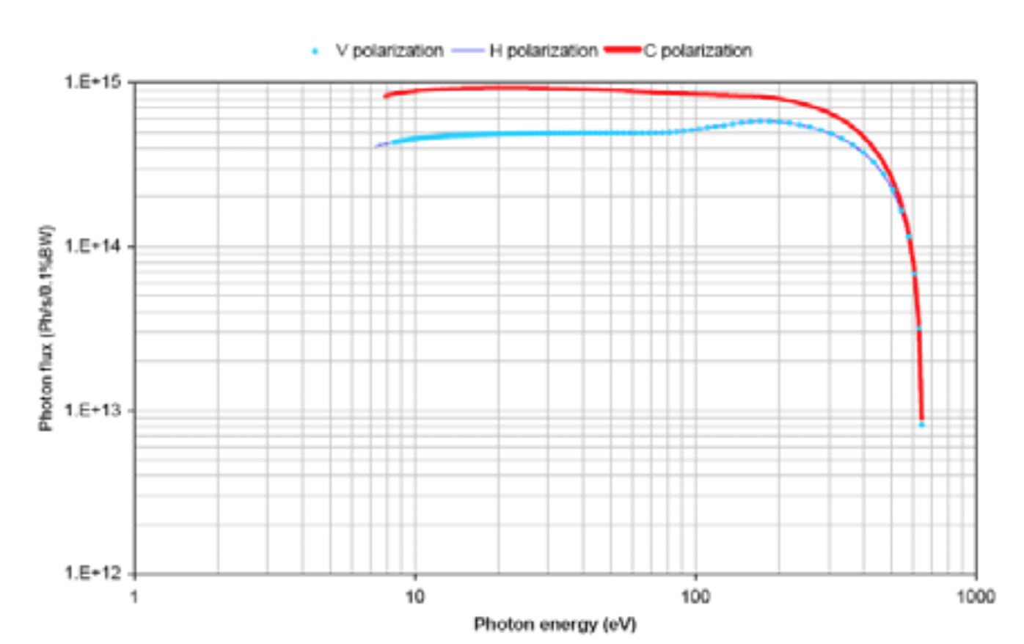
LOREA
Angle resolved photoemission - Soft X-Ray (15-450 eV)
Beamline scientist appointed (Nov’14), arriving on Jan’15
Source selection:
EU250 (EM)
EU125 (Apple II)
Apple II undulator provides higher flux and reaches much higher energy while preserving the low energy end. It saves much power.
Although EM undulator switches polarization more quickly (18s vs 125s) it fits user requirements.

Slide 44

STATUS/SCHEDULE: LOREA

Slide 45
Phase III BL process

Slide 46

Phase III BL Process - 2014
April June October November December
Workshop Assignment Submission of Referees SAC
at ALBA for of ALBA Proposals to review to meeting
Preliminary spokespersons ALBA proposers for
proposal to 6 proposals evaluation
presentations
End 2014 – ALBA publishes the Phase III Beamline ranking, based on SAC recommendations and internal considerations.

Slide 47
Six BLs projects presented today
1. Microfocus diffraction beamline for macromolecular crystallography
Spokesperson(s): Núria Verdaguer (IBMB-CSIC, Barcelona); Maria Solà (IBMB-CSIC, Barcelona,); Isabel Usón (IBMB-CSIC, Barcelona); Jeronimo Bravo, IBV)
ALBA-spokesperson: Jordi Juanhuix
2. Submicrometer-beam diffraction, fluorescence and absorption beamline
Spokesperson (s): Adela Muñoz (Universidad de Sevilla); Gema Martinez Criado. (ESRF))
ALBA-spokesperson: Josep Nicolas/Laura Simonelli
3. High-energy imaging beamline
Spokesperson (s): Juan Gómez Barreiro (Universidad de Salamanca), Federico Sket (IMDEA Materials Institute - Madrid)
ALBA-spokespersons: Xavier Turrillas/Eva Pereiro
4. Surface-interface diffraction beamline
Spokesperson(s): Xavier Torrelles (ICMAB-CSIC)
ALBA-spokesperson: Salvador Ferrer (ALBA)
5. Skiron: Chiroptical spectroscopy beamline
Spokesperson(s): Salvador Ferrer (ALBA)
6. Instrument development and Innovation beamline
Spokesperson(s): Josep Nicolas (ALBA), Miguel A. G. Aranda (ALBA)

Slide 48








Phase III: Some of the proposed scientific opportunities
Nano technology, earth and environmental sciences, cultural heritage and bio-medicine at submicron diffraction, flourescence and absorption
Nanostructures, surface-interface, catalysis at surface-interface diffraction
Microcrystals,
Proteins at microfocus PX
Food science, geology, material science, Life science, medicine, paleontology at Fast Tomography
Bioscience, chemistry, materials
At Chiroptical Spectroscopy
Detector and instrument developments at Notos

Slide 49
Means for funding new BLs and related staff being defined with administrations and other funding agencies
Availability of ERDF funds (50% of inversion) already assured, still pending the amount and therefore the number and the sequence of future BLs

Slide 50
Acknowledgements
(for this special SAC edition)
To the BL proposers and supporters
(a community of about 250 people has shown its interest in ALBA Phase III projects)
To the 12 Referees who have submitted their reports during the last month
To the ALBA staff who has participated in the proposal preparation while working full time in the operation
To the SAC members for their support and advice

