Slide 1
Requirements from the FEL Beam Dynamics community
Eduard Prat :: SwissFEL Beam Dynamics :: Paul Scherrer Institut
Topical Workshop on Emittance Measurements for Light Sources and FELs
30 January 2018, ALBA, Cerdanyola del Vallès (Catalunya)

Slide 2
Contents
Introduction: FELs and emittance
Emittance measurements
Thermal emittance measurements
Status of emittance measurements at different XFEL facilities
Summary of requirements, future challenges and conclusion

Slide 3
Contents
Introduction: FELs and emittance
Emittance measurements
Thermal emittance measurements
Status of emittance measurements at different FEL facilities
Summary of requirements, future challenges and conclusion

Slide 4
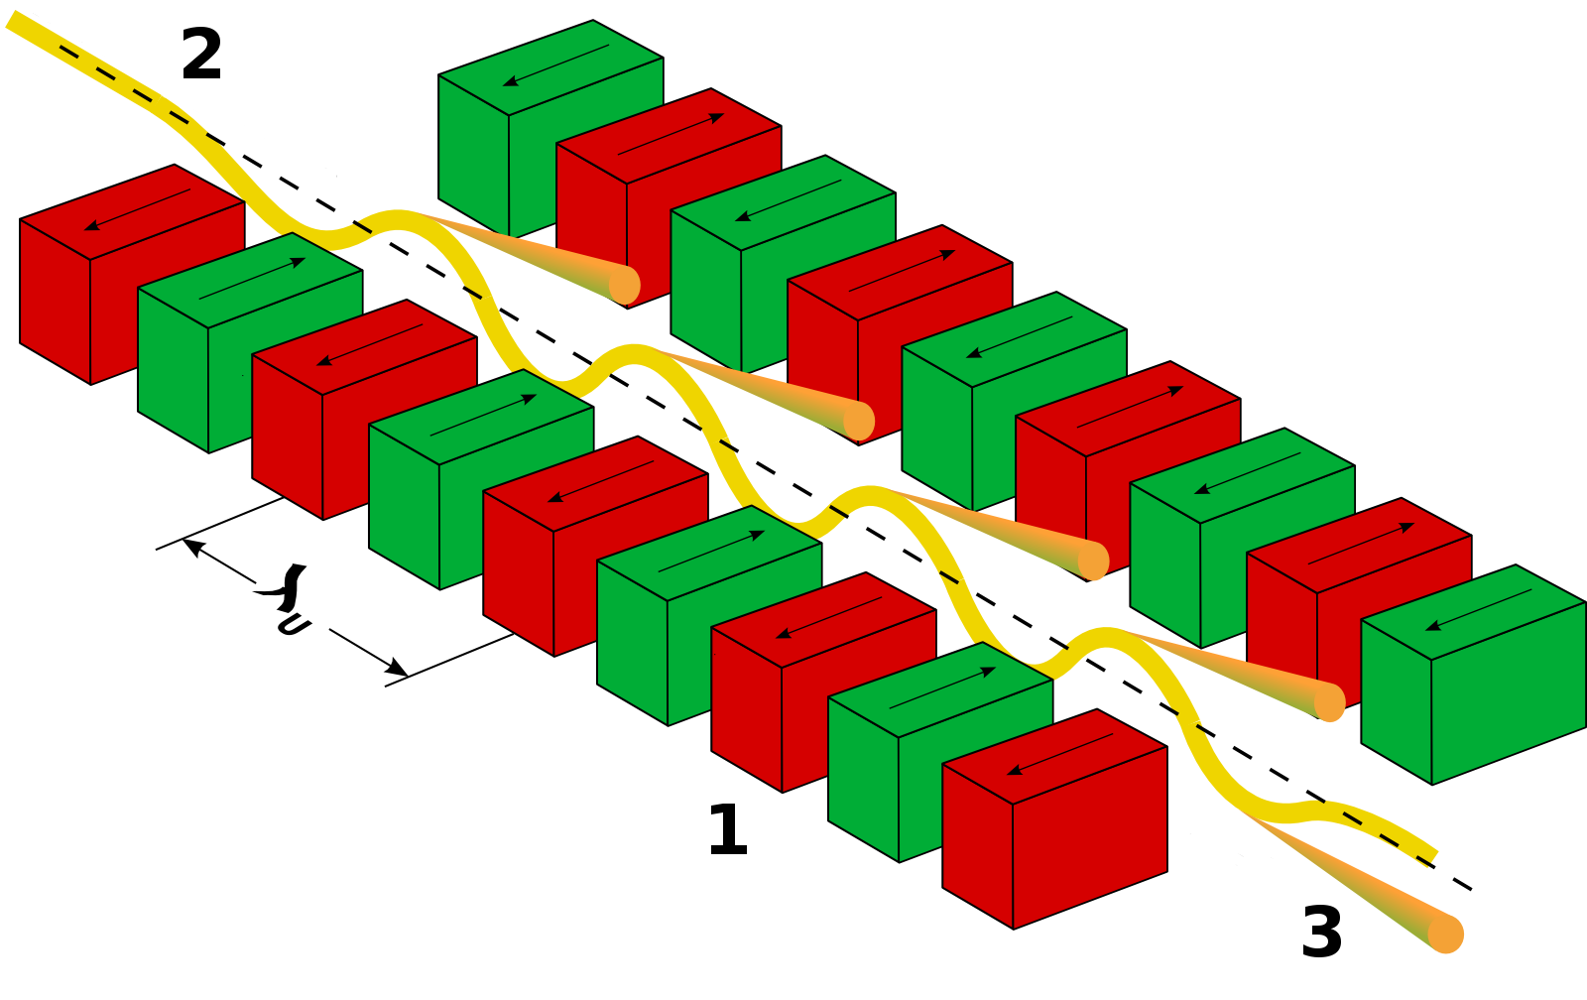
Introduction: FELs
X-ray free-electron lasers (XFELs) are cutting-edge research tools that produce almost fully coherent radiation with peak powers of 10-100 GW and pulse durations of 10 fs and shorter.
The FEL is based on a collective process (energy modulation – density modulation – coherent emission) occurring at the resonant wavelength:
  There are few XFEL facilities operating around the world:
    FLASH, DESY Hamburg in Germany, soft X-ray, since 2002
    LCLS, SLAC in USA, hard X-ray, since 2009
    FERMI, Trieste in Italy, soft X-ray, since 2010
    SACLA, Spring 8 in Japan, hard X-ray, since 2011
    PAL-XFEL, in Korea, hard X-ray, since 2016
    E-XFEL, DESY Hamburg in Germany, hard X-ray, since 2017
    SwissFEL, PSI in Switzerland, hard X-ray, since 2017
  And more to come (LCLS-II, Shanghai FEL…)

Slide 5
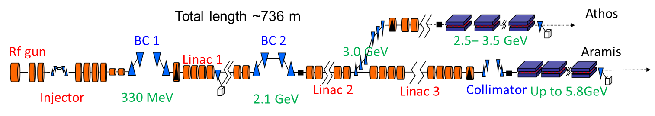
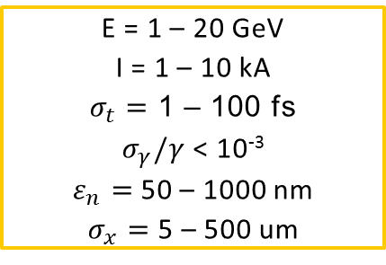
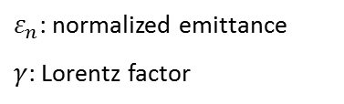
Introduction: XFELs are driven by linacs
E = 1 – 20 GeV
I = 1 – 10 kA
$σ_{t}=$ 1 – 100 fs
$σ_{γ}/γ$ < 10⁻³
$ε_{n}=$50 – 1000 nm
$σ_{x}=$ 5 – 500 um
$ε_{n}$: normalized emittance
$γ$: Lorentz factor
Typical FEL beam parameters
FEL performance depends on charge density in 6D → Need to measure particle distribution in 6D
Only linear accelerators can be used to provide the drive beam for XFELs
Typically long beams are produced in an RF photoinjector with low emittance and then accelerated and compressed later.
Bunch compression is done in 2 or 3 stages
Typical structure of an FEL facility:
  RF photoinjector + acceleration + 1st bunch compression + acceleration +
  + 2nd bunch compression + acceleration + undulator beamline
SwissFEL layout

Slide 6

Introduction: importance of emittance
$$\frac{ε_{n}}{γ}≈\frac{λ}{4π}$$
Transversely coherent FEL radiation is generated when
If the normalized emittance is reduced:
  The final beam energy can be decreased →more compact and cheaper accelerator
  Higher radiation power and shorter undulator line for a given beam energy
Simulations for SwissFEL at 0.1 nm: Relative FEL power vs normalized emittance (200 pC)
FEL process occurs within a small fraction of the bunch length and properties can vary along the longitudinal beam position → need for time resolved (“slice”) measurements
FEL performance strongly depends on a good transverse overlap between electrons and photons. Therefore we need to control:
Trajectory:
  Projected (with BBA)
  Slice misalignment or tilt
Beam size:
  Projected (with optics matching)
  Mismatch along the bunch
Notes:
6

Slide 7
Introduction: emittance contributions
Final emittance = Emittance at the source + deteriorating effects
  Emittance at the source: thermal emittance + space charge + RF
  Deteriorating effects: wakefields + CSR + space charge + coupling + beam tilts …
Emittance goals:
  Optimize emittance at the injector
  Minimize deteriorating effects due to transport and compression
  → Need to measure emittance at different locations and conditions
Projected measurement location Projected and slice measurement location
We need to measure and minimize:
Slice and projected emittance
Beam correlations (beam tilt, transverse coupling)
Optics mismatch along the bunch
Notes:
7

Slide 8
Contents
Introduction: FELs and emittance
Emittance measurements
Thermal emittance measurements
Status of emittance measurements at different FEL facilities
Summary of requirements, future challenges and conclusion

Slide 9
Optics-based emittance measurements
In linacs the beam optics are generally not known, therefore it is not sufficient to measure the beam size at a single location (without changing the optics) to obtain the beam emittance.
When space-charge effects are negligible, the most common way to obtain the emittance is using linear-optics transformations. The 2D (4D) transverse beam matrix is obtained measuring the beam sizes (and <xy>) for different phase advances between reconstruction point s₀ and measurement point s.
What we can measure at s
2D
What we want to reconstruct at s₀
4D
Intrinsic emittances ε₁, ε₂ are derived from 2D and coupling terms [K. Kubo, ATF Report 99-02 (1999)]
Notes:
9

Slide 10
Optics-based emittance measurements
What we can measure at s
What we want to reconstruct at s₀
At least 3 (4) transformations are needed for 2D (4D) parameters, but more measurements improve the robustness of the reconstruction
The best 2D reconstruction is when the phase-advance is covered regularly between 0 and π
There are 2 general strategies to scan the phase advance: fixed optics and variable position (FODO), fixed position and variable optics (quadrupole scans).
Alternatives:
OTR screens can be used to measure the beam size and divergence at the same time. In a beam waist, this is sufficient to obtain the emittance. [F. Bisesto et al, JP 874, 012035, 2017]
Pepperpot at high energies [C. Thomas et al, NIMA 729, 554, 2013]
Others?
Notes:
10

Slide 11
Time-resolved measurements
The beam is deflected in one direction as a function of time and the slice
parameters in the other direction are reconstructed using 2D profile monitors.
Matching quads
reconstruction
point
Profile
monitor
Deflector
Measurement quads
Streaking.
The streaking can be done:
1. Using RF Transverse Deflectors
2. Introducing dispersion to an energy chirped beam
3. Using transverse wakefields
Optics. The optics are scanned using several quads between the transverse deflector and the observation point (alternatively, a FODO-like section can be used)
Image analysis. The beam is split into slices. Per each slice the beam size and centroid are obtained (e.g. doing Gaussian fits).
Emittance/mismatch determination. From the beam sizes per each optics the emittance and optics are obtained per each slice
Beam tilt determination. From the slice trajectory at each optics, the tilt in offset (<xs>) and angle (<x’s>) are obtained
Required resolution 1 fs and below
Notes:
11

Slide 12
Streaking methods
Streaking can be done with different methods. Here we consider:
Transverse deflecting RF structure (TDS) – standard method
Introducing dispersion to an energy chirped beam
Transverse wakefields
Shared problem: streaking is invasive → better methods?
 | TDS | Dispersion | Wakefields
fs resolution feasible? Demonstrated res. | Yes ~1 fs (*) | Yes ~100 fs (**) | Yes ~100 fs (***)
resolution scaling | TDS voltage TDS frequency | Magnets strength Energy chirp | Structure length Structure offset
Hardware requirements | High | None | Moderate
Impact to the beam | Moderate (slice energy spread) | High (Slice emittance increase) | Moderate (Slice energy spread and energy chirp)
Generality | Poor (only one plane at a time where there is a TDS) (&) | Very good (both planes where beam has a chirp) | Good (both planes where wakefields can be induced)
(&) X-Band collaboration (CERN, DESY, PSI) will use a TDS with variable polarization able to streak in both planes
(*) [C. Behrens et al, Nat. Comm. 5, 3762 (2014)]
(**) [K. N. Ricci et al, PRSTAB 3, 032801 (2000)]
[E. Prat et al, PRSTAB 17, 032801, 2014]
(***) [S. Bettoni et al, PRAB 19, 021304 (2016)]
The best method depends on the beam parameters (e.g. energy spread, emittance) and facility conditions (e.g. availability of TDS)
Best: TDS after each compression stage, use other methods everywhere else

Slide 13
Emittance errors
We can distinguish:
Statistical errors from beam size variations.
Systematic errors expected to be below 5%:
  Profile monitor (PM) calibration (~x%→~2x%)
  PM resolution
  Energy and quadrupole field errors
  Optics mismatch
  Others (e.g. associated to Gauss fit)
Errors should be well below 10%. To achieve that we need to:
  Properly setup the PM to have calibration error in the order of 1%
  Have a good PM resolution (see next slide)
  Correct quadrupole field errors and calibrate energy down the ~1% level
  Match the optics
  Ensure a proper determination of beam size
SwissFEL example: Emittance measurement error as a function of mismatch parameter M (for 5% beam size measurement error)
Matched solution
Notes:
13

Slide 14
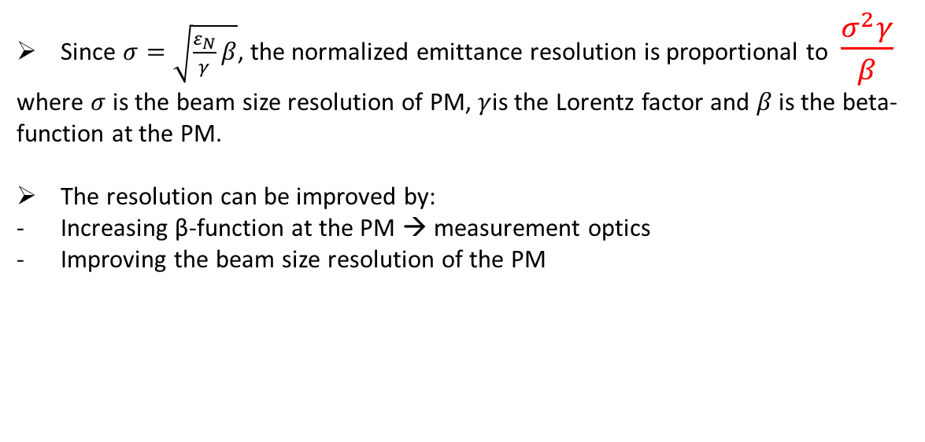
Emittance resolution
Since $σ=\sqrt{\frac{ε_{N}}{γ}β}$, the normalized emittance resolution is proportional to $\frac{σ^{2}γ}{β}$
where $σ$is the beam size resolution of PM, $γ$is the Lorentz factor and $β$ is the beta-function at the PM.
The resolution can be improved by:
Increasing β-function at the PM → measurement optics
Improving the beam size resolution of the PM
Emittance resolution for a beam size resolution of 10 µm
Profile monitors need to have resolutions of few µm
(Example: if we want a normalized emittance resolution of 10 nm, for an energy of 10 GeV and a beta-function of 10 m, the required beam size resolution needs to be 2.3 µm)
Notes:
14

Slide 15
Profile monitors (PM)
The devices commonly used to measure the transverse beam parameters in FEL facilities are OTR screens, scintillator screens (e. g. YAG, LuAG), and wire-scanners.
WS have the best resolution, but 2D information is missing – and they are slow.
Scintillators are better than OTRs but a MO is required for few-µm resolution – and saturation effects have to be counteracted.
Future?
 | Scintillator screens | OTR screens | Wire-scanners (WS)
Demonstrated resolution | 15 µm w/o MO (*) 5 µm with MO (**) | (As good as scintillators) | 0.5 µm (***)
2D information (slice, coupling, tilts) | Yes | Yes | No
Charge sensitivity | Very good | Poor | Very good
Measurement time | Fast | Fast | Slow
Interference with operation | Yes | Yes | Minimal
Issues | Saturation effects | COTR | Multi shot measurement (jitter correction required)
MO = microscope objective.
(*) [R. Ischebeck et al, PRSTAB 18, 082802 (2015)] Scintillator thickness was 100 µm
(**) [J. Maxson et al, PRL 118, 154802 (2017)] Scintillator thickness was 20 µm
(***) [S. Borrelli et al, tbp] Use of sub-µm metallic stripes on a membrane using lithography, standard WS has a resolution of 1.25 µm
Notes:
15

Slide 16
Measurement optics: FODO vs quad scans
Measurement point
Reconstruction point
Quadrupole magnet
FODO Quadrupole scan
Multiple-position/fixed-optics Fixed-position/multiple-optics
Parasitic measurements No parasitic measurements
More equipment Less equipment
Dedicated long lattices More compact
Not-flexible optics Flexible optics
Non-flexible measurement location Flexible measurement location
Less sensitive to PM errors More sensitive to PM errors
Typically worse resolution Better resolution
Larger phase-advance steps Smaller phase-advance steps
Quadrupole scans are preferred since they are more flexible, require less components, are more compact and can have better resolutions
(My) best approach:
For commissioning or machine setup: use quadrupole scans at several locations in the machine
For routine operation: FODO measurements. Don’t allocate dedicated lattices but use what it is already there (e.g. long linac sections) → more compact accelerator
Notes:
16
Mention the case of Mingjie..
[M. Yan et al, FEL14, THP088], [M. Yan, DESY-THESIS-2016-017]

Slide 17
Optimized multiple-quadrupole scan for slice emittance measurements
Longitudinal
resolution
Beta functions at the screen
β_{yTDi} : β-function at the deflector i in the streaking direction
Δμ_{yTDi→PM}: vertical phase-advance in the streaking direction between deflector I and profile monitor
ε_{y}= emittance in the streaking direction
Phase-advances
Several quadrupoles are used to:
Scan phase-advance in the meas. plane
Optimize longitudinal resolution (constant phase-advance in streaking plane such that sinµ=1)
Keep beta-functions at the PM under control (large in measurement plane for good resolution)
k-values
[E. Prat et al, PRSTAB 17, 104401 (2014)]
See backup slides for optimized scans for other measurement types
Notes:
17

Slide 18
Contents
Introduction: FELs and emittance
Emittance measurements
Thermal emittance measurements
Status of emittance measurements at different FEL facilities
Summary of requirements, future challenges and conclusion

Slide 19
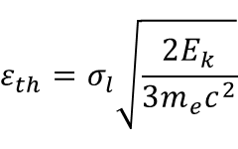

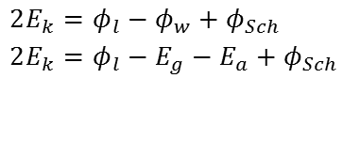
Thermal emittance
The thermal emittance is a crucial contributor to the final emittance (~70% for SwissFEL)
  σ_{l}: rms laser beam size
  E_{K}: average kinetic energy of the electrons at
  the cathode surface
$$ε_{th}=σ_{l}\sqrt{\frac{2E_{k}}{3m_{e}c^{2}}}$$
metals:
semiconductors:
Schottky effect:
$${2E}_{k}=φ_{l}−φ_{w}+φ_{Sch}$$
$${2E}_{k}=φ_{l}−E_{g}−E_{a}+φ_{Sch}$$
$$φ_{Sch}=\sqrt{\frac{e^{3}}{{4πε}_{0}}βE_{c}}$$
Φ_{l}: laser photon energy, Φ_{w}: material work function, E_{g}: gap energy, E_{a}: electron affinity, E_{g+} E_{g:} threshold energy, β: local field enhancement factor (surface properties), E_{c}: field at the cathode
Wide range of parameter values in literature
Thermal emittance measurements performed at different facilities show big differences
Thermal emittance can not be estimated accurately and needs to be measured
Thermal emittance depends on the laser wavelength, field at the cathode, cathode material and surface properties
Why it is important to know the thermal emittance?
It gives the minimal reachable emittance, crucial for optimization
It is the basis for cathode development (including laser)
Notes:
19

Slide 20
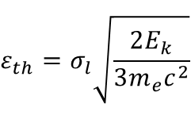
Thermal emittance measurements
      The normalized thermal emittance ε_{th}/σ_{l} can be reconstructed by measuring the emittance as a function of the rms laser beam size
We need to be sure that space-charge
effects are negligible
Space-charge limit by decreasing the charge until the emittance is constant. Then the charge-density is kept constant for all the laser sizes
Need to have high-sensitivity profile monitor!
$$ε_{th}=σ_{l}\sqrt{\frac{2E_{k}}{3m_{e}c^{2}}}$$
Measurements for 10 ps bunch length (FWHM) at the SwissFEL Injector Test Faciliy
Notes:
20

Slide 21
Measurements at the SwissFEL Test Facility
Field at the cathode dependence (Cu-19)
Wavelength dependence (Cu-3)
  [M. C. Divall et al, PRSTAB 18, 033401 (2015)]
  [E. Prat et al, PRSTAB 18, 063401 (2015)]
Cathode field | ε_{th}/σ_{l} | 2nd order
49.9 MV/m | 428±16 nm/mm | 724±84 nm/mm²
34.8 MV/m | 370±25 nm/mm | 505±137 nm/mm²
16.4 MV/m | 346±25 nm/mm | 321±105 nm/mm²
Material dependence
Dependencies on wavelength and field according to expectations
Cs₂Te has much higher QE than Cu and equivalent emittance
Thermal emittance around 0.5 µm/mm
Measurements at other labs
Cu: ~0.9 µm/mm [H. J. Qian et al, PRSTAB 15, 040102 (2012)], [Y. Ding et al, PRL. 102, 254801 (2009)]
Cs₂Te: > 1 µm/mm [F. Stephan et al., PRSTAB 13, 020704 (2010)]
  [E. Prat et al, PRSTAB, 043401 (2015)]
Notes:
21

Slide 22
Contents
Introduction: FELs and emittance
Emittance measurements
Thermal emittance measurements
Status of emittance measurements at different FEL facilities
Summary of requirements, future challenges and conclusion

Slide 23
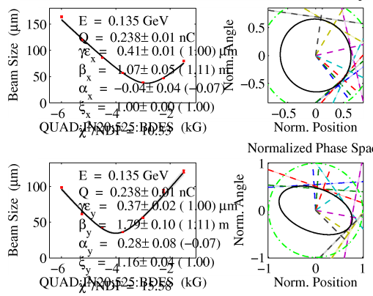
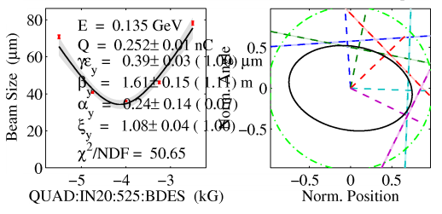
LCLS
Measured LCLS injector performance at 250 pC and 135 MeV (no bunch compression):
  About 0.4 μm projected/slice emittance with
  About 45A of peak current
LCLS injector has two diagnostics for emittance measurement:
  OTR screen using rms area cutting 5%
  Wire scanner with Gaussian fitting
  Waist rms beam size 40-45 μm
  Measured emittance is close with the two diagnostics
Courtesy of Feng Zhou
w/ OTR
w/ Wire scanner

Slide 24
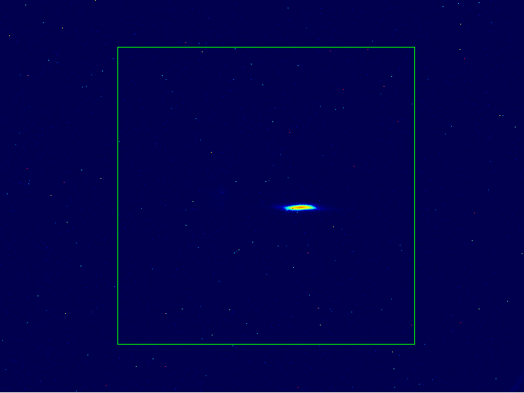
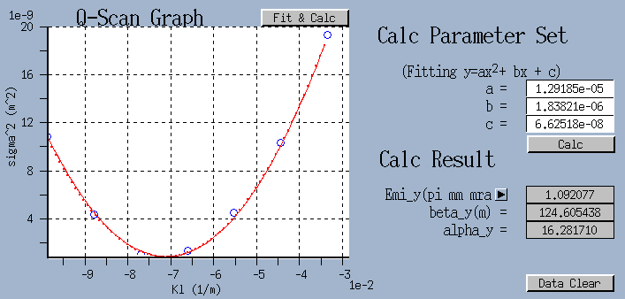
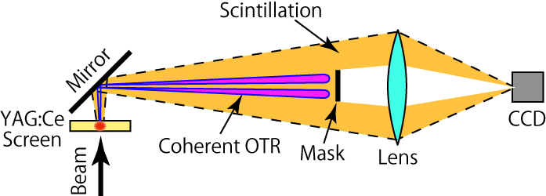
SACLA
Courtesy of H. Maesaka and T. Tanaka
Quad. Scan method with YAG:Ce screen monitor
Quad. scan result after BC3
(1.4 GeV, ~10 fs bunch length)
YAG:Ce with C-OTR mask
Parabola Fit
(beam size)²
(beam size [std.])²
Data
σ ~ 30 μm (Minimum)
by Gaussian fit
KL of Quad.
Normalized emittance
1.09 µm rad
Mitigation of Coherent OTR for Screen Monitor
OTR is emitted forward within ~1/γ radian.
Scintillation of YAG:Ce has no directional dependence.
Optical resolution ~ 10 µm
^{t} 0.1 mm

Slide 25
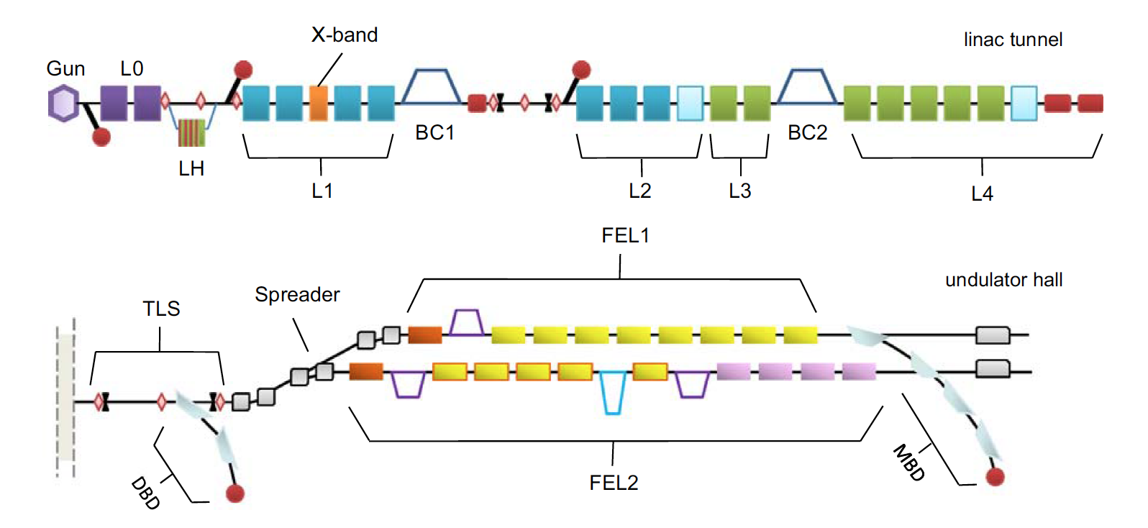
FERMI
Courtesy of G. Penco
Nominal Beam: Q=700pC at 10-50Hz
ε_{n}=0.8 μm, I=70A
ε_{n}=1.0-1.2 μm, I=500-700A
ε_{n}=1.0*-1.2 μm, I=500-700A
Quadrupole Scan to measure the optics parameters (α, β, ε)
100MeV
300MeV
1.2-1.5GeV
Projected values are used in a iterative
process to match the beam optics to the lattice design (mismatch <1.05) in four strategic regions along the machine: Injector, after BC1, linac end, in front of the modulator.
RF Deflector (vert)
RF Deflector (hor and vert)
All diag. stations are equipped with YAG and
OTR target: the latter are routinely used for their better resolution (~20 μm), setting the laser heater (LH) to the maximum power to suppress μ-bunching instabilities and therefore the coherent-OTR emission.
ε_{n}=1.2 μm, I=500-700A
NB: The larger value of ε_{proj} are mainly due to the transversal wakefields
The minimum beam spot size ~ 70-100μm (rms) everywhere but at the end of the linac (~30-40μm): here
we installed a *wire-scanner system (built by PSI) with resolution ~1.5μm: more reliable for emit meas. but more time-consuming (not used for matching operation). PRAB 19, 092802 (2016) & Proc. FEL15, MOP034.
Several methods to analyze the spot size: Gaussian, asymmetric Super Gaussian, rms over a fractional
area-integrated cut: the last one is routinely used, setting a 2D-cutting at 90% of the while charge.
Although projected values are used for matching, it is possible to measure the slice emittance and slice
parameters after BC1 (only horizontal) and at the end of the linac (both planes, P. Craievich et al. IEEE Transactions on Nuclear Science 62, 1-11 (2015): typical values in the core of the bunch are ~ 1.0 μm for compressed beam.
Notes:
25

Slide 26
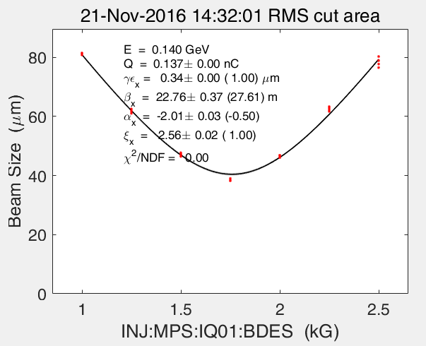
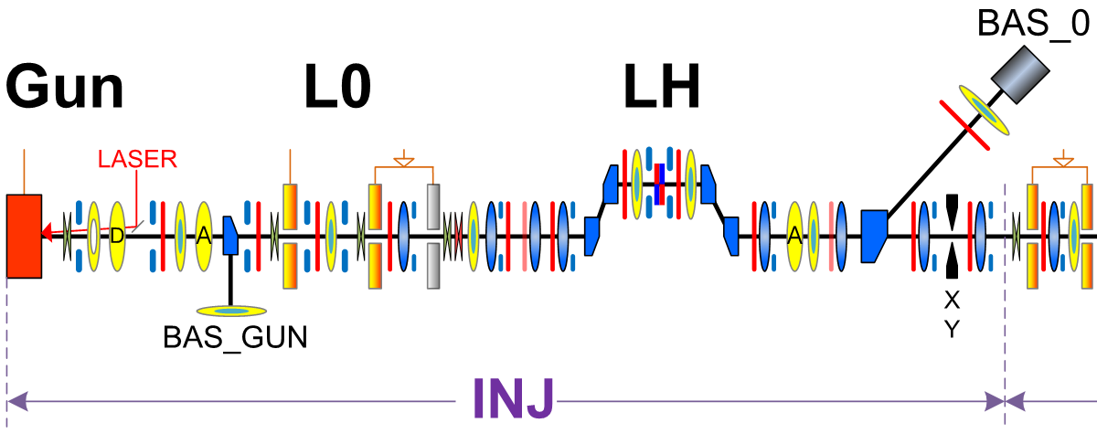
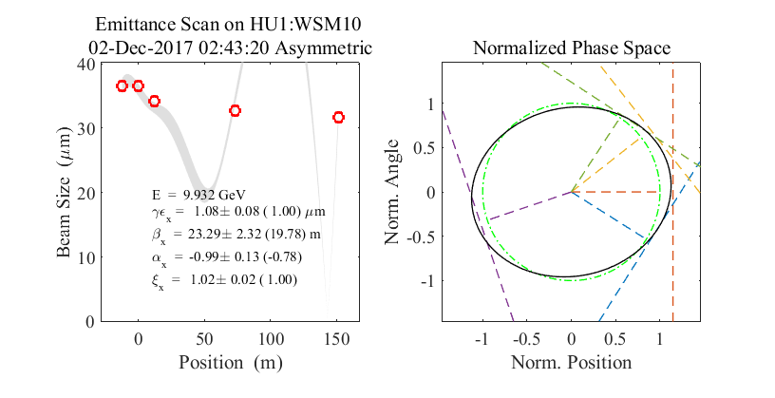
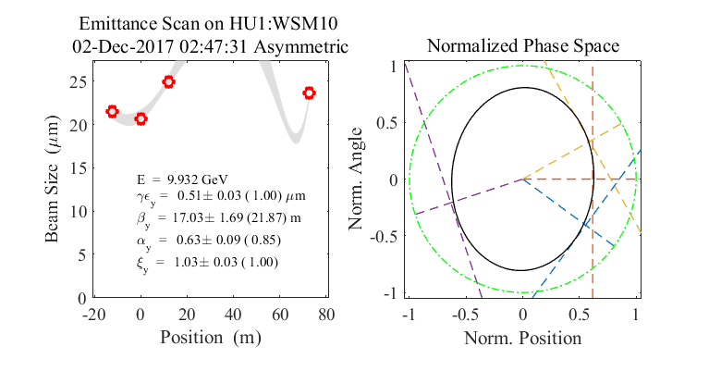
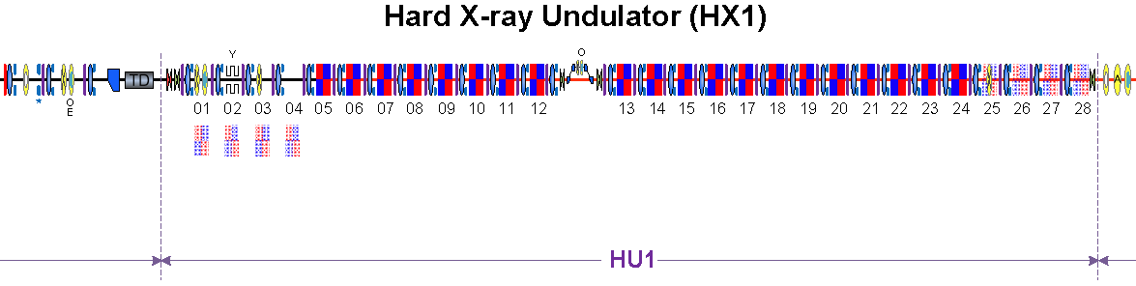
Courtesy of Heung-Sik Kang
PAL-XFEL
Injector: Quad scan
YAG screen
quad
Undulator line: multiple wire scanners
  Wire thickness: 18 μm (Tungsten)
Multiple Wire Scanners (5 ea)
Notes:
26

Slide 27
SwissFEL
Projected measurement location Projected and slice measurement location
Most of the measurements are done with quadrupole scan and a screen. At some locations, a WS is also available. For linac 1 and linac 2, parasitic FODO measurements with WS are also planned.
Done:
  Measurement commissioning at laser heater, BC1, BC2, Linac 3 and undulator.
  Optimization for uncompressed beam (200 pC) → projected emittance of 250 nm, slice of 150 nm
  Compressed values at BC2 around 350 nm (projected)
To be done:
  Commission other measurement locations
  Optimization for uncompressed beam at different charges, including coupling and beam tilt corrections
  Systematic emittance preservation after compression and transport to the undulator
Notes:
27

Slide 28
Summary
 | Method | Locations | PM | Streaking | Values
LCLS | Quad scan | Injector | OTR & WS | Yes, TDS | 400 nm (45 A, 250 pC)
SACLA | Quad scan | After BC3 | YAG (10 um resolution) | ? (TDS) | 1090 nm (10 fs)
FERMI | Quad scan | Injector, after BC1 and after BC2 | YAG, OTR, WS (1.5 um resolution) | Yes, TDS | 800 nm (70 A), 1000-1200 nm (500- 700A)
PAL-XFEL | Quad scan FODO | Injector Undulator | YAG WS | ? | 340 nm 510-1080 nm
SwissFEL | Quad scan FODO | 6-7 Linac 1 and 3 | YAG, WS WS | Yes (TDS, dispersion and wakefields) | ~200 nm (200 pC, 20 A), ~350 nm (200 pC, 200 A)
E-XFEL | FODO Quad scan | Injector, after BC, … | LySO, WS | Yes, TDS | ?
Most of the labs:
Use quadrupole scans to measure the emittance, others also employ FODO sections
Measure the emittance before and after compression
Measure projected and slice emittance
Notes:
28

Slide 29
Contents
Introduction: FELs and emittance
Emittance measurements
Thermal emittance measurements
Status of emittance measurements at different FEL facilities
Summary of requirements, future challenges and conclusion

Slide 30
Summary of requirements
Measurement at several locations
Emittance needs to be minimized at the source, deteriorating effects related to compression and transport need to be controlled
Measure beam sizes for different optics: Better if using optimized quadrupole scans
Normalized emittance resolution ~10 nm → beam size resolution to ~1 µm
Charge sensitivity: ~10 - ~1000 pC
Time-resolved measurements: required time resolution ~1 fs
Measurement of beam correlations besides 2D emittances (transverse coupling and beam tilts)
Bonus: measure the thermal emittance to characterize the source (PM needs to be sensitive to ~1pC)
Notes:
30

Slide 31
Future challenges
Ideal profile monitor (best from screen + best from WS)
  Can measure charges from 1 pC to 1 nC
  Resolution down to 1 µm
  Non-invasive
  Fast
  Can obtain 2D information
Time-resolved measurements:
  Demonstrate slice emittance measurements with fs resolution
  TDS with variable polarization to streak in both planes (X-band collaboration project going on between CERN, DESY and PSI)
  Develop better (non-invasive) streaking methods to reach sub-fs resolution
Single-shot emittance measurements?
Notes:
31

Slide 32
Conclusion
Emittance is fundamental for FELs
Emittance is normally determined by measuring beam sizes for different optics → better with optimized quadrupole scans
Projected and slice emittance needs to be measured and minimized at several locations along the accelerator
Required resolutions:
  Beam sizes: ~1 µm for charges from ~1 pC to ~1 nC
  Time: < 1 fs

Slide 33
Back-up slides
Notes:
33

Slide 34
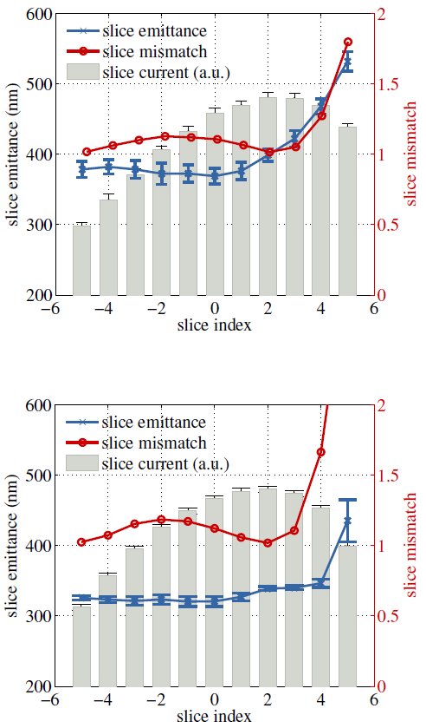
Comparison FODO-quadrupole scan
[M. Yan et al, FEL14, THP088], [M. Yan, DESY-THESIS-2016-017]
Projected measurement
Slice measurement
FODO
 | FODO | Quad scan
ε_{x} | 513 ± 8 nm | 486 ± 2 nm
ε_{y} | 495 ± 6 nm | 458 ± 3 nm
M_{x} | 1.12 | 1.00
M_{y} | 1.07 | 1.06
 | FODO | Quad scan
ε | 369 ± 11 nm | 321 ± 7 nm
 | 353 ± 13 nm | 314 ± 7 nm
M | 1.10 | 1.12
 | 1.18 | 1.19
Equivalent optics
Larger emittance with FODO, most likely due to worse emittance resolution (smaller beta-function, ~3m vs ~35-40m)
Quad scan
Notes:
34

Slide 35
Symmetric single quadrupole scan
L
Example used at the end of the linac for SwissFEL β₀=5.07, α₀=0.5, L=10.13m, β_{min}= 20.3 m
[E. Prat, NIMA 743, 103 (2014)]
Beta functions at the screen
In quadrupole scans it is generally required to scan separately x and y. But it is possible to scan both x and y with one quadrupole if:
The optics at the reconstruction point are the same for x and y: β_{x}=β_{y}=β₀, α_{x}=α_{y}=α₀
α₀L=β₀ (L is distance from quad to PM)
In this case:
The waist occurs for no quadrupole gradient (μ=90°): β_{min} = L² / β₀
The beta at the PM is: β = L² / [(sinμ)² • β₀]
The ratio between beta and the beta at the waist is: β/β_{min} = 1/ (sinμ)² (33 for 170/10°, 15 for 165/15°)
The required quad strengths are: (1/kl) = tan(μ/β₀)
Intuitive measurement
Scan parameters (e.g beam waist and required quad strengths) can be easily controlled
Phase-advances
k-values
Notes:
35

Slide 36
Optimized scan for 4D measurements
To measure the 4 coupling terms from <xy> we need:
<xy>: Δμ_{x} = 0, Δμ_{y} = 0
<xy’>: Δμ_{x} = 0, Δμ_{y} = π/2
<x’y>: Δμ_{x} = π/2, Δμ_{y} = 0
<x’y’>: Δμ_{x} = π/2, Δμ_{y} = π/2
3-4 quadrupoles are used to:
Scan phase-advance in x (while not controlling the phase advance in y)
Scan phase-advance in x (while not controlling the phase advance)
Keep beta-functions at the PM under control
First half allows reconstruction of x-x’
Second half allows reconstruction of y-y’
Both allows reconstruction of 4D parameters
Beta functions at the screen
Phase-advances
k-values
[E. Prat and M. Aiba, PRSTAB 17, 052801 (2014)]
Notes:
36

