Slide 1
Status of X-ray Pinhole Cameras for 3GSLS
L. Bobb

Slide 2
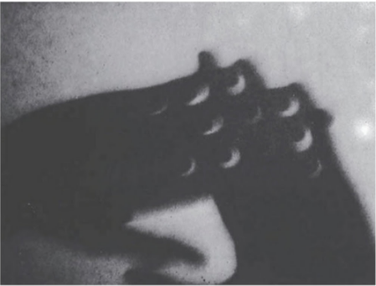
Ancient meets State-of-the-Art
≈ 400 – 300 BC : Earliest written observations
Chinese philosopher Mozi [1].
“Why does the sun penetrating through quadrilaterals form not rectilinear shapes but circles, as for instance when it passes through wicker-work?”
Greek philosopher Aristotle (384-322 BC) [2].
Time
Observation of a partial solar eclipse through overlapping fingers that Aristotle could not explain [3].

Slide 3
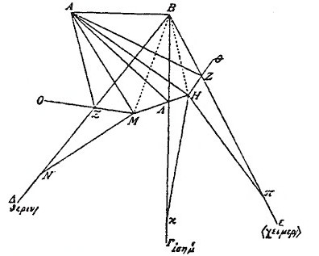
Ancient meets State-of-the-Art
≈ 400 – 300 BC : Earliest written observations
Light ray diagram by Anthemius of Tralles [3].
Time
500 – 1100 AD : First experimental studies
555 AD: Ray-tracing diagram by Anthemius of Tralles (mathematician and co-architect of the Hagia Sophia) [3].
965 – 1039 AD: Optical scientist Ibn al-Haitham (Alhazen) describes imaging candles in a darkened room using a pinhole and states:
“The image of the Sun at the time of the eclipse, unless it is total, demonstrates that when light passes through a narrow, round hole and is cast on a plane opposite to the hole, it takes on the form of a moonsickle.”

Slide 4
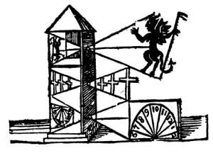
Ancient meets State-of-the-Art
≈ 400 – 300 BC : Earliest written observations
1100 – 1400 AD : Finding applications
Theodoric of Freiberg and Kamal al-Din al Farisi simultaneously and independently study the colour theory of sunlight using a pinhole.
≈1300 AD: Roger Bacon uses science to reaffirm religious belief [3].
Time
Drawing of a 3-tiered camera by Roger Bacon.
500 – 1100 AD : First experimental studies

Slide 5
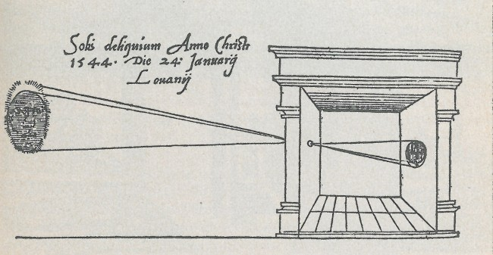
Ancient meets State-of-the-Art
≈ 400 – 300 BC : Earliest written observations
1100 – 1400 AD : Finding applications
Time
Schematic of a pinhole camera in 1545 [3].
1400 – 1600 AD : Renaissance of human understanding
Optical and astronomical experiments by Antonio de Dominus, René Descartes, Tycho Brahe, Johannes Kepler and Leonardo da Vinci.
1545 AD: First published picture of a pinhole camera obscura in the book, De Radio Astronomica et Geometrica, by Gemma Frisius [3].
500 – 1100 AD : First experimental studies

Slide 6
Ancient meets State-of-the-Art
≈ 400 – 300 BC : Earliest written observations
1600 – 1900 AD : Replaced by lenses
Pinhole aperture replaced by a lens in the majority of camera obscuras.
David Brewster describes pinhole camera photography in his book, The Stereoscope, in 1856 [3].
1100 – 1400 AD : Finding applications
Time
1400 – 1600 AD : Renaissance of human understanding
500 – 1100 AD : First experimental studies

Slide 7
Ancient meets State-of-the-Art
≈ 400 – 300 BC : Earliest written observations
1100 – 1400 AD : Finding applications
1600 – 1900 AD : Replaced by lenses
Time
1900 – Now : Rise of scientific pinhole cameras
Pinhole cameras coupled with films, scintillators, lenses and modern camera sensors are used in high energy physics.
→ Transverse profiling of particle beams in light sources.
1400 – 1600 AD : Renaissance of human understanding
500 – 1100 AD : First experimental studies

Slide 8


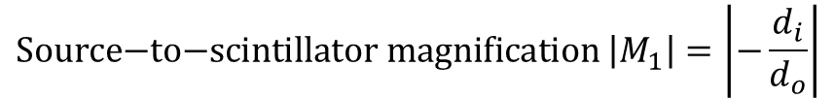
Principle of Operation
Camera
Synchrotron radiation is emitted from the source point.
Intermediate image is formed at the scintillator screen via a pinhole.
Image is relayed to the camera by a lens.
X-rays
$$\text{Source}\text{−}\text{to}\text{−}\text{scintillator} \text{magnification} \left|M_{1}\right|=\left|−\frac{d_{i}}{d_{o}}\right|$$
Visible light
$$\text{Scintillator}\text{−}\text{to}\text{−}\text{camera} \text{magnification} \left|M_{2}\right|\sim 1$$
Lens
Source
Pinhole
Mirror
Scintillator
$$d_{o}$$
$$d_{i}$$

Slide 9
Emittance Calculation
X-ray pinhole cameras measure the transverse profile of the beam, from which the emittance may be calculated.
Example image from Diamond Light Source in 2010, from which the emittance can be calculated [4, 5].

Slide 10
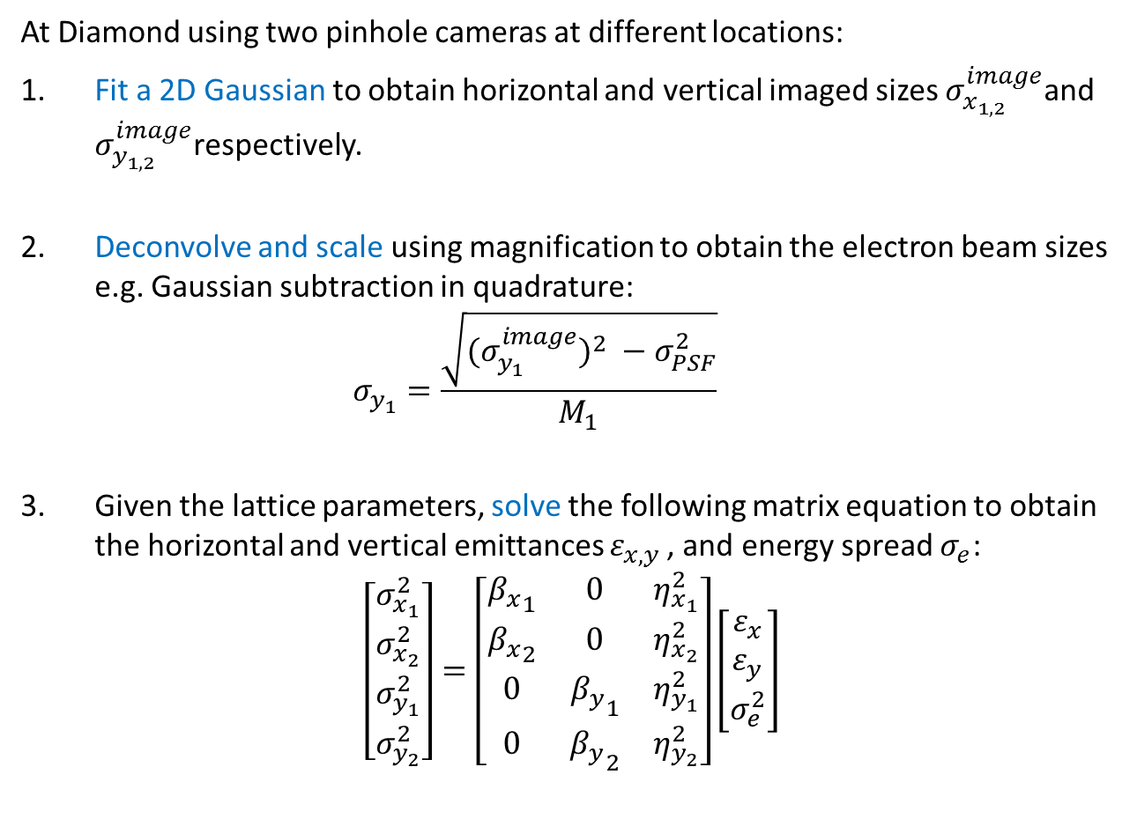
Emittance Calculation
At Diamond using two pinhole cameras at different locations:
Fit a 2D Gaussian to obtain horizontal and vertical imaged sizes $σ_{x_{1,2}}^{image}$and $σ_{y_{1,2}}^{image}$respectively.
Deconvolve and scale using magnification to obtain the electron beam sizes e.g. Gaussian subtraction in quadrature:
$σ_{y_{1}}=\frac{\sqrt{{{(σ}_{y_{1}}^{image})}^{2} −σ_{PSF}^{2}}}{M_{1}}$
Given the lattice parameters, solve the following matrix equation to obtain the horizontal and vertical emittances $ε_{x,y }$, and energy spread $σ_{e}$:
$$\left[\begin{matrix}\begin{matrix}σ_{x_{1}}^{2} \\ σ_{x_{2}}^{2}\end{matrix} \\ \begin{matrix}σ_{y_{1}}^{2} \\ σ_{y_{2}}^{2}\end{matrix}\end{matrix}\right]=\left[\begin{matrix}{β_{x}}_{1} & 0 & η_{x_{1}}^{2} \\ {β_{x}}_{2} & 0 & η_{x_{2}}^{2} \\ 0 & {β_{y}}_{1} & η_{y_{1}}^{2} \\ 0 & {β_{y}}_{2} & η_{y_{2}}^{2}\end{matrix}\right]\left[\begin{matrix}ε_{x} \\ ε_{y} \\ σ_{e}^{2}\end{matrix}\right]$$

Slide 11
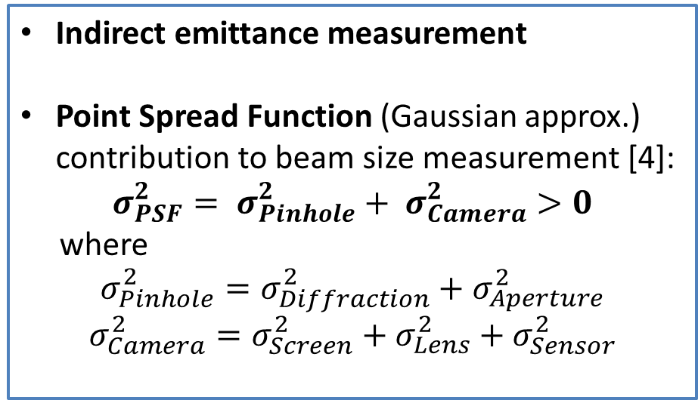
Fundamental Limitations
Indirect emittance measurement
Point Spread Function (Gaussian approx.) contribution to beam size measurement [4]:
$$σ_{PSF}^{2}= σ_{Pinhole}^{2}+ σ_{Camera}^{2}>0$$
where
$$σ_{Pinhole}^{2}=σ_{Diffraction}^{2}+σ_{Aperture}^{2}$$
$$σ_{Camera}^{2}=σ_{Screen}^{2}+σ_{Lens}^{2}+σ_{Sensor}^{2}$$
Camera
Lens
Source
Pinhole
Mirror
Scintillator
$$d_{o}$$
$$d_{i}$$

Slide 12
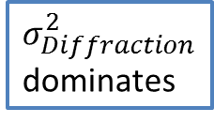
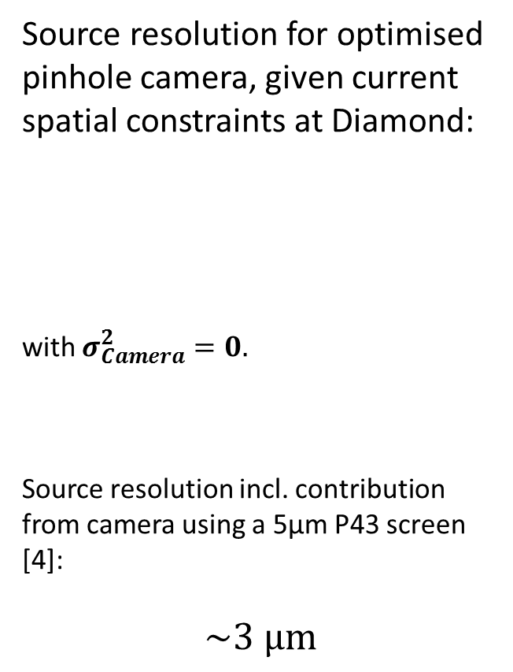
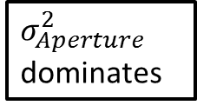
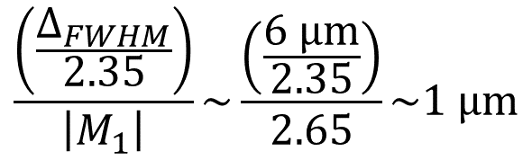
Fundamental Limitations
$$σ_{PSF}^{2}= σ_{Pinhole}^{2}+ σ_{Camera}^{2}>0$$
Source resolution for optimised pinhole camera, given current spatial constraints at Diamond:
with $σ_{Camera}^{2}=0.$
Source resolution incl. contribution from camera using a 5µm P43 screen [4]:
$$\sim \text{3} \text{μ}\text{m}$$
$$\frac{\left(\frac{∆_{FWHM}}{2.35}\right)}{\left|M_{1}\right|}\sim \frac{\left(\frac{6 \text{μ}\text{m}}{2.35}\right)}{2.65}\sim 1 \text{μ}\text{m}$$
$σ_{Diffraction}^{2}$ dominates
$σ_{Aperture}^{2}$ dominates

Slide 13
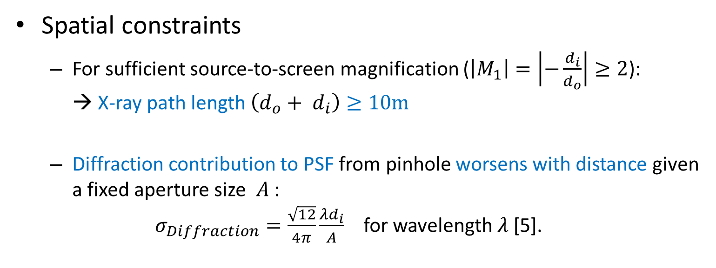

Practical Challenges
Spatial constraints
  For sufficient source-to-screen magnification ($\left|M_{1}\right|=\left|−\frac{d_{i}}{d_{o}}\right|≥2$):
  → X-ray path length $\left(d_{o}+ d_{i}\right)≥10\text{m}$
  Diffraction contribution to PSF from pinhole worsens with distance given a fixed aperture size $A$ :
  $σ_{Diffraction}=\frac{\sqrt{12}}{4π}\frac{λd_{i}}{A}$ for wavelength $λ$ [5].
Source
Pinhole
$$A$$
Scintillator screen
$$d_{o}$$
$$d_{i}$$

Slide 14
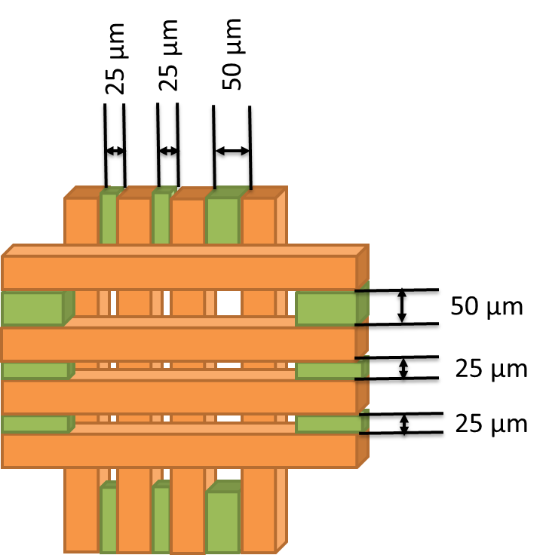
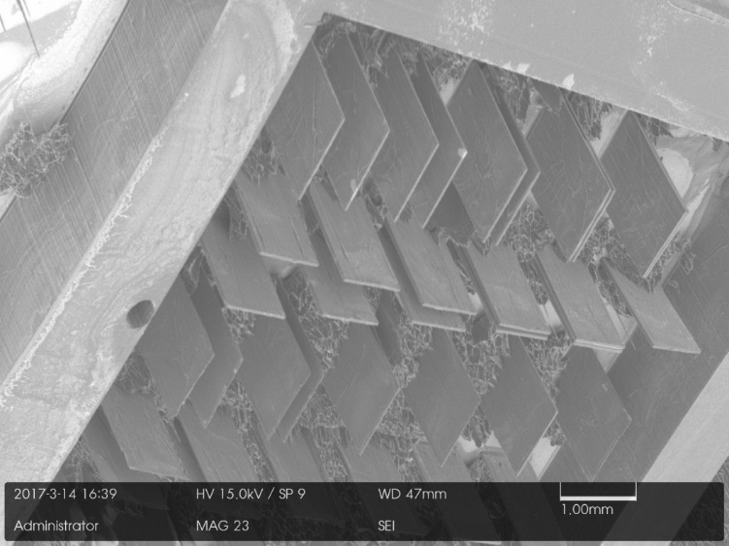
Practical Challenges
Pinhole fabrication
  For the pinhole to be opaque to keV X-rays a high Z material is required e.g. 1mm thick Tungsten.
  Often these materials are difficult to machine.
  Especially given the high aspect ratio
  10 µm (aperture): 1mm (thickness)
  → 1:100
Environment and oxidation
  Air, nitrogen or vacuum?
  Lifetime and maintenance considerations

Slide 15
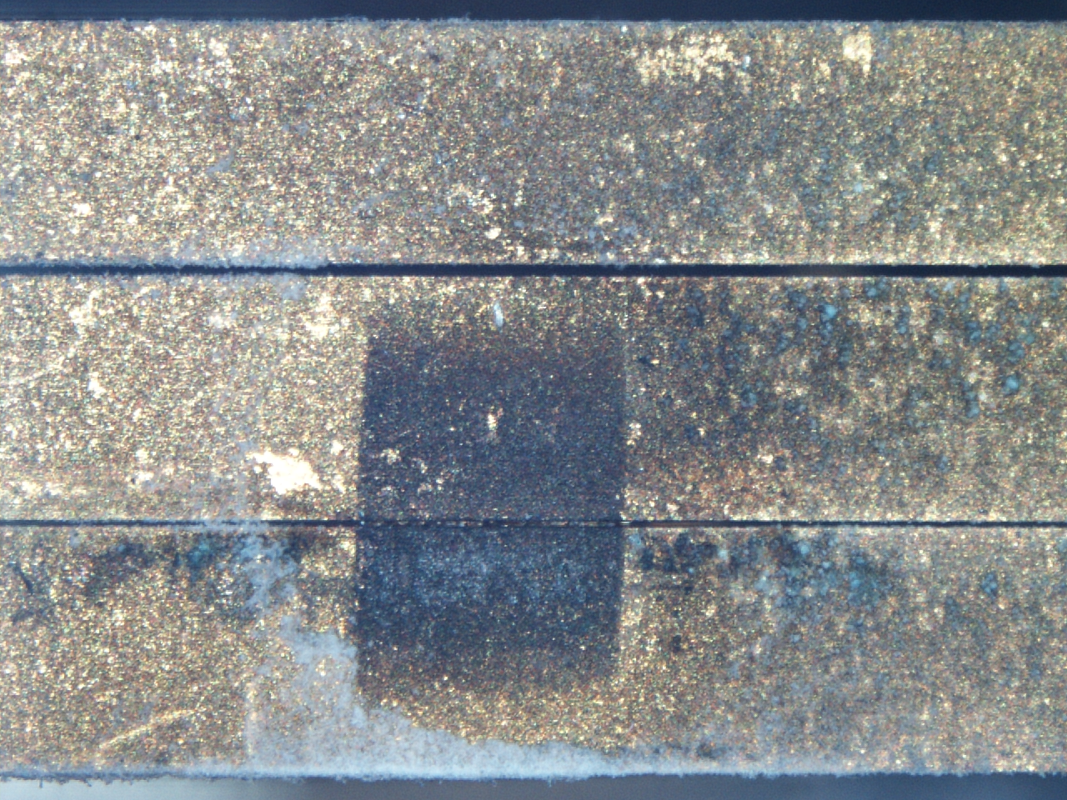
Nov 2014: Gold Plated Tungsten Blades
400 µm
Tungsten Oxide (blue) forms on bare Tungsten areas
50 µm
25 µm
Gold “nuggets” clogging pinhole
Fluffy white deposits
= Aluminium Oxide
Upstream view of Pinhole 2

Slide 16
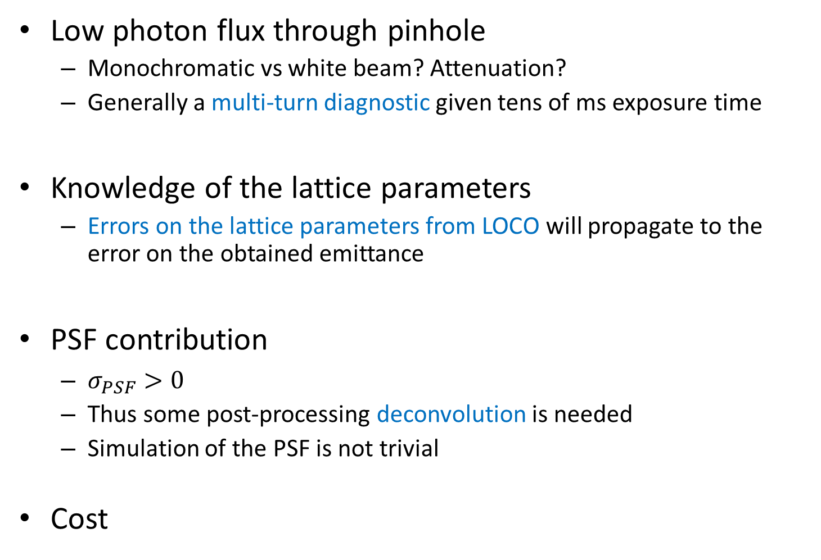
Practical Challenges
Low photon flux through pinhole
  Monochromatic vs white beam? Attenuation?
  Generally a multi-turn diagnostic given tens of ms exposure time
Knowledge of the lattice parameters
  Errors on the lattice parameters from LOCO will propagate to the error on the obtained emittance
PSF contribution
  $σ_{PSF}>0$
  Thus some post-processing deconvolution is needed
  Simulation of the PSF is not trivial
Cost

Slide 17
Now tell us the perks!
Simple design. Simple alignment. Simple maintenance. Simple analysis. Simple…
  Quick to commission e.g. < 1 week at Diamond (2006)
  So simple, a human can learn a lot just by looking…!
Provides 2D transverse profile.
Non-invasive.
Cheap options are available.
Possible to custom build the imager to optimise for spatial resolution, turn-by-turn acquisition, dynamic range etc.
Fast image processing, thus suitable for feedback systems.

Slide 18
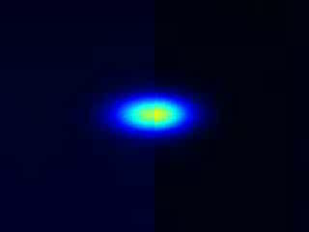
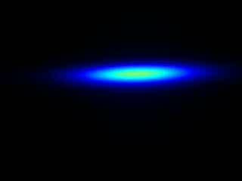
Dual Purpose Diagnostic
Emittance Monitoring
+
CCTV
While we have human operators, the importance of easy human interpretation shouldn’t be overlooked.
Injection at Diamond 2015
TMBF at Diamond 2015

Slide 19
Dual Purpose Diagnostic
Emittance Monitoring
+
CCTV
Beam sizes (2D)
X-ray pinhole camera image
Transverse profile
Skew
Beam instabilities
Beam position

Slide 20
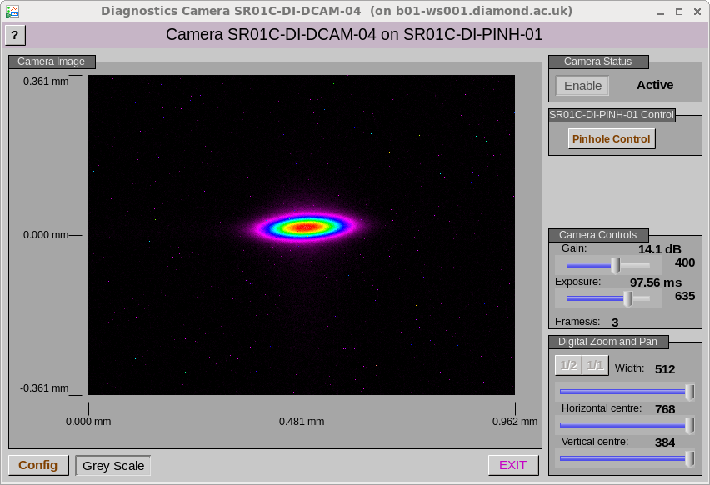
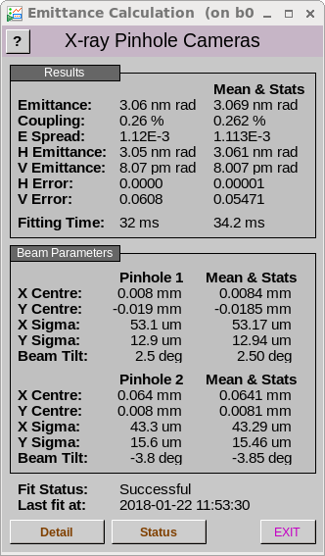
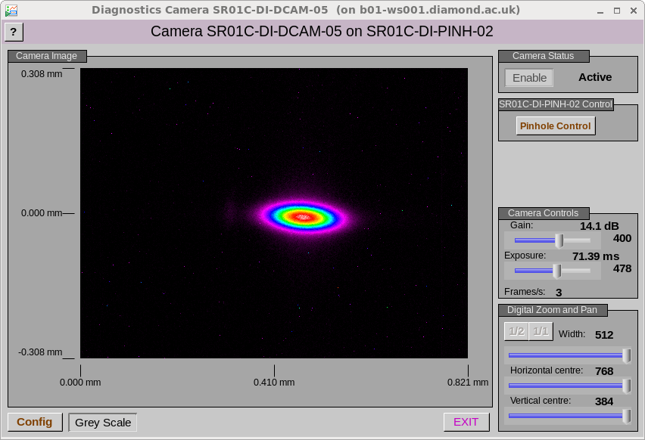
In Operation

Slide 21
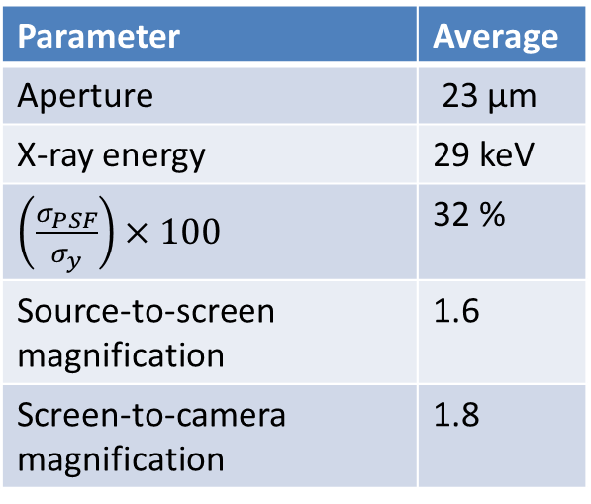
“Snapshot” of Current Status
Parameter | Average
Aperture | 23 µm
X-ray energy | 29 keV
$\left(\frac{σ_{PSF}}{σ_{y}}\right)×100$ | 32 %
Source-to-screen magnification | 1.6
Screen-to-camera magnification | 1.8
π-polarisation
Diffraction
Interferometry
CRL imaging
Air (6)
Vacuum (3)
Nitrogen (1)

Slide 22
Summary
Simple! → Easy to commission → Easy maintenance
Survey shows primary instrument for emittance monitoring
Fundamental limitations, given space and 30 keV X-rays etc., mean sub-micron beam size measurements are not possible.
Many practical challenges are being improved with technological advances.
Complementary general diagnostic → CCTV
Suitable for emittance feedback
Easy human interpretation

Slide 23
References
[1] V. Popovic et al., Design and Implementation of Real-Time Multi-Sensor Vision Systems, Springer, 2017.
[2] E. S. Forster, Problemata by Aristotle, translated to English, Vol VII, 912b, 1927.
[3] E. Renner, Pinhole Photography from Historic Technique to Digital Application, Fourth Ed., Focal Press, 2009.
[4] C. Thomas et al., X-ray pinhole camera resolution and emittance measurement, Phys. Rev. ST Accel. Beams 13, 022805 (2010).
[5] P. Elleaume et al., J. Synchrotron Radiat. 2, 209 (1995).
[6] M. Madou, ``Chapter 10: Micromolding Techniques - LIGA'', Fundamentals of Microfabrication and Nanotechnology, Vol. 2, Third Ed., CRC Press, 2012, p.591-642.
[7] L.M. Bobb et al., ``Performance Evaluation of Molybdenum Blades in an X-ray Pinhole Camera'', Proc. IBIC2016, p. 796-799.

Slide 24
Acknowledgements
Thank you for your attention.
Thanks to the Diamond Diagnostics group and to all those who participated in the survey!
Ximenes Rocha Resende | Brazilian Synchrotron Light Laboratory |  | Kuo-Tung Hsu | TPS/NSRRC
Åke Andersson | MAX IV Laboratory |  | Marcel Schuh | KARA / KIT
Volker Schlott | PSI |  | Suntao Wang | CESR/CHESS
Yongbin | SSRF/SINAP |  | Friederike Ewald | ESRF
Shiro TAKANO | SPring-8 |  | Marie Labat | SOLEIL
Rohan Dowd | Australian synchrotron |  | Gero Kube | DESY
Akash Deep Garg | RRCAT Indore INDIA |  | Ubaldo Iriso | ALBA
Oleg Meshkov | BINP |  | Jeff Corbett | SLAC

Slide 25
END

