Slide 1
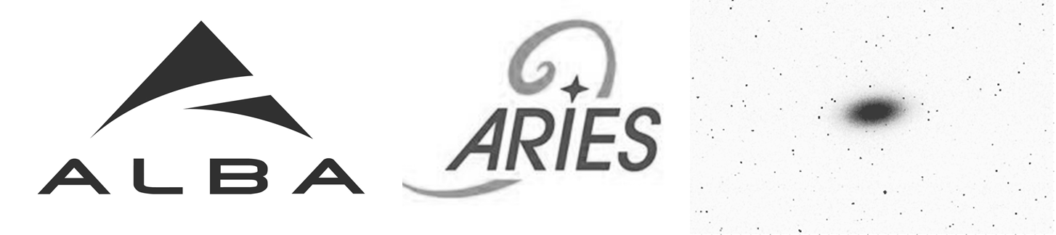
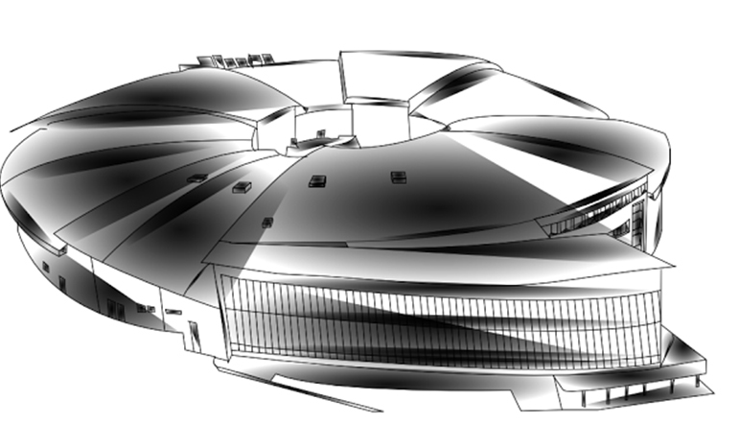
Workshop on Emittance Measurements
for Light Sources and FELs

Slide 2
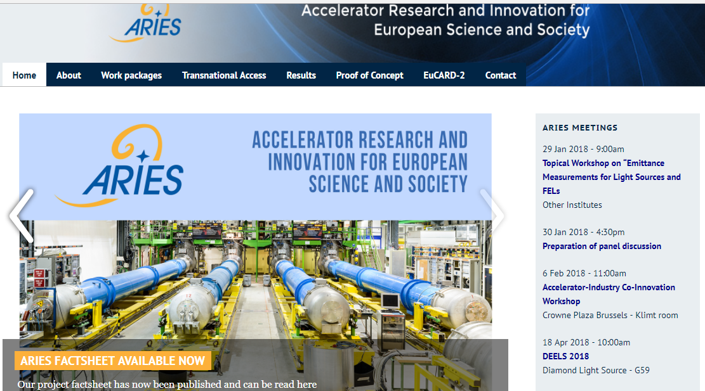
ARIES?
Accelerator Research and Innovation for European Science and Society
Project related to boost up R&D in accelerator science (EuCARD successor)
Funded by EU with10 M€ from 2017 to 2021
https://aries.web.cern.ch/
Up to 18
Work Packages!

Slide 3
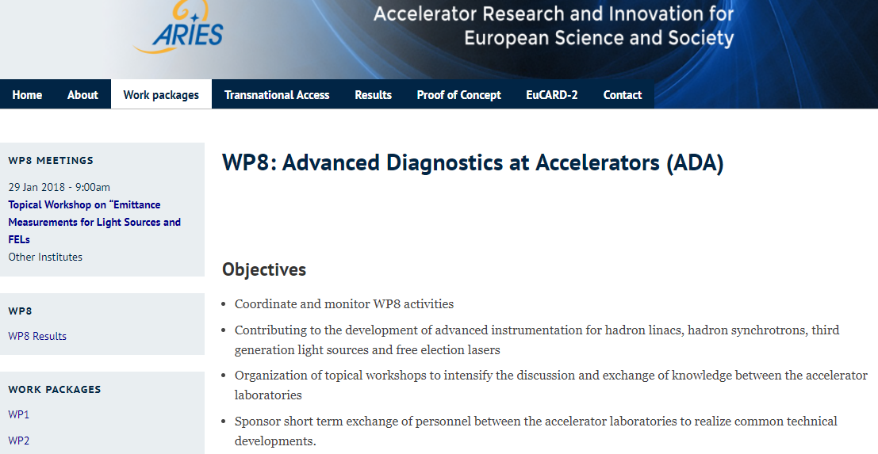
ARIES WP8: Advanced Diagnostics for Accelerators – ADA
WP8.1: Coordination
WP8.2: Di at hadron LINACs
WP8.3: Di at hadron synchrotrons
WP8.4: Di at 3rd gen. light sources
WP8.5: Di at FELs

Slide 4
Workshop On Emittance Measurements for
Light Sources & FELs
Day 1: Focused on Synchrotron Light Sources
  Requirements for 3rd & 4th generation of SLS
  Direct Imaging Techniques
  Techniques Based on Light Coherence Analysis
  “Uncommon” techniques: HNFS, Cherenkov Radiation, x-ray diffraction
Day 2: Focused on FELs
  Requirements for xFELs
  OTR/ODR techniques
  Wire scanner techniques
  Inheritance from other accelerators: from Hadron Colliders to Plasma Acceleration
          38 registrants
          24 Talks:
          12 Talks about SLS
          9 Talks about FELs
          2 Talks for Hadron Machines
          1 Talk for Plasma Accel.
Some
Numbers

Slide 5
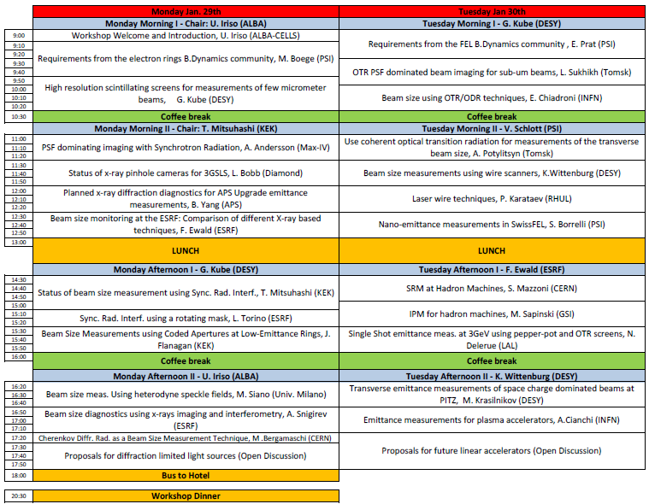
THIS Workshop
Please update your contributions to the workshop website
This is a Workshop: ask any question and contribute to the discussions!!

Slide 6
THIS Workshop
Skype Talks
Timing Exchanged due to time difference USA - Japan
Let´s cross fingers...

Slide 7
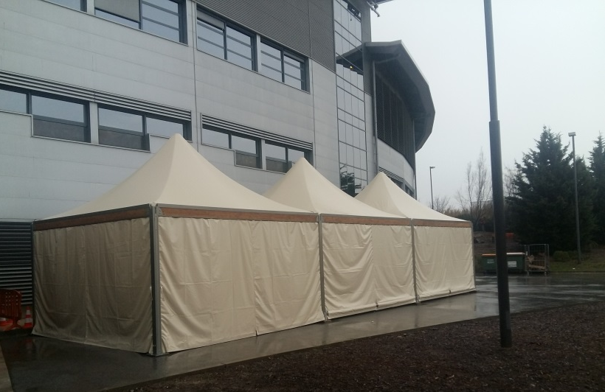
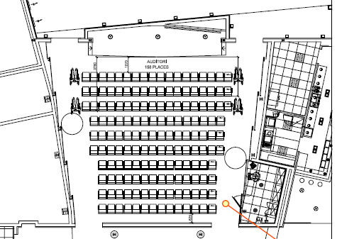
Social Events: Coffee Breaks & Lunches
Lunches: tents outside building
Auditorium Stage & Screen
Coffee Breaks

Slide 8
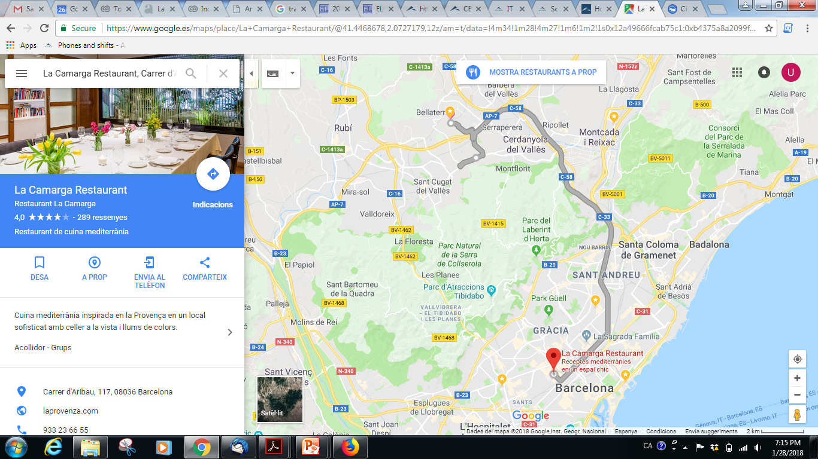
Social Events: Gala Dinner
18h00: Bus from CELLS to Hotel Campus
19h30: Bus from Hotel Campus to Barcelona Restaurant “La Camarga”
22h30: Bus from Rest. “La Camarga” to Hotel Campus
Hotel
Campus UAB
ALBA
Synchrotron
Rest. La Camarga
C. Aribau, 117

Slide 9
LET´S GET STARTED

Slide 10
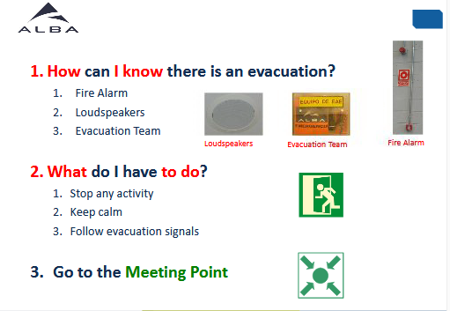
Basic Emergency Rules @ALBA

Slide 11
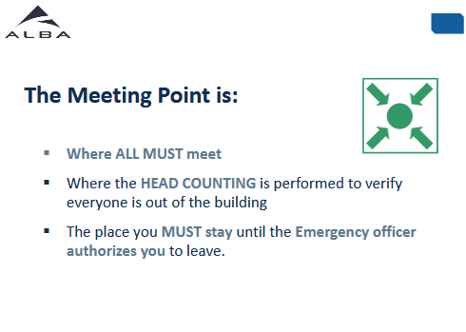
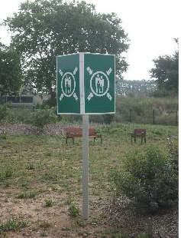
Basic Emergency Rules @ALBA

Slide 12
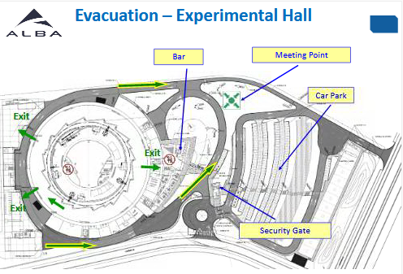
Basic Emergency Rules @ALBA
Auditorium

