Slide 1


Emittance measurement for plasma accelerators
Alessandro Cianchi
University of Rome Tor Vergata & INFN

Slide 2
Outline
Motivation
Plasma acceleration
Problems in emittance measurements
Proposals
Conclusions

Slide 3
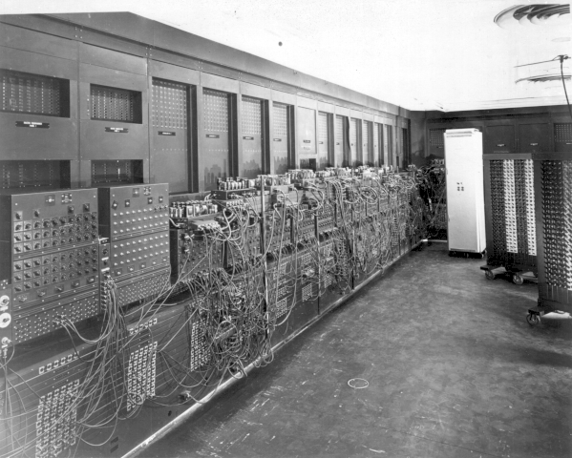
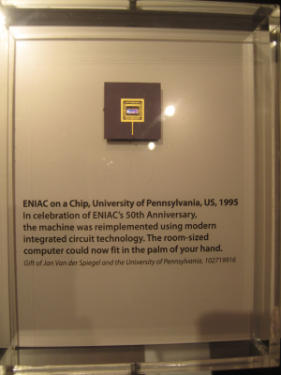
ENIAC Then and now…
1946
1995
Notes:
180 m^2 30 tonn

Slide 4
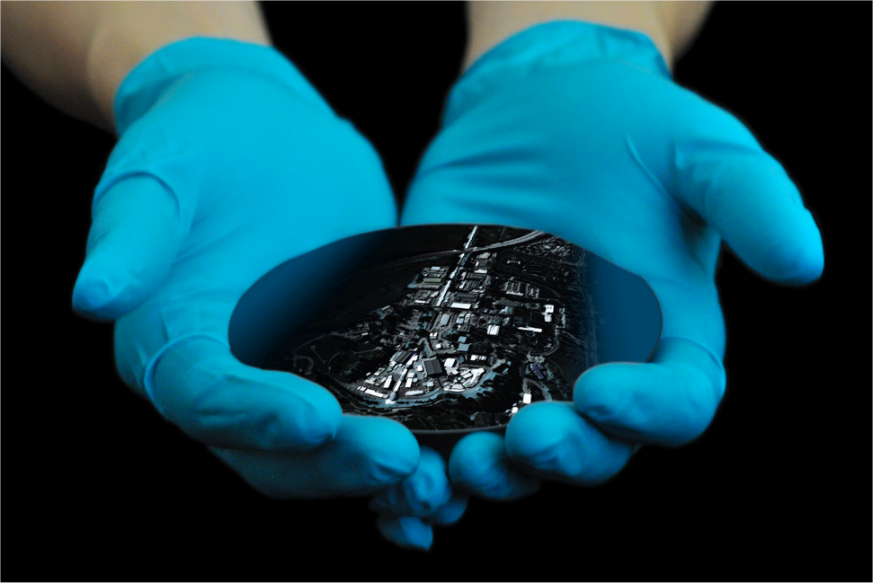
SLAC Now and Tomorrow
2018
20??

Slide 5
EuPRAXIA is a design study for a “European plasma research accelerator with excellence in applications”
Eupraxia will produce a conceptual design report for the worldwide first 5 GeV plasma-based accelerator with industrial beam quality and user areas.

Slide 6
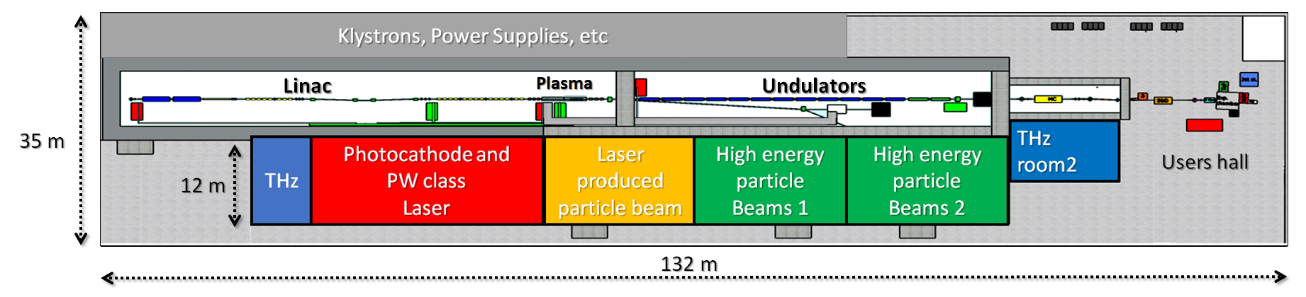
EuPRAXIA@SPARC_LAB
Candidate LNF to host EuPRAXIA (1-5 GeV)
FEL user facility (1 GeV – 3 nm)
Advanced Accelerator Test facility (LC) + CERN
500 MeV by RF Linac + 500 MeV by Plasma (LWFA or PWFA)
1 GeV by X-band RF Linac only

Slide 7
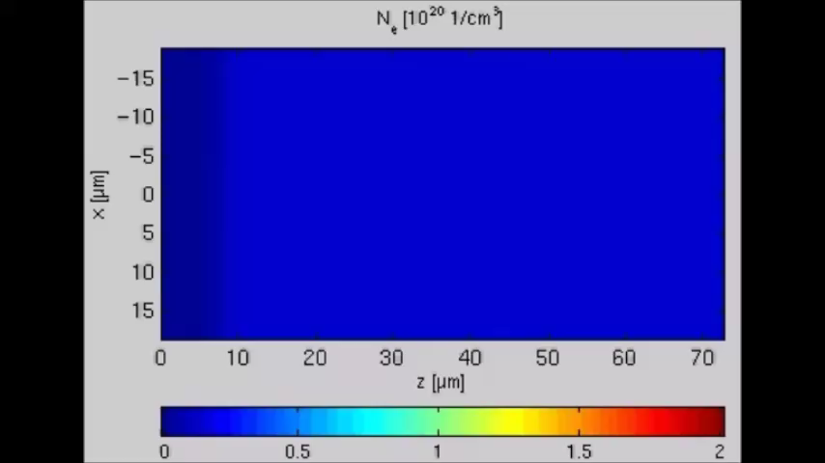
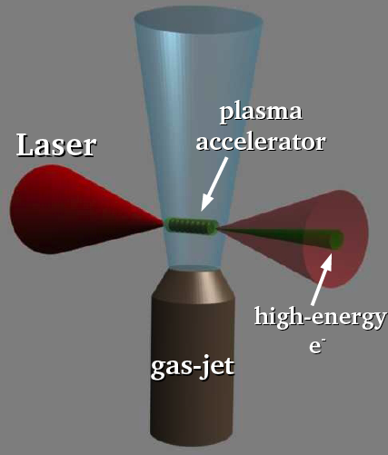
LWFA
Billions of free electrons inside the plasma can be manipulated together and forced to act coherently.
Plasma acts as an energy transformer. It does not provide energy; it only transfer the energy of an existing beam to a trailing beam.

Slide 8
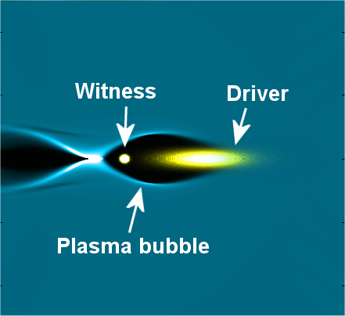

PWFA
PWFA not limited by diffraction or by dephasing
Particle bunches have long Rayleigh length (up to m)
N₁ particles in the drivers, N₂ particles in the witness
ΔE₁ energy loss in the drivers,
ΔE₂ energy gain in the witness

Slide 9
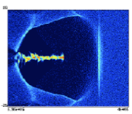
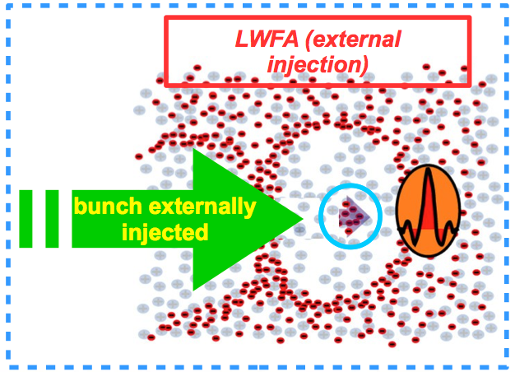
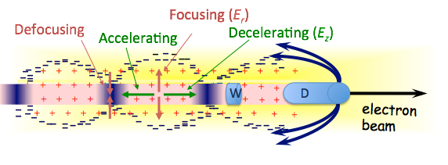
Different schemes
Laser only
Electrons only
Laser and electrons
The “easiest” to implement (requires “only” to tune the laser and the target)
Difficult control over the whole process
Easier implementation than laser+electrons (no need for independent synchronization system and driver guiding)
It depends heavily on the ability to properly tailor the driver(s) and witness phase spaces
In principle has the best potentialities in term of e-beam brightness and energy
The hardest to implement (laser guiding, synchronization issues, ...)

Slide 10
Diagnostics point of view
Similar problems
  Driver removal
  Difficulties in capture optics
  High divergence
Resolution for emittance must be better than 1e-6 mm-mrad
The device must work even with shot to shot pointing, energy, time jitter instabilities
Compactness is a fundamental requirement

Slide 11

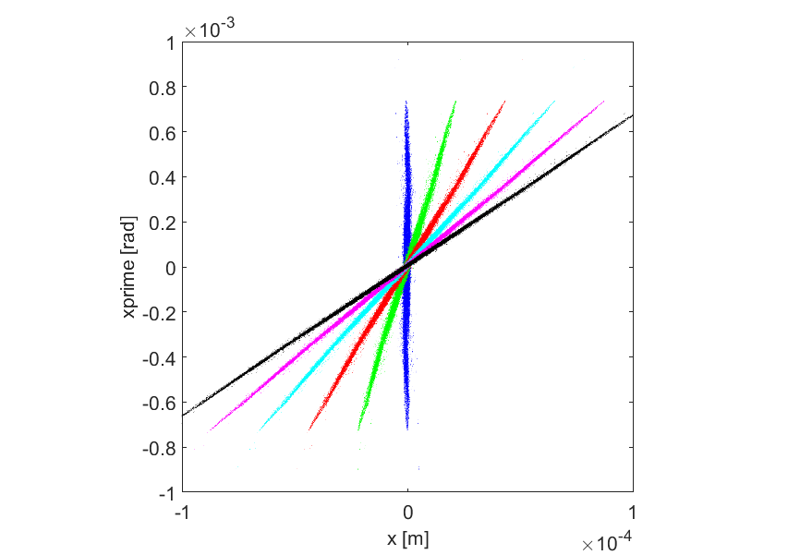
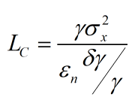
The role of the energy spread
3cm
9cm
source
15cm
M. Migliorati et al, Physical Review Special Topics,Accelerators and Beams 16, 011302 (2013)
K. Floettmann, PRSTAB,6, 034202 (2003)
The normalized rms emittance is a tricky parameter
6D rms emittance even is not conserved in a drift!

Slide 12
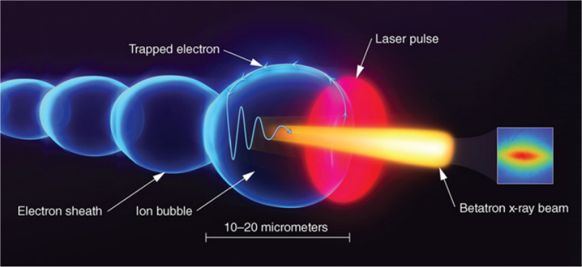


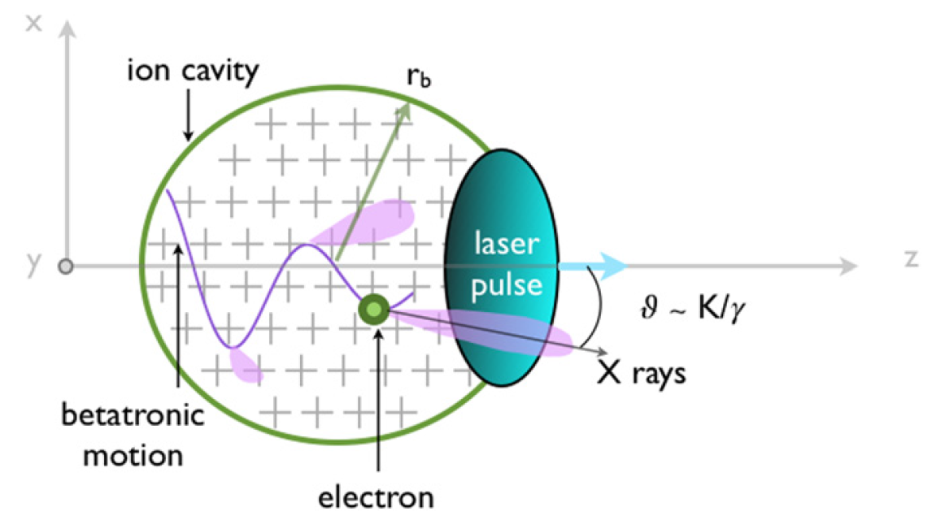
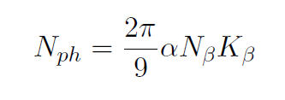
Betatron radiation
Picture from F Albert et al Plasma Phys. Control. Fusion 56 (2014) 084015
Highly anharmonic regime limit K_{β}>>1
Picture from S Corde et al 2012 Plasma Phys. Control. Fusion 54 124023
Notes:
Per moto intorno all’asse c’è solo la fondamentale ed è monocromatico. Quando le oscillazioni sono di qualche um invece abbiamo anche armoniche di ordine superiore. Numero di fotoni emessi da elettrone è 5.6X10^-3*numero oscillazioni*K
Si potrebbe osservare anche lo spettro e vedere come sono fatte le armoniche per capire qualcosa sulle dimensioni della sorgente.

Slide 13
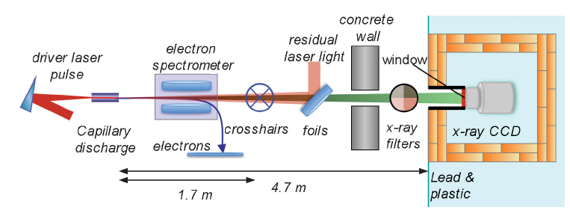
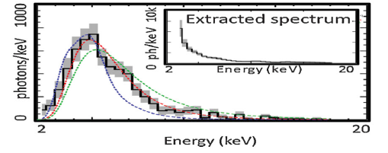
Betatron spectroscopy
G. R. Plateau and al., Low-Emittance Electron Bunches from a Laser-Plasma Accelerator Measured using Single-Shot X-Ray Spectroscopy, PRL 109, 064802 (2012)
400 MeV energy with a rms energy spread of less than 5% and 1 mrad divergence from a plasma density of 5 10¹⁸cm³
Notes:
LOASIS facility of the Lawrence Berkeley National
Laboratory. 2-20 keV multi foils to shield lasers
In silicon CCD cameras, an electron is created for every 3.65 eV of energy from the absorbed x-ray; thus, the size of the signal from a pixel in a CCD is a direct measure of the
x-ray energy. For a beam with radius x and a given momentum distribution, the spectrum is an incoherent sum over the spectra of the individual electrons. Different electrons have different a values, which typically blends the harmonics into a continuum whose shape is determined by sx and gamma.
Moltissime ipotesi su come è fatta la sorgente.

Slide 14
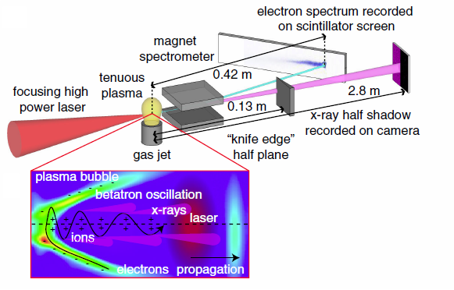
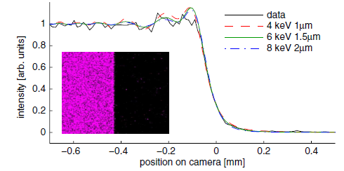
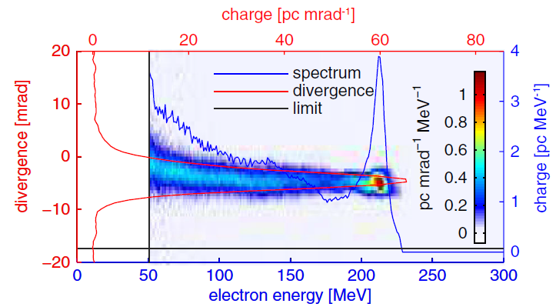
σ σ’ γ Δγ at the same time
S. Kneip and al., PRST-AB 15, 021302 (2012)
Source size by Fresnel diffraction
Notes:
NIVFE senza k
Enormi oscillazioni nel puntamento e nella carica nel loro esperimento. Esperimento a 230 MeV. Hercules laser of the Center for Ultrafast Optical Science at the University of Michigan, Ann Arbor

Slide 15
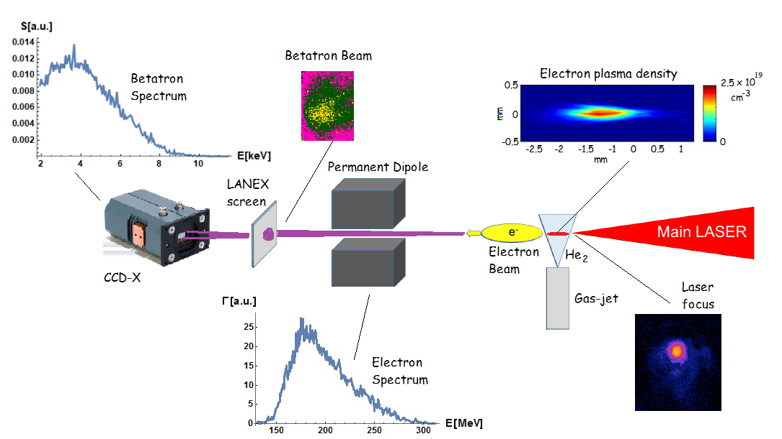
Emittance with the correlation term
First measurement of the emittance including the correlation term
The beam profile is retrieved not simply the average dimensions
An expression is given for the correlation function between the betatron oscillation amplitude and the divergence of the single accelerated electrons, i.e. the angle with respect the acceleration axis, in order to obtain the distribution of the electron divergences.
1 J
30 fs (FWHM)
10 μm diameter focus,
a0 ∼ 4.4
n_{e}=(8±1)10¹⁸ cm⁻³
Curcio, A., et al. "Trace-space reconstruction of low-emittance electron beams through betatron radiation in laser-plasma accelerators." Physical Review Accelerators and Beams 20.1 (2017): 012801.

Slide 16
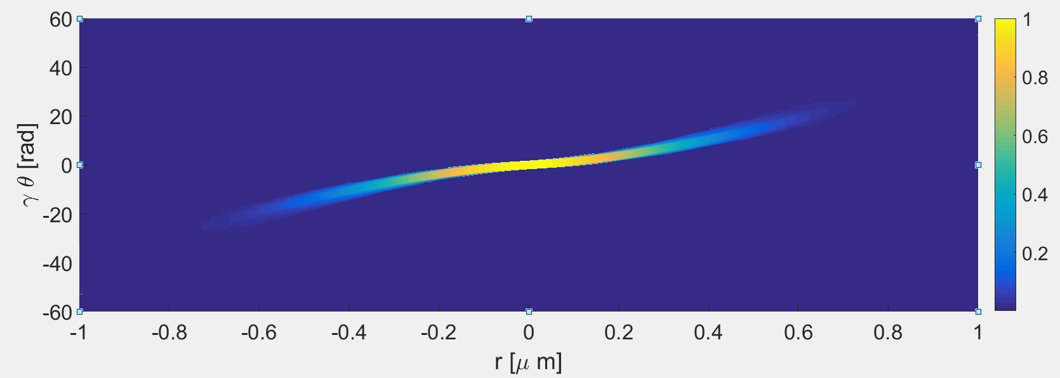
Phase space recontruction
Normalized rms emittance (correlated): 0.6 mm mrad
Normalized rms emittance (non correlated, upper limit): 1.6 mm mrad

Slide 17
Open problems
Separation of Betatron radiation from Synchrotron radiation coming from a bending magnet: not big deal
Beam charge 30 pC
Energy 1 GeV
plasma density 2 10¹⁶cm⁻³
magnet filed 1.5 T
radius of curvature 2.2 m
Separation of witness and driver radiation in case of beam driven: it is a problem!

Slide 18
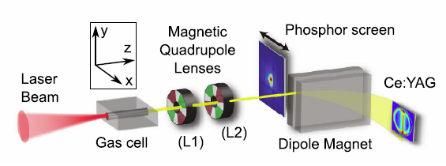
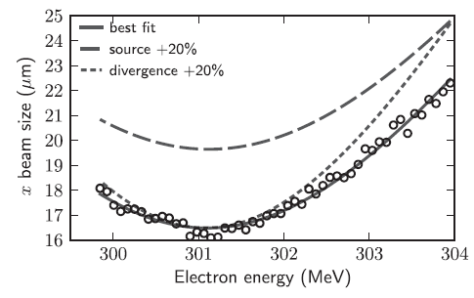
A new kind of Quadscan
Reduction of energy spread (highly desirable) will dramatically reduce the resolution of this measurement
R. Weingartner and al., PRST-AB 15, 111302 (2012),
Barber, S. K., et al., Physical Review Letters 119.10 (2017): 104801.
F Li et al 2018 Plasma Phys. Control. Fusion 60 014029
Notes:
ATLAS facility at the MPI of Quantum Optics Due toroidi prima e dopo per controllare la carica.
Misure multishot and single shot
480 T/m è il gradiente dei quadrupoli.
Ipotesi forte sull’emittanza costante a diverse energie. Il fascio è correlato o termico?

Slide 19
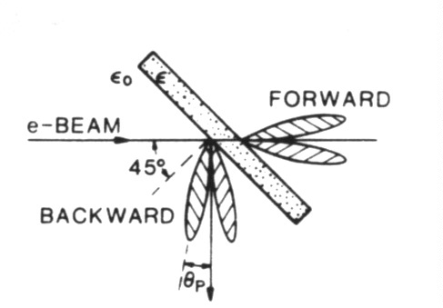
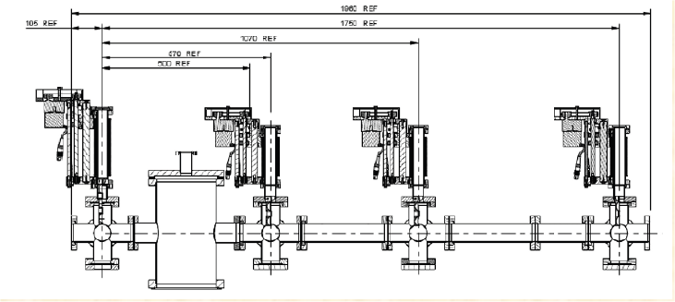
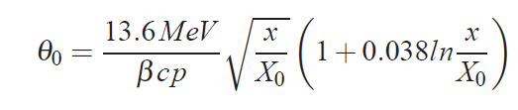
Multiple OTR monitors
C. Thomas, N. Delerue and R. Bartolini “Single shot transverse emittance measurement from OTR screens in a drift transport section”, 2011 JINST 6 P07004
In their case (3GeV) the multiple scattering is not a factor for thin (5 μm) screens
It is possible to produce even 1 μm aluminum screen
This system seems not feasible for beams with energy in the range of hundreds of MeV
Notes:
Parla prima del single shot e del problema driver-witness. Necessario avere un waist nel percorso
PW laser system operating
at APRI GIST in Gwangju (Korea

Slide 20
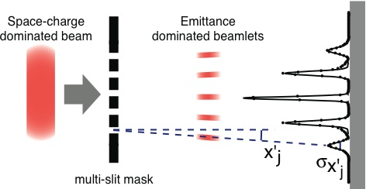

Pepper-pot like structures
To measure the emittance for a space charge dominated beam the used technique is the well known 1-D pepper-pot
The emittance can be reconstructed from the second momentum of the distribution
C. Lejeune and J. Aubert, Adv. Electron. Electron Phys. Suppl. A 13, 159 (1980)
Notes:
Non si può misurare l’energia nello stesso shot.

Slide 21

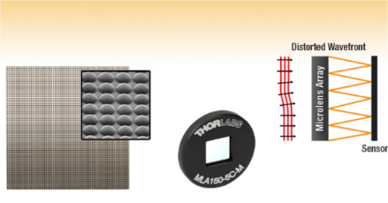
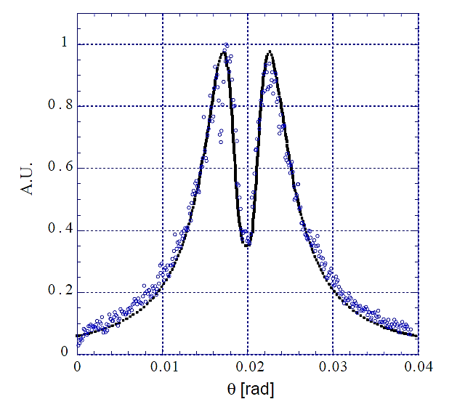

One Shot emittance
Electron beam
Metallic screen
Beam splitter
Beam imaging system + High-QE CCD
Microlens array
Imaging of the microlens focal plane
Intensified camera, angular distribution
Cianchi, A., et al. "Transverse emittance diagnostics for high brightness electron beams." Nuclear Instruments and Methods in Physics Research Section A: Accelerators, Spectrometers, Detectors and Associated Equipment 865 (2017): 63-66.

Slide 22
Optical vs conventional
The sampling is only on the mask and not also on the view screen due to the distance between screen and mask
There is no problem of scattering, material thickness, cutting of phase space etc.
Parameters fine tuning can be optical

Slide 23
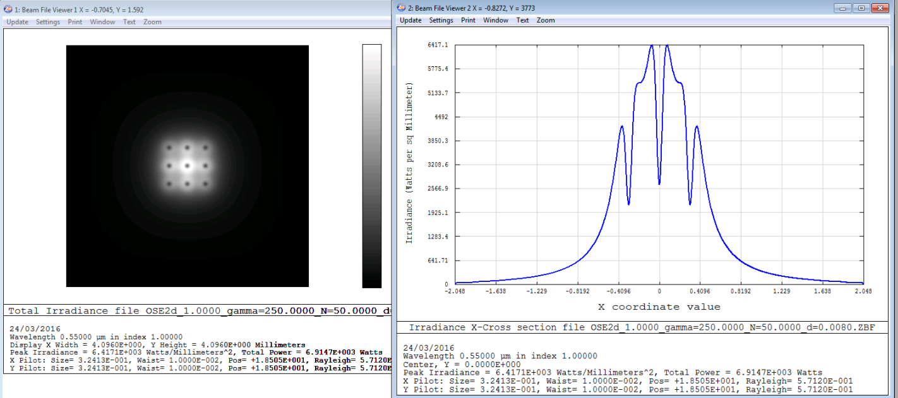
Zemax simulations
Courtesy F. Bisesto
Bisesto Fabrizio, et al. "Zemax simulations describing collective effects in transition and diffraction radiation." accepted on Optics Express (2018)

Slide 24
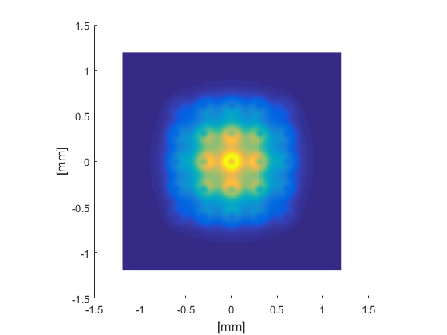
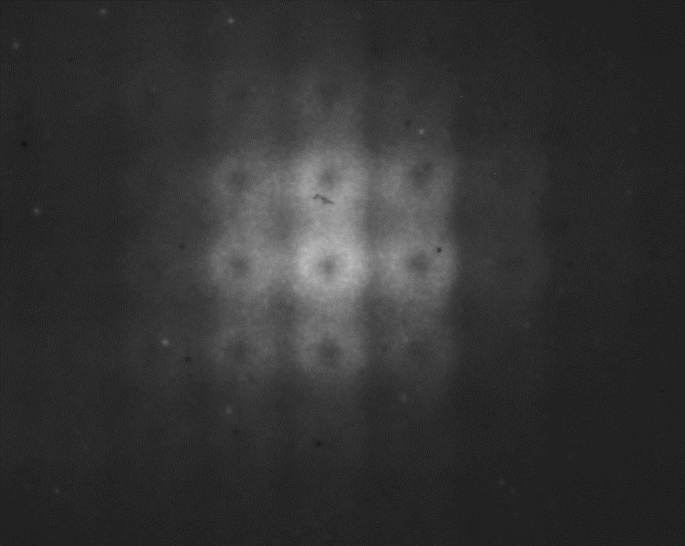
2D

Slide 25
Angular Resolution vs Energy
At 1 GeV, with a beam size of about 125 μm, optics magnification 3x, σ’_{x} about 100 μrad (resolution limit is 70 μrad) we can measure a normalized emittance of 7e-7

Slide 26
Conclusions
Plasma accelerated beam diagnostics is very challenging especially for emittance measurements
Compact, single shot, reliable system must be implemented
Betatron radiation is a good candidate to measure the beam properties at the end of the plasma
Other methods are still in developing stage

Slide 27

Conclusions
We are developing:
  Plasma accelerator structures
  Plasma lenses
  Plasma dipoles
  Plasma deflectors
  Plasma dumps
  Plasma undulators
We need to develop also solutions for plasma accelerated beams diagnostics

Slide 28
It is over, finally!!
Thank you for your attention

Slide 29
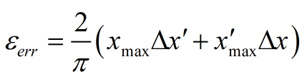
Quantization error
T. Ludwig, K. Volk, W. Barth, and H. Klein, “Quantization error of slit‐grid emittance measurement devices”, Review of Scientific Instruments 65, 1462 (1994)

Slide 30
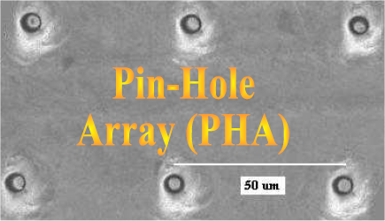
Holes machining
Holes array have been successfully produced.
The thickness of the material can be as large as 100 times the hole diameter
T. Levato and al. “Fabrication of 3 μm diameter pin hole array (PHA) on thick W substrates”, AIP Conf. Proc. Vol 1209, pp 59-62 (2010)

Slide 31
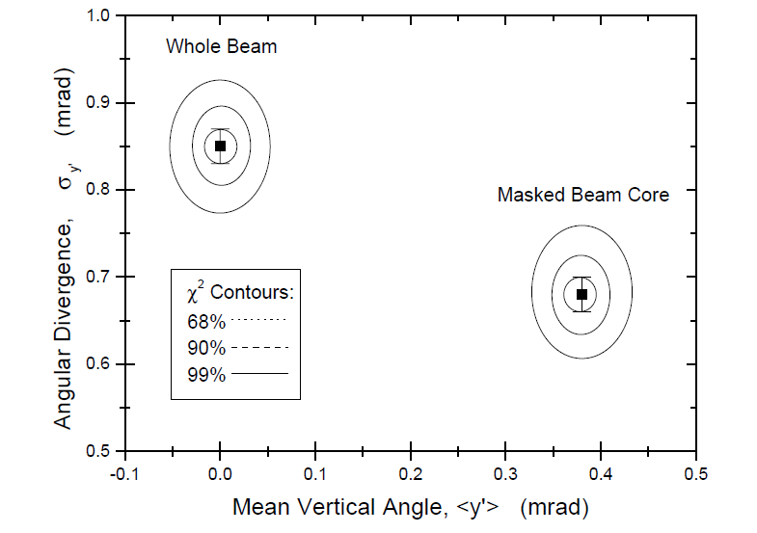
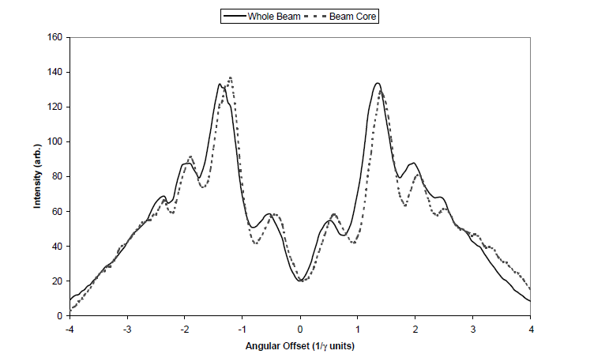
With a mask
G. P. Le Sage, T. E. Cowan, R. B. Fiorito, and D. W. Rule, ”Transverse phase space mapping of relativistic electron beams
using optical transition radiation” , PHYSICAL REVIEW SPECIAL TOPICS - ACCELERATORS AND BEAMS, VOLUME 2, 122802 (1999)
Notes:
In prospettiva potremmo risolvere driver and witness

Slide 32
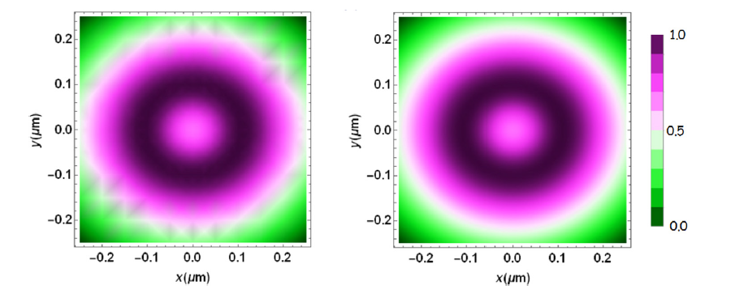
From 1D to 2D
Retrieved
Simulation
2D beam profile monitor could be therefore possible only when the correlated angular-spectral distribution of the betatron radiation is detected
Great monitor for nm beam size
Curcio, A., et al. "Single-shot non-intercepting profile monitor of plasma-accelerated electron beams with nanometric resolution." Applied Physics Letters 111.13 (2017): 133105.
Notes:
Synthetic data

