Slide 2
From mammalian circuits to synapses: correlative multimodal imaging using hard X-rays
Carles Bosch Piñol
Sensory circuits and neurotechnology lab (Schaefer Lab)
ALBA II Long Beamlines Workshop
15th November 2022
Notes:
Hi everyone, thank you very much for your time.
I will try to convince you that using hard x-rays can be useful for studying systems neuroscience in mammals.

Slide 3
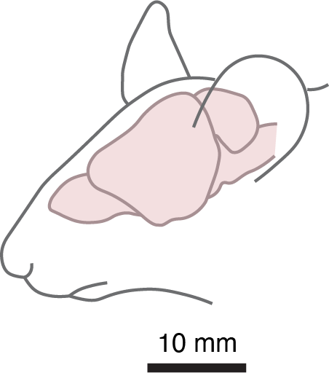

Slide 4
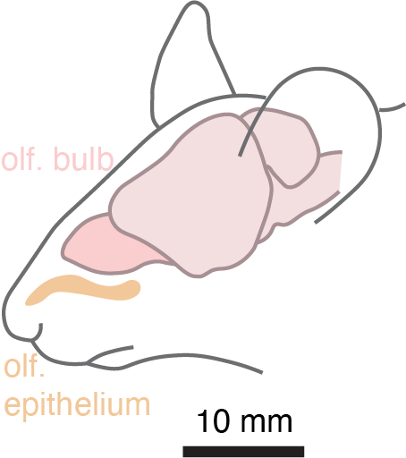

Slide 5
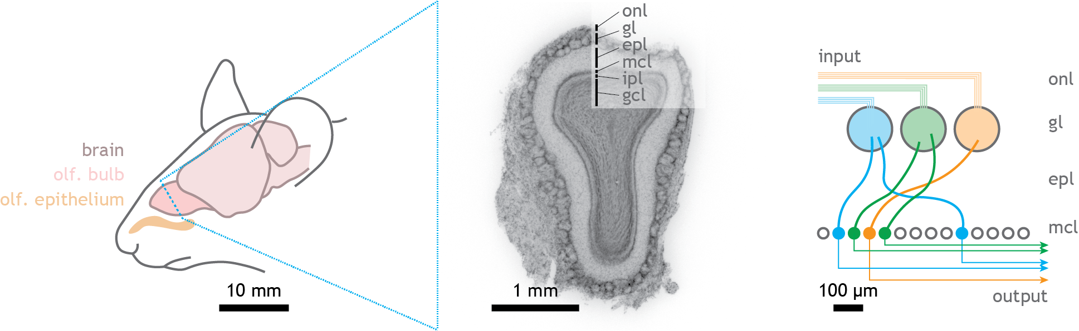
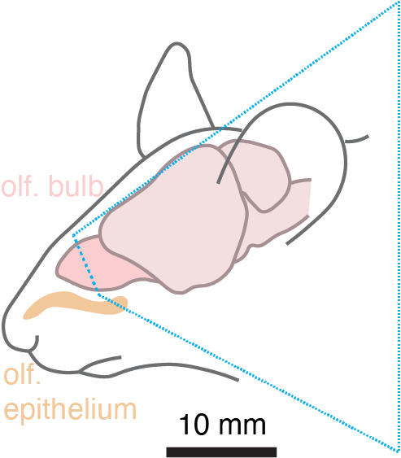

Slide 6
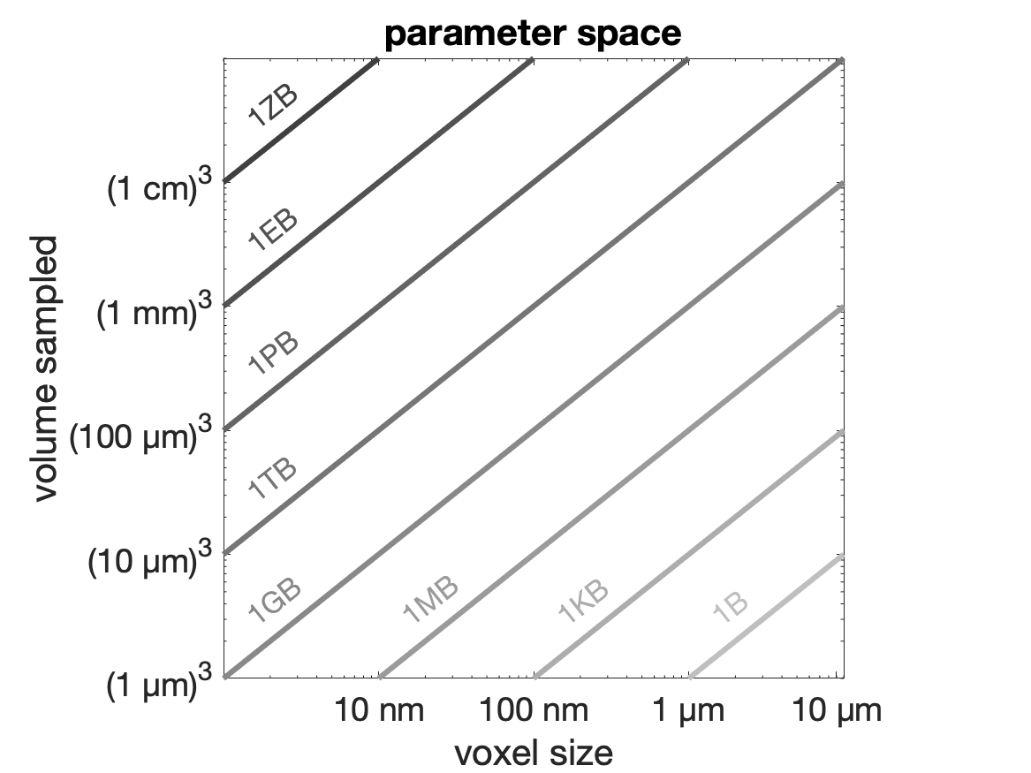
Dimensions of complete mammalian circuits
Notes:
We are interested in understanding how neuronal circuits operate in the brain. For that, we are set up to acquire maps that cover full neuronal circuits – at least with both their input and their output – at a resolution sufficient to discriminate individual functional units.
Those – coverage and detail – are two key parameters to keep in mind when designing these experiments. I will use this diagram during the talk to illustrate where do the different datasets mentioned live in terms of coverage and detail.

Slide 7
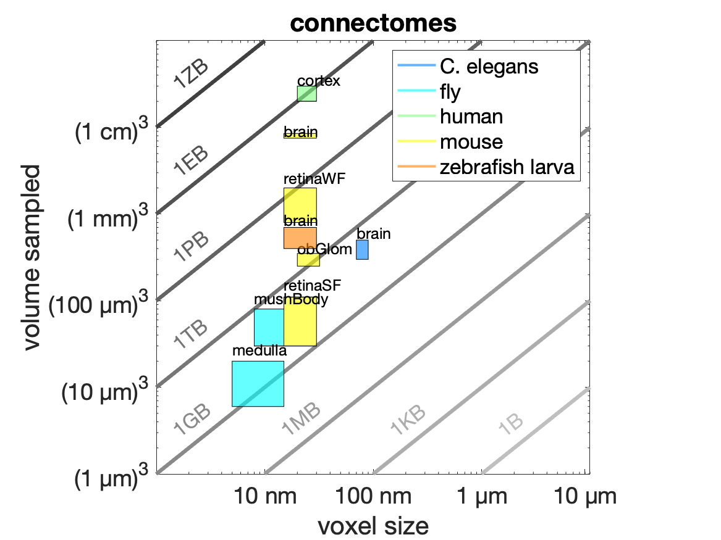
Dimensions of complete mammalian circuits
Adapted from Helmstaedter et al. 2013
Notes:
Yet, synapses are not the only features functionally-relevant in circuits.
Many outstanding biological questions lie on resolving apical dendrites across neighboring columns, or lateral dendrites within a local vicinity, or synapses only within the input compartment – the glomerulus.
This view relaxes the requirements we may put onto the maps we should aim to obtain.
And now, which techniques could provide the datasets that would solve those questions?

Slide 8
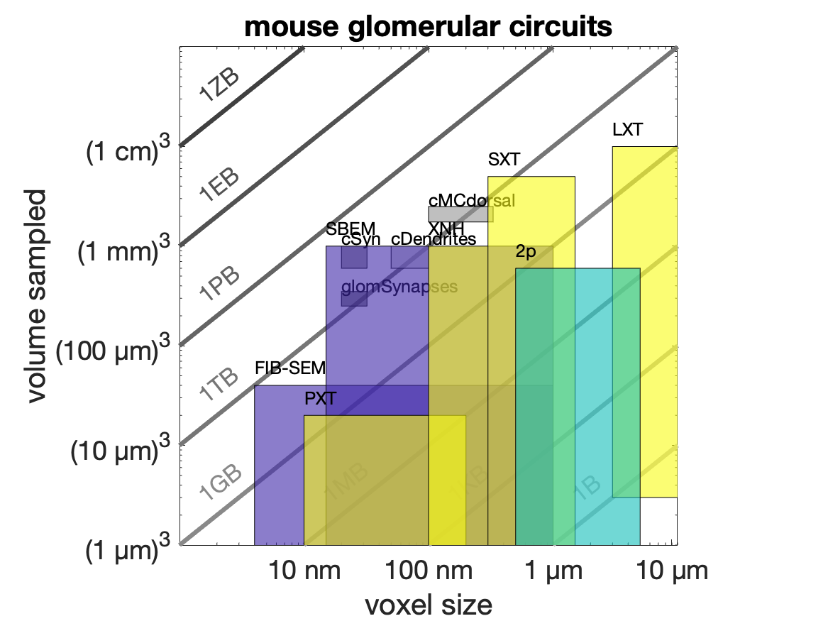
Dimensions of complete mammalian circuits
Notes:
Yet, synapses are not the only features functionally-relevant in circuits.
Many outstanding biological questions lie on resolving apical dendrites across neighboring columns, or lateral dendrites within a local vicinity, or synapses only within the input compartment – the glomerulus.
This view relaxes the requirements we may put onto the maps we should aim to obtain.
And now, which techniques could provide the datasets that would solve those questions?

Slide 9
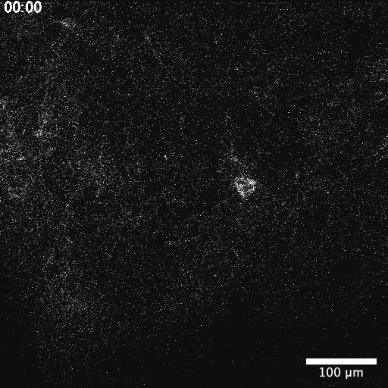
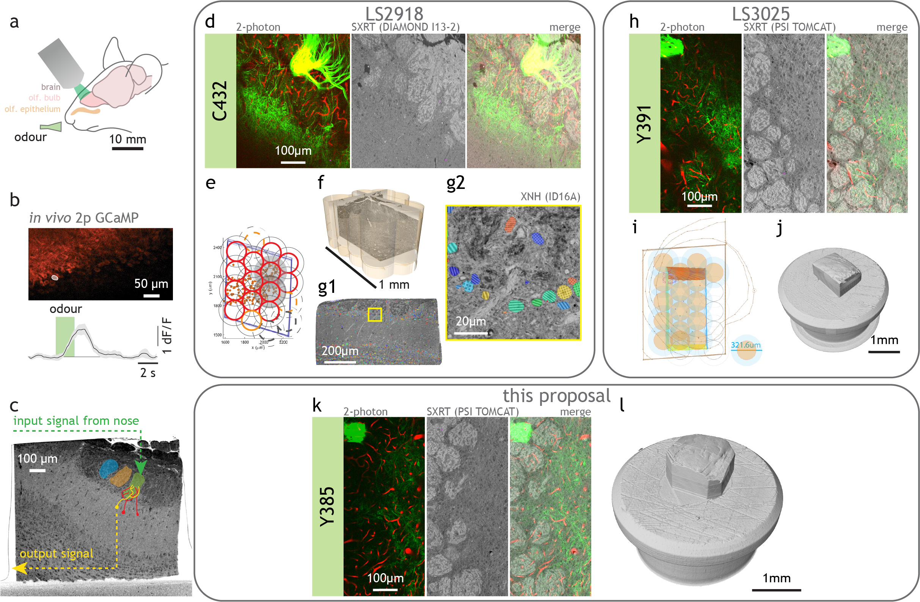
Dimensions of complete mammalian circuits
Notes:
Yet, synapses are not the only features functionally-relevant in circuits.
Many outstanding biological questions lie on resolving apical dendrites across neighboring columns, or lateral dendrites within a local vicinity, or synapses only within the input compartment – the glomerulus.
This view relaxes the requirements we may put onto the maps we should aim to obtain.
And now, which techniques could provide the datasets that would solve those questions?

Slide 10
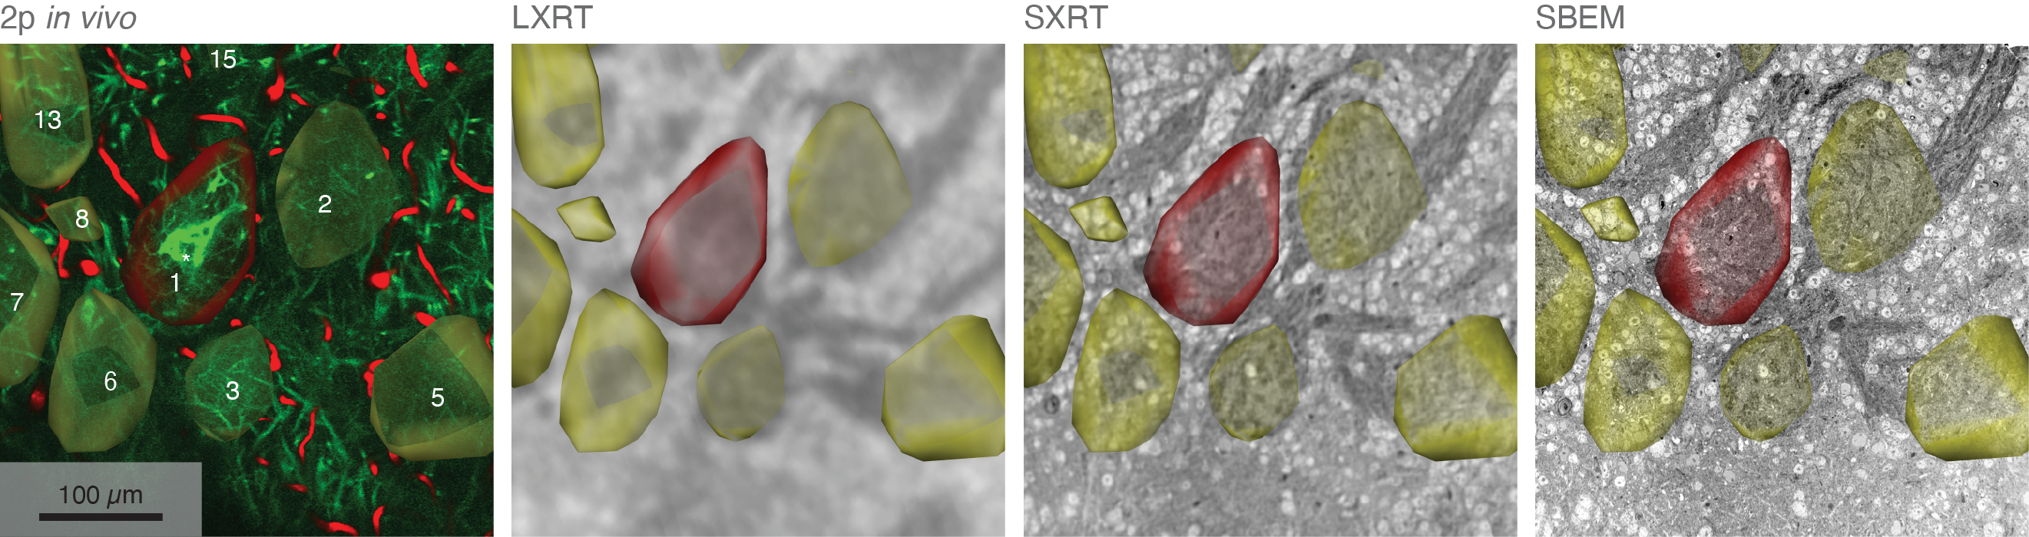
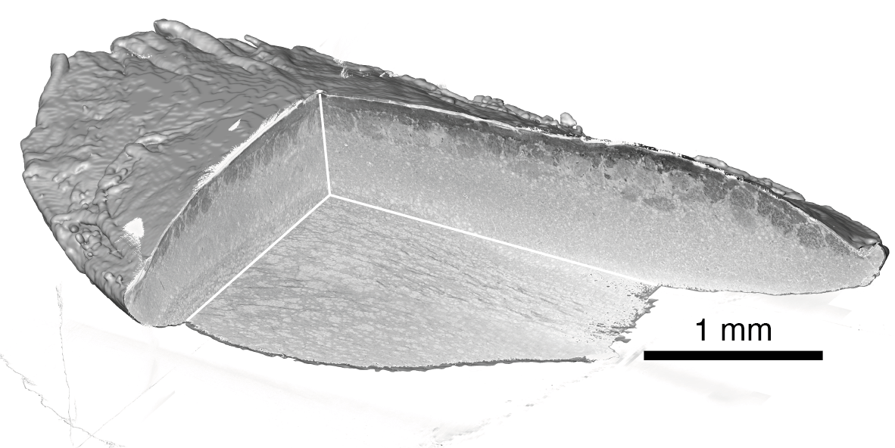
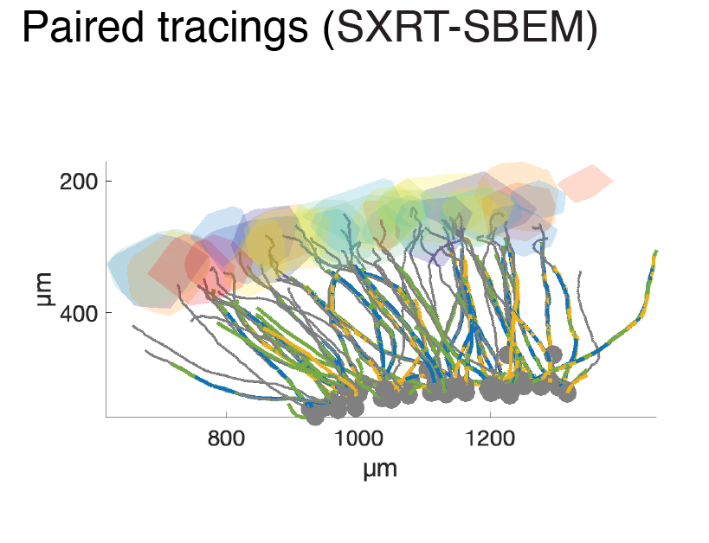
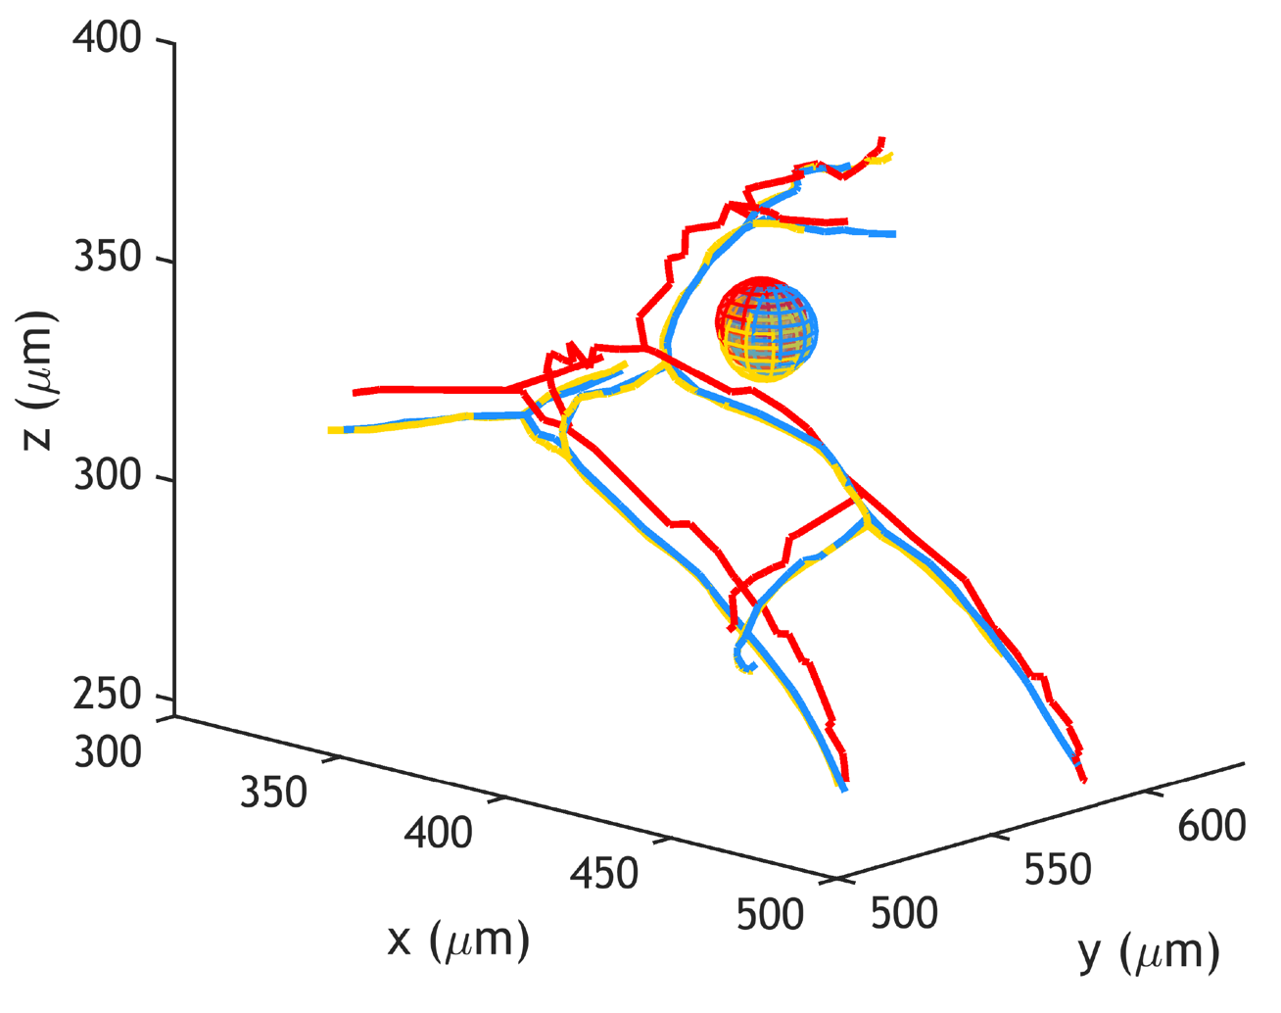
Correlative 2-photon, synchrotron X-ray tomography with propagation-based phase contrast and volume electron microscopy
Diamond Light Source I13-2,
PSI TOMCAT
SXRT can provide near-µm context across >100µm landscapes.
2P and SXRT can be warped at
single-cell accuracy
CMI workflow applicable to other biological soft tissue systems
CMI workflow compatible
with other X-Ray modalities
C. Bosch et al., Functional and multiscale 3D structural investigation of brain tissue through correlative in vivo physiology, synchrotron microtomography and volume electron microscopy. Nature communications 13, 2923 (2022).
Y. Zhang et al., Sample Preparation and Warping Accuracy for Correlative Multimodal Imaging in the Mouse Olfactory Bulb Using 2-Photon, Synchrotron X-Ray and Volume Electron Microscopy. Front Cell Dev Biol 10, 880696 (2022).

Slide 11
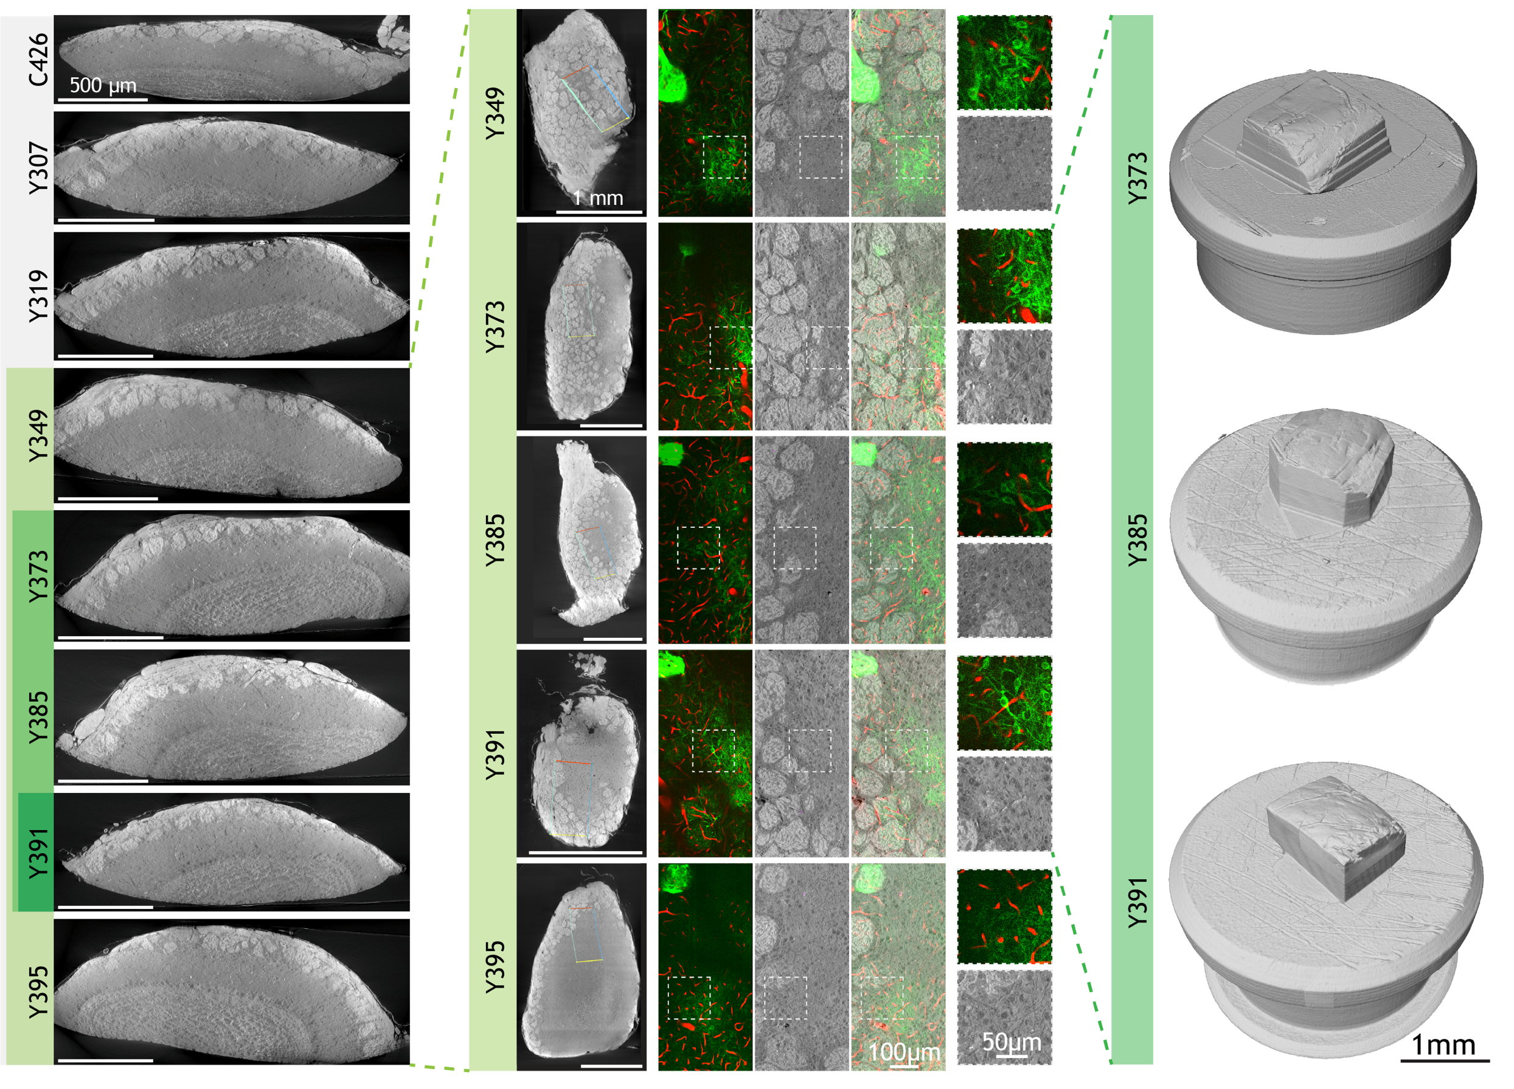
Correlative 2p-SXRT at single-cell resolution… and beyond
PSI TOMCAT

Slide 12
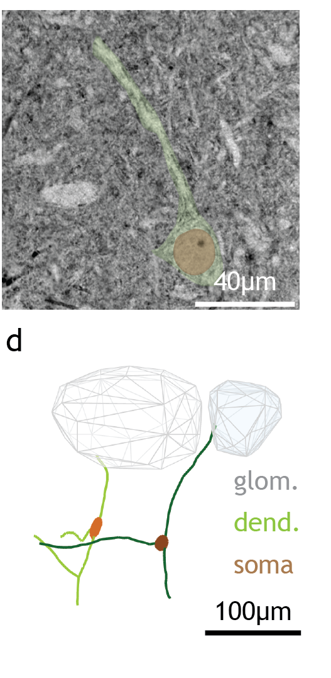
Hard X-ray Holographic Tomography
Adapted from Kuan et al. 2020
ESRF ID16A

Slide 13
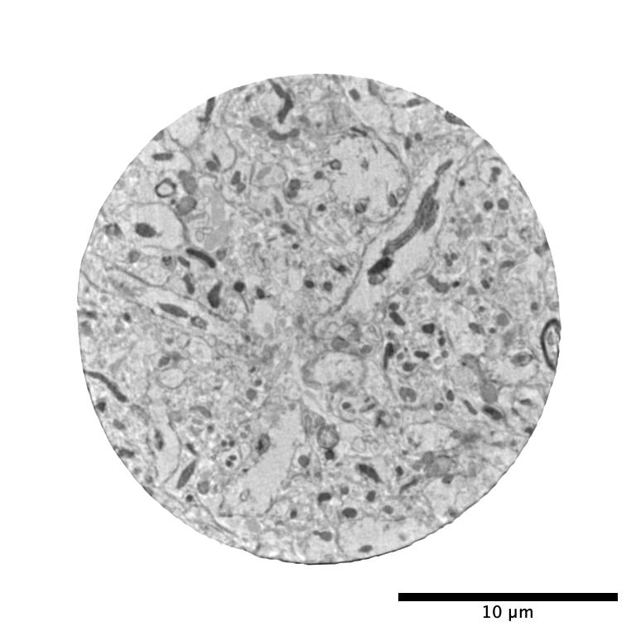
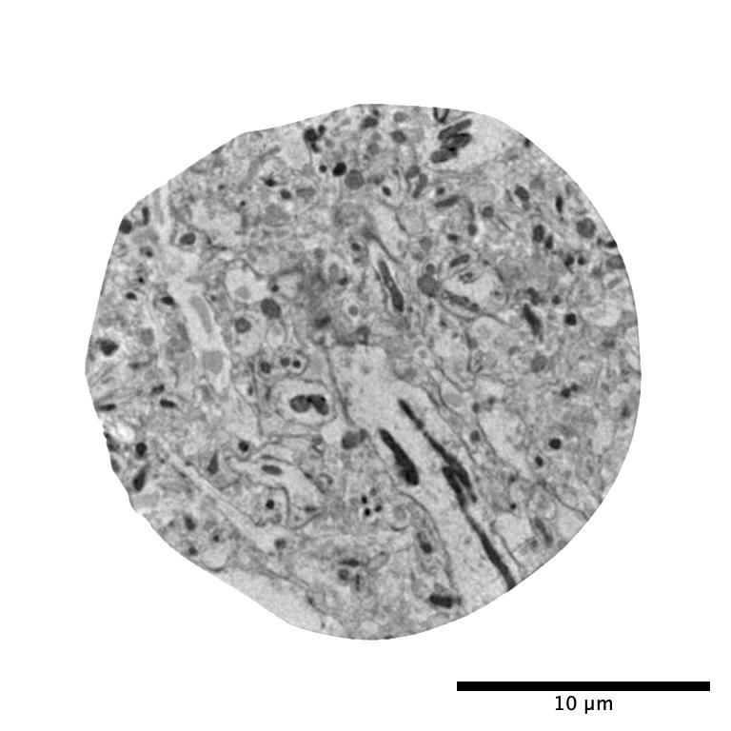
Ptychography of stained, embedded brain samples
EPL1_273
EPL5_359
PSI cSAXS

Slide 14
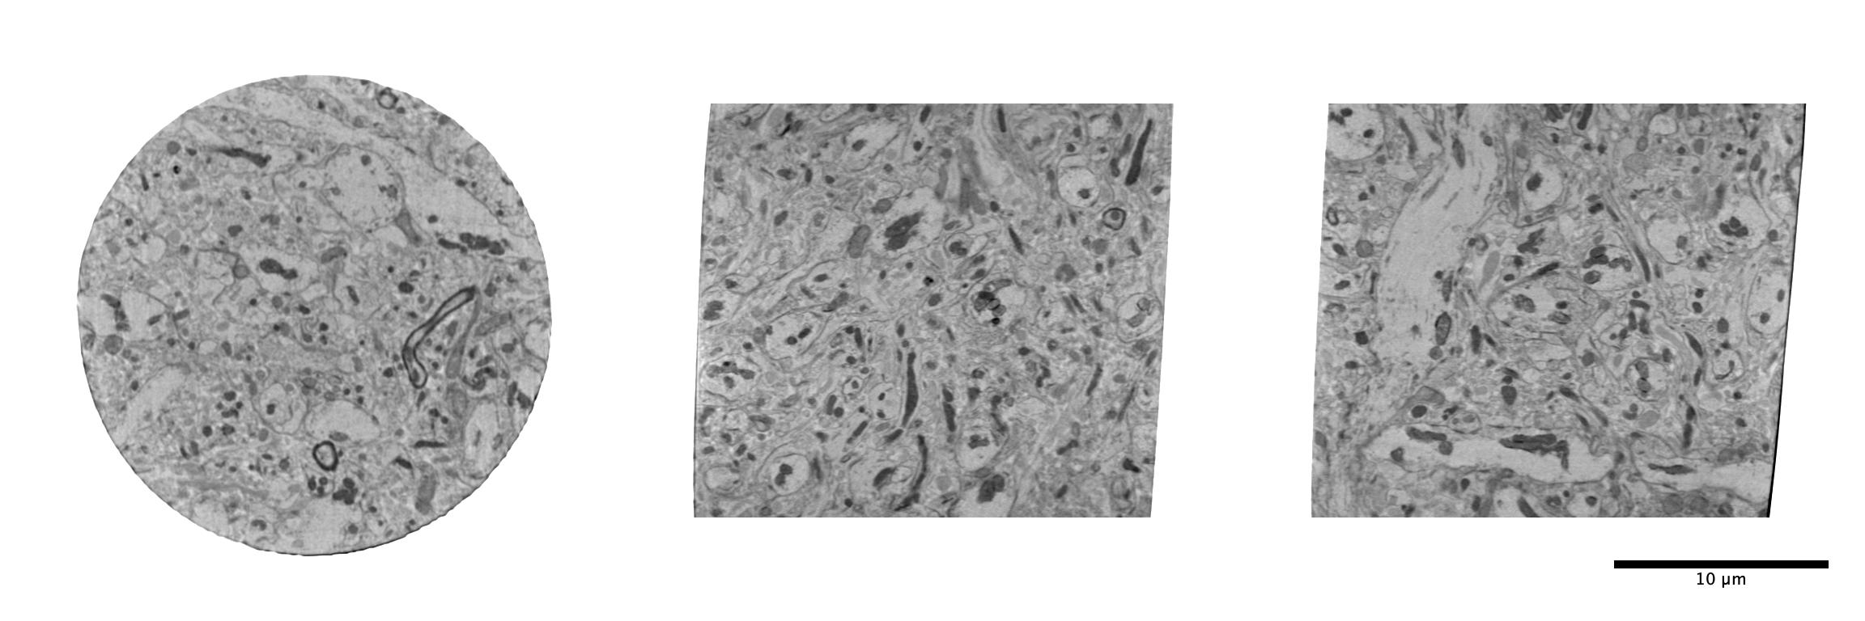
EPL1_273

Slide 15
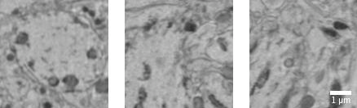
EPL1_273

Slide 16
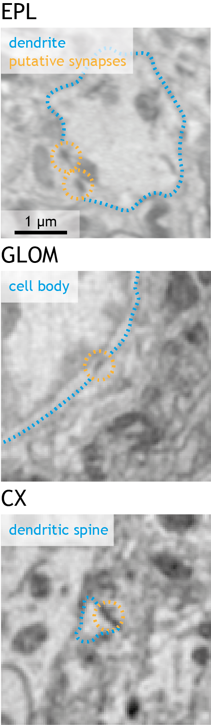
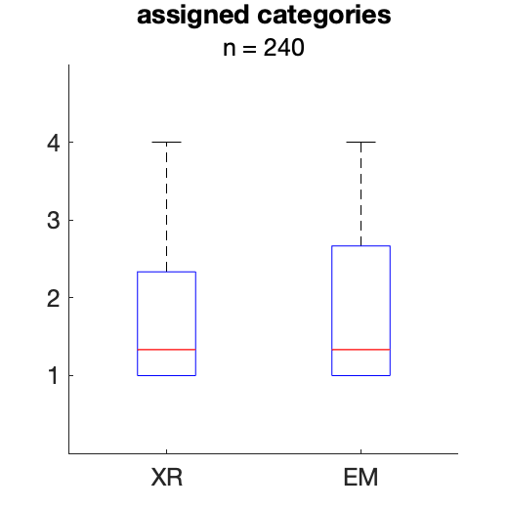
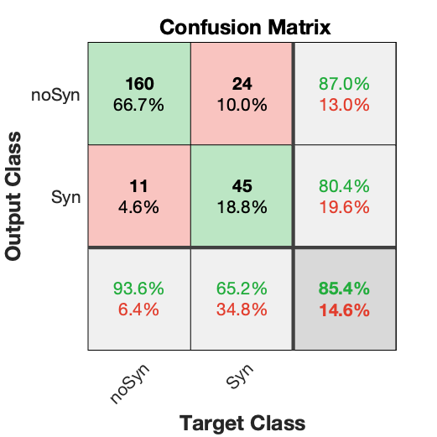
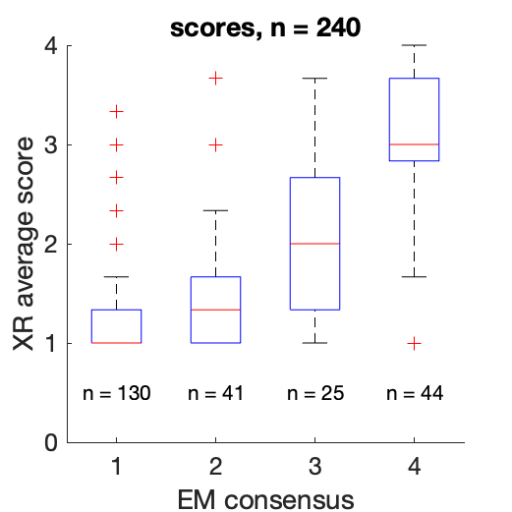
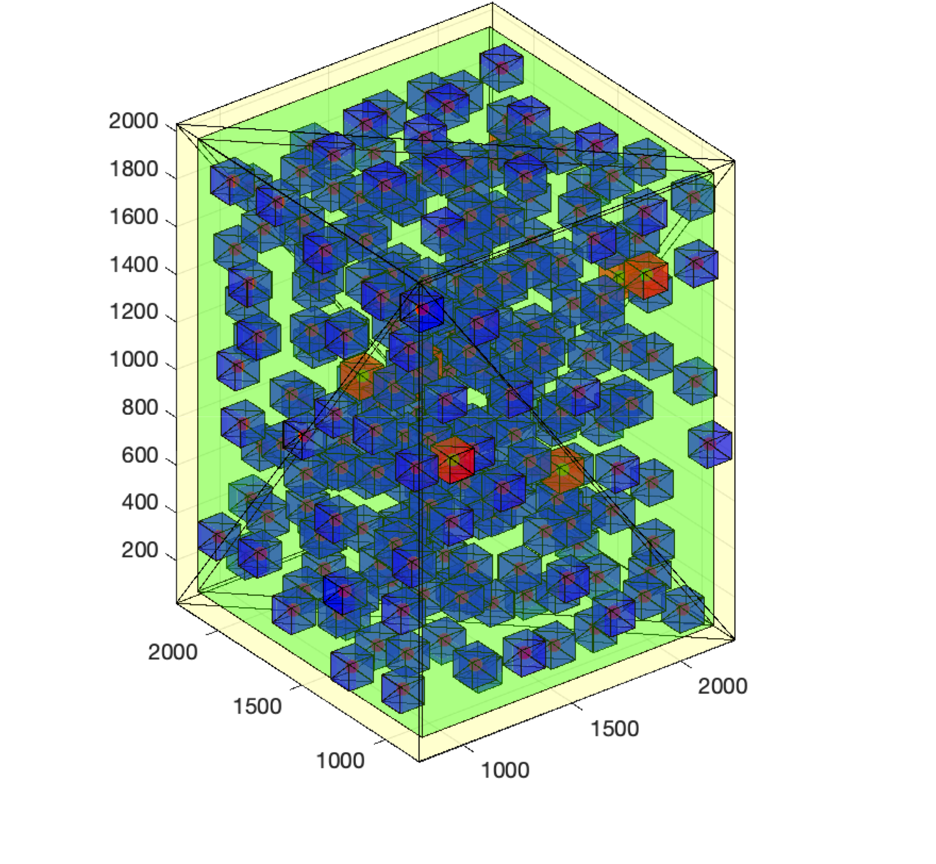
Biological features resolved: synapse detection
X-ray ptychography can detect 60% of the synaptic contacts
in the mouse olfactory bulb external plexiform layer
with an 80% precision.
Bosch et al. 2023, in preparation
Notes:
- we observed that in the ptychography dataset researchers could detect 60% of the synapses with an 80% precision, whereas false negative rate was comparable to ground truth.

Slide 17
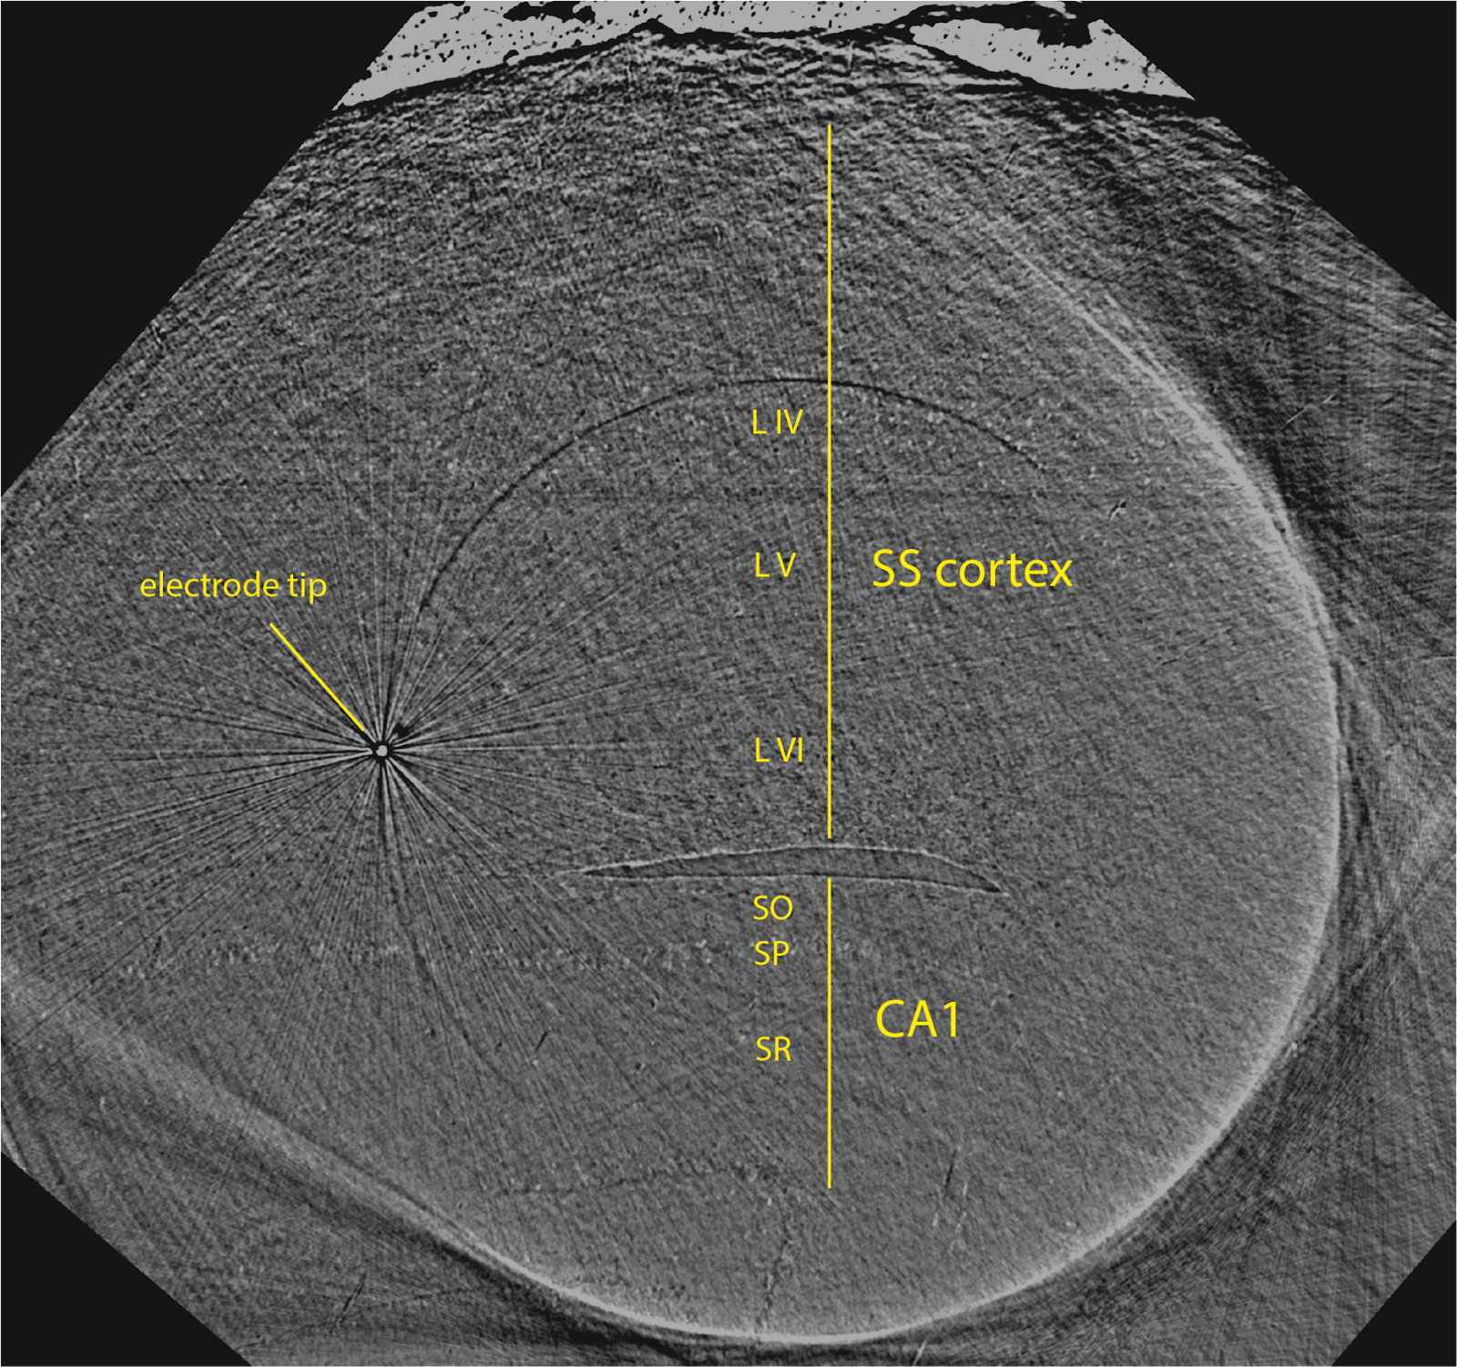
Unstained fresh tissue & microelectrodes
Diamond Light Source I13-2

Slide 18
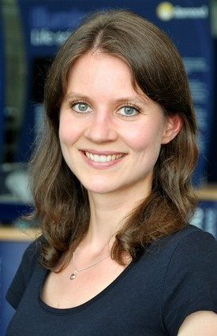
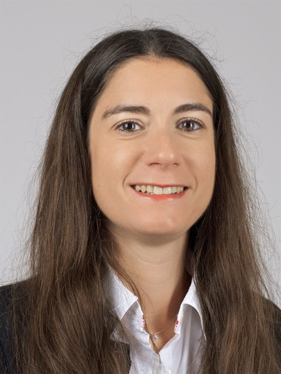
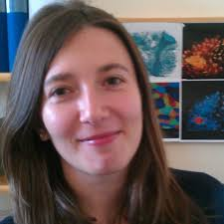

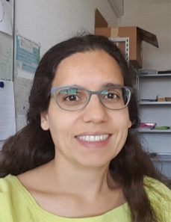
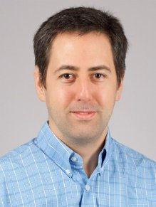

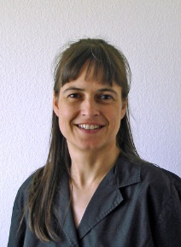

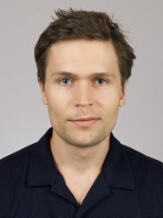




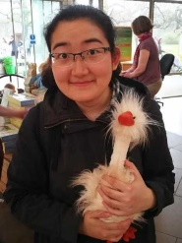




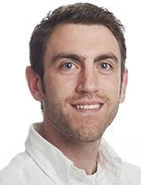
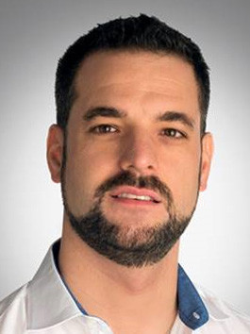
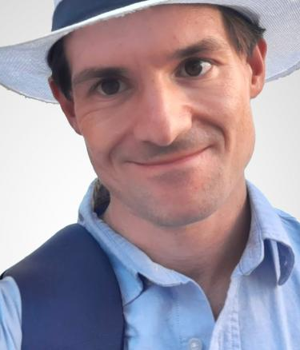
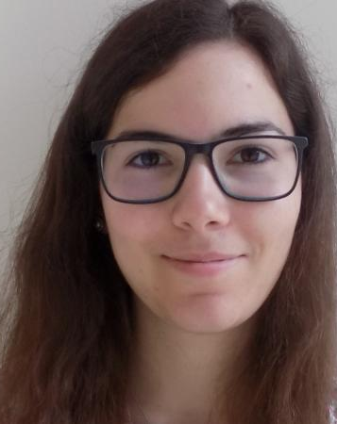
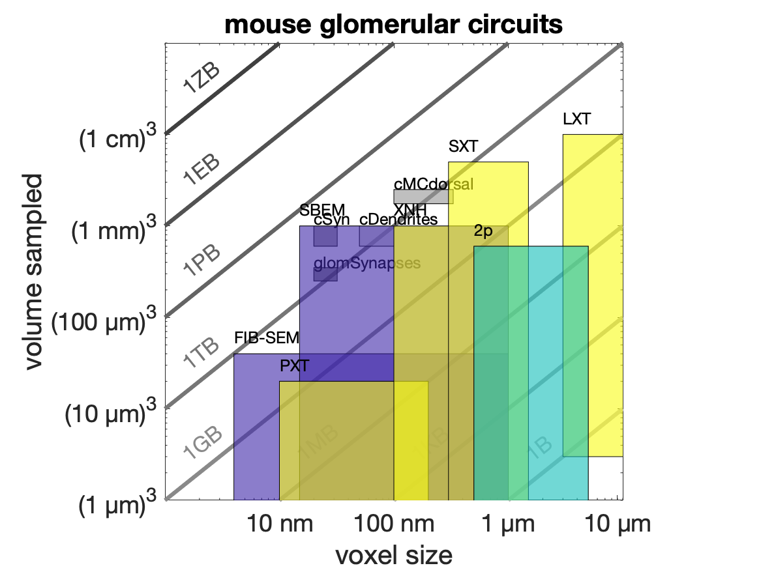

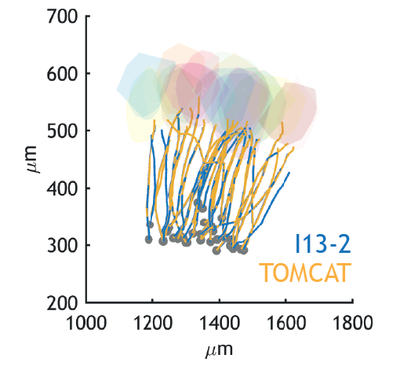
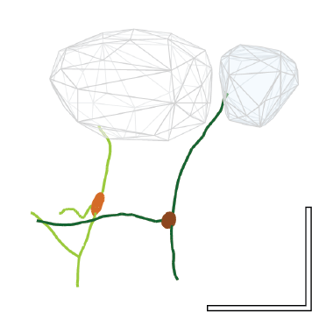


Acknowledgements
Marie-C
Zdora
Anne
Bonnin
Alexandra
Pacureanu
Malte
Storm
Ana
Diaz
Mirko
Holler
Manuel
Guizar-Sicairos
Elisabeth
Müller
Liz
Duke
Tomas
Aidukas
Andreas
Schaefer
Lucy
Collinson
Chris
Peddie
Tobias
Ackels
Yuxin
Zhang
Sina
Tootoonian
Manuel
Berning
Norman
Rzepka
Ruairi
Roberts
Jon
Bogovic
Adrian
Wanner
Mihály
Köllő
Ester
Lopes
SXRT
XNH (ID16A)
PXT (cSAXS)
100 µm
Notes:
#### acknowledgements
last but not least, this work has been in close collaboration with a wide range of excellent collaborators, hope not missing anyone
- But would be fair to highlight three key groups, being the teammates at schaeferlab with whom we ran the correlative in vivo – to – stained workflow, the team at scalableminds for continued support in setting up a versatile dataset ecosystem, and the top row: X-ray physicists at the multiple synchrotron beamlines we’ve visited, that have provided stellar insights in a field sometimes way beyond my own expertise, and with whom is also a pleasure to work with.
And with this, I will be very pleased to answer any questions you might have.

Slide 19
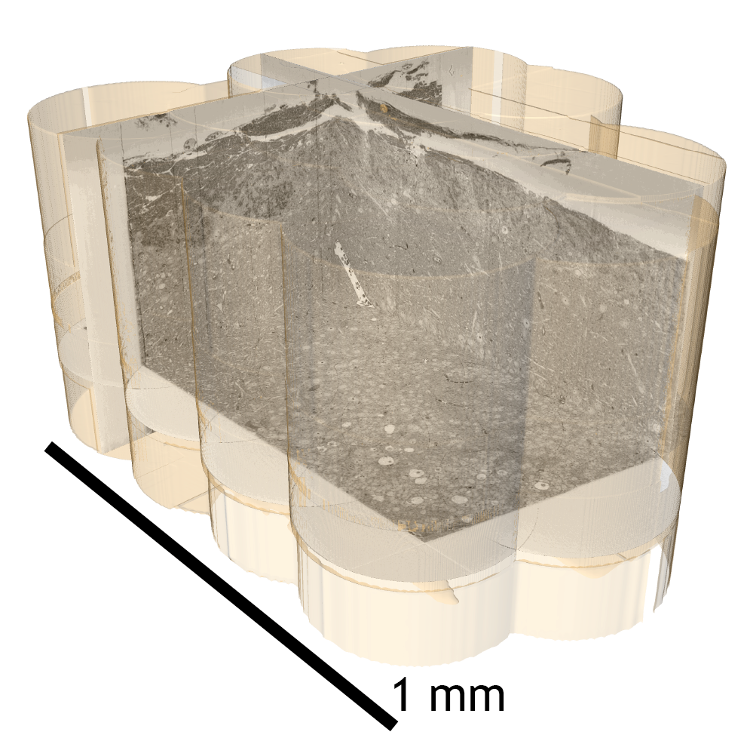
From mammalian circuits to synapses: correlative multimodal imaging using hard X-rays
100 µm
SXRT
XNH (ID16A)
PXT (cSAXS)
Notes:
#### acknowledgements
last but not least, this work has been in close collaboration with a wide range of excellent collaborators, hope not missing anyone
- But would be fair to highlight three key groups, being the teammates at schaeferlab with whom we ran the correlative in vivo – to – stained workflow, the team at scalableminds for continued support in setting up a versatile dataset ecosystem, and the top row: X-ray physicists at the multiple synchrotron beamlines we’ve visited, that have provided stellar insights in a field sometimes way beyond my own expertise, and with whom is also a pleasure to work with.
And with this, I will be very pleased to answer any questions you might have.

