Slide 1
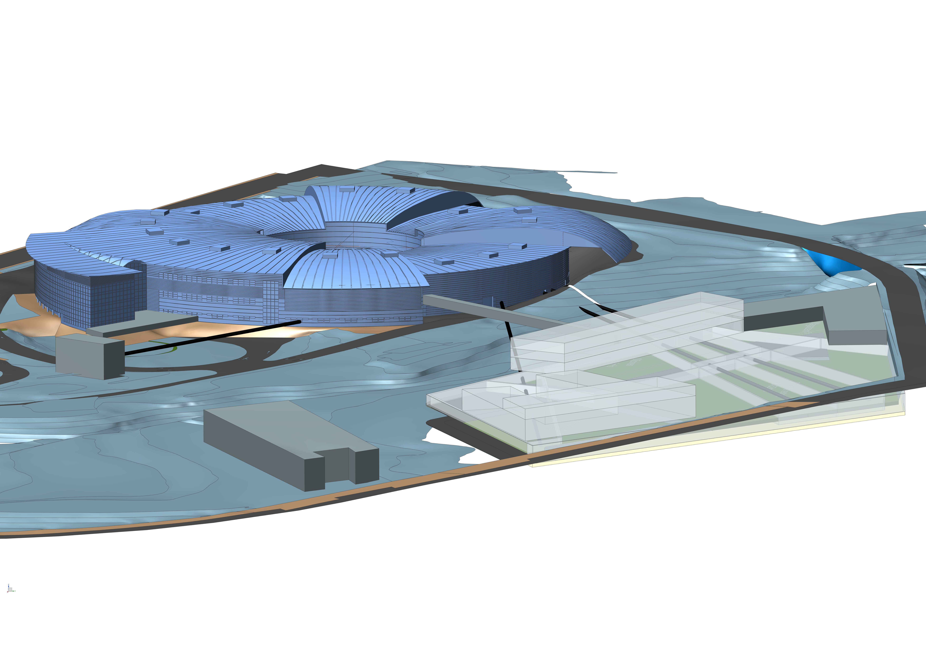
Introduction to ALBA II
Caterina Biscari
14 November 2022
ALBA II Long BLs Workshop

Slide 2
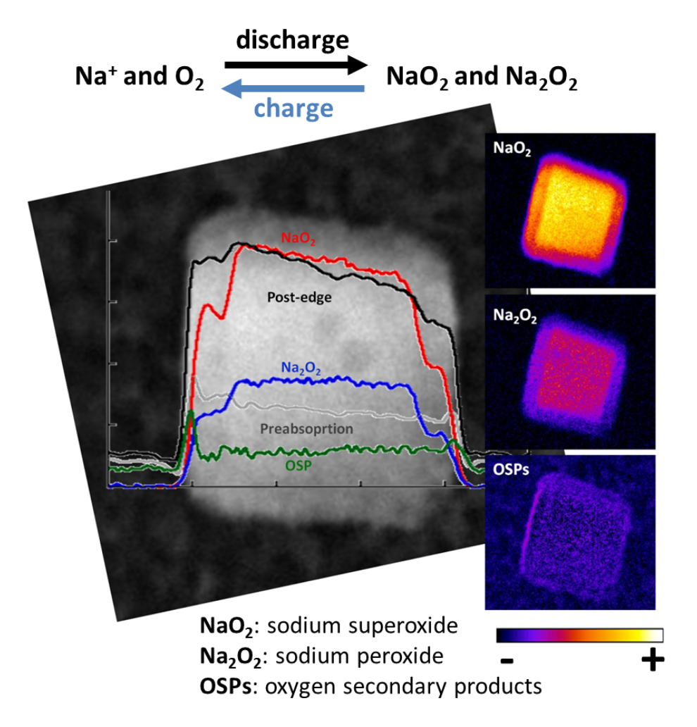
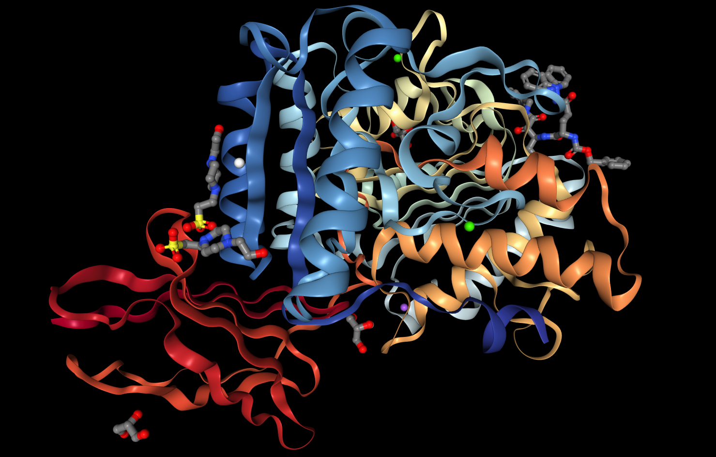
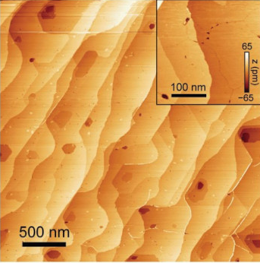
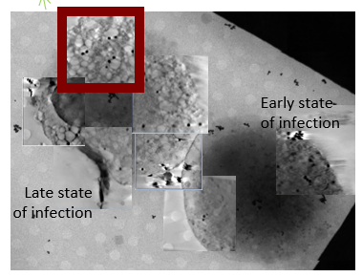
ALBA Synchrotron
50% national Government (Ministerio de Ciencia e Innovación)
50% regional GenCat (Department de Recerca i Universitats)
Life Science
From the protein to the cell
Chemistry and Material Science
Energy material, catalysts, environment
Electronic and Magnetic Structure of Matter
Advanced materials
Cell infected by covid-19
Battery developments
Nanomagnetism for data storage
Scientific pillars
Drug design, characterization and biological processes
Catalysis and environmental sciences
Magnetic nanomaterials
Materials for energy-related applications

Slide 3



+ 2200 yearly user visits
+300 yearly experiments
3400 national and 3200 international users
+2500 publications
ALBA
key features
+7500 yearly public visits
JEMCA – EM center
+250 trained students
Beamlines:
10 in operation
2 in commissioning
2 in construction
3 Gev Light Source
+230 staff
Planning the upgrade towards ALBA II

Slide 4
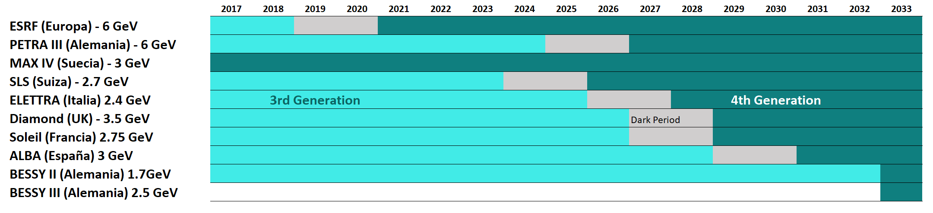
Evolution from 3rd to 4th generation in Europe
LEAPS ESAPS2022 aiming at harmonizing upgrades to avoid contemporaneous dark times
Today

Slide 5
From ALBA to ALBA II
ALBA II is bringing life to ALBA for the next 20-30 years. The upgrade brings the capabilities of the facility to the forefront of synchrotron light experiments and allows to update the program
The changes from ALBA to ALBA II:
Renewing the accelerator reduces the dimensions of the photon beam and increases its brightness
Experimental lines of more than 100m in length enhance resolution and coherence properties, positioning themselves at the forefront of technology for the use of synchrotron light
Updating the existing lines will update the lines to state of the art instruments and will allow to optimize the portfolio
Integrating automated data pipeline and updating the computing infrastructure will integrate the facility into big-data world

Slide 6
ALBA II short history - Key dates so far
2020
Jul - First presentation of ALBA II storage ring upgrade ideas to SAC
Nov - Presentation of ALBA II preliminary upgrade plans to SAC
Dec - Pre-white paper presented to Council – Go ahead from Council to start the design
2021
Along the whole year – Preparing the scientific case - Colloquia and workshops with participation of hundreds of researchers from all over the world - ALBA Scientific Sections review
Advancing in the design of the accelerator upgrade
Mar – 2021-2024 ALBA strategy plan including ALBA II
Jun – ALBA II Day – Call for ideas on ALBA II Beamlines for starting a new BL on 2021
Jul – 1st funding for ‘ALBA II Enabling Technologies’ – Recovery funds – 7.5 M€
2022
Advancing in the design of the accelerator upgrade
Jan - Funding for a full new beamline – 10 M€
Feb – Decision on the 14th ALBA BL (3Sbar)
Sep - Call for ideas on ALBA II LONG Beamlines for starting a new BL on 2022, in case of new funding
Oct - Official Council agreement on assignment of the new plots
ALBA II approval and Long term agreement (2023-2037) in negotiation

Slide 7
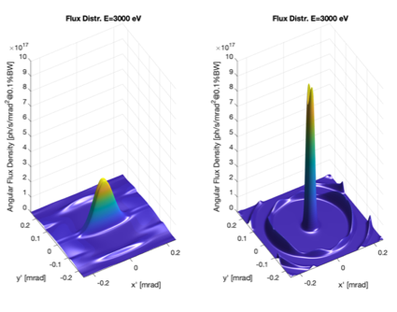
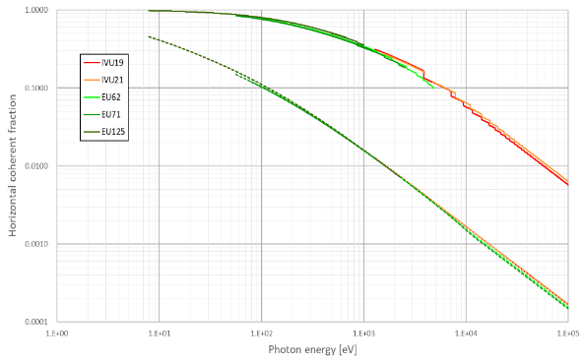
ALBA II design as today
4th generation light source
Emittance 150 pm (30 times smaller than ALBA)
Current 300 mA (+ 20% with respect to ALBA)
Increase of brilliance by orders of magnitude
Increase of coherence
Advanced properties for imaging, spectroscopy, diffraction
FLUX
Coherence
From ALBA to ALBA II

Slide 8
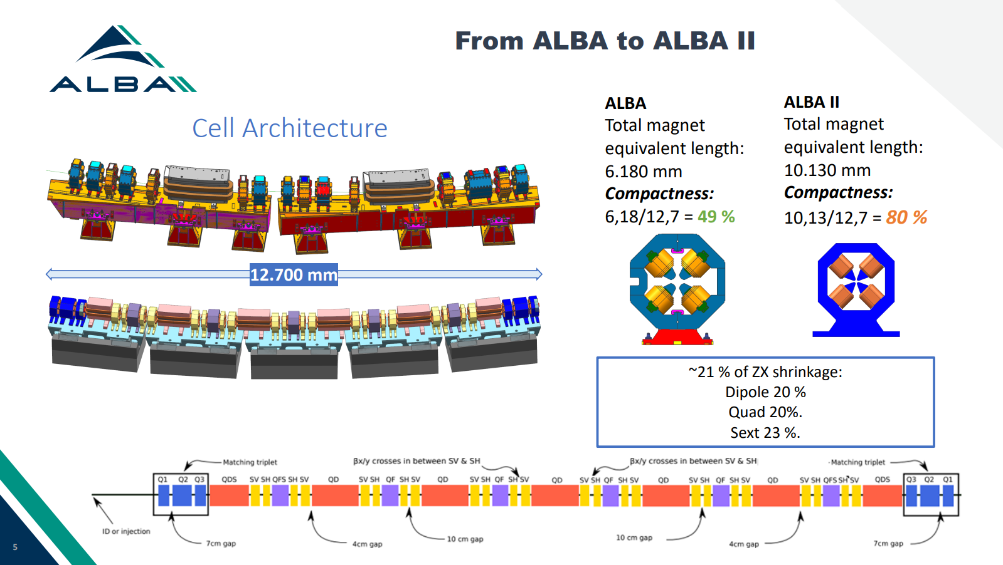
Accelerator systems
example of on-going developments

Slide 9
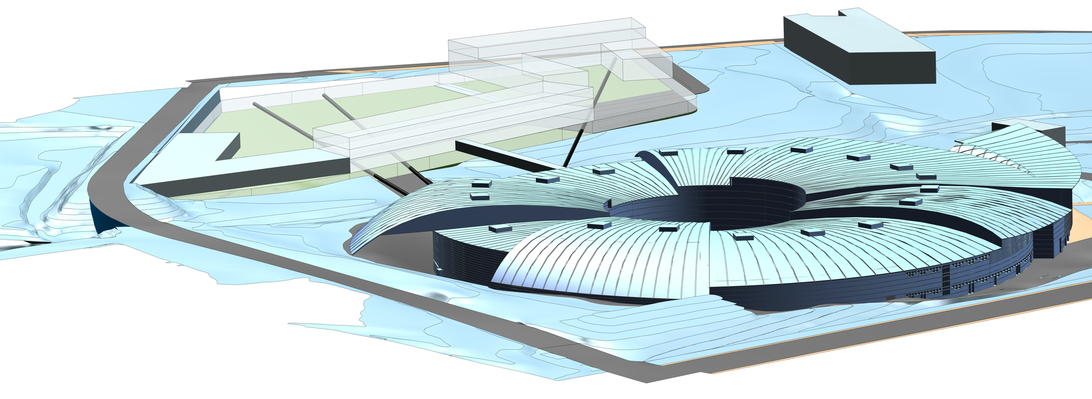
Enlarging ALBA research infrastructure
The potential of ALBAII is boosted by the availability of nearby green field – Activities for plot urbanization just started
Space for long beamlines experimental stations and space for other research institutions
Building capacity up to 40000 m²
ALBA II will use ~ 10000 m²
Partnerships welcome to profit from the opportunity

Slide 10
ALBA II Long BL call – open now
ALBA II’s long beamlines will be made for the users and will be selected from the users proposals for new beamlines. Current call asks for scientific cases of instruments which are fully exploiting ALBA II’s capabilities and use the capabilities of long beamlines.
Long beamline options at ALBA II will provide:
3 ID beamlines and 1 super bend option up to high energy.
Long beamlines can provide optimal conditions for high resolution imaging instruments.
Available space will allow to install multiple end stations dedicated to specific scientific experiments.
End stations can be within an independent safety area.
End stations can be integrated with research institutes, including complex preparation, operando, or complementary characterization and computing infrastructure.
Call for long beamlines is now open; all users are welcome to participate and define the future of their user facility:
Call opened on 19.10.2022 and will close on 16.12.2022
Information to the call:
https://indico.cells.es/event/1230/
Workshop to discuss proposals today (https://indico.cells.es/event/1259/timetable/#20221114)
Ideas for partnerships are welcome
end Jan 2023 – ITRP evaluation – Invitation to prepare proposals
mid April 2023 – Proposals submission
mid May 2023 – Evaluation of proposals
June 2023 – Prioritized list for istruments

Slide 11
List of available ports for ALBA II (in green)
BM | BL |  | Super Bend | Comments
SR02_QD_3 ? | 1 | MIRAS
SR02_QD_1 | 3 | FREE | Ok
SR03_QD_1 | 5 | FREE |  | Limited space due to MSPD
SR04_QD_2 | 7 | FREE
SR05_QD_1 | 9 | MISTRAL
 | 10 | Blocked |  | NCD
 | 12 | Blocked |  | Xaloc
SR07_QD_2 | 14 | FREE
SR08_QD_2 | 16 | NOTOS | Ok (-2.5º) | Superbend requires to move BL 480mm
 | 18 | Blocked |  | Truck entrance
SR09_QD_4 | 19 | FREE | Ok
 | 21 | Blocked |  | CLAESS – Used for Pinhole2
SR11_QD_2 | 23 | FREE
SR12_QD_2 | 25 | MINERVA
 | 27 | Blocked |  | eALBA
SR13_QD_3 | 28 | FREE | Ok
SR14_QD_4 | 30 | FREE | Ok
SR15_QD_4 | 32 | FREE | Ok
 | 34 | Blocked |  | Pinhole1 + Xanadu
Straight | BL |  | Comments
SR01 | 2 | FREE
SR02 | 4 | MSPD | 68mm displacement
SR03 | 6 | XAIRA
SR04 | 8 | FREE | 308mm displacement / Large Beta
SR05 | 11 | NCD
SR06 | 13 | XALOC | 68mm displacement
SR07 | 15 | 3Sbar
SR08 | 17 | RF | & Pinhole3
SR09 | 20 | LOREA
SR10 | 22 | CLAESS | 68mm displacement
SR11 | 24 | CIRCE
SR12 | 26 | RF
SR13 | 29 | BOREAS
SR14 | 31 | FAXTOR | 68mm displacement
SR15 | 33 | FREE
SR16 | 0 | INJECTION

Slide 12
Total available photon sources
13 IDs
  12 low beta (10 in use) 2 for long beamlines
  1 high beta 1 for medium-length beamline
13 bendings (4 in use)
  Keep the bending beamlines MISTRAL & MINERVA with 1T bending
  Change NOTOS bending to a 3T Superbend
  4 more possible with 1T bending
  5 more possible with either 1T or up to 3T bending 1 for long beamline
  MIRAS – IR Beamline - could be maintained in the same position. Mechanical design of the extraction from the SR has to be investigated

Slide 13
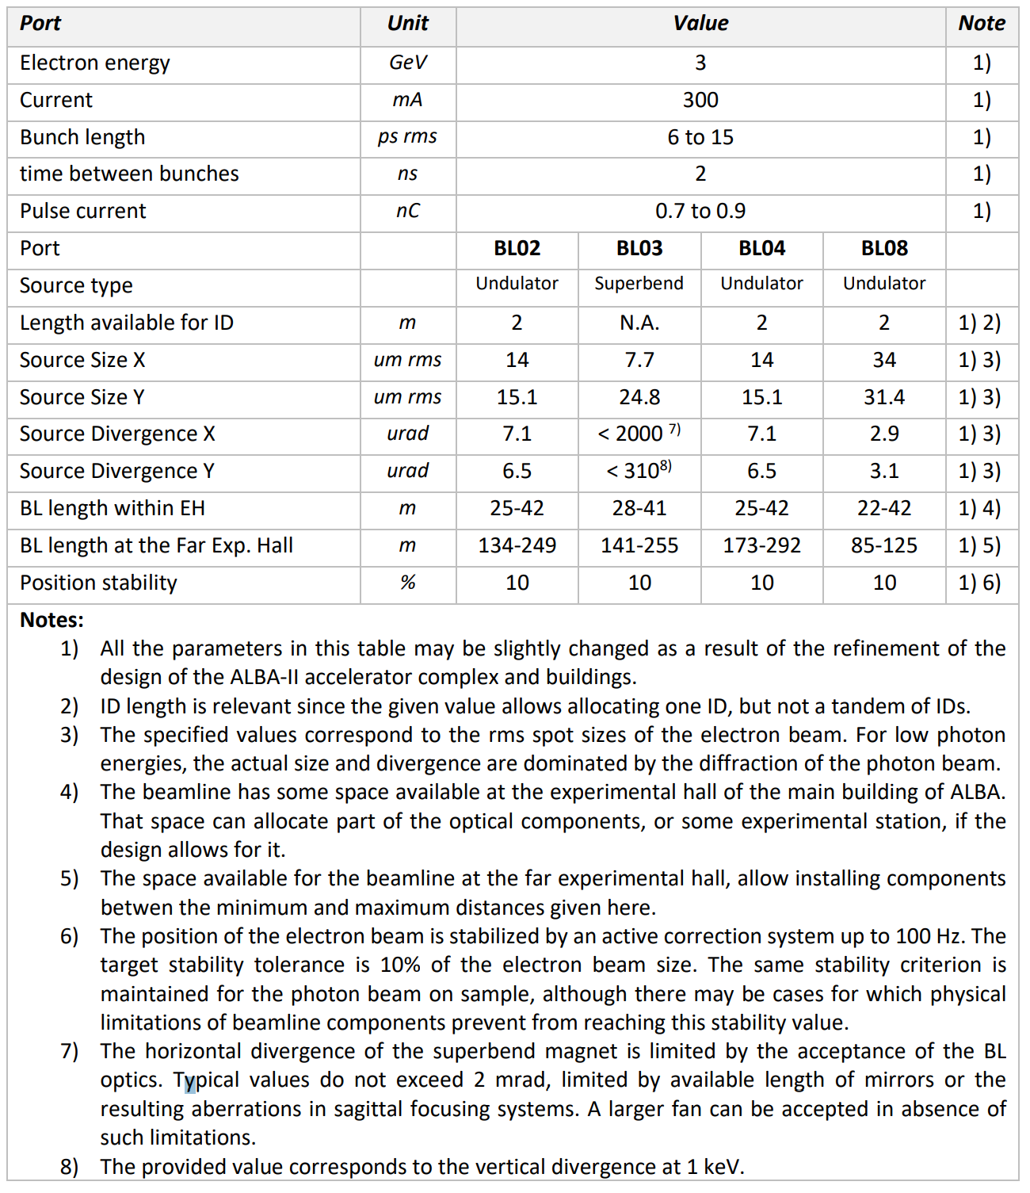
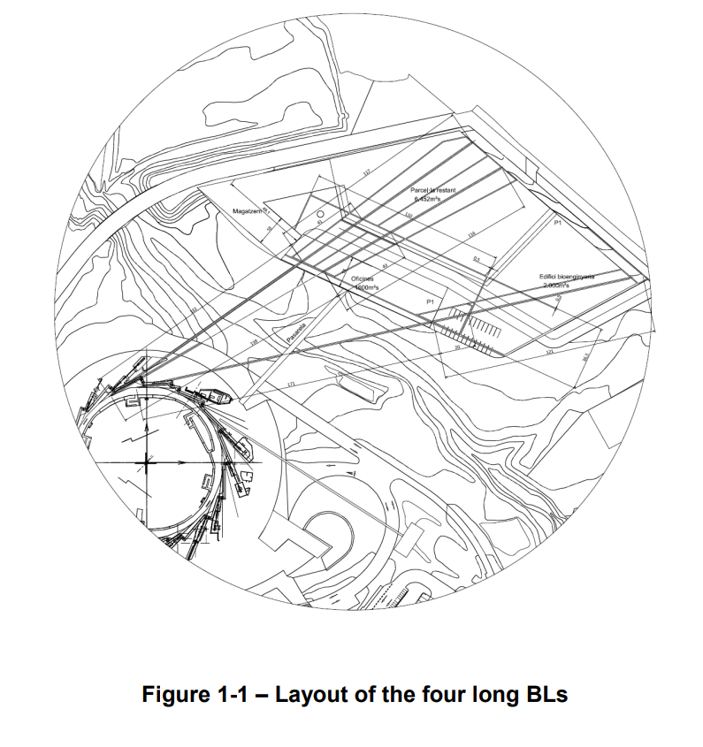
Long BLs technical information (available at the call webpage)

Slide 14
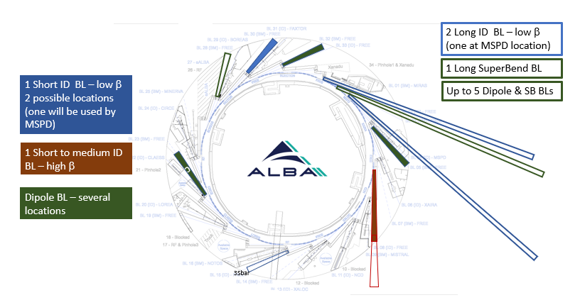
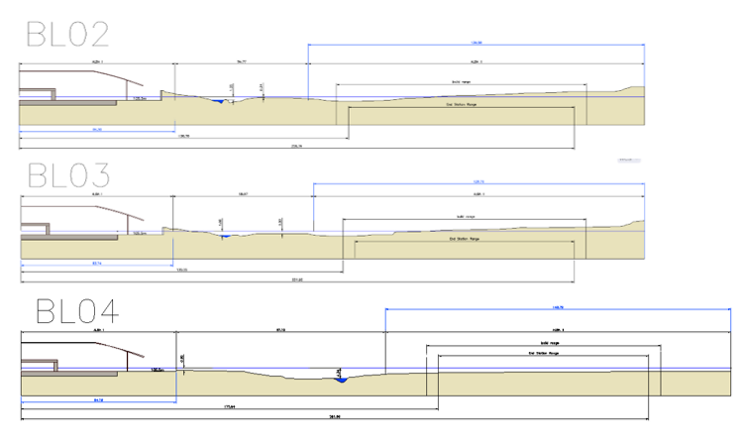
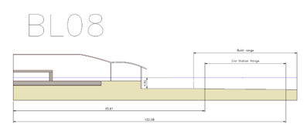
Long BLs layouts
New position for MSPD
Port | D_{min} (m) | D_{max} (m) | Source | β_{x}, β_{y}, D_{x} (m)
2 | 133 | 150 | ID | 2.0, 2.4, 0.0
3 | 140 | 160 | SB | 1.0, 5.0, 0.018
4 | 173 | 200 | ID | 2.0, 2.4, 0.0
8 | 35/60 | 56/200 | ID | 11.8, 10.0, 0.0
D refers to distance from source to sample

Slide 15
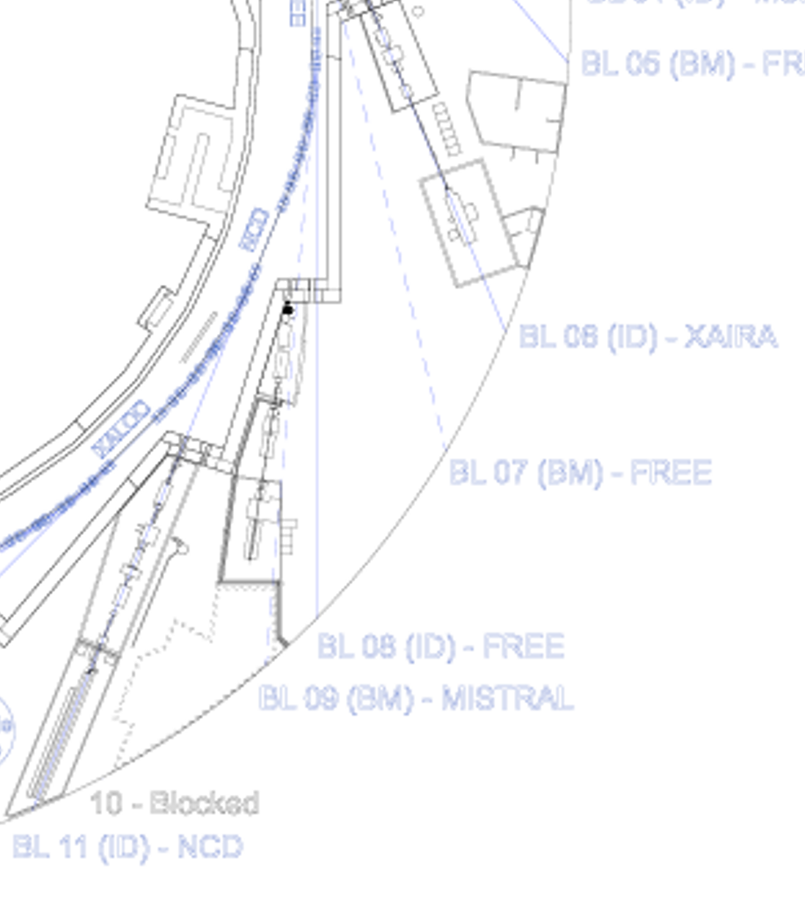
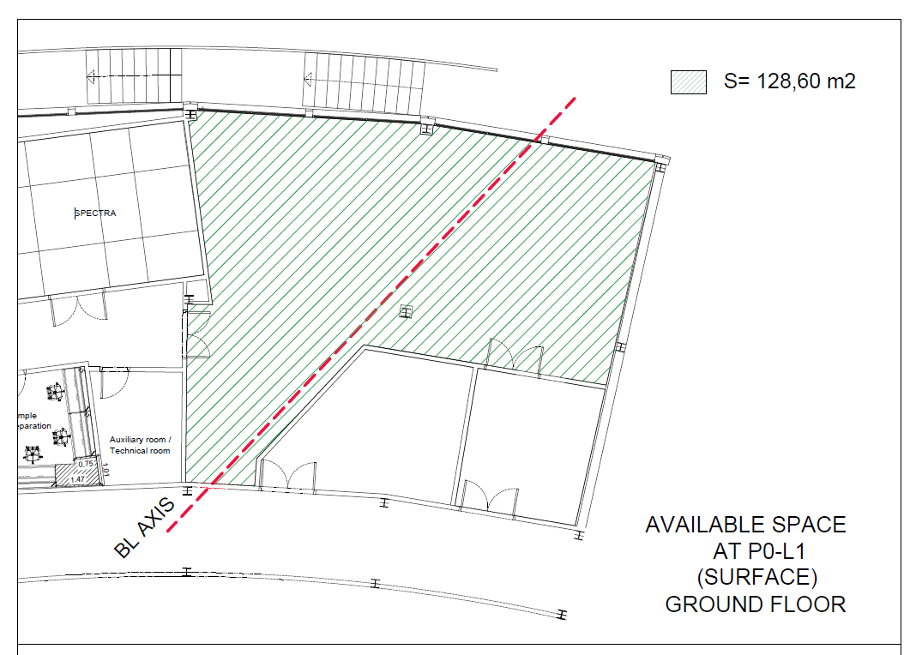
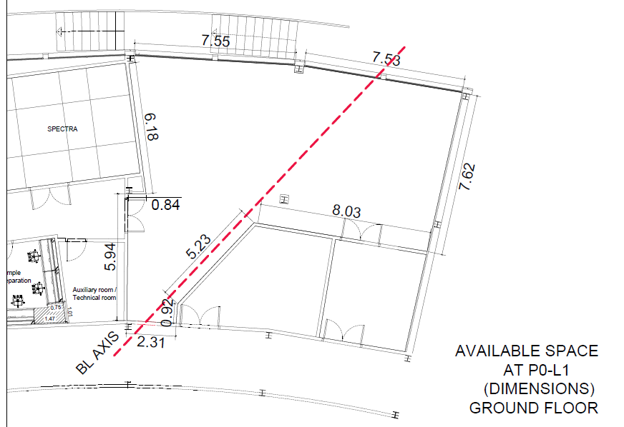
BL port 8
Port | D_{min} (m) | D_{max} (m) | Source | β_{x}, β_{y}, D_{x} (m)
8 | 35/60 | 56/200 | ID | 11.8, 10.0, 0.0
Photon source: ID
Beam size x2 with respect to other ID sections
Beam divergence x 0.5 with respect to other ID sections
Space inside the experimental hall
Space inside ALBA building near JEMCA
Space outside ALBA up to 200 m from source but with ground slope: experimental station should be high with respect to ground
JEMCA

Slide 16
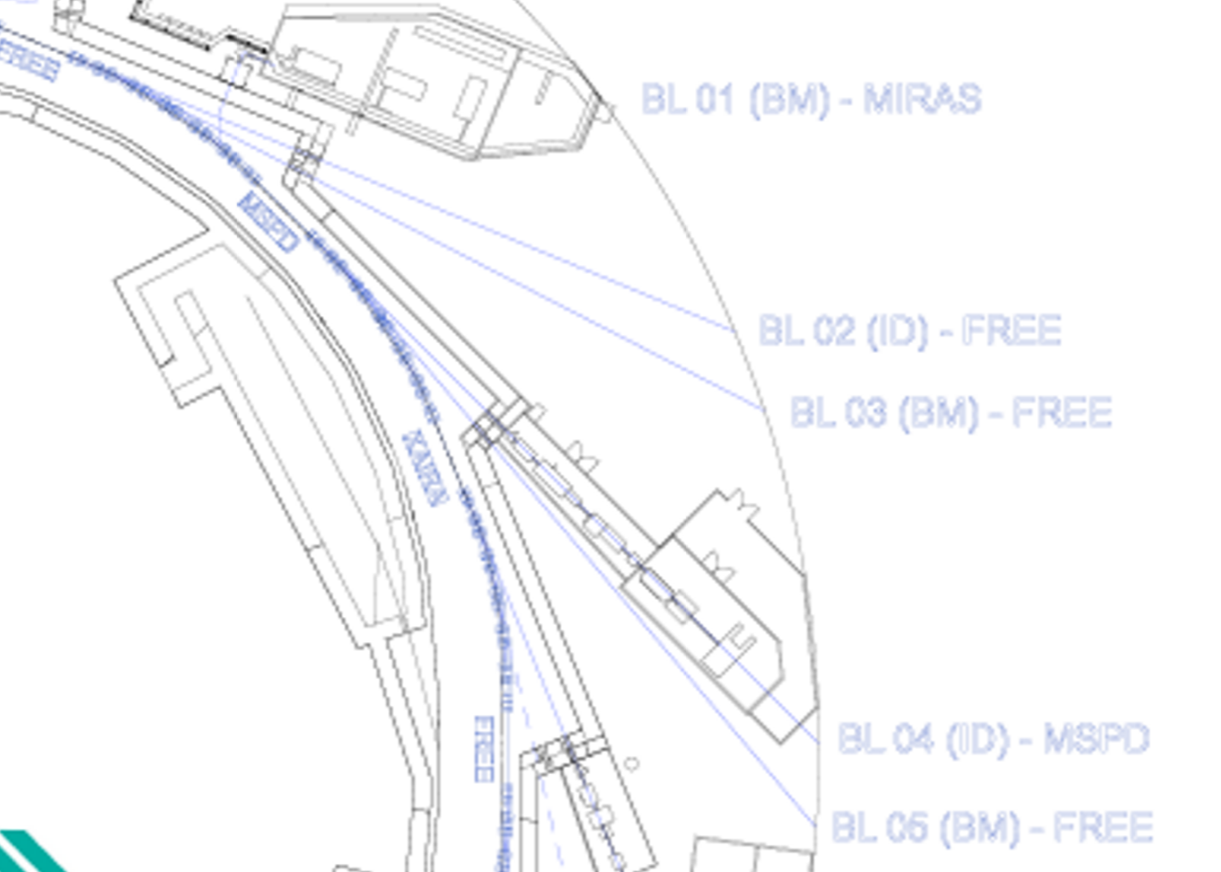
BL ports 2 and 4
Port | D_{min} (m) | D_{max} (m) | Source | β_{x}, β_{y}, D_{x} (m)
2 | 133 | 150 | ID | 2.0, 2.4, 0.0
4 | 173 | 200 | ID | 2.0, 2.4, 0.0
Photon source: ID
Beam size and divergence small on both planes
Space inside the experimental hall
Space outside ALBA from 130 (port2) and 170 m (port4) from source in the new plots
Port 4 occupied now by MSPD. Planning MSPD upgrade and reallocation on port 33

Slide 17
BL ports 3
Port | D_{min} (m) | D_{max} (m) | Source | β_{x}, β_{y}, D_{x} (m)
3 | 140 | 160 | SB | 1.0, 5.0, 0.018
Photon source: Superbend up to 3 T
Beam size and divergence small on both planes
Space inside the experimental hall
Space outside ALBA from 140 m on from source in the new plots
Port 4 occupied now by MSPD. Planning MSPD upgrade and reallocation on port 33

Slide 18
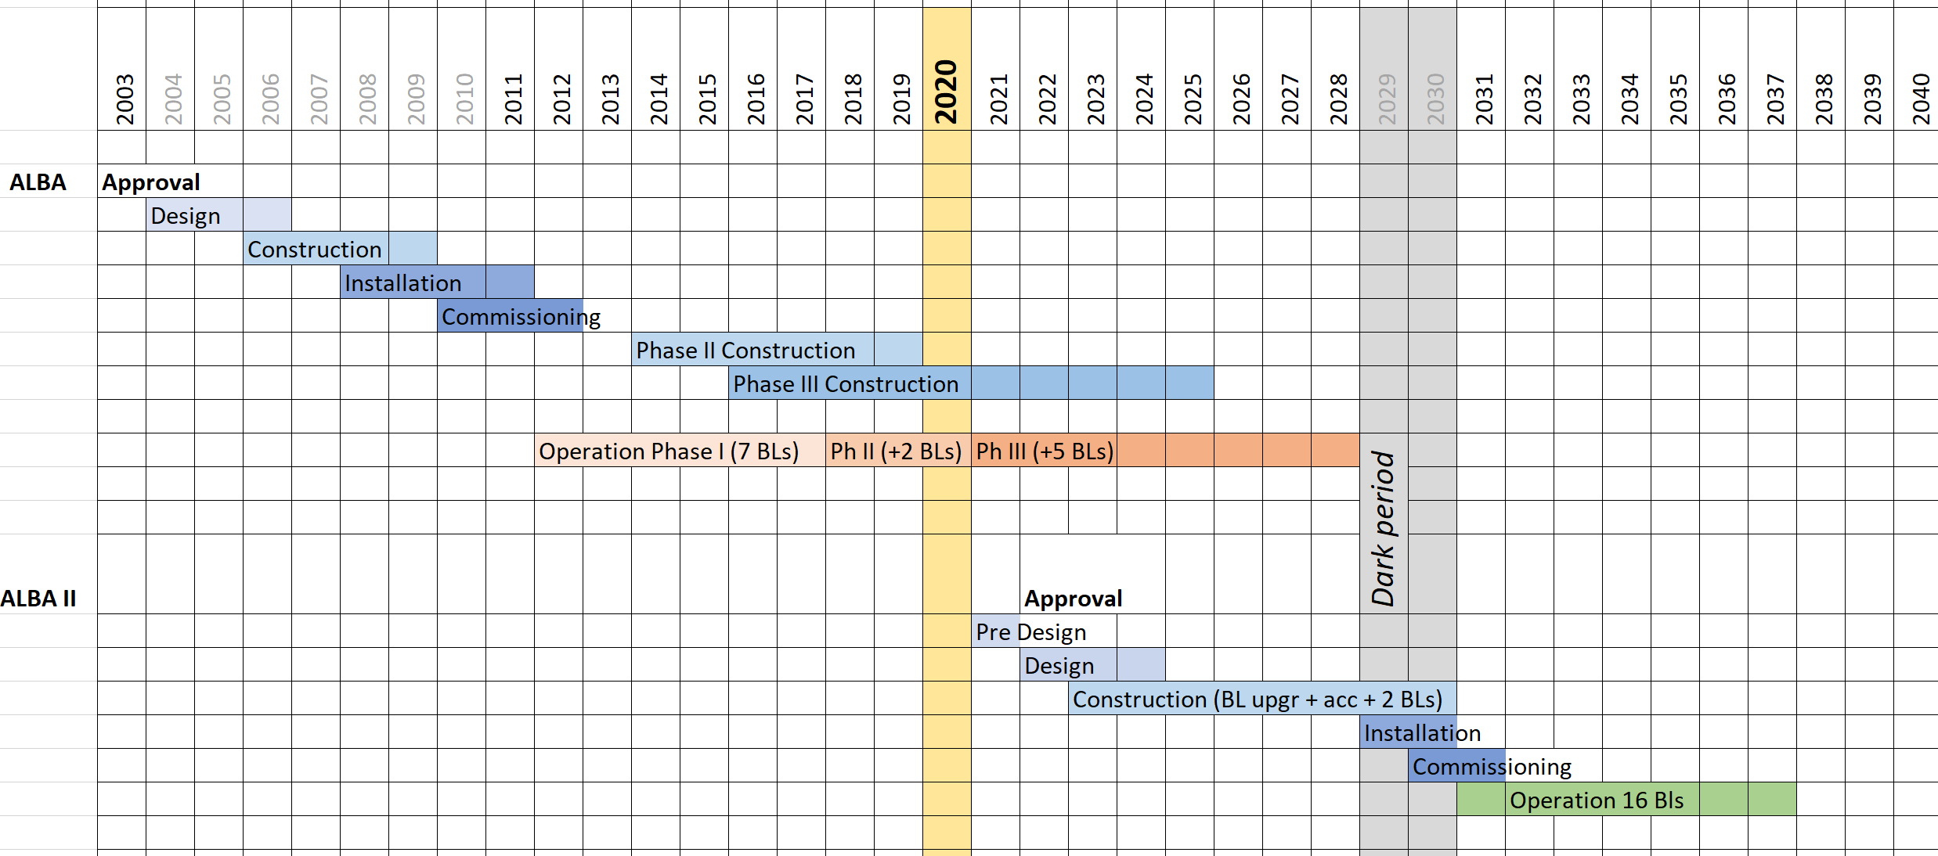
ALBA II tentative timeline
Today
Timeline depending on funding availability

Slide 19
Questions welcome

