Slide 1
Overview of proposals
Josep Nicolas
15th November 2022

Slide 2

Call for proposals of ALBAII long BLs
https://indico.cells.es/event/1230/
Deadline: 16th December 2022

Slide 3
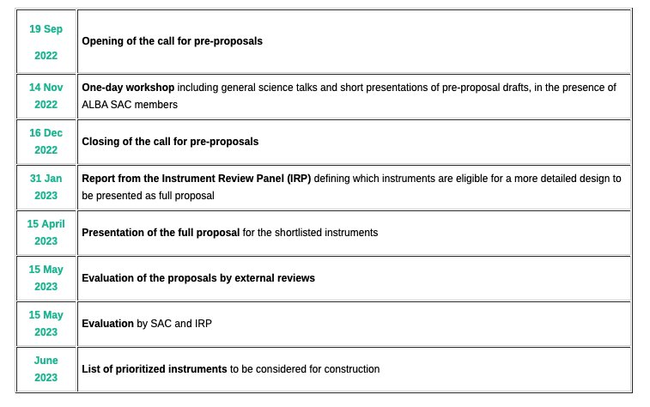
Process and Calendar

Slide 4
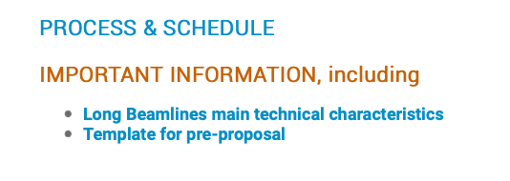
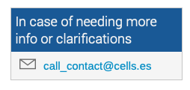
Information
Main technical characteristics of the long beamlines
Technical information about the beamlines, like source sizes, available length, and expected flux, coherence, etc.
Template for the pre-proposal
Document where you have to fill the basic information required for a scientific and technical assessment.

Slide 5
Overview
Port | EH | FEH
BL02 (ID) | 25-42 m | 134-249 m
BL03 (SBM) | 28-41 m | 141-255 m
BL04 (ID) | 25-42 m | 173-292 m
BL08 (ID) | 22-42 m | 85-125 m
Main building (or extension)
Dead length
Far Experimental Hall
BL02 ID source
BL03 Superbend
Stream course
(not usable)
BL08 ID source
BL04 ID source

Slide 6
Overview
FEH is yet to build and there is a lot of space along the beam direction.
Each BL may host more than one experimental station
There is also space for additional facilities and laboratories
Main building (or extension)
Dead length
Far Experimental Hall
BL02 ID source
BL03 Superbend
Stream course
(not usable)
BL08 ID source
BL04 ID source

Slide 7
Proposals in preparation
Title | Presenter | Energy Range | Experimental technique | AREA | Remarks
CORUS | Jose Javier Conesa | HXR | nano-XRF/ Phase contrast imaging/ nano-XANES | Bio | nanoprobe
CoDI | Ana Diaz | HXR | Ptychography | Materials / Bio | coherence
HXR imaging | Carles Bosch | HXR | Ptychography | Bio | coherence
SXR nanoprobe | Mari Cruz García-Gutierrez | SXR | STXM+Resonant Scattering | Structure | nanoprobe
SXR RIXS | Santiago Blanco Canosa | SXR | RiXS | Structure | space around
3D INXAS |  | HXR | nano-XRF / nano-XAS XRD /Imaging | Materials | Nanoprobe call 2021
EXTQα |  | HXR | SAXS/WAXS | Materials | call 2021, may be not long BL
ATTOMS |  | SXR | XAS/XPCS/Ptychography | Structure | call 2021, may be not long BL
Disclaimer: Table based on the information available at the abstracts for today’s presentation, and last call pre-proposals
The period to submit proposals is still open, and additional proposals may be presented
Only proposals submitted to this new call will be considered for the evaluation.

Slide 8
One classification
Hard x-ray nanoprobes
RIXS beamline
Soft x-ray nanoprobes
Ptychography
Coherent imaging

Slide 9
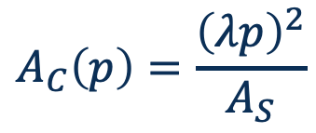



Transversal coherence
Many imaging techniques , like ptychography, require a high degree of transversal coherence
Pinhole
$$A≤A_{C}$$
$A_{S}$ area
$$A_{C}\left(p\right)=\frac{{\left(λp\right)}^{2}}{A_{S}}$$
Coherence based experiment
Incoherent Source
$$p$$
Coherent Source
J. Goodman “statistical optics” Ch. 5
7% @1keV
1.5% @1keV
BL02, BL04
BL08

Slide 10
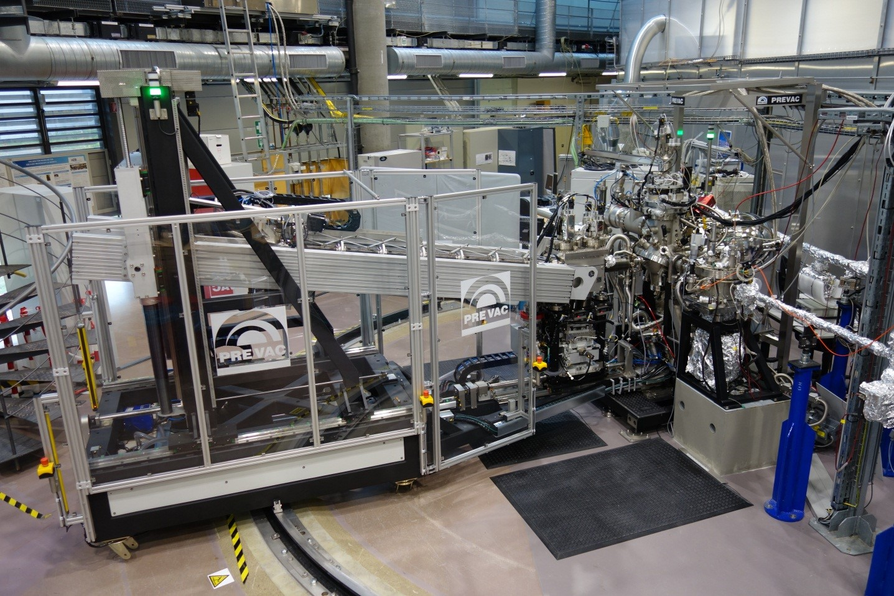
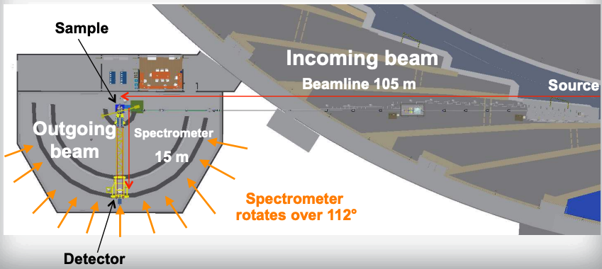
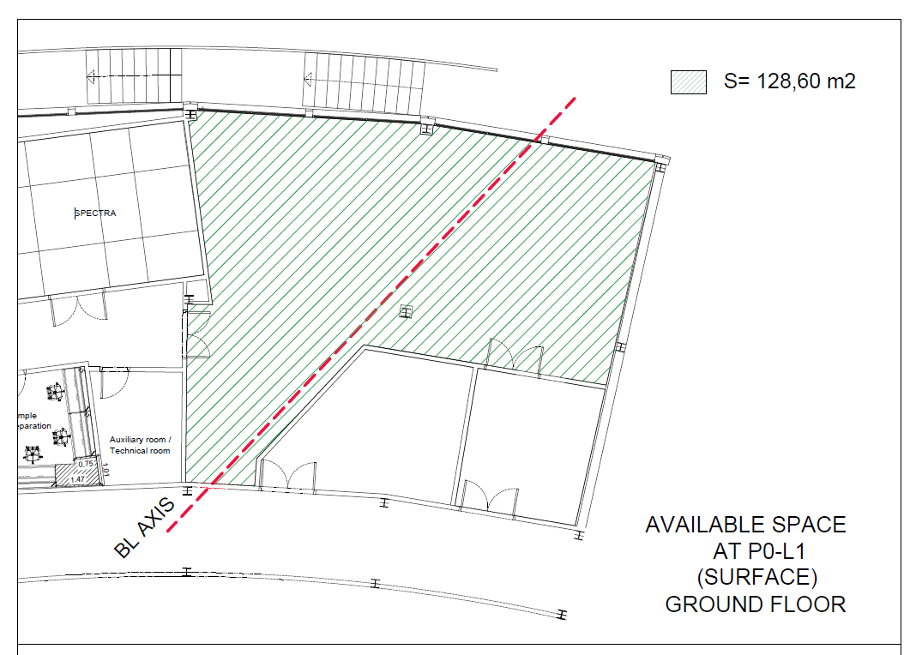
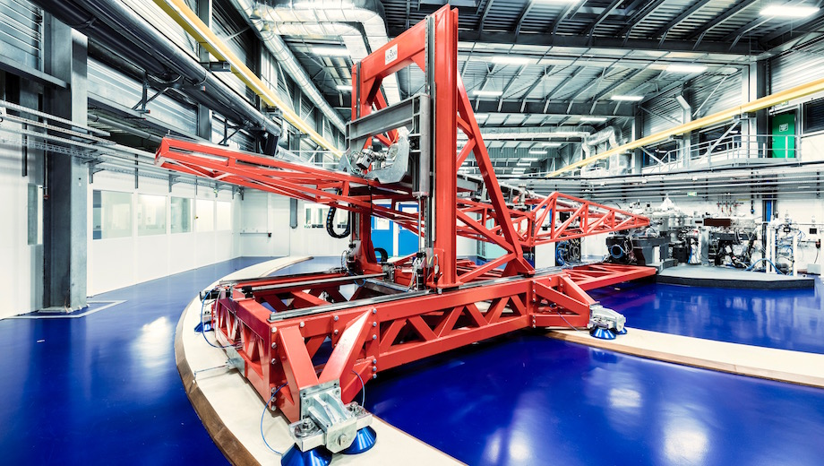
RIXS beamline
The high resolution spectrometer of a RIXS endstation as well as its wide angular range require a lot of space around the endstation.
RIXS station at NSLSII
RIXS station at HZB
RIXS station at ESRF
RIXS station at ESRF

Slide 11
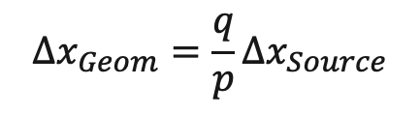

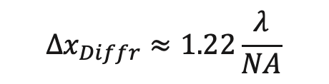

Nanoprobes
Independently of the focusing device, there are several contributions to the achievable spot size
$$Δx_{Total }≈\sqrt{Δx_{Geom }^{2}+Δx_{MirErr}^{2}+Δx_{Diffr. }^{2}}$$
The source is finite. (few µm) and needs to be strongly demagnified.
The only term that depends on p
Errors of mirrors (or lenses)
Aberrations
Deformations
Difficult optics (strong curvature, low error tolerance)
The mirror or lens is finite in size, and limits the N.A.
Depends on λ
$$Δx_{Diffr}≈1.22\frac{λ}{NA}$$
$$Δx_{Geom}=\frac{q}{p}Δx_{Source}$$
$$Δx_{MirErr}=2qσ_{SlopeErr}$$
Having reflectivity in the full mirror length often requires graded multilayers
It requires just distance
It depends on technology
It is the fundamental limit

Slide 12
Nanoprobe at soft x-ray (265 eV)
40 m beamline
150 m beamline
B
A
FZP
Parameter | 40 m | 150 m A | 150 m B | FZP 40 m
Achievable Resolution | 140 nm | 70 nm | 80 nm | 30 nm
Working distance (opt-sample) | 35 mm | 25 mm | 41 mm | 2 mm
Mirror Length | 60 mm | 150 mm | 250 mm | --
Min. Radius | 1.0 m | 1.0 m | 1.6 m | --
Fraction of beam accepted | 55% | 25 % | 45% | --
Flux density Ratio | x1.0 | x4.4 | X7.8 | --

Slide 13
Nanoprobe at hard x-ray (12 keV)
Parameter | 150 m
Achievable Resolution | 40 nm
Working distance (opt-sample) | 57 mm
Mirror Length | 86 mm
Min. Radius | 28.8 m
Fraction of beam accepted | <10%

Slide 14
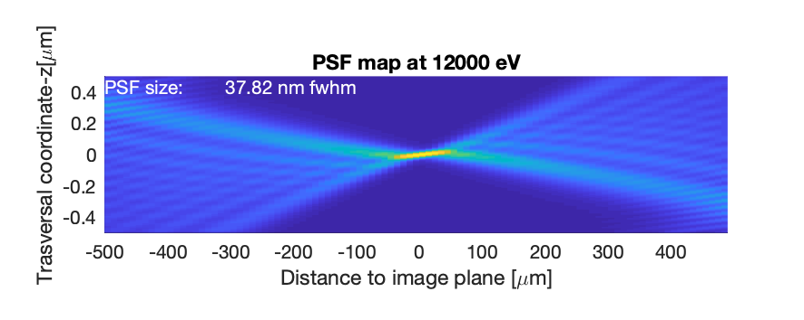
Nanoprobe at hard x-ray (12keV)

Slide 15
Topics for discussion
After today’s presentations
Scientific or innovation problem to be addressed.
Contribution of the proposed instruments to solve specific problems.
Potential user community.
Proposer team and its strength.
Interested partnership.
Possibility of combining different instruments in a single BL, using the same port

Slide 16
Call for proposals of ALBAII long BLs
https://indico.cells.es/event/1230/
Deadline: 16th December 2022

Slide 17
Backup slides

Slide 18
Source characteristics: Flux
BL02, BL04, BL08
BL03
Flux tuning curves of typical insertion devices, similar to those existing at ALBA, to cover the different energy ranges
BL03 is fed by a superbend, while the flux is lower than for IDs, it is sustained to higher photon energies.

Slide 19
Size and divergence (BL02,04)
Approximation of the source size and divergence for a 2m long undulator.
The plots consider the contribution of the diffraction limit and the electron beam

Slide 20
Size and divergence (BL08)
Approximation of the source size and divergence for a 2m long undulator.
The plots consider the contribution of the diffraction limit and the electron beam

