Slide 1
Permanent Magnets at STFC
Ben Shepherd
2nd PerMaLIC Workshop
ALBA
3 November 2022

Slide 2
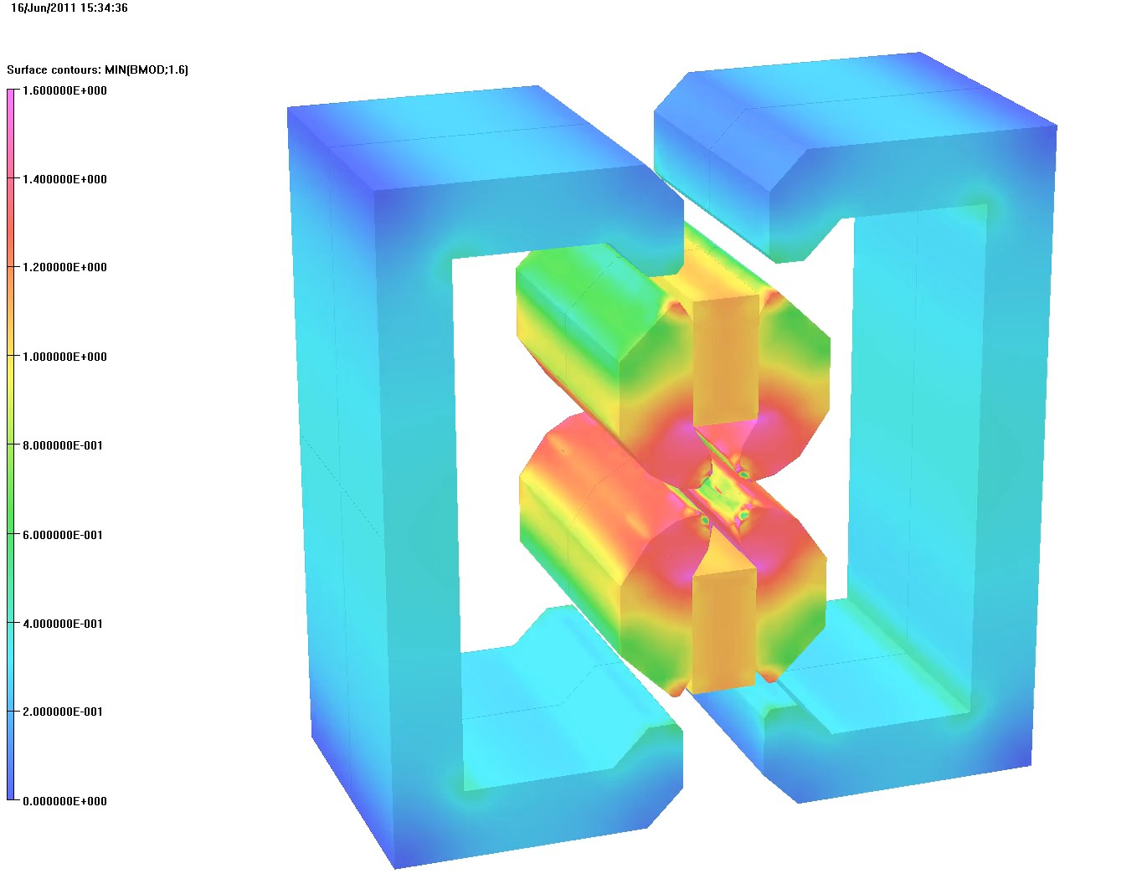
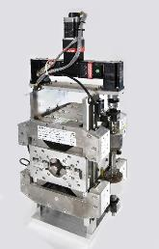
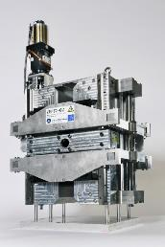
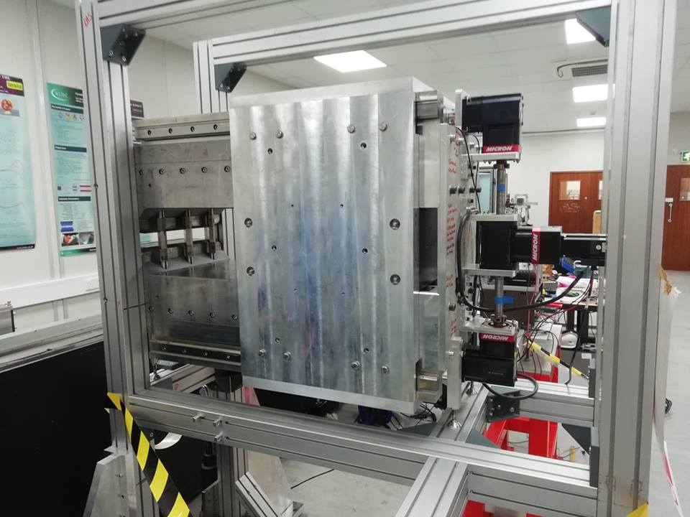
The ZEPTO concept
Shepherd et al, IPAC2014 TUPRO113
Zero-Power Tuneable Optics
Highly adjustable PM quadrupole and dipole magnets to replace electromagnets
  Large tuning range using motors to move PMs
  Same physical footprint
  No energy usage
  (except a tiny amount when adjusting)
  Less infrastructure required
  (no big current cables, power supplies, cooling)
Prototypes built at Daresbury: 2 quads, 1 dipole
  27 mm aperture (40 mm for dipole)
  230 mm length
  15-60 T/m, 4-35 T/m, 0.55-1.1 T ranges
  Fixed steel poles, movable NdFeB PMs
  Simple control system with one motor
Q1
Q2
D1

Slide 3
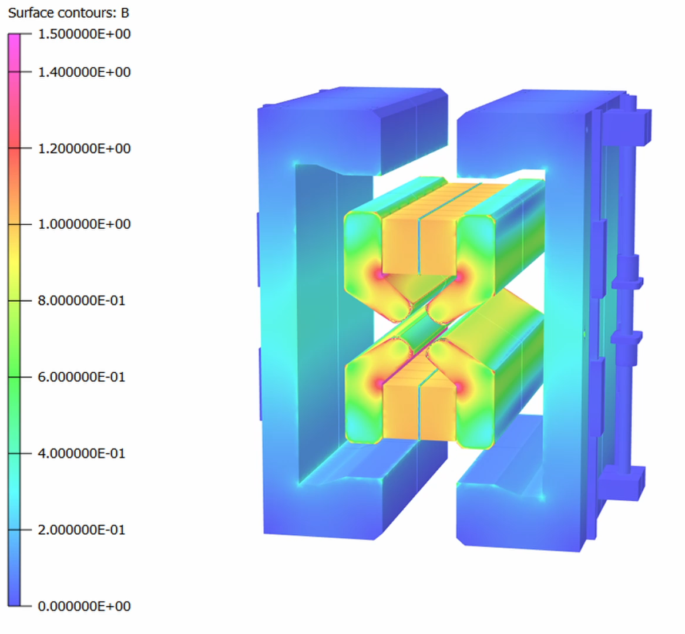
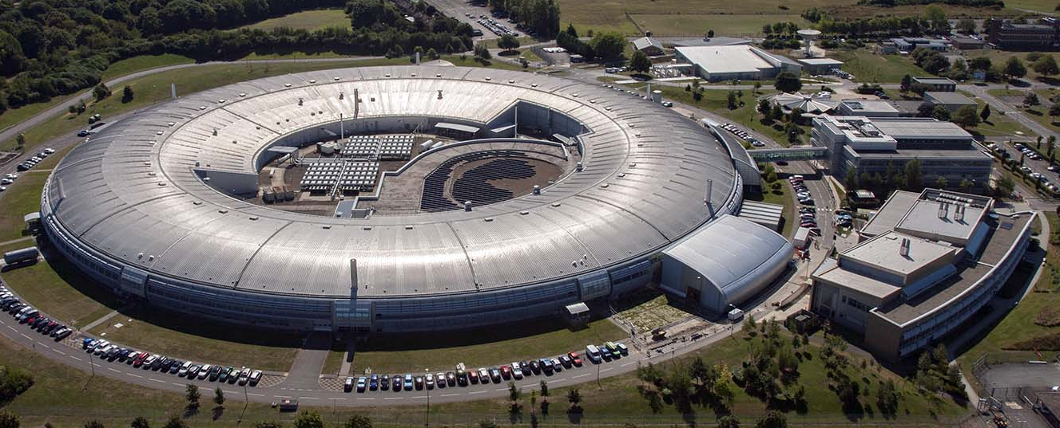
Slide: Alex Bainbridge
ZEPTO @ Diamond Light Source
Contours B (T)
ZEPTO technology is applicable anywhere that adjustable DC magnets are required, and can be used as an energy saving `drop-in' replacement for electromagnets on accelerators such as existing light sources.
We have developed a new ZEPTO quadrupole for the booster-to-storage ring section of Diamond Light Source.
1.4
1.4
1.2
1.2
1.0
1.0
0.8
0.8
0.6
0.6
0.4
0.4
0.2
0.2
0

Slide 4
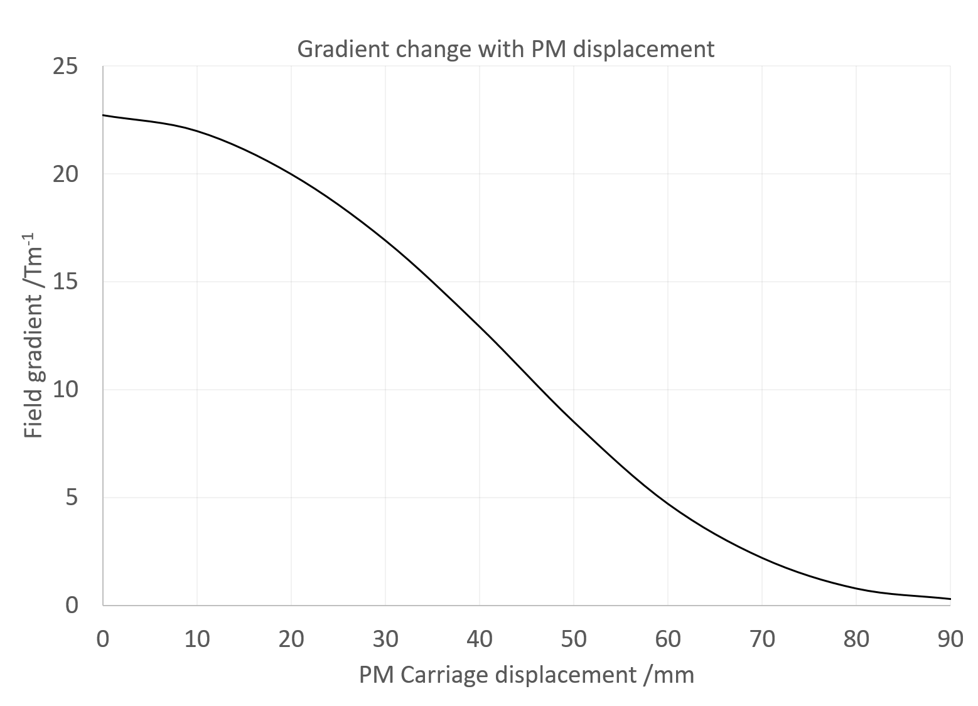
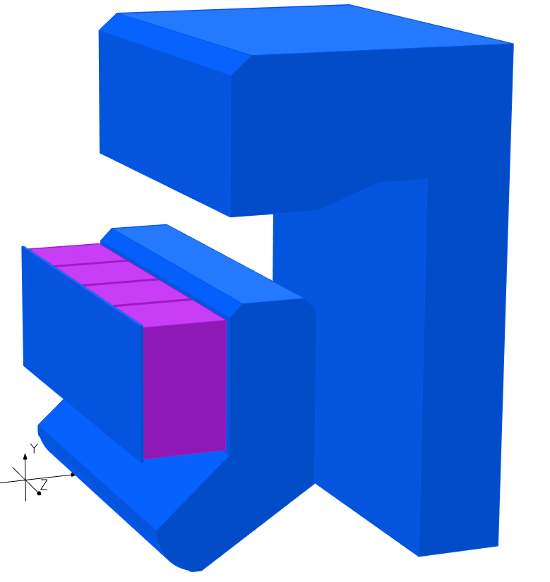
Slide: Alex Bainbridge
ZEPTO-Q3
SmCo blocks attached to vertical motion system with 90mm movement range and 1 µm precision
OPERA 3D model
Fixed “inner yoke” defines the quadrupole field
Fixed “outer yoke” can steer flux away from the beam, allowing the gradient to be adjusted
Simulations predicted a gradient tuning range from 23 T/m down to 0.35 T/m
The outer yoke acts as a short circuit for the flux, allowing the magnet to be ‘turned off’.
32 mm aperture
No magnetic contact between yokes, the gap between is filled with aluminium for rigidity

Slide 5
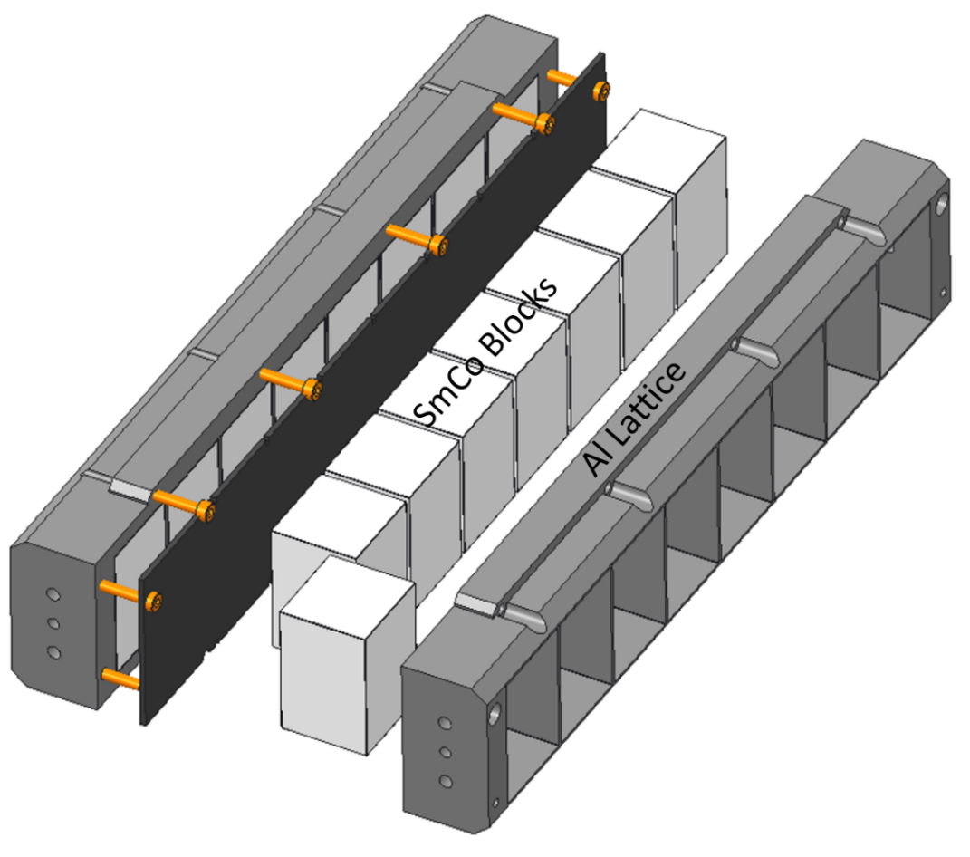
Slide: Alex Bainbridge
Permanent magnets
Previous ZEPTO magnets used large NdFeB blocks to produce the magnetic flux, which are difficult to manufacture and handle.
New magnet uses a “carriage” with a number of smaller blocks set into an aluminium latticework.
Advantages over larger single blocks which include:
Blocks are easier and cheaper to manufacture.
Damaged single blocks may be replaced instead of the entire carriage.
Variation in block BH curves may be compensated.
Modular magnet "families" may be created by strategic removal of blocks.
The gaps between blocks do not affect field quality as the flux must pass through a steel pole before reaching the beam.
300 mm
50 mm
33 mm
We use SmCo instead of NdFeB for improved radiation hardness and temperature stability.
No thermal shunts are needed

Slide 6
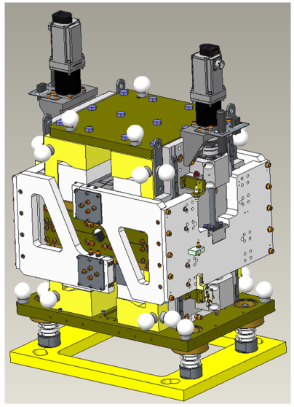
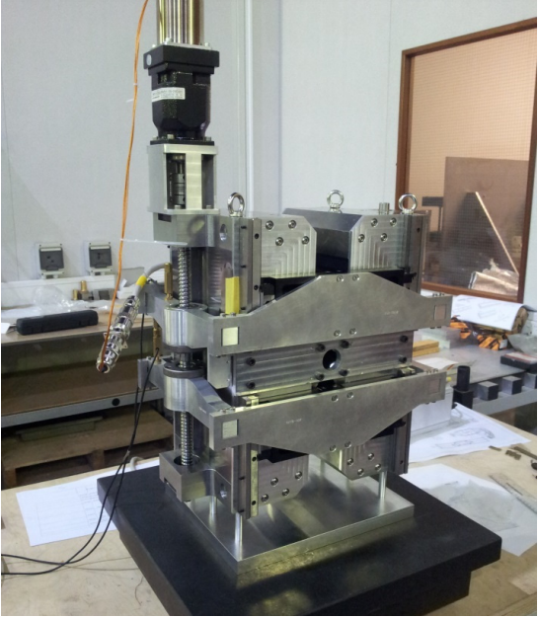
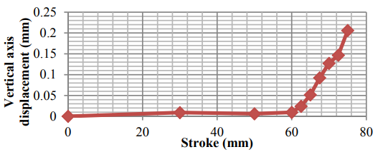
Slide: Alex Bainbridge
Dual motor system
Motor
PM Carriage
Ball screw
In previous ZEPTO quadrupoles field measurements revealed the magnetic centre moving as function of magnet block position, mostly vertically, due to unexpectedly magnetic components.
Expecting this, each magnet carriage now has a dedicated motor and associated driving ball screw to help compensate.
Look-up table can be applied to either carriage position to compensate and restore the magnetic centre to the geometric centre.
Carriage holder
Shepherd et al, IPAC’14, Dresden, Germany, paper TUPRO113.

Slide 7
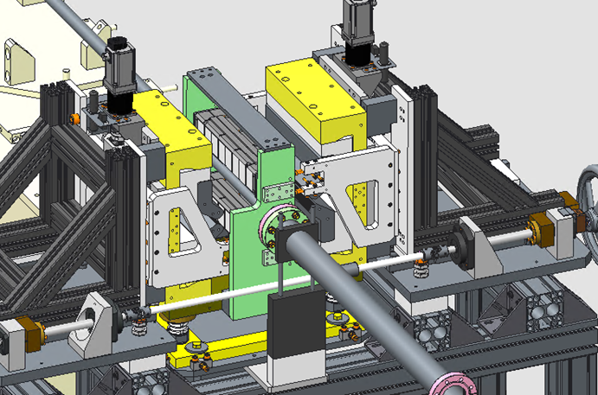
Slide: Alex Bainbridge
Split design
Pre-bolted inner and outer yokes
Temporary PM carriage holder
Electromagnetic quadrupoles can typically be split for installation around an existing vacuum vessel – previous ZEPTO quadrupoles could not.
The new version may be split about the vertical axis and reassembled around an existing vacuum system using a dedicated assembly frame.
This allows replacements or repair to be conducted without needing to keep the accelerator offline for the additional time needed to restore the quality of the vacuum.
Vacuum chamber
Rail
Yoke supports

Slide 8
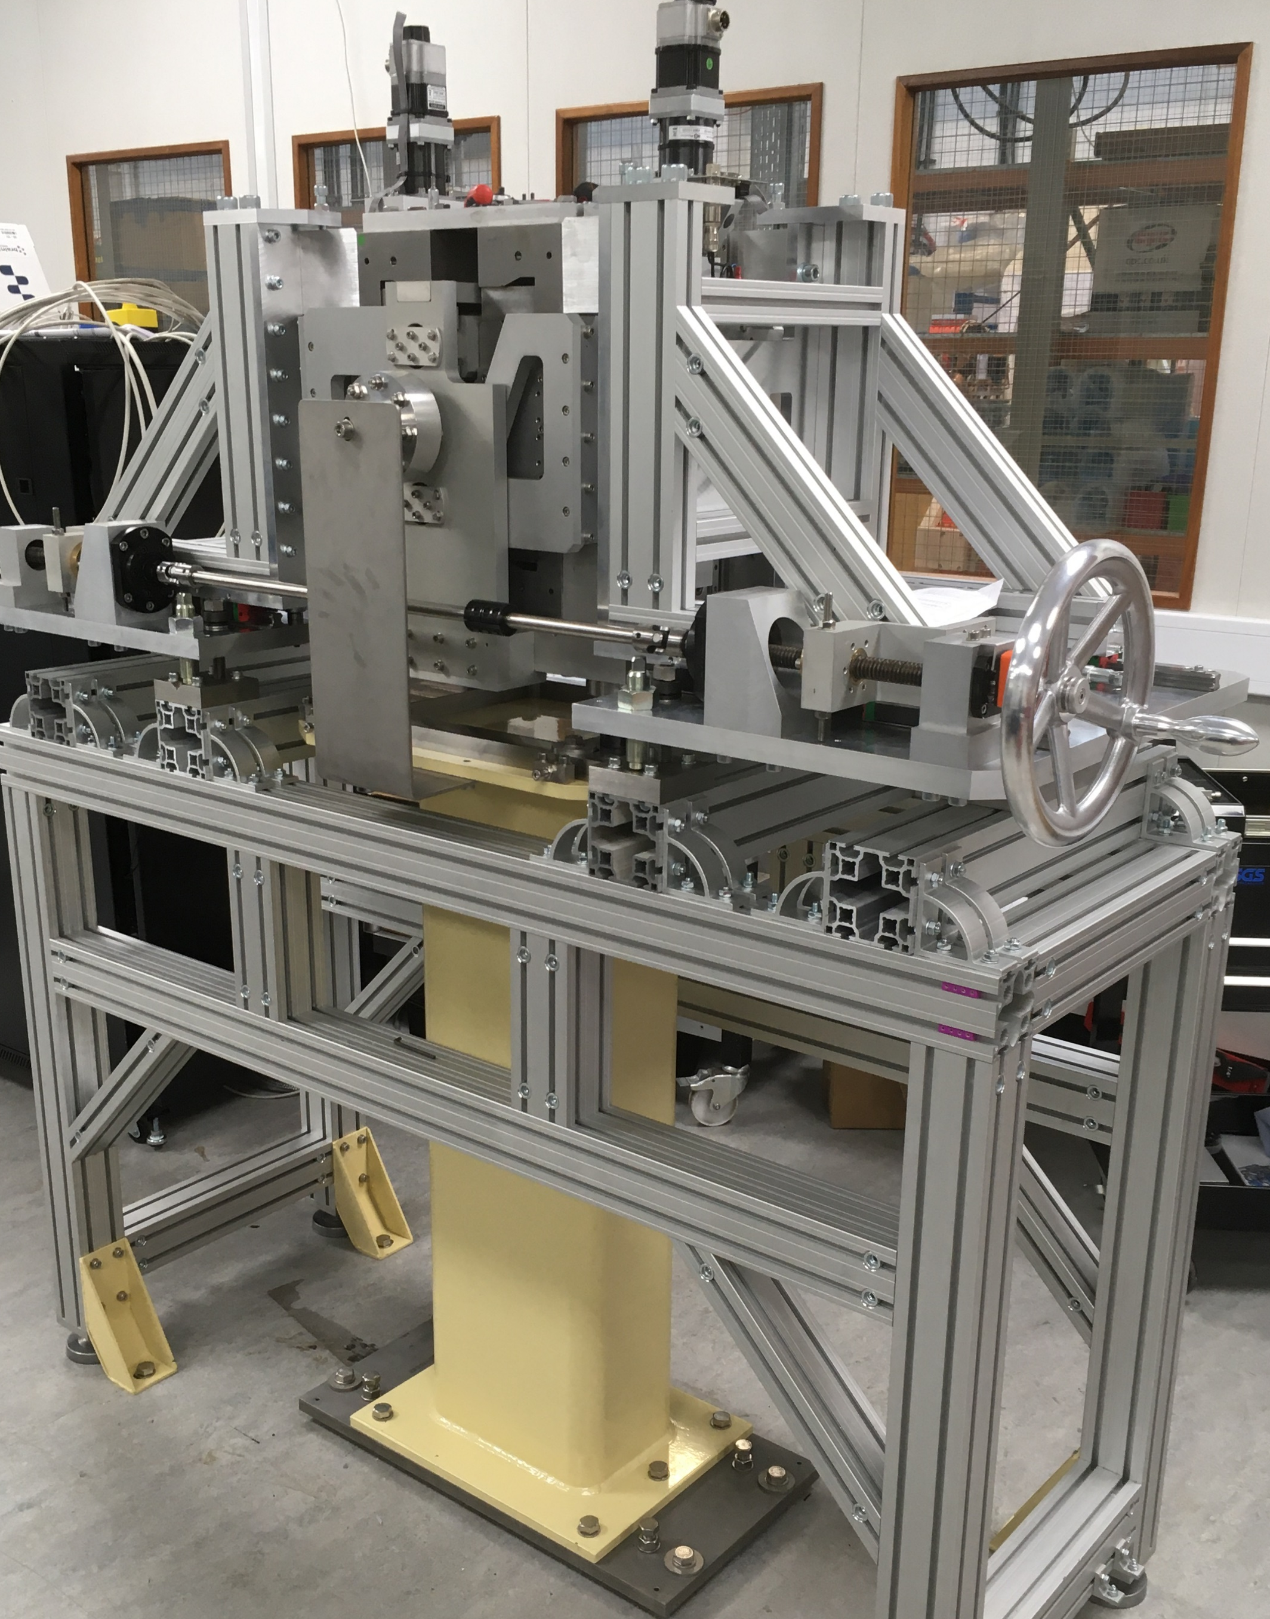
Slide: Alex Bainbridge
Split design
Electromagnetic quadrupoles can typically be split for installation around an existing vacuum vessel – previous ZEPTO quadrupoles could not.
The new version may be split about the vertical axis and reassembled around an existing vacuum system using a dedicated assembly frame.
This allows replacements or repair to be conducted without needing to keep the accelerator offline for the additional time needed to restore the quality of the vacuum.

Slide 9
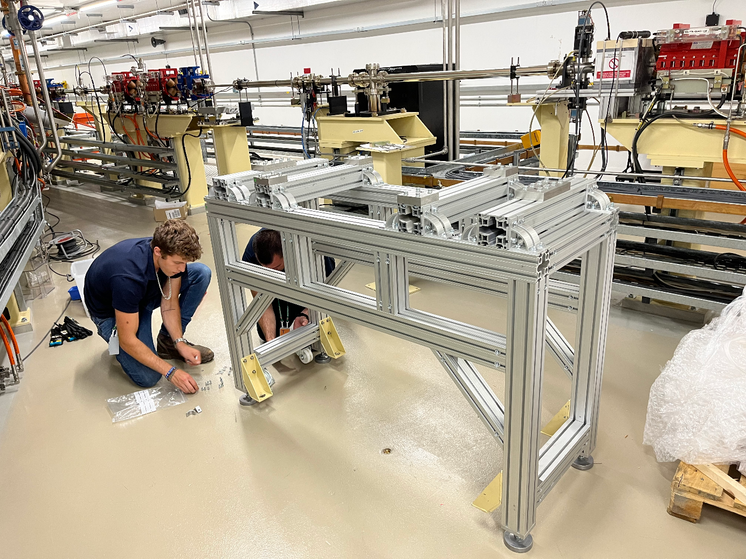
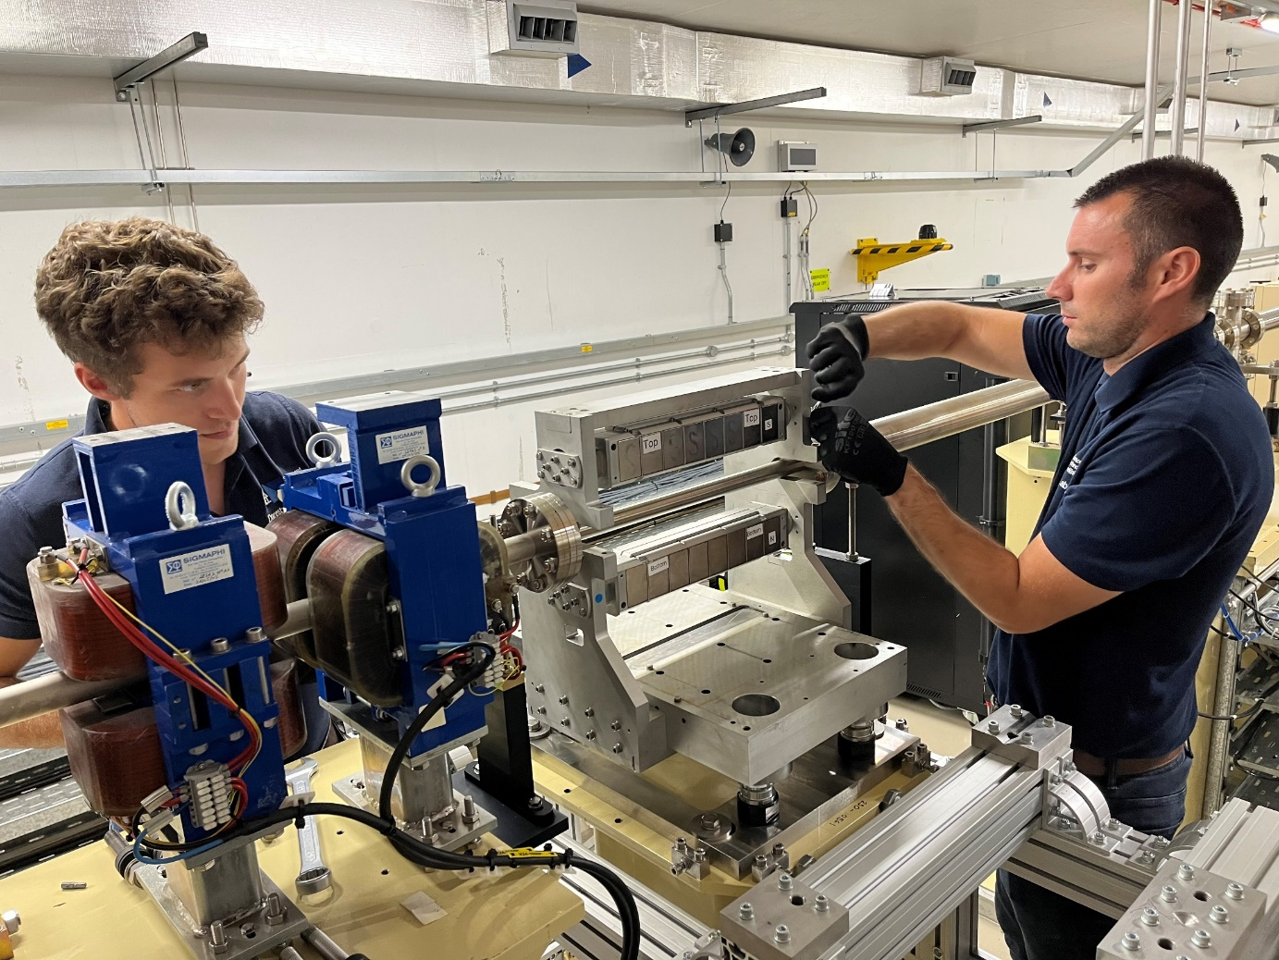
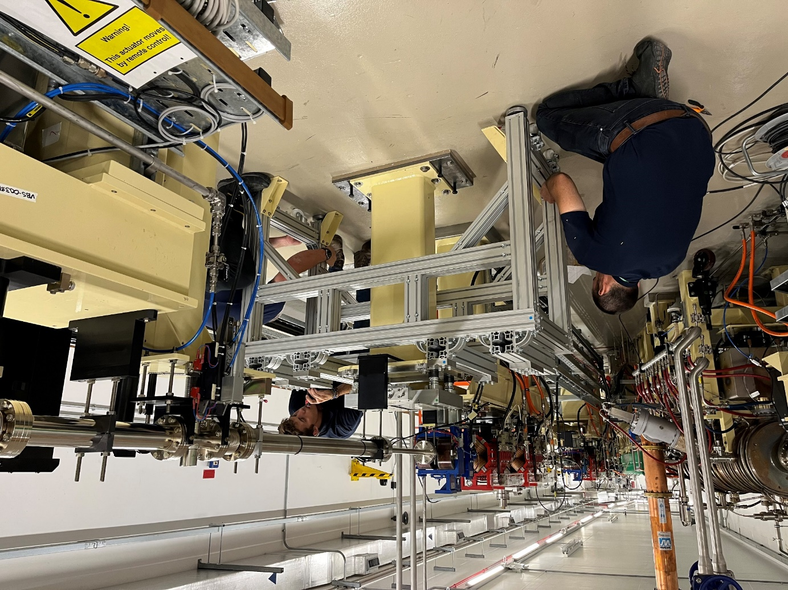
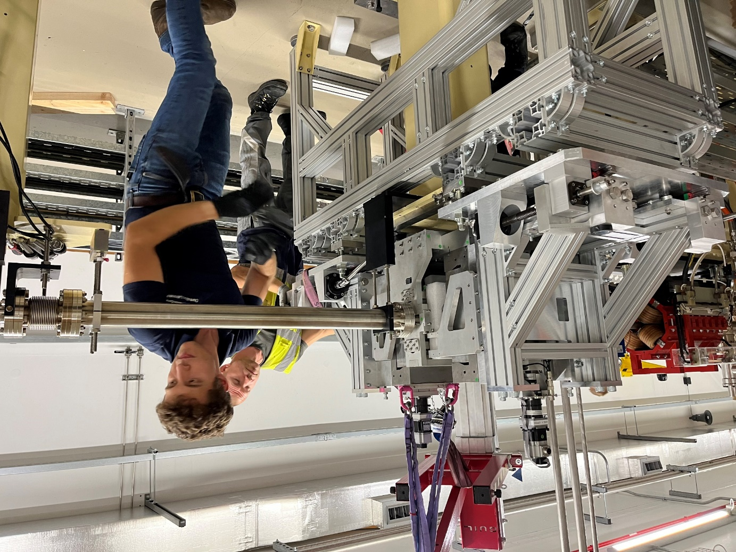
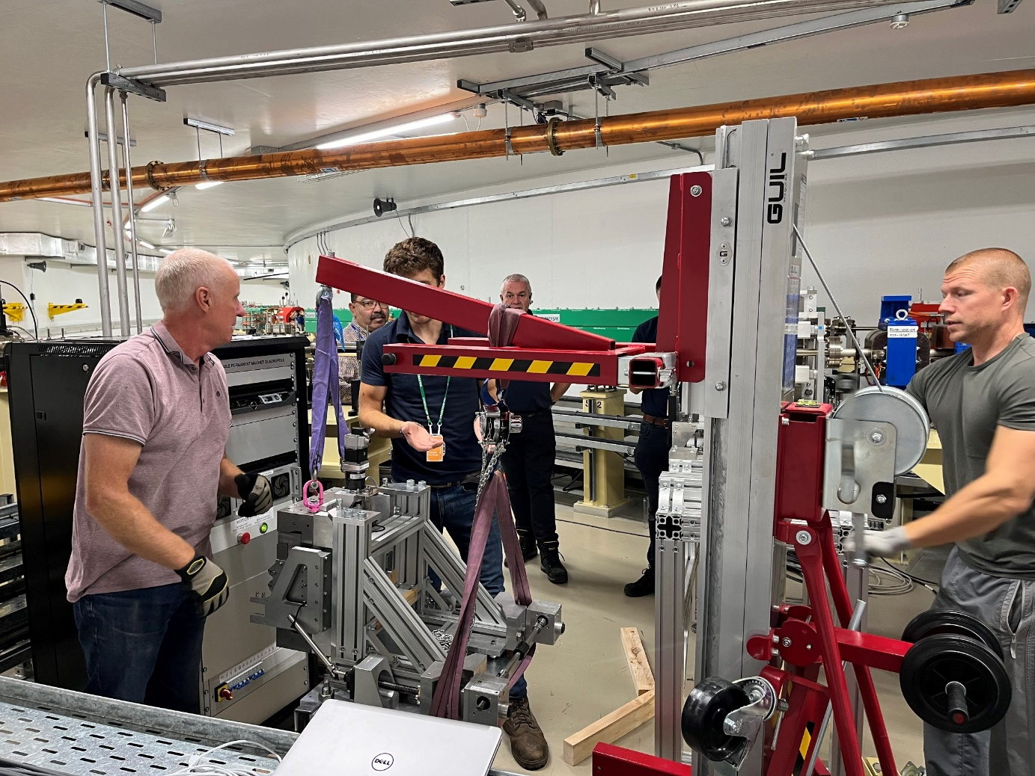
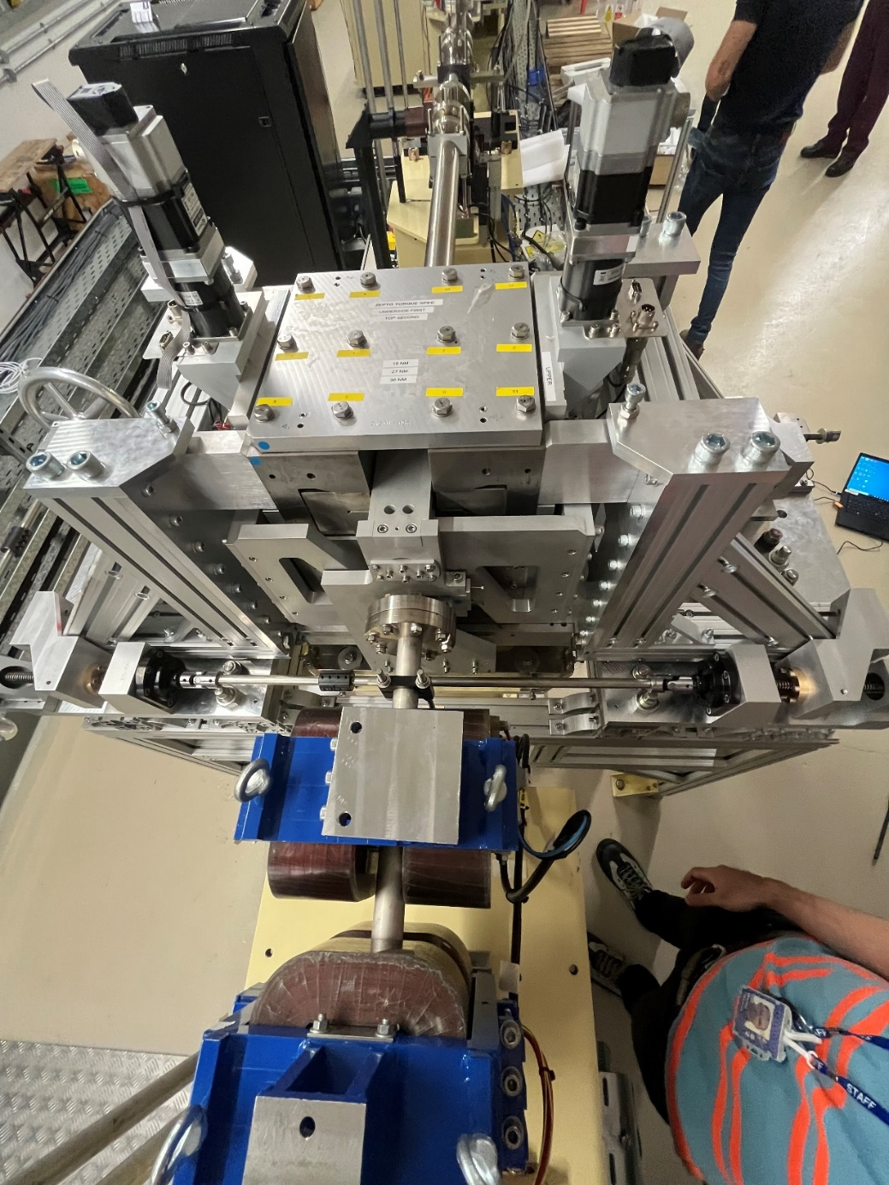
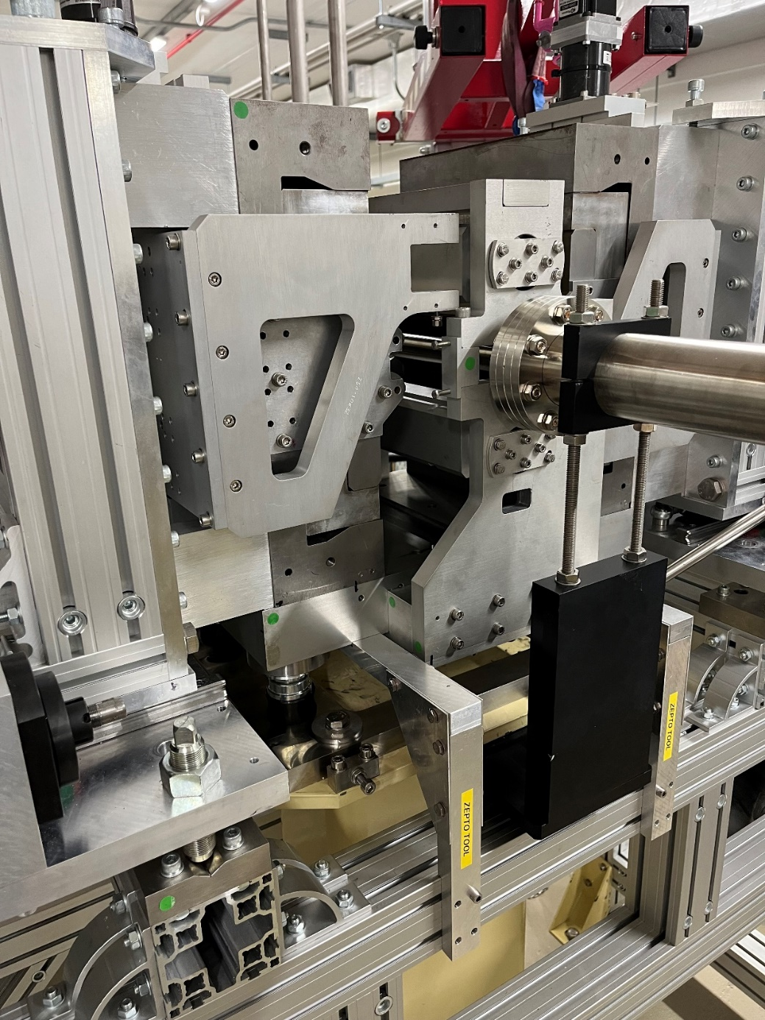
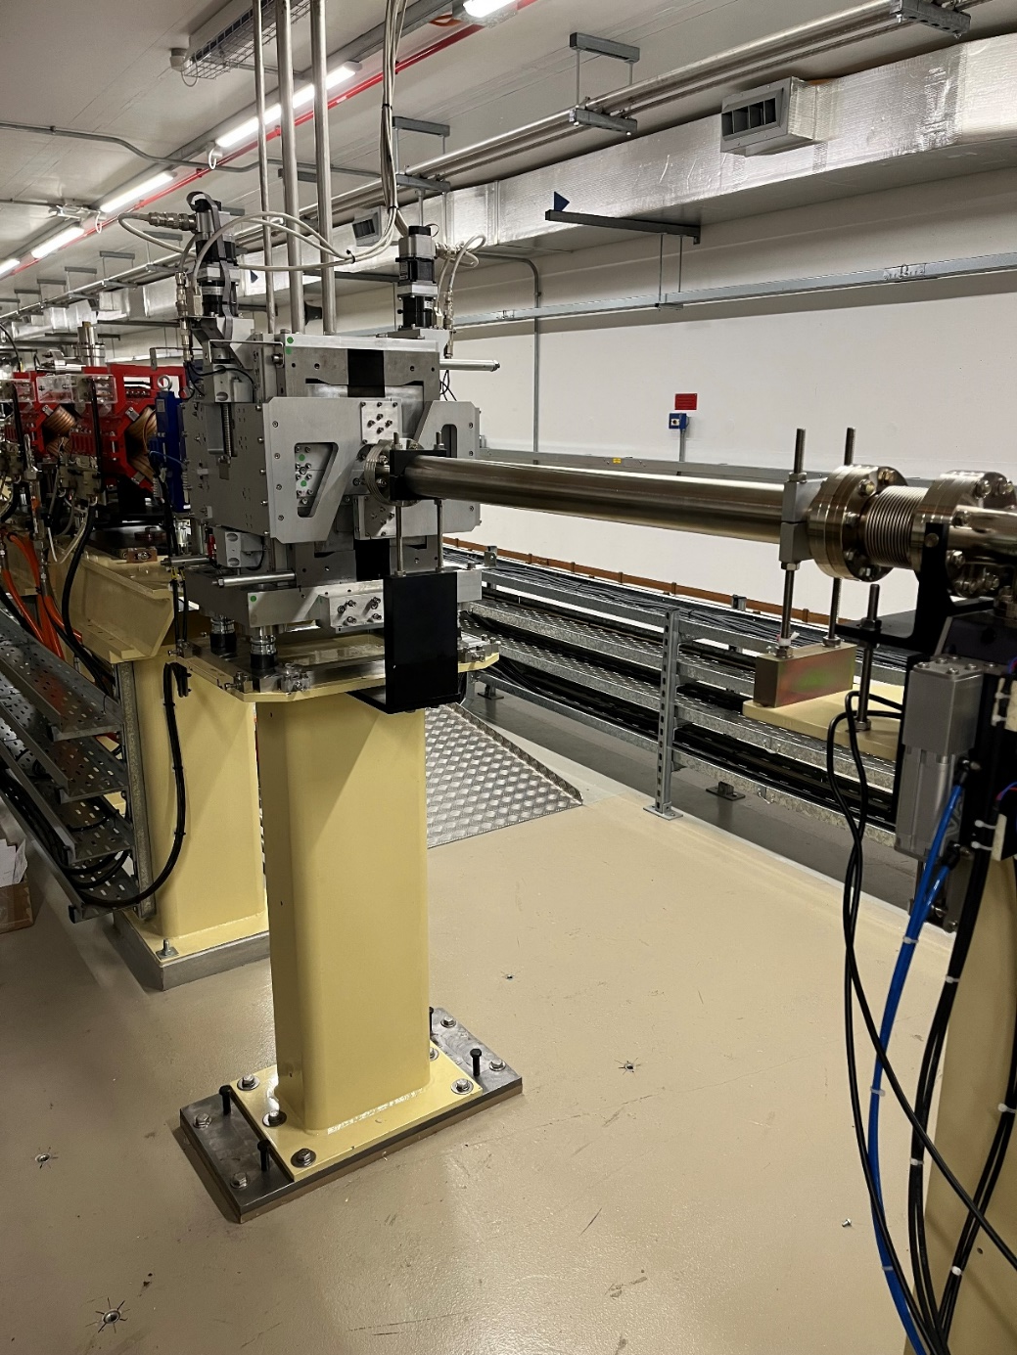
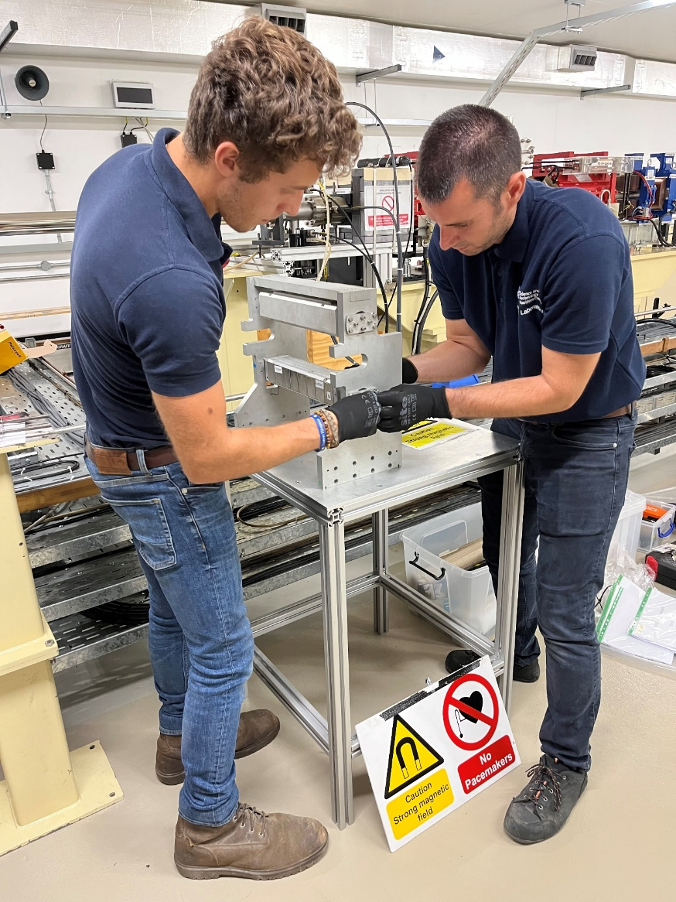
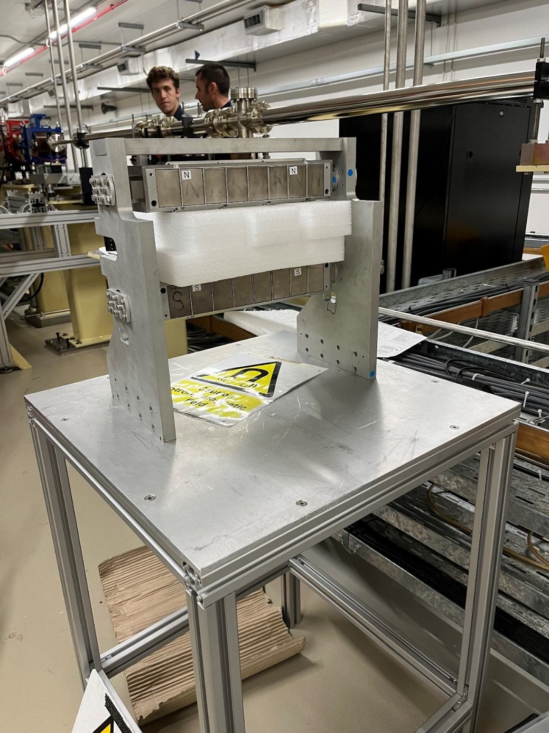
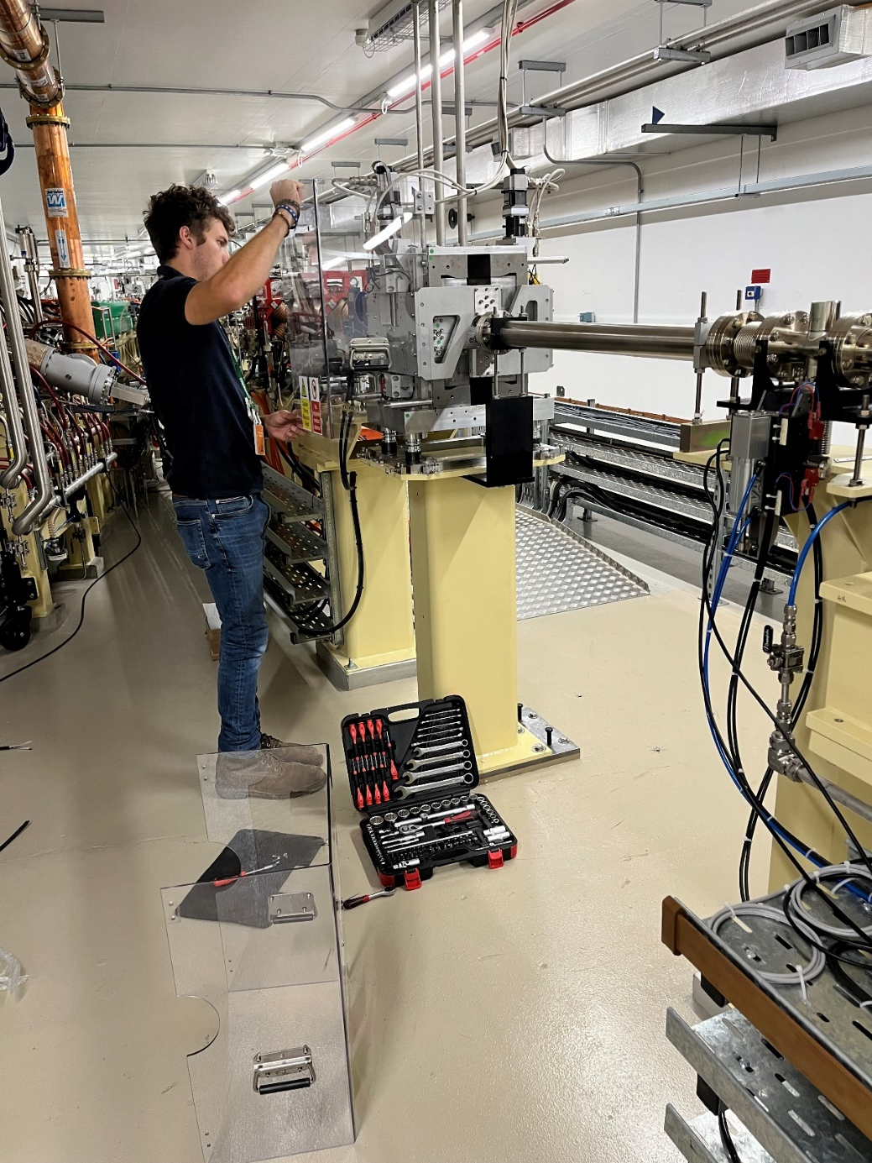
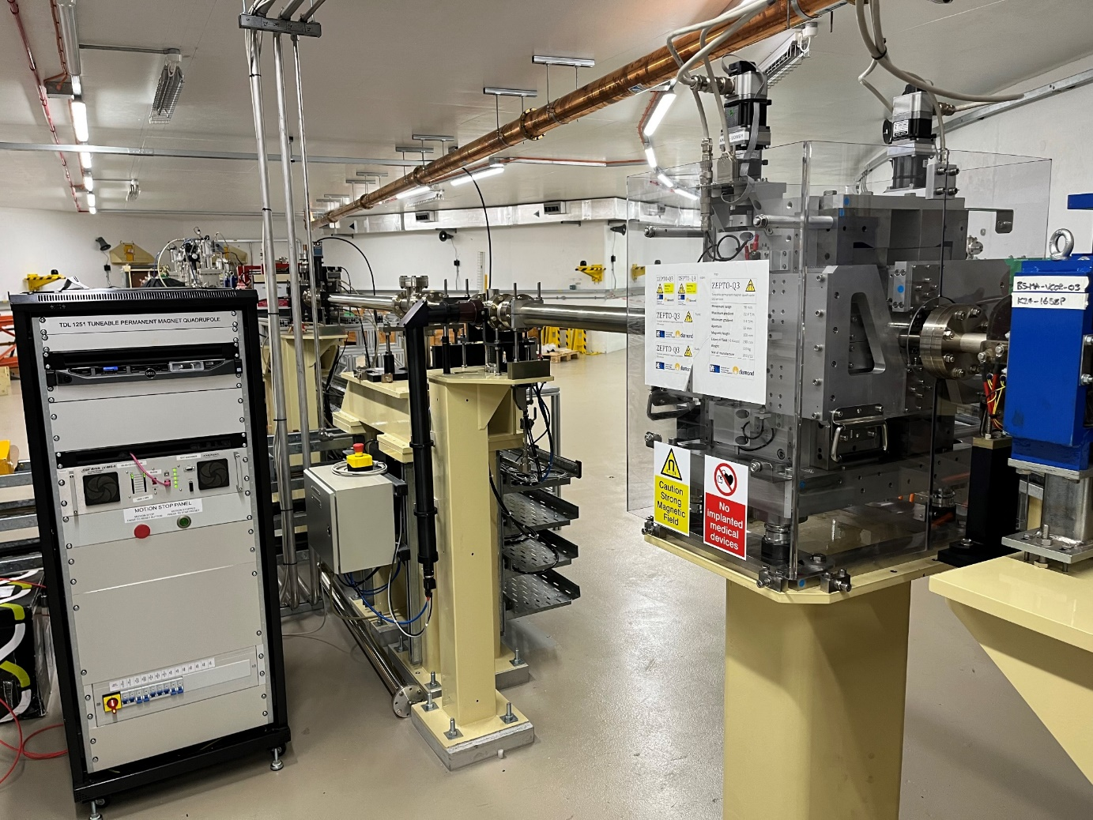
ZEPTO-Q3 installation
Installation complete
Permanent magnet blocks
Bring in magnet sides
Fully assembled magnet
Place PMs around
vacuum chamber
Bringing in magnet sides
Protective Perspex cover
Assemble sides around
dummy magnets
Magnet sides to meet
PMs in centre
Frame around pedestal
Installation frame
Dummy magnet holder

Slide 10
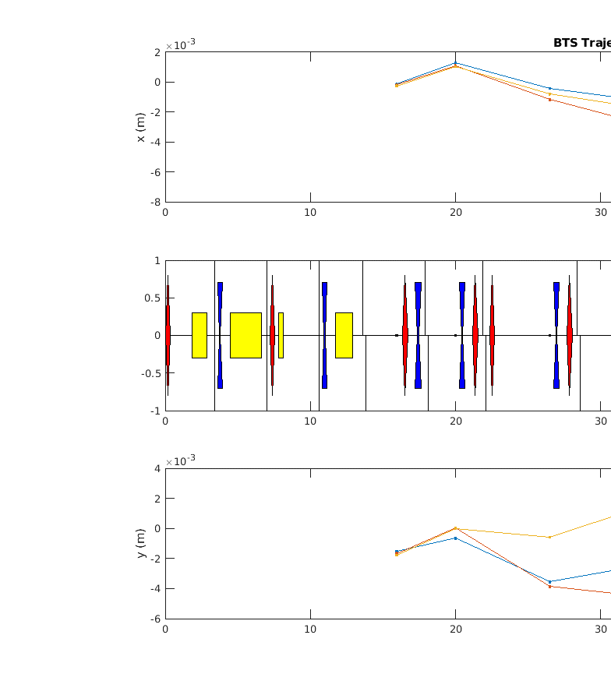
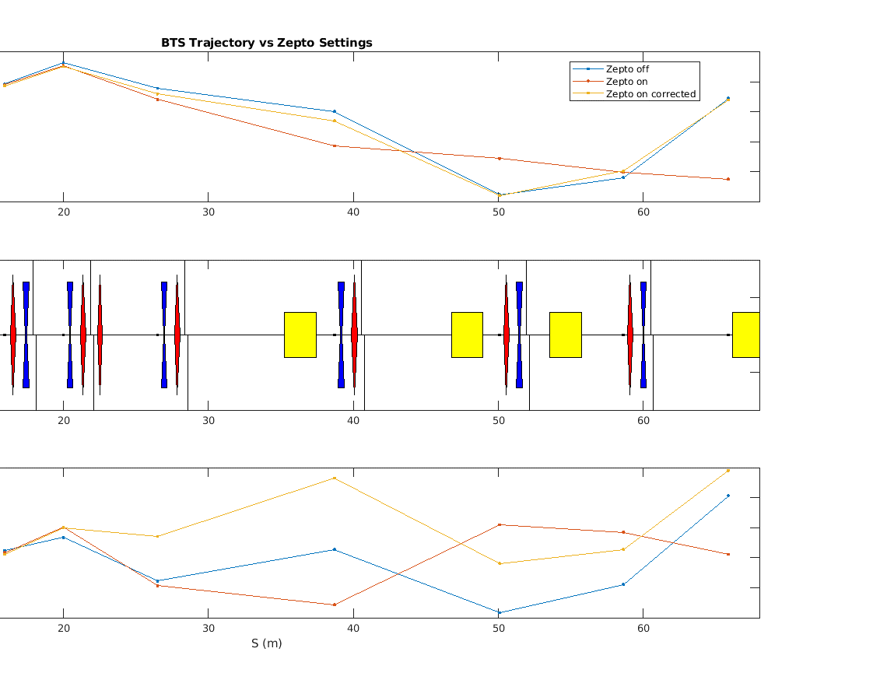
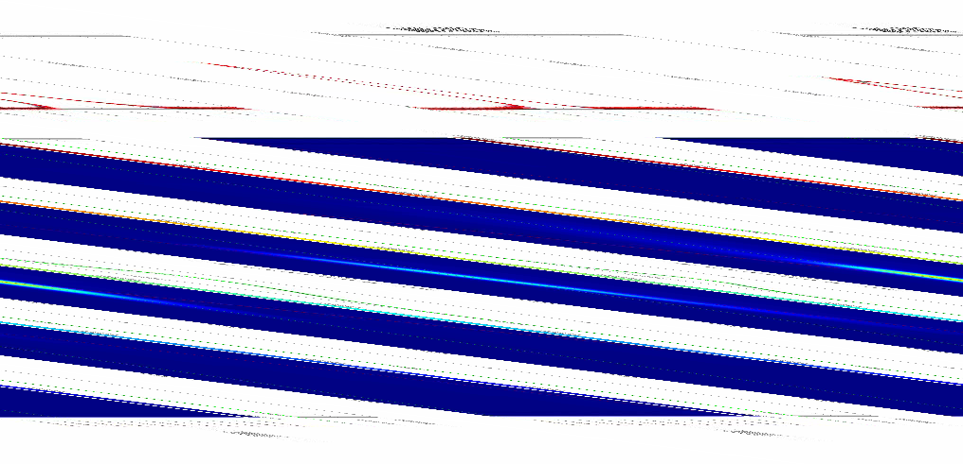
ZEPTO vs electromagnet performance
Minor trajectory corrections after turning ZEPTO up to nominal field
Injection efficiency returned to normal level (70%)
Now running in user mode with top-up injection
Beam shape on screen for same field:
ZEPTO
EMQ
ZEPTO

Slide 11

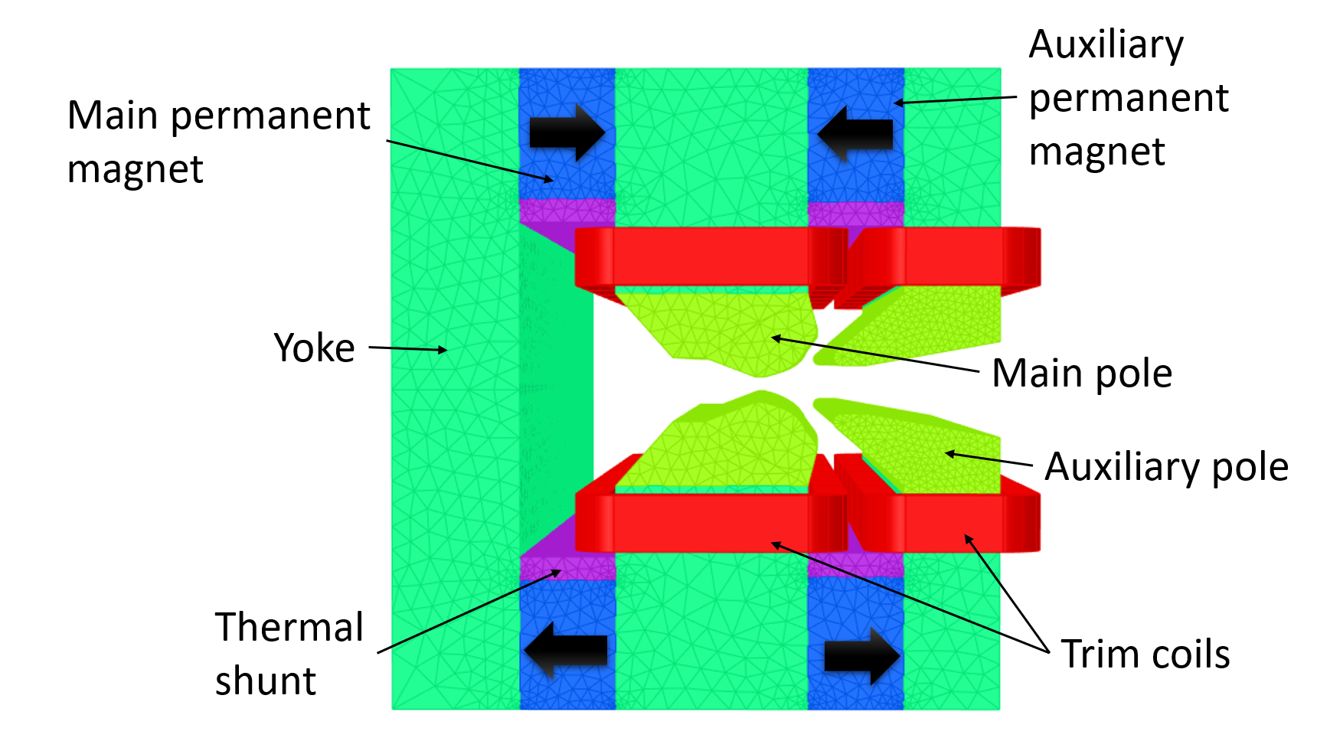
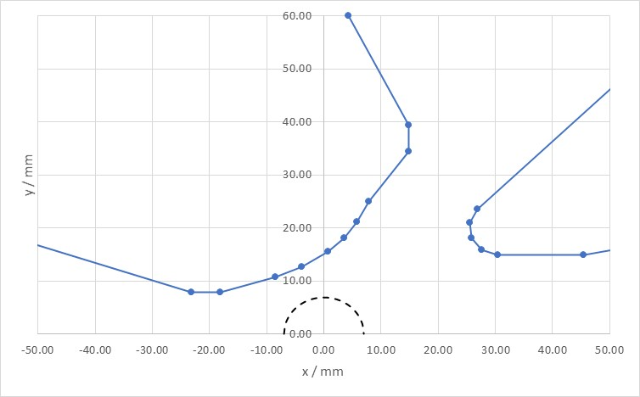
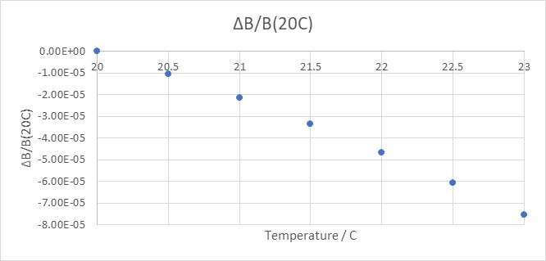
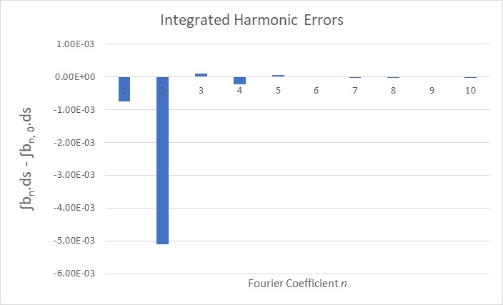
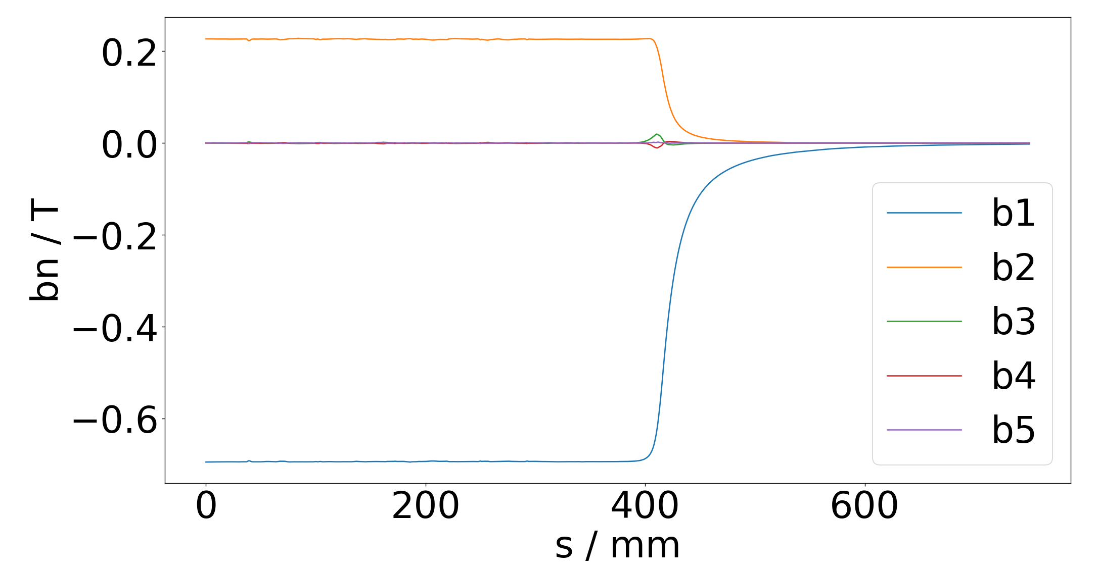
HEPTO: coil-adjustable PMs for light sources
Slide: Alex Hinton
ifast-project.eu
Hybrid Electro-Permanent Tuneable Optics
Central dipole field: 0.695 T
Central gradient: 32.4 T/m
Magnetic length: 0.870 m
Integrated dipole field: 0.605 Tm
Integrated gradient: 28.2 T
Good field region radius: 7 mm
Field quality ΔB/B within GFR: 5x10⁻⁴
Gradient quality ΔG/G within GFR: 1x10⁻³
Integrated multipoles < 10⁻³
Integrated field quality < 10⁻⁴
Dipole tuning range: ±2.5%
Gradient tuning range: ±2.5%

Slide 12
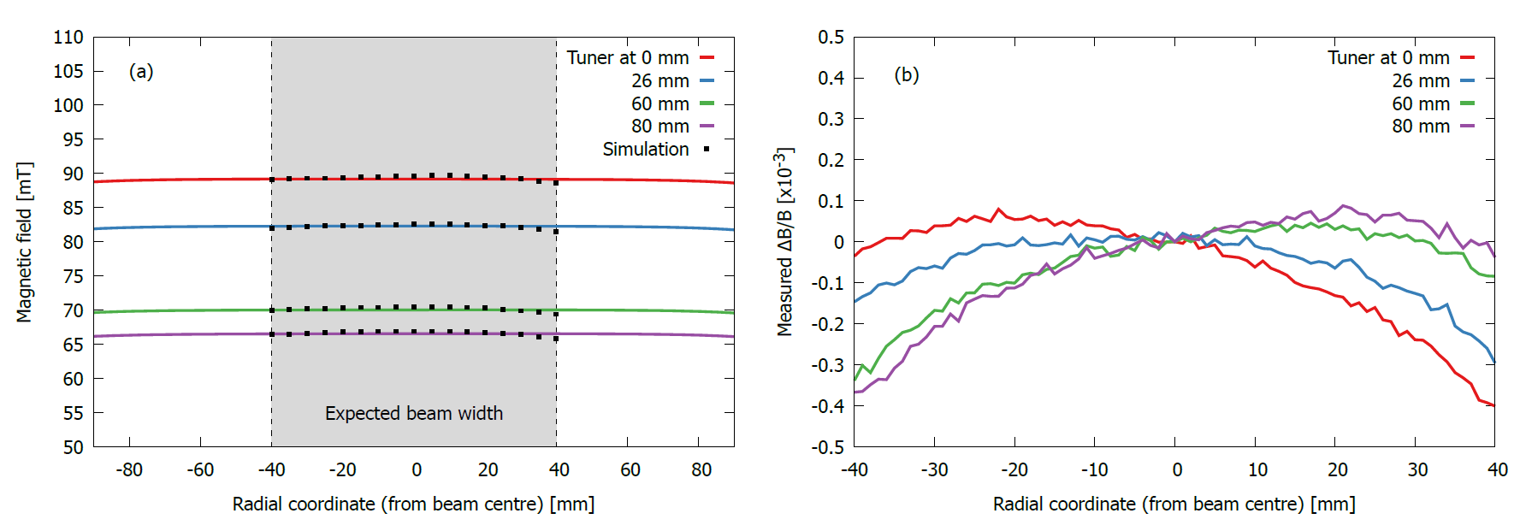
ECRIS: adjustable
PM dipole for ion sources
Olli Tarvainen et al, Nuclear Physics B (2022), in press
Compact ion source applicable to
  Thin Films centre
  Materials characterisation at ISIS
Includes PM-based m/q separator
  Simpler than traditional EM-based system
Mechanical adjustment: 65-87 mT
Assembled and tested at DL in 2022
Excellent agreement with modelling
Field quality 5x10⁻⁴

Slide 13
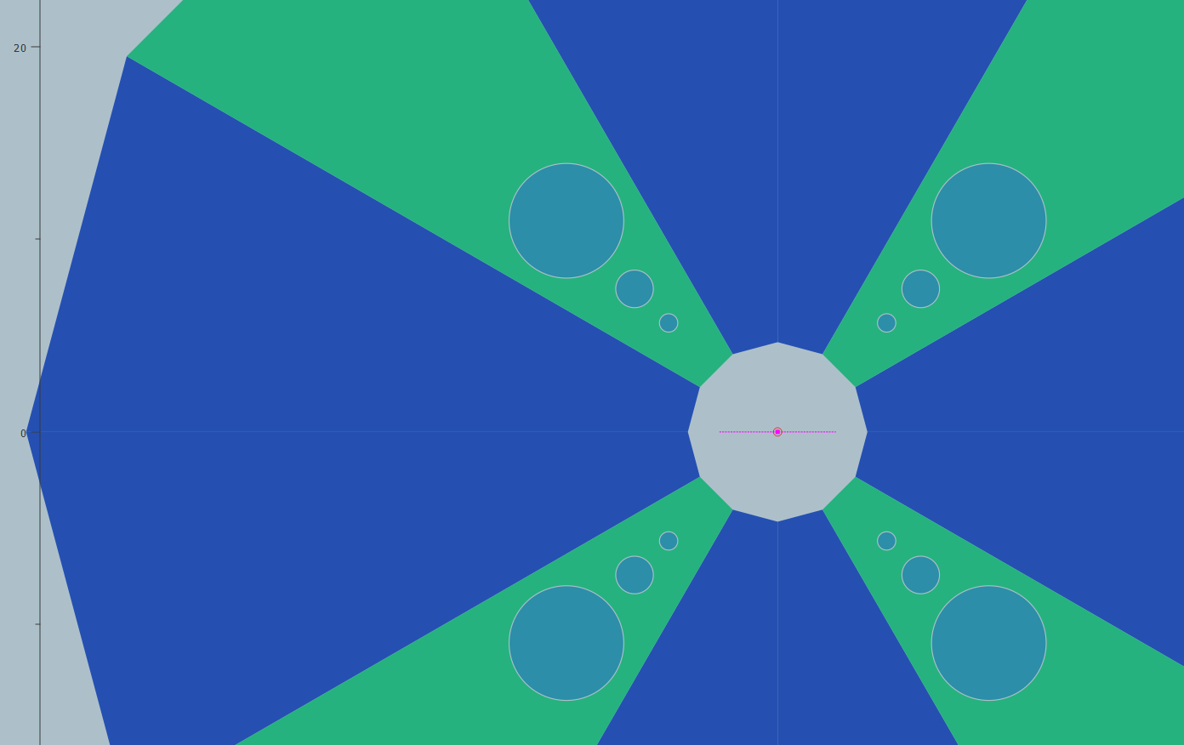
Shimmable Hybrid Halbach quadrupoles for EPAC
Slide: Neil Thompson
Vacuum pipe
Inner radius 4.0 mm
Outer radius 4.5 mm
EPAC is the Extreme Photonics Application Centre, currently under construction at RAL
ASTeC is responsible for designing an electron beamline to capture an electron bunch accelerated in a Laser Plasma system
High divergence bunches with energies from 100 MeV to several GeV are anticipated
To capture and focus the bunches, a beamline comprising 10 high strength fixed gradient small aperture quadrupoles is proposed
3 insertable tuning rods for each pole: 1006 Steel
Poles: 1006 Steel
Rod-3
PM Blocks: VACODYM-764-TP
NdFeB, B_{r} 1.37 T
Rod-2
Rod-1
Rod | ΔG
1 | 4 T/m
2 | 8 T/m
3 | 16 T/m
Peak Gradient | 500 T/m
Physical Length | 50 mm
Integrated Gradient | > 25 T
Internal Radius | 4 mm

Slide 14
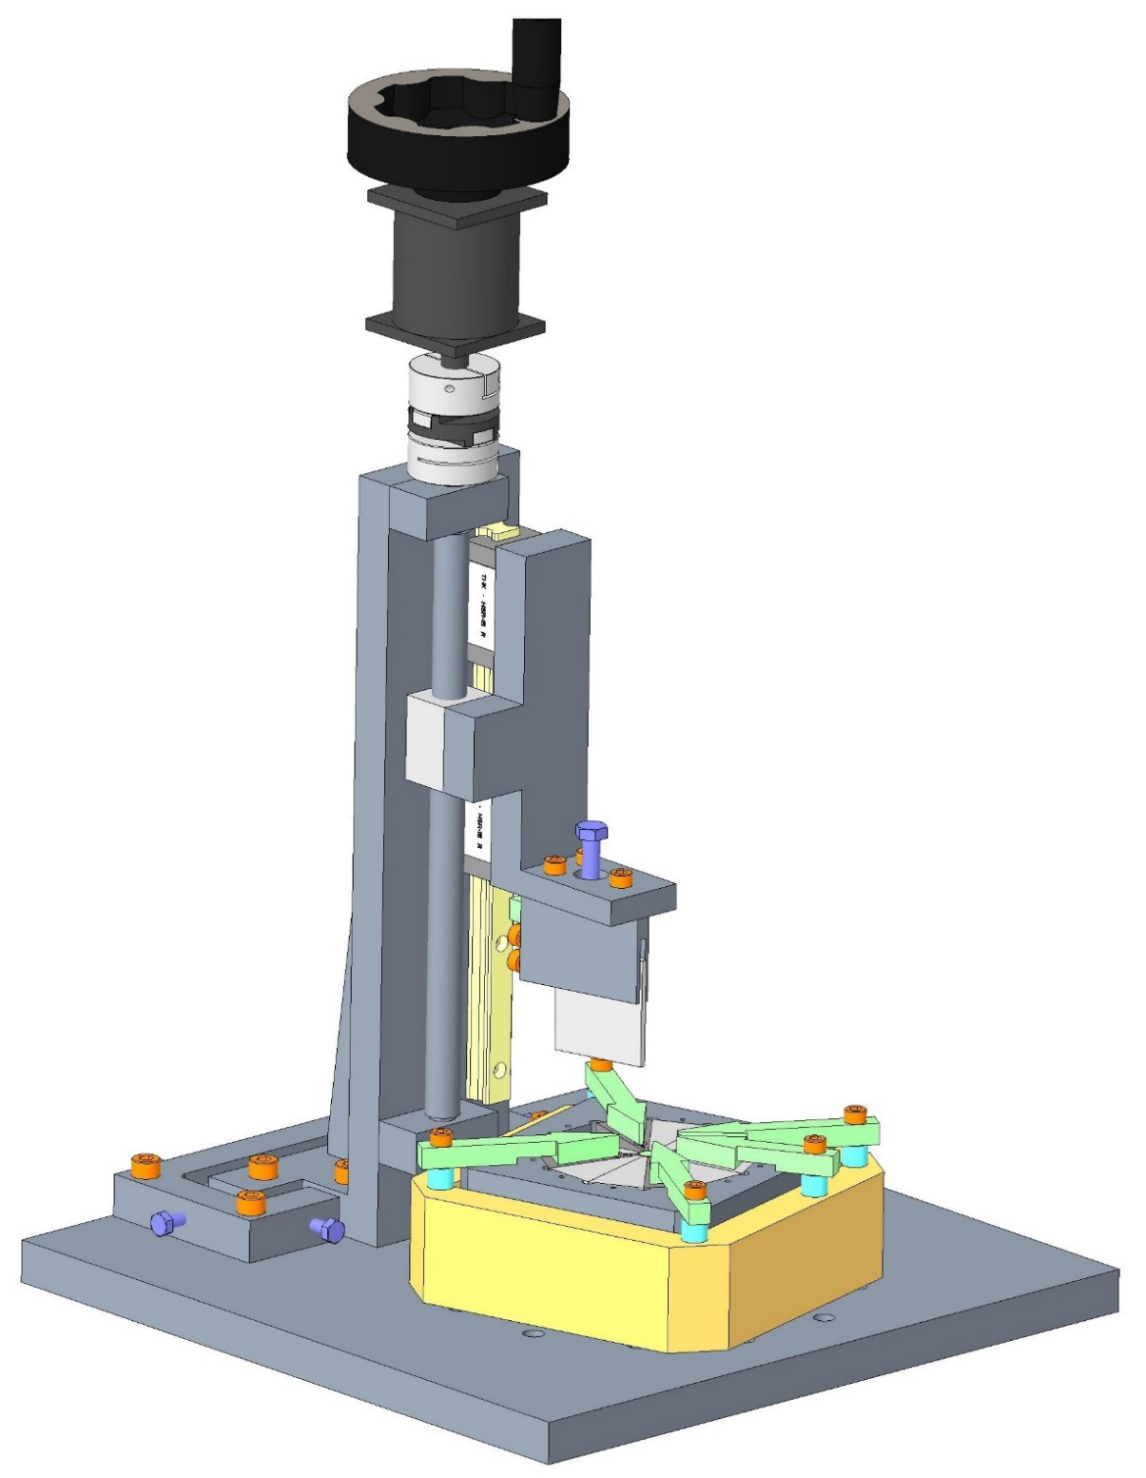
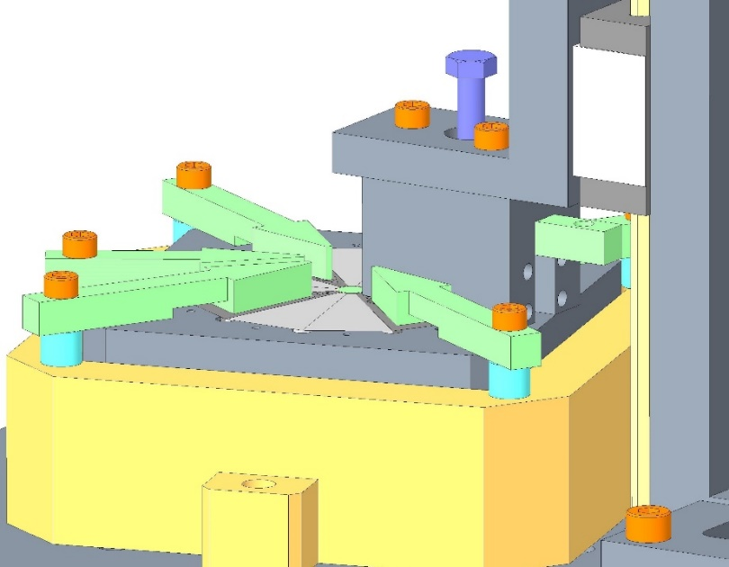
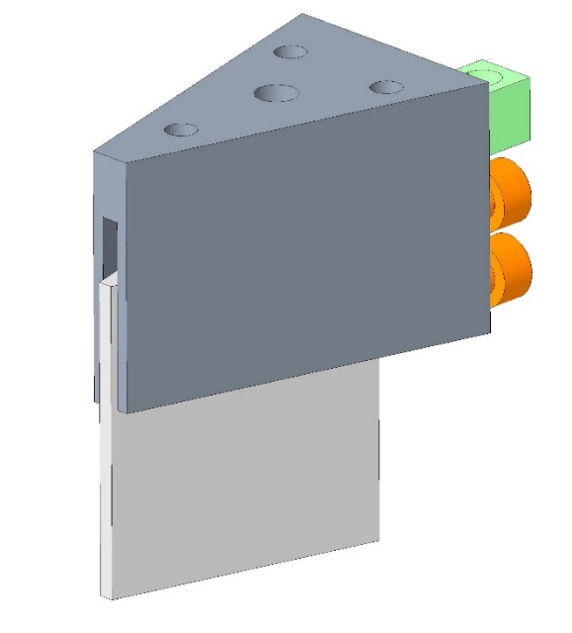
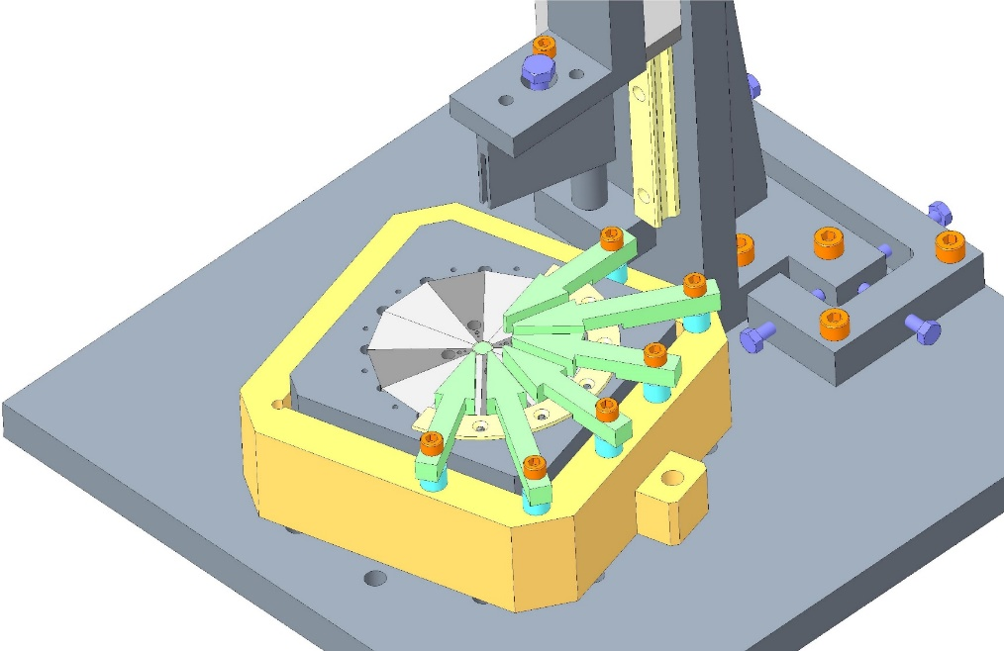
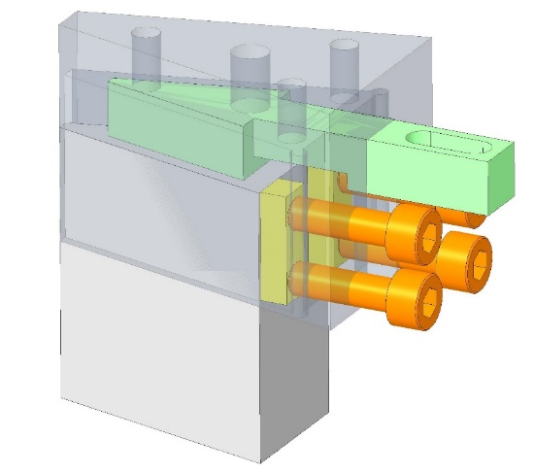
Assembly of Halbach quadrupole
Slide: Clive Hill
Continue translating magnet block into position by turning screw
Assembly tooling
Hand wheel
Magnet block holder assembly
Magnet block clamped with clamping finger
Magnet block holder
Gearbox
Linear guides and leadscrew
Magnet block
Remove clamping screws
Clamping finger
Magnet block holder assembly
Remove aluminium spacer to enable magnet assembly
Clamping pads (yellow)
Clamping screws
Set base block position and lock into position with pin in indexing feature
Add clamp ring and remove clamp fingers

Slide 15
Conclusions
ZEPTO magnets provide a viable highly-adjustable alternative to electromagnets for many accelerator applications
ZEPTO technology is now being used on a user facility
More PM technology is being developed and deployed
Acknowledgments:
Alex Bainbridge, Alex Hinton, Olli Tarvainen, Neil Thompson

