Slide 1
Diamond-II Magnets
Alfie Shahveh
2nd PerMaLIC Workshop

Slide 2
Diamond-II magnets
Total 1032 magnets..

Slide 3
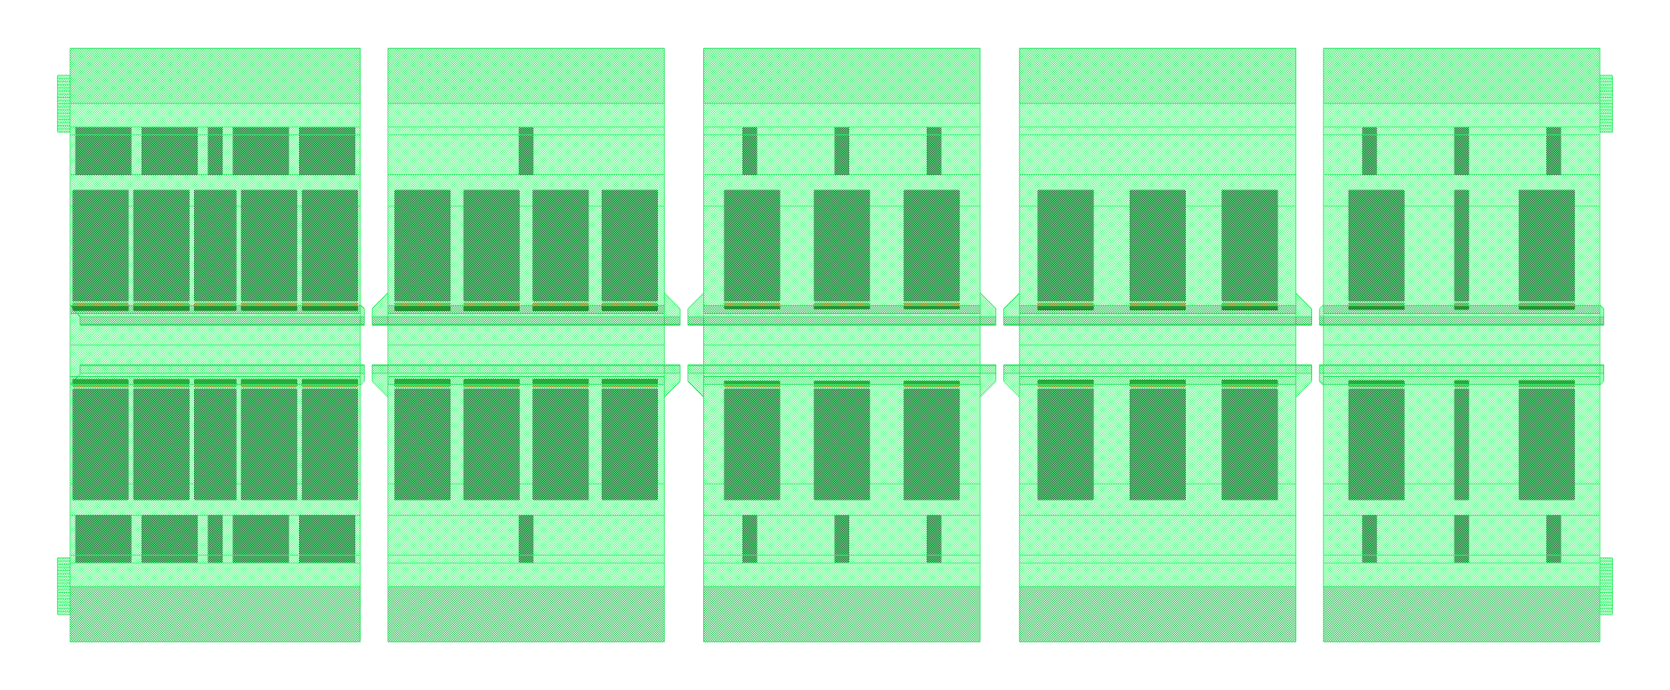
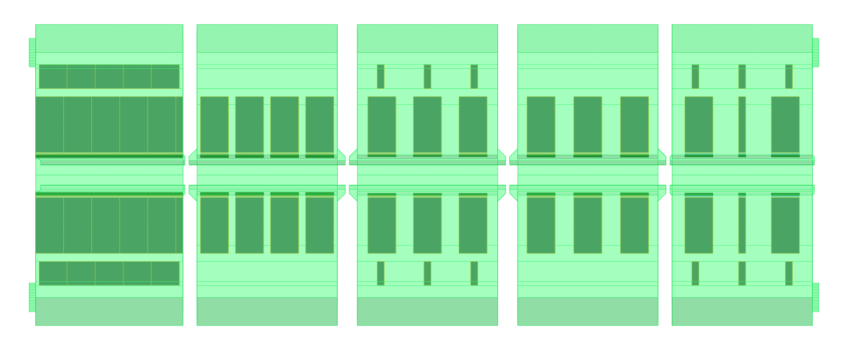
DL Magnets
Design Parameters
Magnet gap: 25 mm
Magnetic Field:
DL2/3: 0.33-0.75 T
DL1/4: 0.33-0.83 T
Yoke and Assembly
The magnet end-tuners added, in simulation the perform very well (1.5% tuning range)
Its performance is planned to validate in prototype DL
First and last modules length shortened (by 3 mm) to reach the required field integral.
Total Iron yoke weight ~385 kg
PM Blocks
Material: Sm₂Co₁₇
Full(quarter) block size: 35(8.75)x70x30 mm³
104 blocks (2 types)per magnet (~ 49 kg)
DL2 and DL3
DL1 and DL4

Slide 4
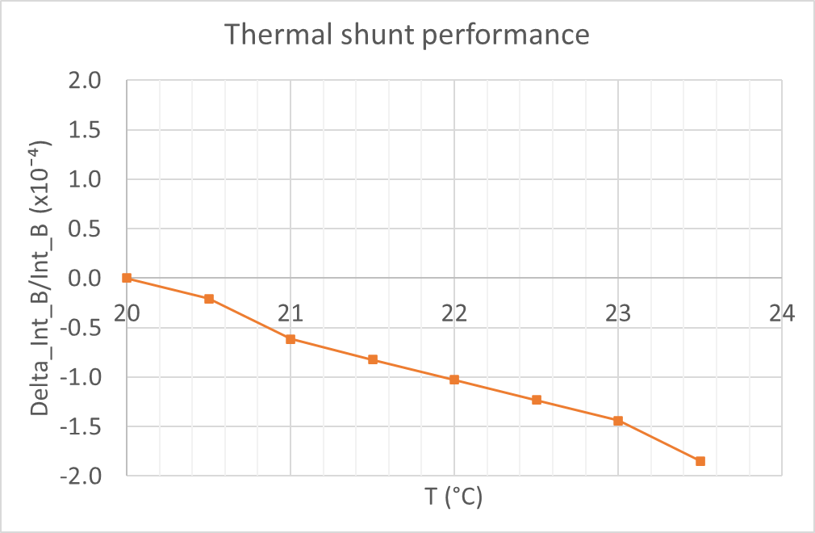
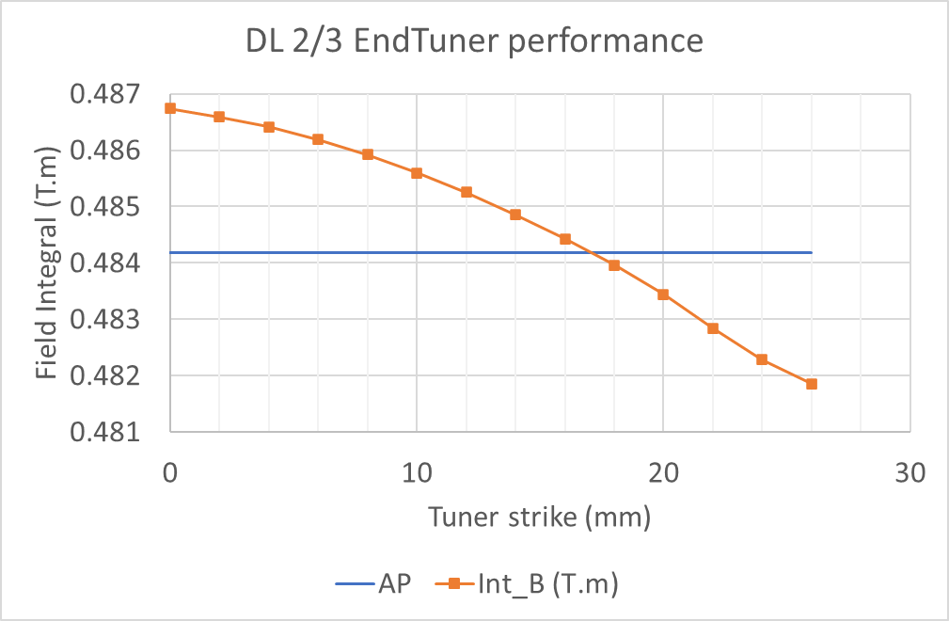
DL Magnets
Thermal shunt performance and end tuners to correct the field integral

Slide 5
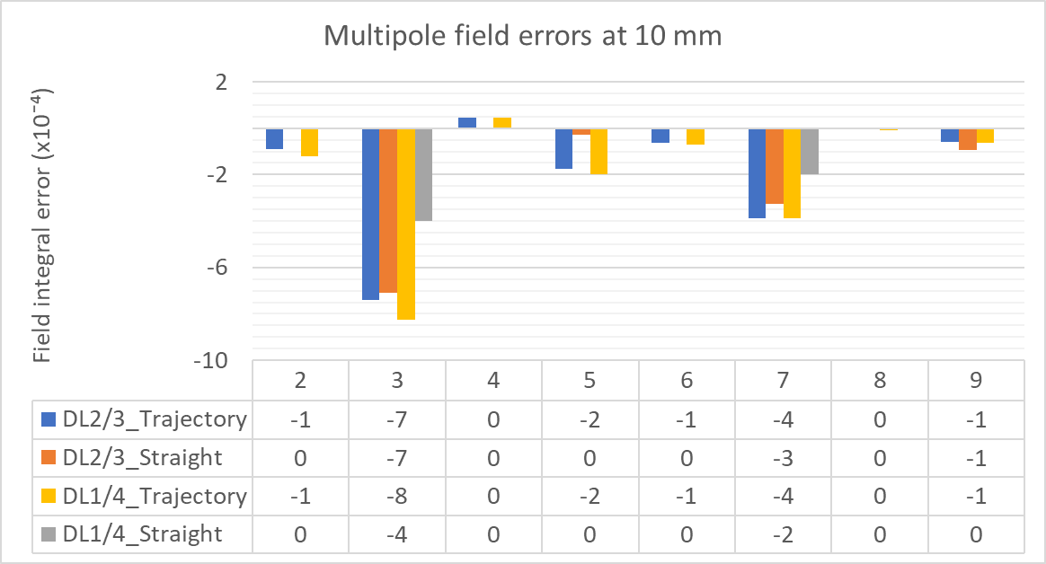
DL Magnets
Multipoles along the trajectory and along the magnet axis

Slide 6
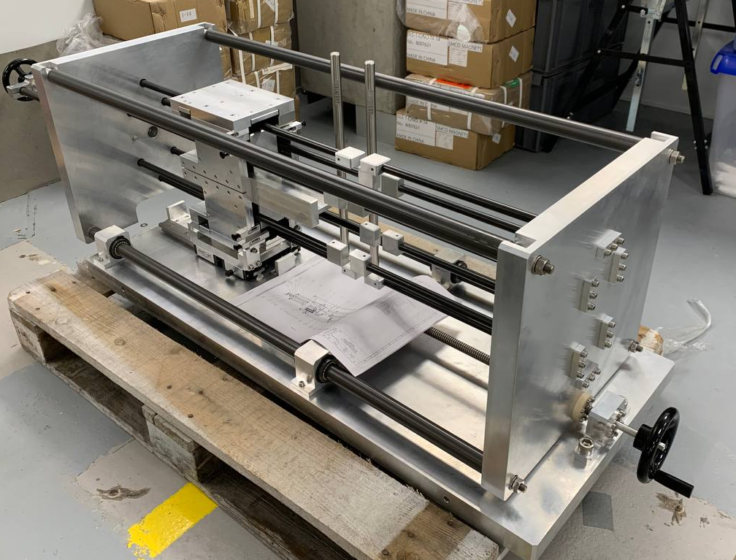
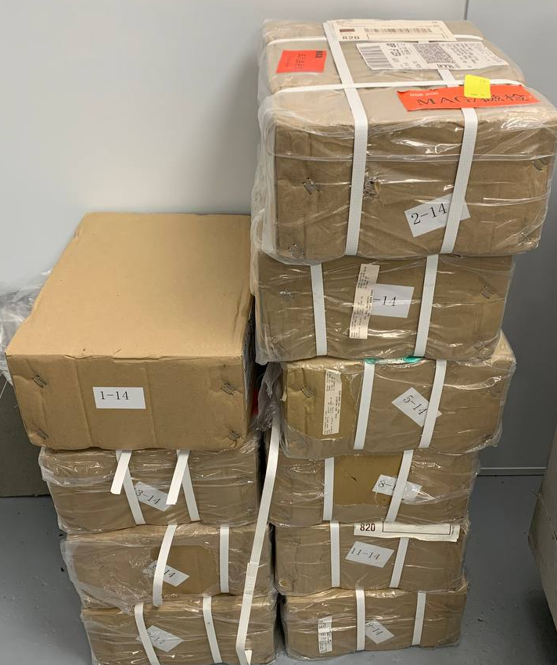
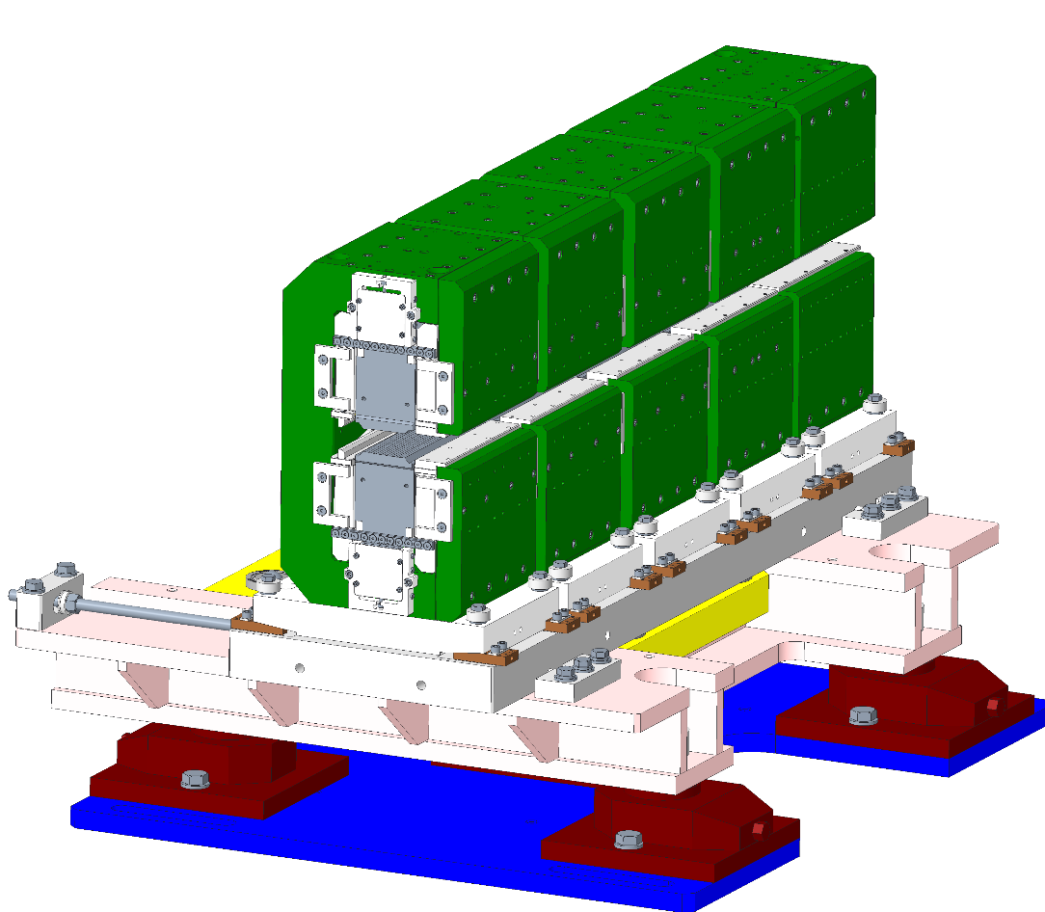
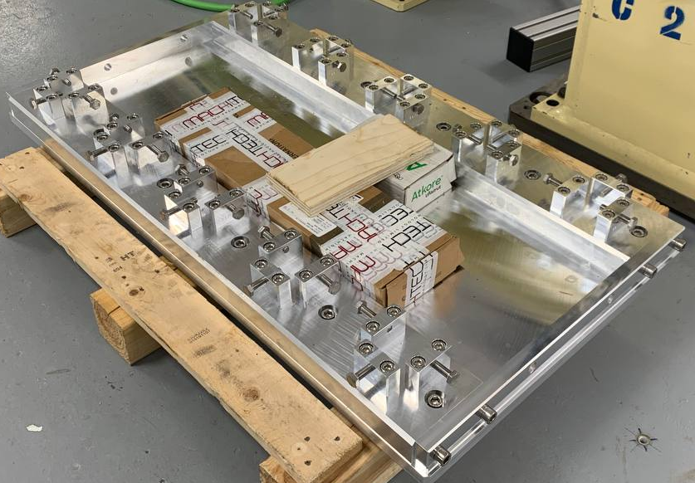
DL Magnet prototype
Some parts delivered and some being delivered before Christmas
PM Blocks
Insertion tool
DL magnet support

Slide 7
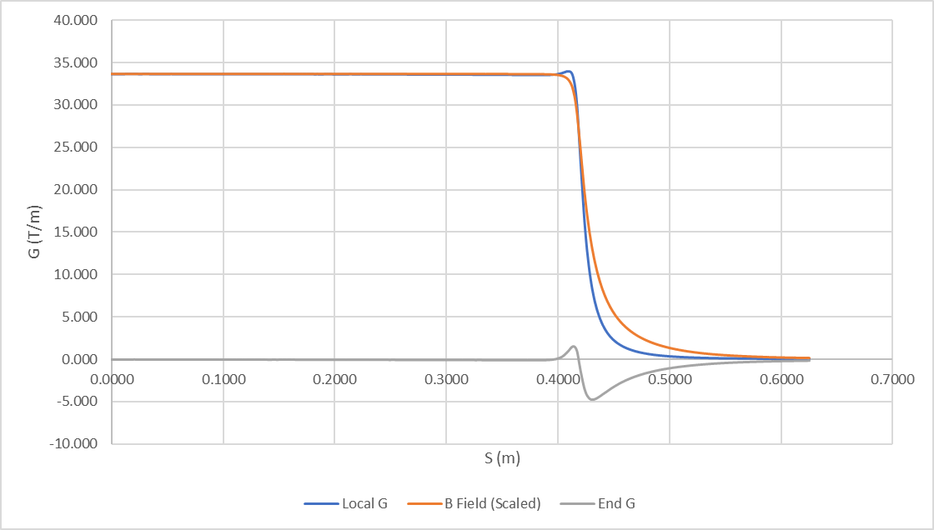
DQ Magnet
Field Quality @ 10 mm : ΔB/B≤5.0E-03
Lowering the weight and power to minimum
Straight yoke and bent pole tips
Max deformation ≤ 5 um (using aluminium spacers)
L_{eff} for B and G is different (G is shorter), hence local G’s slightly increased to compensate
B and G are capable of tuning independently, while a relatively large sextupole error appeared as soon as the nominal set point is left

Slide 8
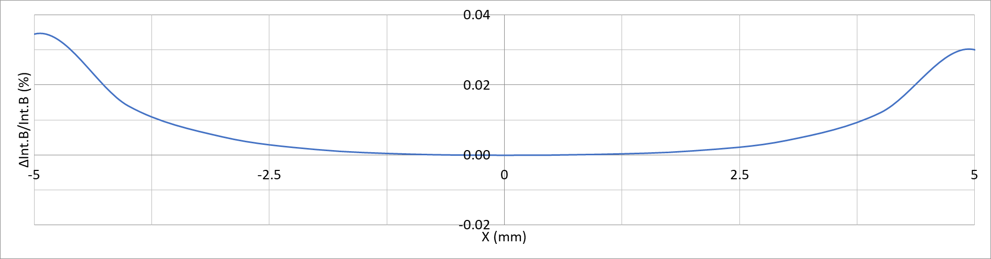
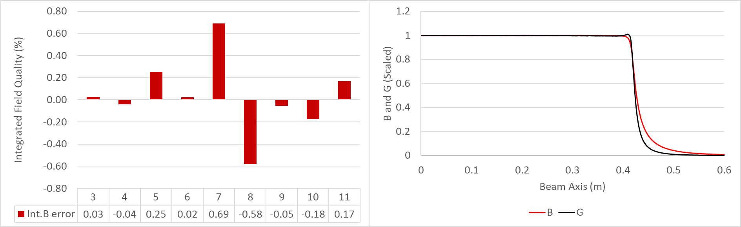
DQ Magnet
Multipole errors at 10 mm

Slide 9
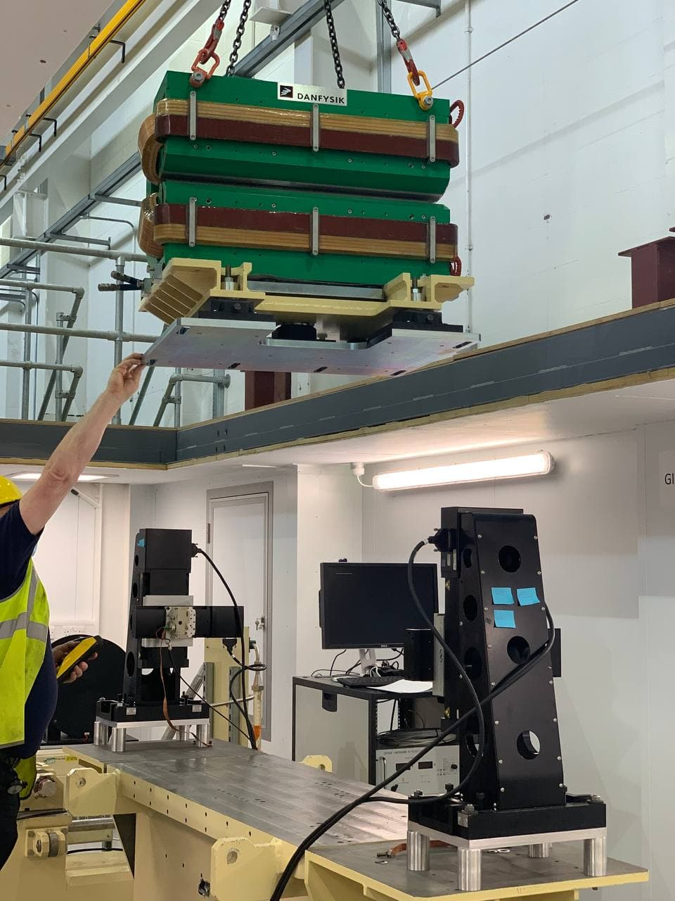
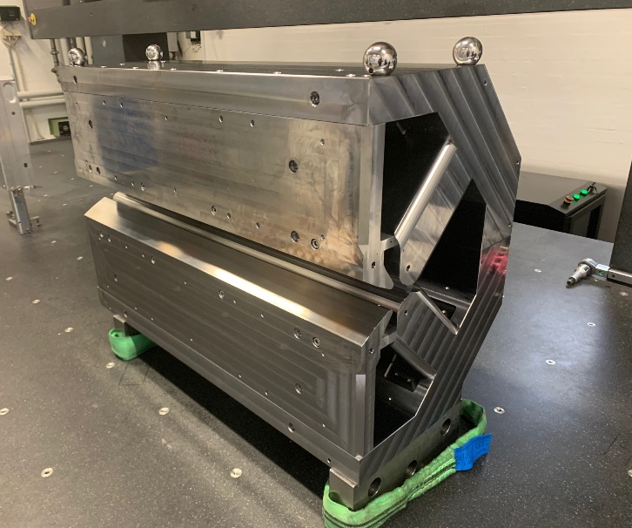
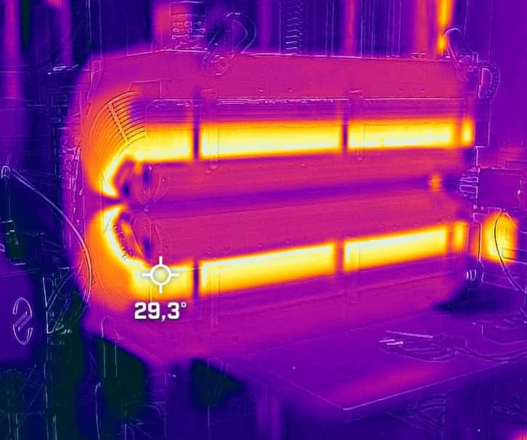
DQ Magnet prototype
The first prototype has been built and delivered to Diamond in January 2022
Stretched wire measurements done, a good agreement between model field and measurements is seen
Hall probe measurements planned to be taken for establishing a better relationship between straight field integral and field integral along the trajectory

Slide 10
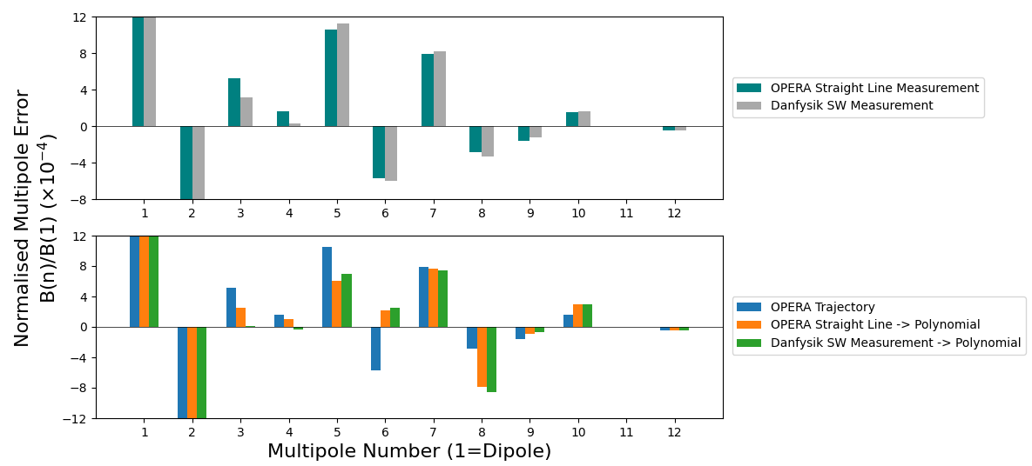
DQ Magnets
DQ measurements (WIP)
Courtesy: Ben Nicholson

Slide 11
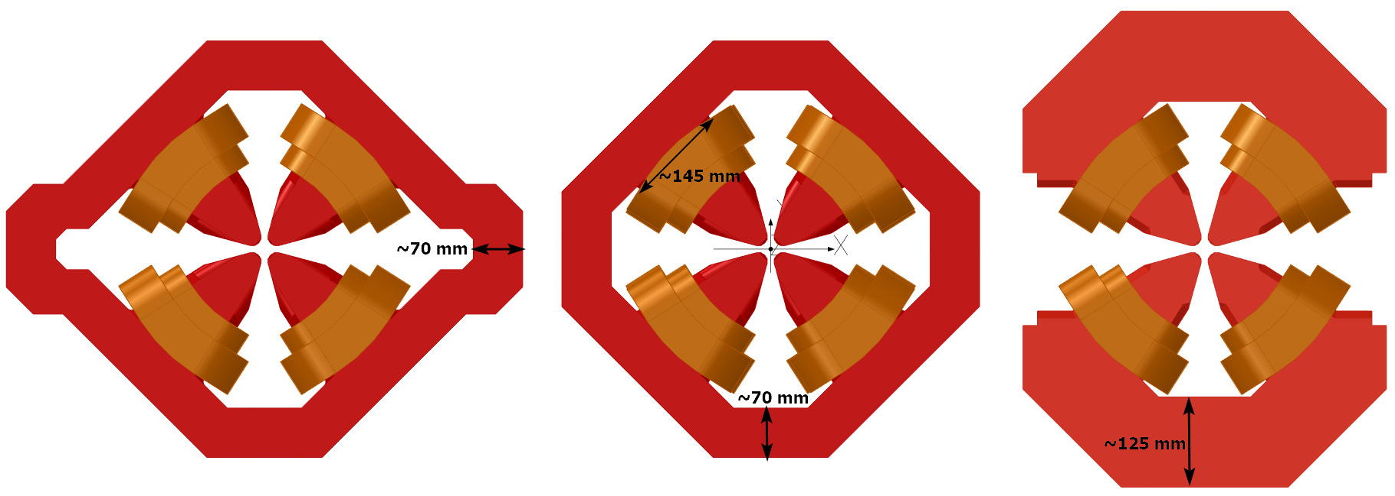
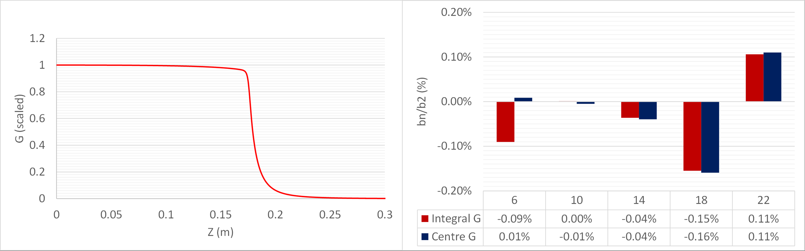
Quadrupoles
Quadrupoles operating range is relatively wide, the multipoles controlled during the whole range (b6 is current dependent due to saturation of poles)
Notes:
TDR Comment:
The quadrupoles have a large gradient range. How does the field quality varies in this range?
Bulk low carbon steel could be another low cost option. We prefer laminated to reduce response time to changes when carrying out accelerator physics measurements.

Slide 12
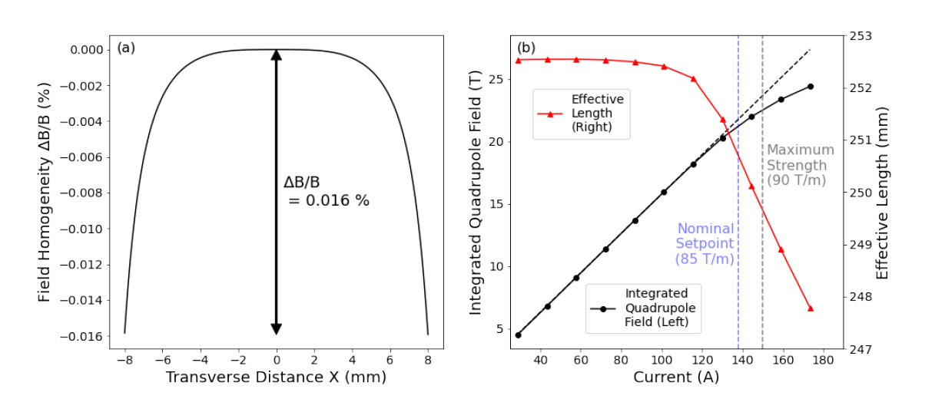
Quadrupoles
Excitation curve of Q-L250-R120 magnets
Courtesy: Ben Nicholson

Slide 13

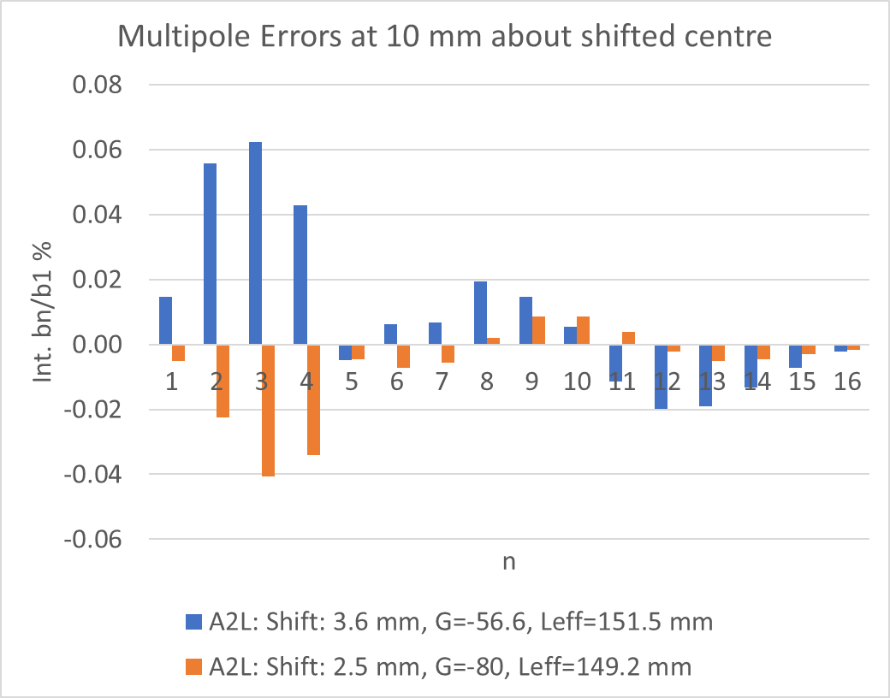
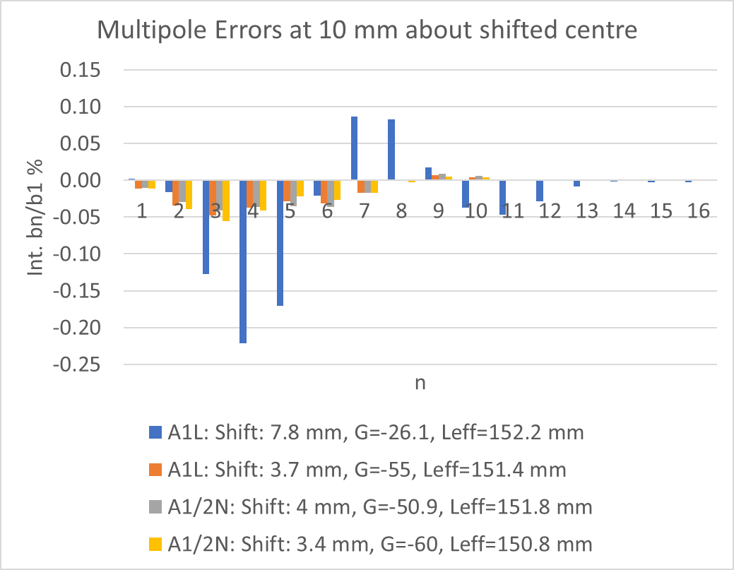
Anti-bend Quadrupoles

Slide 14
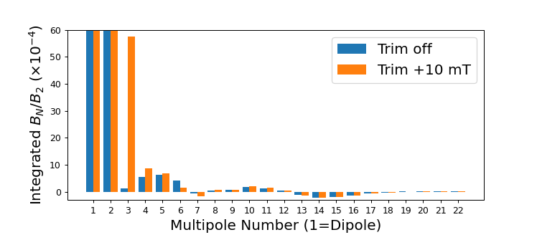

Anti-bend Quadrupoles
Anti-bend at 56.6 T/m (3.6 mm offset)
All anti-bends have a consistent reverse bend angle of 2.618 mrad (corresponding to 204 mT).
Each magnet includes trim coils for up to ±10 mT dipole field (5 % of bend angle).
Much like the DQ magnet, a strong sextupole component is induced of up to 5.8×10⁻³.

Slide 15
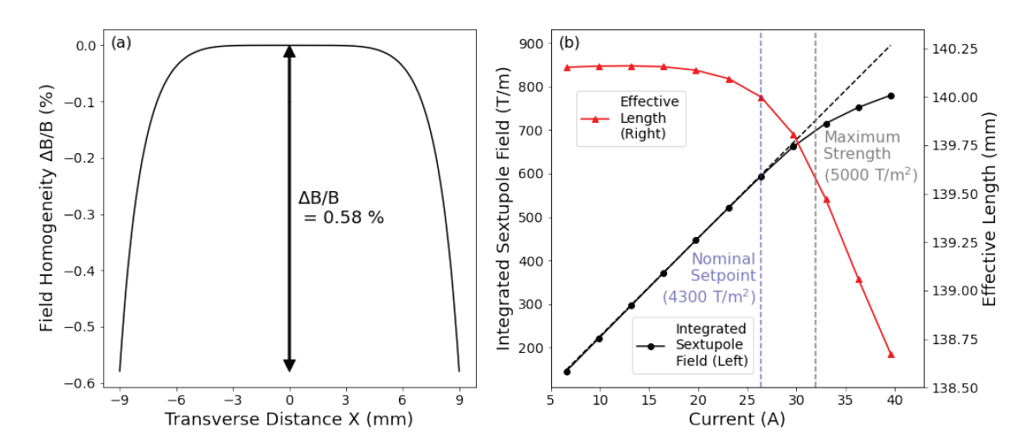
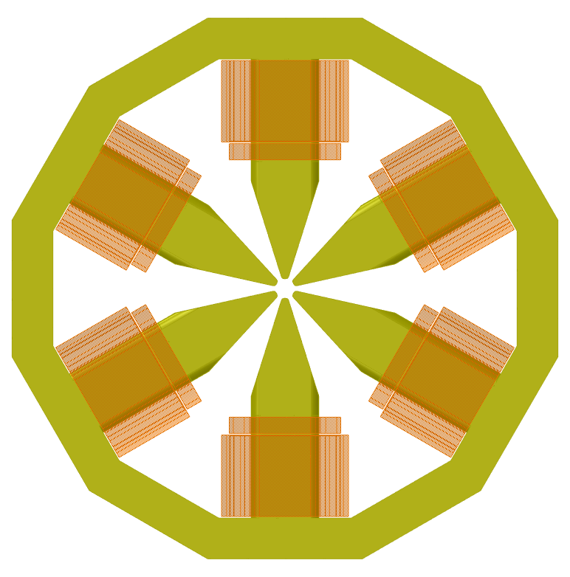
Sextupoles
Sextupoles are categorised in 2 different inscribed radius, R=12 mm and R=15 mm
Max strength (including contingency) is 3500 T/m^2 and 5000 T/m^2 for R= 15mm and R=12 mm respectively (excitation curve when all correctors are ON shown below)

Slide 16
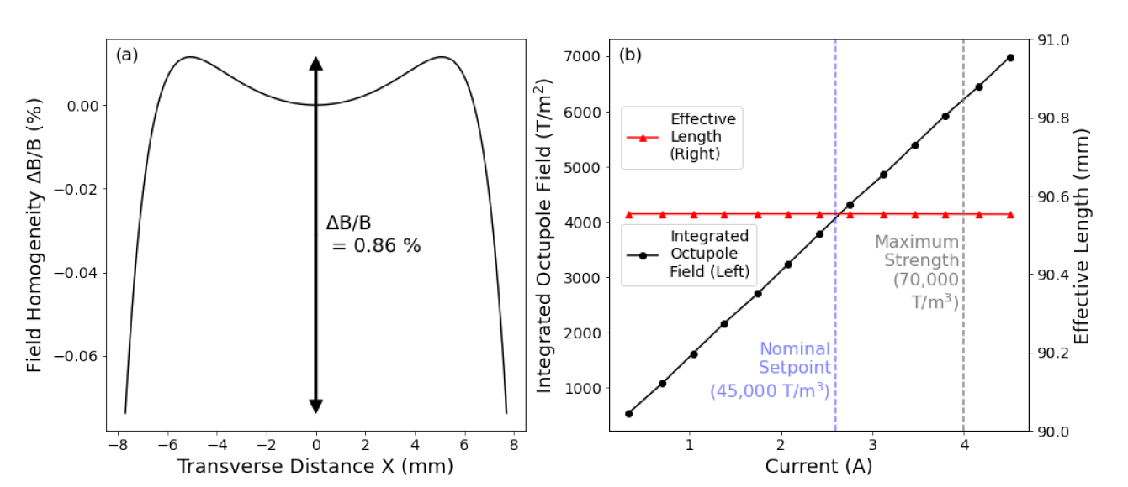
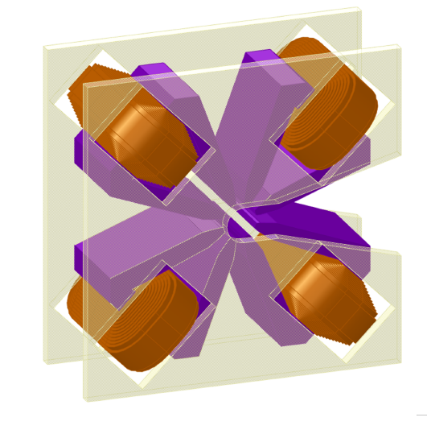
Octupoles
Octupoles are relatively low strength, hence they are tiny magnets
Octupole max strength 70,000.0 T/m³
Radius 14 mm

Slide 17
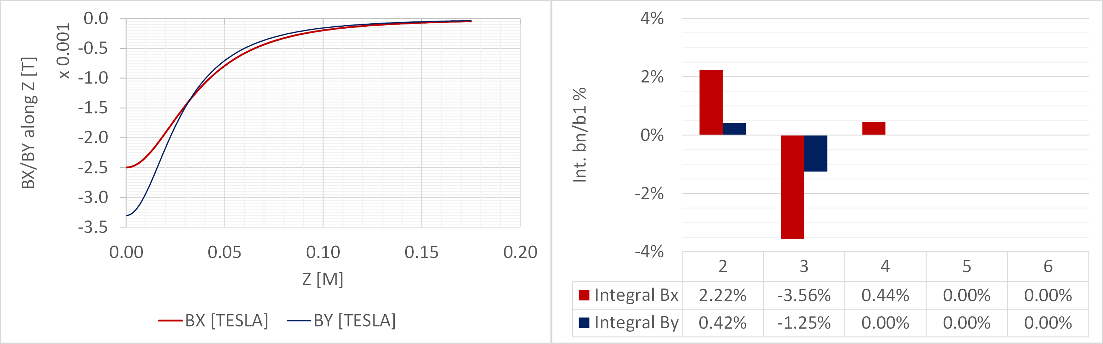
Correctors
Slow correctors are literally two H-shape dipoles with additional coils that rotated 90 degrees (to reduce cross-talk between Bx and By
Slow correctors of this shape always have poor field quality, its been checked by AP an it looks OK.
Fast correctors: 20 urad deflection
Slow correctors: 1 mrad deflection

Slide 18
Summary
Magnet design work almost complete but cross-talk studies on a variety of magnet groups are done which require adjustment of the designed magnets
DQ prototype measurements is half-way through and the early results showed a good agreement between model and measurements
DL magnet prototype method statement and risk assessment document are being prepared for in-house manufacturing
The measurement lab and assembly workshop preparations are ongoing

Slide 19
Any Questions?
Thanks for your attention

Slide 20
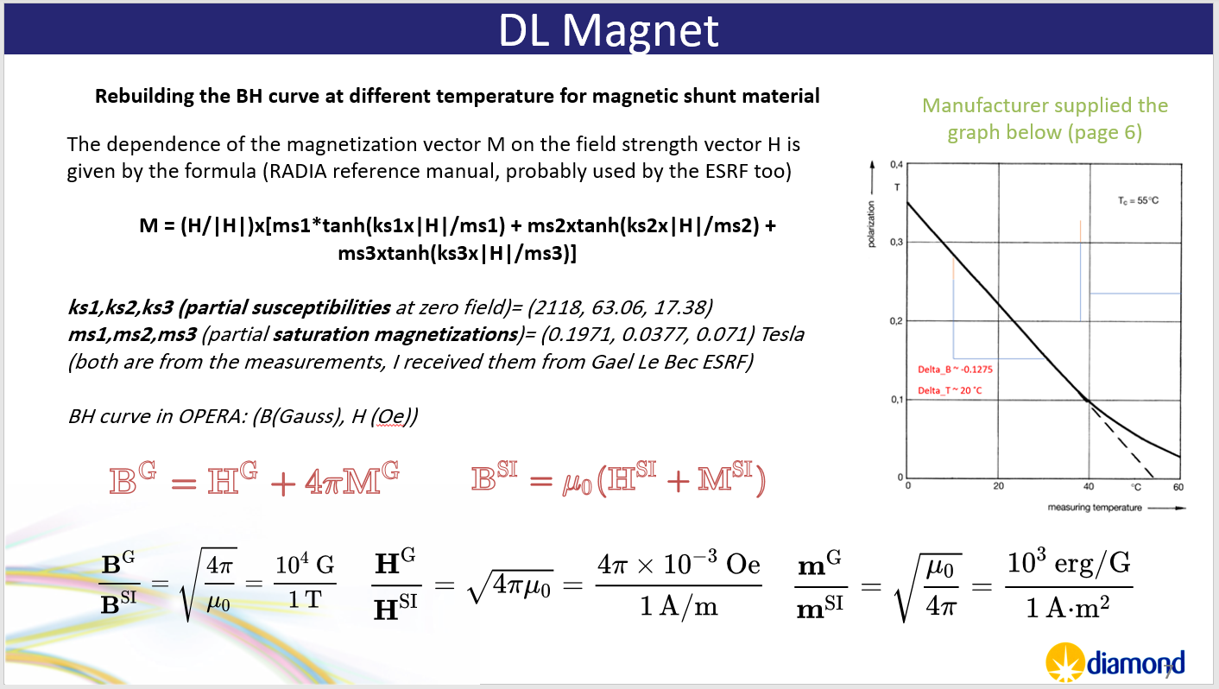
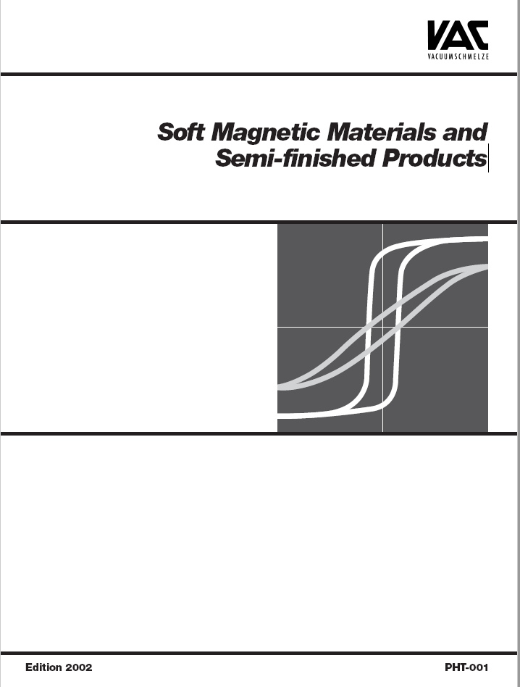
Backup Slides
tt

Slide 21
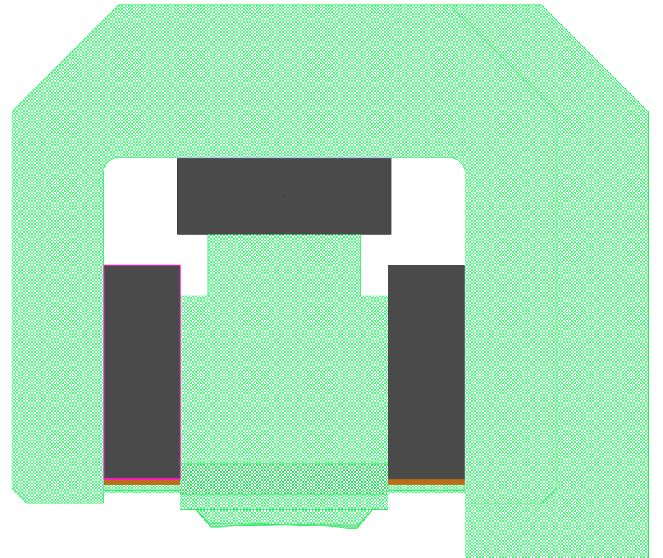
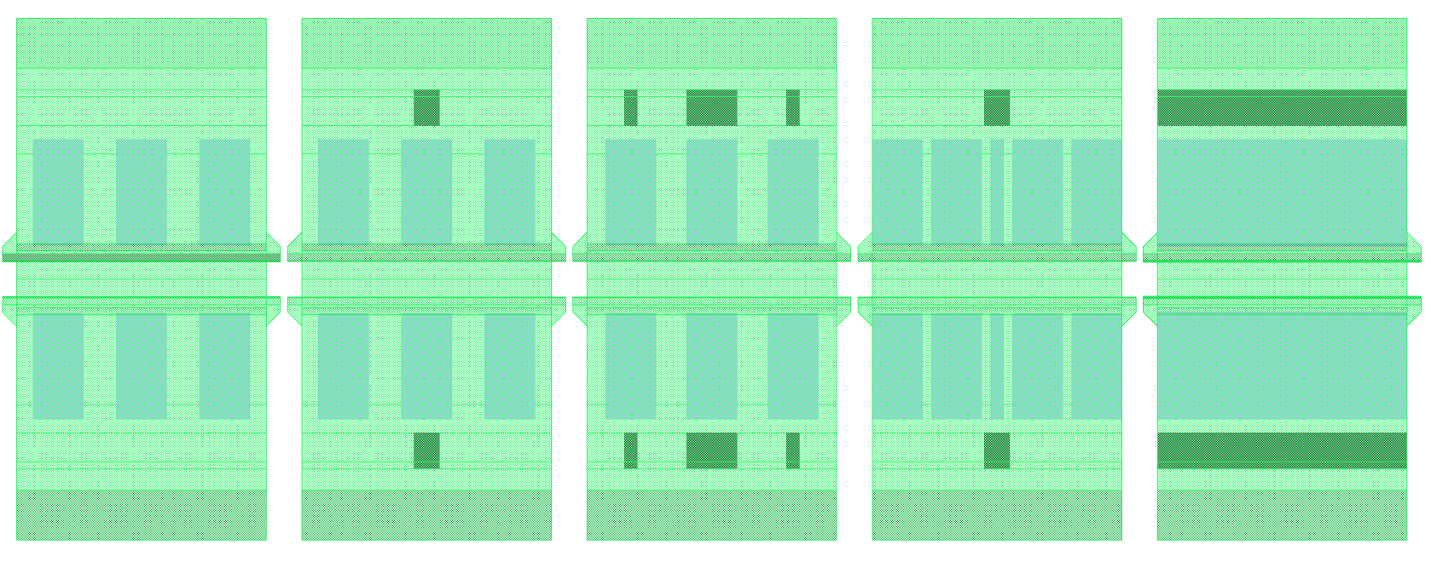
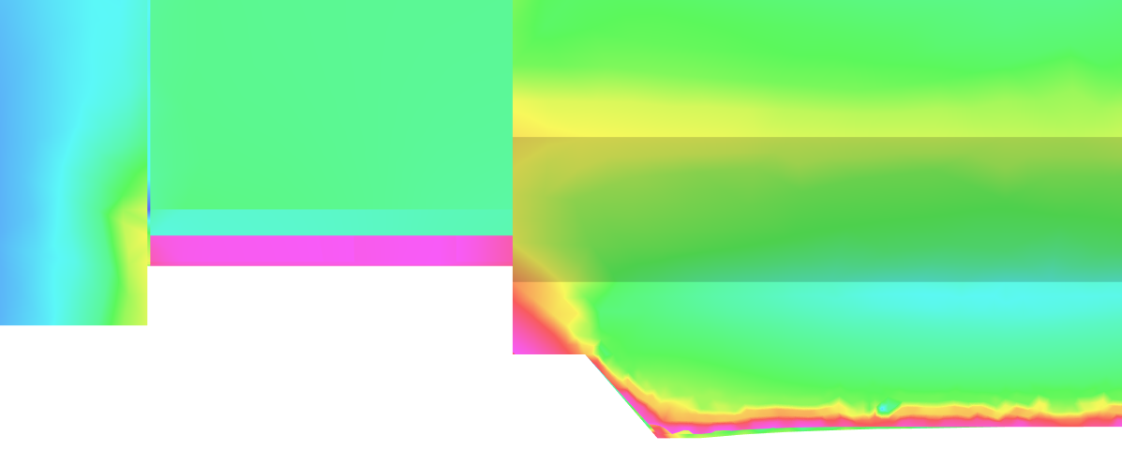
DL Magnets
All Shunts are placed both sides, only on top of PM blocks
Thermal shunts
Magnetic shunts

