Slide 1
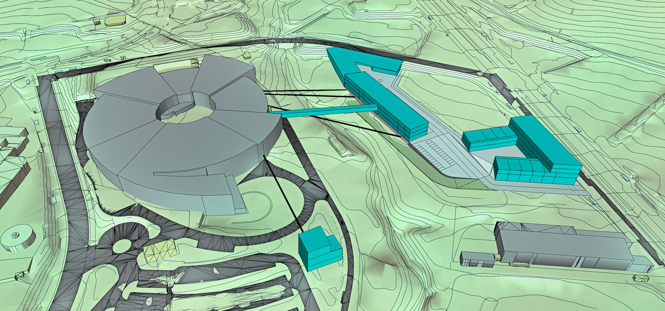



Towards ALBA II
Caterina Biscari
8 September 2022
AUSE and ALBA Users’ meeting

Slide 2
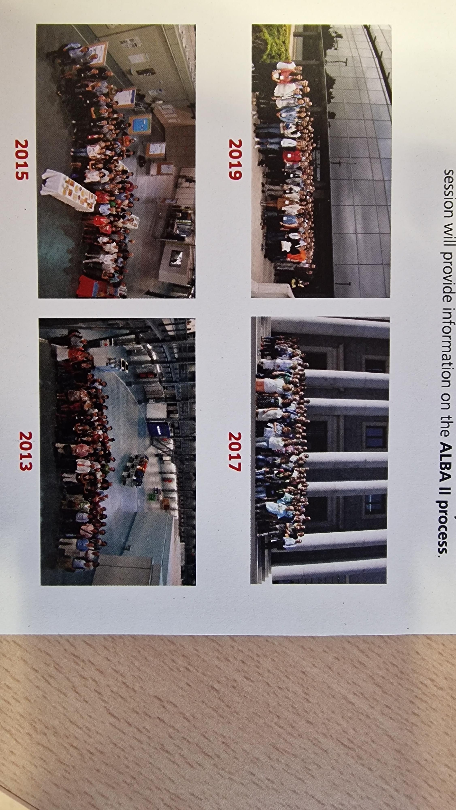
Why ALBA II?
Answering your needs and providing you capacities for facing the future

Slide 3
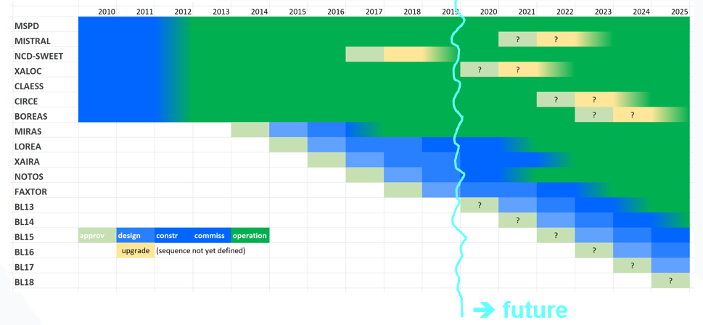
Slide on ALBA Future from last AUSE meeting (8-10 October 2019)

Slide 4



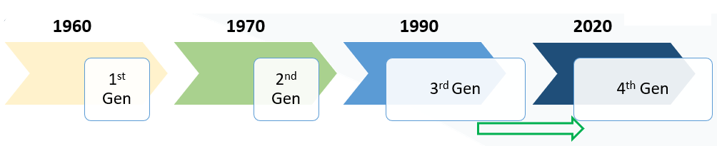
Evolution of Synchrotron Radiation Sources
Increase in Brilliance
Increase in Resolution Power
Increase in Coherence
Increase in Data Analytics capacity
Representation of photon beam on sample

Slide 5
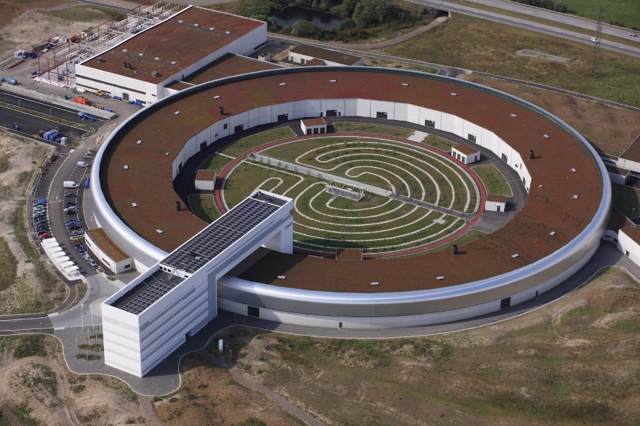
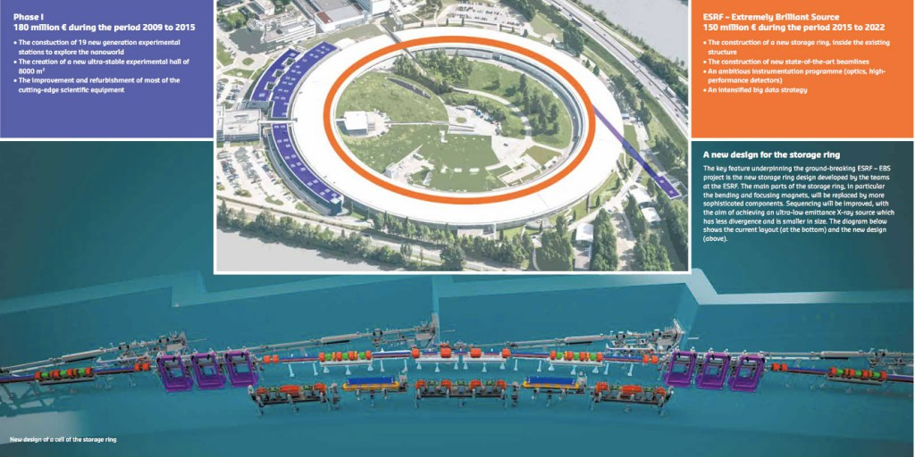
Present of Synchrotron Radiation facilities in Europe
3rd gen facilities at full power
4th gen facilities in operation:
Max IV – first 4th gen SR facilities in the world
ESRF–EBS – first upgrade from 3rd to 4th gen facility in the world

Slide 6
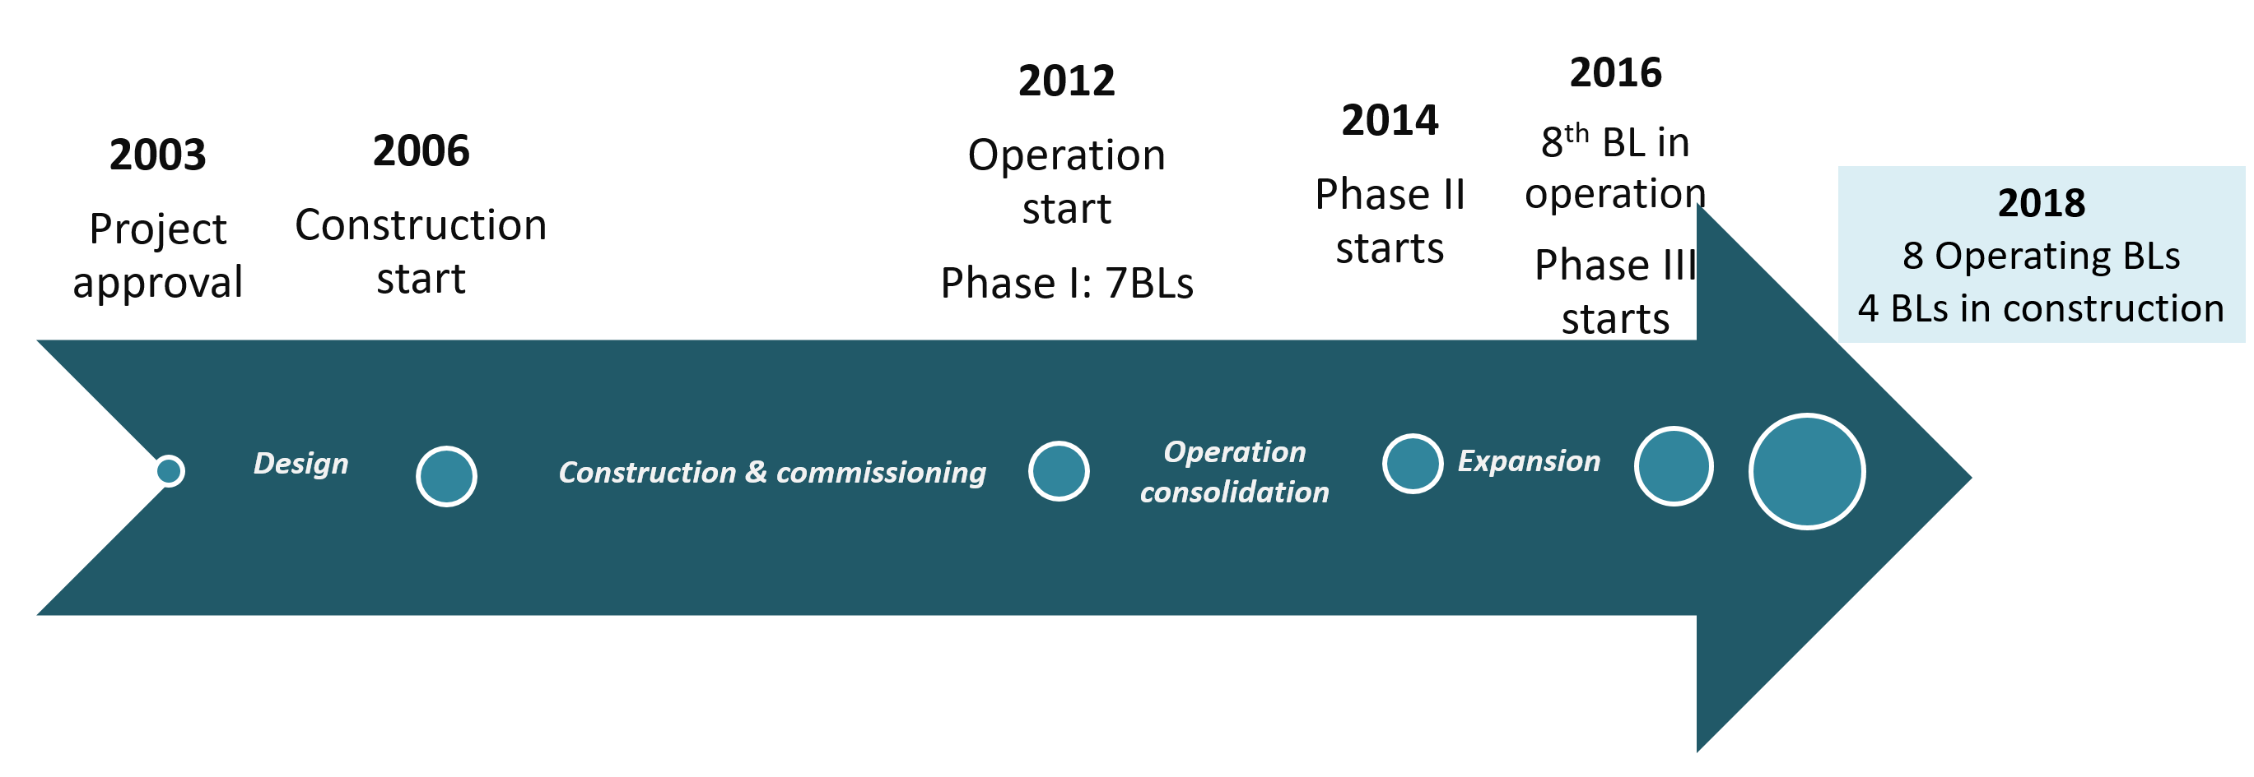
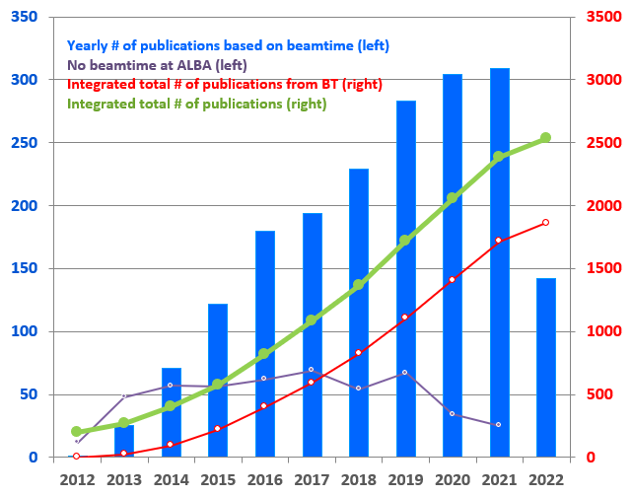
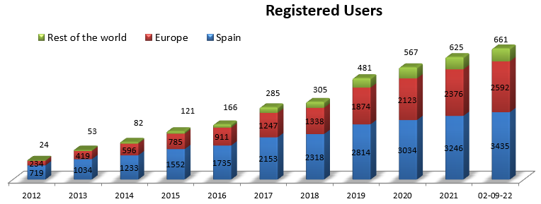
ALBA History and Present
2022
10 Operating BLs
4 BLs in construction
First proposal for building a synchrotron in Spain: in the ’90s
Approval process: one decade
Design, construction and commissioning: one decade
ALBA explotation so far: one decade

Slide 7
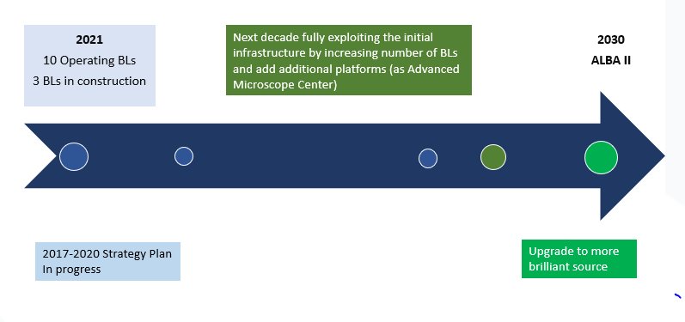
ALBA Future
2022
10 BL in operation
4 BLs in construction
2021-2024
Strategy Plan
First proposal for building a synchrotron in Spain: in the ’90s
Approval process: one decade
Design, construction and commissioning: one decade
ALBA explotation so far: one decade
ALBA II preparation: one decade
ALBA II explotation: from 2030 on

Slide 8

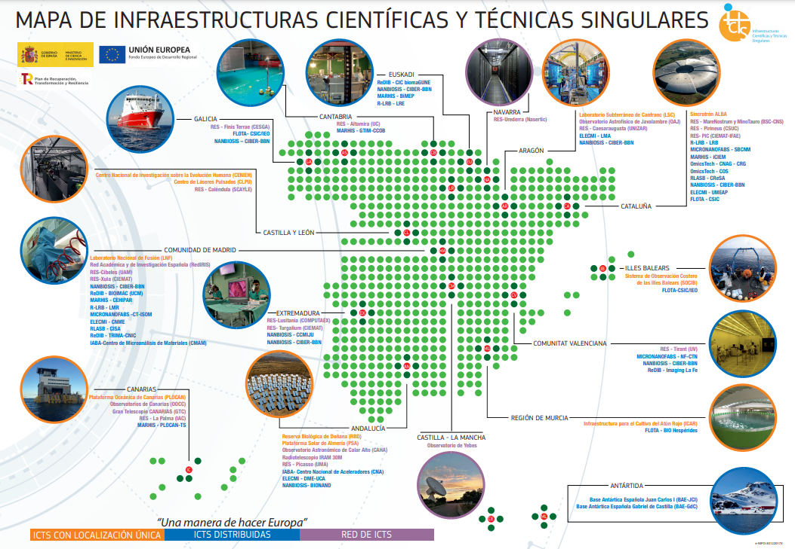
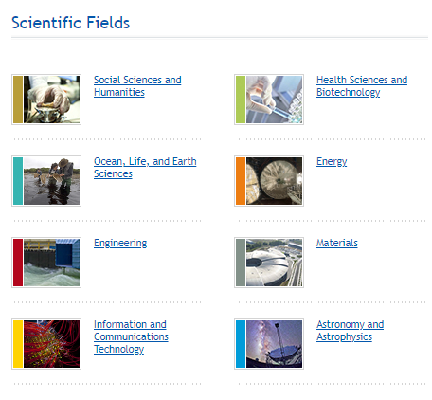
ALBA Synchrotron in the ICTS Map
1st Map of ICTS agreed at the III Conference of Presidents, held on 11th January 2007.
The "Spanish Strategic of Science, Technology and Innovation 2013-2020", approved by the Council of Ministers in February 2013, establishes that the ICTS Map is the long-term planning and development tool for these infrastructures in coordination with the CCAA.
The ICTS Map is updated every four years, approved by the Scientific, Technological and Innovation Policy Council (CPCTI).
Updates so far: 7 October 2014, 6 November 2018, 19 January 2022

Slide 9
Evolution of the strategy
To research in, deliver and maintain methods and techniques with which to conduct cutting edge Synchrotron Light based research and development
Plan to increase # of BLs at the rhythm of 1.5/year – Not done due to lack of new investment funds
20 BLs in 2020 - based on new investments, ALBA to be refurbished in 2035
2010-2014
2013-2016
Enhance expertise and promote the utilization of Synchrotron Light by working with the Spanish and international scientific communities;
20 BLs in 2020 – based on new investments
Be a center of excellence in synchrotron radiation (SR) science and technology at European level and consolidate the status of CELLS as a recognized world class facility in its field.
16 BLs in 2020 – based on new investments and ERDF funds
Starting planning ALBA II
2017-2020

Slide 10
Evolution of the strategy
To research in, deliver and maintain methods and techniques with which to conduct cutting edge Synchrotron Light based research and development
Plan to increase # of BLs at the rhythm of 1.5/year – Not done due to lack of new investment funds
20 BLs in 2020 - based on new investments, ALBA to be refurbished in 2035
2010-2014
2013-2016
Enhance expertise and promote the utilization of Synchrotron Light by working with the Spanish and international scientific communities;
20 BLs in 2020 – based on new investments
2017-2020
Be a center of excellence in synchrotron radiation (SR) science and technology at European level and consolidate the status of CELLS as a recognized world class facility in its field.
16 BLs in 2020 – based on new investments and ERDF funds
Starting planning ALBA II
2021-2024
Contribute to the improvement of well-being and progress of society as a whole through provision of scientific instruments dedicated to solving societal challenges such as health, environment, energy and communication.
Act as a catalyst for regional and national collaborations addressing overarching societal challenges
Start ALBA II project

Slide 11
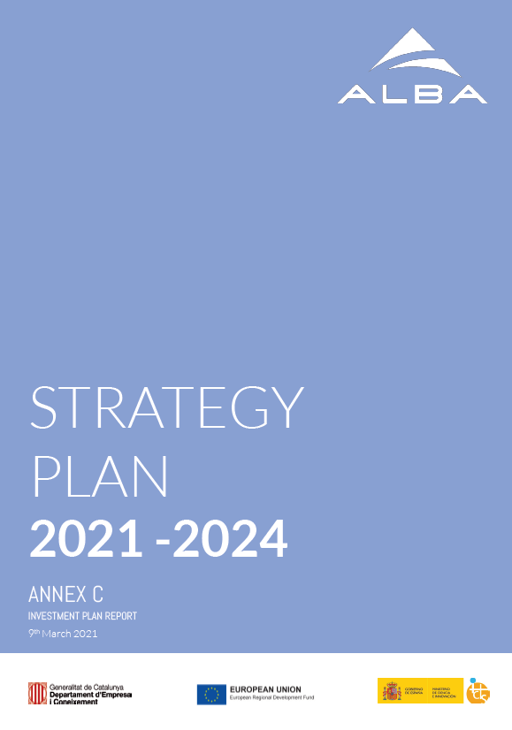
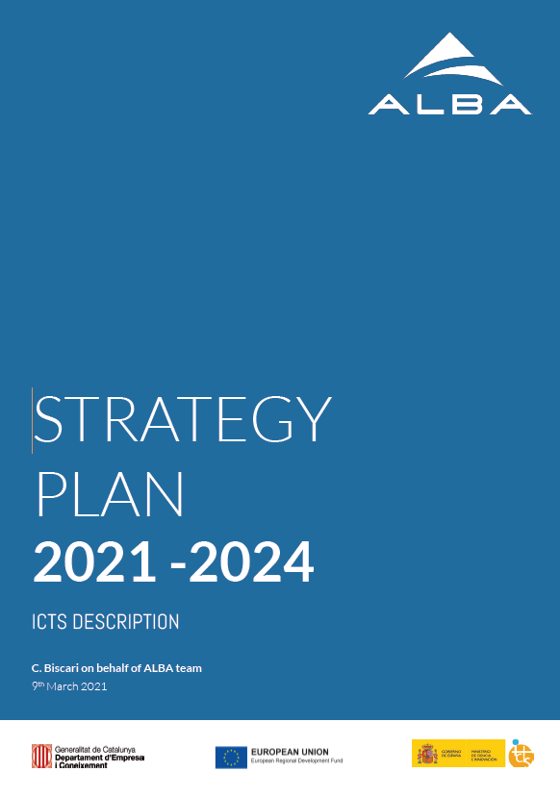
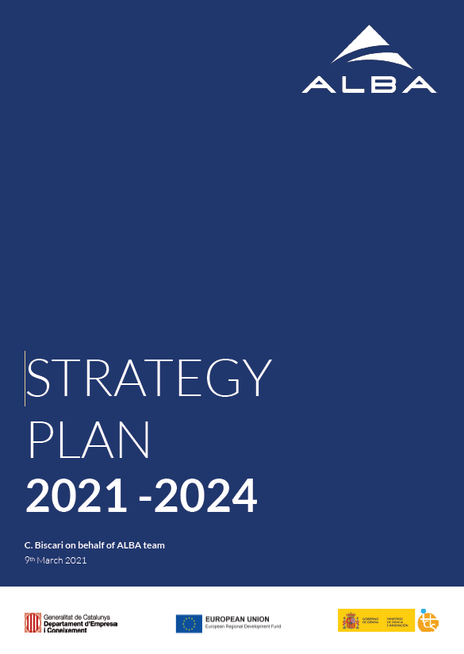
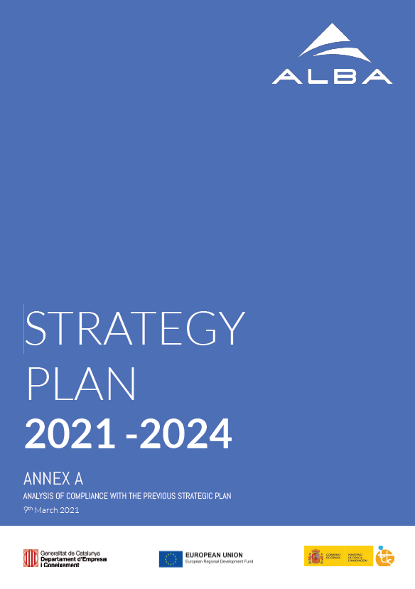
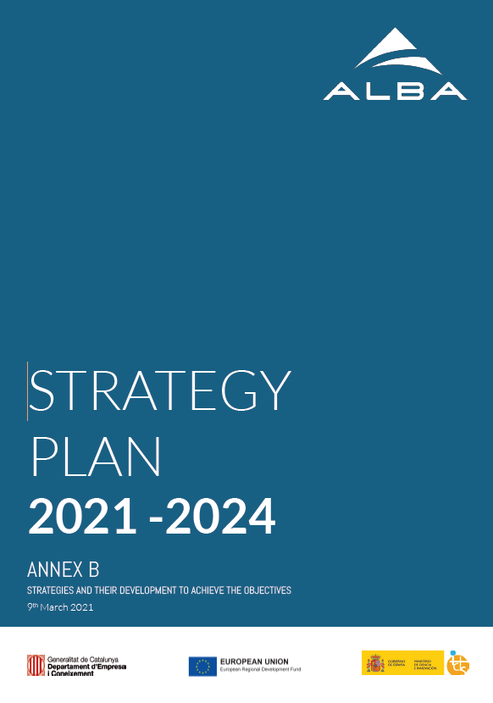
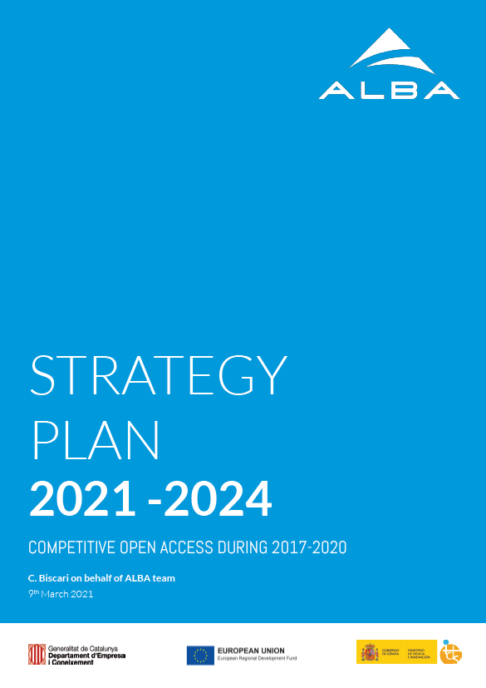
ALBA II Project first steps and new SP 21-24
Spring 2020 – First preliminary design of low emittance lattice for ALBA II
September/October 2020 – Preliminary plan for ALBA II Project and informal presentation to funding agencies
December 2020 – Approval from Consejo Rector to start the design
March-April 2021 – Preparation of Strategy Plan 2021-24 including ALBA II Plan
https://www.cells.es/en/about/strategic-plans/

Slide 12
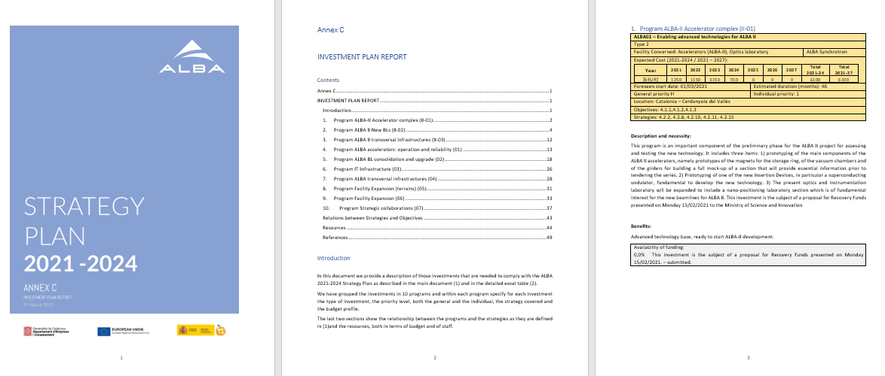
Strategy Plan 2021-2024 – Evaluation received March 2022
Positive evaluation, including plans for ALBA II
Annex C includes the proposed investment plan
From the proposed investments evaluators have provided those with High/Medium/Low priority which are eligible for funding through ordinary budget/ERDF/Recovery funds

Slide 13
End 2020: ALBA II kick-off
2021: Project start-up
Checking feasibility of a low emittance ring in the ALBA tunnel (see Francis’ talk)
Reviewing the present instruments and the scientific reach (see Klaus’ talk)
Starting the conceptual design and the definition of the preliminary budget
Starting the process for the project approval
New logo

Slide 14
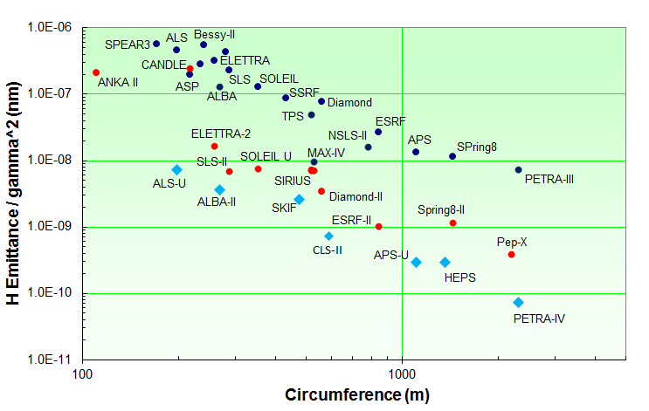
From 3rd to 4th generation synchrotron light sources
In operation
Proposals/construction
Proposals
DBA/TBA
MBA
+ technology
On-axis inj.
+ technology
Courtesy of Riccardo Bartolini
10/10/19 – ALBA User Meeting – ALBA Future

Slide 15
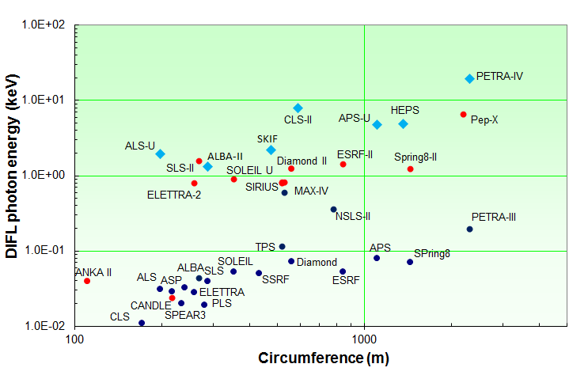
(quasi-) diffraction limited light sources
λ = 1 Å
MBA
λ = 1 nm
λ = 10 nm
DBA/TBA
Courtesy of Riccardo Bartolini
readapted from G. Schroer (DESY)
Even in the limit of zero beam emittance the phase space of the radiation emission from an undulator is itself finite due to diffraction effects at the source. For single-mode photon emission, the corresponding diffraction-limited ‘emittance’ of the photon beam is given by
$$ε\left(photon\right)≤\frac{λ}{4π}=0.159λ=98.66[pm rad]/E_{γ}[keV]$$
A light source is ‘diffraction limited’ when the e- beam emittance is less than that of the radiated photon beam at the desired X-ray λ

Slide 16
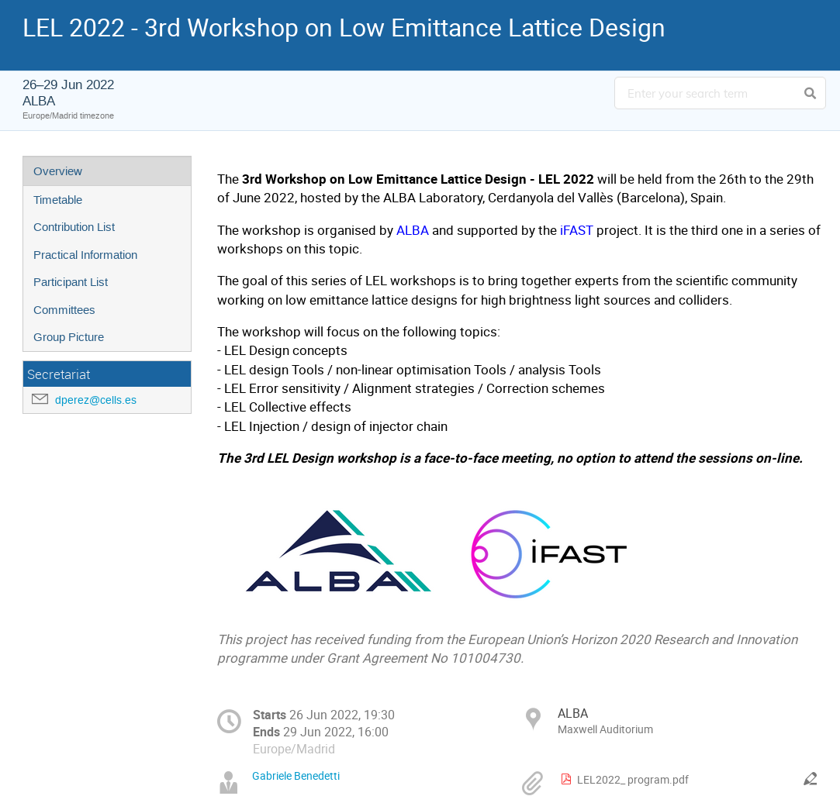
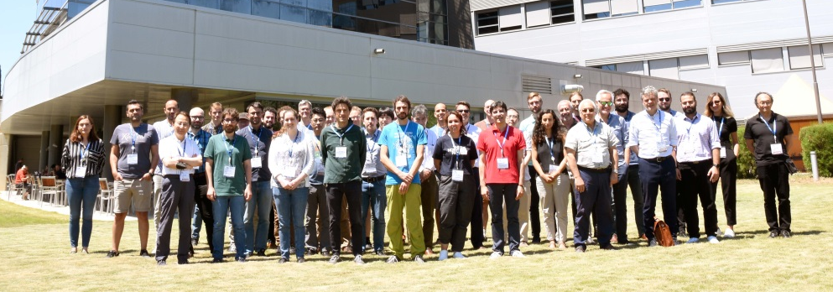
LEL 2022 workshop at ALBA
26-29 June 2022, face-to-face meeting at the ALBA Maxwell auditorium dedicated to low emittance lattice design for high brightness light sources
52 accelerator experts presented 12 synchrotron upgrade projects from all around the world

Slide 17
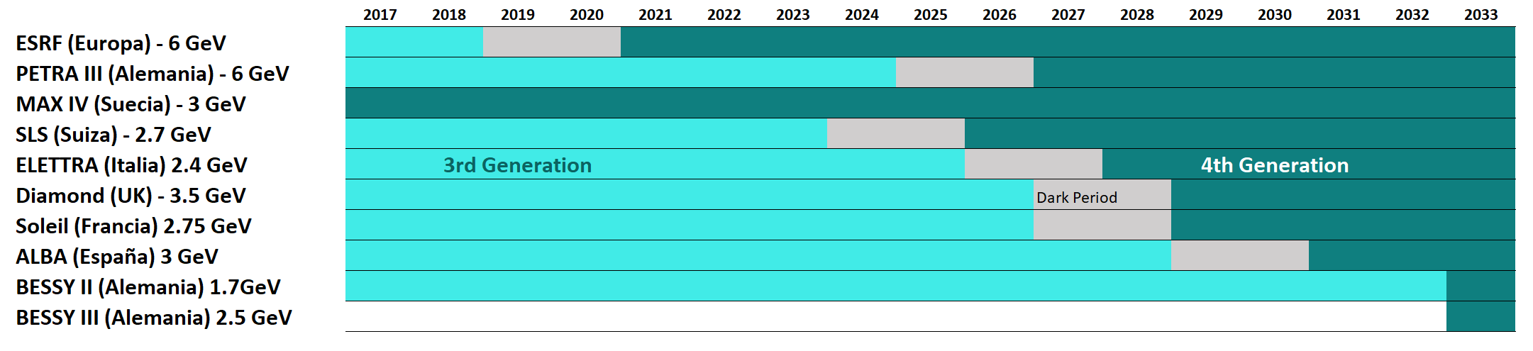
Evolution from 3rd to 4th generation in Europe
LEAPS ESAPS2022 aiming at harmonizing upgradesto avoid contemporaneous dark times
Today

Slide 18
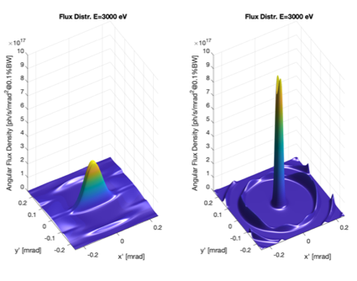
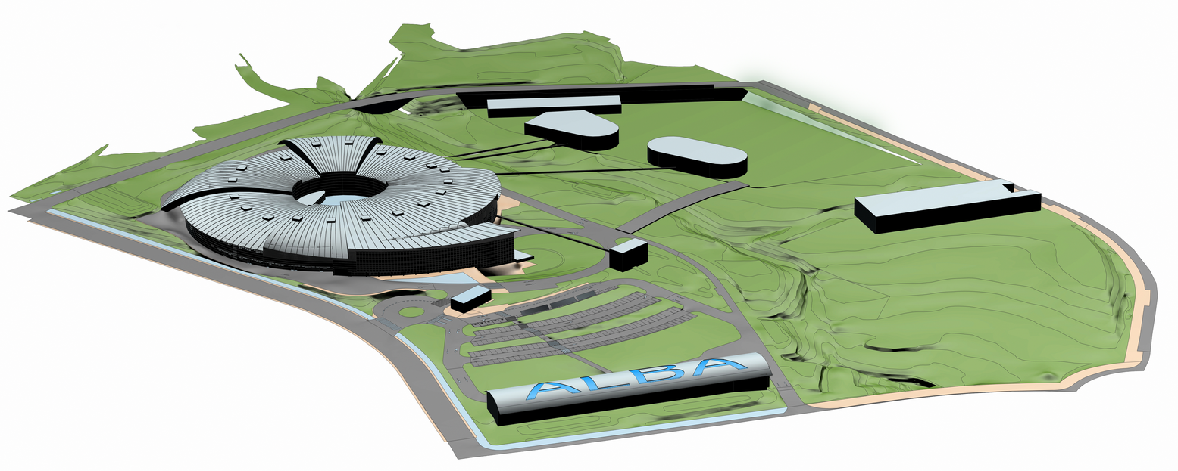
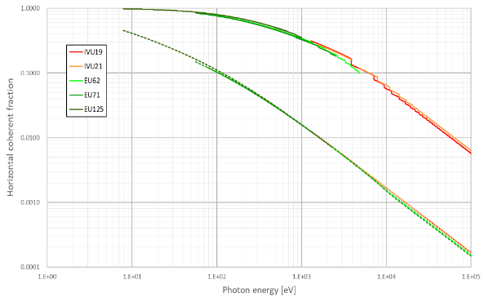
ALBA II design as today
4th generation light source
Emittance 150 pm (30 times smaller than ALBA)
Current 300 mA (+ 20% with respect to ALBA)
Increase of brilliance by orders of magnitude
Increase of coherence
Advanced properties for imaging, spectroscopy, diffraction
FLUX
Coherence
From ALBA to ALBA II

Slide 19
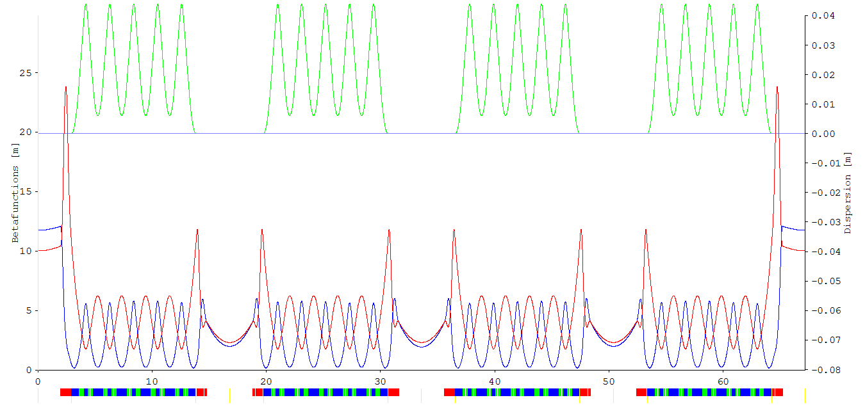
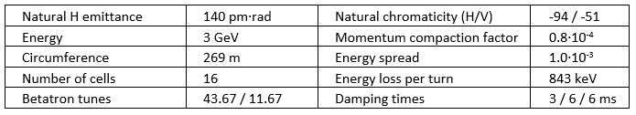
Optics solution for ALBA low emittance ring
(see Francis talk)
From 2 x 8 double-bend lattice (DBA)
To 1 x 16 multi-bend lattice (6BA)
Presented at IPAC2021:

Slide 20
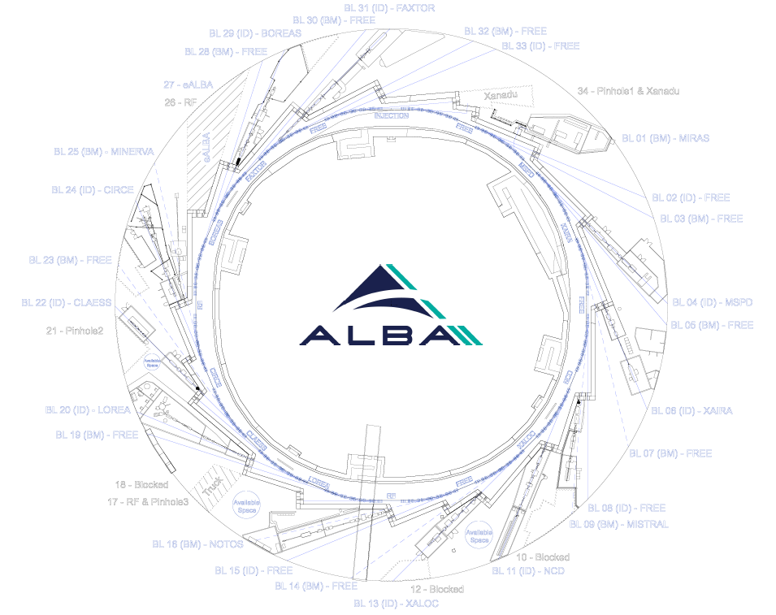
ALBA II Layout in ALBA tunnel
ALBA II ports:
13 IDs
  12 low beta (10 in use)
  1 high beta
13 bendings (4 in use)

Slide 21
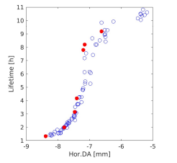
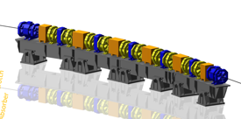
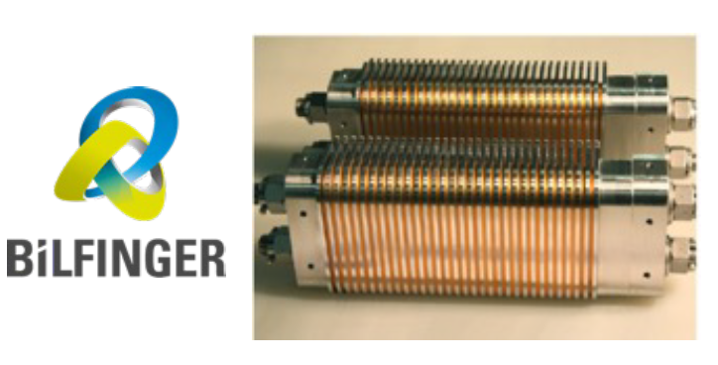
Prototyping accelerator systems
ALBA01: Enabling advanced technologies for ALBA II
Funded (7.5 ME) and on-going (see Francis’ talk)
Includes
Design, and prototype construction of:
  Magnets
  NEG Coated vacuum chambers
  Pulsed magnets
  Girder for arc assembly tests
Superconducting Undulator
Dynamic Aperture
Planning dedicated ALBA II MAC meetings from 2023 on
Plus special advisory for ALBA01 end of this year

Slide 22
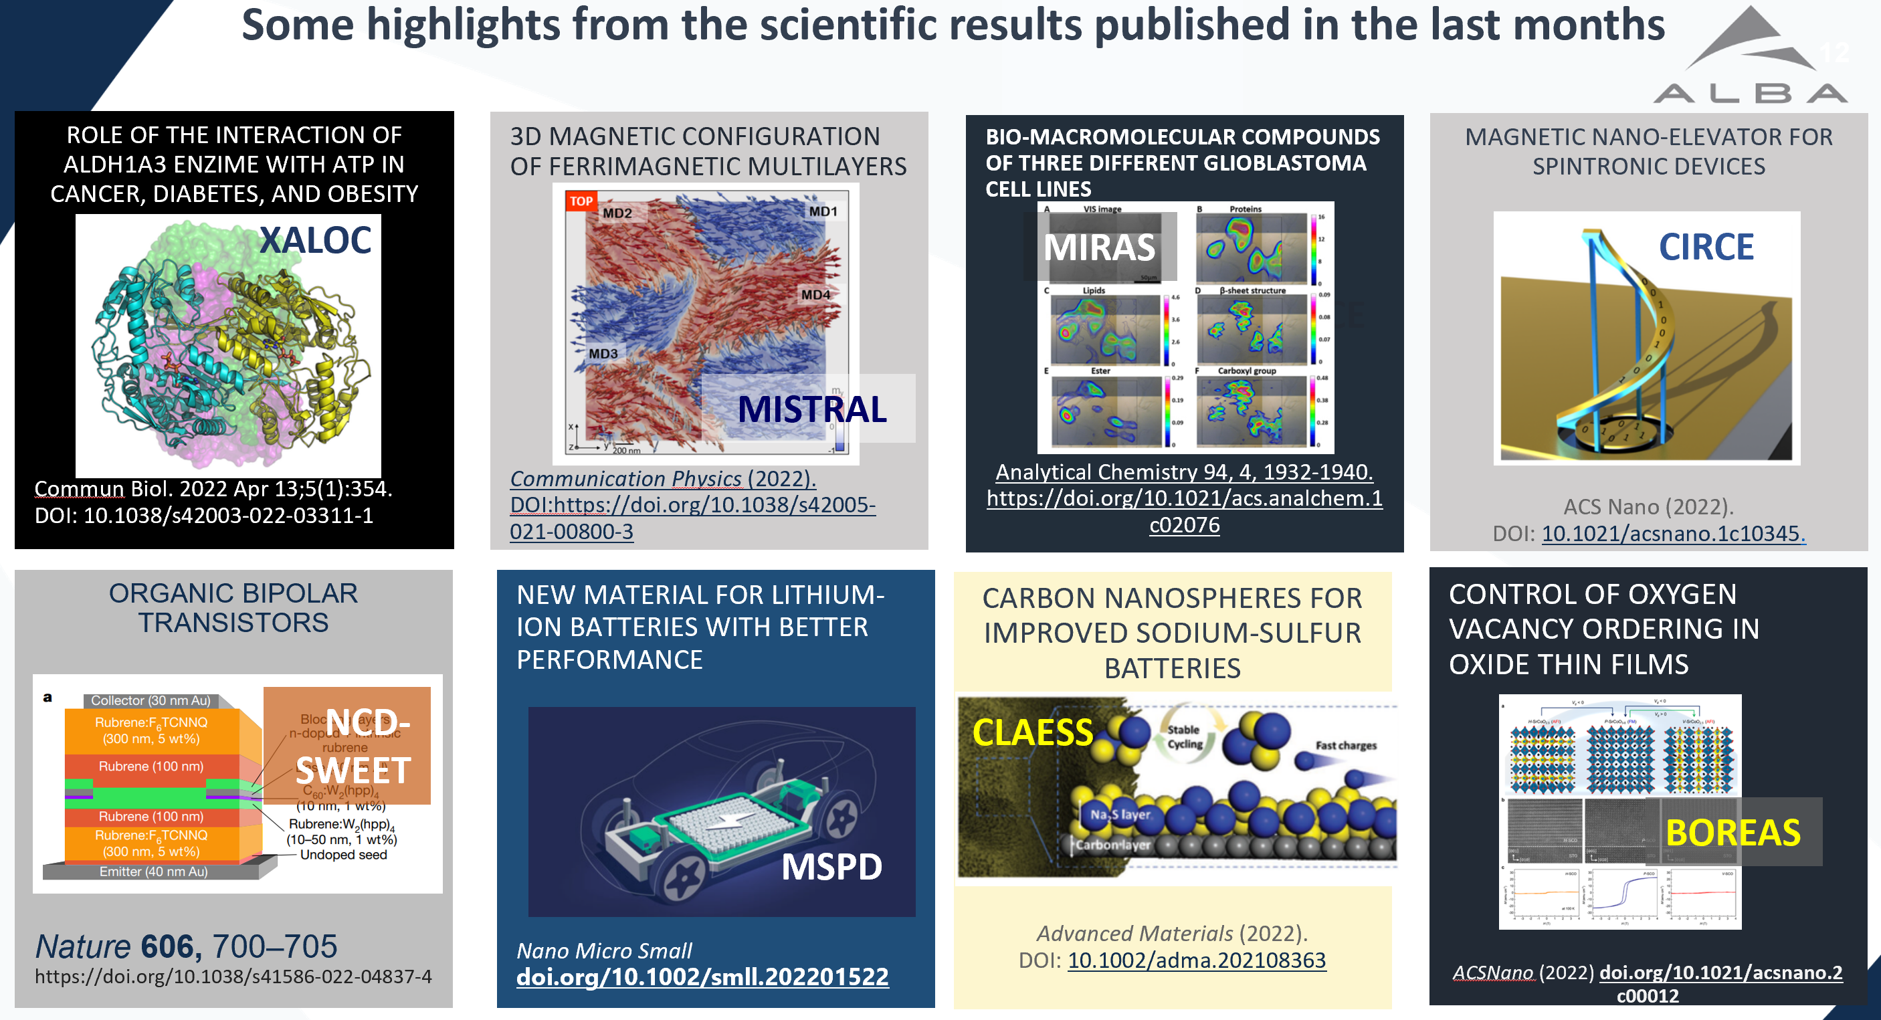
Science: from ALBA to ALBA II :
Building on ALBA strengths
Filling ALBA gaps
Upgrade of existing BLs (to be effective the sooner and profit from ALBA)
Complement the existing techniques
Include JEMCA in the full scenario
Define the new BLs
Example 1

Slide 23

2021 - Preparing the Science case of ALBA II: Colloquia & Workshops
Several events with user and ALBA users community involvement
About 20 colloquia, most of them with video available
See https://www.cells.es/en/science-at-alba/alba-ii-colloquium
+ ALBA II Workshops
12 April: " 2D materials and synchrotron radiation“
17 May: “Spintronics and synchrotron radiation”
31 May: “Coherence and time-resolved X-ray science”
7 July: “PEEM Workshop”
19 July: “Catalysis: present and future perspectives”
9 September: “APXPS”
4 October: “Hard X-Rays for coherent, time-resolved and imaging experiments at ALBA II”
28 October: “Scientific and Instrumental Advances in High Pressure techniques”

Slide 24
2021 - Preparing the Science case of ALBA II: Section Reviews
Areas of review:
  Structural Molecular Biology (focus area: health).
  Cellular Biology (focus area: health).
  Chemical and Material Sciences (focus area: batteries, catalysis).
  Electronic and Magnetic Structure (focus area: sustainable information technology).
General goals of the review:
  Provides ownership to the section team by creating mission and strategy in a bottom up approach.
  Is there a clear defined vision for the reviewed area which
    Brands ALBA giving it a unique role within the synchrotron community.
    Matches the societal needs of the next 2 decades.
    Reflects the expected needs of the Spanish community.
  Are the risks understood and is the strategy appropriate to fulfil the mission?
Documentation:
  Webpage with all talks.
  Written review documentation.
  Review report.

Slide 25
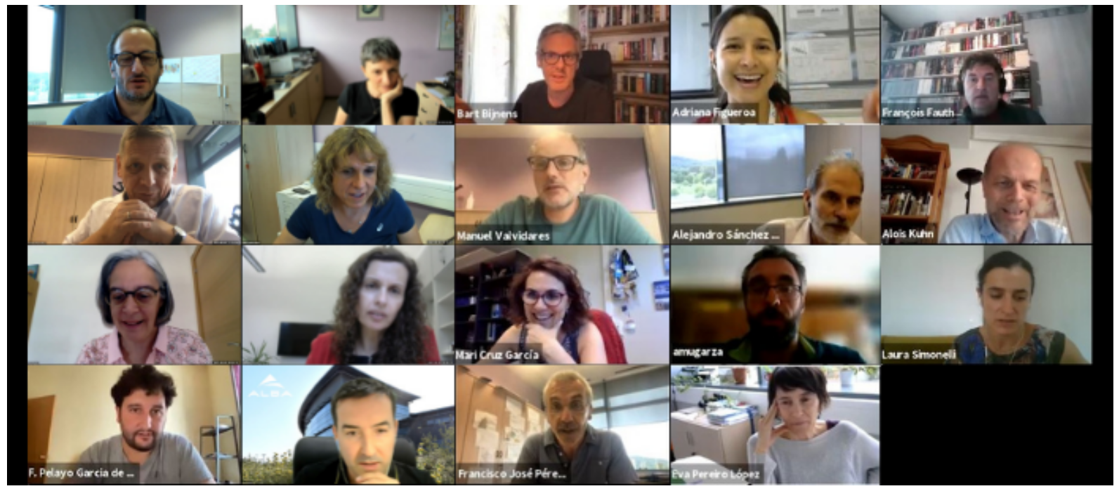
ALBA II Day 30 June 2021 – on line event
Presentation to the user community of ALBA II project and plans
more than 260 participants,
First session: dedicated to overview on the user perspectives, strategy and mission for academic and industrial communities, the future of the accelerator, the beamlines, and the partnership strategy for ALBA II.
Second session: focused on the main strategy fields for the future facility: Health, Information Technology, and Materials & Energy. After a short introduction to each of them, a breakout session for each topic was opened so attendees could further discuss them.
Closing session covered a summary of each of the breakout sessions and the conclusions and closing remarks. A new call for beamline concept proposals was presented.

Slide 26
1st call for new BLs proposals
Starting to choose the new ALBA II Instruments
30 June 2021: within ALBA II DAY
BL concepts input started at ALBA, by ALBA scientists, in collaboration with external collaborators (April/May 2021), resulting in 6 draft proposals, plus other 10 preliminary concepts
Call open on beginning of July 2021
Deadline for concepts: beginning of September 2021
Selection of few BL proposals for first short beamlines to be fully developed: September 2021
Presentation of these BL proposals deadline: beginning of December 2021
Evaluation of BL proposals: January 2022
Decision on the first two ALBA II BLs: February 2022
Possibility for funding one/two BLs in 2022 was then foreseen
Finally funding for a single BL was granted

Slide 27
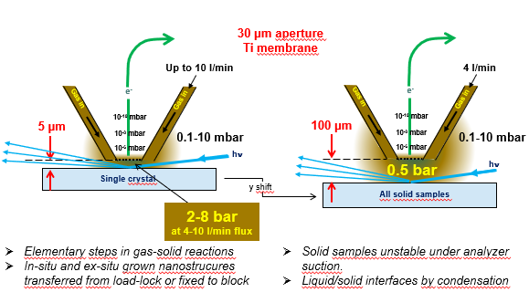
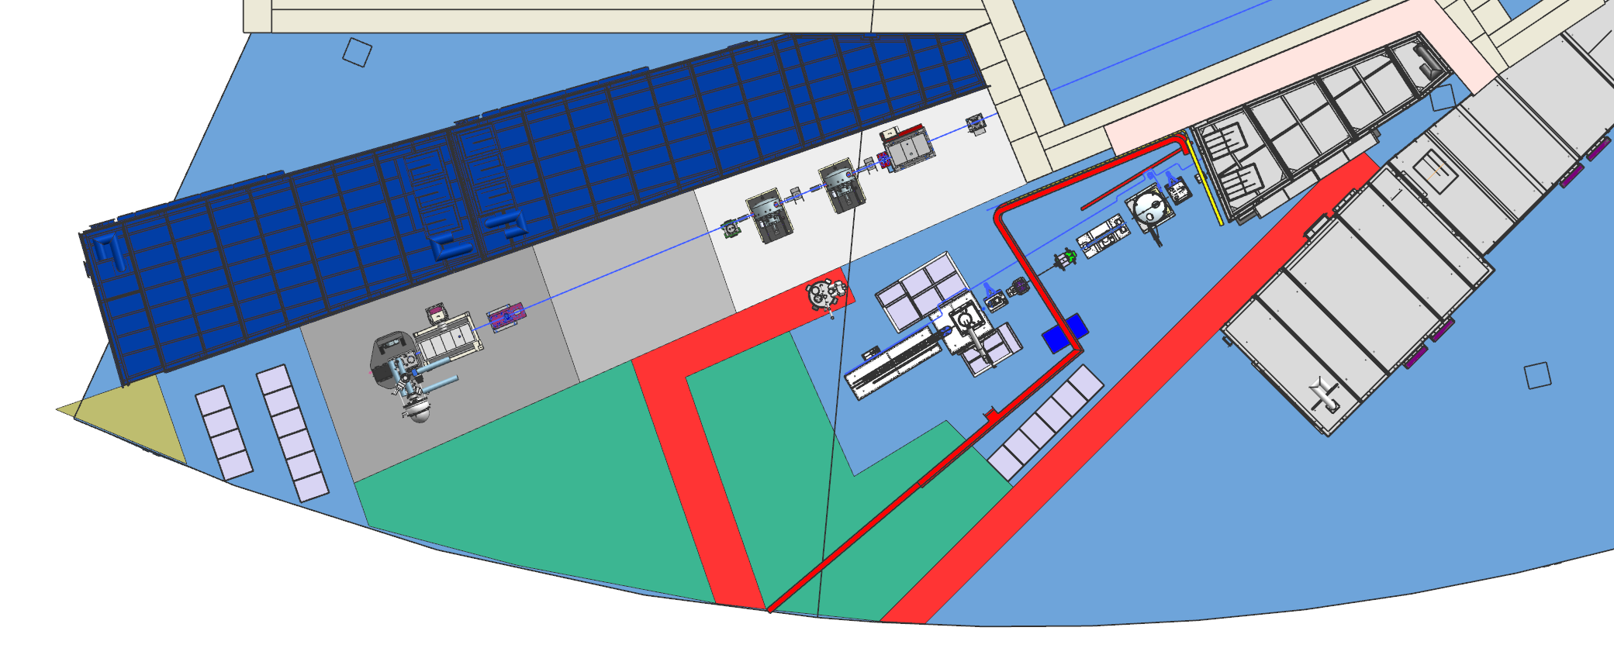
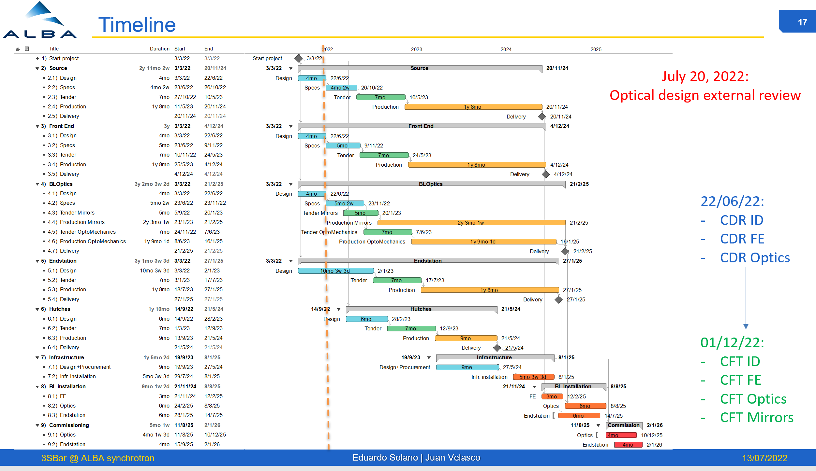
New BL – 3Sbar
Surface Structure and Spectroscopy at 1 bar
NOTOS
3Sbar
XALOC
Important dates
January 2022 Presentation of the 3 BL proposals
January 2022 Evaluation of BL proposals
February 2022 Decision on first new ALBA II BL: 3Sbar
May 2022 – Appointment of acting BL responsible
May 2022 – Appointment of BL responsible, joining us in Oct 22
July 2022 – Presentation to SAC by both scientists
July 2022 – External review of optics
September 2022 – presentation in AUSE and ALBA user meeting
See Velasco talk

Slide 28
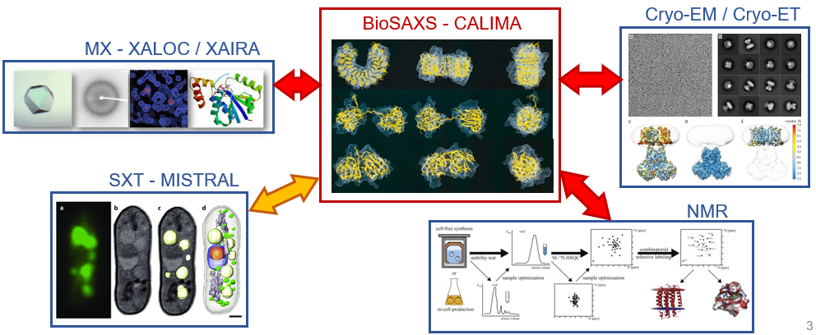
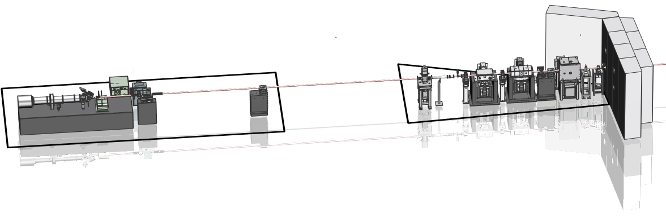
BioSAXS/CALIMA proposal in the pipeline
Techniques
Scientific case
Batch mode SAXS
SAXS + chromatography
Time-resolved SAXS
Fiber diffraction
3D scanning SAXS
nLC/MS SAXS
WAXS
Allosteric biomolecules modulation
Intrinsically Disordered Proteins
Membrane proteins
Amyloid proteins
Domain swapping in diseases
Complex biological assemblies
RNA folding
Microtubules GTPase cycle
Bone arrangement
Brain connectivity
Skin damage
Polymers
Bending magnet beamline (ALBA) and Superbend (ALBA II)
Gains in ALBA-II: better q resolution (standard mode), gain x7 H size
2 optical setups:
  Large (standard): ~200-500 μm beam size
  Microfocus: ~10 μm beam size
Experimental Hutch
Optical Hutch
28

Slide 29
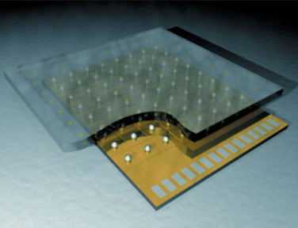
Work in progress
From ALBA to ALBA II – Instrumentation & DATA
Detectors
Collaborations to be developed within LEAPS initiatives
DATA
ALBA in EOSC – Participation in H2020 (see ExPANDS) and future HE initiatives
New Scientific Data Management section since 2021
Optics
ALBA metrology lab – used by academy and industry worldwide
Already at the forefront – Opportunity for ALBA II
Sample environment
In-situ, operando, extreme conditions, automatization, remote control. See DIGITAL LEAPS initiative

Slide 30
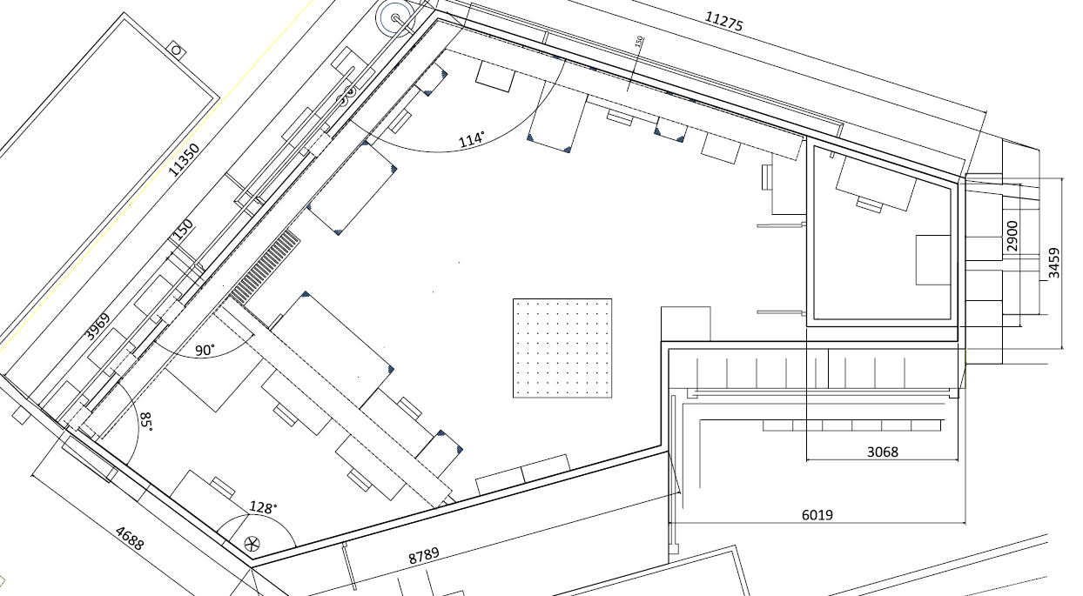
Creating the tools to face ALBA II technologies
ALBA 01: Nano Position Laboratory – funded through MRR funds
Working on:
  Spaces definition and detailing
    Construction solutions
    Services & Network
    Conventional and Mechanical installations
  Material:
    Furniture, benches, tools, tooling list…
  Instrumentation and controllers definition

Slide 31
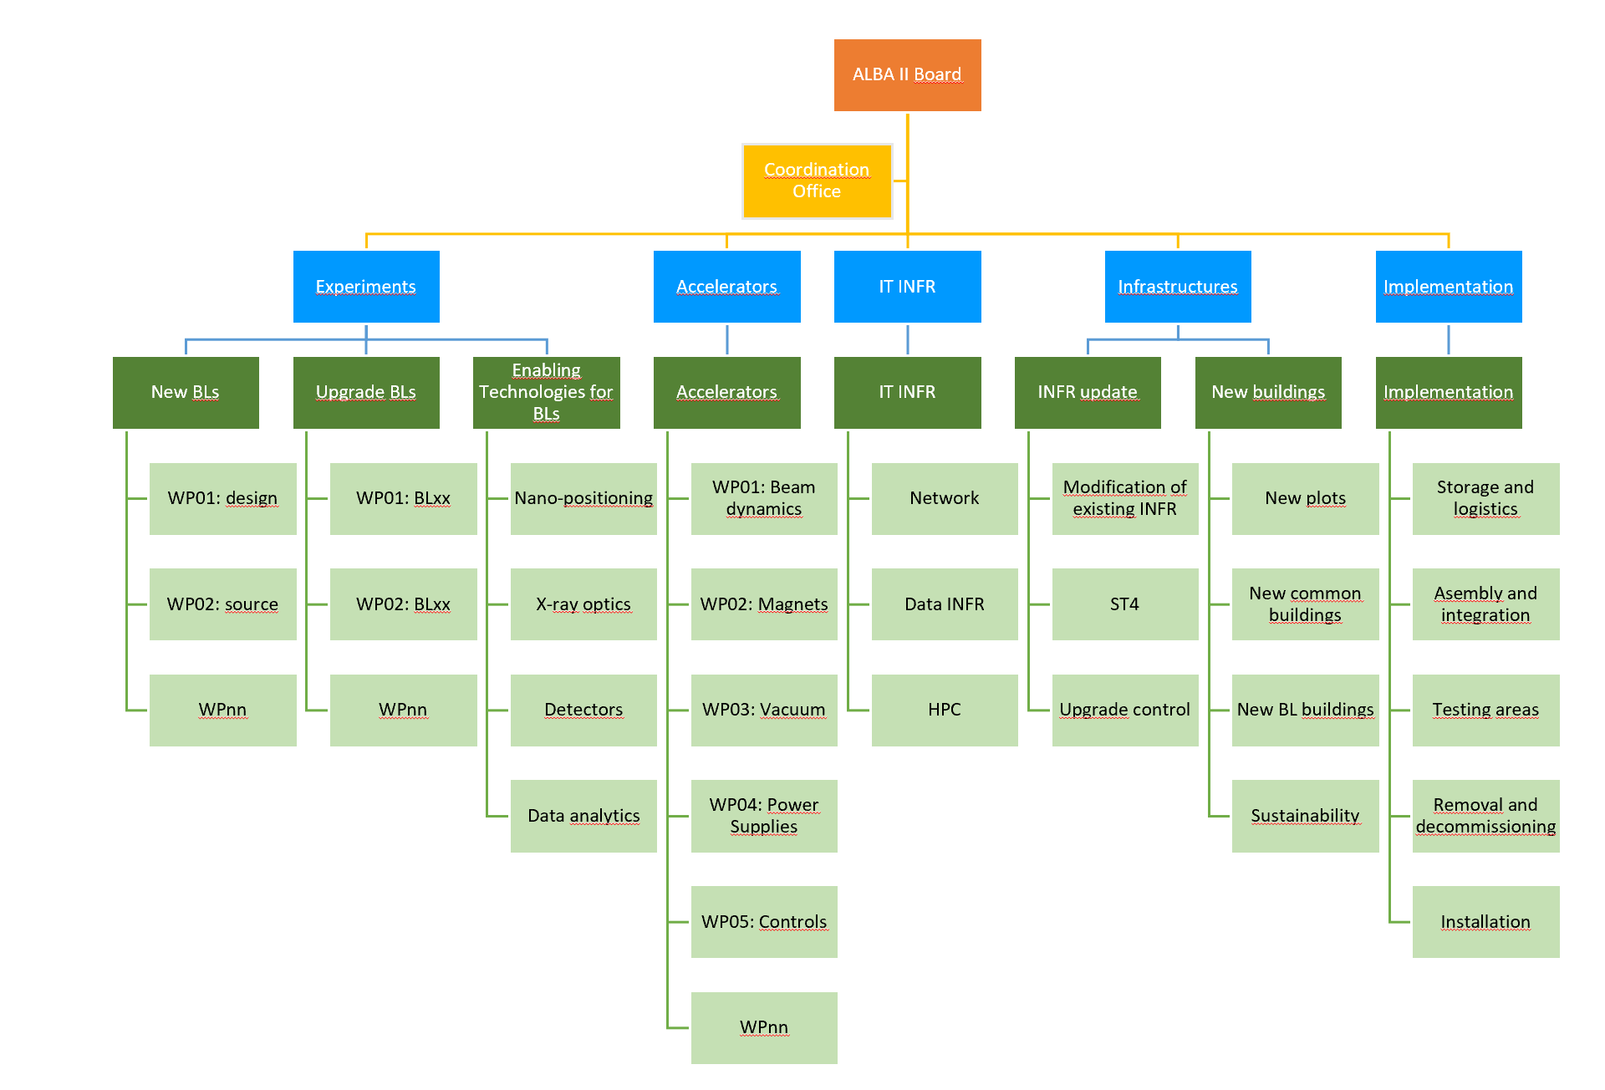
ALBA II Organization
ALBA II is supervised by a Board, chaired by the director;
organized
into Programs:
Beamlines
Accelerators
IT Infrastructures
Infrastructures
Implementation
then into Projects, and corresponding Work Packages.
ALBA II is involving the whole ALBA staff.

Slide 32
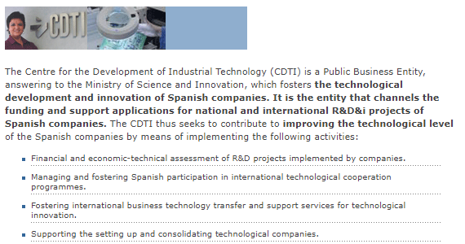
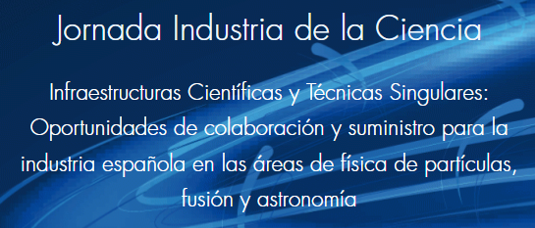
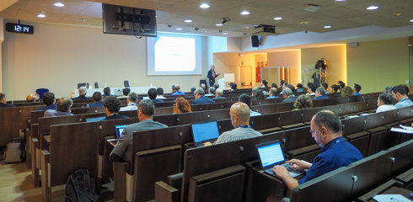
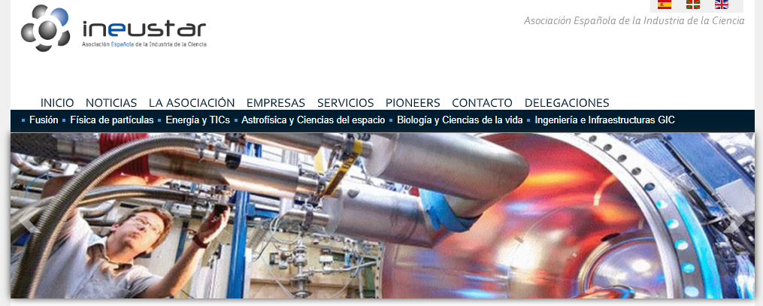
Opportunity for Spanish industries as suppliers
Two meetings organized with CDTI
26 April – in Madrid with other ICTS
26 May – at ALBA
Organized with CDTI and INEUSTAR
More than 40 Spanish companies represented
Shared information on present and future ALBA programs

Slide 33
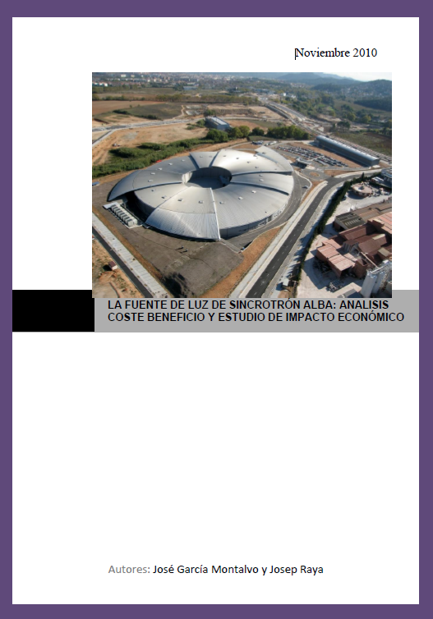

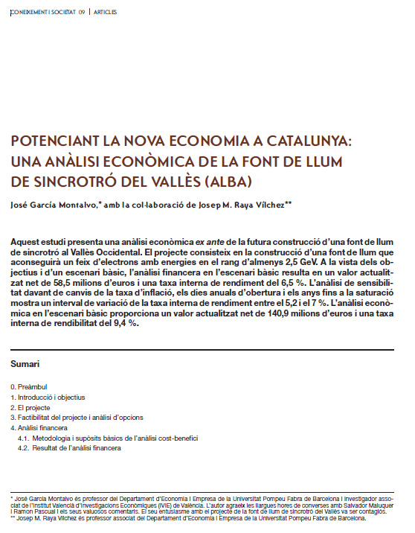
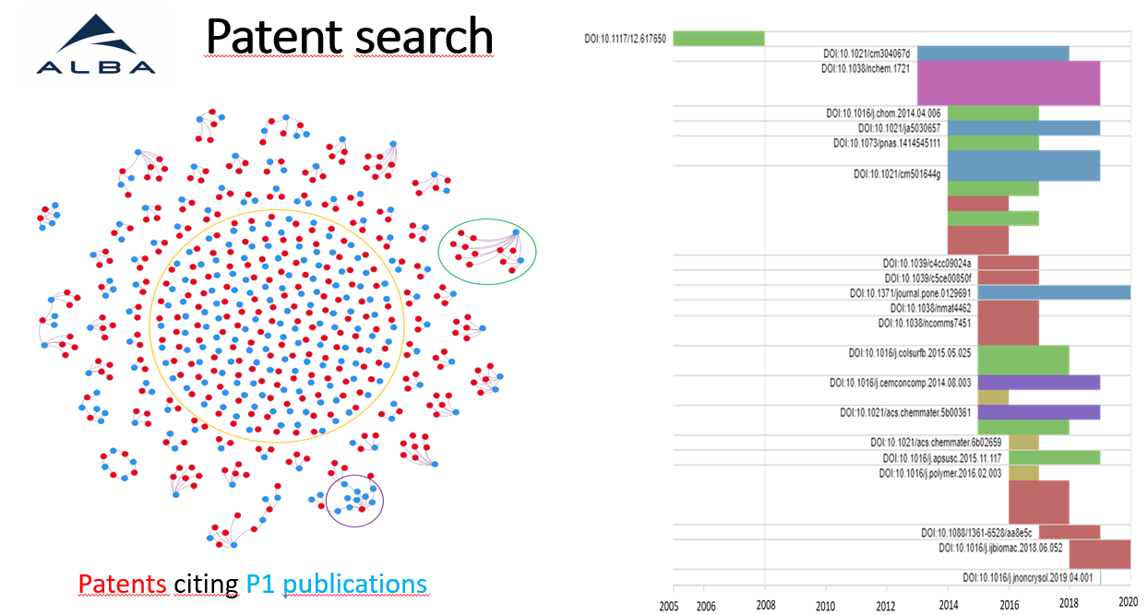
Socio-economic Impact Assessment to be included in the White Paper
2003: ex-ante
Garcia Montalvo & Raya
2020: Participation in
Pilot project on patent search
2010: after the construction
Garcia Montalvo & Raya
TODAY:
J. Raya & J. Garcia Montalvo
Working on the ALBA II impact

Slide 34
2020 2021 2022 2023 2024 2025 2026 2027 2028 2029 2030
Strategy Plan
Strategy Plan
Strategy Plan
ERDF 2021-2027
ERDF 2028-2035?
New economic agreement 2023-2035, including ALBA II
Technology
Society
Review of present status
Call for new BL proposals
Science
Call for new BL proposals
ALBA II
Present status upgrades/evolution
New BL to operate in ALBA, designed for ALBA II
ALBA II BLs construction
ALBA II design
ALBA II construction

Slide 35
Involved players
As today:
Under ALBA responsibility
Resource organization for the preliminary phase
Preparation of White Paper
Definition of cost
Involvement of user community in science case and new beamline definition
Involvement of collaborators
Involvement of evaluators in the project
And of course cooperating with funding agencies for full approval of the project
Under user community responsibility in cooperation with ALBA
Defining their needs
Propose ideas
Participate in the definition of new instruments
Under funding agencies responsibility
Definition of funding mechanism
Approval of funding

Slide 36

Tentative timeline
Today
Timeline depending on funding availability

Slide 37



Possible evolution of Parc de l’ALBA
Proposal of developing ALBA surroundings in collaboration with other scientific and technological institutions (i.e. IFAE, ICN2, ICMAB, UAB, CSIC). Plan supported by Ayuntamiento de Cerdanyola del Valles
Synergies:
Quantum Technology (IFAE, ICN2)
Data Center (PIC @ IFAE)
Nanotechnology (ICN2)
Energy materials
Detectors (IFAE)
Shared Advanced Microscope Platform @ ALBA
Structural Biology center (IBMB)
Guest house serving a wide scientific community
Auditorium for large events

Slide 38

Enlarging the space to host new long Beamlines
Infrastructure enlargement
Agreement among Departament de Recerca i Universitat, Departament de Territori (INCASOL), Parc de l’ALBA and CELLS for transferring the adjacent plots to CELLS. The cost will be included in the ordinary budget for next 10 years
Agreement to be signed soon
Started the activities to define the urbanization

Slide 39

Enlarging the space to host new long Beamlines
Preparing the design and execution of new civil infrastructures during 2022
Progress on the urbanistic design of the area (streets, parking, accesses, green areas, connection with ALBA building, lighting... ) and preliminary design of buildings, including the corresponding Z coordinate of the ground plane
Designing with "Consorci del Parc de l'ALBA" the public zone between the two ALBA's plots of land The most relevant item in this area is a small river. Scheduled:
Clean wild vegetation around the river [August 2022]
Measure the survey of the river (updated and precise topography) [September 2022]
"Parc de l'ALBA" proposes a modification of the river to gain some clearance for the vacuum chambers that will cross the river [September/October 2022], with a hydrological study to evaluate the suitability of the modification of the river
Approval for the modification from the "Agencia Catalana de l'Aigua", ACA [End 2022]
Opening the position for a dedicated engineer, as responsible of the civil infrastructures

Slide 40
Approval process – recent PAST
October 2020 – Informal presentation of ALBA II Project to funding agencies
December 2020 – pre White Paper distributed
December 2020 – Council (chaired by Minister & Conseller) approves starting ALBA II design
July 2021 – Presentation of program for funding period 2023-2037 to Council
July 2021 – ALBA01 project granted
September 2021 – Adjacent plots preassigned
October 2021 – ALBA01 funds received
October 2021 – Funds for 14th BL included in 2022 Government Financial Law (still in the Parliament)
Approval process – PRESENT
Start-up of 14th BL - Done
Along 2022 – Continue negotiation for approval of 2023-2037 budget (including staff) by Governments
2023 – aiming at full funding approval

Slide 41

Questions welcome

