Slide 1



3SBar: new opportunities at ALBA
Surface Spectroscopy and Structure at 1 bar and beyond (starting 2026)

Slide 2
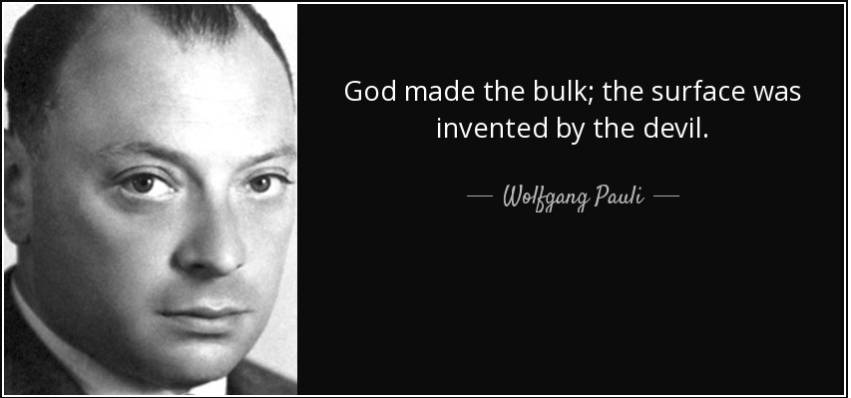
Gaps in material science
Structural complexity
and chemical composition
R. Schlögl, Angew. Chem. Int. Ed. 2015, 54, 2–58

Slide 3
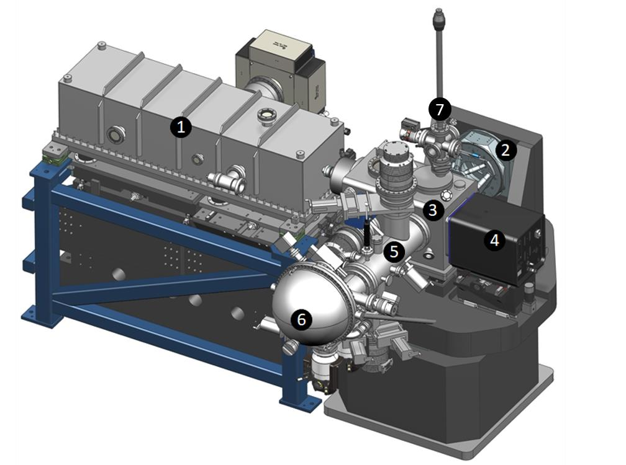
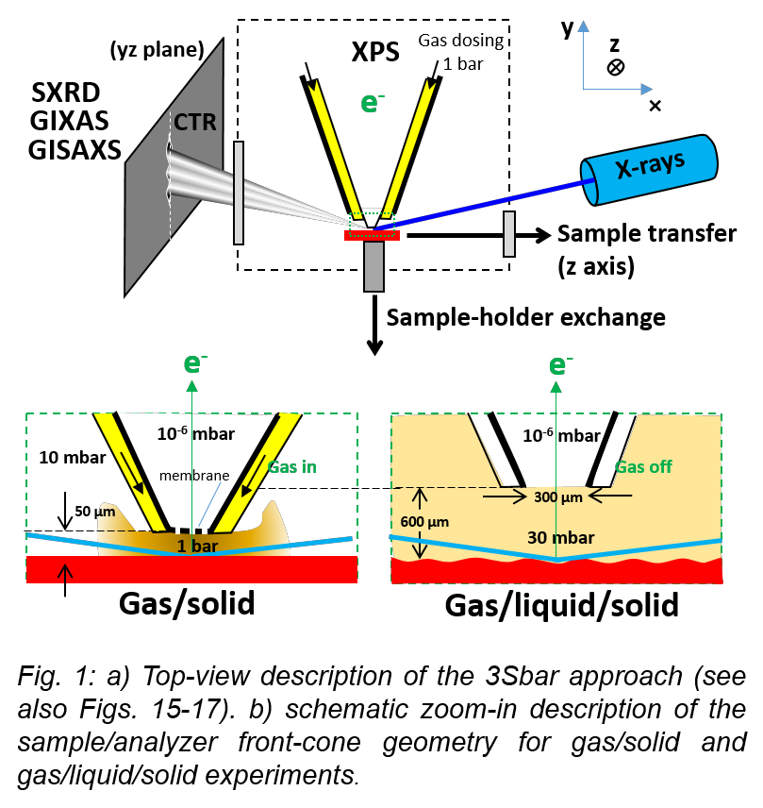
Overview
3SBar will combine ambient pressure X-ray Photoemission Spectroscopy (AP-XPS) at high pressures(1 bar or more) and surface X-ray diffraction (SXRD) at grazing incidence angles. First beamline designed for ALBA II.
BL14
Constructed 31st December 2025
α_{i}<α_{c}
Surface sensitivity
Total external reflection: X-ray depth control
Signal enhancement!

Slide 4
Why simultaneous complementary methods?
Same information: result confirmation
Different information: complementary result
z
z
?
?
y
y
X
X

Slide 5
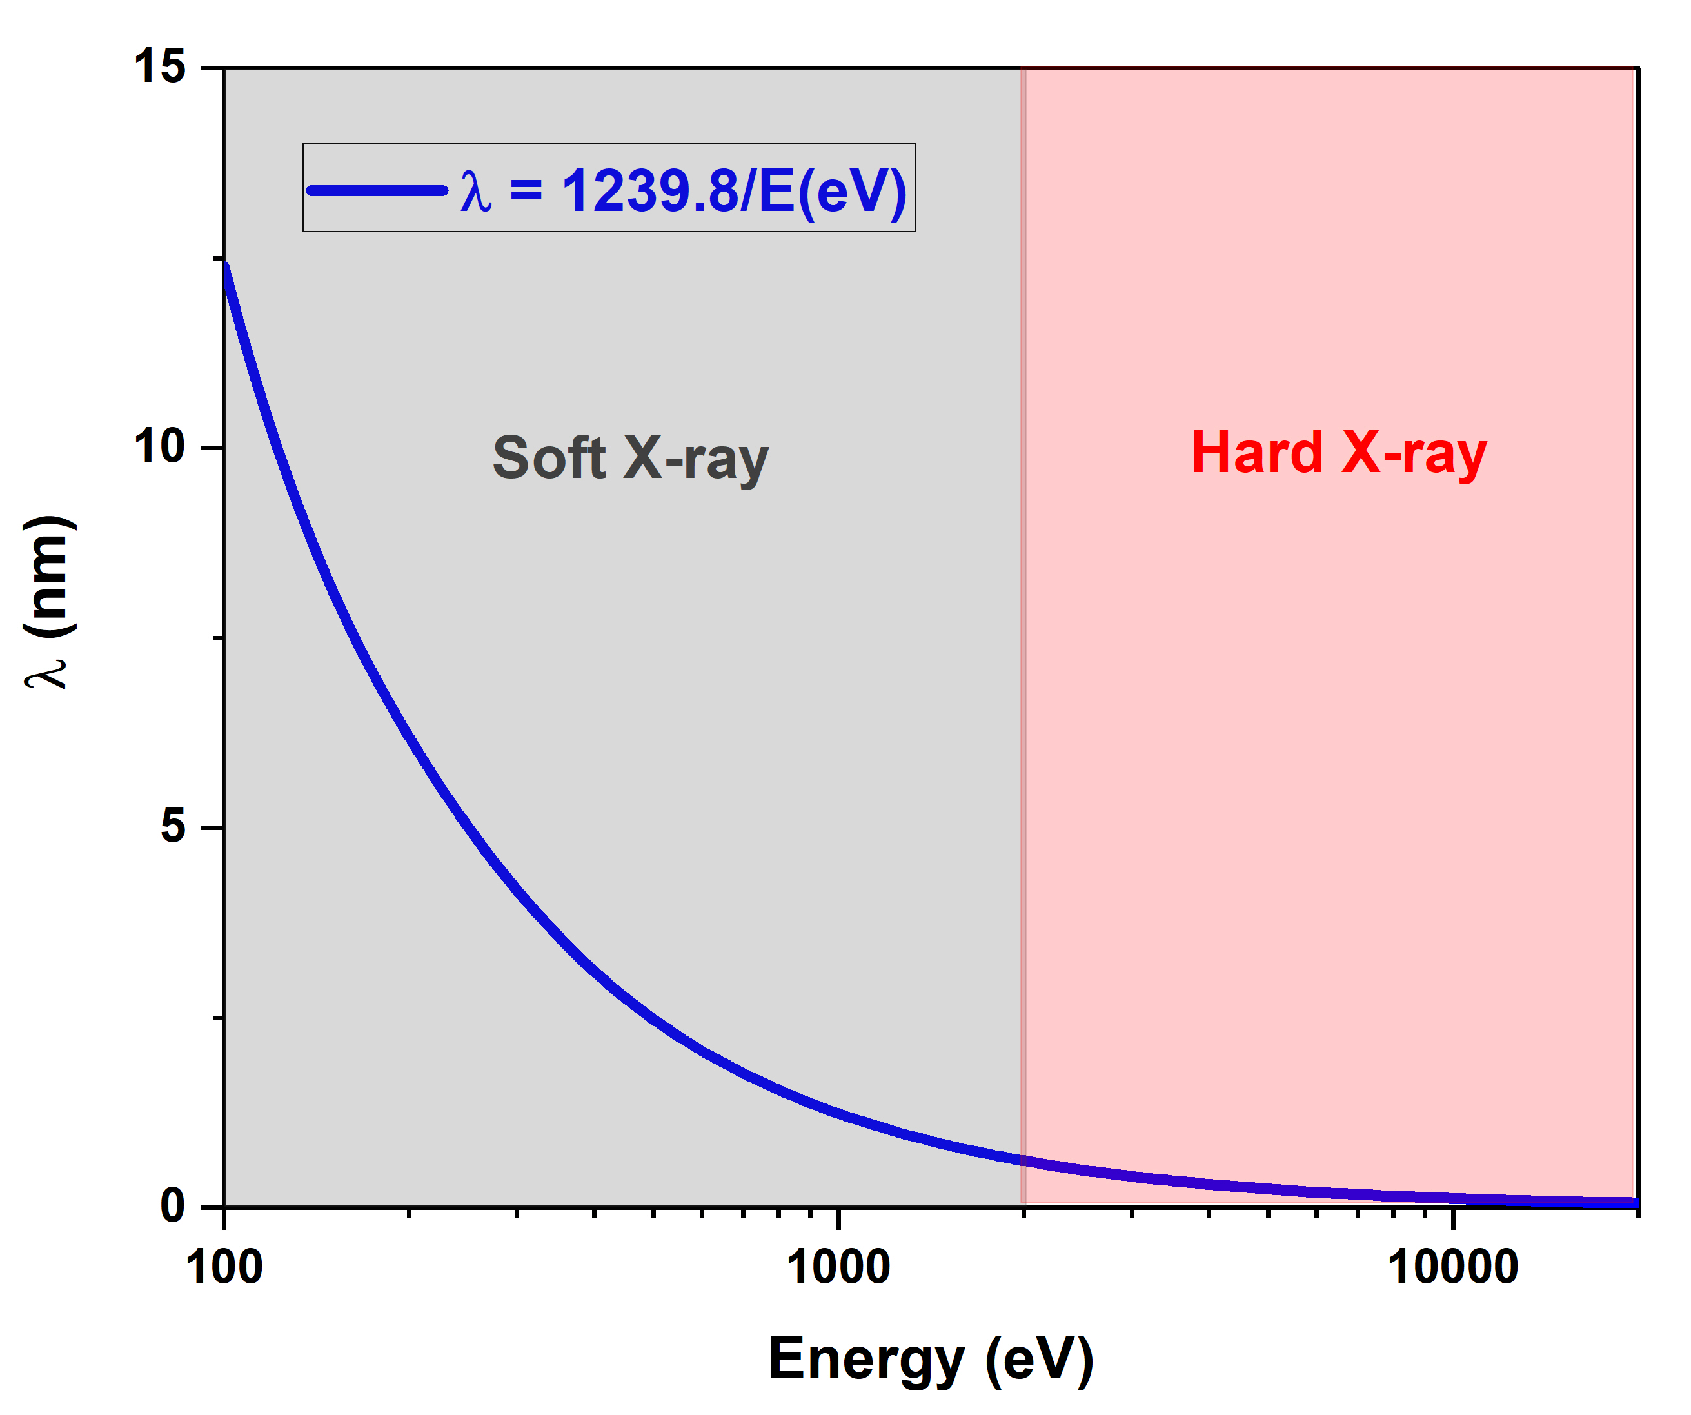

Similar concepts (ALS BL11, soft X-ray beamline)
$$σ=\frac{λD}{a}$$
Few mbars
Slavo Nemsak, RSCI 92, 044102 (2021)
R. Schlögl, Angew. Chem. Int. Ed. 2015, 54, 2–58

Slide 6
Beamline requeriments (proposal)
Photon energy range: 3 -17 keV
Footprint on sample:
  Along the beam at 0.5º grazing incidence: 900 µm
  Transverse to the beam: 2 µm
Expected Total Electron Energy resolution (photons+electrons):
  At 4 keV (Si(111)) and 100 eV pass energy of analyzer: 0.18 eV,
  At 5 keV (Si(311)) and pass energy 50 eV: 0.13 eV
Photon incidence angle (αi) with respect to sample plane: 0º < αi < 15º
2D Photon detector area and pixel size: ca. 250 x 250 mm²
Working pressure on sample: Up to 3 bar for sample/front-cone gap of up to 20 µm
Working pressure in chamber: 30 mbar maximum
Maximum gas flow: 10 liters/minute
Sample temperature: up to ca. 1000 K, down to 100 K (liquid N2 cooling)

Slide 7
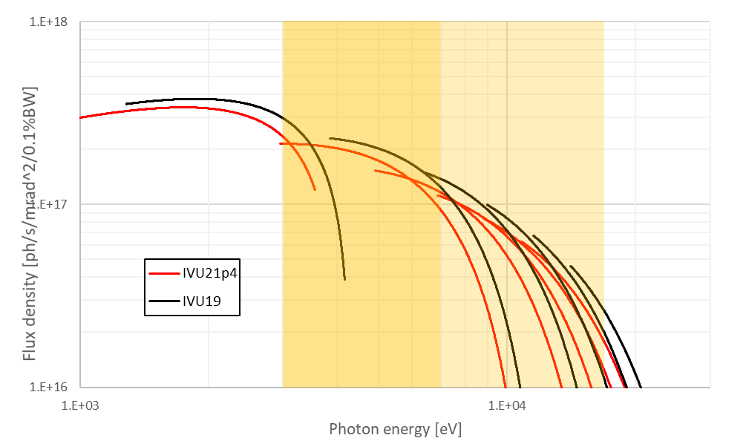
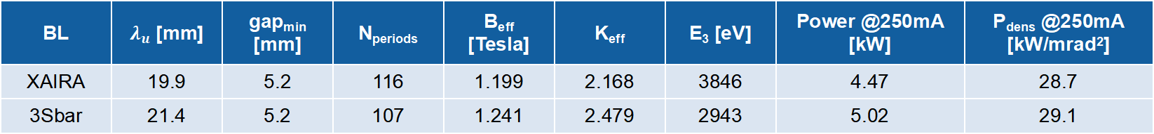
3Sbar ID (source)
It has been decided to increase the period length in order to shift the start of the 3rd harmonic (at 5.2mm minimum gap) just below 3keV:
BL | $λ_{u}$ [mm] | gap_{min} [mm] | N_{periods} | B_{eff} [Tesla] | K_{eff} | E₃ [eV] | Power @250mA [kW] | P_{dens} @250mA [kW/mrad²]
XAIRA | 19.9 | 5.2 | 116 | 1.199 | 2.168 | 3846 | 4.47 | 28.7
3Sbar | 21.4 | 5.2 | 107 | 1.241 | 2.479 | 2943 | 5.02 | 29.1
The price to pay to extend the 3rd harmonic down to 3keV is a flux density reduction of ~15% at 5keV
(decrease of the number of periods and lower K values to reach a given energy)
ID: Jordi Marcos

Slide 8
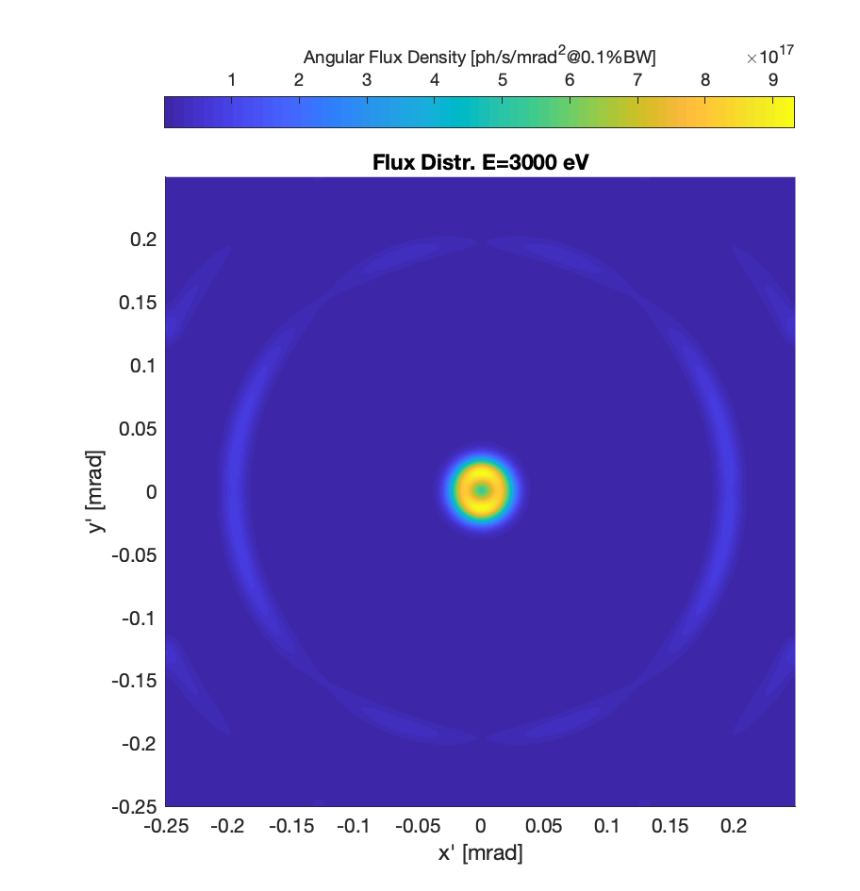
3Sbar FE acceptance optimization
The acceptance of the beamline is very reduced, to match the divergence of the emission cone of the ID without accepting useless power.
For ALBA, this represents accepting only 60% of the máximum flux at 3keV
FE: Raquel Monge

Slide 9
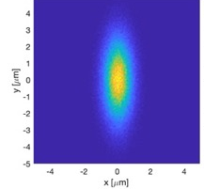
3Sbar optical layout
Optical Hutch
xBPM2
Experimental Hutch
ALBA II
FS1,
Grating 1
FSM2
Grating 2
Sample
Slit 1
VFM
HFM
DiagOn
xBPM1
FSM3
DCM
VCM
SLIT2
Item | Horz. distance |  | Height
 | to prev | to src | Height
Unit | m | m | m
Source | 0.00 | 0.00 | 1.400
FE | 10.00 | 10.00 | 1.400
VCM | 10.60 | 20.60 | 1.400
DCM | 1.00 | 21.60 | 1.408
DCM-2 | 2.00 | 23.69 | 1.443
VFM | 11.56 | 35.36 | 1.532
HFM | 0.64 | 35.99 | 1.532
Sample | 1.20 | 37.19 | 1.532
Parameter | Value | Remark
Flux at 5 keV | 1.76x10¹³ ph/s | Si(311) B4C
Resolution at 5 keV | 128 meV | Si(311)
Spot size on sample | 1.27 x 3.66 µm² FWHM | ALBA II
Divergence on Sample | 0.76 x 0.30 mrad² FWHM | ALBA II
Optics: Josep Nicolás

Slide 10
3Sbar monochromator resolution
Si(333) no VCM
Si(311) and Si(333) show the need of the collimating mirror
Resolutions between 100-200 meV accesible in most of the energy range of the beamline
Si(333) VCM
Energy [keV]
Optics: Josep Nicolás

Slide 11
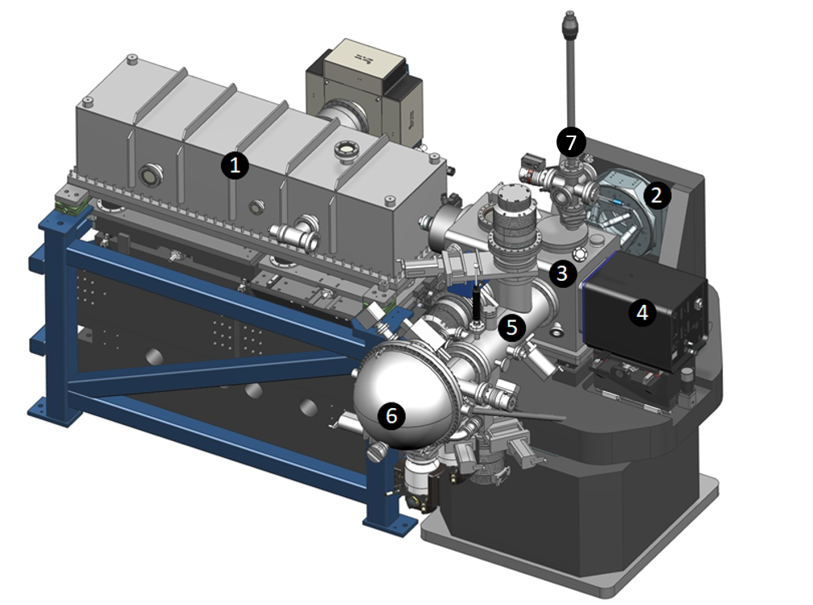
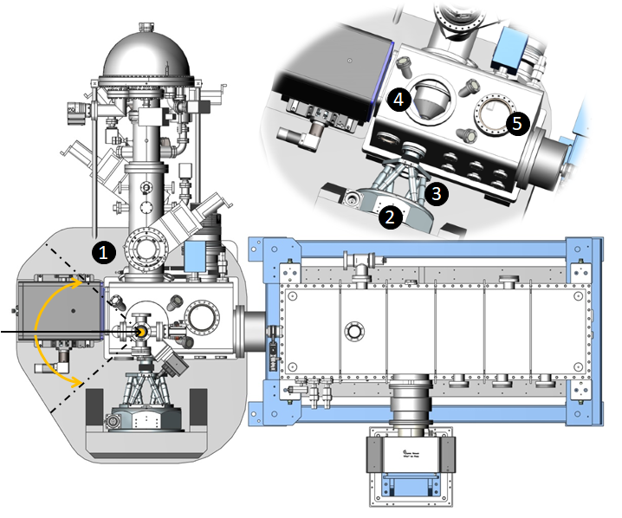
3Sbar endstation
2D detector OFF-VACUUM motion
8
y
Gas dosing and products analysis
KB mirrors (nanobender)
x-y-z sample positioning and azimuthal rotation for setting diffraction conditions
Main analysis chamber
Commercial 2D X ray pixel detector
Differential-pumping, inside XPS analyzer
Hemispherical photoelectron analyzer
Load-lock and transfer
2D detector movement (y, z)
Whole chamber rotation, to set the angle of incidence by rotating around a vertical axis intercepting the sample surface
Goniometer, to azimuthally rotate the samples
Hexapod for sample alignment and sample transfer. Sample positioning (wires, encoders) is off-vacuum.
Sample load-lock and transfer, front-cone exchange
Front-cone exchange access
Critical! We profit from extreme accuracy and robustness in SXRD setups
Enstation design: Nahikari Gonzalez and Alejandro Crisol

Slide 12
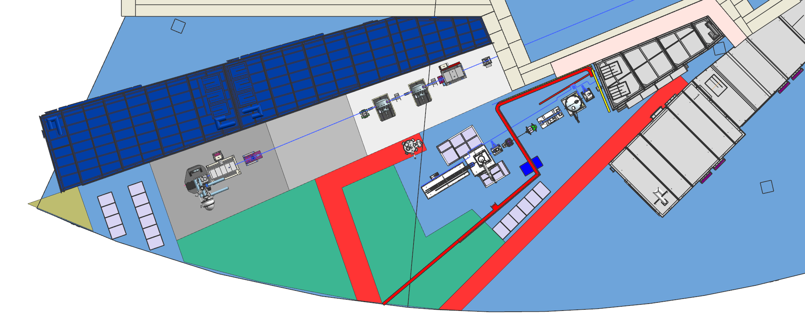
3Sbar beamline layout
VCM
DCM
DCM2
Optical hucht
NOTOS
ES2
Cryocooler
ES
BL14 (Mistral simulated)
Corridor
XALOC
Control room (32.6 m²)
RACKS & Gases
Enstation design: Alejandro Crisol

Slide 13
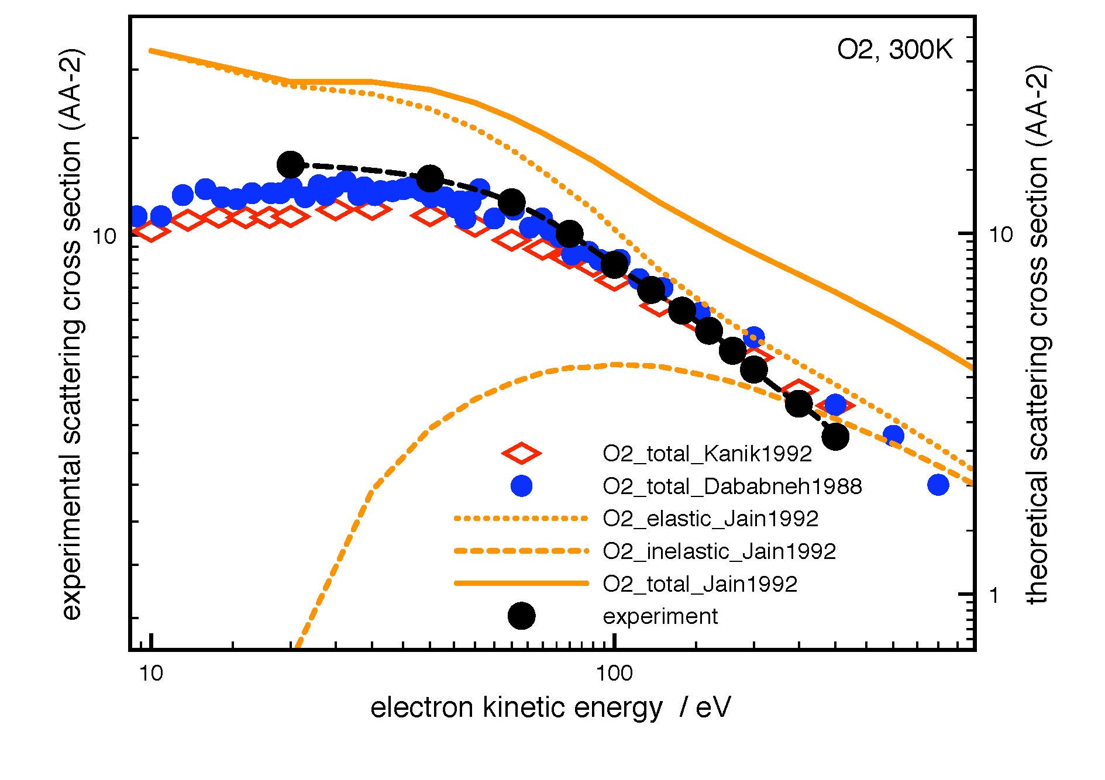
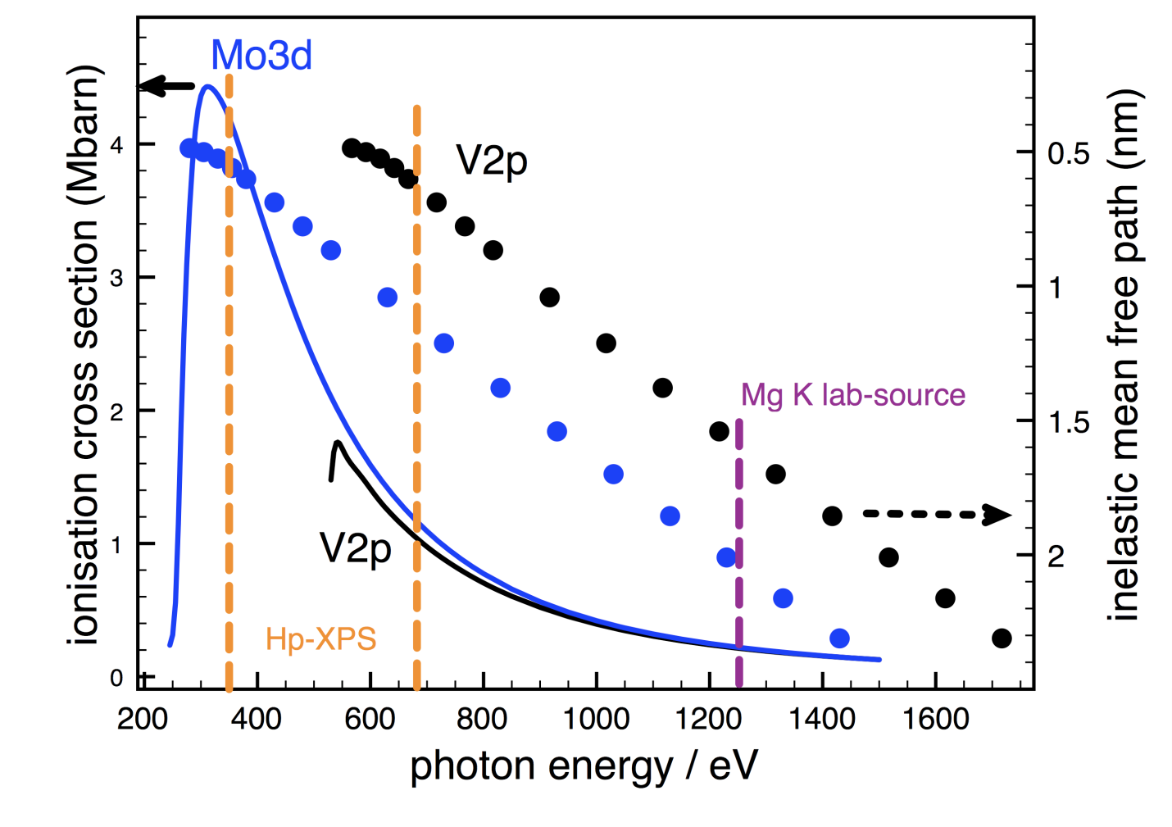
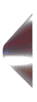
Higher working pressures
Ionisation cross section
IMFP
Electron scattering in gas phase
increasing sensitivity
X-ray
Ionisation cross section:
J.J. Yeh and I. Lindau, Atomic Data Nucl. Tables 32 (1985) 1.
Inelastic mean free path:
S. Tanuma, J. Powell, D.R. Penn, Surf. Interf. Anal. 21 (1993) 165.
3SBar operated in total reflexion
(few nm X-ray penetretation depth)
↓
Enhanced diffraction
and
photoemission signals
d
e⁻
APXPS
Nozzle
D

Slide 14
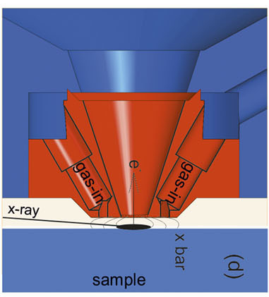
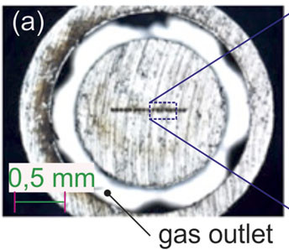
3Sbar endstation: exchangeable nozzle and reaction cells
POLARIS
at PETRA-III
e⁻
HV
XPS/XANES
SXRD
e⁻
ionomeric membrane
EC-cell
X-ray in
Electrolyte
Gas in
Gas in
e⁻
0.1-10 mbar
e⁻
~50 mbar
e⁻
HV
Sample
EC-cell
Gas-cell
Sample
D
Electrolyte
Gas
D
Local
High Pressure
Enstation design: Nahikari Gonzalez and Alejandro Crisol

Slide 15
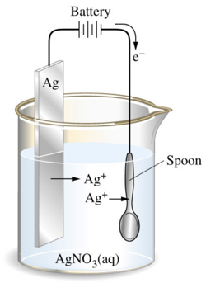
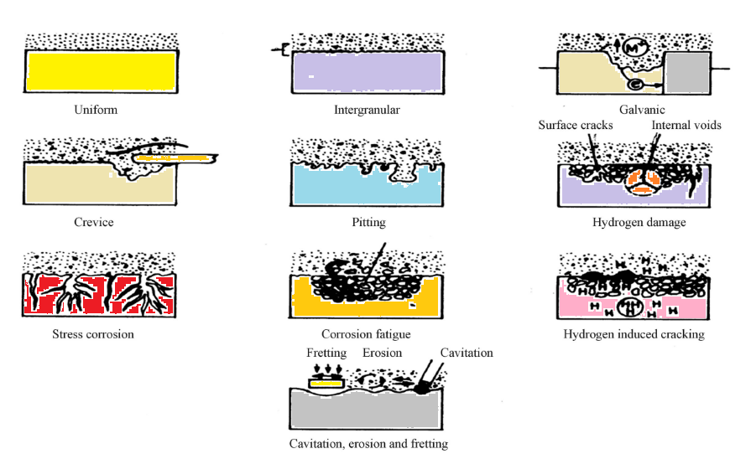
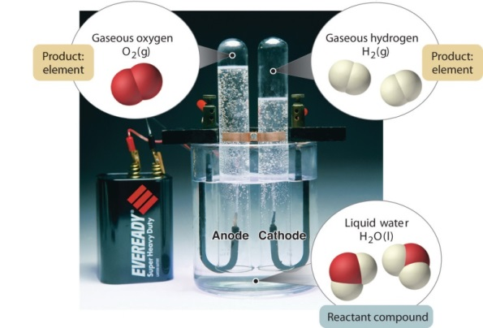
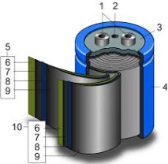
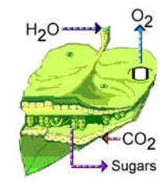
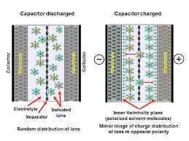
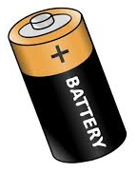
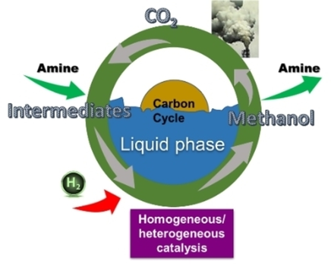
Topics and more...
Electroplating
Electrocatalysis
Corrosion
Artificial Photosynthesis
Supercapacitors-EDL
Batteries
  Liquid phase catalyts

Slide 16
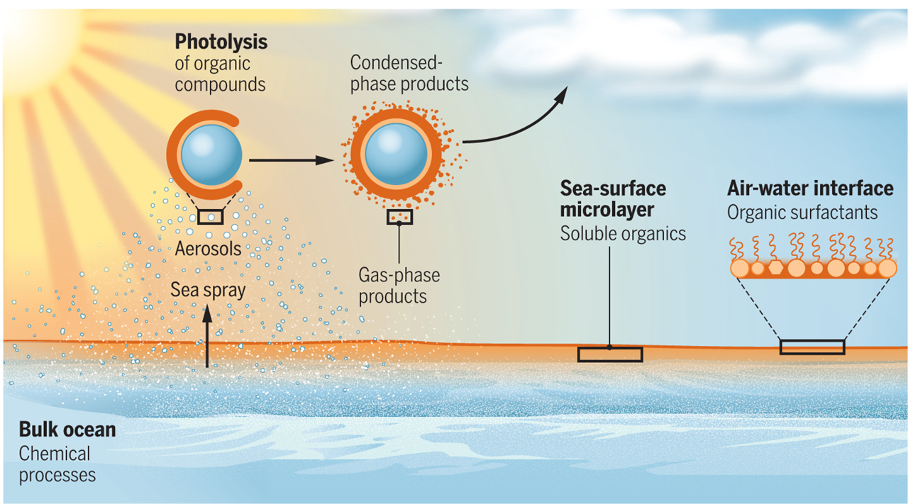
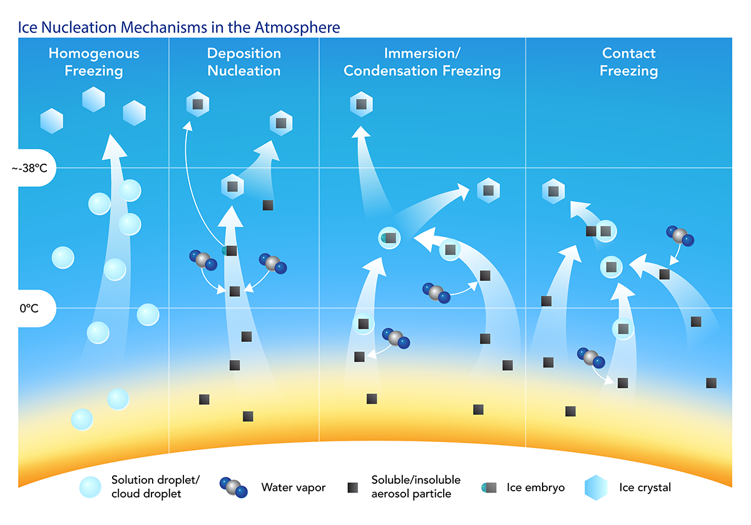
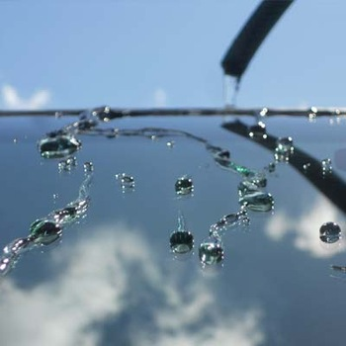
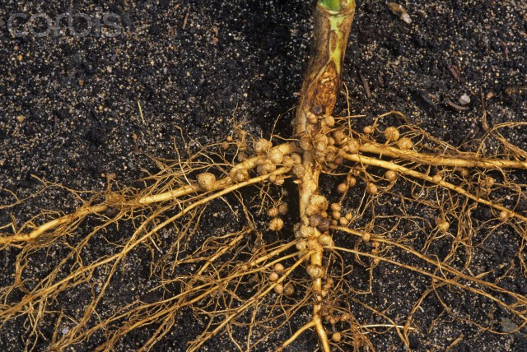
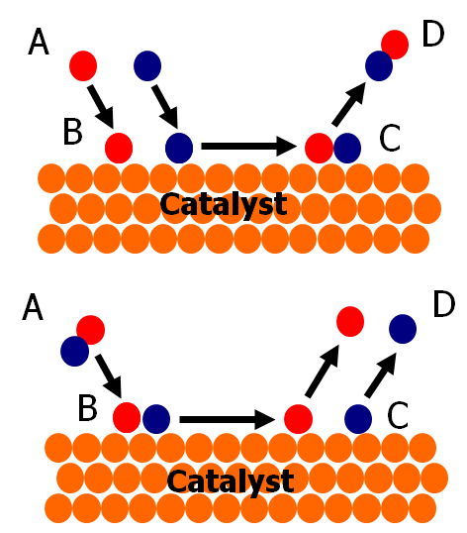
Topics and more...
Nitrogen Fixation

Slide 17
Selective alkynes semi-hydrogenation to alkenes on Pd catalyst
These reaction routes are essential for example in polymerization processes where the complete elimination of alkynes and diolefins from the alkene feedstocks is the aim. The selective elimination of propyne from a propylene rich stream is important to avoid the poisoning of the polymerization catalysts
Partial selective hydrogenation
C_{n}H_{2n-2 (gas)}
C_{n}H_{2n (gas)}
Low pressures
Pd
Full unselective
hydrogenation
C_{n}H_{2n-2 (gas)}
C_{n}H_{2n+2 (gas)}
High pressures
Pd

Slide 18
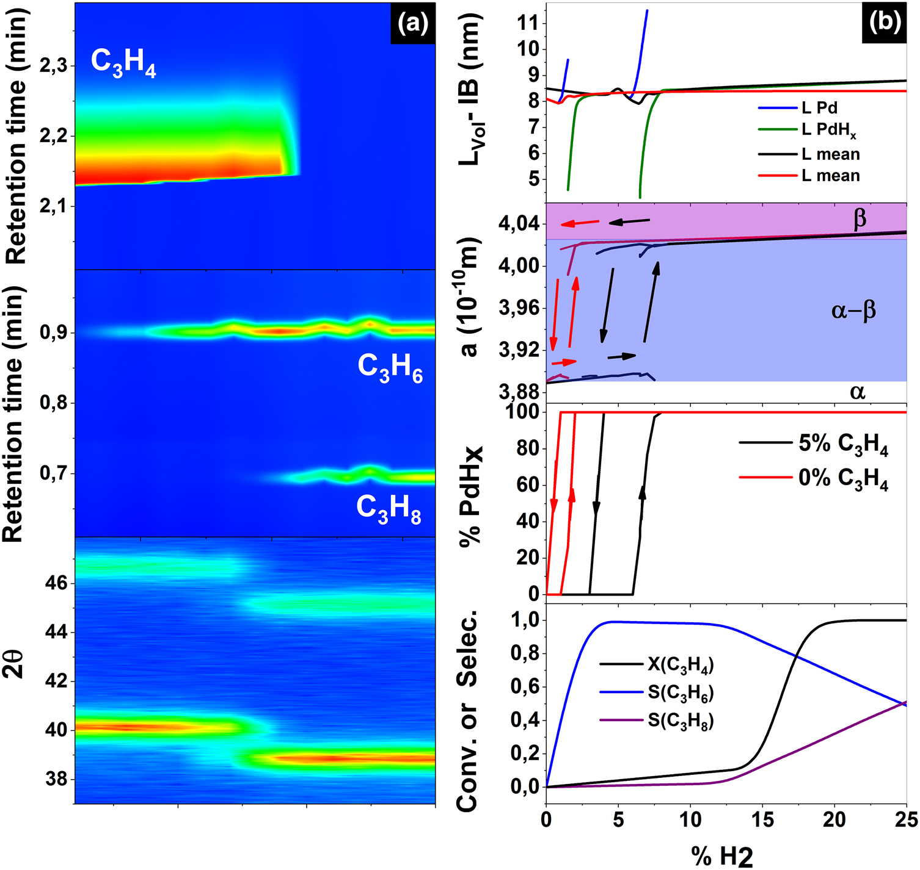
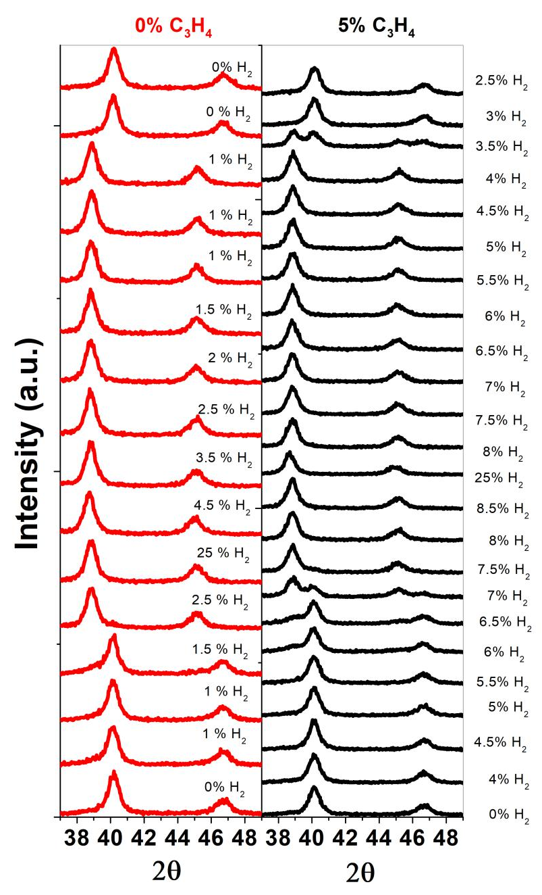
Operando XRD at 1 bar
75 mbar
25 mbar
Velasco-Vélez et al, (2018). Topics in catalysis, 61(20), 2052-2061.

Slide 19
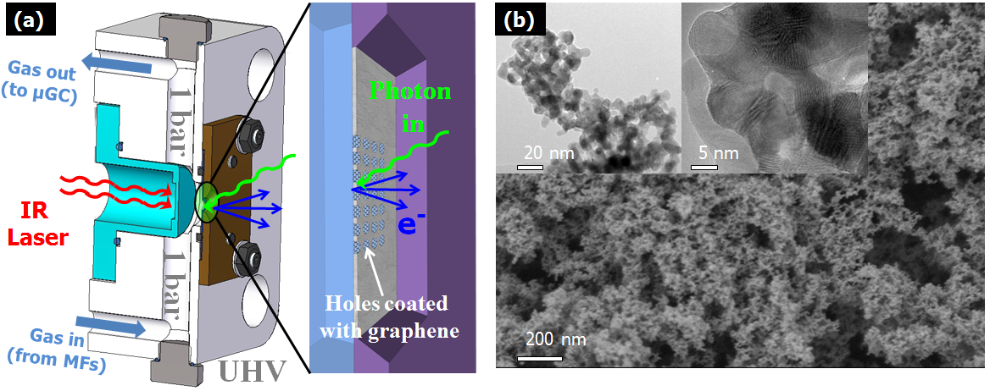
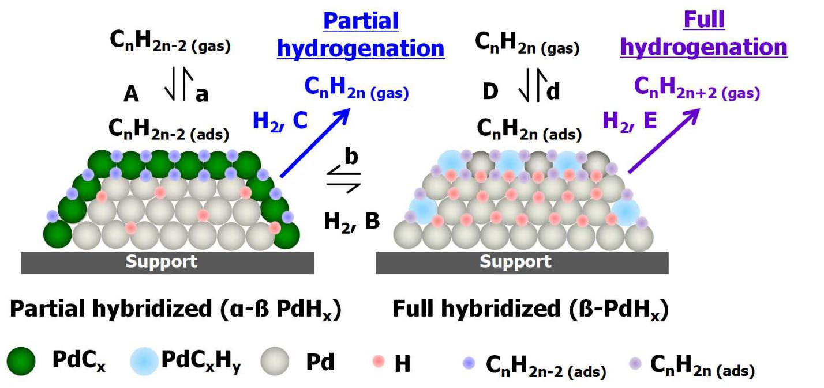
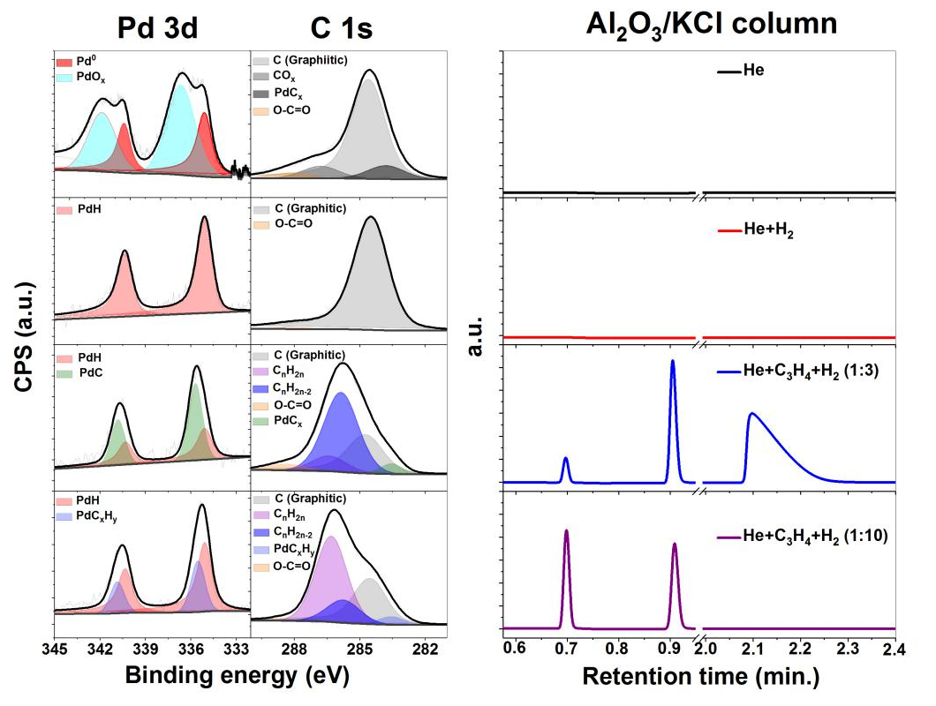
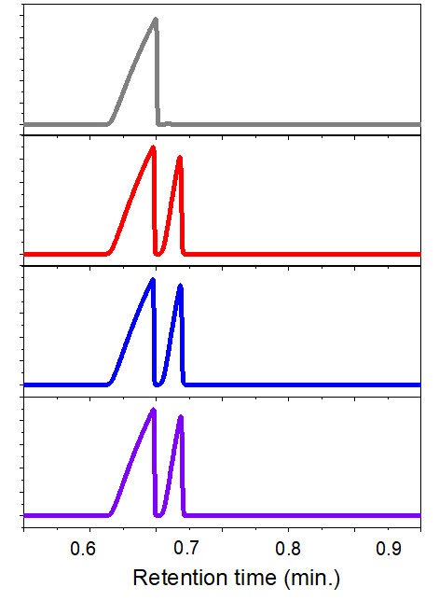
Operando XPS at 1 bar
MS5 column
He
H₂
C₃H₆
C₃H₈
C₃H₄
Velasco-Vélez et al, (2018). Topics in catalysis, 61(20), 2052-2061.

Slide 20
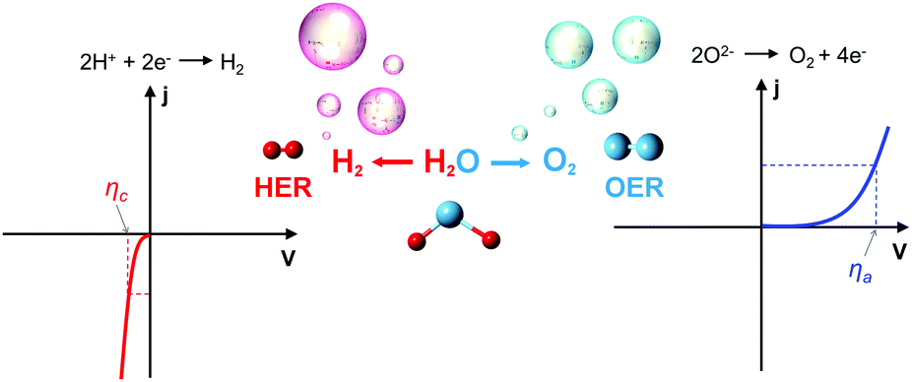
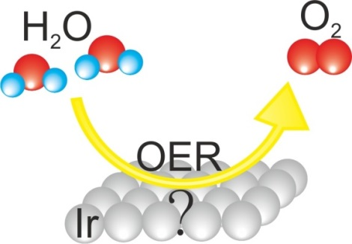
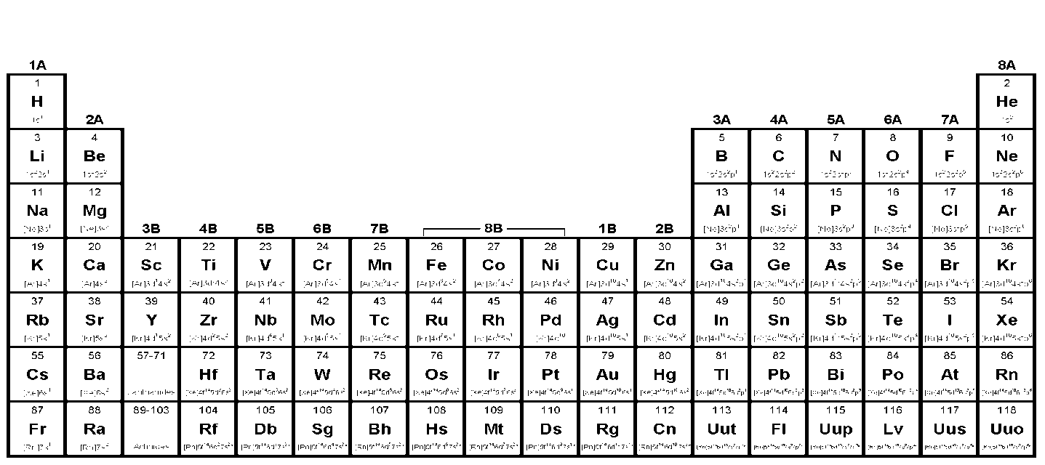
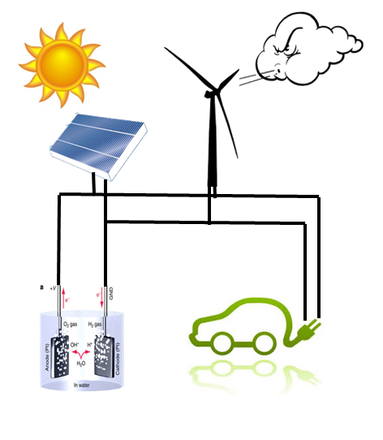
Oxygen evolution reaction (OER)
Almost ideal (Pt)
Overpotential
*cortesy of Dr. R Garcia-Diez

Slide 21
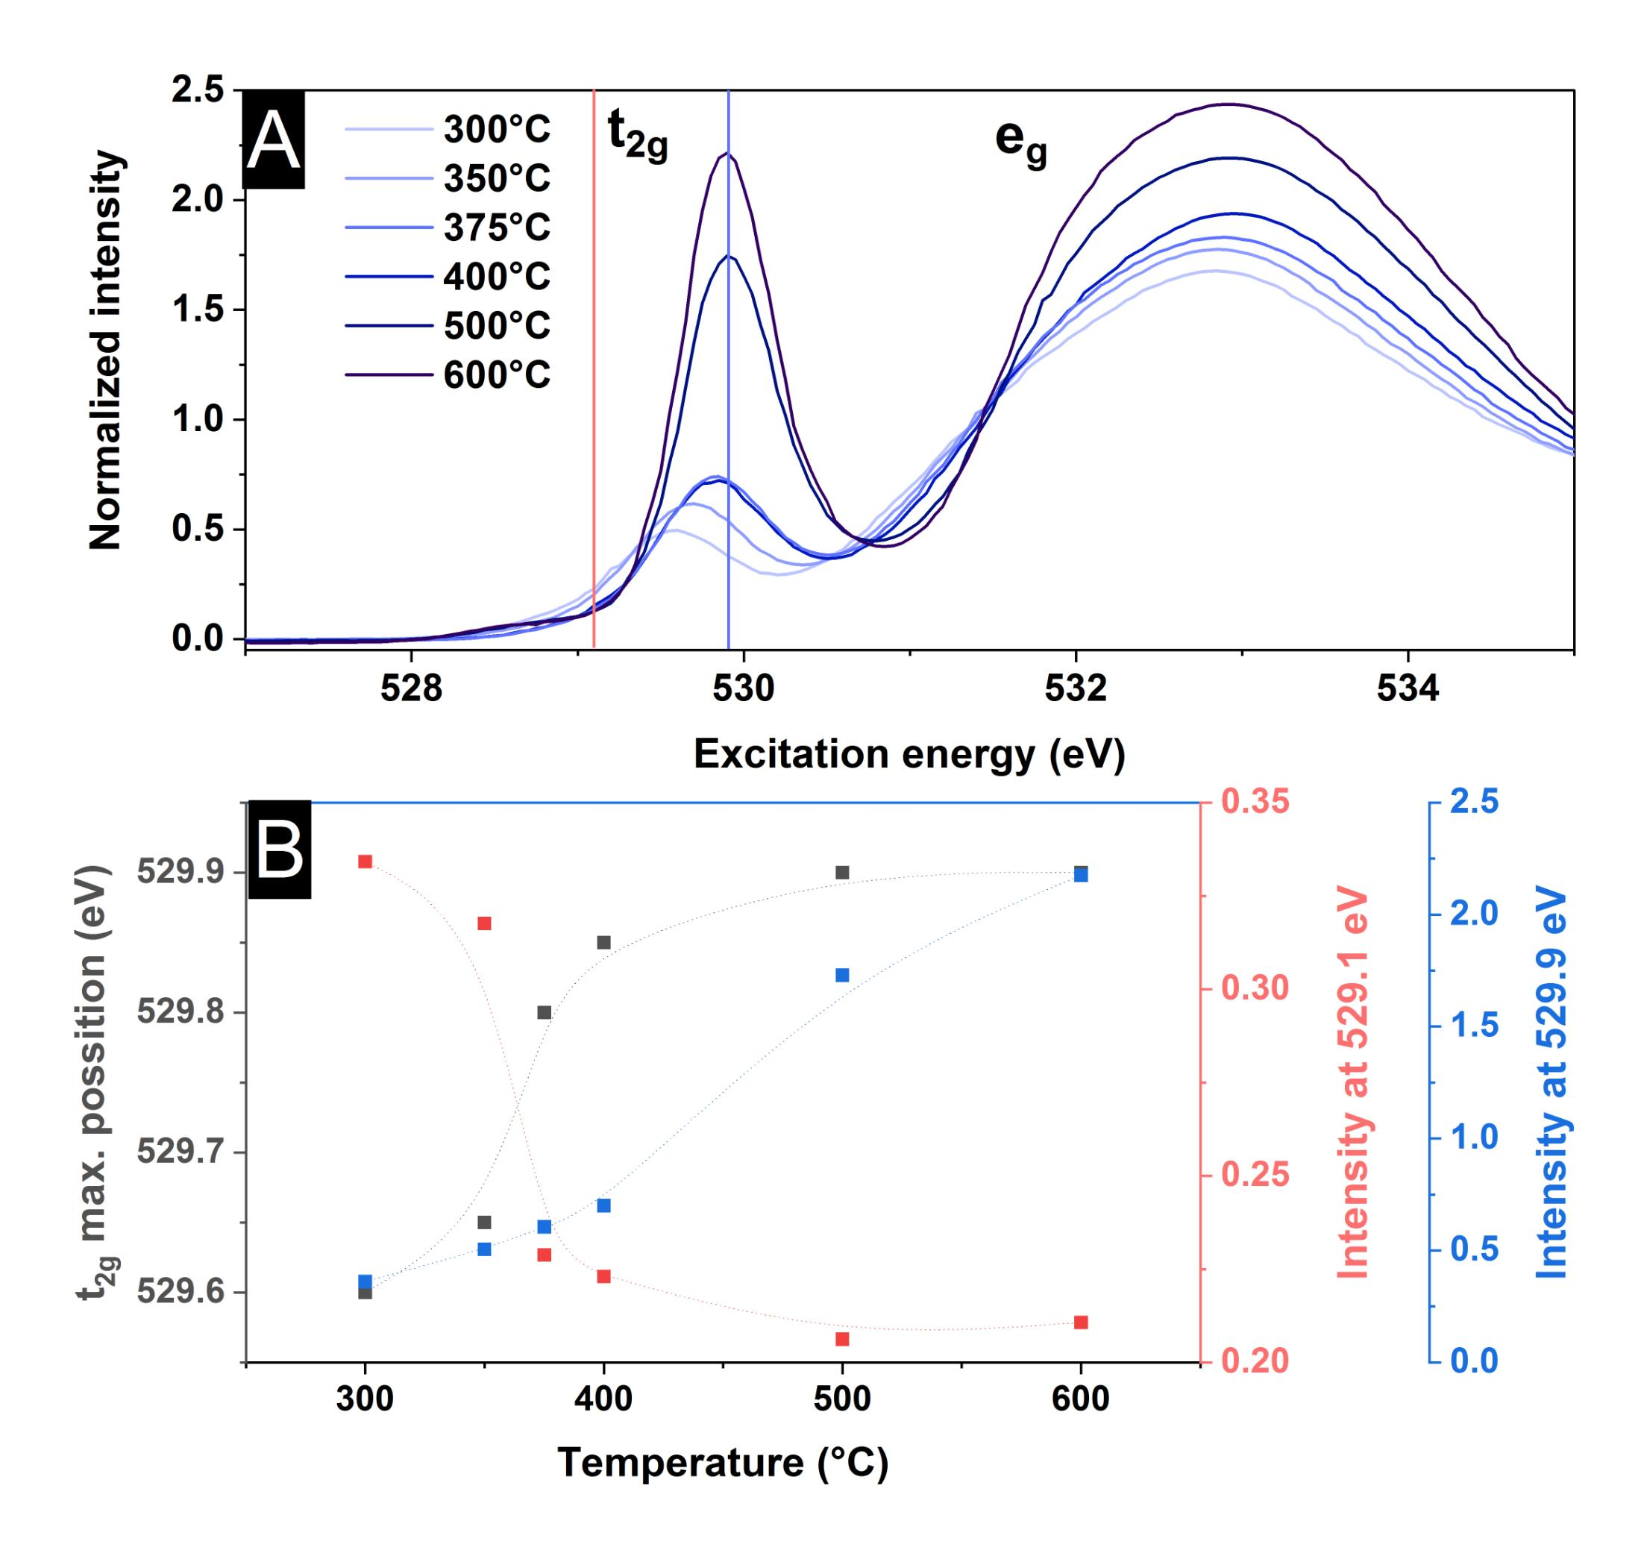
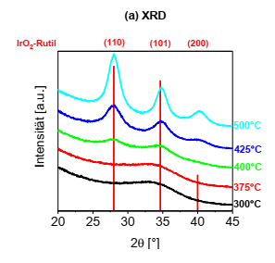
Mesoporous IrO_{x}
300°C
350°C
375°C
400°C
500°C
600°C
Dr. R. Krähnert (TU Berlin)
Dr. D. Bernsmeier (TU Berlin)

Slide 22
Mesoporous IrO_{x}
Pfeifer, V. et al., (2016), Surface and Interface Analysis, 48(5), 261-273.

Slide 23
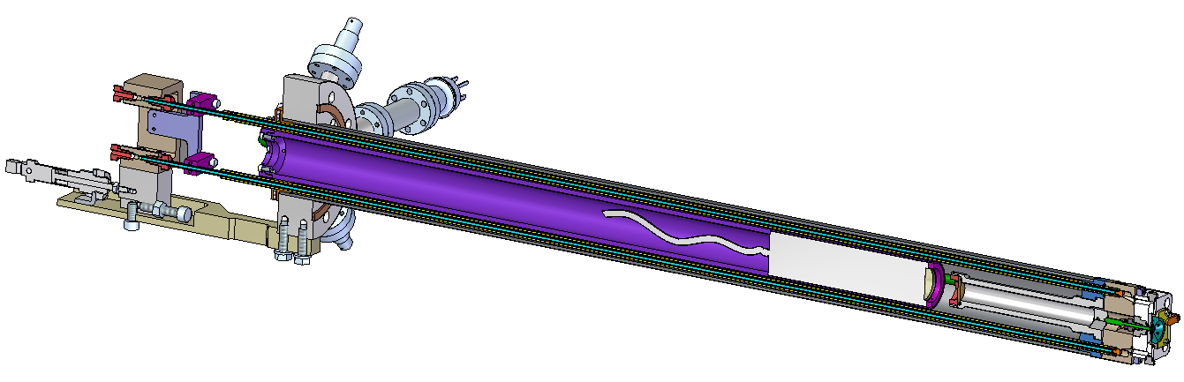
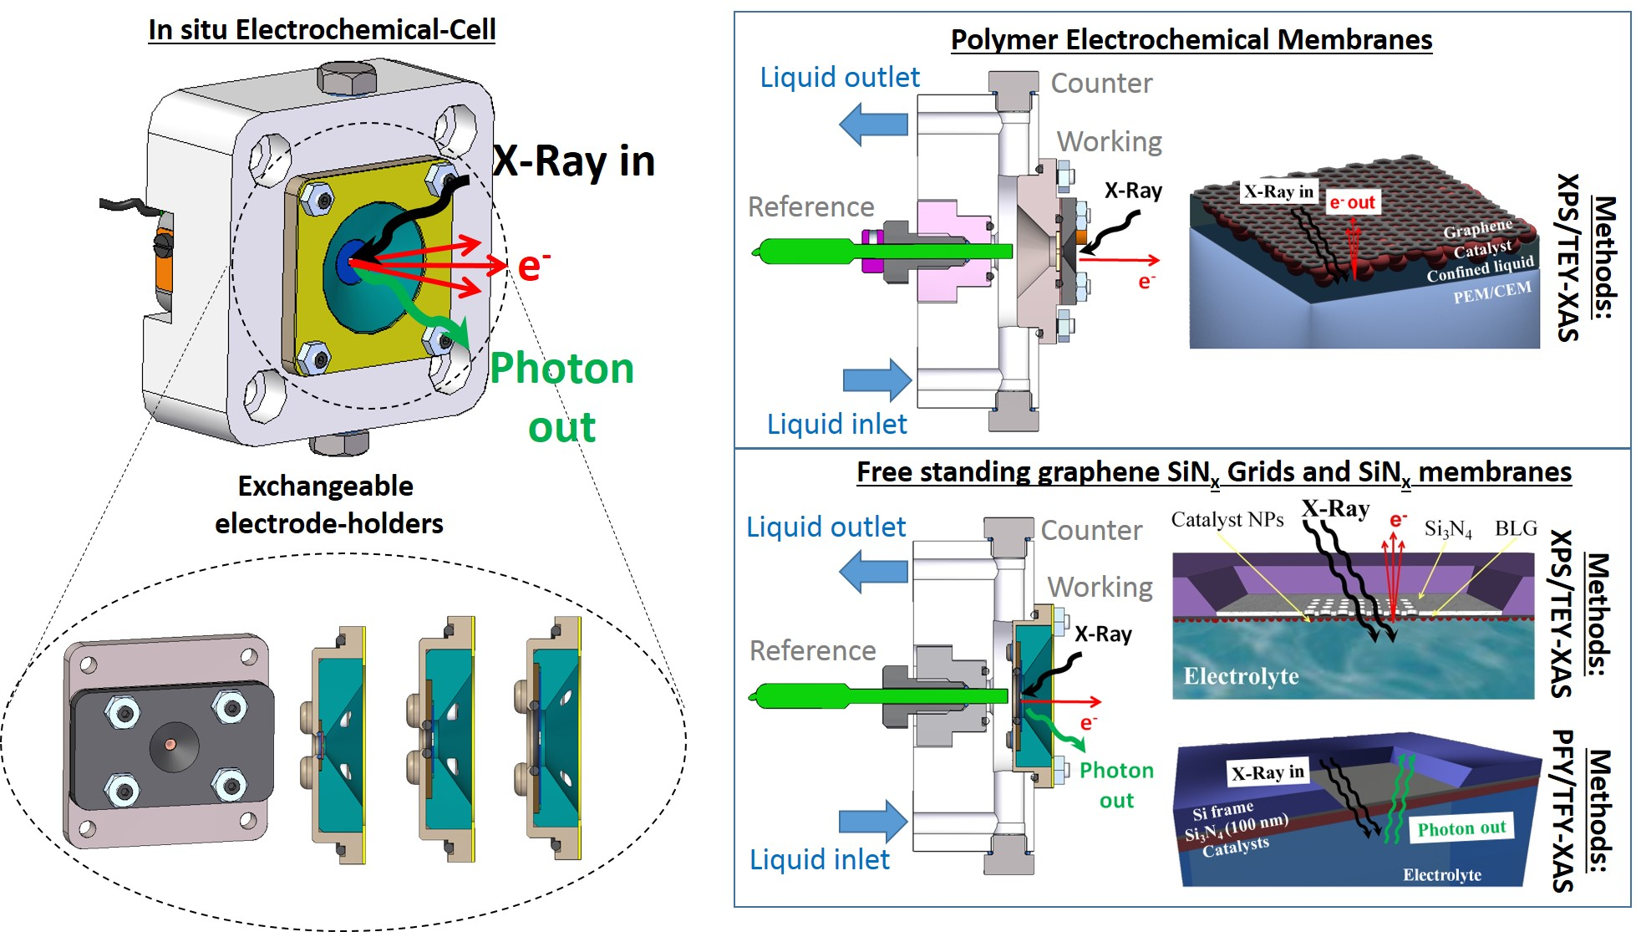
In situ EC cell
Manipulator

Slide 24
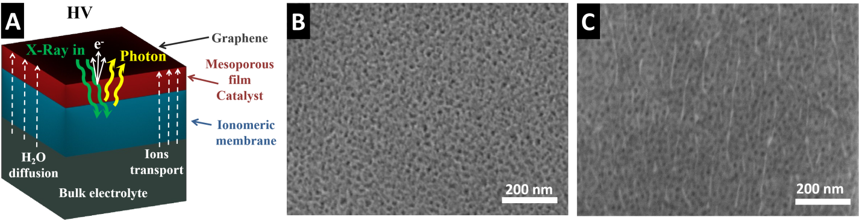
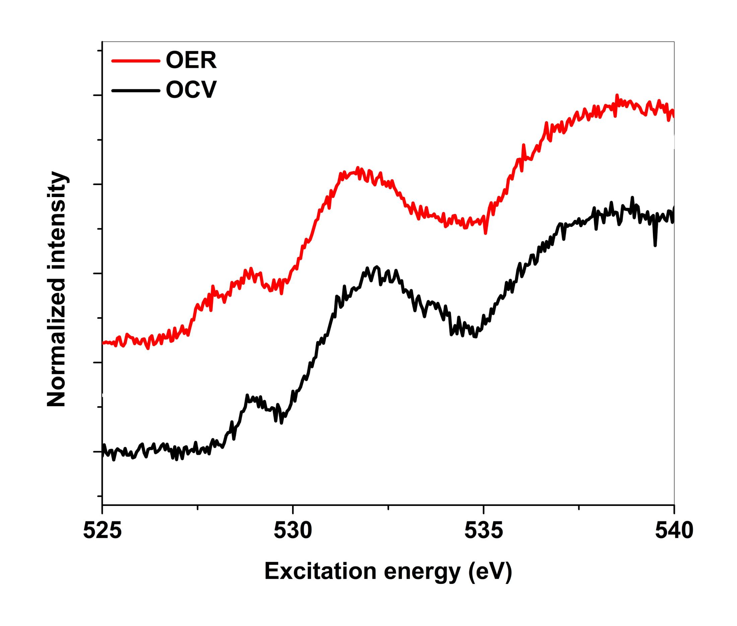
_{Operado EC characterization}
Velasco-Vélez et al.,Faraday Dis., 2022, DOI:10.1039/D1FD00114K

Slide 25
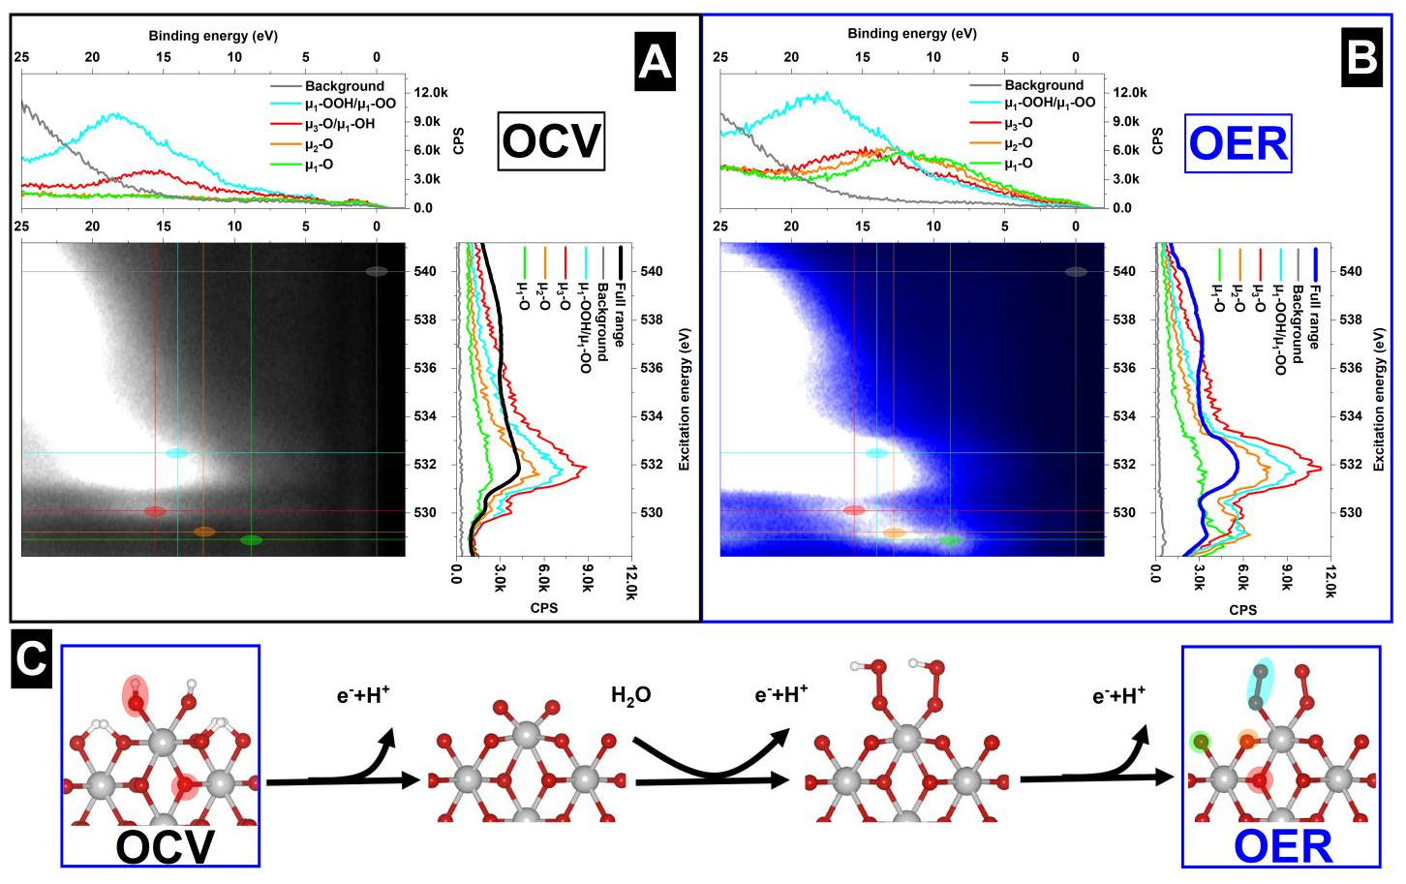
Operando ResPES characterization
Velasco-Vélez et al.,Faraday Discussions, 2022, DOI: 10.1039/D1FD00114K

Slide 26
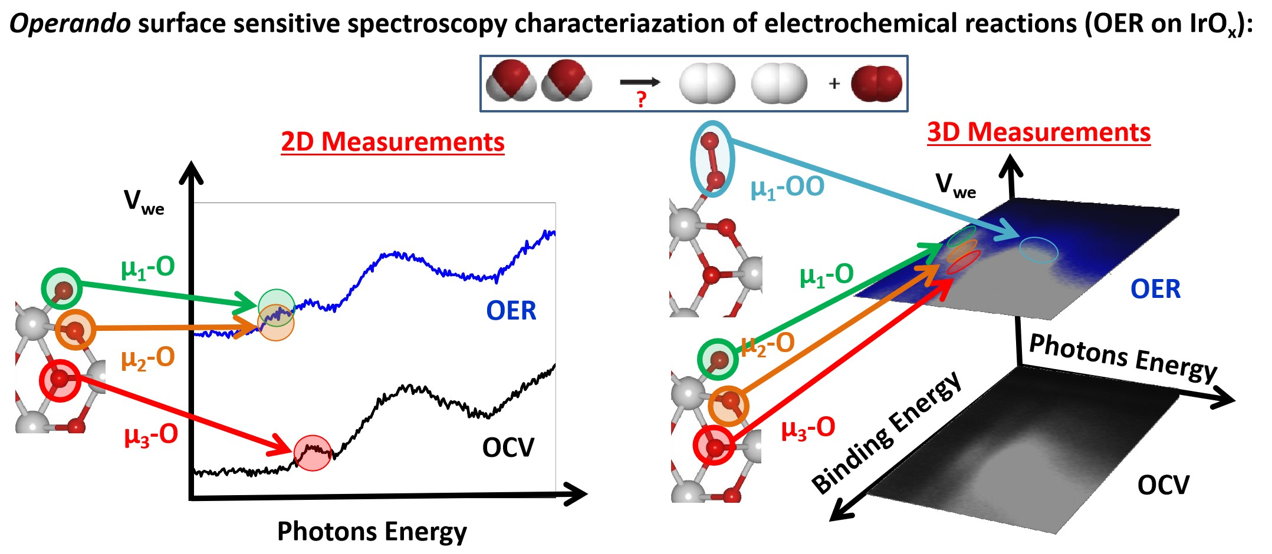
µ₁-O active species
Velasco-Vélez et al.,Faraday Discussions, 2022, DOI: 10.1039/D1FD00114K

Slide 27
Thanks!
3SBar team:
Juan J. Velasco
Eduardo Solano
Salvador Ferrer
Christopher Goodwin
ID & FE:
Jordi Marcos
Raquel Monge
Optics:
Josep Nicolás
Dominique Heinis
Engineering:
Alejandro Crisol
Nahikari González
Marcos Quispe
…and many more!
External experts:
Enrique Ortega (UPV)
Hendrik Bluhm (FHI der MPG)
Slavo Nemsak (ALS)
Robert Seidel (BESSY)
Marco Favaro (BESSY)
Christoph Schlüter (DESY)
Fernando García Martínez (DESY)
Lucia Alianelli (Diamond)
Ray Barrett (ESRF)
Francesco Carlà (Diamond)
Peter Amann (OMICRON/SCIENTA)
Andreas Thissen (SPECS)
Alex Marco Gil (SPECS)
Management :
Caterina Biscari
Klaus Attenkofer
Francois Fauth

Slide 28
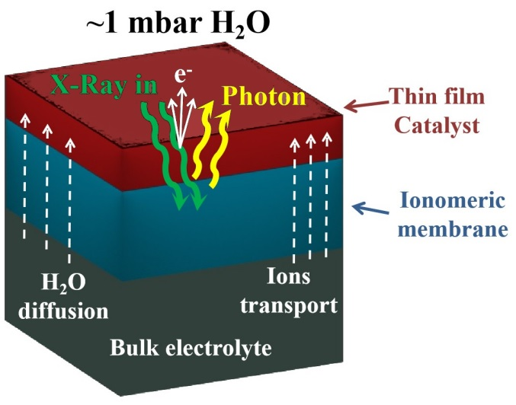
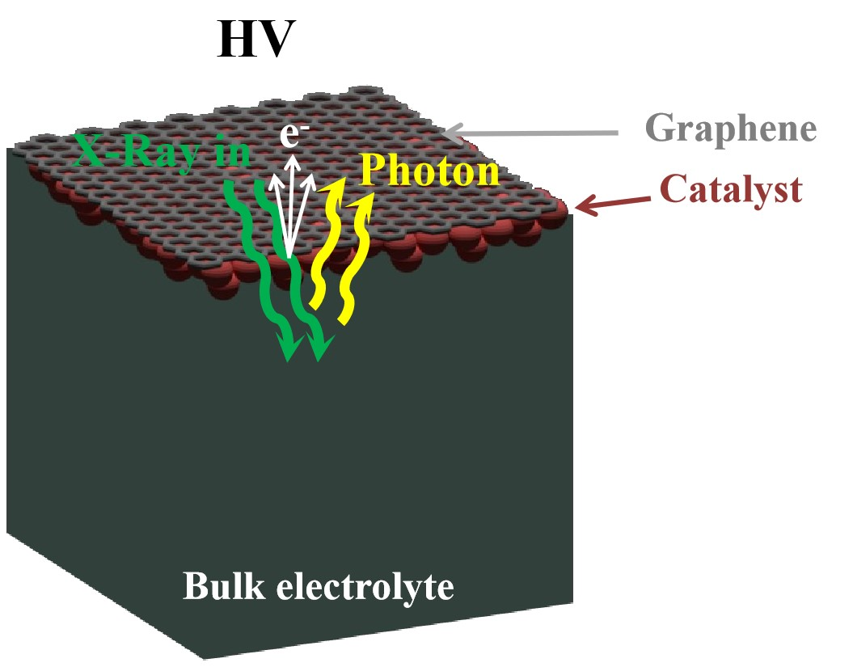
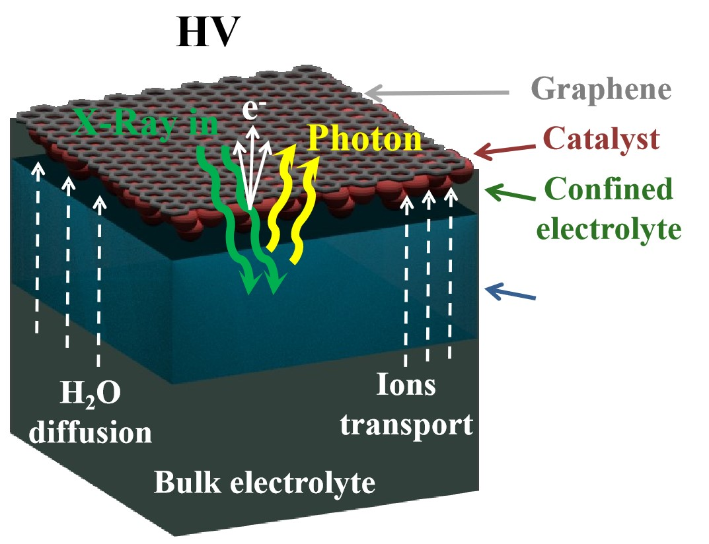

In situ XPS approaches
Gas phase
to
liquid phase
Arrigo, et al., Angew. Chem. Int. Ed., 2013, 52(44), 11660-11664
Kolmakov et al, Nat. Nanotech., 2011, 6(10), 651-657
Casalongue et al, Angew. Chem. Int. Ed., 2014, 53(28), 7169-7172
Velasco-Vélez et al, Angew. Chem. Int. Ed., 2015, 54, 14554-1455
Pfeifer et al., Chem. Sci., 2017, 8(3), 2143-2149
Larger area
(fresh spot)
Velasco-Vélez et al,Surf. Sci., 2019, 681, 1-8
Velasco-Vélez et al, JACS, 2021, 143(32), 12524-12534
Enhanced stability (beamdamage)
Frevel et al, J. Phys. Chem. C, 2019, 123(14), 9146-9152
Mom et al, JACS, 2019, 141(16), 6537-6544
Velasco-Vélez et al.,Faraday Dis., 2022, DOI:10.1039/D1FD00114K
Velasco-Vélez et al, ACS En. Lett., 2020, 5(6), 2106-2111
Falling et al, ACS App. Mat. Int., 2020,12(33), 37680-37692

Slide 29

Endstation geometry considerations
$$σ=\frac{λD}{a}$$
Beam
dimensions
Scattered beam
z
θ_{f}
Azimuthal
Incident beam
r
d
Angle
α_{f}
α_{i}
Angle
Sample
y
Polar τ
Divergence
Beam
footprint
Polar σ
X
Small beam (~1µm x ~1µm) with divergence of 1.5 mrad i.e. at 10 mm the sample the beam is 15 µm.
We aim to work with nozzle to sample distances of ~ 30 µm!!

Slide 30
Timeline
July 20, 2022:
Optical design external review
22/06/22:
CDR ID
CDR FE
CDR Optics
01/12/22:
CFT ID
CFT FE
CFT Optics
CFT Mirrors

