Slide 1
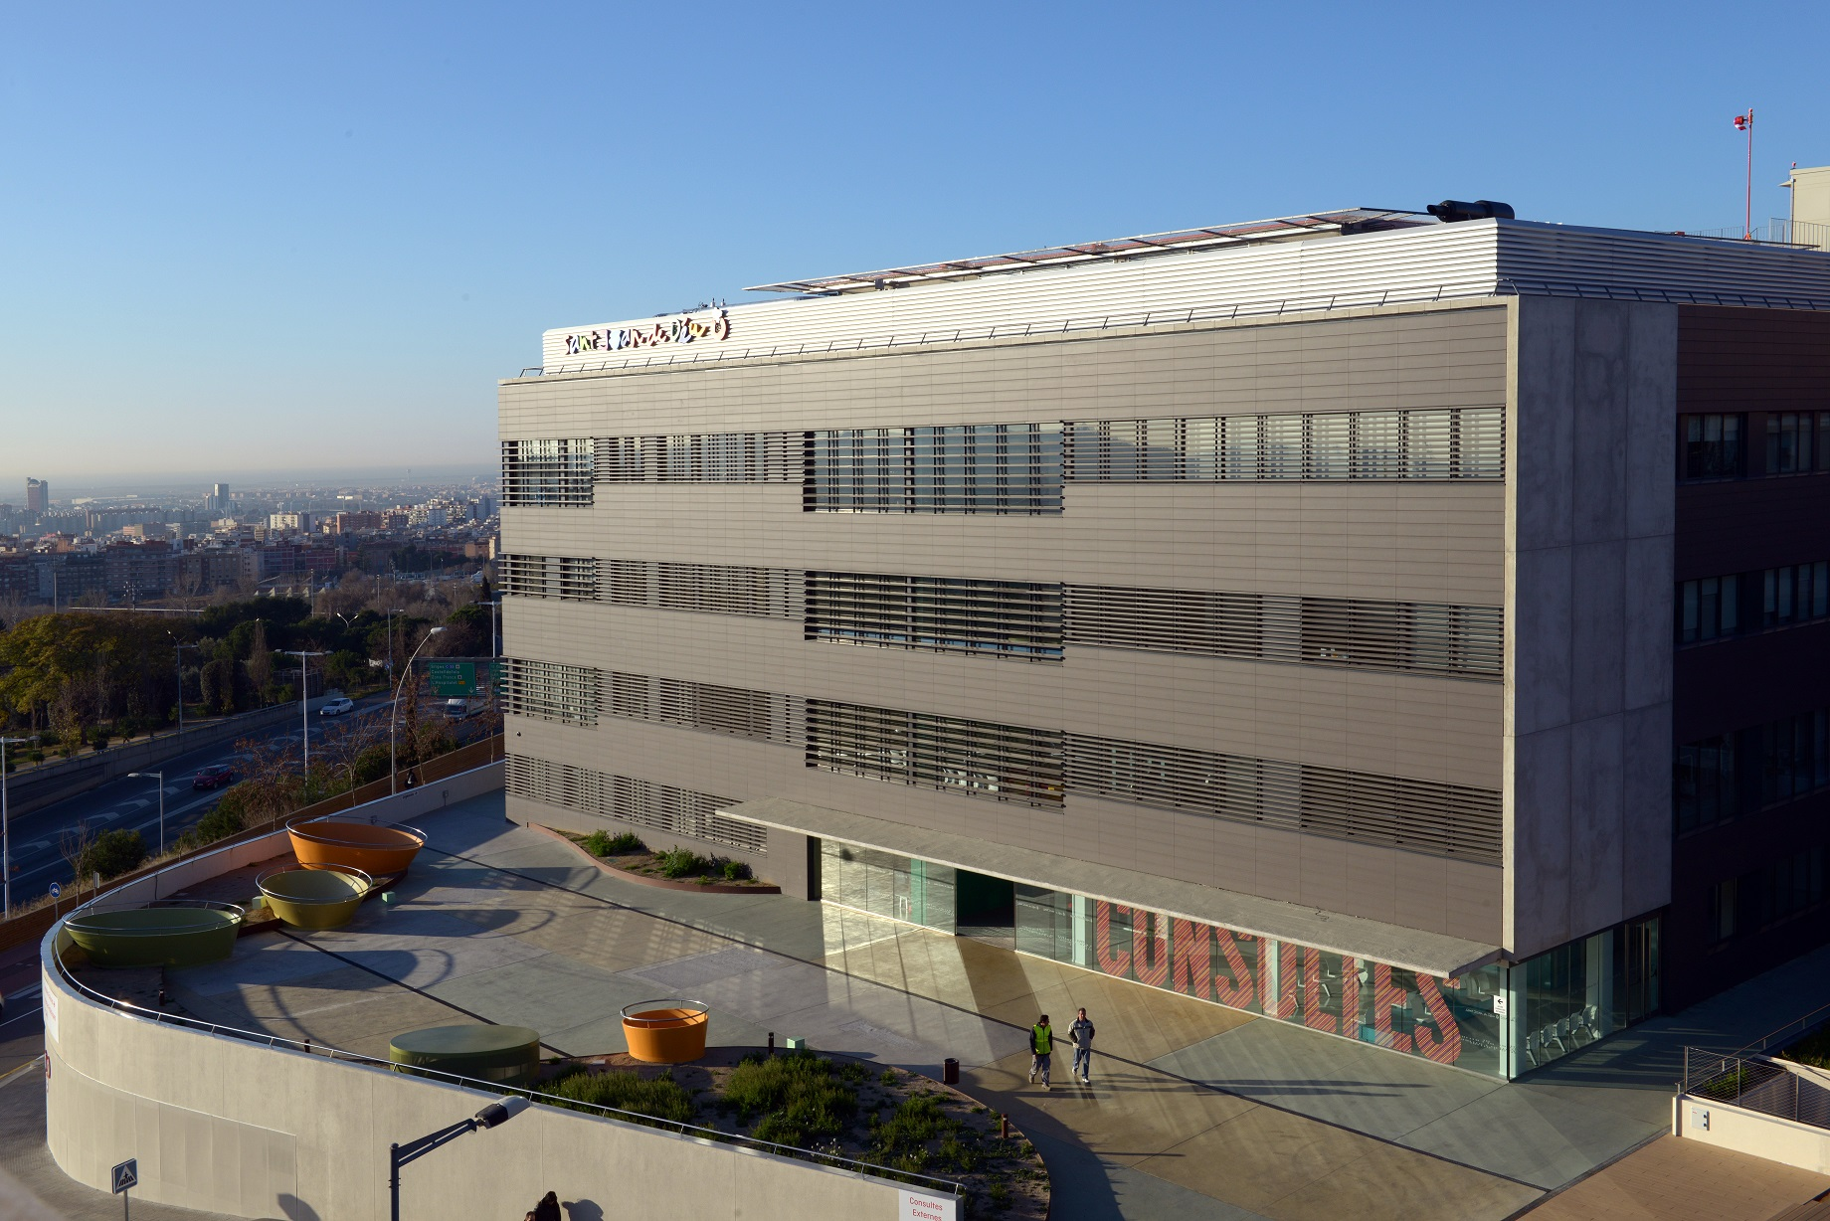


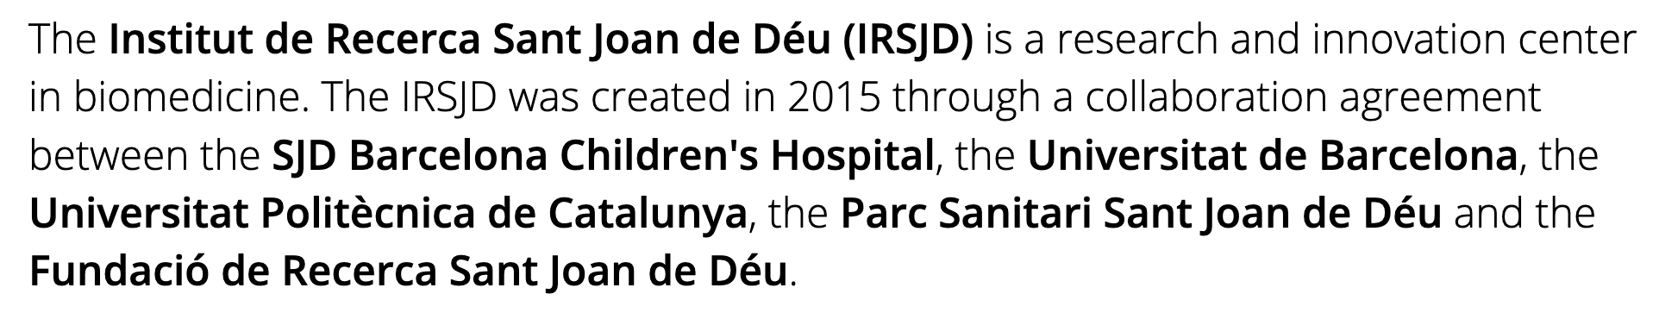
The Hospital Sant Joan de Déu is one of the leading paeditric Hospitals in Spain and Europe. It is home of the Institute of Paediatric Rare Diseases (IPER) and participates in 9 European Reference Networks.
Applying soft X-ray tomography to support therapeutic development for Muscular Dystrophies
AUSE Meeting, 8th September 2022
Cecilia Jimenez-Mallebrera
Notes:
Private Hospital of the Order of Sant Joan de Deu that has 300 centres in 50 countries. Specialises in paediatric disesaes and women´s health.
Our activity is paid by the local Health Authority of Catalunya. Tertiary hospital referral centre for Catalunya and Spain
Participates in 9 ERNs
1700 employees, 300 beds, 18,000 admissions/year, 250,000 outpatient consultations/year, 21,000 surgical procedures and over 3,000 births

Slide 2

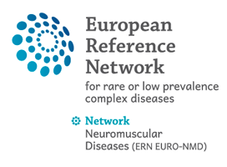

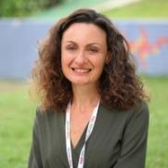




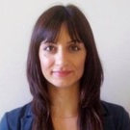
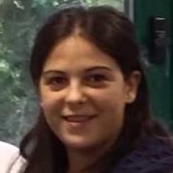
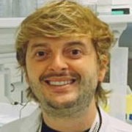
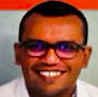
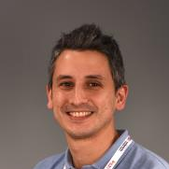
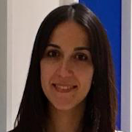

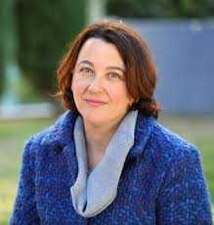
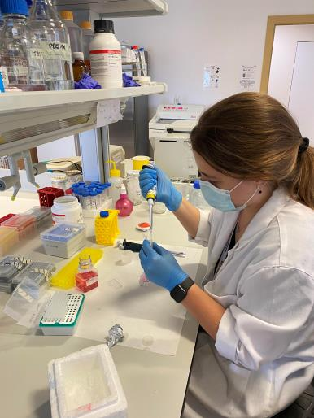

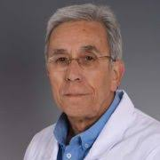
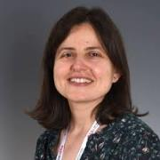
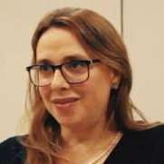

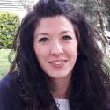
Translational Research in Children´s NMD
Neurociencias Pediátricas
Cecilia Jiménez Mallebrera
Andrés Nascimento
BRAIN Project
M Carmen
Badosa
Selena
Trifunov
Arístides
López
Carlos
Ortez
Daniel
Natera
Laura Carrera
Jesica
Expósito
M. Roldán
E. Castroflorio
ICFO
Julita
Medina
Irene Zschaeck
Cristina Jou
Anna Codina
A. Serradell
Jaume
Colomer
Notes:
IRSJD. Area de Neurociencias

Slide 3
Muscular Dystrophy:
CMD (COL6-RM)
DMD/BMD,
Congenital Myopathies
Daniel
Natera
Mitochondrial
Myopathies
Spinal Muscular Atrophy
Selena
Trifunov
Selena
Trifunov
Biomarkers & Diagnostic Techniques
Advanced Microscopy
and AI
Therapies: gene editing/therapy
Arístides
López
E. Castroflorio
Notes:
AME Galicia: 20 patients in treatment with nusinersen. Early prognostic and therapeutic biomarkers in SMA (CSF and blood): SMN protein SIMOA, SMN2 gene by ddPCR and profile of lnCRNA by RNA seq.
DMD/BMD: Biomarkers (miRNAs, longitudinal study, target analysis), psychological support in schools and quantification of dystrophin
Congenital Myopathies: D. Natera

Slide 4
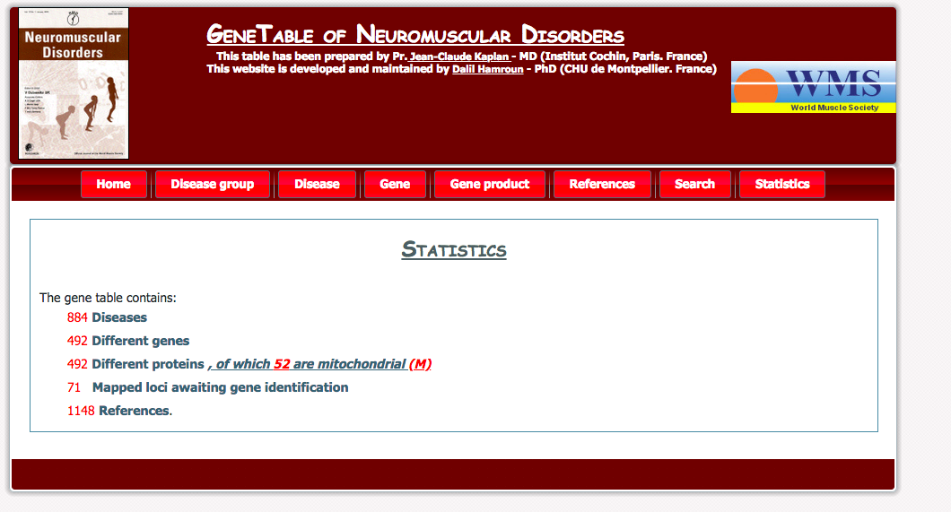
Inherited, monogenic, rare, multi-systemic, severe, incurable,
can present at any time
Rare but as a whole as prevalent (160 per 100.000) as PD (100-300 per 100.000) and MS (80 per 100.000) in Europe (Deenen et al., 2015).
In Spain c. 60,000 affected individuals (ASEM)
Notes:
What are NMD:
They are a very heterogenous group of neurological conditions. Most are inherited (exceptions of autoinmune, acquired toxic myopathies), rare (< 1/2000 but..), multisystemic (to a varying degree skeletal and cardiac muscle, central and peripheral nervous tissue, connective tissues)
Severe with reduced life expectancy due to heart and respiratory failure
Uncurable with a few exceptions. In most cases treatment is symptomatic
From birth to adulthood
Almost 500 genes and proteins, including mitochondrial proteins, for almost 900 diseases
Global prevalence high: significant burden for health systems.
Significant burden to health care systems

Slide 5

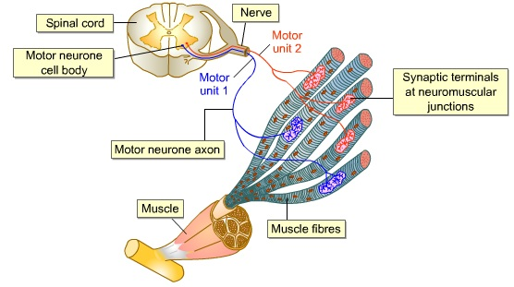
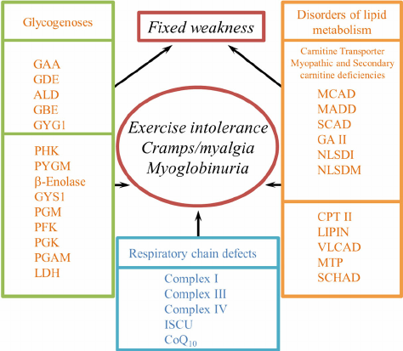
Neuromuscular Diseases (inherited)
Spinal Muscular Atrophy
(SMA)
Peripheral Neuropathies (CMTD)
Congenital
Myasthenias
Amyotrophic Lateral Sclerosis
(ALS)
Dystrophies and Myopathies
Duchenne and Becker MD
Limb-Girdle- Muscular Dystrophy
Fascio-scapulohumeral MD
Myotonic Dystrophy
Congenital Muscular Dystrophies Congenital Myopathies
Metabolic and
Mitochondrial Myopathies
Notes:
Inherited NMD are classified according to where the primary defect lies:
But in addition they include a wide range of metabolic alterations that affect high energy expenditure tissues such as skeletal muscle. This is the case for mitochondrial diseases.

Slide 6
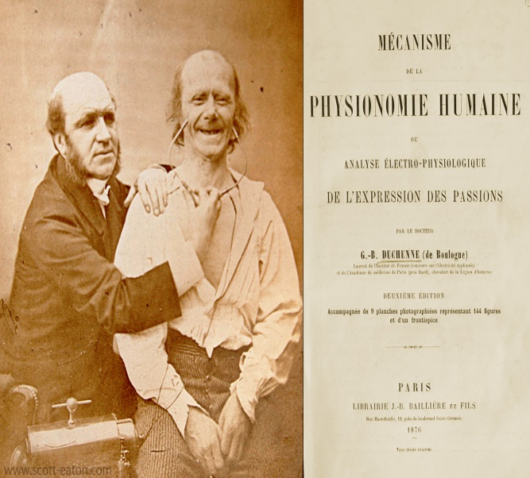
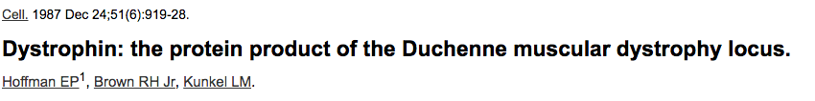

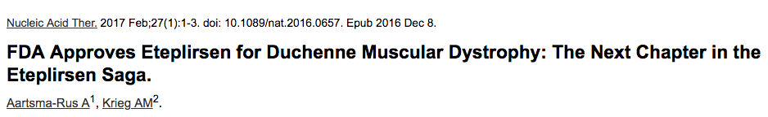
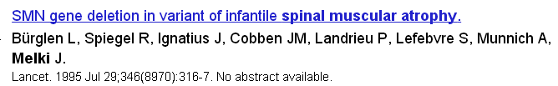

1876
2017
Terapia Génica para SMA 2019 FDA y EMA 2020 (En España en negociación)
Spain: March 2018
Terapia génica para DMD: 1 paciente
tratado en Marzo 2022
Notes:
Ambas estrategias se basan en terapias avanzadas, en este caso mediante el uso de oligonucleotides anti-sentido.
Thirty years after the identification of the dystrophin gene and 20 after the gene for SMA last year (led by Judith Melki at the Univ of Paris) the FDA approved the first treatments both based on antisense oligonucleotides for both diseases so we are at the beginning of a new era of promising treatments. But the most likely is that this advanced therapies will be used in combination with more traditional drugs such as corticoids, antifibrotics etc…
Here a little homage to French medicine and Genetics: Duchenne de Boulougne in the Salpetriere in the 19th century, father of neurology, described many myopathies including DMD, electropohysiology, muscle biopsy .
Institut National de la Santé et de la Recherche Médicale (Inserm) UMR-1169, Université Paris Sud, 94276 Le Kremlin Bicêtre, France.

Slide 7
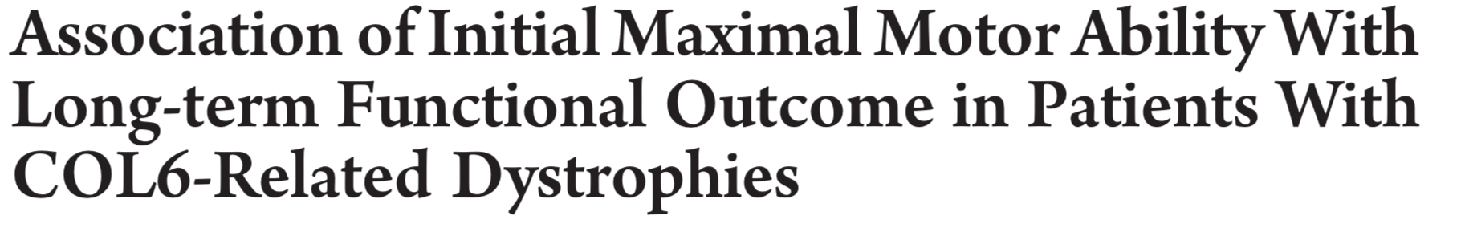
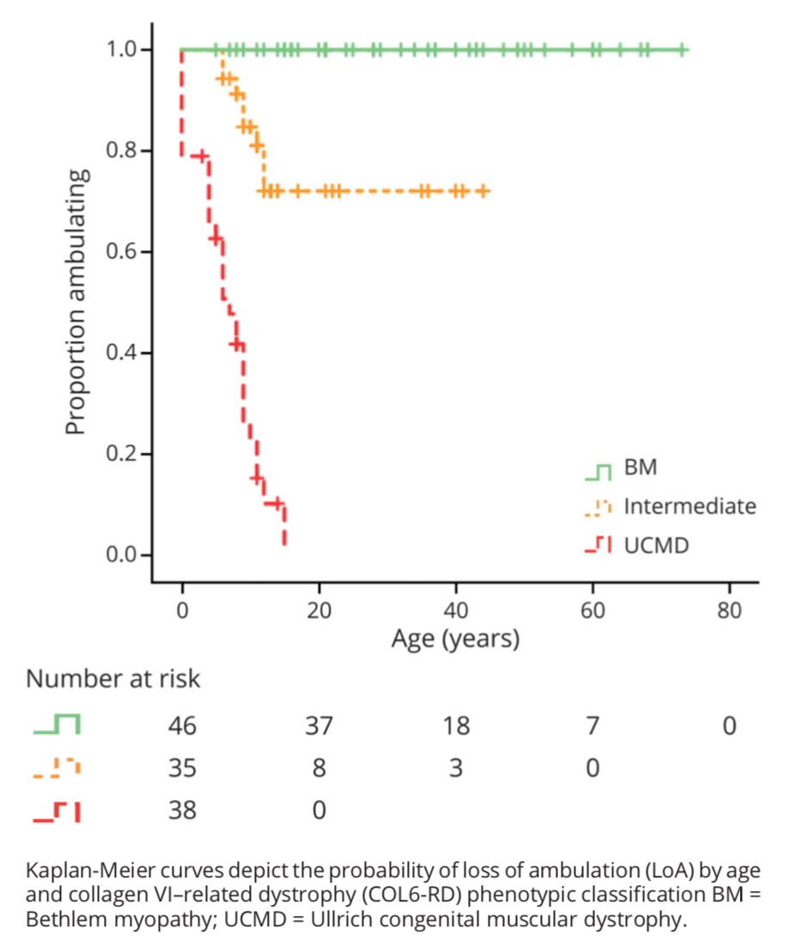
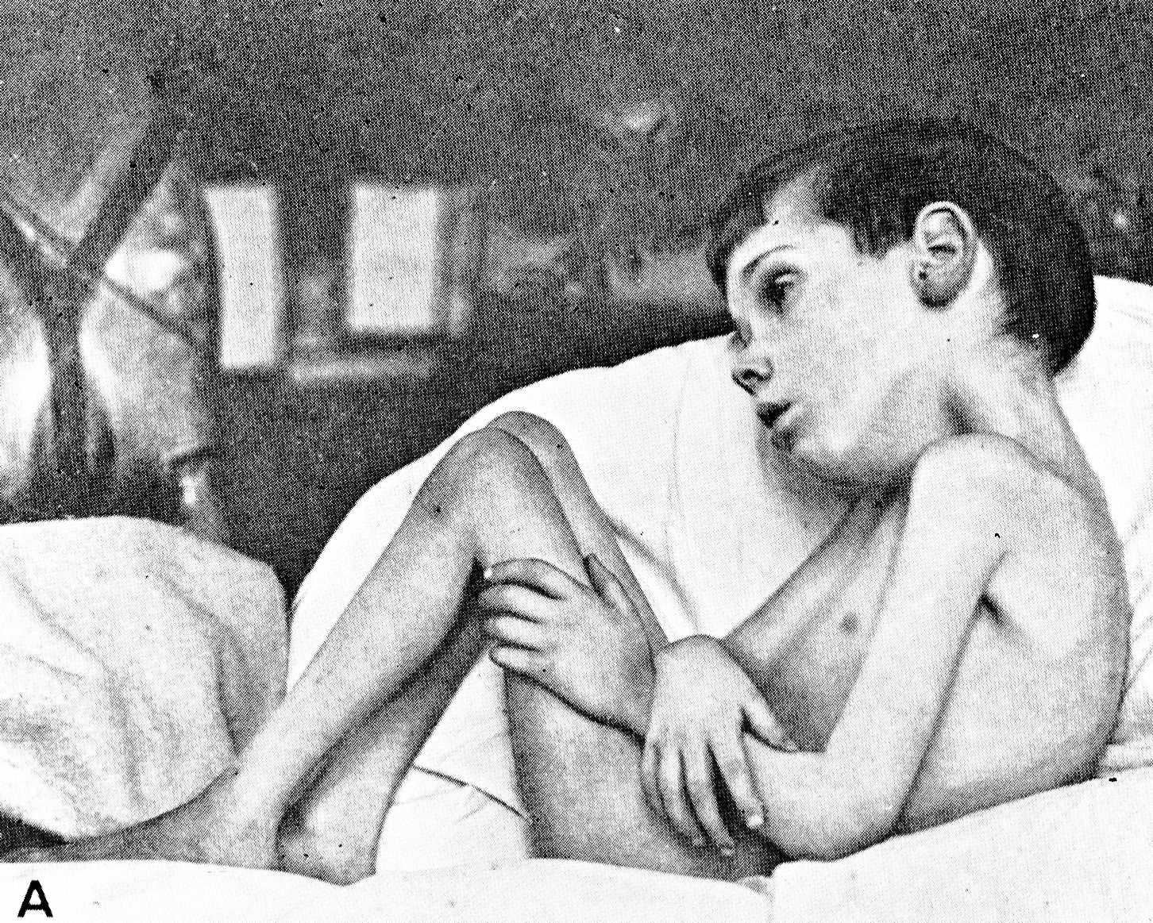
Collagen VI related Muscular Dystrophies encompass a range of phenotypes: UCMD (MIM #254090) y BM (#158810).
Mutations in COL6A1, COL6A2 y COL6A3.
Prevalence <1 per 100,000.
Variable severity and progression.
Muscle weakness, respiratory insufficiency, joint contractures, distal hyperlaxity, scoliosis are frequent.
achieved rising from the floor only with assistance (UCMD),
(2) achieved rising from the floor unassisted (intermediate COL6-RD)
(3) achieved stair climbing (ascending a minimum of 4 steps without use of a railing)
Batten 1903 “Then frozen child”
(Trans Clin Soc London 37:12)
Natera-De Benito et al., 2021

Slide 8
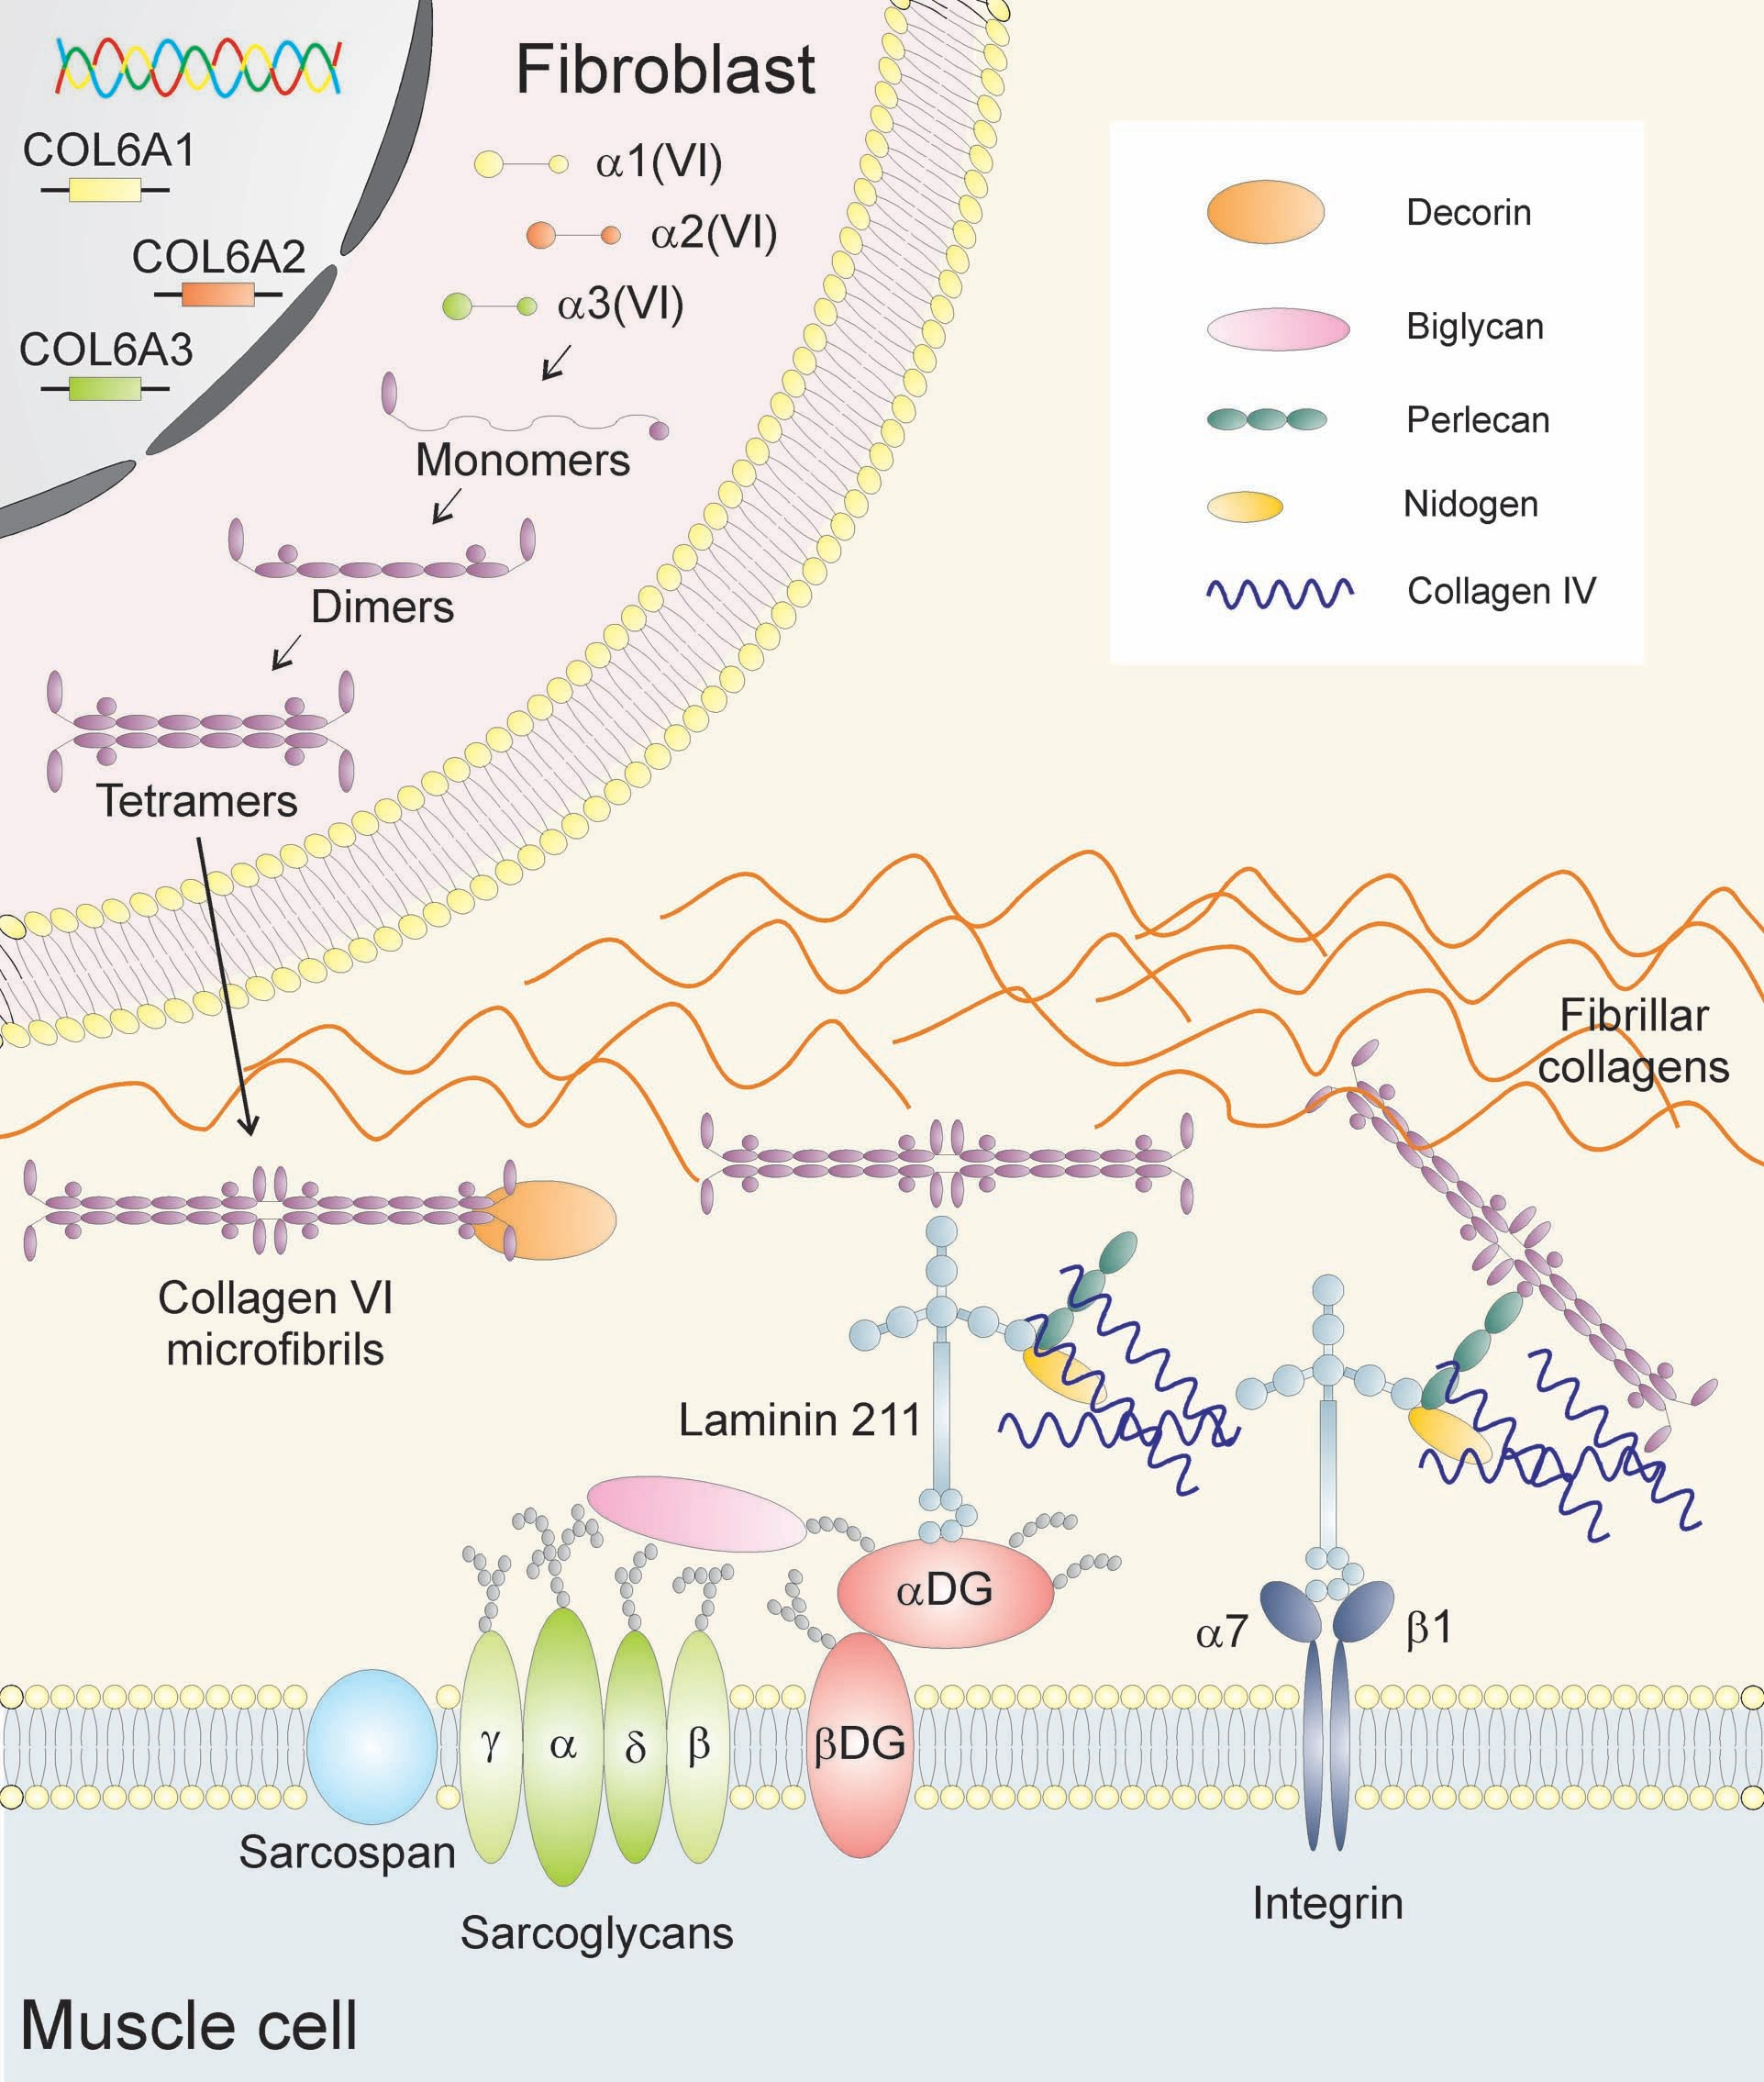
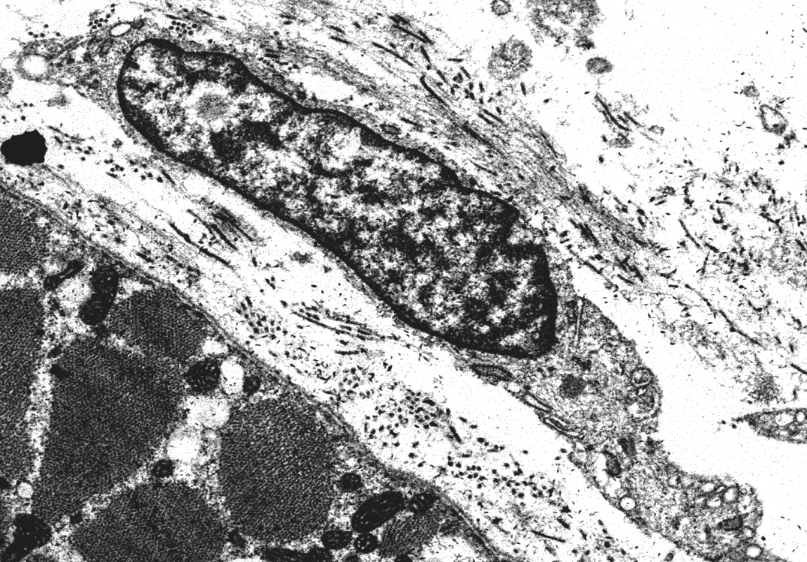
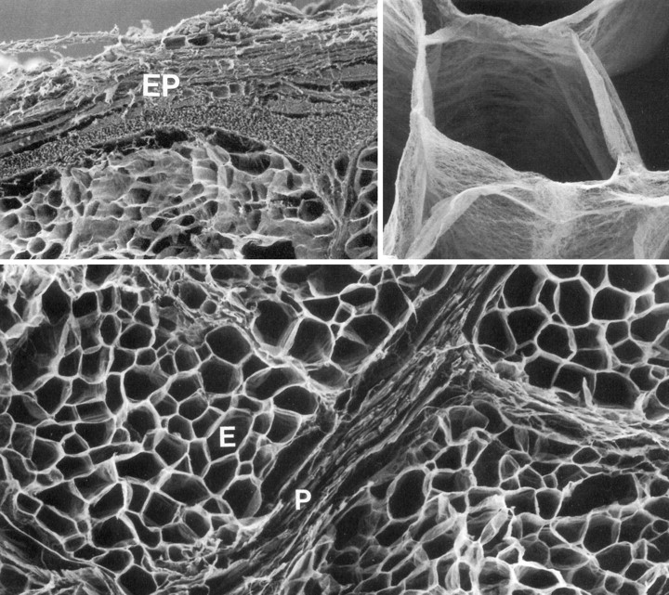
The target cell is the fibroblast
FUNCTIONS:
-Adhesion
-Proliferation
-DNA synthesis
-tumor progression
PATIENTS:
Loss of adhesión between the cell basement membrane and the extracelular matrix
Notes:
El colageno VI se expresa en muchos tejidos y es sintetizado por el fibroblasto que en el caso del musculo esqueletico se encuentran en el endomisio entre las celulas musculares como muestra esta imagen. Las tres cadenas alpha se asoacian en monomeros, dimeros y finalmente tetrameros que son secretados al espacio extracelular donde se unen a otros tetrameros para formar una red microfibrilar que conecta la matriz extracelular a la membrana basal muscular que rodea a la fibra muscular.

Slide 9
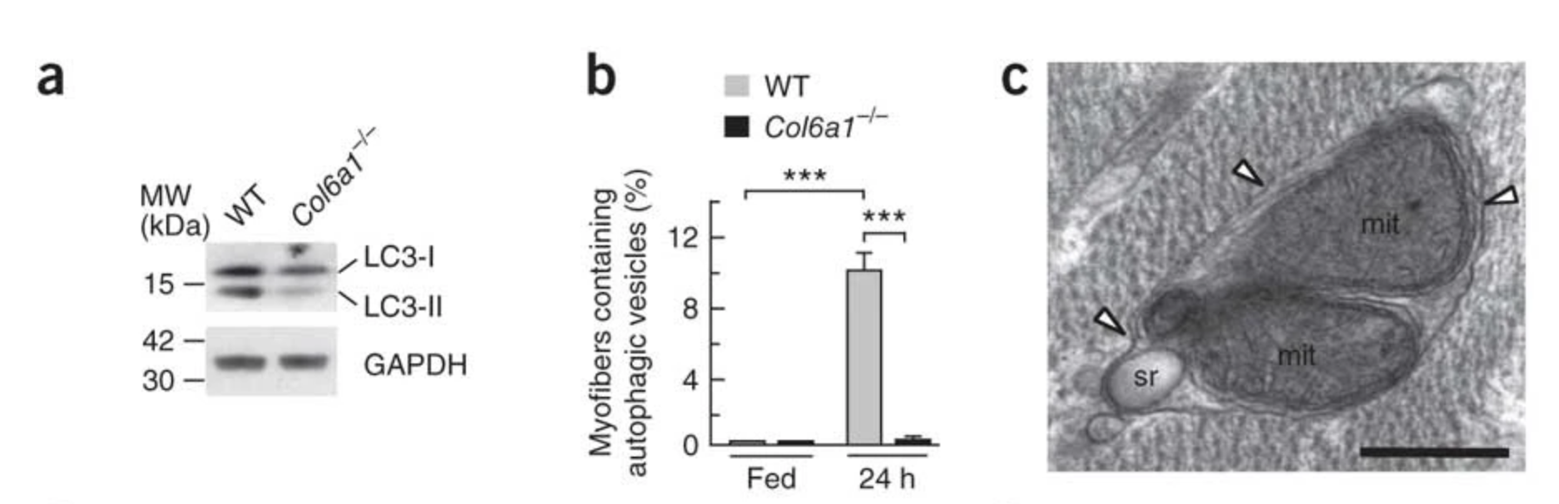
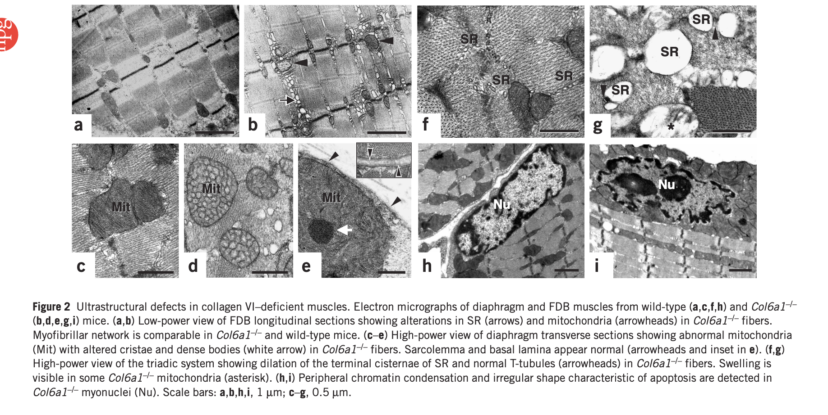
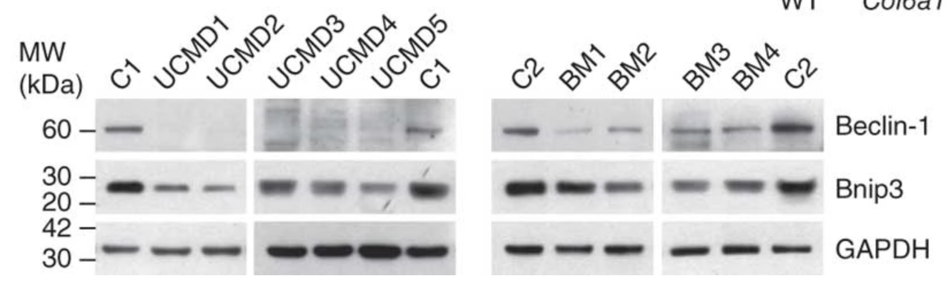
Autophagy is defective in collagen VI deficiency
Mice
Collagen VI deficient mice (col6a1 KO)
Grumati et al., 2011
Irwin et al., 20023
Patients muscle biopsies

Slide 10
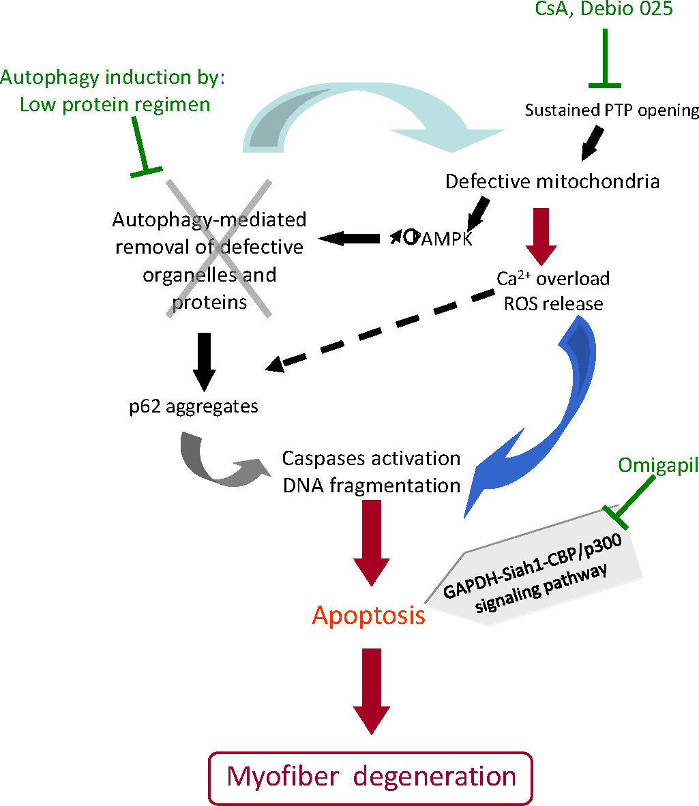
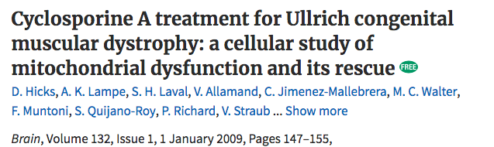
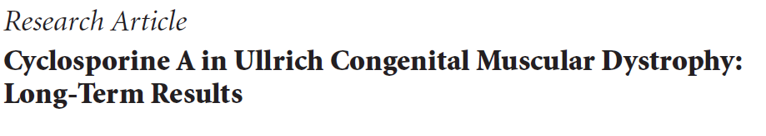
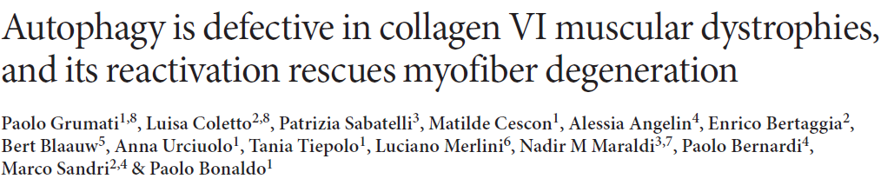
Collagen VI
Allamand V. Skelet Muscle. 2012
Notes:
Hipótesis patológicas actuales y dianas terapéuticas. Se muestra la cascada actualmente conocida de eventos principales que conducen a la degeneración de miofibras en el músculo esquelético deficiente en ColVI. La disfunción mitocondrial (debido en parte a la apertura defectuosa del poro de transición de permeabilidad (PTP)) desencadena un desequilibrio energético con el aumento de los niveles de proteína quinasa activada por monofosfato de adenosina fosforilada (p-AMPK), sobrecarga de Ca2 + y producción de especies reactivas de oxígeno (ROS ). La falta de inducción de autofagia exacerba la disfunción celular porque las mitocondrias y proteínas defectuosas (como los agregados de p62) no se eliminan del citoplasma. Juntos, estos defectos conducen a un aumento de la apoptosis. Las posibles intervenciones terapéuticas se indican en verde.

Slide 11
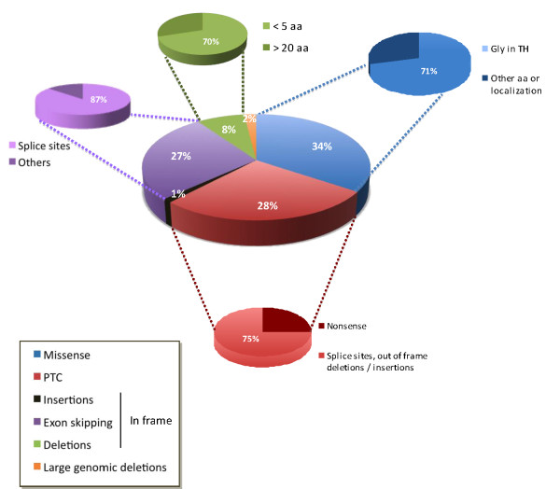
Pathogenic variants in Collagen VI genes
Allamand V. Skelet Muscle. 2012

Slide 12
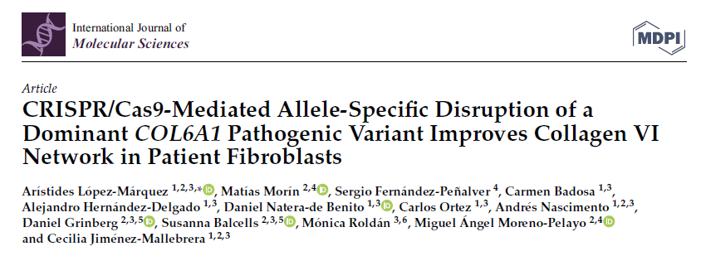
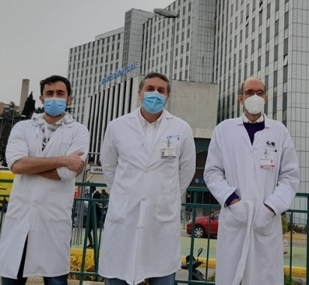
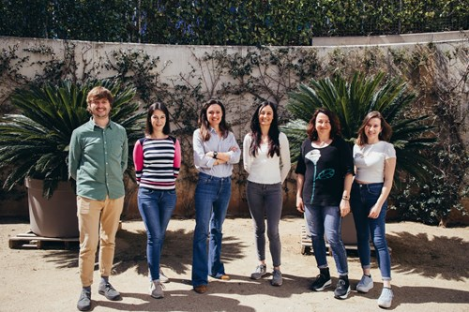
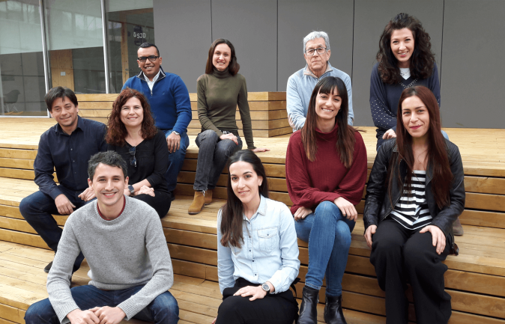
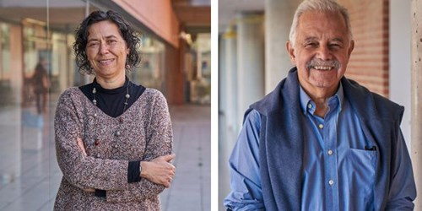
April 2022

Slide 13
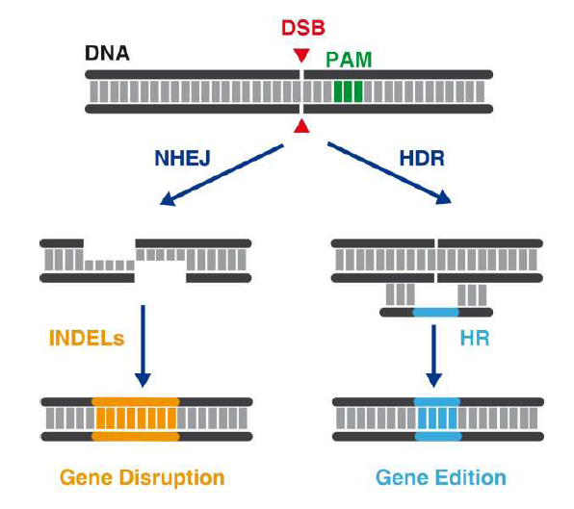
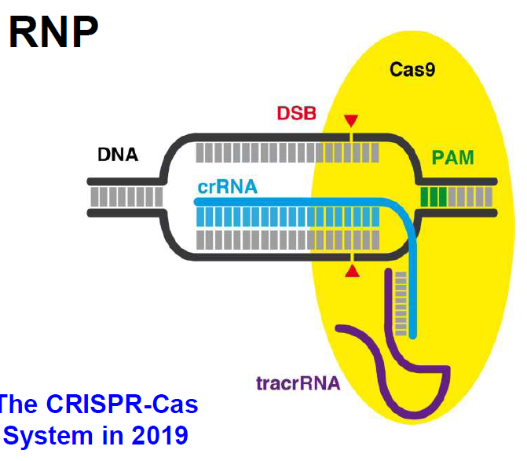

CRISPR: Clustered Regularly Interspaced Short Palindromic Repeats,
o Repeticiones Palindrómicas Cortas Agrupadas y Regularmente Espaciadas.
Cells are growing but
Not ready to divide
G1
S and G2
Soon after DNA replication
when sister chromatids are
available
:Ribonucleoproteína
It is estimated that 10 double-strand breaks are
formed each time the mammalian genome
is replicated .

Slide 14
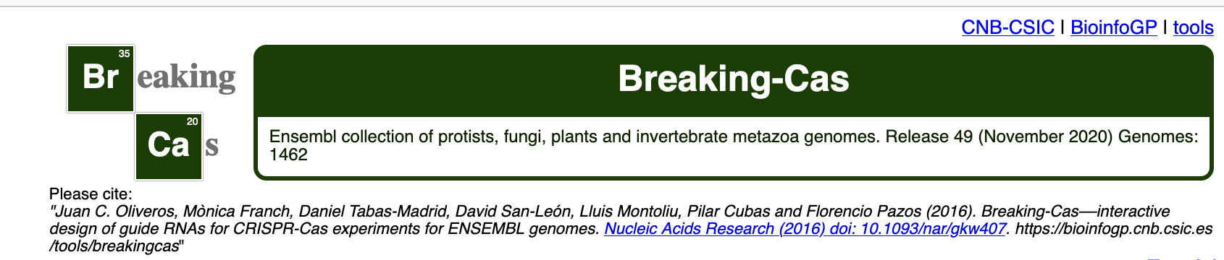
ESTUDIOS DE EFICACIA EN FIBROBLASTOS DE PACIENTES

Slide 15
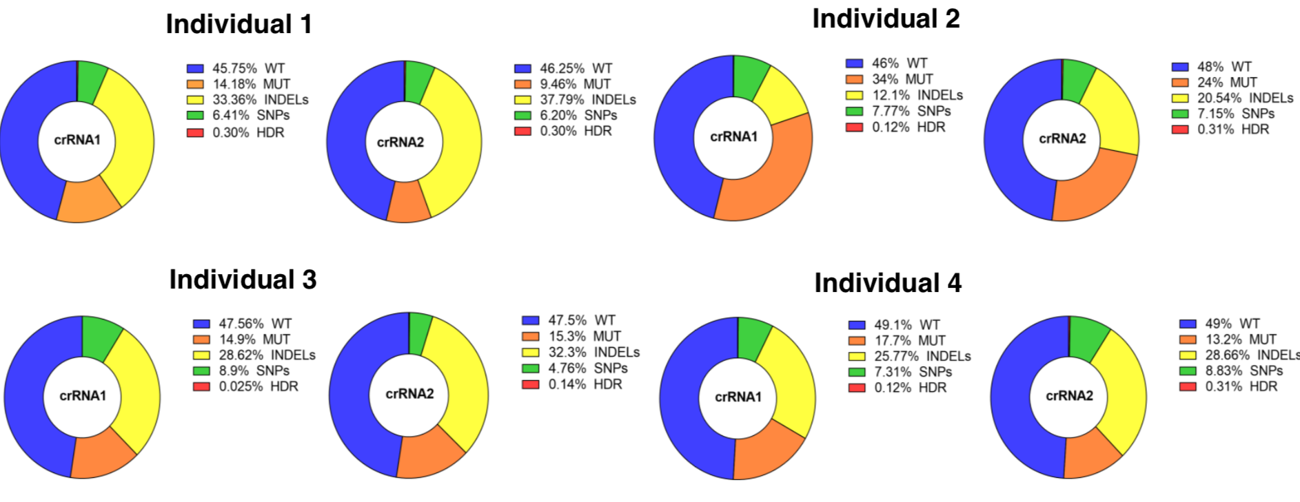
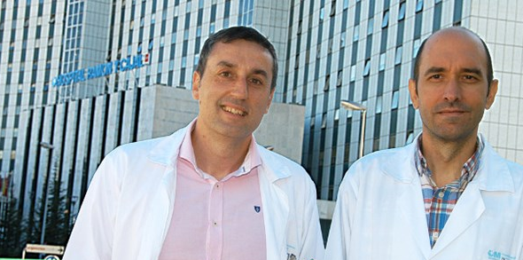
EDITION ANALYSIS AT THE GENOMIC LEVEL- MOSAIC FINDER
M. A. Moreno-Pelayo, M. Morín
Hospital Ramón y Cajal Madrid
SILENCING OF THE MUTATED ALLELE- digital droplet PCR with
Specific probes for each allele.
Before tretament 1/2 chains is mutated
1/5 of mutated COL6A1 mRNA
(4/5)⁴ 40 % of the tetramers are normal

Slide 16
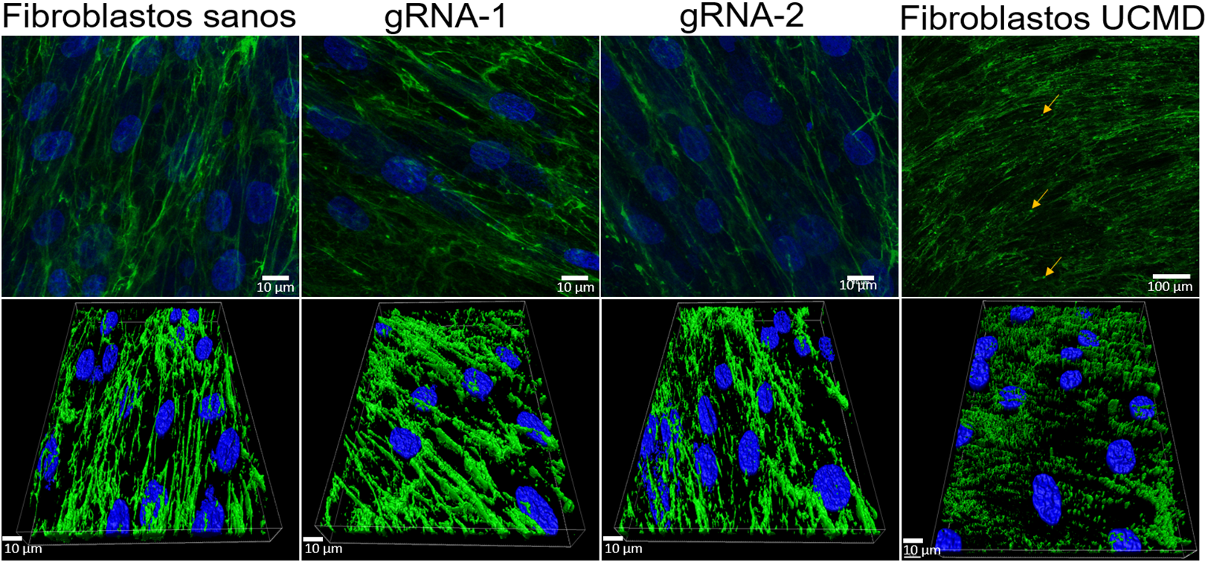
Super-resolution Microscopy: recovery of collagen VI matrix in editd cells.
Reconstrucciones 3D
Dra. Mónica Roldán. Unidad de Microscopía Confocal e Imagen Celular. HSJD.

Slide 17


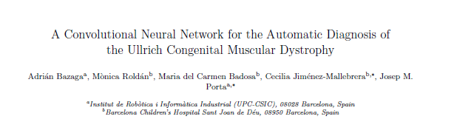
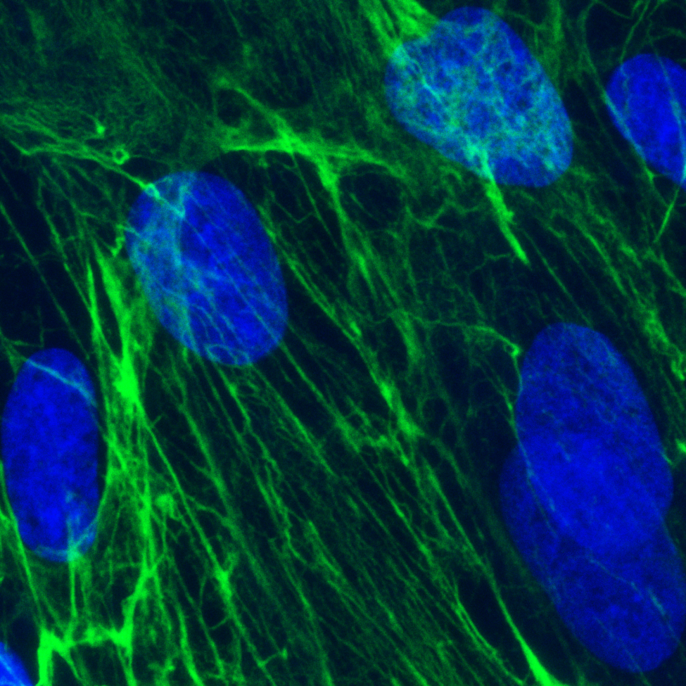

control
Patient
Notes:
Nuestro grupo es referente internacional en déficit de colágeno VI y llevamos mas de 10 años ofreciendo el “gold standard” del diagnostico que hemos desarrollado nosotros mismos y que se basa en el estudio de colágeno VI en fibroblastos de pacientes lo que genera imágenes de microscopia. Anteriormente lo hacíamos con un microscopio de epifluorescencia convencional y con una técnica semicuantitativa de análsis para generar un informe diagnóstico (firmado por mi COB y por A Nascimento) y hace 3-4 años empezamos a trabajar con Monica para trasladar la metodología al sistema de confocal lo que ha supuesto una gran mejoría.
Punto de partida fue una colaboracion con el CSIC haciendo uso de las imágenes de confocal de controles y pacientes que habíamos ido captando desde hacia 2-3 años.
Decir que se publico en una revista de DI en temas de AI

Slide 18




Software 6 versión 1.0
Representative data for P1
M. Roldán, HSJD
J. Porta, CSIC-UPC
Notes:
Pimera version

Slide 19


E. Castroflorio
A. López
THE SYNCHROTRON TEAM
Notes:
Our group is a molecular medicine group: we want to learn about the disease and develop therapies using a solid molecular knowledge of the pathology, this is the only
way to identify the right target and strategy and the right outcome measure. As important as the therapy itself.
What are the main subcellular alterations?. Can we give some light into the question of the signalling scaffold for Col6RD and receptor? Can we find a functional surrogate
measure for therapies
Resolucion
Como lo hicimos, resaltar la ayuda de Ana y Eva+: máximum qualification- 5 days and nights
Foto del equipo- really nice teamn building experience
Cuantas tomos hicimos, que condiciones, añadir alguna tomo mas.
Proceso de selección: Enrico y Ana, análisis
Publicacion
Cont.
Decir que fue muy bien, a bit daunting at times. Technical problems that were solved on the spot so we could continue to work.
Decir que ha tenido mucho impacto: noticia Ciberer, que creo hemos animado a otros investigadores ciberer a usarlo y nosotros espero no sea la ultima vez siempre y cuando tengamos una buena propuesta

Slide 20

Tomografía de Rayos X: Línea Mistral

Slide 21



Cells are not fixed or stained
And are rotated so
We can obtain an artifact
free 3D reconstruction of
The cell.
Spatial resolution 50nm.

Slide 22

Tomography:
Image obtained while sample rotates (over 180 degrees) to obtain a 3 D
Reconstruction.
If all OK each tomography
Takes 8 minutes.
400 tomos in 5 days and
nights

Slide 23

Careful selection of tomographies for image reconstruction and quantification

Slide 24

Endosomes/lysosomes
Other vesicles
Mitochondria
Perez Berna
E. Castroflorio

Slide 25
Endosomes/Lysosomes
Other vesicles (coollagen ?)
Control
fibroblasts
COL6-RD
fibroblasts
Edited COL6-RD
fibroblasts
Notes:
Correlative 3D cryo X-ray imaging reveals intracellular location and effect of designed antifibrotic protein–nanomaterial hybrids†
J. Groen, a A. Palanca, bc A. Aires,d J. J. Conesa,ae D. Maestro,b S. Rehbein,f M. Harkiolaki,g A. V. Villar, bh A. L. Cortajarena *di and E. Pereiro

Slide 26



E. Castroflorio
Researcher, ICFO
M. Roldán Molina
Servicio Microscopia Confocal
& Imagen Celular IPER, HSJD
Institute of Photonic Sciences- Casteldefells, Barcelona.
UPC University
Pablo Loza
Super-resolution Light Microscopy & Nanoscopy
ICFO

Slide 27


STED: STimulated Emission Depletion microscopy
SJD & ICFO
This intense radiation causes almost all of the excited molecules to return to the ground state. Fluorescence from the remaining excited dye molecules in the center of the excitation focus is then detected and used to form the high resolution images.
Lasers:
647
775
Pros:
Cons:
1- same sample requirement classical confocal microscopy
1- No thick-sample friendly: both intensity and geometry of the excitation and depletion beams are differently affected while traveling across the biological sample
2- 40 nm resolution in live, 20 nm resolution in fixed cells
3- Image fidelity: does not require post-processing of the images, which strongly limits the risk for artifact generation.
2- Multicolor can be difficult because some of the fluorophore can be permanently bleached by the donut.

Slide 28





Novel signalling pathway for COL6-RD
And CMG2 is hyper-phosphorylated providing a novel link between collagen VI and the cell

Slide 29




Slide 30







Conclusions
soft X-ray tomography has revealed subcellular alterations on collagen VI deficient fibroblasts which in combination with advanced microscopy and biochemical tools indicate a role for the collagen VI- CMG2 axis in endosomal and lysosomal regulation
This represents a novel disease hallmark but also a functional surrogate biomarker to monitor future genetic therapies for COL6_RD and foster the development of new treatments.

