Slide 1
Cell imaging at ALBA
Current and proposed techniques
Judith Juanhuix
Slides from:
Tanja Ducic
Alberto Mittone
Eva Pereiro
Ana Pérez-Berná
Andrea Sorrentino
06.10.2021

Slide 2
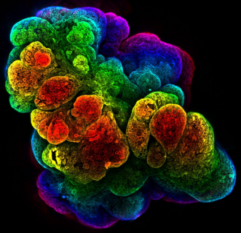
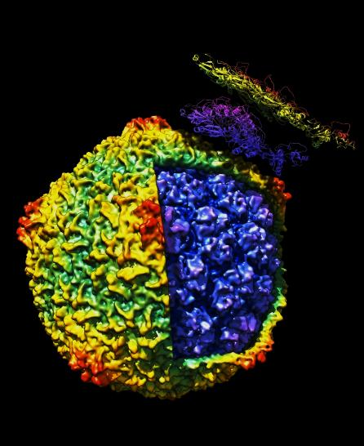
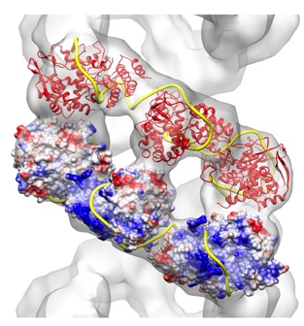
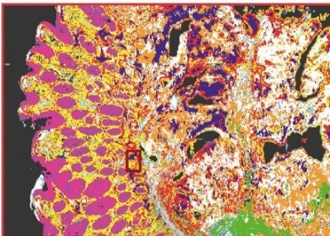
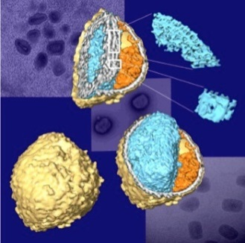
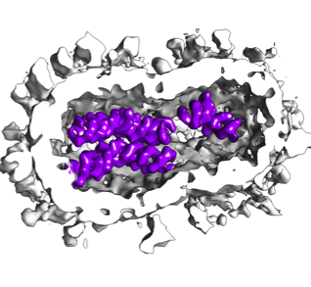
Biological imaging techniques today
operational
in development
out of Alba
5 µm
500 nm
30 nm
5 nm
1 Å
resolution
subμPCXT
subμXRF
NMR
µPCXT
µFTIR
BioSAXS
MX
cryo-3DSIM
cryo-SXT
Single Particle
nanoXRF
cryo-ET
VLM
cryo-SR
nanoPCXT
sample thickness
cryo FIB-SEM
Tissue
Organoids
Cellular Biology Interactomics Macromolecules
Multimodal imaging across resolution scales is essential to understand biological mechanisms.
Notes:
Lab-grown mouse mammary gland imaged by 3D confocal (Dr. Harris Univ. Cambridge)

Slide 3
Synchrotron-based imaging at 3rd
and 4th generation sources
 | cell sub-10 nm | cell sub-100 nm | tissue sub-100 nm | tissue 100-500 nm | Tissue/cells 1-5 µm
3D structure | --- | SXT | holotomography | phase contrast tomography ptychotomography+ | phase contrast tomography
2D chemical info | --- | XANES |  | XANES | µFTIR
3D chemical info | --- | spectro-tomography*, edge enhanced tomography
2D elemental quantification (ppm) | --- | XRF |  | XRF
3D elemental quantification (ppm) | --- | XRF
Sample conditioning | cryo | cryo | HPFreezing/cryo with embedded samples# | cryo/RT | RT
3D XRF & ptychotomography slow: 1 tomo/day
* dose limitation slow techniques
+ difficult for users # sample shrinking in the beam

Slide 4
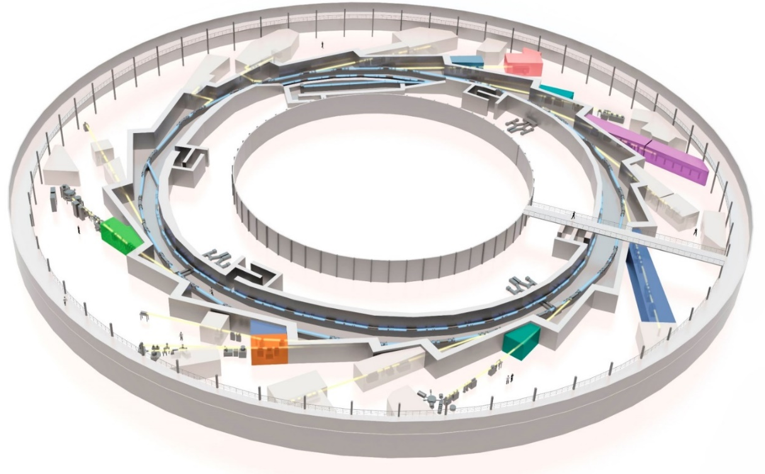
Current tools in Structural Cellular and Tissue Biology at ALBA
FAXTOR (HXT)
MIRAS (IR)
XAIRA (μMX)
MISTRAL (TXM)
Facilities in Structural
Cell Biology:
MIRAS (IR bl)
MISTRAL (TXM, full field, soft XR)
FAXTOR (HXTomo)
CryoEM-SPA (200kV)
BioLabs
NCD-SWEET
(SAXS)
Fully
dedicated
XALOC (MX)
Partially
dedicated
Residual
use
In
construction
Molecular
Biology
CLAESS (XANES)

Slide 5

MISTRAL beamline: Soft X-ray Tomo
CCD
capillary condenser lens
sample
central stop
objective zone plate lens
(40nm and 25 nm ZP)
TXM (Transmission X-ray Microscope) capability :
  2D Measured Spatial Resolution ≈ 30 nm half pitch.
  Detector effective Pixel size 16 nm – 8 nm, Field of view 8x8 µm² - 16x16 µm².
  Cryo environment ( ≈ 110 K).
  On-line visible light epifluorescence microscope for correlative low resolution 2D imaging.
Available techniques for bio-samples (with 30 nm spatial resolution):
  Cryo – soft X-ray Tomography (± 70◦ max angular range, typical acquisition time ≈ 5 -10 min.).
  Cryo – X-ray Spectromicroscopy (from Ca L – edge).
Notes:
≈10⁹ Gray.
5 BLs like Mistral (Mistral was the 3rd one).

Slide 6
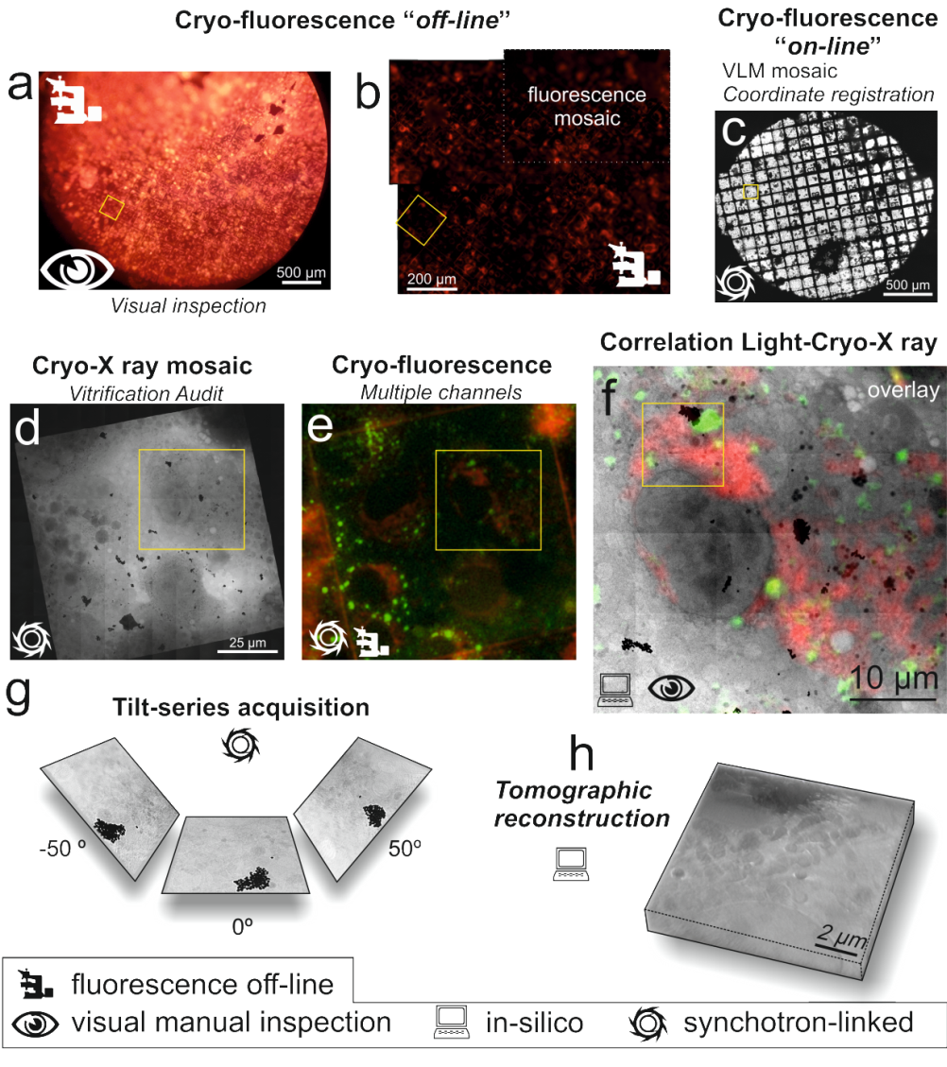
What we do now at MISTRAL
Identifying specific cellular structures
Follow processes
Evaluating cellular morphological changes
only 2D low resolution VLM
correlation in cryo… still.

Slide 7
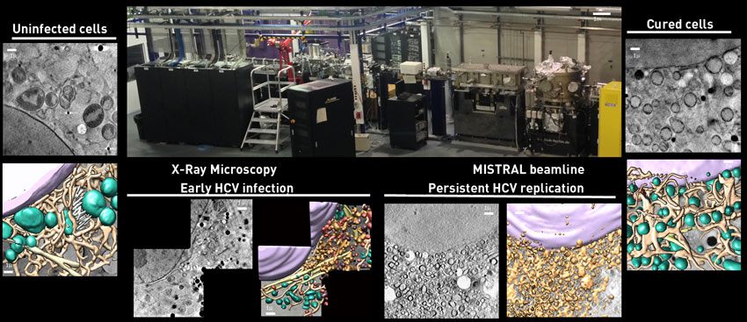
In-house program: Structural info of infectious diseases
Hepatitis C infection
Assessment of the reversion of HCV-induced cellular ultrastructural changes direct-acting antiviral drugs

Slide 8
In-house program: Structural info of infectious diseases
Damia Garriga
XAIRA BL
Characterisation of structural alterations induced by Zika virus
Integrated Structural Biology Study of Mycoplasmas
Barbara Machado
XALOC BL
Study of SARS-CoV-2 infection and therapy causing intracellular membrane alterations
Ana Pérez
MISTRAL BL
Sample preparation strategies for efficient correlation of cryo 3D-SIM and soft X-ray tomography
Ana Pérez
MISTRAL BL

Slide 9
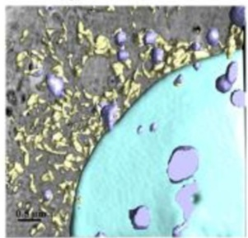
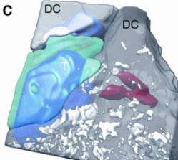
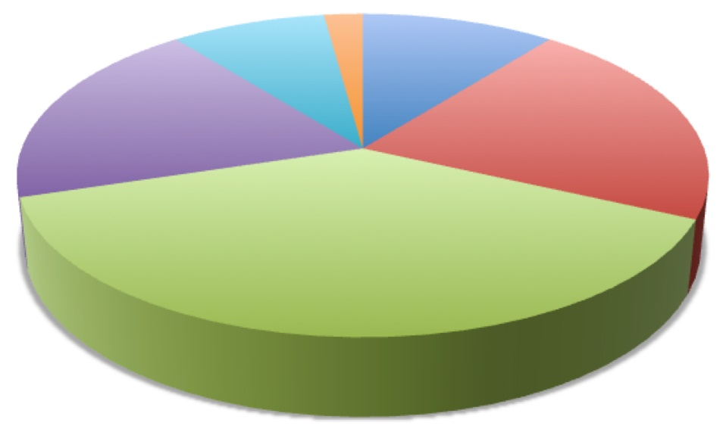
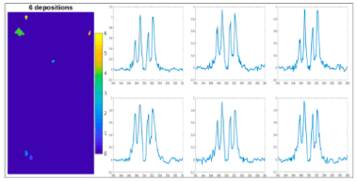
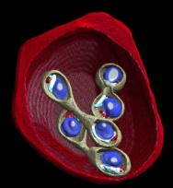
Cell biology at MISTRAL
Cancer research
Chemotherapy
hyperthermia in tumor cells
Mitochondrial dysfunction
Chromatin expression
Immune systems
Cholesterol
T-Cell Migration
T-Cell interaction with pathogens
Primary T-cells
Alzheimer
Nanoparticle:
hyperthermia in tumor cells
Gold coated siRNA
Anti-inflammatory events
Drug delivery
Nano liposomes
1%
5%
10%
19%
21%
Bio mineralization
Cholesterol
Calcium
Hydroxyapatite
Pathogens
HCV
Zika
Mycoplasma
SARS-CoV-2
Plasmodium Falciparum
Babesia divergens
Herpes
Torovirus
Vaccinia
38%
Rotavirus
Trypanosome Brucei
Influenza
Mycoplasma
E. Coli
SARS
Cytomegalovirus

Slide 10
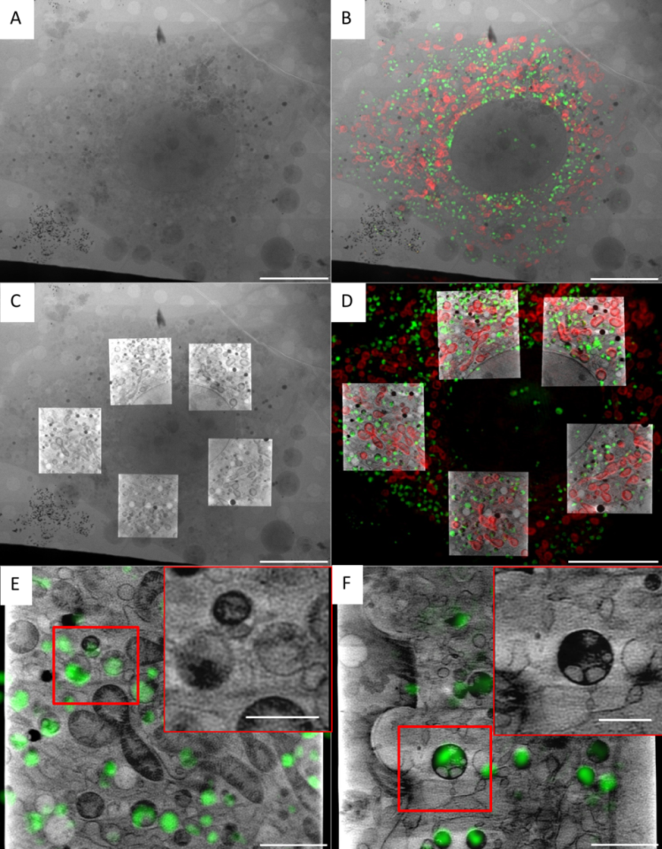
What we’ll be doing soon: 3D cryo CLXM
Identifying specific cellular structures
Follow processes
Evaluating cellular morphological changes
2D X-ray mosaic
2D mosaic & 2D SIM
2D X-ray mosaic & SXT
3D SIM & SXT
cryo 3D-SIM correlated to cryo-SXT
All users groups will benefit!
NIH-3T3 cells
primary fibroblats

Slide 11
Ongoing at Mistral & Miras… and new!
cryo
nano-XANES
cryo-ET
cryo FIB-SEM
?
cryo
epifluorescence
cryo-3D-SIM
cryo-SXT
μXANES
μXRF
cryo
nano-XRF
SR-µFTIR
μPCXT
operational
in development
out of Alba
new
protocols demonstrated on system models

Slide 12
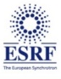

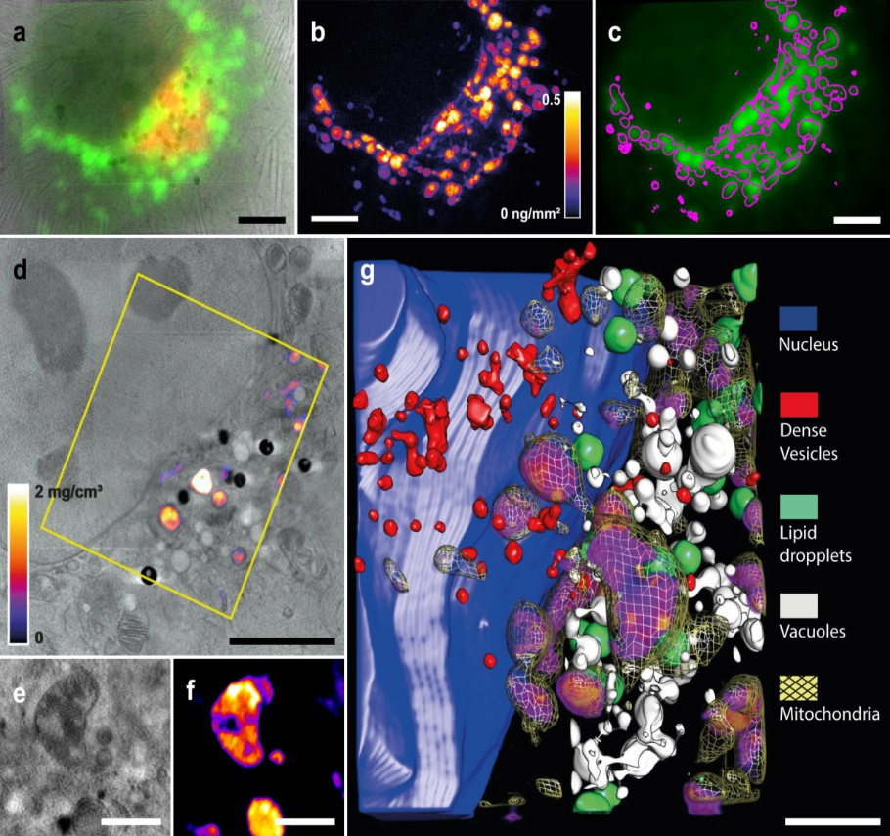
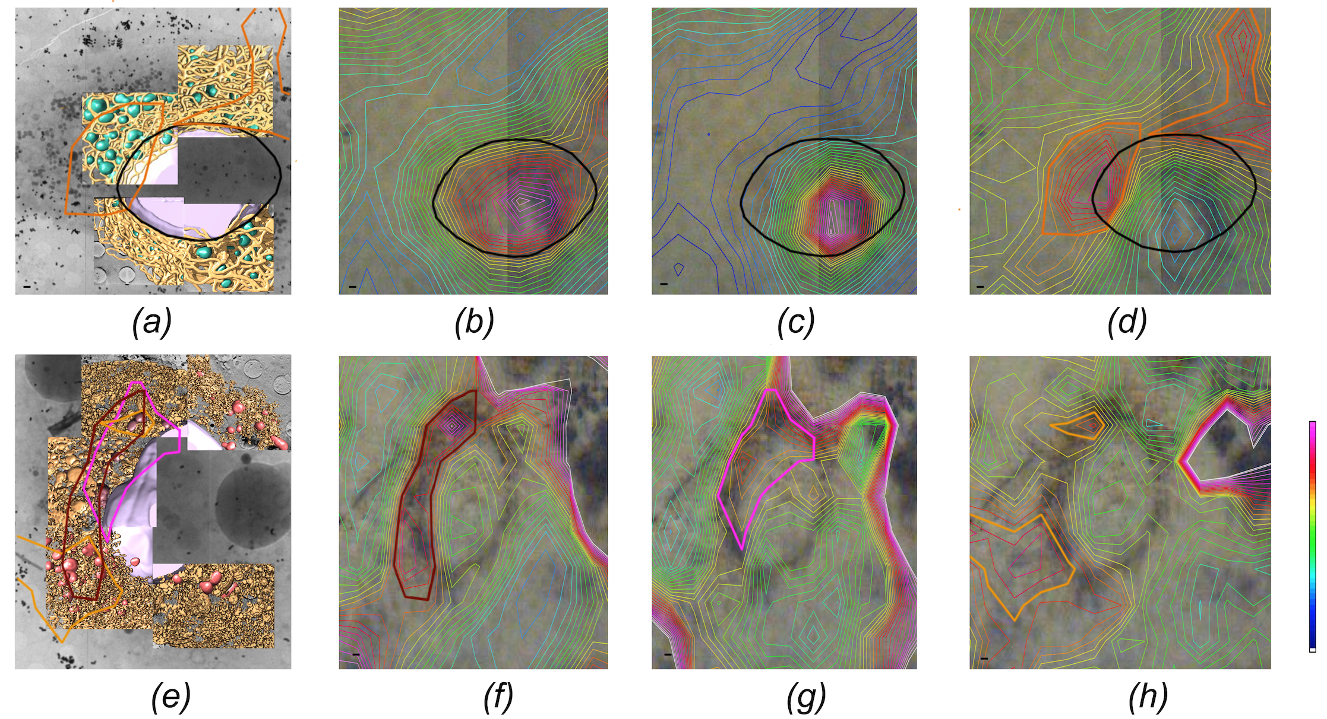
Example of
cryo-SXT correlated to
3D cryo XRF
Example of cryo-SXT
correlated to SR-µFTIR
cryo-SXT
lipids
amide I
oxidation
control
5 µm
HCV replicating cells
5 µm
Pérez-Berná et al. (in press)
1 µm
2 µm
J.J Conesa et al. Angew. Chem. 1270-1278 (2020)
…in addition to cryo 3D-SIM

Slide 13
MISTRAL User support
Cell culture Platform
Vitrification Platform
Sample screening at cryo
MISTRAL BEAMTIME
Data Processing support
Asistance to the user during the beamtime from 8:00 to 20:00
Notes:
The idea is to expand the capabilities of this services

Slide 14
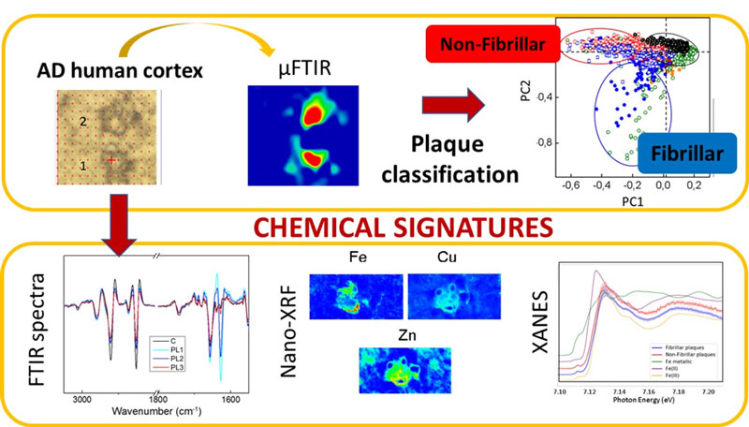
MIRAS BL (FTIR) Current work on Alzheimer disease
Synchrotron X-ray Fluorescence and FTIR signatures for Amyloid Fibrillary and non-fibrillary Plaques.
Álvarez-Marimon et al., ACS Chem. Neurosci. 2021

Slide 15
Multimodal synchrotron-radiation approach combining FTIR, hard and soft X-ray microscopy on intact astrocytes from a rat model of Amyotrophic Lateral Sclerosis (ALS) disease
MIRAS BL (FTIR) Current work on Amyotrophic Lateral Sclerosis
Ducic et al, Analytical Chemistry 2019

Slide 16
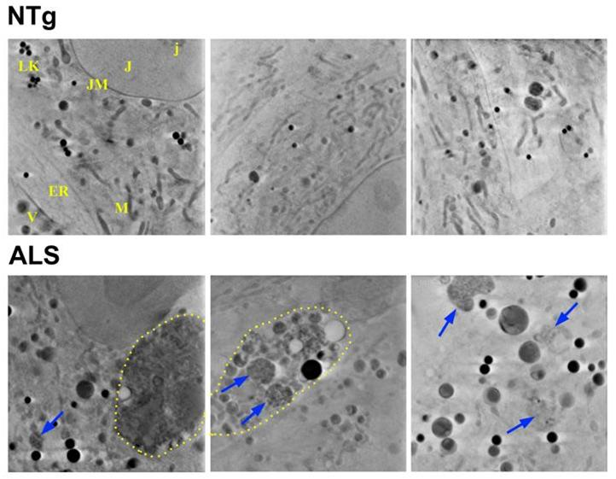
TOWARDS INTEGRATIVE IH PROJECTS
Organic and elemental correlative imaging by using synchrotron light for illuminating molecular disorders in neuro diseases
Soft X-ray tomography
X-ray
fluorescence
FTIR
Invited talk to Microscopy and Microanalysis 2021
organized by Microscopy Society of America
doi:10.1017/S1431927621000982
Ducic et al., Microscopy and Microanalysis 2021

Slide 17
Techniques and science at FAXTOR (CT)
Available techniques:
X-ray phase contrast imaging
X-ray absorption imaging
Time resolved radiography
Computed tomography (3D/4D)
In-situ visualization of sound-induced otolith motion using hard X-ray phase contrast imaging.
+ Combination with external stimuli
Micro-imaging of Brain Cancer Radiation Therapy Using Phase-contrast Computed Tomography.
T. Schulz-Mirbach et al, Sci. Rep, 2018.
Multiscale X-ray phase contrast imaging of human cartilage for investigating osteoarthritis formation.
land
G. Barbone et al. IJROBP, 2018.
A. Horng et al, J. Biomed. Sci, 2021.
+ Material science, Paleontology and cultural heritage, Earth and Planetary Sciences...
Notes:
As techniques propagation based X-ray phase-contrast and absorption-based imaging will be used on a daily basis. Future extensions including differential phase-contrast imaging can be also foreseen. Different acquisition protocols will be available, from time resolved projection imaging, to static and time resolved computed tomography.

Slide 18
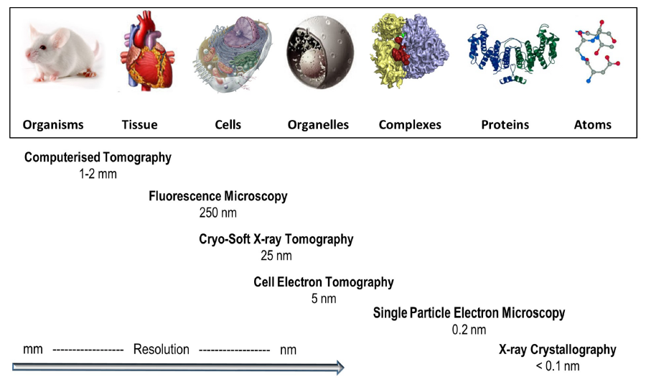
Current status of the Life Sciences tools
There is a resolution gap between molecular and cell biology to be filled
To become “catalist for health and environment” requires more tools and services
FAXTOR
MISTRAL
XAIRA
XALOC
MIRAS
SAXS
1 nm
FTIR
3 μm
From Harkiolaki et al. DOI:10.1042/ETLS20170086 ; CC BY 4.0 modified

Slide 19
New tools to fill in the gaps
New tools based on different probes required: XR, visible light, electrons, IR
Aiming at a continuous path from genotype to phenotype structural studies
ALBA embedded within their strategic partners provides leading capabilities
BioSAXS
FAXTOR
STXM
XALOC
MIRAS
MISTRAL
XAIRA
Computational
Biology
Cry-EM/SPA
BioSAXS
1 nm
Correlative Microscopies
Visible Li
From Harkiolaki et al. DOI:10.1042/ETLS20170086 ; CC BY 4.0 modified
Notes:
Eva: visible light FLUORESCENCE
“nanoprobe”: Holotomography full field + STXM

Slide 20

Proposed tools in Structural Cell and Tissue Biology
New tools proposed in Cell and Tissue Biology:
2 new hard XR BLs, 1 new branch
nanoIR facility
Correlative microscopies
CryoET
Computational Bio
CryoFIB-SEM
nanoIR
Cryo nanofocus 3D
(fluo+phase contrast)
MISTRAL (SXT)
Cryo3D-SIM
MIRAS (IR)
CryoET
BioLabs
sub-μm CT
FAXTOR (HXT)
High energy CT
Existing
tools
Proposed
tools
Notes:
Green: have it
Yellow: in construction
black: we are proposing
Red: simply NO
Upgrade to THz in the beamline

Slide 21
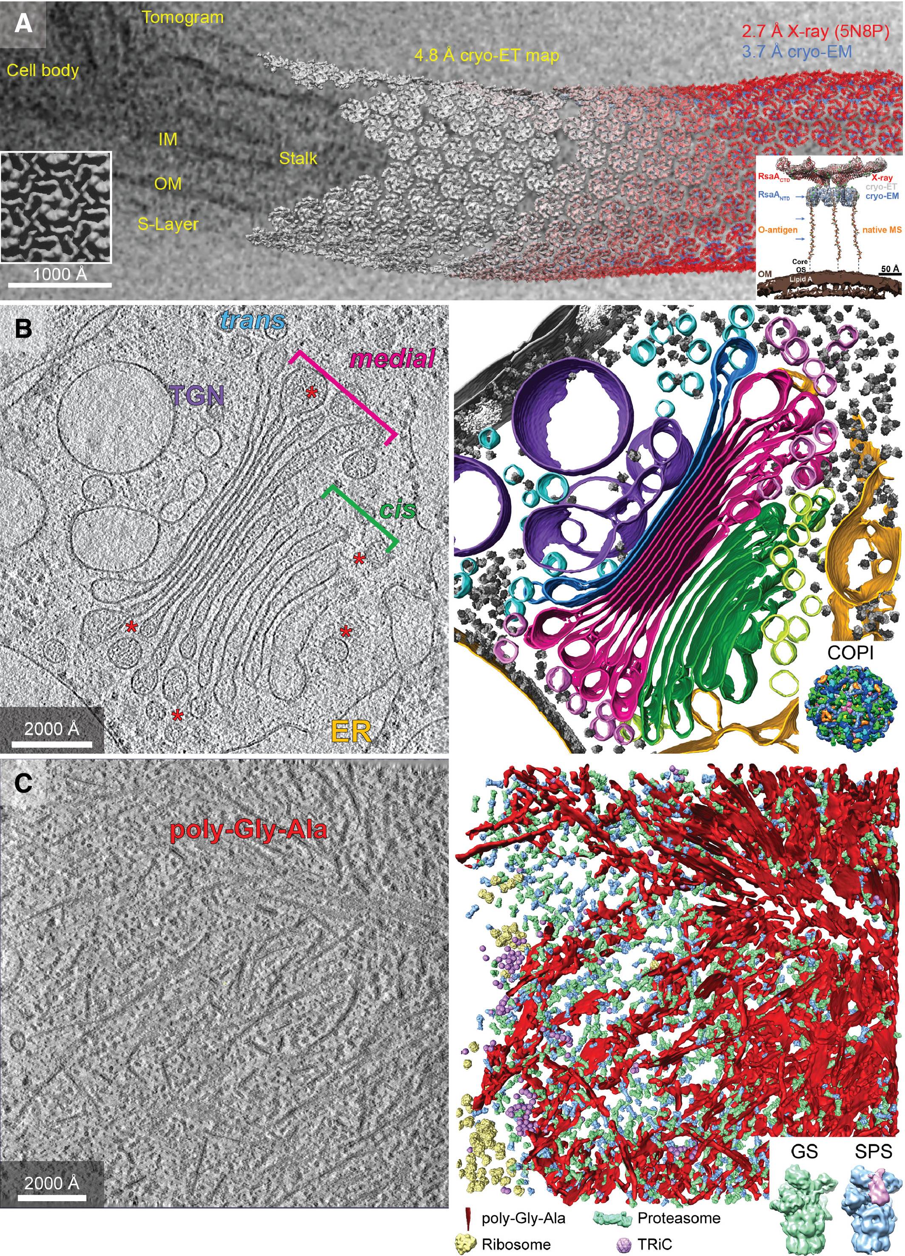
Cryo-Electron Tomography
Suitable for visualizing organelles and cell ultrastructure
Solves structures in situ, and mixed populations
Bridges the gap between structural molecular and cellular biology
Requires:
  Sample preparation lab
  Screening electron microscopes
  Correlative cryo super-resolution microscopies for best results
Cryo-EM (Tomo, also SPA) facilities often associated to Synchrotrons
  Similar sample prep to other techniques
  Similar user community
Need to coordinate with CNB national facility for electron microscopy
FEBS Letters, 594:20, 2020
DOI: 10.1002/1873-3468.13948
Data integration from molecules to cells.
Tomographic slice of a C. crescentus cell.
(B) The in situ molecular organization of the Golgi apparatus from C. reinhardtii.
(C) Molecular sociology within poly‐Gly‐Ala aggregates shows an increased concentration of 26S proteasomes.
Notes:
Examples of in situ cryo‐ET application. (A) Data integration from molecules to cells. A tomographic slice of a C. crescentus cell showing the inner membrane (IM), outer membrane (OM), and surface layers (S‐layer). The 4.8 Å in situ cryo‐ET sub‐tomogram averages (gray) of the S‐layer lattice are mapped back into the tomogram, and structures from X‐ray crystallography at 2.7 Å (red) and single‐particle averaging at 3.7 Å (blue) are docked. The inset (right) illustrates an integrative model of the S‐layer anchoring into the outer membrane, combining structural and native MS methods. For comparison, the inset (left) shows an early electron crystallography map of the S‐layer ring structure at 2 nm resolution [124]. (B) The in situ molecular organization of the Golgi apparatus from C. reinhardtii. A tomographic slice containing the cisternae stacks of the Golgi apparatus (left) and its segmented representation (right) revealing the cis (green), medial (magenta), and trans (blue) cisternae and COPI vesicles as well as the morphology of the endoplasmic reticulum (ER, yellow), trans Golgi network (TGN, purple), and two nuclear pore complexes, ribosomes, and other membranes (gray). In the tomographic slice, several COPI‐coated vesicles and those budding off are indicated by asterisks. The inset shows the molecular architecture of the ex situ COPI‐coated vesicle. (C) Molecular sociology within poly‐Gly‐Ala aggregates shows an increased concentration of 26S proteasomes. A tomographic slice (left) of a neuron expressing poly‐Gly‐Ala repeats. Mapping of macromolecules near the periphery of an aggregate region (right) shows 26S proteasomes in the ground state (GS, green) and an enrichment for the substrate‐processing state (SPS, blue) proximal to poly‐Gly‐Ala twisted ribbons (red). Other molecular species, such as the ribosomes (yellow) and the chaperonin TRiC (purple), are largely excluded from the aggregate material. The inset shows a closeup of two 26S proteasome sub‐tomogram averages after classification revealing the non‐processing GS and the engaged SPS. Figure (A) inset (left) reproduced from Ref. [124].

Slide 22
Cryo-nano XR Fluorescence and phase-contrast imaging
Nanofocus beamline with a scanning transmission X-ray cryo-microscope
  Nanofluorescence: quantification of trace endo- and exogenous elements at high-sensitivity
  Phase contrast-based imaging: 2D and tomography of cells
Addressed community: Cell Biology, Metallobiology, drug delivery, nanomedicine, applied nanomaterials, new therapeutic agents, genetic recessive diseases, viral infections, biocatalysis.
Required: spatial stability in cryo conditions, isometric aspect ratio, flux at focus
Desirable: coherence for near-field ptychography and holotomography.
Open questions: Energy range? Resonant energies for scanning specific oxidation states?
Similar beamlines: ID16A@ESRF, I14@Diamond, P06@DESY (cryogenic condition to be installed), Nanoscopium@SOLEIL, NanoMAX@MAXIV (no cryogenic conditions)

Slide 23
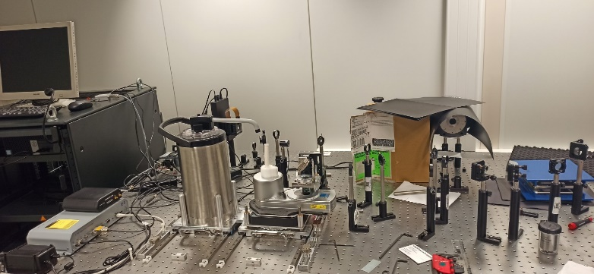
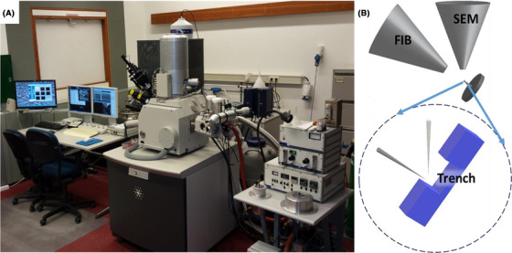
Non-SR Microscopies
Key to correlate images from external optical labs to images from SR-based techniques
Cryo-3DSIM
Used as a preferred correlative microscopy for SR techniques
Only 2 units worlswide: Diamond and ALBA
Sample preparation lab required
Screening microscopes required
CryoFIB-SEM
Imaging of cryo-sectioned cells and tissues
Resolution down to 30 nm
Long acquisition time
Common sample preparation with other techniques
MF Hayles, DAM de Winter, DOI: 10.1111/jmi.12951

Slide 24
Map of existing, in construction and proposed tools
BioMed BL
(HE CT)
MISTRAL
(SXR Transmission Tomo)
XAIRA BL
(μ-MX, fixed-target SSX)
FAXTOR BL
(HXR and sub-μ CTomography)
Cryo nano-XRF BL
Cryo-EM
(Single Particle Analysis)
MIRAS BL
(FTIR)
nano-IR
Cryo-EM
(Electron Tomography)
BioSAXS BL
XALOC BL
(HT MX, jet SSX)
Cryo-3D SIM
Cryo FIB-SEM
Standardization
Biolab
Mammal cell lab
BioLab
Sample prep (P2)
BioLab
Proteomics
Resolution
existing
In construction
proposed

Slide 25
The Conclusion
 | FTIR live cells | nano IR | Cryo SXT | Cryo XRF | Cryo ET | Cryo 3D-SIM | CryoFIB-SEM | Sub-μm CT | HE CT in vivo
 | IR | IR | Soft X-rays | Hard X-rays | Electrons | Visible | Electrons | Hard X-rays | Hard X-rays
 | SB | SB/FEL | SB | U |  | - | - | SB/W | SB/W
 | Far IR | Near IR | 280-3000 eV | 10-25 keV | (300 kV) | - | - | 20 keV | 30-120 keV
 | 100 μm | 10 nm | < 25nm + unfocus | <100nm + unfocus | - | - | . | <1- µm | 500-50 nm
Near Native
Multimodal
Time-resolved
Capability
3th generation upgrade
4th generation upgrade
essential tool
Desirable tool
Notes:
Tanja, Ibreheem: feed for FTIR live cells. Diffraction limit? Useful for Life Sciences???
Weakness: 0.5 um microXRF

