Slide 1
Magnetic and electronic properties of 2D metal-organic networks
Sofia de Oliveira Parreiras
sofia.oliveira@imdea.org

Slide 2
Molecular magnetism
On-surface synthesis
High potential for technological applications
  High density information storage
  Molecular spin qubits
  Spintronics devices
Low dimensional materials
  Novel quantum properties
2D metal-organic networks
  Long range ordering
π-conjugated metal-organic networks
Lanthanide metal-organic networks
Molecules
Metal
Surface

Slide 3
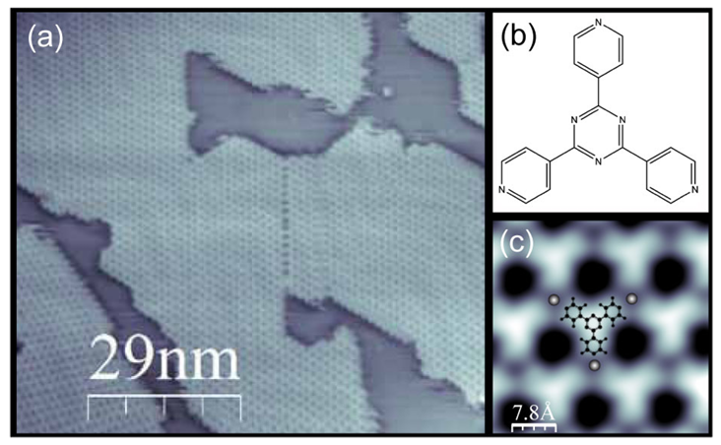
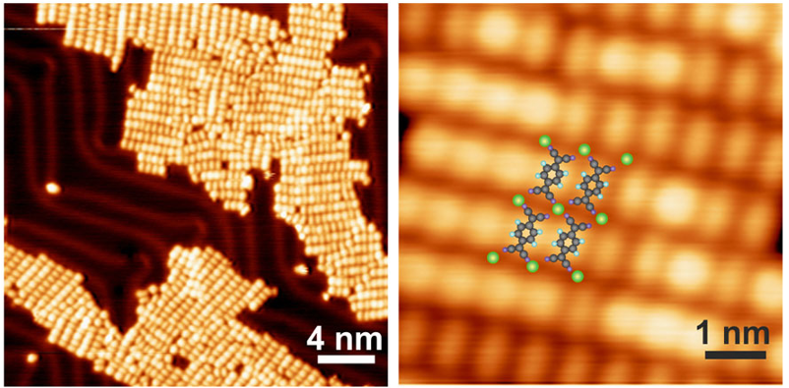
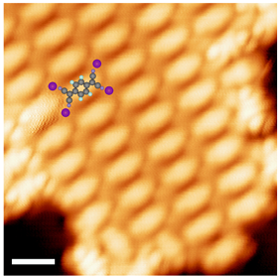
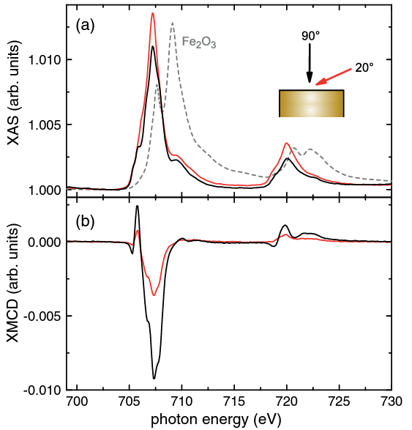
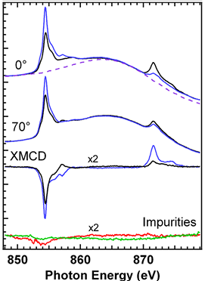
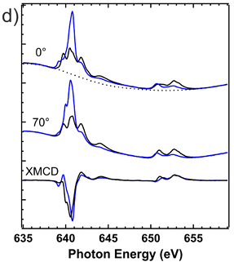
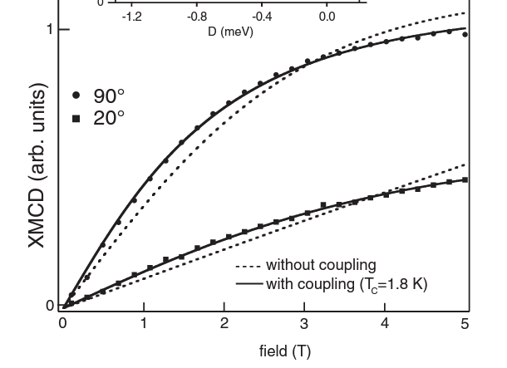
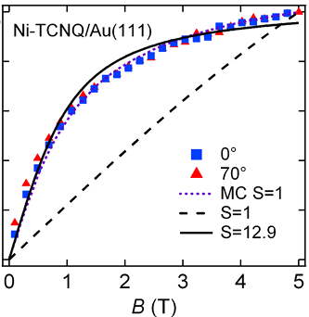
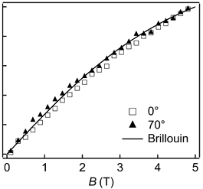
Magnetism of metal-organic networks
Fe-T4PT/Au(111)
Ni-TCQN/Au(111)
Mn-TCQN/Au(111)
Ferromagnetic coupling
Ferromagnetic coupling
Weak antiferromagnetism
Phys. Rev. Lett. 2012, 109, 267207
Phys. Rev. Lett. 2013, 110, 027202
J Phys. Chem. C 2015, 119, 547-555

Slide 4
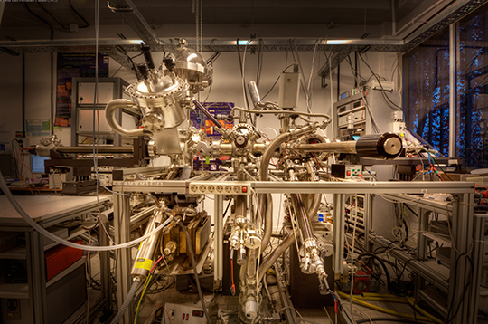
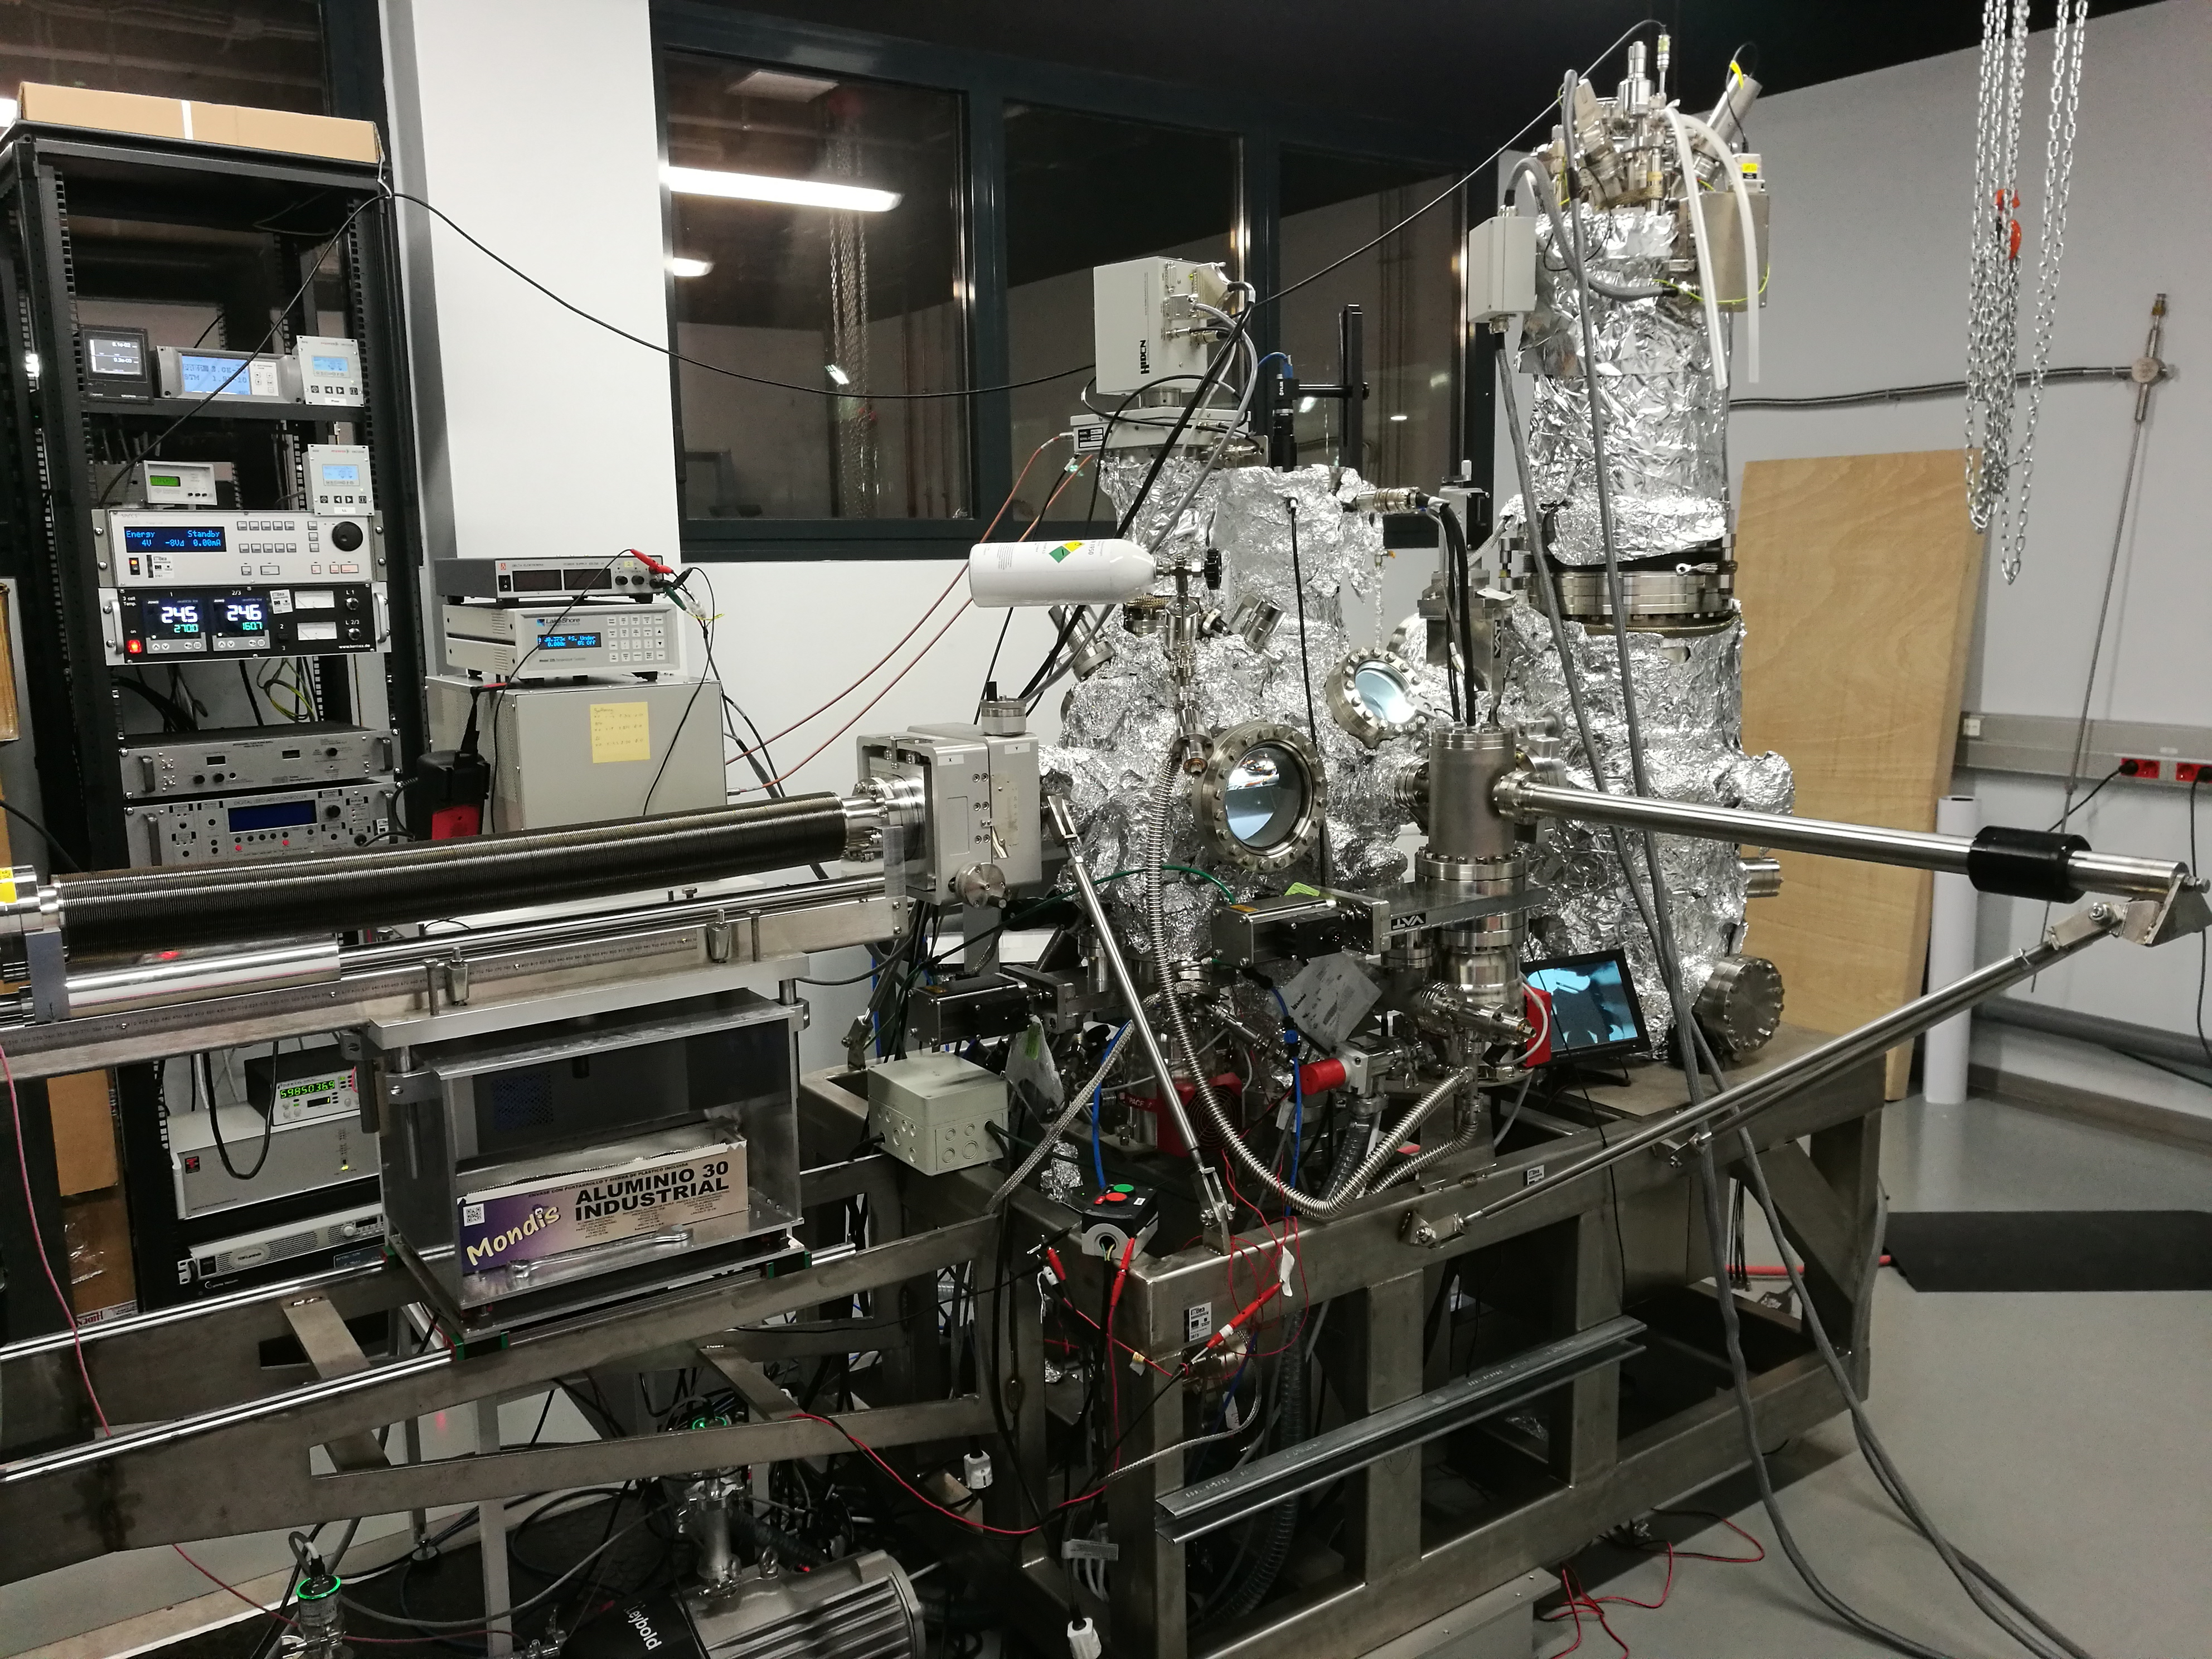
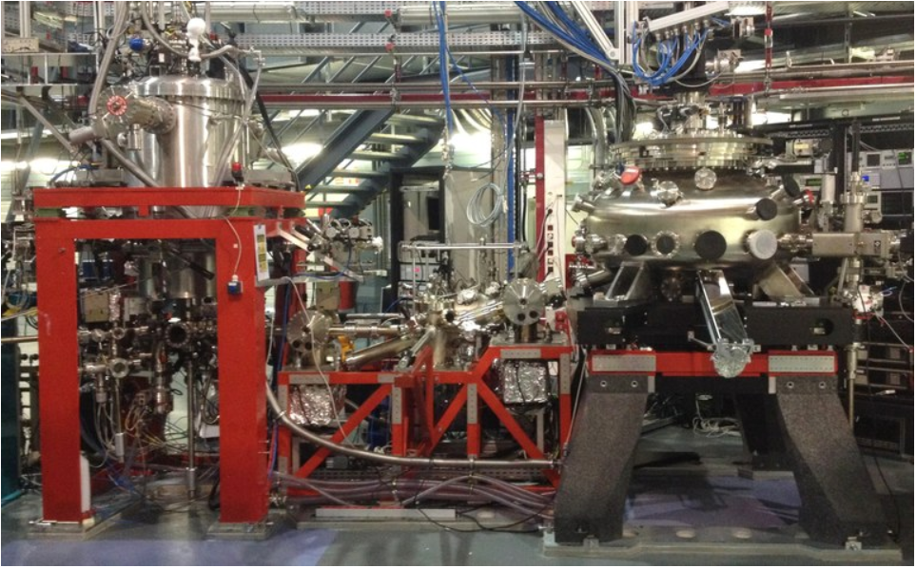
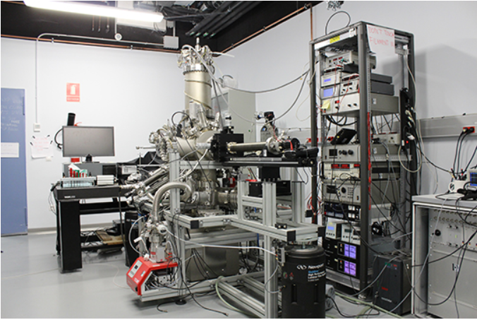
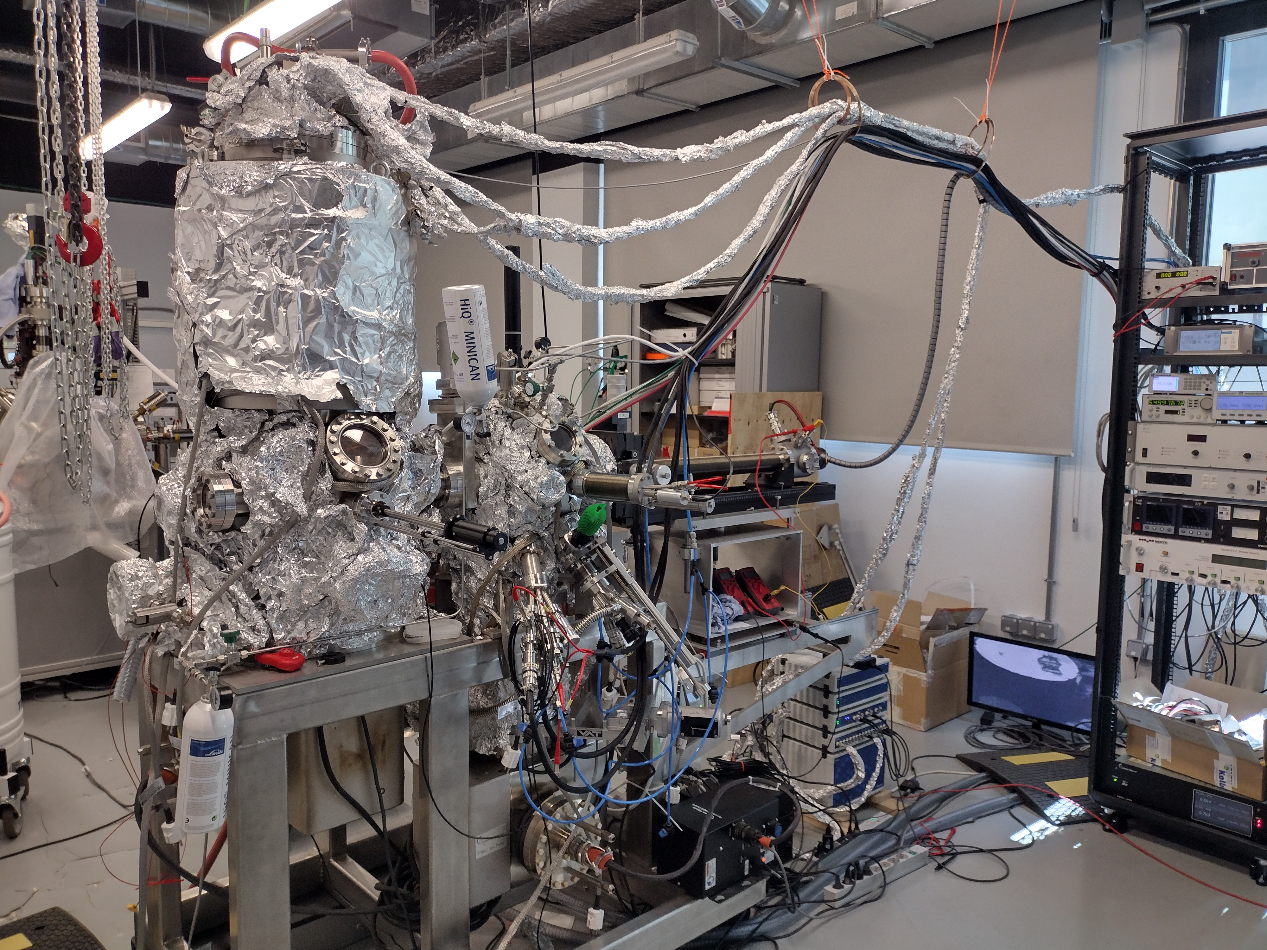
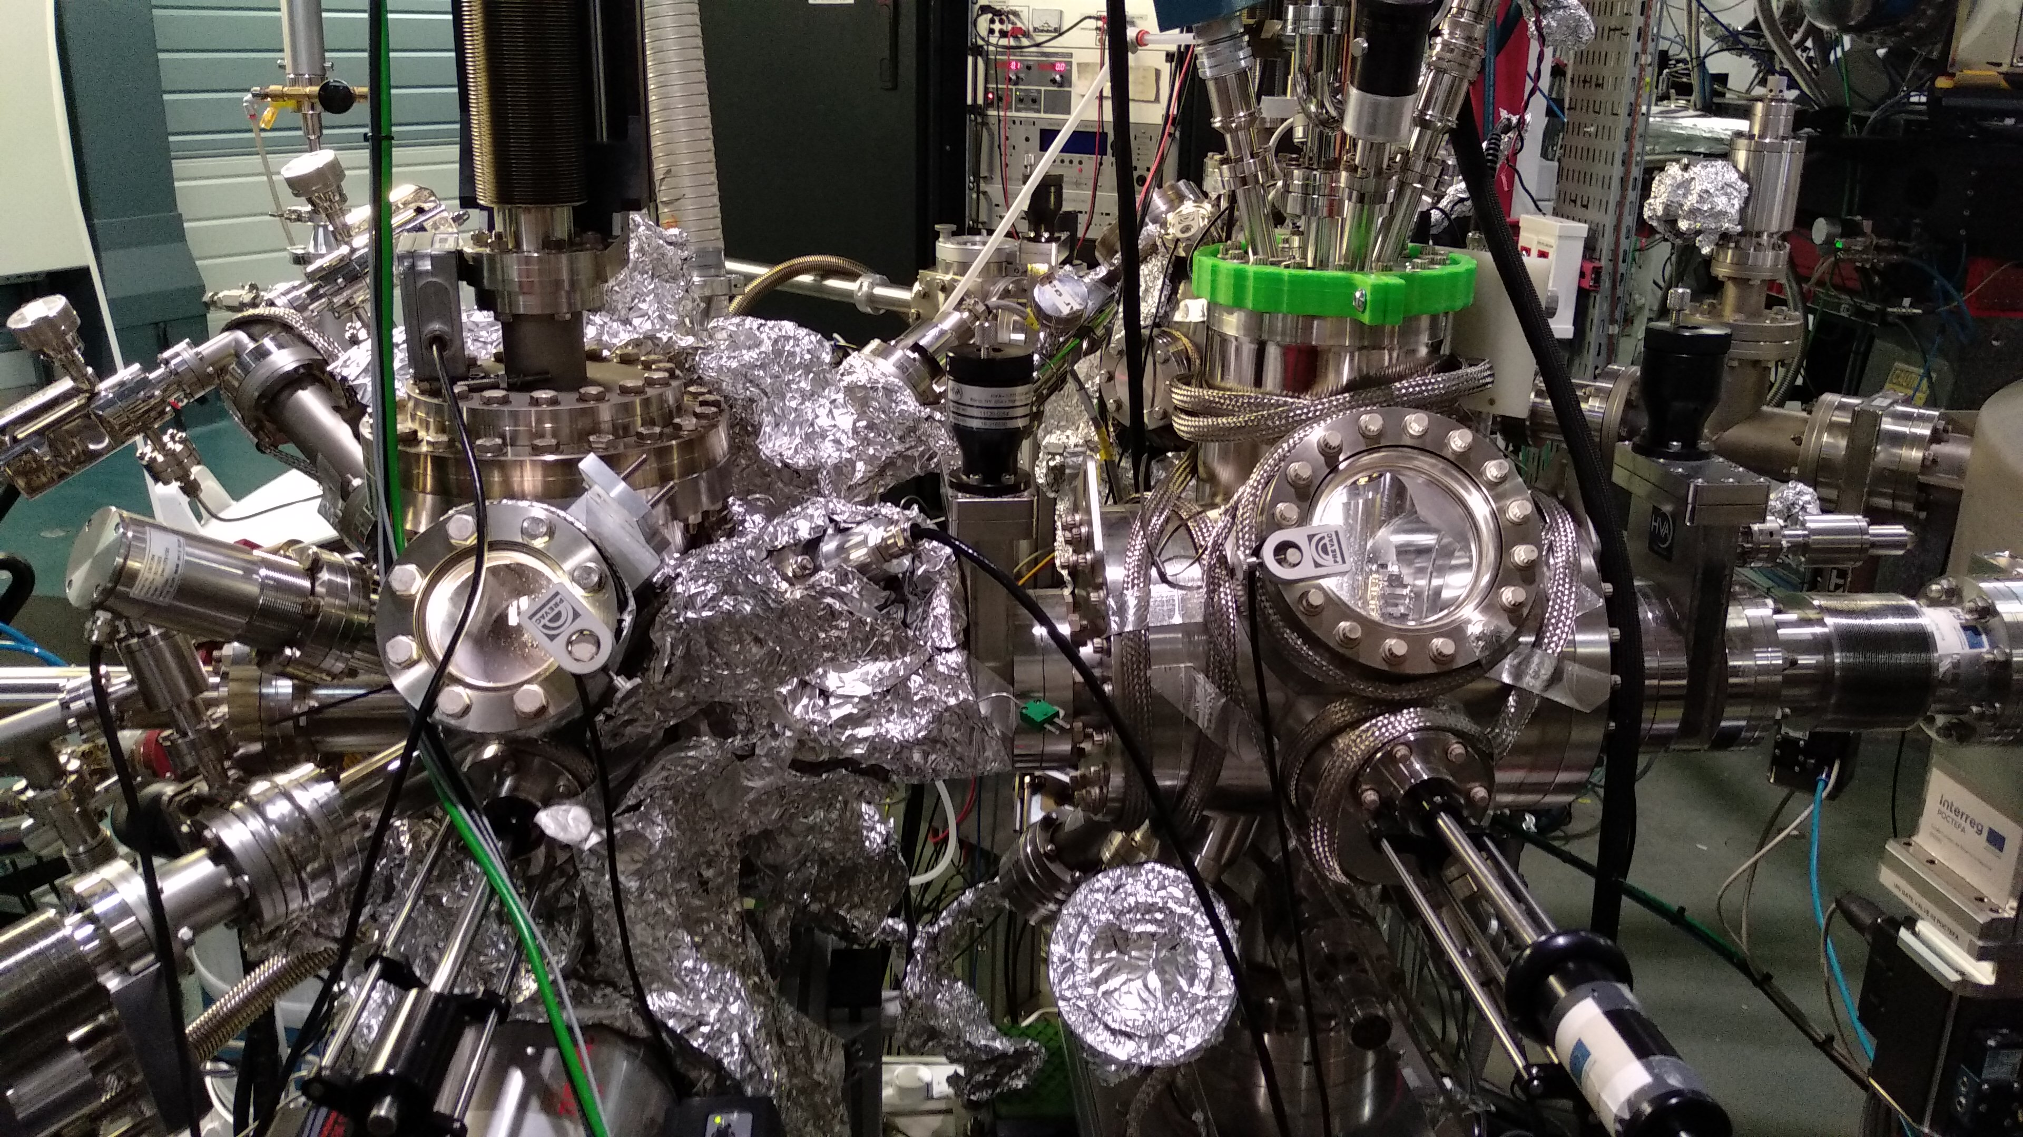
Experimental setups
XAS, XLD, XMCD, STM
ALBA synchrotron
STM, STS, nc-AFM
IMDEA Nanoscience

Slide 5
π-conjugated metal-organic networks

Slide 6
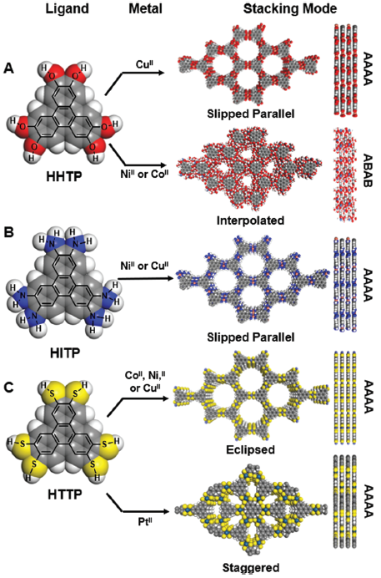
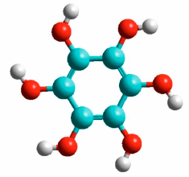
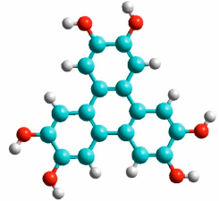
π-conjugated metal-organic networks
Molecular linkers:
2D layered networks
HOB
1,2,3,4,5,6-hexahydroxybenzene
Exotic quantum phases of matter
  Superconductivity
  Quantum anomalous Hall effect
  Flat-band
Antiferromagnetic ground-states
  Absence of stray fields
  Magnetic robustness
  Ultrafast dynamics
Truly 2D systems
  Networks prepared by on-surface synthesis
  Reduction of the coordination of number
  Route to unquenched orbital moment
HOTP
2,3,6,7,10,11-Hexahydroxytriphenylene
Light blue: carbon; Gray: hydrogen; Red: oxygen
3d metal:
Co
M. Ko et al., Chem.Commun., 2018, 54, 7873

Slide 7

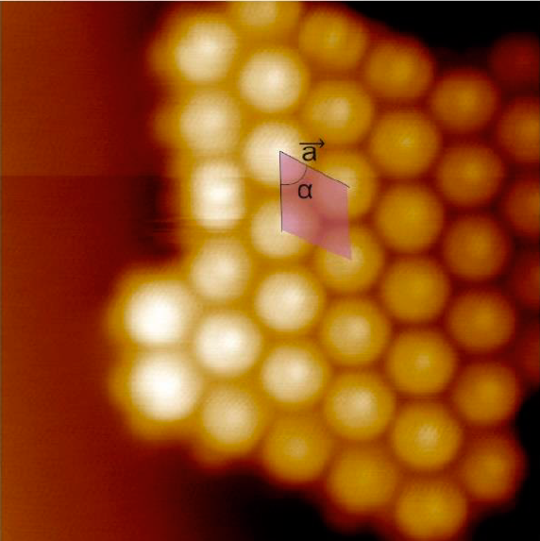
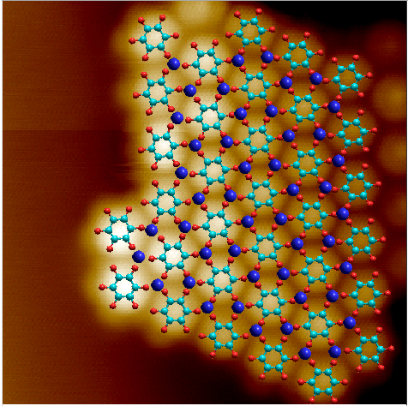
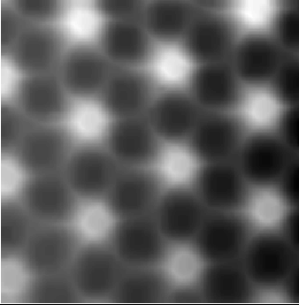
Co-HOB metal-organic network
HOB
Co
+
Au(111)
STM image
STM image + model
nc-AFM image
V_{b} = -500 mV, I = 800 pA,
T = 4 K, 5 nm x 5 nm
V_{b} = -500 mV, I = 800 pA,
T = 4 K, 5 nm x 5 nm
Constant height,
V_{b} = 5mV, T = 4 K, 2 nm x 2 nm

Slide 8
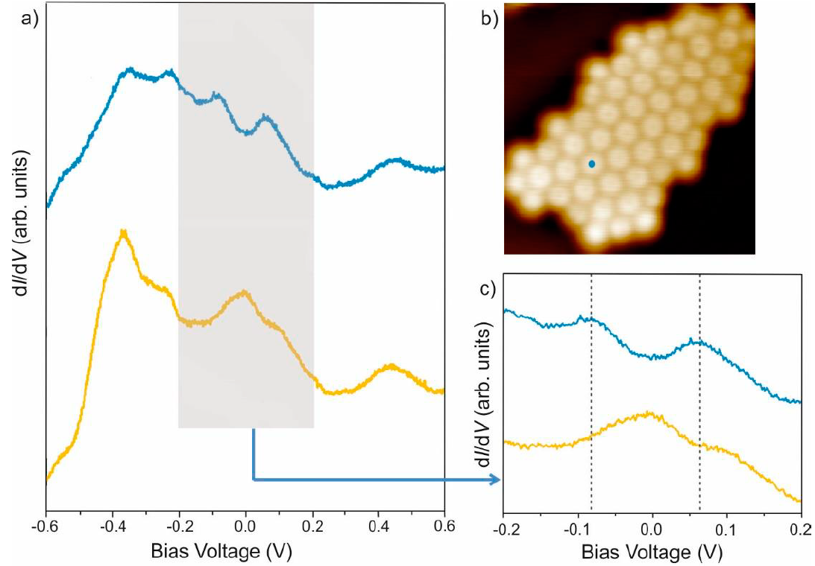
Electronic properties: Co-HOB
Semiconductor with very low bangap
0.14 V

Slide 9
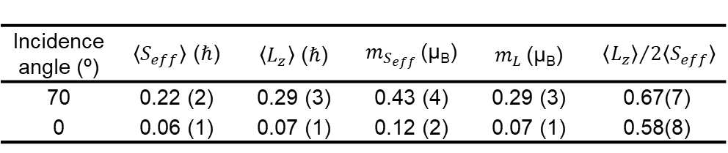
Magnetic properties: Co-HOB
6 T
Strong in-plane magnetic anisotropy
  Unquenched orbital moment
  Large orbital to effective spin moment
Magnetization curves compatible with paramagnetism or antiferromagnetism
L₃
70°
L₂
Total Electron Yield (norm. unit)
Intensity (norm. unit)
0°
Field (T)
Magnetic moments (n_{H}=3)
XMCD (norm. unit)
Incidence angle (º) | $〈S_{eff}〉$ (ℏ) | $〈L_{z}〉$ (ℏ) | $m_{S_{eff}}$ (μ_{B}) | $m_{L}$ (μ_{B}) | ${〈L_{z}〉}/{2〈S_{eff}〉}$
70 | 0.22 (2) | 0.29 (3) | 0.43 (4) | 0.29 (3) | 0.67(7)
0 | 0.06 (1) | 0.07 (1) | 0.12 (2) | 0.07 (1) | 0.58(8)
Energy (eV)

Slide 10
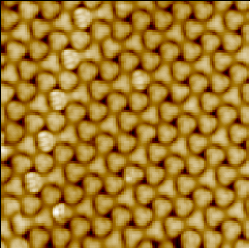
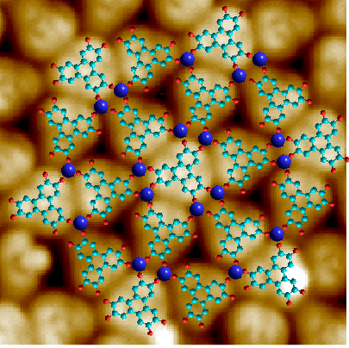
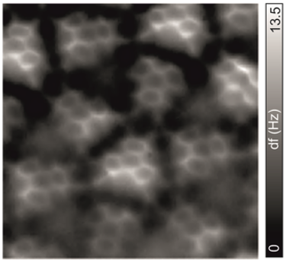
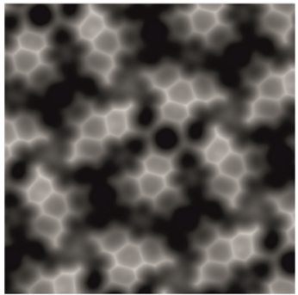
Co-HOTP metal-organic network
HOTP
Co
Co-O coordination: 3-fold
Two molecular species: 4-fold and 6-fold
+
Au(111)
STM image
STM image + model
nc-AFM image
nc-AFM simulation
-0.5
df (Hz)
1.2
V_{b} = 20 mV, I = 120 pA,
T = 4 K, 11.7 nm x 11.7 nm
V_{b} = 20 mV, I = 100 pA,
T = 4 K, 4 nm x 4 nm
Open feedback: V_{b} = 5mV, I_{t} = 150 pA, Z_{offset} = 150 pm,T = 4 K, 3.2 nm x 3.2 nm

Slide 11
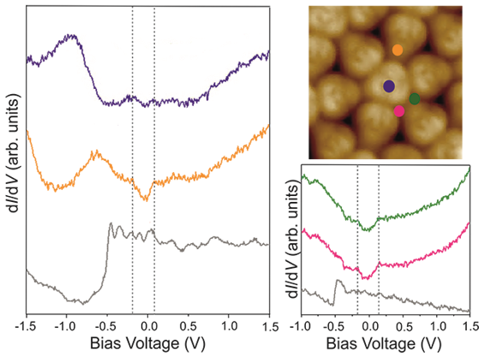
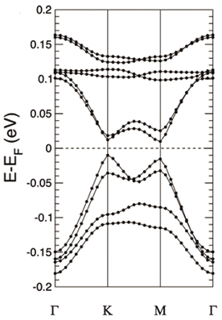
Electronic properties: Co-HOTP
STS
DFT+U
6-fold molecule
-0.9 V
0.28 V
4-fold molecule
-0.7 V
30 mV
0.25 V
0.29 V
Semiconductor with very low bangap

Slide 12
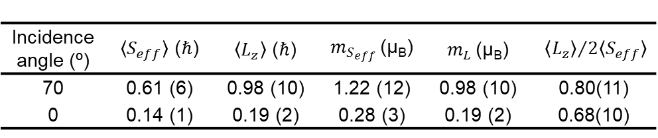
Magnetic properties: Co-HOTP
6 T
Strong in-plane magnetic anisotropy
  Large unquenched orbital moment
  Large orbital to effective spin moment
Magnetization curves compatible with paramagnetism or antiferromagnetism
L₃
70°
L₂
Total Electron Yield (norm. unit)
Intensity (norm. unit)
0°
Field (T)
Magnetic moments (n_{H}=2.74, DFT)
XMCD (norm. unit)
Incidence angle (º) | $〈S_{eff}〉$ (ℏ) | $〈L_{z}〉$ (ℏ) | $m_{S_{eff}}$ (μ_{B}) | $m_{L}$ (μ_{B}) | ${〈L_{z}〉}/{2〈S_{eff}〉}$
70 | 0.61 (6) | 0.98 (10) | 1.22 (12) | 0.98 (10) | 0.80(11)
0 | 0.14 (1) | 0.19 (2) | 0.28 (3) | 0.19 (2) | 0.68(10)
Energy (eV)

Slide 13
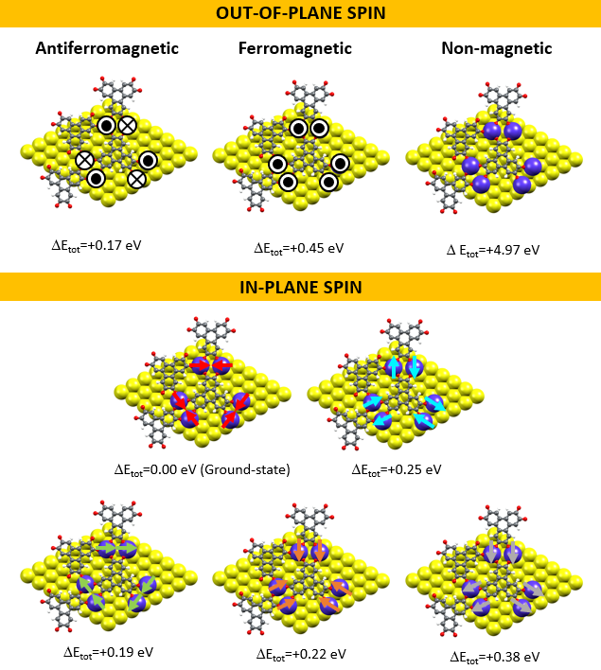
Magnetic properties:
Co-HOTP
In-plane antiferromagnetic

Slide 14
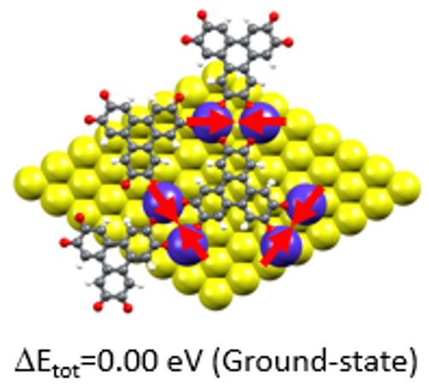
Magnetic properties: Co-HOTP
6 T
L₃
70°
L₂
Total Electron Yield (norm. unit)
0°
Intensity (norm. unit)
In-plane antiferromagnetic
XMCD (norm. unit)
Field (T)
Energy (eV)
Compatible with antiferromagnetism
In-plane anisotropy

Slide 15
Summary: π-conjugated metal-organic networks
On-surface synthesis of a Co-coordinated metal-organic networks on Au(111)
Semiconductors with very low bandgaps
Antiferromagnetic ground state
Large unquenched orbital magnetic moment and large orbital to effective spin moment ratio
  Unprecedented in 2D transition metal-organic architectures

Slide 16
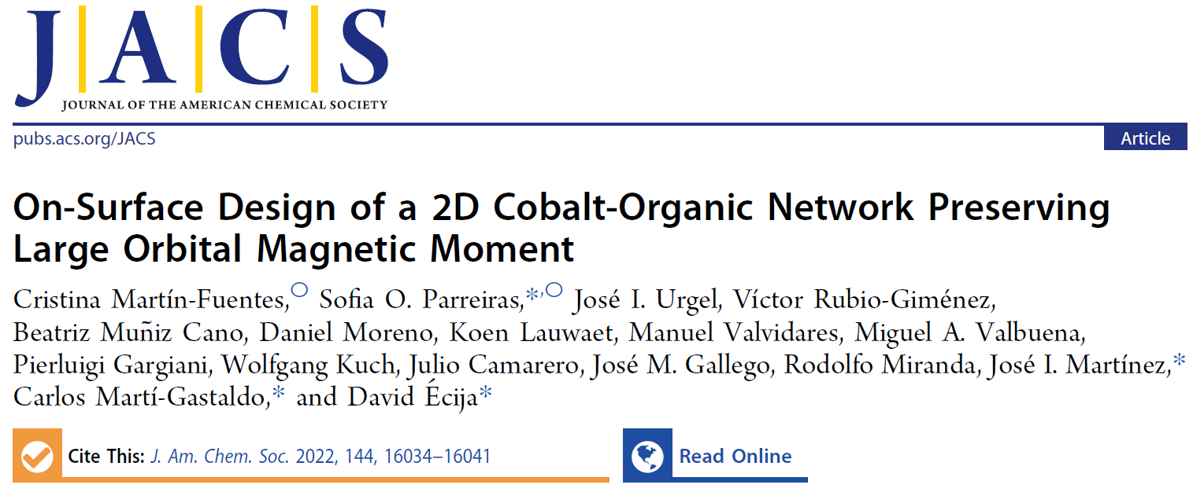

Slide 17
Lanthanides metal-organic networks

Slide 18
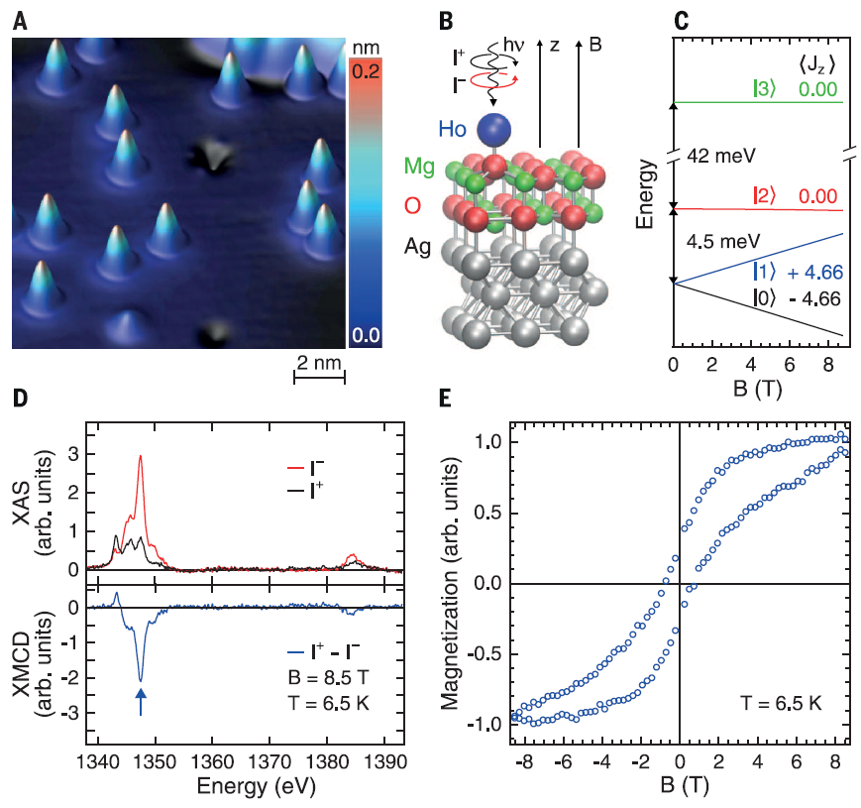
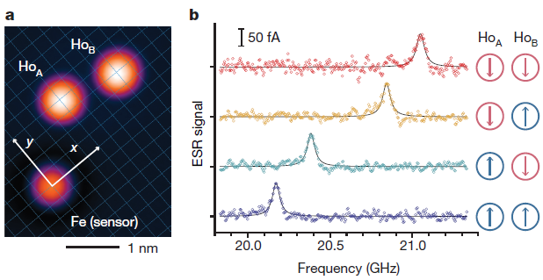
Magnetism of lanthanides
Magnetic remanence in single atoms
Strong spin-orbit coupling
Strong localization of 4f states
High magnetic moments and magnetic anisotropy
Large spin lifetimes
Writing and reading single atoms
F. Donati et al., Science 2016, 352, 318-321
F. Natterer et al., Nature 2017, 543, 226-228

Slide 19
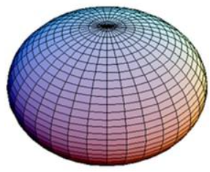
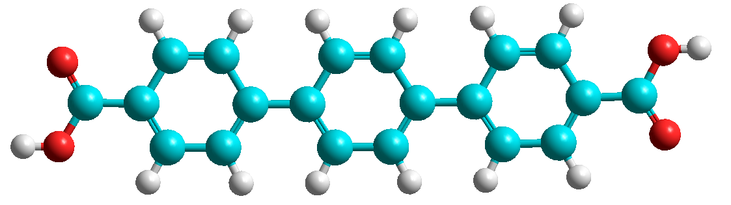
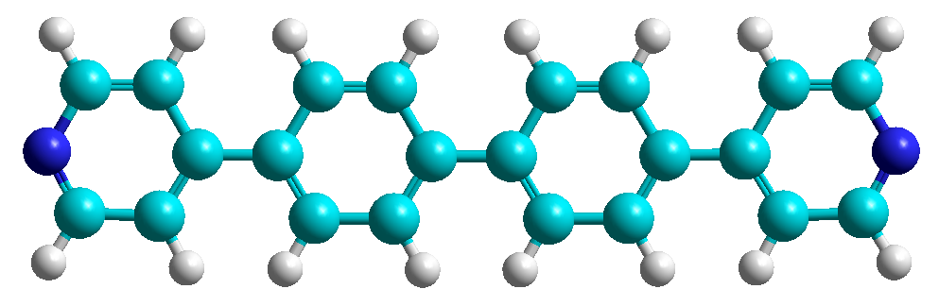
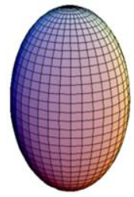
Lanthanide metal-organic networks
Molecular linkers:
4f metals:
Dy⁺³
oblate charge density
Er⁺³
prolate charge density
TDA
Dy
p-terphenyl-4,4-dicarboxylic acid
DPBP
Er
4,4'-di(pyridin-4-yl)-1,1'-biphenyl
Light blue: carbon; Gray: hydrogen; Red: oxygen; Dark blue: Nitrogen

Slide 20
Dinuclear networks: Dy-DPBP and Er-DPBP
DPBP
Er
DPBP
Dy
+
+
Au(111)
Au(111)
V_{b} = 100 mV, I = 3.0 nA,
T = 4 K, Scale bar: 2.0 nm
V_{b} = 5 mV, I = 50 pA, CO tip
T = 4 K, Scale bar: 1.0 nm
V_{b} = -300 mV, I = 1.5 nA, CO tip
T = 4 K, Scale bar: 2.0 nm
V_{b} = 500 mV, I = 200 pA,
T = 4 K, Scale bar: 3.0 nm
V_{b} = -1.00 V, Z_{offset} = -94 pm, CO tip
T = 4 K, Scale bar: 1.0 nm

Slide 21
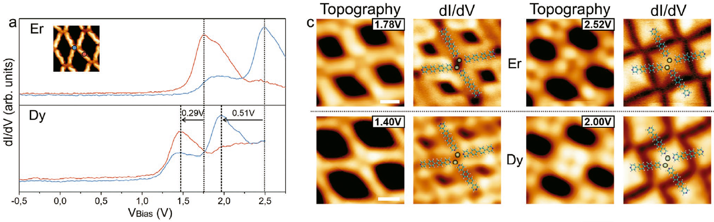
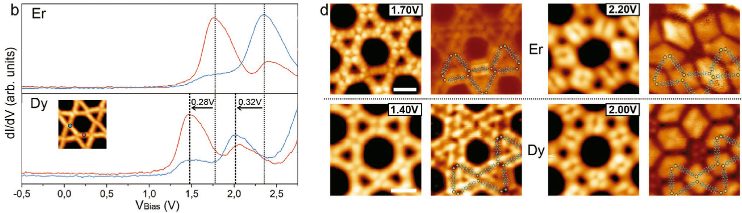
Electronic properties: Dy-DPBP and Er-DPBP

Slide 22
Magnetic properties: Rhombic networks
DPBP
Er
DPBP
Dy
+
Multiplet calculations:
MultiX
A. Uldry et al., Phys. Rev. B 2012, 85, 125133
+
Au(111)
Au(111)
Er⁺³
Dy⁺³
0°
70°
0°
70°
0°
70°
0°
70°

Slide 23
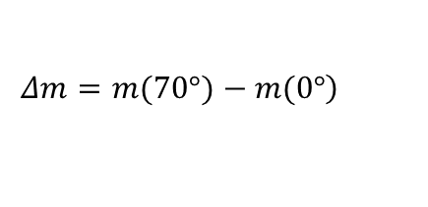
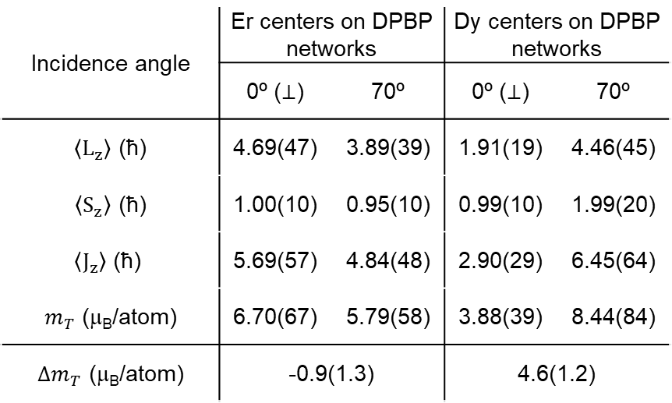
Magnetic properties: Rhombic networks
DPBP
Er
50°
DPBP
Dy
80°
+
+
Incidence angle | Er centers on DPBP networks |  | Dy centers on DPBP networks
 | 0º ($⊥$) | 70º | 0º ($⊥$) | 70º
$〈L_{z}〉$ (ħ) | 4.69(47) | 3.89(39) | 1.91(19) | 4.46(45)
$〈S_{z}〉$ (ħ) | 1.00(10) | 0.95(10) | 0.99(10) | 1.99(20)
$$〈J_{z}〉\text{ (}\text{ħ}\text{)}$$ | 5.69(57) | 4.84(48) | 2.90(29) | 6.45(64)
$m_{T}$ (μ_{B}/atom) | 6.70(67) | 5.79(58) | 3.88(39) | 8.44(84)
$Δm_{T}$ (μ_{B}/atom) | -0.9(1.3) |  | 4.6(1.2)
Au(111)
Au(111)
$$Δm=m(70°)−\left.m(0°\right)$$
Multiplet calculations:
MultiX
A. Uldry et al., Phys. Rev. B 2012, 85, 125133

Slide 24

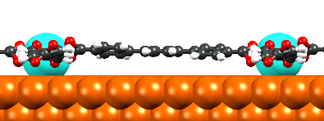
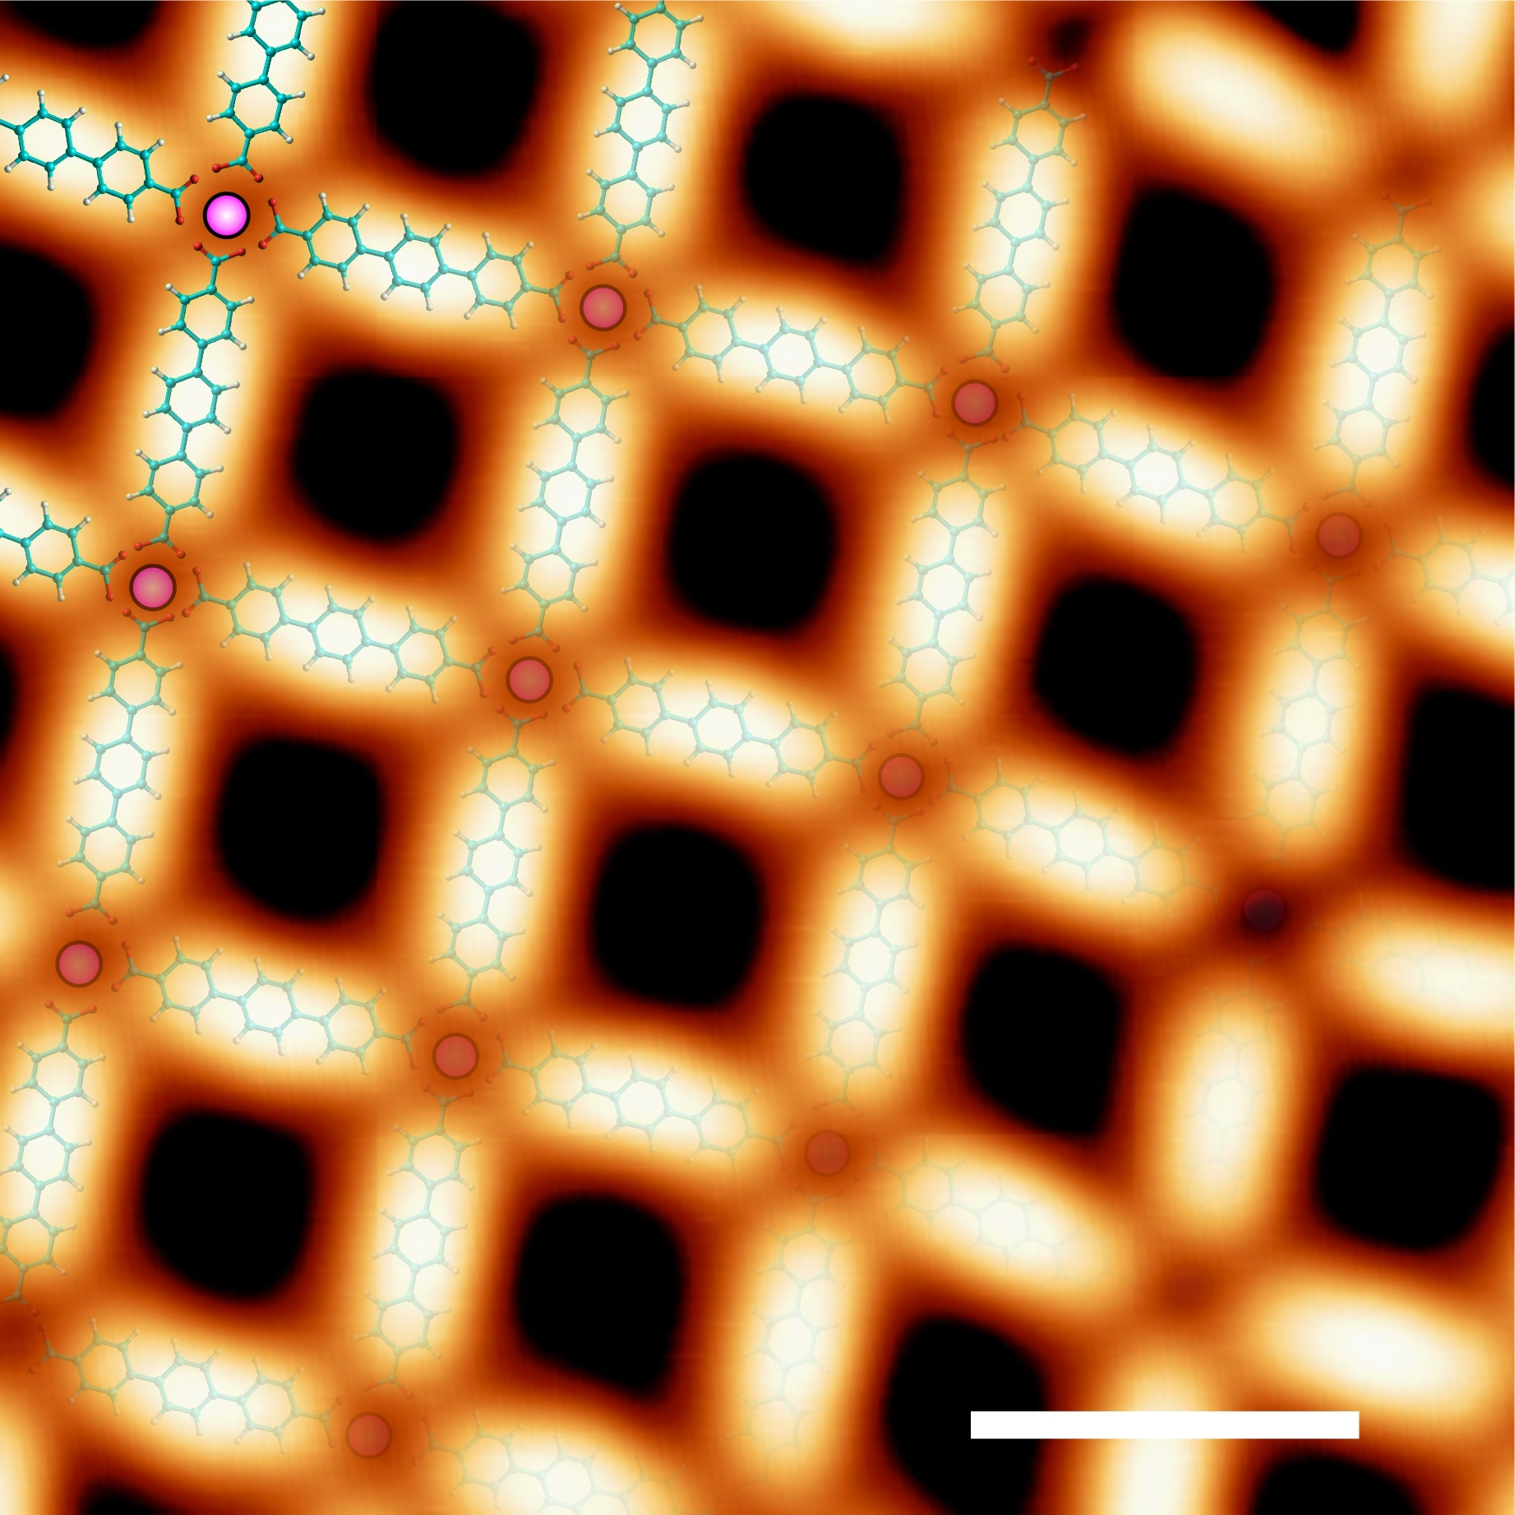
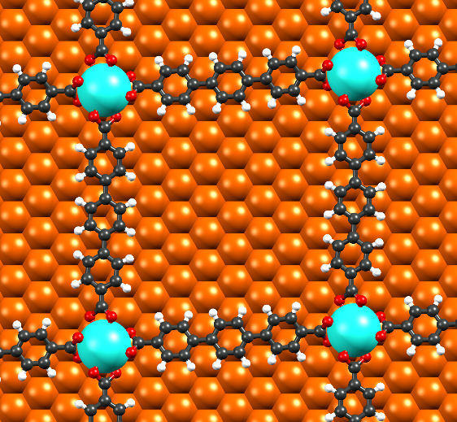
Mononuclear networks: Dy-TDA and Er-TDA
TDA
+
Dy
TDA
+
Er
Cu(111)
Cu(111)
V_{b} = -0.80 V, I = 150 pA,
T = 4 K, Scale bar: 1.0 nm
V_{b} = 500 mV, I = 500 pA,
T = 4 K, Scale bar: 2.0 nm

Slide 25
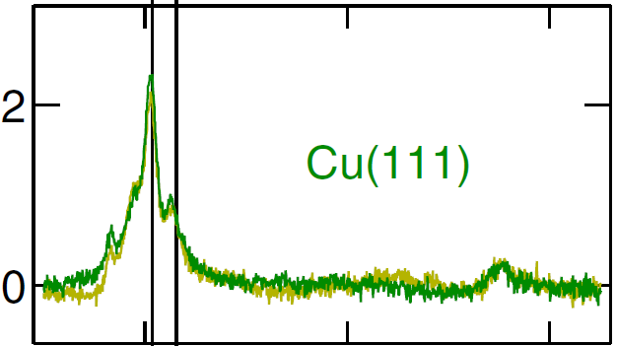
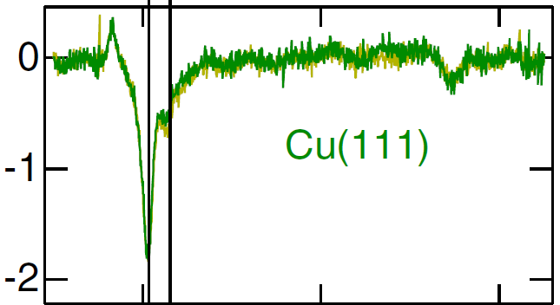
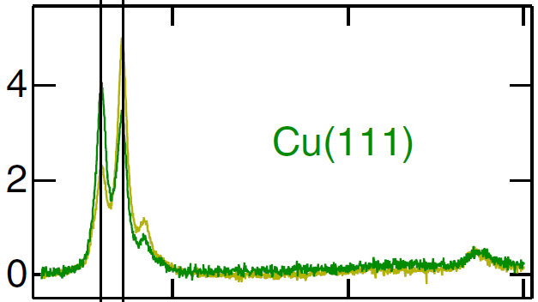
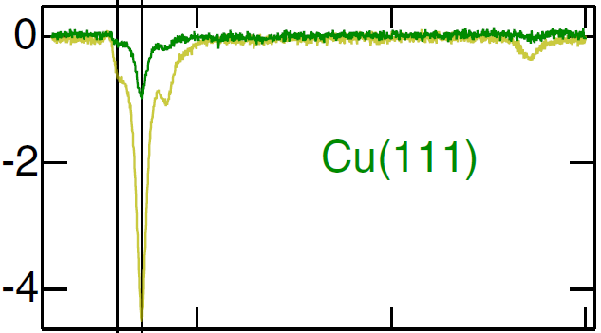
Magnetic properties: Dy-TDA and Er-TPA
TDA
+
Dy
TDA
+
Er
Cu(111)
Cu(111)
Single atoms
6 T
M₅
6 T
Dy⁺²
M₅
70°
M₄
70°
Total Electron
Yield (norm. u.)
M₄
Total Electron
Yield (norm. u.)
Dy⁺³
Er⁺³
0°
0°
Nearly in-plane
Out-of-plane
Almost Isotropic
XMCD (norm. u.)
XMCD (norm. u.)
Er⁺³
Energy (eV)
Energy (eV)
θ = 71.2°
Intensity
Intensity (norm. unit)
In-plane
A. Singha et al., Phys. Rev. B 2017, 96, 224418
Magnetic Field (T)
Magnetic Field (T)

Slide 26


Expectation values of magnetic moments
Incidence angle | Dy centers on TDA networks |  | Dy single atoms on Cu(111)* |  | Er centers on TDA networks |  | Er single atoms on Cu(111)*
 | 0º ($⊥$) | 70º | 0º ($⊥$) | 60º | 0º ($⊥$) | 70º | 0º ($⊥$) | 60º
$〈L_{z}〉$ (ħ) | 1.36 (14) | 2.35 (24) | 4.7 (2) | 4.4 (2) | 6.08(61) | 3.05(31) | 0.7(1) | 4.0(2)
$〈S_{z}〉$ (ħ) | 0.44 (4) | 1.14 (11) | 1.6 (1) | 1.5 (0) | 1.79(18) | 0.91(9) | 0.3(0) | 1.0(1)
$$〈J_{z}〉\text{ (}\text{ħ}\text{)}$$ | 1.80 (18) | 3.49 (35) | 6.3 (2) | 5.9 (2) | 7.87(79) | 3.96(40) | 1.0(1) | 5.0(2)
$m_{T}$ (μ_{B}/atom) | 2.24 (22) | 4.63 (46) | 7.9 (3) | 7.4 (2) | 9.66(97) | 4.87(49) | 1.3(1) | 6.0(3)
$Δm_{T}$ (μ_{B}/atom) | 2.4 (7) |  | -0.5 (5) |  | -4.8(1.5) |  | 4.7(4)
Strong moment anisotropy
$$Δm=m(70°)−\left.m(0°\right)$$
*A. Singha et al., Phys. Rev. B 2017, 96, 224418

Slide 27
Summary: Lanthanides metal-organic networks
Unprecedented mononuclear and dinuclear lanthanide-directed metal-organic networks designed by on-surface chemistry
By metal-exchange:
  Network integrity
  Tailoring of energy level alignment
  Drastic modification of magnetic properties
It is possible to tailor the magnetic anisotropy of lanthanide elements on surfaces by coordinative metal-organic protocols

Slide 28





Slide 29

Thanks for your attention!
ALBA synchroton
Dr. Pierluigi Gargiani
Dr. Manuel Valvidares
ICMol Universitat de València
Prof. Carlos Martí-Gastaldo
Dr. Victor Rubio-Giménez
ICN2
Prof. Aitor Mugarza
Dr. Markos Paradinas
Dr. Mirco Panighel
ICMM-CISC
Dr. José I. Martínez
Freie Universität
Prof. Wolfgang Kuch
IMDEA Nanoscience
Prof. David Écija
Prof. Rodolfo Miranda
Dr. Paolo Perna
Prof. Julio Camarero
Dr. Daniel Moreno
Dr. Borja Cirera
Dr. Miguel A. Valbuena
Dr. José I. Urgel
Dr. Koen Lauwaet
Beatriz Muñiz-Cano
Dr. José M. Gallego
Dr. Miguel A. Niño
Cristina Martín-Fuentes
Dr. Fernando Ajejas
Nanoarchtectonics on Surfaces Group
sofia.oliveira@imdea.org

Slide 30

Electronic properties: Co-HOTP
STS
dI/dV maps
6-fold molecule
-0.9 V
4-fold molecule
-0.7 V

Slide 31




Oxidation state
Co⁺³
Co⁺²
a)
c)
Intensity (arb. unit)
Intensity (arb. unit)
Energy (eV)
Energy (eV)
This work
b)
d)
e)
L₃
6 T
L₂
Intensity (arb. unit)
Intensity (arb. unit)
Total Electron Yield (norm. unit)
Energy (eV)
Energy (eV)
Energy (eV)

Slide 32
Electronic properties: Dy-TDA and Er-TDA
TDA
+
Dy
TDA
+
Er
Cu(111)
Cu(111)
dI/dV (arb. u.)
dI/dV (arb. u.)
V_{b} = -0.70 V, I = 80 pA,
T = 4 K, Scale bar: 3.0 nm
V_{b} = 500 mV, I = 500 pA,
T = 4 K, Scale bar: 3.0 nm
Bias (V)
Bias (V)
Topography
dI/dV map
Topography
dI/dV map
Topography
dI/dV map
1.6 V
1.7 V
2.7 V
V_{b} = -0.20 V, I = 80 pA,
T = 4 K Scale bar: 1.0 nm
V_{b} = 1.73 V, I = 200 pA,
T = 4 K Scale bar: 2.0 nm
V_{b} = 2.67 V, I = 200 pA,
T = 4 K Scale bar: 2.0 nm

Slide 33
Dy-TDA: Background subtraction
M₅
M₅
Total Electron Yield (arb. u.)
M₄
Total Electron Yield (norm. u.)
M₄
XMCD (norm. u.)
XMCD (arb. u.)
Energy (eV)
Energy (eV)

Slide 34



Mononuclear networks: Dy-TDA and Dy-TPA
TDA
+
Dy
TPA
+
Dy
Cu(111)
Cu(111)
V_{b} = -0.80 V, I = 150 pA,
T = 4 K, Scale bar: 1.0 nm
V_{b} = -1.10 V, I = -170 pA,
T = 300 K, Scale bar: 1.0 nm

Slide 35
DPBP
Er
DPBP
Dy
+
+
Au(111)
Au(111)
M₅
M₅
XAS
(norm. u.)
XAS
(norm. u.)
70°
70°
XNLD
(norm. u.)
XNLD
(norm. u.)
0.05 T
0.05 T
Energy (eV)
Energy (eV)
TPA
Dy
TDA
Dy
TDA
Er
+
+
+
Cu(111)
Cu(111)
Cu(111)
M₅
0.01 T
M₅
0.01 T
M₅
0.01 T
XAS
(norm. u.)
XAS
(norm. u.)
XAS
(norm. u.)
70°
70°
70°
XNLD
(norm. u.)
XNLD
(norm. u.)
XNLD
(norm. u.)
Energy (eV)
Energy (eV)
Energy (eV)

Slide 36
Magnetic properties: Dy-TDA and Dy-TPA
M₅
6 T
70°
M₄
TDA
+
Dy
θ = 71.2°
XAS (norm. u.)
Cu(111)
Intensity
0°
XMCD
(norm. u.)
Magnetic Field (T)
Nearly in-plane
anisotropy
Energy (eV)
M₅
6 T
70°
M₄
TPA
+
Dy
θ = 72.9°
XAS (norm. u.)
Intensity
Cu(111)
0°
XMCD
(norm. u.)
Magnetic Field (T)
Energy (eV)

Slide 37

Expectation values of magnetic moments
Incidence angle | Dy centers on TDA networks |  | Dy centers on TPA networks |  | Dy single atoms on Cu(111)* |  | Er centers on TDA networks |  | Er single atoms on Cu(111)*
 | 0º ($⊥$) | 70º | 0º ($⊥$) | 70º | 0º ($⊥$) | 60º | 0º ($⊥$) | 70º | 0º ($⊥$) | 60º
$〈L_{z}〉$ (ħ) | 1.36 (14) | 2.35 (24) | 1.00 (10) | 2.77 (28) | 4.7 (2) | 4.4 (2) | 6.08(61) | 3.05(31) | 0.7(1) | 4.0(2)
$〈S_{z}〉$ (ħ) | 0.44 (4) | 1.14 (11) | 0.60 (6) | 1.18 (11) | 1.6 (1) | 1.5 (0) | 1.79(18) | 0.91(9) | 0.3(0) | 1.0(1)
$$〈J_{z}〉\text{ (}\text{ħ}\text{)}$$ | 1.80 (18) | 3.49 (35) | 1.60 (16) | 3.95 (40) | 6.3 (2) | 5.9 (2) | 7.87(79) | 3.96(40) | 1.0(1) | 5.0(2)
$m_{T}$ (μ_{B}/atom) | 2.24 (22) | 4.63 (46) | 2.20 (22) | 5.13 (51) | 7.9 (3) | 7.4 (2) | 9.66(97) | 4.87(49) | 1.3(1) | 6.0(3)
$Δm_{T}$ (μ_{B}/atom) | 2.4 (7) |  | 2.9 (7) |  | -0.5 (5) |  | -4.8(1.5) |  | 4.7(4)
Strong moment anisotropy
$$Δm=m(70°)−\left.m(0°\right)$$
*A. Singha et al., Phys. Rev. B 2017, 96, 224418

Slide 38

Theoretical fitting of magnetization curves
Parameter | Dy clusters in Cu(111) | Dy centers in TDA networks | Dy centers in TPA networks
T (K) | 6.8 | 6.0 | 6.3
θ (°) | 65.0 | 71.2 | 72.9
D (meV) | -9.98 | -10 (-$∞$) | -10 (-$∞$)
a | 0.58 | 0.57 | 0.56
Dy clusters
Dy-TDA
Dy-TPA
θ = 65.0°
θ = 71.2°
θ = 72.9°
Intensity
Magnetic Field (T)
Magnetic Field (T)
Magnetic Field (T)

