Slide 1



Opportunities in Non-equilibrium (Bio)chemistry
via THz-driven Water Dynamics
Sergio Carbajo, Assistant Professor
UCLA Electrical & Computer Engineering | Physics & Astronomy
Stanford Photon Science Directorate, SLAC
California Nanosystems Institute
Center for Quantum Science and Engineering
September 7, 2022
email: scarbajo@ucla.edu
https://light-matter.seas.ucla.edu/
Notes:
- bons dies / buenos días / good morning
Express gratefulnesss
self Introduction if needed
Today, we’re going to delve into how water dynamics can be our playground for consequential dynamics in soft matter, chemistry, and biology – and explore what water’s nonequilibrium dynamics may teach us

Slide 2
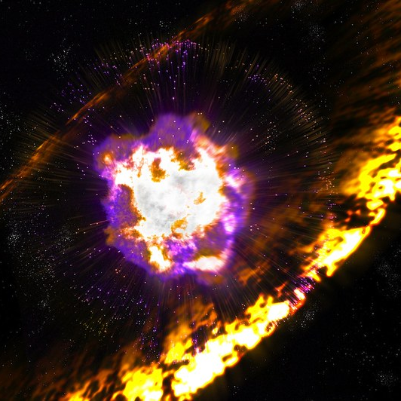
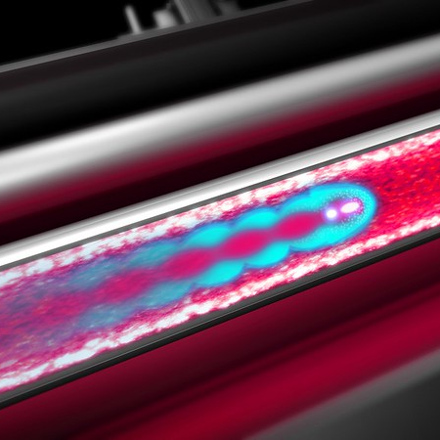
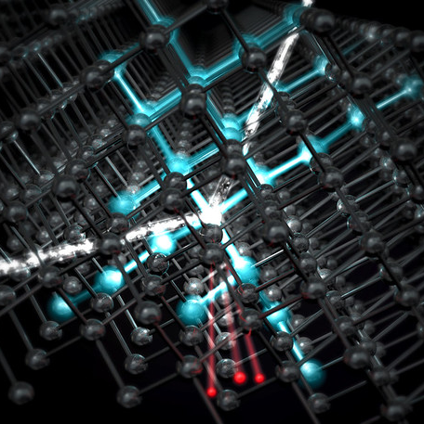

Nonequilibrium Phenomena are Prevalent
Nonequilibrium systems – systems not in thermodynamic equilibrium, frequently driven by outside forces – range from gas giants in the outer solar system to living organisms and quantized particles.
Astrophysics
Plasma physics
Quantum phenomena
Notes:
Nonequilibrium dynamics are ubiquitous
These are systems not in thermodynamic equilibrium, ranging from astrophysics to plasma, to living organisms and quantum phenomena
They tend to be short-lived or elusive, and in constant intermediation with their environment

Slide 3
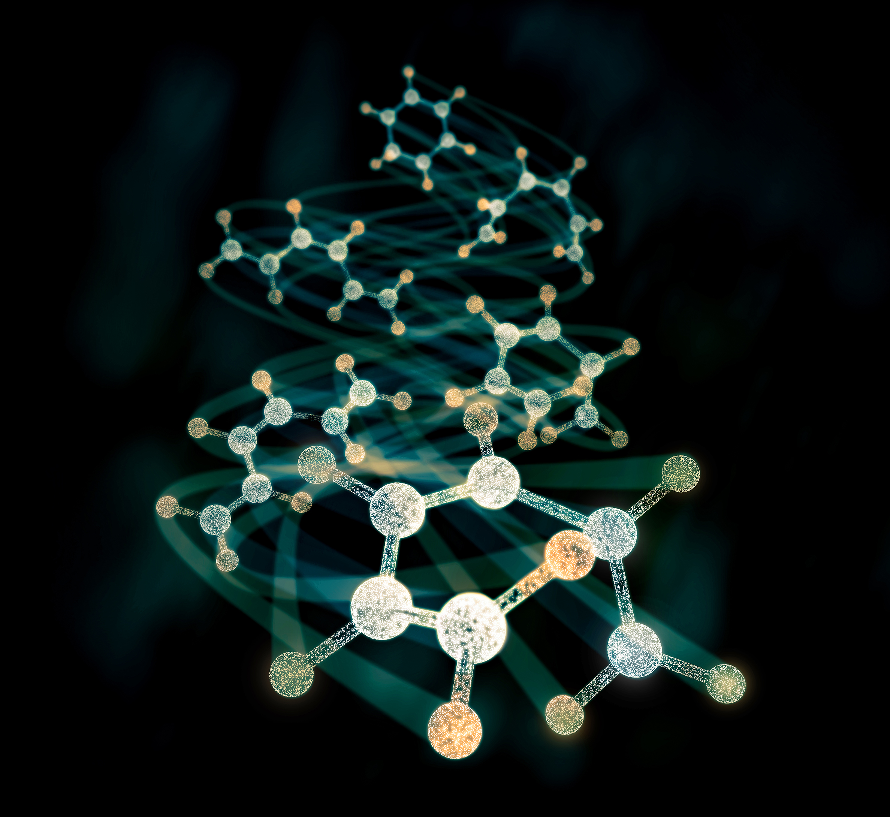
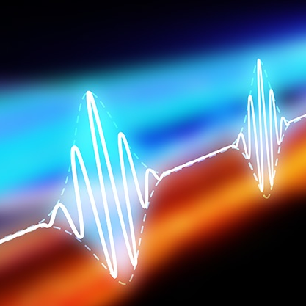
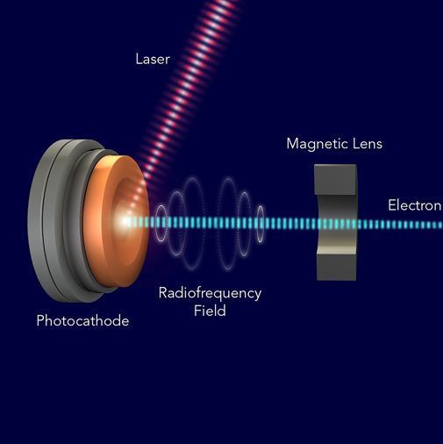
Today’s Outline – Scientific & Instrumentation Demands for Understanding and Ultimately Controlling Nonequilibrium (Biological) Phenomena
Ultrafast
Molecular Dynamics
Studying many-body localized states that evade thermalization
Novel Drives
Ultrafast electron and
X-ray wavepackets
6D-shaped electron and photon wave packets to orchestrate and control them.
New instruments and probes at attosecond time and Ångstrom length scales
Notes:
For today, let’s focus on nonequilibrium dynamics of water. For that, my presentation will be focused on three main aspects

Slide 4
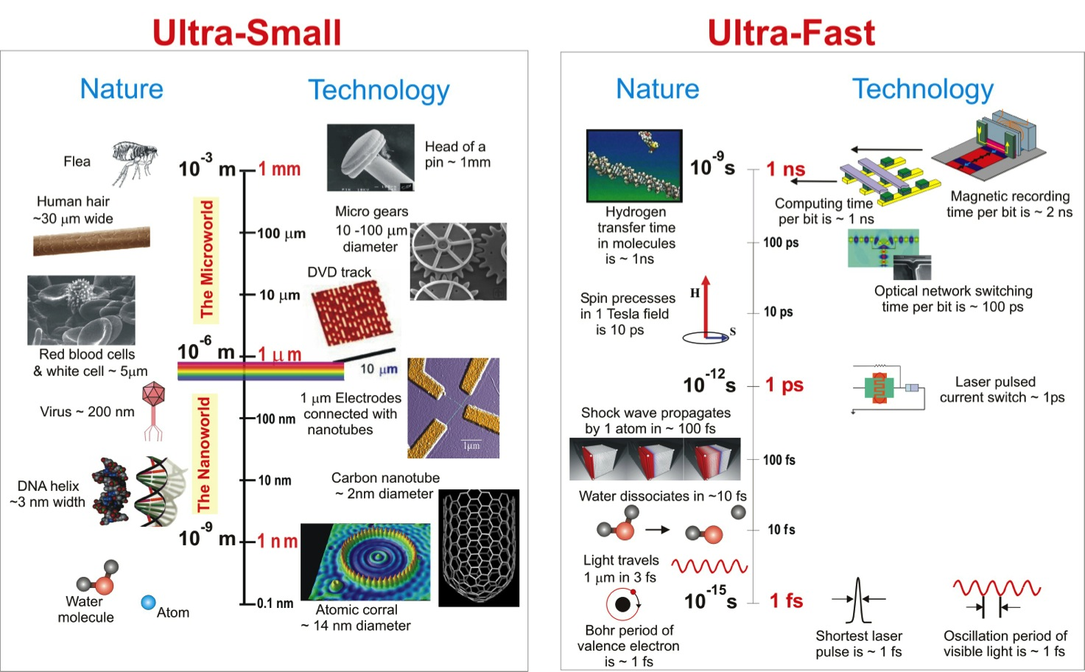

Visualizing Electronic, Atomic, Molecular Structure and Dynamics
Recording stop-action events involving attosecond electronic transitions in quantum systems is the hallmark of today’s frontiers in ultrafast physical chemistry and quantum mechanics
atto 10⁻¹⁸ s
Electronic dynamics
Atomic, molecular &
(soft) condensed matter physics
Physical and biological
chemistry / optoelectronics
Electro-mechanical
procceses
femto 10⁻¹⁵ s
pico 10⁻¹² s
nano 10⁻⁹ s
micro 10⁻⁶ s
functional
properties
Notes:
And why is this important?
A typical experiment consists of using an otpical pump and ultrafast probe with XFELs or semi-relativistic electron sources?

Slide 5


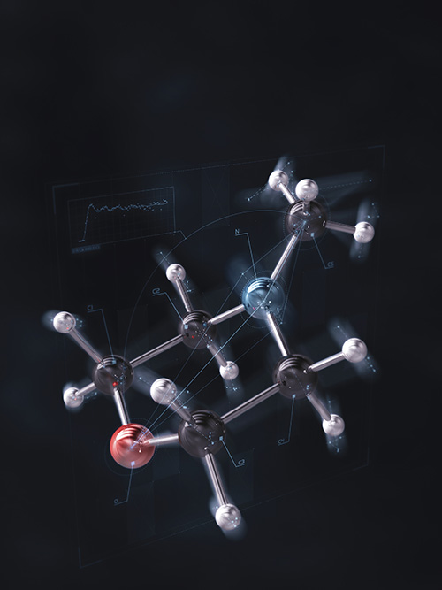
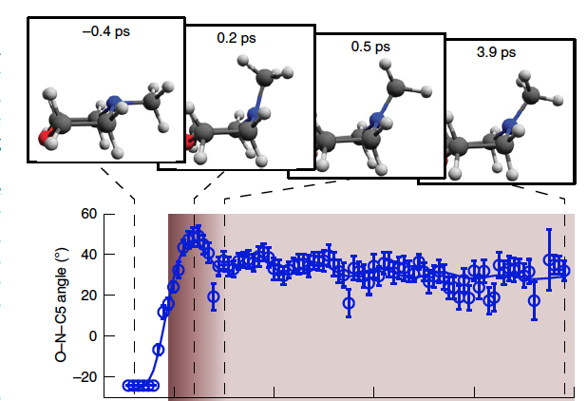
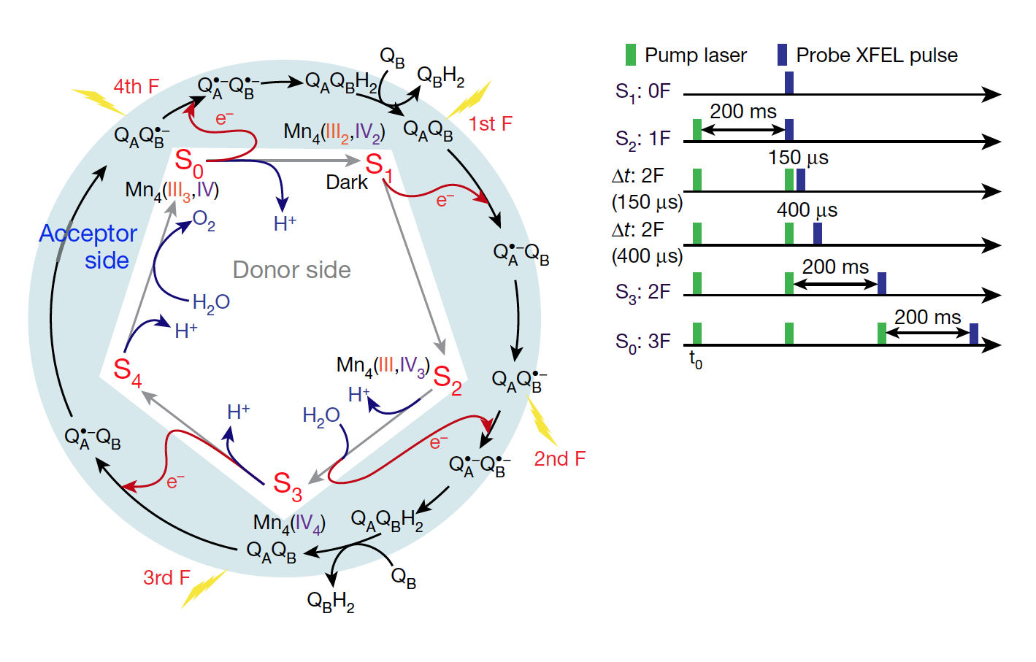
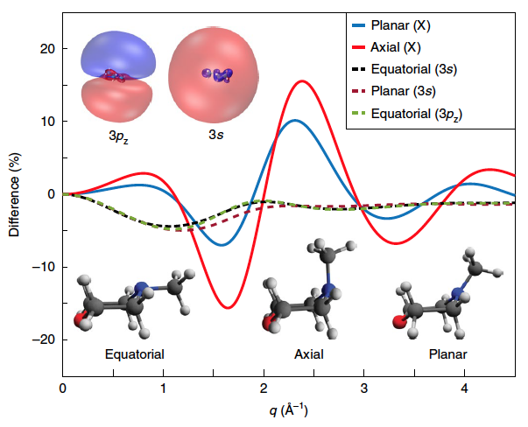
Impact of Ultrafast Sciences
Recent breakthroughs in life and energy sciences
Photosynthetic water oxidation clock
• Fundamental life process on Earth
• Path towards synthesis of sun-light harvesting
biotechnologies in energy
Electronic and atomic rearrangement in light-triggered reactions
• Example of photoexcited fs-to-ps molecular dynamics of NMM
• Understanding and theoretically modeling photoreactions for material sciences, environmental engineering, and medicine
Stankus, Nat. Chem. 11,
716–721(2019)
Ruddock, Science Advances 5,
eaax6625 (2019)
Dods, Nature (2020)
https://doi.org/10.1038/s41586-020-3000-7
Kern, Nature 563, 421–425 (2018)
Ibrahim, PNAS 117, 12624 (2020)
Hussein, Nat. Comm. 12.1 (2021)
Notes:
With the advent of these instruments, the last decade is experiencing a renaissance in life and energy sciences. For example
(NMM: N-Methylmorpholine)
But much of the ultrafast structural biology using XFELs today is light-triggered, while the vast ensemble of kinetically or thermally activated chemical and biochemical reactions remain unaddressed or only studied after thermalization

Slide 6


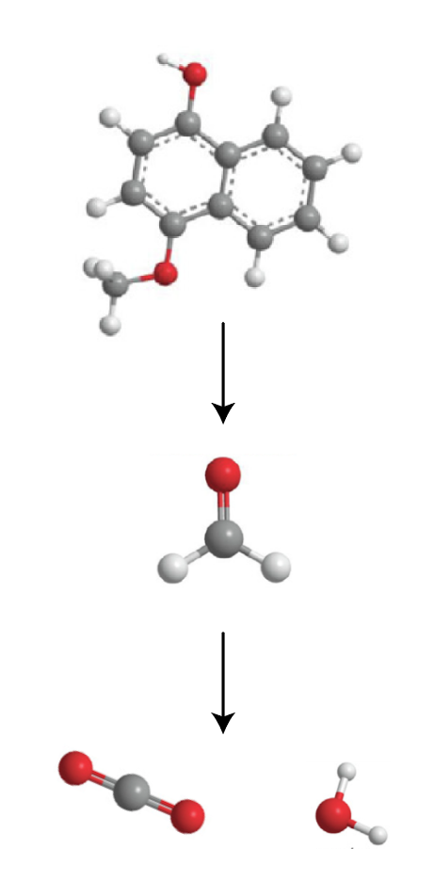
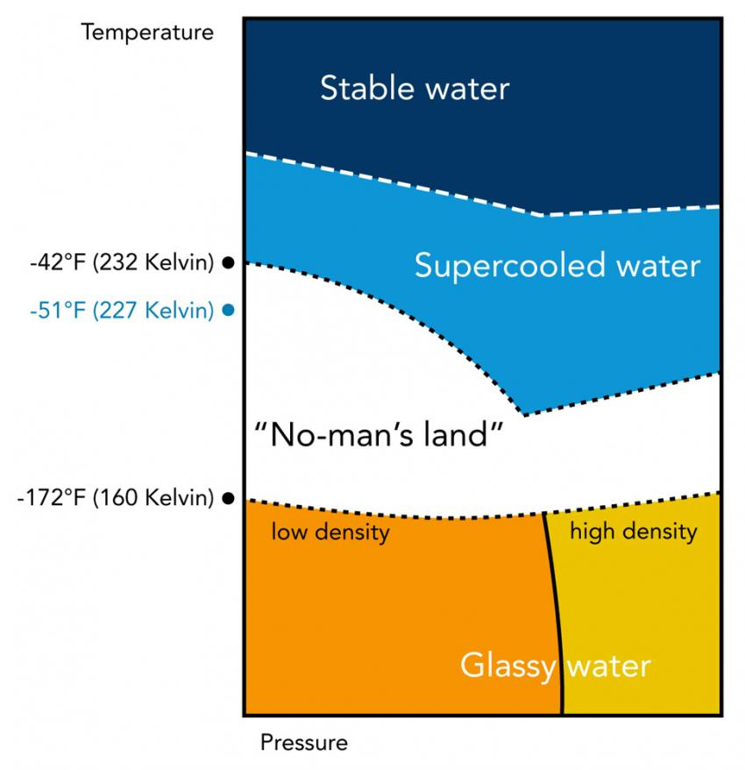
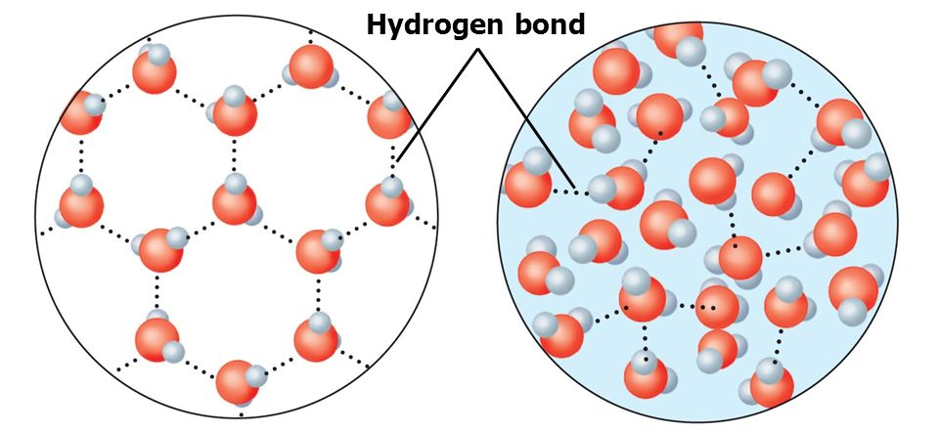

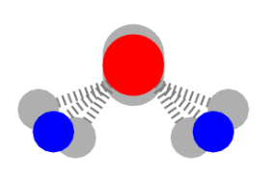
Nonequilibrium Dynamics of Water
A Gateway to Generalized Biochemistry and Physical Chemistry
THz pulse
Active medium for the vast majority of chemical and biological processes
  Isolated molecule, clusters, and bulk
  Temperatures & pressures (relatively unknown phase diagram)
  H-bond network is at the heart of the diverse facets of water
4-methyl-1-naphtol (C₁₁H₁₀O)
T-jump
How can we activate and precisely control the
H-bond network?
THz librations
Formaldehyde (CH₂O)
fs-ps / non-equilibrium
H-bond disruption
ns and beyond / equilibrium
thermalization
Controlling the H-bond network offers multi-faceted functions
  Biochem/biotech: guest-host interactions, quantum mechanical effects in enzymatic catalysis, personalized drug delivery and activation
  Chemical and environmental engineering: supercritical water is an effective supersolvent with complete miscibility for catalyzed organic chemistry (e.g. supercritical water oxidation and waste reduction)
  Atmospheric and geoengineering: superheated and supercooled opens the door to study and control atmospheric phenomena in a laboratory (ice nucleation, weather dissipation)
CO₂
H₂O
Phillips, Y. Mizutani, PNAS 92, 7292 (1995)
Ma, PNAS 105, 12754 (2008)
Notes:
So then, how is water central to all of these dynamical studies? Here, I posit that we can use water to bypass the electronic excitation manifold for generalized kinetically activated processes, at ultrafast timescales, and in nonequilibrium conditions all the way to thermalization

Slide 7
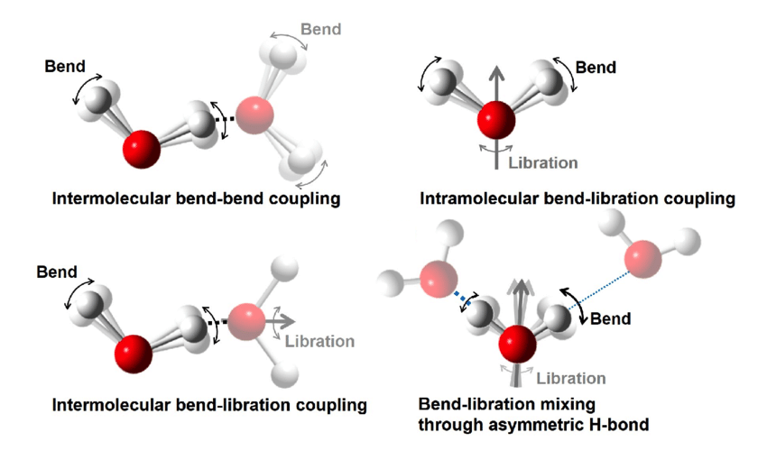
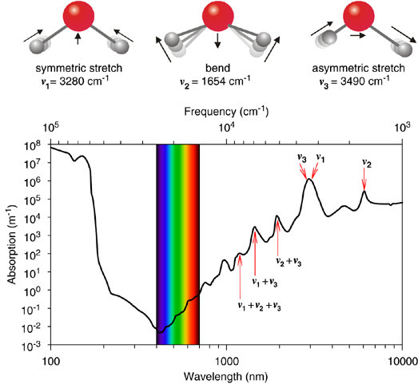
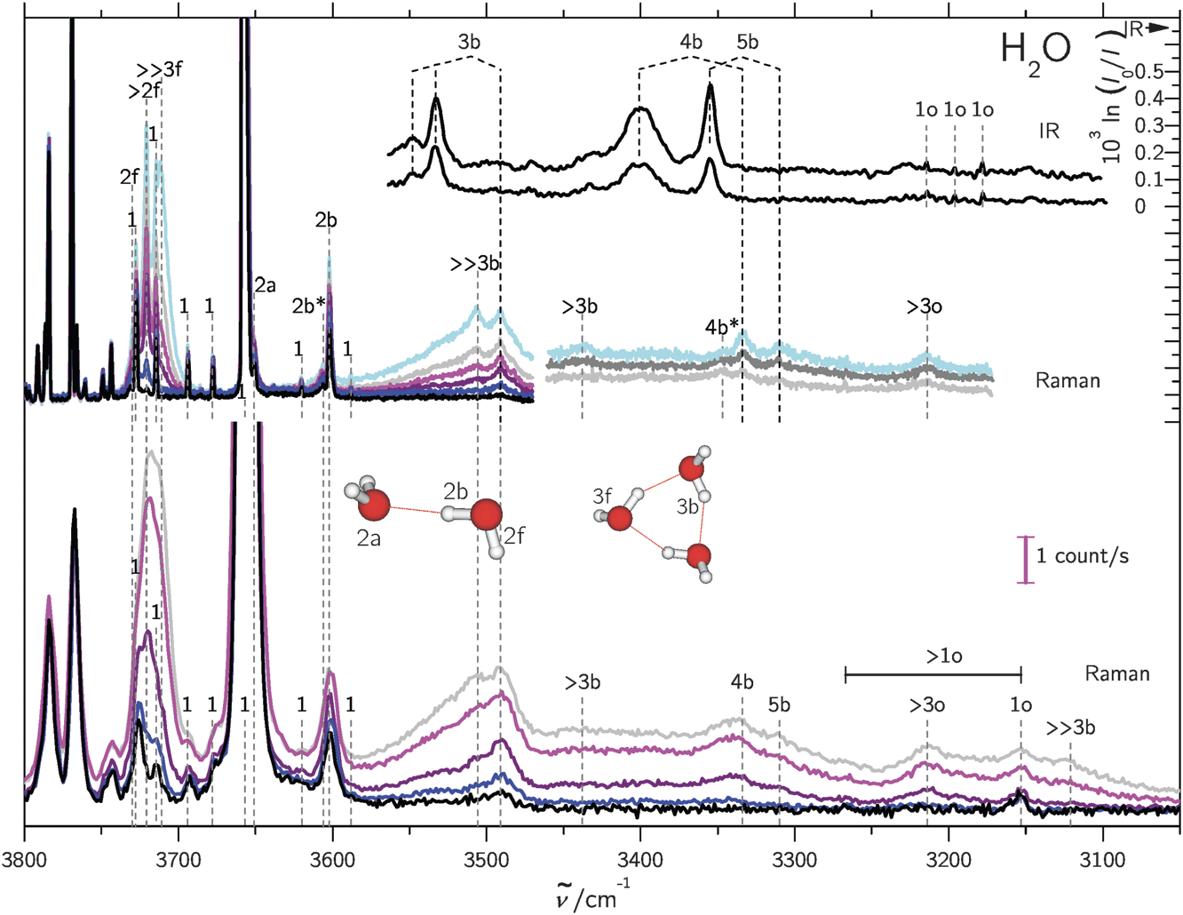
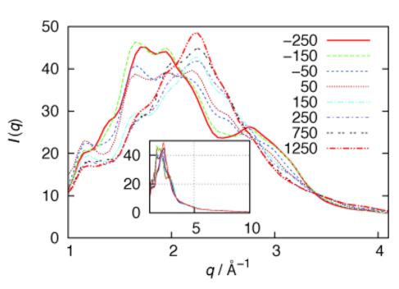
Accessing Librational Coupling
IR drivers vis-à-vis far-IR and THz drives
ΔKE and ΔT – Drive 30 THz (1000 cm⁻¹), 100 fs;
decompositions (translational and rotational) and XCS
Librations
Yu, Nature Comm. 11.1 (2020): 1-8
Librations
• Prominent beyond ~7 μm (1500 cm⁻¹) into the THz (10 cm⁻¹)
• High absorption cross-section
• Flat absorption spectrum / low chromatic selectivity
• Ultrafast dynamical O-O and O-H features can be extracted directly through
X-ray scattering
Curcio, JOSA 41.5 (1951)
Hasted, Chem Phys Lett 118.6 (1985): 622-625
Stomp, ISME J 1, 271–282 (2007)
Otto, Phys Chem Chem Phys 16.21 (2014): 9849
Mishra, Ang. Chemie 52.51 (2013): 13685
Mishra, Phys. Rev. E 93, 32124 (2016).
Schienbein, Angew. Chemie (2020)
Lehmkühler, PNAS 117, 24110 (2020)
Notes:
Accessing IR-coupled water excitation is certainly not new.
Simply using near-IR excitation, there are still open questions on collective effects, many-body interactions and coupling, and thermalization pathways being studied today.
But generally speaking, it’s well understood that a water monomer exhibits symmetric and asymmetric O-H stretching and bending at distinct resonances in the few-micron wavelength range as well as combinations of these.
Librations require a slower temporal cycle for the entire monomer to follow the polarizability and thus lie at a flat plateau approximately beyond 7 um and into the THz with high absorption cross section.
Here – we simulate the energy deposited with a 30 THz pulse and its distribution into translational and rotational modes, and an equivalent Temperature jump of hundreds of K for moderately high and achievable THz intensities. In these timescales, water clusters don’t yet have time to expand and the structure may resemble supercritical like water. We can also retrieve this from X-ray scattering data with high spatiotemporal resolution – we’ll talk about this shortly

Slide 8
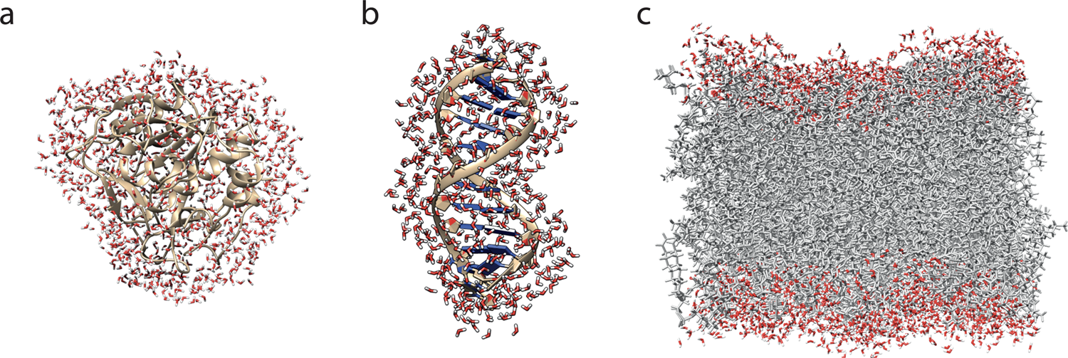
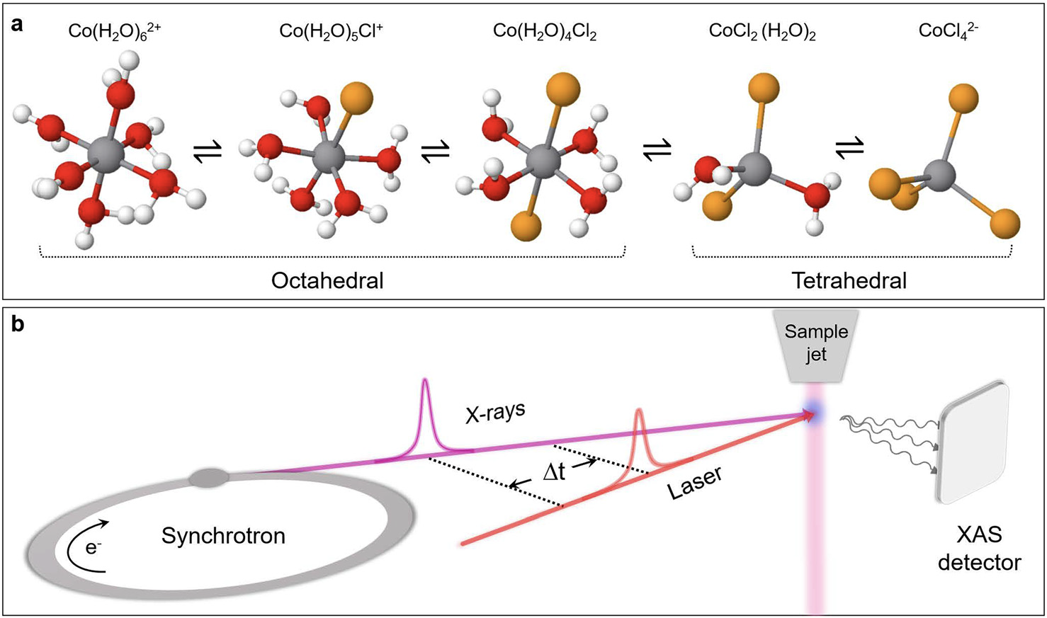
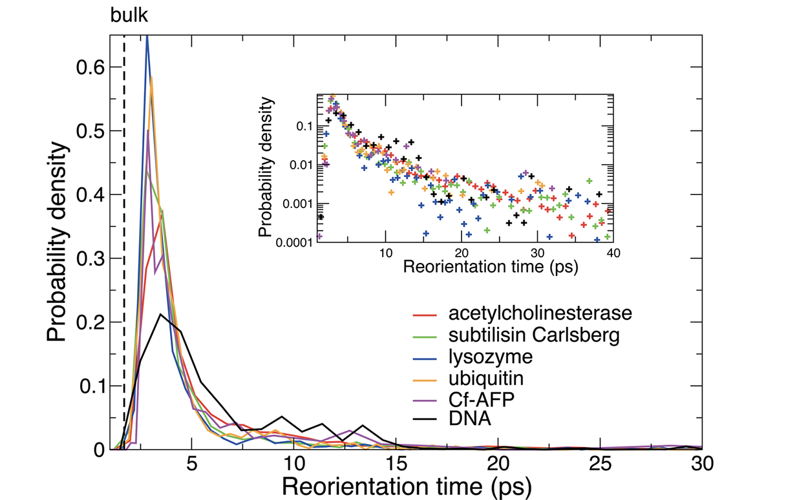
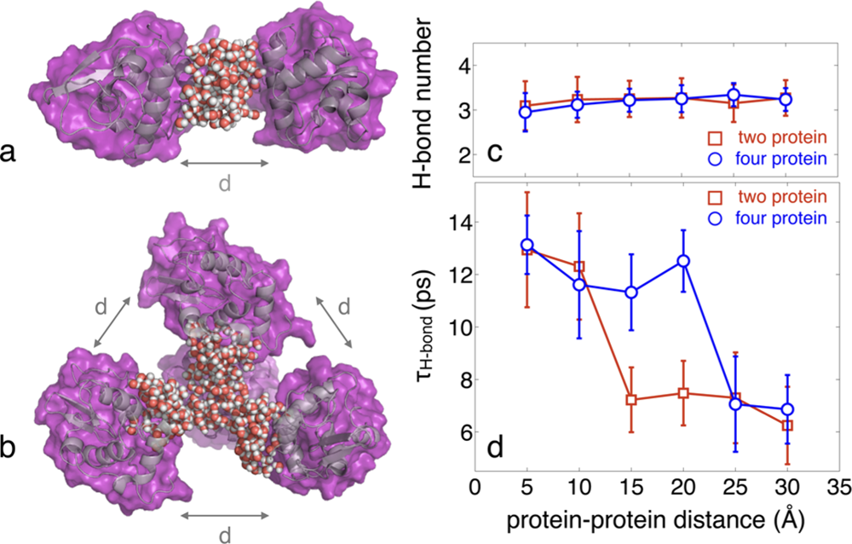
Hydration Layers in (Quantum) Biology – Studies of Conformation and Reaction Dynamics at the Thermal Limit
Structurally and dynamically perturbed hydration shells that surround proteins and biomolecules
have a substantial influence upon their function and stability
Dynamical T-jump bringing reactants above the energy barrier for reaction
Protein
DNA
PL bilayer
It is challenging to gain a comparable understanding of water dynamics in actual biochemical systems
• Enhanced sensitivity and selectivity will be required (sub-Å and femtosecond)
• Preferably noninvasively
• Describe collective interplay between the water
H-bond fluctuations and the biomolecular electrostatic interactions
Possibility to understand the consequences of the perturbed hydration dynamics on the properties and on the function of biomolecules
Reorientation times
Crowding effects
Cannelli, Structural Dynamics 6.6 (2019): 064303
Laage, Chemical Reviews 117.16 (2017): 10694-10725
Notes:
But before I do, I wanted to briefly review some of the work that’s already established a linkage between the perturbation of water and biomolecular function and stability – all of it in thermalized states
Using synchrotron radiation synched with an IR laser…
In similar configurations, proteins, DNA, and lipid bilayers have been studied from T-jump to study reorientation times or crowding effects…
But it’s still challenging to study

Slide 9
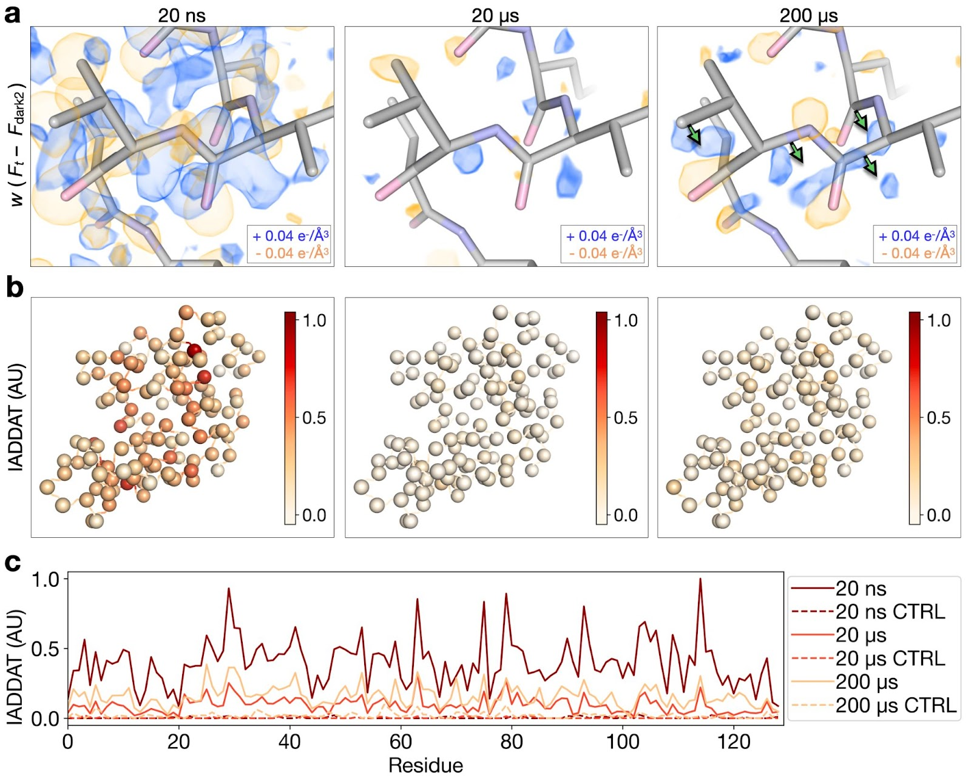
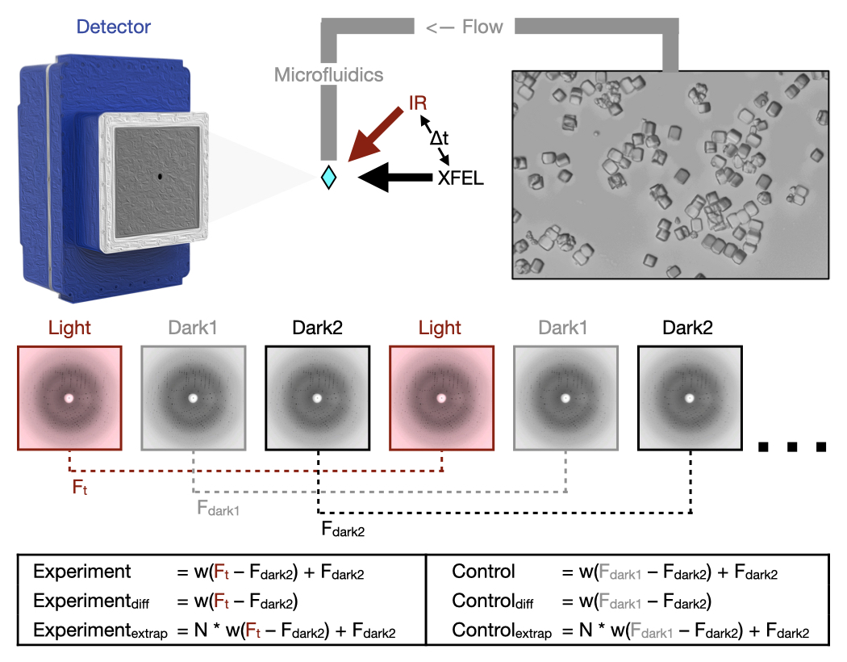
Understanding Protein Dynamics
T-jump time-resolved crystallography of lysozyme
Conformational dynamics are key to complex biomolecular functions including enzyme catalysis and allosteric regulation
• T-jump is a universal method for perturbing molecular motion, so it’s a model broadly applicable for studying protein dynamics
• Key motions that allow energy to dissipate from vibrations into functional movements linked to the catalytic cycle are blocked with an orthogonal perturbation to the enzyme (inhibitor binding)
Inhibitor Binding Alters T-Jump Induced Dynamics
• Data for lysozyme bound to a naturally-occurring inhibitor, chitobiose
• T-jump data for chitobiose-bound crystals is collected at two pump-probe time delays (20 ns and 200 μs)
• Time-resolved difference maps calculated for chitobiose bound crystals reveal an altered dynamic response
20 ns difference density looks similar for both unbound and chitobiose-bound crystals
Marked differences are evident by 200 µs
Wolff et al. bioRxiv (2022)
doi: 10.1101/2022.06.10.495662
Notes:
In fact, to show you a recent example from our collaborators,

Slide 10
Challenges Ahead for a Leap in Ultrafast Dynamical Biochemistry
Instrumentation – cost and size of probes and pumps
    Compact quasi-relativistic electron sources
    Compact ultrafast (hard) X-ray sources
    Tunable, high average power mid-, far-IR and THz sources
Sample delivery and methods
  Lab-on-a-chip microfluidic devices in (compact) XFELs
  Liquid-phase and soft-condensed matter systems in UED
  THz-PIC (photonic integrated circuits) integrated microfluidic devices
Fundamentals – beyond the nanosecond time resolution
  Fundamental knowledge of nonequilibrium systems
  Collective and coupled effects
Access
  Comprehensive biomolecular dynamics library
  Standardized computational methods to enable real-time reconstruction of dynamical biomolecular activity
Notes:
From this background and recent work, I wanted to present, from my point of view, some broadly applicable challenges to make great strides in water-driven nonequilibrium biochemistry

Slide 11
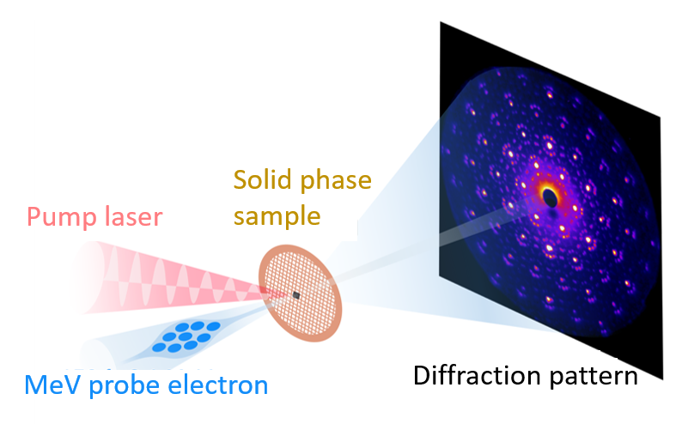
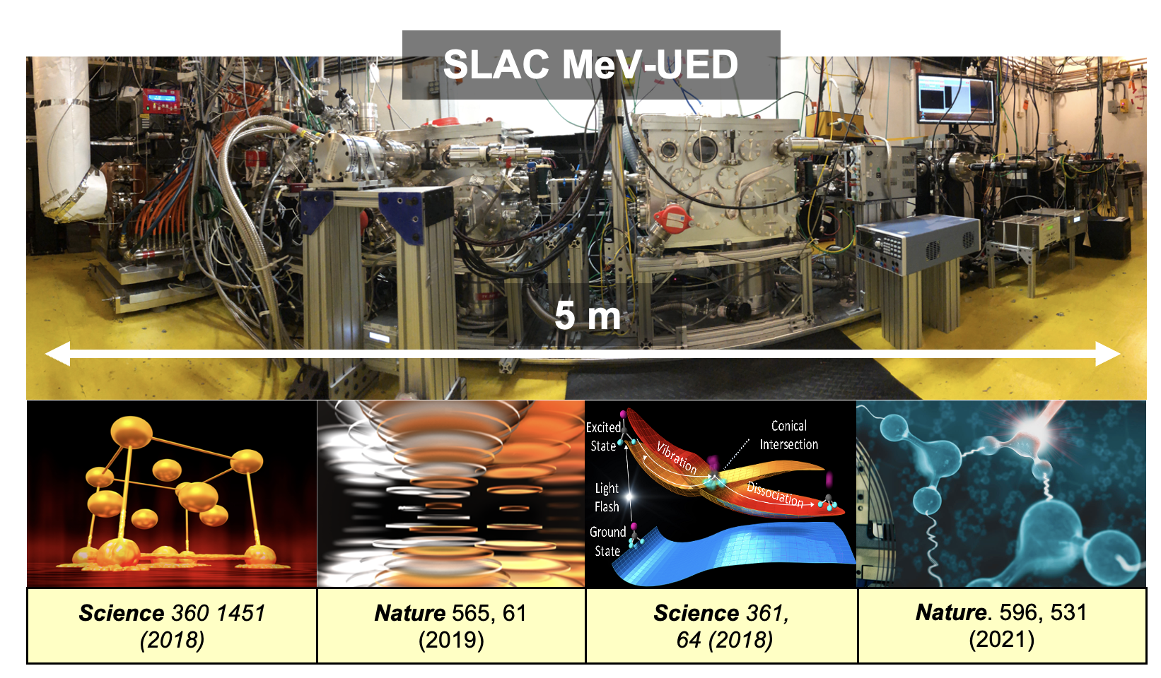

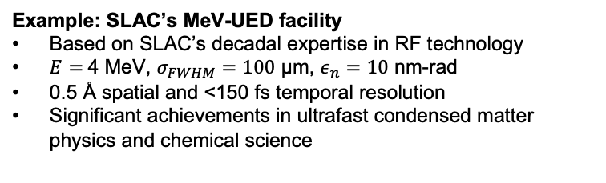
Probes – Ultrafast Free (Semi-relativistic) Electrons
Ultrafast electron diffraction (UED)
high-sensitivity probe for atomic structures
atomic spatial-temporal resolutions
complementary to x-ray probe for ultrafast science
Example: SLAC’s MeV-UED facility
Based on SLAC’s decadal expertise in RF technology
$E$ $=$4 MeV, $σ_{FWHM}=100$ μm, $ε_{n}=10$ nm-rad
0.5 Å spatial and <150 fs temporal resolution
Significant achievements in ultrafast condensed matter
physics and chemical science
Other UED machines:
North America (BNL, LBNL), Europe, Asia, etc.
e-beam energy keV – MeV
Notes:
So let’s briefly review some of these challenges & opportunities starting form electron probes

Slide 12
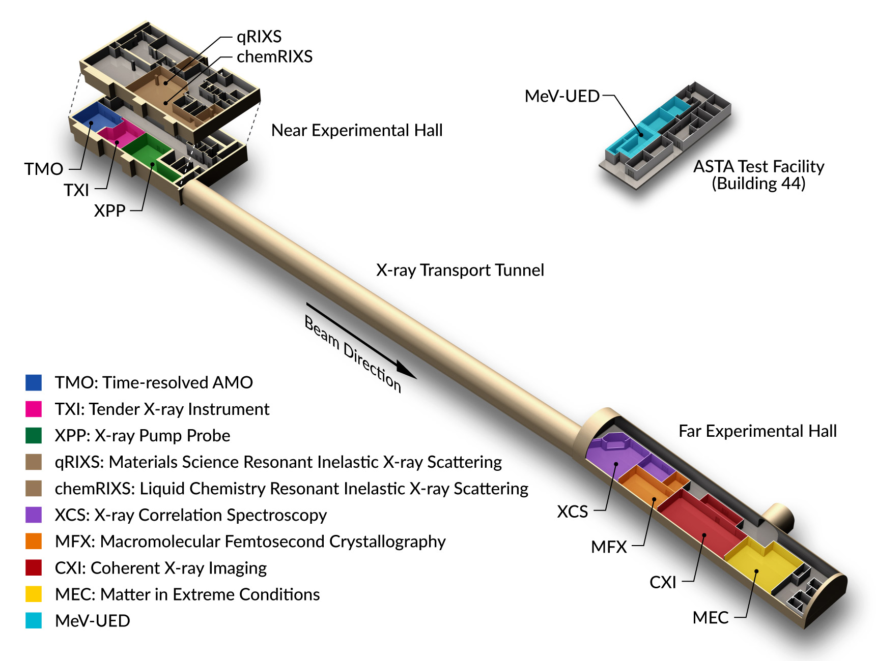
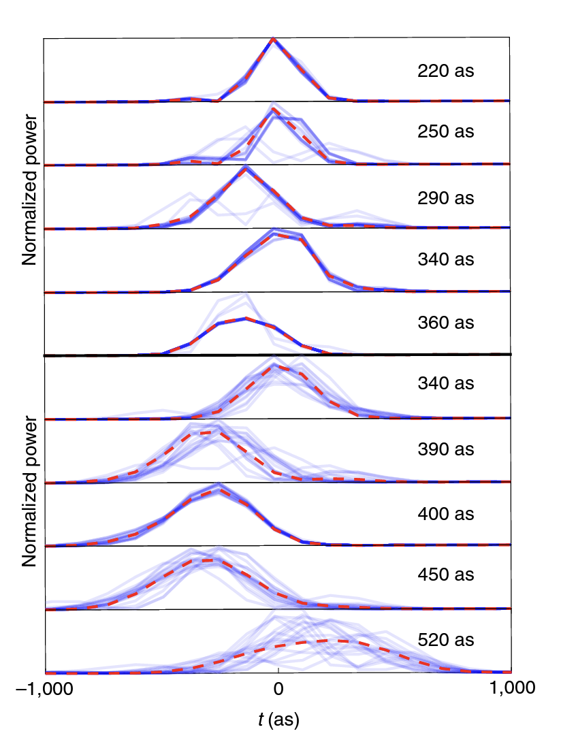
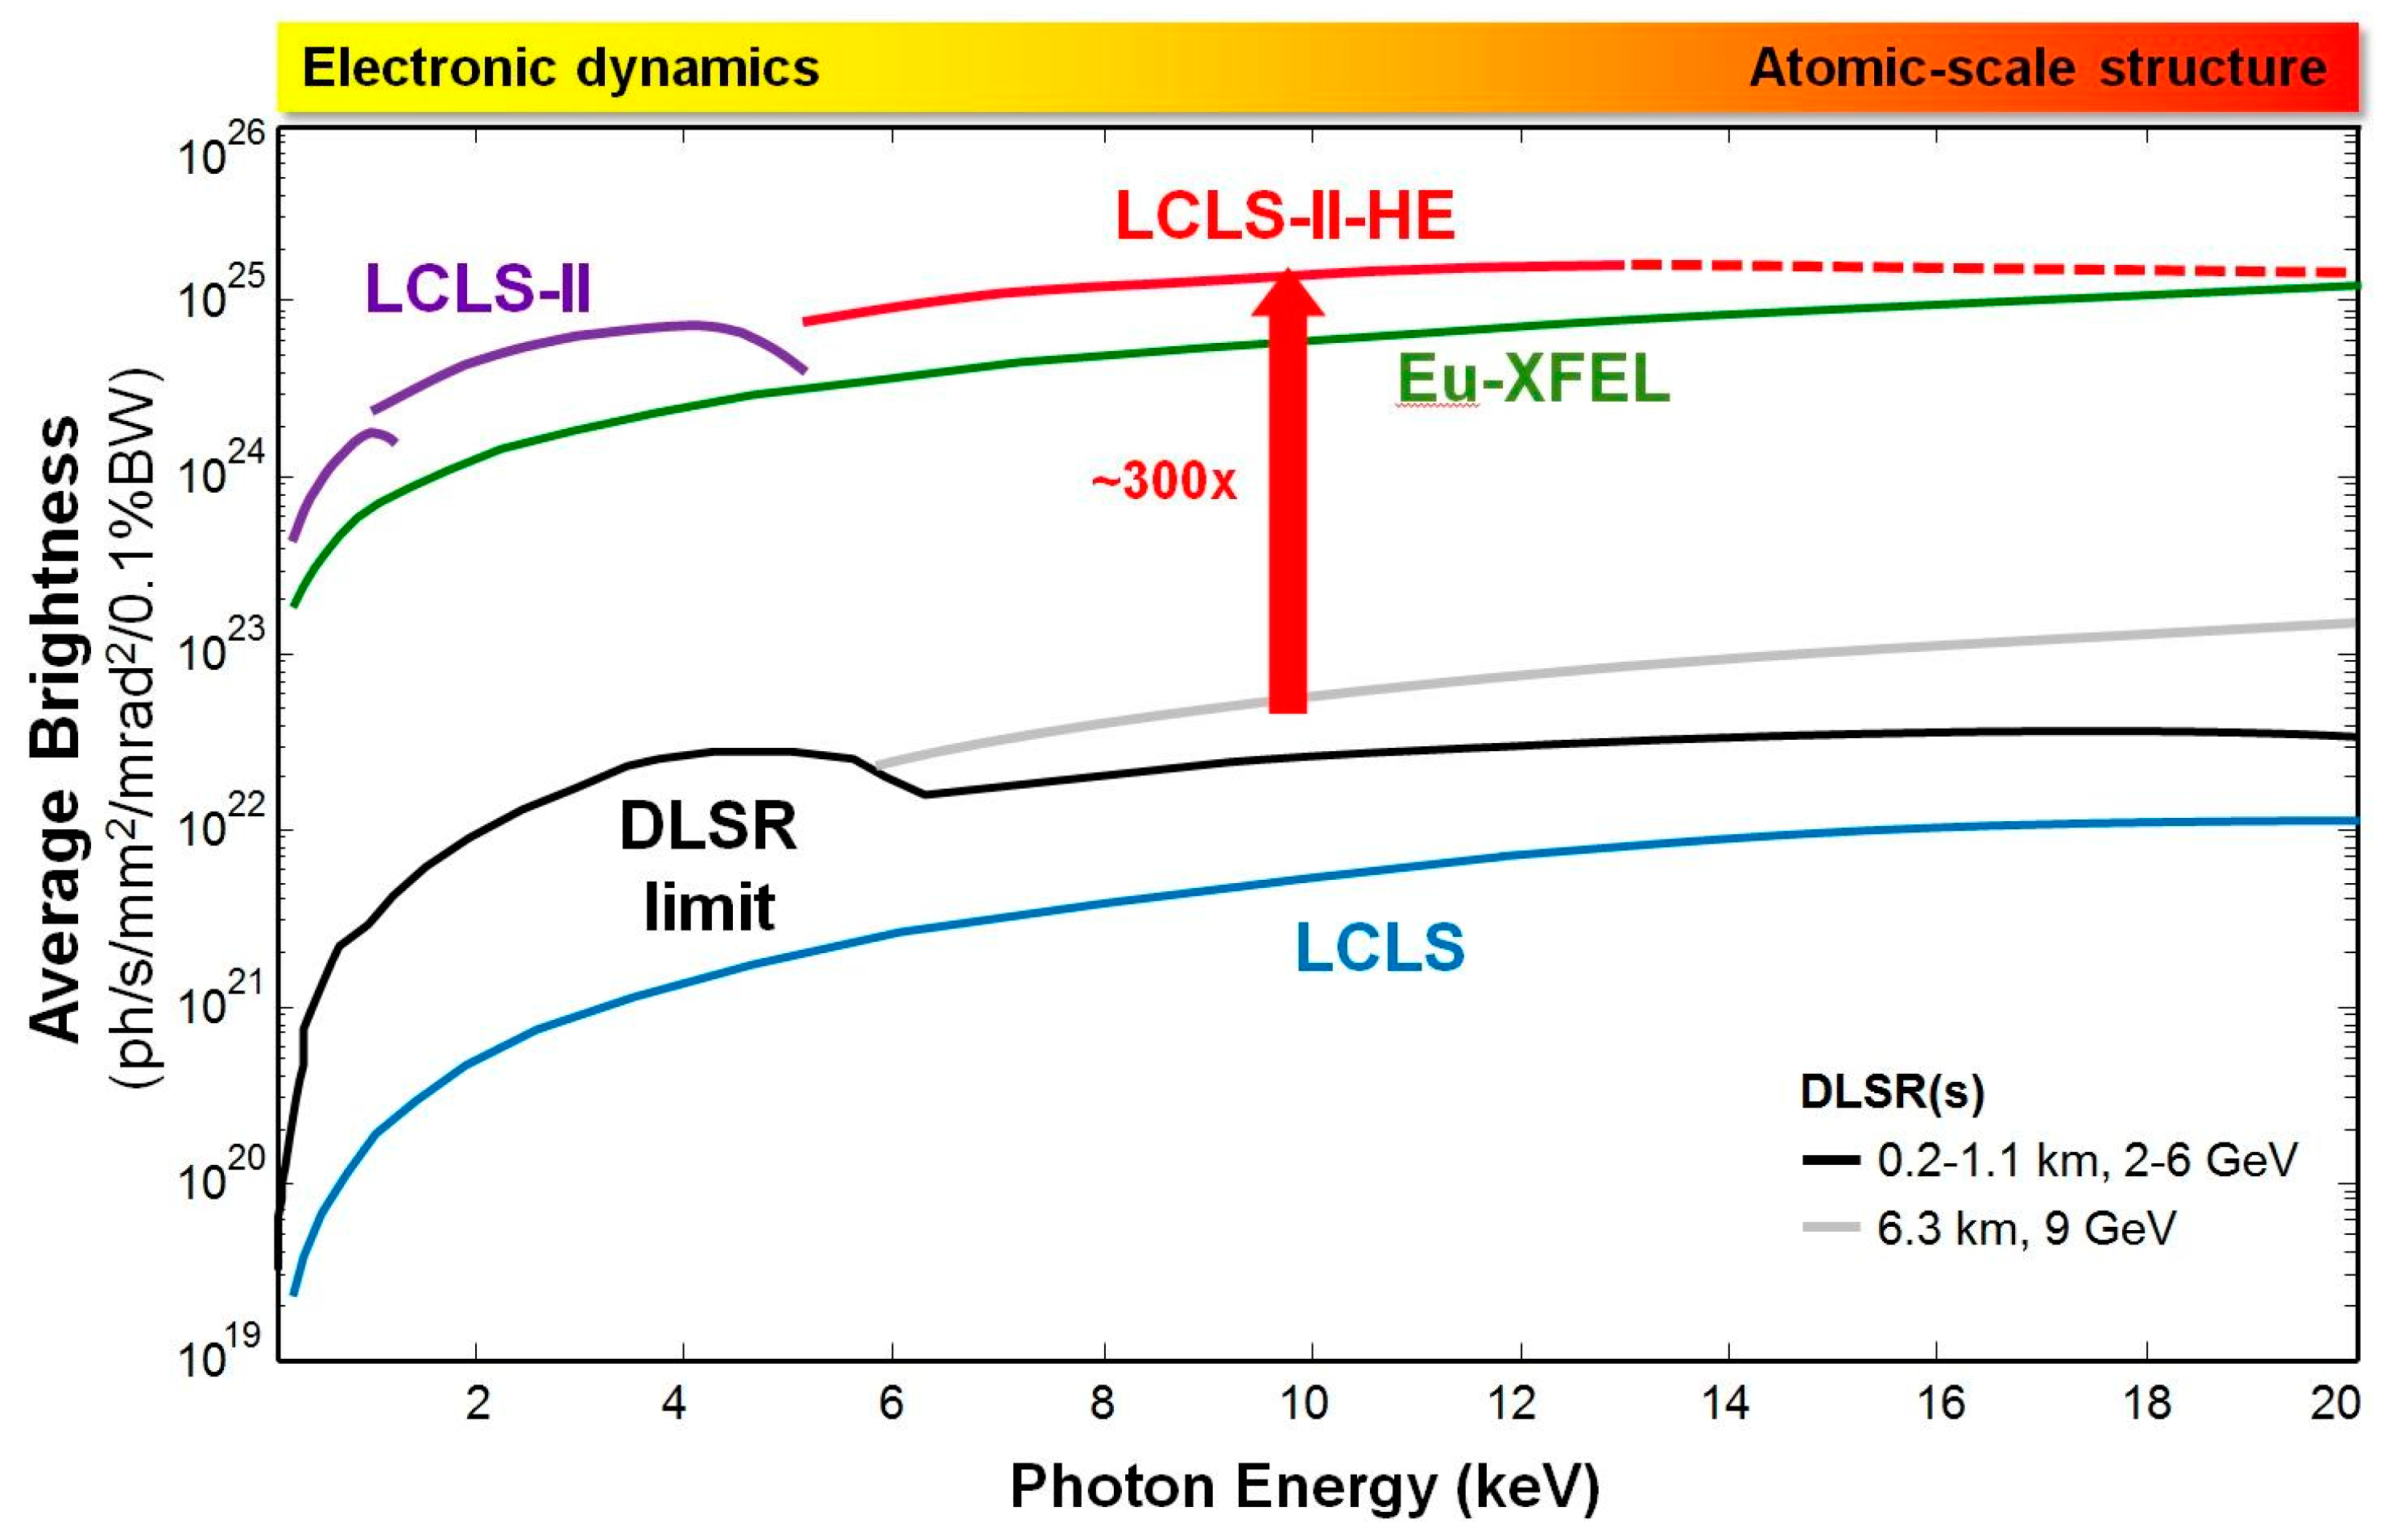
Probes – The new XFEL era, Eu-XFEL and LCLS-II
Nascent attosecond XFELs
gradually more routine
XFELs are here to stay and proliferating
Schoenlein, Applied Sciences 7.8 (2017): 850
Duris, Nat. Phot. 14, 30–36 (2020)
Notes:
In terms of XFELs,…

Slide 13
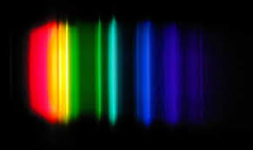
Drives – Development of mid-IR, far-IR, and THz sources
Tunable UV
NIR
UV - visible
mid-IR / FIR / THz
Notes:
Now let’s look at optical probes. UV, visible and NIR are routinely operated in UED and XFELs – but mid-IR and longer wavelengths are not as established

Slide 14
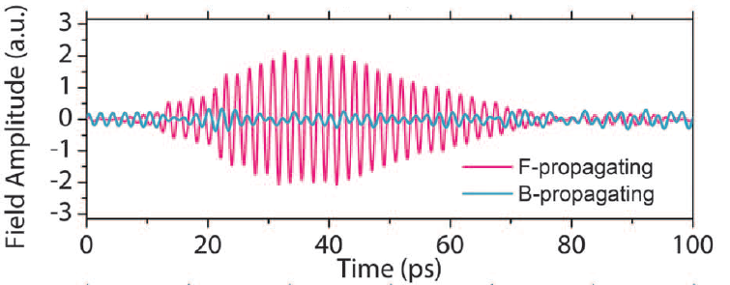
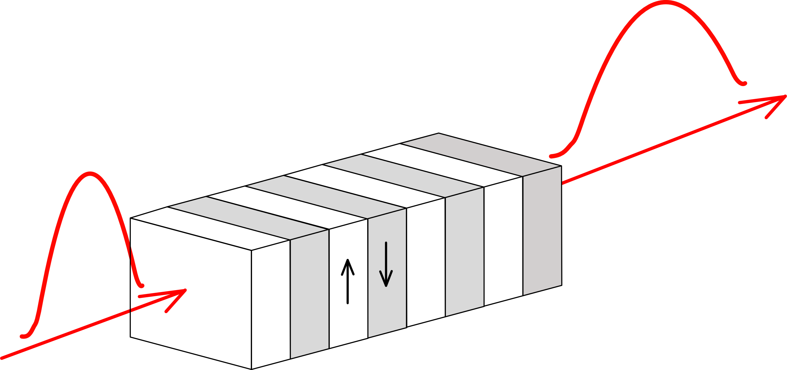
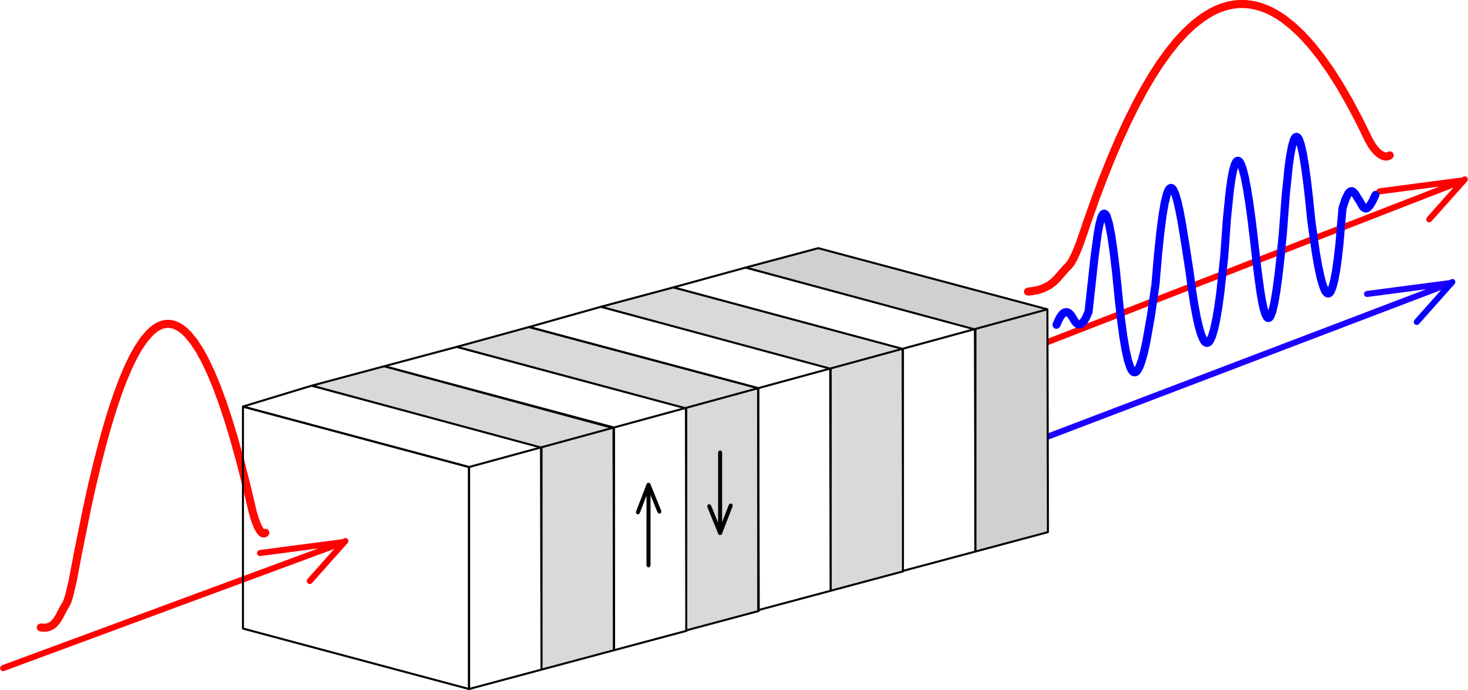
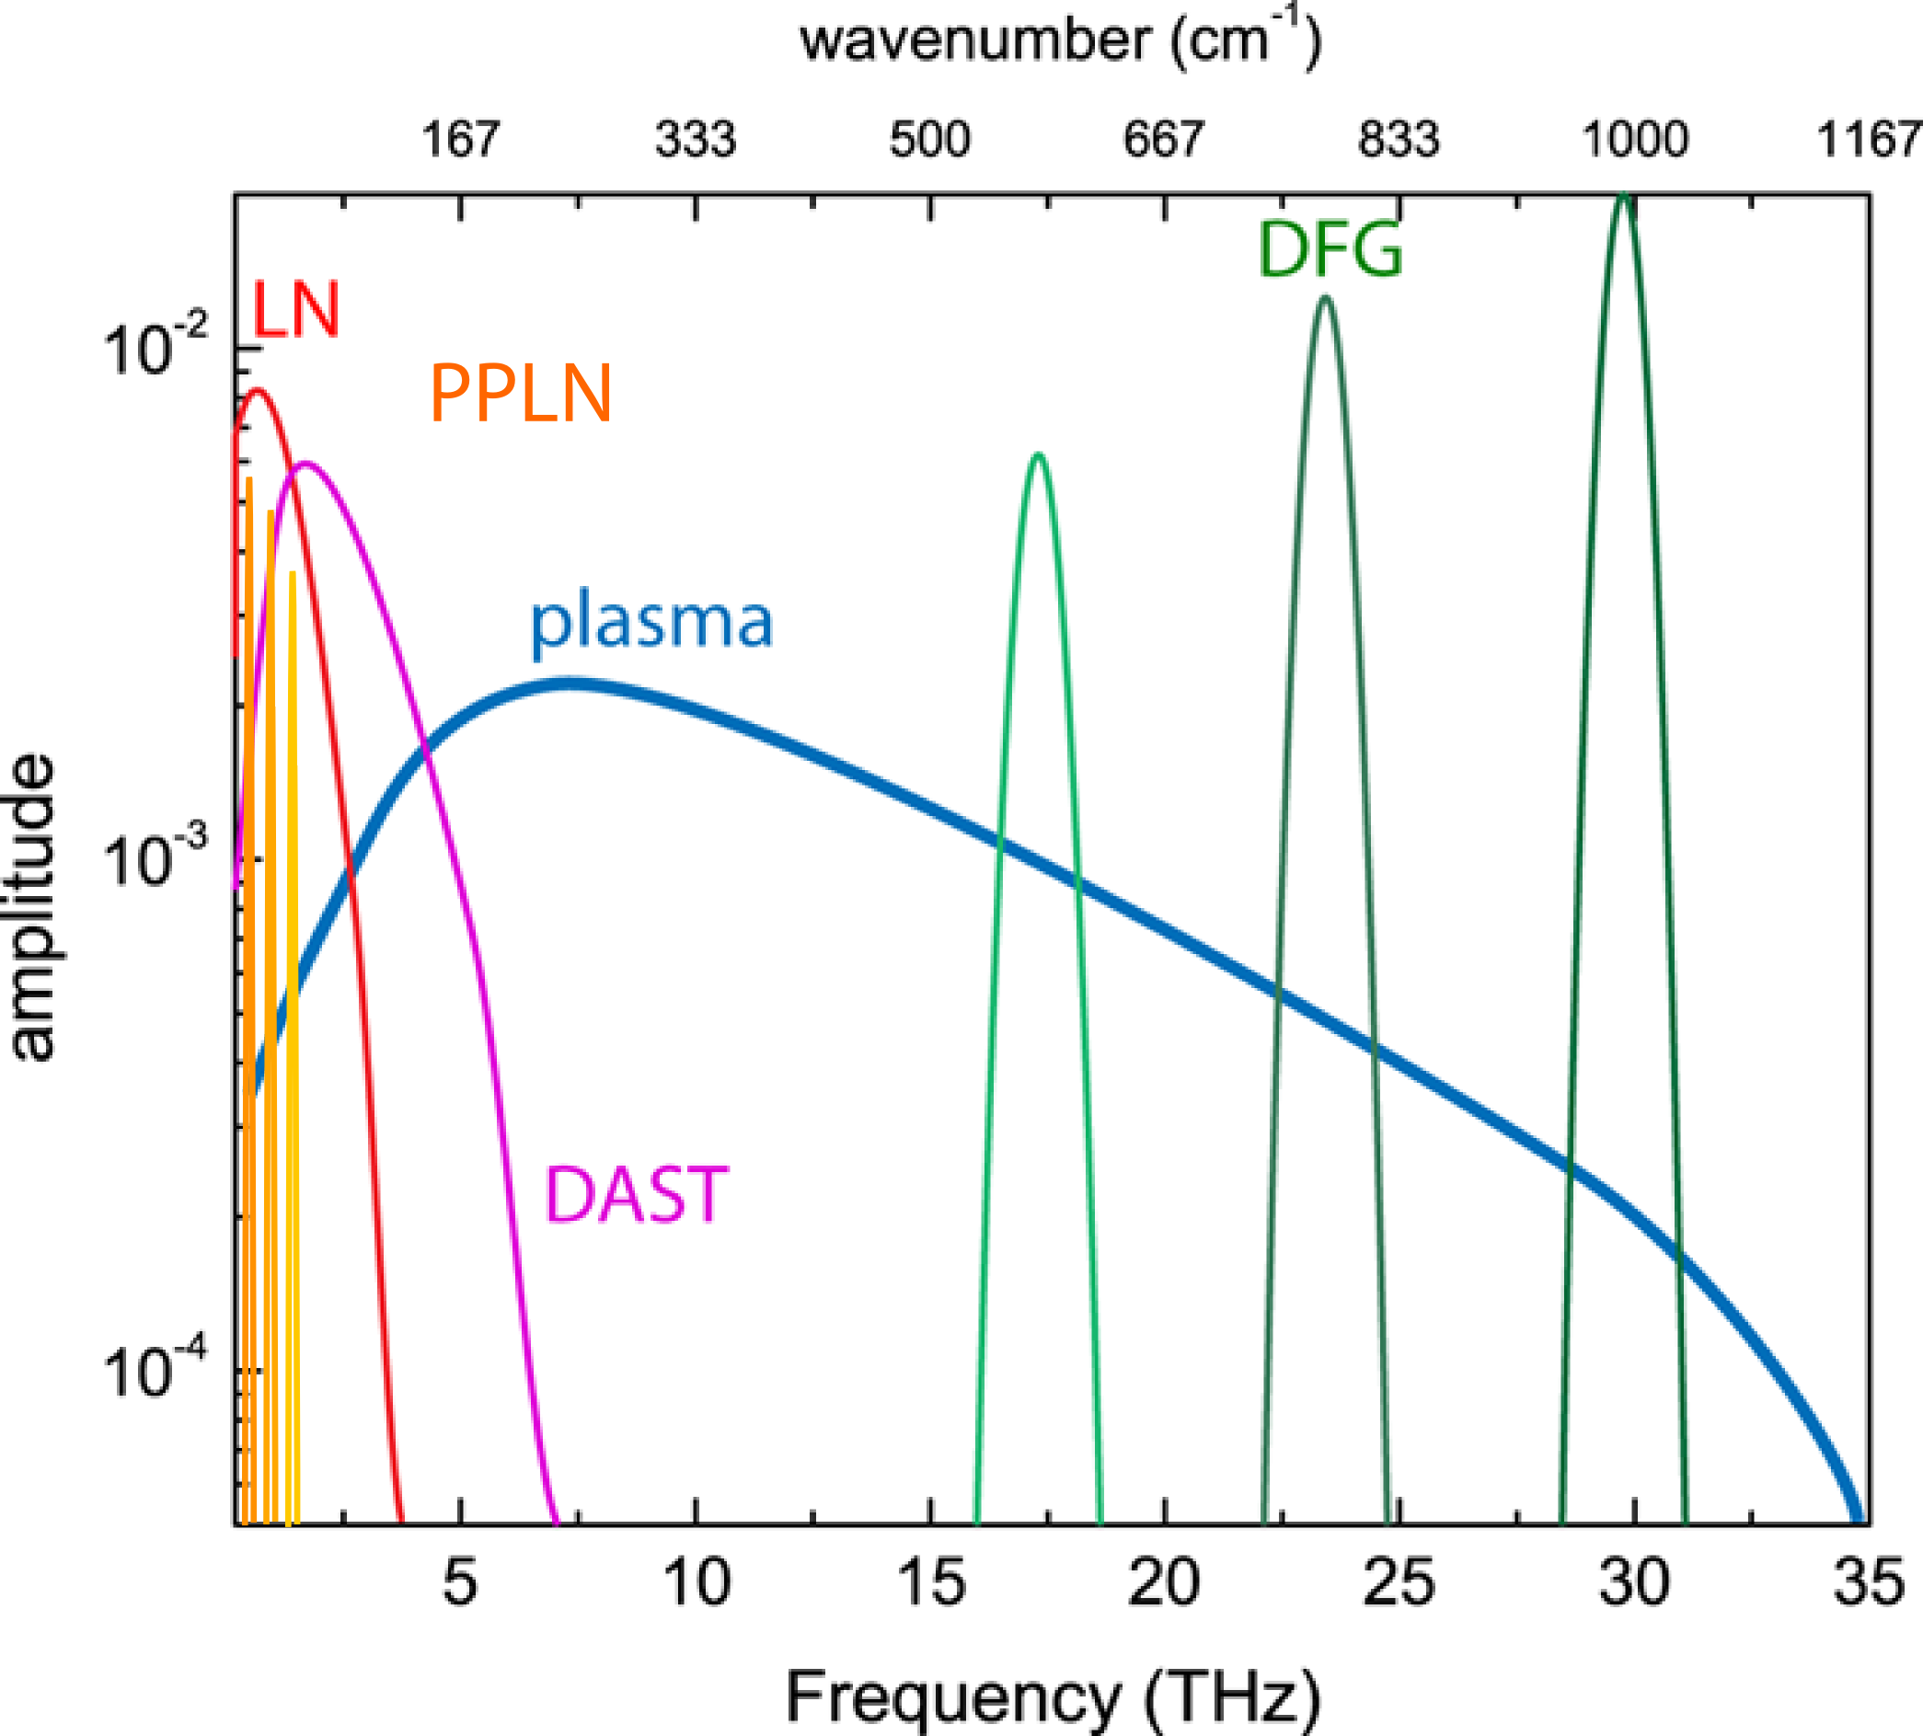
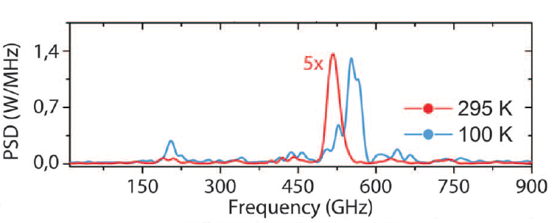
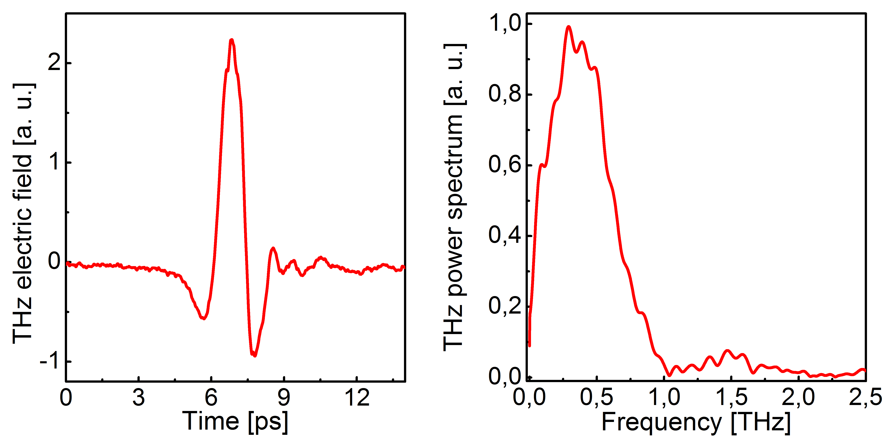
Drives – Development of mid-IR, far-IR, and THz sources
Laser-based FIR and THz Sources
• Optical rectification
  (in)organic crystals
  (quasi) phase matching
  Unmatched (plasma)
• Difference Freq Generation (DFG)
Quasi-phase matching
Narrowband / multi-cycle
PPLN
(also PPLT)
IR
IR
E_{THz}
Λ: domain period
Optical Rectification
Broadband / single-cycle transients
Carbajo, Optics letters 40.24 (2015): 5762-5765.
Koustuban, Optics express 23.4 (2015): 5253-5276.
Jolly, Nat Commun 10, 2591 (2019)
Notes:
First, producing them is not as easy

Slide 15
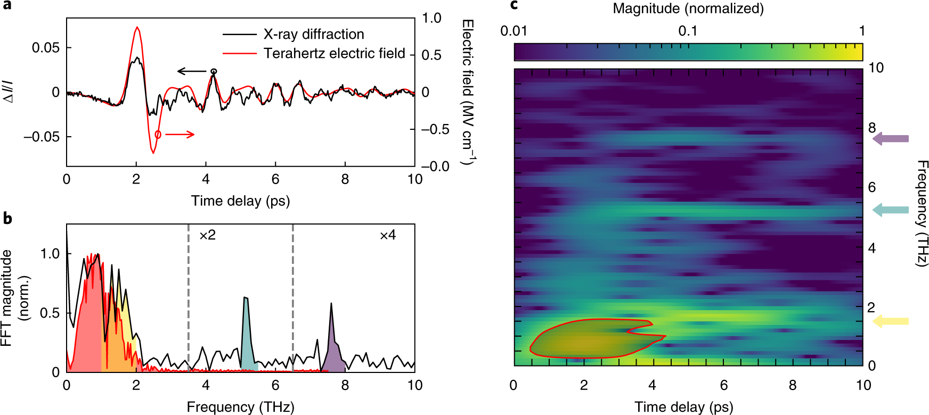
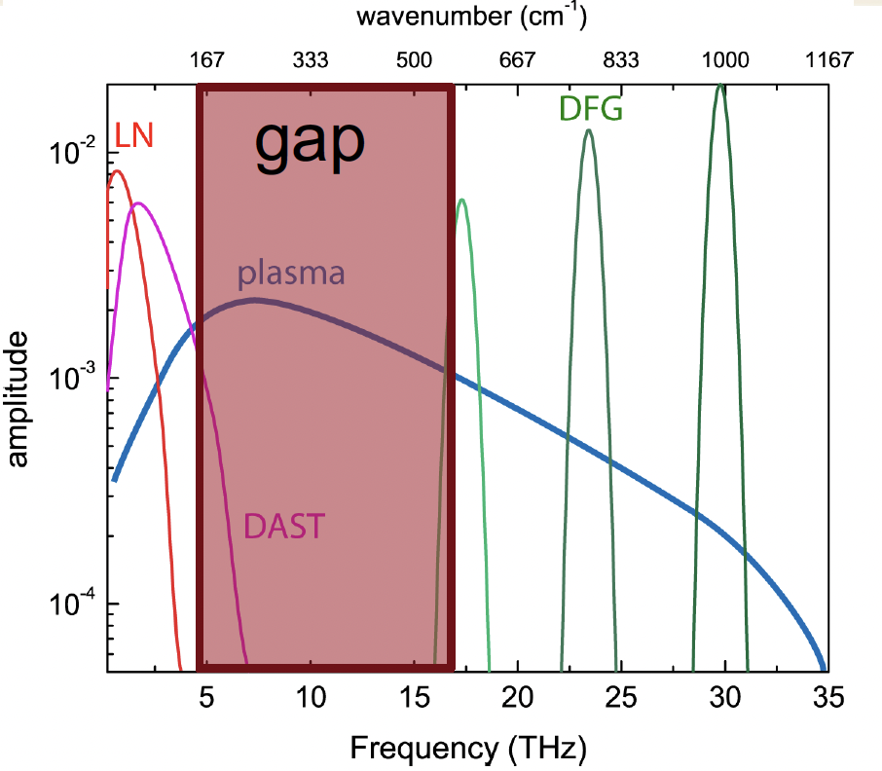
Drives – Development of mid-IR, far-IR, and THz sources alongside ultrafast X-ray and electron sources
THz generation in LNbO3
THz with tilted pulse front from grating or echelon using 800 nm OPCPA (100kHz, 30W)
THz with 1μm spectrally broadened Amphos system (150 kV/cm demonstrated at 100kHz)
PL Kramer,et al, Optics Express 28, 16951 (2020)
Power limits of difference frequency generation to MIR need to be explored
THz and MIR processes benefit from higher laser energy.
Power-scaling needs to be further investigated for MIR
Electron beam based THz source:
Potentially addresses the THz gap ~5-15 THz
THz beam transport from undulator hall to endstations
Notes:
Now, not only are these sources not as established but having the tethered to facilities is another added hurdle

Slide 16
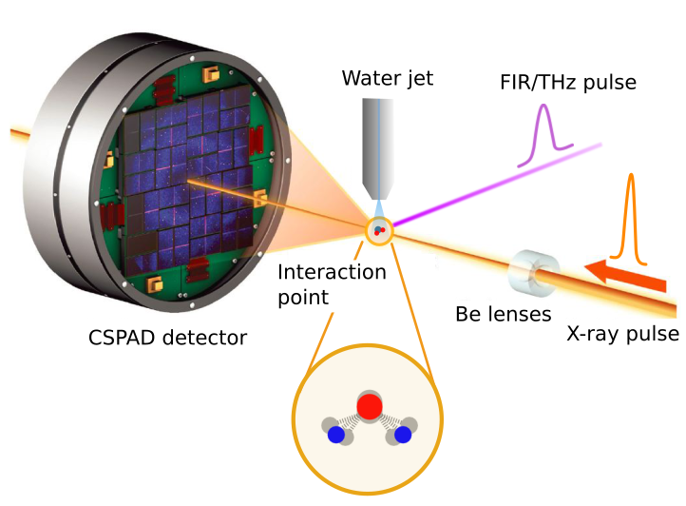
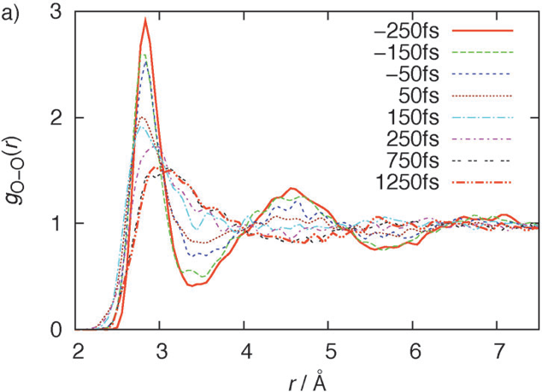
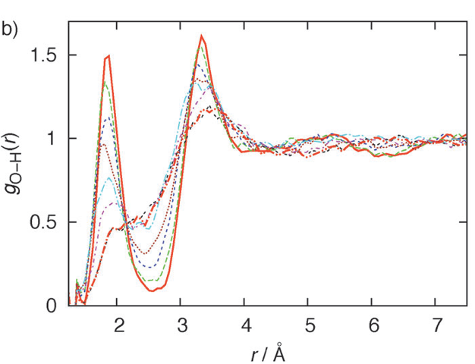
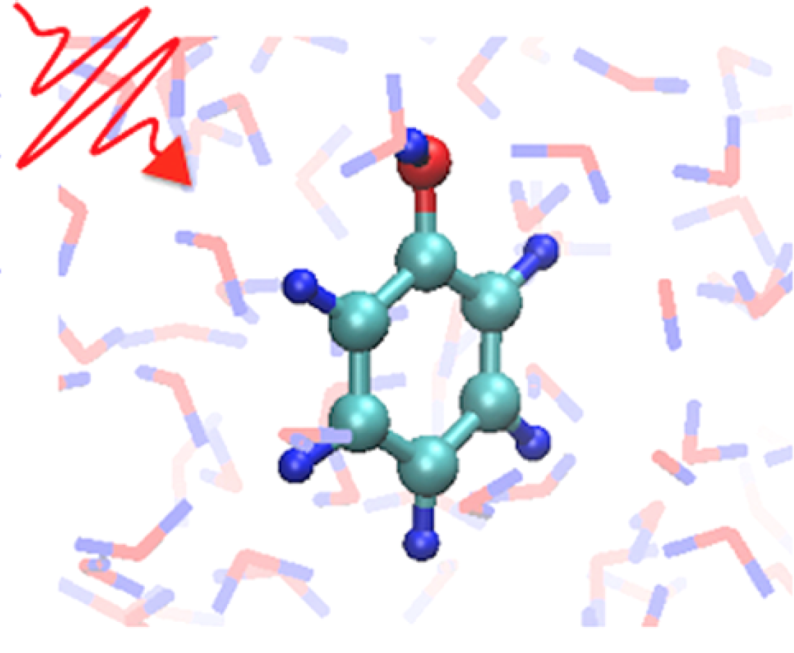
Methods – Nonequilibrium Dynamical Structure of Supercritical-like Water through X-ray Scattering
Time-resolved X-ray Scattering
Kinetic Energy Transfer
Time-resolved X-ray Scattering
Kinetic Energy Transfer
1 THz pulse / Phenol in solution
O-O RDF
O-H RDF
Mishra, Phys. Chem. B 2015, 119, 25, 8080–8086 (2015)
C Arnold, J. Chem. Phys. 150 (4), 044505 (2019)
Yong, PNAS 118.19 (2021): e2021714118
Ma, Structural Dynamics 7.3 (2020): 034102
Notes:
When we look at methods we’ve recently explored, in addition to the T-jump crystallize lysozyme example given earlier, we’re studying water structure dynamics simply from x-ray scattering
I showed these two plots briefly earlier displaying the KE transfer into an equivalent Temperature and the time-resolved X-ray scattering, which can be directly mapped to strong fluctuation and shifts of the O-O and O-H radial distribution functions
In addition, as a model example of physical chemistry in nonequilibrium water, we have experimental plans to measure the vibrational and ring opening dynamics of phenol under a single-cycle THz excitation to confirm and validate our simulations as a means to establish computational methods to predict, analyze, and interpret results.

Slide 17
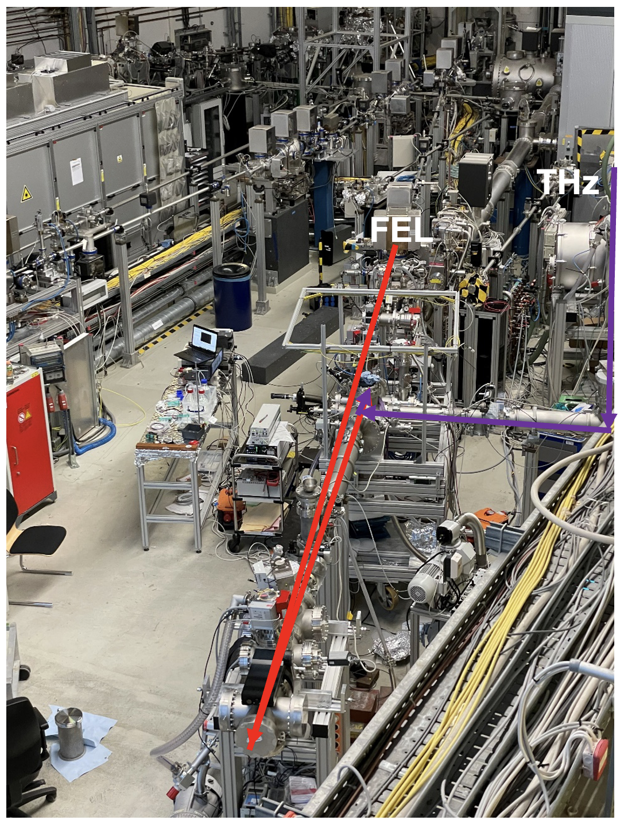
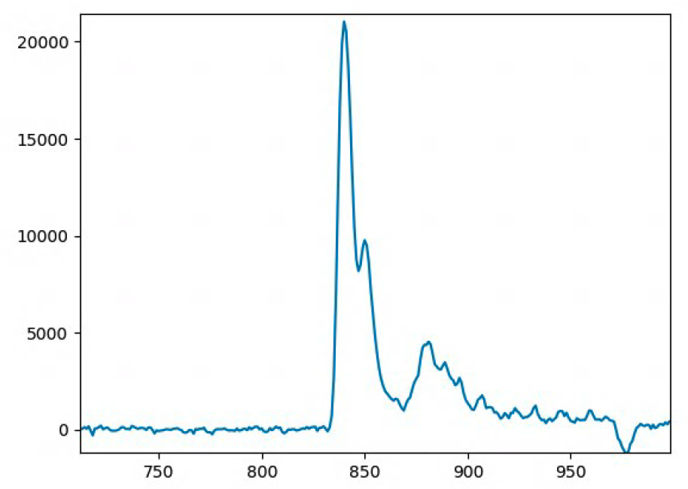
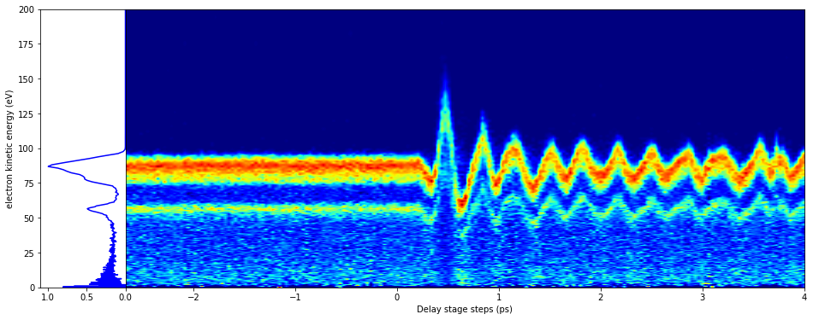
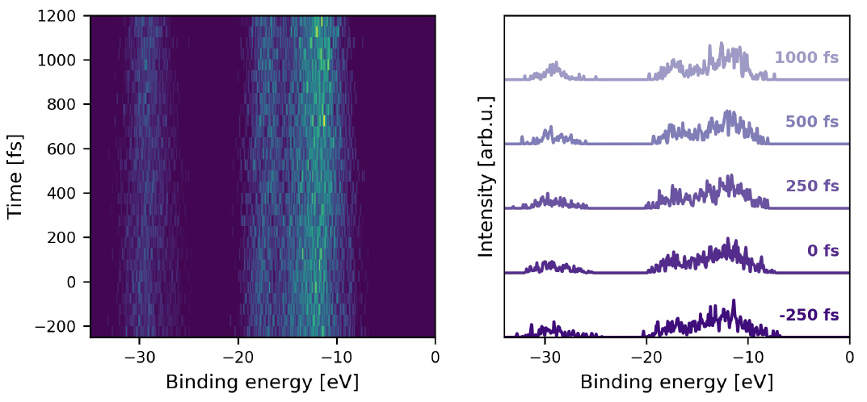
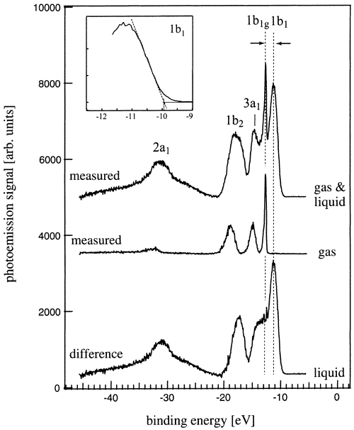
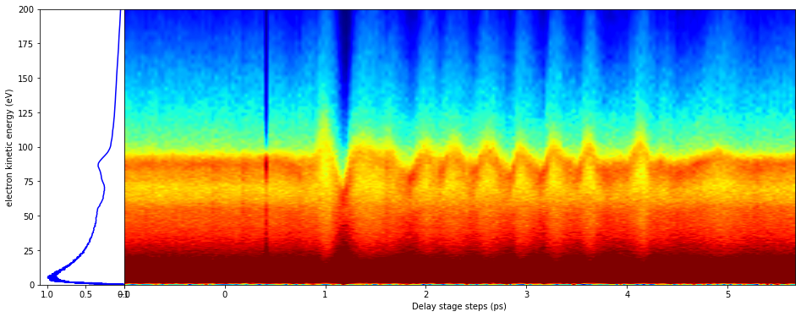
Methods – Measuring Nonequilibrium Dynamical Energy States of Water via Photoelectron Spectroscopy and THz streaking
Time-resolved Photoelectron Spectroscopy
Gas phase
Time-resolved Photoelectron Spectrum
1 THz pulse / Water only
Liquid phase
Winter et al. J. Phys. Chem. A 2004, 108, 14, 2625
Mishra, Phys. Chem. B 2015, 119, 25, 8080–8086 (2015)
C Arnold, J. Chem. Phys. 150 (4), 044505 (2019)
Notes:
We can also obtain a complementary picture by looking at the photoelectron spectrum of water from THz radiation as a function of time. And we can further the resolution of electron time of flight spectrometers using THz streaking.
This capability, a high power THz source and an XUV FEL is uniquely possible at FLASH in DESY, where we are currently analyzing results on secondary electrons streaked by THz radiation to carefully measure timescales of intermolecular coulombic decay in water.

Slide 18

Access – Democratizing Access via Compact Sources, Multi-modal Imaging, Integrated Devices, and Computational Methods
Q1: can the production compact and ultrafast sources be materialized by novel quantum electrodynamics?
Q2: can multi-modal operando (X-ray/electron) techniques provide new insights in quantum biochemistry?
Notes:
Based on this brief overview of challenges and recent feats, I wanted to offer an outlook by posing some open questions to democratizing access to this science and its applications through some of our ongoing work in QED
We won’t have time to go over Q2 but I’d love to open this question for discussion later today

Slide 19





Emerging Compact Attosecond Electron Sources
Progress on Dielectric Laser Accelerators
Dielectric laser accelerator (DLA)
leverages advances in semiconductor fabrication and solid-state lasers
based on nano-scale dielectric structure and ultrafast laser
compact, high gradient and low cost
Accelerator-on-a-Chip (ACHIP) DLA program
Electron beam energy $60 – 150$keV (MeV upgrades underway)
sub-um spot size $σ_{FWHM}<1$μm
ultra-low emittance $ε_{n}<0.5$nm-rad
sub-fs micro bunch train
high repetition rate 100 kHz with 0.1-10 electrons per macro bunch
19
N. Schönenberger, PRL. 123, 264803 (2019).

Slide 20

New Paradigms in Quantum Electrodynamics
Electron Waveshaping for Enhanced X-ray Radiation
Quantum Interference and laser-bunching can make bremsstrahlung radiation highly directional,
monochromatic, and attosecond duration
Wong, Nature communications 12.1 (2021): 1-10
Notes:
As per the first question on what QED can teach us – we do not know yet and one strategy is to build such instruments – another is to build the theory
We’re using emerging QED theory to explore how coherent shaping electron wavepackets affects bremsstrahlung radiation
Imagine a case scenario

Slide 21

New Paradigms in Quantum Electrodynamics
Electron Waveshaping for Enhanced X-ray Radiation
What happens if we use more than 2 coherent state interference?
N_{s} : discrete electron momentum eigenstates
N_{a} : number of atoms in the graphene lattice
Notes:
If we build this example further with more than 2 states…

Slide 22




Photon and Electron Beams by Design
Is mode-locking a (compact) XFEL gain a possibility?
“
Beams by design is an ensemble of laser-based techniques to control and manipulate charged particle beams and/or to initiate tailored secondary emission processes
”
for example
  Fully coherent compact attosecond X-ray generation
  “Mode-locking” the gain of an XFEL
Robb, G. Nature Photon 10, 3–4 (2016)
Mode-locked an X-ray laser
Zholents, Nucl. Ins. Phys. 612 (2010)
Duris et al. Nature Photonics 14.1 (2020)
Hemsing, Rev. Mod.
Phys. 86 (2014)
22
Notes:
And to take this example further, we can also longitudinally shape electron beams.
Altogether, we coin this as generating beams by design, which can render ultracompact attosecond electron and x-ray sources and even potentially a mode-locked FEL
To take mode-locking as a thought-provoking example, theoretical studies show that longitudinal modulation of electron beams with proper dispersion management can lead to a ultrastable frequency comb in the x-ray range. A mode-locked laser in the X-rays could be as revolutionary as th eoptical mode locked laser for several decades.
Some nascent ideas to accomplish this is to combine momentum and time shaping of electron wavepackets with coherent emission from plasmos, say in graphene.

Slide 23
Final Recap
Nonequilibrium phenomena are ubiquitous and lie at the heart of quantum and ultrafast processes, which determine functional properties of macro and mesoscale physical systems
Insight into the structural and dynamical phenomena of matter far-from-equilibrium at elementary timescales of atomic and electronic motion is essential to unlock the potential of (soft) matter
In biology and chemistry, water can be a powerful out-of-equilibrium active medium in which vastly consequential processes can be studied and controlled
        Post-thermalization T-jump driven dynamics in lysozyme linked to inhibitor binding
          In the near future, nonequilibrium dynamics of water driven under different coupling conditions (e.g., IR v THz) could further our understanding of these structural and functional dynamics
Instrumentation:
Review state-of-the-art probes, drives, and methods. They all present complex tradeoffs.
Accessibility is a quintessentially old challenge. New QED theory and key experimental demonstrations are underway promising to materialize ultracompact, inexpensive, attosecond electron and X-ray sources

Slide 24

























Acknowledgements
It takes a village
Open Research Associate (post-doc or higher level) at LCLS, in nonlinear and ultrafast optics!
scarbajo@stanford.edu
The Q-LMC team and research facilities are co-located across California (UCLA & Stanford)
Sponsors

Slide 25
Thank you for your attention
For more questions, information, or opportunities please visit
https://light-matter.seas.ucla.edu

Slide 26




Ultrafast Probes
Free (Semi-relativistic) Electrons
SLAC MeV-UED
5 m
Science 360 1451 (2018)
Nature 565, 61
(2019)
Science 361,
64 (2018)
Nature. 596, 531
(2021)

Slide 27






Attosecond Science
Femtosecond Electron Pulse Slicing and Electron pulse-train formation
Femtosecond pulses desired for some experiments (e.g. measuring molecular vibrational states below 10 fs or nonlinear mixing in hard X-rays)
Since the e-beam produces the X-rays, shortening the part of the electron beam which lases shortens the X-rays
Selectively “heat” parts of the e-beam for spoilage
LASER HEATER
Linac 0
BC1
BC2
Linac 1
Linac 2
Linac 3
A. Marinelli, et al. PRL, 116:254801, 2016
Undulators

Slide 28
The New LCLS-II era

Slide 29

Rebuilt Laser Hall serves all NEH instruments
Clean room environment
Four separate laser bays
OPCPA and Ti:Sapphire laser systems
Laser beam switchyard and transport system beneath raised access floor
Lasers from any of the four bays can be delivered to any of the instruments in the NEH
Currently 4 destinations for the laser, growing to 8 in the next ~year

Slide 30

Laser Systems Coming Online for LCLS-II
Hutch 2.2
chemRIXS - LCLS-II hutch laser setup mostly installed for Run 21
qRIXS - Laser installation late 2022
3rd endstation - Planned for 2023
NEH Laer Hall
1st High power OPCPA - being installed alongside Ti:S
Additional OPCPA in early 2023
Lasers shared amongst endstations via transport
system
TMO
IP1 - LCLS-II hutch laser setup mostly installed
High rate in Run 21
DREAM - October 2023
TXI
Planned for October 2023
XPP and FEH hutches continue to run with Ti:S at 120Hz

Slide 31



High-power OPCPA laser system
Oscillator
Carbide
OPCPA pre-amplifier
  ASC lab commissioning complete
  Relocation to NEH complete
  Start of re-commissioning
S1
HP-OPCPA
Amphos amplifier
Grating compressor
Synchronization
S2
S3
1.03$μ$m spectral broadening units
  Design based on R&D laser amplifier
  Pumped with 350 W Yb:YAG amplifier
  Output is ~35 W at 800 nm
  33/93 kHz operation (1 MHz possible)
  Compressed pulse duration: <20 fs
Location: zone 3 NEH
K. Mecseki et al "High average power 88 W OPCPA system for high-repetition-rate experiments at the LCLS x-ray free-electron laser," Opt. Lett. 44, 1257-1260 (2019)
Mecseki, Katalin, et al. "High-power dual mode IR and NIR OPCPA." High-Power, High-Energy, and High-Intensity Laser Technology IV. Vol. 11033, 2019.
Windeler et al. "100 W high-repetition-rate near-infrared optical parametric chirped pulse amplifier." Optics letters 44, no. 17 (2019): 4287-4290.

Slide 32

Laser Capabilities Driven by Science at Each Endstation
Capabilities tailored for each LCLS instrument and driven by science needs
  Determined by instrument leads in consultation with Instrument Review Panels
Typical needs cover the spectrum from UV - THz
TMO
Short-pulse, tunable UV and NIR
Tunable UV
NIR
chemRIXS, TXI, 2.2.3
Short-pulse, UV + Tunable Vis.
UV - visible
qRIXS, 2.2.3
Tunable IR, THz
IR - THz
High-power, short-pulse laser systems, and high-power frequency, broadband conversion techniques are required to deliver all these capabilities
OPCPA System

Slide 33
Infrared and THz sources
Infrared and THz and sources are of particular importance for materials science applications and also have some application in X-ray diagnostics (e.g. electron streaking)
THz generation in LNbO3
THz with tilted pulse front from grating or echelon using 800 nm OPCPA (100kHz, 30W)
THz with 1μm spectrally broadened Amphos system (150 kV/cm demonstrated at 100kHz)
PL Kramer,et al, Optics Express 28, 16951 (2020)
Power limits of difference frequency generation to MIR need to be explored
THz and MIR processes benefit from higher laser energy.
Power-scaling needs to be further investigated for MIR
Beam based THz source:
Potentially addresses the THz gap ~5-15THz
THz beam transport from undulator hall to NEH (DOE project with Huang, Fisher)

Slide 34

Laser infrastructure to support delivery to endstations
For each of the LCLS-II instruments we will install or update equipment to support laser delivery
Beam transport components
Modular Optical Delivery System
Interface with the ATM
Controls equipment
Laser Safety System

Slide 35

Modular approach currently operating in LCLS-II instruments
Injection: Consistent conditioning of spatial mode and beam-pointing
Standard Modules: that perform a specific function
e.g. pulse compression, harmonic generation, tunable visible generation etc.
To endstation
Ejection: Delivery of beams to the interaction point, tailored for each endstation
From
transport
Remote operation possible via a significant number of laser controls (~50) and diagnostics (~30) per table/endstation

Slide 36

PFTS integration and cross-correlations
Integration of commercial distributed timing system from Cycle is ongoing in ASC
Performance: <1fs RMS [1Hz…1MHz]; (typical ~0.2fs RMS measured between any 2 links); environmental dependent
Weakest link anticipated to be physical path between cross-correlation measurements and X-ray interaction points, which can be ~10m
OL-MDL
Laser Hall
Timing Lab
1
Pump Laser
Osc
2
TCBOC
3
Pump Laser
Amp
Basement
Sub-basement
Hutch
~30m of
transport
Combine with ATM readings
ATM-MDL
MODS
table
TCBOC
TCBOC
X-rays
ATM
IP
Future R&D: All -color cross-correlation between PFTS and pump laser
Direct cross correlation between pulse train from the fiber to the x-ray beam

Slide 37






High power OPCPA/OPA laser sources
Current R&D and production system based around a ~1ps, ~350W Amphos Yb:YAG pump laser
Initial R&D efforts used a <1ps, ~900W pump laser which proved to be too unstable for productive development
NIR OPCPA in BBO K. Mecseki et al., Optics Letters 1(1), 45-63 (2019)
Current laser source for LCLS-II
<20fs, 35W, 800nm OPCPA at 33 or 93 kHz
(88W demonstrated with R&D pump laser)
Potential for MHz operation with ~30uJ at 800nm
Tunable IR OPCPA or OPA Optics Letters Vol. 44, Issue 17, pp. 4287-4290 (2019)
Non-collinear OPCPA for broadband operation, and potential UV-vis generation
  30fs, 1.6μm, 30W
(~100W demonstrated with R&D pump laser)
Collinear OPA promising source for IR and THz generation
  Tunable, 100-300fs, 1.7-2.5μm IR OPA with ~45W in S&I

