Slide 1

New possibilities of hard X-ray photon-in/photon-out spectroscopies
Sara Lafuerza^{a,b,c}
ªESRF – The European Synchrotron;
^{b}Instituto de Nanociencia y Materiales de Aragón (INMA);
^{c}Departamento de Física de la Materia Condensada, Universidad de Zaragoza
X AUSE Conference & V ALBA User’s Meeting 5 – 8 September 2022 ALBA Synchrotron, Barcelona (Spain)

Slide 2
Outline
Hard X-ray photon-in/photon-out (PIPO) spectroscopies
  Brief introduction
Range-extended EXAFS
  The edge interference problem
  Examples of applications
A liquid jet setup for RIXS-MCD
  Why applying RIXS-MCD?
  Application to colloidal NPs
Further reading

Slide 3
Outline
Hard X-ray photon-in/photon-out (PIPO) spectroscopies
  Brief introduction
Range-extended EXAFS
  The edge interference problem
  Examples of applications
A liquid jet setup for RIXS-MCD
  Why applying RIXS-MCD?
  Application to colloidal NPs
Further reading

Slide 4
1. Hard X-ray PIPO spectroscopies_Brief introduction
PIPO spectroscopies: techniques derived from the combination of XAS-XES
X-ray
Absorption Spectroscopy
X-ray
Emission Spectroscopy
Photon
in
Photon
out
Energy bandwidth ≈ 1 eV
X-ray emission spectrometer
scanning
dispersive

Slide 5
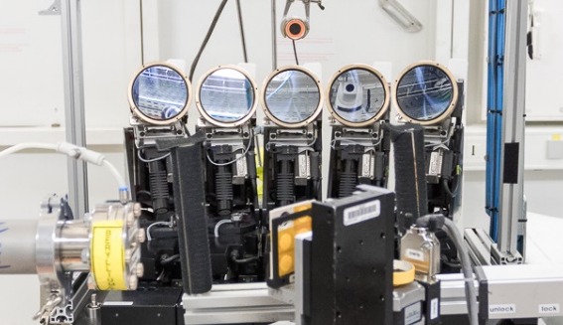
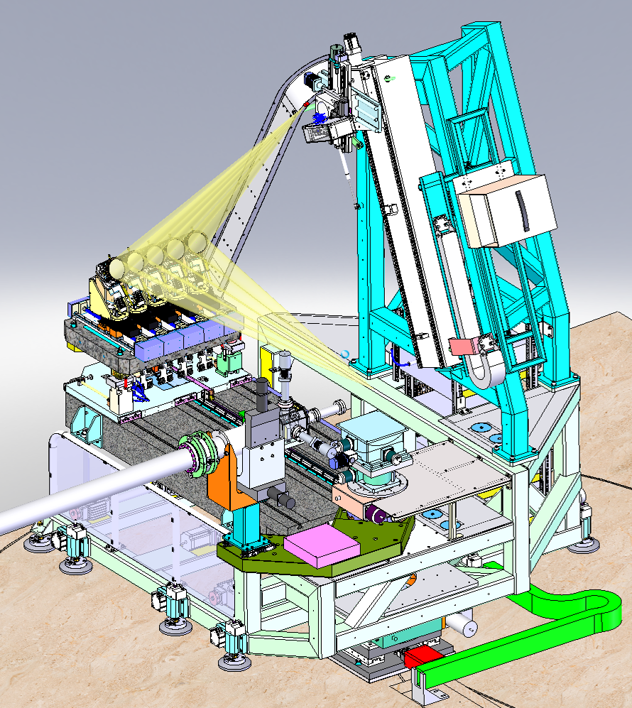

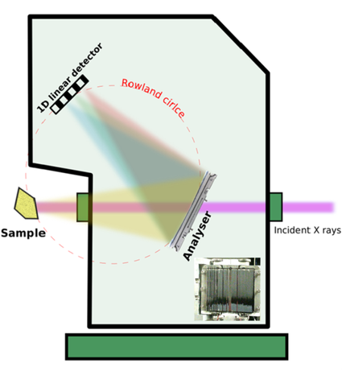
1. Hard X-ray PIPO spectroscopies_Brief introduction
PIPO spectroscopies: the boom of XES spectrometers
  Hard X-ray spectrometer: ID26, ID20, ROBL (BM20), FAME-UHD (BM16), BM23/ID24, ID09
  Tender X-ray spectrometer: ID26
Detector
  Hard X-ray spectrometer: CLAESS
5x analyzer
crystals
Rowland circle
Sample
From https://www.cells.es/en/beamlines/bl22-claess
P. Glatzel et al., J. Synchrotron Rad. 28 362 (2021)
☞ And many more at other synchrotrons, XFELs and also home laboratories!

Slide 6
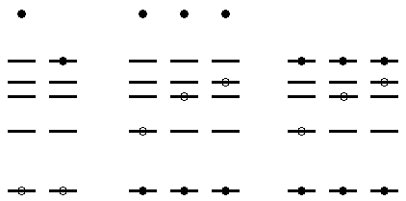
1. Hard X-ray PIPO spectroscopies_Brief introduction
PIPO spectroscopies with hard X-rays:
  Bulk-sensitivity
  Compatibility with demanding sample environments
  VTC = valence-to-core
The particular case of K-emission in 3d transition metals:
  - Non-resonant (NR): E_{i} >> E_{F}
  - Resonant (R): E_{i} >≈ E_{F}
Kβ
VTC
Kα
3p → 1s
V → 1s
2p → 1s
E_{F}
3d
L, (3d)
3p
2p
Kα
Kβ
VTC
Kα
Kβ
VTC
1s
NR
R
NR
R

Slide 7
1. Hard X-ray PIPO spectroscopies_Brief introduction
PIPO spectroscopies with hard X-rays: the umbrella of techniques
e.g. Fe Kα and Kβ XES & Fe K edge HERFD-XAS
E_{i} = 7200 eV
I_{f}/I₀
Kα₁
X-ray
Emission Spectroscopy
Si(111) or Si(311)
Kα₂
Kα
Ge(440)
X-ray emission spectrometer
E_{e}
I_{f}/I₀
Kβ_{1,3}
Kβ
Ge(620)
I₀, E_{i}
Kβ’
Emitted X-rays
E_{e}
Detector
Sample
High Energy Res. Fluo. Detected
I_{f}/I₀
X-ray
Absorption Spectroscopy
Incident X-rays
E_{e} @ Kα₁ or Kβ_{1,3}
I_{f}, E_{e}
Analyzer crystals
E_{i}

Slide 8
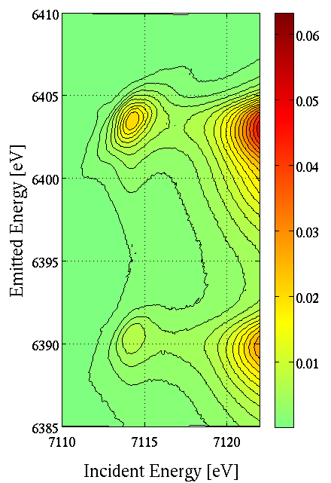
1. Hard X-ray PIPO spectroscopies_Brief introduction
PIPO spectroscopies with hard X-rays: the umbrella of techniques
e.g. Fe 1s2p RIXS @ K pre-edge
High Energy Res. Fluo. Detected
I_{f}/I₀
1s → 4p
X-ray
Absorption Spectroscopy
Si(111) or Si(311)
1s → 3d
E_{i}
X-ray emission spectrometer
E_{e}
Kα₁
Resonant
Inelastic
X-ray Scattering
I₀, E_{i}
Emitted X-rays
Detector
Kα₂
Sample
I_{f}/I₀
X-ray
Emission Spectroscopy
Incident X-rays
I_{f}, E_{e}
Analyzer crystals

Slide 9
Outline
Hard X-ray photon-in/photon-out (PIPO) spectroscopies
  Brief introduction
Range-extended EXAFS
  The edge interference problem
  Examples of applications
A liquid jet setup for RIXS-MCD
  Why applying RIXS-MCD?
  Application to colloidal NPs
Further reading

Slide 10
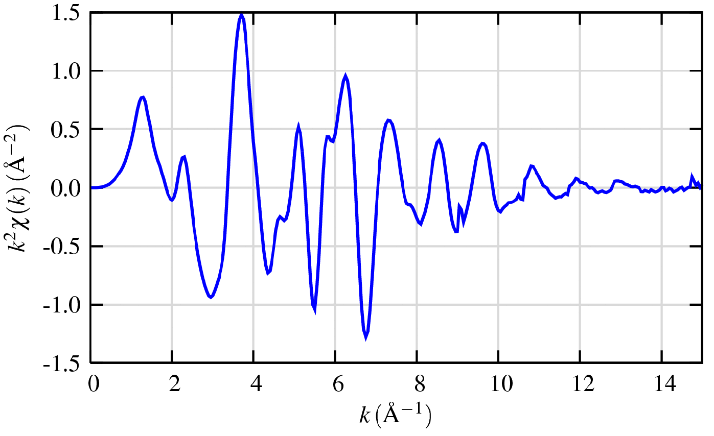
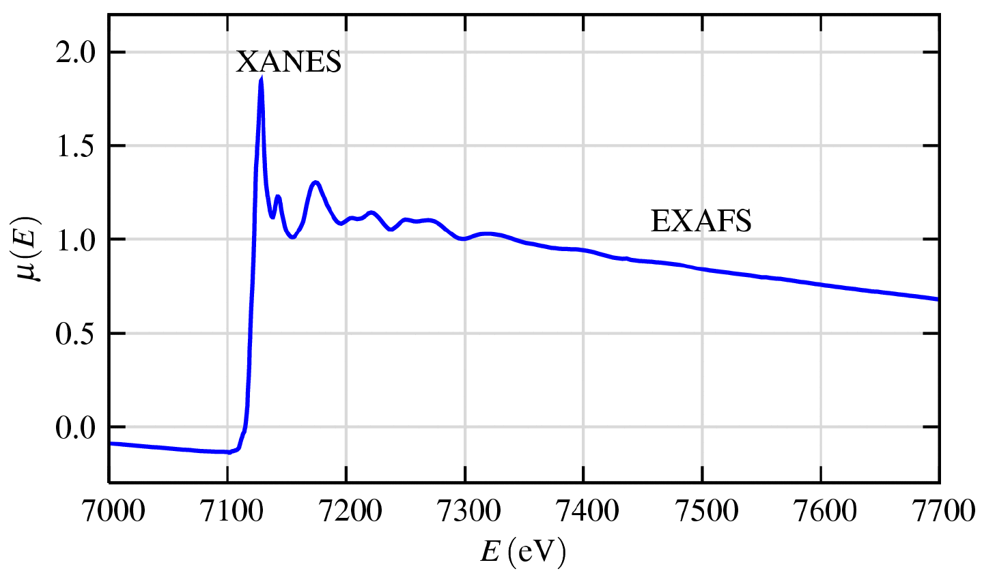
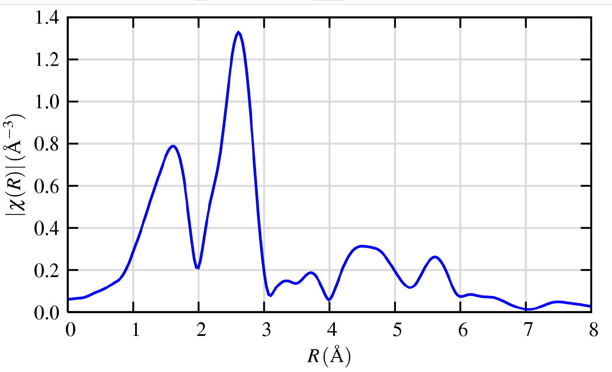
2. Range-extended EXAFS_The edge interference problem
Extended X-ray absorption Fine Structure (EXAFS):
Quantitative information of the local geometrical structure
Coordination number N_{j}
Interatomic distances R_{j}
Thermal and static disorder σ_{j}²
XANES
Fe K edge XAS
EXAFS signal χ(k)
k → R
FeO
Fe-O
Fe-Fe
Photon E → Photo-electron k
M. Newville, Fundamentals of XAFS, University of Chicago (2004)

Slide 11
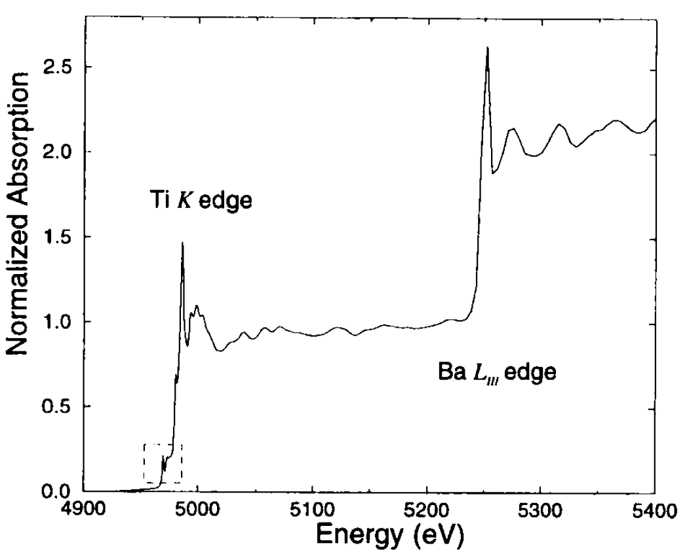
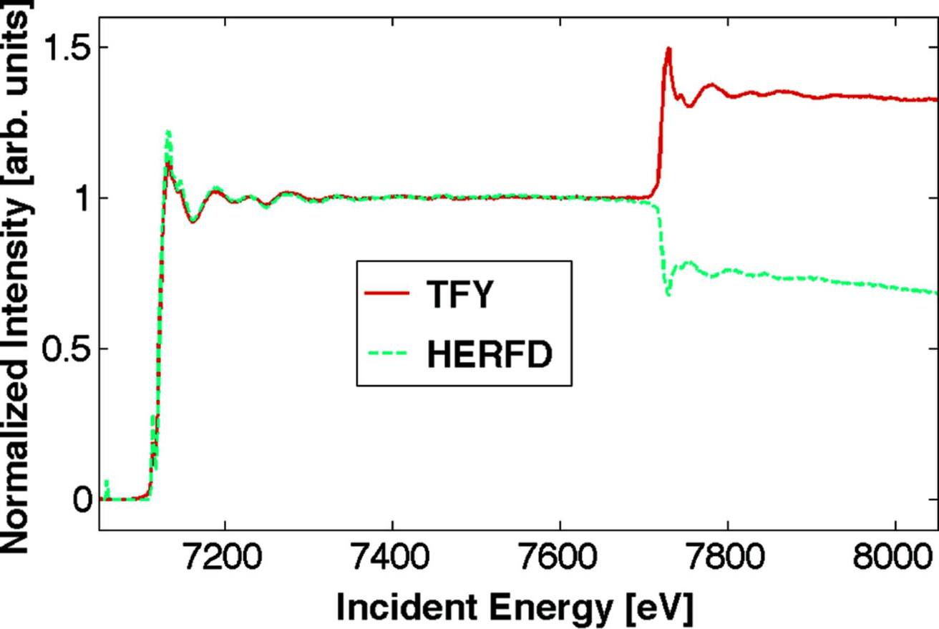
2. Range-extended EXAFS_The edge interference problem
A challenging EXAFS signal extraction:
In multi-element compounds, unfortunate edge interference may occur…
CoFe₂O₄
BaTiO₃
Fe K edge
Co K edge
B. Ravel et al., Ferroelectrics 206 407 (1998)
M. Bianchini and P. Glatzel, J. Synchrotron. Rad. 19 911 (2012)
Positive contribution in TFY & negative contribution in HERFD
⇩
HERFD-XAS can help to extend the EXAFS range beyond unwanted edges!

Slide 12
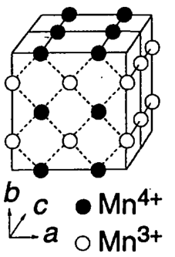
2. Range-extended EXAFS_Examples of applications
Mn K edge EXAFS in mixed-valence Nd_{0.5}Sr_{0.5}MnO₃
Half-doped Nd_{0.5}Sr_{0.5}MnO₃, a particularly interesting magnetoresistive manganite….
Mn³⁺
T_{N}≈T_{CO}≈150 K
Mn⁴⁺
Mn local structure in the three magneto-electric phases?
Mn^{3.5+}
T_{C}≈T_{MI}≈255 K
Experiment at ID26 beamline
Simultaneous TFY- and HERFD-XAS at the Mn Kα₁ maximum
Si(311) mono & Ge(333) crystal analyzers → ΔE ≈ 0.4 eV
Continuous He-flow cryostat
H. Kuwahara et al., Science 270 961 (1995)

Slide 13
2. Range-extended EXAFS_Examples of applications
Mn K edge EXAFS in mixed-valence Nd_{0.5}Sr_{0.5}MnO₃
→ Interference of Mn K edge (6.5 keV) with Nd L₂ edge (6.7 keV)
*
Nd L₂ edge
      - Linear combination of TFY- and HERFD-XAS data leads to a “range-extended” EXAFS signal
      - The interference with Nd L₂ edge would limit the EXAFS range in k-space to only 7 Å⁻¹

Slide 14
2. Range-extended EXAFS_Examples of applications
Mn K edge EXAFS in mixed-valence Nd_{0.5}Sr_{0.5}MnO₃
→ “Range-extended” EXAFS temperature dependence across the transitions
Small changes in MnO₆ octahedron:
  R_{Mn-O:} ↑ until T_{CO}, then stable
  σ²_{Mn-O:} ↓ until T_{CO}, then ↑ with a high value at low T
Mn-O
T_{N}≈T_{CO}
T_{C}≈T_{MI}
AF-I CO
FM-M
PM-I

↑ distortion
 dynamic
distortion
⇩
↓ distortion
due to long-range FM
☞ More information: S. Lafuerza et al., Phys. Rev. B 93 205108 (2016)

Slide 15

2. Range-extended EXAFS_Examples of applications
Mn K edge EXAFS in ordered REBaMn₂O₆ (RE=Nd, Sm)
Polar & magnetic phases ↔ A-site ordered ↔ Controlled synthesis
A-site disordered
A-site ordered
RE_{0.5}Ba_{0.5}MnO₃
REBaMn₂O₃
Non-polar
No long-range magnetic order
G. Subías et al., submitted
Experiment at CLAESS beamline
Simultaneous TFY- and HERFD-XAS at the Mn Kβ_{1,3} maximum
Si(311) mono & Si(333) crystal analyzers → ΔE ≈ 0.5 eV
Liquid-N₂ cryostat (80-600 K)
Mn local structure as a function of A-site order, RE-type and temperature?

Slide 16
2. Range-extended EXAFS_Examples of applications
Mn K edge EXAFS in ordered REBaMn₂O₆ (RE=Nd, Sm)
→ Interference of Mn K edge (6.5 keV) with Nd L₂ edge or Sm L₃ edge (6.7 keV)
NdBaMn₂O₃
Nd L₂ edge
*
SmBaMn₂O₃
Sm L₃ edge
G. Subías et al., submitted

Slide 17
2. Range-extended EXAFS_Examples of applications
Mn K edge EXAFS in ordered REBaMn₂O₆ (RE=Nd, Sm)
→ “Range-extended” EXAFS temperature dependence in ordered/disordered samples
A-site ordered
A-site disordered
G. Subías et al., submitted
☞ More information: Poster by G. Subías “Effects of A-site order on the Mn local structure and polar phases of magnetoelectric REBaMn₂O₆ (RE: La, Nd, Sm and Y)”

Slide 18
Outline
Hard X-ray photon-in/photon-out (PIPO) spectroscopies
  Brief introduction
Range-extended EXAFS
  The edge interference problem
  Examples of applications
A liquid jet setup for RIXS-MCD
  Why applying RIXS-MCD?
  Application to colloidal NPs
Further reading

Slide 19
3. A liquid jet setup for RIXS-MCD_Why applying RIXS-MCD?
1s2p RIXS @ K pre-edge:
Fe₃O₄
High Energy Res. Fluo. Detected
I_{f}/I₀
1s → 4p
X-ray
Absorption Spectroscopy
1s²2p⁶3d^{n}
1s → 3d
E_{i}
A site: T_{d}
B site: O_{h}
E_{i}
XAS
E_{e}
Fe³⁺_{A}[Fe²⁺,Fe³⁺]_{B}O²⁻₄
1s¹2p⁶3d^{n+1}
Kα₁
Resonant
Inelastic
X-ray Scattering
E_{e}
XES
No site-selectivity
Kα₂
1s²2p⁵3d^{n+1}
I_{f}/I₀
X-ray
Emission Spectroscopy

Slide 20
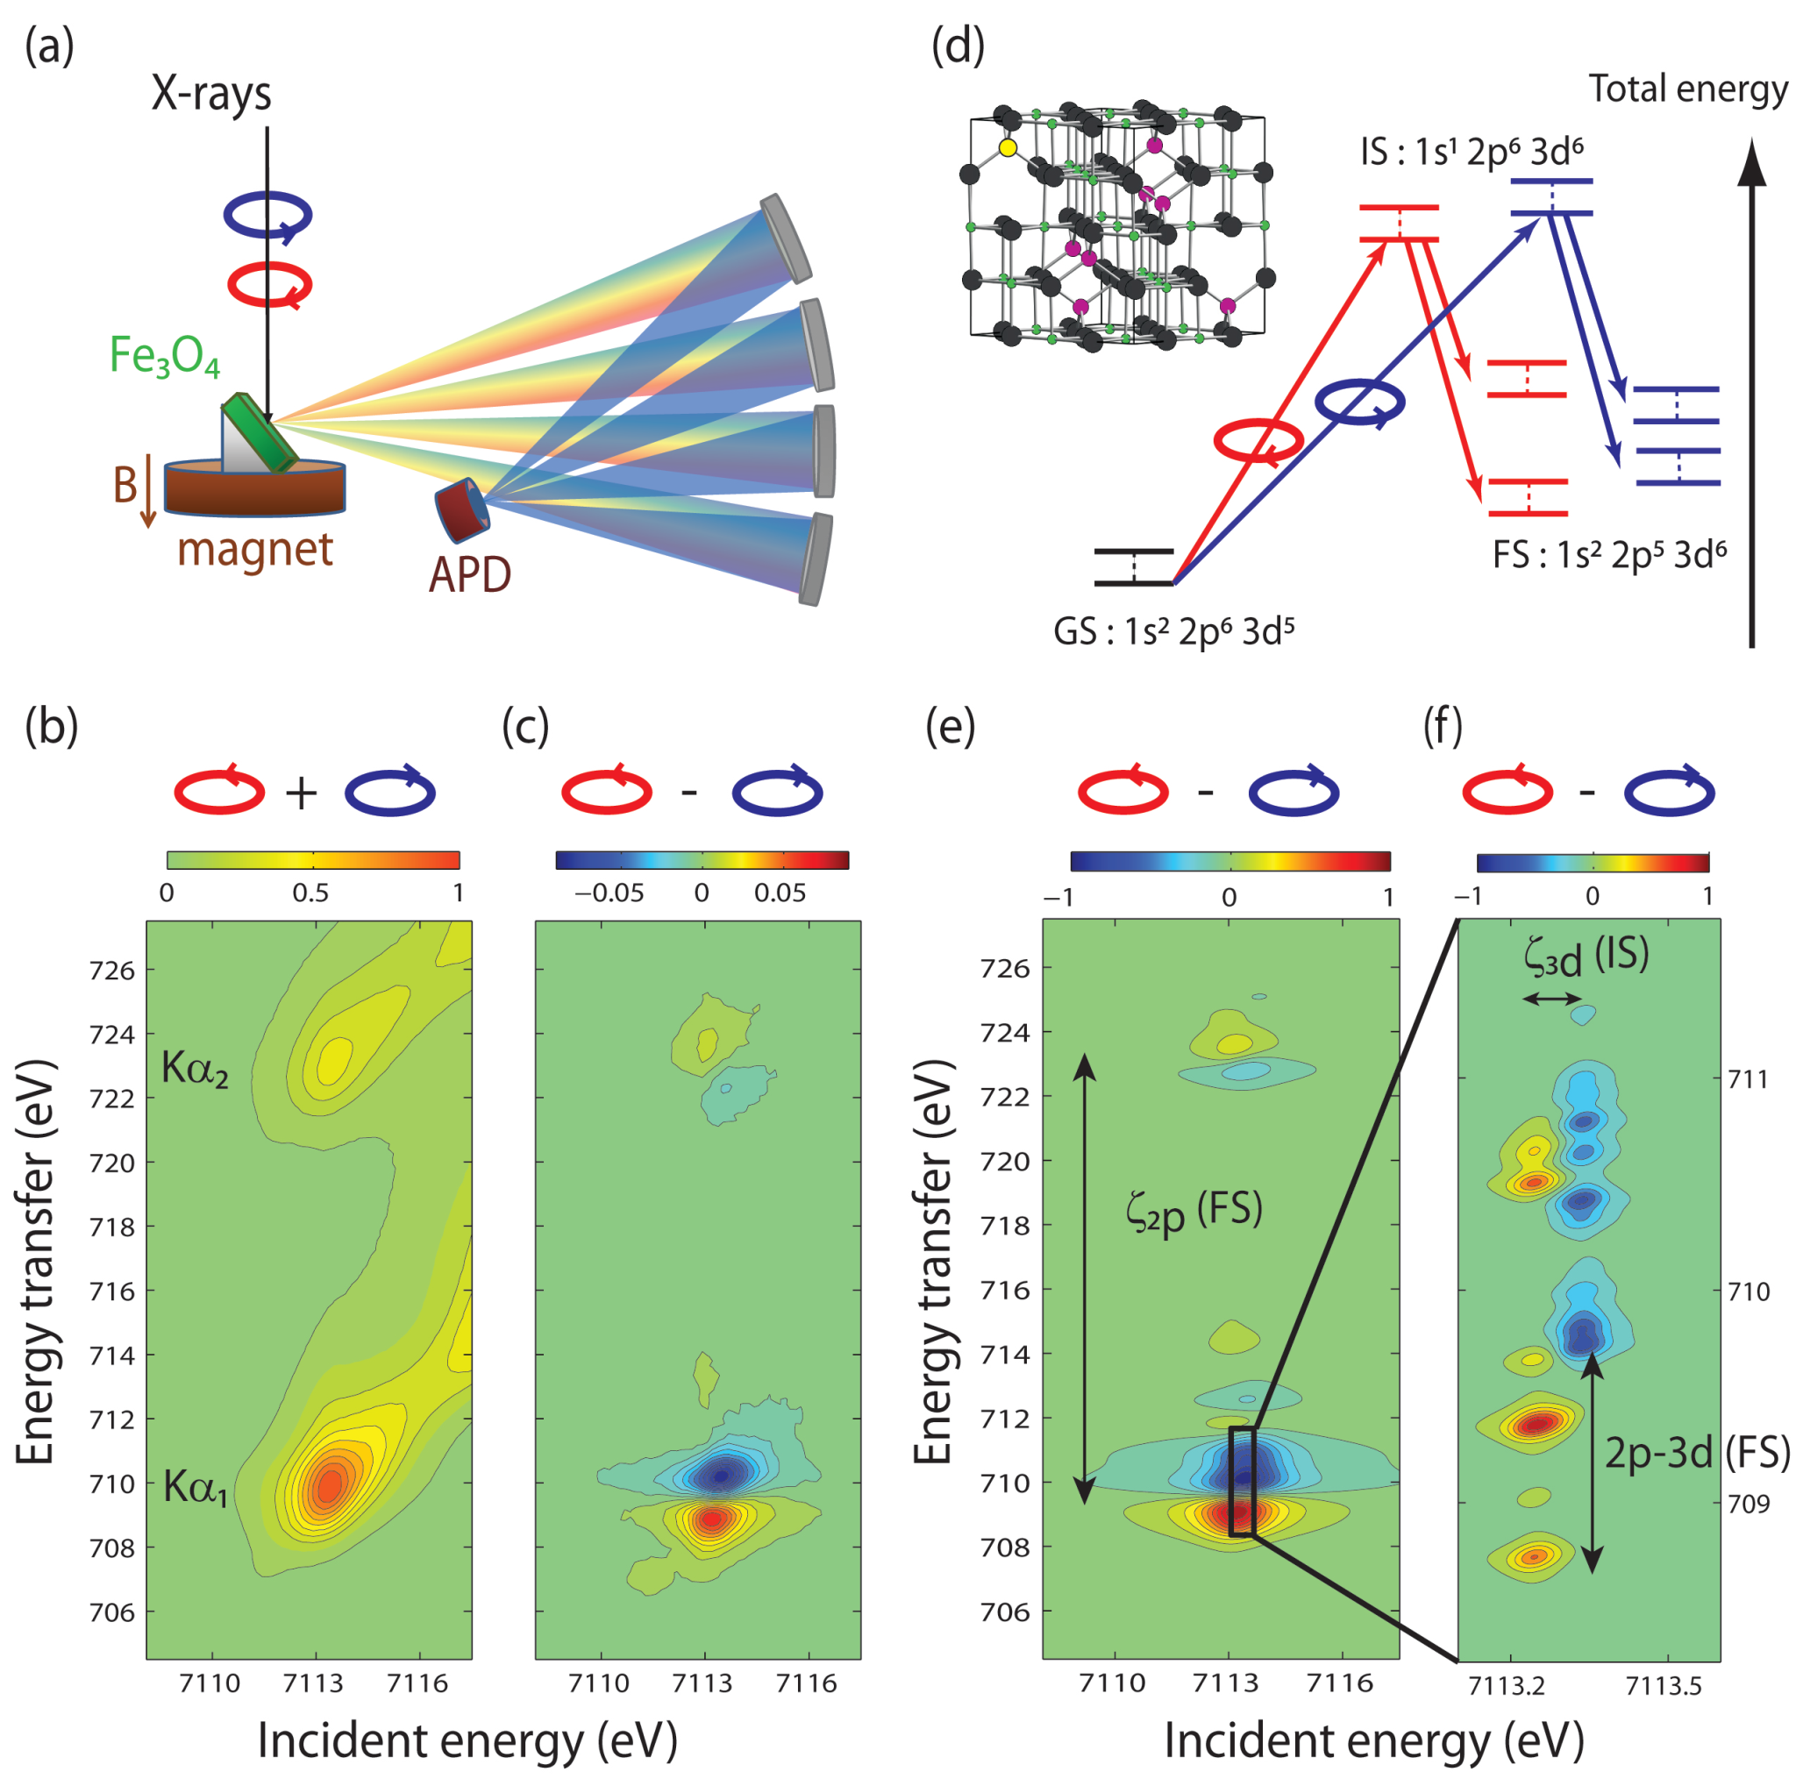
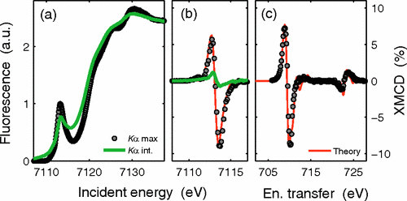
3. A liquid jet setup for RIXS-MCD_Why applying RIXS-MCD?
1s2p RIXS @ K pre-edge
+ X-ray magnetic circular dichroism (RIXS-MCD):
Fe₃O₄
N
S
1s²2p⁶3d^{n}
A site: T_{d}
B site: O_{h}
E_{i}
XAS
Fe³⁺_{A}[Fe²⁺,Fe³⁺]_{B}O²⁻₄
1s¹2p⁶3d^{n+1}
E_{e}
XES
Fe³⁺ T_{d}
Site selectivity!
1s²2p⁵3d^{n+1}
Fe²⁺ O_{h}
E_{transfer} = E_{i} - E_{e}
M. Sikora et al., Phys. Rev. Lett. 105 037202 (2010)

Slide 21
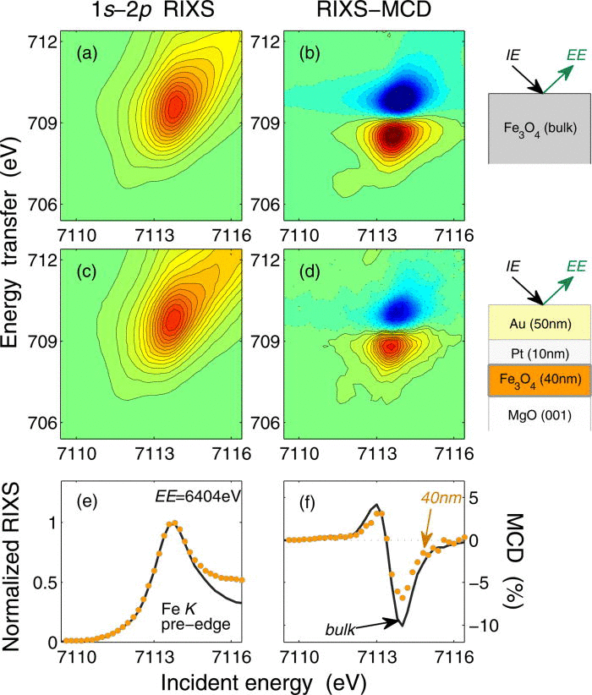
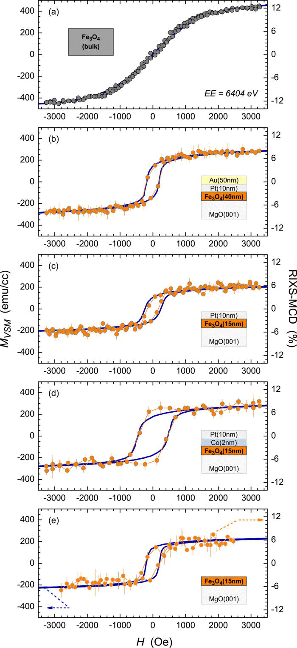
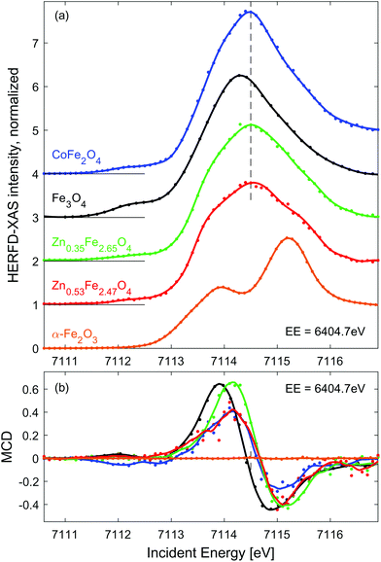
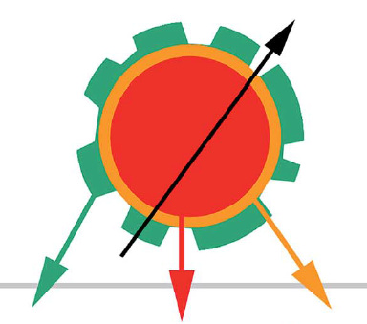
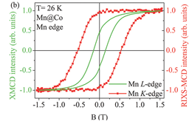
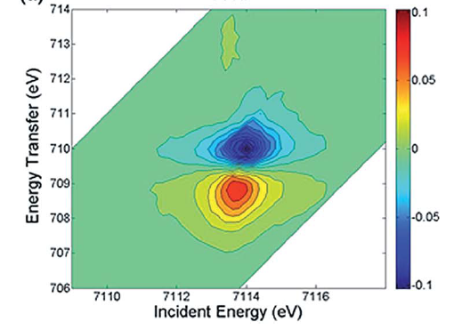
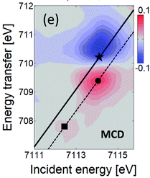
3. A liquid jet setup for RIXS-MCD_Why applying RIXS-MCD?
1s2p RIXS-MCD: a powerful bulk-sensitive magneto-spectroscopy!
→ Fe₃O₄ buried thin films
E_{i} = 7113.8 eV
E_{t} = 710.8 eV
M. Sikora et al.,
J. App. Phys. 111 07E301 (2012)
→ Core-shell nanoparticles (NPs)
Soft Core - Hard shell MnFe₂O₄ @ CoFe₂O₄ NPs
Co- and Zn-doped spinel NPs
  (Fe,Mn)₃O₄
  γ-Fe₂O₃
J. Kuciakowski et al., Nanoscale 12 16420 (2020)
  Mn₃O₄
N. Daffé et al.,
Adv. Mater. Interfaces 4 1700599 (2017)
A. Juhin et al.,
Nanoscale 6 11911 (2014)

Slide 22
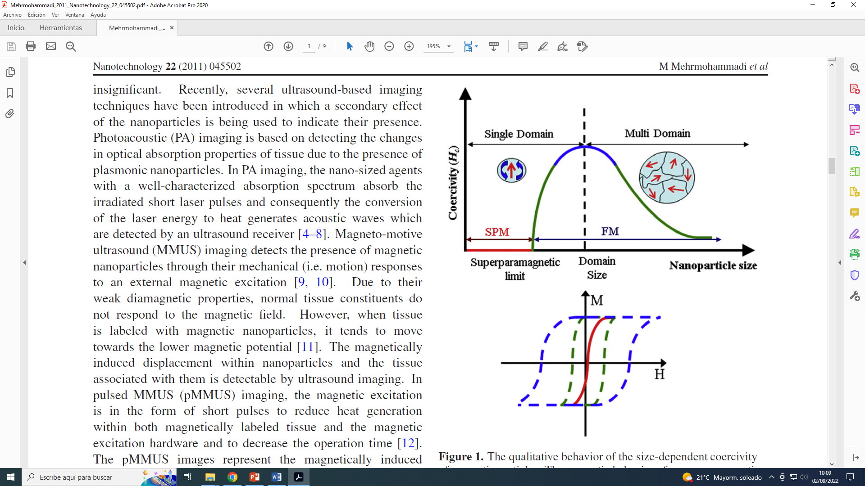
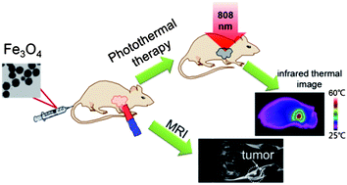
3. A liquid jet setup for RIXS-MCD_Application to colloidal NPs
Colloidal magnetic nanoparticles (NPs):
  Sufficiently small NPs → superparamagnetic at room temperature (ferromagnetic at cryogenic temperatures)
  Very promising for biomedical applications, especially in cancer therapies (e.g. hyperthermia, photothermia, …)
  Iron oxide-based NPs are the preferred materials due to its biocompatibility
S. Shen et al., Nanoscale 5 8056 (2013)
M. Mehrmohammadi et al., Nanotechnology 22 045501 (2011)
Characterization of colloidal NPs useful only under in situ conditions,
i.e. directly in the carrier liquid at room temperature
⇩
Liquid jet setup for in situ RIXS-MCD

Slide 23
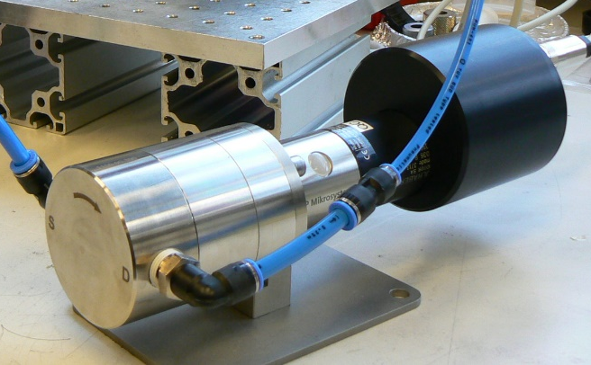
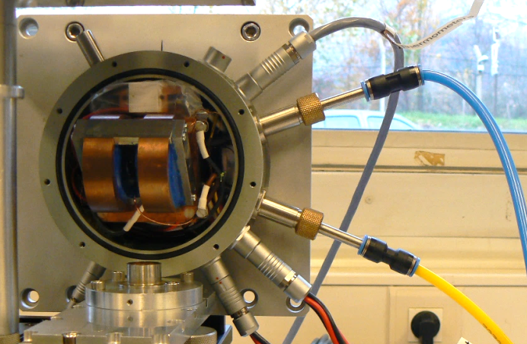
3. A liquid jet setup for RIXS-MCD_Application to colloidal NPs
Main components and requirements for RIXS-MCD liquid jet:
Pump
Suitable for magnetic fluids (✗ Magnetic drive gear pump)
Continuous flow (✗ Peristaltic pump)
Magnet
Compact and suited for X-ray fluorescence geometry
Field sweep and reversal (✗ Permanent magnet)
→ Rotatory gear pump
→ Small split coil electromagnet
Beam access Ø 2 mm
6 mm gap
Inlet
Ø 120 mm
Water cooling
Outlet
Brushed DC electric motor
mzr-11508X1 model, HNP Mikrosysteme GmbH
@ ESRF Sample Environment Support Service
Generally resistant to solvents (pH > 4)
Flow rate: 0.2 – 1000 ml/min
±0.5 Tesla peak (±5.5 A)
Peltier stage for temperature control

Slide 24
3. A liquid jet setup for RIXS-MCD_Application to colloidal NPs
The liquid jet setup for RIXS-MCD at ID26 beamline (ESRF)
Si(311) mono.
Circular polarization (diamond phase plate)
Incident x-rays
Sample volume:
≈ 30 ml
I₀, E_{i}
Free jet
H
Emitted X-rays
I_{f}, E_{e}
Electro-magnet
Rotatory gear pump
X-ray emission spectrometer
Reservoir
Stirrer

Slide 25
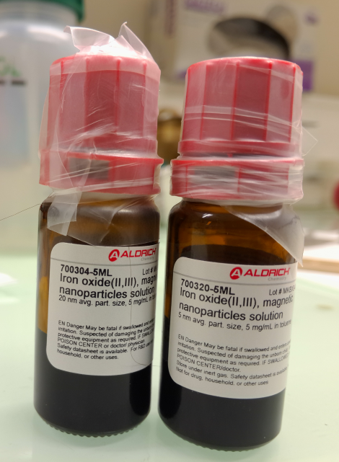
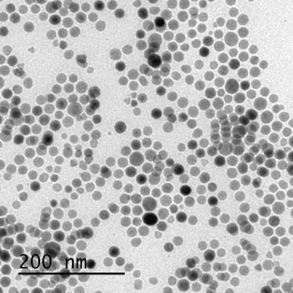
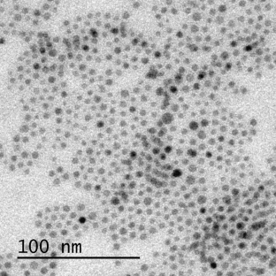
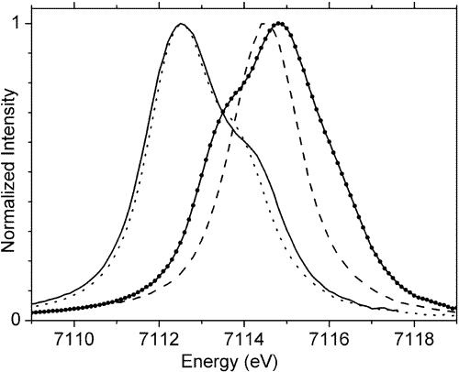
3. A liquid jet setup for RIXS-MCD_Application to colloidal NPs
First RIXS-MCD experiment in the liquid jet setup
Samples: commercial nominally Fe₃O₄ NPs
20 nm
5 nm
      - Spherical NPs of 20, 10 and 5 nm diameter synthesized by thermal decomposition and dispersed in toluene (Sigma-Aldrich)
TEM images courtesy of A. G. Roca
→ Kα₁-detected Fe K edge HERFD-XANES
      - Main edge: ↓ size ⇨ ↑ oxidation
      - Pre-edge: ↓ size ⇨ ↓ Fe²⁺, ↑ Fe³⁺
Fe²⁺
Fe³⁺
T_{d}
Fe₃O₄
(Fe³⁺_{Td}[Fe²⁺,Fe³⁺]_{Oh}O²⁻₄)
⇩
γ-Fe₂O₃
(Fe³⁺_{Td}[Fe³⁺ _{5/3}◻_{1/3}]_{Oh}O²⁻₄)
O_{h}
O_{h}
T_{d}
Fe²⁺
Fe³⁺
F. M. F. de Groot et al.,
J. Phys. Chem. B 109 20751 (2005)

Slide 26
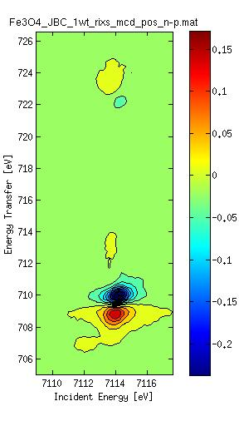
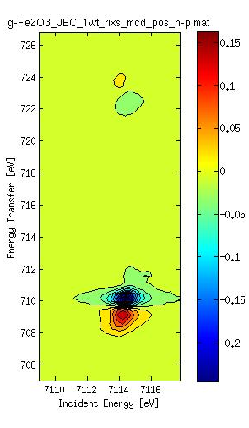
3. A liquid jet setup for RIXS-MCD_Application to colloidal NPs
First RIXS-MCD experiment in the liquid jet setup
→ RIXS-MCD maps & diagonal cuts
Fe₃O₄
γ-Fe₂O₃
Fe₃O₄
γ-Fe₂O₃
Fe³⁺ T_{d}
Fe²⁺ O_{h}
      - Line-shape: 20 nm≈Fe₃O₄, 5 nm≈γ-Fe₂O₃
      - Amplitude: NPs < bulk & 20 nm < 5nm, poorer crystallinity of 20 nm sample?

Slide 27
Outline
Hard X-ray photon-in/photon-out (PIPO) spectroscopies
  Brief introduction
Range-extended EXAFS
  The edge interference problem
  Examples of applications
A liquid jet setup for RIXS-MCD
  Why applying RIXS-MCD?
  Application to colloidal NPs
Further reading

Slide 28
4. Further reading
Reviews:
S. Lafuerza et al. New reflections on hard X-ray photon-in/photon-out spectroscopy. Nanoscale 12 16270 (2020)
M. Rovezzi et al. Hard x-ray emission spectroscopy: a powerful tool for the characterization of magnetic semiconductors. Semicond. Sci. Technol. 29 023002 (2014)
P. Glatzel et al. High resolution 1s core hole X-ray spectroscopy in 3d transition metal complexes—electronic and structural information. Coord. Chem. Rev. 249 65 (2005)
Book chapters:
S. P. Cramer, 2020 Photon-in Photon-out Spectroscopy, X-Ray Spectroscopy with Synchrotron Radiation Fundamentals and Applications (Springer) Chapter 8
P. Glatzel et al., 2016 Hard X-Ray Photon-in/Photon-out Spectroscopy: Instrumentation, Theory and Applications, X-ray Absorption and X-Ray Emission Spectroscopy: Theory and Applications (Wiley) Chapter 6
P. Glatzel et al., 2014 X-ray Absorption and Emission Spectroscopy, Local Structural Characterization Inorganic Materials Series (Wiley) Chapter 2

Slide 29


Acknowledgements
Range-extended EXAFS
P. Glatzel
B. Detlefs
T. Bohdan
G. Subías, J. García, J. Blasco & V. Cuartero
G. Gorni & L. Simonelli
Liquid jet setup for RIXS-MCD
P. Van der Linden (ESRF)
Y. Watier (ESRF)
M. Rovezzi (CNRS)
H. Elnaggar (Sorbonne Université)
Thank you
for your attention!
J. Nogués
A. G. Roca
J. Muro-Cruces
V. Puntes
M. Busquets-Fité
J. Piella

Slide 30
New possibilities of hard X-ray photon-in/photon-out spectroscopies
Sara Lafuerza^{a,b,c}
ªESRF – The European Synchrotron;
^{b}Instituto de Nanociencia y Materiales de Aragón (INMA);
^{c}Departamento de Física de la Materia Condensada, Universidad de Zaragoza
X AUSE Conference & V ALBA User’s Meeting 5 – 8 September 2022 ALBA Synchrotron, Barcelona (Spain)

Slide 31
1. Hard X-ray PIPO spectroscopies_Brief introduction
The hard X-ray emission spectrometer at ID26
Point-to-point scanning Johann vertical spectrometer
Rowland circle geometry (1 or 0.5 m)
Bragg angle (θ): 65° - 85°
Energy range: 4.5 – 17 keV
Energy resolution: ~ 1 eV
5x spherical crystals
Detector
5x analyzer
crystals
Rowland circle
Sample
Si <400>
Si <220>
Si <111>
Si <531>
Si <551>
Si <951>
Si <620>
Si <311>
Si <422>
Ge <400>
Ge <220>
Ge <111>
Ge <620>
Ge <311>
Ge <422>
X-rays
P. Glatzel et al.,
J. Synchrotron Rad. 28 362 (2021)

Slide 32
2. Range-extended EXAFS_Examples of applications
Mn K edge EXAFS in ordered REBaMn₂O₆ (RE=Nd, Sm)
→ “Range-extended” EXAFS temperature dependence in ordered/disordered samples
A-site ordered
A-site disordered
G. Subías et al., submitted

Slide 33
3. A liquid jet setup for RIXS-MCD_Application to colloidal NPs
First RIXS-MCD experiment in the liquid jet setup
→ Site-selective hysteresis loops at selected MCD features
Fe³⁺ T_{d}
Fe²⁺ O_{h}

