Slide 1

Rashba-like spin textures in Graphene promoted by ferromagnet-mediated Electronic-Hybridization with heavy metal.
Beatriz Muñiz Cano, A. Gudín, A Anadón, J. M. Díez, P. Olleros-Rodríguez, Fernando Ajejas,
I. Arnay, M. Jugovac, J. Rault, P. Le Fèvre, F. Bertran, D. Mazhjoo, G. Bihlmayer, S. Blügel, R. Miranda, J. Camarero, Miguel Angel Valbuena, Paolo Perna.
X AUSE Conference & V ALBA user’s meeting.
Alba synchrotron, Barcelona 5-8 september 2022

Slide 2
Outline
Introduction:
  SOC in graphene.
  Engineering Gr/FM/HM/oxide insulators Heterostructures for spintronics
ARPES Gr/Ir(111)/Al2O3(0001)
Intercalating Co:
  Gr/2 ML Co/Ir(111): ARPES, Spin-ARPES, DFT calculations
  Gr/10 ML Co/Ir(111)
Conclusions

Slide 3
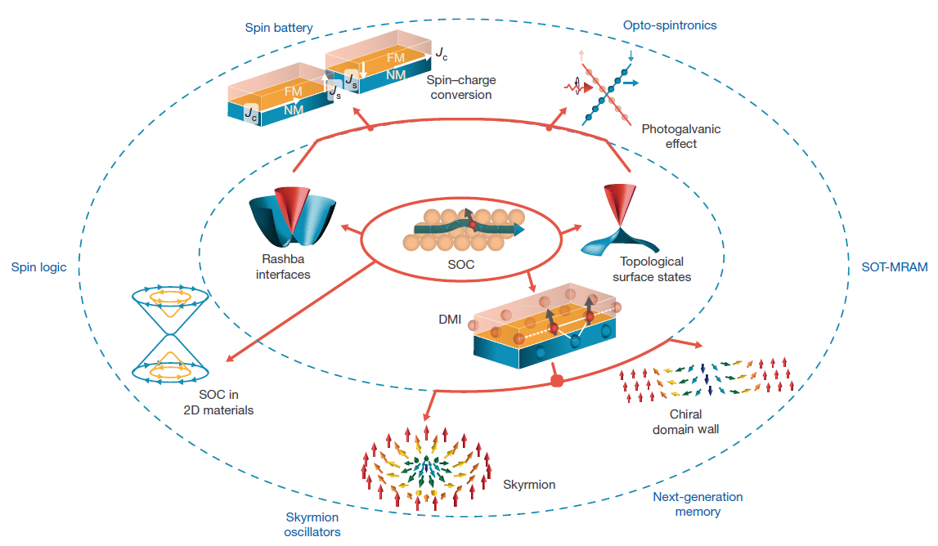
Introduction: Spin-Orbit Coupling Phenomena
Emergent phenomena induced by spin-orbit coupling (SOC) at surfaces and interfaces:
- Social needs of developing new devices faster, more efficient, cleaner and that require less energetic consumption:
Rashba states, topological states…
DM Interaction -> skyrmions, domain chiral wall
Spin-Charge conversion (FM/NM) heterostructures (Edelstein effect).
Non-volatile MRAM SOT devices
SOC in 2D materials at the basis of high speed, low energy consumption devices
Graphene based heterostructures for spintronics?
A. Soumyanarayanan,et al. Nature 539 (2016) 509

Slide 4
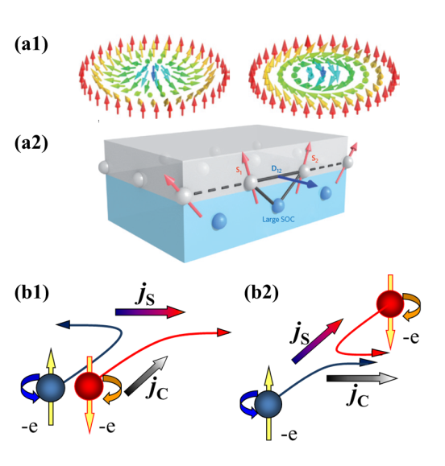
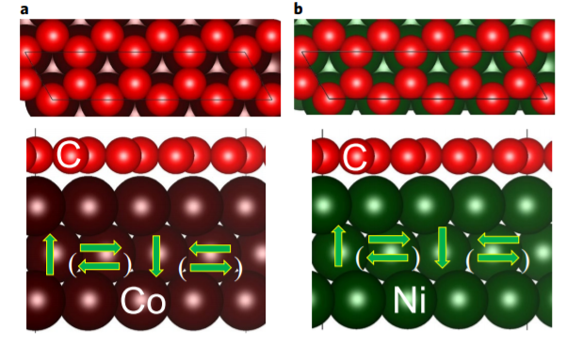
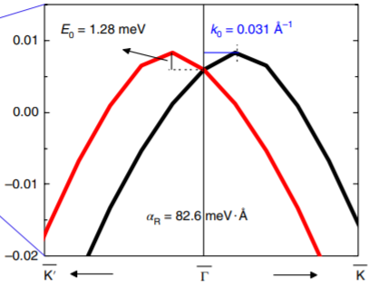
Introduction: Inducing a giant Spin-Orbit Coupling in graphene
Why Graphene ?
Long spin diffusion length
Long spin lifetime
But … negligible SOC !
Spintronics, Spin-Orbitronics devices
Induce SOC in gr by heavy metal intercalation, gating, functionalization, …
Pb-intercalated Gr / Ir(111) by STM
Significant DMI at graphene–ferromagnet interfaces due to the Rashba effect
SR-ARPES
hν=21.2 eV
Gr/Pb/Ir(111)
F. Calleja et al. Nat. Phys. (2015) 11, 43
M. Garnica, et al. Nat. Phys. (2013) 9, 368
D. Maccariello et al. Chem. Mat. (2014) 26, 2883
Spin-split Graphene bands by a Giant
Spin Orbit interaction induced by Pb atoms
Otrokov et al. 2D Mater. 5 (2018) 035029
Yang, H., Chshiev, M. et al. Nature materials, 17(7), 605. 2018
Notes:
Graphene presents very interesting properties for spintronics, since it is an optimal spin conductor due to its long spin difussion length and spin lifetime. To design spintronic devices we need also to convert and measure spin currents and that is usually done taking advantage of the Spin Hall effect or other SOC induce effects. Graphene by itself does not present SOC, but it has been reported that the intercalation of appropiate elements can induce Rashba type SOC.
SOC SPARPES our group

Slide 5
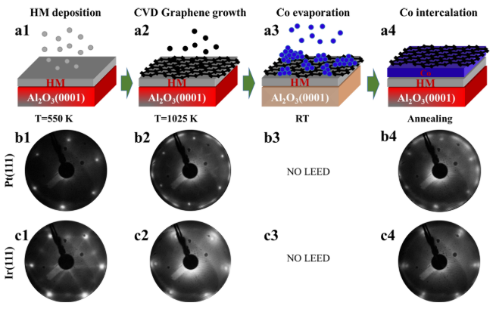
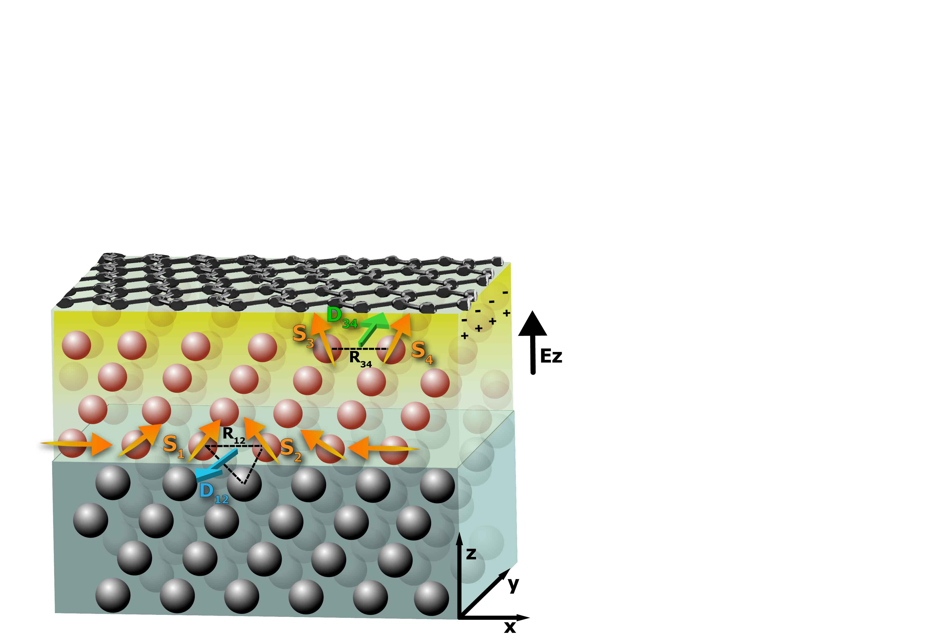
Growth of fully epitaxial graphene/FM/HM interfaces on oxide substrates
UHV epitaxial growth process:
Spin-orbitronics group at IMDEA (P. Perna):
Engeneering Gr/FM/HM heterostructures on insulating oxides.
Choose of the suitable oxide substrate: MgO(111), STO(111), Al₂O₃(0001)
Sputtered HM (Ir, Pt) epitaxial buffers on insulating crystals @ 500 ºC
In-situ UHV CVD gr growth @ 750 ºC
Co RT Evaporation & Intercalation of Co @ (595-665 K)
Monitoring by XPS and LEED, STM at each stage
Avoiding Co/HM intermixing (checked by XPS)
ML graphene
n-doped
Unexpected giant Rashba-like DMI at gr/Co OPPOSITE to SOC-induced Co/Pt
DMI
Co
Ajejas, et al. ACS Appl. Mater. Interfaces 2020, 12, 4088−4096
70 eV
Direct implementation on devices, induced or generated electrical/spin currents not drained by metallic syngle crystals
Missing electronic band structure characterization
Elucidate electronic origin of Rashba SOC in the interface
DMI
Pt
Ajejas et al. Nano Lett. 2018, 18, 5364

Slide 6

Electronic structure epitaxial graphene/Ir(111) on oxide insulating substrates
ARPES on Gr/Ir(111)/Al₂O₃(0001)
Fermi Surface and Constant: Trigonal Dirac cone
Samples grown at MBE chamber (IMDEA) and transferred in UHV to Cassiopée Beamline (Soleil Synchrotron)
Weak Interacting Gr electronic band structure
n-doped preserved Dirac cone
ARPES electronic band comparable to
Gr monolayer grown on Ir(111) single crystals
Preprint at B. Muñiz Cano, A. Gudín, Al. Anadón,…, M. A. Valbuena, P. Perna arXiv:2206.04351 [cond-mat.mtrl-sci]

Slide 7
Electronic structure vs thickness intercalated Co
Weakly interacting Gr
Gr π and σ
Ir(111) FS features
Rashba SS state
Gr/Ir(111)/
Al2O3(0001)
Strong charge transfer.
Shift ∼ 2eV Gr π.
Dirac cone Apex ∼ 2eV
Intense and well-defined Co 3d states
Co intercalation
2 ML Co
Splitting Gr π band:
Non interacting Gr
Interacting Gr
Co localized states
10 ML Co
Highly quality epitaxial thin films
Is there any interaction Gr, Co, Ir states?
Preprint at B. Muñiz Cano, A. Gudín, Al. Anadón,…, M. A. Valbuena, P. Perna arXiv:2206.04351 [cond-mat.mtrl-sci]
Notes:
Co

Slide 8
Electronic structure vs 2 ML Co intercalated:
Interaction Co 3d and Ir states
Ir 5d FS states
ARPES band maps
Gr/Ir(111)/
Al2O3(0001)
hybridization between Co 3d states and Ir 5d states close to M point.
Hybridization between Co 3d states and Ir Rashba SS
Ir Rashba SS
Interaction between Ir states and Co states can induce giant SOC at the interface
Co 3d states
2 ML Co
Consistent with recent DFT calculations where Gr/Co and Co/HM interfaces have similar contributions from the strongly hybridized SOC-split d bands
Preprint at B. Muñiz Cano, A. Gudín, Al. Anadón,…, M. A. Valbuena, P. Perna arXiv:2206.04351 [cond-mat.mtrl-sci]
Gr-capped 3d/5d metal heterostructures richer physics than what is expected from the prediction of single-band models, such as the Rashba DMI model.
Blanco-Rey et al. Phys. Rev B 106, 064426 (2022)

Slide 9
Electronic structure vs 2 ML Co intercalated:
Interaction Co 3d and Ir states
ARPES Fermi Surface and Constant Energy maps
Gr/Ir(111)/
Al2O3(0001)
Ir FS elipsoidal pockets preserved after intercalation
Co 3d hybridization wih Ir ⇒ closer elipsoidal pockets
2 ML Co
Interaction between Ir states and Co states can induce giant SOC at the interface
Preprint at B. Muñiz Cano, A. Gudín, Al. Anadón,…, M. A. Valbuena, P. Perna arXiv:2206.04351 [cond-mat.mtrl-sci]
Prominent state ak K ?

Slide 10
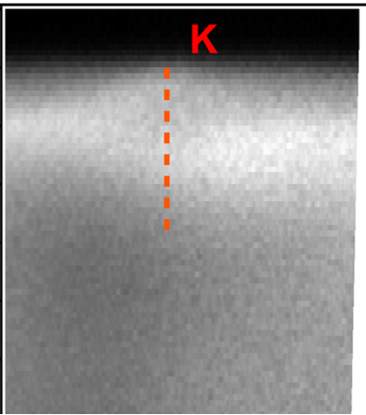
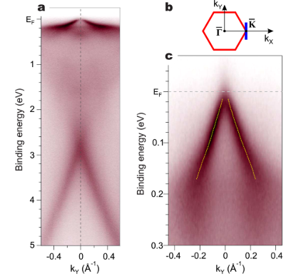
Electronic structure vs 2 ML Co intercalated:
Interaction Co 3d and C states
2 ML Co
Mini Dirac Cone Fully spin polarized.
Prominent state ak K ?
Hybridization C 2p – Co 3d
Usachov et al. Nano Lett. 2015, 15, 2396−2401
Previously reported for Gr/Co(0001) single crystal.
Mini Dirac Cone at K at E_{F}. Bandwidth ∼ 200 meV
Fully spin polarized Mini Dirac cone developed on thin film samples grown onto insulating substrates
Spintronic devices
Preprint at B. Muñiz Cano, A. Gudín, Al. Anadón,…, M. A. Valbuena, P. Perna arXiv:2206.04351 [cond-mat.mtrl-sci]

Slide 11
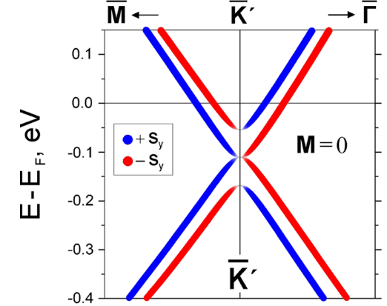
Spin Resolved ARPES measurements:
Energy Spin Splitting and Spin Polarization
2 ML Co
Zoom Gr π Peak
In-Plane
Out-of-Plane
In-Plane
Out-of-Plane
uct
Co 2 ML
ΔE ∼ 100 ± 40 meV
ΔE ∼ 20 ± 40 meV
In-plane spin texture of graphene π-bands in the presence of Rashba SOC
In-plane energy splitting and spin polarization of the same order of others Rashba-SOC systems (Pb, Au intercalated…)
Preprint at B. Muñiz Cano, A. Gudín, Al. Anadón,…, M. A. Valbuena, P. Perna arXiv:2206.04351 [cond-mat.mtrl-sci]
Negligible out-of-plane energy splitting and spin polarization
Nano Lett. 2018, 18, 1564−1574

Slide 12
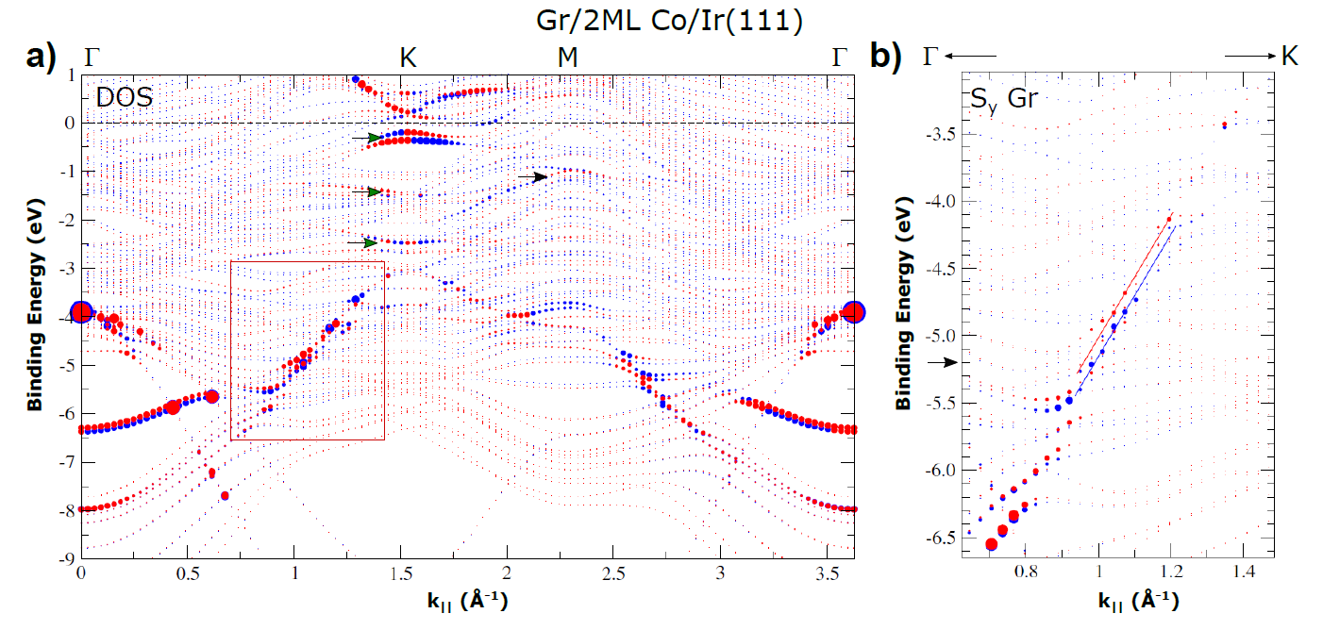
Spin Polarized Electronic Structure Gr/2 ML Co/Ir(111)
DFT calculations
In-plane spin Sy
2 ML Co
ΔE∼ 100 meV
Preprint at B. Muñiz Cano, A. Gudín, Al. Anadón,…, M. A. Valbuena, P. Perna arXiv:2206.04351 [cond-mat.mtrl-sci]
Fully spin polarized mini Dirac Cone (Co-C interaction)
DFT calculations largely agree with experimental ARPES and SR-ARPES results
Hybridization Co/Ir states (E_{F} - 3eV)
In-plane energy spin splitting (Gr π -6, -4 eV)
Neglect charge transfer effects

Slide 13
Spin Polarized Electronic Structure Gr/10 ML Co/Ir(111)
10 ML Co
Preprint at B. Muñiz Cano, A. Gudín, Al. Anadón,…, M. A. Valbuena, P. Perna arXiv:2206.04351 [cond-mat.mtrl-sci]
Negligible In-plane and out-of-plane energy spin splitting
Thicker Co layer decouples Gr from SOC Ir source
Consistent with recent DFT calculations where Gr is decoupled for more than 3 FM ML
Blanco-Rey et al. Phys. Rev B 106, 064426 (2022)

Slide 14
CONCLUSIONS
We have determined the electronic structure of Gr onto Ferromagnetic / Heavy Metal interfaces grown onto oxide insulating surfaces, suitable to be implemented in electronic/spintronic devices
Gr/Ir(111)/Al₂O₃(0001) Weak interacting Gr electronic band structure. Dirac cone preserved. Slightly n-doped. Similar to Gr grown on Ir(111) single crystals
Gr/2 ML Co/Ir(111)/Al2O3(0001):
  Identify SOC source from Ir-Co-C hybridization.
  We resolve fully spin polarized mini Dirac cone (as from Gr grown on Co(0001) single crystal)
  Rashba-like spin texture determined fron SR-ARPES and DFT calculations
  Consistent with recent DFT predictions where not only a Rashba like scenario should be considered at the DMI of Gr/Co.interface
Gr/10 ML Co/Ir(111)/Al2O3(0001)
  Increasing Co thickness decouples Gr from SOC induction

Slide 15

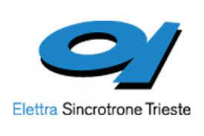







Acknowledgments:
J. Camarero
R. Miranda
Synchrotron experiments
J. Rault, P. Le Fèvre, F. Bertran
M. Jugovac
Spin-ARPES
B. Muñiz Cano.
M. A. Valbuena
Spin-Orbitronics
A. Gudín A. Anadón
J. M. Diaz F. Ajejas
I. Arnay P. Olleros
P. Perna
DFT Calculations
D. Mazhjoo, G. Bihlmayer, S. Blügel
Financial Support:
Programme for Centres of Excellence in R&D
Grant: SEV-2017-0706
SpOrQuMat: PGC2018-098613-B-C21
SOnanoBrain PID2020-116181RB-C31
CONPHASETM PID2021-123776NB-C21
Programa Operativo de Empleo Juvenil y la Iniciativa de Empleo Juvenil.
Consejeria Ciencia, Universidades e Innovación PEJD-2019-PRE/IND-17048
Project P2018/NMT-4321 (NANOMAGCOST-CM).
Spin-ARPES: EQC2019-006304-P

Slide 17
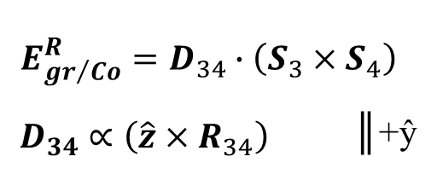
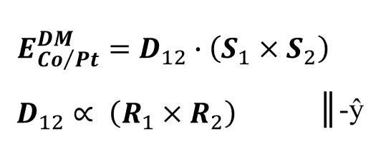
Origin of the unusual (large) DMI at gr/Co
Rashba-like DMI at gr/Co
(existence of sizeable electric field)
n-doped graphene
Co
Kundu A et al. Phys. Rev. B 92, 094434 (2015)
Yang, H., et al. Nature materials, 17(7), 605.
Pt
SOC-DMI at Co/Pt interface
Three-sites model (Fert-Levy) based on HM impurities in Co layer
F. Ajejas, AA, PP et al. Nano Lett. 2018, 18, 5364
Fert A. & Levy P. M., Role of Anisotropic Exchange Interactions in Determining the Properties of Spin-Glasses, Phys. Rev. Lett. 44, 1538–1541 (1980).
Rashba-like DMI at gr/Co OPPOSITE to SOC-induced Co/Pt
F. Ajejas, PP et al. Nano Lett. 2018, 18, 5364
Notes:
conduction electron mediated Rashba−DMI mechanism

