Slide 1



Application of synchrotron-based techniques for the study of calcium oxalate hydrates transformation
Iris H.Validoª, Roberto Boadaª, Montserrat Resina-Gallegoª, Victor Fuentes-Cebriánª, Ibraheem Yousef^{b}, Oriol Vallcorba^{b}, Manuel Valienteª, Montserrat López-Mesasª
ª GTS Research Group, Department of Chemistry, Faculty of Science, Universitat Autònoma de Barcelona, 08193 Bellaterra, Cerdanyola del Vallès, Spain.
^{b} ALBA Synchrotorn Light Source, Cerdanyola del Vallès, Barcelona, Spain

Slide 2
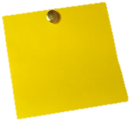
PRESENTATION INDEX
1. Introduction
2. Objectives
3. CaOx characterization
4. Organic matter distribution
5. COM formation origin
6. Conclusions

Slide 3
1. INTRODUCTION

Slide 4
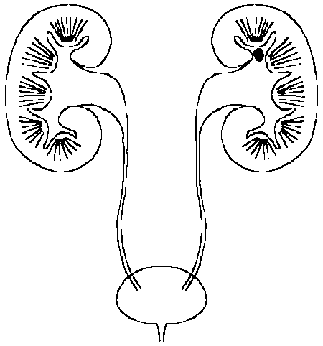
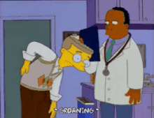

1. INTRODUCTION
Kidney Stones vs. Giving Birth
©DreamWorks Animation
WHAT IS MORE PAINFUL?
©Giphy.com
©Giphy.com
Solid concretion in the urinary tract
Incapacitating pain

Slide 5
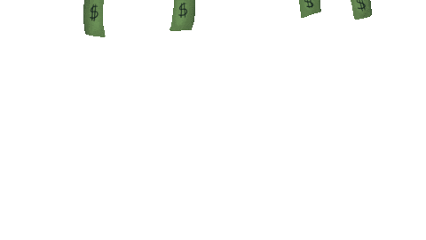







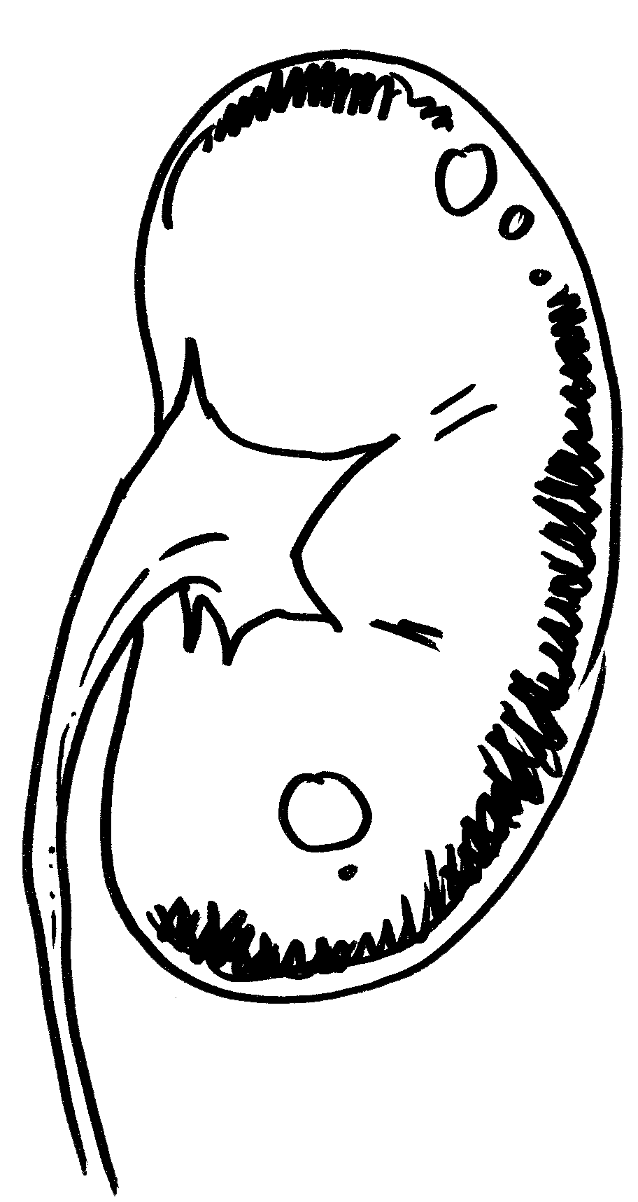
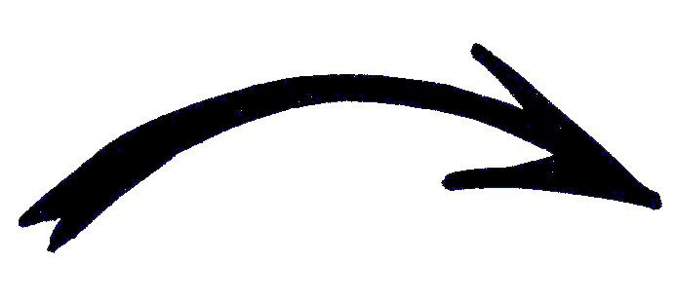
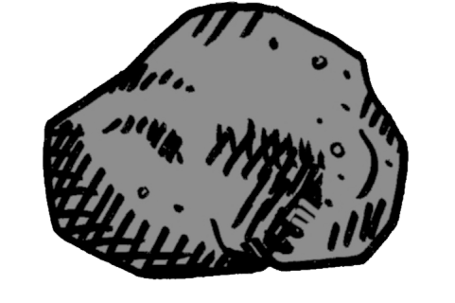






1. INTRODUCTION – Epidemiology and cost for the health care system
30-50% in 5 to 10 years
75% after 20 years
3-6%
7-15%
©Giphy.com

Slide 6


1. INTRODUCTION – Formation hypotheses
Urinary saturation
Crystal germination
and growth
Retention of
crystallized particles
Crystal aggregation
and agglomeration

Slide 7
1. INTRODUCTION – Formation hypotheses
STONE
Calcium
Oxalate
Sodium
Urate
Cystine
Organic matter
Citrate
Pyrophosphate
Phytate
Mg
Organic matter
Promoters
Inhibitors

Slide 8

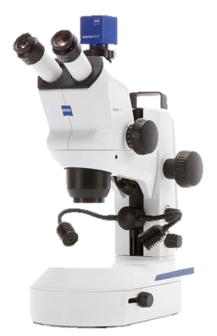
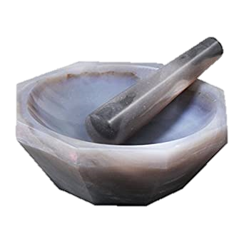
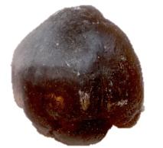
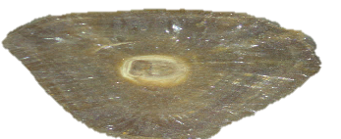
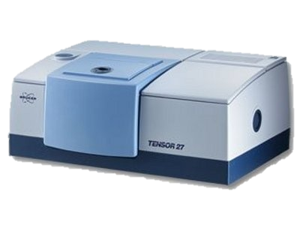
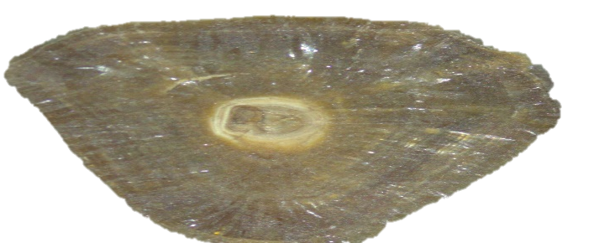
1. INTRODUCTION – Kidney stone classification
Infrared spectroscopy
X-ray diffraction
Chemical analysis
Bulk analysis
Morpho-constitutional analysis

Slide 9
1. INTRODUCTION – Kidney stone classification
Kidney Stones
Oxalate
Phosphate
Uric Acid
Cystine
Others
Calcium Oxalate (CaOx)
Dihydrate (COD)
Monohydrate (COM)
Calcium Phosphate (CaP)
Struvite (STR)
Hydroxyapatite (HAP)
Brushite (BRU)
Anhydre (AUA)
Dihydrate (AUD)
Mixed

Slide 10
1. INTRODUCTION – Kidney stone classification
TRANSFORMATION
Dihydrated
(Lost of one molecule of water)
Monohydrated
(Kinetically favorable)
(Thermodynamically stable)
CaC₂O₄·2H₂O
Contact time with the solution (urine)
Deficit of stabilizers
CaC₂O₄·H₂O
=
=
COD
X
TRA
COM
?
Origin
Hypercalciuria
Different pathologies
Hyperoxaluria

Slide 11
2. OBJECTIVES

Slide 12
2. OBJECTIVES
COD
Crystalline conversion
TRA
?
Origin
COM
Crystalline conversion
COD stabilization
Formation origin?
COM vs. TRA
Promoters or inhibitors?
Organic matter

Slide 13
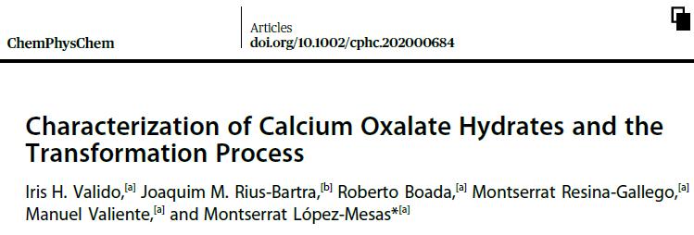
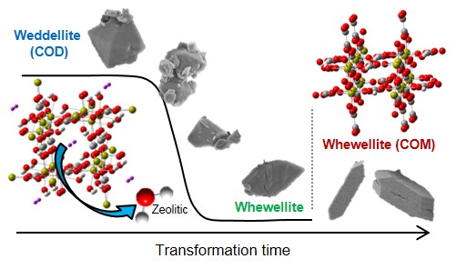
3. CaOx
CHARACTERIZATION

Slide 14
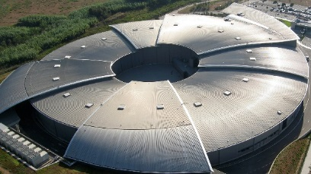
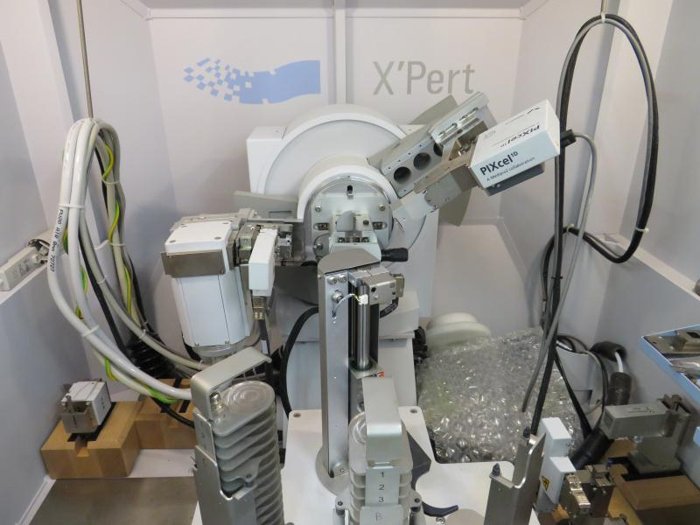
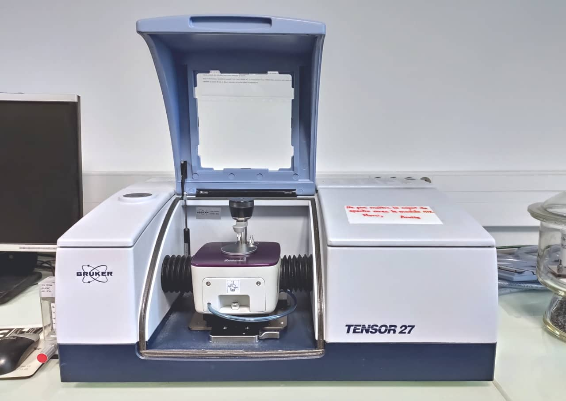
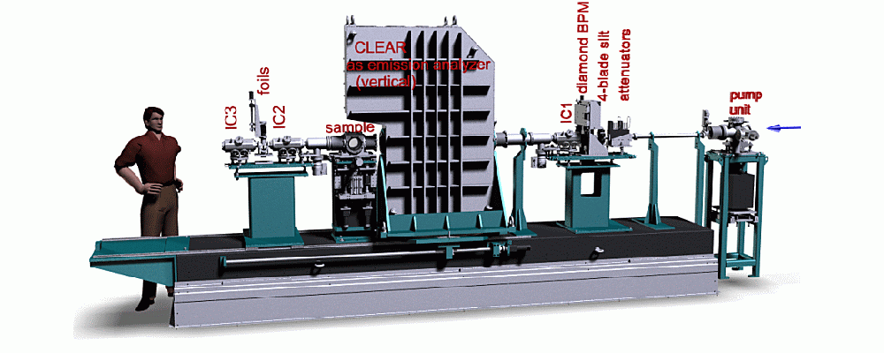
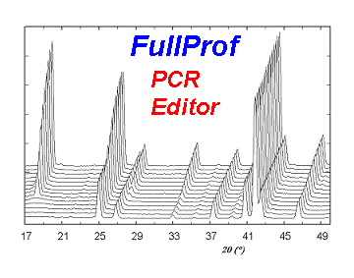
3. CaOx CHARACTERIZATION – Experimental section
Characterization
X-ray Absorption Spectroscopy (XAS)
X-ray Diffraction (XRD)
Infrared spectroscopy
Vibrational spectroscopy characterization
Theoretical frequencies calculated via DFT with Gaussian software
©2014 CELLS
X-ray absorption near edge structure (XANES)
Extended X-ray absorption fine structure (EXAFS)
(Local site symmetry, charge state, orbital occupancy)
(Local structure (bond distance, number, type of neighbors…))
Notes:
For the characterization of the synthetized crystals, four different techniques were used:

Slide 15
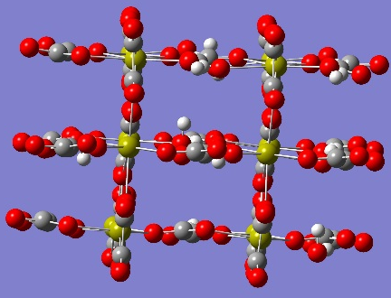
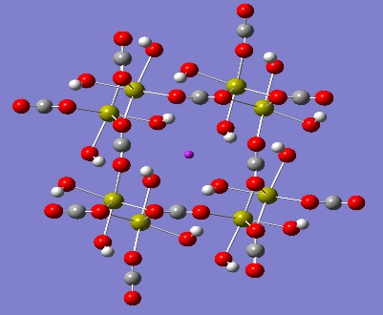
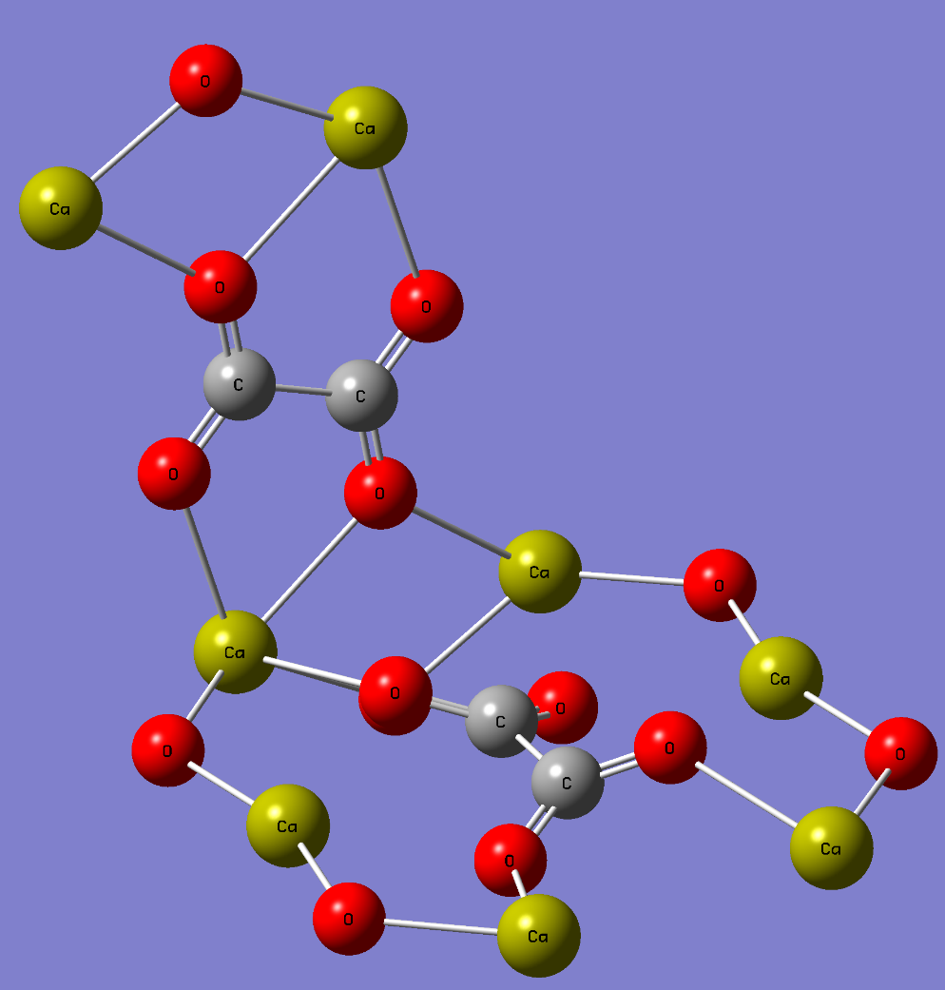
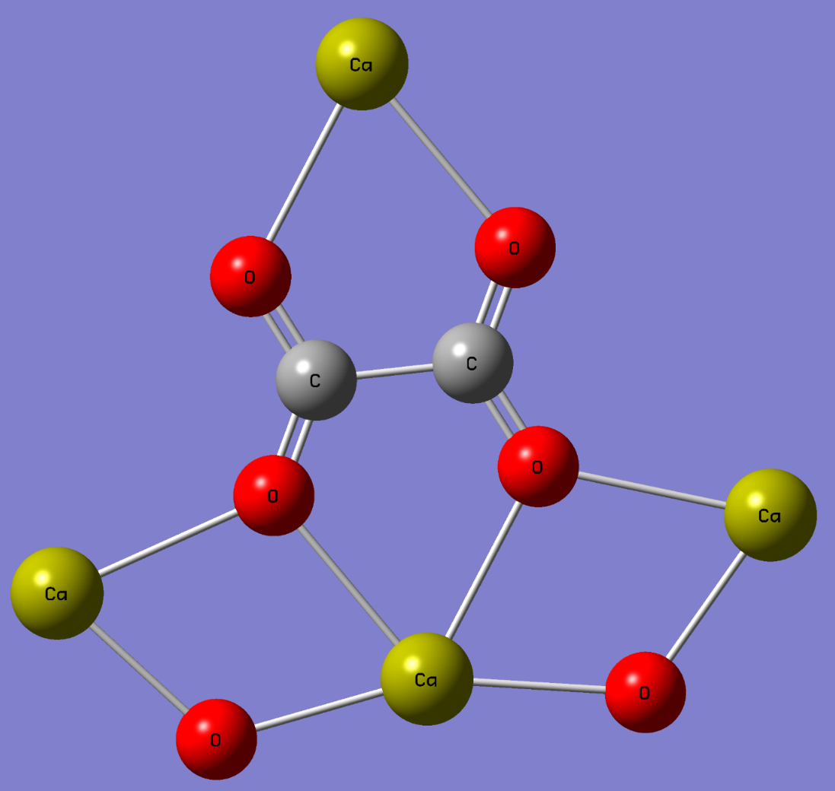
3. CaOx CHARACTERIZATION – Results and discussion
XRD
COM
XAS
Oxalate ion coordination
COD
P2₁/c
I₄/m

Slide 16
3. CaOx CHARACTERIZATION – Results and discussion
Infrared spectroscopy (IR)
COD
COM

Slide 17
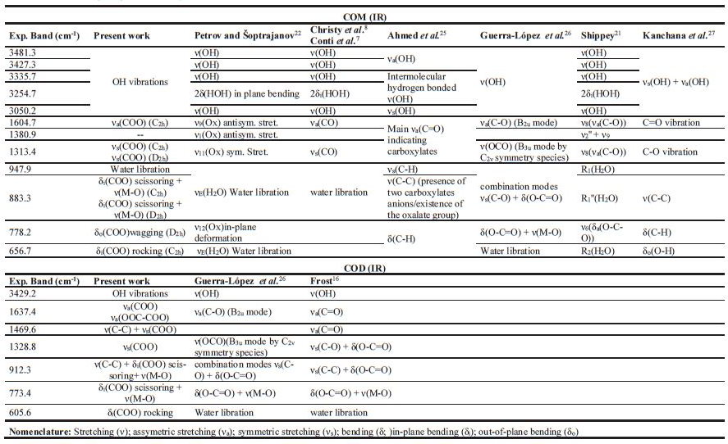
3. CaOx CHARACTERIZATION – Results and discussion

Slide 18
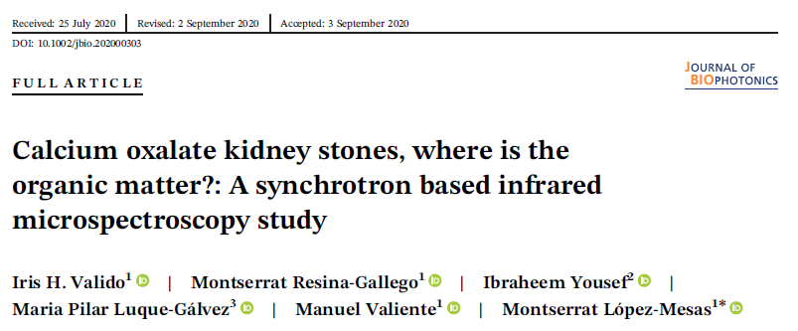
4. ORGANIC MATTER
DISTRIBUTION
Notes:
This section corresponds to the second article, Calcium oxalate kidney stones, where is the organic matter? A synchrotron based infrared microspectroscopy study, already published in the journal of Biophotonics.

Slide 19
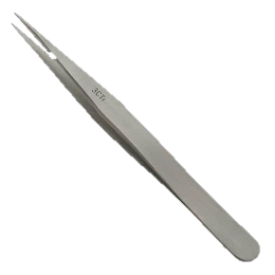
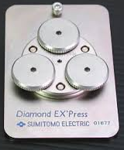
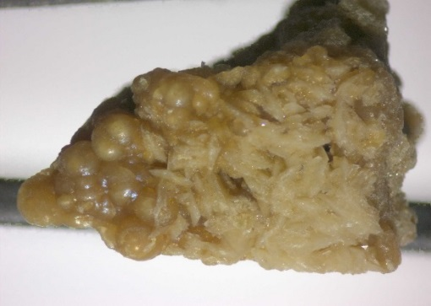

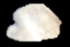
4. ORGANIC MATTER DISTRIBUTION – Experimental section
SR-µIR in transmission mode
Resolution: 4 cm⁻¹
Apperture size: 10x10 µm²
Nº of scans: 512

Slide 20
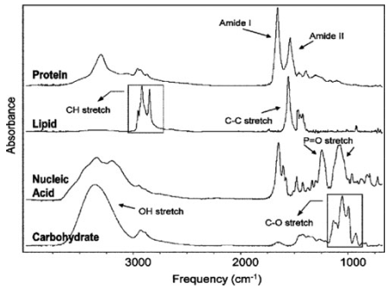


4. ORGANIC MATTER DISTRIBUTION – Results and discussion
Organic matter distribution
CH₃ asym. Stret.
(~2960 cm⁻¹)
CH₂ asym. Stret.
(~2920 cm⁻¹)
$$\frac{{−CH}_{2}}{{−CH}_{3}}=\frac{v_{2920}}{v_{2957}}>1$$
$$\frac{{−CH}_{2}}{{−CH}_{3}}=\frac{v_{2920}}{v_{2957}}≈1$$
Lipids
Proteins
*
* Bunaciu, A. A., et. al., Appl Spectros Rev, 2015, 50:176-191

Slide 21


4. ORGANIC MATTER DISTRIBUTION – Results and discussion
Organic matter distribution
COD
COM
Nucleus
Surface
$$\frac{{−CH}_{2}}{{−CH}_{3}}=\frac{v_{2920}}{v_{2957}}>1$$
Lipids
$$\frac{{−CH}_{2}}{{−CH}_{3}}=\frac{v_{2920}}{v_{2957}}≈1$$
Proteins

Slide 22
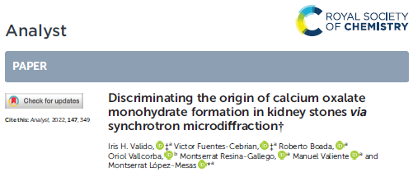
5. COM
FORMATION ORIGIN
Notes:
This section corresponds to the third article, Discriminating the formation origin of calcium oxalate monohydrate in kidney stones via synchrotron microdiffraction.

Slide 23
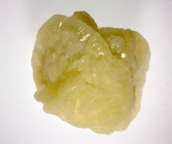
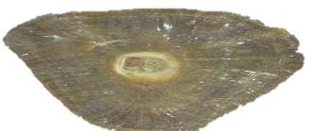
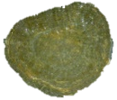
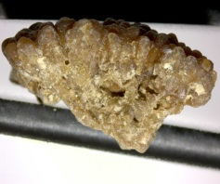
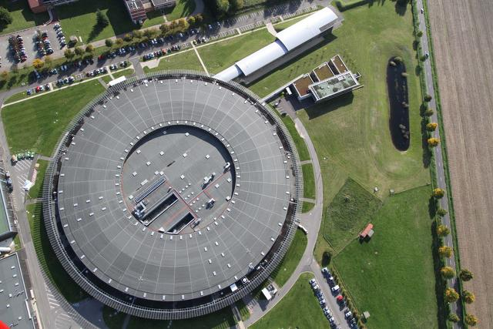
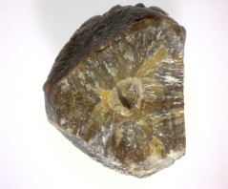
5. COM FORMATION ORIGIN – Experimental section
COD
30 µm thickness
EpoFix resin
TRA
COM
SMIS beamline
µIR
MSPD beamline
µXRD
Resolution: 4 cm⁻¹
Apperture size: 12x12 µm²
Nº of scans: 128
Beam size: 15 µm²

Slide 24
5. COM FORMATION ORIGIN – Results and discussion
SR-µIR in reflectance mode

Slide 25
5. COM FORMATION ORIGIN – Results and discussion
SR-µXRD

Slide 26
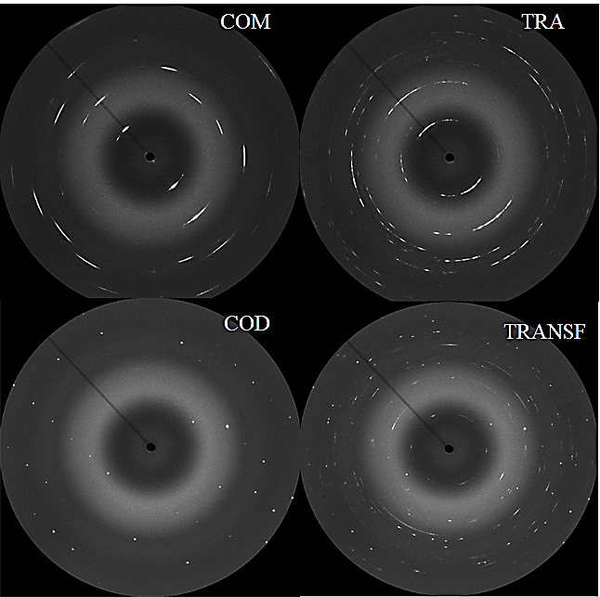
5. COM FORMATION ORIGIN – Results and discussion
2D µXRD patterns
COD
TRA
COM
180º
0
360
φ (º)

Slide 27
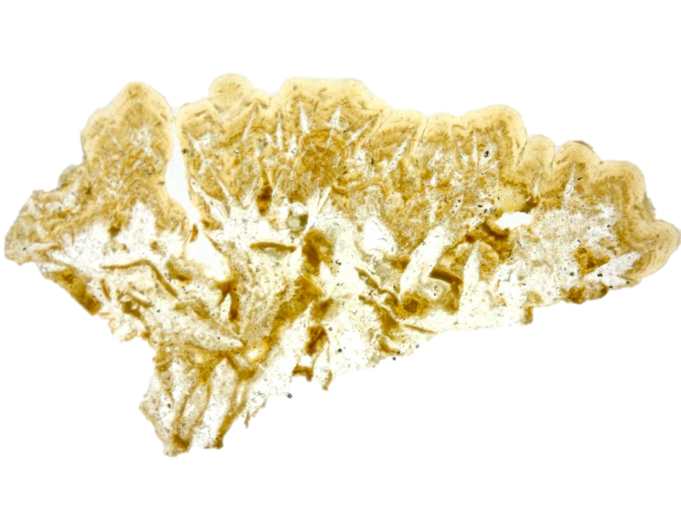
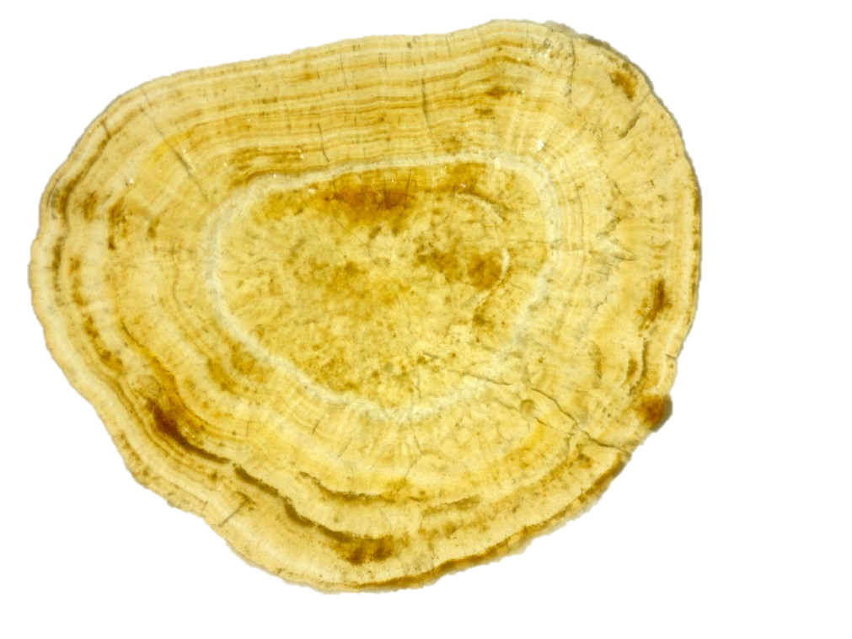
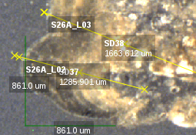
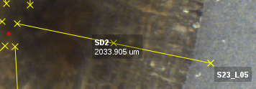
5. COM FORMATION ORIGIN – Results and discussion
TRA (S26A)
COM (S23)
HAP

Slide 28
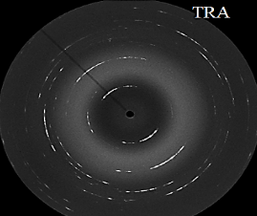
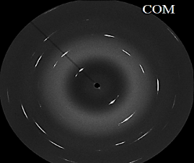
5. COM FORMATION ORIGIN – Results and discussion
COM (S23)
TRA (S26A)
(100)
(040)

Slide 29
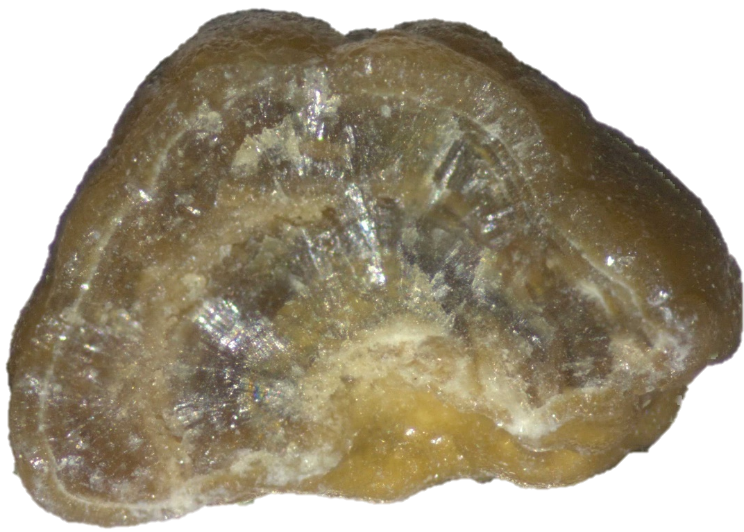
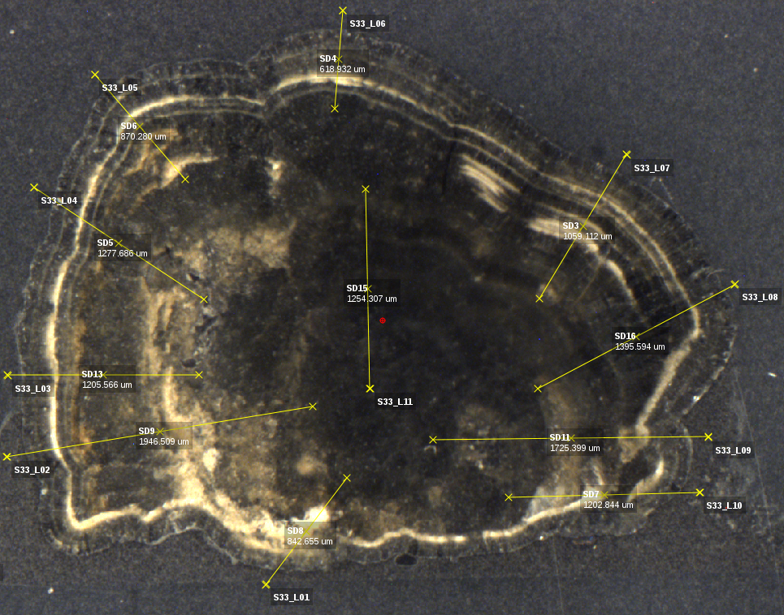
5. COM FORMATION ORIGIN – Results and discussion

Slide 30
5. COM FORMATION ORIGIN – Results and discussion
??? (S33)
(100)
(040)
TRA
COM
COM

Slide 31
6. CONCLUSIONS

Slide 32
6. CONCLUSIONS
Characterization of calcium oxalate hydrates
The long-range (XRD) and short-range (XAS) order characterization of the synthetic oxalocalcic species , in combination with the application of DFT computational analysis, allowed to assign the characteristic bands from the infrared spectra to the corresponding vibration.
Distribution of the organic matter on oxalocalcic stones
By analyzing the asymmetric stretching of the aliphatic –CH₂- and –CH₃ on the SR-µFTIR study, it was possible to differentiate between proteins and lipids.
It was possible to determine that lipids participate in the stabilization of COD crystallites and as possible inhibitors of the COM formation/development.
Proteins could act as promotors of the COM formation since they are found in the nucleus.
Formation origin of calcium oxalate monohydrate
Due to the high variability on the oxalocalcic spectra by applying SR-µFTIR in reflectance mode, the differences observed between COM and TRA are not considered significant enough to distinguish them with this technique.
However, it is possible to distinguish them by studying their crystalline texture degree with the qualitative analysis of the azimuthal plot of the selected reflections from the 2D µ-XRD data.

Slide 33
ACKNOWLEDGEMENTS

Slide 34







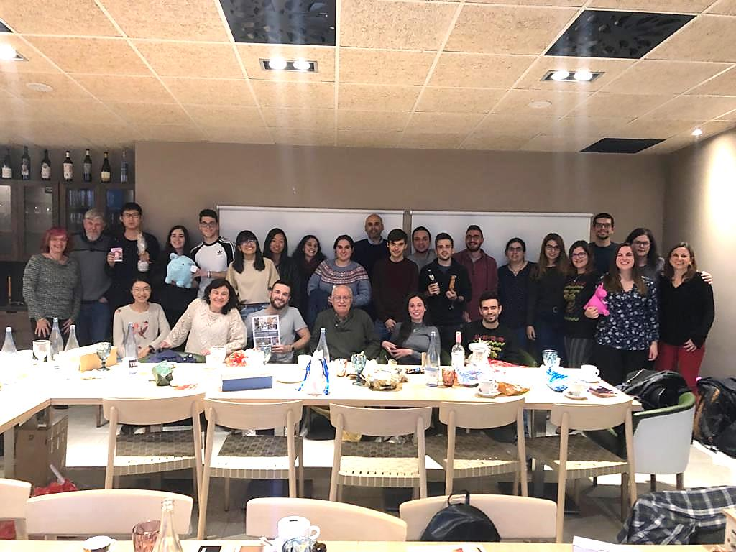
ACKNOWLEDGEMENTS

Slide 35
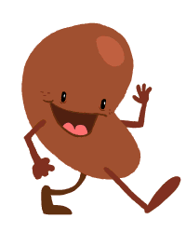
Thanks for your attention!
©Giphy.com

Slide 36
Application of synchrotron-based techniques for the study of calcium oxalate hydrates transformation
Iris H.Validoª, Roberto Boadaª, Montserrat Resina-Gallegoª, Victor Fuentes-Cebriánª, Ibraheem Yousef^{b}, Oriol Vallcorba^{b}, Manuel Valienteª, Montserrat López-Mesasª
ª GTS Research Group, Department of Chemistry, Faculty of Science, Universitat Autònoma de Barcelona, 08193 Bellaterra, Cerdanyola del Vallès, Spain.
^{b} ALBA Synchrotorn Light Source, Cerdanyola del Vallès, Barcelona, Spain

Slide 37
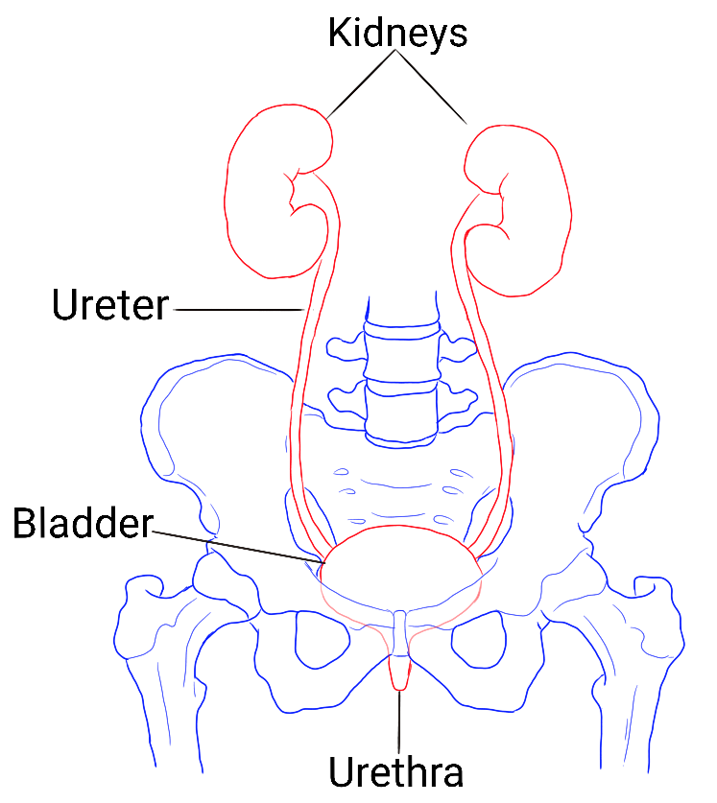


Support
Urinary tract
Kidney section
Neprhon

Slide 38

Support
Organic matter distribution
CH₃ asym. Stret.
(~2960 cm⁻¹)
CH₂ asym. Stret.
(~2920 cm⁻¹)
*
**
* Mallamace, F., et. al., Comput Struct Biotechnol, 2014, 13:33-7
** Bunaciu, A. A., et. al., Appl Spectros Rev, 2015, 50:176-191

Slide 39
Support

Slide 40

Support

Slide 41
Support

Slide 42
Support

Slide 43










Slide 44



Support

Slide 45

Support

Slide 46


Support
(100)
(040)

Slide 47
Support

