Slide 1
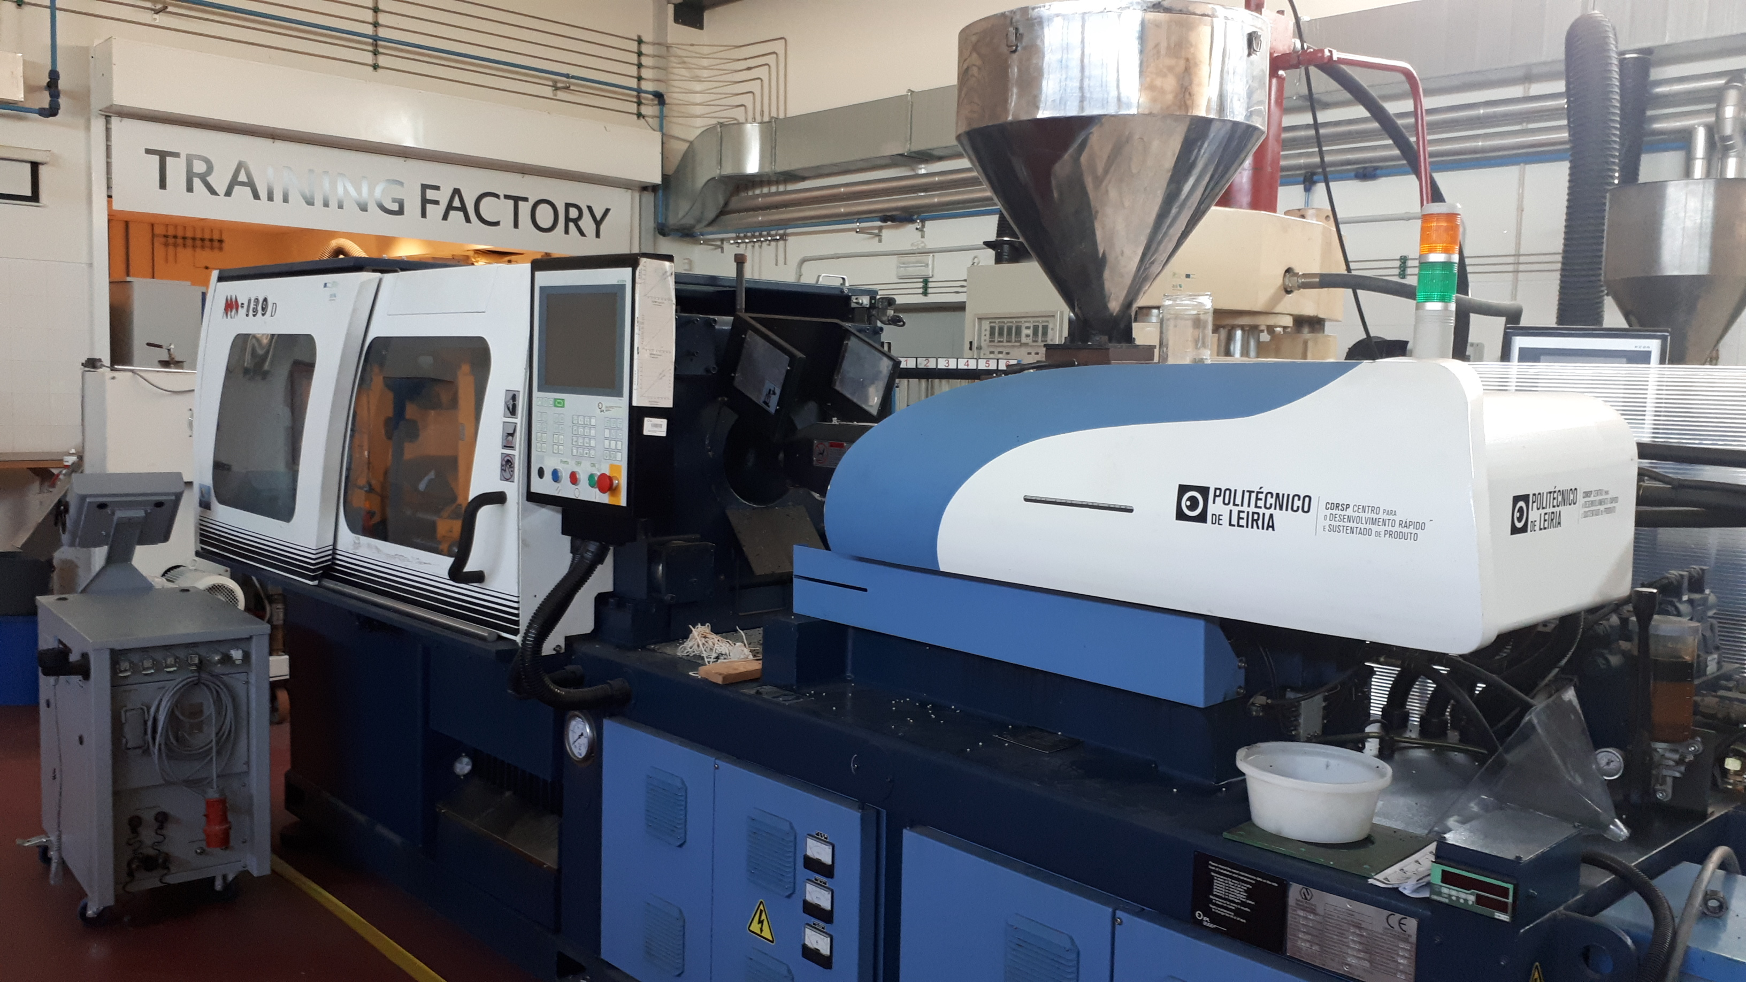



Bringing Injection Moulding of Plastics to the SAXS Beamline at ALBA
Andre A. Costa¹, Daniel P. Silva¹, Paula Pascoal Faria¹, Artur Mateus¹, Tiago Ruivo², Geoffrey R. Mitchell¹*
geoffrey.mitchell@ipleiria.pt
¹Centre for Rapid and Sustainable Product Development, Institute Polytechnic of Leira, Marinha Grande, Portugal
Geoffrey.mitchell@ipleiria.pt

Slide 2

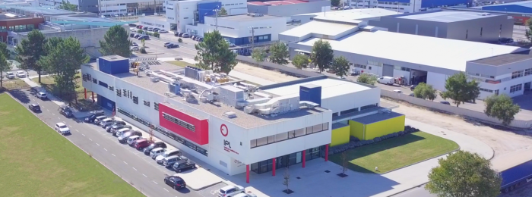
CDRSP and Funding
Manufacturing a better future
CDRSP is a centre of excellence in the field of direct digital manufacturing
This work was performed at CDRSP-IPLEIRIA and This work is supported by the Fundação para a Ciência e Tecnologia (FCT) through the Project references: UID/Multi/04044/2013; PAMI-ROTEIRO/0328/2013 (Nº 022158), Add.Additive-POCI-01-0247-FEDER-024533 and Tailored Cooling POCI-01-0145-FEDER-03243), S4PLAST and PAC. We thank the NM3D Iberica Company based in Marinha Grande for making the CT scans of the mould inserts
Geoffrey.mitchell@ipleiria.pt

Slide 3
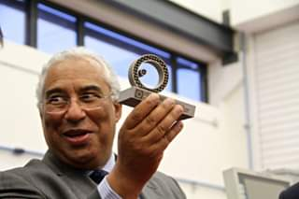
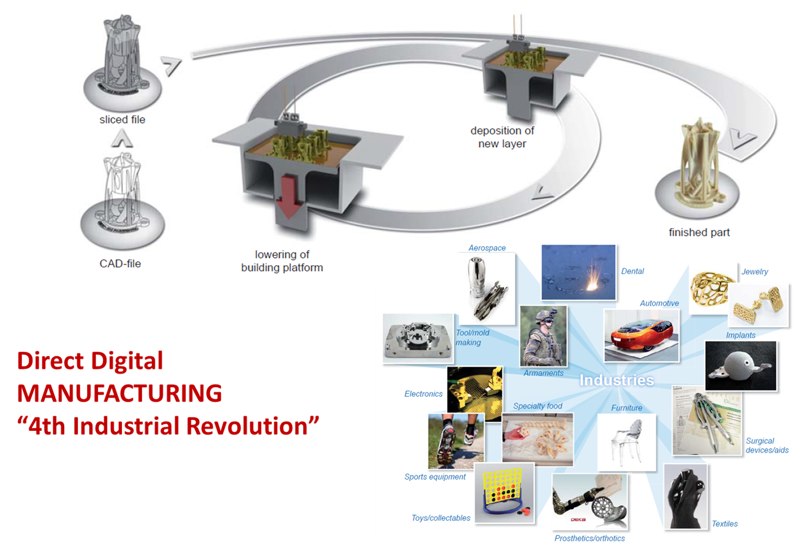
WHAT WE DO ?
Prime Minister António Costa with a DDM object at the opening of CDRSP Building
CDRSP IS THE LEAD INSTITUTE IN THE FCT
FUNDED PAMI - Portuguese Additive Manufacturing Initative

Slide 4
Publications
Costa, A.; Gameiro, F.; Potencio, A.; Silva, D.; Carreira, P.; Martinez, J.C.; Pascoal-Faria, P.; Mateus, A.; Mitchell, G.R. In Situ Time-Resolving Small-Angle X-ray Scattering Study of the Injection Moulding of Isotactic Polypropylene Parts. Mater. Proc. 2022, 8, 30. https://doi.org/10.3390/materproc2022008030
Costa, A.A., Gameiro, F., Potêncio, A., da Silva, D.P., Carreira, P., Martinez, J.C., Pascoal-Faria, P., Mateus, A., and Mitchell, G.R. “Evaluating the Injection Moulding of Plastic Parts using In Situ Time-Resolved Small-Angle X-Ray Scattering Techniques
Polymers 2022, to appear
Andre A. Costaª, Fábio Gameiroª, Artur Potêncioª, Daniel P. da Silvaª, Pedro Carreiraª, Juan Carlos Martínez^{b}, Paula Pascoal-Fariaª, Pedro G. Martinhoª, Artur Mateusª, Geoffrey R. Mitchell^{a,}“ Industrially relevant Injection Moulding Apparatus for In-Situ Time- Resolving Small-Angle X-ray Scattering Study” to be submitted to Journal of Manufacturing Processes, September 2022

Slide 5
Injection Moulding of Plastics
History
Plastic injection molding was invented in the 19th century, with the first moulding machine patented in 1872 by John and Isaiah Hyatt. While the device was simple by today’s standards, it quickly led to the growth of a growing plastic manufacturing industry, where combs, buttons, and other simple articles were molded in plastic.
Today plastic manufacturing is the 3rd largest is the USA.
Plastic materials emerged in the post-war period. Industry recognized the tremendous cost benefits over rival materials, global supply chains were reevaluated, and plastics became firmly entrenched in the mid-20th century’s economy and manufacturing processes.
By 1946, an American inventor James Watson Hendry built the world’s first extrusion screw injection machine. Using a rotating screw, Hendry was able to better control the injection process itself. This dramatically increased the quality of the products produced. Hendry went on to develop gas assisted injection moulding

Slide 6
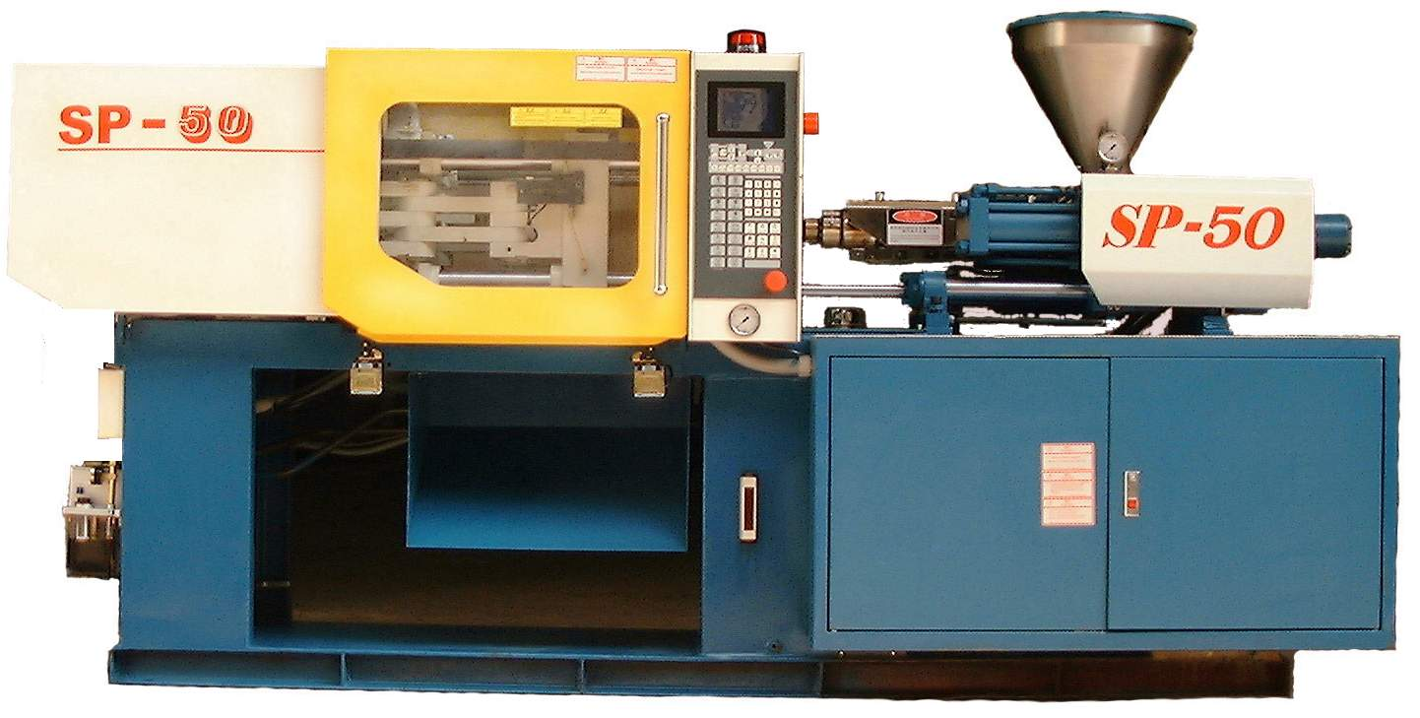
Injection moulding machine
Mould
Plastic pellets feedstock
Hydraulic clamping unit
Injection unit

Slide 7
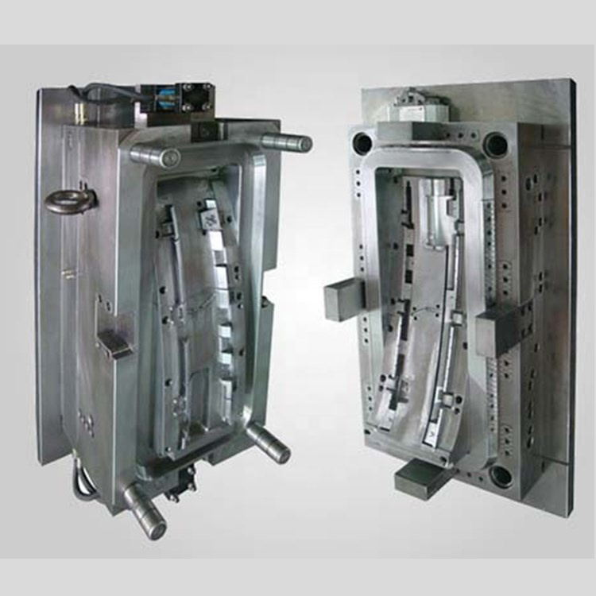
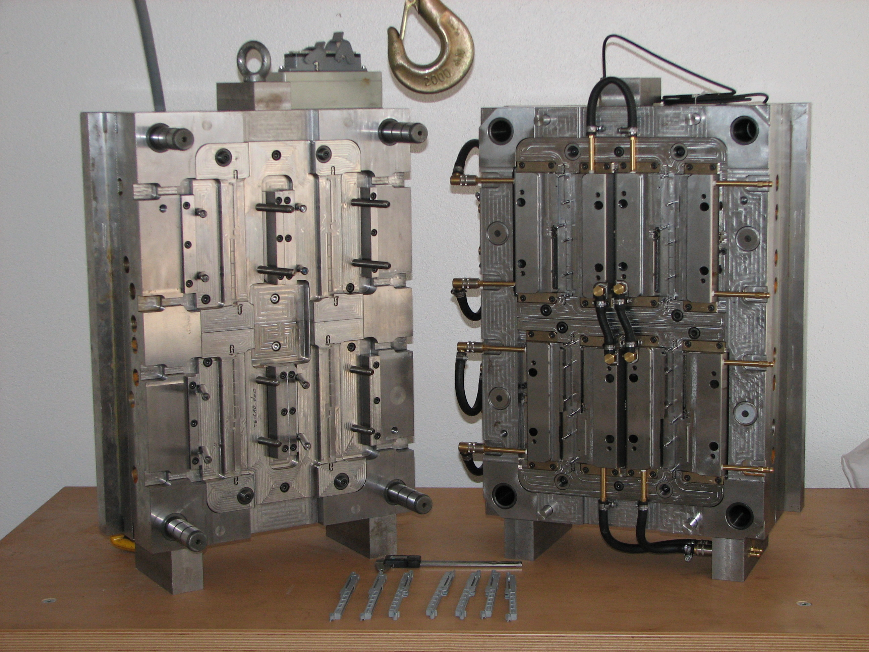
Moulds made from steel or more recently from Aluminium Aolloys
Mould systems are much more than shapes and containing coolimg circuits, sensors, gates and ejectors

Slide 8
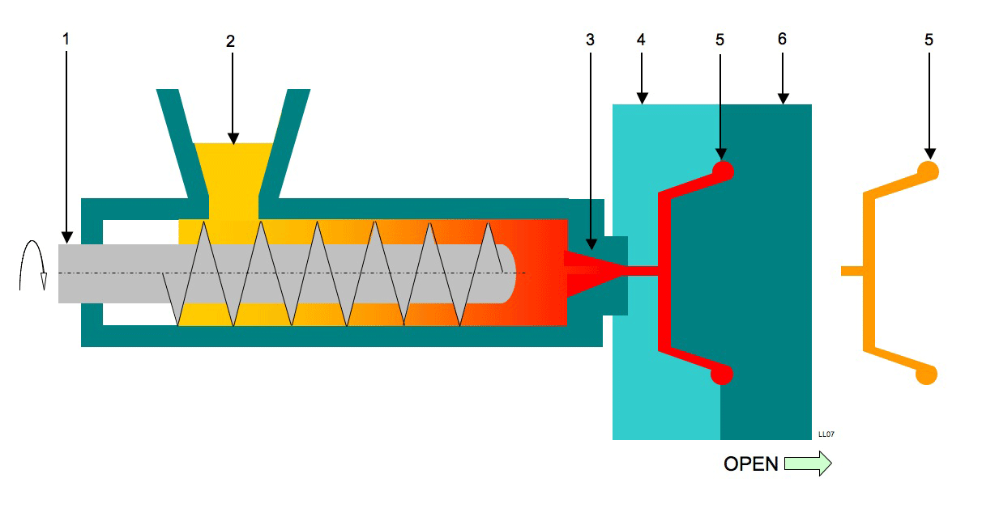
Manufacturing with plastics
polymer in
A high proportion of plastic parts are made by injection moulding in which molten plastic is forced in to a mould and solidifies in the imposed shape on cooling
Big investment so good for mass production
Mould
Injection moulding is ideal for making thousands of identical components from the sample material

Slide 9
Materials for Injection Moulding
Now Injection Moulding is the most common method of manufacturing plastic parts
All thermoplastics can be used but the composition needs to be optimized for injection moulding
The five most common materials are
ABS Acrylonitrile Butadiene Styrene
PP Polypropylene*
PA Polyamide (Nylon 6)*
PC Polycarbonate
PE Polyethylene* * is a semi-crystalline polymer

Slide 10
The Moulding Process
Temperature
Phase 1, heat polymer pellets in to liquid state
Phase 2 Fill mould cavity under high pressure
Phase 3, Plastic cools and solidifies as a glass or crystallises and retains the shape of the mould
Mould Temperature
Phase 4 Solid part ejected

Slide 11
The Molecular Processes
Temperature
Phase 1, heat polymer pellets in to liquid state
Phase 2 Fill mould cavity under high pressure
Phase 3, Plastic cools and solidifies as a glass or crystallises and retains the shape of the mould
Mould Temperature
Formation of a homogenous liquid state
Some long chain molecules become extended in flow within the cavity
Formation of a solid, semi-crystalline if crystallizable, glass, if not crystallisable
Phase 4 Solid part ejected

Slide 12
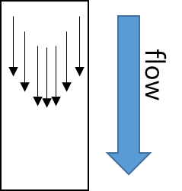

Flow in Polymer Melts
In the typical polydisperse polymer used for injection moulding
If the polymer is glass forming and the extended chains are present at the glass forming temperature then we obtain a frozen version of the polymer melt

Slide 13


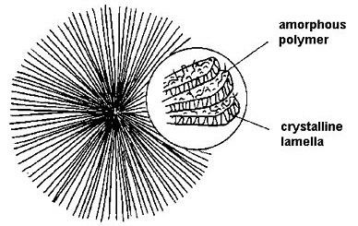
Crystallisation can be an amplifier
Time
flow
Crystallisation is reached with extended chains intact
Modulus 2X
Highly anisotropic structure
Modulus 1x
Chain extension relaxes and spherulites form an isotropic structure

Slide 14
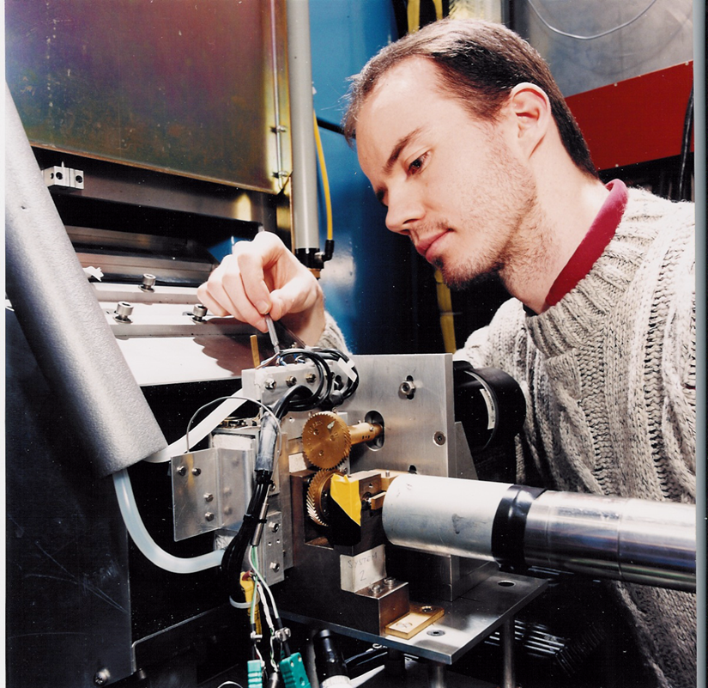
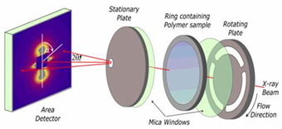
Anisotropy Amplification with Polymers
Flow
Small-angle Neutron Scattering using a mixture of polyethylenes with a deuterium labelled version
Performed using LOQ at ISIS
Results from the PhD work of James Holt
Modest shear rates 10s⁻¹ using
a parallel plate shear cell

Slide 15
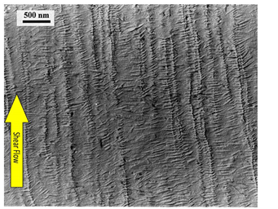
Anisotropy Amplification with Polymers
Flow
Small-angle Neutron Scattering using a mixture of polyethylenes with a deuterium labelled version
TEM of a replica of a differentially etched surface
Results Courtesy of James Holt
Modest shear rates 10s⁻¹ Applied using a parallel plate shear cell

Slide 16
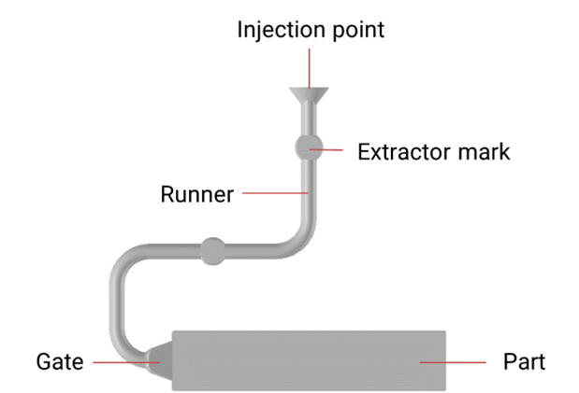
Can we make measurements during injection moulding where shear rates and cooling rates are very much greater than in such experimental stages?
Key Challenges
Weight
Size
Strength of mould to withstand pressure
X-ray Transparency
60mm

Slide 17
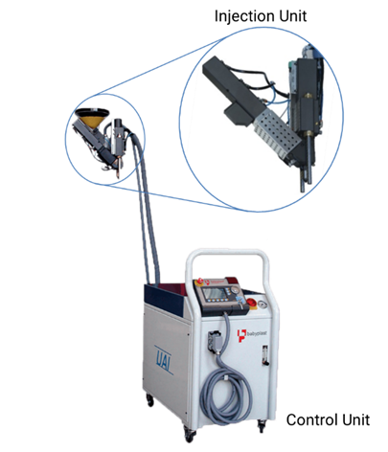
Weight and Size
Separate parts

Slide 18
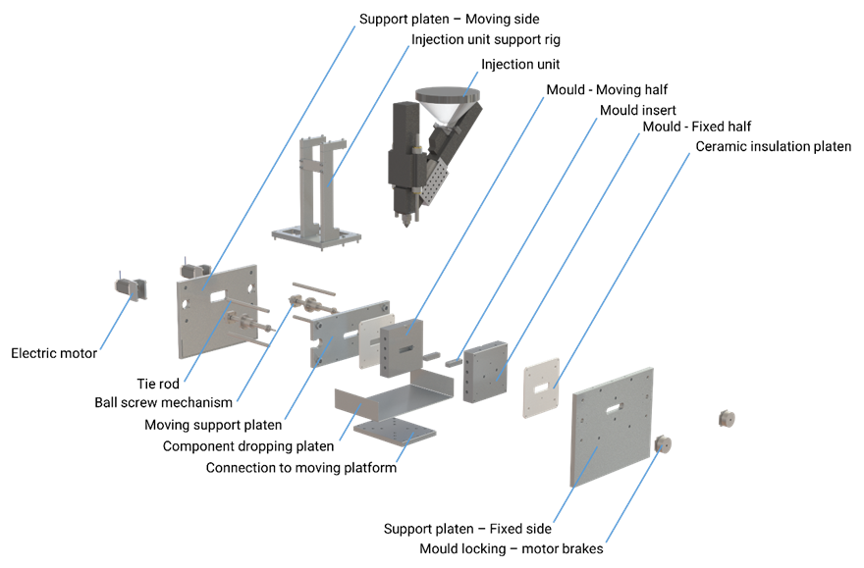
Strength and X-Ray Transparency
Mould cavity fabricated from Standard Mould Plates and Mould Inserts made from an Aluminium/Silicon Alloy.

Slide 19
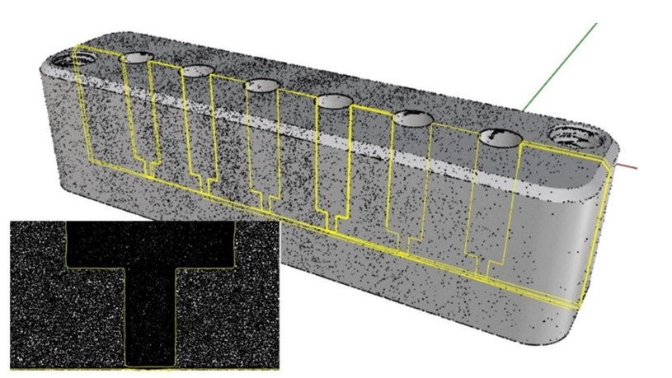
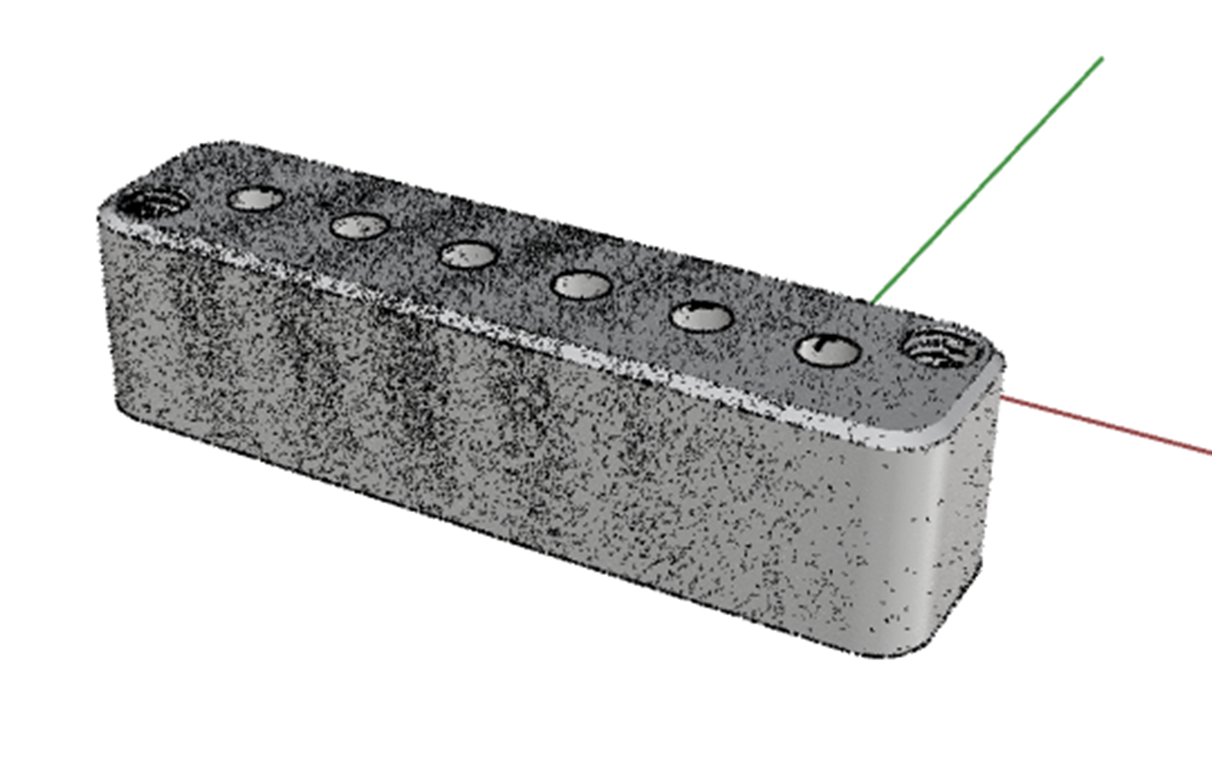
X-ray Transparency
6 “Windows” with an average
Thickness of 0.0832 mm with a
standard deviation of 0.0015 mm. Attenuation for 12.4keV photons is less than 30%

Slide 20
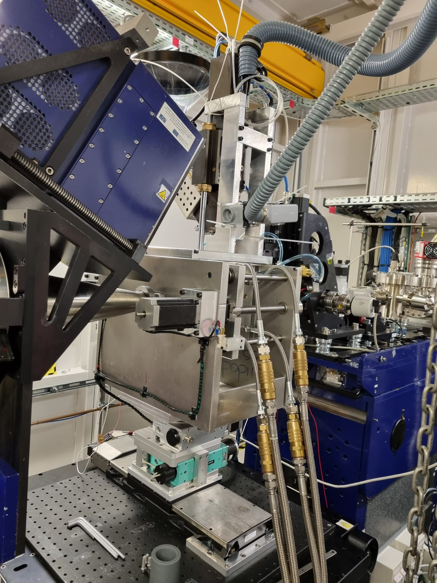
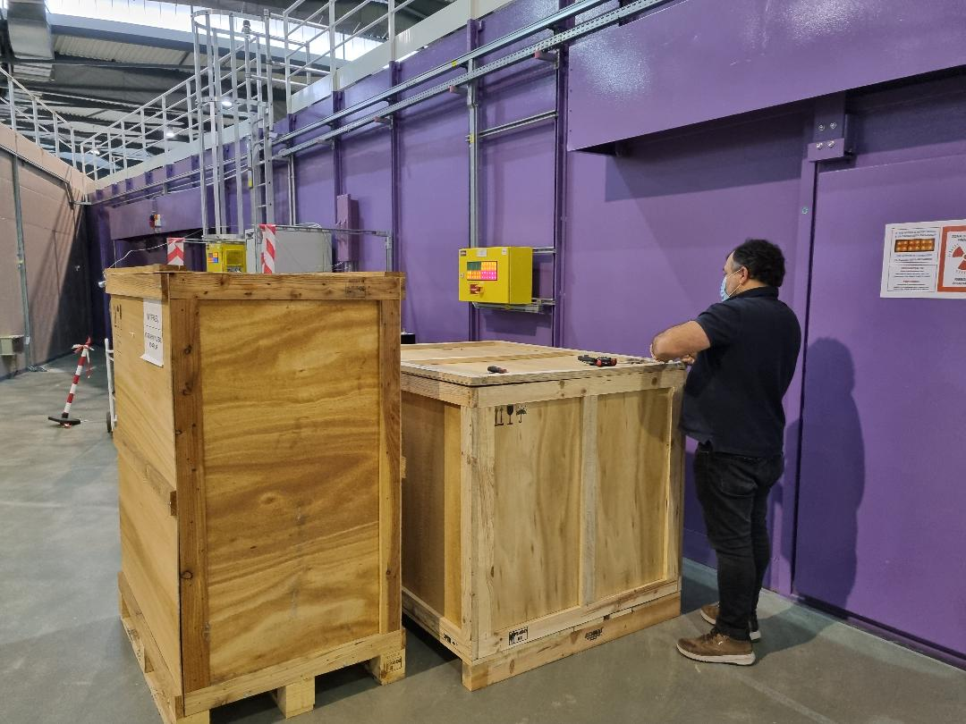
Injection Moulding System on ALBA NCD-SWEET Beamline

Slide 21
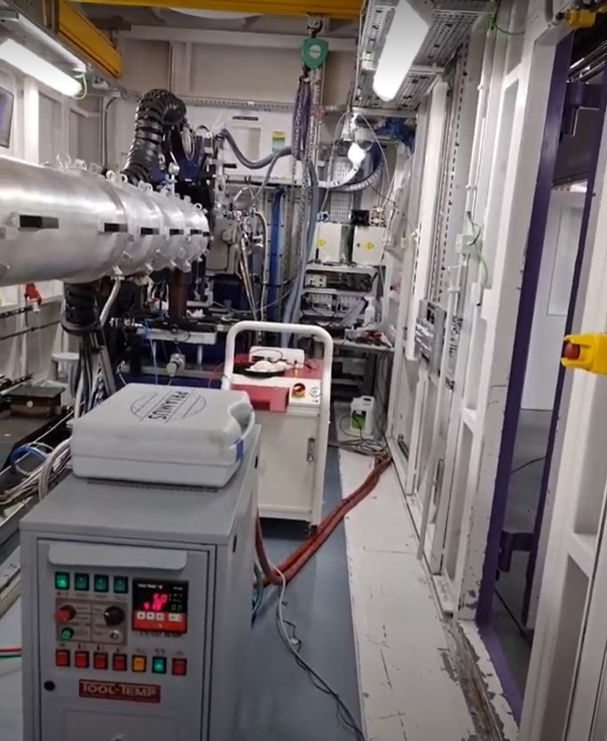
Injection Moulding System on ALBA NCD-SWEET Beamline

Slide 22
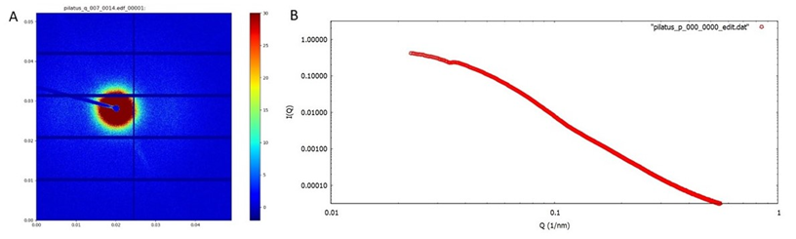
Background Signal from Empty Mould Cavity

Slide 23
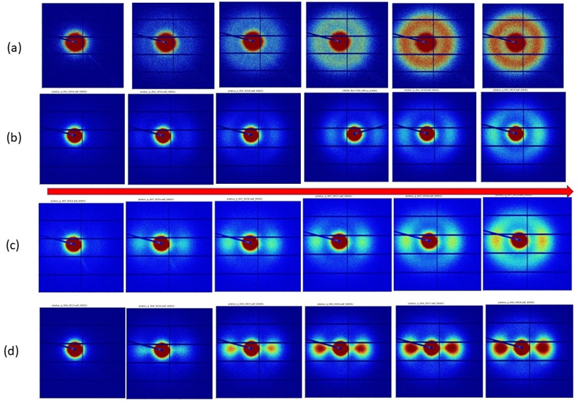
Injection Moulding with a standard polypropylene from
LydoellBasell MOPLEN HP500N which is a general purpose polypropylene suitable for food contact applications. It exhibits a melt flow index (MFI) of 12 g/10 min at 230°C.
Extruder Temperature
250°C
210°°C
205°C
190°C
Mould Temperature 50°C

Slide 24
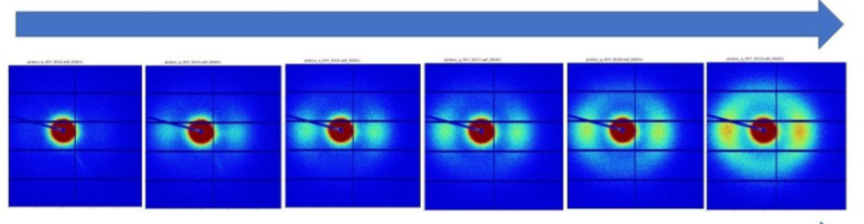

Developments
Data Analysis
We use the azimuthual variation in Intensity at fixed value of |Q|
We use a representation of the data in polar coordinates using a series of spherical harmonics
Which has several advantages of processing the data
And leads directly to the evaluation of the parameters describing the level of preferred orientation
We are developing a robust automatic system for processing the data as it is collected, as each sequence contains 300 images
This is the first step towards a multiscale digital twin of injection moulding

Slide 25
Developments
Higher Energy photons?
It is interesting to explore the use of higher energy photons to increase the x-ray transparency of the mould inserts
The NCD-SWEET beam can deliver photons at 20keV, but the most intense flux is at 12.4keV
At 12.4 keV attenuation is 26.22% for the Aluminium window
At 20 keV attenuation is 7.33% for the Aluminium window
Of course there are other factors which including detector sensitivity and to the sample to detector required which with 20keV could move beyond the available length on the NCD-SWEET Beam Line

Slide 26

Developments
4D perspective - time
WE are developing a robust automatic system to unpack the accumulated data in the scattering representing each time interval
Time Period of data measurement
0-1 s | 0-1s + 1-2s | 0-1s + 1-2s + 2-3s | 0-1s + 1-2s + 2-3s + 3-4s | 0-1s + 1-2s + 2-3s + 3-4s + 4-5s | 0-1s + 1-2s + 2-3s + 3-4s + 4-5s + 5-6s
Time Period of data measurement
0-1 s | 1-2s | 2-3s | 3-4s | 4-5s | 5-6s

Slide 27
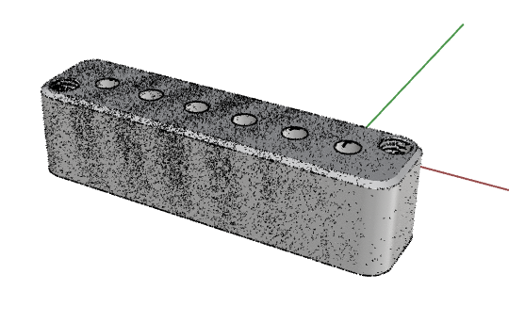
Developments
4D perspective - space
WE are developing a robust automatic system to unpack the accumulated data in the scattering representing each time interval
6 windows
Positions easily changed through the use of replacement mould inserts based on results of simulations

Slide 28
Developments
Local Mould Heating/Cooling
Changing the mould inserts to provide differentially heating and cooling to impart different properties to different regions of the part

Slide 29
ALBA and the NCD-SWEET Beamline
I am a user of ALBA and the NCD-SWEET Beam line, and part of a team which is developing experimental stages including the Injection Moulding System, 3D printer, Biaxial Deformation stage, shear cells and may be more. This is a major investment of time and effort.
We value the high performance of ALBA and the NCD-SWEET Beam line, the stability of the facility in terms of effective user time and the stability of the beam-line, the rapid installation of user equipment, the ease of working at ALBA and the high calibre of beam-line scientists and other staff.
As a user all of these factors are critical to the successful completion of a a research programme.
We have been fortunate to have regular beam-time at ALBA for which we are very thankful.
The type of research I have described is a long term process and critical to progress is that regular access to beam-time and being able to make effective use of it. We thank Juan Carlos Martinez and Marc Malfois for their help over a prolonged period.

Slide 30
Summary
We have designed, fabricated and successfully validated an industrially relevant injection moulding system which can be mounted on the ALBA NCD-SWEET Beam line
We have successfully used this with an industry standard isotactic polypropylene to reveal the morphology which develops following injection using different extruder temperatures and a fixed mould temperature. We are able to observe the few fraction of material to solidify through crystallization. We have observed isotropic morphology at high temperatures of 250°C , while at 190°C we observe a very high level of preferred orientation which continues throughout the mould cycling.
The design of the injection moulding systems enables rapid changes to part thickness, differential heating and cooling and window positions through interchangeable mould inserts.
In the test system the mould inserts have 6 windows equally spaced along the centre line of the mould cavity which will enable a 4D perspective of the morphology development in the mould cavity.
The systems and the experiments described here provide invaluable, hitherto unavailable data with which to validate and optimize the output of numerical simulation of injection moulding
The systems provides flexibility to support a development programme
We are developing the software to support the data acquisition during the injection moulding cycle which produce upwards of 300 2d patterns. We expect to be able to run this software on the fly in the next year as the first step towards the development of a multiscale digital twin for injection moulding.

Slide 31
Publications
Costa, A.; Gameiro, F.; Potencio, A.; Silva, D.; Carreira, P.; Martinez, J.C.; Pascoal-Faria, P.; Mateus, A.; Mitchell, G.R. In Situ Time-Resolving Small-Angle X-ray Scattering Study of the Injection Moulding of Isotactic Polypropylene Parts. Mater. Proc. 2022, 8, 30. https://doi.org/10.3390/materproc2022008030
Costa, A.A., Gameiro, F., Potêncio, A., da Silva, D.P., Carreira, P., Martinez, J.C., Pascoal-Faria, P., Mateus, A., and Mitchell, G.R. “Evaluating the Injection Moulding of Plastic Parts using In Situ Time-Resolved Small-Angle X-Ray Scattering Techniques
Polymers 2022, to appear
Andre A. Costaª, Fábio Gameiroª, Artur Potêncioª, Daniel P. da Silvaª, Pedro Carreiraª, Juan Carlos Martínez^{b}, Paula Pascoal-Fariaª, Pedro G. Martinhoª, Artur Mateusª, Geoffrey R. Mitchell^{a,}“ Industrially relevant Injection Moulding Apparatus for In-Situ Time- Resolving Small-Angle X-ray Scattering Study” to be submitted to Journal of Manufacturing Processes, September 2022

