Slide 1



In-situ GIWAXS of thermally-induced co-crystallization in Doped Organic Semiconductor Films
Alba Cazorla¹, Adara Babuji¹ , Eduardo Solano², Carmen Ocal^{1*}, Esther Barrena ^{1*}
¹ Institut de Ciència de Materials de Barcelona (ICMAB-CSIC)
² ALBA Synchrotron
6/09/2022

Slide 2
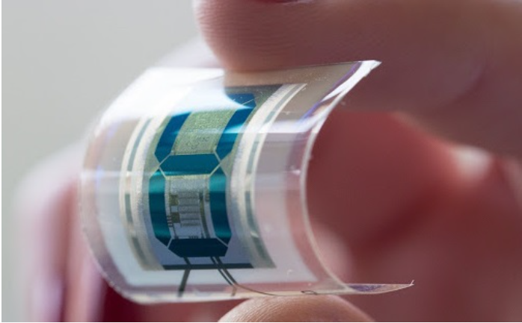
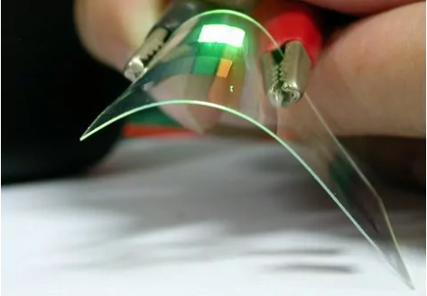
ORGANIC SEMICONDUCTORS (OSCs)
Low-temperature processing
Low-cost production
Mechanical flexibility
Light weight
Applied to OLEDs, OFETs, solar cells, photodetectors..
Possible issues:
Polymorphism
Needed microstructure control
Dewetting
Organic Light Emitting Diodes
[1]
[2]
[1] https://www.eletimes.com/organic-semiconductors-for-flexible-electronic-devices
[2] https://in-part.com/blog/top-nanotechnology-innovations-2017/

Slide 3
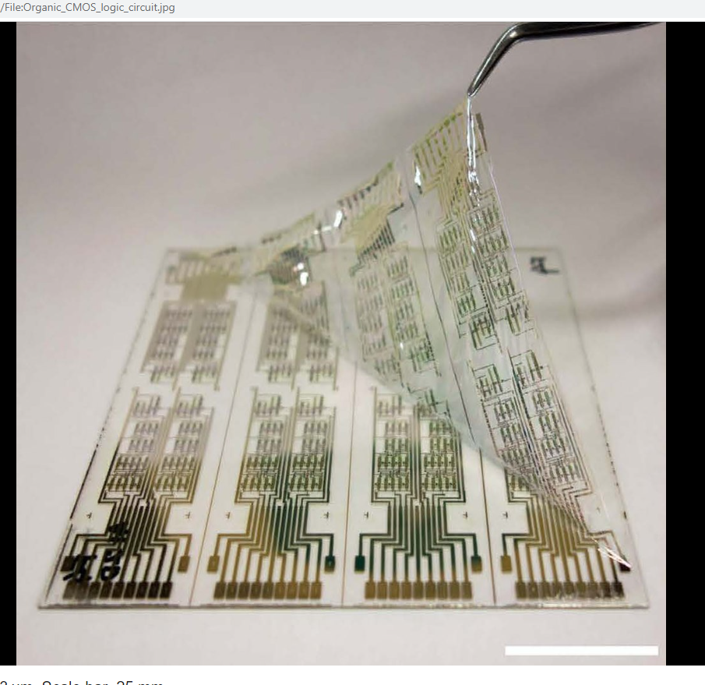
Organic Field Effect Transistors (OFETs)
Drain
Source
OSC film
Dielectric
Gate
[3]
High ordered crystalline structure → High charge carrier mobility
Challenging to have good charge injection from electrodes: MOLECULAR DOPING as a strategy
Structural characterization of the interface is key to understand charge transport properties
[3] https://en.wikipedia.org/wiki/Organic_field-effect_transistor

Slide 4

MOLECULAR DOPING
Improved device performance and control of the electrical properties of OSCs
CONVENTIONAL PICTURE
ALTERNATIVE MODEL
LUMO
LUMO
$$e^{−}$$
Binding Energy
Binding Energy
HOMO
HOMO
OSC matrix
OSC matrix
CTC
p-dopant
p-dopant
Integer charge transfer (ICT)
Charge transfer complex (CTC)
(Mendez et al Angew. Chem. Int. Ed. 2013)
(Scaccabarozzi et al Angew. Chem. Rev. 2022)

Slide 5
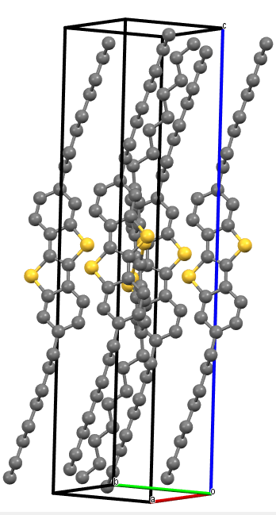
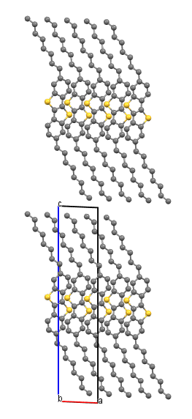


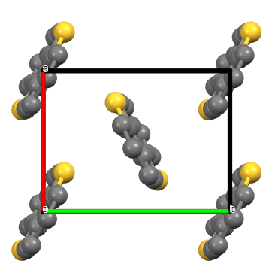
Small molecule organic semiconductors: BTBT derivatives
[1]benzothieno[3,2-b][1]- benzothiophene
C₈-BTBT-C₈
Mobility comparable or larger than polysilicon devices (1 cm² V⁻¹ s⁻¹)
Highly ordered crystalline layers (lamellar structures)
Low-lying HOMO → air-stable devices
x Large contact resistance between source and semiconductor layer
C₈-BTBT-C₈
DPh-BTBT
Herringbone arrangement
a
2,7 dioctyl -[1]benzothieno[3,2-b][1]- benzothiophene
2,7 diphenyl -[1]benzothieno[3,2-b][1]- benzothiophene
b

Slide 6
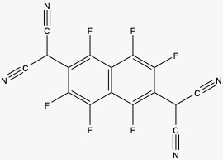
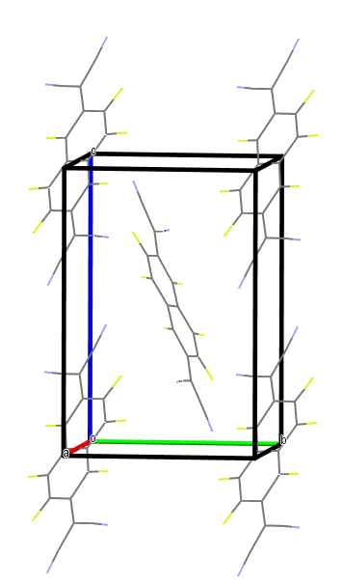
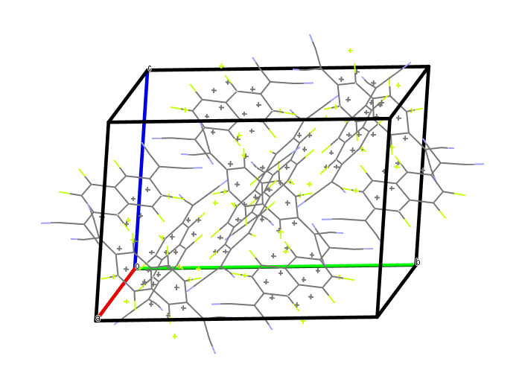
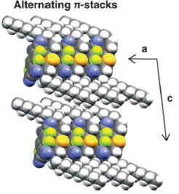
F6TCNNQ as p-type dopant
1,3,4,5,7,8-hexafluoro-tetracyanonapthoquinodimethane
F₆TCNNQ
BTBT derivatives
LUMO
-5.43
Binding Energy (eV)
LUMO
HOMO
HOMO
2 polymorphs reported
(Dasari et al. Adv. Funct. Matter. 2019)
C_{m}BTBT/F_{x}TCNQ co-crystal reported
α-polymorph
(trigonal system)
β-polymorph
(monoclinic system)
1:1 co-crystal structure for C₁₀-BTBT-C₁₀ : F₄TCNQ
(co-deposited from solution)
Intercalation
(Mendez et al Angew. Chem. Int. Ed. 2013)

Slide 7
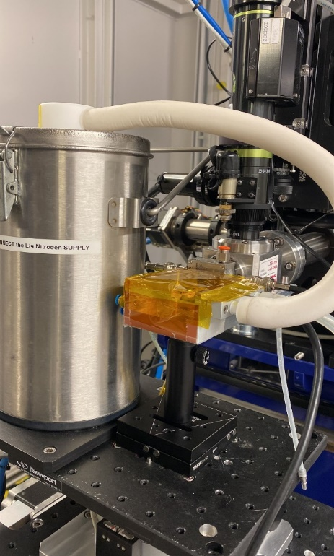
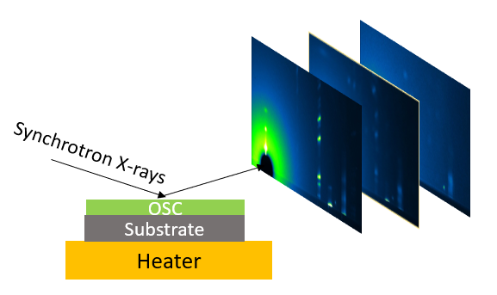
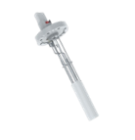
Structural characterization by Grazing-Incidence Wide-Angle X-ray Scattering (GIWAXS)
Thin Film growth
Thermal Evaporation
F6TCNNQ
C₈-BTBT-C₈
DPh-BTBT
OSC
SiO2/Si(100)
Evolution of the structure during thermal annealing
LINKAM heater stage
at NCD-SWEET Beamline (ALBA Synchrotron)
Samples of this project were grown by Adara Babuji and Shunya Yan (PCSI group at ICMAB)

Slide 8
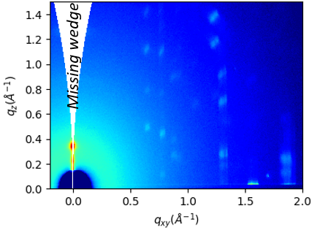




GIWAXS to understand thin film structure
Probed out-of-plane (OOP) and in-plane (IP) scattering:
OOP
2D detector
$$k_{f}$$
$$k_{i}$$
In-plane (IP) ∼ $q_{xy}$
Structure
Crystallinity degree
Crystallite orientation
Possible to get information about:

Slide 9
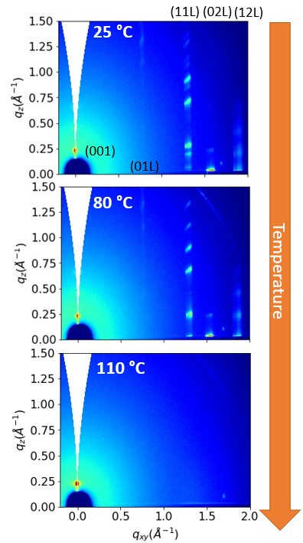
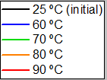

C₈-BTBT-C₈ (20nm)
2D GIWAXS patterns
IP
Line cuts
Same structure as the reported one
Remarkable shift of the in-plane peaks to lower q values
Film partially desorbed at 110 °C
a (Å) | b (Å) | c (Å) | α (°) | β (°) | γ (°)
5.90 | 7.97 | 28.7 | 90 | 92.44 | 90
(Space group: P$2_{1}$/c)
Thermal expansion
OOP
IP
< 1 %
b (+4 %)
At 25 °C
29.0 Å
b
At 100 °C
a

Slide 10
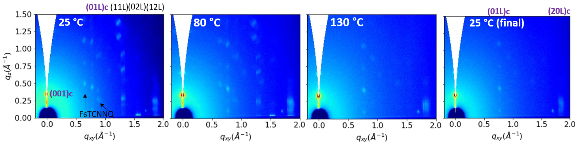
F₆TCNNQ (14nm) on C₈-BTBT-C₈ (20nm)
EFFECT OF ADDING THE MOLECULAR DOPANT
OOP Line cuts
(001)
(001)c
(011)
(111)
Co-crystal peak observed at $q_{z} \sim 0.337{ Å}^{−1}$(spacing of 19 Å) corresponding to (001)c plane
At RT, three structures coexist: C₈-BTBT-C₈ + F₆TCNNQ + co-crystal
‘Charge Transfer Complexes in Organic Field-Effect Transistors: Superior Suitability of Surface Doping’,
A. Babuji, A.Cazorla, E. Solano, C. Habenicht, C. Ocal, K. Leo, E. Barrena (Submitted May 2022).

Slide 11
F₆TCNNQ (14nm) on C₈-BTBT-C₈ (20nm)
EFFECT OF POST-ANNEALING AFTER ADDING THE MOLECULAR DOPANT
OOP Line cuts
Annealing promote co-crystal formation.
Co-crystals have higher thermal stability than the pristine BTBT films.
‘Charge Transfer Complexes in Organic Field-Effect Transistors: Superior Suitability of Surface Doping’,
A. Babuji, A.Cazorla, E. Solano, C. Habenicht, C. Ocal, K. Leo, E. Barrena (Submitted May 2022).

Slide 12
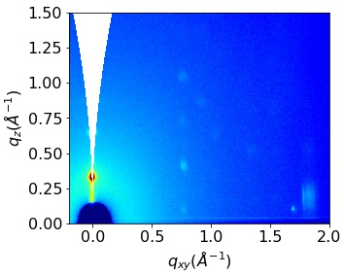
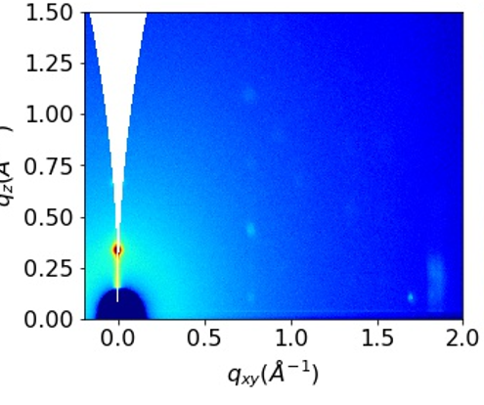
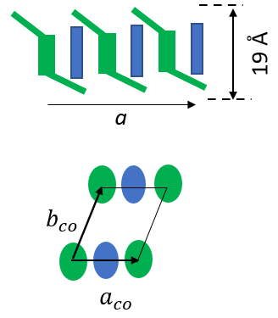
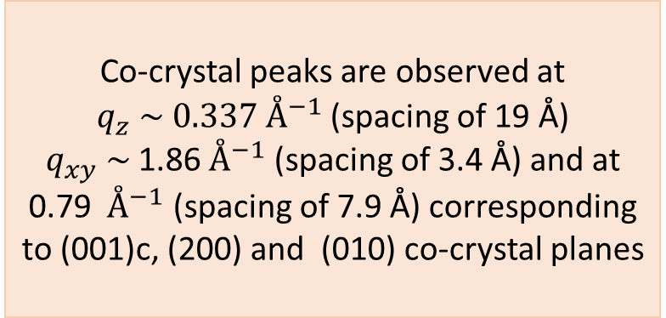
F₆TCNNQ (14nm) on C₈-BTBT-C₈ (20nm)
(01L)c
(20L)c
(01L)c
(20L)c
IP
130 °C
25 °C (final)
(020)
(110)
(120)
(001)c
(200)c
(001)c
C₈-BTBT-C₈
Co-crystal
Co-crystal peaks are observed at $q_{z} \sim 0.337{ Å}^{−1}$(spacing of 19 Å) $q_{xy} \sim$1.86${ Å}^{−1}$(spacing of 3.4 Å) and at 0.79 ${ Å}^{−1}$ (spacing of 7.9 Å) corresponding to (001)c, (200) and (010) co-crystal planes
29 Å
(200)c
(010)c
b
a

Slide 13
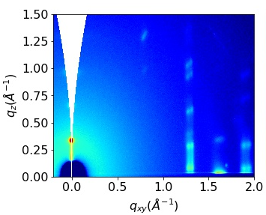
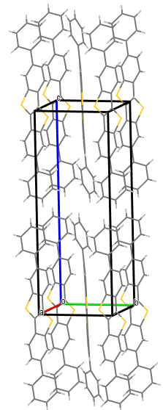

DPh-BTBT (20nm)
DPh-BTBT thin film 25 °C
Line cuts
OOP
IP
(02L)
(12L)
(11L)
(003)
(002)
Effect of temperature in the structure of the film
(001)
BTBT core
IP
OOP
a (Å) | b (Å) | c (Å) | α (°) | β (°) | γ (°)
6.20 | 7.85 | 19.3 | 90 | 93.06 | 90
(Space group: P$2_{1}$/c)
19.3 Å
b
a
Same crystal structure as the reported one
NO thermal expansion

Slide 14
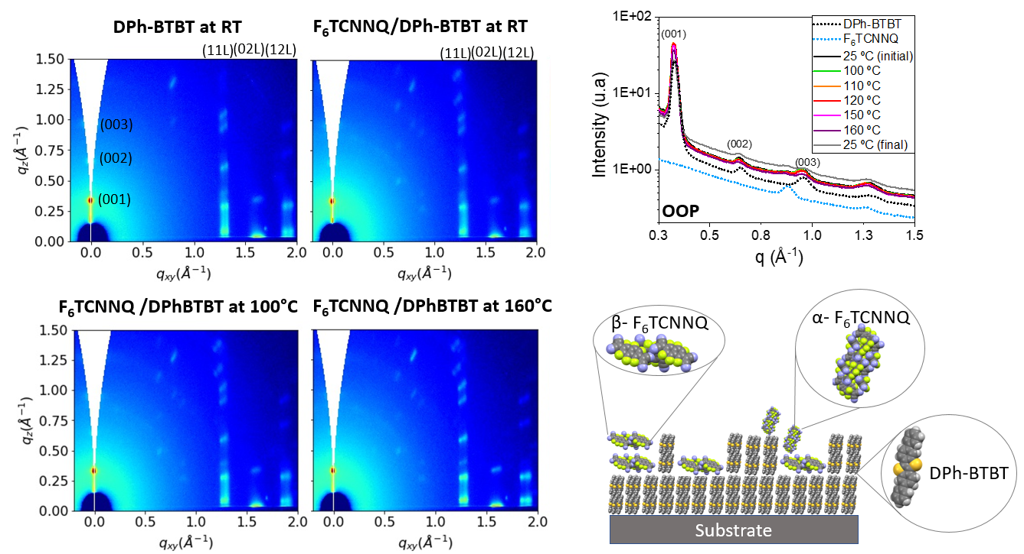
F₆TCNNQ (14nm) on DPh-BTBT (20nm)
EFFECT OF POST-ANNEALING AFTER ADDING THE MOLECULAR DOPANT
No co-crystal formation

Slide 15
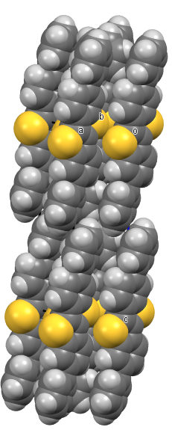
Conclusions
Side groups play a role on thermal expansion
Co-crystal structure formed for F₆TCNNQ deposited on C₈-BTBT-C₈, promoted with annealing
Thermal expansion of the in-plane unit cell facilitates the formation of co-crystal.
Co-crystalline structure has a higher thermal stability than the pristine film
C₈ BTBTC₈
DPhBTBT
Substrate
Substrate
Dopant Deposition
Dopant Deposition
F₆TCNNQ
F₆TCNNQ
F₆TCNNQ
C₈ BTBTC₈
DPhBTBT
Substrate
Substrate
Annealing
(up to 130 °C)
Annealing
F₆TCNNQ
DPhBTBT
Substrate
Substrate
Stable structure

Slide 16
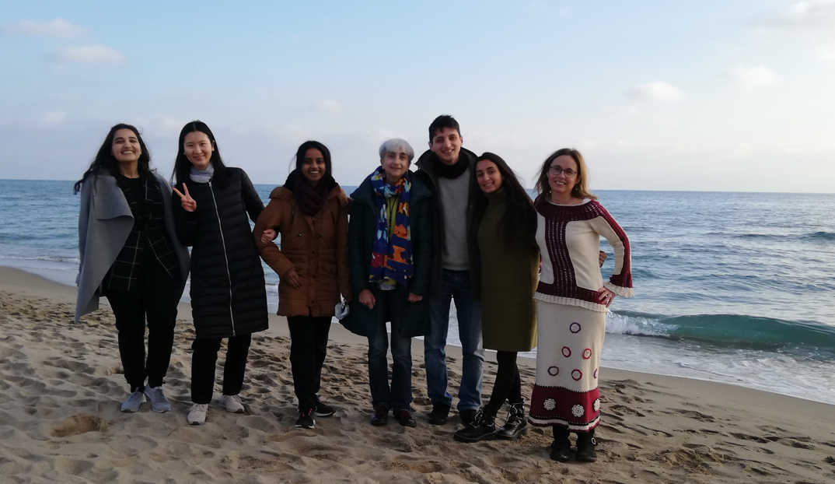



THANK YOU ALL
The PCSI Research Group:
ALBA:
Prof. Carmen Ocal
Dr. Esther Barrena
Adara Babuji
Shunya Yan
Shaghayegh Mesforoush
Dr. Eduardo Solano
(NCD-SWEET Beamline)

Slide 18
EXTRA SLIDES

Slide 19
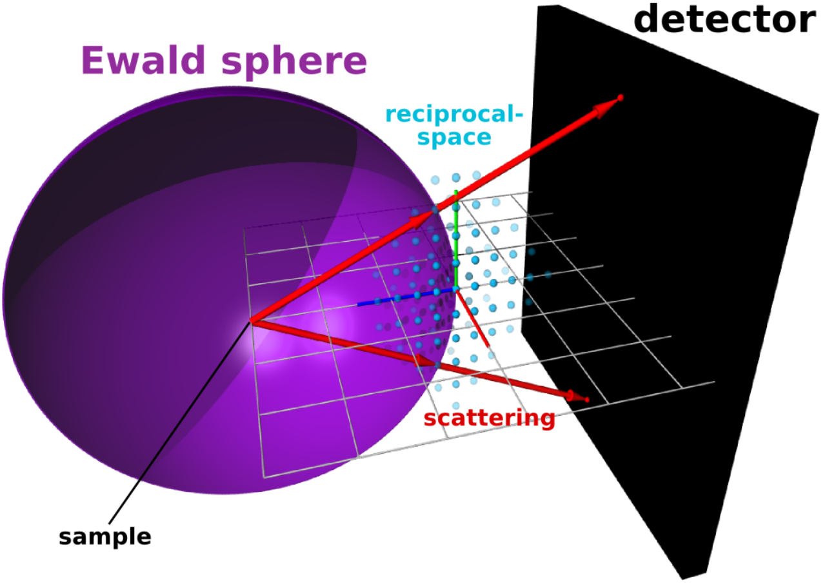
MISSING WEDGE USING GIWAXS
http://gisaxs.com/index.php/GI_missing_wedge
2D GIWAXS patterns: 2D slices through the 3D-reciprocal space
qz obtained from GIWAXS experiments is NOT a true specular scan

Slide 20
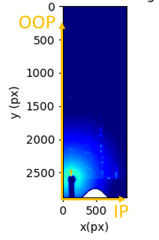
DATA CONVERSION FROM PIXELS TO RECIPROCAL MAP
Raw (pixels)
Converted
Data treatment with python package (pyFAI)
Emergence of missing data along qz=0 in the reciprocal space

Slide 21
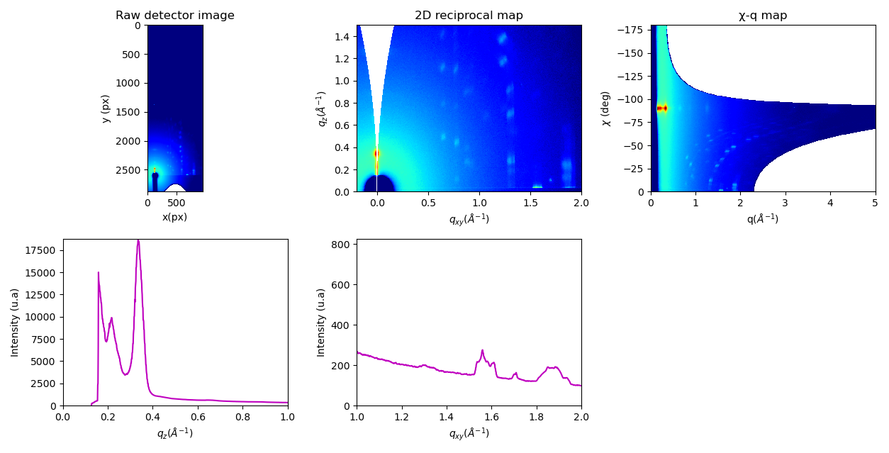
Data Analysis
Out-of-plane (OOP)
-90°
χ
Missing wedge
0°
OOP
IP
In-plane (IP)
OOP
IP
GIXD Data treatment with pyFAI
Detector image in pixels
Experimental geometry parameters
Conversion to q-space
(Ashiotis et al J. App. Crystallography, 2015)
Calibration (Cr2O3 as ref. material)

Slide 22
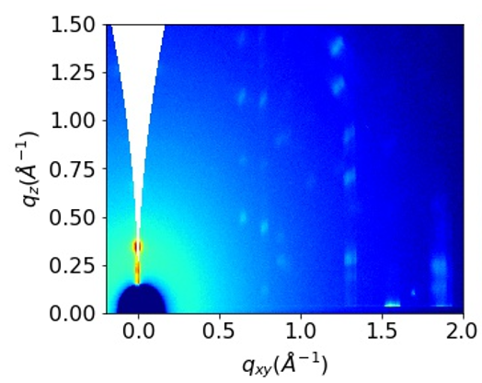
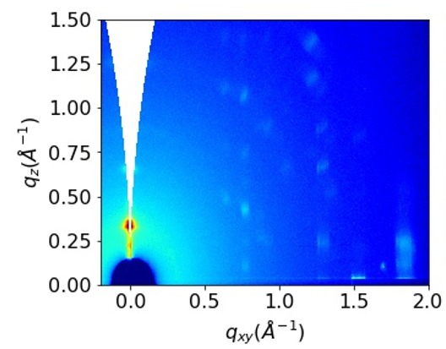
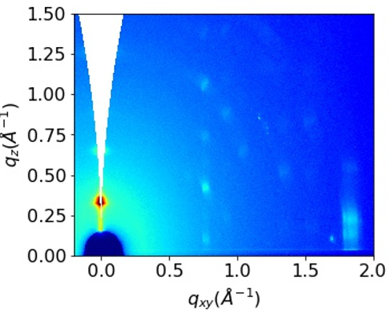
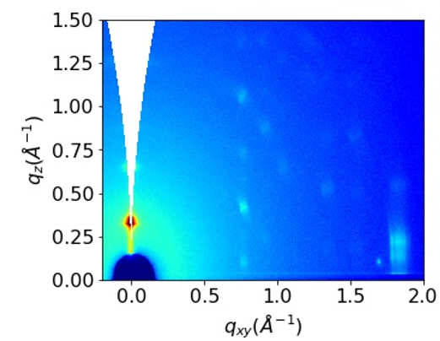
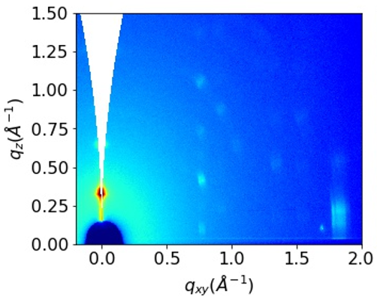
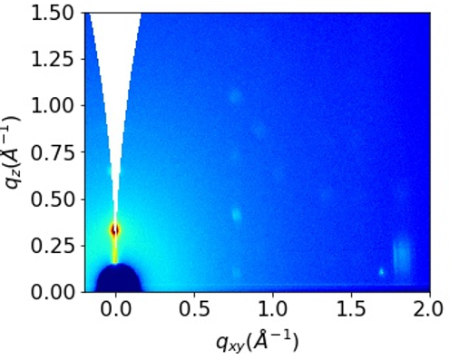
F6TCNNQ/C8-BTBT-C8 sample for an incident angle of 0.12 °
(02L)
(12L)
(11L)
25 °C
80 °C
100 °C
110 °C
(01L)c
(001)c
(001)
120 °C
130 °C
25 °C (final)
Notes:
A2. 2D GIXD maps of F6TCNNQ/C8BTBT sample acquired at different temperatures for an incident angle of 0.12º.

Slide 23

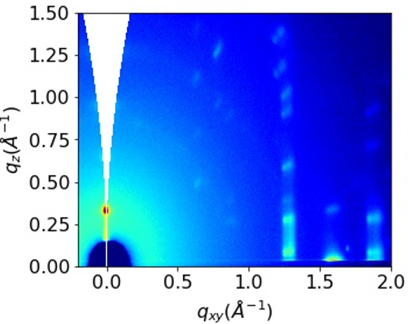
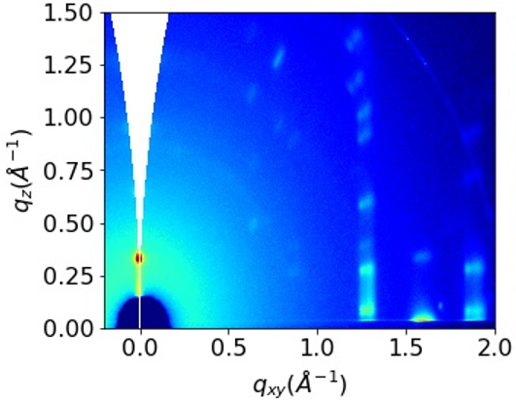
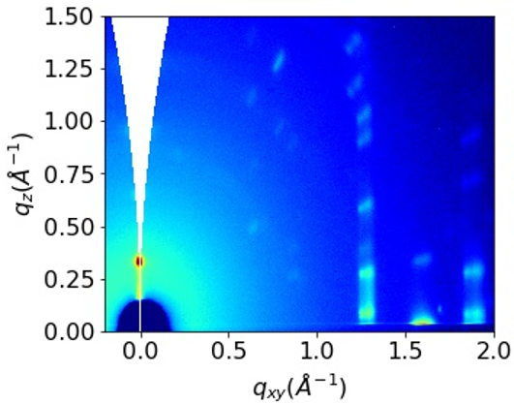



F6TCNNQ/DPh-BTBT sample for an incident angle of 0.12 °
(02L)
(12L)
(11L)
25 °C
100 °C
110 °C
120 °C
(001)
150 °C
160 °C
25 °C (final)
Notes:
A4. 2D GIXD maps of F6TCNNQ/DphBTBT sample acquired at different temperatures for an incident angle of 0.12º.

Slide 24
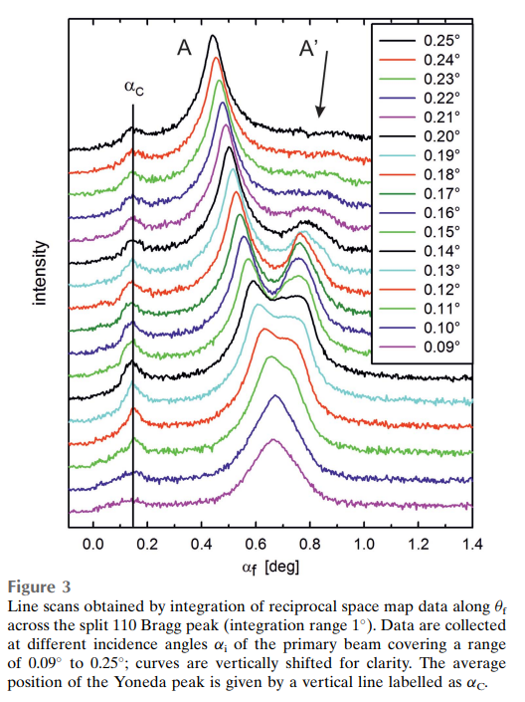
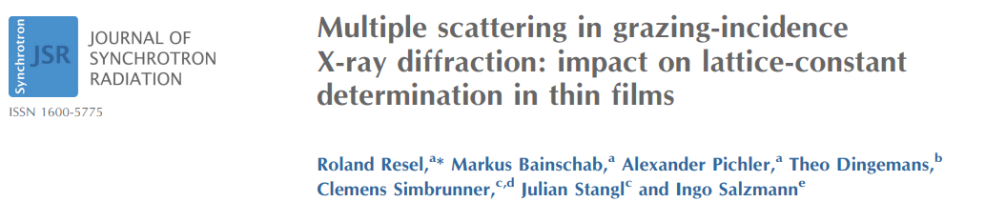
Multiple peak effect
Peak splitting appears for incident (αi) and scattering (αf ) angles close to the critical angle of the substrate because of 2 different scattering pathways of the incident X-rays:
Direct Bragg scattering at the organic crystallites
An optically reflected primary beam at the substrate and subsequent Bragg scattering at the organic layer

Slide 25
BTBT derivatives: Crystal Structure
Same crystal symmetry for Dph-BTBT (for bulk or thin films form)
C₈-BTBT-C₈
c
Lamella structure
Herringbone arrangement
α
b
β
γ
a
(001) plane
a
c
b
a

