Slide 1


Few atoms metal clusters with high catalytic and cytotoxic activity characterized by synchrotron techniques.
Judit Oliver-Meseguer, PhD
6/9/2022
Notes:
Good morning. Thanks for the introduction. Today, I would like to present our recent results using synchrotron x ray absorption spectroscopy as a powerful technique for characterization measured at the CLAESS beamline.

Slide 2
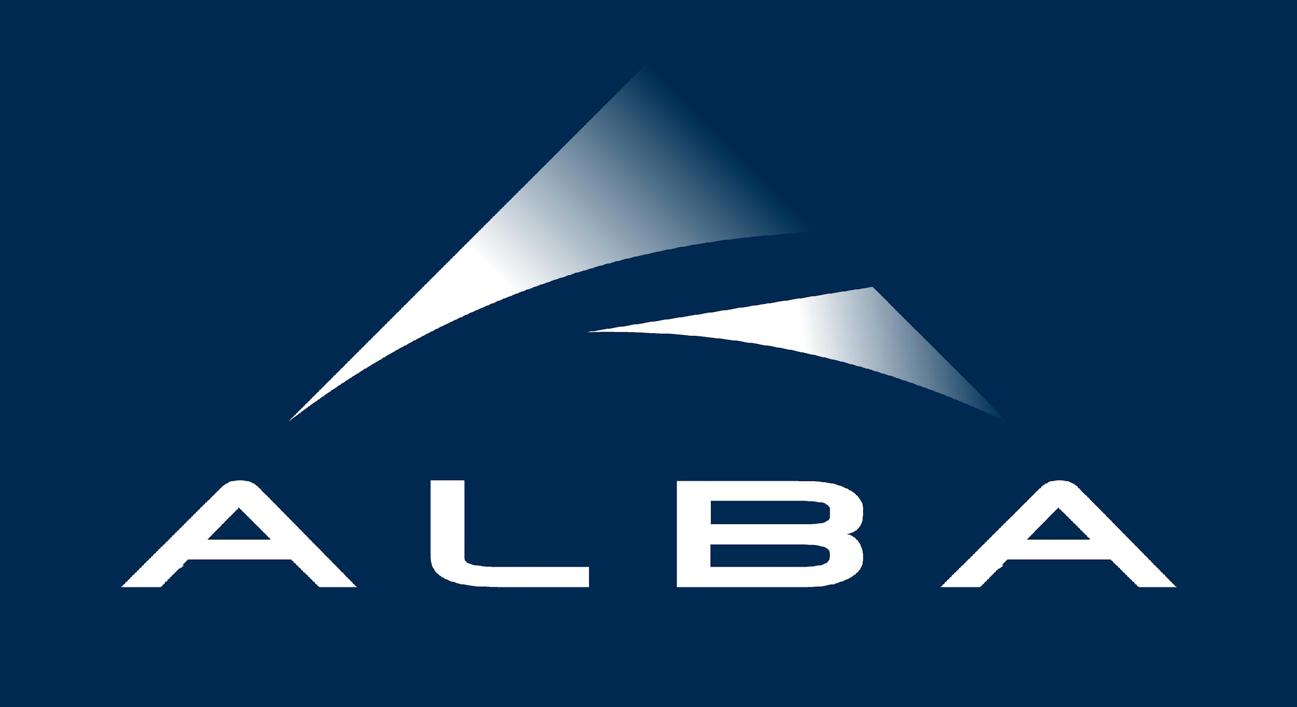
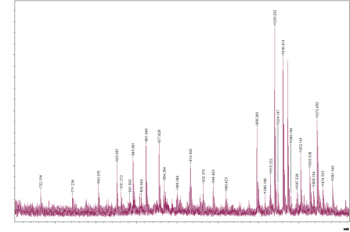
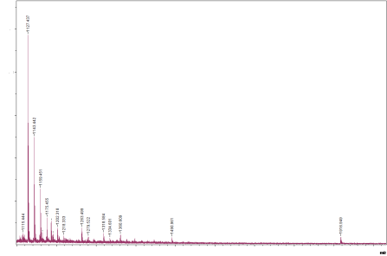
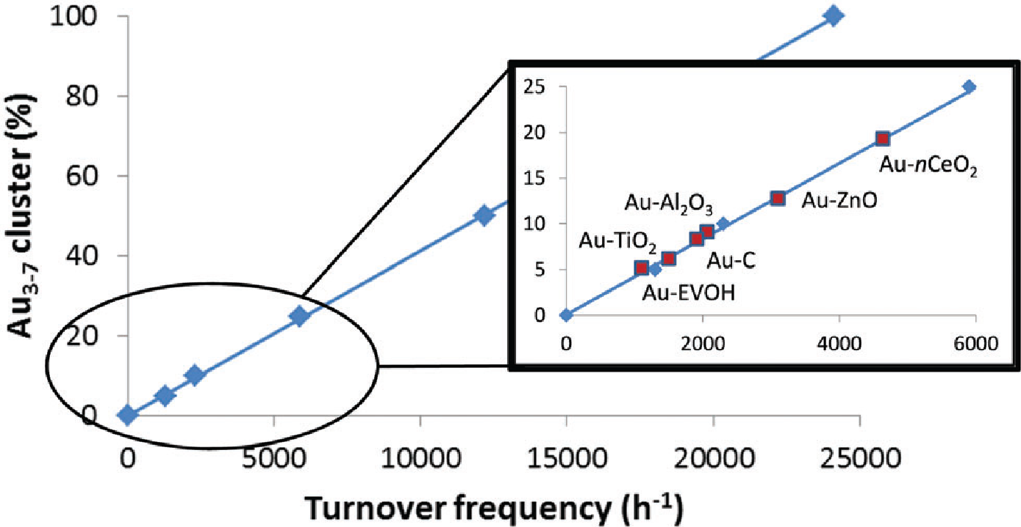
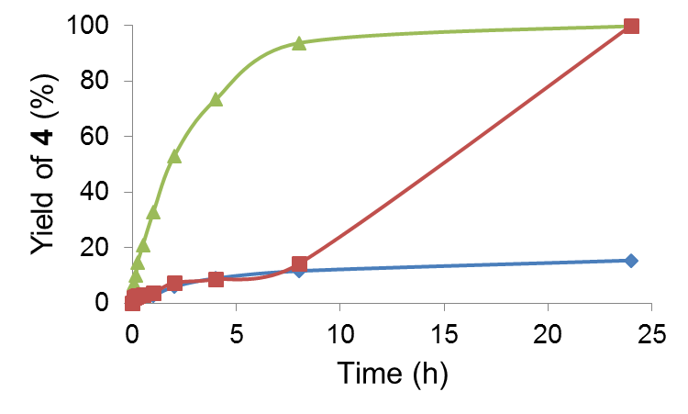


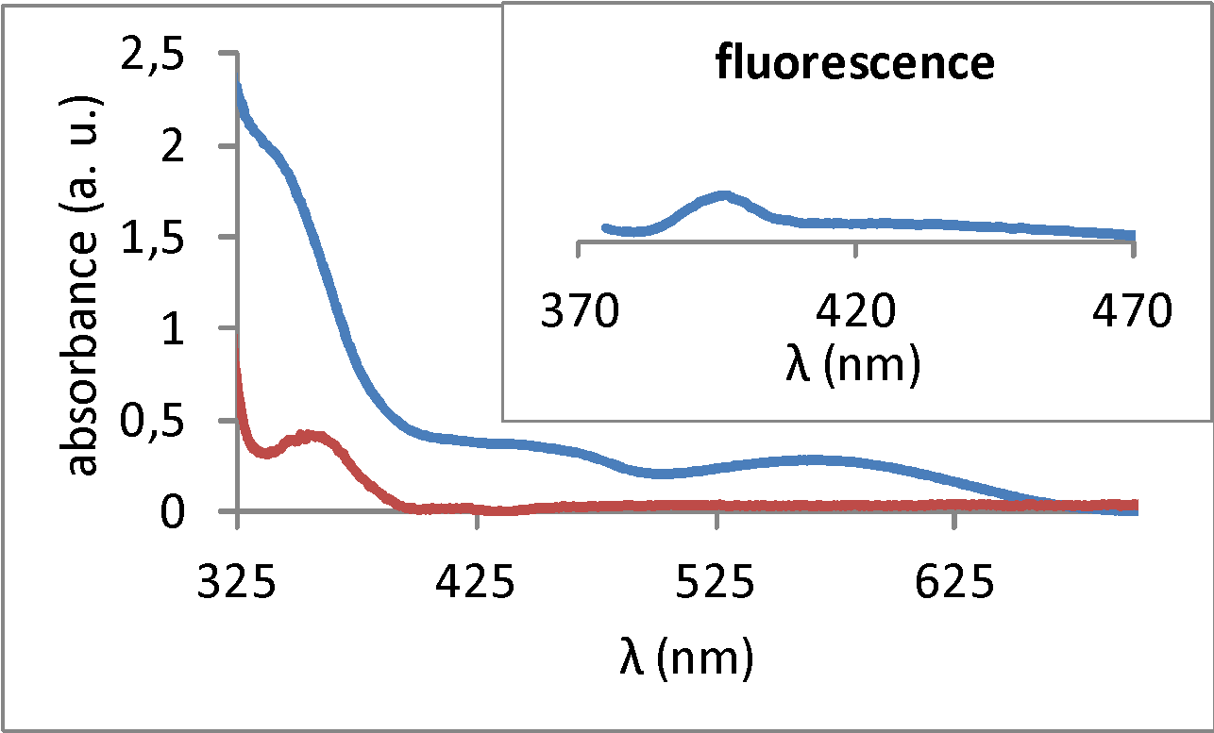
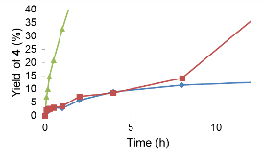
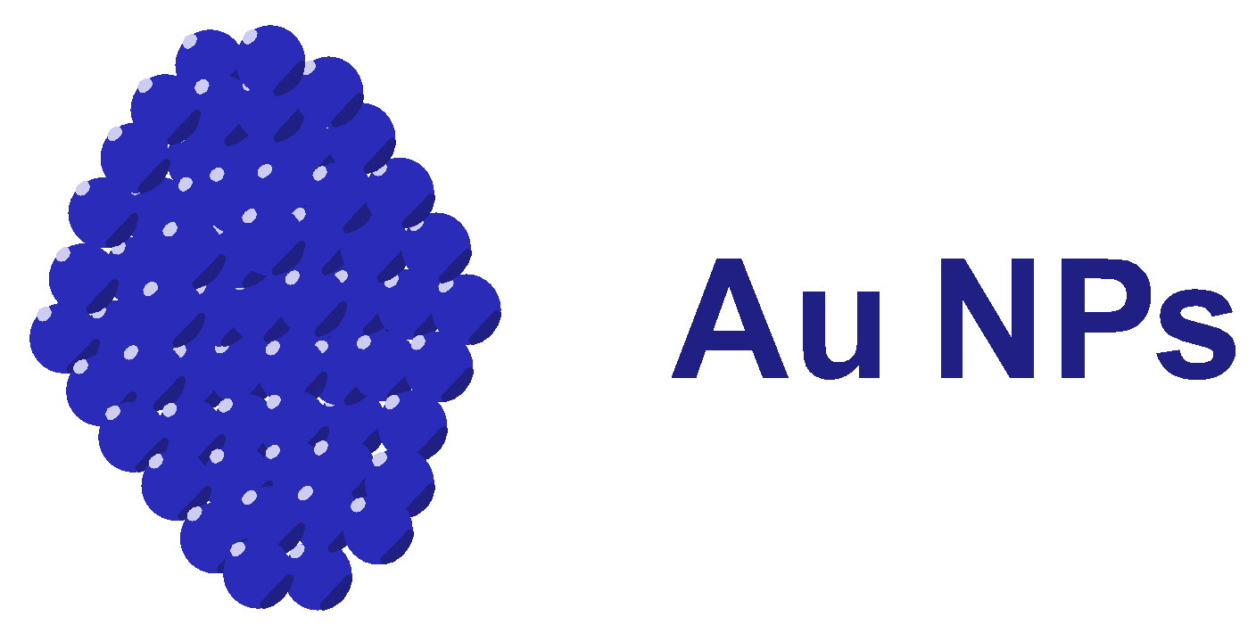
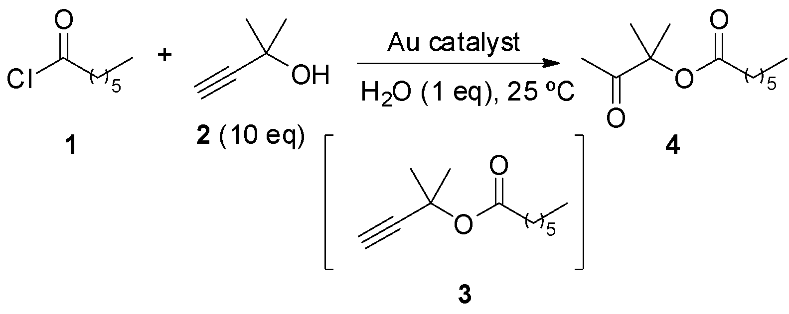
Introduction
Characterization of metallic clusters in solution.
The product formation started only when Au₃-Au₅ species where predominant in the solution.
[Au₄]
[Au₆]
[Au₇]
[Au₂]
[Au₃]
[Au₅]
J. Oliver-Meseguer, et al., Chem. Commun. 2017, 53, 1116-1119.
J. Oliver-Meseguer, et al., Science , 2012, 338, 1452-1455.
Notes:
Before that, I want you to know how we arrive to it. Some years ago, during my PhD, we demonstrated that gold clusters were the active species for the ester-assisted hydration of alkynes, formed from gold salts, complexes and nanoparticles. Moreover, only when a precise size of these clusters were present, the reaction started. For that, we could use lab techniques, as fluorescence, considering that clusters have fluorescence but not nanoparticles, and mass MALDI-TOF to confirm the size. For that, we took samples during the reaction and observe the formation of them. CLICK
Because this reaction was specific for gold clusters, it was also possible to use it as a test to quantify the amount of clusters supported in different metal oxides, carbon or polymeric films.

Slide 3
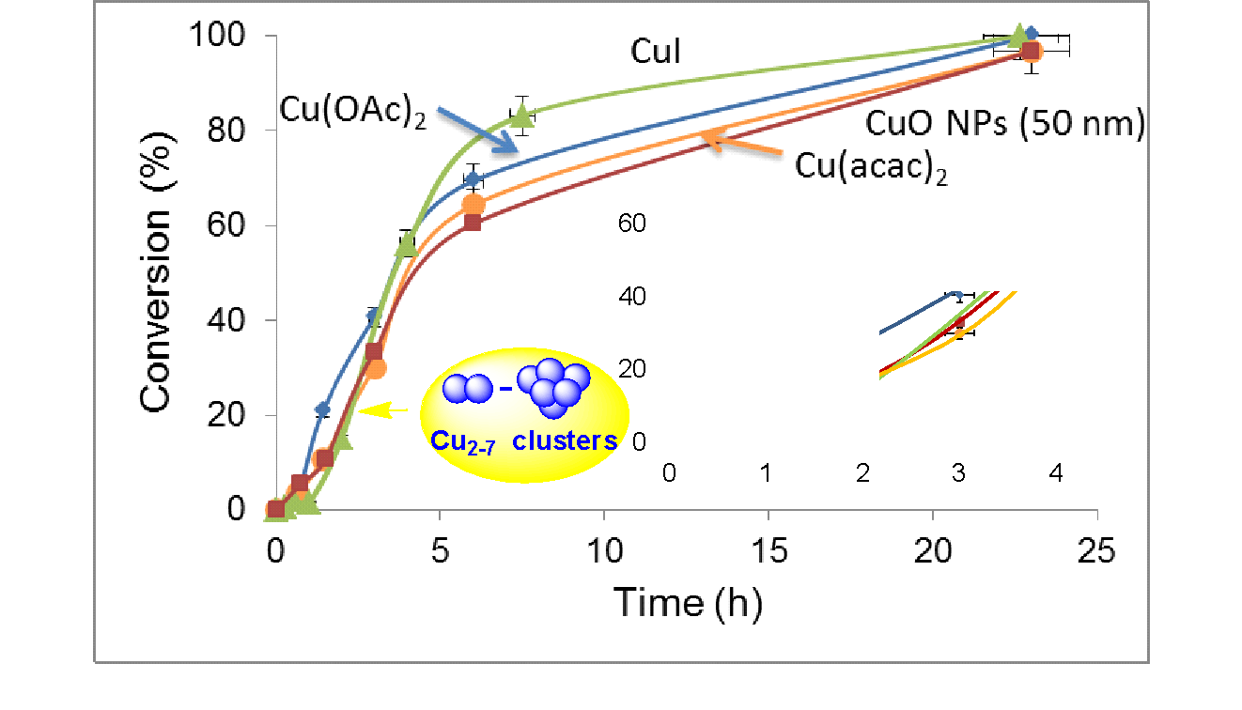
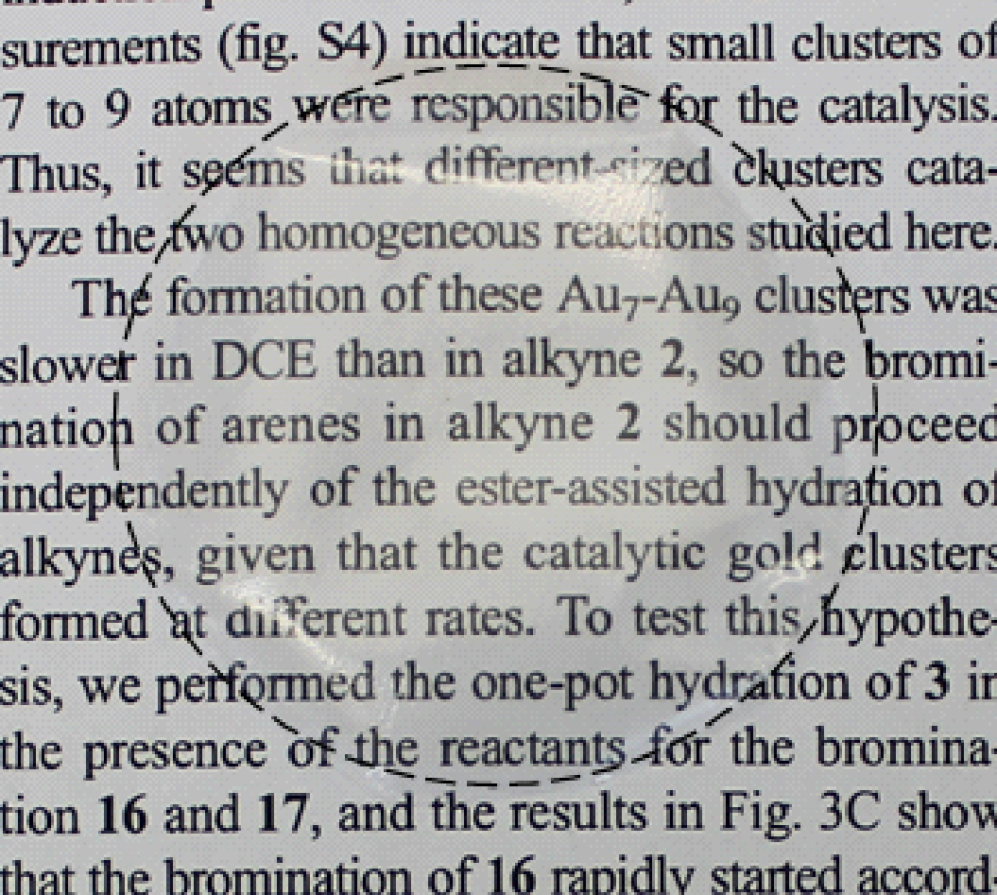
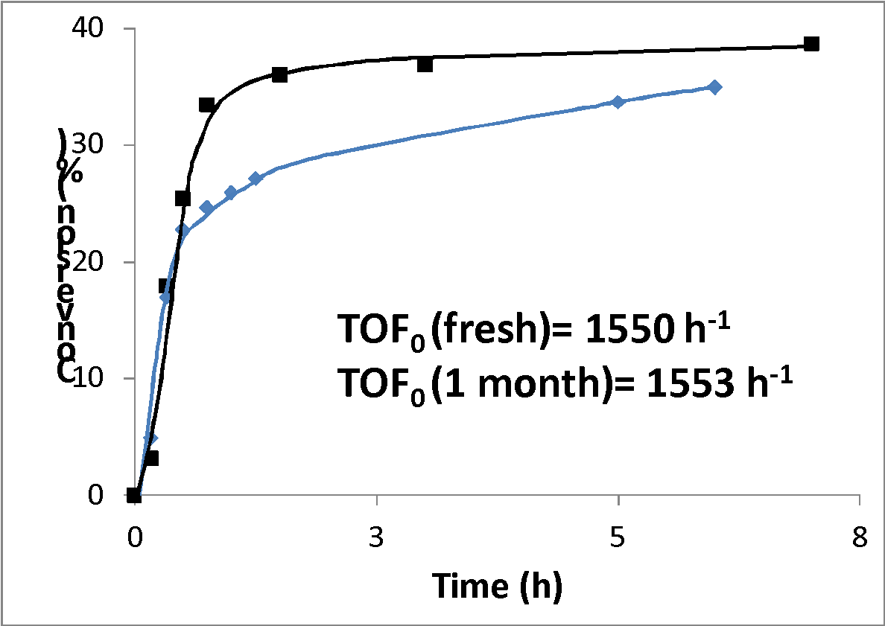
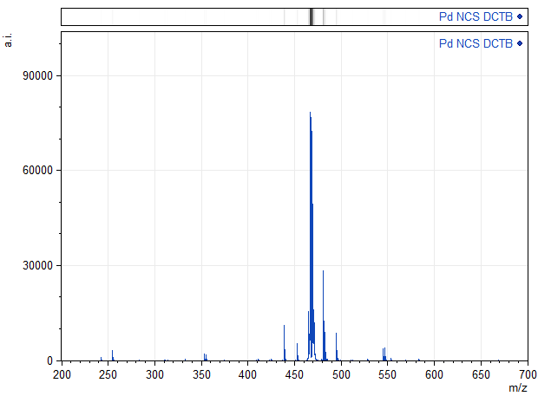
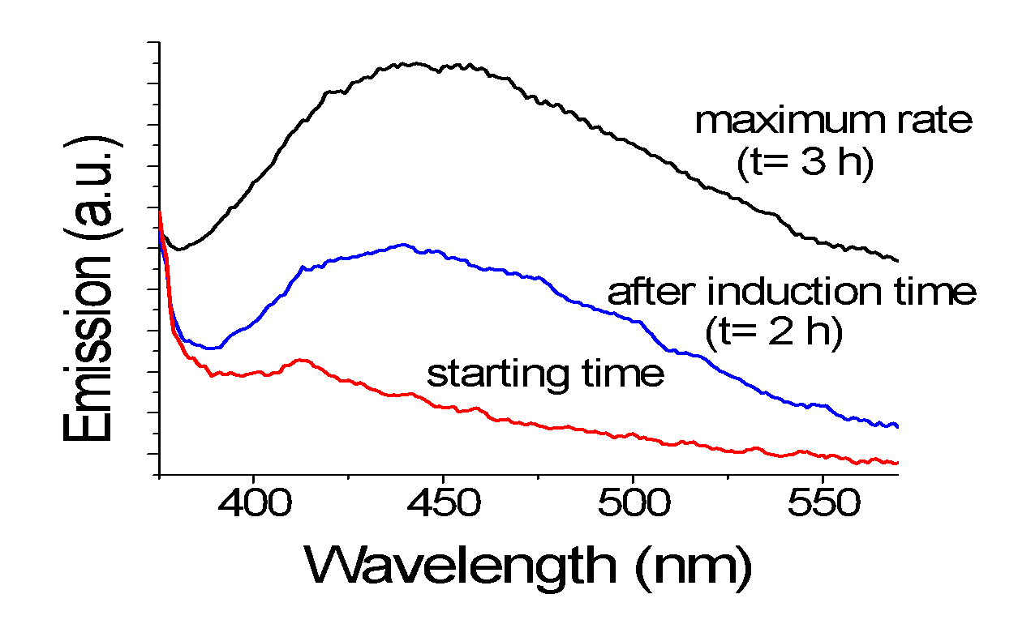
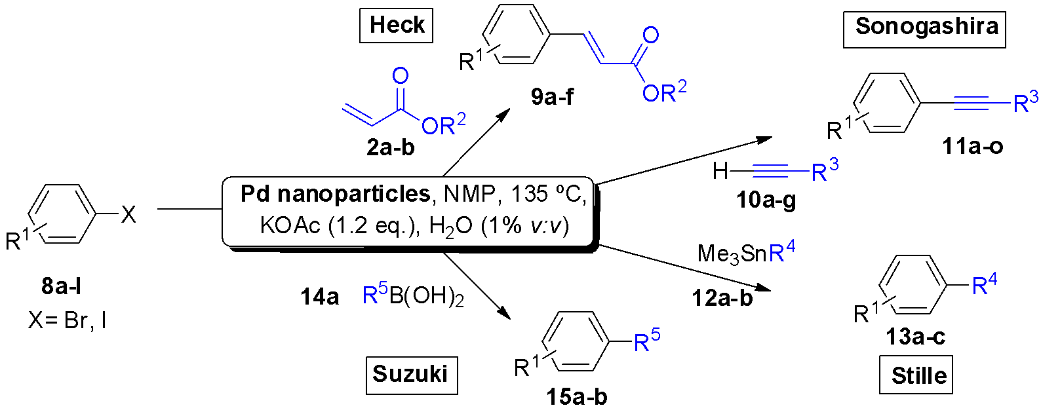
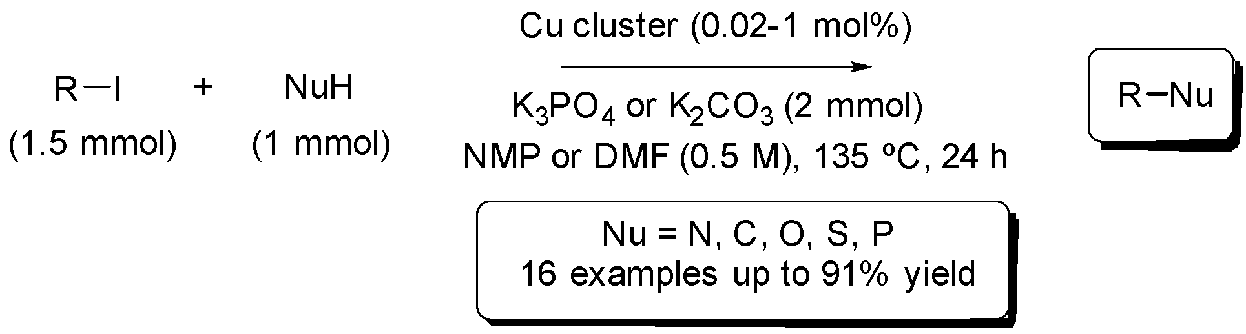
Other metal clusters in solution
Pd₄(CH₃CN)
Pd₃₋₄
A. Leyva Pérez, J. Oliver-Meseguer et al., Angew. Chem., Int. Ed. 2013, 52, 11554-11559.
J. Oliver-Meseguer et al., J. Am. Chem. Soc. 2015, 137, 3894-3900.
Notes:
After that, we studied some of the most important C-C and C-heteroatom coupling reactions catalyzed by different palladium and copper salts, complexes, and nanoparticles, obtaining also that the corresponding metal clusters were active species for these reactions. CLICK Even more, we were also able to stabilize them in solution, in the case of palladium during more than one month without losing activity and in polymeric films, for Cu clusters.

Slide 4
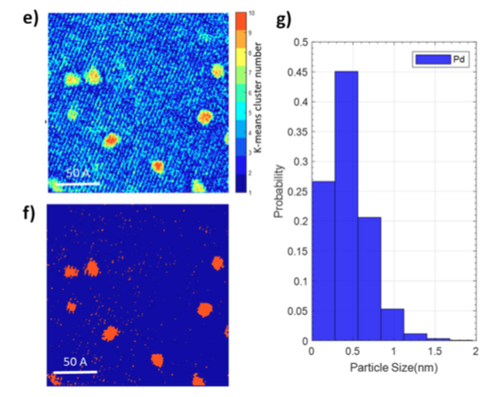
Next step…
Heterogeneous catalysts?
Reactions non specific for metallic clusters or single atoms?
Clusters for non catalytic uses?
Notes:
At this point, we wanted to study also the formation and the catalytic activity of supported metal clusters. But with the techniques that we were using was only possible for gold clusters reactions, so we can not generalize to other metals or even for single atoms catalysis. For example, High resolution TEM microscopy that we perform in collaboration with a group in Cadiz is an excellent technique to observe them, but not during reaction, so it is not possible to fully confirm that they are the active species during the catalysis. And moreover, what happens with metal clusters that are not going to be used as catalyst? How can we confirm the structure?

Slide 5
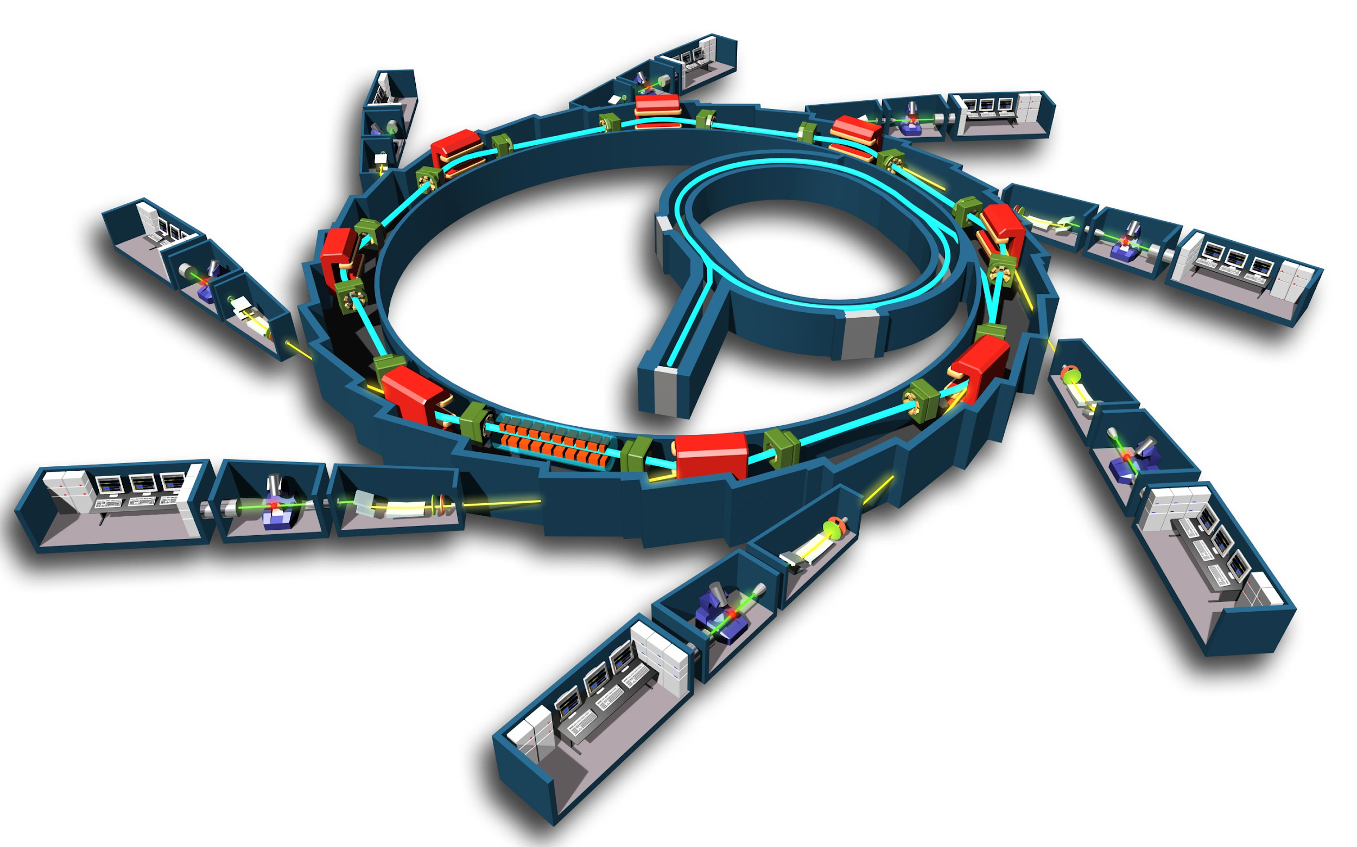
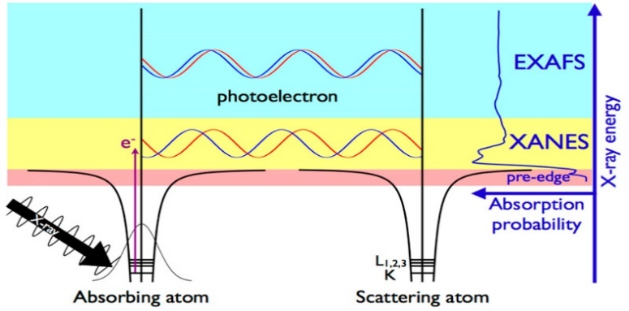

Why X-Ray Absorption
XAS provides information about the electronic structure of the X-ray absorbing atom and about the structure that surrounds it. It is one of the most powerful techniques for characterizing catalysts that does not require a long range order and that can be implemented under arbitrary conditions.
Notes:
To achieve all these, XAS provides information about the electronic structure of the X-ray absorbing atom and about the structure that surrounds it. As most of you know, it is one of the most powerful techniques for characterizing catalysts that does not require a long range order and that can be implemented under arbitrary conditions. These experiments are usually performed at synchrotron radiation facilities, which provide intense and tunable X-ray beams. Samples can be in the gas phase, solutions, or solids and disposed in a cell to obtain data in situ. To demonstrate you the viability of this technique in our research, I’m going to show in the next slides some examples of our recent work.

Slide 6
Pd-CsX before and after C-C coupling reaction
F. Garnes-Portolés, R. Greco, J. Oliver-Meseguer, et al., Nat. Catal., 2021, 4, 293-303
With sterically hindered chemical environment around the mixture of palladium atoms and sub–nanometric clusters without any substrate assistance it is possible to obtain them
Notes:
In the first example, we studied the Heck coupling between aryl halides and alkenes. Usually, the product obtained in this reaction is the beta coupling, but when we used Pd clusters, constrained in a cavity of a zeolite using Cs as a base, it was possible to switch the selectivity towards the alpha product, obtaining a variety of alfa compounds with different substituents, even internal ones. Furthermore, we are able to use the catalyst in a flow reactor, obtaining the desired product with moderate selectivity.

Slide 7
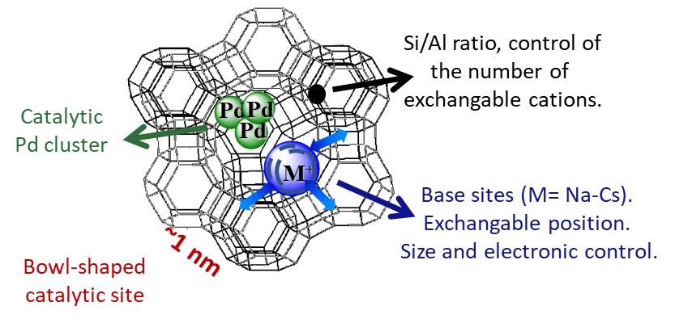
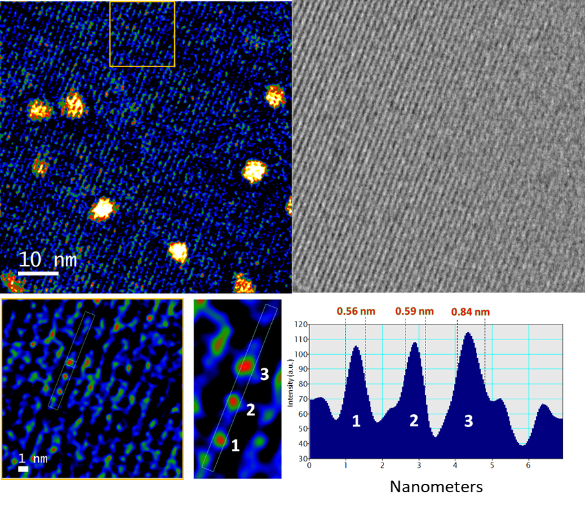
Pd-CsX before and after C-C coupling reaction
From Pd⁺-O structures as starting material to Pd⁰ aggregates after reaction.
F. Garnes-Portolés, R. Greco, J. Oliver-Meseguer, et al., Nat. Catal., 2021, 4, 293-303
Notes:
We used several characterization techniques to confirm the structure of the active species. For example, XRD measurements confirmed the presence of Cs and Pd in the cavities of the zeolite. HRTEM measured in collaboration with the University of Cádiz showed the presence of small clusters of Pd with a size below 1 nm. But only XANES experiments showed how the Pd was reduced during reaction and with EXAFS we were able to study the coordination number of the new reduced species obtained, confirming the presence of Pd reduced clusters during reaction.

Slide 8
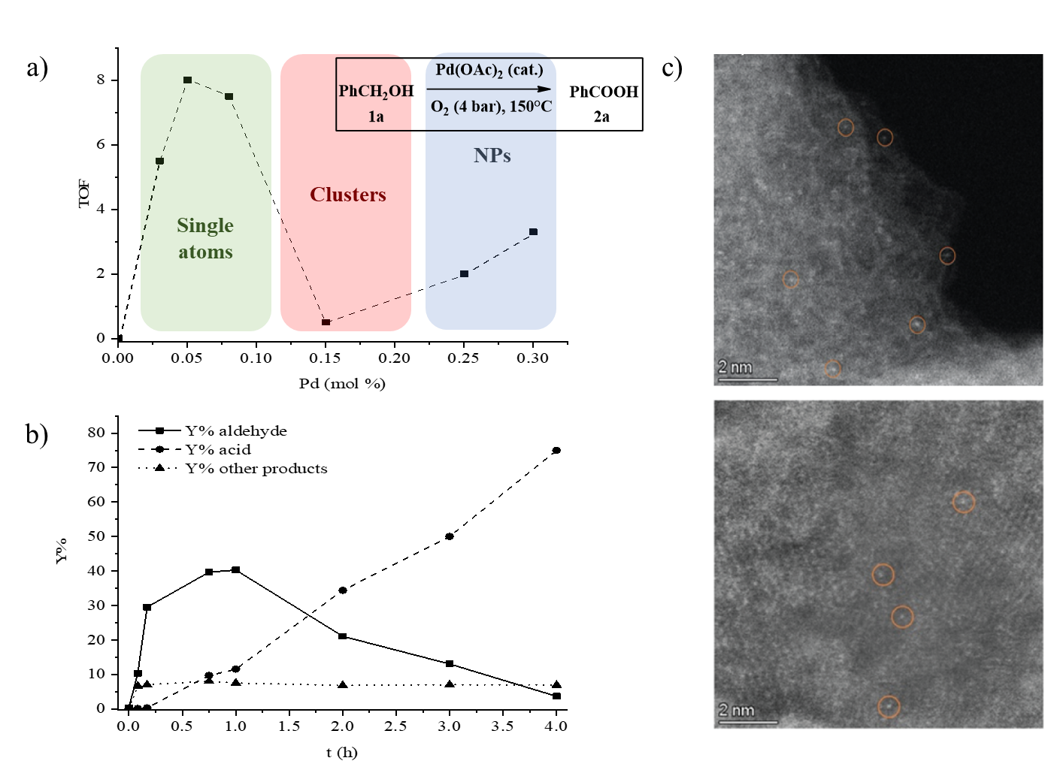
Soluble & MOF-Supported Pd SACs catalyze
benzyl alcohol oxidation
E. Tiburcio, R. Greco, J. Oliver-Meseguer, et al., J. Am. Chem. Soc., 2021, 143, 2581−2592.
Notes:
In the next example, we studied the spontaneously formation of Pd single atoms in solution in the presence of benzyl alcohol and the oxidation of the alcohol to acid in only 1 step. Once observed that palladium single atoms are spontaneously formed after dissolving tiny amounts of palladium salts in neat benzyl alcohols, the next step was to use Pd single atoms isolated inside a MOF. Here, we also observe the same activity, confirming that the active species present in the solution are the Pd single atoms. Moreover, this material can be used up to 3 times maintaining the activity. Also in collaboration with the University in Cádiz, we confirmed the isolated atoms in the pores of the MOF.

Slide 9
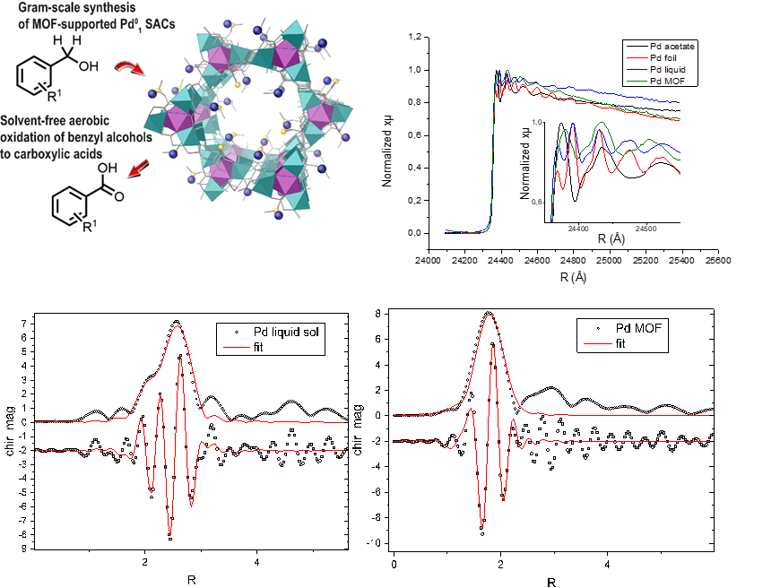
Soluble & MOF-Supported Pd SACs catalyze benzyl alcohol oxidation
XANES confirms reduction of Pd and the generation of very small agglomerates
E. Tiburcio, R. Greco, J. Oliver-Meseguer, et al., J. Am. Chem. Soc., 2021, 143, 2581−2592.
Notes:
In this case, we used CLAESS beamline to compare the Pd in the liquid samples and in the MOF. For the liquid sample, we obtained a mixture of different Pd species containing also Pd single atoms but for the MOF, the most part of the Pd was present as single atoms, confirming the stability of the material and the utility.

Slide 10
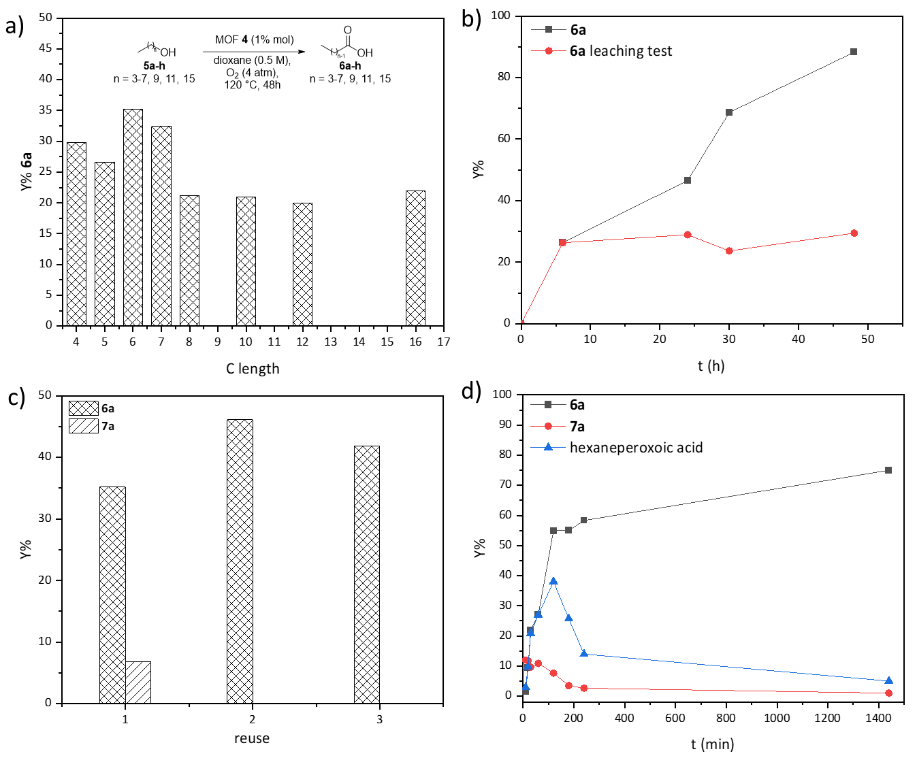
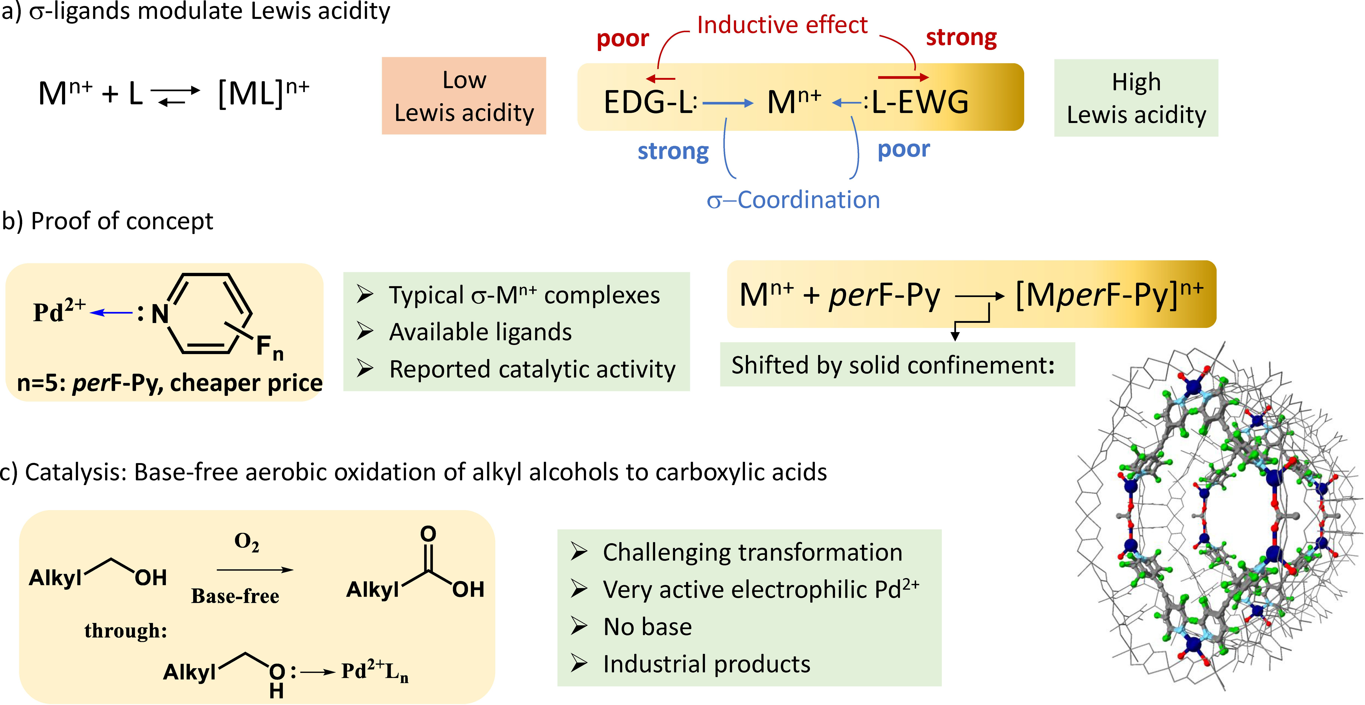
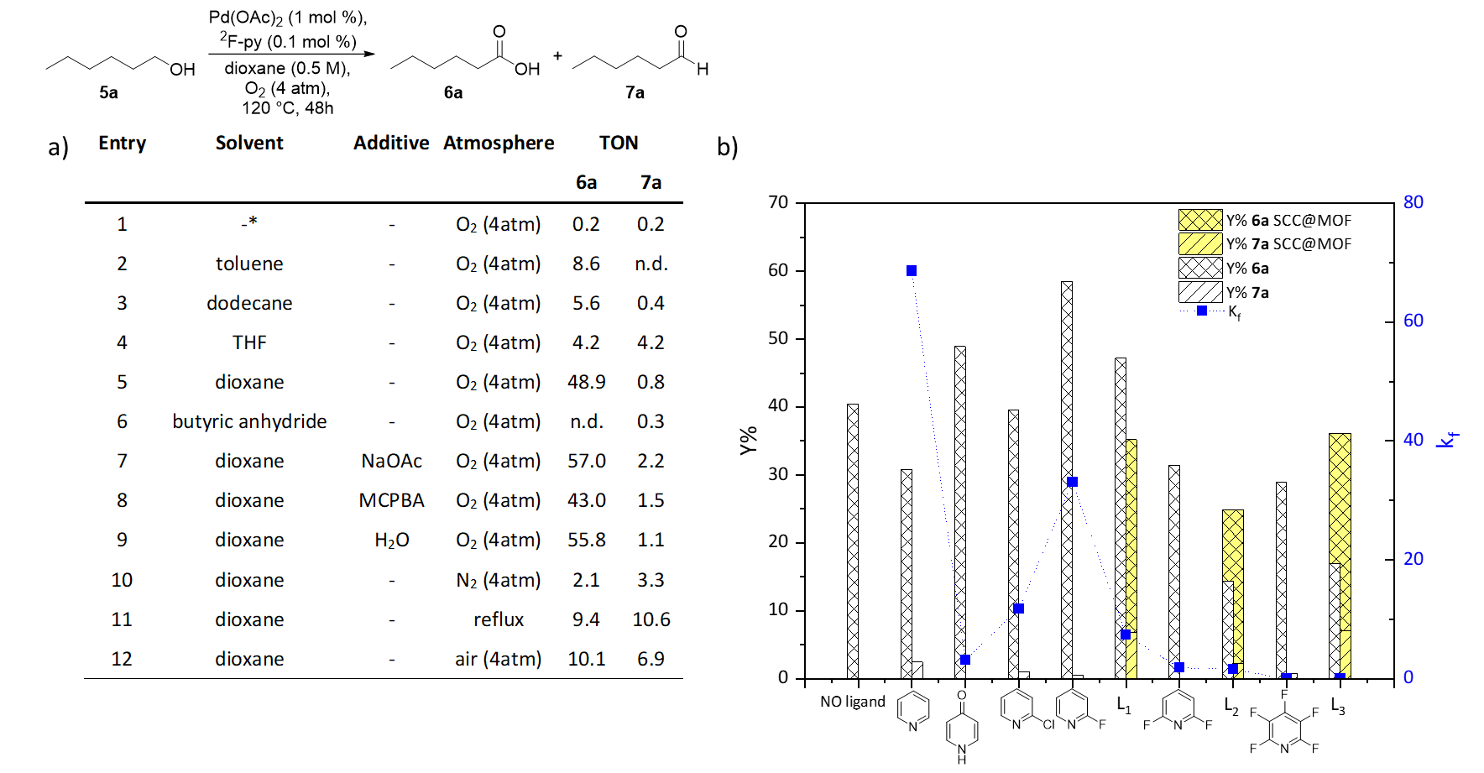
Extremely high electrophilic Pd²⁺ sites
R. Greco, J. Oliver-Meseguer, et al., Chem. Eur. J. 2022, e202103781.
Notes:
In catalysis it is known that the more electron donor the ligand is, the more stable the complex becomes, but at expenses of decreasing the metal Lewis acidity/catalytic activity. This dichotomy has been often overcome with different chemical manifolds; such as oxidizing the ligand or the metal to a high-valence state, and using non-coordinating counteranions or other donoracceptor ligands, with anchimeric assistance or redox properties. However, these approaches eventually increase the synthetic complexity and price of the final metal catalyst. A straightforward synthetic strategy to decrease the electronic donation of the ligand to the metal is fluorination of the former, due to the strong inductive effect of fluoride. Indeed, monofluorinated pyridine-Pd2+ complexes have been reported as extremely active catalysts for carbon-carbon cross-coupling reactions and oxidation reactions after aryl C-H activation. On this basis, it is reasonable to think that perfluorinated pyridines will give even better results, since are weaker electron σ-donor ligands, and consequently, they will increase more the electrophilicity of the metal catalyst. Moreover, perfluoropyridines are one order of magnitude cheaper than the corresponding mono- and bisfluorinated pyridines– since pyridine fluorination is difficult to stop at one carbon and goes all through to the perfluorinated derivative skeleton. However, despite both suitable features, perfluorinated pyridines have not been profited in catalysis, as consequence of their inability to bind strongly enough metal cations and stabilize the resulting complex. In this case, the Pd-pyridine solvent has shown a reasonable activity for the oxidation of alkyl chain alcohols. But, following our research line strategy of the heterogenization of the catalytically active species, we used the confined spaces of a crystalline MOF to stabilize Pd oxidized species by fluorinated pyridine MOFs to obtain a stable and reusable catalyst. For that, we used MOFs containing the named Fujita cages.

Slide 11
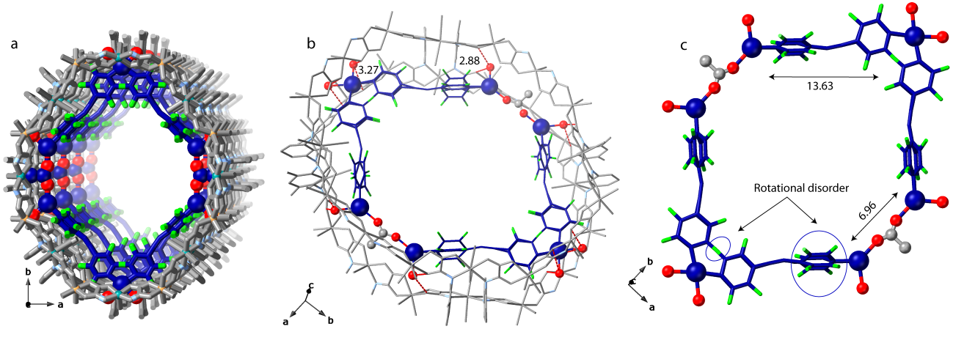
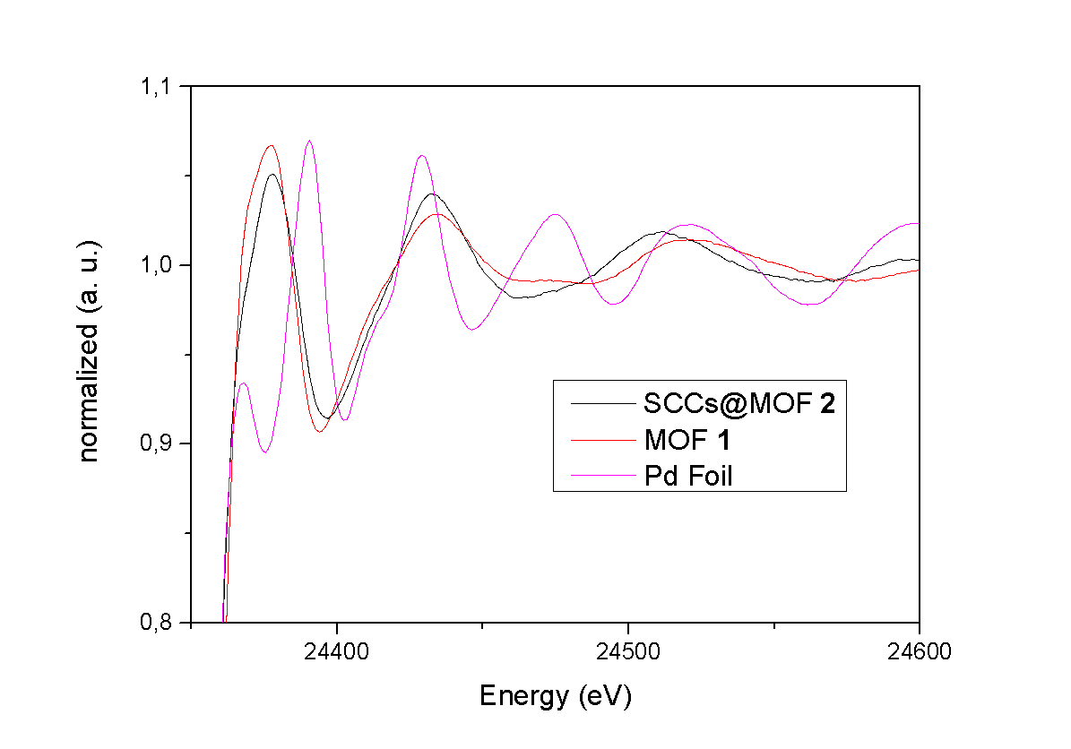
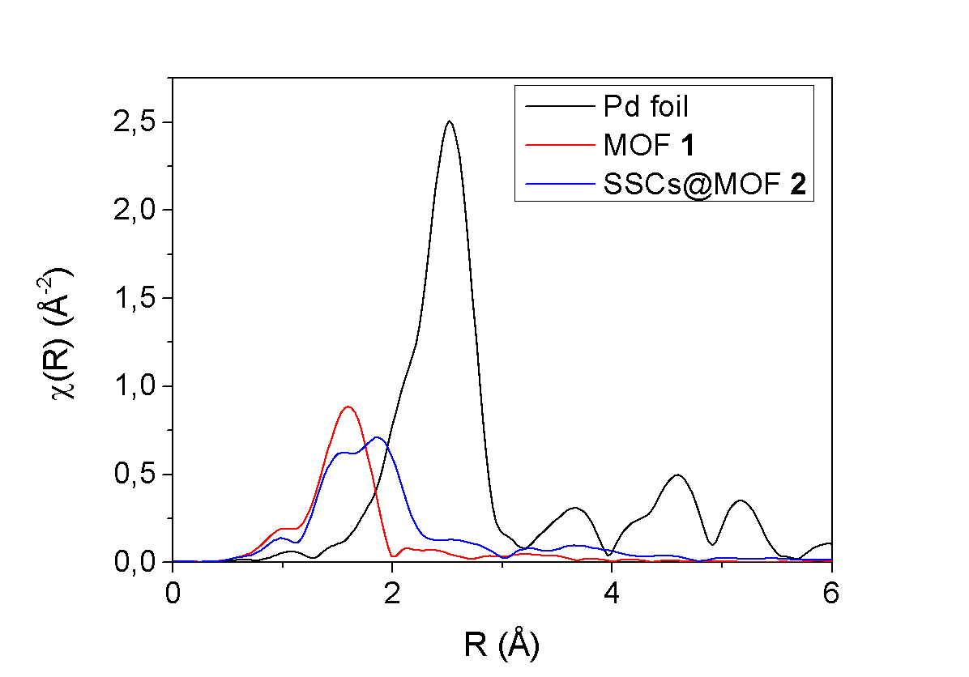
Extremely high electrophilic Pd²⁺ sites
MOF structures composed by metal cation and very electron poor s–donor ancillary ligands with high activity to oxidation reactions
Pd-N, Pd-O and Pd-F distances confirmed
 | CN and estimated distances (Å)
Pd-O | CN: 2.35±0.93 and 2.02 Å
Pd-N | CN: 4.40±0.73 and 2.19 Å
Pd-F | CN: 1.50±0.86 and 2.45 Å
R. Greco, J. Oliver-Meseguer, et al., Chem. Eur. J. 2022, e202103781.
Notes:
In this case, XAS techniques were necessary to confirm the high electrophilic character of the Pd sites and the influence of the F contained in the ligands on these high elecrophilic character, by the Pd-N and Pd-F distances. XANES results confirm the electrophilicity of PdII in 2, similar to 1 without any ligand
EXAFS results for 2 strongly support the formation of the SCCs inside the MOF, with coordination numbers indicated in the table.

Slide 12
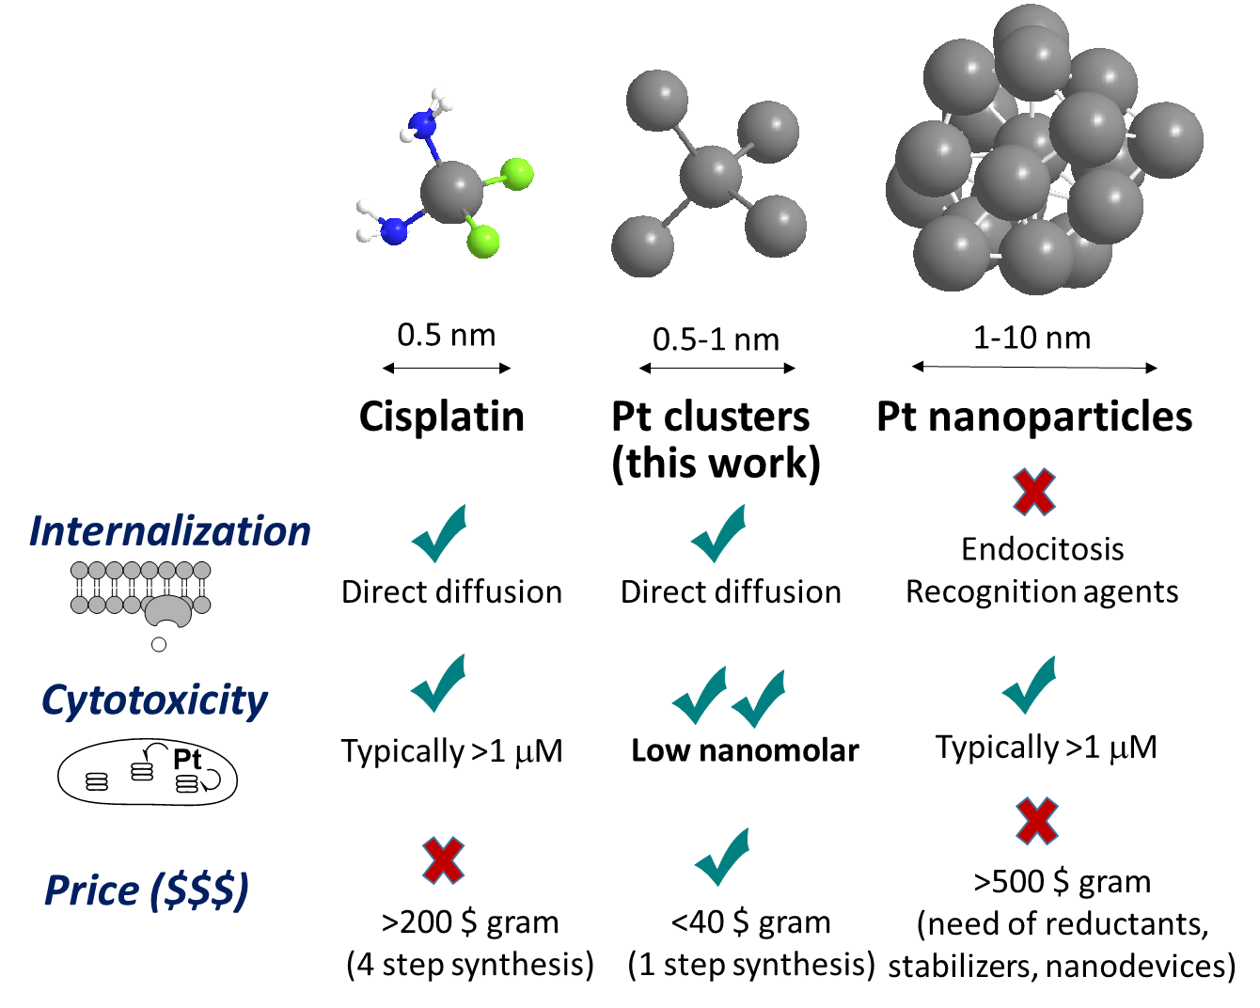
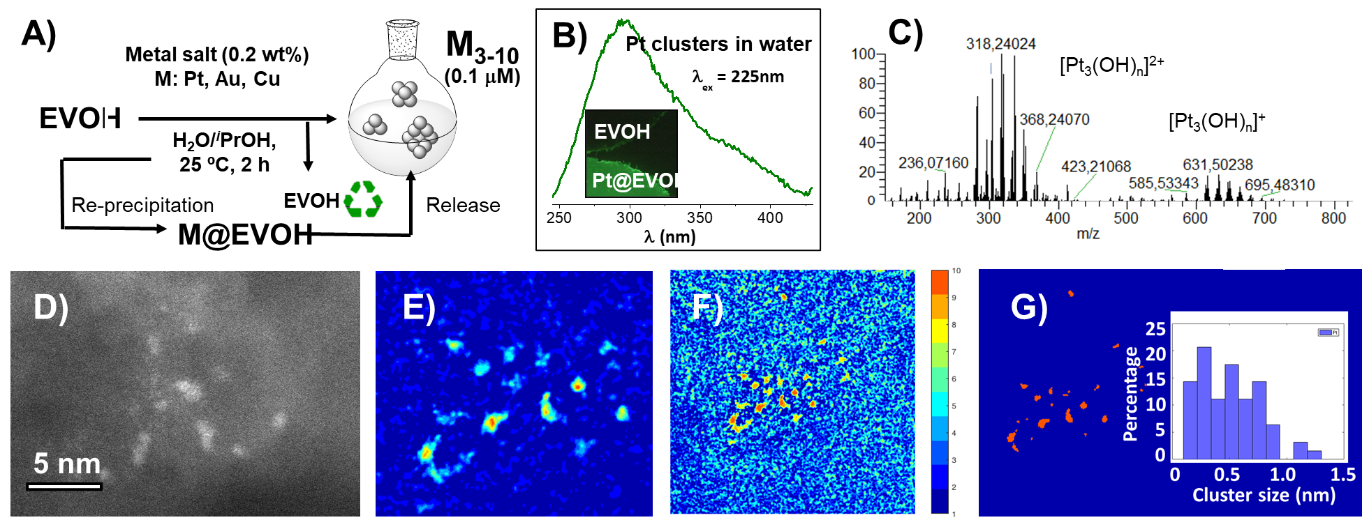
Aqueous PtNCs with high cytotoxic activity
Pd NCs able to do the internalization process across the lipid bilayer in similar ways than cisplatin.
Higher activity than cisplatin.
R. Greco, G. García–Lainez, J. Oliver–Meseguer, et al. Antitumoral sub–nanometer aqueous metal clusters overcome cisplatin–resistance, under revision.
Notes:
The last example that I wanted to show you is not a catalytic one. In this case, observing the pros and cons of the cisplatin and Pt nanopaticles for antitumoral activity, we expected that an intermediate structure between them was able to accomplish all the requirements, as the internalization in the cell, achieving high cytotoxic activity and in a very low price compared with the cisplatin, a well-known drug that is been used at the moment, comparing the activity in cell lines from lung and cervix cancer. To prepare them, we dissolve a small amount of the Pt salt in the presence of the EVOH polymer, forming the corresponing clusters as we oberved some years ago during my PhD. The characterization was perormed using fluorescence, orbital trap (a mass spectroscopy technique) and HRTEM.

Slide 13
Aqueous PtNCs with high cytotoxic activity
HeLa cell line
A549 cell line
Blank
Pt NPs (2 μM)
Pt clusters (0.025 μM)
Pt clusters (0.15 μM)
100 μm
100 μm
100 μm
100 μm
R. Greco, G. García–Lainez, J. Oliver–Meseguer, et al. Antitumoral sub–nanometer aqueous metal clusters overcome cisplatin–resistance, under revision.
Notes:
The cell activity experiments were performed at the Hospital La Fe. I’m not an expert in this field but it is cleary observe the nanomolar activity of the Pt NCs for different cancer cells for lung and cervix cancer and their how they are even more active that the cisplatin provided nowadays for the treatment of these cancers.

Slide 14
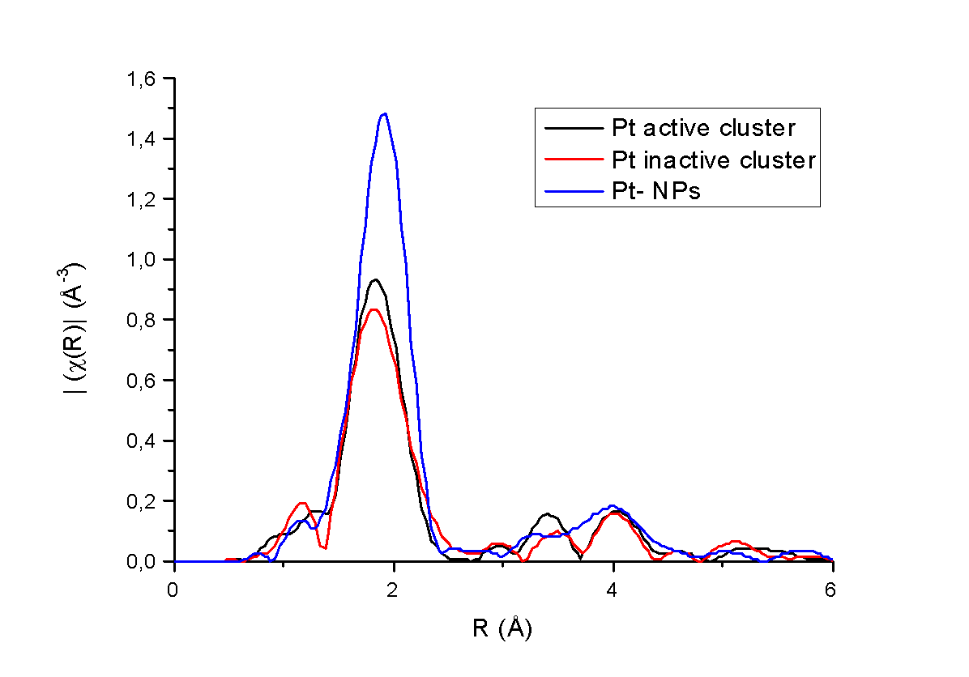
Aqueous PtNCs with high cytotoxic activity
Pd NCs able to do the internalization process across the lipid bilayer in similar ways than cisplatin.
Higher activity than cisplatin.
EXAFS decisive to confirm the structure of the active species suggested using other techniques.
Fit for Pt₃O₄ structures
R. Greco, G. García–Lainez, J. Oliver–Meseguer, et al. Antitumoral sub–nanometer aqueous metal clusters overcome cisplatin–resistance, under revision.
Notes:
In order to fully confirm the active species in this case, it was necessary a complete study of the geometric and electronic structure, obtaining that Pt-O species were the most active ones, predicted by other techniques, as orbitrap, but fully confirmed by our experiments at the synchrotron.

Slide 15
In conclusion
1) Metal single atoms and clusters can be stabilized in zeolites and MOFs and use as active species in different organic reactions with industrial interest.
2) XAS has become an indispensable method for probing the structure and composition of catalysts, revealing the nature of the active species, single atoms or clusters, and establishing links between structural motifs in a catalyst, local electronic structure, and catalytic properties.
Notes:
So, to summarize the presentation, Metal single atoms and clusters can be stabilized in zeolites and MOFs and use as active species in different organic reactions with industrial interest. And even more important, regarding the useful techniques that we used before, XAS has become an indispensable method for probing the structure and composition of catalysts, revealing the nature of the active species, single atoms or clusters, and establishing links between structural motifs in a catalyst, local electronic structure, and catalytic properties.

Slide 16


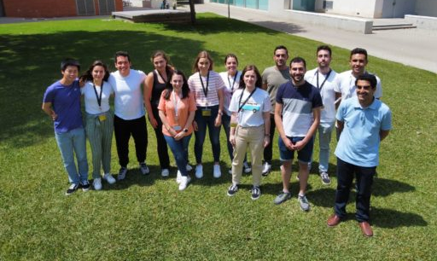


MINECO projects CTQ 2017-86735-P and Severo Ochoa SEV-2016- 0683
Juan de la Cierva contract IJC2018-036514-I
GVA Grupos Emergentes GV/2021/138
Acknowledgments
Catalysis for Sustainable Organic Reactions
Instituto de Tecnología Química ITQ (UPV-CSIC)
Rossella Greco, PhD
Francisco Garnes-Portolés
Dr. Antonio Leyva-Pérez
Dr. Emilio Pardo and group
Dr. Carlo Marini,
CLÆSS beamline
Dr. Donatella Armentano
Dr. Inmaculada Andreu
Guillermo García
Notes:
I would like to thank the Catalysis for Sustainable Organic Reactions group at the ITQ for their excellent work, specially to the former student Rossella Greco, PhD student Francisco Garnes and our PI Antonio Leyva. The MuPoMat at the ICMOL for providing us their amazing MOFS and Dr, Donatella Armentano for her excellent job in the Diffraction characterization. Also to the research performed at the Instituto de Investigación Sanitaria La Fe regarding the antitumoral activity of the Pt clusters. And last but very important to the ALBA synchrotron facilities, specially Dr Carlo Marini and all the team at the CLAESS beamline for their advice and help to perform the experiments. Finally I would like to thank all the programs that support the research presented here

Slide 17

Thanks for your attention
@DrJuditOliMe
@CatSusGroup_ITQ
https://catsusorg-itq.webs.upv.es
Notes:
And all of you for your attention.

