Slide 1
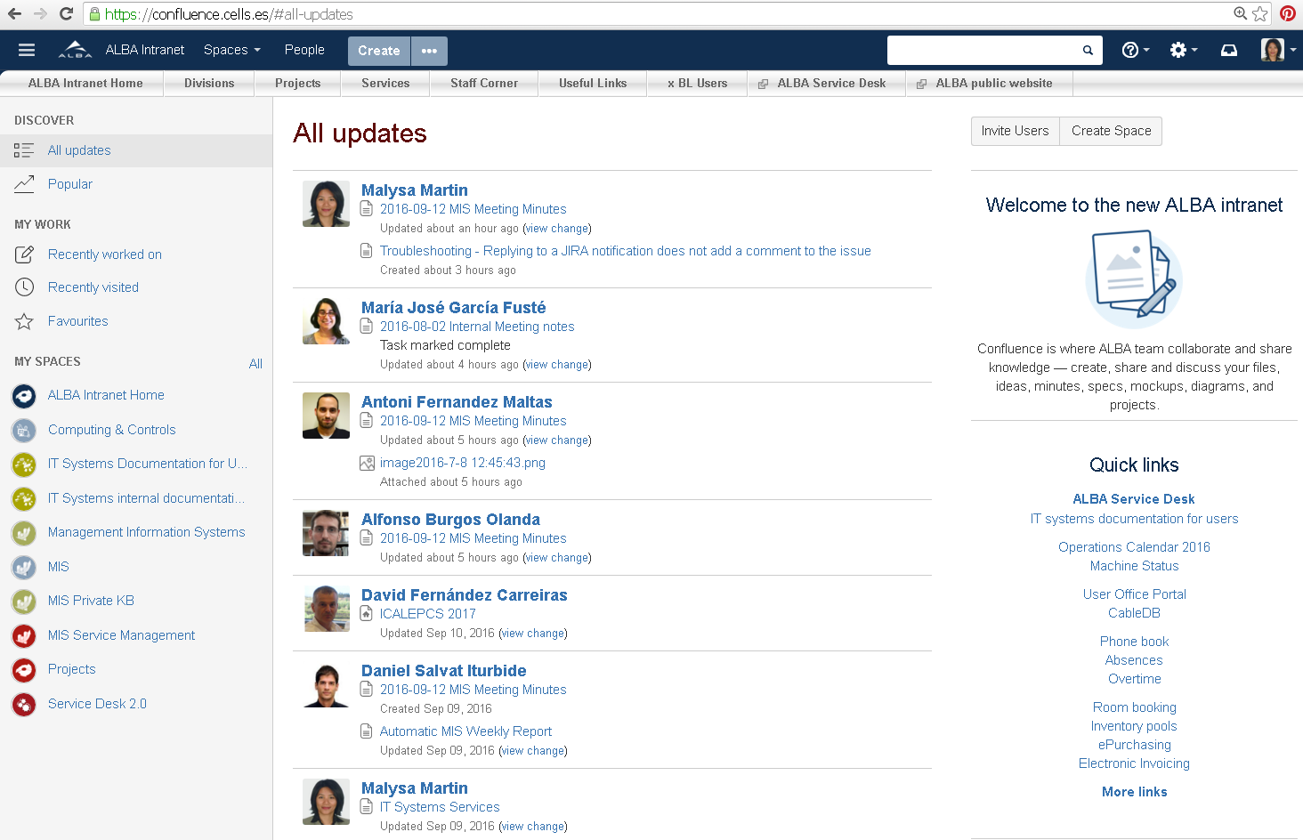
ALBA Intranet 2.0
Introduction
– Basics
Seminar with Experiment Division

Slide 2
ALBA Intranet 2.0
Why change…
… and choose Confluence
Current intranet: 2004
Sedimentary information structure
Outdated technology
Difficult to search
Need to improve internal communication tools
Up-to-date collaborative spaces for Teams, Projects and Knowledge Bases
Usage based information structure
Integration with our new service desk and project management tool

Slide 3
Collaborative Spaces
Usage Based Structure
Service and Project Management Integration

Slide 4



Collaborative Spaces
i
Organized workspaces
Spaces for every team, division, or major project to share information and keep work organized.
Best practice templates
They can help you get started with your space, so you don't have to fuss with formatting.
Blogs and discussions
Share news and announcements across ALBA, and have active discussions with comments, @mentions and likes.
User and content permissions
Spaces and pages have granular permissions for viewing and editing.
Page and file versioning
Track every version and change that you make to a page. Files are automatically versioned as well
JIRA integration
Provide insight into your work planning and execution with automatic linking, quick issue creation and reports.

Slide 5
Collaborative Spaces
Fast access:
All updates
My recently worked on
My recently visited
My favorite pages
My favorite spaces
My open tasks
Quick links

Slide 6
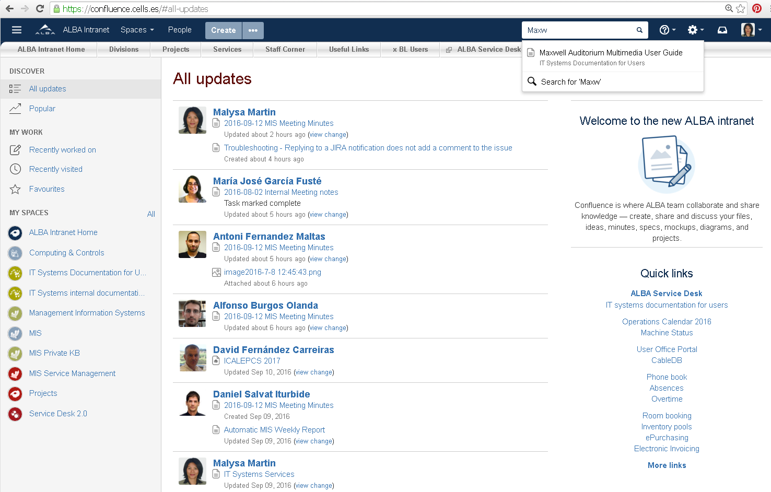
Collaborative Spaces
Search

Slide 7
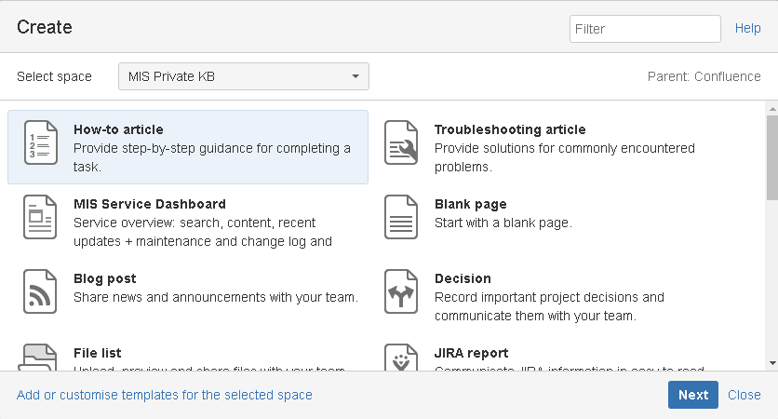
Collaborative Spaces
Create rich content from available templates

Slide 8
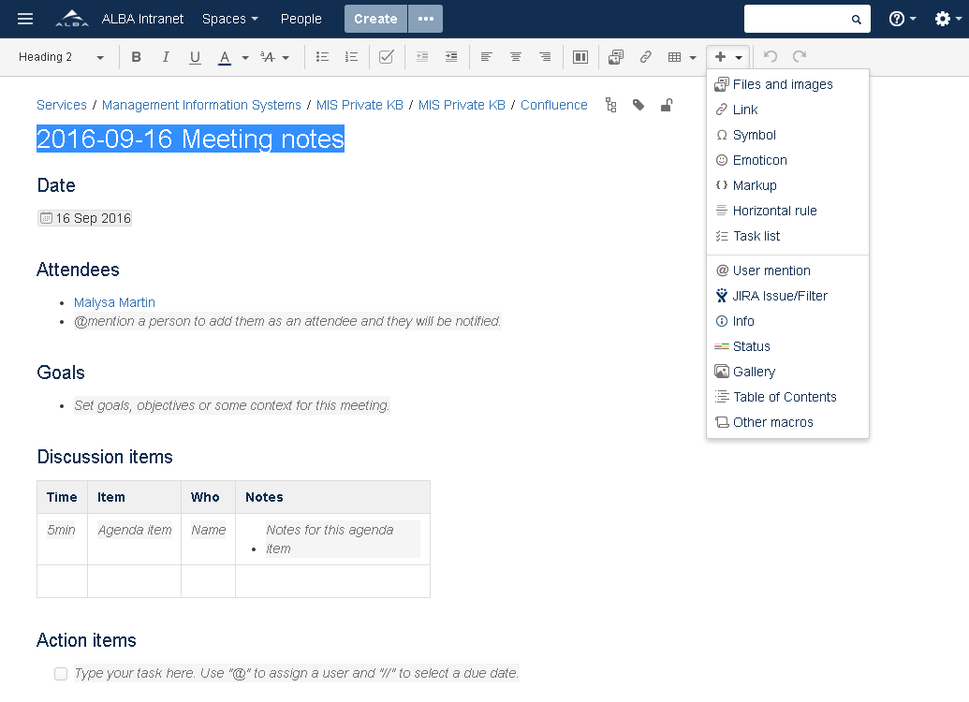
Collaborative Spaces
Create rich content easily
Section layouts
Styles
Tables
Images and video
Search
Table of content
Children pages
Announcement panels
Hide/Expand
…

Slide 9
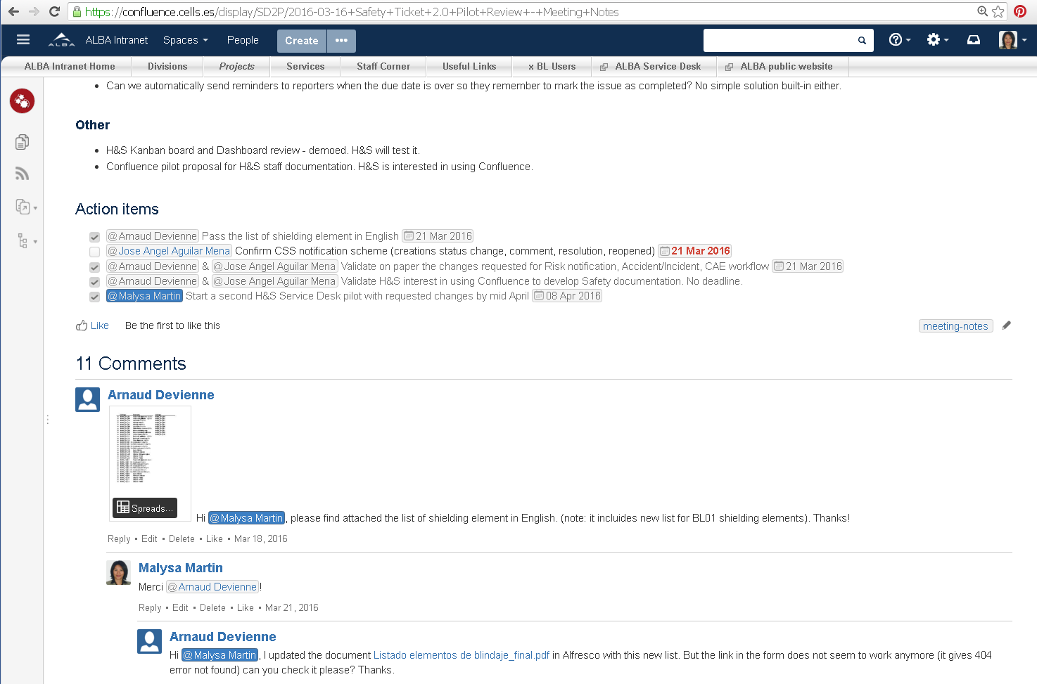
Collaborative Spaces
Like pages

Slide 10
Collaborative Spaces
Comment pages

Slide 11
Collaborative Spaces
Assign action items to people with due dates

Slide 12
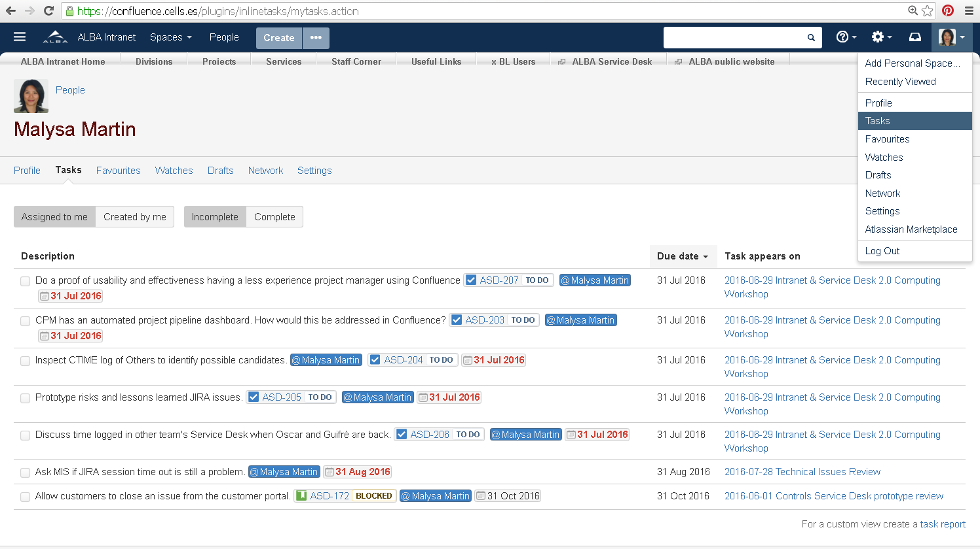
Collaborative Spaces
Review your tasks

Slide 13
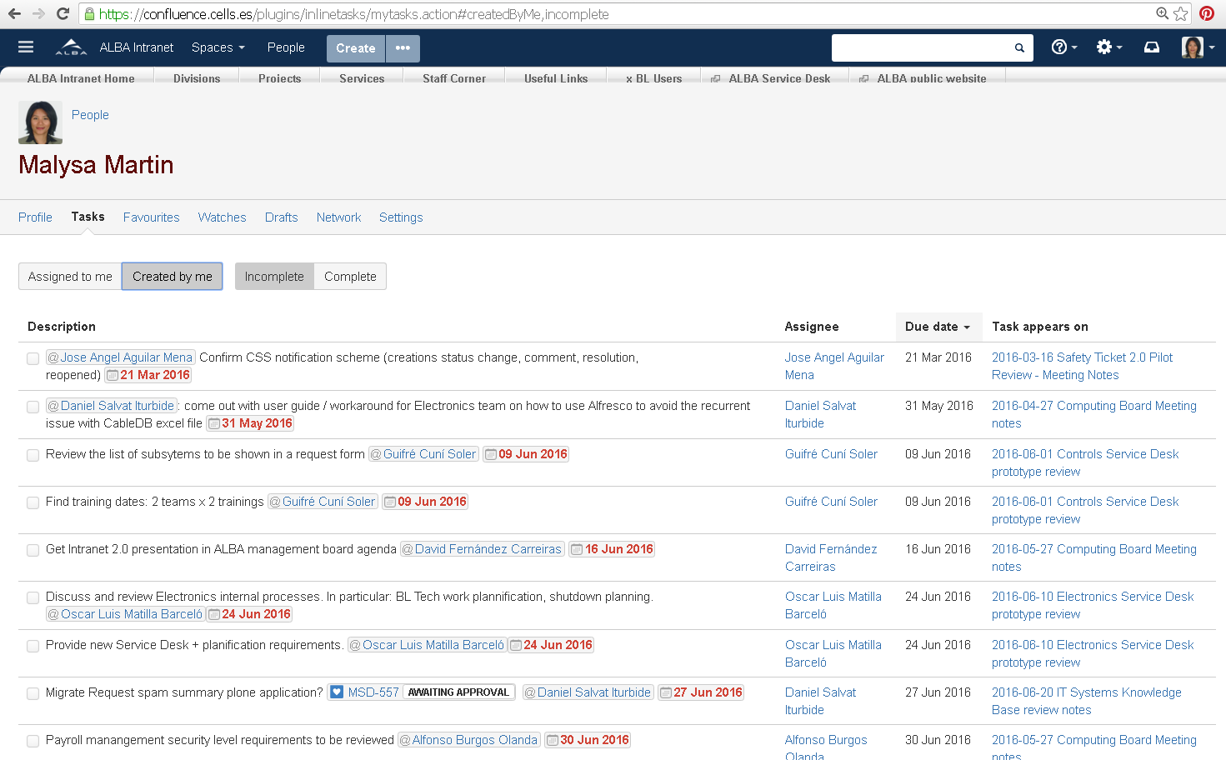
Collaborative Spaces
Review the tasks you created and assigned to other people

Slide 14
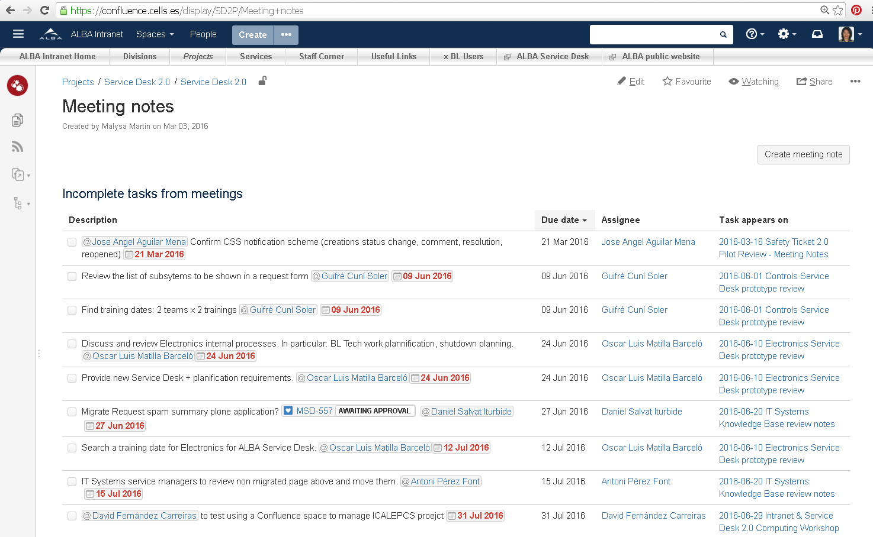
Collaborative Spaces
Generate a task report for a project, a team, a label or a group of users, etc.

Slide 15
Collaborative Spaces
Spaces where teams, projects, services can share information with granular space/page permissions
Templates and rich editing tools
Social features:
  Quick access to all recent updates, favorites, tasks, etc.
  Blogs
  Like, comment, @mypeople
Basic task management

Slide 16
Collaborative Spaces
Usage Based Structure
Service and Project Management Integration

Slide 17
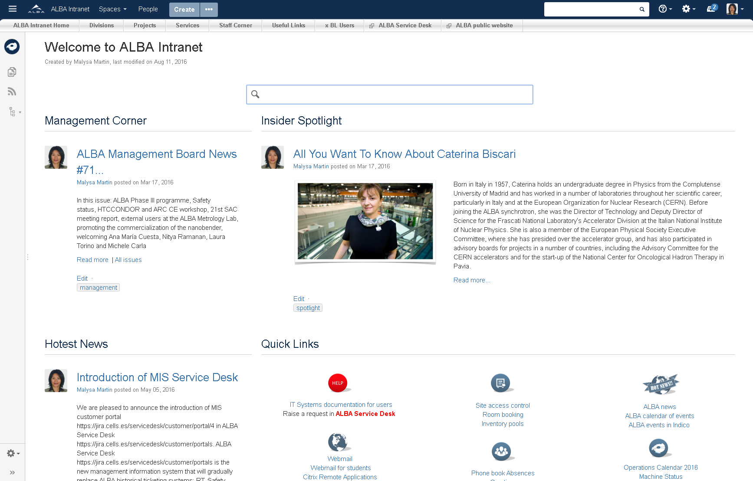
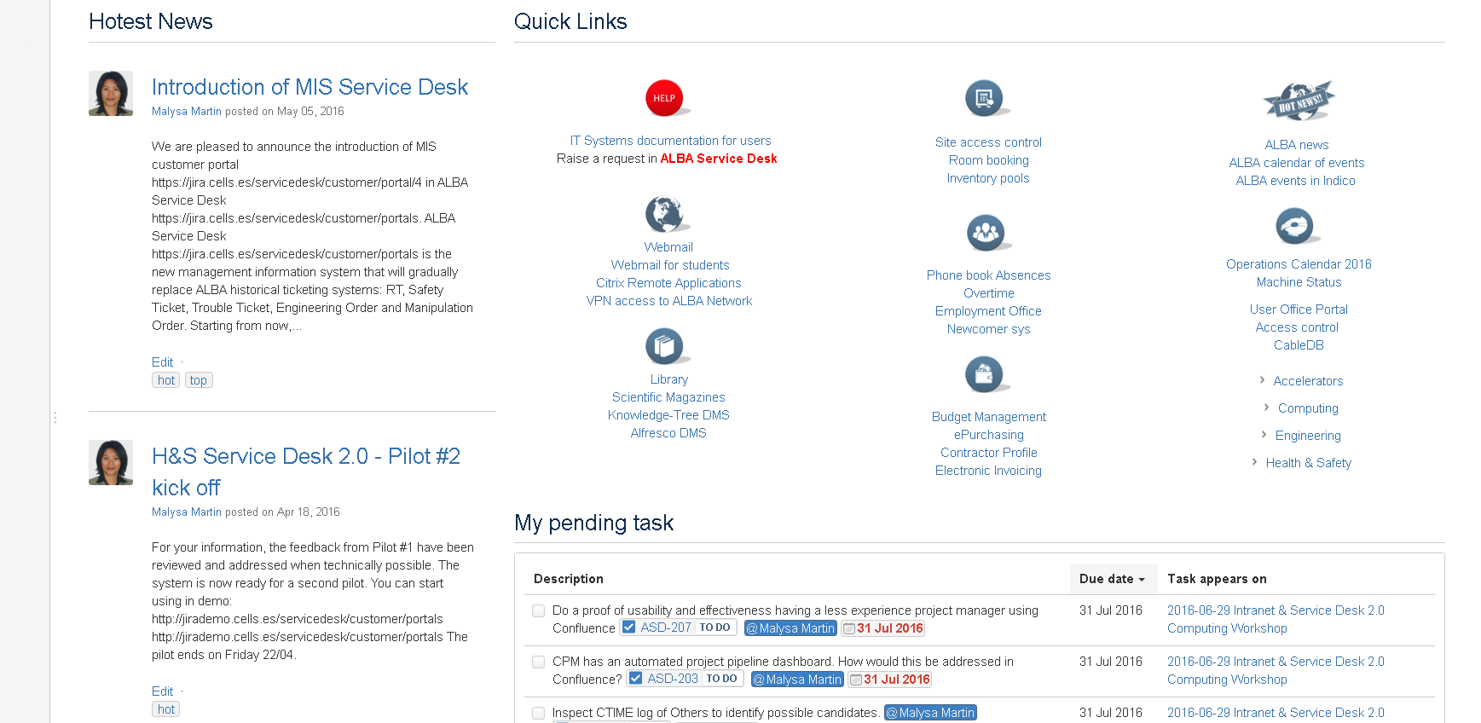
Space navigation bar

Slide 18
Social spaces
Service and Knowledge spaces
Project spaces
Organizational spaces
Internal communication

Slide 19
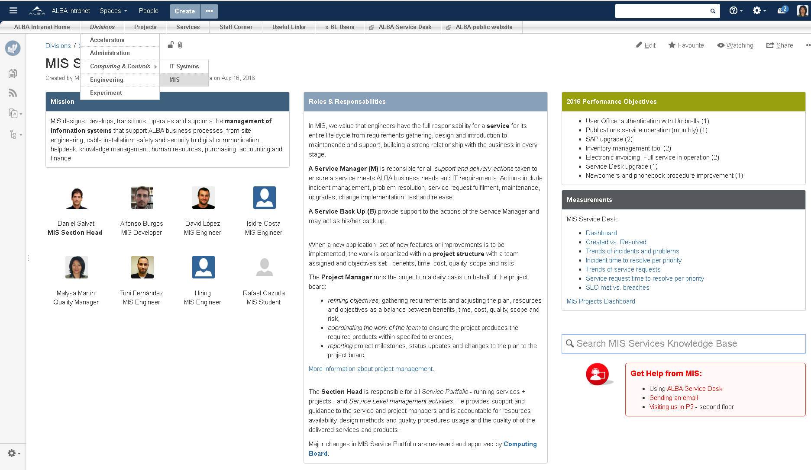
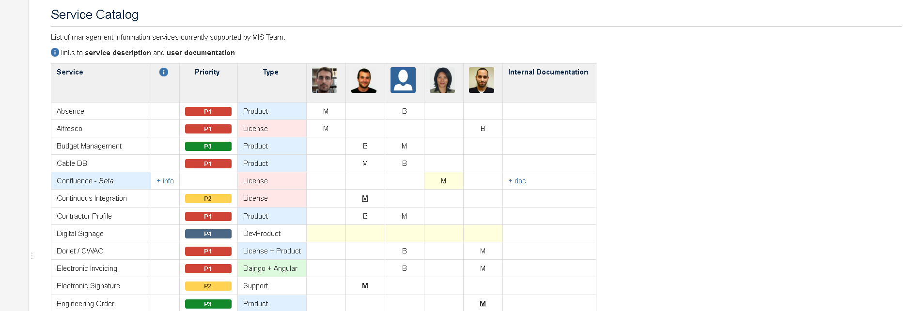
Organizational spaces
Information that should reflect ALBA organization.
Typically includes:
A vision - ALBA only -
A mission
Objectives
Roles & Responsibilities
Service and project portfolio
Team meeting minutes
A team's blog eventually
Critical success factors
Key performance indicators
Measurement
Useful templates:
Team overview
Meeting minutes
Blue
icon
Who
does
what?

Slide 20
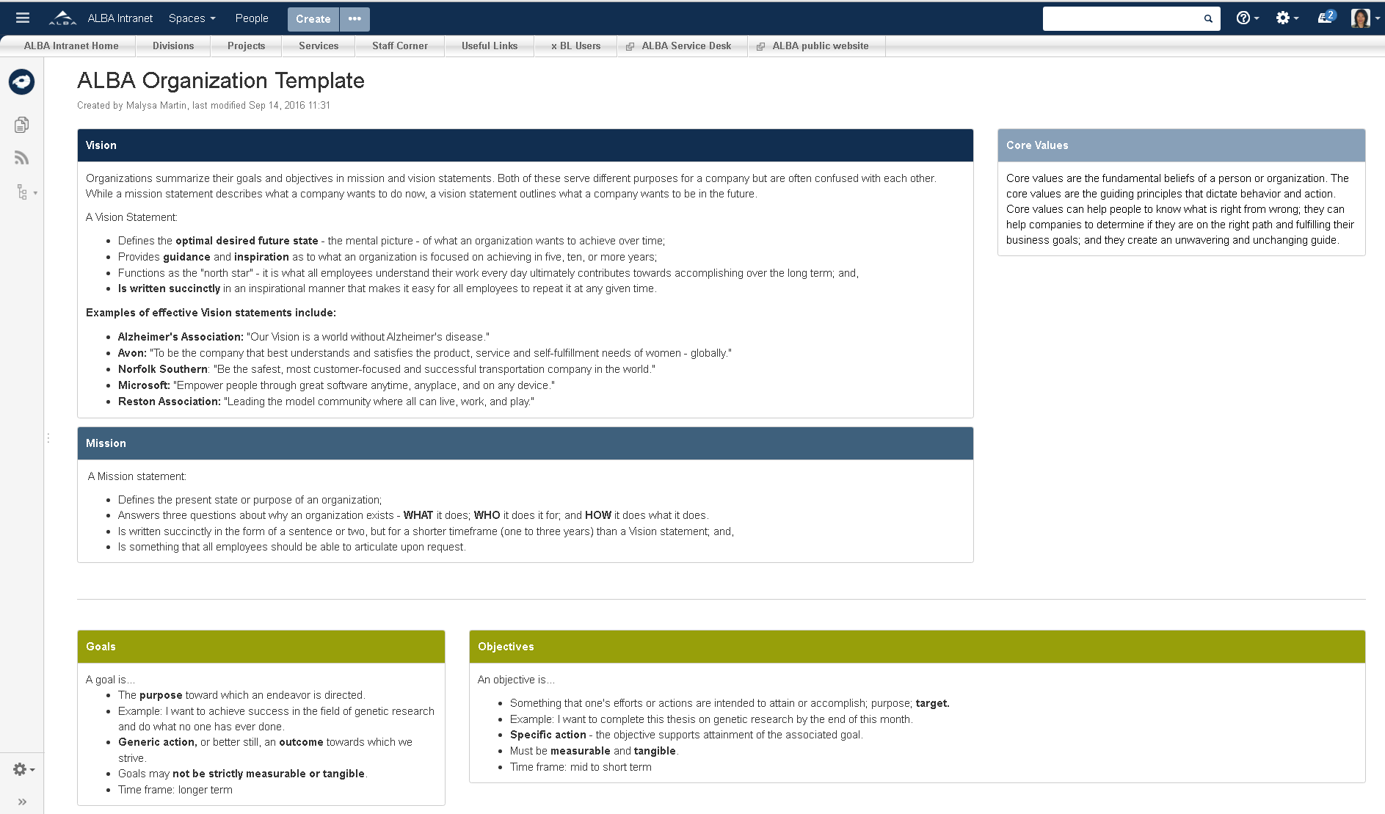
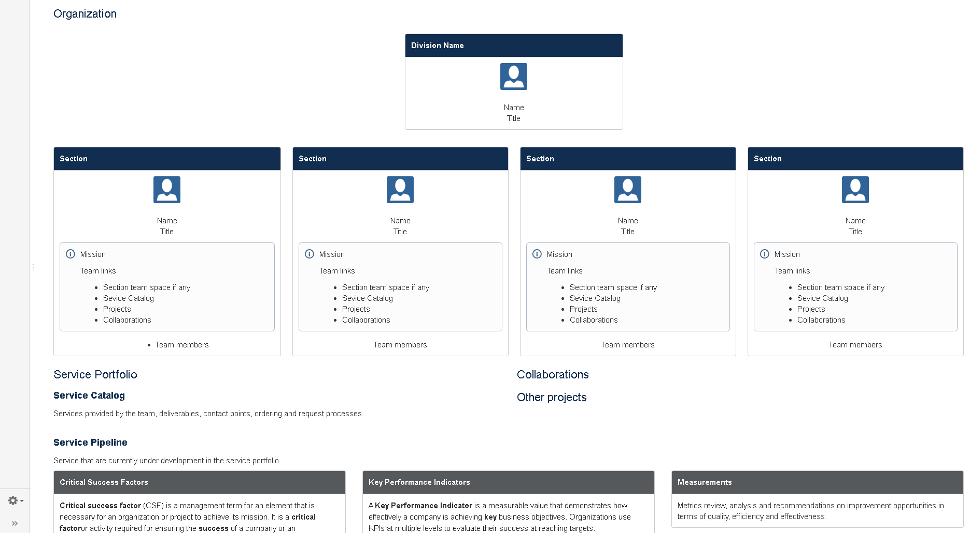
Guiding principles that keep us on the right path
What we want to be in the future
What we presently do for who and how
Mid to short term targets, specific actions. Measurable and tangible.
Long term purpose, generic action, wanted outcome

Slide 21
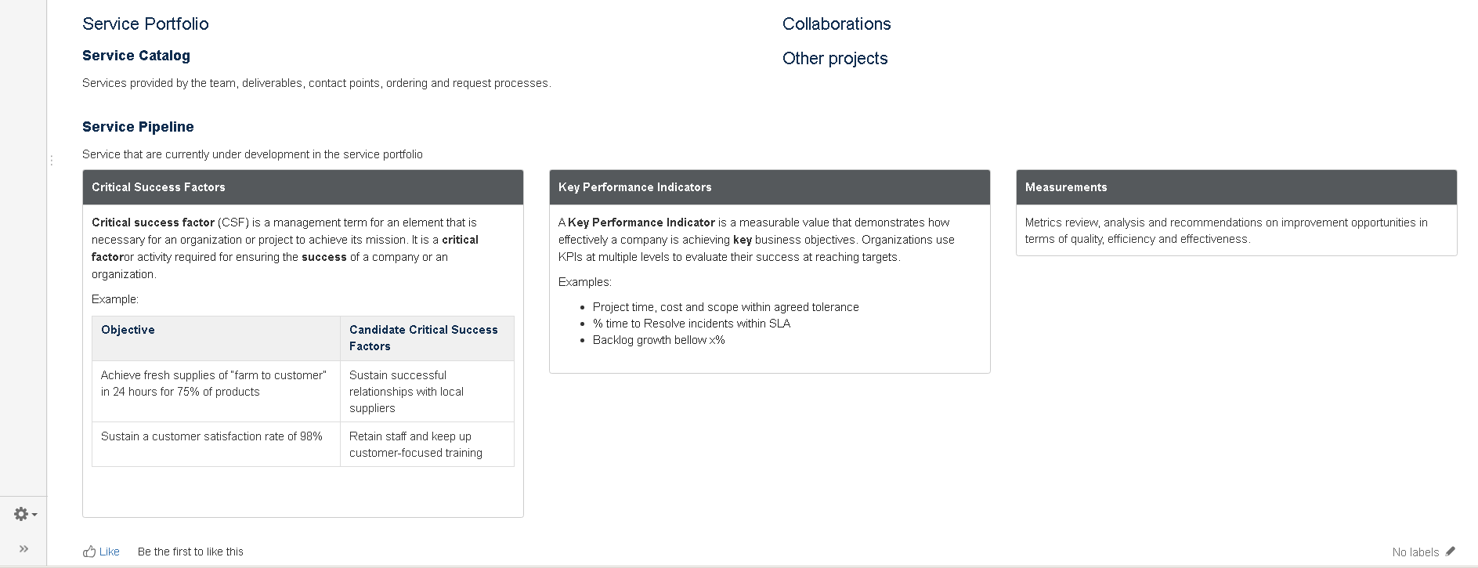
CSFs activities that are critical to our success
KPIs measure the achievement of key business objectives

Slide 22
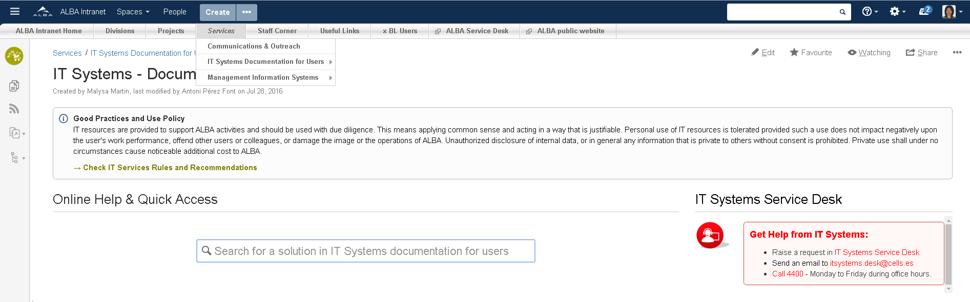
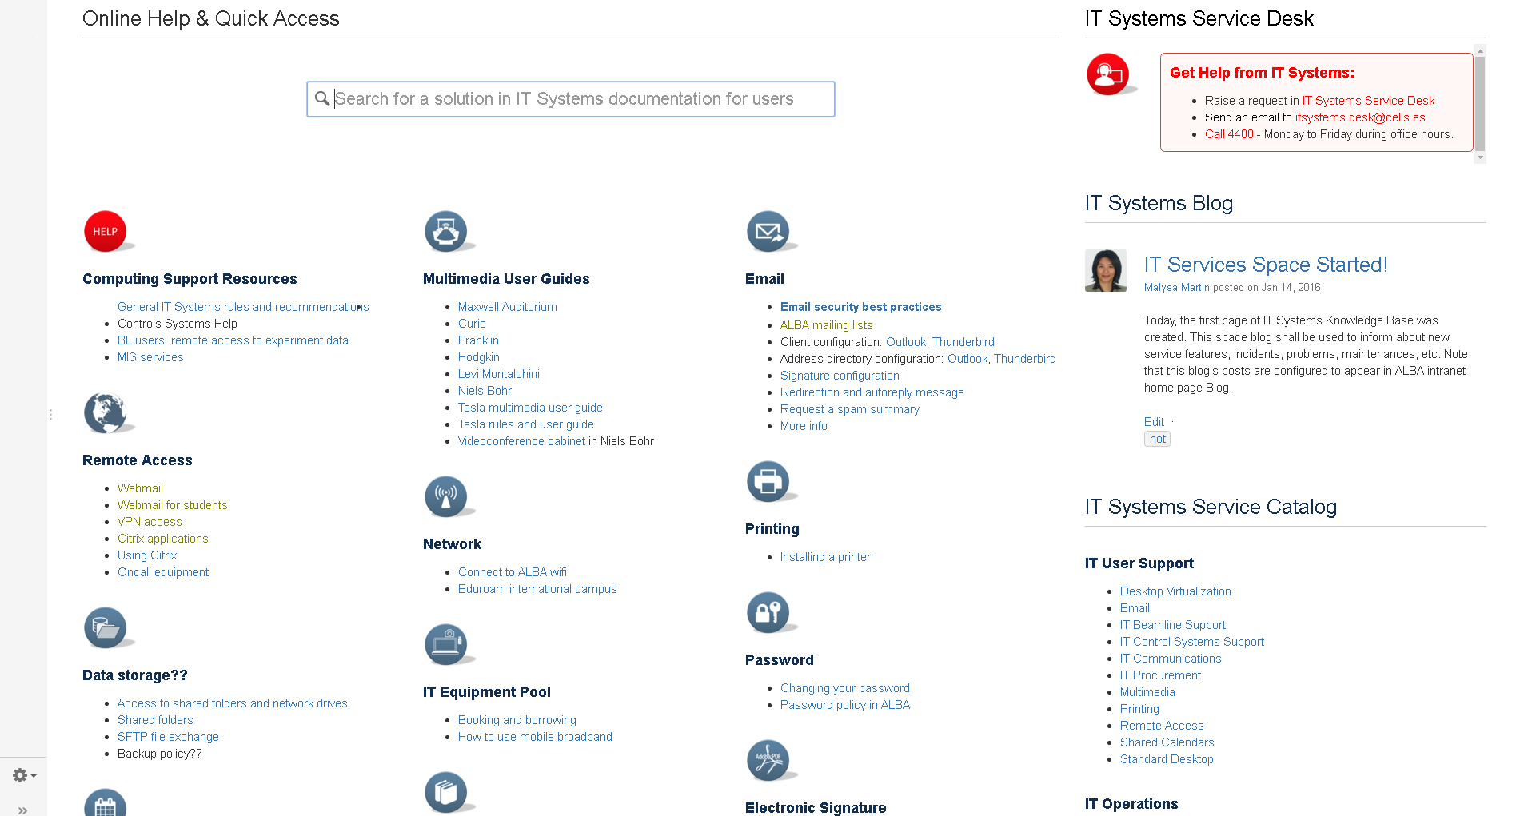
Services & Knowledge Bases
Service information.
Long term documentation.
Easy to search.
Typically includes:
Staff or user information
Service catalog
Service description
How to
Troubleshooting
Templates:
Service description
How to article
Troubleshooting article
Root cause analysis
Green
icon
Help
How-to

Slide 23
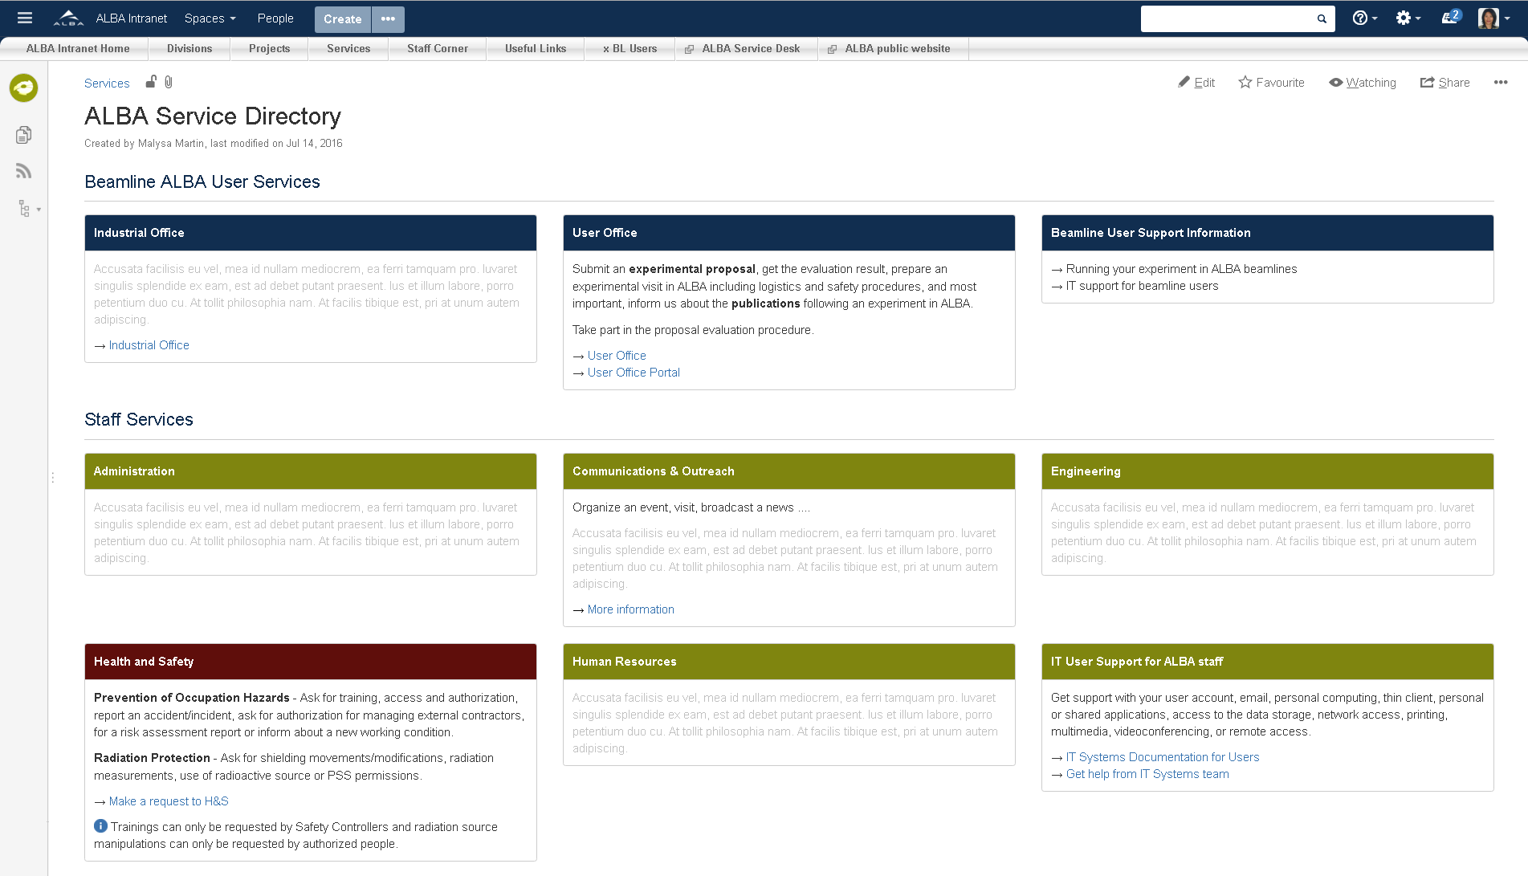
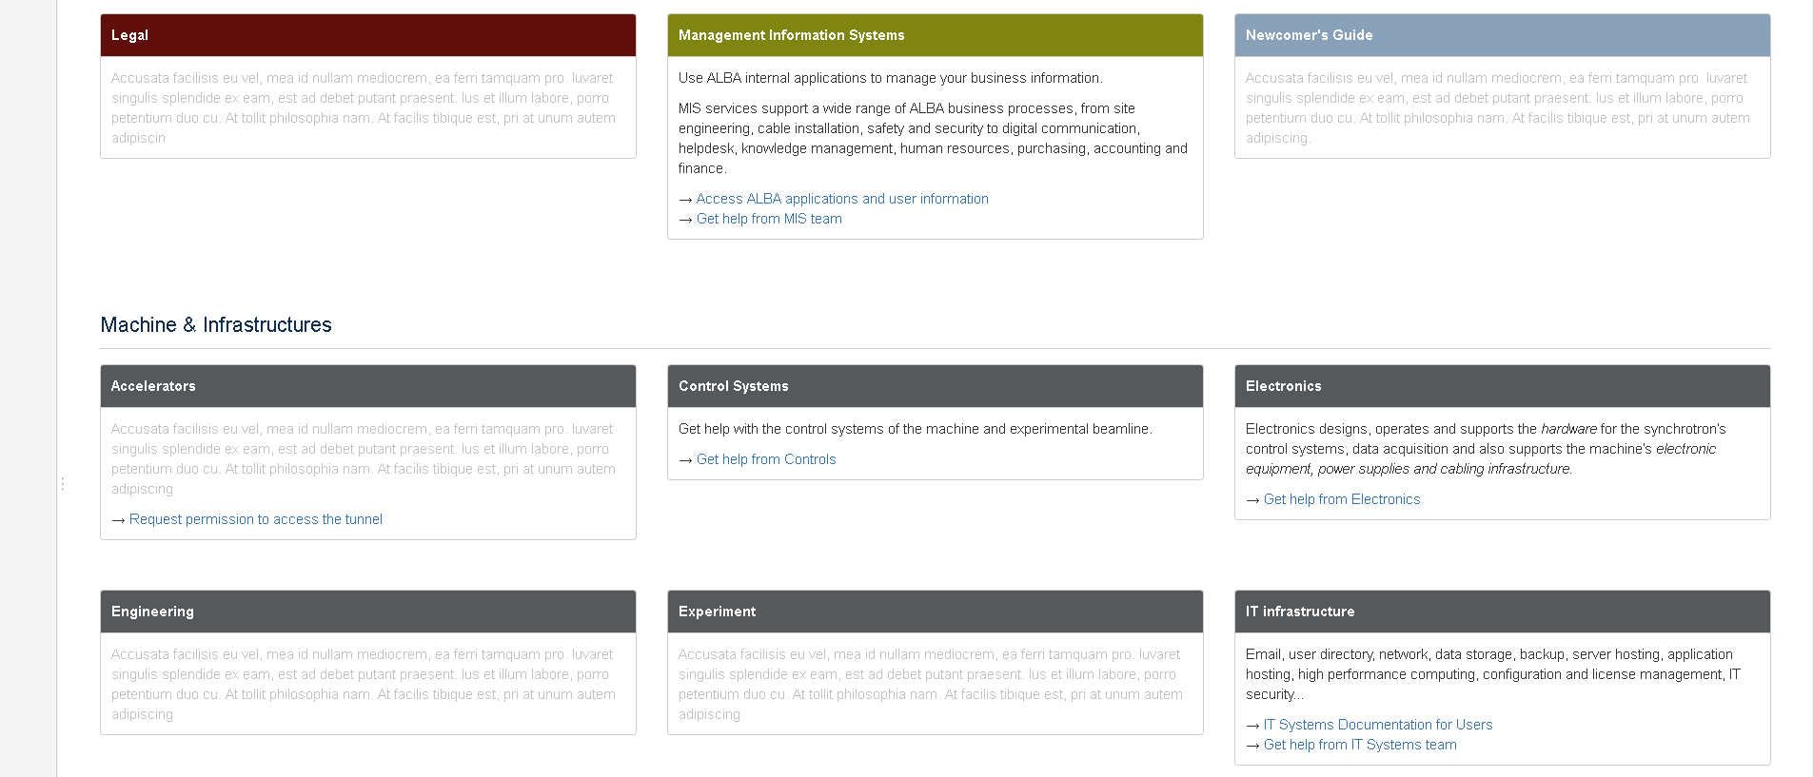
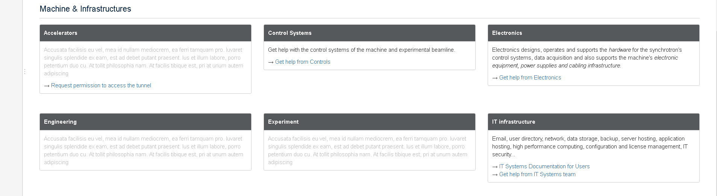
WHAT
support can
you get
WHERE
to find
INFO
HOW
to get
HELP

Slide 24
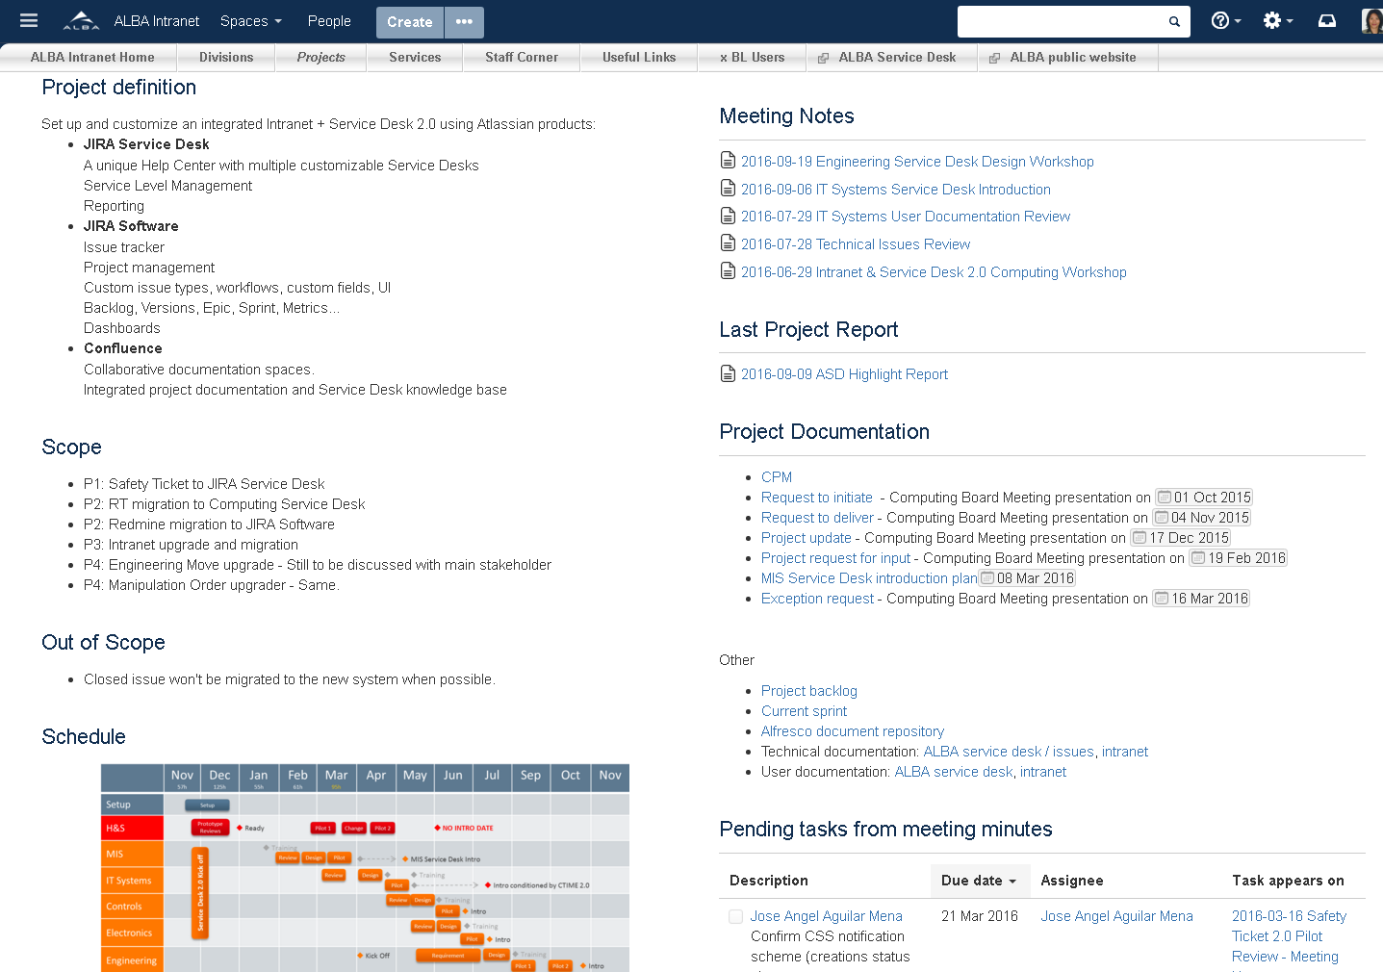
Project Spaces
Collaborative information for temporary or transversal teams.
Short term information to be archived.
Typically includes:
A project overview: needs, definition, objectives, scope, dashboard
Requirements
Specifications
Meeting minutes
Reports
Project blog
Templates:
Project overview
Product requirements
Project highlight report
Project exception report
Project closure report
Meeting minutes
JIRA report
Retrospective
Red
icon
Organize
& document
your work

Slide 25
Automatically updated lists:
Blog entries
Meeting notes
Last project report
Task report
Notes:
Ex:

Slide 26
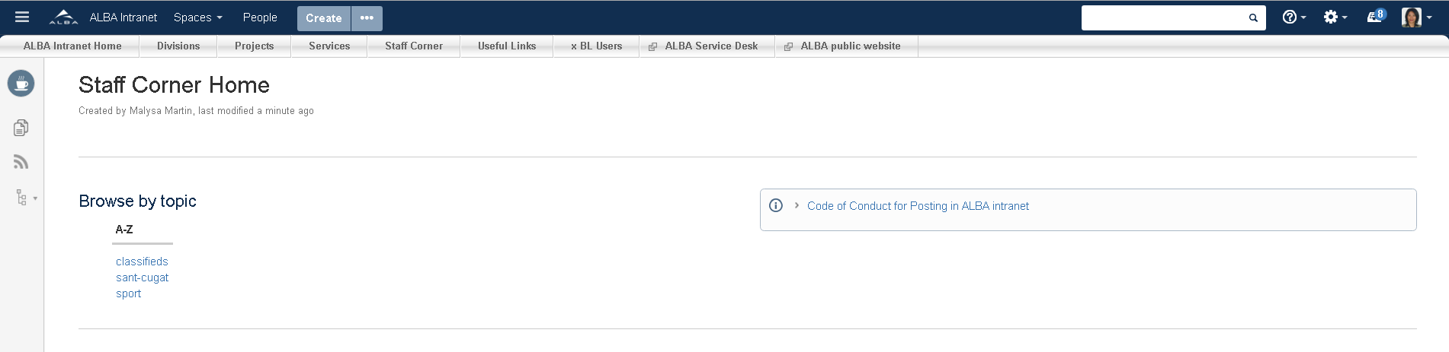

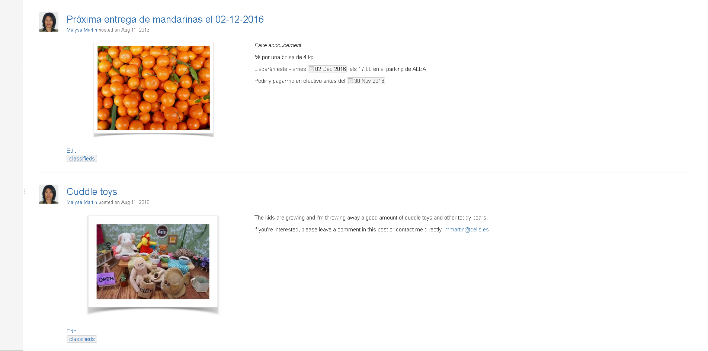
Social spaces

Slide 27
Code of Conduct for Posting in ALBA intranet
Those of us who started this intranet believe deeply in free speech. Given our role in offering this service, however, we must reserve the right to remove certain content that you may post. As a general matter, you may post content freely to your spaces and to those of others, so long as the content is not illegal, obscene, defamatory, threatening, infringing of intellectual property rights, invasive of privacy or otherwise injurious or objectionable.
You may not use the ALBA name to endorse or promote any product, opinion, cause or political candidate. Representation of your personal opinions as institutionally endorsed by ALBA or any other organizations is strictly prohibited.
By posting content to any space, you warrant and represent that you either own or otherwise control all of the rights to that content, including, without limitation, all the rights necessary for you to provide, post, upload, input or submit the content, or that your use of the content is a protected fair use. You agree that you will not knowingly and with intent to defraud provide material and misleading false information.

Slide 28
Social spaces
Service and Knowledge spaces
Project spaces
Organizational spaces
Internal communication

Slide 29
Collaborative Spaces
Usage Based Structure
Service and Project Management Integration

Slide 30
Atlassian Suite
Confluence
Spaces for every team, division, or major project or service to share information and keep work organized.
JIRA Core
Issue tracker
Custom issue types, workflows, custom fields, UI
JIRA Service Desk
A unique Help Center with multiple customizable Service Desks
Service Level Management
Reporting
JIRA Software
Project management
Calendar
Agile methodologies: Backlog, SCRUM or KANBAN boards, Versions, Epic, Sprint, Metrics…
Custom dashboards

Slide 31
Atlassian Suite
Create issues from a Confluence page
Automatic status update in Confluence page
Ex: meeting minutes, project requirements, service note.
Create ad-hoc reports
Service activity reports
Project reports
Release notes
Confluence
JIRA Core
JIRA Service Desk
JIRA Software
Link a Service Desk with a Knowledge Base Space
Feed self help suggestions in you customer portal
Link issues to a Confluence page
Ex: Troubleshooting, How-to

Slide 32
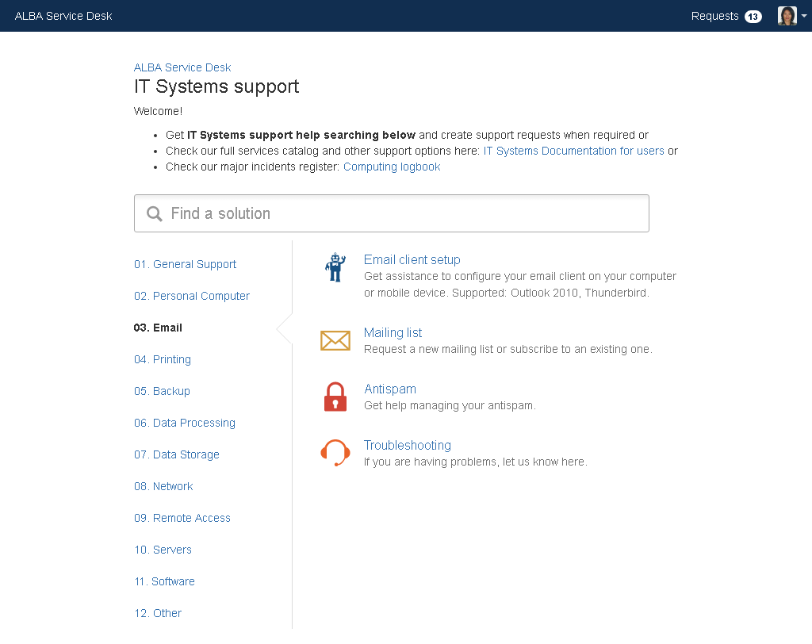
Service Desk + Knowledge Base

Slide 33
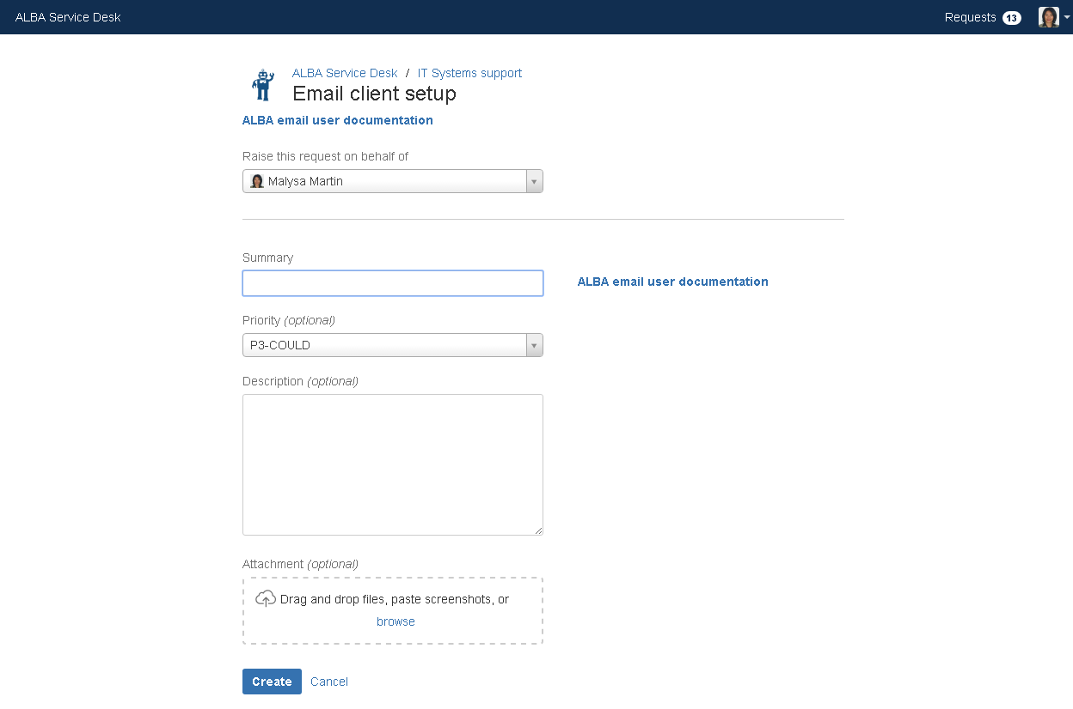
Service Desk + Knowledge Base

Slide 34
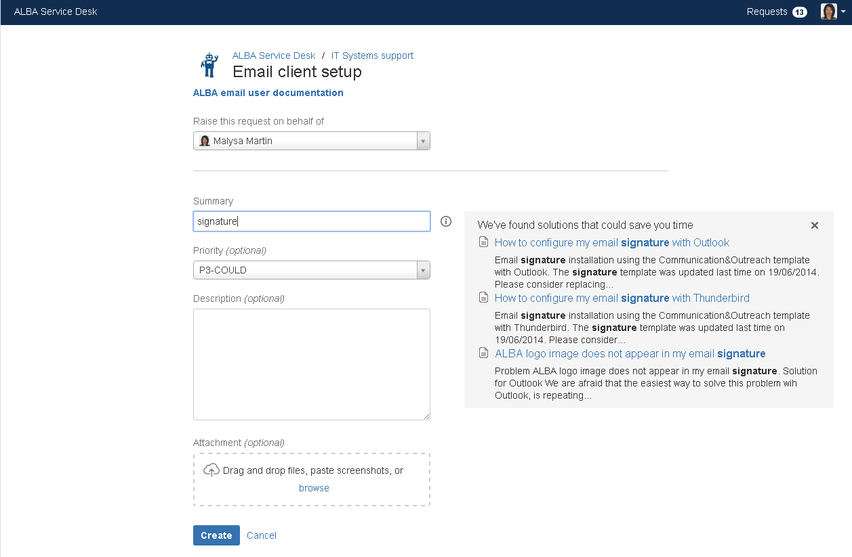
Service Desk + Knowledge Base

Slide 35
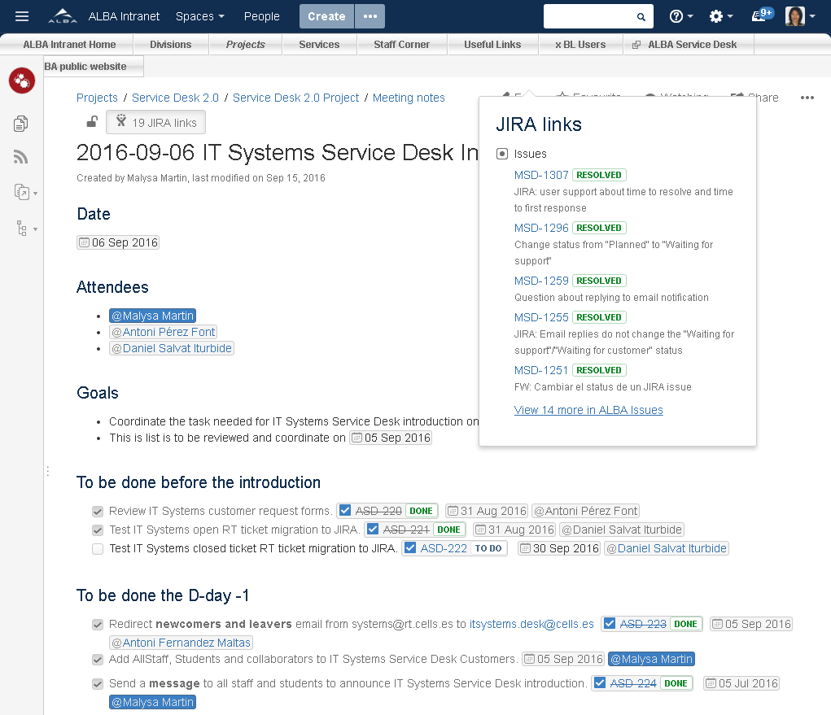
Link issues with a page

Slide 36
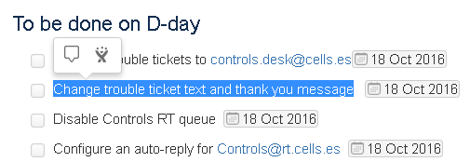
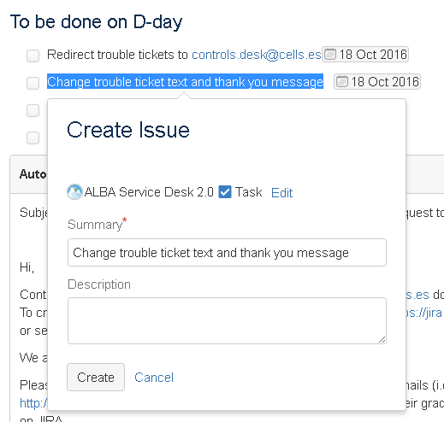
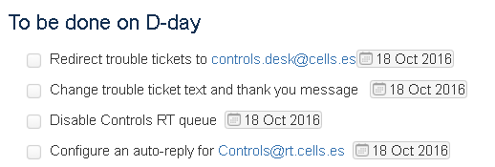
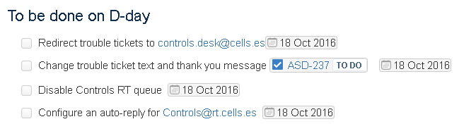
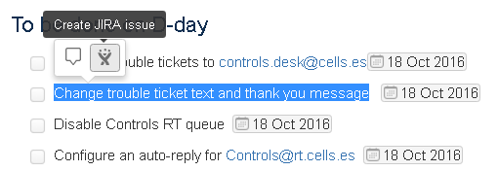
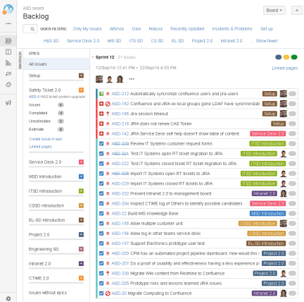
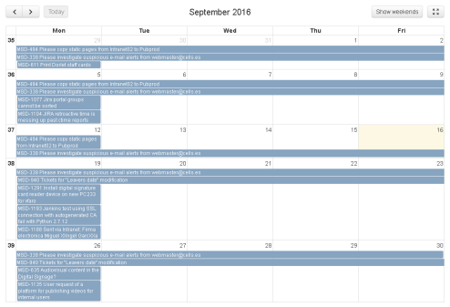
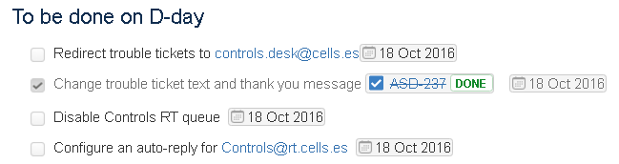
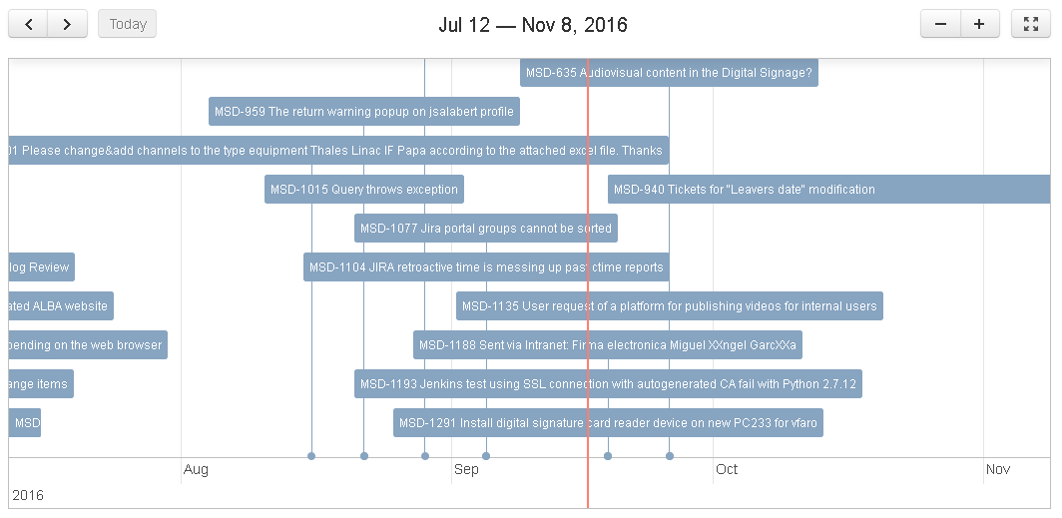
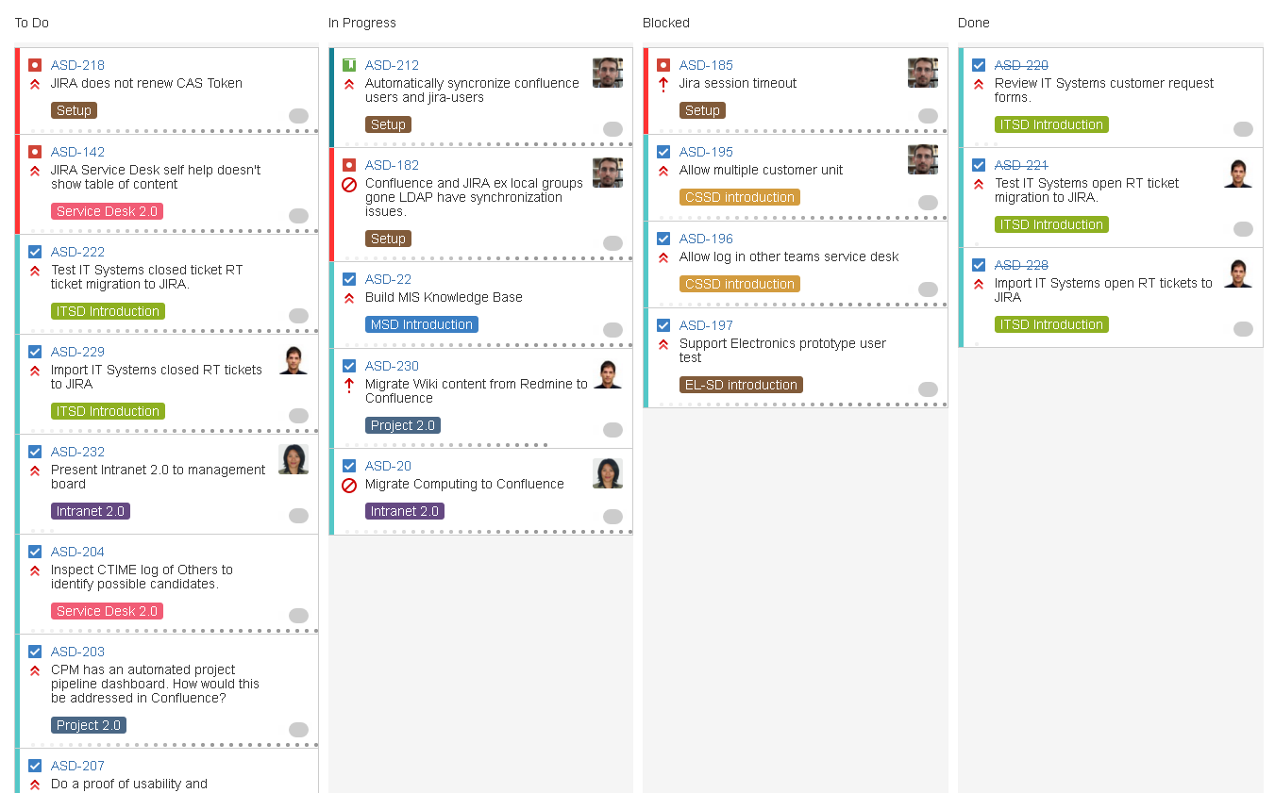
Creating Issues from Intranet Pages
Intranet note
Project or Service Management
Prioritize
Schedule
Assign
Track

Slide 37
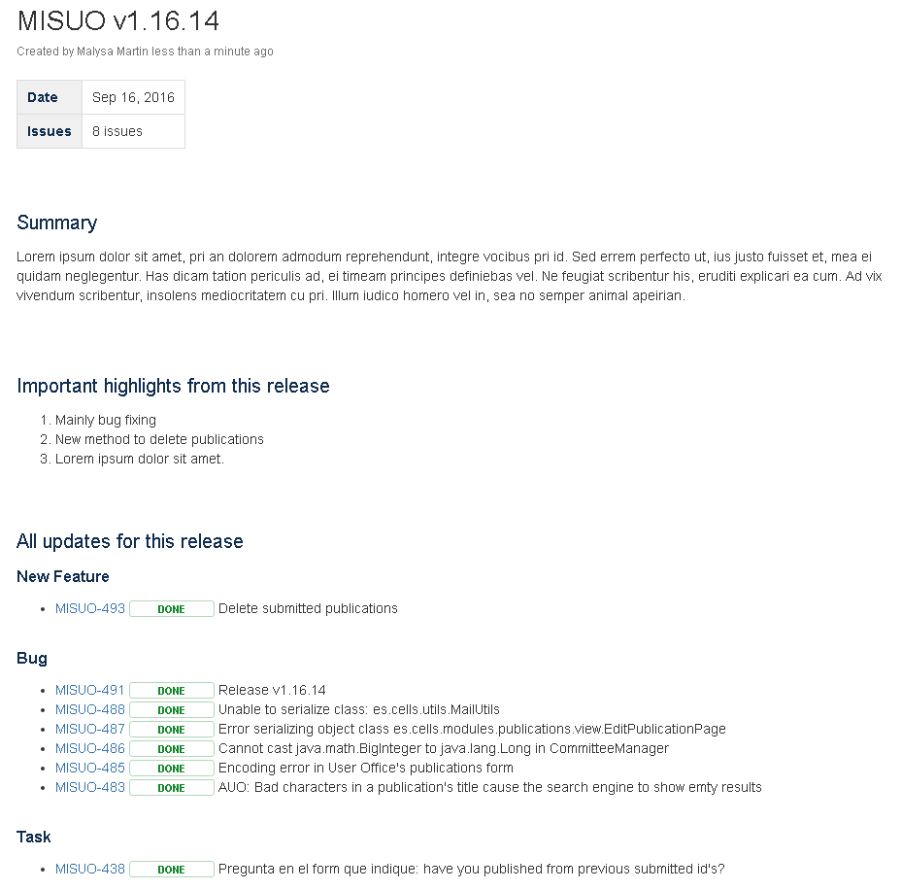
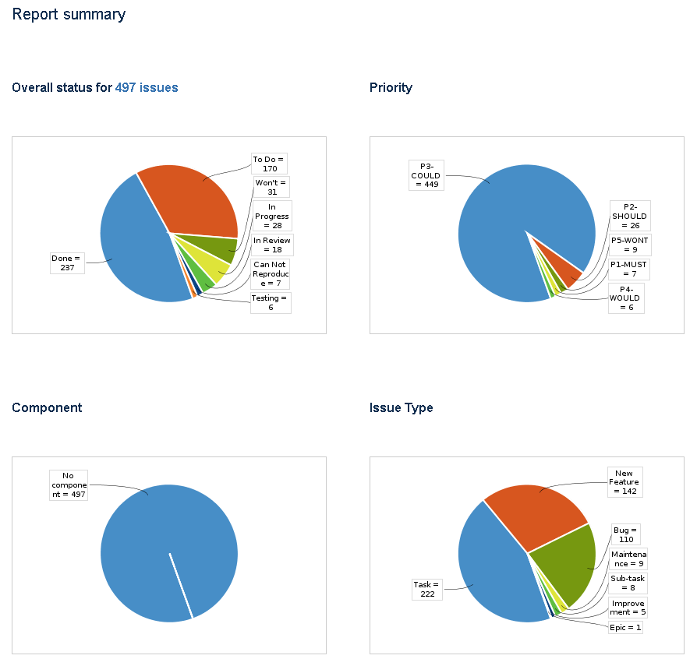
Automatic Project Reports in Intranet
Release notes
Status reports

Slide 38
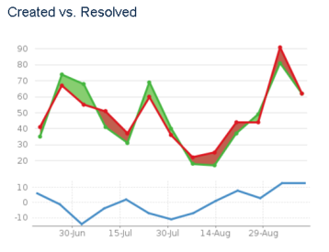
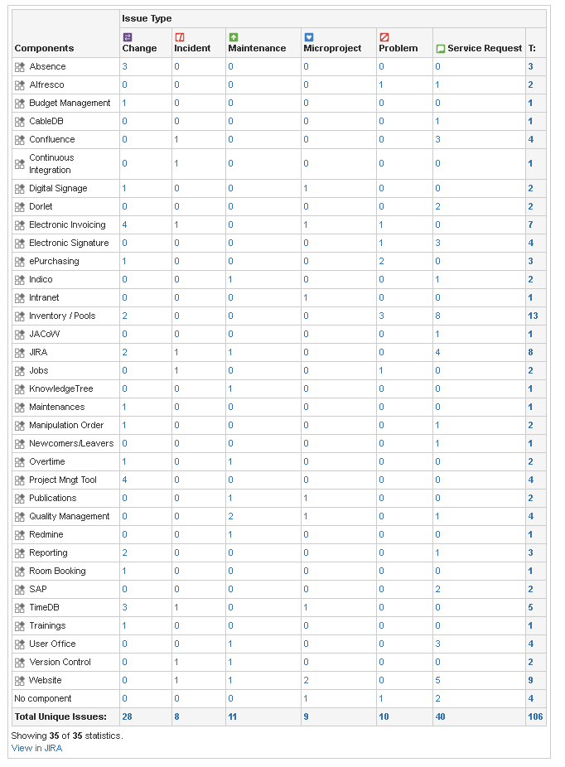
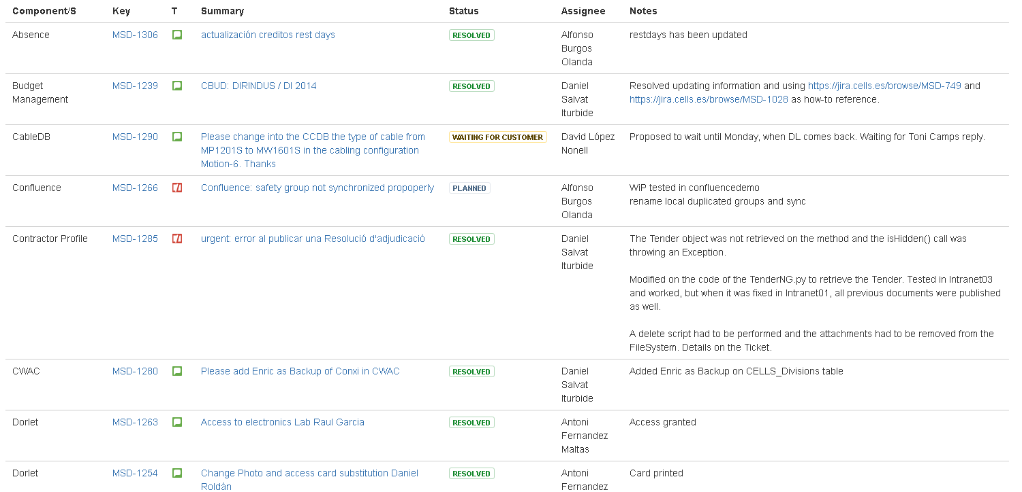
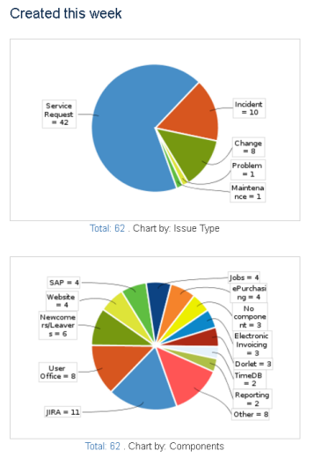
Automatic Service Reports in Intranet
Activity report
Backlog of open issues
Issues planned for the week
Issues with TTR expiring soon
Issues with work logged this week with their status and relevant notes for the team

Slide 39
Collaborative Spaces
Usage Based Structure
Service and Project Management Integration

Slide 40
Document vs. Information
Alfresco
Confluence
Document Management
Advanced site and document permission management
Workflow management
Record management (administration)
Best for document control
Collaborative information
Space permissions
Page tree with inherited permissions
Draft but NO WORKFLOW
Action item tracking
Integration with JIRA
Best for team, project and service management and user information.

