Slide 1
MIK performance at the MAX IV 3 GeV ring and beam dynamics of a MIK for the MAX IV 1.5 GeV ring
Marco Apollonio
MAX IV Laboratory, Lund, Sweden
3rd workshop on low-emittance lattice design
ALBA – Barcelona, June 2022

Slide 2
foreword and layout – why a Multipole Injection Kicker?
reducing the transient stored beam perturbation during (frequent) top-up injections
more and more relevant when moving towards 4th generation low emittance machines
Engineering design by SOLEIL (2012-2017)
  Prototype installed 2017
  Final version since 2019
MIK design and commissioning for the 3 GeV ring
performance:
  high injection efficiency
  high “transparency”
porting the concept to the 1.5GeV ring
  beam dynamics studies
  state of the project
M. Apollonio, LEL-III, ALBA, Barcelona, 2022

Slide 3
MAX IV complex
MAX IV SR in numbers
ring | R3 | R1
lattice type | 7BA – 20 achromats | DBA – 12 achromats
energy (GeV) | 3.0 | 1.5
L (m) / T (μs) | 528 / 1.76 | 96 / 0.32
I_{beam} (mA) | 300 | 400
top-up interval (min) | 10 | 30
ν_{x,y} | 44.20 / 16.28 | 11.22 / 3.15
ξ_{x,y}^{nat} | -49.9 / -50.0 | -24.9 / -16.6
ε_{x} / ε_{y} (pm rad) | 330* / 8 | 5900* / 27
(*) bare lattice
M. Apollonio, LEL-III, ALBA, Barcelona, 2022

Slide 4
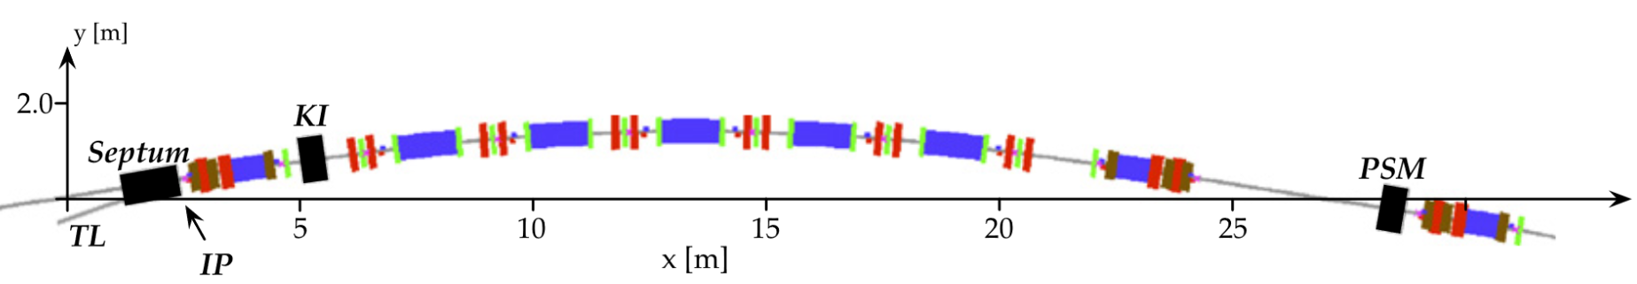
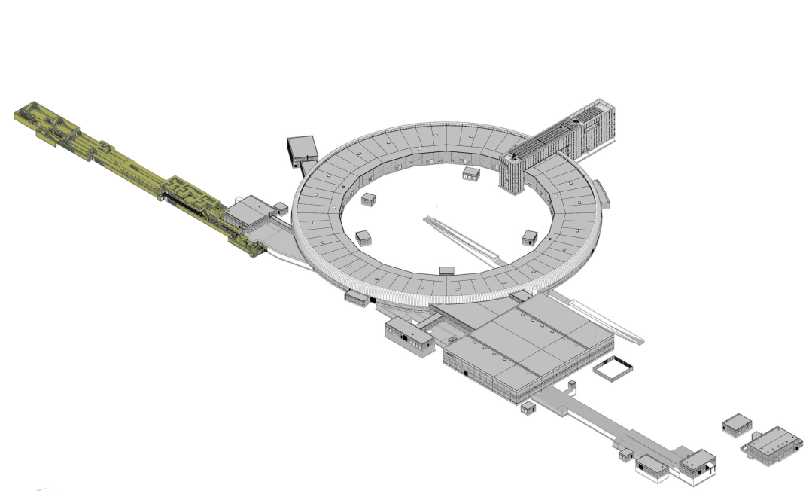
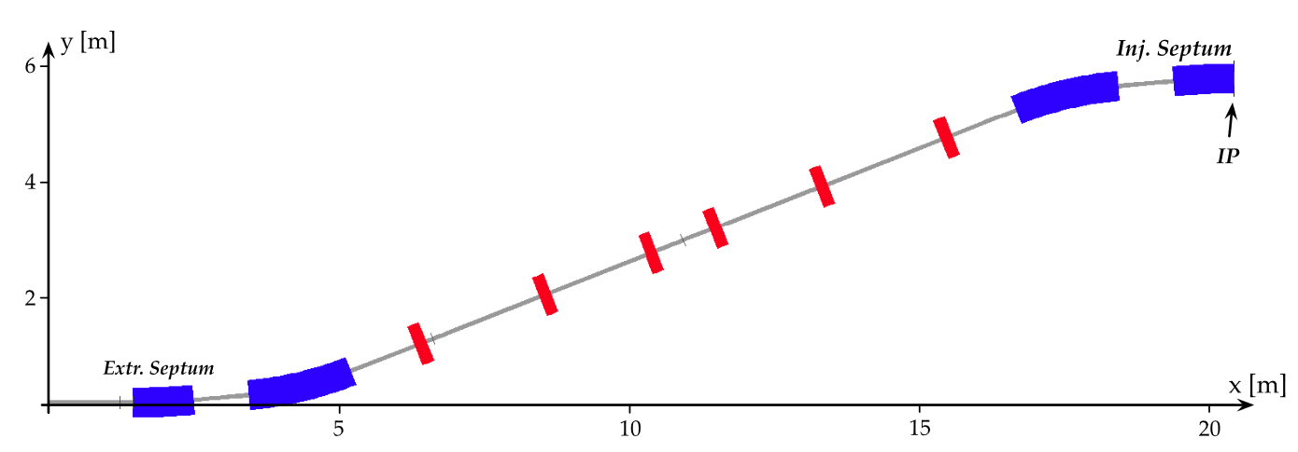
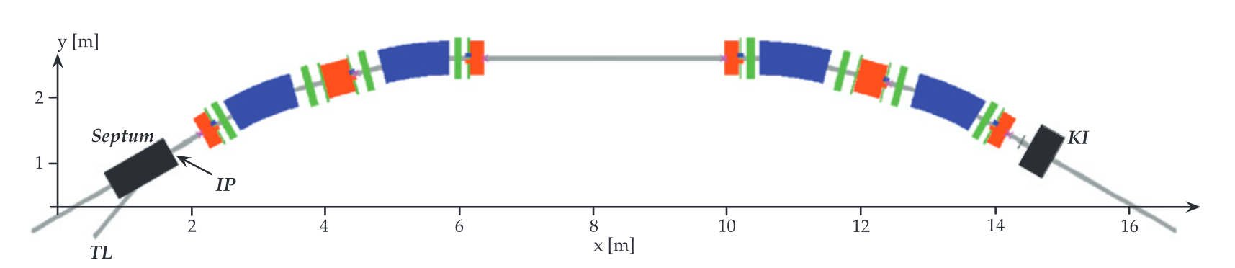
MAX IV complex
3.0 GeV ring
DK
MIK
MIK
DK
septum
new MIK
Vertical Transfer Lines
DK
septum
1.5 GeV ring
DK
MIK

Slide 5
MAX IV complex
Storage Ring INJECTION
 | R3 – 3.0 GeV | R1 – 1.5 GeV
Septum inner / outer wall | -10.0mm / -12.5mm | -13.5mm / -16.0mm
Vertical Extraction Septum bending angle | 5º | 10º
Injection Point (end of septum magnetic field) | 1.90m (from injection straight mid-point) | 1.25m (from injection straight mid-point)
Nominal Injection position (horizontal plane) | -13.5mm | -17.0mm
Present Injection Kicker | Multipole Injection Kicker (28.3m from injection straight mid-point) | Dipole Kicker (14.8m from injection straight mid-point)
Complementary device | Dipole Kicker (5.04m from injection straight mid-point) | -
Future Injection Kicker | - | Multipole Injection Kicker (15.7m from injection straight mid-point)
M. Apollonio, LEL-III, ALBA, Barcelona, 2022

Slide 6
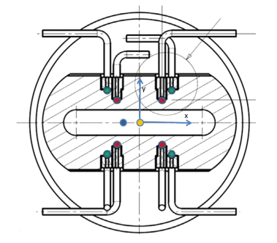
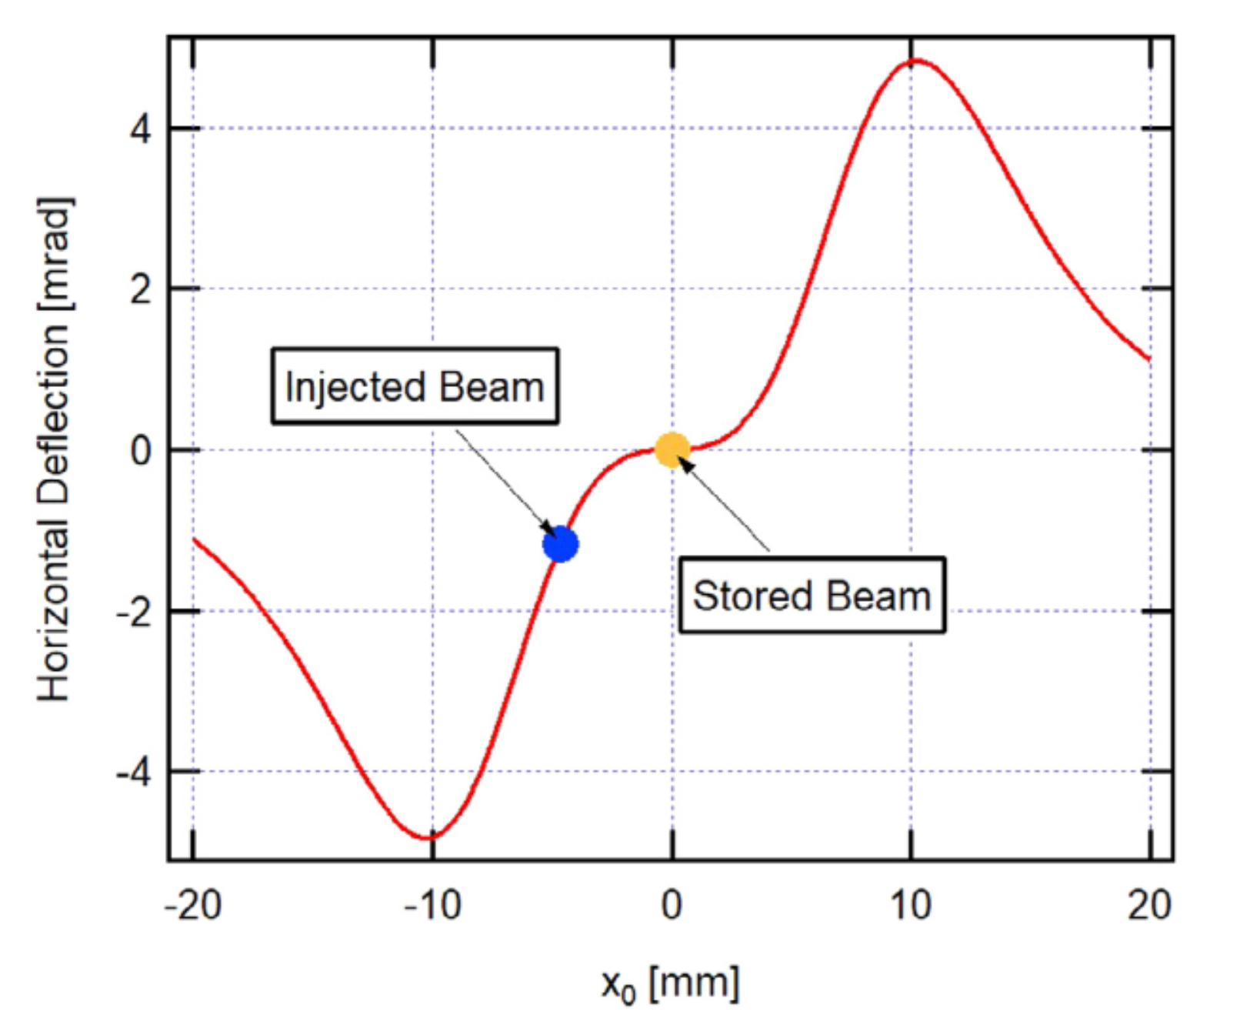
MIK main characteristics
top-up injection [1] of the e-beam into the storage ring without disturbance on stored beam
8 copper rods [2] form the octupole field with “zero” field region at the position of the stored beam
precisely machined monocrystal sapphire ceramic chamber to insure the accurate copper rods positioning
titanium coating of few μm-thick inner surface of the vacuum chamber (image current)
few μs, half sine signal, generated by pulser with repetition rate of up to 10 Hz.
R3 (3GeV) - MIK details
βx / βy (MIK) | 9.4 / 3.8 m
βx / βy (ID long str.) | 9 / 2 m
Injected beam position @MIK (x, y) | (-4.665, 0) mm
MIK deflection angle | -1.176 mrad
L_{MIK} | 30 cm
Nominal pulse duration (half-sine w.f.) | 3.5 μs
Nominal rep. rate | Up to 10 Hz
Integrated Field at inj. Beam position | 11.7 x mT.m
Horiz. / Vert. BSC | 46.8 / 7.8 mm
Peak current (max voltage) | 7kA (15kV)
7.8mm
14mm
20mm
46.8mm
Integrated magnetic field distribution, expressed as a deflection angle of the 3.0 GeV e-beam
MIK cross-section showing the copper rods positions
[1] Patrick Alexandre, Rachid Ben El Fekih, Antoine Letrésor, Serge Thoraud, José da Silva Castro, François Bouvet, Jonas Breunlin, Åke Andersson, and Pedro Fernandes Tavares, Transparent top-up injection into a fourth-generation storage ring,
Nuclear Inst. and Methods in Physics Research, A 986, 164739 (2021).
[2] T. Atkinson, M. Dirsat, O. Dressler, P. Kuske, H. Rast, Development of a non-linear kicker system to facilitate a new injection scheme for the Bessy-II storage ring, in:
IPAC 2011 - 2nd International Particle Accelerator Conference, ISBN:9789290833666, 2011, pp. 3394–3396.
M. Apollonio, LEL-III, ALBA, Barcelona, 2022

Slide 7
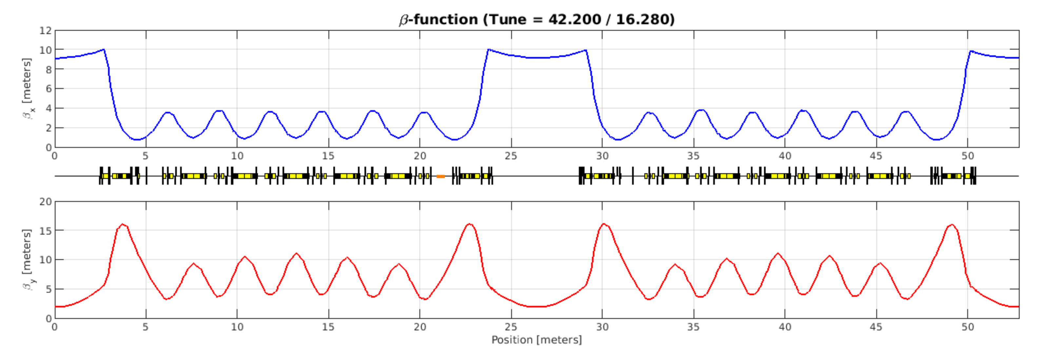
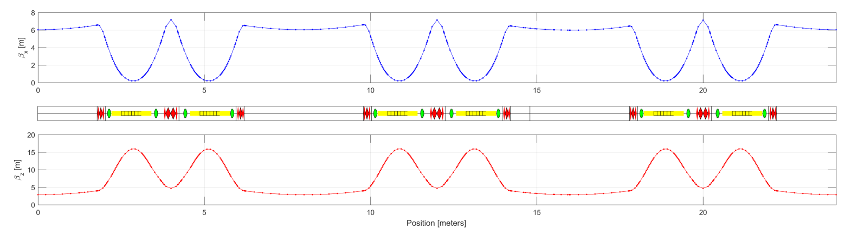
Horizontal Beam Dynamics during MIK injection
Twiss Parameters of 3GeV ring
LINAC emittance @ R3 injection
ε_{X} = 1.7 nm / β_{X} = 9.2m
σ_{X} = 125 μm
Twiss Parameters of 1.5GeV ring
LINAC emittance @ R1 injection
ε_{X} = 3.4 nm / β_{X} = 6.2m
σ_{X} = 145 μm

Slide 8
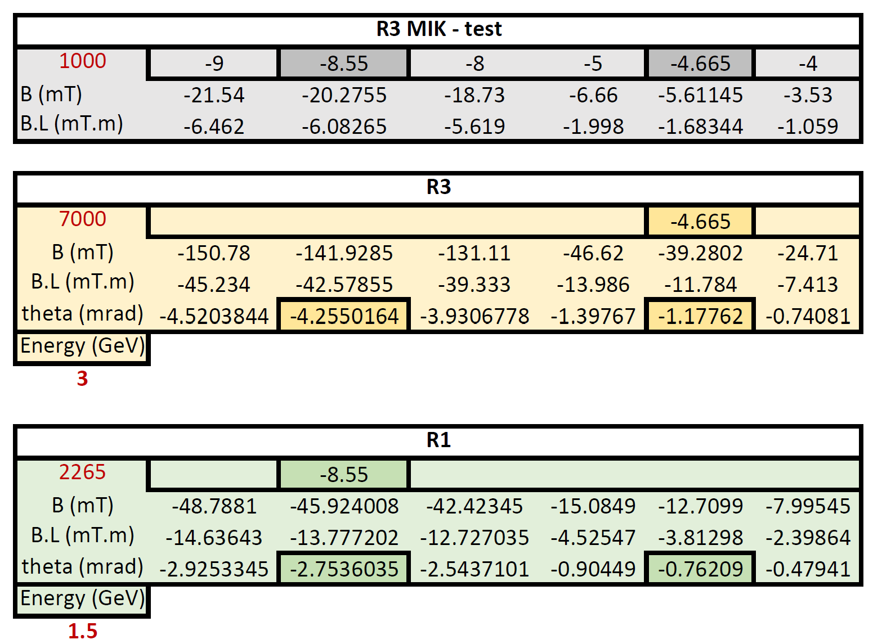
MIK main characteristics – SOLEIL measurements
2D measured map of the integrated field [Internal Short Note on MAXIV MIK-2, Magnetic Measurement Report 13/3/2019, Soleil]
MIK introduced as a KickMap in the AT model
With a beam crossing at -4.665mm MIK@R3 imparts a kick of 1.17mrad This corresponds a current of about 7kA
With a beam crossing at -8.55mm and a reduced beam rigidity, MIK@R1 imparts a kick of -2.75mrad with a peak current of about 2.3kA

Slide 9
MIK @ R3 – 3GeV
M. Apollonio, LEL-III, ALBA, Barcelona, 2022

Slide 10
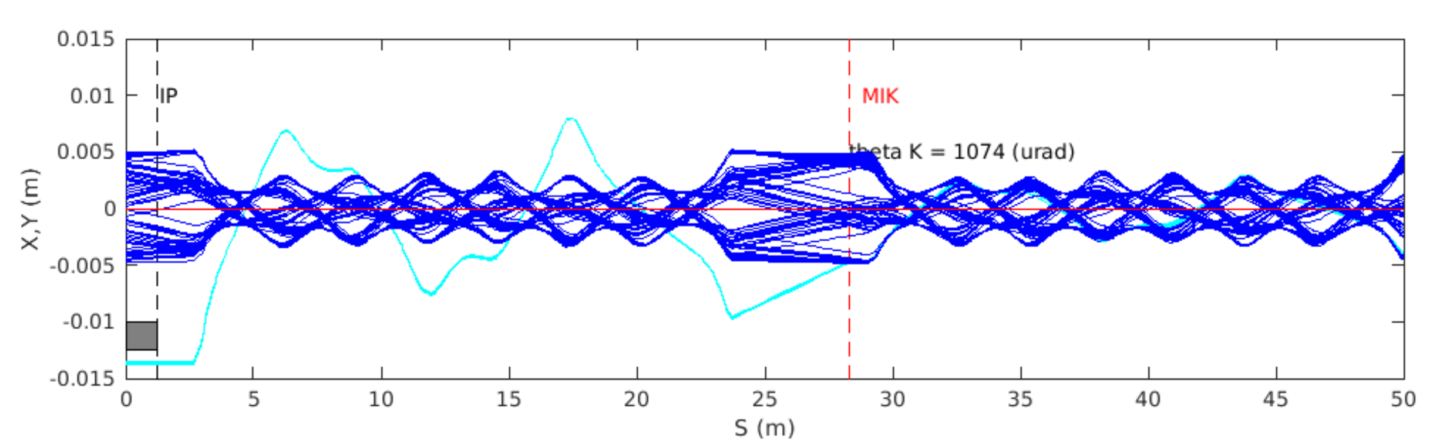
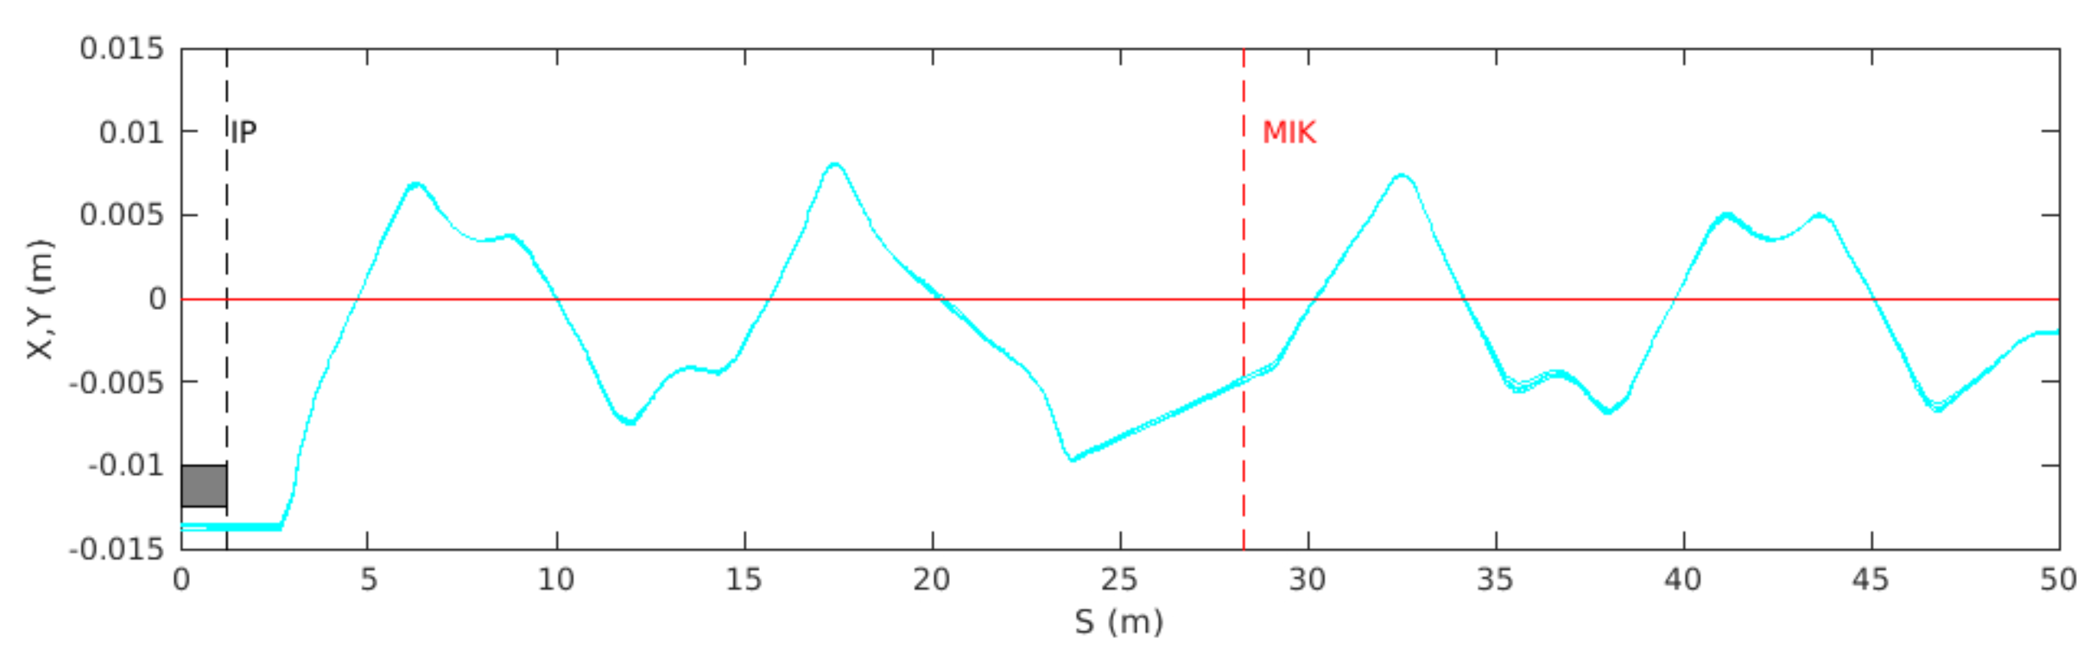
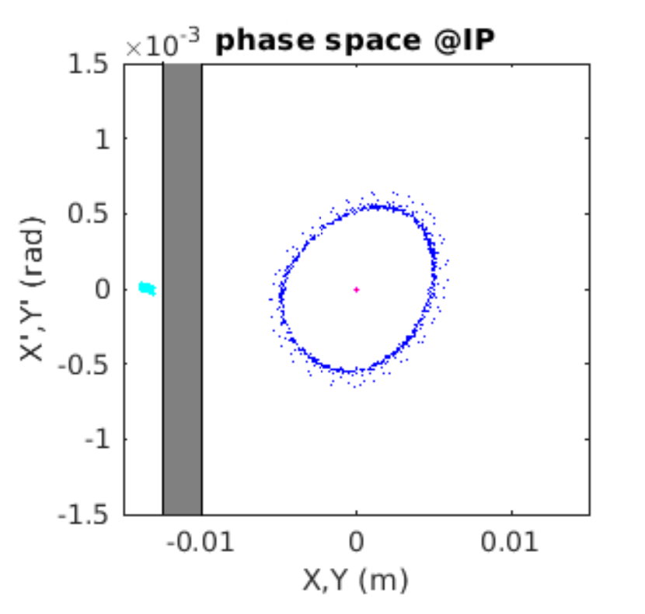
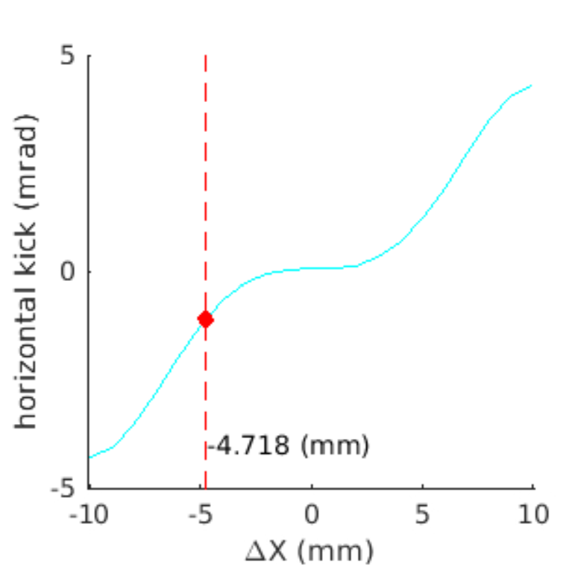
Horizontal Beam Dynamics during MIK injection
AT-model
propagated beam
no-kick: beam lost
injected beam
crossing @MIK crucially defines kick effectiveness
small beam size important to reduce kick spread
M. Apollonio, LEL-III, ALBA, Barcelona, 2022

Slide 11
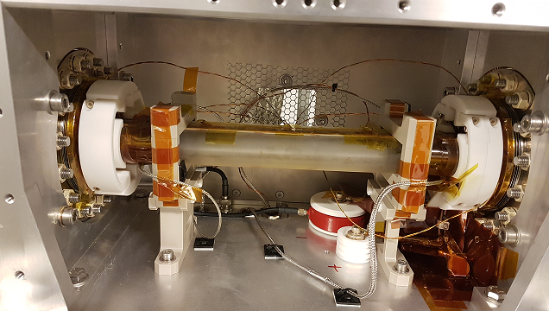
MIK @3.0 GeV ring: MAX IV-Soleil collaboration (2012-2017, 2019)
MIK @ 3.0GeV ring main parameters
Integrated field strength (3.0 GeV, X_{inj}=-4.66 mm, -1.176 mrad) | -11.7 mTm
Pulse duration / Repetition rate | 3.5 µs / up to 10Hz
Pulse peak current | 7 kA @U_{max}=15 kV
prototype installed and successfully commissioned in 3.0 GeV ring (2017) / backup system – Dipole Kicker (BINP)
Chamber #1(Prototype)
coating thickness=0.8 µm ➔ max. measured
surface temperature@250 mA beam= 75°C
replaced by the new chamber #2(final version) in summer 2019
coating thickness 3.5 µm ➔
max. measured surface temperature@ 250mA
beam =47°C
precise positioning of the copper rods ➔
better field quality (wider “zero” field region)
Courtesy of A. Vorozhstov, MAC 11-12-2021, MAX IV
MIK magnet/vacuum chamber installed in 3.0 GeV Ring
10 temperature probes on sapphire chamber
M. Apollonio, LEL-III, ALBA, Barcelona, 2022

Slide 12
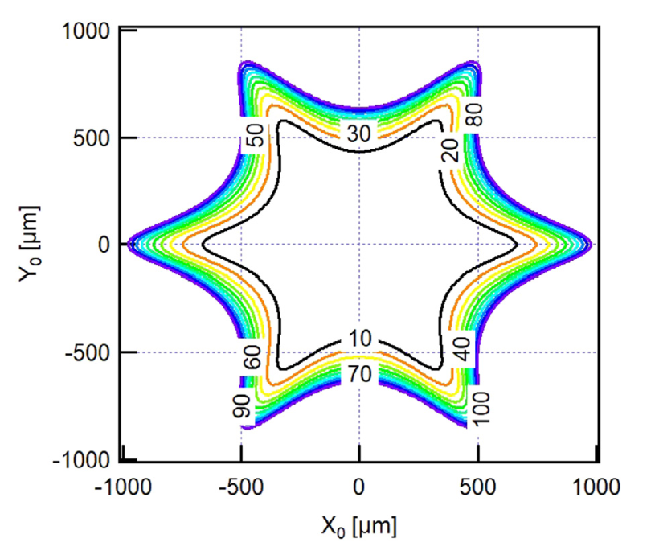
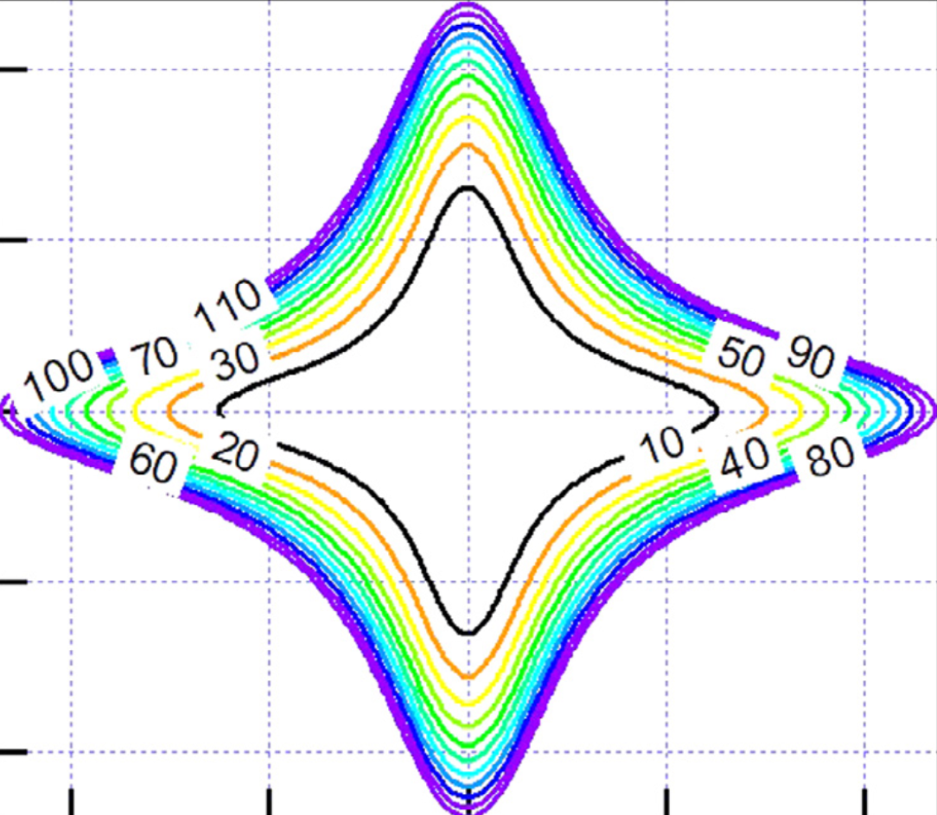
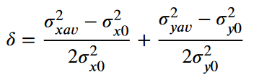
MIK @3.0 GeV ring: performance – stored beam transparency
Map of iso-inflation of the beam size for an ideal MIK with (x0, y0) position shifts
e.g. within 433 μm stored beam inflation less tan 10%
MIK octupolar field outperforms a pulse sextupole injector (originally thought [3] for MAX IV – R3)
[3] S. C. Leemann, Pulsed sextupole injection for Sweden’s new light source MAX IV, Phys. Rev. ST Accel. Beams 15, 050705 – Published 8 May 2012
M. Apollonio, LEL-III, ALBA, Barcelona, 2022

Slide 13
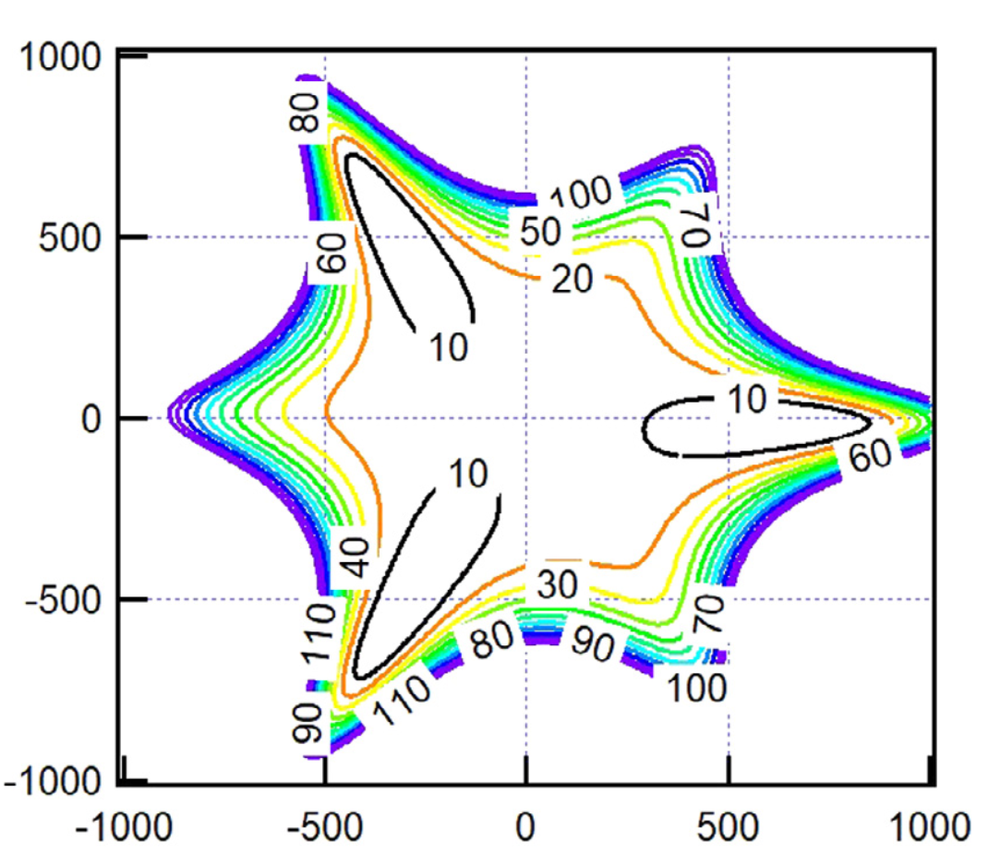
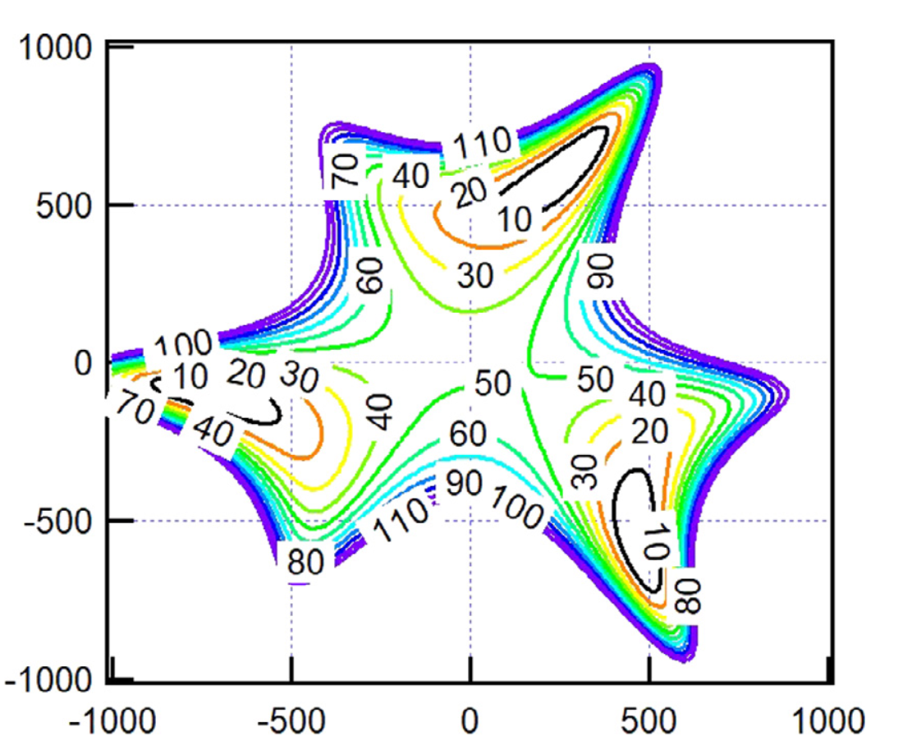
MIK @3.0 GeV ring: performance – stored beam transparency
effect of rod mis-alignments
δ = 20 μm displacement
20 μm (x,y) RMS
M. Apollonio, LEL-III, ALBA, Barcelona, 2022

Slide 14
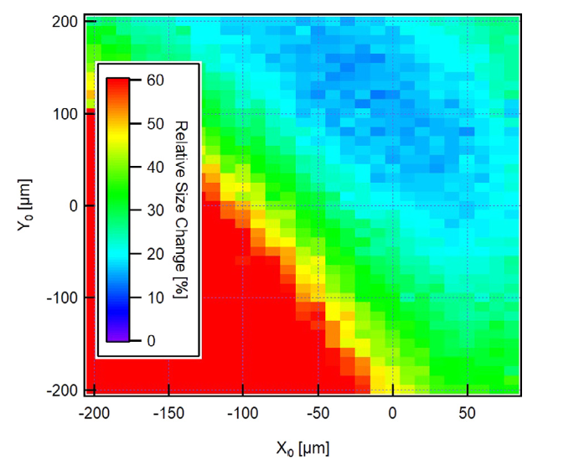
MIK @3.0 GeV ring: performance – measured residuals
Identifying optimal working point
minimal perturbation on Stored Beam
scan in (X,Y) while pulsing MIK (2019 final device)
beam size measured by Diagnostic BL synchronized with MIK pulse
camera integration time: compromise between fast acquisition and good S/N
TbT data from 40 + 40 BPMs
Measurement Details
3mA
bunch train (10 bunches) < 100ns
  kick almost uniform within 0.1%
Initial coarse scan with single CM
  MIK re-aligned by
  (-600 μm, -500 μm)
  finer scans w. closed bumps
measured residual perturbation map
M. Apollonio, LEL-III, ALBA, Barcelona, 2022

Slide 15
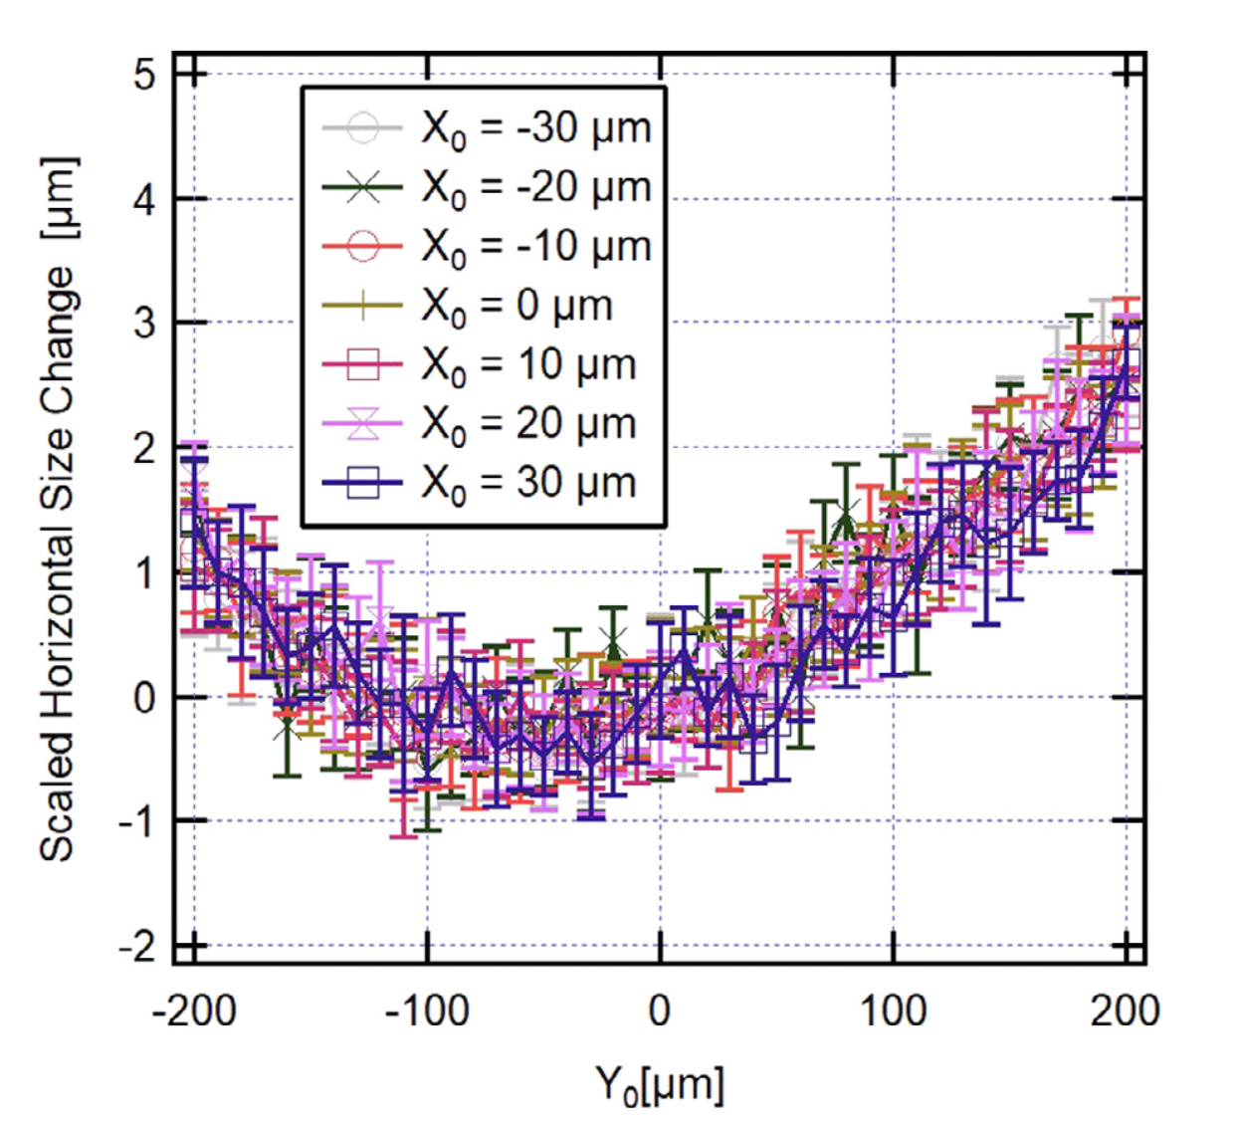
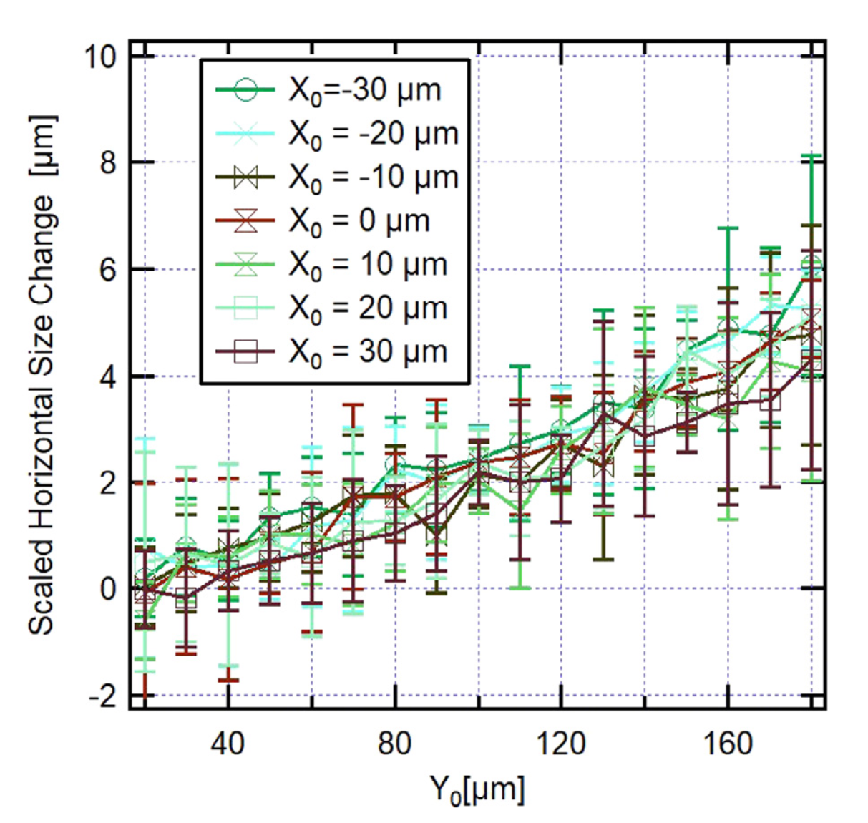
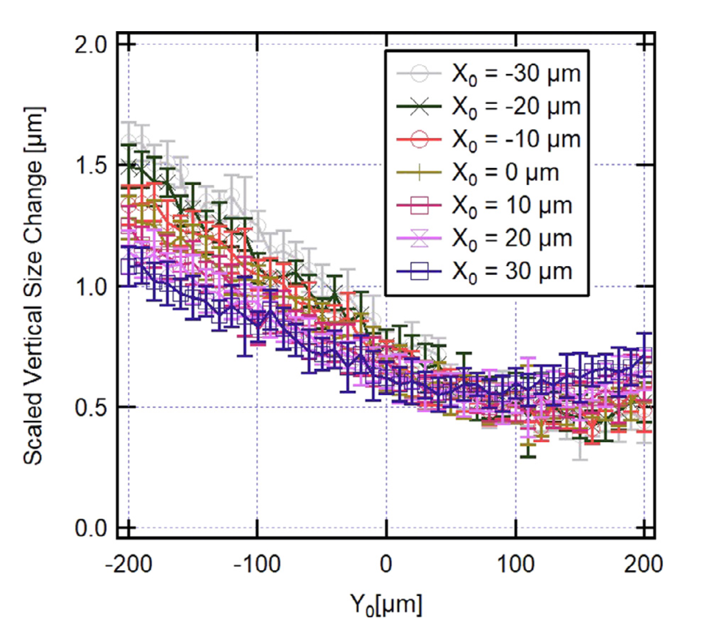
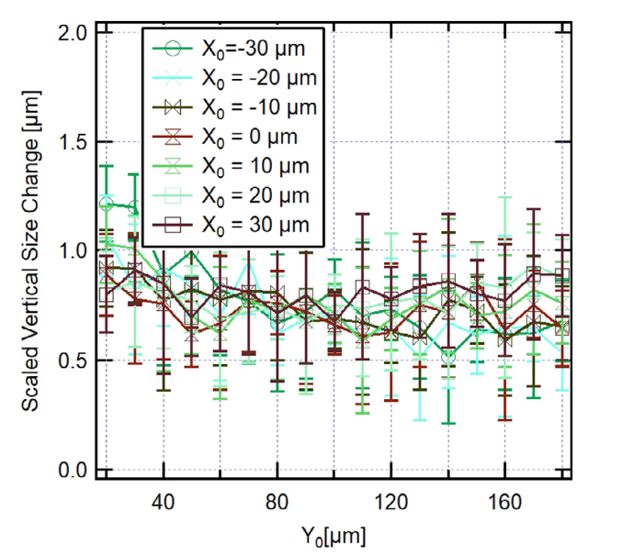
MIK @3.0 GeV ring: performance – MIK “transparency”
“MIK transparency”
beam size variation when operating the kicker
(sub)-μm H/V beam size variation achieved
slow camera acquisition: 4.4ms (2500 turns)
fast camera acquisition: 0.25ms (150 turns)
Vertical stored beam size change caused by pulsing the MIK, 𝛿𝜎_{𝑦}=0.6±0.1 𝜇𝑚
M. Apollonio, LEL-III, ALBA, Barcelona, 2022

Slide 16
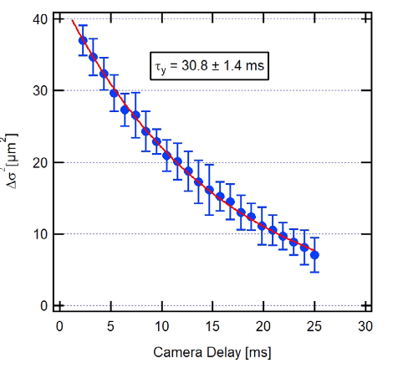
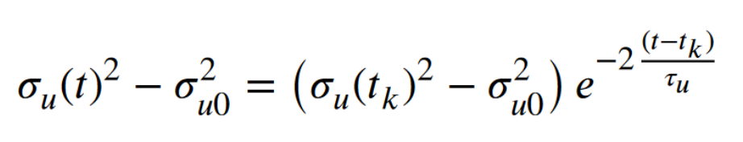
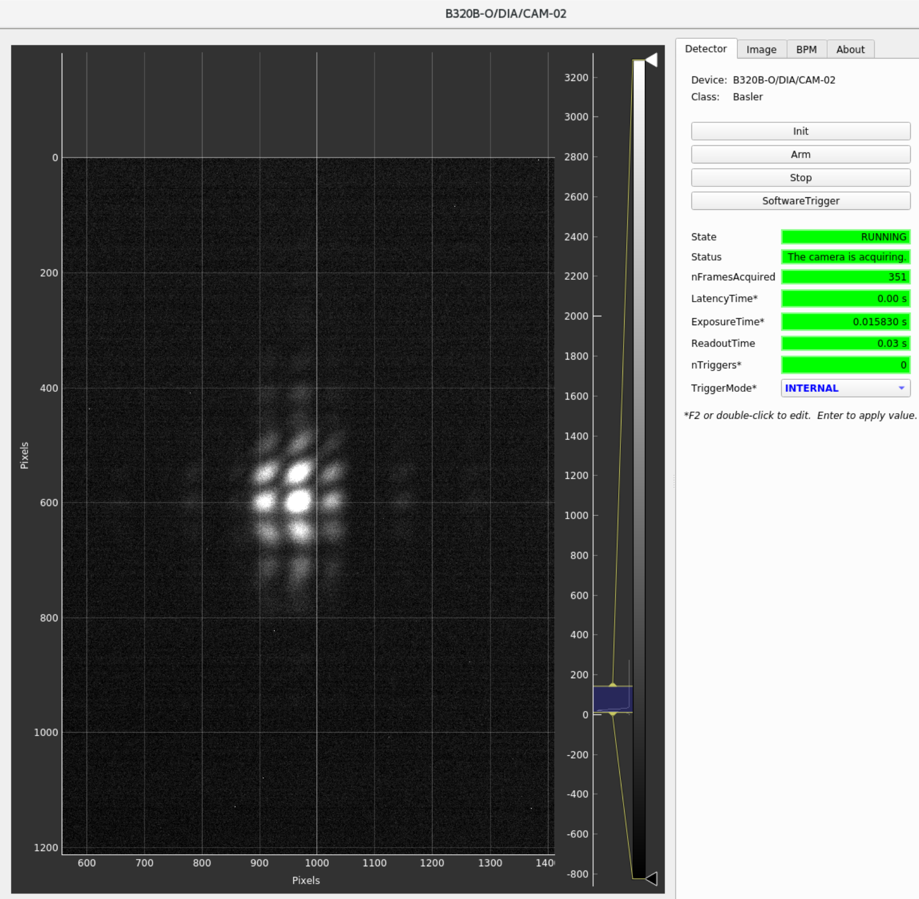
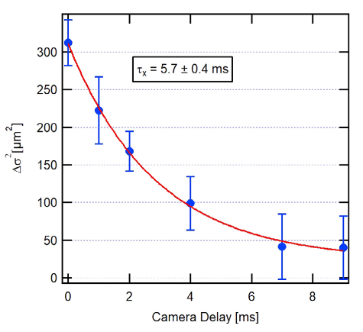
MIK @3.0 GeV ring: performance – measured damping times
measured damping times
diag. camera synch’d to acquire at given delay w.r.t. MIK pulse trigger
τ_{y}^{th} = 29ms
τ_{ξ}^{th} = 16ms
MIK pulse
(t=t_{K})
t (ms)
NB: beam moved out of soft spot to enhance signal
M. Apollonio, LEL-III, ALBA, Barcelona, 2022

Slide 17
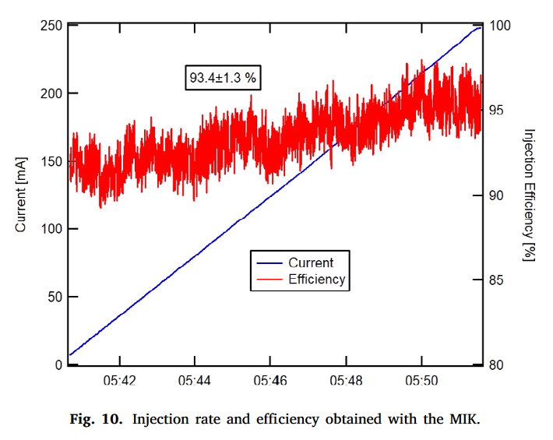
MIK @3.0 GeV ring: performance – injection efficiency
injection efficiency [1] between 92 and 94% (improving at larger currents)
M. Apollonio, LEL-III, ALBA, Barcelona, 2022

Slide 18
MIK @ R1 – 1.5GeV
M. Apollonio, LEL-III, ALBA, Barcelona, 2022

Slide 19
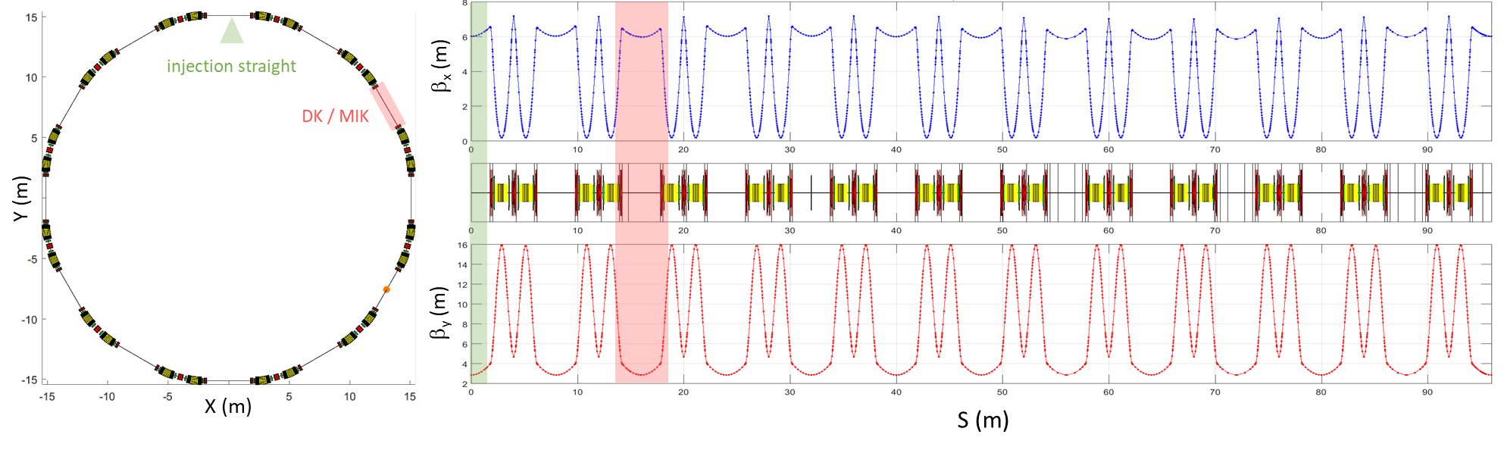
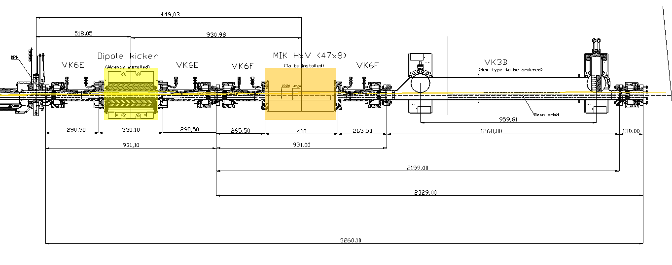
porting the MIK injector to the 1.5 GeV ring
R1 (1.5 GeV) - MIK details
βx / βy (MIK) | 6.2 / 3.8 m
βx / βy (ID long str.) | 5.99 / 2.87 m
Injected beam position @MIK (x, y) | (-8.55, 0) mm
MIK deflection angle (1st) – double shot | S1: +2.75 mrad S2: +2.40 mrad
L_{MIK} | 30 cm
Nominal pulse duration (half-sine w.f.) | 1.28 μs
Nominal rep. rate | Up to 10 Hz
Integrated Field at inj. Beam position | +13.7 mT.m
Horiz. / Vert. BSC | 46.8 / 7.8 mm
Peak current (max voltage) | 5kA (24kV)
NB: MIK@R1 more challenging than @R3
Large peak current
Shorter pulse
Double kick
project to implement transparent injection into the 1.5 GeV Ring started in 2021
M. Apollonio, LEL-III, ALBA, Barcelona, 2022

Slide 20
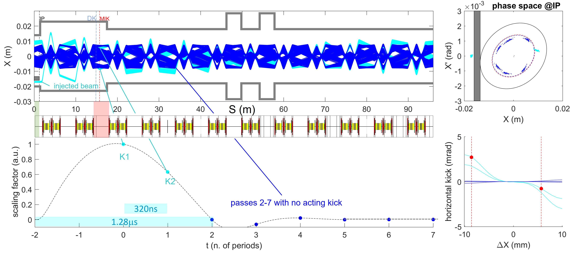
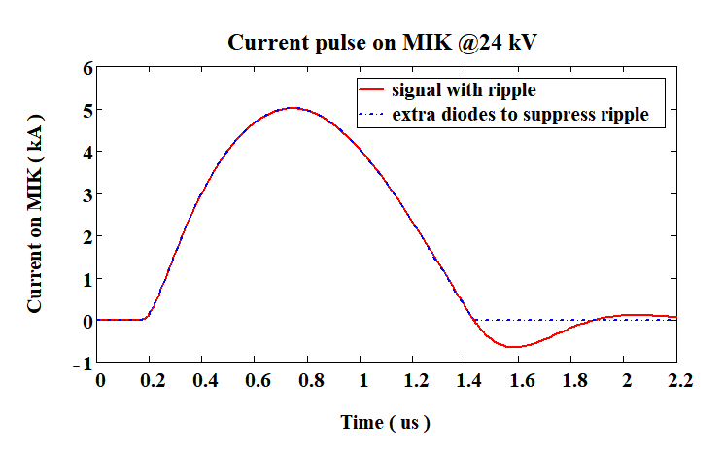
MIK @1.5 GeV ring: injection dynamics [3]
MIK kick map
[Internal Short Note on MAXIV MIK-2, Magnetic Measurement Report 13/3/2019, Soleil]
Matlab-AT model
+2.75mrad
-0.87mrad
Courtesy of A. Vorozhstov,
MAC 11-12-2021, MAX IV
[4] M. Apollonio, Å. Andersson, M. Brosi, D. K. Olsson, P. F. Tavares, A. S. Vorozhstov, Beam Dynamics of the Transparent Injection for the MAX IV 1.5 GeV Ring, In Proc. IPAC22, MOPOPT022
M. Apollonio, LEL-III, ALBA, Barcelona, 2022

Slide 21
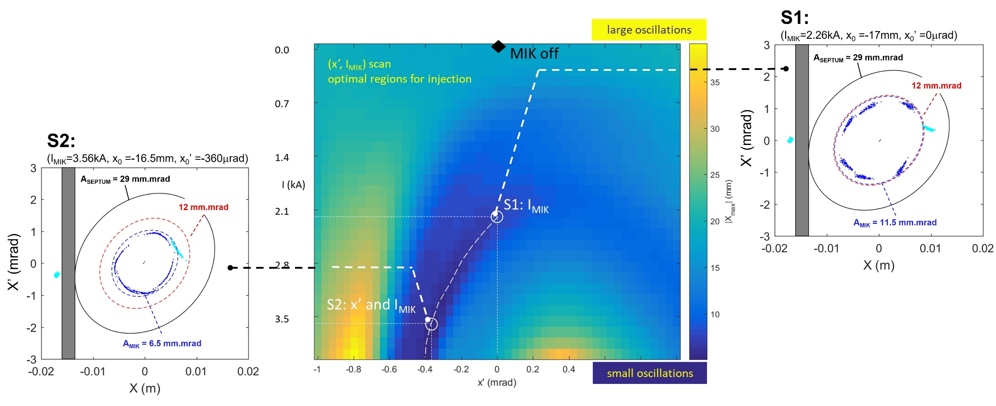
MIK @1.5 GeV ring: optimisation
Parameter scan on transfer line exit angle and MIK peak current: (x’_{inj}, I_{beam})
Full optimization on transfer line parameters and MIK peak current: (x_{inj}, x’ _{inj}, I_{beam})
Courant-Snyder invariant compression
M. Apollonio, LEL-III, ALBA, Barcelona, 2022

Slide 22
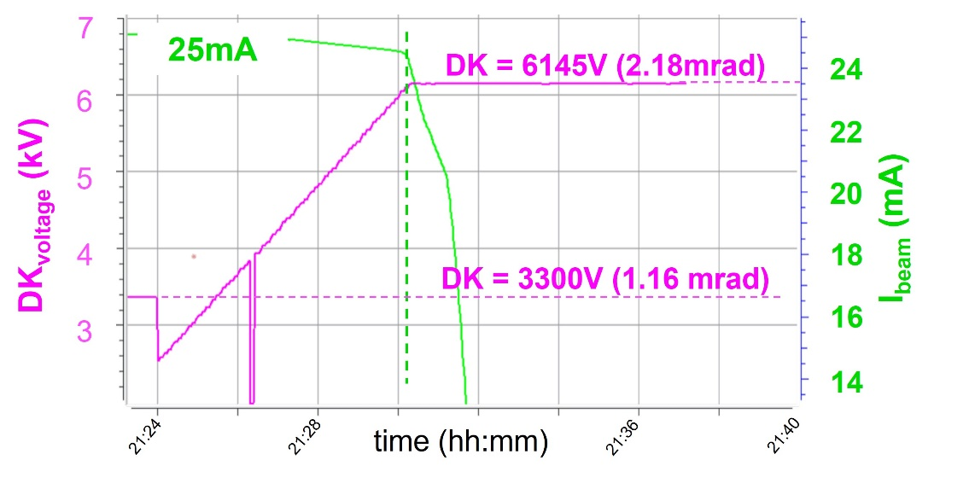
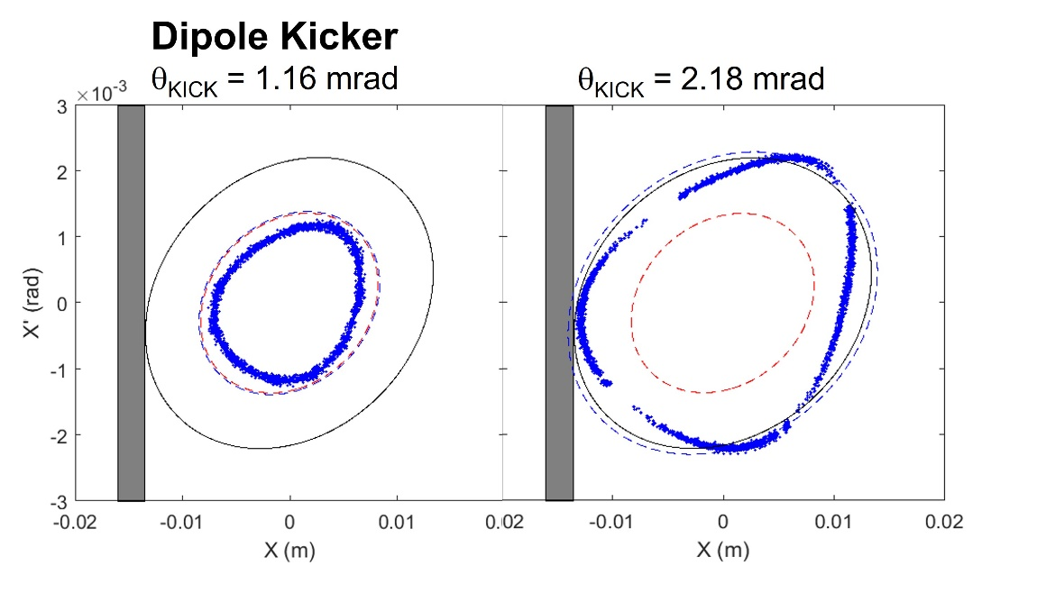
MIK @1.5 GeV ring: real machine acceptance
Machine test to assess real acceptance prior to installation of the device
Stored beam excited with DK at growing voltages (kicking angles)
Beam current sudden drop at θ_{DK} = 2.18 mrad
Simulation with DK injection predicts injected beam touches septum inner wall at about the same kicking angle
This corresponds to A = 29 mm.mrad, well above the 11.5 mm.mrad needed for solution S1
Conclusion: no evident issue to install MIK in straight-3
M. Apollonio, LEL-III, ALBA, Barcelona, 2022

Slide 23
CONCLUSIONS
R3 - MIK
MAX IV installed and commissioned a MIK prototype in 2017
Swapped (2019) with a better and fully operating a MIK (top-up period 10min)
Designed/built at SOLEIL
  pure crystalline sapphire chamber (Kyocera)
  machining and rod-positioning crucial for field definition
  Ti-coating thickness important to reduce temperature in operation
Injection Efficiency at large current: >94% (commissioning) / >90% (today)
Sub-μm transparency
Anecdotical feedback of good performance from beamlines
  No BL using gating / no issue claimed / happy with top-up interval (30min → 10min)
R1 - MIK
Design closely following MIK @R3, although we will operate with a shorter pulse
  two-turn kick due to short length of R1
R3 prototype device ready to be installed → summer shutdown
  2 spare chambers considered
pulser / electronics for control may undergo some delay
M. Apollonio, LEL-III, ALBA, Barcelona, 2022

Slide 24
Thanks for your attention …
M. Apollonio, LEL-III, ALBA, Barcelona, 2022

Slide 25
… spares
M. Apollonio, LEL-III, ALBA, Barcelona, 2022

Slide 26
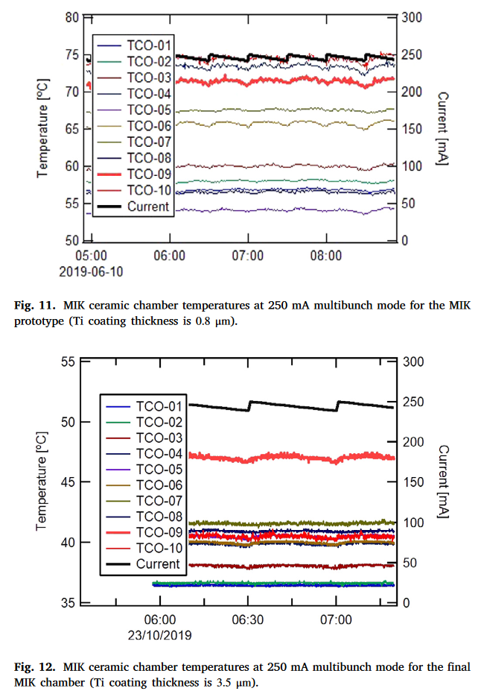
MIK @3.0 GeV ring: performance – control of temperatures
MIK ceramic temperatures at 250mA multi-bunch mode
tolerance: 120 ºC
Prototype 2017 – Ti thickness: 0.8 μm
T = [55, 75] ºC
analysis of effects of eddy currents
Final Chamber 2019 – Ti thickness: 3.5 μm
T = [35, 48] ºC
M. Apollonio, LEL-III, ALBA, Barcelona, 2022

Slide 27
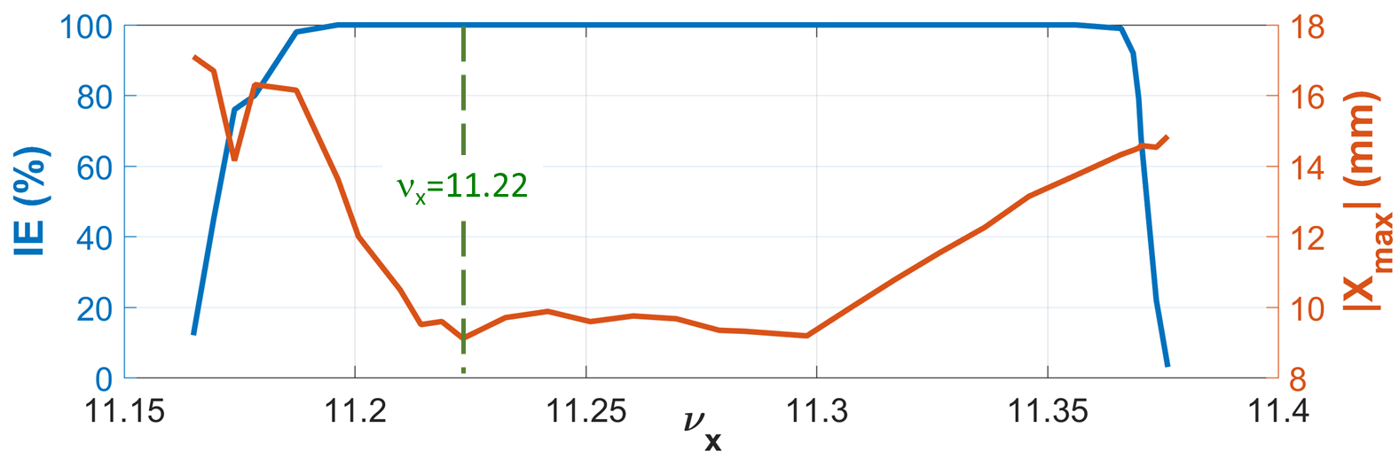
MIK @1.5 GeV ring: tune resilience
Tune shifts may be a either a deliberate choice or e.g.the result of non completely compensated variations of ID gaps.
Studies show that a simulated injection with the MIK for chosen optimized solution (e.g. S1) is unaffected by horizontal tune variations between 11.19 and 11.37
M. Apollonio, LEL-III, ALBA, Barcelona, 2022

Slide 28
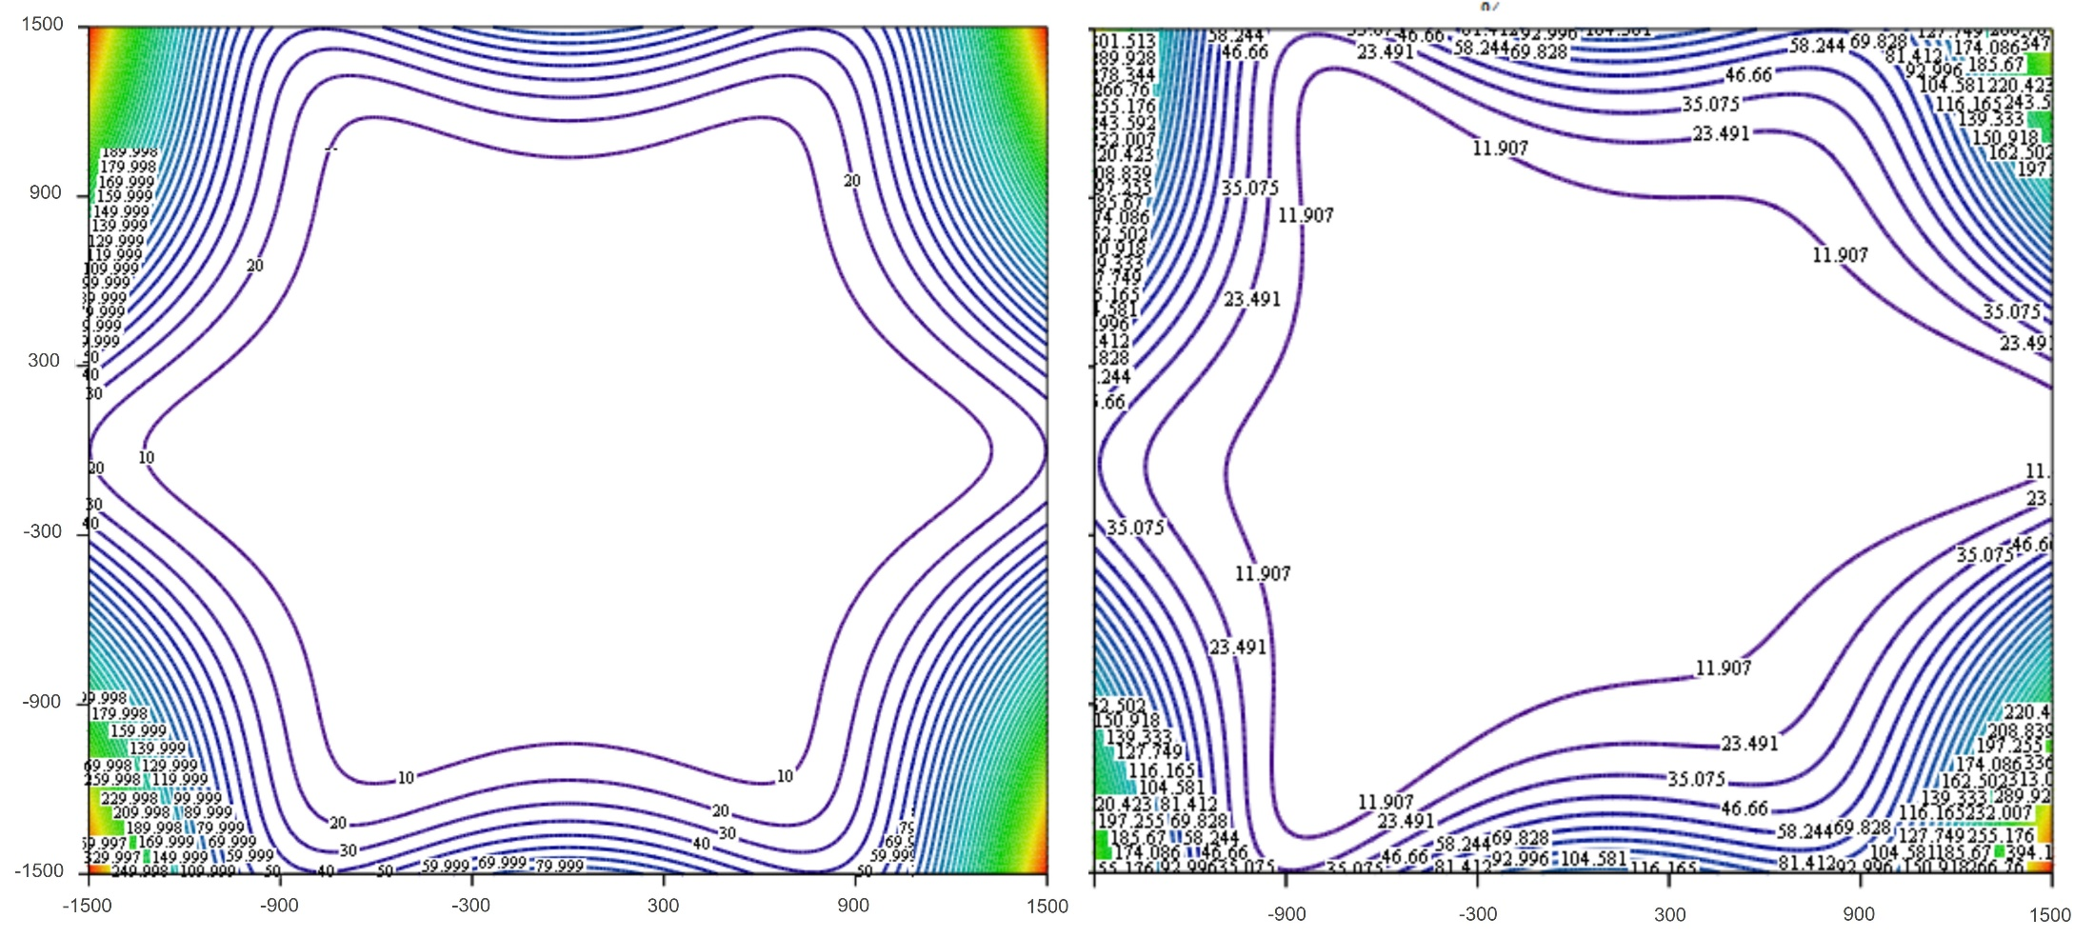
MIK @1.5 GeV ring: stored beam transparency
effect of rod mis-alignments (preliminary): one rod moved by 50μm
Beam inflation less pronounced than the low-emittance case
MIK @R1 less demanding in mechanical tolerance
M. Apollonio, LEL-III, ALBA, Barcelona, 2022

Slide 29
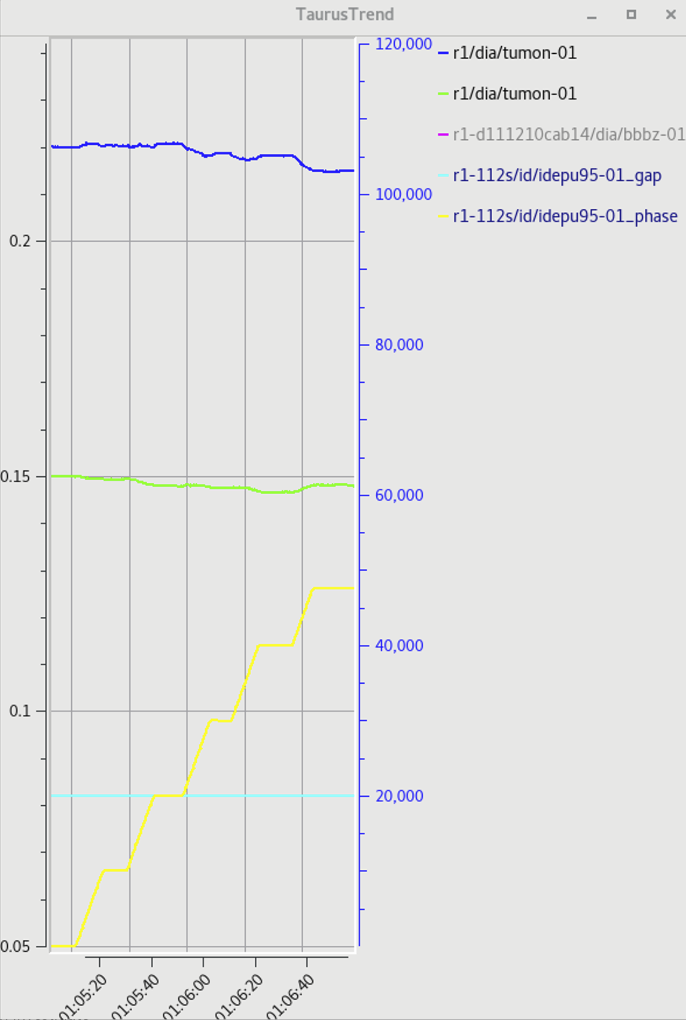
M. Apollonio, LEL-III, ALBA, Barcelona, 2022

