Slide 1


SC - A Toolkit for Simulated Commissioning
Thorsten Hellert
LEL 2022 – 3rd Workshop on Low Emittance Lattice Design
ALBA, Barcelona, 27.06.22

Slide 2
Table of Contents
Introduction:
  Sensitivity of ALS-U storage ring performance to BBA accuracy
  Need for realistic error modelling and correction scripts during lattice design phase
Toolkit Design Features
  Workflow
  Error model
  Documentation and examples
Commissioning Tests at ALS:
  First steps of integrating SC toolkit and Matlab Middle Layer (MML)

Slide 3
Introduction

Slide 4
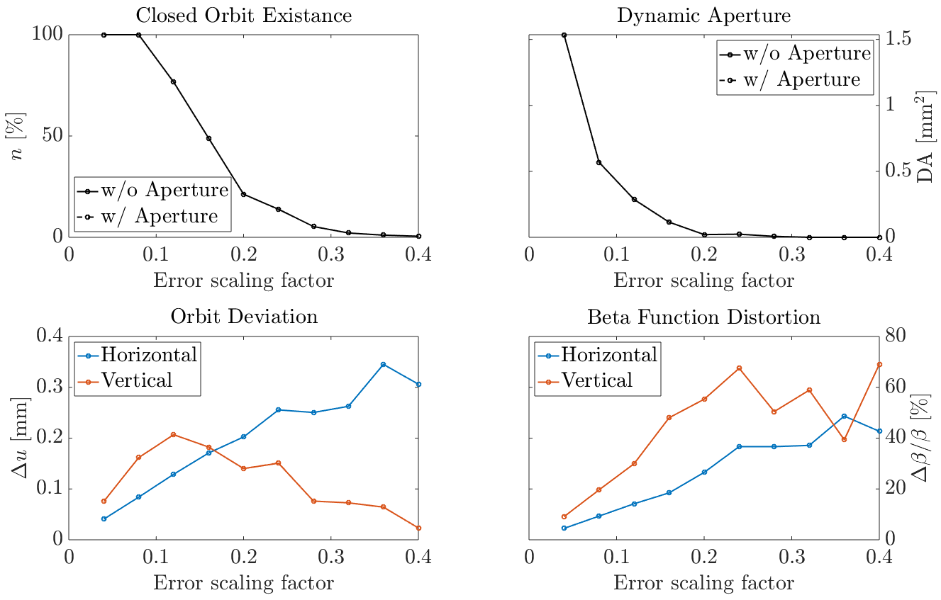
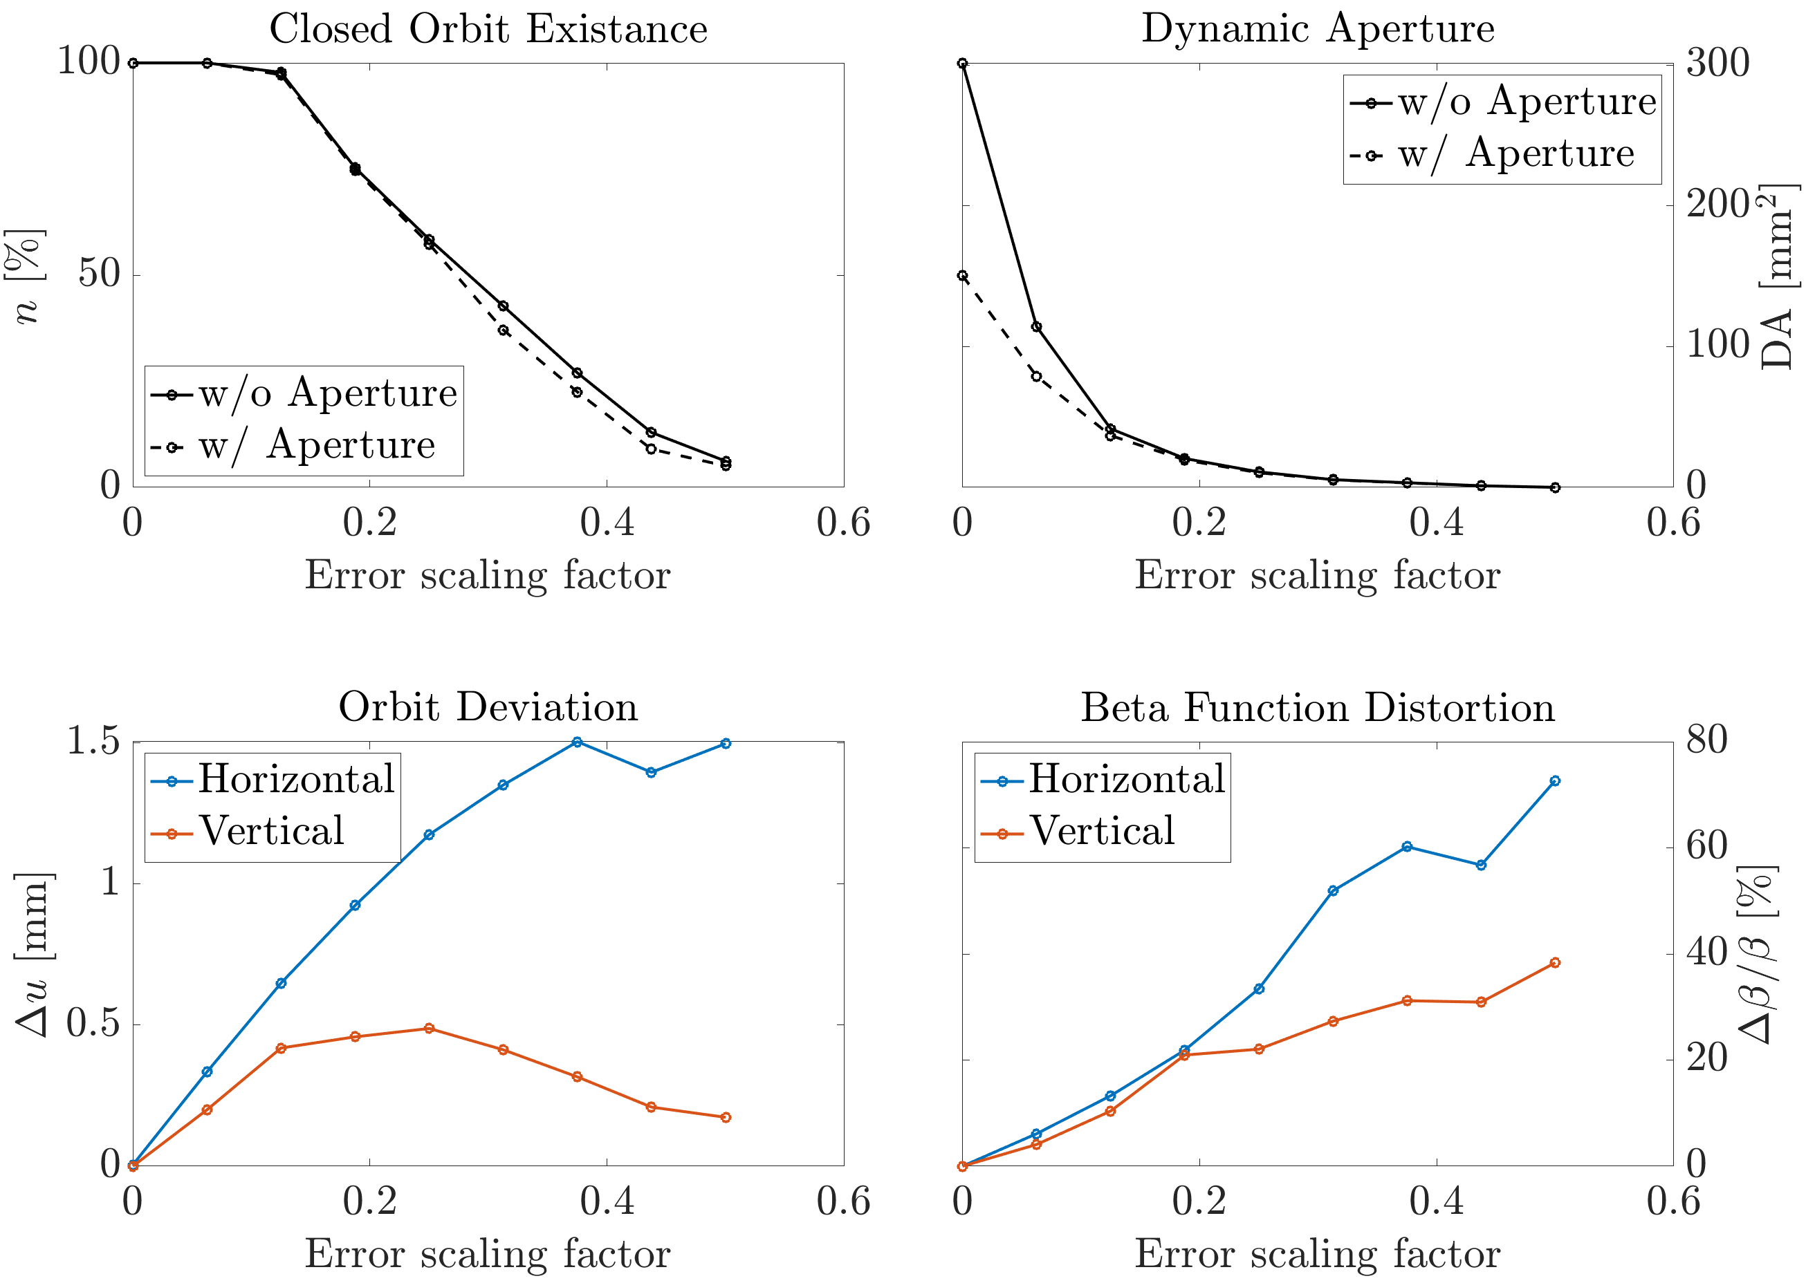
Conventional Methods For Establishing Error Tolerances Don’t Work
  ALS-U Storage Ring
  PETRA-IV
Unstable lattice when including errors without correction

Slide 5
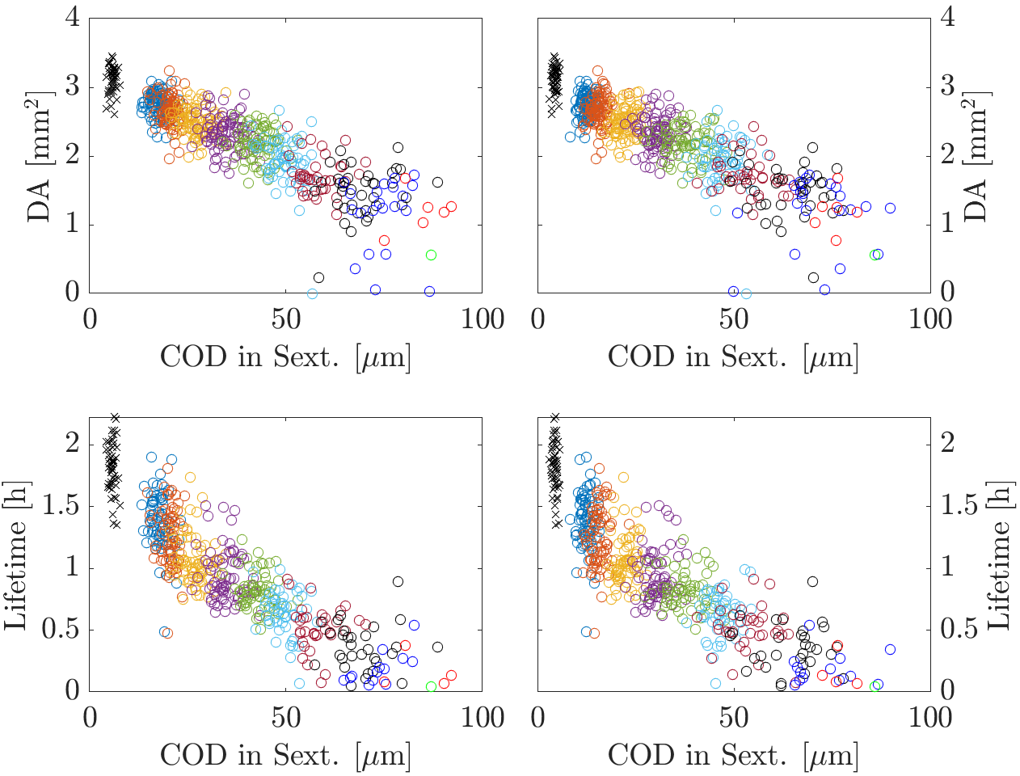
Lattice Performance Degradation due to Sextupole Offsets at ALS-U SR
Errors included in all commissioning simulations:
  RF, Injection, Diagnostic
  Sys. multipoles, magnet strength and roll errors
Errors varied in simulations:
  Girder and magnet offset
  Simulated BBA accuracy
Findings:
  Correlation between pre-LOCO closed orbit deviation in sextupole magnets and post-LOCO performance
  Lifetime virtually zero above COD of 50 µm rms
Conclusion:
  Small COD in sextupoles crucial for lattice performance
Different data sets

Slide 6
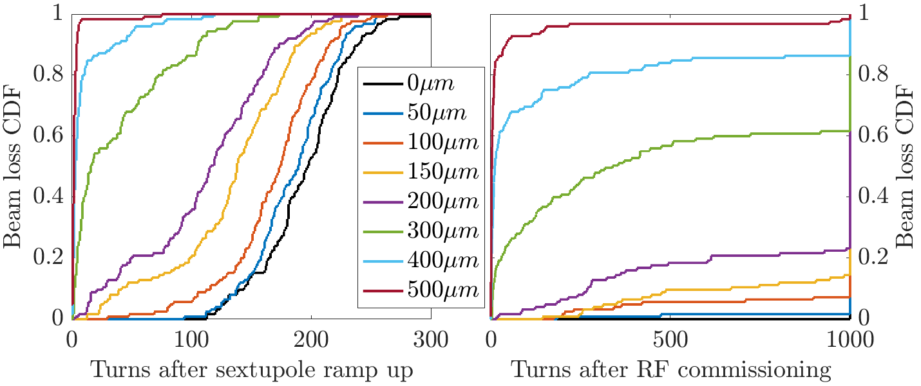
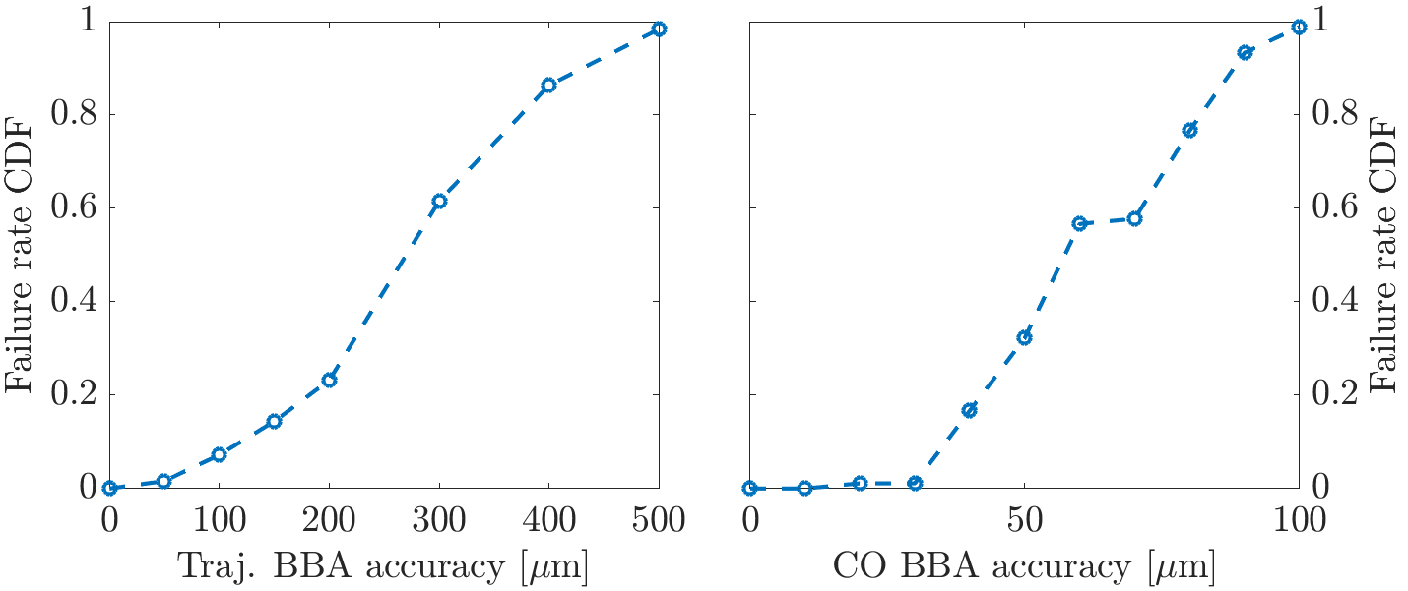
Demanding BPM Offset Requirements During Commissioning
Errors included in all commissioning simulations:
  RF, Injection, Diagnostic
  Sys. multipoles, magnet strength and roll errors
  Magnet and Support Structure Misalignments
Errors varied in simulations:
  Simulated turn-by-turn and stored beam BBA accuracy
Findings:
  Achievable number of turns strongly dependent on turn-by-turn BBA accuracy, 500um rms BPM offset not feasible
  Stored beam BBA accuracy <35um needed to successfully perform optics correction
Conclusion:
  Realistic modelling of (turn-by-turn) BBA procedure required in commissioning simulation

Slide 7
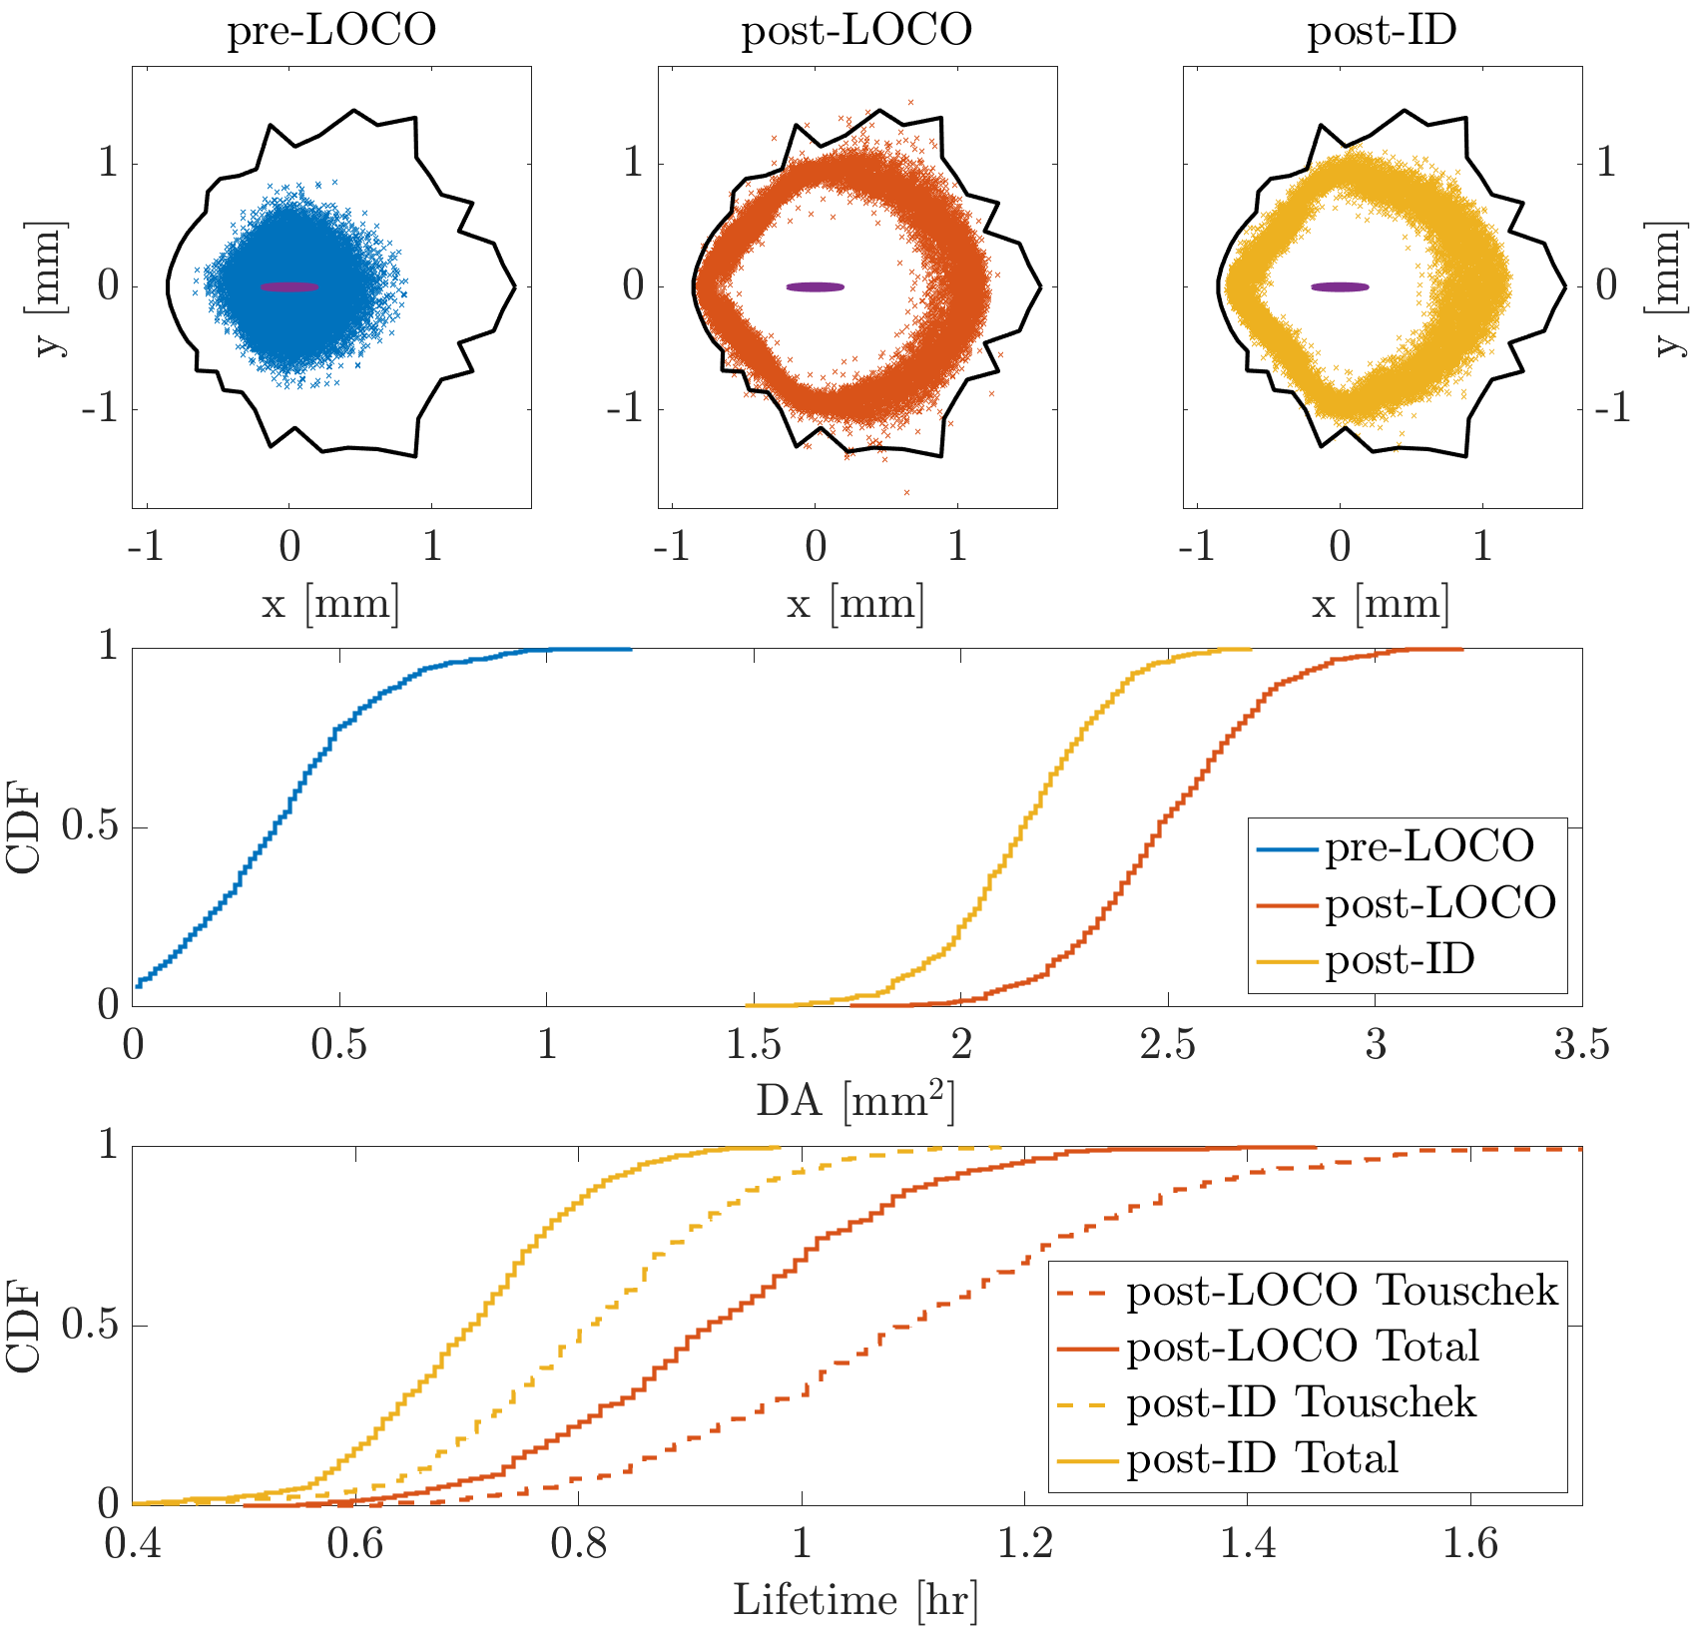
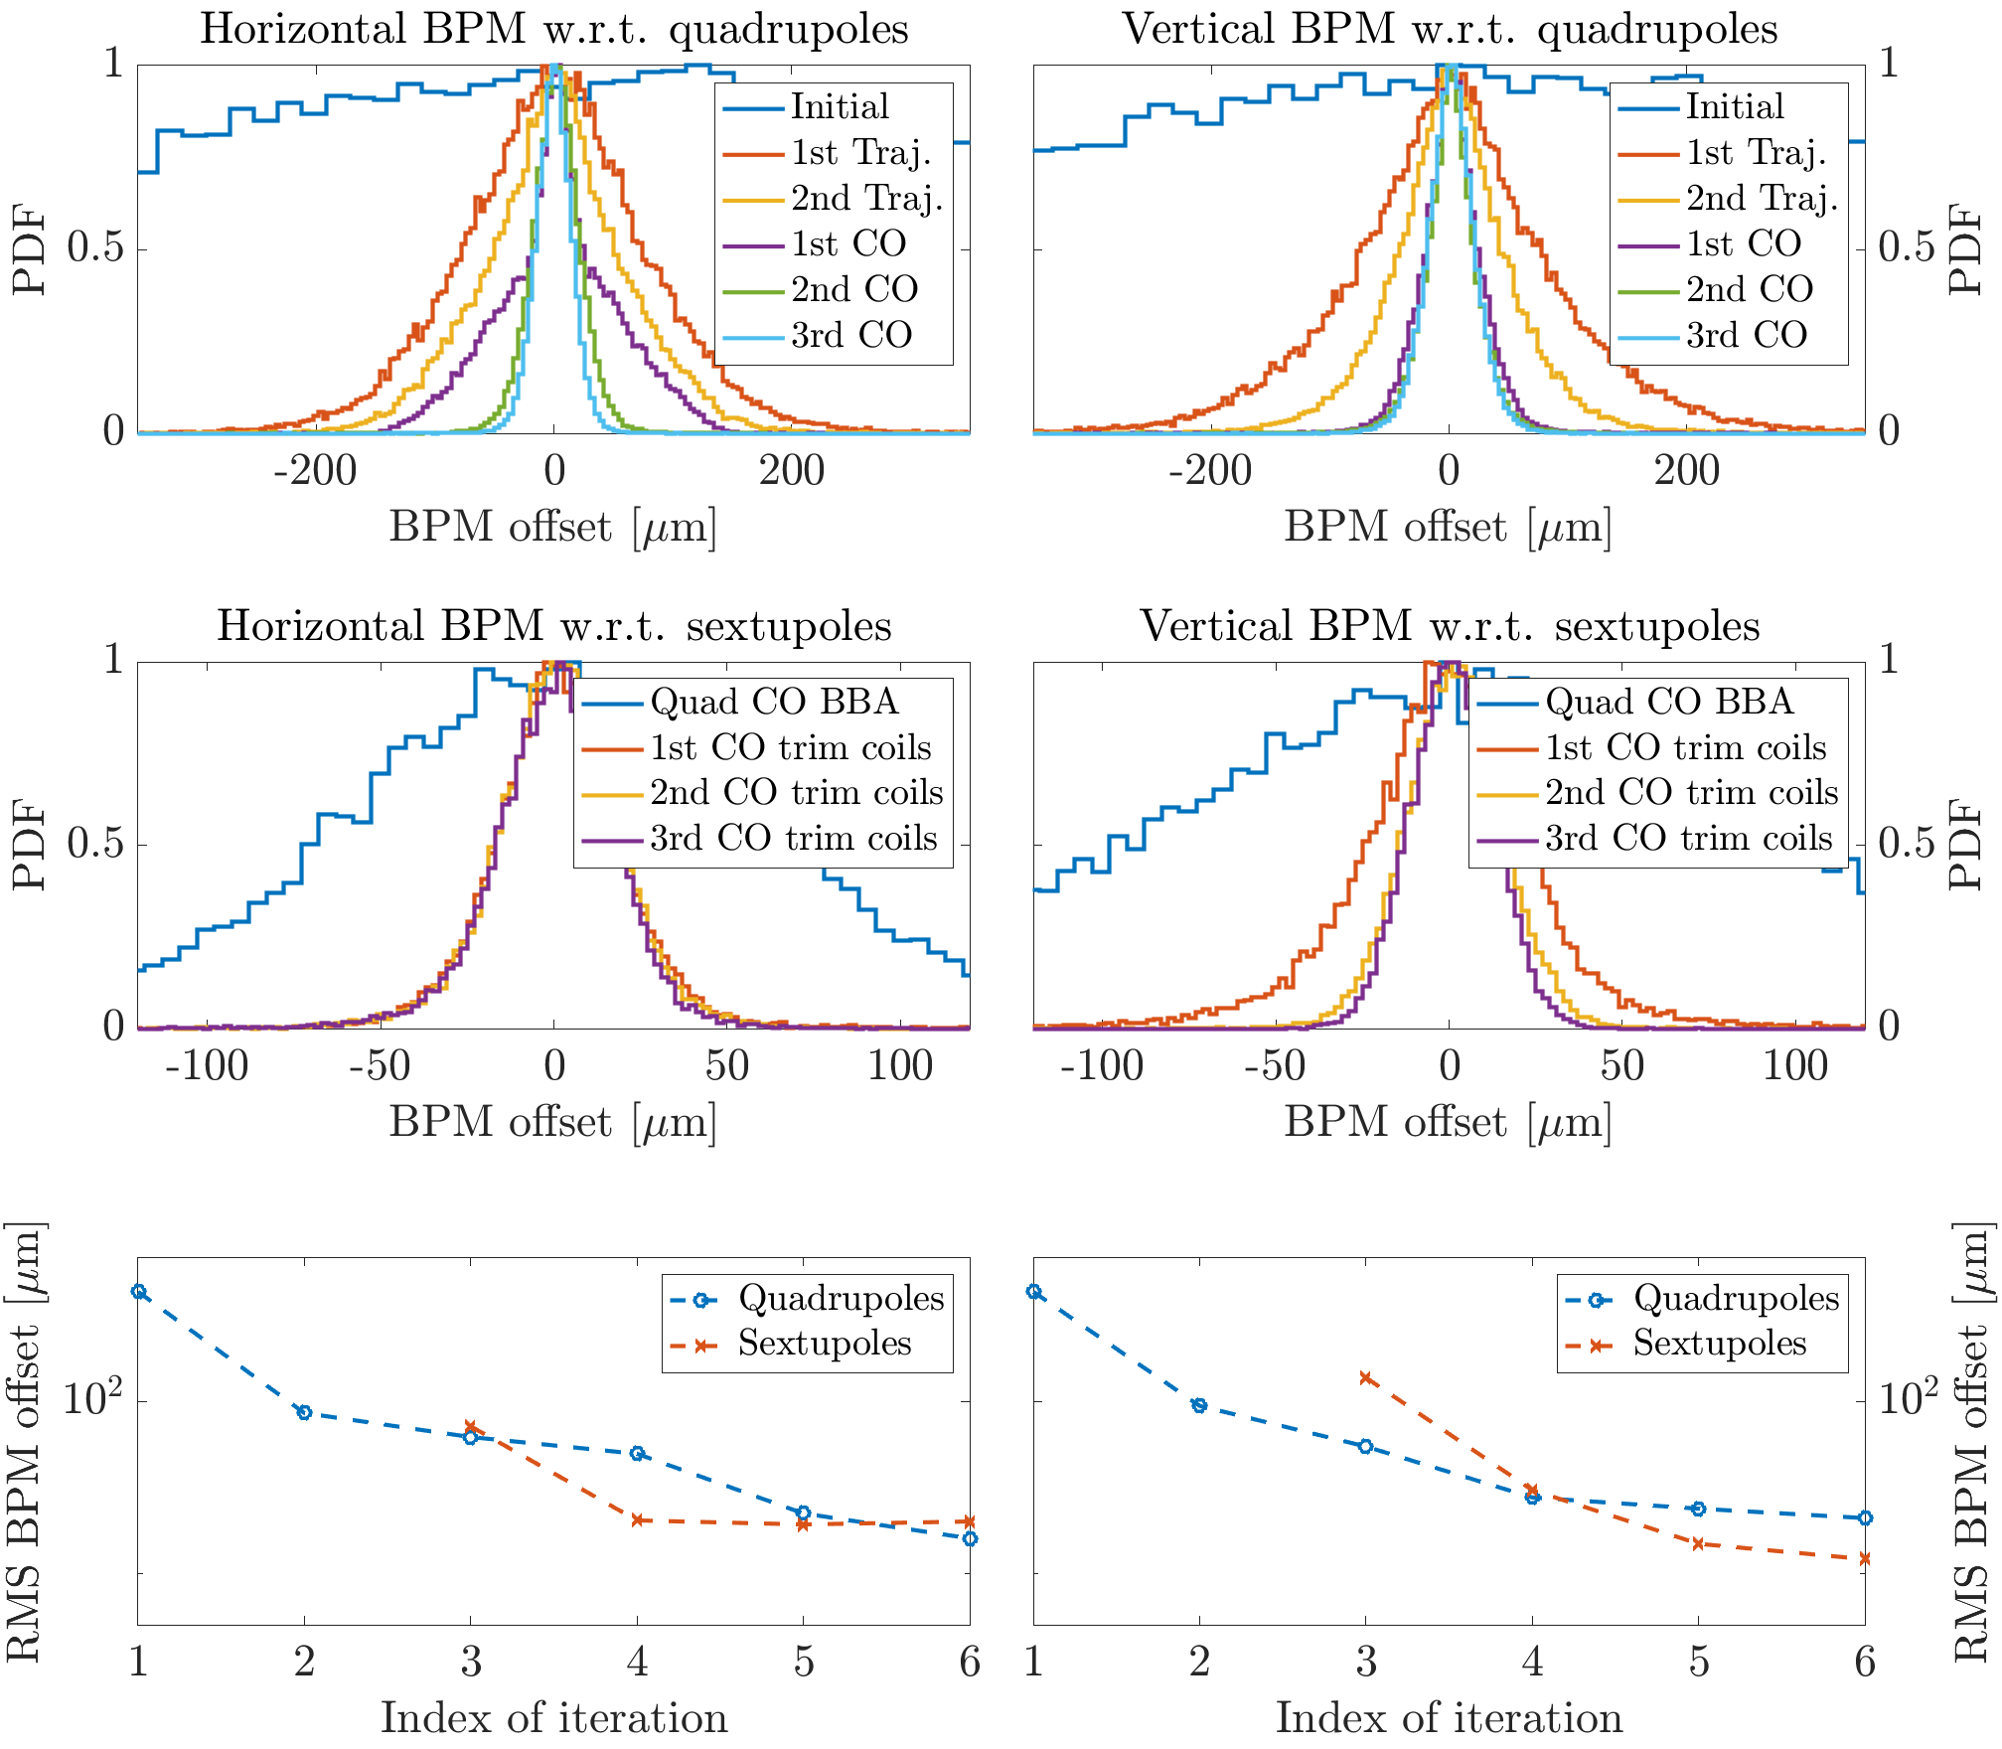
Commissioning Simulation: Quadrupole Trim Coils on Sextupoles Required
Initial Transmission
  Achieve first turn transmission
  2-turn trajectory correction
Multi-Turn Transmission
  Trajectory based BBA
  Static injection error correction
Sextupole Ramp-Up
  In loop with 2-turn trajectory correction
Achieve Beam Capture
  RF phase and frequency correction
  Tune scan
Linear Optics Correction
  Beam based alignment
  Closed orbit correction
  LOCO based optics correction
ID Compensation
  Close IDs and include kick maps
  Global optics correction
  Evaluation of lattice properties
  2 Iterations
  3 Iterations

Slide 8
Toolkit Design Features

Slide 9
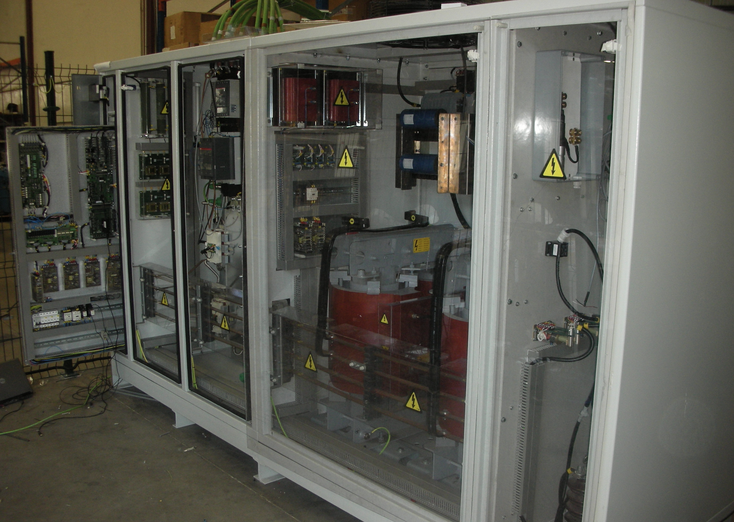
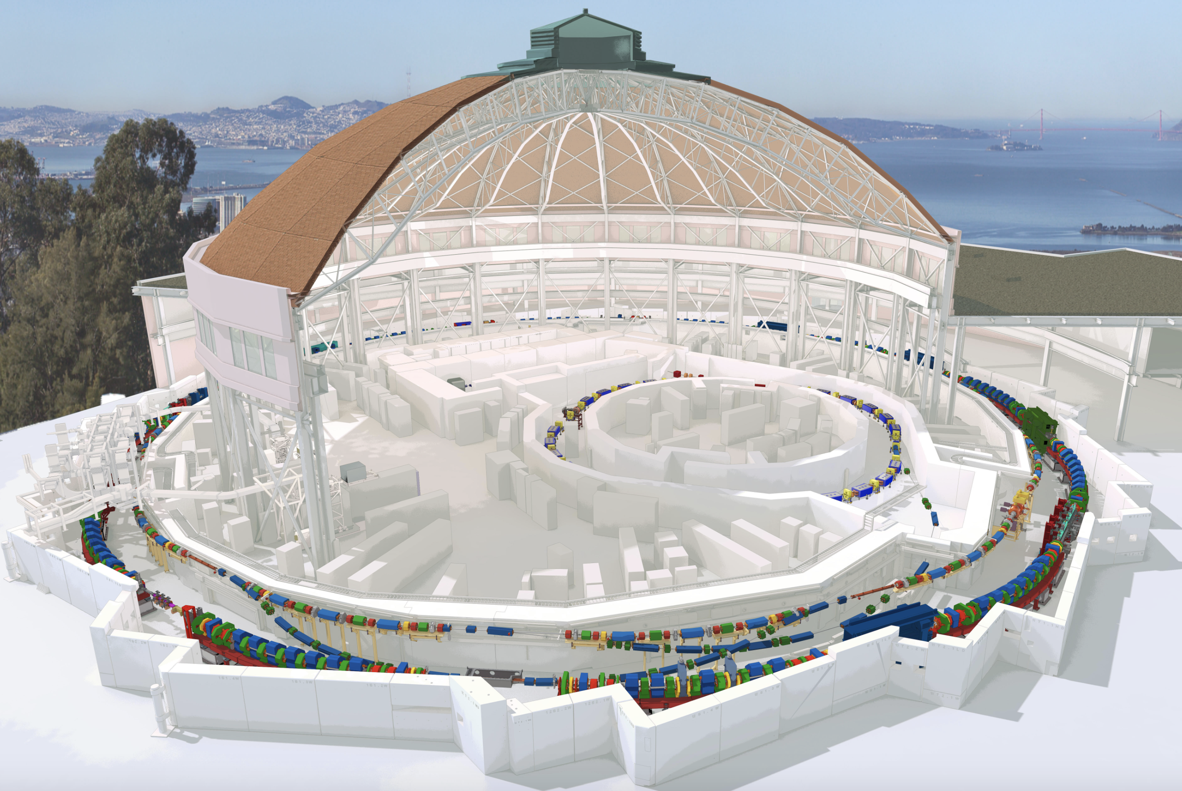
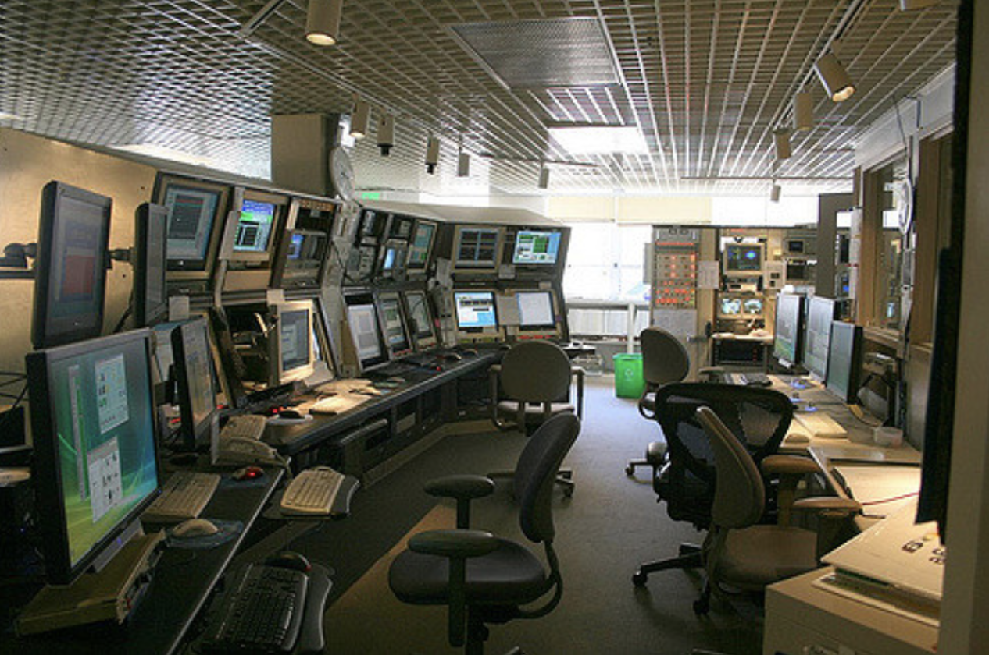
Limited Accessibility of Machine Parameters
Power supplies
Operating machine
High level controls
Diagnostic
devices
Magnetic fields
Particle trajectories
Magnet offsets
…
Limited access!
Setpoints and read back values

Slide 10
Realistic Workflow of Toolkit Important
Machine manipulation
Magnetic fields
Machine state
Beam reading
High level scripts
Set CM to setpoint
Error model
Get response matrix
Set Quad to setpoint
PolynomA
PolynomB
RING
Trajectory correction
Get BPM reading
Set Sext to setpoint
Aux. Structures
BBA
…
Injection pattern
RF commissioning
Set Quad to setpoint
Calculate fields
Auxiliary structures
Get BPM reading
High level
Compensates bending angle difference by setting horizontal CM
Calibration errors of all components
Diagnostic errors
Performs tracking including aperture
High level functions use only BPM and setpoints as input
Injected beam trajectory
Includes dipole kick from bending angle (set-point & roll)
Gets BPM signal from ensemble of particle trajectories
Checks for CM range (clipping)
Injection pattern
High level functions write only setpoints

Slide 11

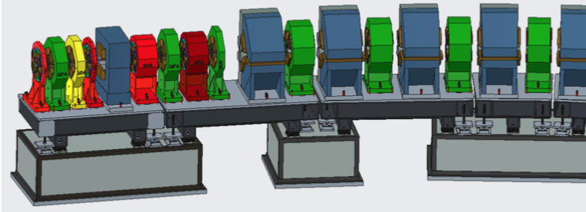
Large Numbers of Error Sources Included
Magnets
y
Horizontal analogously
Diagnostic errors
  BPM offset
  BPM cal. error
  BPM noise (TbT/CO)
  BPM roll
  CM cal. error
  CM roll
  CM / skew-quad limits
Support Structure
  Rafts, Plinths, Sections
  Roll & Offsets
  Pitch & Jaw
Circumference
Higher Order Multipoles
  Systematic for arbitrary coil excitations
  Random
Magnets
  Offset (x/y/z)
  Roll, pitch, jaw
  Strength
  Calibration
RF Errors
  Phase
  Frequency
  Voltage
Injection
  Static
  Shot-by-shot jitter
0
∆yMagnet
Rafts (Girders)
∆yRaft
∆yPlinth
∆ySection
Plinths
S

Slide 12
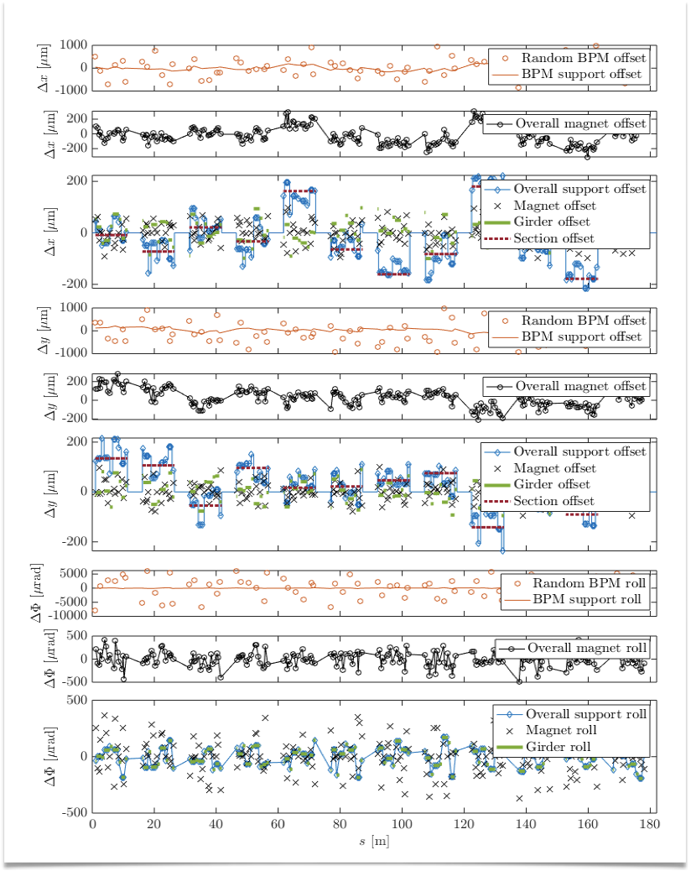
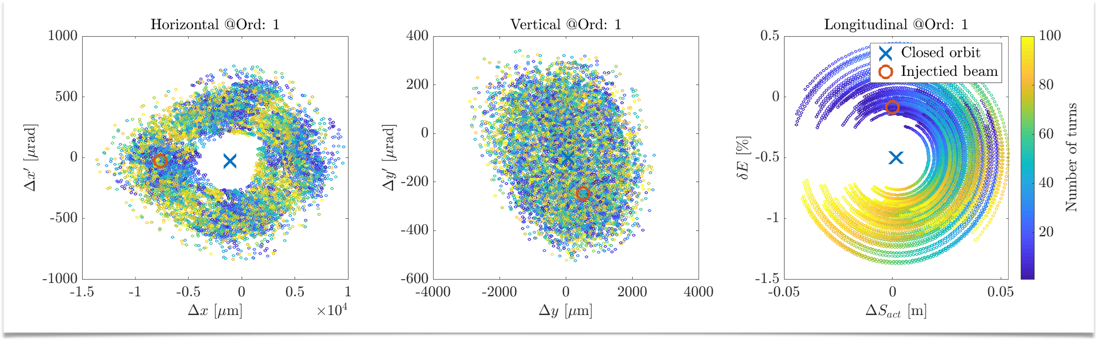
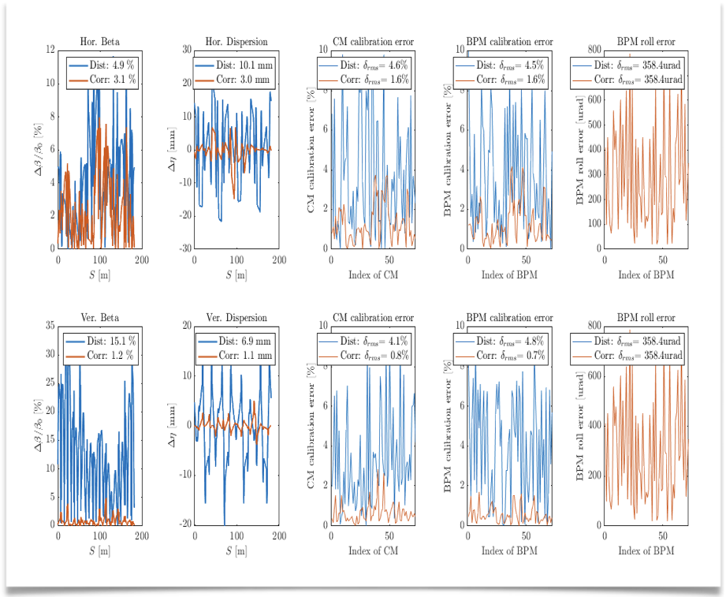
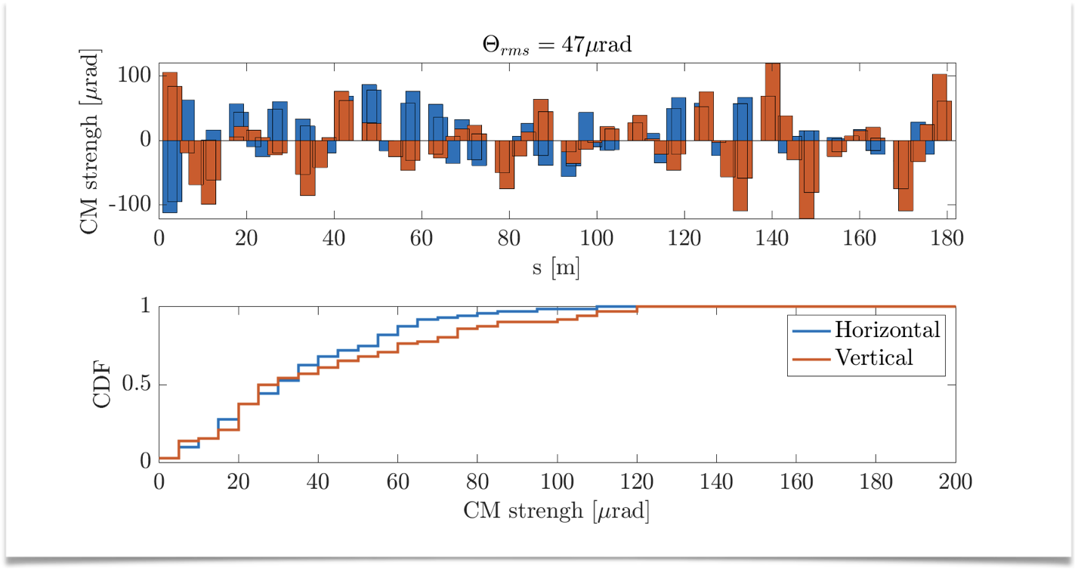
Various Visualisation Tools for Easy R&D
Misalignments
Turn-by-turn Phase Space
LOCO Status
Corrector Strength

Slide 13
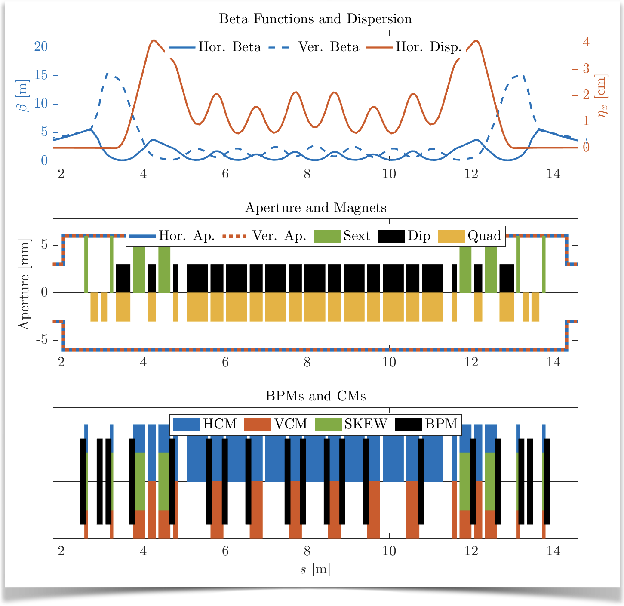
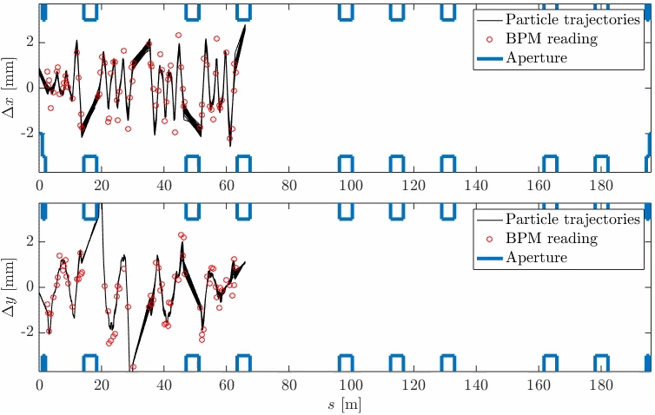
Various Visualisation Tools for Easy R&D
Lattice and Element Registration in Toolkit
Trajectories/Orbit and BPM Readings

Slide 14
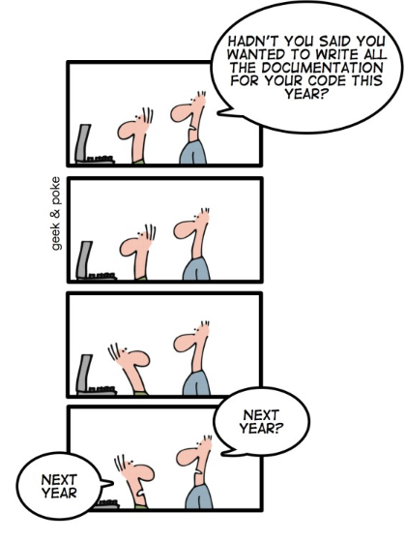
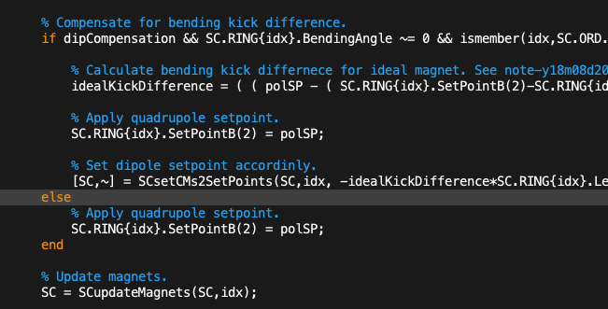
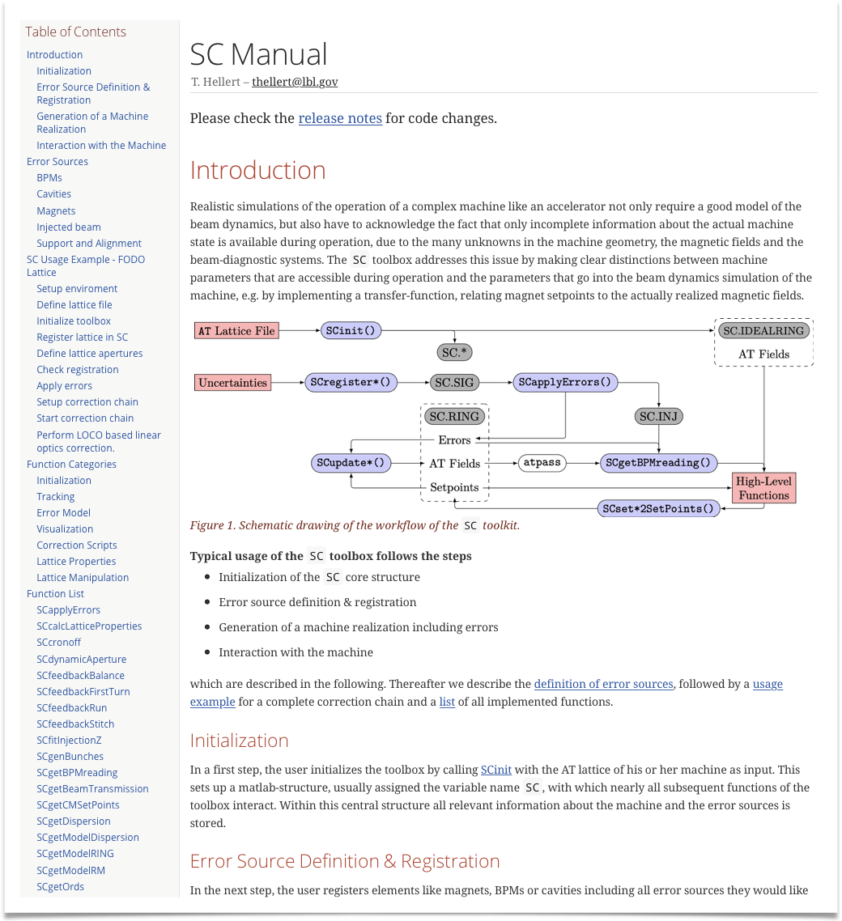
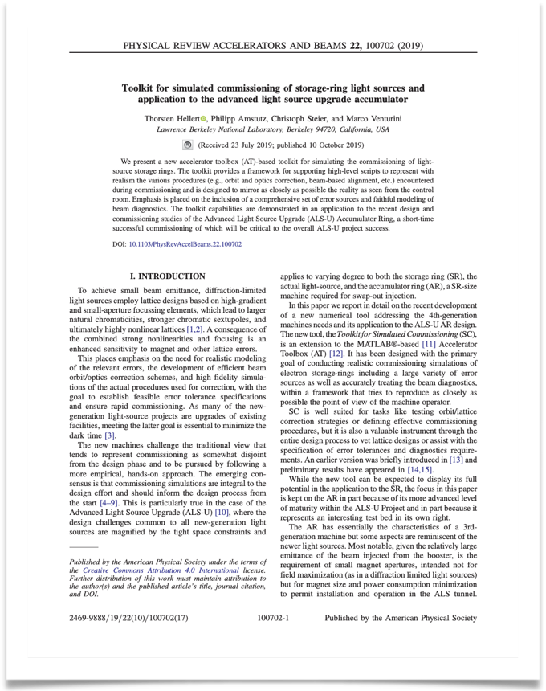
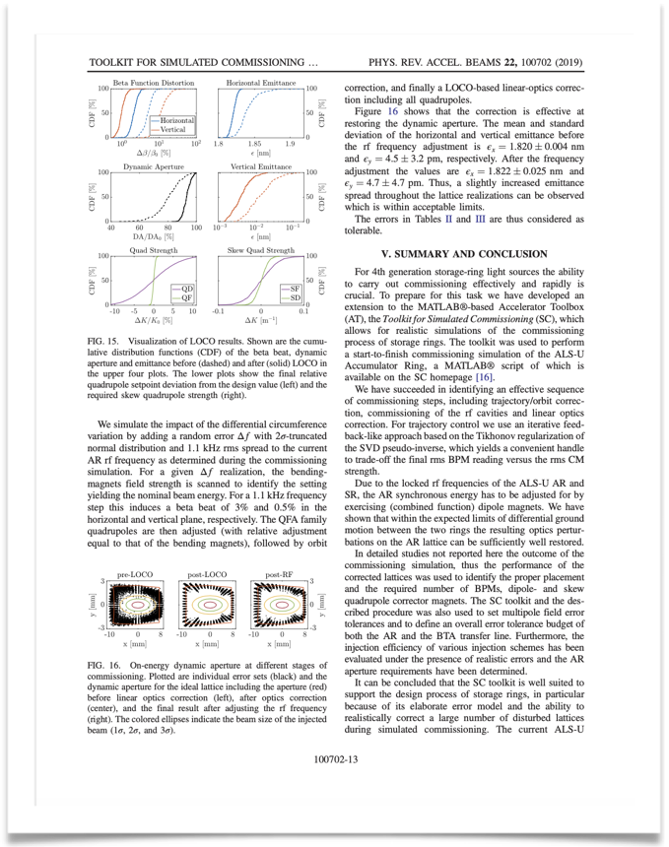

Comprehensive Source Code Documentation
Extensive Code Comments
Online Manual
Full ALS-U Examples (PRAB 22/100702)
Version Control

Slide 15
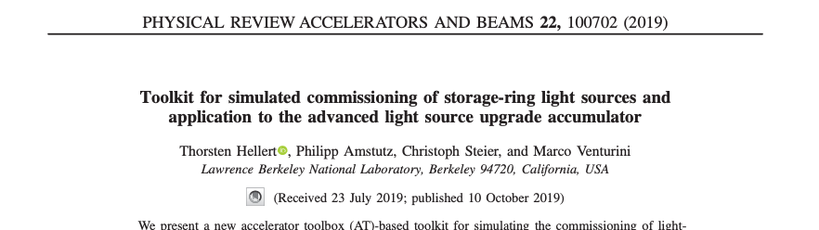
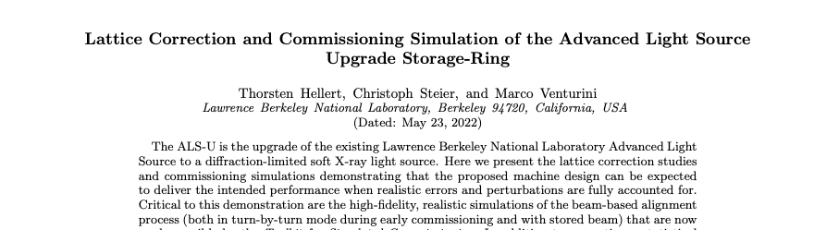
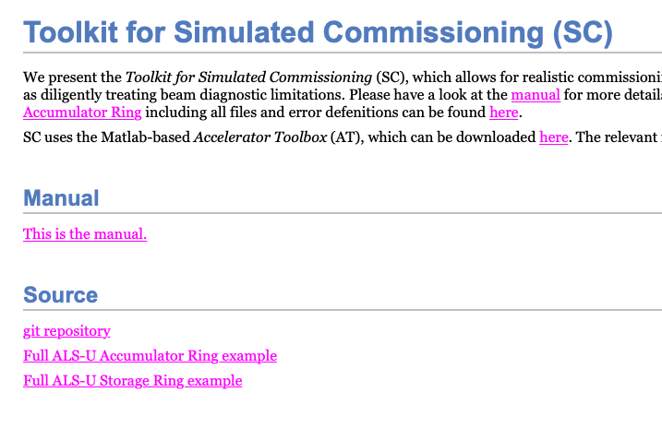
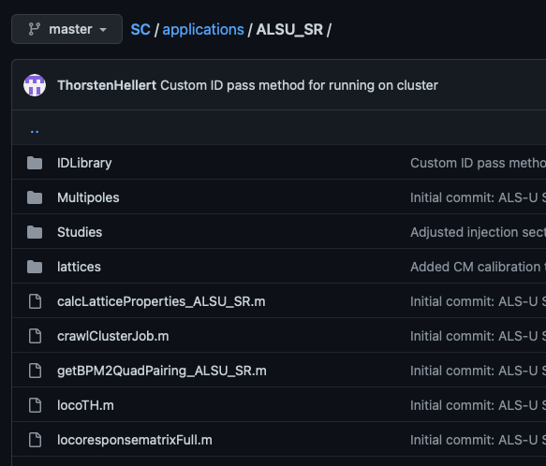
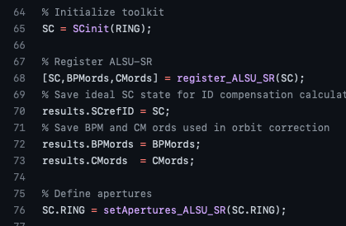
Easy Accessibility For New Users with Full Example Scripts
PRAB Paper for ALSU-AR
PRAB Paper for ALSU-SR (under review)
Toolkit Webpage
Git Repository
Annotated Scripts

Slide 16
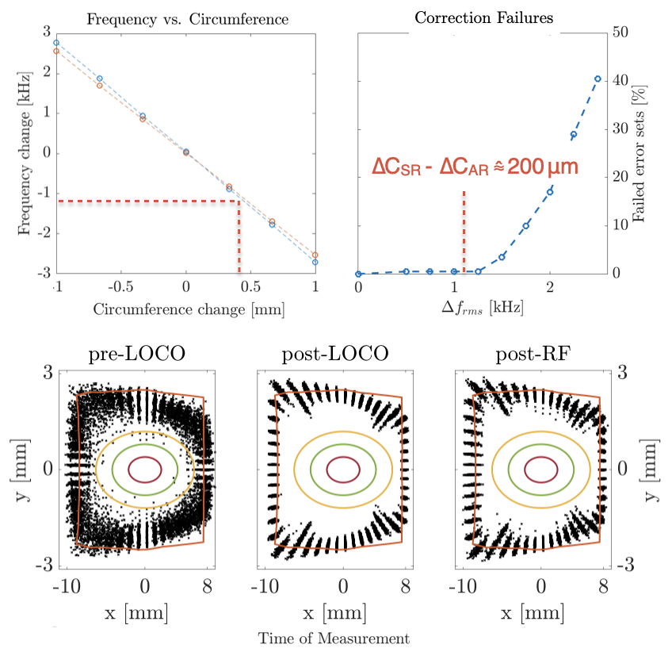
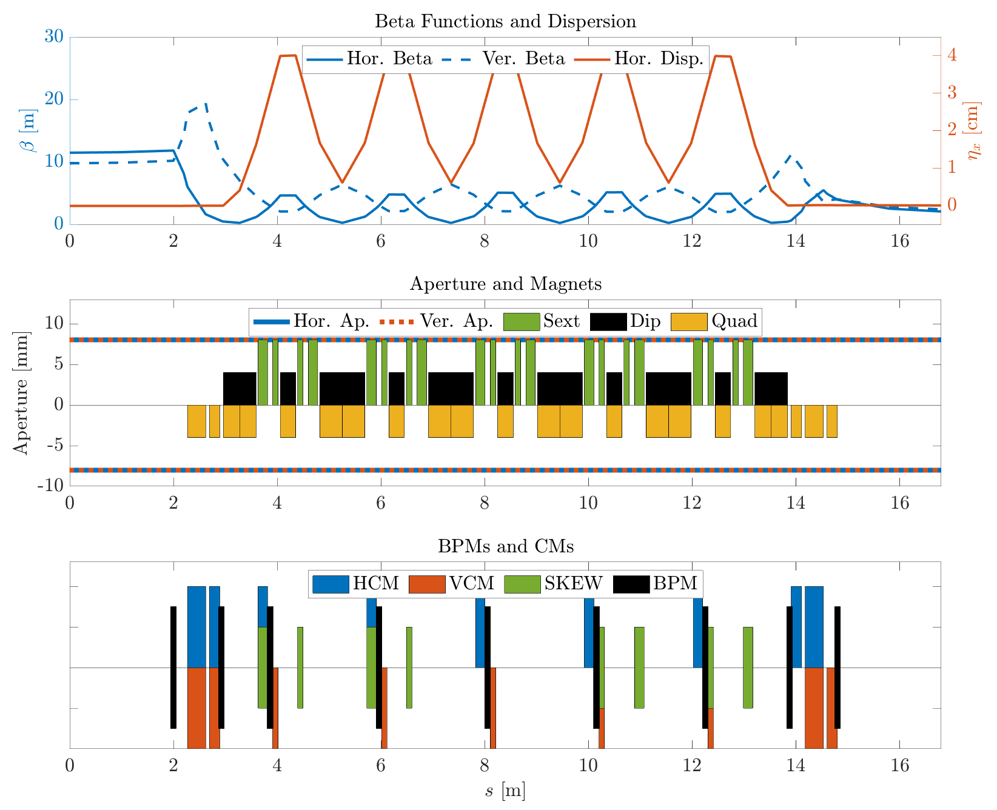
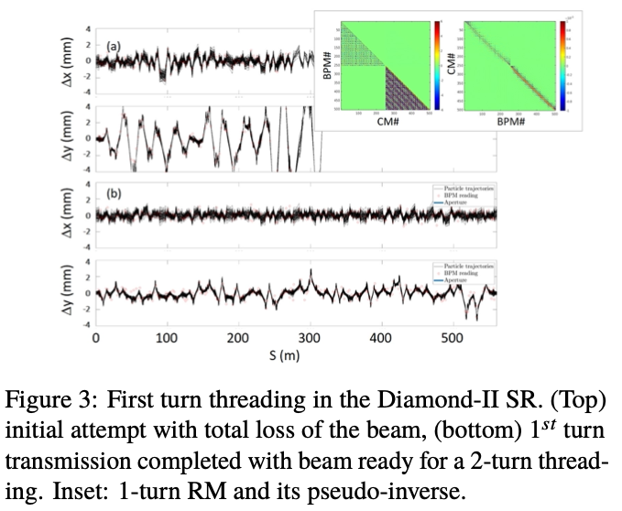
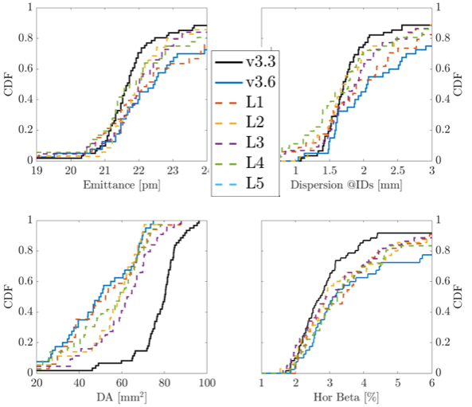
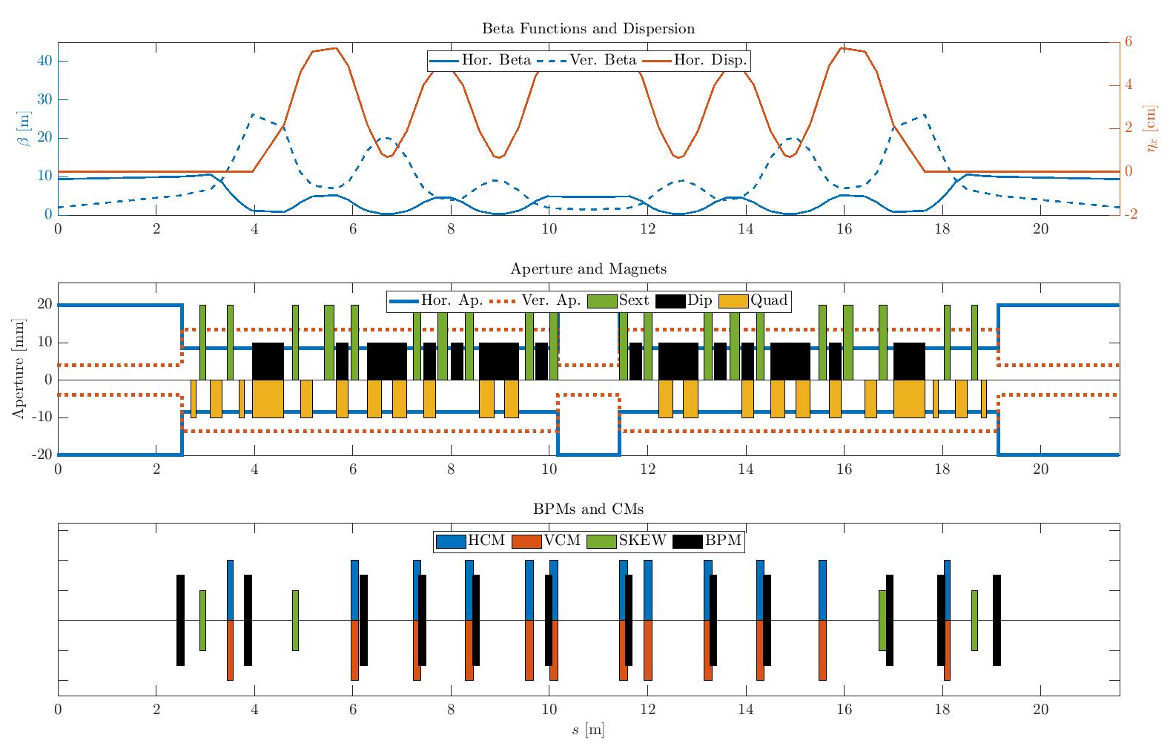
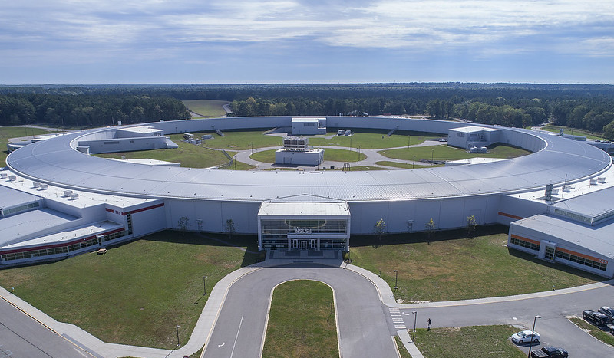
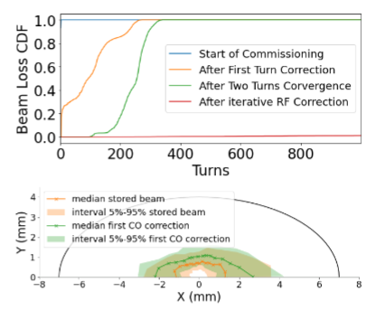
Toolkit Used for Guiding Design Process at Various Machines
ALS-U AR (T. Hellert)
ALBA-II (Z. Marti Diaz)
Diamond-II (D. Amorin)
PETRA-IV (T. Hellert)
IPAC’21, MOPAB063
ALS-U SR (T. Hellert)
Elettra 2.0 (S. Dastan)
NSLS-II (A. Kahn)
SOLEIL Upgrade (O. Garcia)

Slide 17
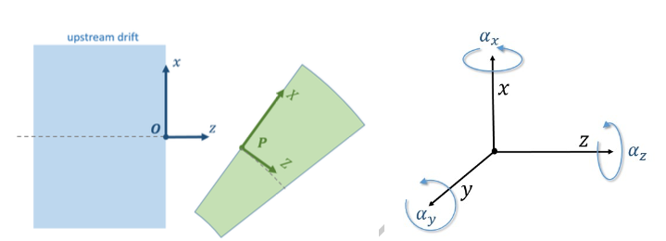
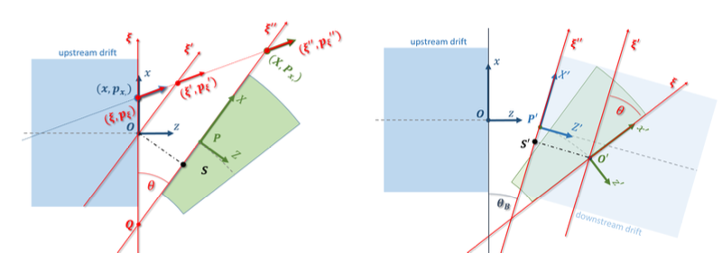
SC -> ELEGANT Corrected Lattice Converter
  AT
  Parameters for Tracking
AT/elegant
  SC allows for easy error model- and correction chain setup
  Elegant allows for more advanced tracking studies than AT
Corrected Lattice Converter
  Set up errors and correction chain with SC
  Convert final lattice to elegant
  Perform e.g. collective effects studies
  Converter now available on SC webpage
T1/T2
R1/R2
PolynomA/B
  SC
Magnet Offset and
Roll/Pitch/Jaw
Sys. Higher Order Multipoles from various coil excitations
Girder Roll/Pitch/Jaw and Offset at Magnet Location
Strength and Calibration Error
Girder Endpoint Offset
Random Higher Order Multipoles
Section/Plinth Offset at Girder Mount Location
Magnet Setpoint(s)
M. Venturini et al., ‘Particle dynamics and misaligned lattice elements’, ALS-U Tech-Note
  Parameters for Bookkeeping

Slide 18
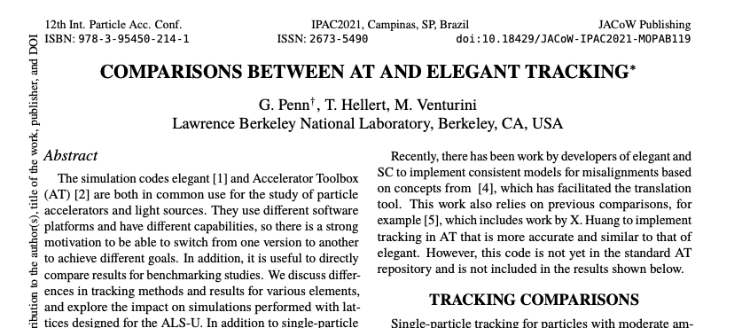
SC -> ELEGANT Corrected Lattice Converter
  Elegant
  Parameters for Tracking
AT/elegant
  SC allows for easy error model- and correction chain setup
  Elegant allows for more advanced tracking studies than AT
Corrected Lattice Converter
  Set up errors and correction chain with SC
  Convert final lattice to elegant
  Perform e.g. collective effects studies
  Converter now available on SC webpage
dx/dy/dz
tilt/pitch/jaw
{Fn}/{Gn}
  SC
Magnet Offset and
Roll/Pitch/Jaw
Sys. Higher Order Multipoles from various coil excitations
Girder Roll/Pitch/Jaw and Offset at Magnet Location
Strength and Calibration Error
Girder Endpoint Offset
Random Higher Order Multipoles
Section/Plinth Offset at Girder Mount Location
Magnet Setpoint(s)
G. Penn et al., MOPAB119, IPAC’21
  Parameters for Bookkeeping

Slide 19
Commissioning Tests Using SC and Matlab Middle Layer (MML)

Slide 20
Motivation and Scope of SC-MML Connection
Automated startup and commissioning scripts will be essential for ALS-U
  Lattice too non-linear to achieve stored beam with conventional methods
  Scheduled commissioning time for AR and SR very short compared to the operational complexities
SC Toolkit developed for simulated commissioning and error analysis studies
  Comprehensive automated lattice correction tools to get from first injection to stored beam
  Workflow mimics machine operation from the control room
Integrating SC Toolkit into the control system
  ALS and ALS-U operated with MML, toolkit written in Matlab
  ALS lattice very similar to ALS-U AR lattice
  Experimental commissioning tests and code development at ALS underway since June ‘21

Slide 21
Current Development: SC-MML Connection
Machine manipulation
Magnetic fields
Machine state
Beam reading
High level scripts
Set CM to setpoint
Error model
Get response matrix
Set Quad to setpoint
PolynomA
PolynomB
RING
Trajectory correction
Get BPM reading
Set Sext to setpoint
Aux. Structures
BBA
…
Injection pattern
RF commissioning
Set Quad to setpoint
Calculate fields
Auxiliary structures
Get BPM reading
High level
Compensates bending angle difference by setting horizontal CM
Calibration errors of all components
Diagnostic errors
Performs tracking including aperture
High level functions use only BPM and setpoints as input
Injected beam trajectory
Includes dipole kick from bending angle (set-point & roll)
Gets BPM signal from ensemble of particle trajectories
Checks for CM range (clipping)
Injection pattern
High level functions write only setpoints

Slide 22
Current Development: SC-MML Connection
Machine manipulation
Running ALS
Beam reading
High level scripts
Set CM to setpoint
Get response matrix
Set Quad to setpoint
Trajectory correction
Get BPM reading
Set Sext to setpoint
BBA
…
Injection pattern
RF commissioning
Set Quad to setpoint
Machine manipulation
Get BPM reading
High level
Compensates bending angle difference by setting horizontal CM
Toolkit calls MML functions to change magnet set points
Toolkit calls MML functions to read BPM readings
High level functions use only BPM and setpoints as input
Checks for CM range (clipping)
High level functions write only setpoints

Slide 23
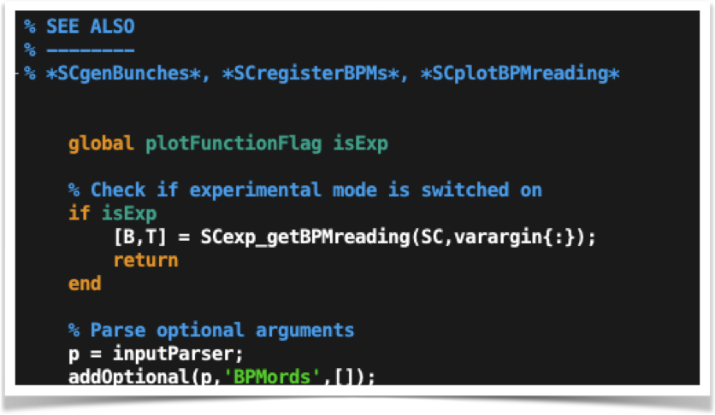
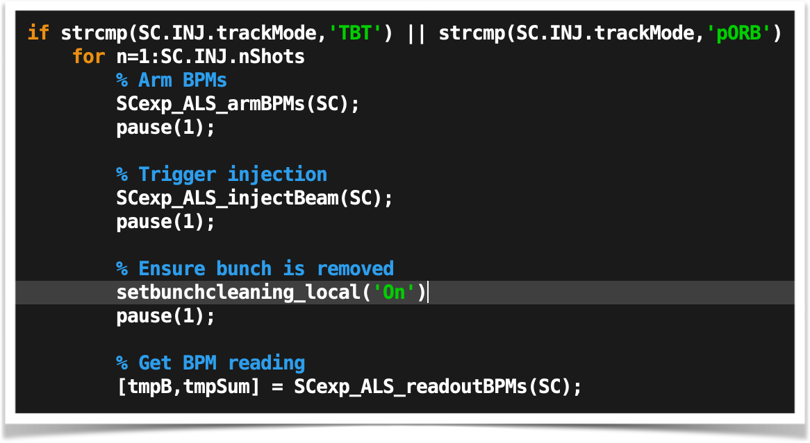
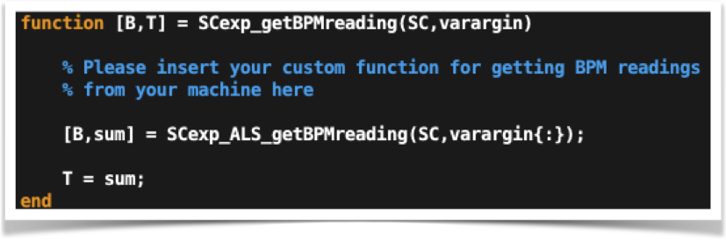
Current Development: SC-MML Connection
SCgetBPMreading (public on GitHub)
High level- and user defined scripts only call SCgetBPMreading()
Global variable ‘isExp’ to check if simulation or real machine
User supplied function to read BPM readings at their machine
All control parameters (number of turns, TBT/ORB, etc) within SC framework
SCexp_ALS_getBPMreading (custom for ALS)
SCexp_getBPMreading (public on GitHub)

Slide 24
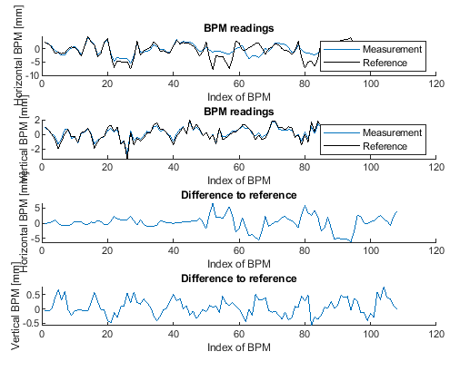
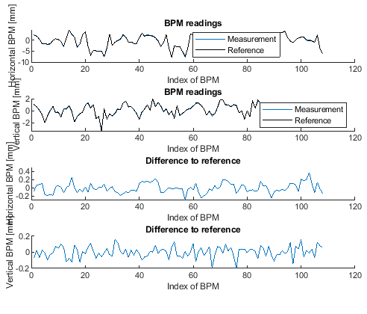
Successful Multi-Turn Trajectory Feedback
Injection with one disturbed CM
Injection after correction

Slide 25
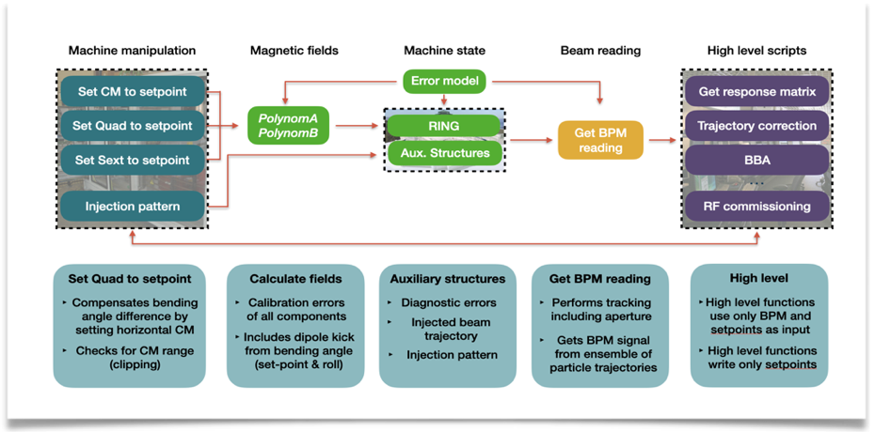
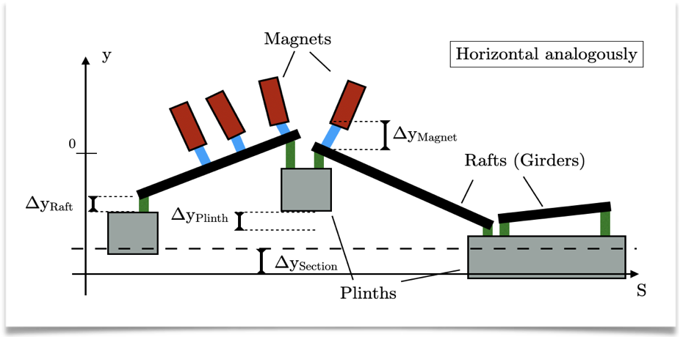
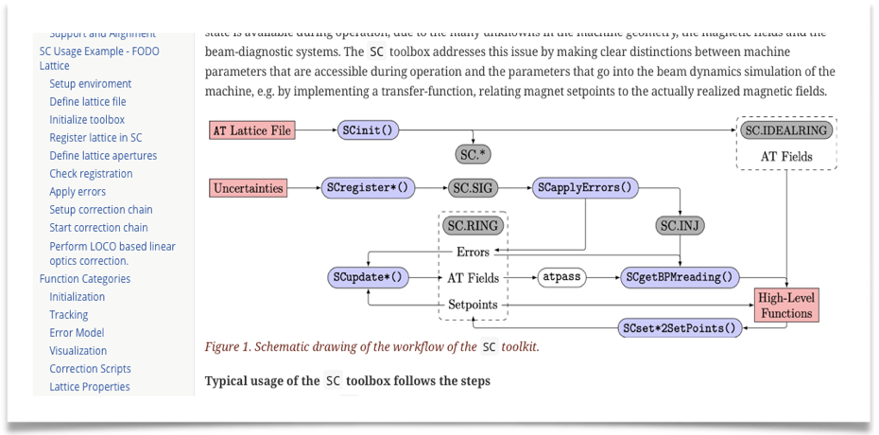
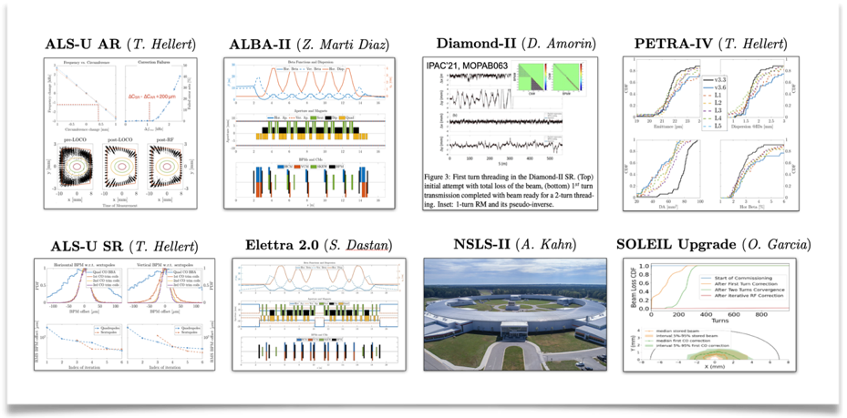
Summary
Commissioning simulations are essential for the design of ultra low emittance storage rings
  Challenging lattice of future light sources
  Tolerances studies must include commissioning process
  Simulation must reflect reasonable information flow
Development of Commissioning Simulation Toolkit
  High fidelity error model
  Realistic workflow
  Comprehensive documentation
  Wide range of application demonstrated at multiple machines
Integrating SC Toolkit into the control system
  Automated startup and commissioning scripts needed for future light sources
  Experimental commissioning tests and code development at ALS underway
https://sc.lbl.gov

Slide 26
Appendix: If I had more time I would work on implementing…
Realistic Errors in Split Magnets
  Future light sources will likely rely more and more on sophisticated longitudinal field profiles
  Cross talk between magnets likely to increase due to space constraints
  Currently no tracking/bookkeeping code available for arbitrary errors on arbitrary magnet slices
‘Non-Linear Errors’
  BPM saturation at high amplitudes
  Magnet saturation and hysteresis effects
  Wrong polarity BPMs/Magnets, etc
Time Depending Errors
  Toolkit already includes various types or magnet support structures and their errors
  Including time dependent misalignment and power supply errors should be relatively easy
Exploring Machine Learning Options for Commissioning
  Surrogate models to accelerate beam threading?
  First turn optics correction?

