Slide 1
Diamond-II Progress
Ian Martin,
on behalf of the Diamond-II design team
3rd Workshop on Low Emittance Lattice Design
27/06/2022

Slide 2
Talk Outline
Diamond-II Design:
  Initial goals / design constraints
  Cell layout
  Optimisation strategy
  Main parameters
  Injection scheme => Talk by Jonas Kallestrup
Performance studies carried out for TDR:
  Magnet cross-talk
  Collimation
  Impact of IDs
  Simulated commissioning
  Collective effects => Talk by Teresia Olsson
  Final performance estimates
Timeline
Conclusions
Diamond-II Design:
  Initial goals / design constraints
  Cell layout
  Optimisation strategy
  Main parameters
  Injection scheme
Performance studies carried out for TDR:
  Magnet cross-talk
  Collimation
  Impact of IDs
  Simulated commissioning
  Collective effects
  Final performance estimates
Timeline
Conclusions

Slide 3
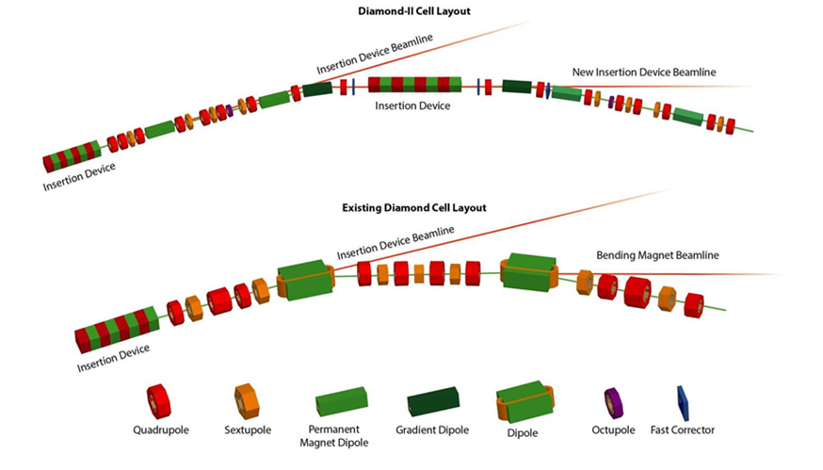
Diamond-II Design Goals
Design
Design Goals for Diamond-II:
Optimise the science enabled at Diamond
Maximise the impact it has for researchers both in universities and in industry
Achieved through integrated approach:
New Modified Hybrid 6-Bend Achromat (M-H6BA) storage ring
  Combines ESRF-EBS and Diamond DDBA
  Lower emittance (x17-25, depending on IDs)
  Double number of straight sections
Raise energy from 3 GeV to 3.5 GeV
  increase flux and brightness above 10 keV
Upgrade IDs / new flagship beamlines
Improved data handling/computation, automation, ...

Slide 4
Diamond-II Lattice
DL
QA
QA
DL
DQ
DQ
DL
QA
QA
DL
½ Long Straight
Mid Straight
½ Standard Straight
Each cell consists of:
4 longitudinally-varying dipoles (DL) 12 (13) quadrupoles
2 transverse gradient dipoles (DQ) 12 sextupoles with windings for SQUAD / HCV / VCM
4 offset quadrupoles producing anti-bends (QA) 2 octupoles
Magnets
Long Straight
Standard Straight
Mid Straight
>35 % of the ring consists of insertion straights (quad to quad)
~11.3m
~8.3m
Diamond super-period
Combines low emittance with high capacity
Diamond-II super-period
~7.5m
~2.9m
~5.1m

Slide 5
Diamond-II Design Constraints
Magnet | Maximum Strength
Quadrupole | 90 T/m
Anti-bend (high gradient) | 80 T/m (3.6 mm offset)
Anti-bend (low gradient) | 60 T/m (7.8 mm offset)
Skew quadrupole | 2 T/m
Sextupole (narrow bore) | 5,000 T/m²
Sextupole (wide bore) | 3,500 T/m²
Octupole | 70,000 T/m³
Layout developed in close collaboration with engineers:
Existing ID source-points to be retained
Magnet separation limited to 75 mm (magnetic lengths)
Magnet strengths: trade-off between aperture and optics
Standardise magnet types / lengths where possible
Allow space for absorbers, BPMs, flanges, gate valves, …
Minimum straight lengths:
Long straights: Keep two undulators and chicane in double mini-beta straights (double MB will be lost)
Standard straights: Allow space for 3.5 m APPLE IDs; allows existing chicanes/beamline angles to be kept
Mid straights: Space for 1.5 m long in-vacuum ID
Design
Straight | Requirement | Diamond | Diamond-II
Long | >7.44 m | 11.3 m | 7.545 m
Standard | >4.884 m | 8.3 m | 5.065 m
Mid | >2.9 m | 3.4 m | 2.872 m

Slide 6
Diamond-II Mid-Straights
Straight | Use
K01 | Injection stripline kickers
K02 | ID for VMXm beamline
K03 | ID for flagship new beamline
K04 | ID for flagship new beamline
K05 | 2×main cavities
K06 | 2×main cavities
K07 | ID for K07 beamline
K08 | ID for flagship new beamline
K09 | electron beam diagnostics
K10 | reserved for future new short beamline
K11 | ID for DIAD beamline
K12 | reserved for future new beamline
K13 | reserved for future new beamline
K14 | ID for flagship new beamline
K15 | Passive SC third harmonic cavity
K16 | ID for K16 beamline
K17 | 2×main cavities
K18 | 3PW for K18 beamline
K19 | ID for flagship new beamline
K20 | 2×main cavities
K21 | ID for K21 beamline
K22 | DQ dipole for B22 beamline
K23 | DQ dipole for B23 beamline
K24 | Injection stripline kickers
Diamond-II contains 24 new mid-straights:
Pros and cons:
  adds capacity to the facility
  limits achievable nat. emittance
  increases vertical chromaticity
Allowable dispersion must be carefully controlled (ID effects)
Proposed usage:
Relocate existing ID beamlines
Upgrade BM beamlines
Five new flagship beamlines
Two straights for injection striplines
Space for diagnostic equipment
Five straights for RF (8×main cavities, 1×3HC)
Space reserved for three future beamlines

Slide 7
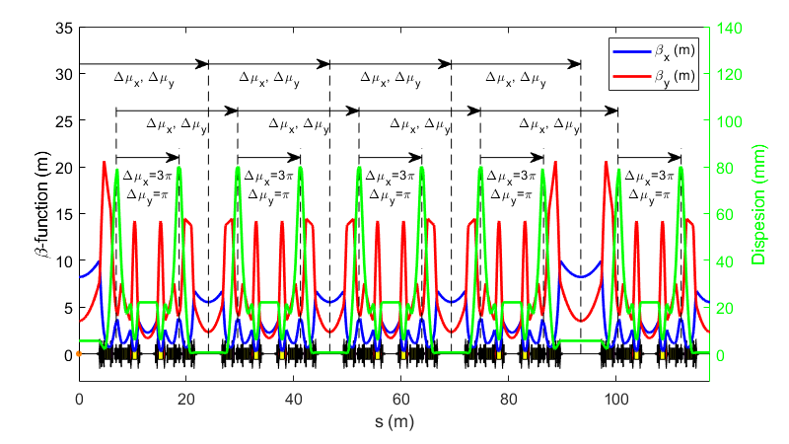
Optimisation Strategy
Linear Lattice:
H-function in mid-straight optimised for emittance with IDs
Anti-bends used to increase dispersion at sextupoles (used to maximise lifetime rather than lower emittance)
Small dispersion leakage in long straights to lower emittance
Beta functions at injection point
Beta functions at IDs minimised (WIP)
DL profile shaped to dispersion function
Nonlinear dynamics:
‘-I transformer’ between chromatic sext.
Cell tunes chosen to cancel RDTs over 8 cells:
  μ_{x} = ~2π*18/8
  μ_{y} = ~2π*7/8
Symmetry maintained:
  cell tunes same for long / standard straights
  cell tunes same f-sext => f-sext
Some detuning necessary:
  ring tunes must avoid main resonances
  -I transformer drives 2nd order chrom. (Δμ/2π ~ 0.025)
  tolerance of Δμ/2π ~ 0.01 for cell tunes

Slide 8
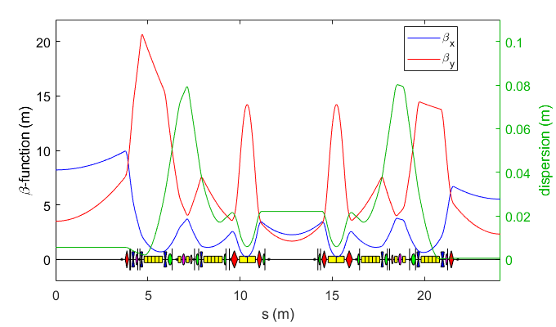
Diamond-II Lattice
Parameter (no IDs) | Units | Diamond | Diamond-II
Energy | GeV | 3.0 | 3.5
Circumference | m | 561.6 | 560.561
RF frequency | MHz | 499.654 | 499.511
Total bend angle | Degree | 360 | 388.8
Betatron tunes | - | [27.21, 12.36] | [54.15, 20.27]
Natural chromaticity | - | [-79.0, -35.6] | [-67.6, -88.5]
Momentum compaction | - | 1.7×10⁻⁴ | 1.0×10⁻⁴
H. damping partition | - | 1.00 | 1.87
Energy loss per turn | MeV | 1.01 | 0.72
Emittance | pm.rad | 2730 | 162
Energy spread | % | 0.096 | 0.094
Bunch length | ps | 11.4@2.4 MV | 12.5@1.4 MV
τ_{x} | ms | 11.1 | 9.7
τ_{y} | ms | 11.2 | 18.1
τ_{E} | ms | 5.6 | 16.0

Slide 9
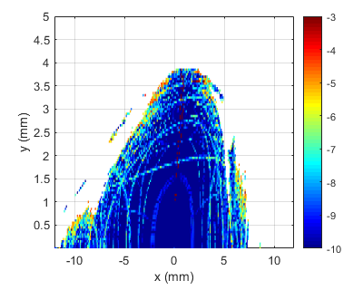
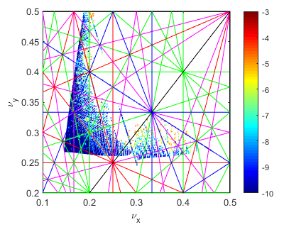
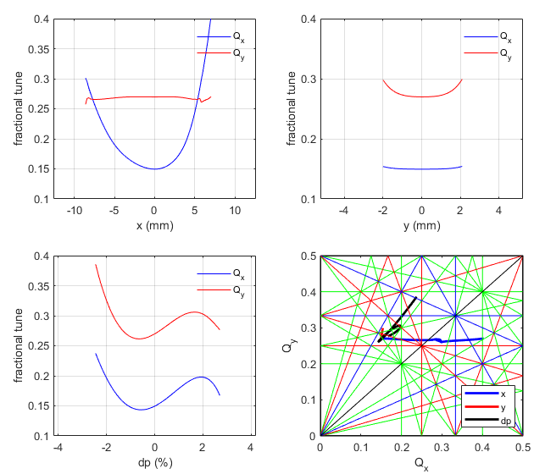
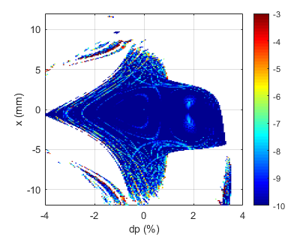
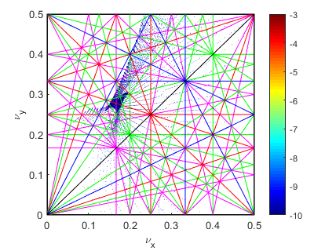
Dynamic Aperture

Slide 10
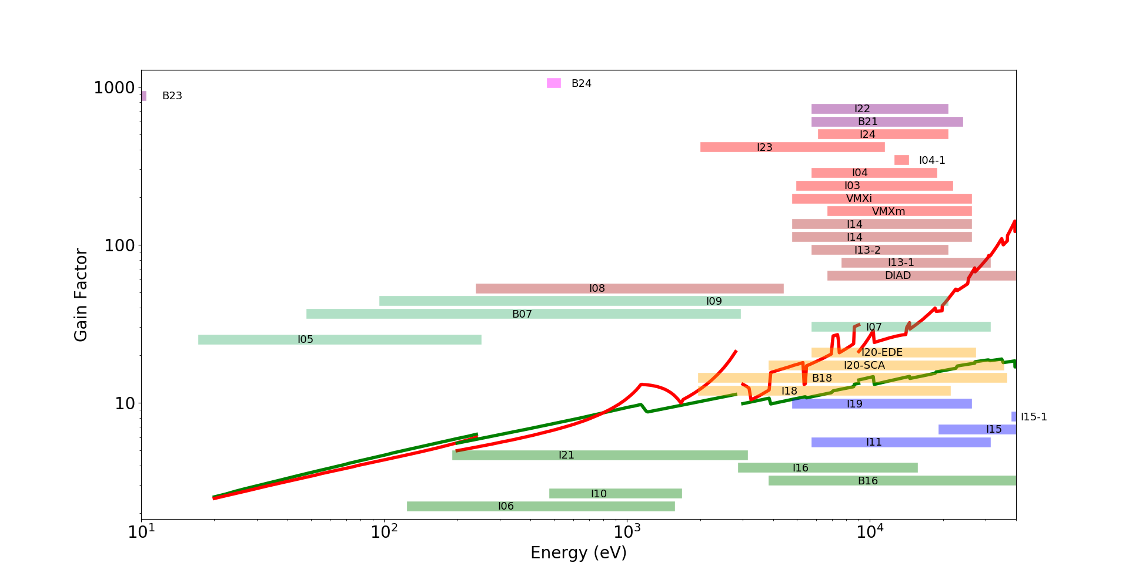
Brightness Gain From Lattice Change and Beam Energy
~×70 at 25 keV
 | emittance (no IDs) | Ratio | emittance (IDs+IBS) | Ratio
Diamond | 2.73 nm | 16.9 | 3.1 nm | 25.6
Diamond-II | 162 pm |  | 121 pm
3.5 GeV, 162 pm†
~×30 at 10 keV
3.0 GeV
119 pm†
† bare lattices

Slide 11
Injection Schemes
The injection straight layout I01 contains:
3 mm-thick septum magnet (1.6 m, 1.0 T, 70 μs)
1 mm-thick septum magnet (0.3 m, 0.4 T, 10 μs)
Four 6 μs half-sine bump kickers (K1-K4)
Four DC chicane magnets (C1-C4)
The DC chicane provides fine-control for the stored beam position and angle w.r.t. the septum plate.
The following stages are foreseen during commissioning and operation:
First turns: single-shot injection using the bump kickers set for on-axis injection (multi/single-bunch)
First accumulation: multi-shot injection using the bump kickers set for aperture-sharing (multi/single-bunch)
Final stages: multi-shot injection using the bump kickers set for closed bump (multi/single-bunch)
Top-up injection: aperture-sharing injection using stripline kickers in K01 straight (single bunch only)
Note: the kickers can be used to refill the machine and as a fall-back option in case of failure of the striplines.
More details of aperture-sharing injection scheme given in Jonas Kallestrup’s talk on Wednesday.

Slide 12
Simulated Commissioning
Storage ring commissioning modelled using T. Hellert’s Simulated Commissioning Toolbox
Phase One (on-axis injection):
First turn / multi-turn threading
Ramp up sextupoles
Turn on RF (adjust phase / frequency)
Quadrupole scan to maximise transmission
Phase Two (off-axis accumulation w/ mis-matched kickers):
Initial, coarse BBA + beta-beat correction
Second BBA + LOCO optics correction
Third BBA + coupling and optics correction
Phase Three (off-axis accumulation w/ closed orbit bump):
Optics correction with IDs and collimators
 | Offset (μm) | Roll (μrad) | Field Error (%)
DL dipole | 100 | 100 | 0.05
DQ dipole | 50 | 100 | 0.05
QA anti-bend | 35 | 100 | 0.05
Multipoles | 35 | 100 | 0.10
Corrector | 150 | 150 | 0.10
Girder | 150/150 | 150 | -
Error source | Error source | Value
BPM | Offset / roll | 500 μm / 10 mrad
 | Calibration | 5 %
 | Noise (TBT / closed orbit) | 60 μm / 1 μm
RF | RF Frequency | 100 Hz
 | RF Voltage | 0.5 %
 | RF phase | 90 degrees
Injected beam | Position / angle | 100 μm / 10 μrad
 | Energy / phase error | 0.1 % / 0.1 deg.
H.-C. Chao

Slide 13
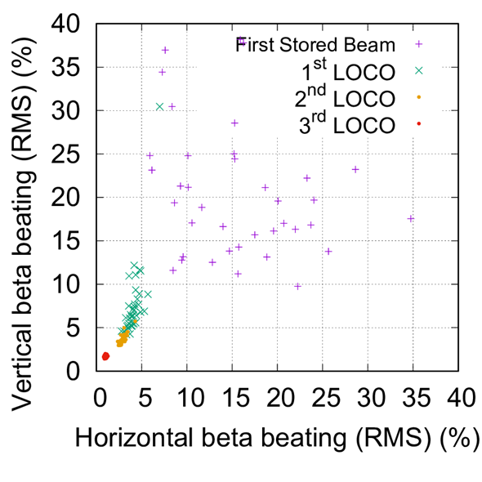
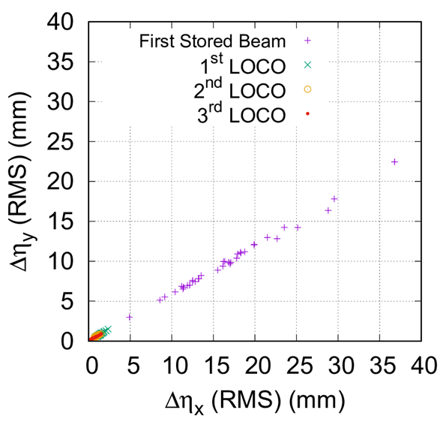
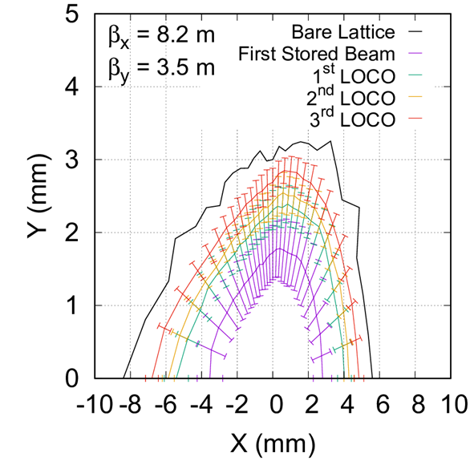
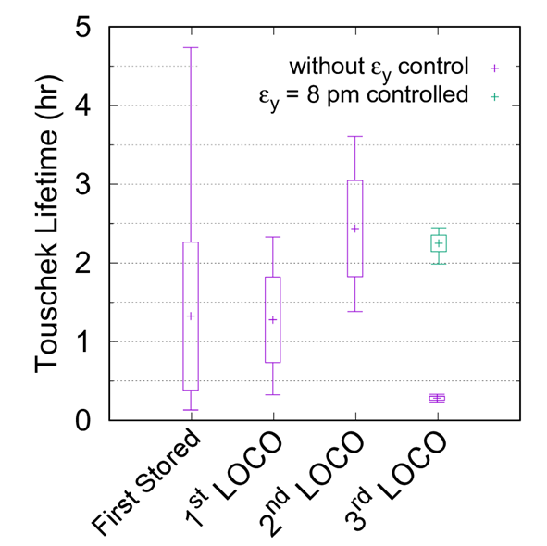
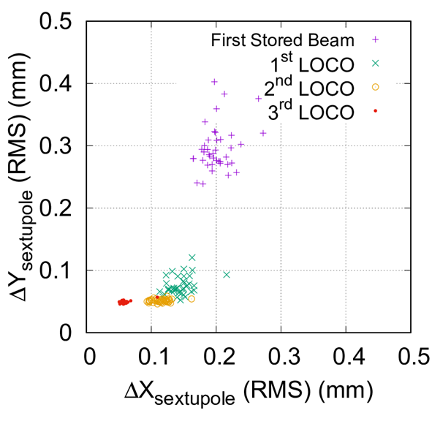
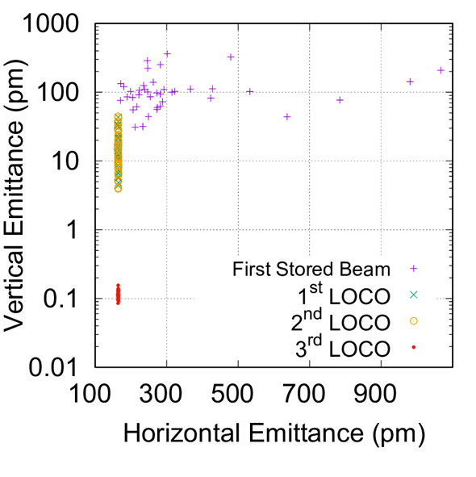
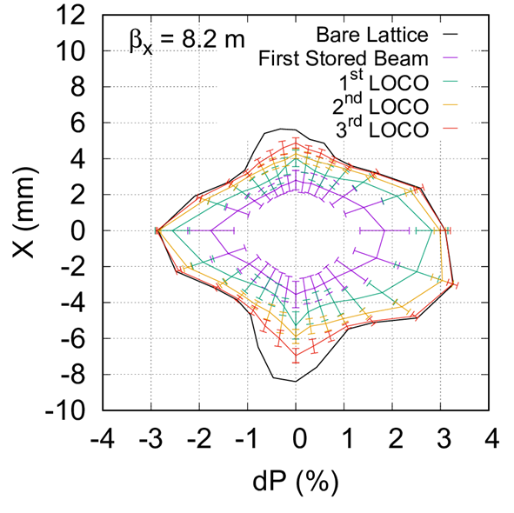
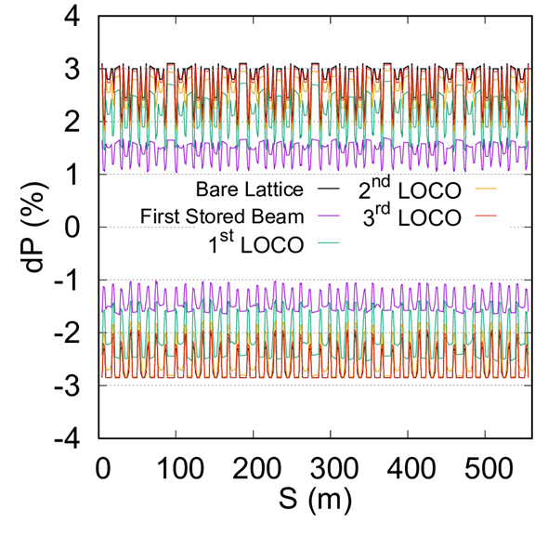
Simulated Commissioning
H.-C. Chao

Slide 14
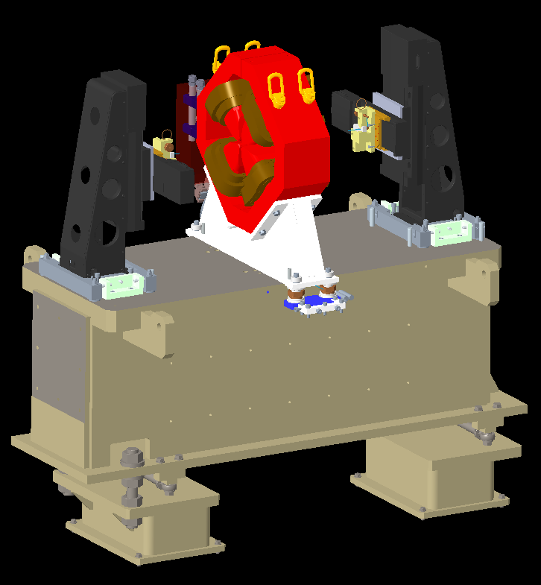
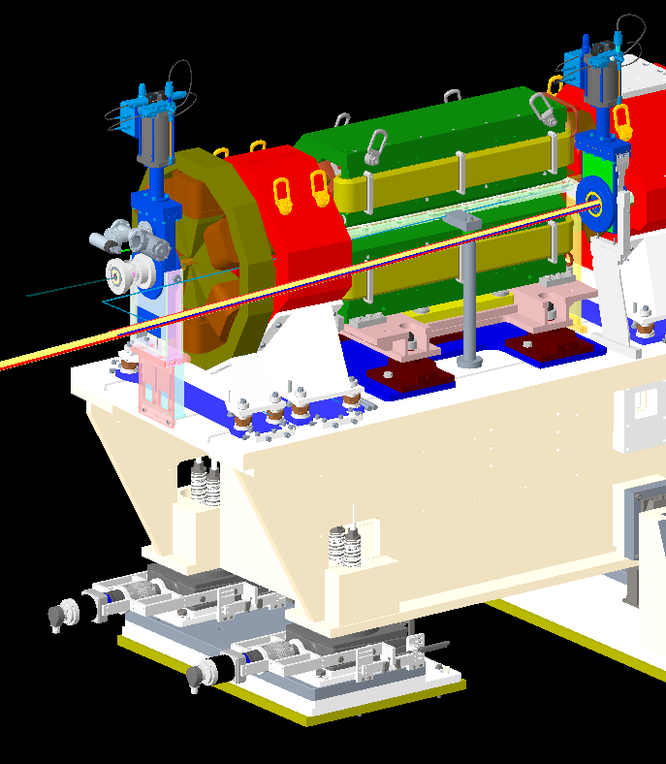
Simulated Commissioning
Analysis of magnet alignment tolerance is in progress by magnet, survey and engineering groups
Combined uncertainty is currently larger than has been assumed in the commissioning simulations
Investigations are in progress to see if relaxing the tolerances is feasible
Wire holder
Magnet onto girder
Wire holder fiducial
Magnet fiducial
Error Source | RMS error
Wire holder inspection | 2
Magnetic centre | 5
Wire holder survey | 25
Magnet fiducial survey | 10
Magnet survey onto girder | 35
Splitting / joining of magnet | 8
Survey monument placement | 3
Transportation / installation in tunnel | 10
Total uncertainty | 46
Measurement bench
Storage ring girder
P. Vivian

Slide 15
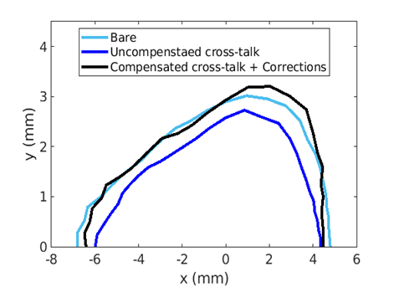
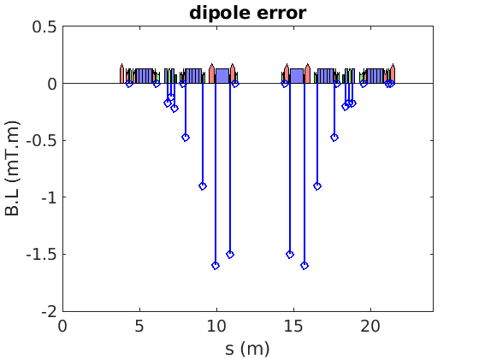
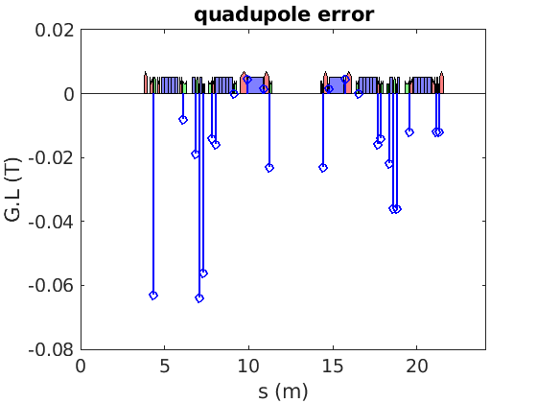
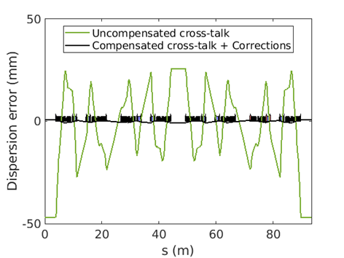
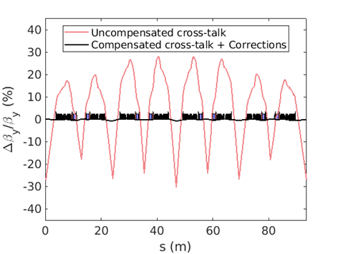
Magnet Cross-Talk
Close proximity of the magnets leads to substantial cross-talk and field errors
Modelled as thin-lenses between magnets; values extracted from OPERA model
Can be largely compensated by adjusting local dipole and quadrupole set-points
Modelling of full s-dependent fringe fields in progress
Mean over 20 seeds
Parameter | Uncompensated | After Correction
Tune-shift [x,y] | [+0.03, +1.02] | [0.00, 0.00]
Chrom. change [x,y] | [+2.8, +11.0] | [0.0, 0.0]
Emittance | 269 pm.rad | 162 pm.rad
Max orbit [x] | 741 μm | 29 μm
Max beta-beat [x,y] | [21.4%, 30.3%] | [3.2%, 1.0%]
Max dispersion error | 47.0 mm | 1.0 mm
Lifetime change | -0.77 h | -0.13 h
H. Ghasem

Slide 16
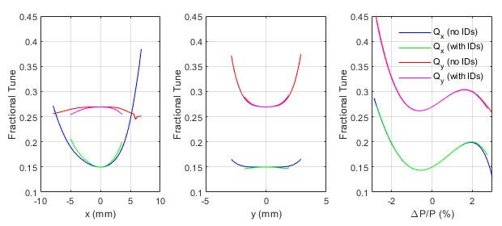
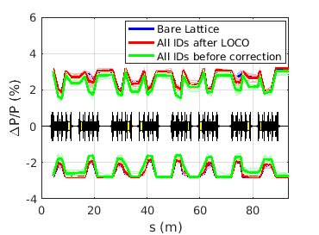
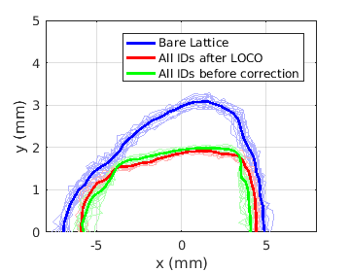
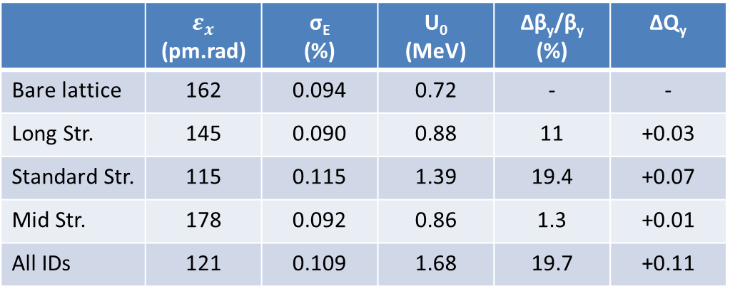
Impact of IDs
Total number of IDs increases from 28 to 36 in D-II
Contribute significantly to overall machine parameters
Mid straight IDs (dispersive location)
  Limited to <1.5 T to avoid emittance blow-up
  Impact on ‘-I transformer’ found to be negligible
  Generally short devices, low beta-functions
LOCO correction effective at restoring lifetime and DA
Active shim wires for APPLE II devices under study
Global tune feedback necessary
 | $$ε_{x}$$ (pm.rad) | σ_{E} (%) | U₀ (MeV) | Δβ_{y}/β_{y} (%) | ΔQ_{y}
Bare lattice | 162 | 0.094 | 0.72 | - | -
Long Str. | 145 | 0.090 | 0.88 | 11 | +0.03
Standard Str. | 115 | 0.115 | 1.39 | 19.4 | +0.07
Mid Str. | 178 | 0.092 | 0.86 | 1.3 | +0.01
All IDs | 121 | 0.109 | 1.68 | 19.7 | +0.11
B. Singh

Slide 17
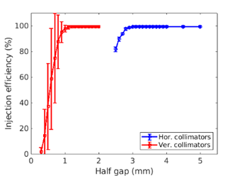
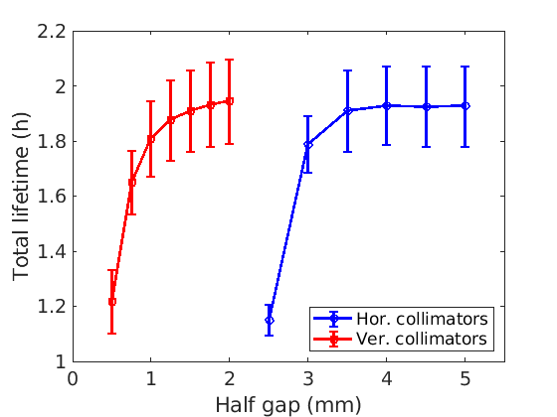
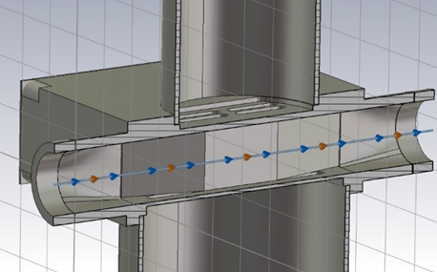
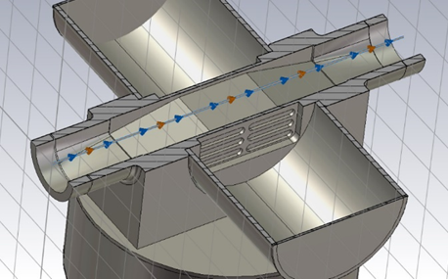
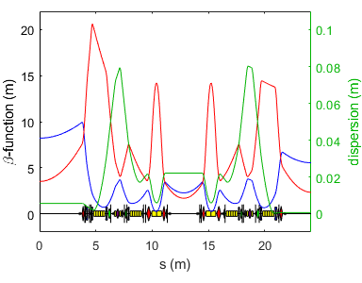
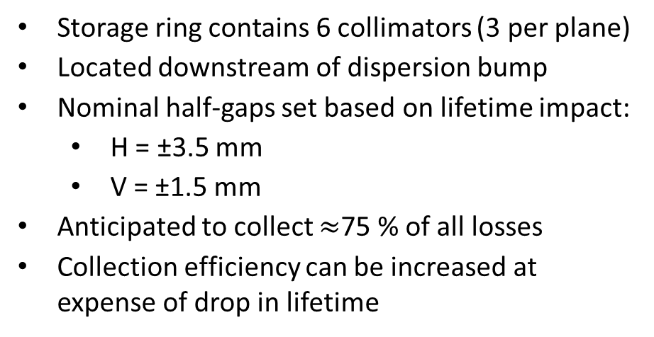
Collimation
Storage ring contains 6 collimators (3 per plane)
Located downstream of dispersion bump
Nominal half-gaps set based on lifetime impact:
  H = ±3.5 mm
  V = ±1.5 mm
Anticipated to collect $≈$75 % of all losses
Collection efficiency can be increased at expense of drop in lifetime
Loss Mechanism | Lost at collimators
RF switch-off | 96.0 ± 5.0 %
Touschek scatter | 68.8 ± 3.6 %
Elastic gas scatter | 21.4 ± 0.4 %
Inelastic gas scatter | 34.5 ± 0.3 %
H. injection mis-steer | 81.4 ± 16.6 %
V. injection mis-steer | 99.9 ± 0.2 %
Collimator location
 | Loss factor (V/pC) | H kick factor (V/pC/mm) | V kick factor (V/pC/mm)
Horizontal | 0.36 | -0.22 | -0.06
Vertical | 0.32 | -0.20 | -1.03
H. Ghasem

Slide 18
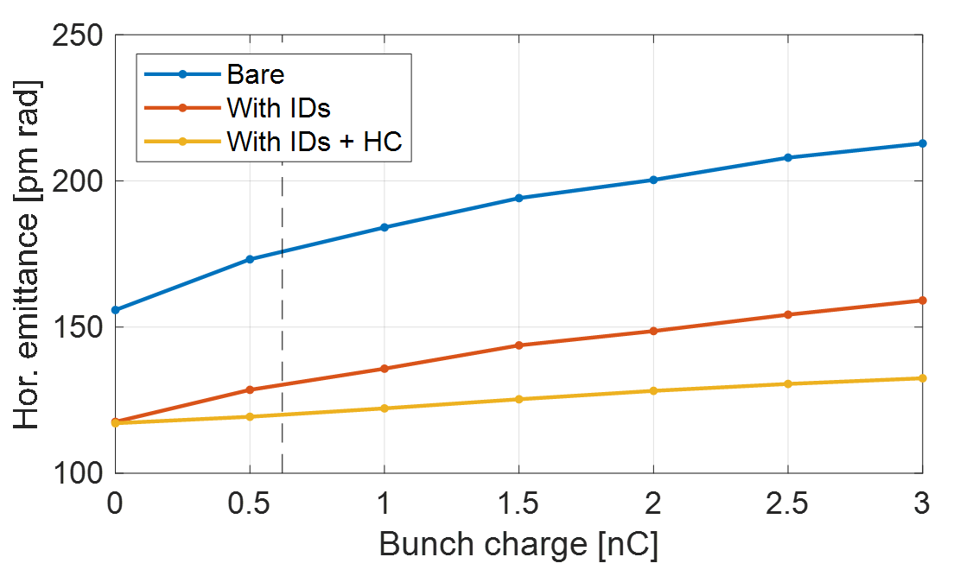
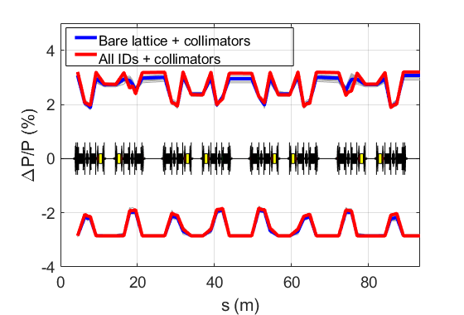
Final Machine Performance
Final performance estimated for $ε_{y}$ = 8 pm.rad, including IBS, harmonic cavity and vacuum chamber impedance
 | Bare Lattice | IDs closed
Horizontal emittance | 163 pm.rad | 120 pm.rad
Energy spread | 0.095 % | 0.109 %
Bunch length (with HC) | 49.1 ps | 48.1 ps
Touschek (without HC) | 2.8 ± 0.1 h | 2.8 ± 0.1 h
Touschek (with HC) | 8.2 ± 0.3 h | 8.8 ± 0.5 h
Coulomb | 60.0 ± 7.2 h | 59.7 ± 7.4 h
Bremsstrahlung | 277.5 ± 0.5 h | 276.6 ± 0.7 h
Total (with HC) | 7.0 h ± 0.2 h | 7.5 ± 0.4 h

Slide 19
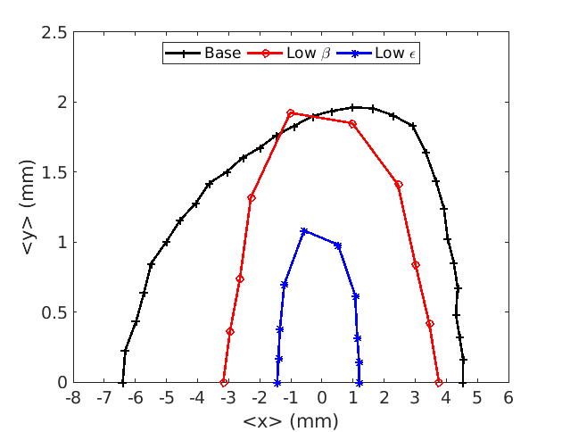
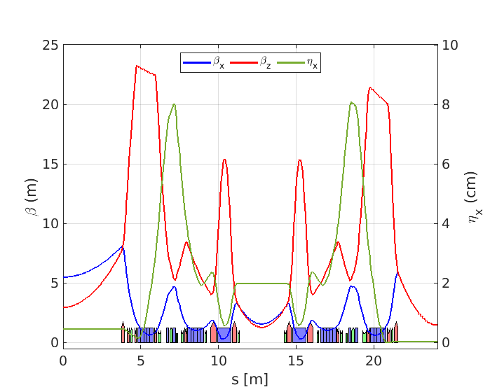
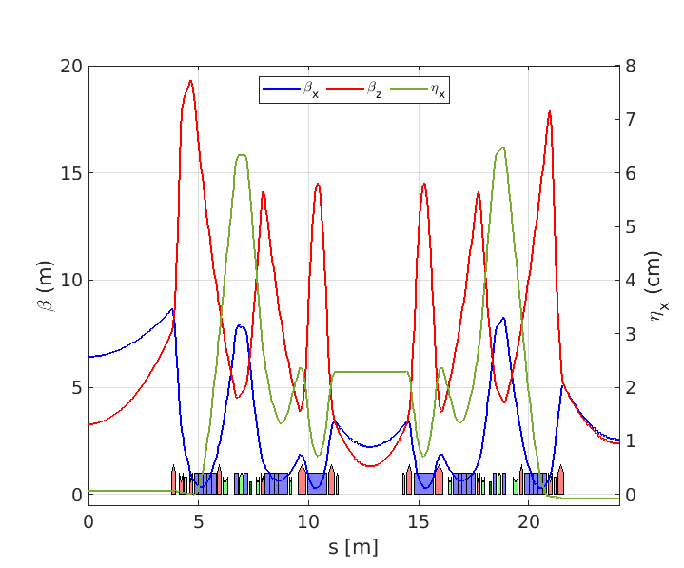
Alternative Optics?
The same hardware can be retuned to increase photon beam brightness:
  Low-beta optics
  Low emittance optics
Dynamic aperture currently considered too small to adopt as baseline
Considered for future ‘brightness-upgrade’
Ideal lattice
With apertures
Low beta
Parameter |  | Nominal | Low-beta | Low-emit
Betatron Tune |  | [54.15,20.27] | [58.14,21.27] | [62.18,20.30]
Emittance (wo, w IDs) |  | 162, 121 pm | 152, 115 pm | 106, 87 pm
Tous. Lifetime (no HC) |  | 2.2 h | 1.2 h | 0.8 h
Long | β_{x} | 8.21 m | 5.53 m | 6.45 m
 | β_{y} | 3.50 m | 2.99 m | 3.30 m
Standard | β_{x} | 5.53 m | 1.50 m | 2.58 m
 | β_{y} | 2.32 m | 1.50 m | 2.39 m
Mid | β_{x} | 2.26 m | 1.60 m | 2.24 m
 | β_{y} | 1.68 m | 1.30 m | 1.32 m
Low emittance

Slide 20
Diamond-II Timeline
Diamond-II to be funded as a Joint Venture between two sources (UK Govn./STFC 86% and Wellcome Trust 14%)
Funding Announcements:
April 2021: Wellcome Trust approve funding, subject to final approval from UK Government
June 2021: UKRI announced pre-funding for Diamond-II (£2.5M, April 2021 until April 2022)
June 2022: UKRI confirmed first phase of funding contingent on FBC (£81.5M April 2022 until April 2025)
Event | Date
CDR Published | May 2019
Outline Business Case approved by UK Government | Oct. 2021
TDR Published | Jul. 2022
Submit Final Business Case to BEIS Project Investment Committee | Dec. 2022
Start of main project funding and procurement | Apr. 2023
Start of shutdown | Sep. 2026
End of booster commissioning | Jul. 2027
End of storage ring commissioning | Dec 2027
Resume full User Mode | Mar. 2028

Slide 21
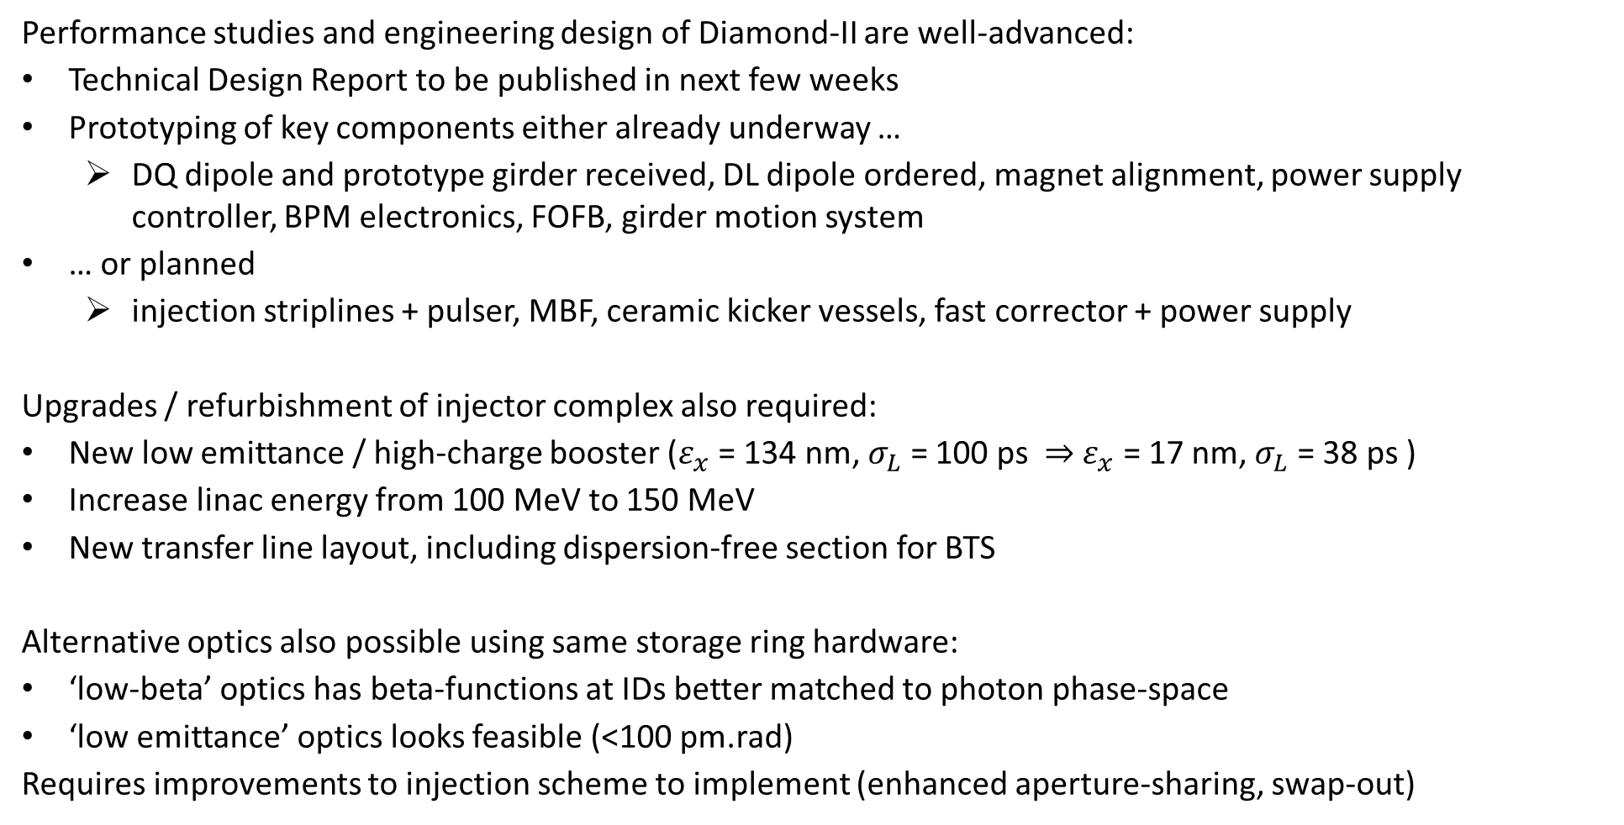
Summary
Performance studies and engineering design of Diamond-II are well-advanced:
Technical Design Report to be published in next few weeks
Prototyping of key components either already underway …
  DQ dipole and prototype girder received, DL dipole ordered, magnet alignment, power supply controller, BPM electronics, FOFB, girder motion system
… or planned
  injection striplines + pulser, MBF, ceramic kicker vessels, fast corrector + power supply
Upgrades / refurbishment of injector complex also required:
New low emittance / high-charge booster ($ε_{x}$ = 134 nm, $σ_{L}$ = 100 ps $⇒$ $ε_{x}$ = 17 nm, $σ_{L}$ = 38 ps )
Increase linac energy from 100 MeV to 150 MeV
New transfer line layout, including dispersion-free section for BTS
Alternative optics also possible using same storage ring hardware:
‘low-beta’ optics has beta-functions at IDs better matched to photon phase-space
‘low emittance’ optics looks feasible (<100 pm.rad)
Requires improvements to injection scheme to implement (enhanced aperture-sharing, swap-out)

Slide 22
Vacancies at Diamond
We now have an opportunity for new members to join the group and contribute to Diamond-II studies:
1 × Accelerator Physicist or Senior Accelerator Physicist (full time / permanent)
2 × PDRA or Senior Researcher (full time / 3-year fixed term)
Working with existing team members to contribute across many different topics:
numerical optimisation of the Diamond-II storage ring optics
studying alternative or future machine optics or special operating modes
modelling of collective effects
study performance of harmonic cavity
injection studies
booster and transfer line development
machine studies of existing Diamond accelerators
https://www.diamond.ac.uk/Careers/Vacancies.html

