Slide 1

Injection into Diamond-II beam dynamics and technological challenges
Jonas Kallestrup

Slide 2
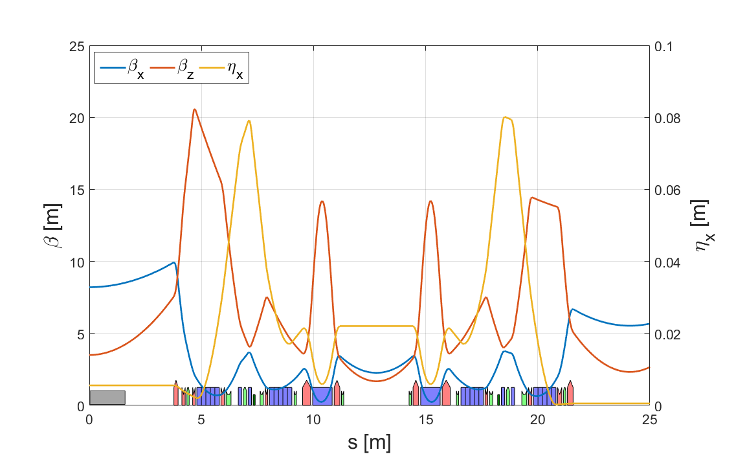
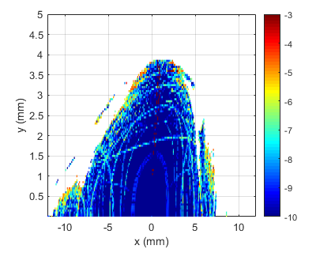
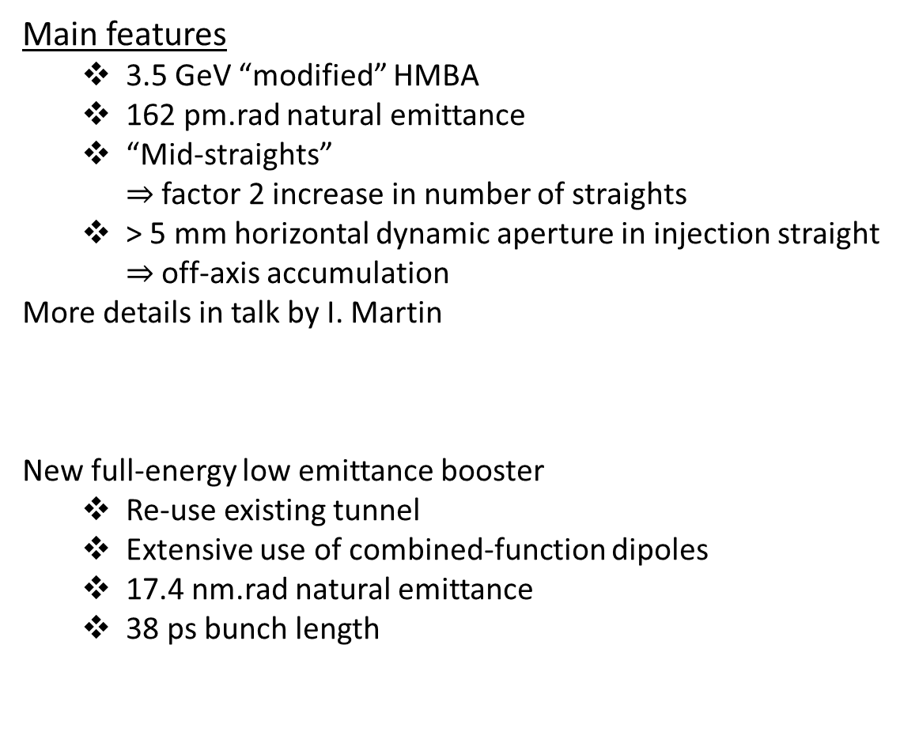

Diamond-II recap
Main features
  3.5 GeV “modified” HMBA
  162 pm.rad natural emittance
  “Mid-straights”
  $⇒$ factor 2 increase in number of straights
  > 5 mm horizontal dynamic aperture in injection straight
  $⇒$ off-axis accumulation
More details in talk by I. Martin
New full-energy low emittance booster
  Re-use existing tunnel
  Extensive use of combined-function dipoles
  17.4 nm.rad natural emittance
  38 ps bunch length
$$β_{x}=8.2m, β_{y}=3.5m$$

Slide 3
Injection strategy
Guiding principles for injection scheme selection and design:
  Flexibility & adjustability
  Transparency
  Upgradability for high-brightness mode
  Risk minimization, maintain fallback options
Three injection schemes to be used for various situations:
Four kicker bump
Single-bunch
aperture sharing
“Enhanced” aperture sharing
Commissioning
Multi-bunch filling
Fallback option
User operation
High-brightness
lattice options

Slide 4
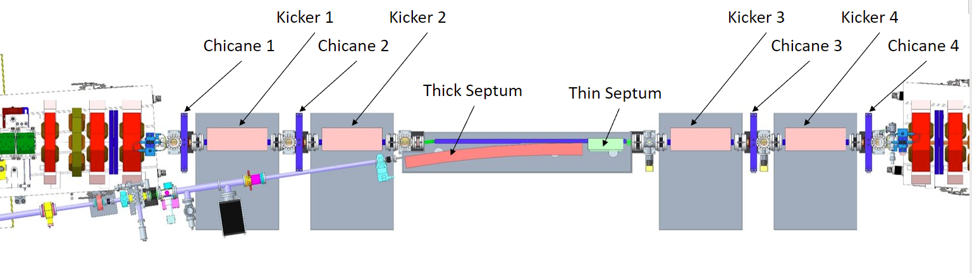
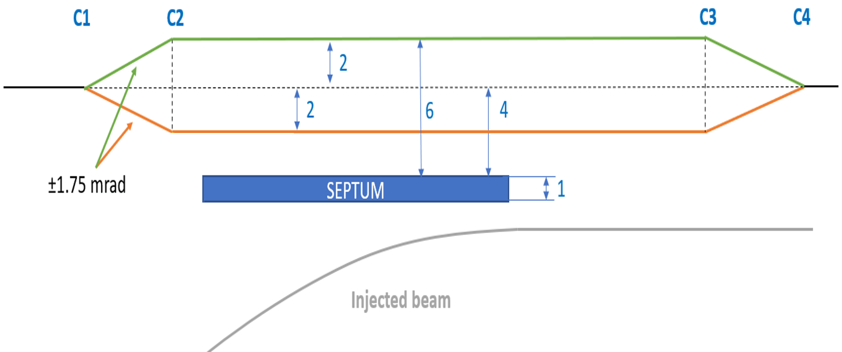
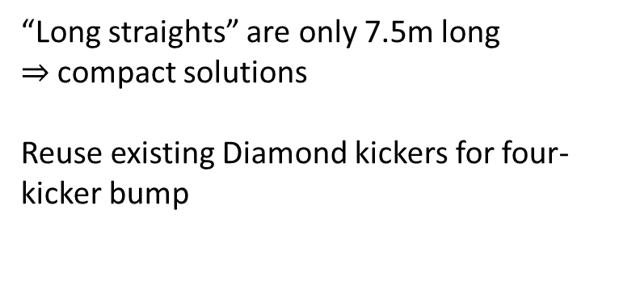
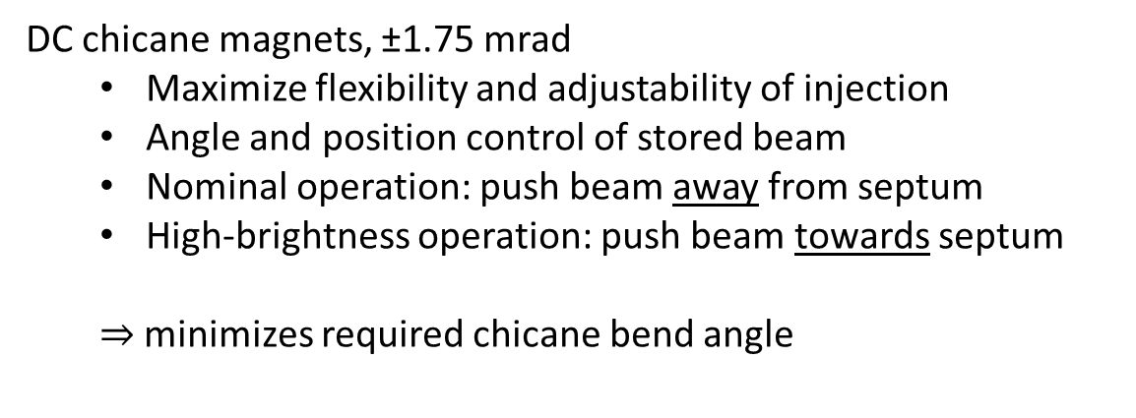
Injection straight
“Long straights” are only 7.5m long
$⇒$ compact solutions
Reuse existing Diamond kickers for four-kicker bump
DC chicane magnets, ±1.75 mrad
  Maximize flexibility and adjustability of injection
  Angle and position control of stored beam
  Nominal operation: push beam away from septum
  High-brightness operation: push beam towards septum
  $⇒$minimizes required chicane bend angle

Slide 5
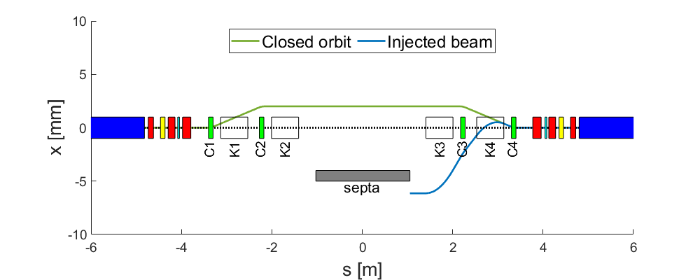
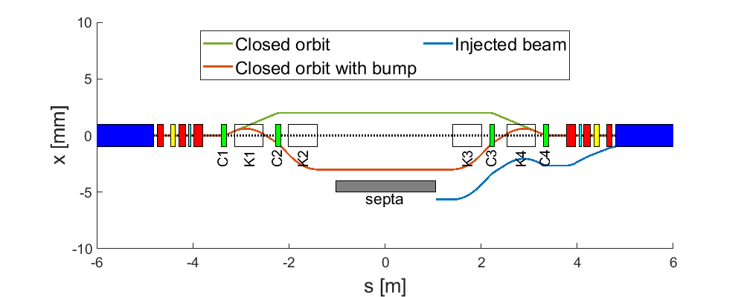
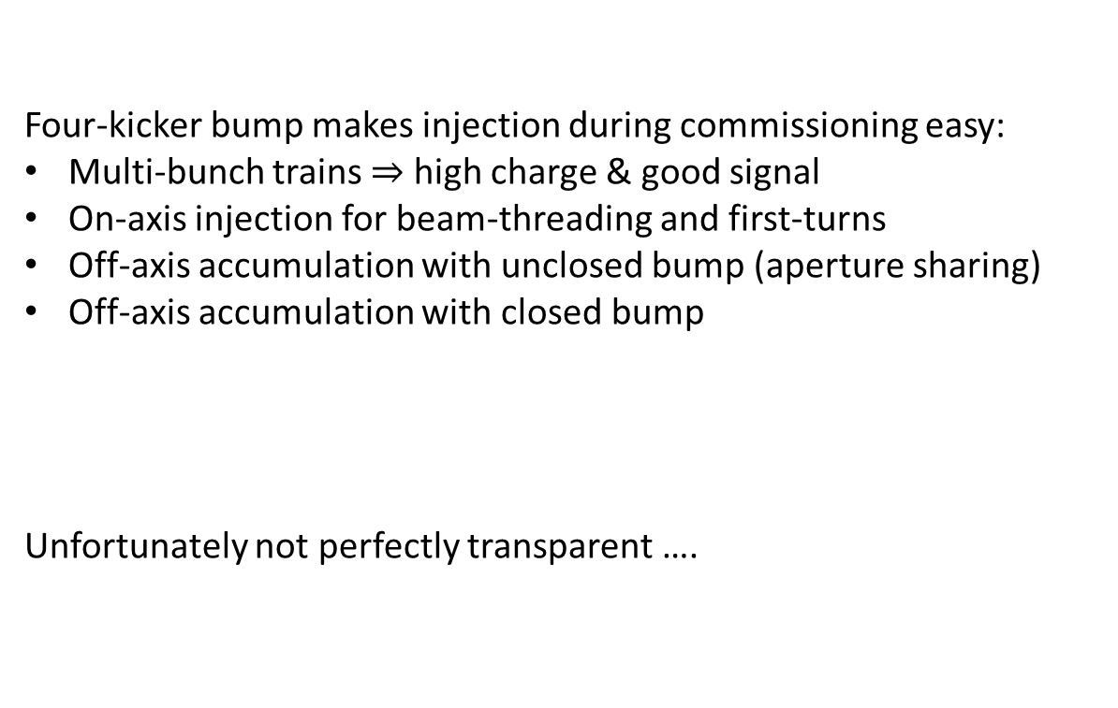
Four-kicker bump for Diamond-II
Four-kicker bump makes injection during commissioning easy:
Multi-bunch trains $⇒$ high charge & good signal
On-axis injection for beam-threading and first-turns
Off-axis accumulation with unclosed bump (aperture sharing)
Off-axis accumulation with closed bump
Unfortunately not perfectly transparent ….

Slide 6
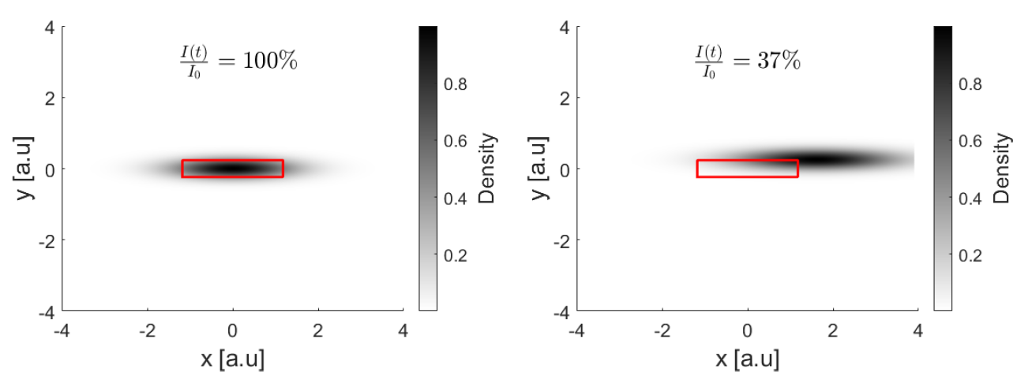
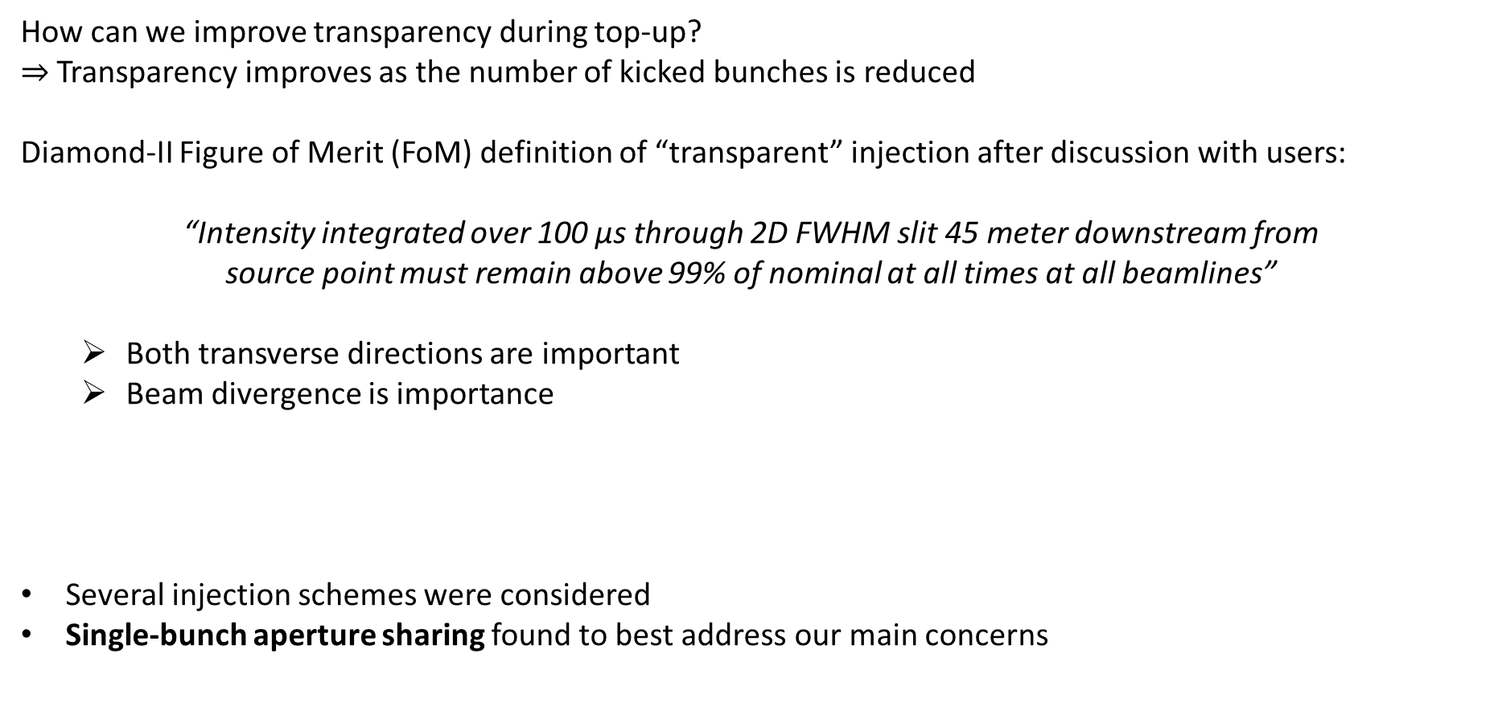
Transparency definition for Diamond-II
How can we improve transparency during top-up?
$⇒$Transparency improves as the number of kicked bunches is reduced
Diamond-II Figure of Merit (FoM) definition of “transparent” injection after discussion with users:
“Intensity integrated over 100 μs through 2D FWHM slit 45 meter downstream from
source point must remain above 99% of nominal at all times at all beamlines”
  Both transverse directions are important
  Beam divergence is importance
Several injection schemes were considered
Single-bunch aperture sharing found to best address our main concerns

Slide 7
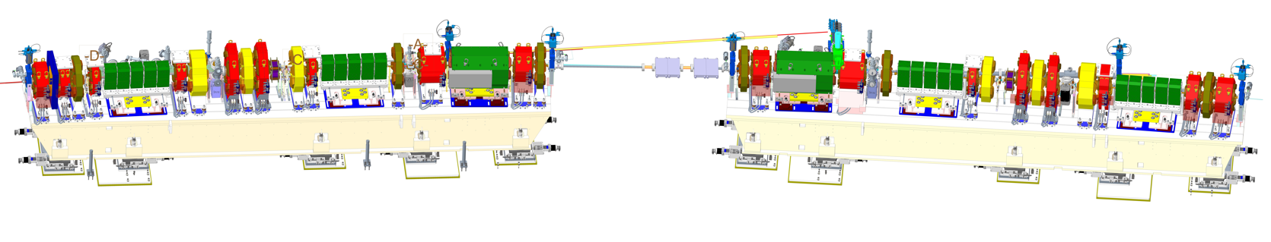
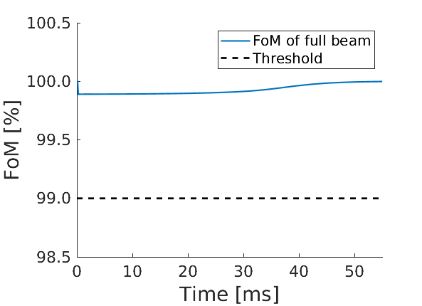
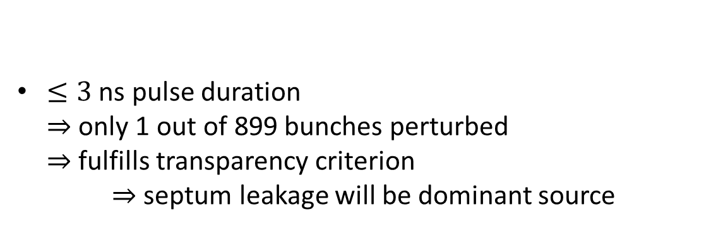
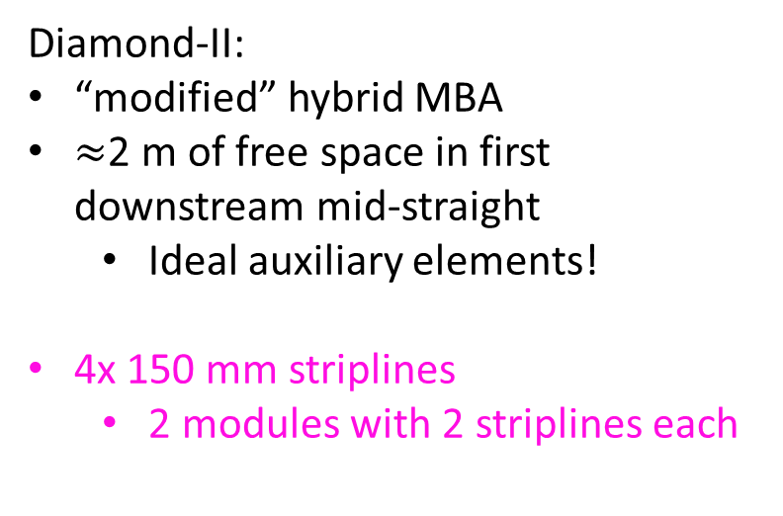
Single-bunch aperture sharing
Diamond-II:
“modified” hybrid MBA
$≈$2 m of free space in first downstream mid-straight
  Ideal auxiliary elements!
4x 150 mm striplines
  2 modules with 2 striplines each
$≤3$ ns pulse duration
$⇒$ only 1 out of 899 bunches perturbed
$⇒$ fulfills transparency criterion
$⇒$ septum leakage will be dominant source

Slide 8
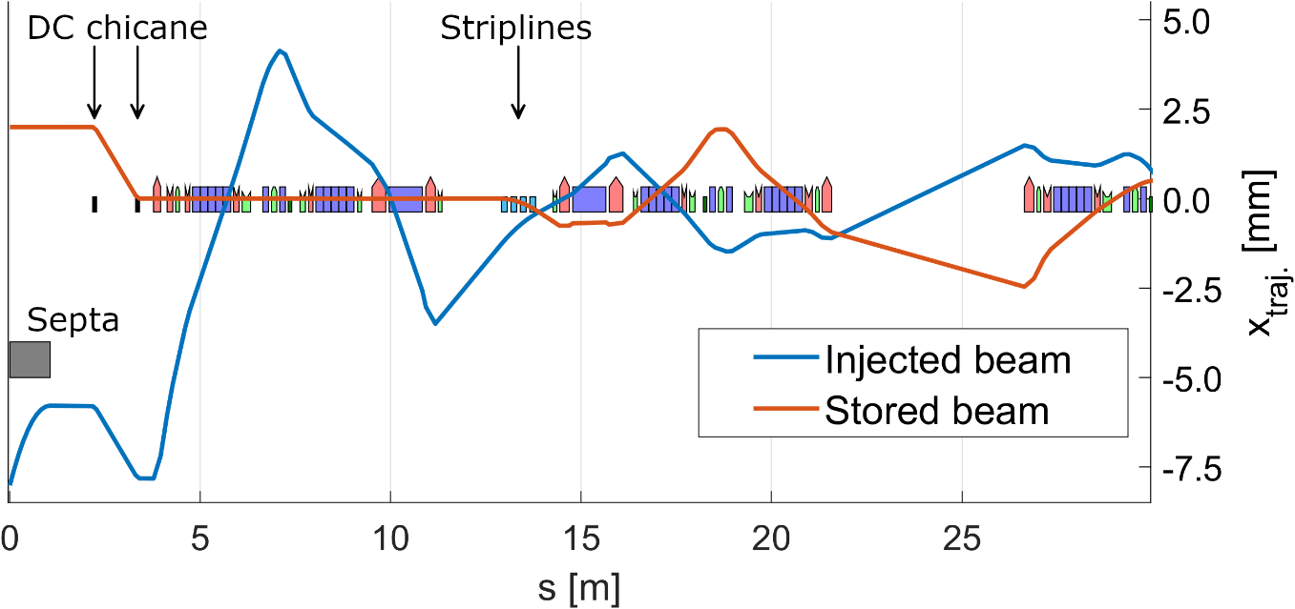
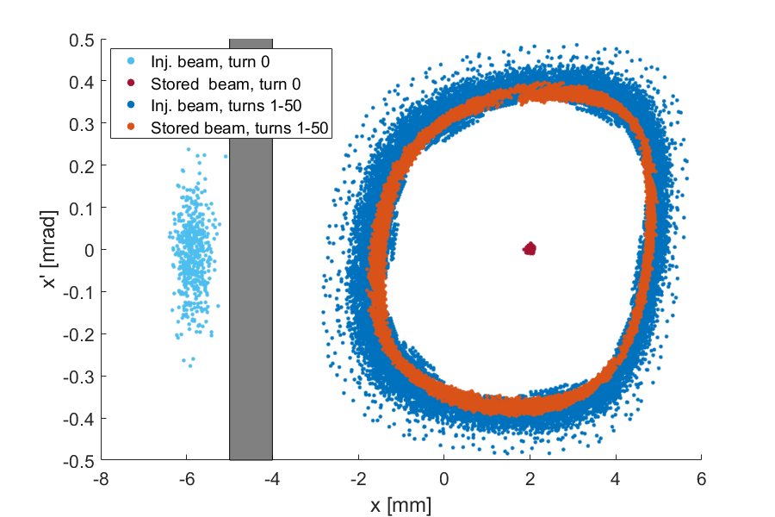
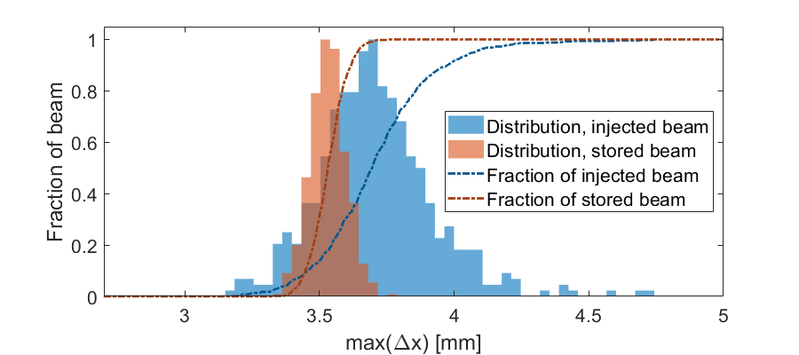
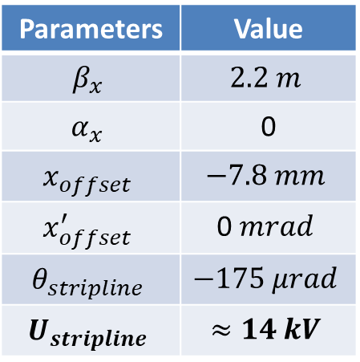
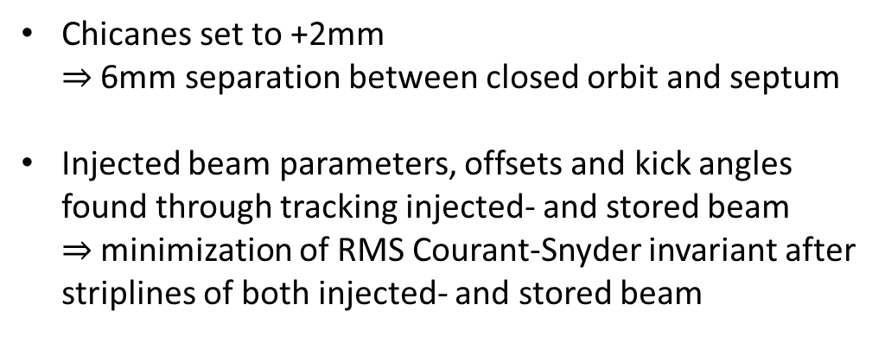
Single-bunch aperture sharing
Chicanes set to +2mm
$⇒$ 6mm separation between closed orbit and septum
Injected beam parameters, offsets and kick angles found through tracking injected- and stored beam
$⇒$minimization of RMS Courant-Snyder invariant after striplines of both injected- and stored beam
Parameters | Value
$$β_{x}$$ | $$2.2 m$$
$$α_{x}$$ | 0
$$x_{offset}$$ | $$−7.8 mm$$
$$x_{offset}^{′}$$ | 0 $mrad$
$$θ_{stripline}$$ | $$−175 μrad$$
$$U_{stripline}$$ | $$≈14 kV$$

Slide 9
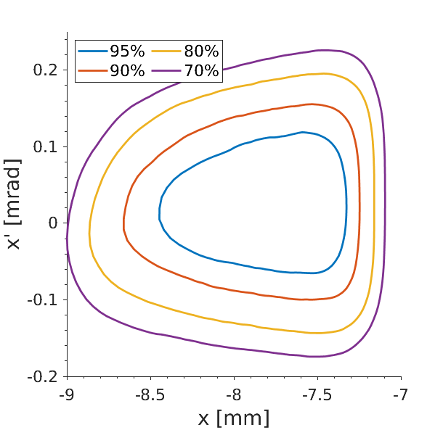
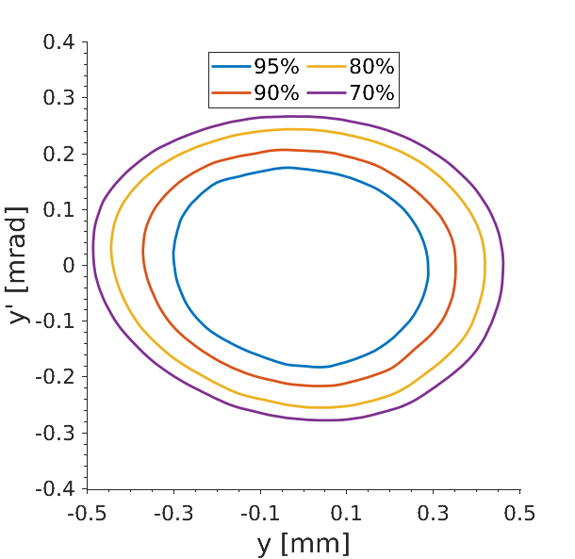
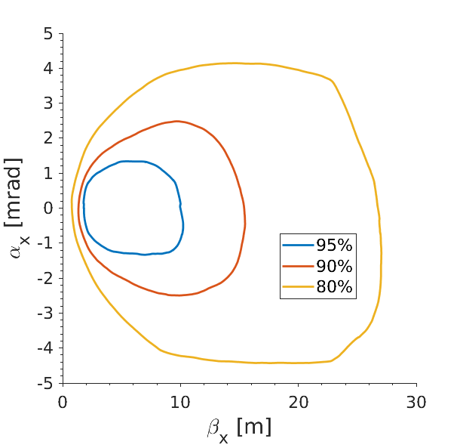
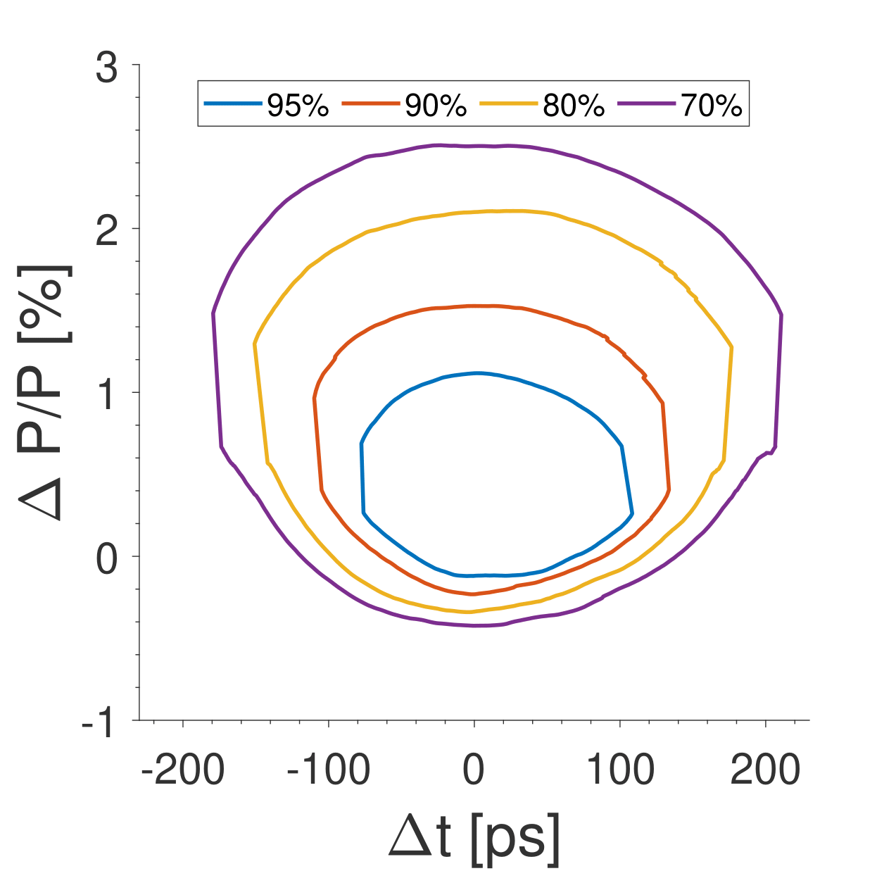
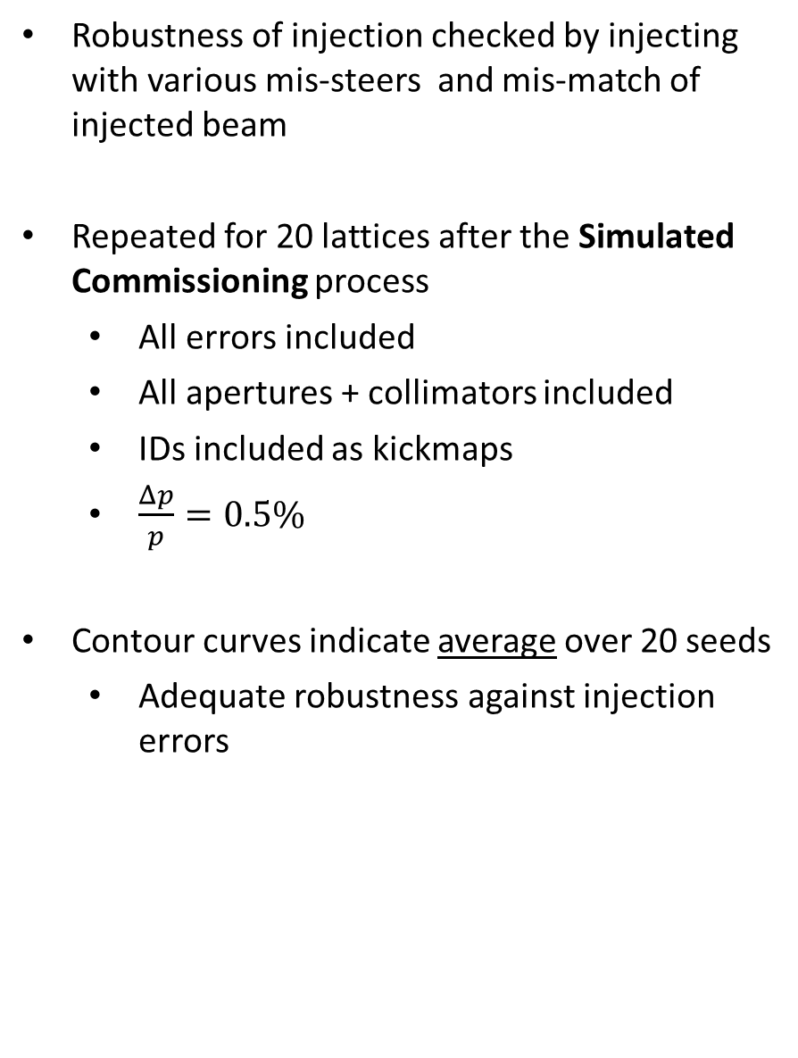
Single-bunch aperture sharing
Robustness of injection checked by injecting with various mis-steers and mis-match of injected beam
Repeated for 20 lattices after the Simulated Commissioning process
  All errors included
  All apertures + collimators included
  IDs included as kickmaps
  $\frac{Δp}{p}=0.5\%$
Contour curves indicate average over 20 seeds
  Adequate robustness against injection errors

Slide 10
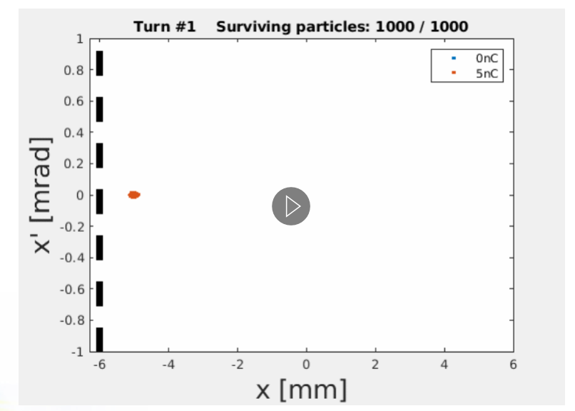
Impact of short-range wakefields
Beam oscillations in combination with impedance lead to short-range wake fields

Slide 11
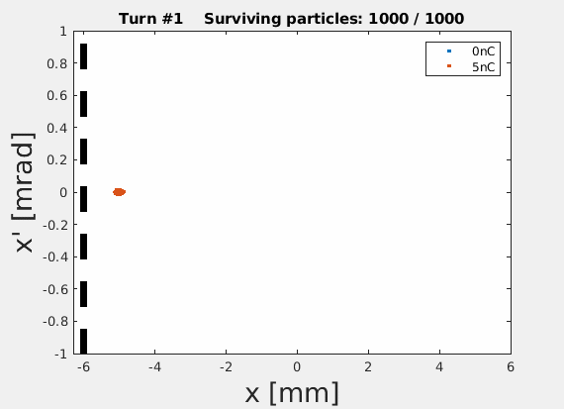
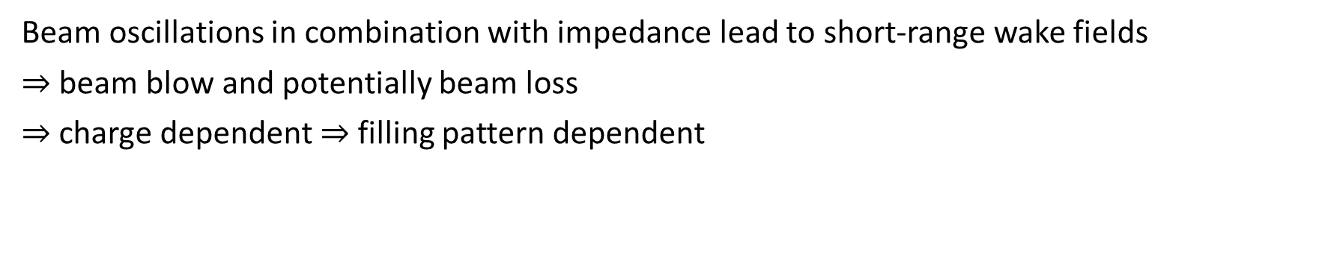
Impact of short-range wakefields
Beam oscillations in combination with impedance lead to short-range wake fields
$⇒$beam blow and potentially beam loss
$⇒$charge dependent $⇒$filling pattern dependent

Slide 12
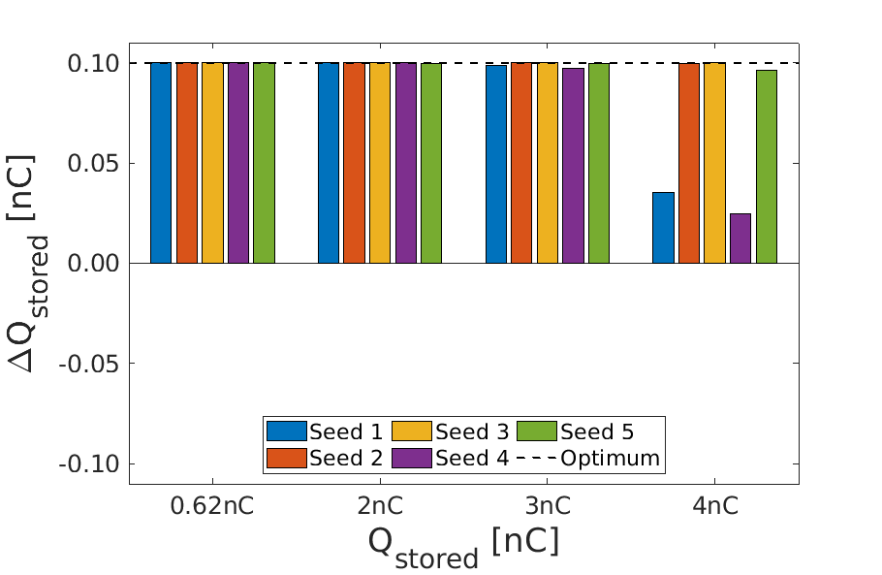
Impact of short-range wakefields
Injection of 100pC bunch into stored bunches of various charges using Elegant
    Element-by-element tracking with collimators
    5 error seeds
    Lumped impedance divided to 24 locations
    3rd harmonic cavity
No problem for nominal operational range (0.62nC)
Might be an issue for camshaft operation
Mitigation techniques found to be helpful:
  Smaller kick angle (smaller stored beam oscillations)
  Higher chromaticity
  Time-separation between injected- and stored bunch
100% injection efficiency
Nominal
operation
Potential camshaft
charge

Slide 13
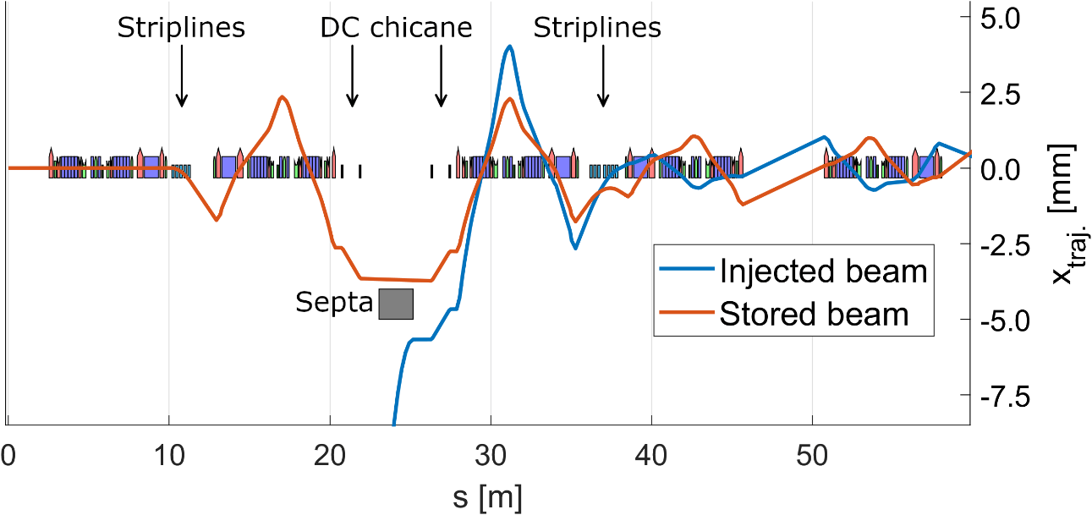
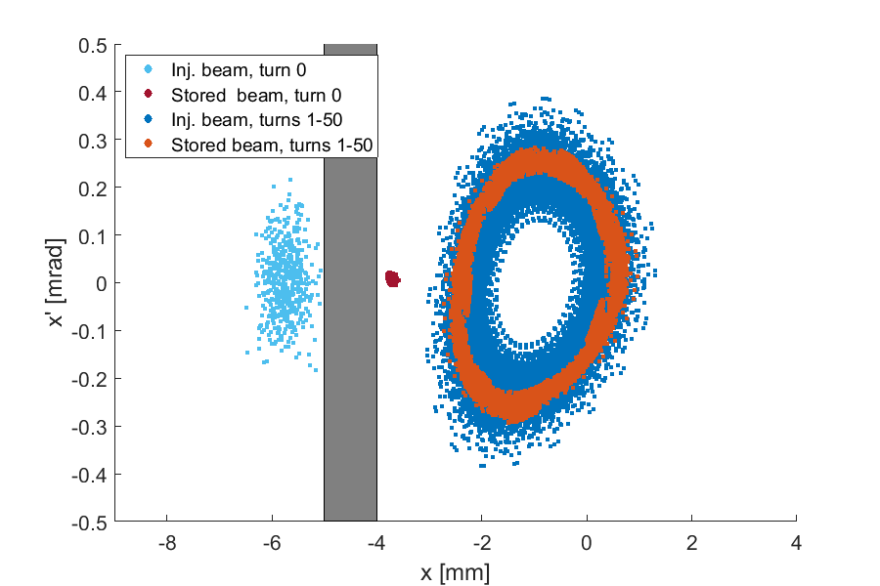
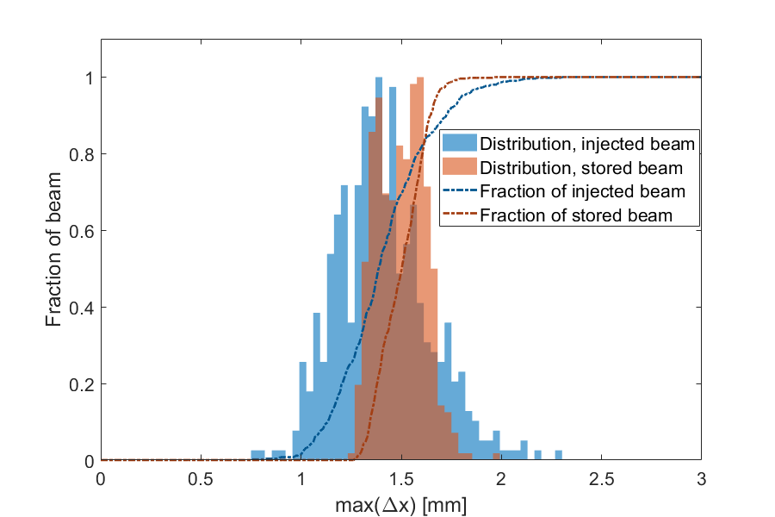
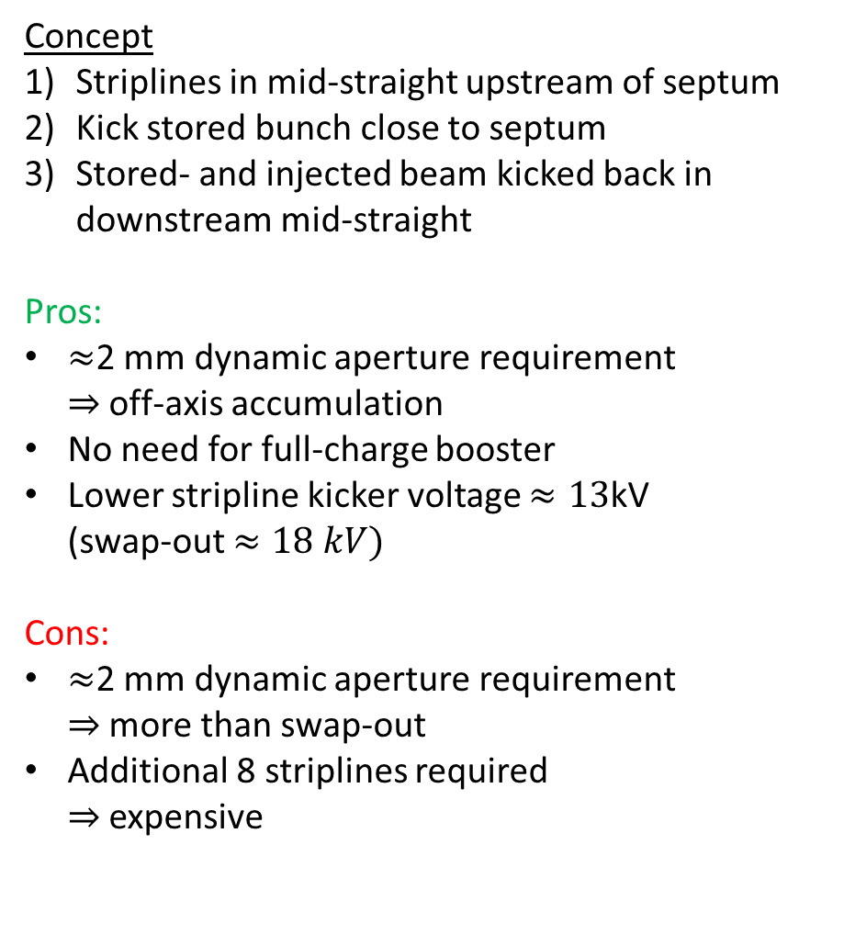
High-brightness injection: enhanced aperture sharing
Concept
Striplines in mid-straight upstream of septum
Kick stored bunch close to septum
Stored- and injected beam kicked back in downstream mid-straight
Pros:
$≈$2 mm dynamic aperture requirement
$⇒$off-axis accumulation
No need for full-charge booster
Lower stripline kicker voltage $≈13$kV
(swap-out $≈18 kV)$
Cons:
$≈$2 mm dynamic aperture requirement
$⇒$ more than swap-out
Additional 8 striplines required
$⇒$expensive

Slide 14
Technical developments and challenges

Slide 15
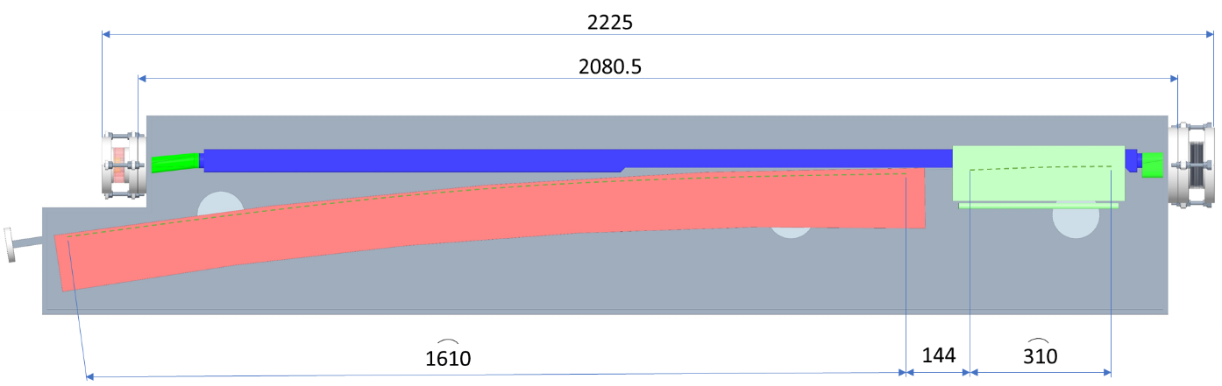
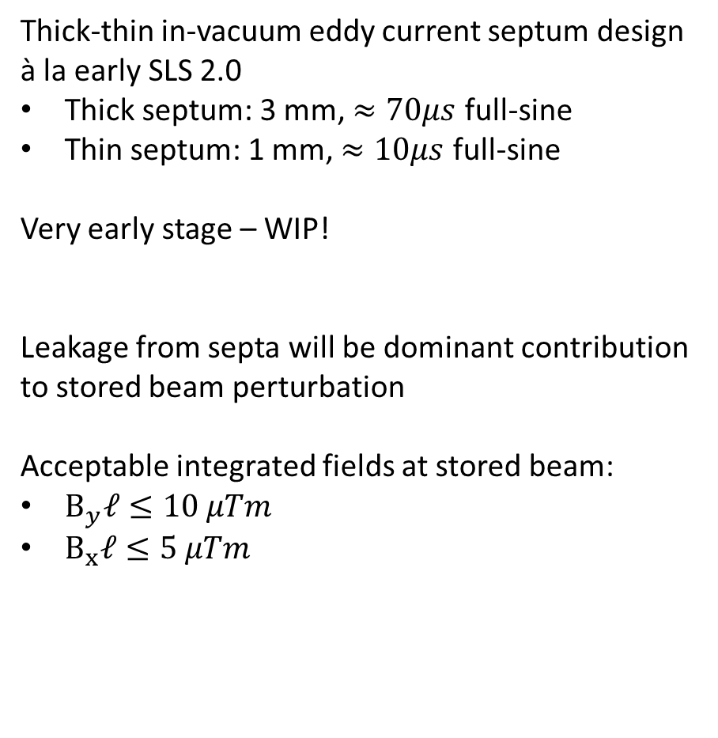
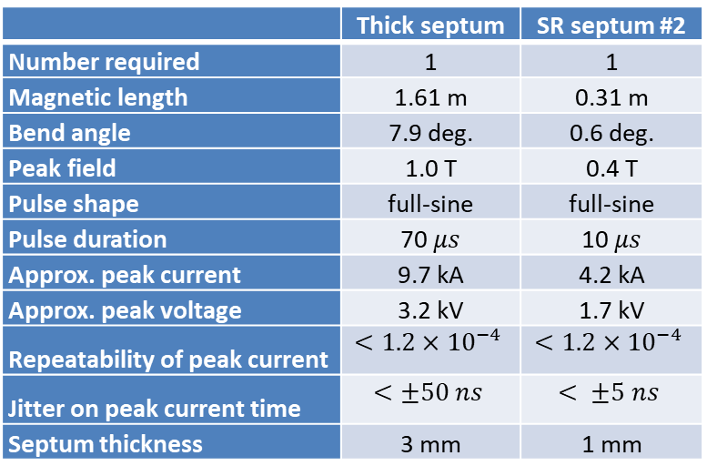
Septa
Thick-thin in-vacuum eddy current septum design à la early SLS 2.0
Thick septum: 3 mm, $≈70μs$ full-sine
Thin septum: 1 mm, $≈10μs$ full-sine
Very early stage – WIP!
Leakage from septa will be dominant contribution to stored beam perturbation
Acceptable integrated fields at stored beam:
$B_{y}ℓ≤10 μTm$
$B_{x}ℓ≤5 μTm$
 | Thick septum | SR septum #2
Number required | 1 | 1
Magnetic length | 1.61 m | 0.31 m
Bend angle | 7.9 deg. | 0.6 deg.
Peak field | 1.0 T | 0.4 T
Pulse shape | full-sine | full-sine
Pulse duration | 70 $μs$ | 10 $μs$
Approx. peak current | 9.7 kA | 4.2 kA
Approx. peak voltage | 3.2 kV | 1.7 kV
Repeatability of peak current | $$<1.2×{10}^{−4}$$ | $$<1.2×{10}^{−4}$$
Jitter on peak current time | $$<±50 ns$$ | $$< ±5 ns$$
Septum thickness | 3 mm | 1 mm

Slide 16
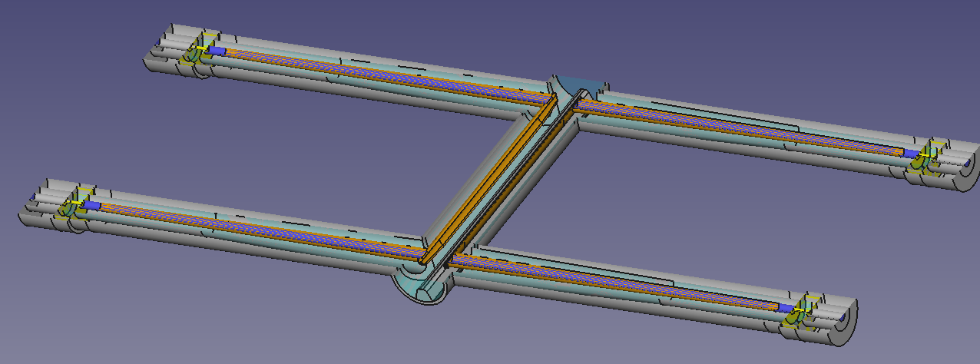
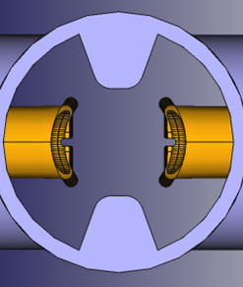
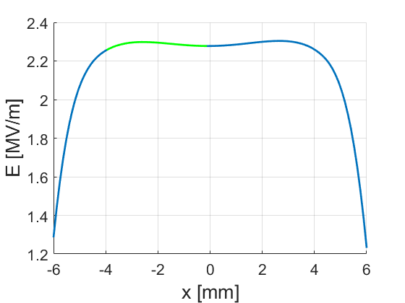
Injection striplines – design
Early conceptual design of striplines inspired by work at PSI and IHEP.
150 mm effective length for optimum straight section filling factor
Curved + flat geometry
  Curved: 14 mm gap
  Flat: ~12 mm full gap
1 mm radius notch for synchrotron radiation clearance
Nose-cones improves impedance matching
Field-flatness off-axis reasonably good
Single set of striplines
≈12 mm
14 mm
14 mm

Slide 17
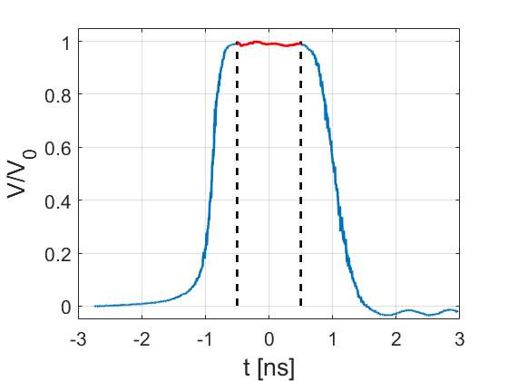
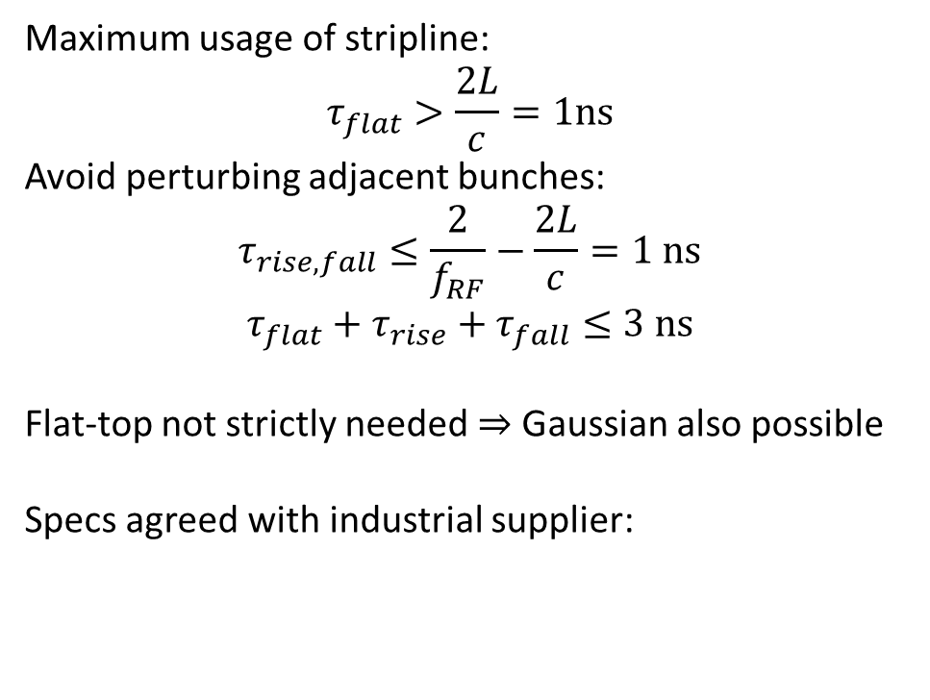
Stripline pulsers
Maximum usage of stripline:
$$τ_{flat}>\frac{2L}{c}=1ns$$
Avoid perturbing adjacent bunches:
$$τ_{rise, fall}≤\frac{2}{f_{RF}}−\frac{2L}{c}=1 ns$$
$$τ_{flat}+τ_{rise}+τ_{fall}≤3 ns$$
Flat-top not strictly needed $⇒$ Gaussian also possible
Specs agreed with industrial supplier:
Note: not from prototype
Parameter | Value
Voltage range | 15-20 kV
Rise time (5%-95%) | 0.6 ns
Flat top (>95%) | 1.4 ns
Fall time (95%-5%) | 0.7 ns

Slide 18
Conclusions
Injection schemes for Diamond-II have been thoroughly studied
Single bunch aperture sharing scheme for user-operation
Kicker-bump for commissioning, fast multi-bunch filling, reliable fallback option
“Enhanced” aperture sharing for accumulation into ≈2 mm dynamic aperture
Mid-straights of modified hybrid multi-bend achromat provides good locations for striplines
Robustness of injection versus mis-steering, mis-match and short-range wakefields checked by tracking in lattices with errors (e.g. Simulated Commissioning)
Good performance!
Several key technologies under development
In-vacuum thick-thin eddy current septa
150 mm striplines
Few nanosecond pulsers from industry
Stage | Scheme
Early commissioning | Traditional 4-kicker bump | Multi-/single-bunch
User operation | Single-bunch aperture sharing | single-bunch
High-brightness mode | Enhanced aperture sharing | single-bunch

Slide 19
Thank you for your attention !

Slide 20
Extra slides

Slide 21
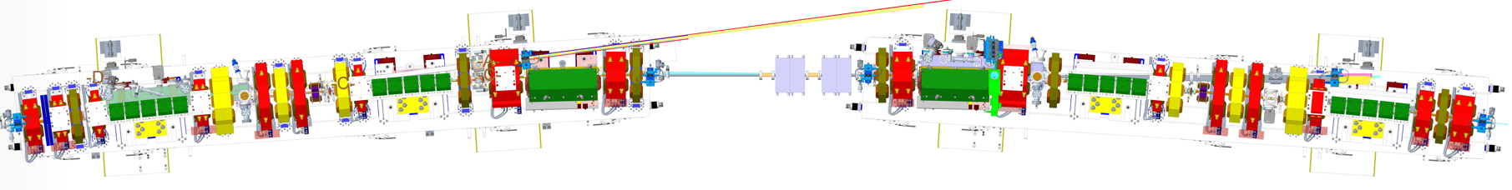
Mid-straight layout

Slide 22
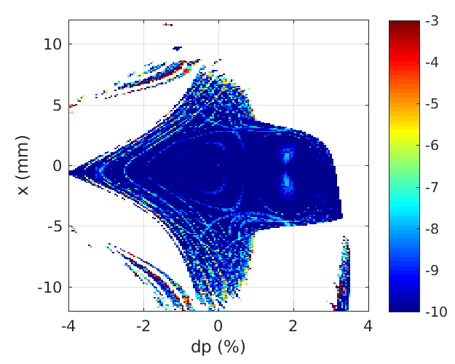
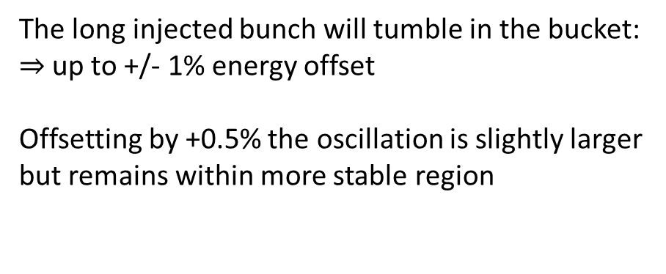
Why $Δp/p$ = 0.5% ?
The long injected bunch will tumble in the bucket:
$⇒$ up to +/- 1% energy offset
Offsetting by +0.5% the oscillation is slightly larger
but remains within more stable region

Slide 23
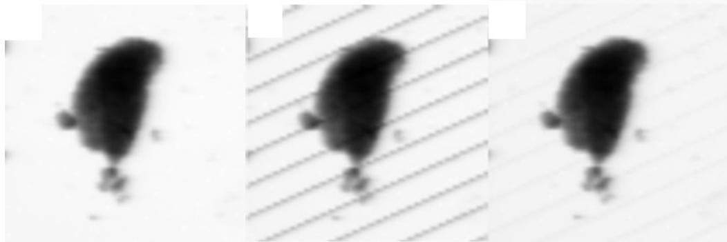
Four-kicker bump for Diamond-II
Four kicker bump injection not perfectly transparent
Experience at Diamond with compensation by pinger magnets
Good improvement but still 2% drop in intensity
No injection
Injection
Injection + compensation
Continuous raster scan, 10 ms/pixel exposure
R.T. Fielder et. al, IPAC’21, doi:10.18429/JACoW-IPAC2021-MOPAB128

Slide 24
Injector upgrade

Slide 25
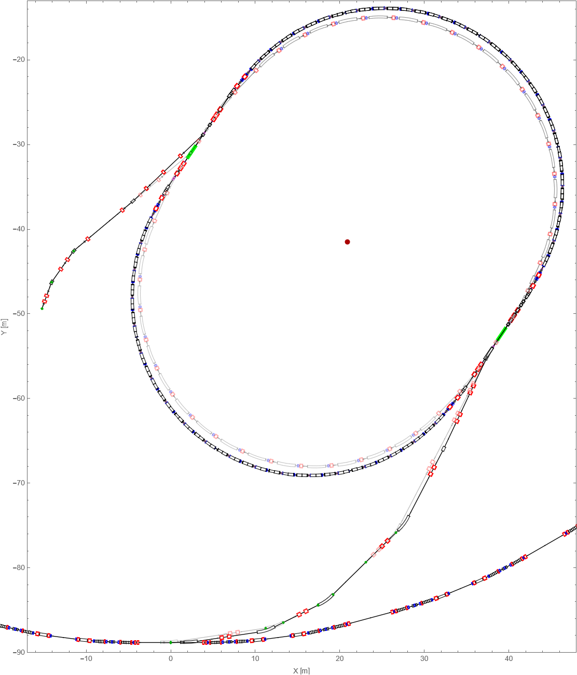
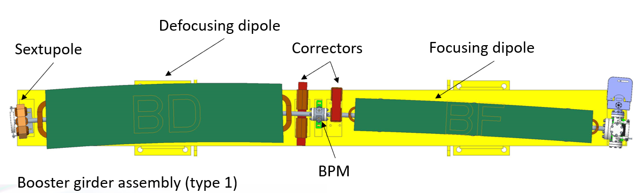
Injector upgrade
Existing booster is insufficient for Diamond-II
Maximum 3.0 GeV electrons
~140 nm emittance, too large for injection
Long bunches
Low charge per shot
New design
Retain race-track structure to fit inside tunnel
Extensive use of combined-function magnets focusing/defocusing gradients and chromaticity correction
Dispersion-free straights
Booster Ring
Old Booster Ring
Fixed Mid-Point

Slide 26
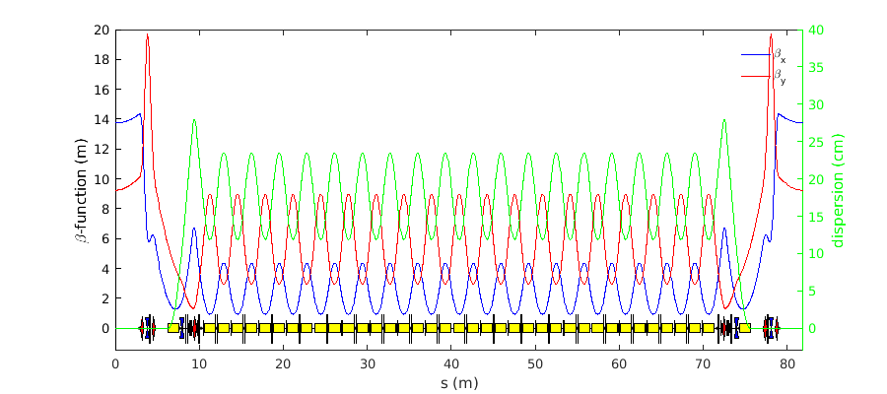
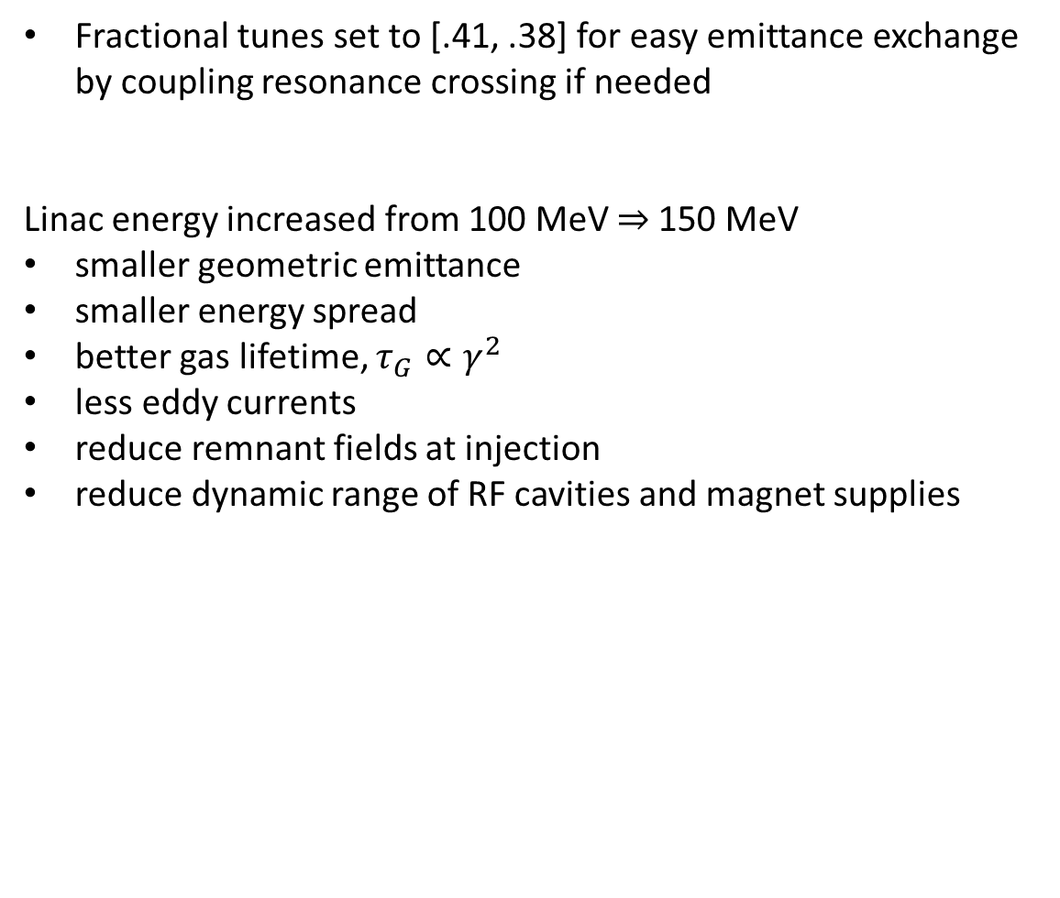
Injector upgrade
Fractional tunes set to [.41, .38] for easy emittance exchange by coupling resonance crossing if needed
Linac energy increased from 100 MeV $⇒$150 MeV
smaller geometric emittance
smaller energy spread
better gas lifetime, $τ_{G}∝γ^{2}$
less eddy currents
reduce remnant fields at injection
reduce dynamic range of RF cavities and magnet supplies
Parameter | Units | Existing Booster | Booster-II
Energy Range | GeV | 0.1 - 3.0 | 0.15 - 3.5
Number of Cells | - | 22 | 36+4
Repetition Frequency | Hz | 5 | 5
Circumference | m | 158.4 | 163.8
Betatron Tunes | - | [7.18, 4.27] | [12.41, 5.38]
Natural Chromaticity | - | [-9.7, -6.3] | [-13.7, -12.3]
Corrected chromaticity | - | [+1.00, +1.00] | [+2.00, +2.00]
Mom. Comp. Factor | - | 0.0252 | 0.00567
Emittance | nm.rad | 134.4 | 17.4
Energy Spread | % | 0.073 | 0.086
Nat. Bunch Length | ps | 99.3 | 38.0
Damping Part. [J_{x}, J_{y}, J_{E}] | - | [1.00, 1.00, 2.00] | [1.10, 1.00, 1.90]

Slide 27

Booster-to-storage ring transfer line
A new booster-to-storage ring transfer line has been designed
Reuse all existing dipoles + girders
Reuse all existing quadrupoles + girders
Reuse all diagnostics with minor modifications
(stripline BPMs, ICTs, screen monitors, etc.)
1 additional small dipole to correct difference in
extraction septum bend angle
Dispersion-free section for simple quadrupole scans

Slide 28
Stripline design and timing effects

Slide 29




Stripline shapes
Different stripline shapes are being checked to improve field uniformity at various horizontal displacements
First solution:
14 mm circular
Problems with field roll-off at $±4$ mm
Second solution:
14 mm circular
$≈$1 mm flattening
Improved field flatness out to $±4$ mm
y = 0

Slide 30



Effect of stripline timing offsets on aperture sharing
Field seen by beam
Tracking simulations indicate that 10% less kick angle on all striplines still leads >95% injection efficiency
Timing offset
The integrated voltage seen by the beam will change if all pulses are offset with respect to the beam
  Example: +/- 350 ps offsets leads to ~2% less kick
Timing jitter
Four striplines with random jitter.
$⇒$ Chances of low total kick voltage when summing 4 contributions?
Fraction of shots with amplitude above either 70%, 80%, 95% 99% of nominal amplitude for varying jitter magnitude $σ\left(t\right)$
(random Gaussian jitter applied to each of 4 striplines)
  For <100 ps rms timing jitter we have ~100% of shots with >99% amplitude
  For <200 ps rms: ~100% of shots with >95% amplitude
  $⇒$ sufficient for good injection efficiency stability

Slide 31


High-brightness injection: swap-out
Swap-out option as alternative to Enhanced Aperture Sharing
Concept
  Add more striplines
  Bring injected bunch on-axis in first mid-straight
  Kick stored bunch into beam dump
Pros:
Simple upgrade from aperture sharing
Able to inject into smallest DA
Cons:
Beam dumped required, tricky engineering
Lots of radiation produced
No accumulation $⇒$full-charge booster required
Larger kick angle required: 18.5kV on striplines
Beam dump

