Slide 1

Injection into SLS 2.0: beam dynamics aspects and technological challenges
M. Aiba, C. Gough, M. Paraliev, A. Streun, PSI
Low Emittance Lattice design workshop
ALBA, Cerdanyola del Vallès, Barcelona, Spain
29.06.2022

Slide 2
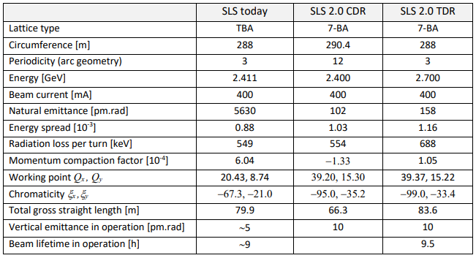
SLS and SLS 2.0 parameters

Slide 3
Injection design goals
Quasi-on-axis injection to cope with the limited machine aperture
100% injection efficiency
Injection hardware with no/low technological risk
Transparent to the stored beam as much as possible
On-axis injection available for the commissioning

Slide 4
“History” of injection design
2017 (CDR): Kicker-bump injection with “Anti-septum” or Multipole kicker injection
2019, Q1: Anti-septum → Thick+ thin septa a la ALS
  Anti-septum is a clever approach but thin septum is a straightforward solution from engineering point of view
2019, Q2: Kicker-bump injection in the vertical plane and Aperture sharing as a future upgrade
  Lambertson septum can be as thin as 1 mm
  Small injection beam emittance
  Large dynamic aperture (when optimized for the vertical plane)
2020: Kicker-bump injection in the horizontal plane and Aperture sharing available on Day 1
  It turned out that the collective effect causes beam losses in case of aperture sharing in the vertical plane
  Small emittance beam (2.5 nm or less) thanks to emittance exchange in the booster
  Short pulse kicker with ~15 ns pulse will be available from Day 1
  “Nano-second kicker” to increase the transparency and/or to achieve on-axis injection as a future upgrade option

Slide 5
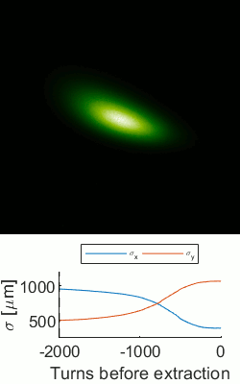
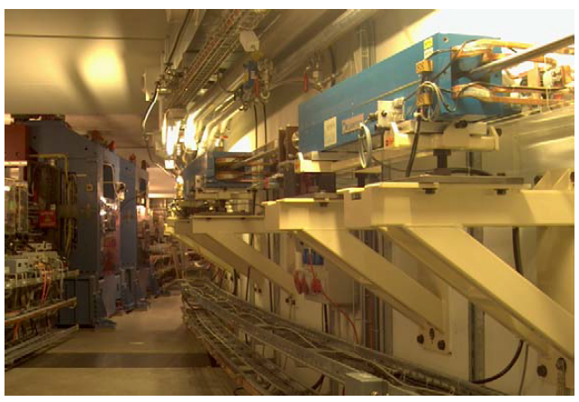
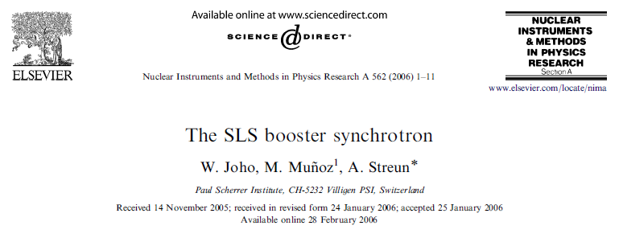
Ingredients for successful injection (1)
Injection beam emittance
  SLS booster to be reused
  Equi. emittance = 11.4 nm at 2.7 GeV
  Emittance exchange →1~2 nm
Emittance exchange experiment
J. Kallestrup, PhD thesis

Slide 6
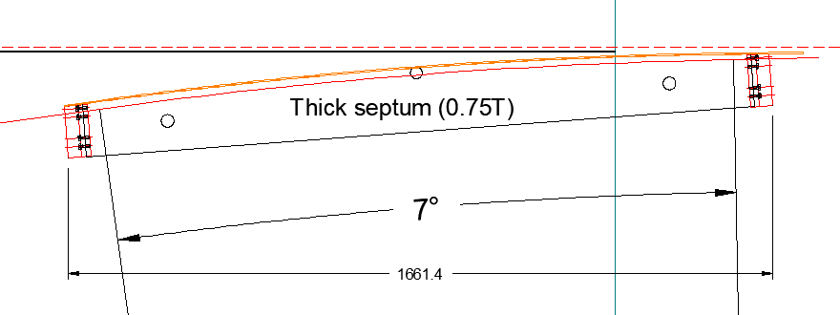
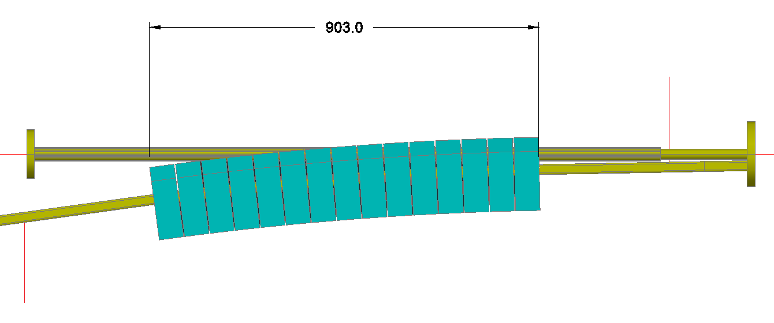
Ingredients for successful injection (2)
Thick+Thin septa a la ALS
  Thin septum
    Eddy current septum, 1 mm
    Deflection = 13.5 mrad
    Pulse length ~15 μs
    Leakage field <20 ppm
  Thick septum
    Eddy current septum, 3 mm copper
    Deflection = 7 deg
    Pulse length ~70 μs
    Leakage field <2 ppm
    PM based septum as an alternative; better stability and no dynamic disturbance to the stored beam
Thick pulsed septum (0.75 T)
Permanent magnet based septum (1.2 -1.3 T)

Slide 7
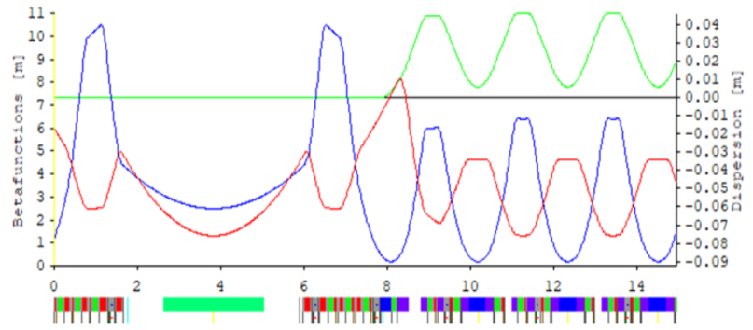
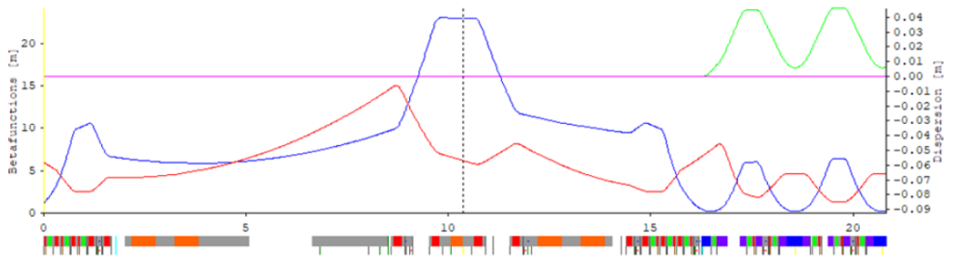
Ingredients for successful injection (3)
Pseudo symmetry, A. Streun
  Phase advance between sextupoles facing to the straight is constant over all straight sections in each plane: Super-periodicity = Number of arcs for on-energy particles, significantly improving the dynamic aperture
  Beta function at the septum can be increased to enlarge the dynamic aperture
SLS2 short straight
SLS2 long straight (Injection straight)
Septum
μ_{x,S} = μ_{x,L}
μ_{y,S} = μ_{x,L}
μ_{x,S} / μ_{y,S}
μ_{x,L} / μ_{y,L}
Last sextupole
upstream of S.S.
First sextupole
downstream of S.S.
Last sextupole
upstream of L.S.
First sextupole
downstream of L.S.
Pseudo symmetry can be extended to off energy:
ESR workshop, P. Raimondi (Link)

Slide 8
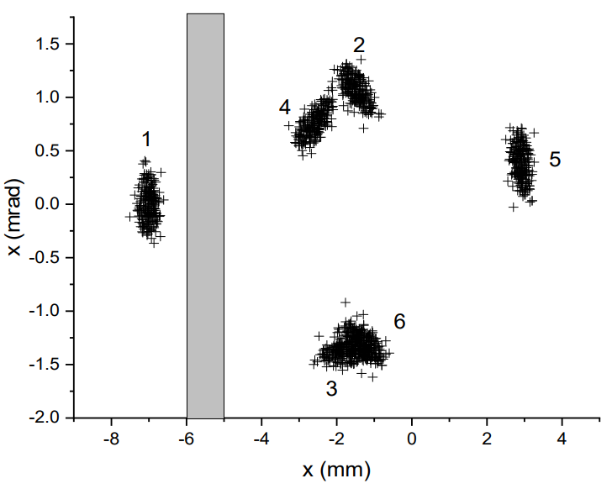
Kicker-bump injection
SLS kickers to be reused
Design clearances
  Injection beam to septum = 1 mm
    → 6σ clearance for 3σ inj. beam (ε=2 nm)
  Stored beam to septum = 1 mm
  → 13σ clearance for 3σ stored beam
  Injected beam centroid oscillation = ±3 mm
X’ (10⁻⁴ rad)
Kicker bump
1 mm
1 mm
Thick septum exit

Slide 9
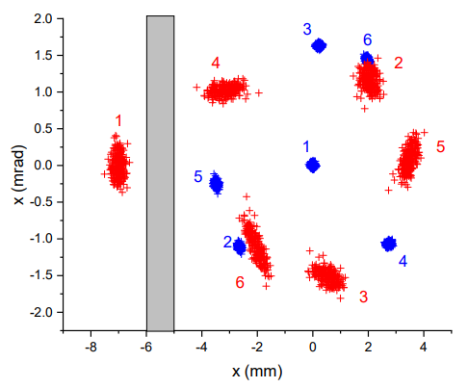
Aperture sharing injection
Two short pulse kickers after 1 sector
Design clearances
  Injection beam to septum = 1 mm
    → Similar clearance to Kicker-bump inj.
  Stored beam to septum = 1.5 mm
  → >20σ clearance for 3σ stored beam
  Injected/stored beam centroid oscillation
    Linear optics = ±3.5 mm
    Nonlinear optics ~ ± 4.3 mm ☹ (for the latest lattice)
3
6
2
5
1
X’ (10⁻⁴ rad)
1
4
4
5
2
3
6
Short pulse kickers
Simulation for an older lattice
Simulation for the latest lattice

Slide 10
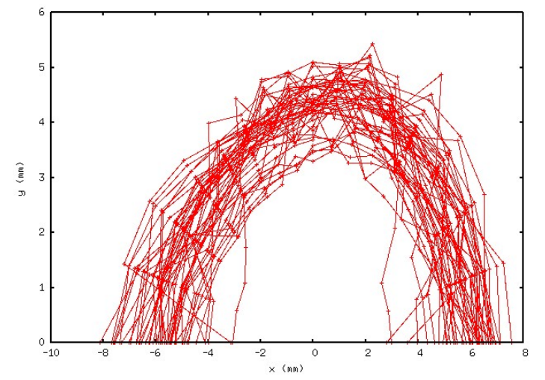
Kicker-bump + Aperture sharing
Combination of two schemes
  On-axis injection for commissioning (might not be needed)
  Fallback for the operation in the worst case, i.e., unexpectedly small DA
  Compatible with the round beam operation ?
DA before BBA and optics correction
50 seeds with errors (not fully exhaustive)
Combined
On-axis injection
Short pulse kickers

Slide 11
Acceptance
Acceptance after BBA and optics correction, 6D tracking
Injection beam oscillation:
Kicker bump injection
Aperture sharing
Booster bunch length
Bad seed
Average
Good seed

Slide 12
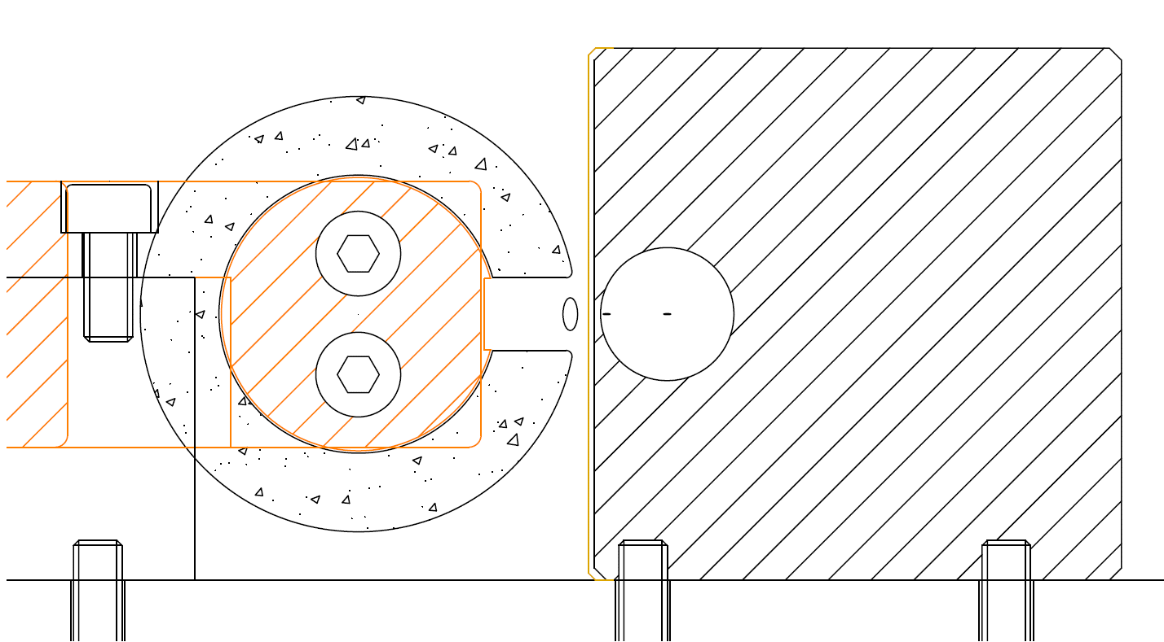
Thin septum (1)
Copper + Iron
0.5 mm +0.5mm
Iron and/or Mumetal
Iron powder ring core
6 mm (H) x 15 mm (W) x 300 mm (L)
330mT @ 11 mrad
2kA peak
6usec full sine pulse
Transverse movement +/-5mm
Leakage field <<10ppm
One turn magnet conductors

Slide 13
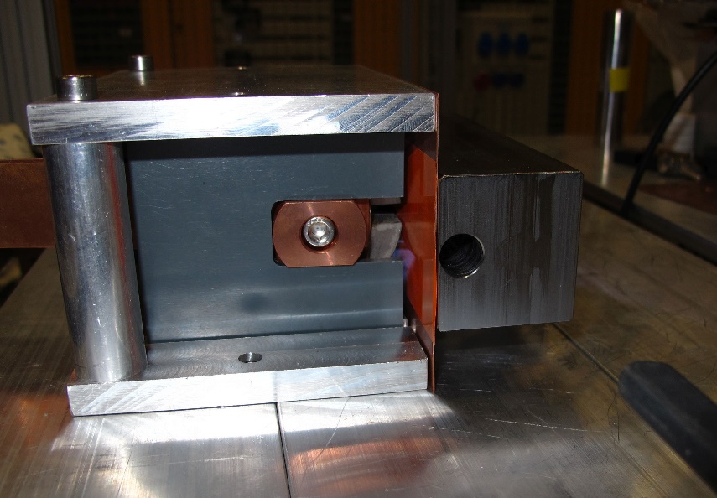
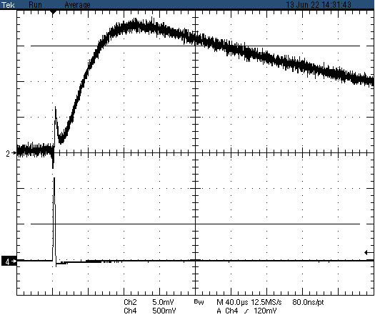
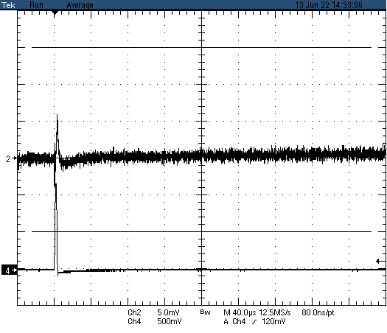
Thin septum (2)
Injection channel
Goal for 10% beam size dilution:
2.37uT-m or 17ppm !
Measured at 2kV / 2kA
Horizontal scale 40 us/div
Spike is artifact, not magnetic field
Eddy current sheet 1mm
+50ppm
+50ppm
-50ppm
-50ppm
Copper + iron
Copper + iron / mumetal

Slide 14
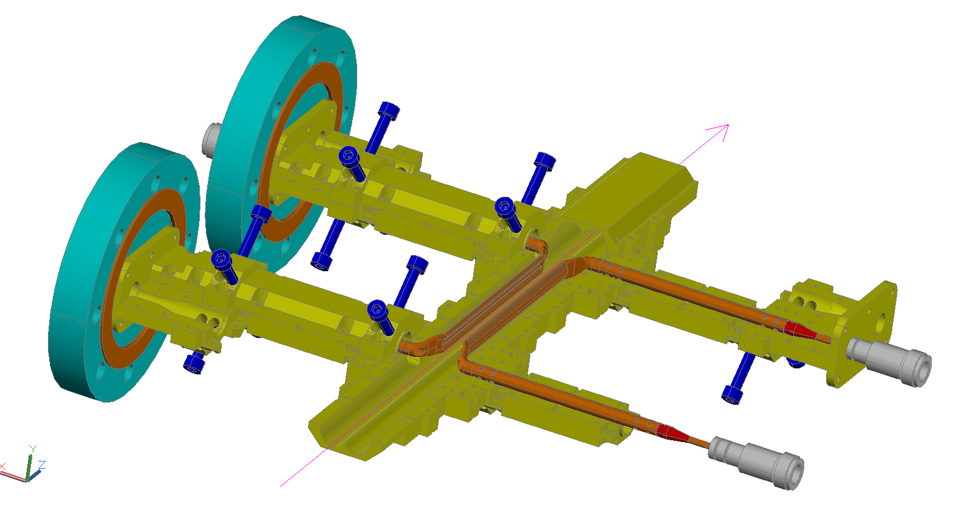
Short pulse kicker development (1)
Given and machine related
Parameter | Fast | Super-fast
Beam momentum | 2.7 GeV/c
SR bunch spacing | 2 ns
Injection repetition rate | 3 Hz
Injection type | Horizontal
Number of defl. SR bunches (off-axis) | <15 | 1
Number of defl. SR bunches (on-axis) | NA | 0
Deflection angle (off-axis) | >0.35 mrad
Deflection angle (on-axis) | NA | 1.0 mrad
Horizontal aperture on axis | ±5 mm
Active kicker length | 800 mm
Fine adjustment supports
100 mm
Electron beam
Impedance matched stress-relief section and longitudinal adjustment
Derived and chosen kicker parameters
Parameter | Fast | Super-fast
Deflection type | Electromagnetic (TEM)
Kicker type | Stripline (vacuum)
Kicker section length | 100 mm
Number of sections | 8
Maximum deflection | 0.5 mrad | 1.0 mrad
Magnetic field | 2.8 mT | 5.7 mT
Electric field | 0.9 MV/m | 1.7 MV/m
Electrode voltage | ±4.3 kV | ±8.5 kV
Electrode current | ±85 A | ±170 A
Excitation pulse length | <30 ns | ~1 ns
Odd / Even el. impedance | 2x 50.0 Ω / 2x 56.0 Ω
Electrodes
Vacuum ports
Broad bandwidth feedthroughs
Single section kicker geometry
3D CAD model (Prototype)

Slide 15
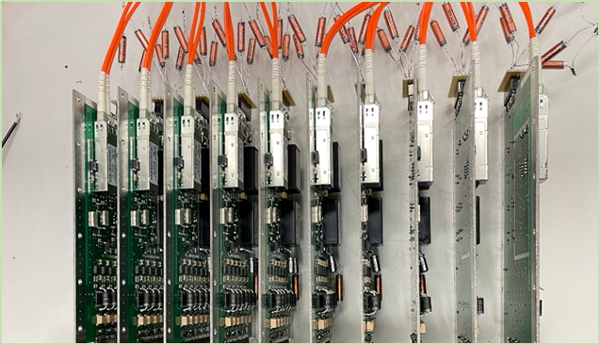
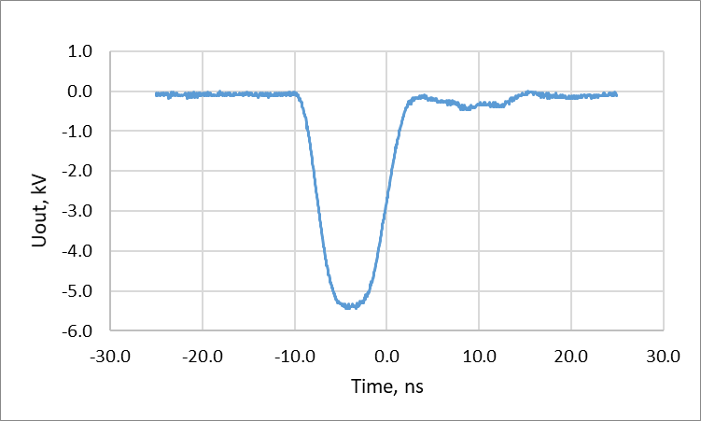
Short pulse kicker development (2)
Pulse generation - Fast (In-house development)
10-stage prototype GaN HEMT Marx generator
with fiber optical triggering
Output pulse
Digital fiber optics based triggering to isolate the stages
Individual stage delay control to fine-adjust the timing
~8 ns FWHM 5.5 kV pulses.
T_fall = 2.9 ns
T_rise = 3.7 ns

Slide 16
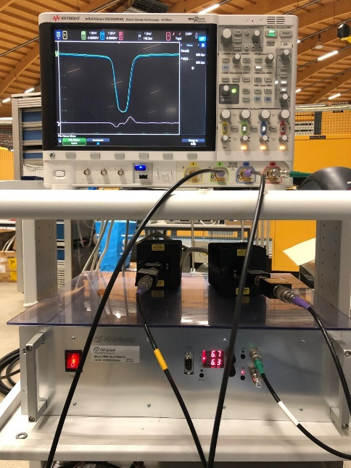
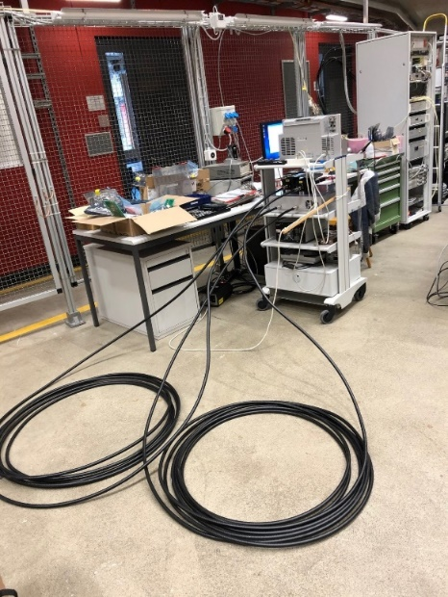
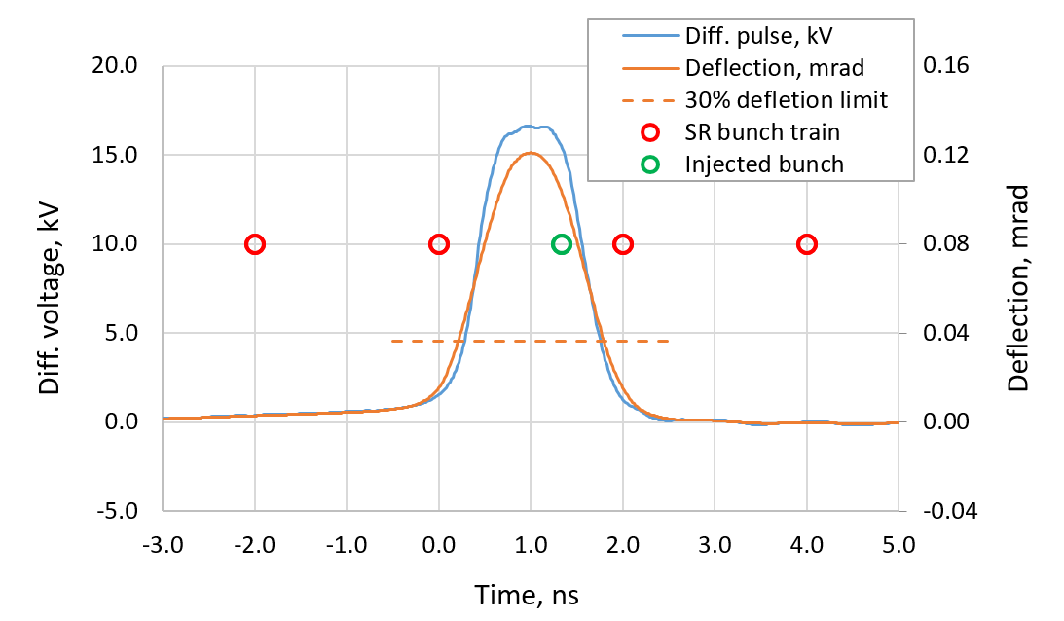
Short pulse kicker development (3)
Pulse generation – Super-fast (Commercial)
Output pulse
FID GmbH pulse generator
Measurement setup
with 20 m cables
- Pulse generator protection
- Inclusion of cable dispersion
Peak voltage ~15 kV
Full pulse length ~2 ns

Slide 17
Summary
Two injection schemes to be implemented
  Kicker-bump injection and Aperture sharing with short pulse kicker
  Very high or 100% injection efficiency expected
    Special cares taken to important parameters, namely, injection beam emittance, septum thickness and beta function at septum (DA)
    Aperture sharing may need precise tuning (or re-optimization of nonlinear optics)
  Two schemes can be combined if necessary
Technological challenges
  Bump kickers → Existing, no risk
  Thick septum → No or low risk
  Thin septum (1mm) → Prototype promising
  Short pulse kicker → Most challenging, prototyping on the right track

