Slide 1
Review of bunch lengthening with harmonic cavities in ultra low-emittance light source rings: their impact on beam collective effects and future directions
Francis Cullinan
MAX IV laboratory, Lund, Sweden
3rd Workshop on Low Emittance Lattice Design, ALBA, Barcelona, June 2022

Slide 2
Outline
Harmonic (Landau) cavities
Active harmonic cavities
Longitudinal plane:
  Robinson mode coupling
  Mode-1 excitation
  Inhomogeneous beam loading
Transverse plane:
  Long-range resistive wall
  Transverse mode-coupling instability
  Amplitude-dependent tune shift
Future directions - multiple higher harmonics
Notes:
For each, investigate dependence on R, Q and R/Q separately
Superconducting vs. Normal conducting - nothing to say OR what Pedro suggested about Robinson mode tuning? - higher Q, less constant? (more about technology)
Intrabeam scattering - nothing to say but perhaps important

Slide 3
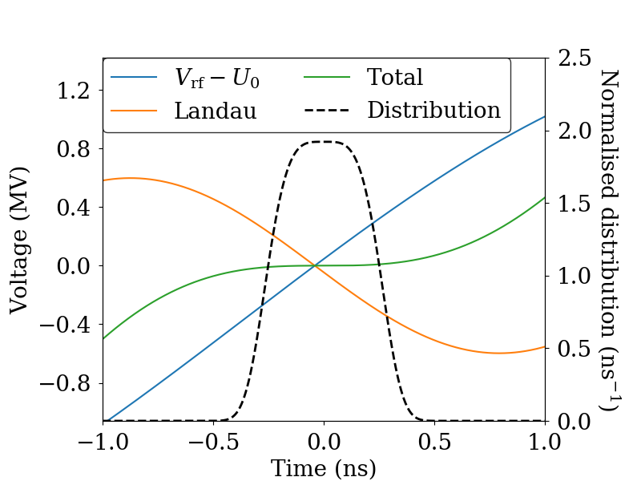
Harmonic Cavities (HCs)
Harmonic cavities used to flatten the RF potential to lengthen the bunches
  Longer Touschek lifetime, less intrabeam scattering
  Landau damping, rejection of impedance at high frequency
J. M. Byrd & M. Georgsson, PRSTAB 4 030701 (2001)
M. Georgsson, Å. Andersson & M. Eriksson, NIM A 416 2-3 pp 465-474 (1998)

Slide 4

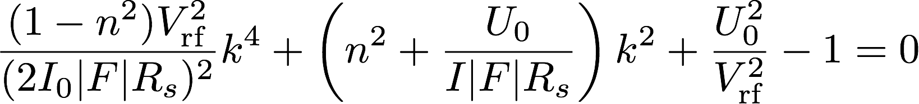
Flattened potential
Optimal bunch lengthening (flat potential):
  1st and 2nd derivative of RF voltage = 0
  In a passive system, requires control of at least two parameters for each beam current (HC detuning, Rs, Q-factor, main RF voltage)
0 first derivative possible for one HC detuning (semi-flat)
  Asymmetric longitudinal bunch profile
  Formula for voltage fraction at appropriate HC detuning:
Notes:
No plots

Slide 5
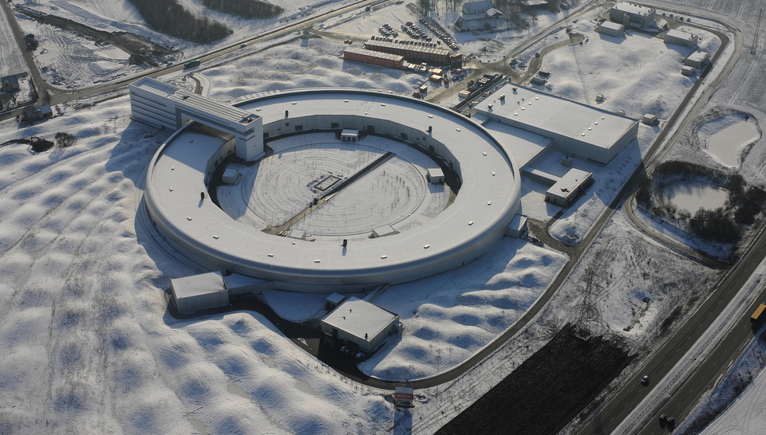
The MAX IV
3 GeV Ring
Linac
3 GeV ring
528 m circ, MBA, 330 pm rad
1.5 GeV Ring
96 m circ.,
DBA, 6 nmrad
Parameter | Value
RF frequency (MHz) | 100
Harmonic-cavity (HC) harmonic | 3
Total HC shunt impedance (MΩ) | 8.25
HC quality factor | 20800
Beam current (mA) | 500
RF voltage (MV) | 1.8
Natural RMS bunch duration (ps) | 30
RMS duration with ideal HC lengthening (ps) | 167
Harmonic number | 176
Number of main (harmonic) cavities | 6 (3)
Short Pulse Facility
Notes:
RF voltage set flat

Slide 6
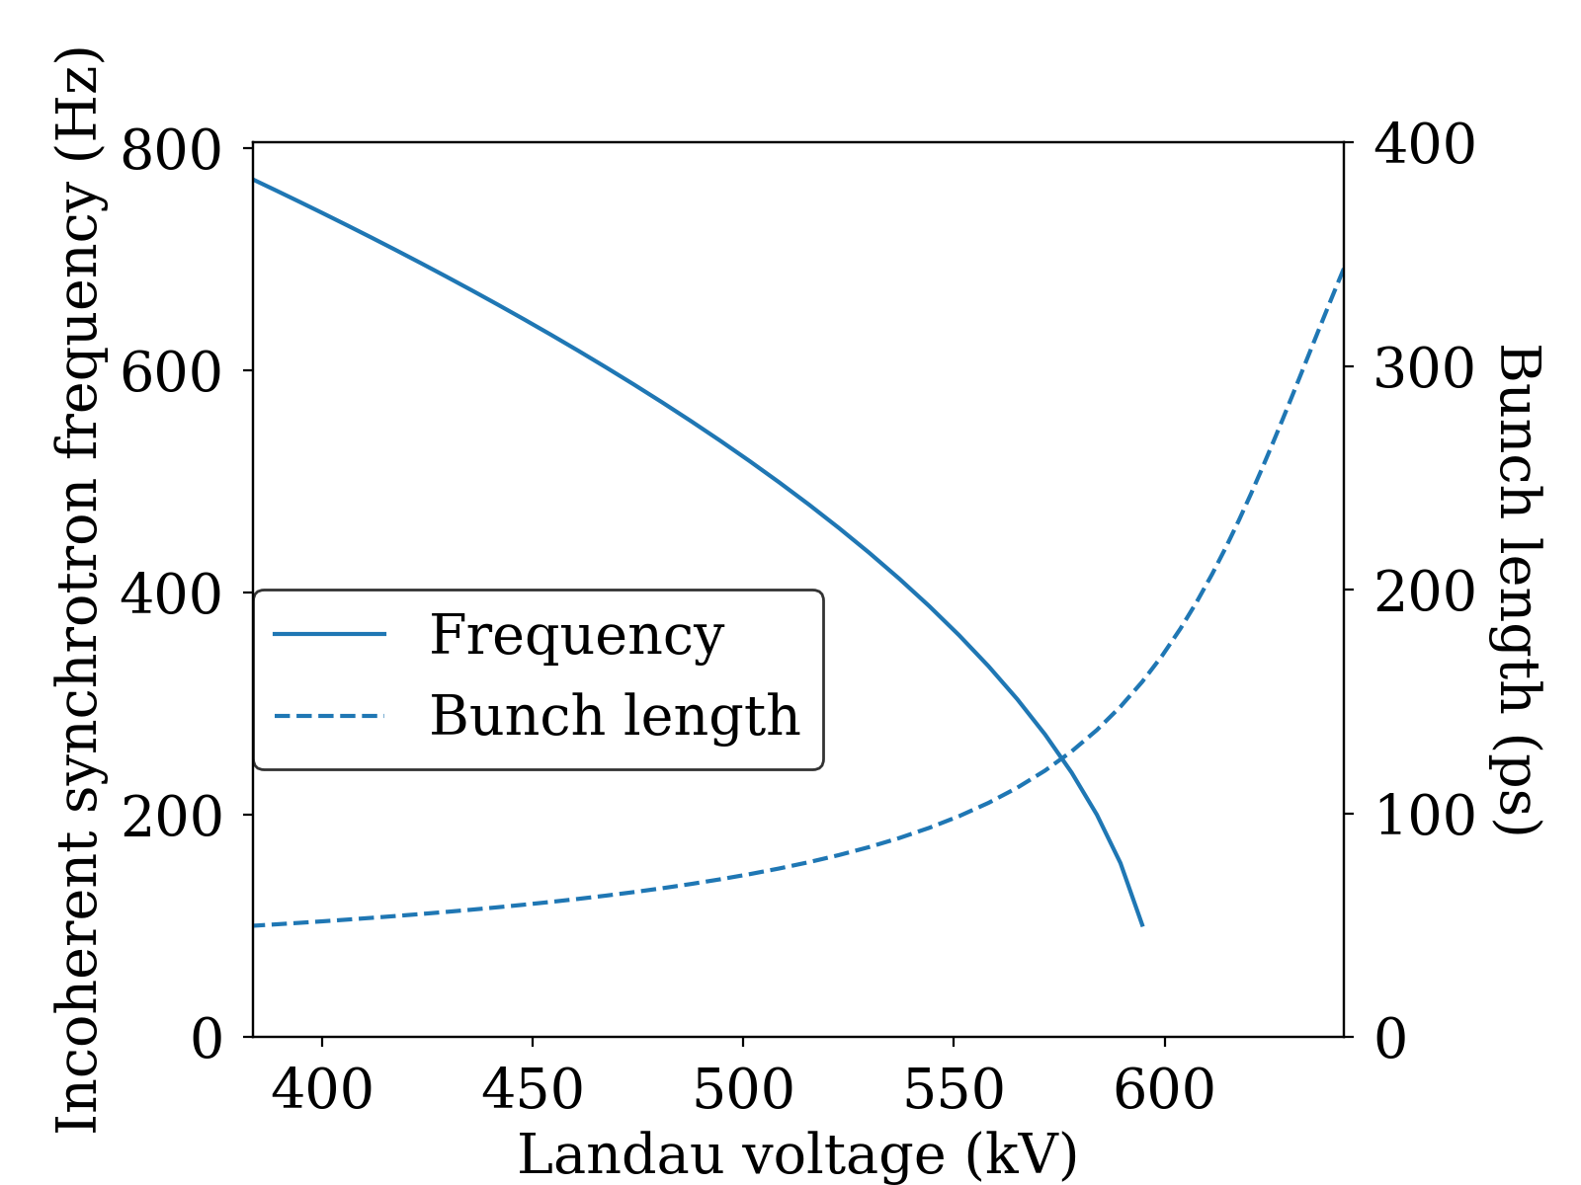
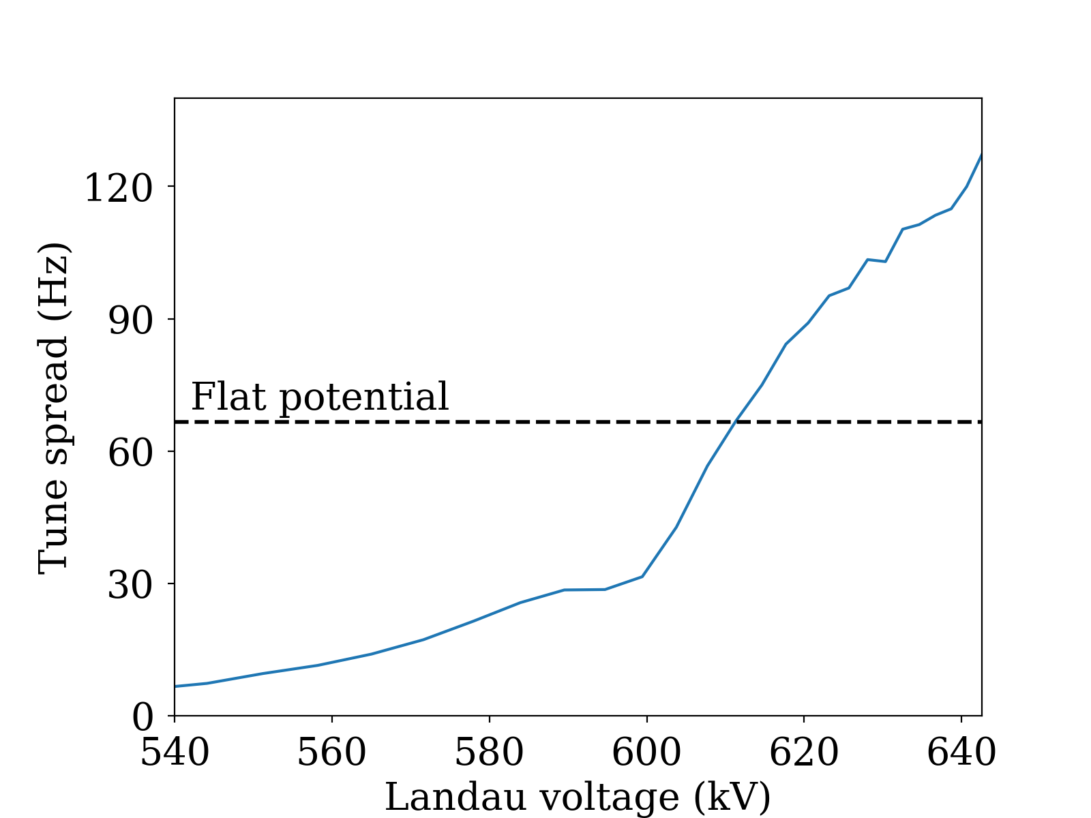
Synchrotron tune
MAX IV parameters, 500 mA current
Main RF voltage, 1.8 MV (flat potential with 3 HCs)
T. Olsson, F. Cullinan & Å. Andersson, PRAB 21 120701 (2018)
P. F. Tavares, Å. Andersson, A. Hansson & J. Breunlin, PRSTAB 17 064401 (2014)
Notes:
Plots
Incoherent synchrotron tune and intrabunch tune spread as a function of HC detuning + bunch length
Two cases: Flat potential vs. Semiflat

Slide 7
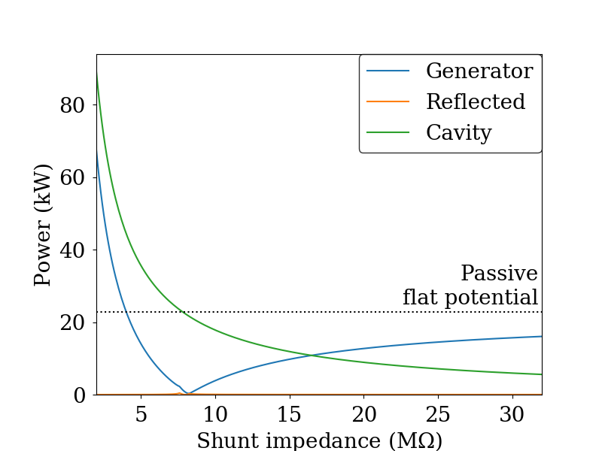
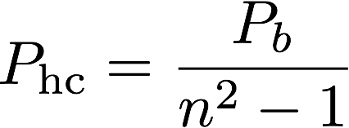
Active cavities
Same formulas as for main system apply
Powers at matched condition
Convenient relation for flat potential for passive HC at harmonic n:
P. B. Wilson, SLAC-PUB-2884 (1991)
Notes:
Lower shunt impedance, R/Q in active case
Power consumption? - plot
More flexibility in case of non-uniform fill patterns

Slide 8
Longitudinal Plane

Slide 9
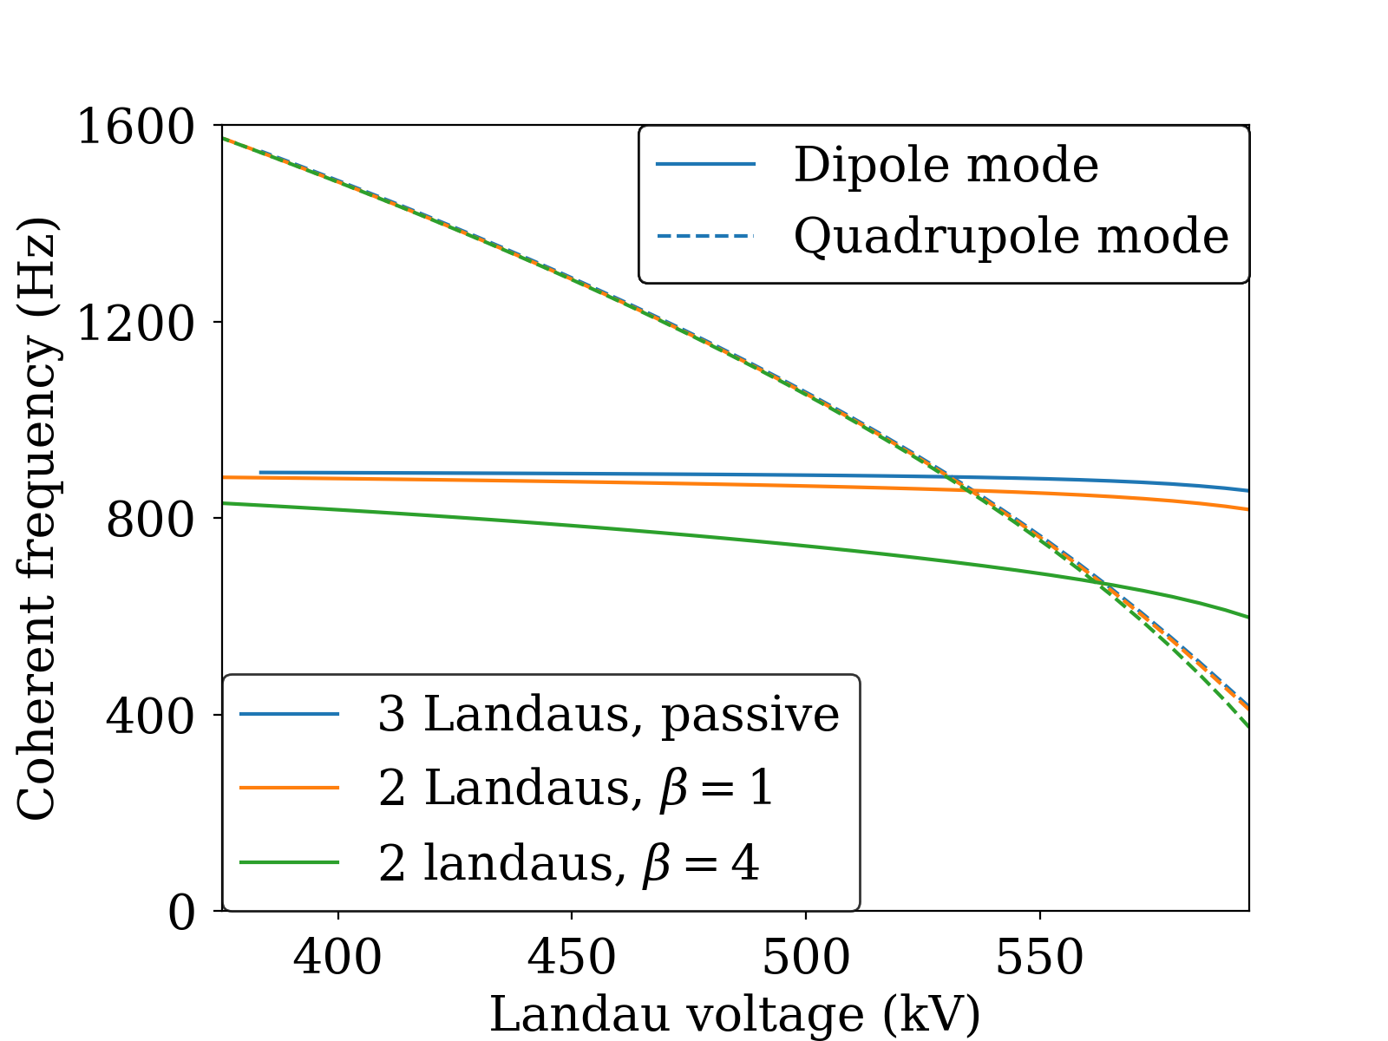
Robinson Mode Coupling
Active HCs tuned for minimum generator power
Can be damped in the main RF cavities using a mode-0 damper*
R. A. Bosch, K. J. Kleman & J. J. Bisognano, PRSTAB 4 074401 (2001)
P. B. Wilson, SLAC-PUB-2884 (1991)
*D. P. McGinnis, presented at the Low-Level Radio Frequency Workshop 2019, Chicago, IL (2019)
Notes:
Active case?
AC Robinson instability - leave to Gamelin? - lowering Q value while keeping shunt impedance constant for both flat potential and semiflat, or keeping R/Q constant PLOT + active case (flat potential with constant vrf)
Plot as it is now (lowering the shunt impedance)
Plot with mode-coupling theory for different HC shunt impedances
3 cavities - beta=1 (lower shunt impedance case)
2 cavities - beta=1 (lower R/Q case)
Mode coupling can depend on RF voltage - see Landau parking

Slide 10
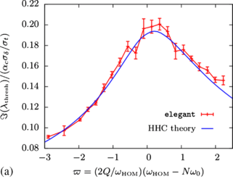
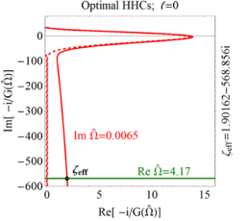
Arbitrary RF potentials
Krinsky & Wang, then Lindberg - specific integral formula for full flat potential:
Venturini - arbitrary potential, discretisation on a grid:
*
*
S. Krinsky & J. M. Wang, Part. Accel. 17, 109 (1985)
*R. R. Lindberg, PRAB 21 124402 (2018)
*M. Venturini, PRAB 21 114404 (2018)

Slide 11
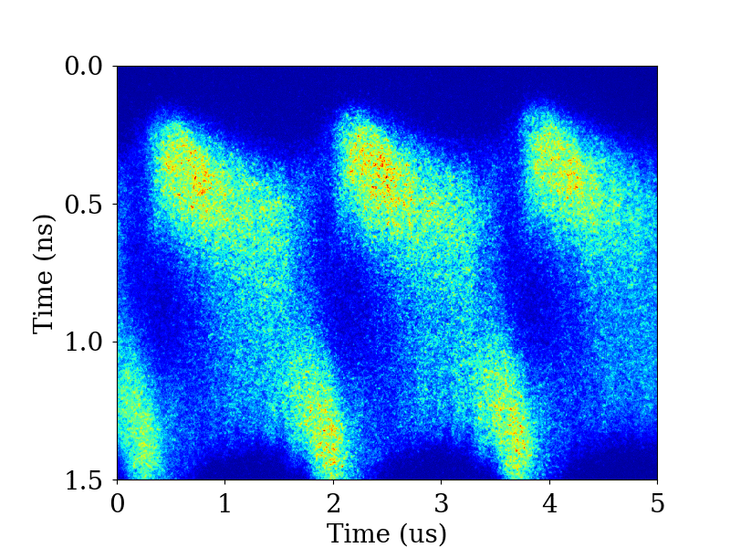
Mode 1 Instability
Excess HC shunt impedance can lead to excitation of mode 1
Seen experimentally at MAX IV - under investigation
Avoided during operation by using a nonuniform fill
260 mA, 1 MV RF voltage, real time
M. Venturini, PRAB 21 114404 (2018)
T. He, W. Li, Z. Bai & L. Wang, PRAB 22 024401 (2022)

Slide 12
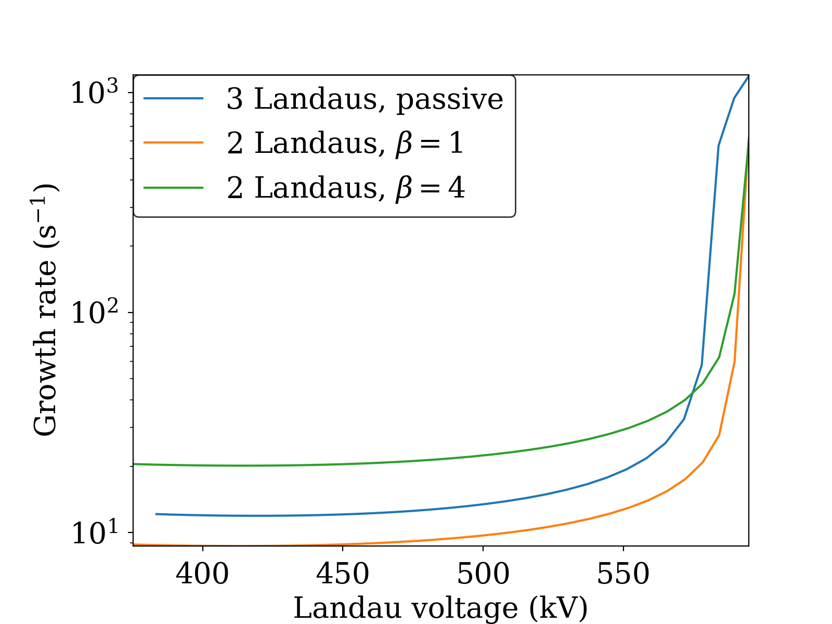
Mode 1 Instability
Lower R/Q beneficial
Lower Q for same R/Q is worse
Theory assumes point bunches (with form factors) but no small-tune-shift approximation
Notes:
Only really a concern in uniform fill
Active case? (lower shunt impedance)
Sensitive to Q value? - I think so
lowering Q value while keeping shunt impedance constant for both flat potential and semiflat, or keeping R/Q constant PLOT

Slide 13
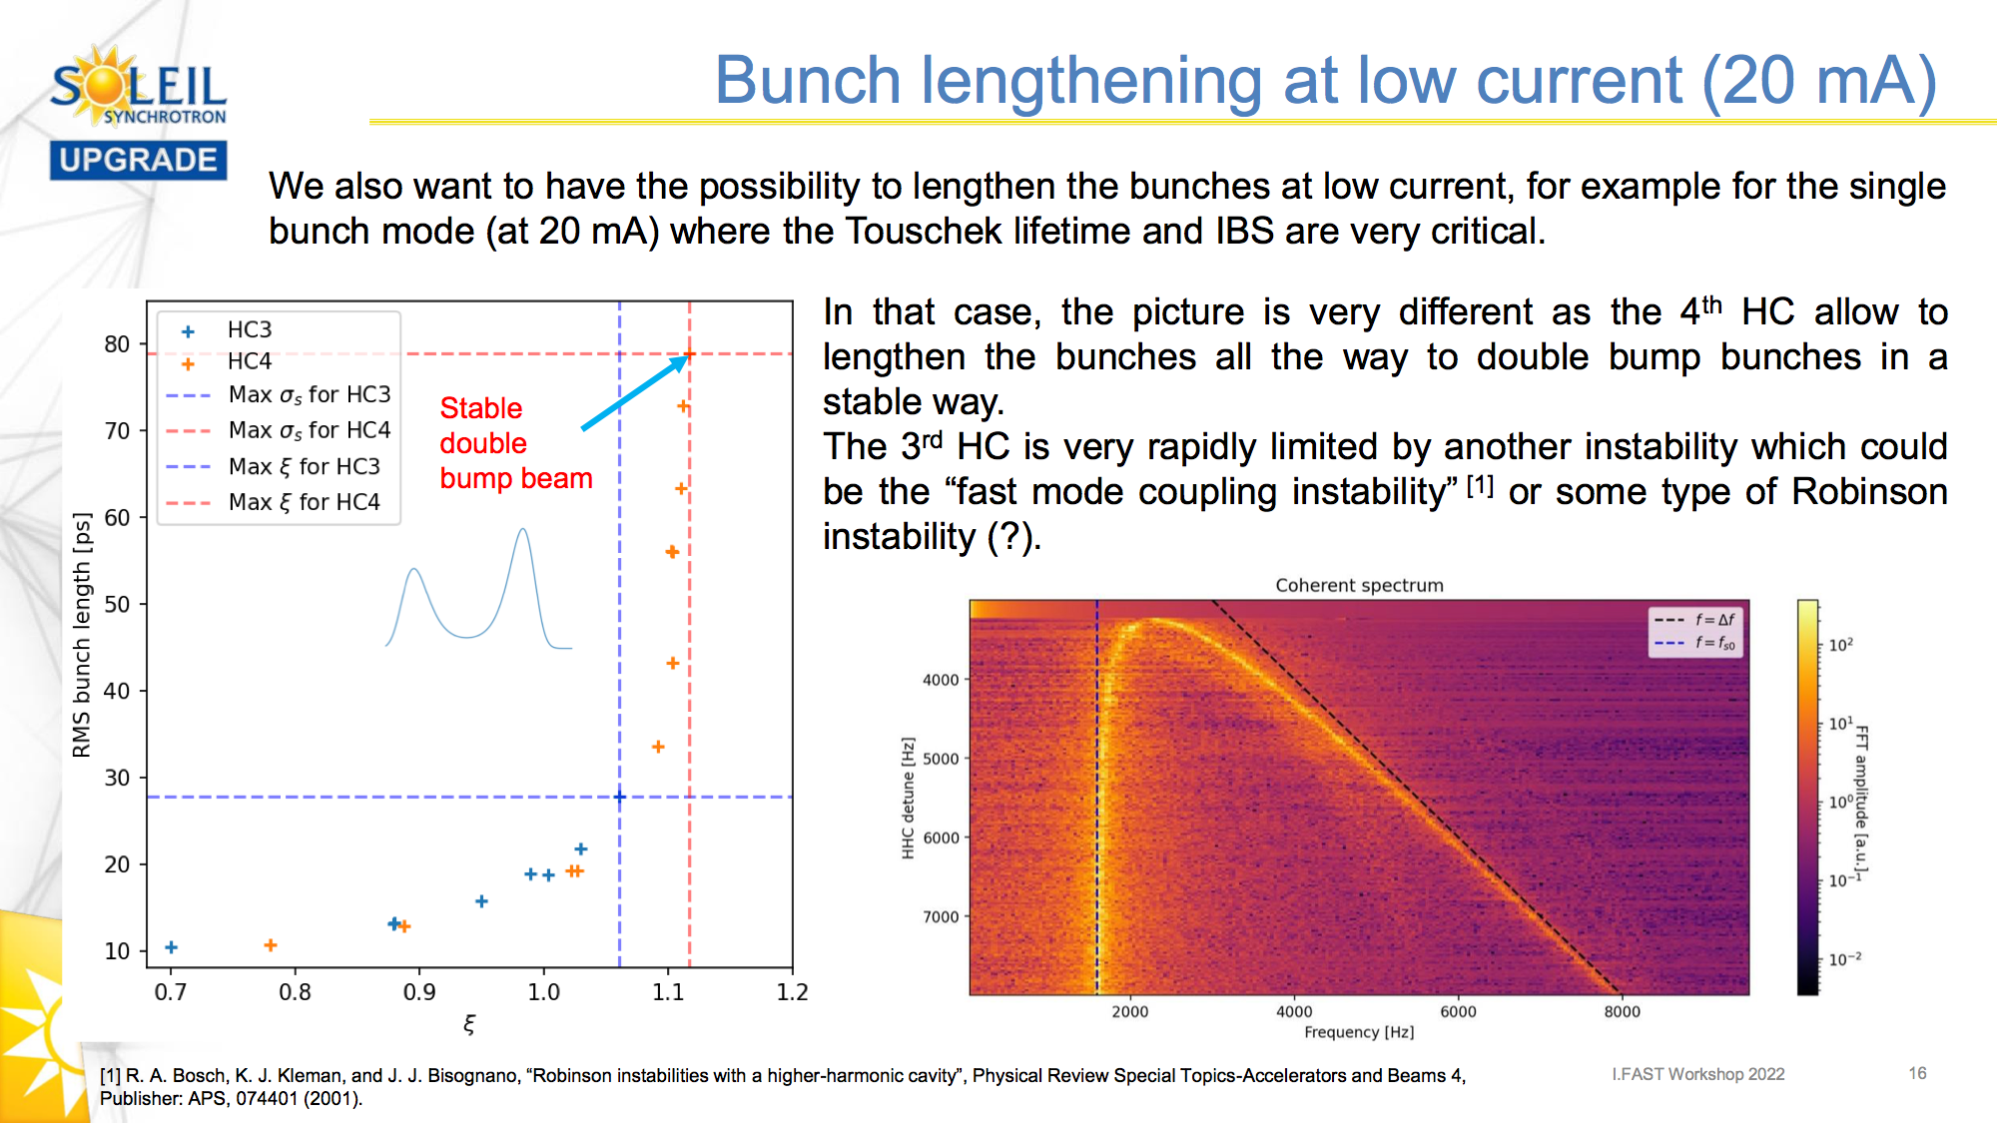
Superconducting passive
A. Gamelin, presented at I.FAST Workshop 2022, Karlsruhe, Germany (virtual)

Slide 14
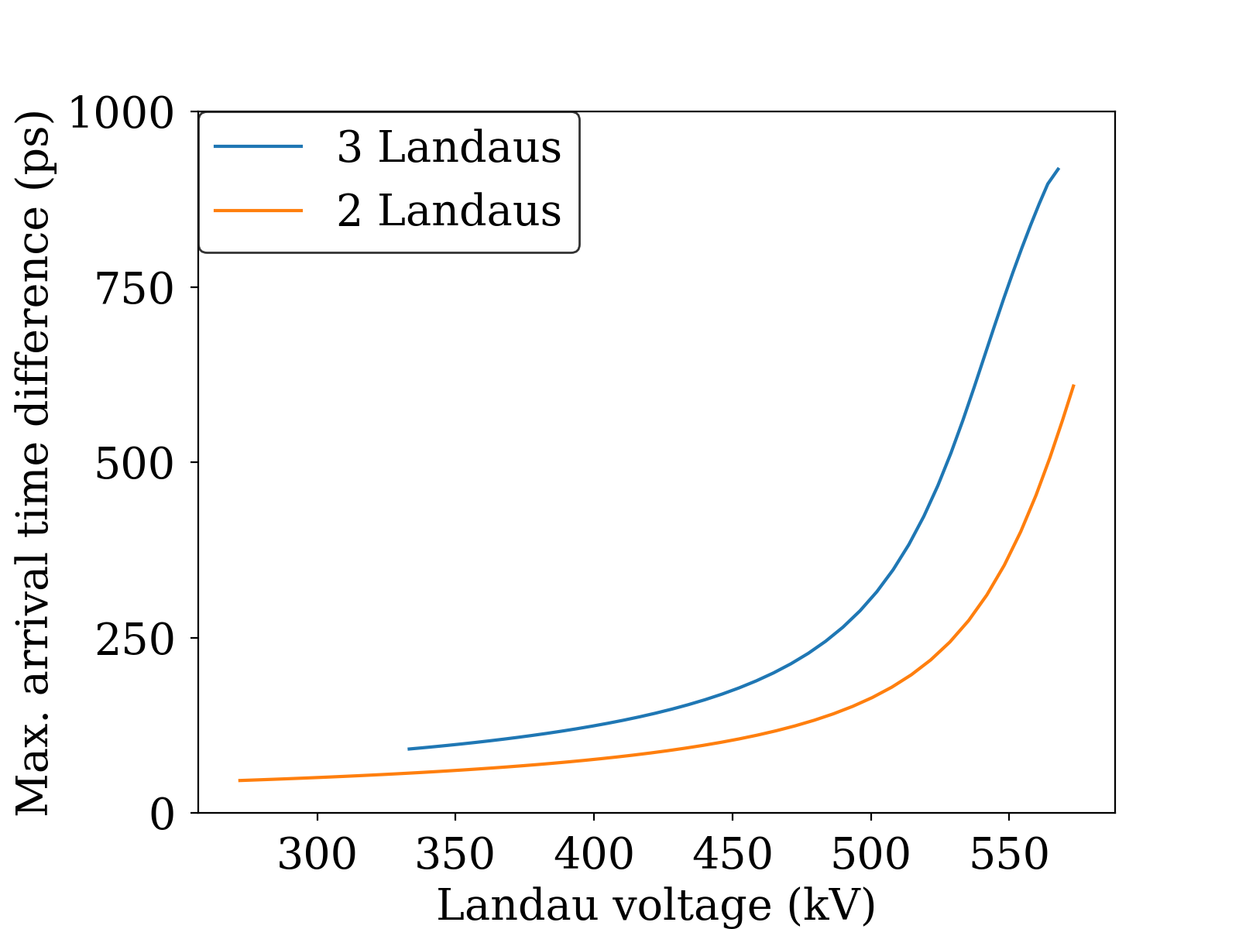
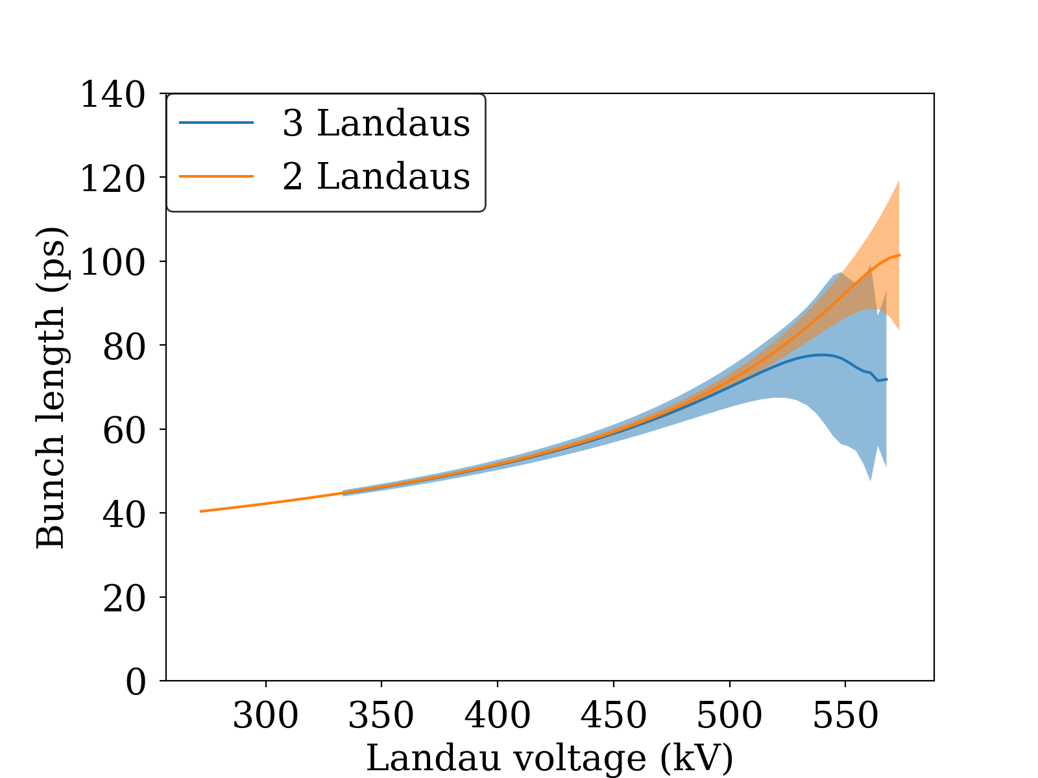
Inhomogeneous Beam Loading
165/176 RF buckets filled
Lower R/Q reduces effect without sacrificing lengthening
T. Olsson, F. Cullinan & Å. Andersson, PRAB 21 120701 (2018)
Notes:
Plot from T. Olsson et al. - briefly explain publications around
Vs R/Q, active case
At flat potential and semiflat, lowering Q with Rs or R/Q constant
Landaus important - larger frequency and larger tuning angle

Slide 15
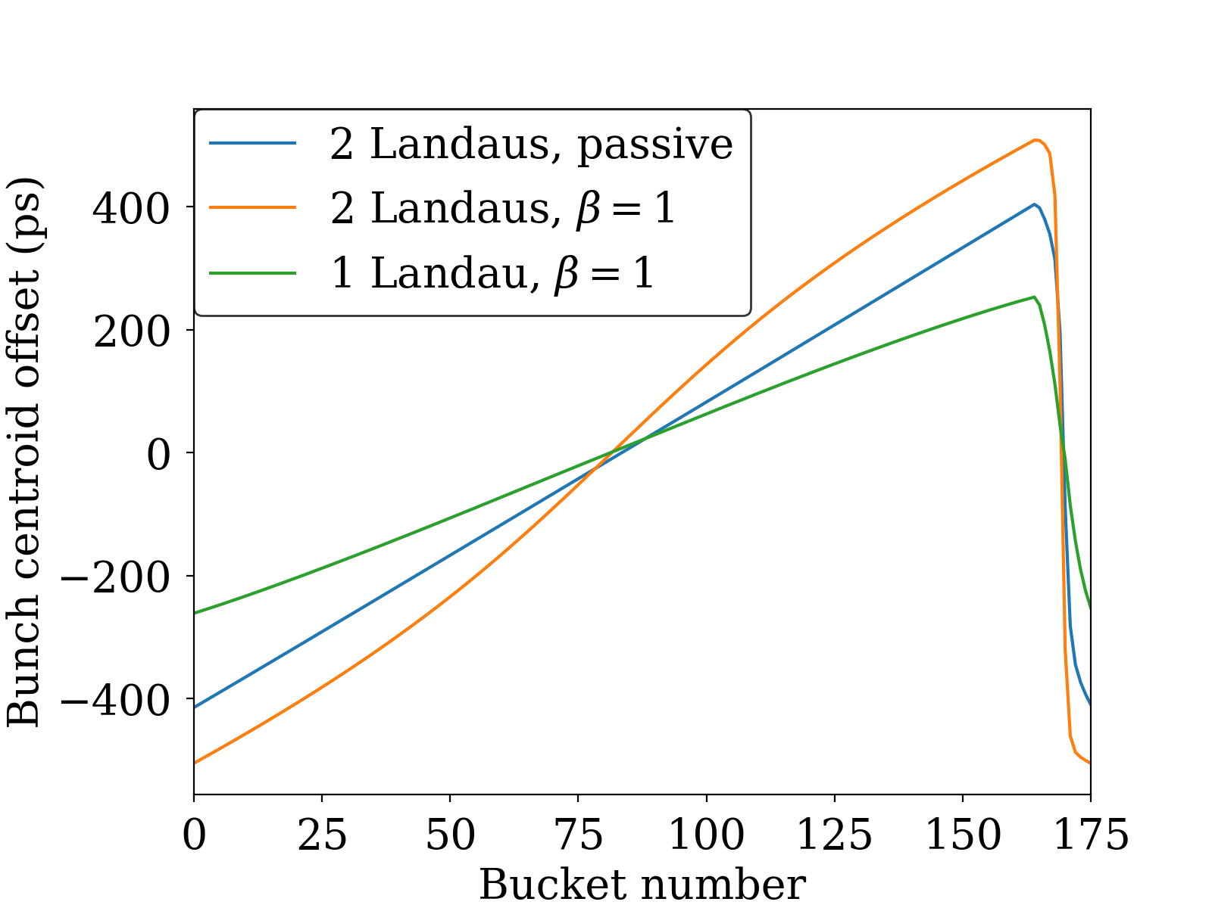
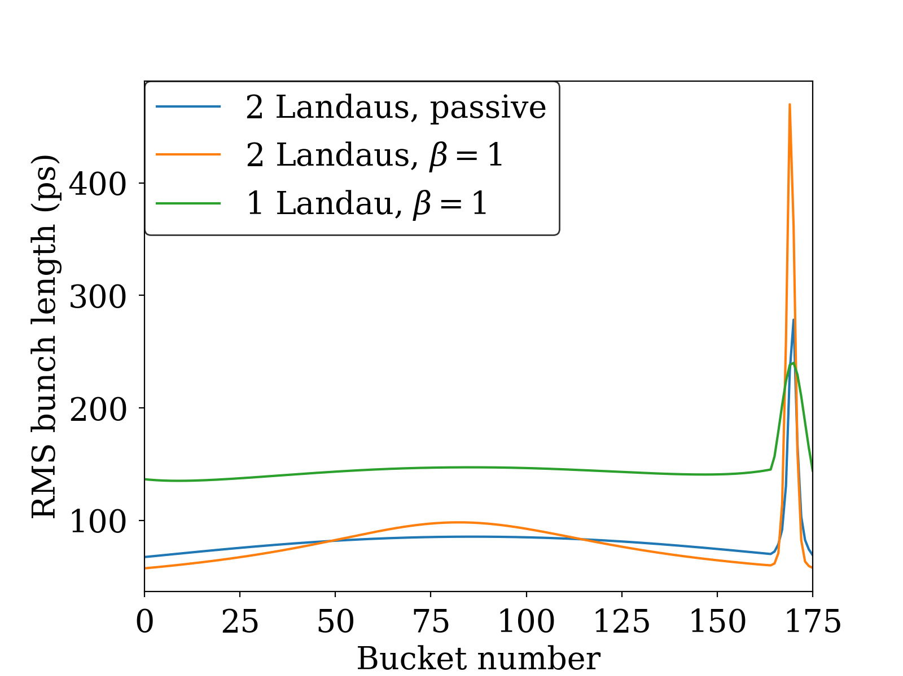
Inhomogeneous Beam Loading
- Active cavities
With conditions close to flat potential for uniform fill (lower RF voltage of 1.5 MV)

Slide 16
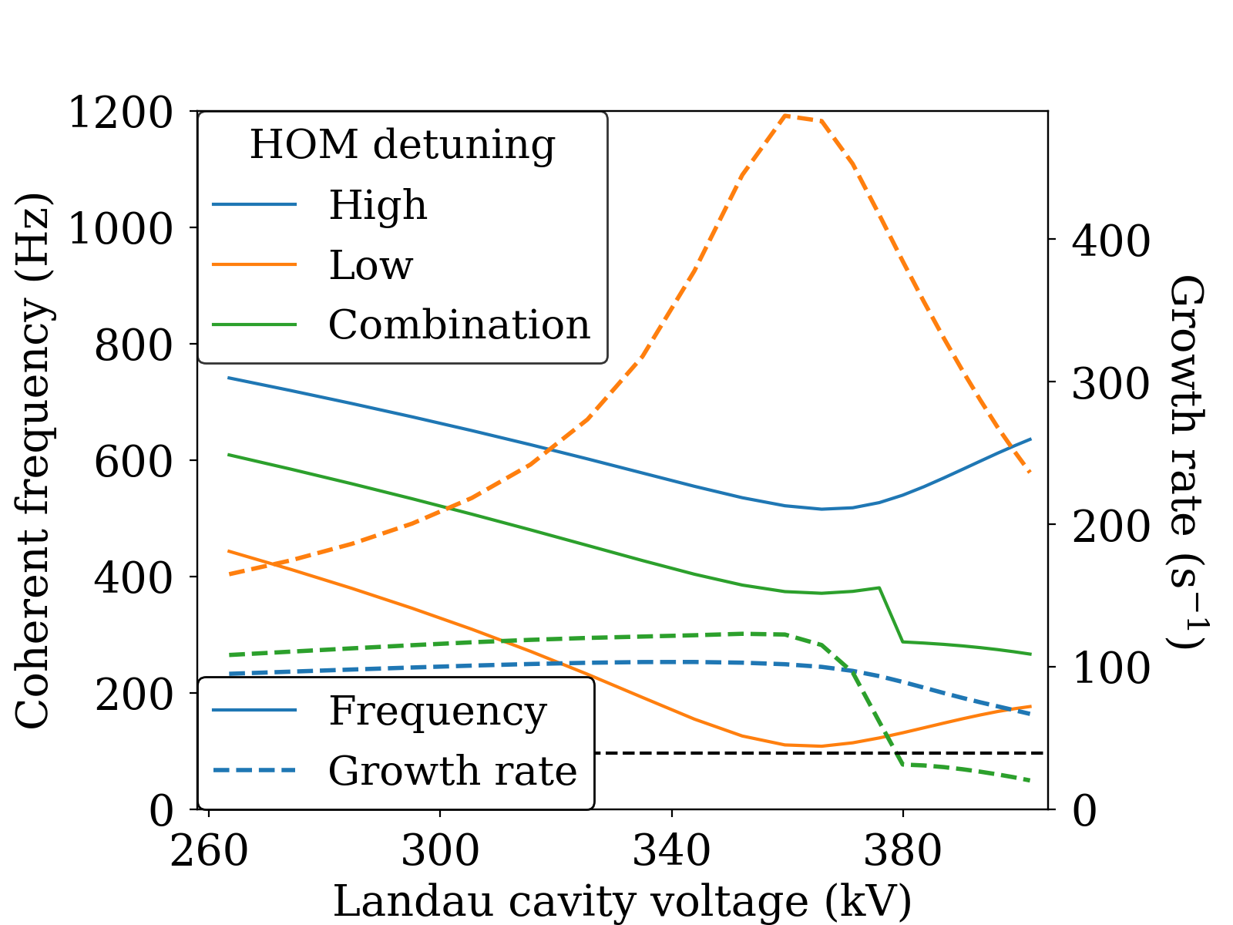
Inhomogeneous Beam Loading
- Longitudinal Stability
Growth rates start to decrease as Landau fields start to generate tune spread
Pair of identical HOMs - tune to cancel reactive impedance for maximum Landau damping
*
*F. J. Cullinan, Å. Andersson & P. F. Tavares, PRAB 23 074402 (2020)

Slide 17
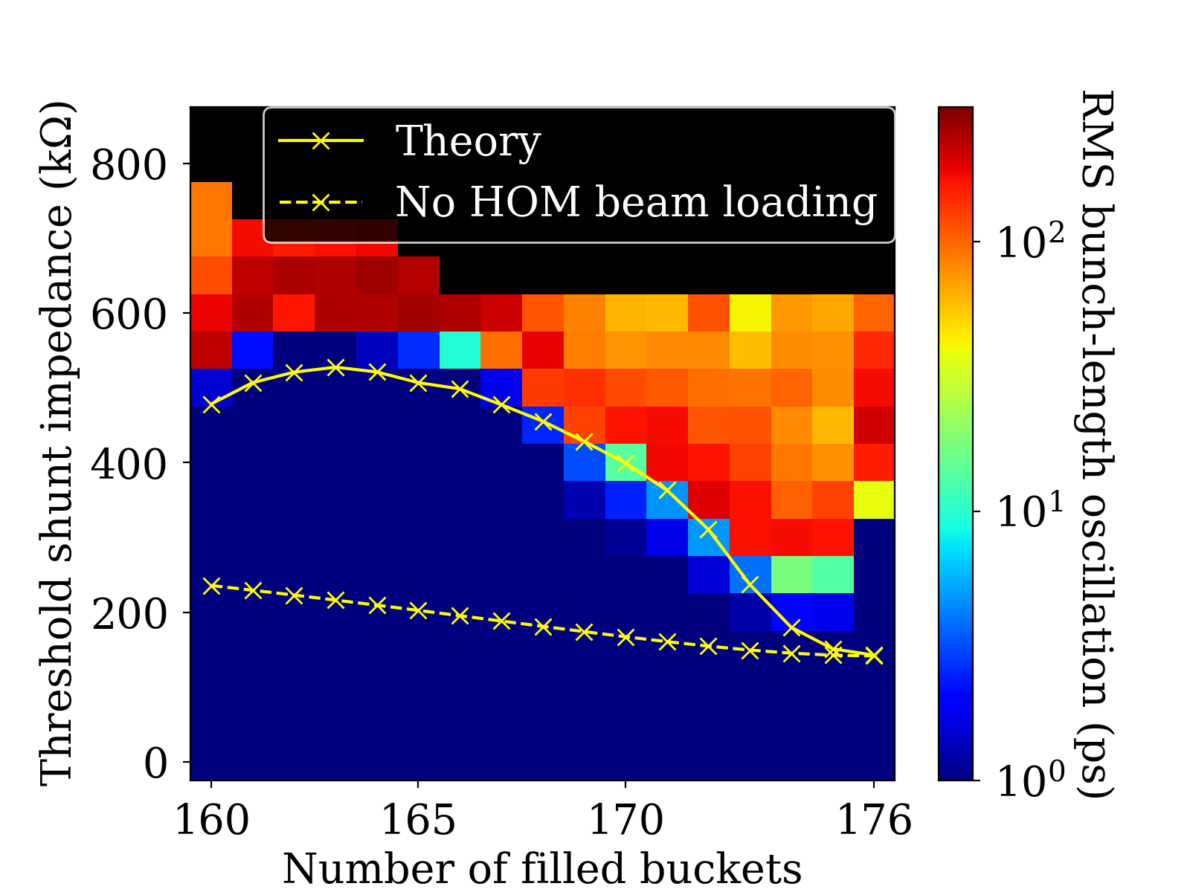
Quadrupole Stability
Can be of concern because they evade most bunch-by-bunch feedbacks
Threshold currents (shunt impedances) higher in nonuniform fills
*
*F. J. Cullinan, Å. Andersson & P. F. Tavares, PRAB 25 044401 (2022)

Slide 18
Transverse Plane

Slide 19
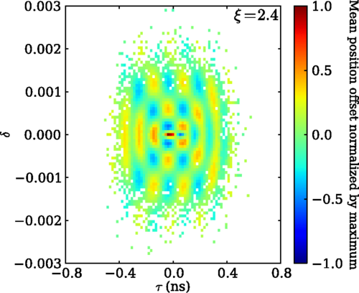
Long-range resistive wall
*
Synchrotron tune spread
  Azimuthal head-tail modes damped
  Radial head-tail modes less affected
Diffusion due to quantum excitation must be included
*F. J. Cullinan, R. Nagaoka, G. Skripka & P. F. Tavares, PRAB 19 124401 (2016)
R. R. Lindberg, PRAB 19 124402 (2016)
T. Suzuki, Part. Accel. 12 237 (1982)
F. Cullinan, R. Nagaoka, G. Skripka & P. F. Tavares, presented at NOCE, Arcidosso, Italy (2017)

Slide 20
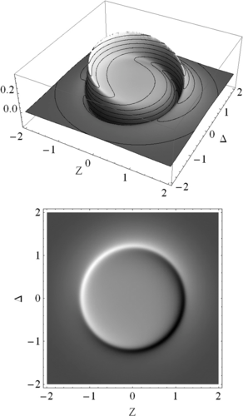
Transverse Mode-Coupling (TMCI)
*
Flat potential:
Amplitude dependence of synchrotron tune means that head-tail modes are always coupled for one part of beam
→ Lower threshold current predicted
*M. Venturini, PRAB 21 024402 (2018)

Slide 21
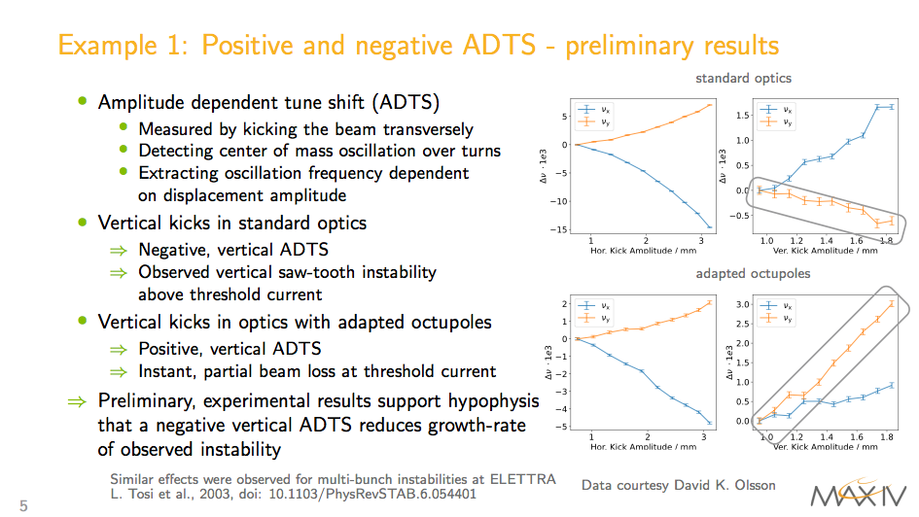
Amplitude-Dependent Tune Shift
L. Tosi et al., 2003, doc: 10.1103/PhysRevSTAB.6.054401
M. Brosi, presented at I.FAST Workshop 2022, Karlsruhe, Germany (virtual)

Slide 22
Future Directions

Slide 23
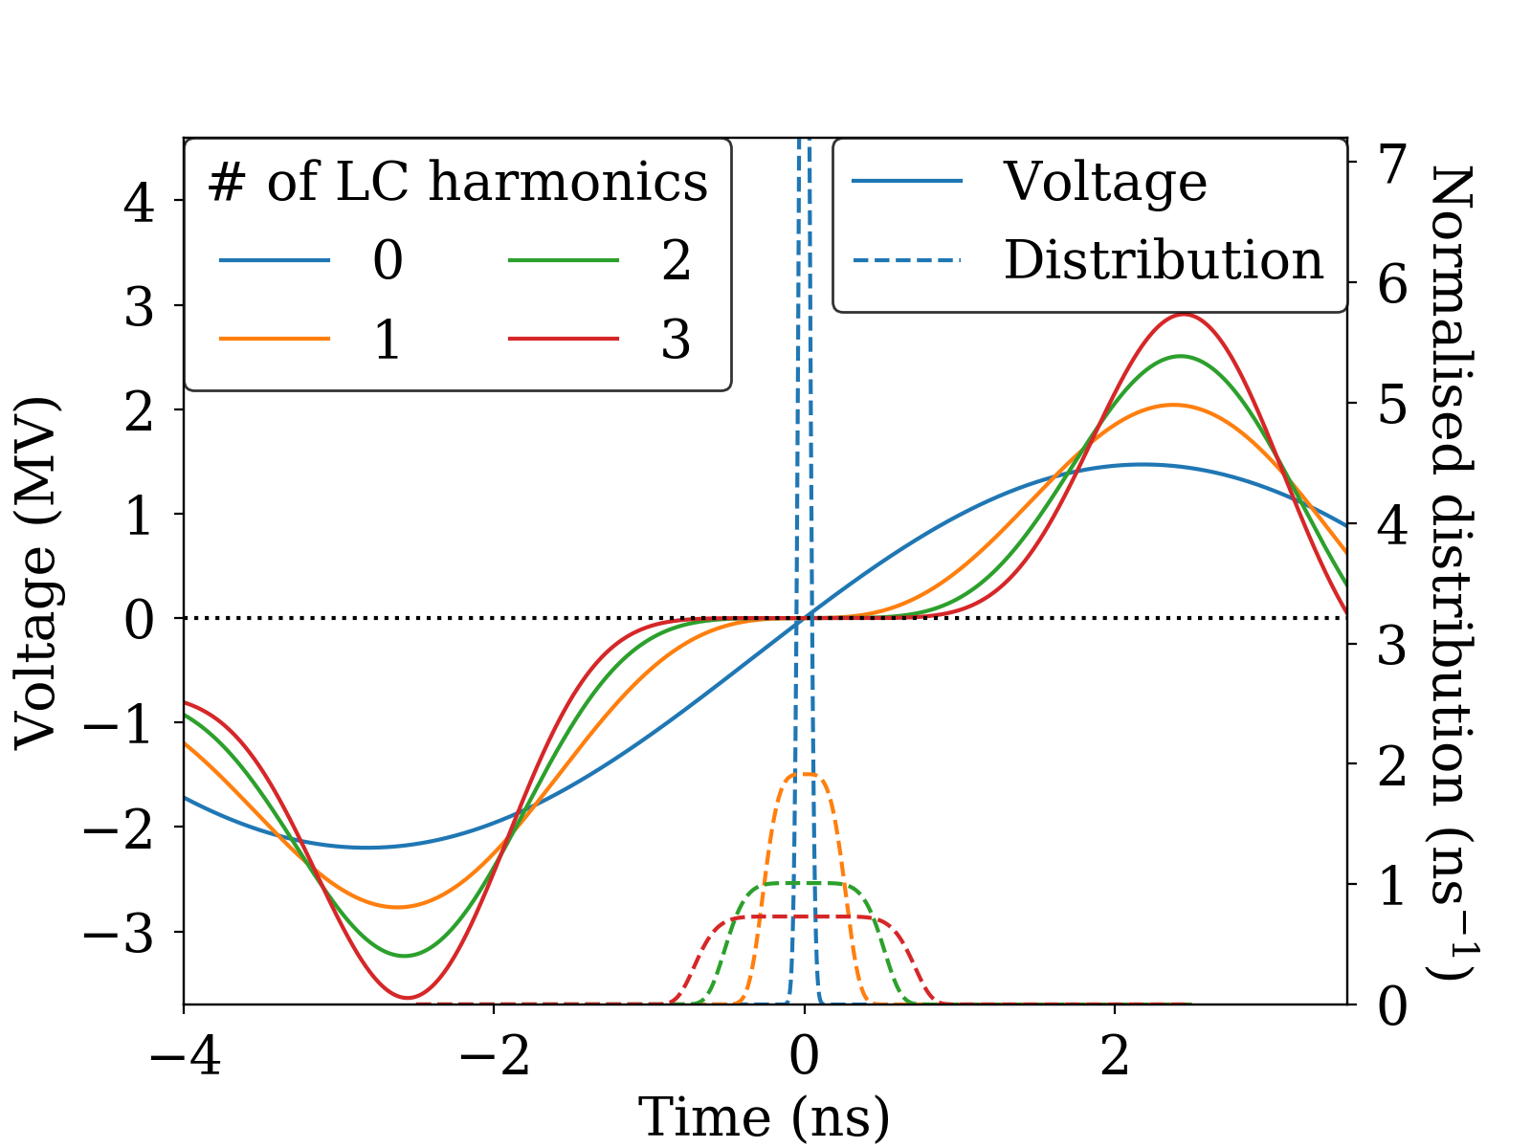
Multiple Higher Harmonics
Developed by Å. Andersson & P. F. Tavares
Analytical method generalising flat potential to higher-order derivatives
Arbitrary number of RF harmonics

Slide 24
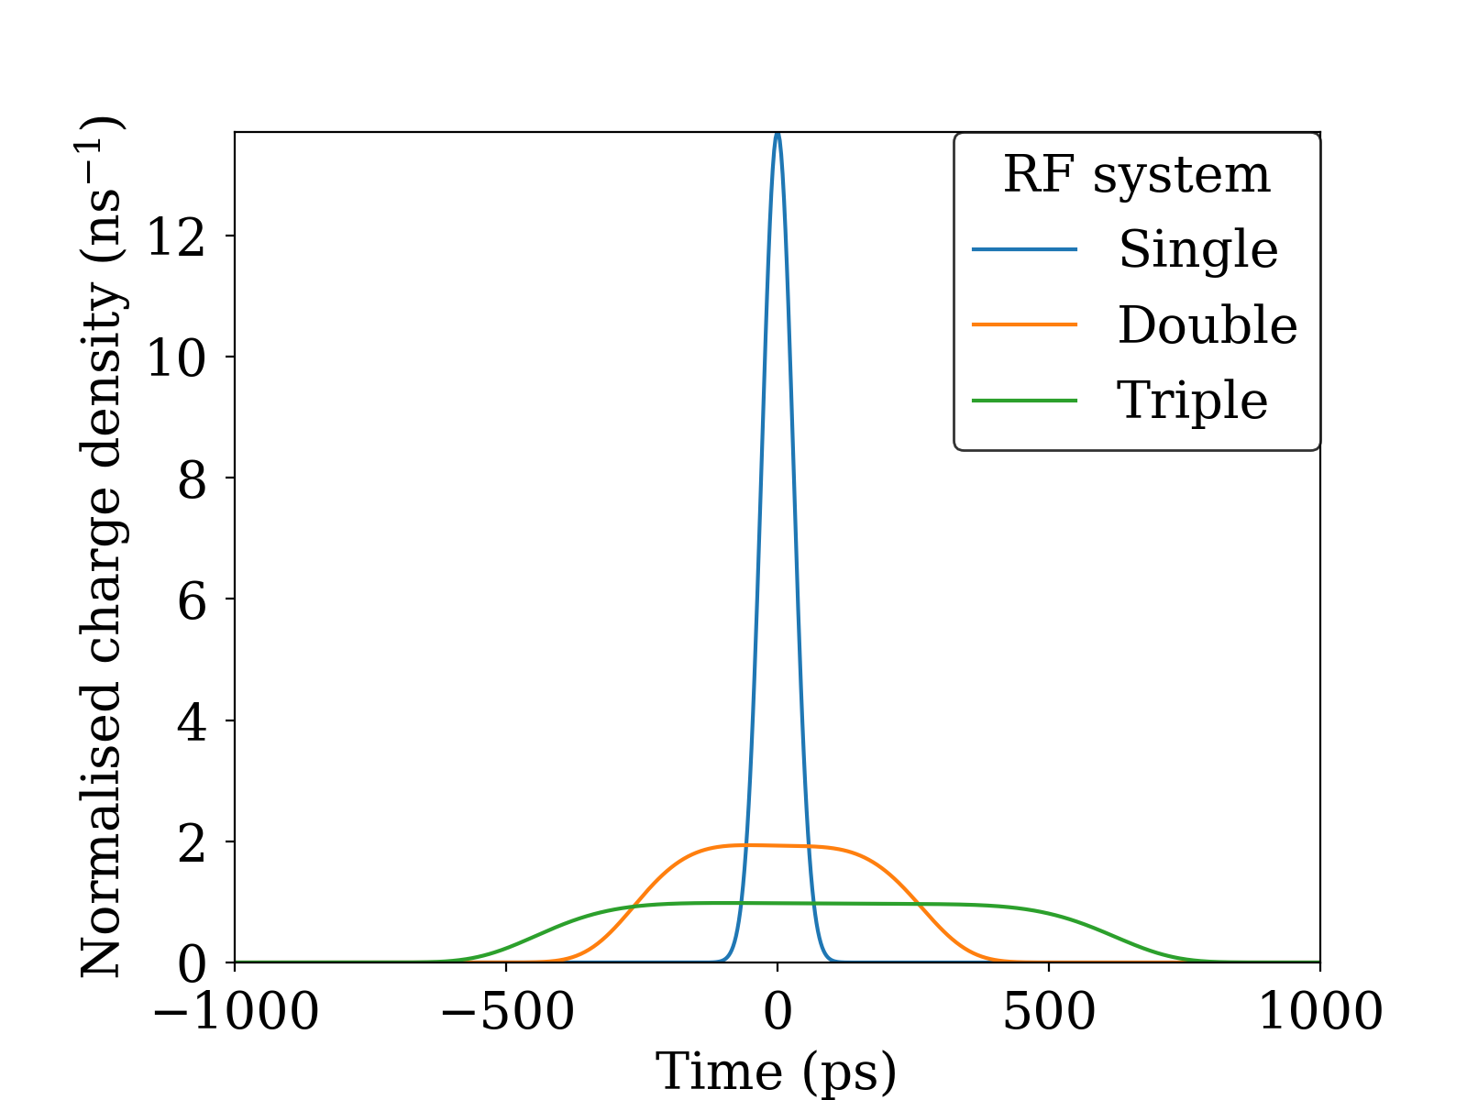
Triple RF system
3rd-harmonic cavities can be passive
Parameter | Single | Double | Triple
RF voltage (MV) | 1.8 | 1.8 | 1.5
RMS bunch duration (ps) | 29.1 | 166 | 312
Detuning of 3rd-harmonic cavity (kHz) | - | 94.4 | 70.4
Voltage in 3rd-harmonic cavity (kV) | - | 598 | 703
Voltage in 5th-harmonic cavity (kV) | - | - | 140
Phase of 3rd-harmonic cavity (degrees) | - | -174 | -174
Phase of 5th-harmonic cavity (degrees) | - | - | 3.5

Slide 25
Conclusion
Harmonic cavities have both stabilising and destabilising effects
  Longer bunches - rejection of (high-frequency) impedance
  Synchrotron tune spread - Landau damping
  Lower synchrotron frequency - longitudinal focussing, head-tail mode separation (TMCI)
  Large impedance - Robinson, mode-1
Various implementations of harmonic cavities exist with different advantages (active/passive, super/normal conducting)
Collective effects must be comprehensively studied with full effect of harmonic cavities included
Even more bunch lengthening can be achieved with additional harmonic cavities at higher harmonics
  5th-harmonic cavity ordered for MAX IV 3 GeV ring

Slide 26
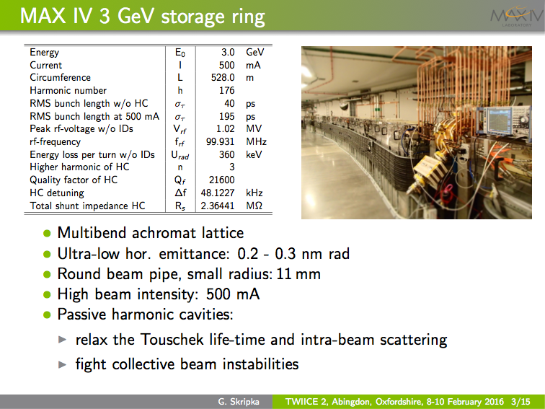


HarmonLIP 2022
11-12th October
Lund, Sweden

