Slide 1
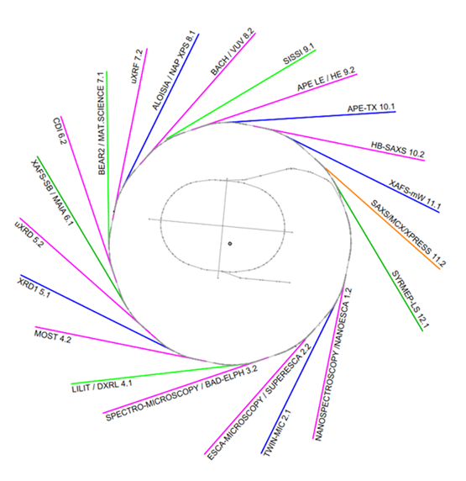
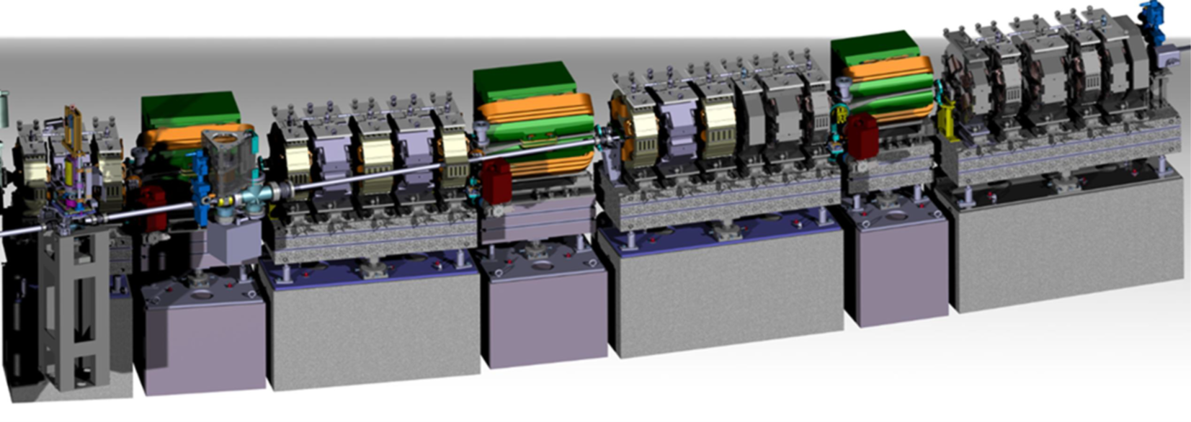
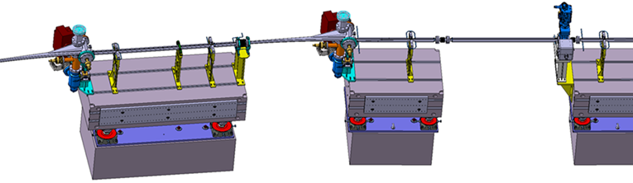
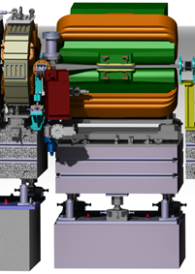
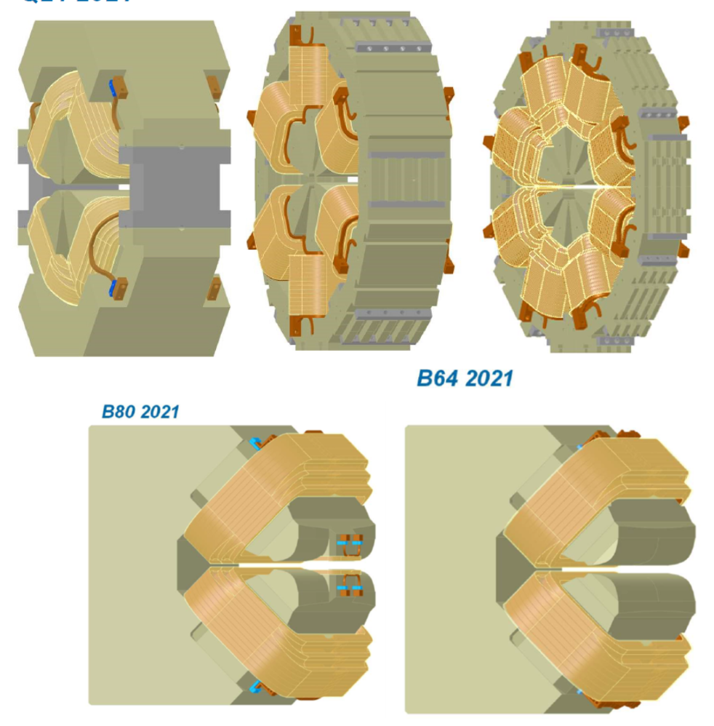
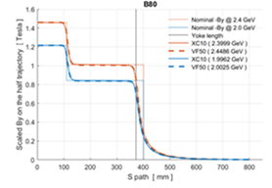
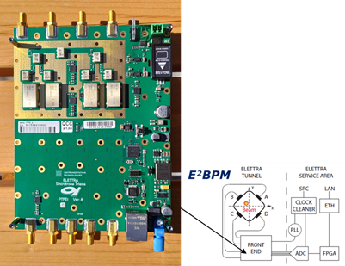
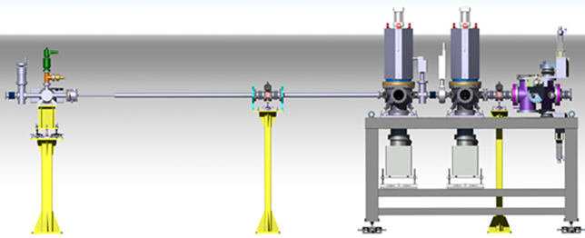
Elettra 2.0
Emanuel Karantzoulis on behalf of the Elettra team
Notes:
Slide 2: Title of the Presentation
Before you start editing the slides of your talk change to the Master Slide view:
Microsoft Office :Menu: View > Slide Master;
Macintosh – View > Master > Slide Master
Edit the following items:
On the Slide Master (first master slide) – lower area
a) On the left Delete the text and write the title of the event/Conference, Location
b) On the right delete the text and write the name and surname of the speaker and the date (day, month , year)
Close Master View
To start adding slides insert a new slide and select a Layout:
For Title & Subtitle
For text with bullet points
For Text
For Picture, graphs, visuals
Two columns
Blank

Slide 2
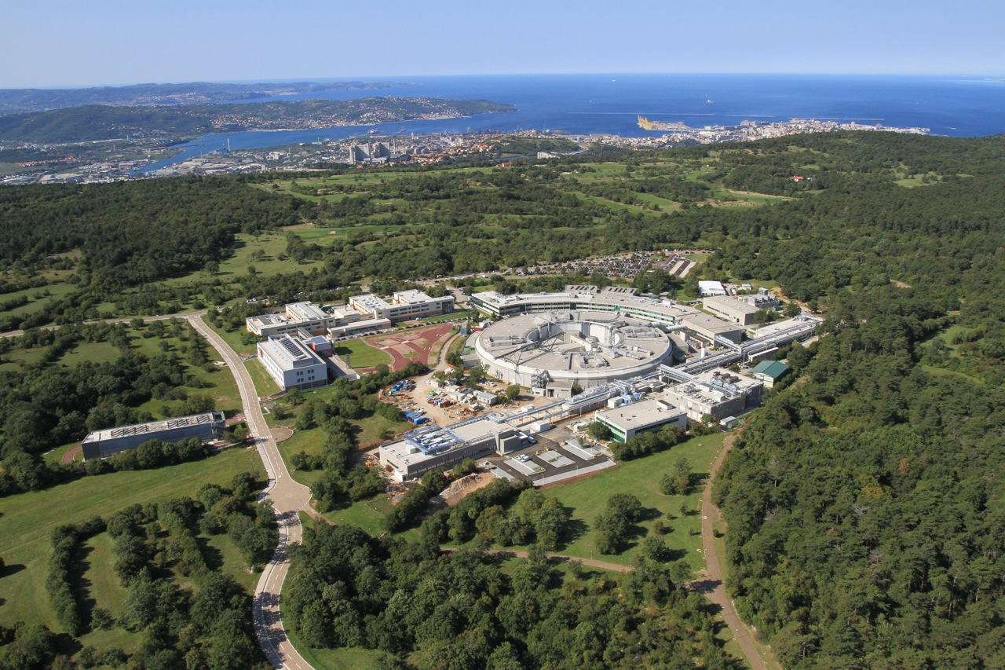
Elettra - Sincrotrone Trieste, Italy: 2 complementary Light Sources
Elettra: open to users since 1994.
First soft X-ray 3rd generation in Europe
7/10 nmrad ( 2 & 2.4 GeV ) (310 & 160 mA)
100-300 um, 300 nm - 0.35 Å
27 active beam lines
FERMI: seeded FEL (4-20-100 nm ) open to users since 2012 (FEL-1) and 2015 (FEL-2)
Notes:
Slide 3 – (..) : Content of the presentation
Insert a new slide: Home > “New Slide” and choose a slide Layout:
For Title & Subtitle
For text with bullet points
For Text
For Picture, graphs, visuals
Two columns
Blank
If you want Copy & paste an element from the Clip Board to the particular slide:
1. Click on a box to mark it.
2. Position the mouse pointer on the box frame: Copy!
3. Click on the particular slide: Paste!
How you intend to use the elements is your choice.
You can combine the text block style with the background colour in different manner.

Slide 3
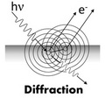
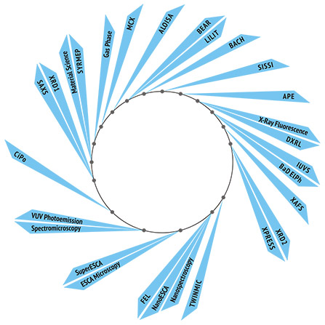
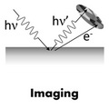
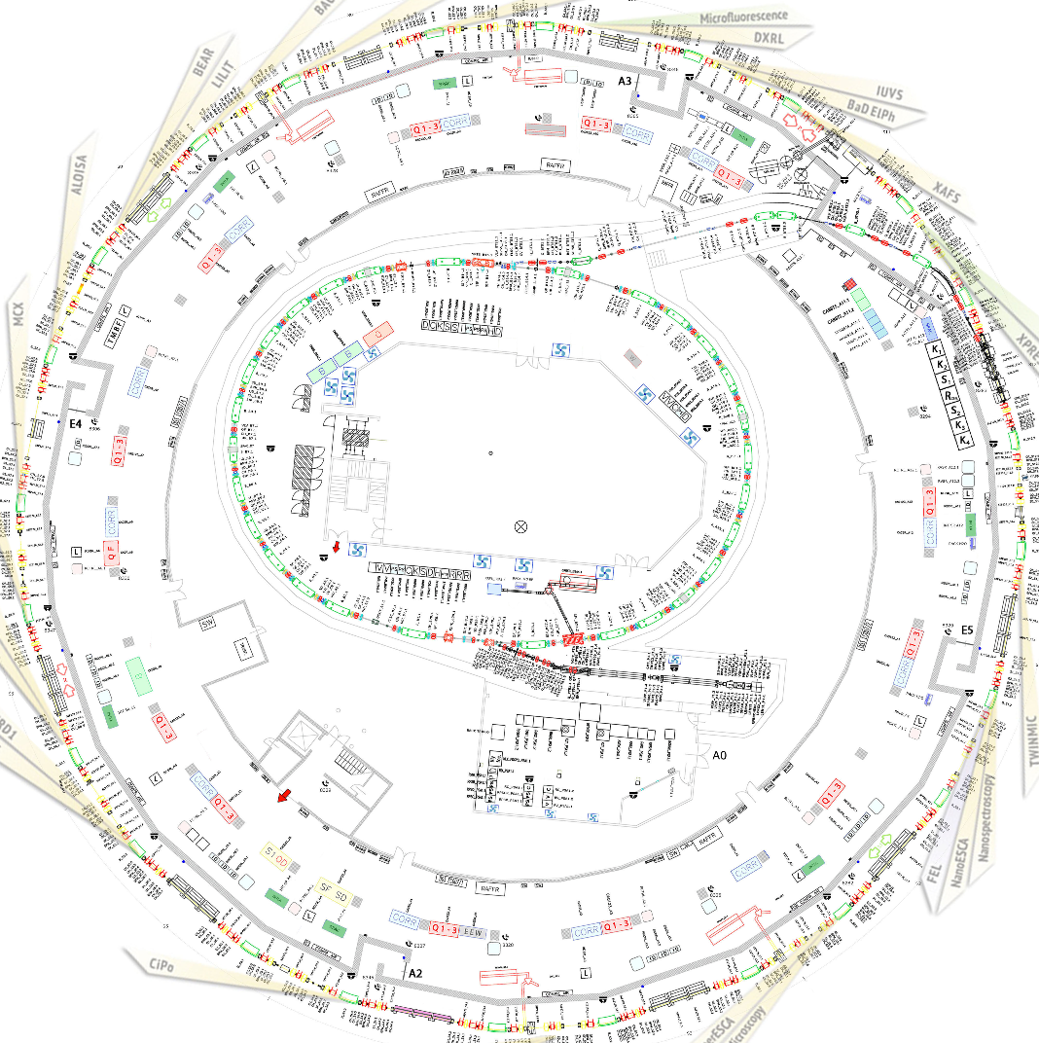
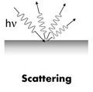
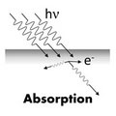
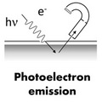
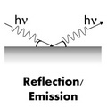
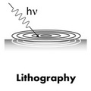
Important: Points of view of what is a light source
For Machine people
For Beam Lines people
For Users
For best results We ALL MUST have the FULL VIEW

Slide 4
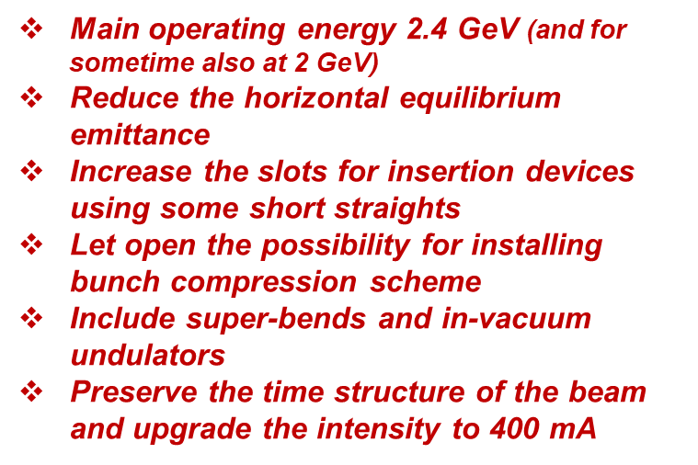
Requirements
2020
2017
Beam energy: 2 GeV
Beam intensity: 400 mA
Reduce the horizontal equilibrium emittance
Horizontal electron beam size: less than 60 µm
Conserve filling patterns: multi-bunch, hybrid, single bunch, few bunches
Keep the same building and the same ring circumference (259-260 m)
Existing ID beam lines and their position should be maintained
Try to increase the slots available for IDs: The space available not less than that of Elettra
Conserve the existing dipole beam lines
Use the existing injectors
Keep the same building and the same ring circumference (259.2 m)
Conserve the same source points in the long straights.
Keep the present injection scheme and injection complex
Minimize the downtime for installation and commissioning to about 18 months maximum.

Slide 5
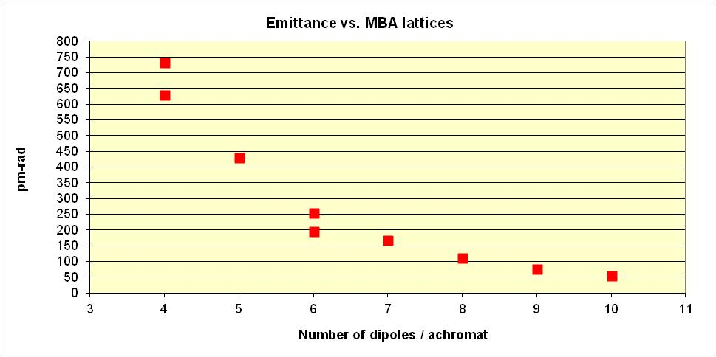
How from initial requirements arrived at the S6BA Elettra 2.0 first version Lattice 2017
All Elettra-like multi-bend lattices have been created up to 10BA
Number of dipoles / achromat | Emittance (nm-rad) @ 2 GeV | σ_{x} ( μm) @ LS | σ_{y} (μm) @1% coupling @ LS
2 | 7 | 240 | 14
4 | 0.74 (0.63) | 80 | 4.5
5 | 0.43 | 70 | 3
6 | 0.25 (0.19) | 55 | 2.2
7 | 0.17 | 40 | 1.9
8 | 0.11 | 26 | 1.7
9 | 0.075 | 22 | 1.5
10 | 0.054 | 20 | 1.3
Brilliance increase factor at 1keV
13 (15)
22
35 (43)
46
60
73
84
Free space available for IDs
Red: free space available for IDs in the long straight section (dispersion free)
Green: free space available for IDs in the arc (dispersive)

Slide 6
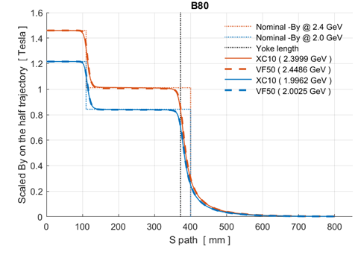
Last requirements: S6BA-E
Use LG dipoles and anti-bends
Original version: Emittance 98 pm-rad ( 58 pm-rad at full coupling) at 2 GeV and 140 pm-rad at 2.4 GeV (87 pm-rad at full coupling)
2.4 GeV | L1 T G=21T/m | L2 T G=0 | L3 T G=21 T/m | Emittance pmrad
VH-LG | 0.77 T | 2.16 | 0.77 | 140
H-LG | 0.92 T | 1.78 | 0.92 | 150
M-LG | 1.036 T | 1.46 | 1.036 | 177
There is a great interest for that kind of magnets for high central fields but using permanent magnets. Recently a joint project (VADER) with CERN, Elettra, KYMA and CIEMAT is financed from the EU (Horizon 2020 - Innovation Pilot Project for Particle Accelerators) - > see talk by Axel Poyet

Slide 7


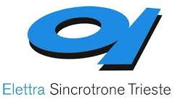

VAriable Dipole for the Elettra Ring - VADER
Main operating energy 2.4 GeV (and only for sometime at 2 GeV)
Once the energy will be fixed, thinking about future, we could replace the LG dipoles with permanent ones
more on Axel Poyet talk
Task 7.3 within I.FAST WP7: High Brightness Accelerators for Light Sources already financed
Partners and contact persons:
Y. Papaphilippou
F. Toral
E. Karantzoulis
R. Geometrante

Slide 8
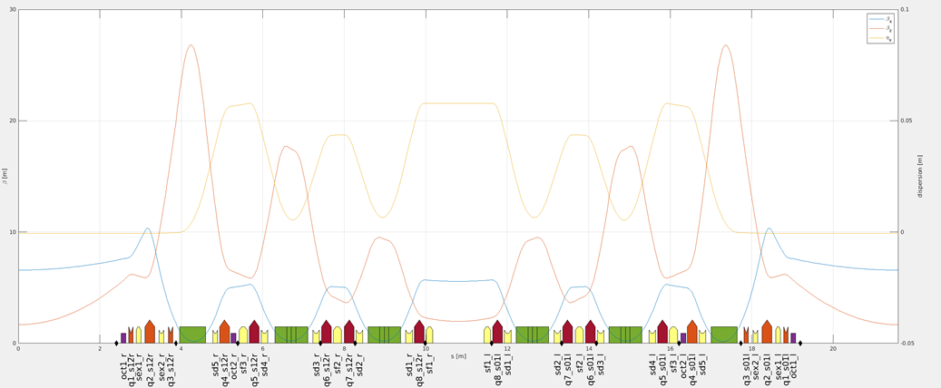
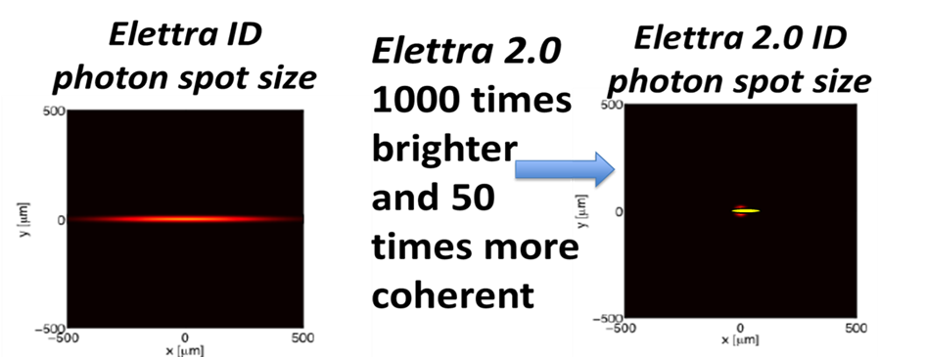
The lattice (S6BA-E) is frozen
Phase 2 optics
Long+vertical focusing dipoles
LS
SS
LS
Reverse bend-quads
The lattice is 12-fold symmetric ( 24 arcs ) with LS=5.104 m and SS=1.26 m (from magnet to magnet) this way the LSs coincide to those of the actual Elettra i.e. no radial shift of the IDs beam lines on the LSs.
More than two orders of magnitude brighter and 50 times more coherent

Slide 9
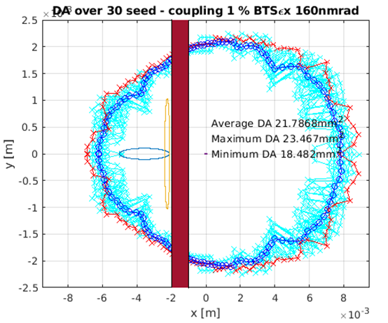
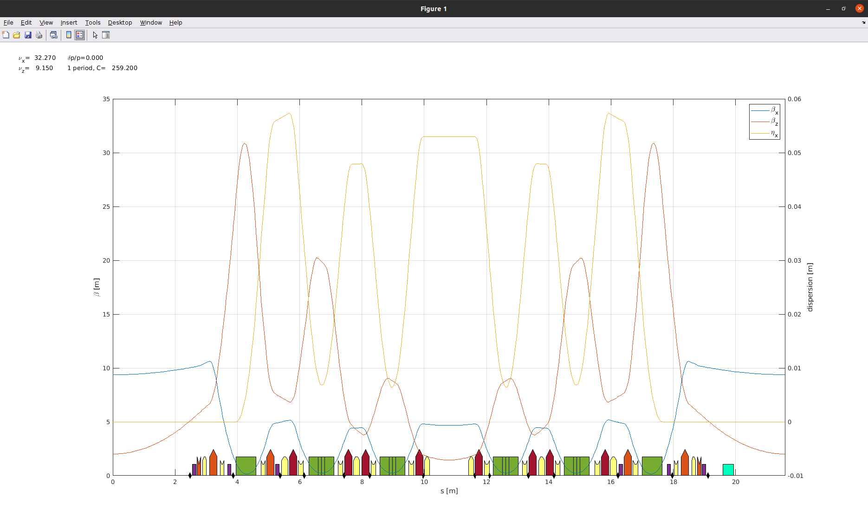
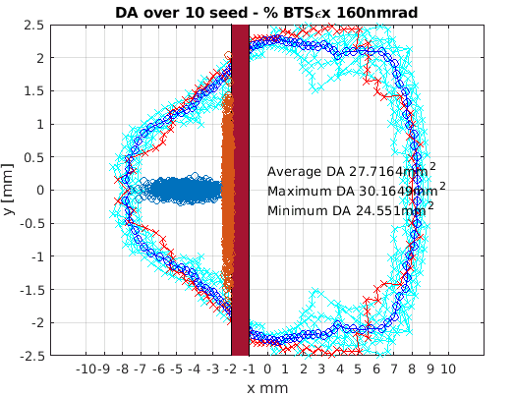
Phase-1 optics
Phase-2 optics
H tune 32.3 i.e. one integer lower
The bare emittance is 227 pm rad
The gain is ±2 mm more DA in the horizontal and appears less sensitivity to errors

Slide 10
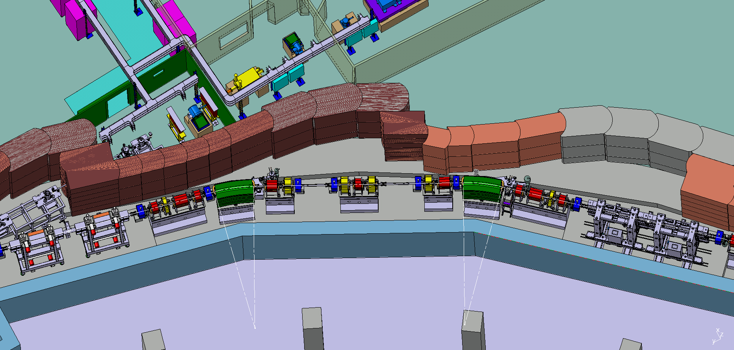
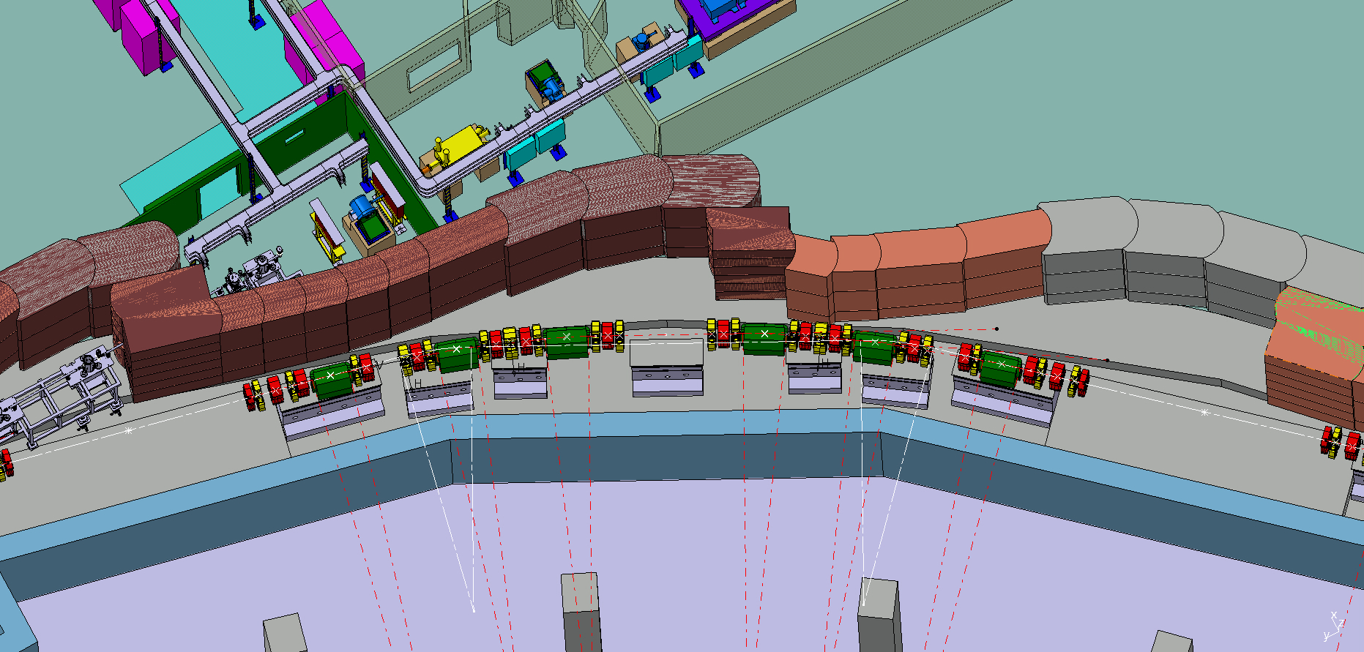
Elettra 2.0 Lattice in the tunnel
The best configuration that satisfied all requirements, including the free space for IDs is based on our enhanced symmetric six-bend achromat (S6BA-E).
259 m circumference with 12 identical sectors and 12 long straight section for insertion devices (IDs: special magnets that produce radiation) . Elettra 2 has also 12 short straight sections
Elettra
Elettra 2.0
A complete Technical Design Report (TDR) was produced in 2021 (https://www.elettra.eu/lightsources/elettra/elettra-2-0.html?showall= )

Slide 11
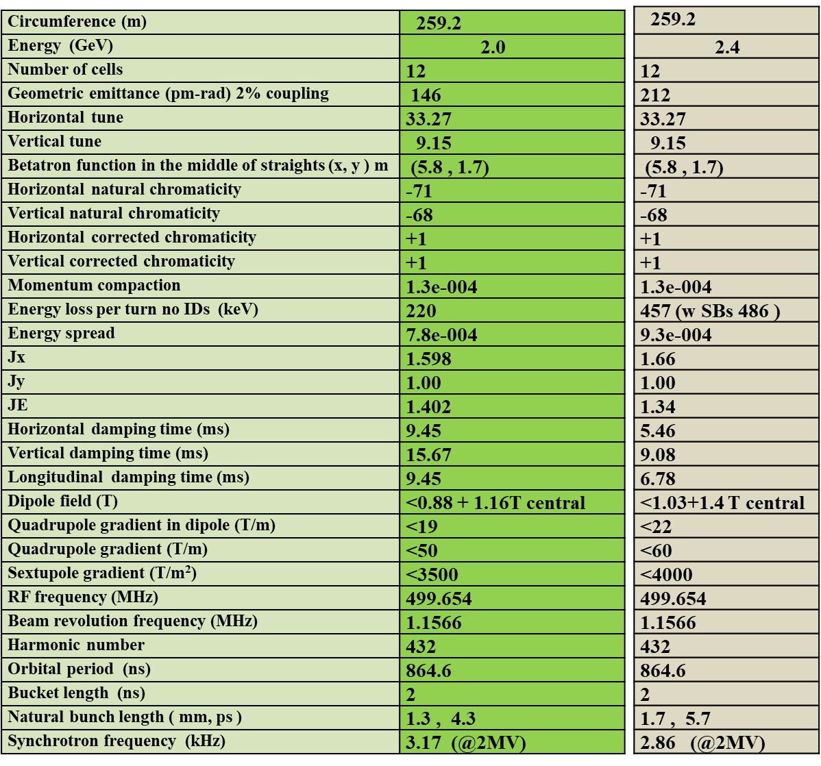
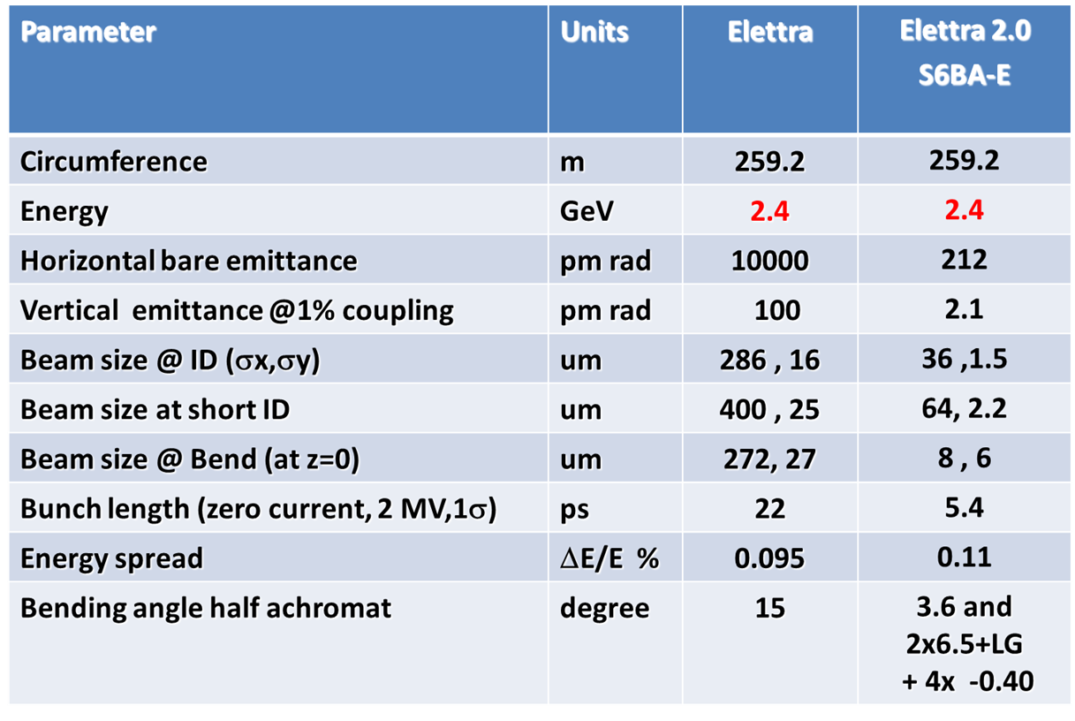
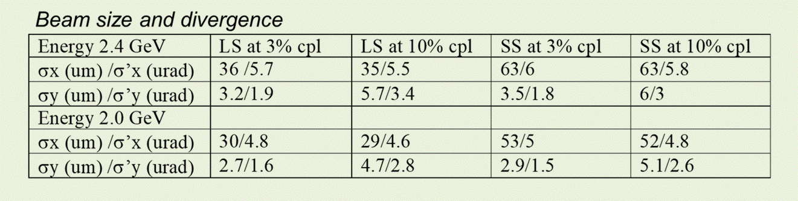
The S6BA-E machine parameters
The Emittance is 212 pm-rad at 2.4 GeV i.e. 47 times reduction in emittance or about 7 or more times reduction in beam size compared with the actual Elettra

Slide 12
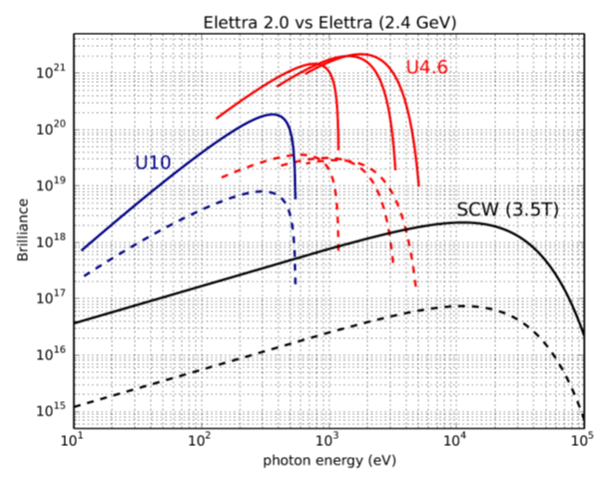
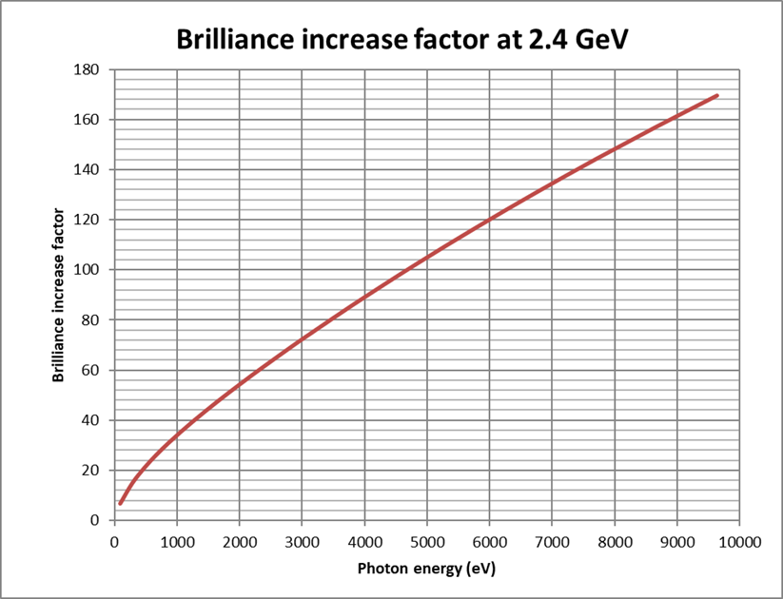
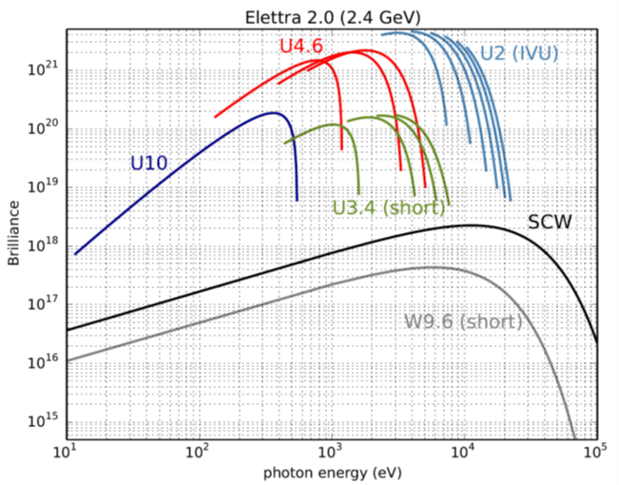
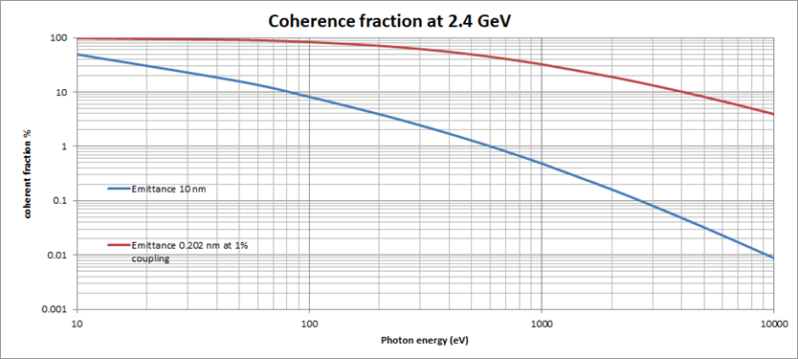
Elettra 2.0
Elettra

Slide 13
Beam lines
The ratio between the Circumference and the free space for IDs is 30%.
The available slots for IDs are 11 on LS and 5 on SS
Elettra Elettra 2.0
27 31 Beam lines
16 15 VUV-soft
9 Hard x-rays
0 3 super bends
0 3 soft-tender X
1 1 IR
Seven sectors will keep their present arrangement in the ring (1,2,3,4,8,9,11 )
10 new beam lines
12 same position / sector
8 to be moved
1 UV laser lab
18 on 11 LSS
6 on 5 SS
3 on 3 SBs
4 on 3 BM
2 mini wigglers of 1.8 T and 3 undulators ( <1 T) will be installed in the SS

Slide 14
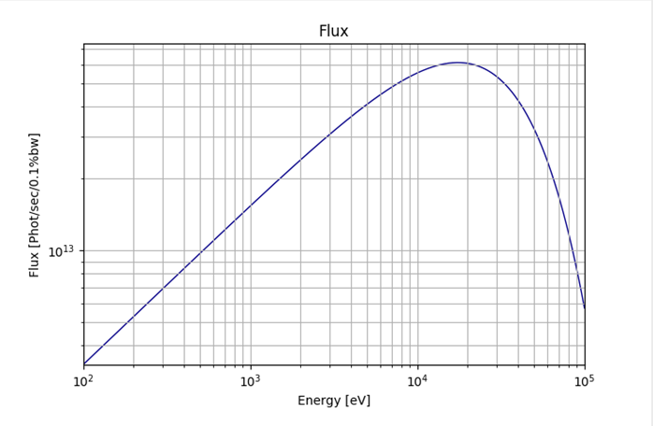
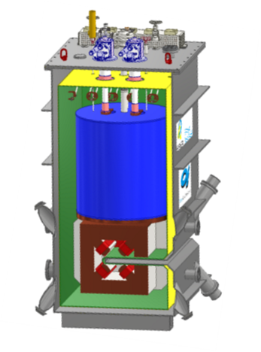
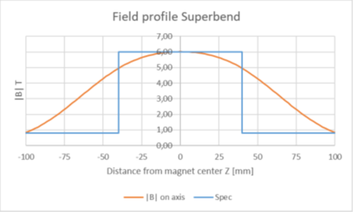
Super conducting dipoles
Three beam lines at 35 and 50 keV and with flux above 10¹³ ph/sec will be constructed and will be served by three 6 T SC-Dipoles to be installed after commissioning in sectors 4,8,12
For the super-bends we opt for a C-shape magnet, technical specs at the end of 2022.
We are (were) in contact with (BINP), Bilfinger Noel and ASG – superconductors in order to find the best proposal.
There is also a MOU with PSI for many items including super-bends.

Slide 15
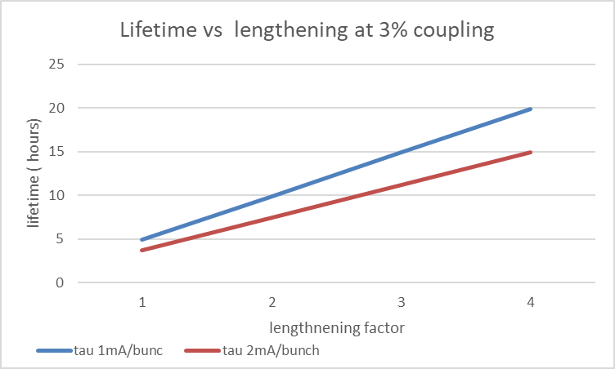
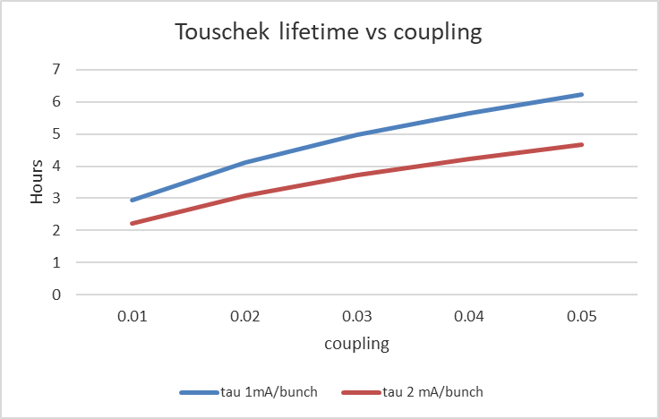
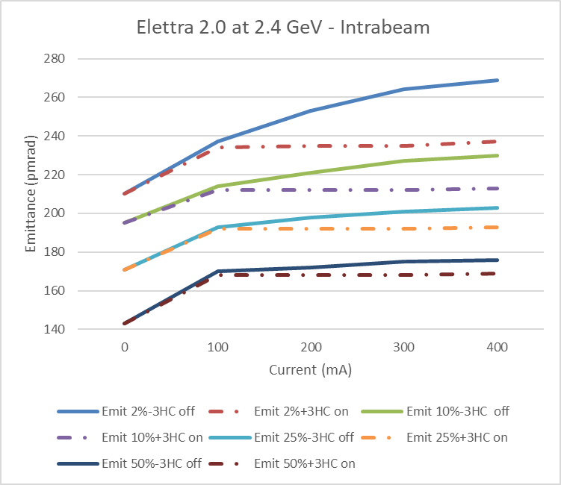
Touschek and intra-beam effects
A 3% coupling seems reasonable. The results are without the 3HC effect. The minimum LF values are shown
Including the 3HC effect the lifetime scales linearly with the bunch length.
The intra-beam scattering without the effect of the third harmonic cavity at 400 mA will increase the emittance from 212 to 275 pm-rad (30% increase) while with the SUPER-3HC effect the emittance will increase to 235 pm-rad (increase at 11%).

Slide 16
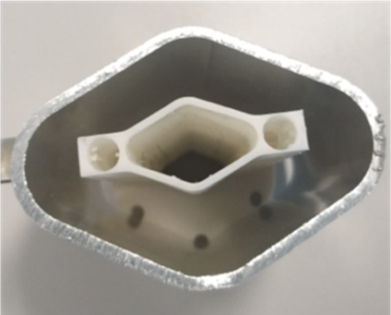
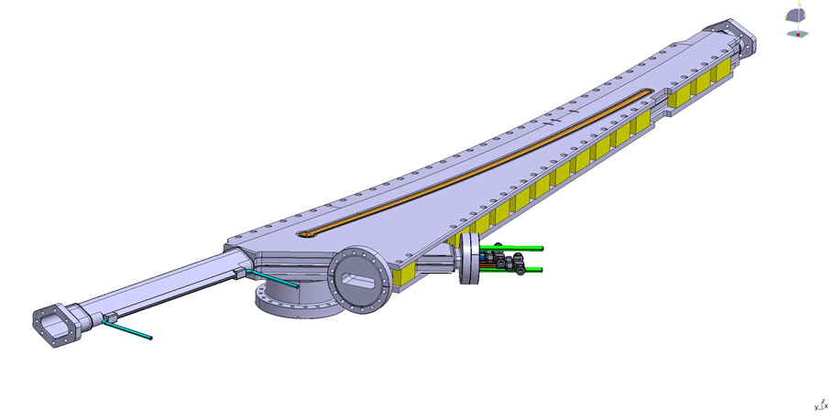
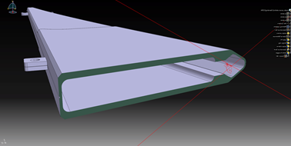
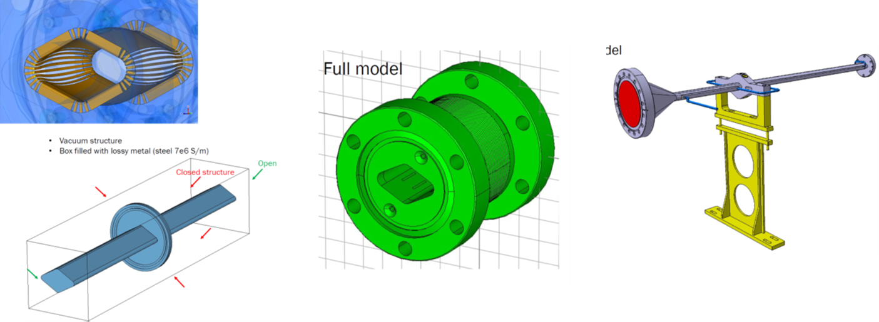
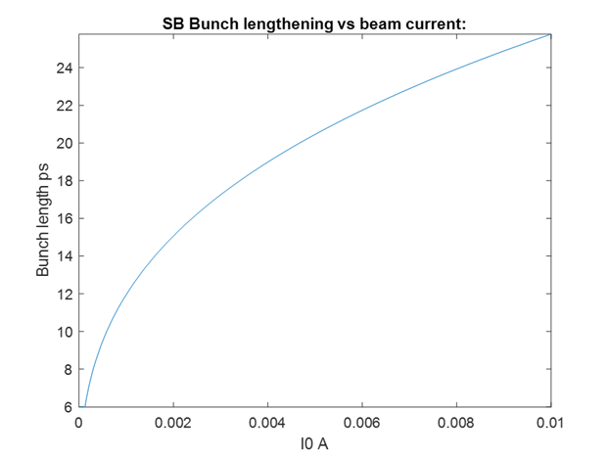
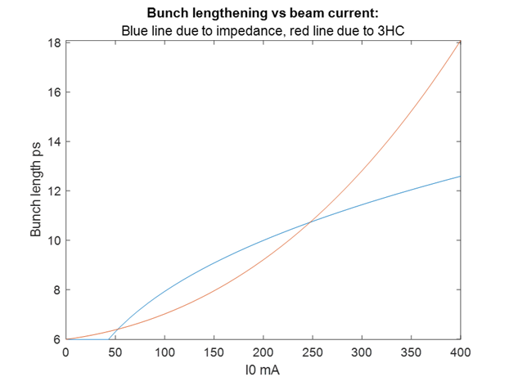
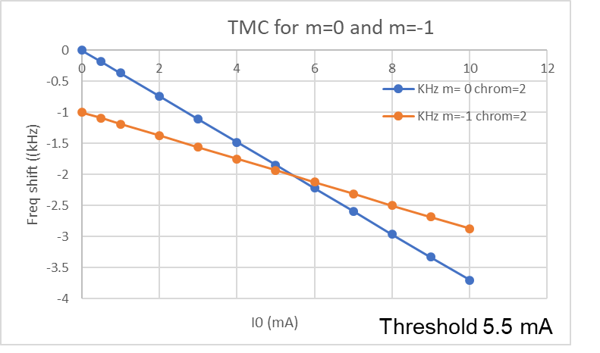
Impedances
The CST code is used. Analytic formulae are also considered
55% of the chamber length Cu (27x17 mm rhomboidal ) , 21% Al and 33% SSt All with 500 nm NEG
Z/n effective 0.24 Ohm , Loss factor 20 V/pC -> 6.75 kW
ZT effective 140 kOhm/m , Δf/ΔI=0.37 kHz/mA. Kick factor 4.8 kV/pC m
(including S-3HC with chrom +2)
Numbers very close to those measured at Elettra 1.0
+
WIP on multi-bunch effects
While the zero current bunch length is 5.7 ps (at 1 σ), at 1 mA/bunch the bunch length will be 12 ps. Similarly, the energy spread ΔE/E will increase from 9.3e-4 to 1.47e-3 and at 2 mA/bunch at 1.86e-3.
Up to 200 mA total current the bunch length remains below 10 ps. However for shorter bunch lengths of the order of 1 ps fwhm deflecting cavities (crab) are needed.

Slide 17
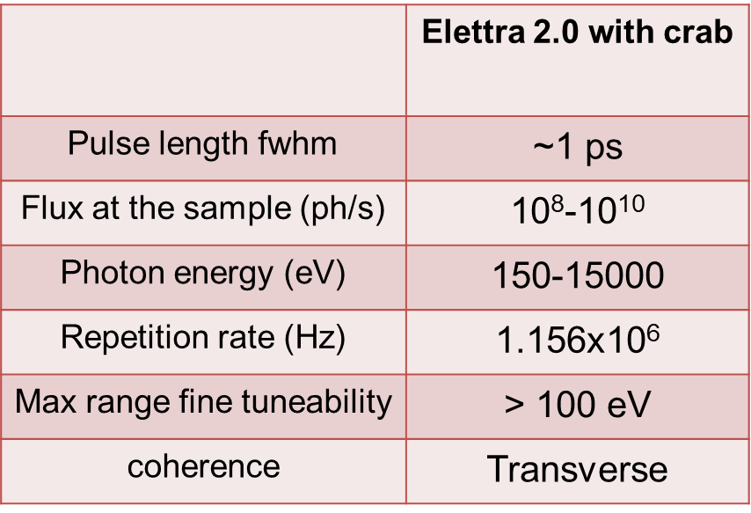
Short pulses
Elettra 2.0 naturally provides e-pulses of 19 ps fwhm at low intensities (i.e. 0.25 mA /bunch, i.e. ~100 mA total ) due to its low momentum compaction ~ 10⁻⁴
But using the deflecting cavities (crab) technology shorter photon pulses can be delivered that are particularly attractive for experiments requiring high repetition rate and low intensity
A pair of deflecting cavities (3 and 3.25 GHz) deflect every other bunch thus we are going to have 200 regular and 200 tilted.
The regular bunches will have 2 mA each to achieve 400 mA target.
dark gap 64 ns
One possible operational scenario consists of one tilted bunch in the middle of a 64 ns dark gap with 2 mA to provide the short pulses.
This way all users can work simultaneously

Slide 18
Schedule

Slide 19
Summary and discussion
The lattice (S6BA-E) is frozen
The TDR version 1 is available (since August 2021) Version 2 since April 2022. Any other further additions will be incorporated as appendices.
Remarkable progress has been made in almost all WPs, (despite COVID-19)
Launching a number of call for tenders (magnets, girders, chambers, vacuum systems, power supplies, IVUs)
You can apply all theory lessons for reducing the emittance but at the end users will try everything possible to upset the machine!
Above all remember that an up to 20% increase in emittance makes a small difference for most of them but it can simplify many things for you.
Thank you for your attention

Slide 20


Emittance and beam variation
All 11 long straight sections will be occupied, the section 2 is reserved for the deflecting RF cavities for achieving for some beamlines pulses as short as 1 ps (FWHM). Additionally 5 short straights will be occupied by IDs. When all insertion devices and SBs are included the emittance at 2.4 GeV reads 214 pm-rad and the energy loss due to radiation is 620 keV which for 400 mA translates to 248 kW radiation power. Moving any ID field for zero to maximum changes the beam dimension by less than 1%.
Fixed gap

Slide 21






Injection and manipulations
Maximum separation of the beams 4 mm, pulse 3μs half sine wave for kickers and anti-septum , anti-septum thickness 1 mm.
The system permits also injection on-axis mainly for diagnostics during commissioning.
Emittance exchange by crossing a linear coupling resonance Qx-Qy=n
80% efficiency with horizontal bunch, > 95 % if in swap mode where the shape of the beam will be optimized for optimum result.

Slide 22

Field and Alignment Errors
For the simulations ±2σ are considered
Element Type | Parameter | Value | Unit
Dipoles | Δx | 50 | μm
 | Δy | 50 | μm
 | Δz | 300 | μm
 | Roll angle | 100 | μrad
Quadrupoles on the girder | Δx | 25 | μm
 | Δy | 25 | μm
 | Δz | 300 | μm
 | Roll angle | 50 | μrad
Sextupole /multipoles on the girder | Δx | 25 | μm
 | Δy | 25 | μm
 | Δz | 300 | μm
 | Roll angle | 50 | μrad
Correctors | Δz | 25 | μm
 | Roll angle | 150 | μrad
BPMs | Δx | 150 | μm
 | Δy | 150 | μm
 | Δz | 300 | μm
 | Roll angle | 150 | μrad
Girders | Δx | 50 | μm
 | Δy | 50 | μm
 | Δz | 300 | μm
 | Roll angle | 100 | μrad
If girders at 100 μm, DA reduction 23% At 150 μm 30%

